Slide 1
Intelligent Agents:
Web-mining Agents
Probabilistic Graphical Models
Lifted Inference
Tanya Braun

Slide 2
Probabilistic Graphical Models (PGMs)
Recap: Propositional modelling
  Factor model, Bayesian network, Markov network
  Semantics, inference tasks
  + algorithms + complexity
Probabilistic relational models (PRMs)
  Parameterised models, Markov logic networks
  Semantics, inference tasks
Lifted inference
  LVE, LJT, FOKC
  Theoretical analysis
Lifted learning
  Recap: propositional learning
  From ground to lifted models
  Direct lifted learning
Approximate Inference: Sampling
  Importance sampling
  MCMC methods
Sequential models & inference
  Dynamic PRMs
  Semantics, inference tasks
  + algorithms + complexity, learning
Decision making
  (Dynamic) Decision PRMs
  Semantics, inference tasks
  + algorithms, learning
Continuous Space
  Gaussian distributions and Bayesian networks
  Probabilistic soft logic

Slide 3

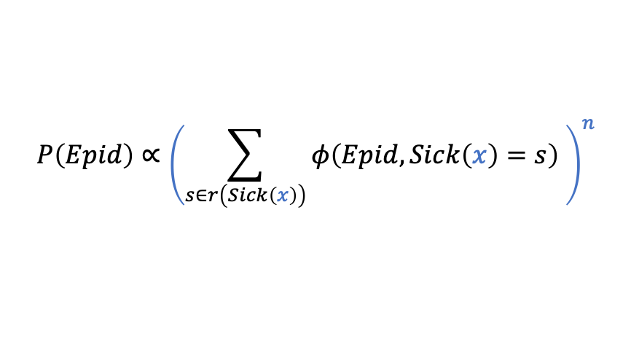


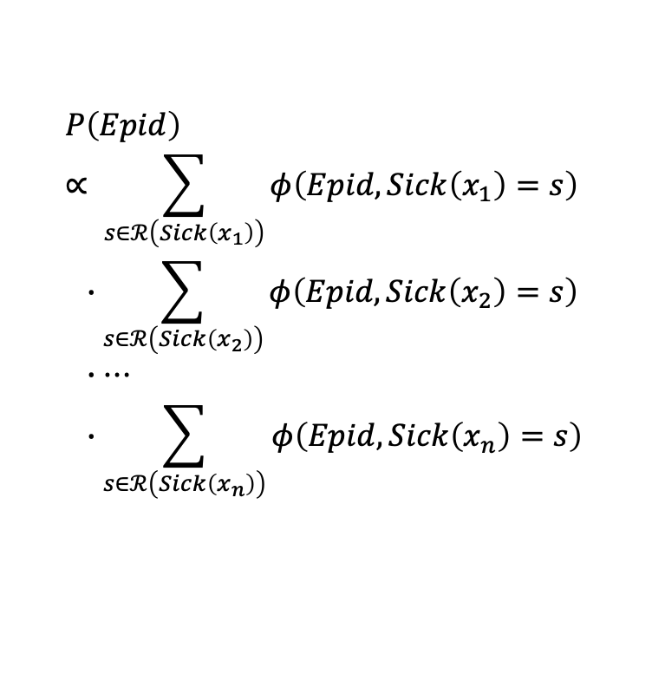












Lifting? ➝ Inverse of grounding!
$$P\left(Epid\right)∝ \sum_{s∈ℛ\left(Sick\left(x_{1}\right)\right)}{φ\left(Epid,Sick\left(x_{1}\right)=s\right) } \\ ∙\sum_{s∈ℛ\left(Sick\left(x_{2}\right)\right)}{φ\left(Epid,Sick\left(x_{2}\right)=s\right) } \\ ∙… \\ ∙\sum_{s∈ℛ\left(Sick\left(x_{n}\right)\right)}{φ\left(Epid,Sick\left(x_{n}\right)=s\right) }$$
$$Epid$$
$$φ$$
$$φ$$
$$φ$$
$$Sick(x_{1})$$
$$Sick(x_{2})$$
$$…$$
$$Sick(x_{n})$$
$$=φ^{′}\left(Epid\right)∙φ^{′}\left(Epid\right)∙…∙φ^{′}\left(Epid\right)$$
$$={\left(φ^{′}\left(Epid\right)\right)}^{n}$$
# of $X$ relative to $φ^{′}\left(Epid \right)$
$n$ times
$$Epid$$
$$P\left(Epid\right)∝{\left(\sum_{s∈r\left(Sick\left(x\right)\right)}{φ\left(Epid,Sick\left(x\right)=s\right) }\right)}^{n}$$
$$={\left(φ^{′}\left(Epid\right)\right)}^{n}$$
$$φ$$
$$Sick(X)$$
Representative for $X$ in $φ\left(Epid,Sick\left(X\right)\right)$

Slide 4

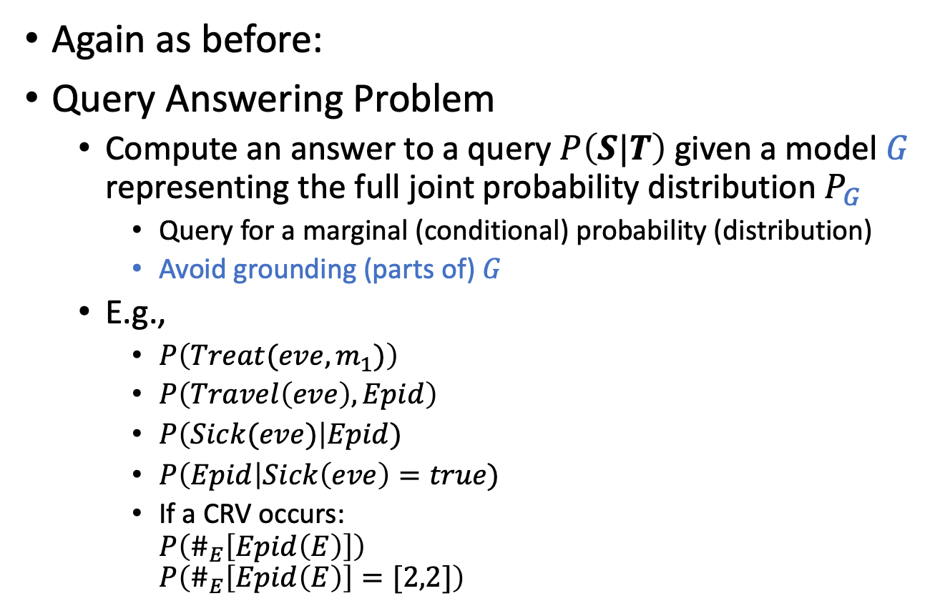








Queries in Parameterised Models
Again as before:
Query Answering Problem
  Compute an answer to a query $P\left(S|T\right)$ given a model $G$ representing the full joint probability distribution $P_{G}$
    Query for a marginal (conditional) probability (distribution)
    Avoid grounding (parts of) $G$
  E.g.,
    $P\left(Treat(eve,m_{1})\right)$
    $P\left(Travel\left(eve\right),Epid\right)$
    $P\left(Sick(eve)\right|Epid)$
    $P\left(Epid\right|Sick\left(eve\right)=true)$
    If a CRV occurs:
    $P\left(\#_{E}\left[Epid\left(E\right)\right]\right)$
    $P\left(\#_{E}\left[Epid\left(E\right)\right]=[2,2]\right)$
$$Nat(D)$$
$$Man(W)$$
$$g_{1}$$
$$Epid$$
$$Travel(X)$$
$$Treat(X,M)$$
$$g_{2}$$
$$g_{3}$$
$$Sick(X)$$
Notes:
Argmax and sum not commutative

Slide 5
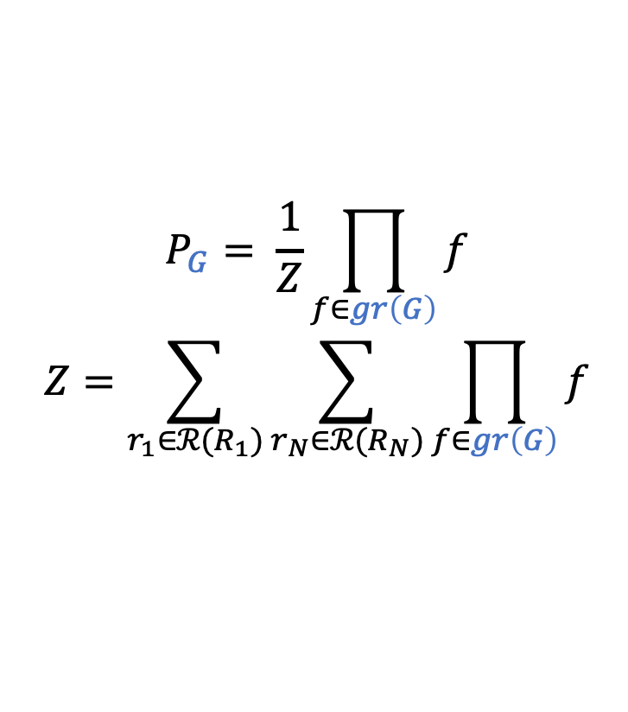


Semantics of Parameterised Models
Given model $G={\left\{g_{i}\right\}}_{i=1}^{n}$
  Over PRVs $rv\left(G\right)$
  Equivalent propositional model over random variables $F=gr\left(rv\left(G\right)\right)=\left\{R_{1},…, R_{N}\right\}$ with semantics over $P_{F}$
Semantics: Build full joint probability distribution $P_{G}$
As a way of ensuring correctness
  $$P_{G}= \frac{1}{Z}\prod_{f∈gr\left(G\right)}{f}$$
  $$Z=\sum_{r_{1}∈ℛ(R_{1})}{\sum_{r_{N}∈ℛ(R_{N})}{\prod_{f∈gr\left(G\right)}{f}}}$$
$$…$$
$$Nat(D)$$
$$Man(W)$$
$$g_{1}$$
$$Epid$$
$$Travel(X)$$
$$Treat(X,M)$$
$$g_{2}$$
$$g_{3}$$
$$Sick(X)$$

Slide 6
Outline: 3. Lifted Inference
Lifted variable elimination (LVE)
  Operators
  Algorithm
  Complexity (including first-order dtrees), completeness, tractability
  Variants
Lifted junction tree algorithm (LJT)
  First-order junction trees (FO jtrees)
  Algorithm
  Complexity, completeness
  Variants
First-order knowledge compilation (FOKC)
  Normal form, circuits
  Algorithm
  Complexity, completeness
Most probable assignment queries
  Distribution vs. assignment queries
  Most probable explanation (MPE) , Maximum-a-posteriori (MAP) assignments
  Changes in LVE, LJT, FOKC
  Complexity, completeness

Slide 7
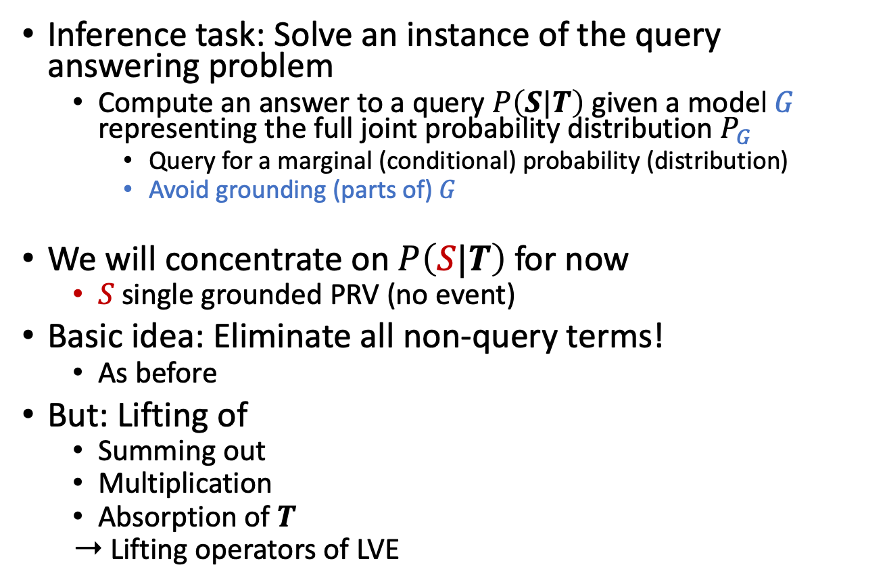
Lifted Variable Elimination (LVE)
Inference task: Solve an instance of the query answering problem
  Compute an answer to a query $P\left(S|T\right)$ given a model $G$ representing the full joint probability distribution $P_{G}$
    Query for a marginal (conditional) probability (distribution)
    Avoid grounding (parts of) $G$
We will concentrate on $P\left(S|T\right)$ for now
  $S$ single grounded PRV (no event)
Basic idea: Eliminate all non-query terms!
  As before
But: Lifting of
  Summing out
  Multiplication
  Absorption of $T$
  ➝ Lifting operators of LVE
Notes:
No probability queries (special case)
No conjunctive queries

Slide 8




Lifted Summing Out: Idea
$$P\left(Epid\right)∝ \sum_{s∈ℛ\left(Sick\left(x_{1}\right)\right)}{φ\left(Epid,Sick\left(x_{1}\right)=s\right) } \\ ∙\sum_{s∈ℛ\left(Sick\left(x_{2}\right)\right)}{φ\left(Epid,Sick\left(x_{2}\right)=s\right) } \\ ∙… \\ ∙\sum_{s∈ℛ\left(Sick\left(x_{n}\right)\right)}{φ\left(Epid,Sick\left(x_{n}\right)=s\right)}$$
$$P\left(Epid\right)∝{\left(\sum_{s∈r\left(Sick\left(x\right)\right)}{φ\left(Epid,Sick\left(x\right)=s\right) }\right)}^{n}$$
Equivalence between ground and lifted calculations
  Requires three preconditions for correct calculations
    Ensuring same outcome for equivalent computations in ground case
$$Epid$$
$$φ$$
$$φ$$
$$φ$$
$$Sick(x_{1})$$
$$Sick(x_{2})$$
$$…$$
$$Sick(x_{n})$$
$$Epid$$
$$φ$$
$$Sick(X)$$

Slide 9
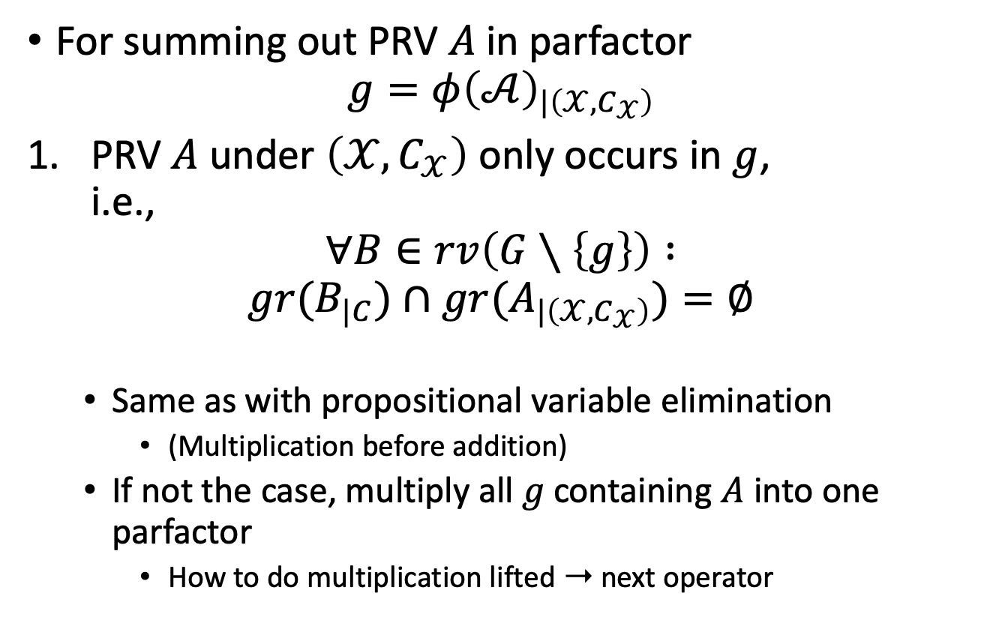
Preconditions
For summing out PRV $A$ in parfactor
$g=φ{\left(𝒜\right)}_{|\left(𝒳,C_{𝒳}\right)}$
PRV $A$ under $\left(𝒳,C_{𝒳}\right)$ only occurs in $g$,
i.e.,
$$∀B∈rv\left(G∖\left\{g\right\}\right) :$$
$$gr(B_{|C})∩gr(A_{|\left(𝒳,C_{𝒳}\right)})=∅$$
  Same as with propositional variable elimination
    (Multiplication before addition)
  If not the case, multiply all $g$ containing $A$ into one parfactor
    How to do multiplication lifted ➝ next operator

Slide 10

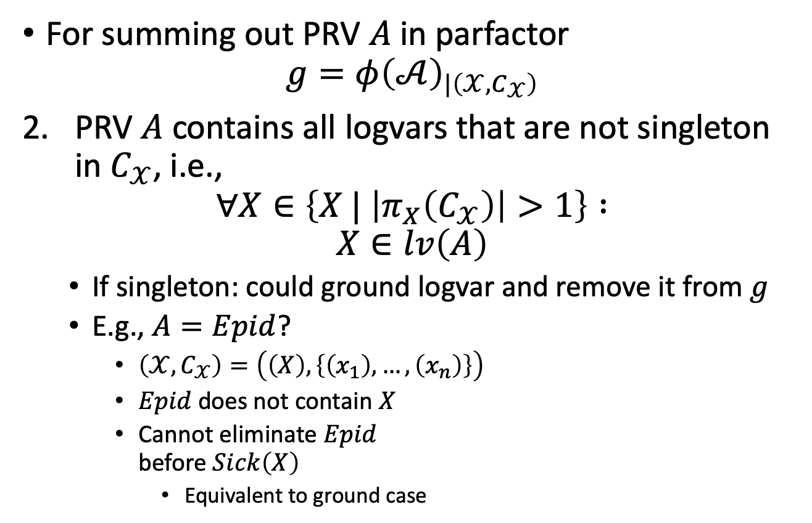

Preconditions
For summing out PRV $A$ in parfactor
$g=φ{\left(𝒜\right)}_{|\left(𝒳,C_{𝒳}\right)}$
PRV $A$ contains all logvars that are not singleton in $C_{𝒳}$, i.e.,
$$∀X∈\left\{X | \left|π_{X}\left(C_{𝒳}\right)\right|>1\right\} :$$
$$X∈lv\left(A\right)$$
  If singleton: could ground logvar and remove it from $g$
  E.g., $A=Epid$?
    $\left(𝒳,C_{𝒳}\right)=\left(\left(X\right),\left\{\left(x_{1}\right),…,\left(x_{n}\right)\right\}\right)$
    $Epid$does not contain $X$
    Cannot eliminate $Epid$
    before $Sick\left(X\right)$
      Equivalent to ground case
$$Epid$$
$$φ$$
$$Sick(X)$$

Slide 11



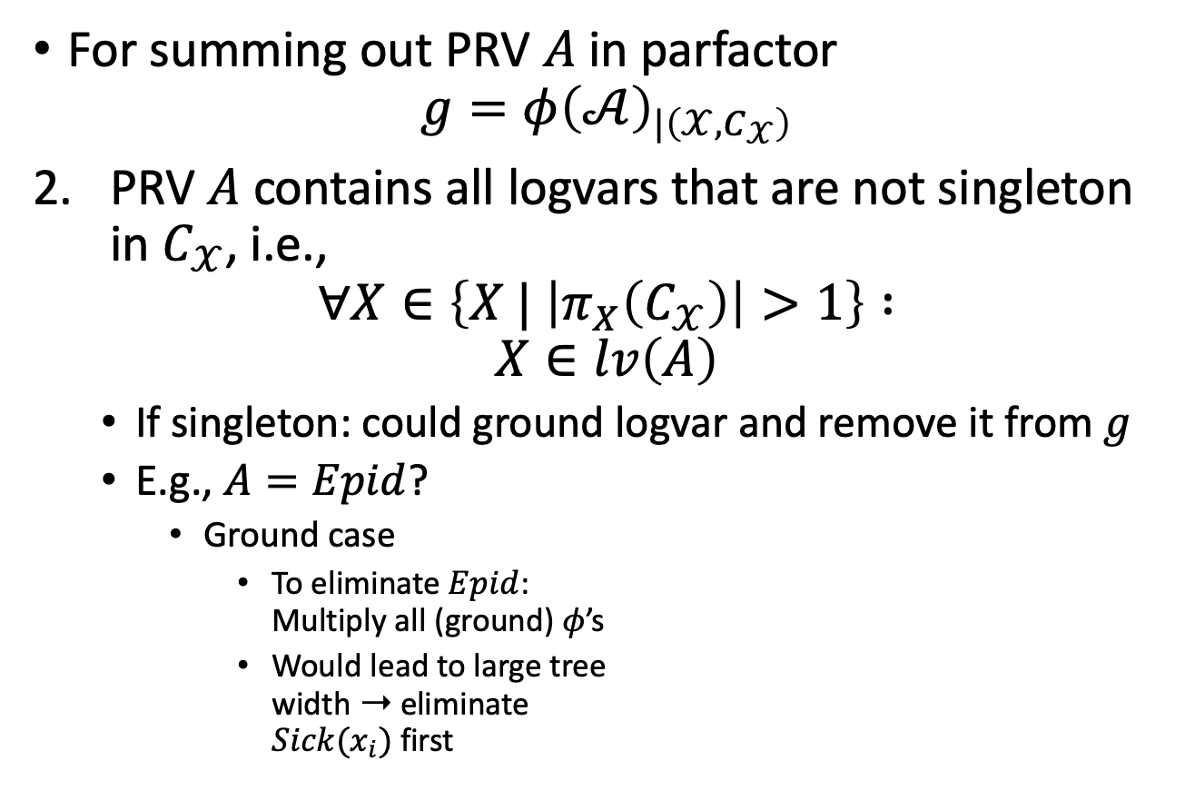
Preconditions
For summing out PRV $A$ in parfactor
$g=φ{\left(𝒜\right)}_{|\left(𝒳,C_{𝒳}\right)}$
PRV $A$ contains all logvars that are not singleton in $C_{𝒳}$, i.e.,
$$∀X∈\left\{X | \left|π_{X}\left(C_{𝒳}\right)\right|>1\right\} :$$
$$X∈lv\left(A\right)$$
  If singleton: could ground logvar and remove it from $g$
  E.g., $A=Epid$?
    Ground case
      To eliminate $Epid$:
      Multiply all (ground) $φ$’s
      Would lead to large tree
      width ➝ eliminate
      $Sick(x_{i})$ first
$$Epid$$
$$φ$$
$$φ$$
$$φ$$
$$Sick(x_{1})$$
$$Sick(x_{2})$$
$$…$$
$$Sick(x_{n})$$

Slide 12
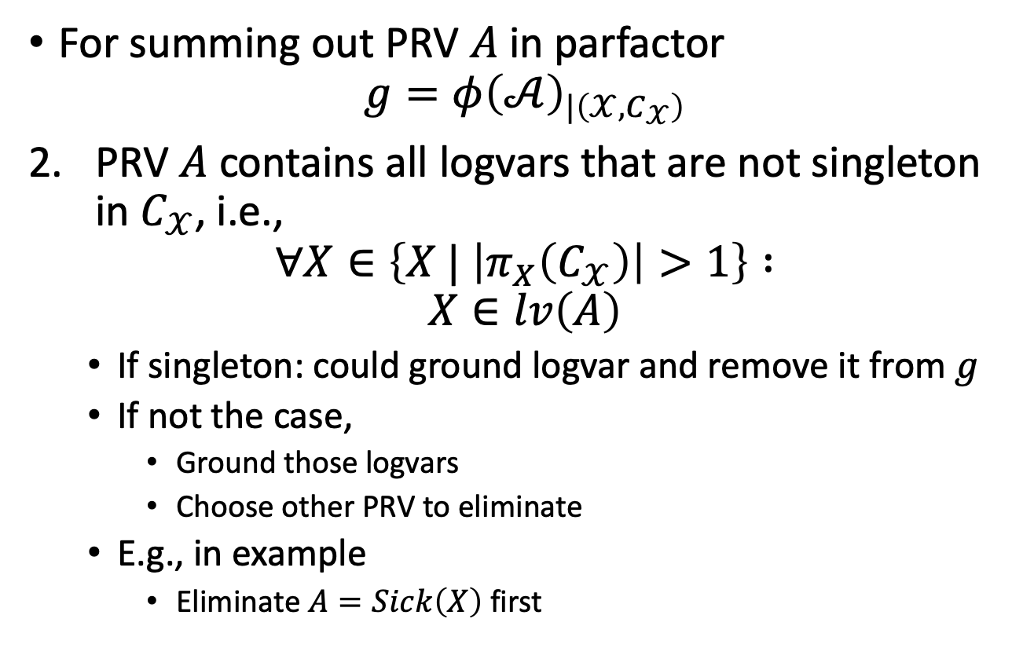
Preconditions
For summing out PRV $A$ in parfactor
$g=φ{\left(𝒜\right)}_{|\left(𝒳,C_{𝒳}\right)}$
PRV $A$ contains all logvars that are not singleton in $C_{𝒳}$, i.e.,
$$∀X∈\left\{X | \left|π_{X}\left(C_{𝒳}\right)\right|>1\right\} :$$
$$X∈lv\left(A\right)$$
  If singleton: could ground logvar and remove it from $g$
  If not the case,
    Ground those logvars
    Choose other PRV to eliminate
  E.g., in example
    Eliminate $A=Sick\left(X\right)$ first
Avoid grounding! (Only a last resort)
$$Epid$$
$$φ$$
$$Sick(X)$$

Slide 13
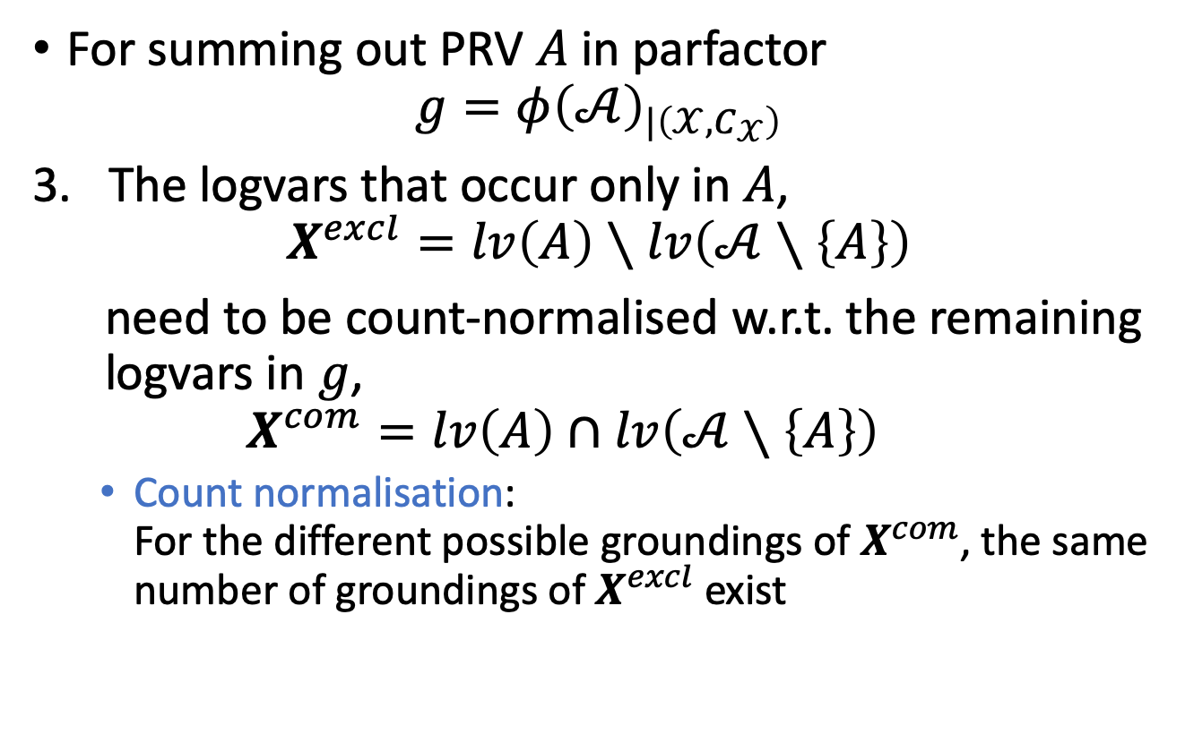
Preconditions
For summing out PRV $A$ in parfactor
$g=φ{\left(𝒜\right)}_{|\left(𝒳,C_{𝒳}\right)}$
The logvars that occur only in $A$,
$$X^{excl}=lv\left(A\right)∖lv\left(𝒜∖\left\{A\right\}\right)$$
need to be count-normalised w.r.t. the remaining logvars in $g$,
$$X^{com}=lv\left(A\right)∩lv\left(𝒜∖\left\{A\right\}\right)$$
  Count normalisation:
  For the different possible groundings of $X^{com}$, the same number of groundings of $X^{excl}$ exist

Slide 14
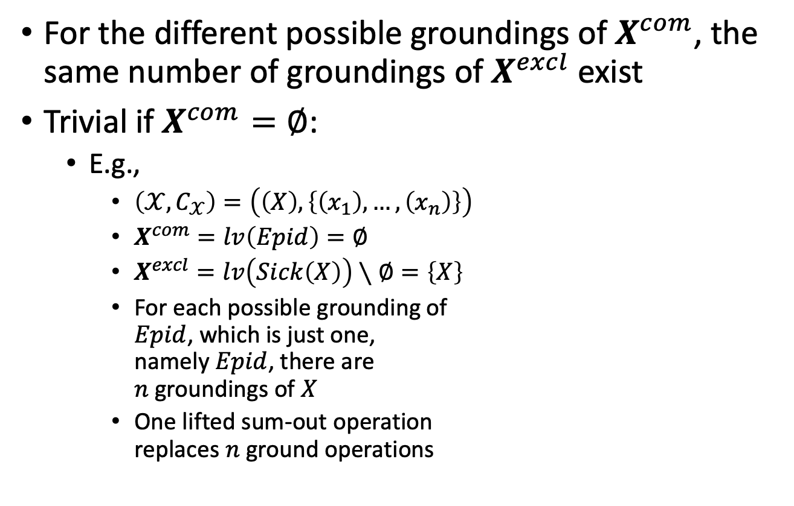


Count Normalisation
For the different possible groundings of $X^{com}$, the same number of groundings of $X^{excl}$ exist
Trivial if $X^{com}=∅$:
  E.g.,
    $\left(𝒳,C_{𝒳}\right)=\left(\left(X\right),\left\{\left(x_{1}\right),…,\left(x_{n}\right)\right\}\right)$
    $X^{com}=lv\left(Epid\right)=∅$
    $X^{excl}=lv\left(Sick\left(X\right)\right)∖∅=\left\{X\right\}$
    For each possible grounding of
    $Epid$, which is just one,
    namely $Epid$, there are
    $n$ groundings of $X$
    One lifted sum-out operation
    replaces $n$ ground operations
$$Epid$$
$$φ$$
$$Sick(X)$$
$$Epid$$
$$φ$$
$$φ$$
$$φ$$
$$Sick(x_{1})$$
$$Sick(x_{2})$$
$$…$$
$$Sick(x_{n})$$

Slide 15




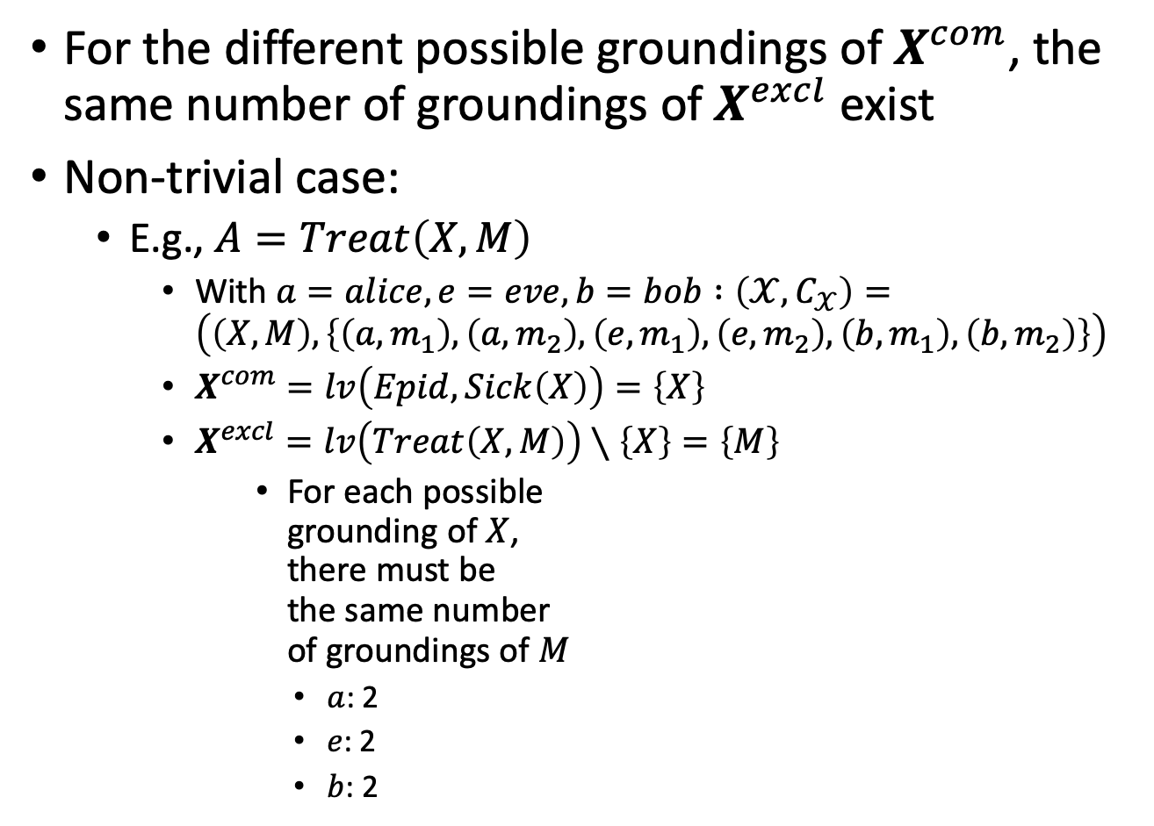

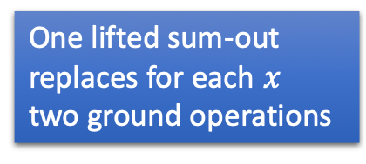
Count Normalisation
For the different possible groundings of $X^{com}$, the same number of groundings of $X^{excl}$ exist
Non-trivial case:
  E.g., $A=Treat\left(X,M\right)$
    With $a=alice,e=eve,b=bob :\left(𝒳,C_{𝒳}\right)=\left(\left(X,M\right),\left\{\left(a,m_{1}\right),\left(a,m_{2}\right),\left(e,m_{1}\right),\left(e,m_{2}\right),\left(b,m_{1}\right),\left(b,m_{2}\right)\right\}\right)$
    $X^{com}=lv\left(Epid,Sick\left(X\right)\right)=\left\{X\right\}$
    $X^{excl}=lv\left(Treat\left(X,M\right)\right)∖\left\{X\right\}=\left\{M\right\}$
    For each possible
    grounding of $X$,
    there must be
    the same number
    of groundings of $M$
        $a$: 2
        $e$: 2
        $b$: 2
      One lifted sum-out
      replaces for each $x$
      two ground operations
Even more strict:
Require not only the same number, but the same constants!
      $$a :\left\{m_{1},m_{2}\right\}$$
      $$e :\left\{m_{1},m_{2}\right\}$$
      $$b :\left\{m_{1},m_{2}\right\}$$
$$Nat(D)$$
$$Man(W)$$
$$g_{1}$$
$$Epid$$
$$Travel(X)$$
$$Treat(X,M)$$
$$g_{2}$$
$$g_{3}$$
$$Sick(X)$$

Slide 16
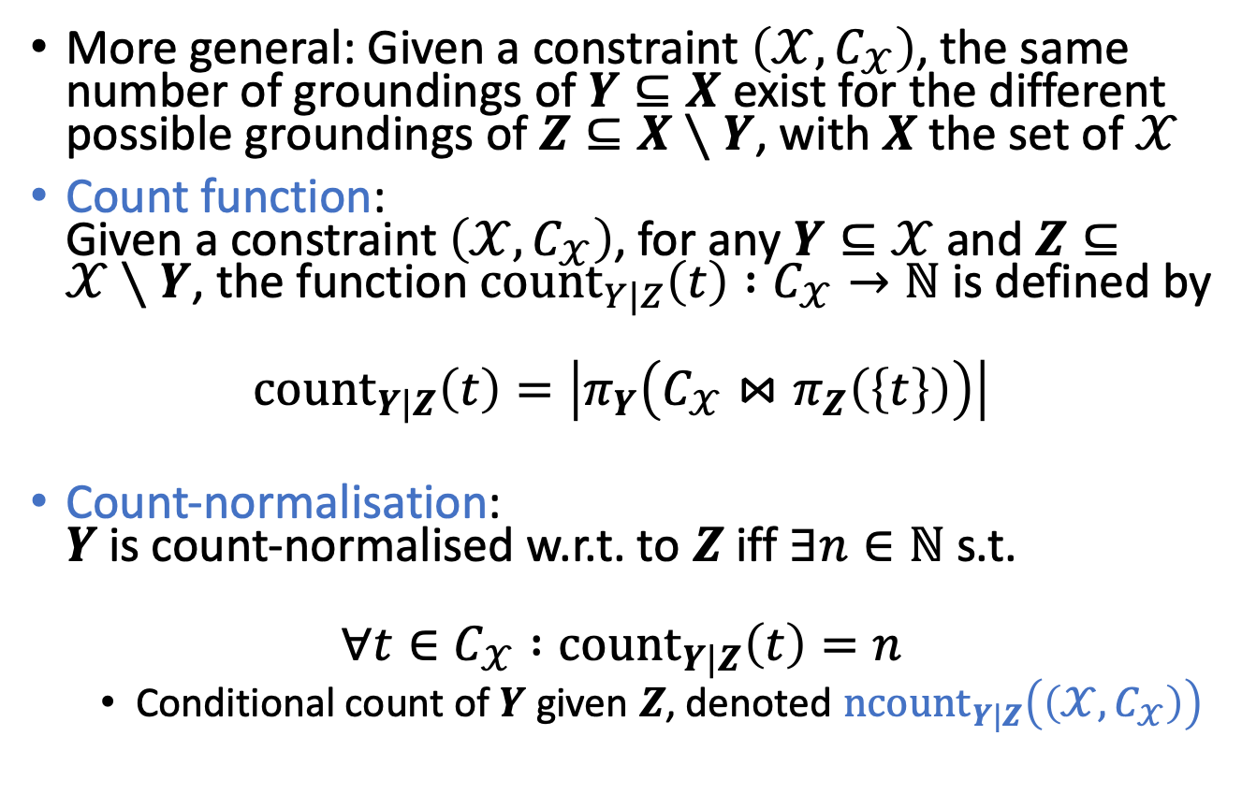
Formal Definition
More general: Given a constraint $\left(𝒳,C_{𝒳}\right)$, the same number of groundings of $Y⊆X$ exist for the different possible groundings of $Z⊆X∖Y$, with $X$ the set of $𝒳$
Count function:
Given a constraint $\left(𝒳,C_{𝒳}\right)$, for any $Y⊆𝒳$ and $Z⊆𝒳∖Y$, the function ${\text{count}}_{Y|Z}\left(t\right) :C_{𝒳}→ℕ$ is defined by
$${\text{coun}\text{t}}_{Y|Z}\left(t\right)=\left|π_{Y}\left(C_{𝒳}⋈π_{Z}\left(\left\{t\right\}\right)\right)\right|$$
Count-normalisation:
$Y$ is count-normalised w.r.t. to $Z$ iff $∃n∈ℕ$ s.t.
$$∀t∈C_{𝒳} :{\text{count}}_{Y|Z}\left(t\right)=n$$
  Conditional count of $Y$ given $Z$, denoted $n{\text{count}}_{Y|Z}\left(\left(𝒳,C_{𝒳}\right)\right)$

Slide 17

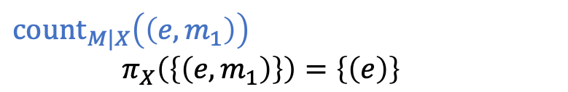




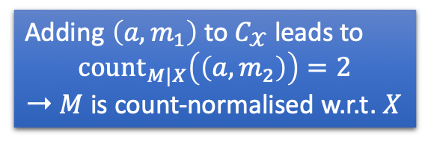
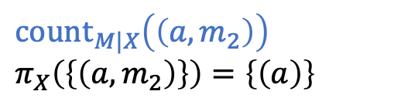

Example
${\text{count}}_{Y|Z}\left(t\right)=\left|π_{Y}\left(C_{𝒳}⋈π_{Z}\left(\left\{t\right\}\right)\right)\right|$
  E.g.,
    $𝒳=\left(X,M\right)$
    $Y=\left\{M\right\}$
    $Z=𝒳∖Y=\left\{X\right\}$
    With $a=alice,e=eve,b=bob :$
    $C_{𝒳}=\left\{\left(a,m_{2}\right),\left(e,m_{1}\right),\left(e,m_{2}\right),\left(b,m_{1}\right),\left(b,m_{2}\right)\right\}$
  Not count-normalised
    $1≠2$
  ${\text{count}}_{M|X}\left(\left(a,m_{2}\right)\right)$
      $$π_{X}\left(\left\{\left(a,m_{2}\right)\right\}\right)=\left\{\left(a\right)\right\}$$
  ${\text{count}}_{M|X}\left(\left(e,m_{1}\right)\right)$
  $π_{X}\left(\left\{\left(e,m_{1}\right)\right\}\right)=\left\{\left(e\right)\right\}$
  $$C_{X,M}⋈\left\{\left(a\right)\right\}=\left\{\left(a,m_{2}\right)\right\}$$
  $$C_{X,M}⋈\left\{\left(e\right)\right\}=\left\{\left(e,m_{1}\right),\left(e,m_{2}\right)\right\}$$
  $$π_{M}\left(\left\{\left(a,m_{2}\right)\right\}\right)=\left\{(m_{2})\right\}$$
  $$π_{M}\left(\left\{\left(e,m_{1}\right),\left(e,m_{2}\right)\right\}\right)=\left\{\left(m_{1}\right),(m_{2})\right\}$$
  $$\left|\left\{\left(m_{2}\right)\right\}\right|=1$$
  $$\left|\left\{\left(m_{1}\right), \left(m_{2}\right)\right\}\right|=2$$
Adding $\left(a,m_{1}\right)$ to $C_{𝒳}$ leads to
$${\text{count}}_{M|X}\left(\left(a,m_{2}\right)\right)=2$$
➝ $M$ is count-normalised w.r.t. $X$

Slide 18
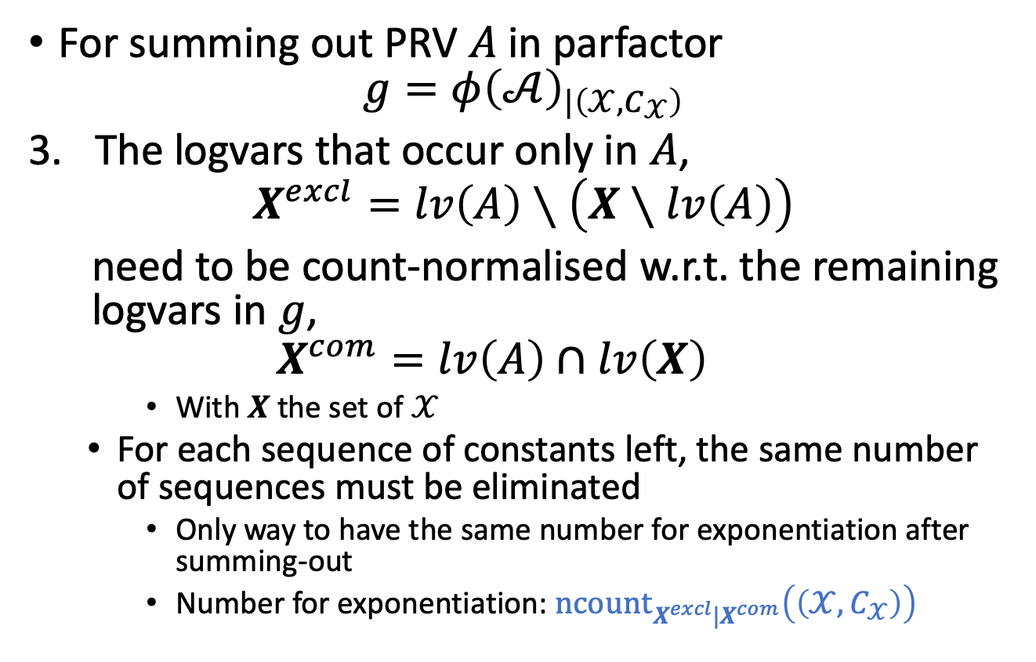
Preconditions
For summing out PRV $A$ in parfactor
$g=φ{\left(𝒜\right)}_{|\left(𝒳,C_{𝒳}\right)}$
The logvars that occur only in $A$,
$$X^{excl}=lv\left(A\right)∖\left(X∖lv\left(A\right)\right)$$
need to be count-normalised w.r.t. the remaining logvars in $g$,
$$X^{com}=lv\left(A\right)∩lv\left(X\right)$$
    With $X$ the set of $𝒳$
  For each sequence of constants left, the same number of sequences must be eliminated
    Only way to have the same number for exponentiation after summing-out
    Number for exponentiation: $n{\text{count}}_{X^{excl}|X^{com}}\left(\left(𝒳,C_{𝒳}\right)\right)$

Slide 19
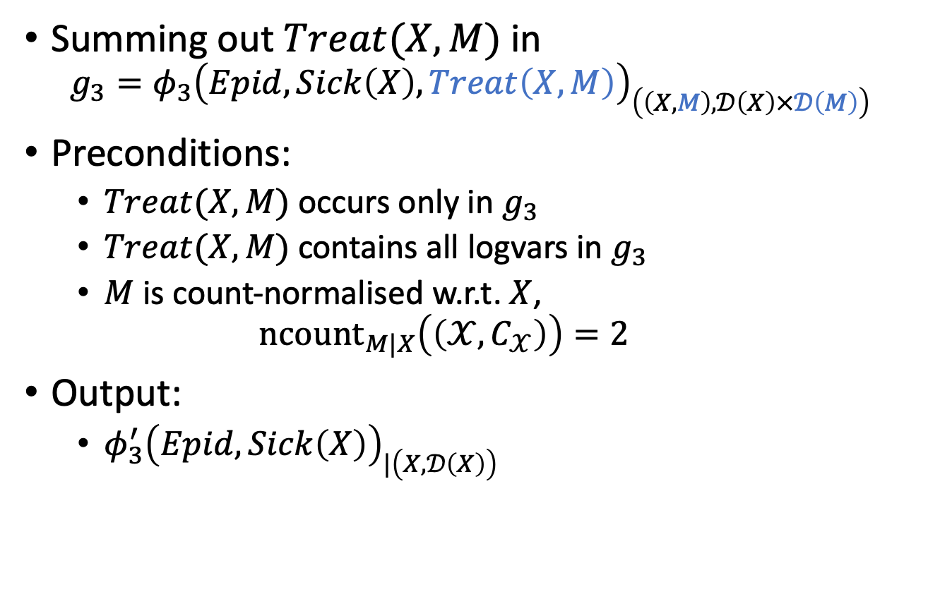
Example
Summing out $Treat(X,M)$ in
$$g_{3}=φ_{3}{\left(Epid, Sick\left(X\right),Treat\left(X,M\right)\right)}_{\left(\left(X,M\right),𝒟\left(X\right)×𝒟\left(M\right)\right)}$$
Preconditions:
  $Treat(X,M)$ occurs only in $g_{3}$
  $Treat(X,M)$ contains all logvars in $g_{3}$
  $M$ is count-normalised w.r.t. $X$,
  $${n\text{count}}_{M|X}\left(\left(𝒳,C_{𝒳}\right)\right)=2$$
Output:
  $φ_{3}^{′}{\left(Epid, Sick\left(X\right)\right)}_{|\left(X,𝒟\left(X\right)\right)}$
$$Nat(D)$$
$$Man(W)$$
$$g_{1}$$
$$Epid$$
$$Travel(X)$$
$$Treat(X,M)$$
$$g_{2}$$
$$g_{3}$$
$$Sick(X)$$

Slide 20











Example
Output:
  $φ_{3}^{′}{\left(Epid, Sick\left(X\right)\right)}_{|\left(X,𝒟\left(X\right)\right)}$
  For each assignment to
  $Epid, Sick\left(X\right)$, sum over
  range values of $Treat(X,M)$…
$$Nat(D)$$
$$Man(W)$$
$$g_{1}$$
$$Epid$$
$$Travel(X)$$
$$g_{2}$$
$$g_{3}^{′}$$
$$Sick(X)$$
$$Epid$$ | $$Sick\left(X\right)$$ | $$φ_{3}^{∗}$$
$$Epid$$ | $$Sick\left(X\right)$$ | $$Treat(X,M)$$ | $$φ_{3}$$
$$false$$ | $$false$$ | $$false$$ | $$5$$
$$false$$ | $$false$$ | $$true$$ | $$0$$
$$false$$ | $$true$$ | $$false$$ | $$4$$
$$false$$ | $$true$$ | $$true$$ | $$6$$
$$true$$ | $$false$$ | $$false$$ | $$4$$
$$true$$ | $$false$$ | $$true$$ | $$6$$
$$true$$ | $$true$$ | $$false$$ | $$2$$
$$true$$ | $$true$$ | $$true$$ | $$9$$
$$false$$ | $$false$$
$$5$$
+
$$false$$ | $$true$$
$$10$$
+
$$true$$ | $$false$$
$$10$$
+
$$true$$ | $$true$$
$$11$$
+

Slide 21









Example
Output:
  $φ_{3}^{′}{\left(Epid, Sick\left(X\right)\right)}_{|\left(X,𝒟\left(X\right)\right)}$
  ... and raise to the power of
  ${n\text{count}}_{M|X}\left(\left(𝒳,C_{𝒳}\right)\right)=2$
$$Nat(D)$$
$$Man(W)$$
$$g_{1}$$
$$Epid$$
$$Travel(X)$$
$$g_{2}$$
$$g_{3}^{′}$$
$$Sick(X)$$
$$Epid$$ | $$Sick\left(X\right)$$ | $$φ_{3}^{′}$$
$$false$$ | $$false$$
$$5^{2}$$
$$false$$ | $$true$$
$${10}^{2}$$
$$true$$ | $$false$$
$${10}^{2}$$
$$true$$ | $$true$$
$${11}^{2}$$

Slide 22













Example
Output:
  $φ_{3}^{′}{\left(Epid, Sick\left(X\right)\right)}_{|\left(X,𝒟\left(X\right)\right)}$
  Equivalent to ground case
    For each $x$, the following
    sum-out operations occur:
$$Nat(D)$$
$$Man(W)$$
$$g_{1}$$
$$Epid$$
$$Travel(X)$$
$$g_{2}$$
$$g_{3}^{′}$$
$$Sick(X)$$
$$Epid$$
$$Epid$$
$$Epid$$
$$Treat(x,m_{2})$$
$$g_{3}$$
$$g_{3}^{∗}$$
$$Treat(x,m_{1})$$
$$g_{3}^{′}$$
$$g_{3}$$
$$g_{3}^{∗}$$
$$Sick(x)$$
$$Sick(x)$$
$$Sick(x)$$
Initial model
After sum-out
After multiply
All factors contain the same arguments after sum-out

Slide 23

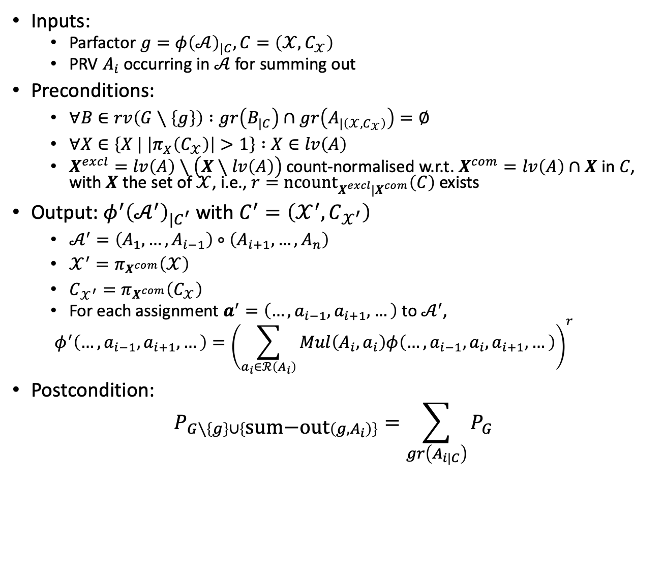
Lifted Summing Out: Operator
Inputs:
  Parfactor $g=φ{\left(𝒜\right)}_{|C}, C=\left(𝒳,C_{𝒳}\right)$
  PRV $A_{i}$ occurring in $𝒜$ for summing out
Preconditions:
  $∀B∈rv\left(G∖\left\{g\right\}\right) :gr\left(B_{|C}\right)∩gr\left(A_{|\left(𝒳,C_{𝒳}\right)}\right)=∅$
  $∀X∈\left\{X | \left|π_{X}\left(C_{𝒳}\right)\right|>1\right\} :X∈lv\left(A\right)$
  $X^{excl}=lv\left(A\right)∖\left(X∖lv\left(A\right)\right)$ count-normalised w.r.t. $X^{com}=lv\left(A\right)∩X$ in $C$,
  with $X$ the set of $𝒳$, i.e., $r=n{\text{count}}_{X^{excl}|X^{com}}\left(C\right)$ exists
Output: $φ^{′}{\left(𝒜^{′}\right)}_{|C^{′}}$ with $C^{′}=\left(𝒳^{′},C_{𝒳^{′}}\right)$
  $𝒜^{′}=\left(A_{1},…, A_{i−1}\right)∘\left(A_{i+1},…, A_{n}\right)$
  $𝒳^{′}=π_{X^{com}}\left(𝒳\right)$
  $C_{𝒳^{′}}=π_{X^{com}}\left(C_{𝒳}\right)$
  For each assignment $a^{′}=\left(…,a_{i−1},a_{i+1},…\right)$ to $𝒜^{′}$,
  $$φ^{′}\left(…,a_{i−1},a_{i+1},…\right)={\left(\sum_{a_{i}∈ℛ\left(A_{i}\right)}{Mul\left(A_{i},a_{i}\right)φ\left(…,a_{i−1},a_{i},a_{i+1},…\right)}\right)}^{r}$$
Postcondition:
$$P_{G∖\left\{g\right\}∪\left\{\text{sum}\text{−}\text{out}\left(g,A_{i}\right)\right\}}=\sum_{gr\left(A_{i|C}\right)}{P_{G}}$$
Concatenation of two sequences
Why $Mul\left(A_{i},a_{i}\right)$?

Slide 24
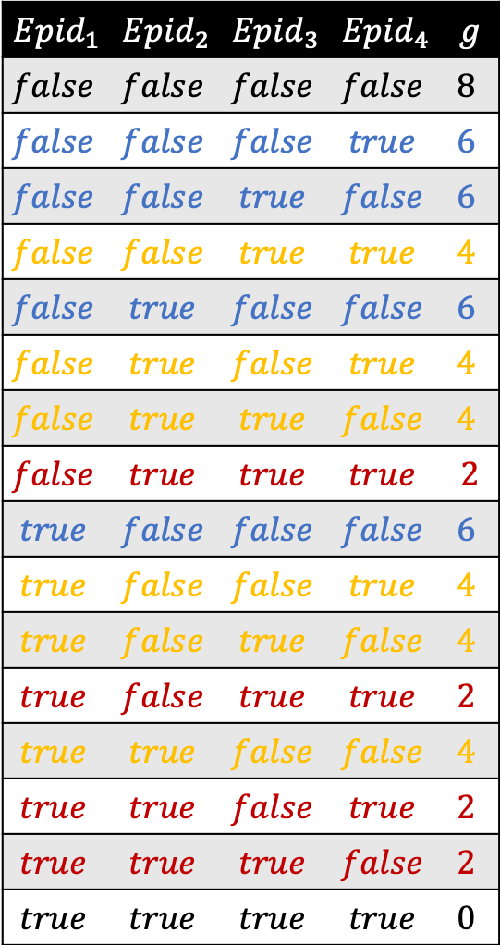
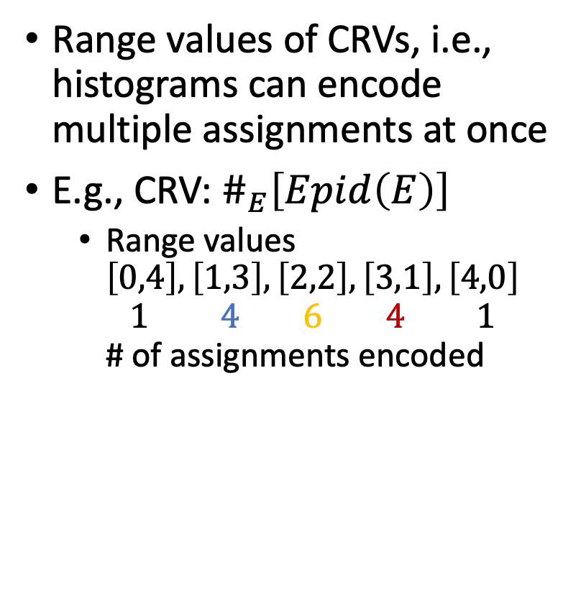
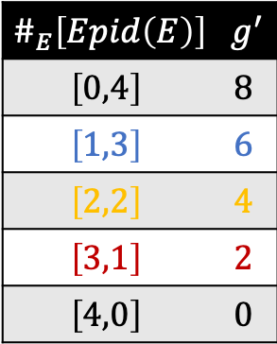
Sum-out with CRVs
$${Epid}_{1}$$ | $${Epid}_{2}$$ | $${Epid}_{3}$$ | $${Epid}_{4}$$ | $$g$$
$$false$$ | $$false$$ | $$false$$ | $$false$$ | $$8$$
$$false$$ | $$false$$ | $$false$$ | $$true$$ | $$6$$
$$false$$ | $$false$$ | $$true$$ | $$false$$ | $$6$$
$$false$$ | $$false$$ | $$true$$ | $$true$$ | $$4$$
$$false$$ | $$true$$ | $$false$$ | $$false$$ | $$6$$
$$false$$ | $$true$$ | $$false$$ | $$true$$ | $$4$$
$$false$$ | $$true$$ | $$true$$ | $$false$$ | $$4$$
$$false$$ | $$true$$ | $$true$$ | $$true$$ | 2
$$true$$ | $$false$$ | $$false$$ | $$false$$ | $$6$$
$$true$$ | $$false$$ | $$false$$ | $$true$$ | $$4$$
$$true$$ | $$false$$ | $$true$$ | $$false$$ | $$4$$
$$true$$ | $$false$$ | $$true$$ | $$true$$ | $$2$$
$$true$$ | $$true$$ | $$false$$ | $$false$$ | $$4$$
$$true$$ | $$true$$ | $$false$$ | $$true$$ | $$2$$
$$true$$ | $$true$$ | $$true$$ | $$false$$ | $$2$$
$$true$$ | $$true$$ | $$true$$ | $$true$$ | $$0$$
Range values of CRVs, i.e., histograms can encode multiple assignments at once
E.g., CRV: $\#_{E}\left[Epid\left(E\right)\right]$
  Range values
  $\left[0,4\right],\left[1,3\right],\left[2,2\right],\left[3,1\right],\left[4,0\right]$
  $1 4 6 4 1$
  # of assignments encoded
$$\#_{E}\left[Epid\left(E\right)\right]$$ | $$g^{′}$$
$$\left[0,4\right]$$ | $$8$$
$$\left[1,3\right]$$ | $$6$$
$$\left[2,2\right]$$ | $$4$$
$$\left[3,1\right]$$ | $$2$$
$$\left[4,0\right]$$ | $$0$$

Slide 25

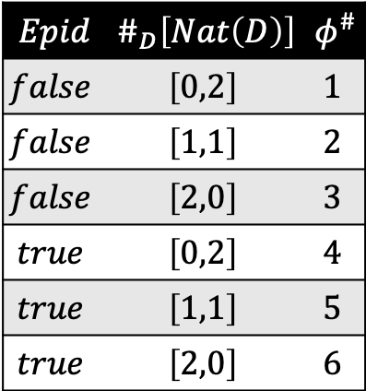









Sum-out with CRVs
Summing over the range of CRVs sums over histograms, i.e., over multiple assignments
  Each histogram $h$ represents $Mul\left(h\right)$ assignments
  E.g., sum out $\#_{D}\left[Nat\left(D\right)\right]$ in $φ^{\#}\left(Epid,\#_{D}\left[Nat\left(D\right)\right]\right)$
    All $gr\left(Nat\left(D\right)\right)$ summed out at once
$$Epid$$ | $$\#_{D}\left[Nat\left(D\right)\right]$$ | $$φ^{\#}$$
$$false$$ | $$\left[0,2\right]$$ | $$1$$
$$false$$ | $$\left[1,1\right]$$ | $$2$$
$$false$$ | $$\left[2,0\right]$$ | $$3$$
$$true$$ | $$\left[0,2\right]$$ | $$4$$
$$true$$ | $$\left[1,1\right]$$ | $$5$$
$$true$$ | $$\left[2,0\right]$$ | $$6$$
$$Epid$$ | $$φ^{′}$$
$$∙Mul\left(\left[0,2\right]\right)$$
$$∙Mul\left(\left[1,1\right]\right)$$
+
$$false$$ | $$1∙1+2∙2+3∙1$$
$$∙Mul\left(\left[2,0\right]\right)$$
$$∙Mul\left(\left[0,2\right]\right)$$
$$∙Mul\left(\left[1,1\right]\right)$$
+
$$true$$ | $$4∙1+5∙2+6∙1$$
$$∙Mul\left(\left[2,0\right]\right)$$

Slide 26

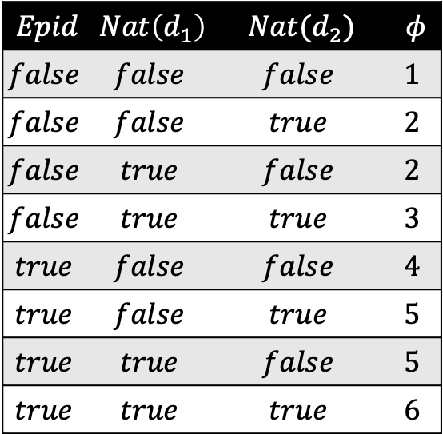


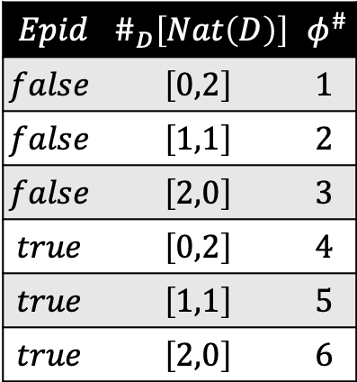






$$Epid$$ | $$\#_{D}\left[Nat\left(D\right)\right]$$ | $$φ^{\#}$$
$$false$$ | $$\left[0,2\right]$$ | $$1$$
$$false$$ | $$\left[1,1\right]$$ | $$2$$
$$false$$ | $$\left[2,0\right]$$ | $$3$$
$$true$$ | $$\left[0,2\right]$$ | $$4$$
$$true$$ | $$\left[1,1\right]$$ | $$5$$
$$true$$ | $$\left[2,0\right]$$ | $$6$$
$$Epid$$ | $$φ^{′}$$
$$∙Mul\left(\left[0,2\right]\right)$$
$$∙Mul\left(\left[1,1\right]\right)$$
+
$$false$$ | $$1∙1+2∙2+3∙1$$
$$∙Mul\left(\left[2,0\right]\right)$$
$$∙Mul\left(\left[0,2\right]\right)$$
$$∙Mul\left(\left[1,1\right]\right)$$
+
$$true$$ | $$4∙1+5∙2+6∙1$$
$$∙Mul\left(\left[2,0\right]\right)$$
$$Epid$$ | $$Nat\left(d_{1}\right)$$ | $$Nat(d_{2})$$ | $$φ$$
$$false$$ | $$false$$ | $$false$$ | $$1$$
$$false$$ | $$false$$ | $$true$$ | $$2$$
$$false$$ | $$true$$ | $$false$$ | $$2$$
$$false$$ | $$true$$ | $$true$$ | $$3$$
$$true$$ | $$false$$ | $$false$$ | $$4$$
$$true$$ | $$false$$ | $$true$$ | $$5$$
$$true$$ | $$true$$ | $$false$$ | $$5$$
$$true$$ | $$true$$ | $$true$$ | $$6$$
+
+
+

Slide 27


$$Epid$$ | $$\#_{D}\left[Nat\left(D\right)\right]$$ | $$φ^{\#}$$
$$false$$ | $$\left[0,2\right]$$ | $$1$$
$$false$$ | $$\left[1,1\right]$$ | $$2$$
$$false$$ | $$\left[2,0\right]$$ | $$3$$
$$true$$ | $$\left[0,2\right]$$ | $$4$$
$$true$$ | $$\left[1,1\right]$$ | $$5$$
$$true$$ | $$\left[2,0\right]$$ | $$6$$
$$Epid$$ | $$φ^{′}$$
$$∙Mul\left(\left[0,2\right]\right)$$
$$∙Mul\left(\left[1,1\right]\right)$$
+
$$false$$ | $$1∙1+2∙2+3∙1$$
$$∙Mul\left(\left[2,0\right]\right)$$
$$∙Mul\left(\left[0,2\right]\right)$$
$$∙Mul\left(\left[1,1\right]\right)$$
+
$$true$$ | $$4∙1+5∙2+6∙1$$
$$∙Mul\left(\left[2,0\right]\right)$$
$$Epid$$ | $$Nat\left(d_{1}\right)$$ | $$Nat(d_{2})$$ | $$φ$$
$$false$$ | $$false$$ | $$false$$ | $$1$$
$$false$$ | $$false$$ | $$true$$ | $$2$$
$$false$$ | $$true$$ | $$false$$ | $$2$$
$$false$$ | $$true$$ | $$true$$ | $$3$$
$$true$$ | $$false$$ | $$false$$ | $$4$$
$$true$$ | $$false$$ | $$true$$ | $$5$$
$$true$$ | $$true$$ | $$false$$ | $$5$$
$$true$$ | $$true$$ | $$true$$ | $$6$$
+
$$false$$ | $$1+2+2+3$$
+
$$true$$ | $$4+5+5+6$$

Slide 28

Lifted Summing Out: Operator
Inputs:
  Parfactor $g=φ{\left(𝒜\right)}_{|C}, C=\left(𝒳,C_{𝒳}\right)$
  PRV $A_{i}$ occurring in $𝒜$ for summing out
Preconditions:
  $∀B∈rv\left(G∖\left\{g\right\}\right) :gr\left(B_{|C}\right)∩gr\left(A_{|\left(𝒳,C_{𝒳}\right)}\right)=∅$
  $∀X∈\left\{X | \left|π_{X}\left(C_{𝒳}\right)\right|>1\right\} :X∈lv\left(A\right)$
  $X^{excl}=lv\left(A\right)∖\left(X∖lv\left(A\right)\right)$ count-normalised w.r.t. $X^{com}=lv\left(A\right)∩X$ in $C$,
  with $X$ the set of $𝒳$, i.e., $r=n{\text{count}}_{X^{excl}|X^{com}}\left(C\right)$ exists
Output: $φ^{′}{\left(𝒜^{′}\right)}_{|C^{′}}$ with $C^{′}=\left(𝒳^{′},C_{𝒳^{′}}\right)$
  $𝒜^{′}=\left(A_{1},…, A_{i−1}\right)∘\left(A_{i+1},…, A_{n}\right)$
  $𝒳^{′}=π_{X^{com}}\left(𝒳\right)$
  $C_{𝒳^{′}}=π_{X^{com}}\left(C_{𝒳}\right)$
  For each assignment $a^{′}=\left(…,a_{i−1},a_{i+1},…\right)$ to $𝒜^{′}$,
  $$φ^{′}\left(…,a_{i−1},a_{i+1},…\right)={\left(\sum_{a_{i}∈ℛ\left(A_{i}\right)}{Mul\left(A_{i},a_{i}\right)φ\left(…,a_{i−1},a_{i},a_{i+1},…\right)}\right)}^{r}$$
Postcondition:
$$P_{G∖\left\{g\right\}∪\left\{\text{sum}\text{−}\text{out}\left(g,A_{i}\right)\right\}}=\sum_{gr\left(A_{i|C}\right)}{P_{G}}$$
$$Mul\left(A_{i},a_{i}\right)$$
makes sum-out of CRVs correct. If $A_{i}$ no CRV,
$$Mul\left(A_{i},a_{i}\right)=1$$

Slide 29
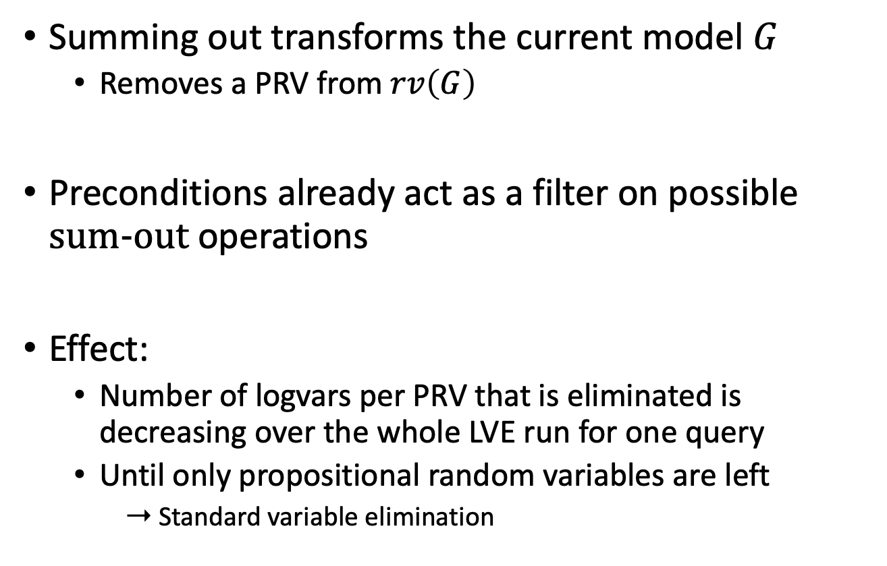
Lifted Summing Out
Summing out transforms the current model $G$
  Removes a PRV from $rv\left(G\right)$
Preconditions already act as a filter on possible $\text{sum}\text{−}\text{out}$ operations
Effect:
  Number of logvars per PRV that is eliminated is decreasing over the whole LVE run for one query
  Until only propositional random variables are left
    ➝ Standard variable elimination

Slide 30
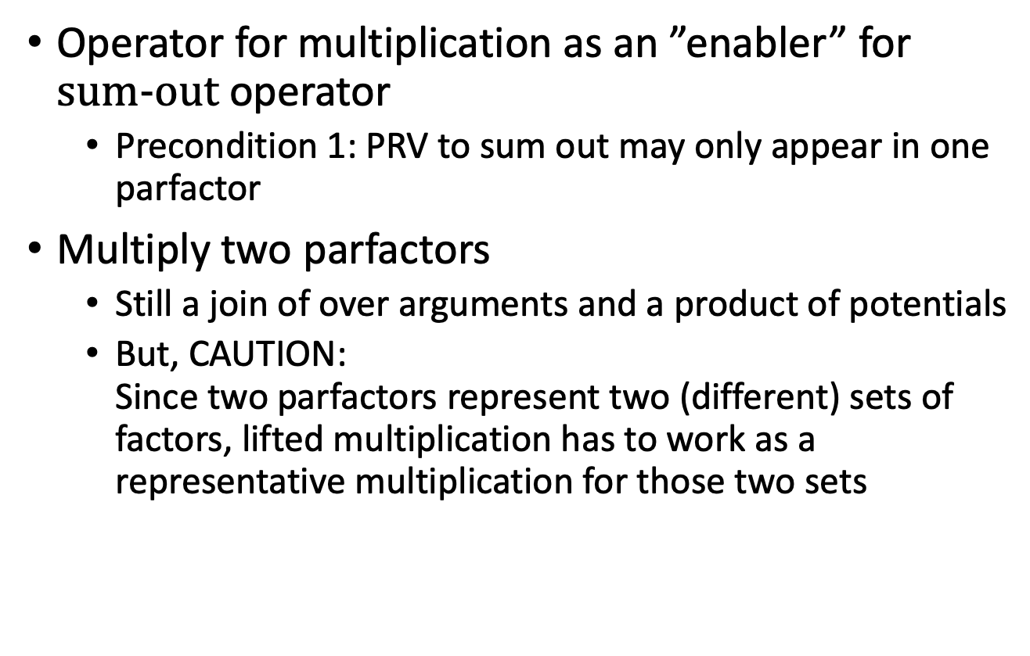
Lifted Multiplication
Operator for multiplication as an ”enabler” for $\text{sum}\text{−}\text{out}$ operator
  Precondition 1: PRV to sum out may only appear in one parfactor
Multiply two parfactors
  Still a join of over arguments and a product of potentials
  But, CAUTION:
  Since two parfactors represent two (different) sets of factors, lifted multiplication has to work as a representative multiplication for those two sets

Slide 31
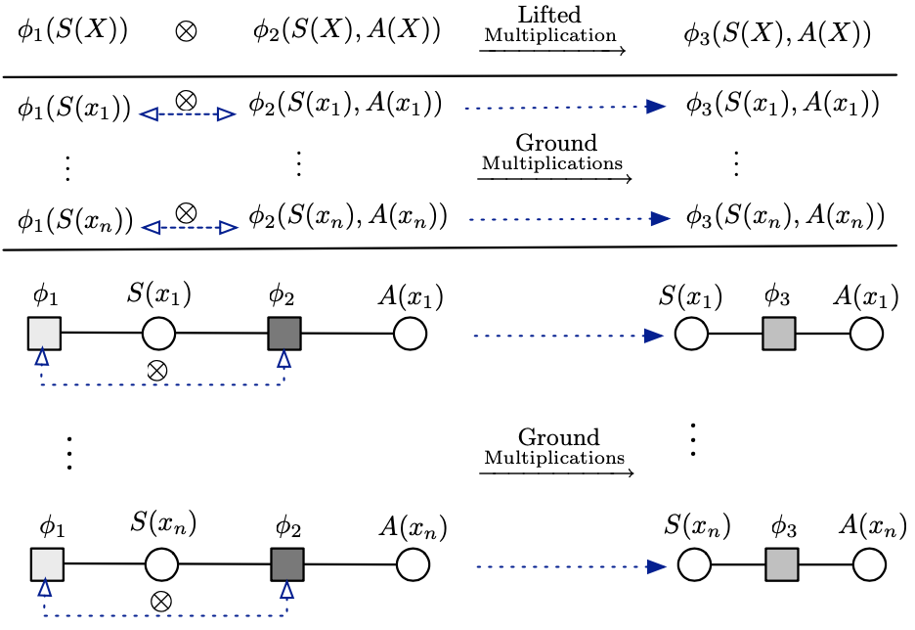






Lifted Multiplication: Trivial Case
1-to-1 correspondence between the ground factors of each parfactor
  E.g., $φ_{1}\left(S\left(X\right)\right)∙φ_{2}\left(S\left(X\right),A\left(X\right)\right)$
$$∙$$
$$∙$$
    Each grounding of $X$ in $gr\left(φ_{1}\left(S\left(X\right)\right)\right)$ interacts with one corresponding grounding of $X$ in $gr\left(φ_{2}\left(S\left(X\right),A\left(X\right)\right)\right)$
$$∙$$
$$∙$$
$$∙$$
Figure taken from: Nima Taghipour, Daan Fierens, Jesse Davis, and Hendrik Blockeel: Lifted Variable Elimination: Decoupling the Operators from the Constraint Language. In: Journal of Artificial Intelligence Research, 2013.

Slide 32
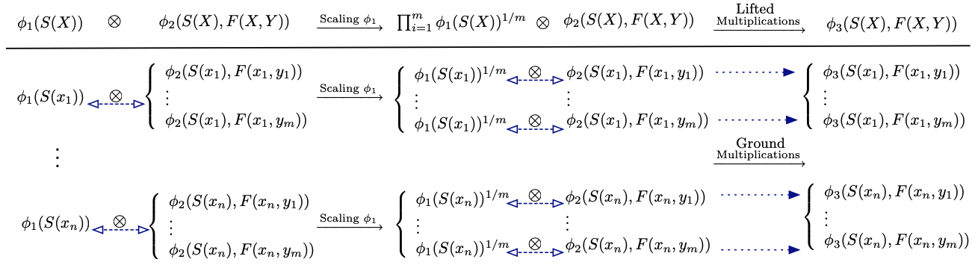









Lifted Multiplication: More General
$1$-to-$m$ correspondence between the
ground factors of each parfactor
  Scaling necessary
  E.g., $φ_{1}\left(S\left(X\right)\right)∙φ_{2}\left(S\left(X\right),F\left(X,Y\right)\right)$
    Each grounding of $X$ in $gr\left(φ_{1}\left(S\left(X\right)\right)\right)$ interacts with $m$ corresponding groundings of $X,Y$ in $gr\left(φ_{2}\left(S\left(X\right),F\left(X,Y\right)\right)\right)$
Distribute $φ_{1}\left(S\left(X\right)\right)$ into $m$ factors proportionally
$$∙$$
$$∙$$
$$∙$$
$$∙$$
$$∙$$
$$∙$$
$$∙$$
$$∙$$
Figure taken from: Nima Taghipour, Daan Fierens, Jesse Davis, and Hendrik Blockeel: Lifted Variable Elimination: Decoupling the Operators from the Constraint Language. In: Journal of Artificial Intelligence Research, 2013.

Slide 33
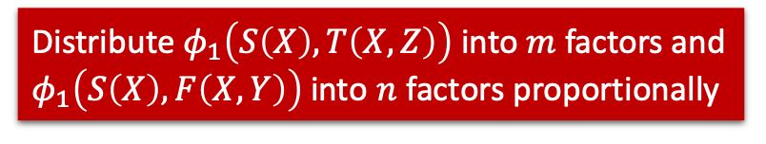
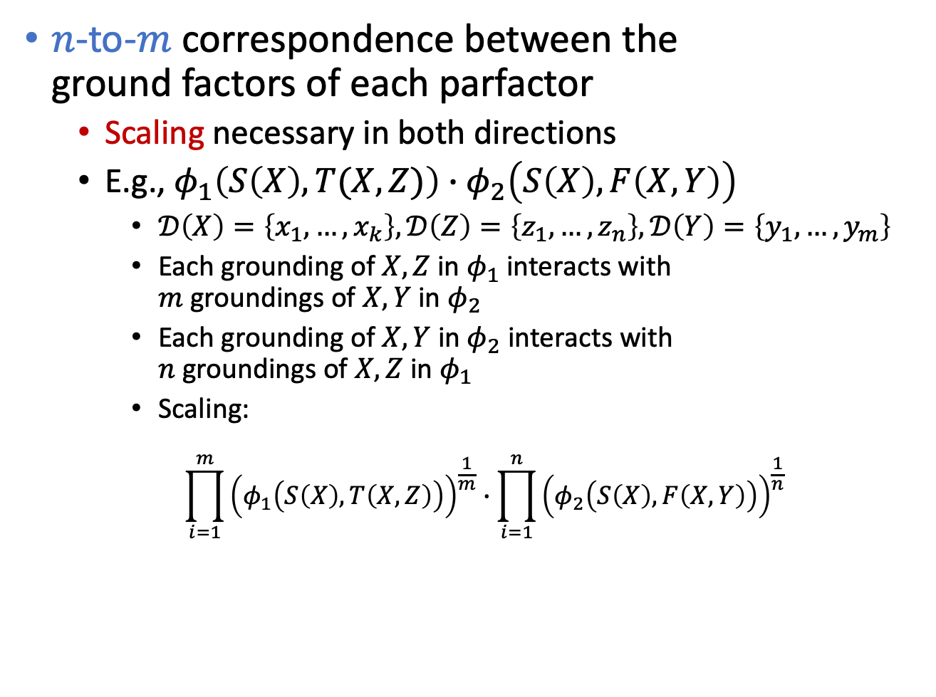
Lifted Multiplication: General Case
$n$-to-$m$ correspondence between the
ground factors of each parfactor
  Scaling necessary in both directions
  E.g., $φ_{1}\left(S\left(X\right),T(X,Z)\right)∙φ_{2}\left(S\left(X\right),F\left(X,Y\right)\right)$
    $𝒟\left(X\right)=\left\{x_{1},…,x_{k}\right\},𝒟\left(Z\right)=\left\{z_{1},…,z_{n}\right\}, 𝒟\left(Y\right)=\left\{y_{1},…,y_{m}\right\}$
    Each grounding of $X,Z$ in $φ_{1}$ interacts with
    $m$ groundings of $X,Y$ in $φ_{2}$
    Each grounding of $X,Y$ in $φ_{2}$ interacts with
    $n$ groundings of $X,Z$ in $φ_{1}$
    Scaling:
      $$\prod_{i=1}^{m}{{\left(φ_{1}\left(S\left(X\right),T\left(X,Z\right)\right)\right)}^{\frac{1}{m}}}∙\prod_{i=1}^{n}{{\left(φ_{2}\left(S\left(X\right),F\left(X,Y\right)\right)\right)}^{\frac{1}{n}} }$$
Distribute $φ_{1}\left(S\left(X\right),T\left(X,Z\right)\right)$ into $m$ factors and $φ_{1}\left(S\left(X\right),F\left(X,Y\right)\right)$ into $n$ factors proportionally

Slide 34
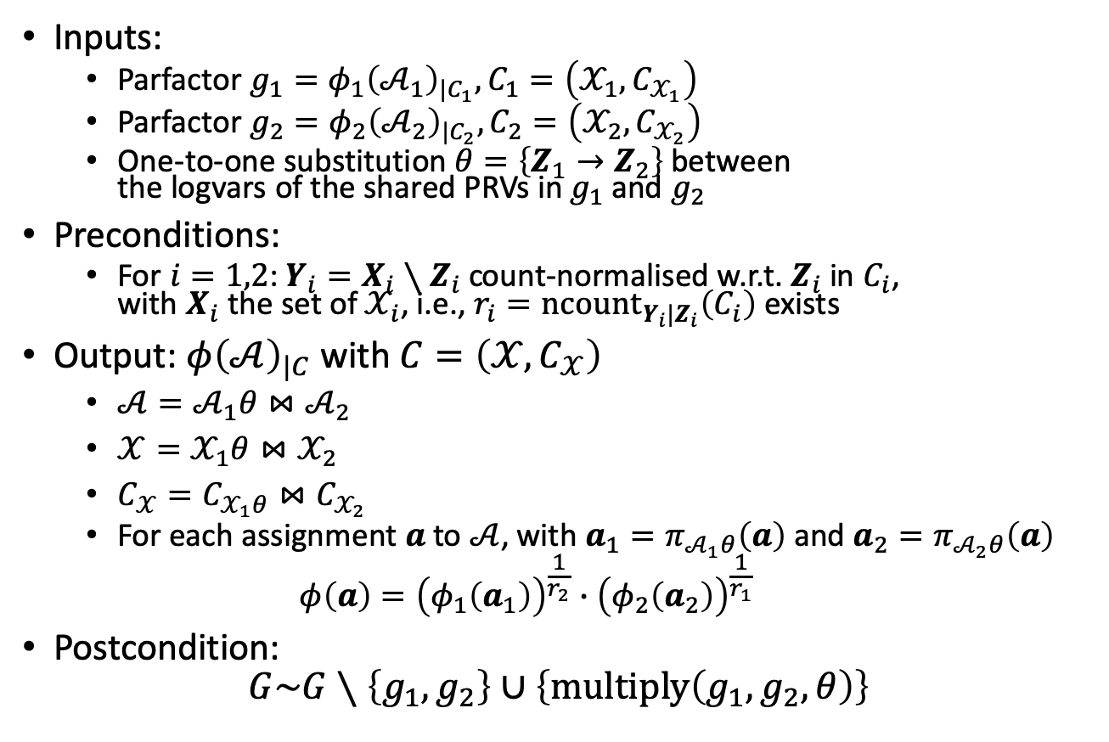
Lifted Multiplication: Operator
Inputs:
  Parfactor $g_{1}=φ_{1}{\left(𝒜_{1}\right)}_{|C_{1}}, C_{1}=\left(𝒳_{1},C_{𝒳_{1}}\right)$
  Parfactor $g_{2}=φ_{2}{\left(𝒜_{2}\right)}_{|C_{2}}, C_{2}=\left(𝒳_{2},C_{𝒳_{2}}\right)$
  One-to-one substitution $θ=\left\{Z_{1}→Z_{2}\right\}$ between
  the logvars of the shared PRVs in $g_{1}$ and $g_{2}$
Preconditions:
  For $i=1,2$: $Y_{i}=X_{i}∖Z_{i}$ count-normalised w.r.t. $Z_{i}$ in $C_{i}$,
  with $X_{i}$ the set of $𝒳_{i}$, i.e., $r_{i}=n{\text{count}}_{Y_{i}|Z_{i}}\left(C_{i}\right)$ exists
Output: $φ{\left(𝒜\right)}_{|C}$ with $C=\left(𝒳,C_{𝒳}\right)$
  $𝒜=𝒜_{1}θ⋈𝒜_{2}$
  $𝒳=𝒳_{1}θ⋈𝒳_{2}$
  $C_{𝒳}=C_{𝒳_{1}θ}⋈C_{𝒳_{2}}$
  For each assignment $a$ to $𝒜$, with $a_{1}=π_{𝒜_{1}θ}\left(a\right)$ and $a_{2}=π_{𝒜_{2}θ}\left(a\right)$
  $$φ\left(a\right)={\left(φ_{1}\left(a_{1}\right)\right)}^{\frac{1}{r_{2}}}∙{\left(φ_{2}\left(a_{2}\right)\right)}^{\frac{1}{r_{1}}}$$
Postcondition:
$$G\sim G∖\left\{g_{1},g_{2}\right\}∪\left\{\text{multiply}\left(g_{1},g_{2},θ\right)\right\}$$
Operator does not assume that logvars with the same applicable constants share the same name

Slide 35
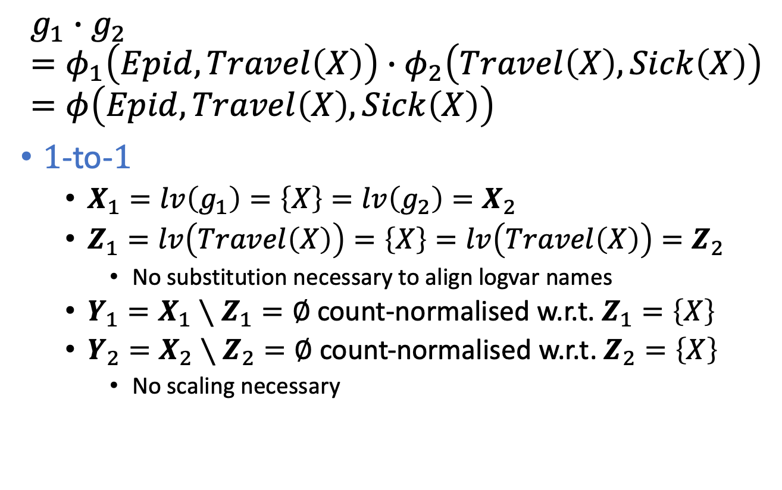
Lifted Multiplication: Example
$$g_{1}∙g_{2}=φ_{1}\left(Epid, Travel\left(X\right)\right)∙φ_{2}\left(Travel\left(X\right), Sick\left(X\right)\right)=φ\left(Epid, Travel\left(X\right),Sick\left(X\right)\right)$$
$1$-to-$1$
  $X_{1}=lv\left(g_{1}\right)=\left\{X\right\}=lv\left(g_{2}\right)=X_{2}$
  $Z_{1}=lv\left(Travel\left(X\right)\right)=\left\{X\right\}=lv\left(Travel\left(X\right)\right)=Z_{2}$
    No substitution necessary to align logvar names
  $Y_{1}=X_{1}∖Z_{1}=∅$ count-normalised w.r.t. $Z_{1}=\left\{X\right\}$
  $Y_{2}=X_{2}∖Z_{2}=∅$ count-normalised w.r.t. $Z_{2}=\left\{X\right\}$
    No scaling necessary
Notes:
Argmax and sum not commutative

Slide 36



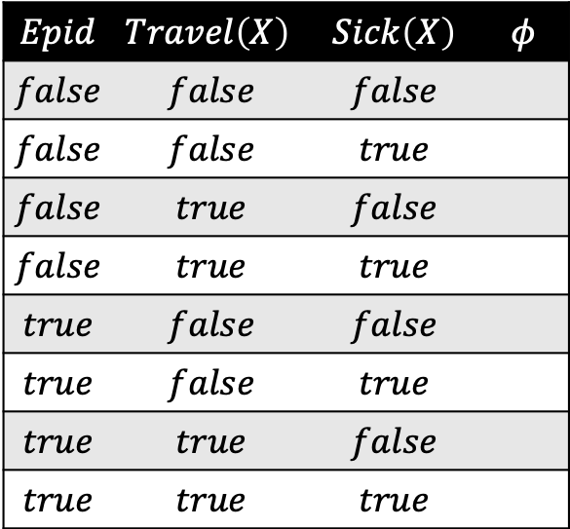




Lifted Multiplication: Example
$$g_{1}∙g_{2}=φ_{1}\left(Epid, Travel\left(X\right)\right)∙φ_{2}\left(Travel\left(X\right), Sick\left(X\right)\right)=φ\left(Epid, Travel\left(X\right),Sick\left(X\right)\right)$$
$$Epid$$ | $$Travel\left(X\right)$$ | $$φ_{1}$$
$$false$$ | $$false$$ | $$1$$
$$false$$ | $$true$$ | $$2$$
$$true$$ | $$false$$ | $$3$$
$$true$$ | $$true$$ | $$4$$
$$π_{Epid,Travel\left(X\right)}$$
$$Epid$$ | $$Travel\left(X\right)$$ | $$Sick\left(X\right)$$ | $$φ$$
$$false$$ | $$false$$ | $$false$$
$$false$$ | $$false$$ | $$true$$
$$false$$ | $$true$$ | $$false$$
$$false$$ | $$true$$ | $$true$$
$$true$$ | $$false$$ | $$false$$
$$true$$ | $$false$$ | $$true$$
$$true$$ | $$true$$ | $$false$$
$$true$$ | $$true$$ | $$true$$
$$1∙5$$
$$∙$$
$$Travel\left(X\right)$$ | $$Sick\left(X\right)$$ | $$φ_{2}$$
$$false$$ | $$false$$ | $$5$$
$$false$$ | $$true$$ | $$6$$
$$true$$ | $$false$$ | $$7$$
$$true$$ | $$true$$ | $$8$$
$$π_{Travel\left(X\right), Sick\left(X\right)}$$
Notes:
Argmax and sum not commutative

Slide 37



Lifted Multiplication: Example
$$g_{1}∙g_{2}=φ_{1}\left(Epid, Travel\left(X\right)\right)∙φ_{2}\left(Travel\left(X\right), Sick\left(X\right)\right)=φ\left(Epid, Travel\left(X\right),Sick\left(X\right)\right)$$
$$Epid$$ | $$Travel\left(X\right)$$ | $$φ_{1}$$
$$false$$ | $$false$$ | $$1$$
$$false$$ | $$true$$ | $$2$$
$$true$$ | $$false$$ | $$3$$
$$true$$ | $$true$$ | $$4$$
$$π_{Epid,Travel\left(X\right)}$$
$$Epid$$ | $$Travel\left(X\right)$$ | $$Sick\left(X\right)$$ | $$φ$$
$$false$$ | $$false$$ | $$false$$
$$false$$ | $$false$$ | $$true$$
$$false$$ | $$true$$ | $$false$$
$$false$$ | $$true$$ | $$true$$
$$true$$ | $$false$$ | $$false$$
$$true$$ | $$false$$ | $$true$$
$$true$$ | $$true$$ | $$false$$
$$true$$ | $$true$$ | $$true$$
$$1∙5$$
$$1∙6$$
$$∙$$
$$Travel\left(X\right)$$ | $$Sick\left(X\right)$$ | $$φ_{2}$$
$$false$$ | $$false$$ | $$5$$
$$false$$ | $$true$$ | $$6$$
$$true$$ | $$false$$ | $$7$$
$$true$$ | $$true$$ | $$8$$
$$π_{Travel\left(X\right), Sick\left(X\right)}$$
Notes:
Argmax and sum not commutative

Slide 38












Lifted Multiplication: Example
$$g_{1}∙g_{2}=φ_{1}\left(Epid, Travel\left(X\right)\right)∙φ_{2}\left(Travel\left(X\right), Sick\left(X\right)\right)=φ\left(Epid, Travel\left(X\right),Sick\left(X\right)\right)$$
$$Epid$$ | $$Travel\left(X\right)$$ | $$φ_{1}$$
$$false$$ | $$false$$ | $$1$$
$$false$$ | $$true$$ | $$2$$
$$true$$ | $$false$$ | $$3$$
$$true$$ | $$true$$ | $$4$$
$$Epid$$ | $$Travel\left(X\right)$$ | $$Sick\left(X\right)$$ | $$φ$$
$$false$$ | $$false$$ | $$false$$
$$false$$ | $$false$$ | $$true$$
$$false$$ | $$true$$ | $$false$$
$$false$$ | $$true$$ | $$true$$
$$true$$ | $$false$$ | $$false$$
$$true$$ | $$false$$ | $$true$$
$$true$$ | $$true$$ | $$false$$
$$true$$ | $$true$$ | $$true$$
$$π_{Epid,Travel\left(X\right)}$$
$$1∙5$$
$$1∙6$$
$$2∙7$$
$$∙$$
$$2∙8$$
$$∙$$
$$Travel\left(X\right)$$ | $$Sick\left(X\right)$$ | $$φ_{2}$$
$$false$$ | $$false$$ | $$5$$
$$false$$ | $$true$$ | $$6$$
$$true$$ | $$false$$ | $$7$$
$$true$$ | $$true$$ | $$8$$
$$3∙5$$
$$∙$$
$$3∙6$$
$$∙$$
$$4∙7$$
$$∙$$
$$4∙8$$
$$∙$$
$$π_{Travel\left(X\right), Sick\left(X\right)}$$
Notes:
Argmax and sum not commutative

Slide 39

Lifted Multiplication: Example
$$g_{1}∙g_{2}=φ_{1}\left(Sick\left(X\right)\right)∙φ_{2}\left(Sick\left(X\right), Treat\left(X,M\right)\right)=φ\left(Sick\left(X\right), Treat\left(X,M\right)\right)$$
  $⊤$ constraints with $\left|𝒟\left(M\right)\right|=2$
$1$-to-$m$
  $X_{1}=lv\left(g_{1}\right)=\left\{X\right\}$
  $X_{2}=lv\left(g_{2}\right)=\left\{X,M\right\}$
  $Z_{1}=lv\left(Sick\left(X\right)\right)=\left\{X\right\}=lv\left(Sick\left(X\right)\right)=Z_{2}$
    No substitution necessary to align logvar names
  $Y_{1}=X_{1}∖Z_{1}=∅$ count-normalised w.r.t. $Z_{1}=\left\{X\right\}$
  $Y_{2}=X_{2}∖Z_{2}=\left\{M\right\}$ count-normalised w.r.t. $Z_{2}=\left\{X\right\}$
    Scaling necessary: $r_{2}=n{\text{count}}_{Y_{2}|Z_{2}}\left(C_{2}\right)=2$
      Scaling of potentials in $g_{1}$
Notes:
Argmax and sum not commutative

Slide 40









Lifted Multiplication: Example
$$g_{1}∙g_{2}=φ_{1}\left(Sick\left(X\right)\right)∙φ_{2}\left(Sick\left(X\right), Treat\left(X,M\right)\right)=φ\left(Sick\left(X\right),Treat\left(X,M\right)\right)$$
$$Sick\left(X\right)$$ | $$φ_{1}$$
$$false$$ | $$1$$
$$true$$ | $$4$$
$$π_{Sick\left(X\right)}$$
$$1^{\frac{1}{2}}=\sqrt[2]{1}=1$$
$$Sick\left(X\right)$$ | $$Treat\left(X,M\right)$$ | $$φ$$
$$false$$ | $$false$$
$$false$$ | $$true$$
$$true$$ | $$false$$
$$true$$ | $$true$$
$$1∙5$$
$$∙$$
$$Sick\left(X\right)$$ | $$Treat\left(X,M\right)$$ | $$φ_{2}$$
$$false$$ | $$false$$ | $$5$$
$$false$$ | $$true$$ | $$6$$
$$true$$ | $$false$$ | $$7$$
$$true$$ | $$true$$ | $$8$$
$$π_{Sick\left(X\right), Treat\left(X,M\right)}$$
Notes:
Argmax and sum not commutative

Slide 41







Lifted Multiplication: Example
$$g_{1}∙g_{2}=φ_{1}\left(Sick\left(X\right)\right)∙φ_{2}\left(Sick\left(X\right), Treat\left(X,M\right)\right)=φ\left(Sick\left(X\right),Treat\left(X,M\right)\right)$$
$$Sick\left(X\right)$$ | $$φ_{1}$$
$$false$$ | $$1$$
$$true$$ | $$4$$
$$π_{Sick\left(X\right)}$$
$$1^{\frac{1}{2}}=\sqrt[2]{1}=1$$
$$4^{\frac{1}{2}}=\sqrt[2]{4}=2$$
$$Sick\left(X\right)$$ | $$Treat\left(X,M\right)$$ | $$φ$$
$$false$$ | $$false$$
$$false$$ | $$true$$
$$true$$ | $$false$$
$$true$$ | $$true$$
$$1∙5$$
$$1∙6$$
$$∙$$
$$2∙7$$
$$∙$$
$$Sick\left(X\right)$$ | $$Treat\left(X,M\right)$$ | $$φ_{2}$$
$$false$$ | $$false$$ | $$5$$
$$false$$ | $$true$$ | $$6$$
$$true$$ | $$false$$ | $$7$$
$$true$$ | $$true$$ | $$8$$
$$2∙8$$
$$∙$$
$$π_{Sick\left(X\right), Treat\left(X,M\right)}$$
Notes:
Argmax and sum not commutative

Slide 42





Count Conversion
Recall Precondition 2 of $\text{sum}\text{−}\text{out}$ operator
  PRV to sum out has to contain all logvars of a parfactor
What if no PRV contains all logvars?
  E.g.,
    $g_{1}=φ_{1}\left(Epid, Man\left(W\right),Nat\left(D\right)\right)$
  Ground a logvar?
$$Nat(D)$$
$$Man(W)$$
$$g_{1}$$
$$Epid$$
$$Travel(X)$$
$$Treat(X,M)$$
$$g_{2}$$
$$g_{3}$$
$$Sick(X)$$

Slide 43

Grounding?
Grounding a logvar
  E.g., $D$, with $𝒟\left(D\right)=\left\{d_{1},d_{2}\right\}$
    $g_{1}=φ_{1}\left(Epid, Man\left(W\right),Nat\left(D\right) \right)$
  Grounding:
    $g_{11}=φ_{1}\left(Epid,Man\left(W\right), Nat\left(d_{1}\right)\right)$
    $g_{12}=φ_{1}\left(Epid,Man\left(W\right), Nat\left(d_{2}\right)\right)$
  Now, $Man\left(W\right)$ contains all logvars
  But, to sum-out
    Multiply $g_{11}$, $g_{12}$
    to fulfil Precondition 1
$$Nat(D)$$
$$Man(W)$$
$$g_{1}$$
$$Epid$$
$$Travel(X)$$
$$Treat(X,M)$$
$$g_{2}$$
$$g_{3}$$
$$Sick(X)$$

Slide 44




Grounding?
$g_{11}∙g_{12}$
$=φ_{1}\left(Epid, Man\left(W\right),Nat\left(d_{1}\right)\right)∙φ_{1}\left(Epid,Man\left(W\right), Nat\left(d_{2}\right)\right)$
$=φ\left(Epid,Man\left(W\right), Nat\left(d_{1}\right),Nat\left(d_{2}\right)\right)$
$$Epid$$ | $$Man\left(W\right)$$ | $$Nat\left(d_{1}\right)$$ | $$φ_{1}$$
$$false$$ | $$false$$ | $$false$$ | $$1$$
$$false$$ | $$false$$ | $$true$$ | $$2$$
$$false$$ | $$true$$ | $$false$$ | $$3$$
$$false$$ | $$true$$ | $$true$$ | $$4$$
$$true$$ | $$false$$ | $$false$$ | $$5$$
$$true$$ | $$false$$ | $$true$$ | $$6$$
$$true$$ | $$true$$ | $$false$$ | $$7$$
$$true$$ | $$true$$ | $$true$$ | $$8$$
$$Epid$$ | $$Man\left(W\right)$$ | $$Nat\left(d_{2}\right)$$ | $$φ_{1}$$
$$false$$ | $$false$$ | $$false$$ | $$1$$
$$false$$ | $$false$$ | $$true$$ | $$2$$
$$false$$ | $$true$$ | $$false$$ | $$3$$
$$false$$ | $$true$$ | $$true$$ | $$4$$
$$true$$ | $$false$$ | $$false$$ | $$5$$
$$true$$ | $$false$$ | $$true$$ | $$6$$
$$true$$ | $$true$$ | $$false$$ | $$7$$
$$true$$ | $$true$$ | $$true$$ | $$8$$
$$∙$$

Slide 45



Grounding?
$g_{11}∙g_{12}$
$=φ_{1}\left(Epid, Man\left(W\right),Nat\left(d_{1}\right)\right)∙φ_{1}\left(Epid,Man\left(W\right), Nat\left(d_{2}\right)\right)$
$=φ\left(Epid,Man\left(W\right), Nat\left(d_{1}\right),Nat\left(d_{2}\right)\right)$
$$Epid$$ | $$Man\left(W\right)$$ | $$Nat\left(d_{1}\right)$$ | $$φ_{1}$$
$$false$$ | $$false$$ | $$false$$ | $$1$$
$$false$$ | $$false$$ | $$true$$ | $$2$$
$$⋮$$ | $$⋮$$ | $$⋮$$ | $$⋮$$
$$Epid$$ | $$Man\left(W\right)$$ | $$Nat\left(d_{2}\right)$$ | $$φ_{1}$$
$$false$$ | $$false$$ | $$false$$ | $$1$$
$$false$$ | $$false$$ | $$true$$ | $$2$$
$$⋮$$ | $$⋮$$ | $$⋮$$ | $$⋮$$
$$∙$$
$$Epid$$ | $$Man\left(W\right)$$ | $$Nat\left(d_{1}\right)$$ | $$Nat\left(d_{2}\right)$$ | $$φ$$
$$false$$ | $$false$$ | $$false$$ | $$false$$ | $$1∙1$$
$$false$$ | $$false$$ | $$false$$ | $$true$$ | $$1∙2$$
$$false$$ | $$false$$ | $$true$$ | $$false$$ | $$2∙1$$
$$false$$ | $$false$$ | $$true$$ | $$true$$ | $$2∙2$$
$$⋮$$ | $$⋮$$ | $$⋮$$ | $$⋮$$ | $$⋮$$

Slide 46







Symmetries Within
$g_{11}∙g_{12}$
$=φ_{1}\left(Epid, Man\left(W\right),Nat\left(d_{1}\right)\right)∙φ_{1}\left(Epid,Man\left(W\right), Nat\left(d_{2}\right)\right)$
$=φ\left(Epid,Man\left(W\right), Nat\left(d_{1}\right),Nat\left(d_{2}\right)\right)$
$$Epid$$ | $$Man\left(W\right)$$ | $$Nat\left(d_{1}\right)$$ | $$φ_{1}$$
$$false$$ | $$false$$ | $$false$$ | $$1$$
$$false$$ | $$false$$ | $$true$$ | $$2$$
$$⋮$$ | $$⋮$$ | $$⋮$$ | $$⋮$$
$$Epid$$ | $$Man\left(W\right)$$ | $$Nat\left(d_{2}\right)$$ | $$φ_{1}$$
$$false$$ | $$false$$ | $$false$$ | $$1$$
$$false$$ | $$false$$ | $$true$$ | $$2$$
$$⋮$$ | $$⋮$$ | $$⋮$$ | $$⋮$$
$$∙$$
$$\#_{true}$$
$$\#_{false}$$
$$Epid$$ | $$Man\left(W\right)$$ | $$Nat\left(d_{1}\right)$$ | $$Nat\left(d_{2}\right)$$ | $$φ$$
$$false$$ | $$false$$ | $$false$$ | $$false$$ | $$1∙1$$
$$false$$ | $$false$$ | $$false$$ | $$true$$ | $$1∙2$$
$$false$$ | $$false$$ | $$true$$ | $$false$$ | $$2∙1$$
$$false$$ | $$false$$ | $$true$$ | $$true$$ | $$2∙2$$
$$⋮$$ | $$⋮$$ | $$⋮$$ | $$⋮$$ | $$⋮$$
$$∙$$
$$\left[0,2\right]$$
$$2^{0}∙1^{2}$$

Slide 47






Symmetries Within
$g_{11}∙g_{12}$
$=φ_{1}\left(Epid, Man\left(W\right),Nat\left(d_{1}\right)\right)∙φ_{1}\left(Epid,Man\left(W\right), Nat\left(d_{2}\right)\right)$
$=φ\left(Epid,Man\left(W\right), Nat\left(d_{1}\right),Nat\left(d_{2}\right)\right)$
$$Epid$$ | $$Man\left(W\right)$$ | $$Nat\left(d_{1}\right)$$ | $$φ_{1}$$
$$false$$ | $$false$$ | $$false$$ | $$1$$
$$false$$ | $$false$$ | $$true$$ | $$2$$
$$⋮$$ | $$⋮$$ | $$⋮$$ | $$⋮$$
$$Epid$$ | $$Man\left(W\right)$$ | $$Nat\left(d_{2}\right)$$ | $$φ_{1}$$
$$false$$ | $$false$$ | $$false$$ | $$1$$
$$false$$ | $$false$$ | $$true$$ | $$2$$
$$⋮$$ | $$⋮$$ | $$⋮$$ | $$⋮$$
$$∙$$
$$\#_{true}$$
$$\#_{false}$$
$$Epid$$ | $$Man\left(W\right)$$ | $$Nat\left(d_{1}\right)$$ | $$Nat\left(d_{2}\right)$$ | $$φ$$
$$false$$ | $$false$$ | $$false$$ | $$false$$ | $$1∙1$$
$$false$$ | $$false$$ | $$false$$ | $$true$$ | $$1∙2$$
$$false$$ | $$false$$ | $$true$$ | $$false$$ | $$2∙1$$
$$false$$ | $$false$$ | $$true$$ | $$true$$ | $$2∙2$$
$$⋮$$ | $$⋮$$ | $$⋮$$ | $$⋮$$ | $$⋮$$
$$\left[0,2\right]$$
$$2^{0}∙1^{2}$$
$$∙$$
$$\left[1,1\right]$$
$$2^{1}∙1^{1}$$

Slide 48






Symmetries Within
$g_{11}∙g_{12}$
$=φ_{1}\left(Epid, Man\left(W\right),Nat\left(d_{1}\right)\right)∙φ_{1}\left(Epid,Man\left(W\right), Nat\left(d_{2}\right)\right)$
$=φ\left(Epid,Man\left(W\right), Nat\left(d_{1}\right),Nat\left(d_{2}\right)\right)$
$$Epid$$ | $$Man\left(W\right)$$ | $$Nat\left(d_{1}\right)$$ | $$φ_{1}$$
$$false$$ | $$false$$ | $$false$$ | $$1$$
$$false$$ | $$false$$ | $$true$$ | $$2$$
$$⋮$$ | $$⋮$$ | $$⋮$$ | $$⋮$$
$$Epid$$ | $$Man\left(W\right)$$ | $$Nat\left(d_{2}\right)$$ | $$φ_{1}$$
$$false$$ | $$false$$ | $$false$$ | $$1$$
$$false$$ | $$false$$ | $$true$$ | $$2$$
$$⋮$$ | $$⋮$$ | $$⋮$$ | $$⋮$$
$$∙$$
$$\#_{true}$$
$$\#_{false}$$
$$Epid$$ | $$Man\left(W\right)$$ | $$Nat\left(d_{1}\right)$$ | $$Nat\left(d_{2}\right)$$ | $$φ$$
$$false$$ | $$false$$ | $$false$$ | $$false$$ | $$1∙1$$
$$false$$ | $$false$$ | $$false$$ | $$true$$ | $$1∙2$$
$$false$$ | $$false$$ | $$true$$ | $$false$$ | $$2∙1$$
$$false$$ | $$false$$ | $$true$$ | $$true$$ | $$2∙2$$
$$⋮$$ | $$⋮$$ | $$⋮$$ | $$⋮$$ | $$⋮$$
$$\left[0,2\right]$$
$$2^{0}∙1^{2}$$
$$\left[1,1\right]$$
$$2^{1}∙1^{1}$$
$$∙$$
$$\left[1,1\right]$$
$$2^{1}∙1^{1}$$

Slide 49





Symmetries Within
$g_{11}∙g_{12}$
$=φ_{1}\left(Epid, Man\left(W\right),Nat\left(d_{1}\right)\right)∙φ_{1}\left(Epid,Man\left(W\right), Nat\left(d_{2}\right)\right)$
$=φ\left(Epid,Man\left(W\right), Nat\left(d_{1}\right),Nat\left(d_{2}\right)\right)$
$$Epid$$ | $$Man\left(W\right)$$ | $$Nat\left(d_{1}\right)$$ | $$φ_{1}$$
$$false$$ | $$false$$ | $$false$$ | $$1$$
$$false$$ | $$false$$ | $$true$$ | $$2$$
$$⋮$$ | $$⋮$$ | $$⋮$$ | $$⋮$$
$$Epid$$ | $$Man\left(W\right)$$ | $$Nat\left(d_{2}\right)$$ | $$φ_{1}$$
$$false$$ | $$false$$ | $$false$$ | $$1$$
$$false$$ | $$false$$ | $$true$$ | $$2$$
$$⋮$$ | $$⋮$$ | $$⋮$$ | $$⋮$$
$$∙$$
$$\#_{true}$$
$$\#_{false}$$
$$Epid$$ | $$Man\left(W\right)$$ | $$Nat\left(d_{1}\right)$$ | $$Nat\left(d_{2}\right)$$ | $$φ$$
$$false$$ | $$false$$ | $$false$$ | $$false$$ | $$1∙1$$
$$false$$ | $$false$$ | $$false$$ | $$true$$ | $$1∙2$$
$$false$$ | $$false$$ | $$true$$ | $$false$$ | $$2∙1$$
$$false$$ | $$false$$ | $$true$$ | $$true$$ | $$2∙2$$
$$⋮$$ | $$⋮$$ | $$⋮$$ | $$⋮$$ | $$⋮$$
$$\left[0,2\right]$$
$$2^{0}∙1^{2}$$
$$\left[1,1\right]$$
$$2^{1}∙1^{1}$$
$$\left[1,1\right]$$
$$2^{1}∙1^{1}$$
$$∙$$
$$\left[2,0\right]$$
$$2^{2}∙1^{0}$$

Slide 50













Encoding with a CRV
$g_{11}∙g_{12}$
$=φ_{1}\left(Epid, Man\left(W\right),Nat\left(d_{1}\right)\right)∙φ_{1}\left(Epid,Man\left(W\right), Nat\left(d_{2}\right)\right)$
$=φ\left(Epid,Man\left(W\right), Nat\left(d_{1}\right),Nat\left(d_{2}\right)\right)$
$=φ_{1}^{′}\left(Epid,Man\left(W\right), \#_{D}[Nat\left(D\right)]\right)$
$$\#_{false}$$
$$\#_{true}$$
$$Epid$$ | $$Man\left(W\right)$$ | $$Nat\left(d_{1}\right)$$ | $$Nat\left(d_{2}\right)$$ | $$φ$$
$$false$$ | $$false$$ | $$false$$ | $$false$$ | $$1∙1$$
$$false$$ | $$false$$ | $$false$$ | $$true$$ | $$1∙2$$
$$false$$ | $$false$$ | $$true$$ | $$false$$ | $$2∙1$$
$$false$$ | $$false$$ | $$true$$ | $$true$$ | $$2∙2$$
$$⋮$$ | $$⋮$$ | $$⋮$$ | $$⋮$$ | $$⋮$$
$$\left[0,2\right]$$
$$2^{0}∙1^{2}$$
$$\left[1,1\right]$$
$$2^{1}∙1^{1}$$
$$\left[1,1\right]$$
$$2^{1}∙1^{1}$$
$$\left[2,0\right]$$
$$2^{2}∙1^{0}$$
$$Epid$$ | $$Man\left(W\right)$$ | $$\#_{D}[Nat\left(D\right)]$$ | $$φ_{1}^{′}$$
$$false$$ | $$false$$ | $$[0,2]$$ | $$2^{0}∙1^{2}$$
$$false$$ | $$false$$ | $$[1,1]$$ | $$2^{1}∙1^{1}$$
$$false$$ | $$false$$ | $$[2,0]$$ | $$2^{2}∙1^{0}$$
$$⋮$$ | $$⋮$$ | $$⋮$$ | $$⋮$$
$$Epid$$ | $$Man\left(W\right)$$ | $$Nat\left(D\right)$$ | $$φ_{1}$$
$$false$$ | $$false$$ | $$false$$ | $$1$$
$$false$$ | $$false$$ | $$true$$ | $$2$$
$$⋮$$ | $$⋮$$ | $$⋮$$ | $$⋮$$

Slide 51



Grounding?
$$Epid$$ | $$Man\left(W\right)$$ | $$Nat\left(d_{1}\right)$$ | $$Nat\left(d_{2}\right)$$ | $$φ$$
$$false$$ | $$false$$ | $$false$$ | $$false$$ | $$1∙1$$
$$false$$ | $$false$$ | $$false$$ | $$true$$ | $$1∙2$$
$$false$$ | $$false$$ | $$true$$ | $$false$$ | $$2∙1$$
$$false$$ | $$false$$ | $$true$$ | $$true$$ | $$2∙2$$
$$false$$ | $$true$$ | $$false$$ | $$false$$ | $$3∙3$$
$$false$$ | $$true$$ | $$false$$ | $$true$$ | $$3∙4$$
$$false$$ | $$true$$ | $$true$$ | $$false$$ | $$4∙3$$
$$false$$ | $$true$$ | $$true$$ | $$true$$ | $$4∙4$$
$$true$$ | $$false$$ | $$false$$ | $$false$$ | $$5∙5$$
$$true$$ | $$false$$ | $$false$$ | $$true$$ | $$5∙6$$
$$true$$ | $$false$$ | $$true$$ | $$false$$ | $$6∙5$$
$$true$$ | $$false$$ | $$true$$ | $$true$$ | $$6∙6$$
$$true$$ | $$true$$ | $$false$$ | $$false$$ | $$7∙7$$
$$true$$ | $$true$$ | $$false$$ | $$true$$ | $$7∙8$$
$$true$$ | $$true$$ | $$true$$ | $$false$$ | $$8∙7$$
$$true$$ | $$true$$ | $$true$$ | $$true$$ | $$8∙8$$
Logvar $D$ in $g_{1}$ grounded
$=φ(Epid,Man\left(W\right), Nat\left(d_{1}\right),Nat\left(d_{2}\right))$
  16 mappings
$$Epid$$ | $$Man\left(W\right)$$ | $$Nat\left(D\right)$$ | $$φ_{1}$$
$$false$$ | $$false$$ | $$false$$ | $$1$$
$$false$$ | $$false$$ | $$true$$ | $$2$$
$$false$$ | $$true$$ | $$false$$ | $$3$$
$$false$$ | $$true$$ | $$true$$ | $$4$$
$$true$$ | $$false$$ | $$false$$ | $$5$$
$$true$$ | $$false$$ | $$true$$ | $$6$$
$$true$$ | $$true$$ | $$false$$ | $$7$$
$$true$$ | $$true$$ | $$true$$ | $$8$$

Slide 52


Counting!
Logvar $D$ in $g_{1}$counted
$=φ_{1}^{′}(Epid, Man\left(W\right), \#_{D}\left[Nat\left(D\right)\right])$
  12 mappings
$$Epid$$ | $$Man\left(W\right)$$ | $$\#_{D}[Nat\left(D\right)]$$ | $$φ_{1}^{′}$$
$$false$$ | $$false$$ | $$[0,2]$$ | $$2^{0}∙1^{2}$$
$$false$$ | $$false$$ | $$[1,1]$$ | $$2^{1}∙1^{1}$$
$$false$$ | $$false$$ | $$[2,0]$$ | $$2^{2}∙1^{0}$$
$$false$$ | $$true$$ | $$[0,2]$$ | $$4^{0}∙3^{2}$$
$$false$$ | $$true$$ | $$[1,1]$$ | $$4^{1}∙3^{1}$$
$$false$$ | $$true$$ | $$[2,0]$$ | $$4^{2}∙3^{0}$$
$$true$$ | $$false$$ | $$[0,2]$$ | $$6^{0}∙5^{2}$$
$$true$$ | $$false$$ | $$[1,1]$$ | $$6^{1}∙5^{1}$$
$$true$$ | $$false$$ | $$[2,0]$$ | $$6^{2}∙5^{0}$$
$$true$$ | $$true$$ | $$[0,2]$$ | $$8^{0}∙7^{2}$$
$$true$$ | $$true$$ | $$[1,1]$$ | $$8^{1}∙7^{1}$$
$$true$$ | $$true$$ | $$[2,0]$$ | $$8^{2}∙7^{0}$$
$$Epid$$ | $$Man\left(W\right)$$ | $$Nat\left(D\right)$$ | $$φ_{1}$$
$$false$$ | $$false$$ | $$false$$ | $$1$$
$$false$$ | $$false$$ | $$true$$ | $$2$$
$$false$$ | $$true$$ | $$false$$ | $$3$$
$$false$$ | $$true$$ | $$true$$ | $$4$$
$$true$$ | $$false$$ | $$false$$ | $$5$$
$$true$$ | $$false$$ | $$true$$ | $$6$$
$$true$$ | $$true$$ | $$false$$ | $$7$$
$$true$$ | $$true$$ | $$true$$ | $$8$$

Slide 53

Count Conversion
Remember: Counting a logvar binds a logvar, i.e., removes logvar from the logvars of the parfactor
  E.g.,
    $g_{1}=φ_{1}(Epid,Man\left(W\right),Nat\left(D\right))$ ➝ $lv\left(g_{1}\right)=\left\{D,W\right\}$
    $g_{1}^{′}=φ_{1}^{′}(Epid,Man\left(W\right),\#_{D}\left[Nat\left(D\right)\right])$ ➝ $lv\left(g_{1}^{′}\right)=\left\{W\right\}$
  Helps with Precondition 2 of summing out!
    Precondition 2: PRV to sum out has to contain all logvars of parfactor
Operator $\text{count}\text{−}\text{convert}$
  Count a logvar ➝ convert a PRV into a (P)CRV
  Works as an ”enabler” for $\text{sum}\text{−}\text{out}$ operator
  Preconditions for $\text{count}\text{−}\text{convert}$ as well

Slide 54

Preconditions
Inputs: Logvar $X$ occurring in parfactor $g=φ{\left(𝒜\right)}_{|C}, C=\left(𝒳,C_{𝒳}\right)$
Three preconditions for correctness
  There is exactly one PRV $A_{i}∈rv\left(g\right)$ s.t. $X∈lv\left(A\right)$
    For this simple version of count conversion
    More generalised versions exist to count

Slide 55




Preconditions
Inputs: Logvar $X$ occurring in parfactor $g=φ{\left(𝒜\right)}_{|C}, C=\left(𝒳,C_{𝒳}\right)$
Three preconditions for correctness
  Logvar $X$ is count-normalised w.r.t. $X∖\left\{X\right\}$
  in $C$, with $X$ the set of $𝒳$
    Identical histograms for all cases of $X∖\left\{X\right\}$
    Each grounding of $X∖\left\{X\right\}$ needs have the same number of groundings of $X$ in $C$ ($=Y$ in graphics)
$$∙$$
$$∙$$
Figure taken from: Nima Taghipour, Daan Fierens, Jesse Davis, and Hendrik Blockeel: Lifted Variable Elimination: Decoupling the Operators from the Constraint Language. In: Journal of Artificial Intelligence Research, 2013.

Slide 56

Preconditions
Inputs: Logvar $X$ occurring in parfactor $g=φ{\left(𝒜\right)}_{|C}, C=\left(𝒳,C_{𝒳}\right)$
Three preconditions for correctness
  For all counted logvars $X^{\#}$ in $g$:
  $$π_{X,X^{\#}}\left(C_{𝒳}\right)=π_{X}\left(C_{𝒳}\right)×π_{X^{\#}}\left(C_{𝒳}\right)$$
    I.e., no inequality constraint exists between $X$ and any other counted logvar in $g$
    Test it out
      with
      $$φ{\left(R\left(X\right),\#_{Y}\left[S\left(Y\right)\right]\right)}_{|\left(\left(X,Y\right),\left\{\left(x_{1},y_{2}\right),\left(x_{1},y_{3}\right),\left(x_{2},y_{1}\right),\left(x_{2},y_{3}\right),\left(x_{3},y_{1}\right),(x_{3},y_{2})\right\}\right)}$$
        Inequality constraint $X≠Y$ encoded in constraint
        Does not fulfil $π_{X}\left(C_{𝒳}\right)×π_{X^{\#}}\left(C_{𝒳}\right)$
      and
      $$φ{\left(R\left(X\right),\#_{Y}\left[S\left(Y\right)\right]\right)}_{|\left(\left(X,Y\right),\left\{x_{1},x_{2},x_{3}\right\}×\left\{y_{1},y_{2},y_{3}\right\}\right)}$$
        Fulfils $π_{X }\left(C_{𝒳}\right)×π_{X^{\#}}\left(C_{𝒳}\right)$
      By comparing full joints before and after counting $X$

Slide 57

Count Conversion: Operator
Inputs:
  Parfactor $g=φ{\left(𝒜\right)}_{|C}, C=\left(𝒳,C_{𝒳}\right)$
  Logvar $X$ occurring in $𝒳$ for counting
Preconditions:
  There is exactly one PRV $A_{i}∈rv\left(g\right)$ s.t. $X∈lv\left(A\right)$
  $X$ is count-normalised w.r.t. $X∖\left\{X\right\}$ in $C$, with $X$ the set of $𝒳$
  For all counted logvars $X^{\#}$ in $g$: $π_{X,X^{\#}}\left(C_{𝒳}\right)=π_{X }\left(C_{𝒳}\right)×π_{X^{\#}}\left(C_{𝒳}\right)$
Output: $φ^{′}{\left(𝒜^{′}\right)}_{|C}$
  $𝒜^{′}=\left(A_{1},…, A_{i−1}\right)∘\left(A_{i}^{′}\right)∘\left(A_{i+1},…, A_{n}\right),A_{i}^{′}=\#_{X}[A_{i}]$
  For each assignment $a^{′}=\left(…,a_{i−1},h,a_{i+1},…\right)$ to $𝒜^{′}$,
  $$φ^{′}\left(…,a_{i−1},{h,a}_{i+1},…\right)=\prod_{a_{i}∈ℛ\left(A_{i}\right)}{φ{\left(…, a_{i−1},a_{i},a_{i+1},…\right)}^{h\left(a_{i}\right)}}$$
    With $h\left(a_{i}\right)$ denoting the count of $a_{i}$ in histogram $h$
Postcondition:
$$G\sim G∖\left\{g \right\}∪\left\{\text{count}\text{−}\text{convert}\left(g,X\right)\right\}$$

Slide 58

Count Conversion: Example Revisited
From
  $$φ_{1}(Epid, Man\left(W\right),Nat\left(D\right))$$
To
  $$φ_{1}^{′}(Epid, Man\left(W\right), \#_{D}\left[Nat\left(D\right)\right])$$
$D$ occurs only in $Nat\left(D\right)$
$D$ is count-normalised w.r.t. $W$ in $\left(\left(W,D\right), 𝒟\left(W\right)×𝒟\left(D\right)\right)$
No other counted logvar
$$Epid$$ | $$Man\left(W\right)$$ | $$Nat\left(D\right)$$ | $$φ_{1}$$
$$false$$ | $$false$$ | $$false$$ | $$1$$
$$false$$ | $$false$$ | $$true$$ | $$2$$
$$false$$ | $$true$$ | $$false$$ | $$3$$
$$false$$ | $$true$$ | $$true$$ | $$4$$
$$true$$ | $$false$$ | $$false$$ | $$5$$
$$true$$ | $$false$$ | $$true$$ | $$6$$
$$true$$ | $$true$$ | $$false$$ | $$7$$
$$true$$ | $$true$$ | $$true$$ | $$8$$

Slide 59



Count Conversion: Example Revisited
Converting $Nat\left(D\right)$ into $\#_{D}\left[Nat\left(D\right)\right]$
$$φ^{′}\left(…,a_{i−1},{h,a}_{i+1},…\right)=\prod_{a_{i}∈ℛ\left(A_{i}\right)}{φ{\left(…, a_{i−1},a_{i},a_{i+1},…\right)}^{h\left(a_{i}\right)}}$$
$$Epid$$ | $$Man\left(W\right)$$ | $$\#_{D}[Nat\left(D\right)]$$ | $$φ_{1}^{′}$$
$$false$$ | $$false$$ | $$[0,2]$$ | $$2^{0}∙1^{2}$$
$$false$$ | $$false$$ | $$[1,1]$$ | $$2^{1}∙1^{1}$$
$$false$$ | $$false$$ | $$[2,0]$$ | $$2^{2}∙1^{0}$$
$$false$$ | $$true$$ | $$[0,2]$$ | $$4^{0}∙3^{2}$$
$$false$$ | $$true$$ | $$[1,1]$$ | $$4^{1}∙3^{1}$$
$$false$$ | $$true$$ | $$[2,0]$$ | $$4^{2}∙3^{0}$$
$$true$$ | $$false$$ | $$[0,2]$$ | $$6^{0}∙5^{2}$$
$$true$$ | $$false$$ | $$[1,1]$$ | $$6^{1}∙5^{1}$$
$$true$$ | $$false$$ | $$[2,0]$$ | $$6^{2}∙5^{0}$$
$$true$$ | $$true$$ | $$[0,2]$$ | $$8^{0}∙7^{2}$$
$$true$$ | $$true$$ | $$[1,1]$$ | $$8^{1}∙7^{1}$$
$$true$$ | $$true$$ | $$[2,0]$$ | $$8^{2}∙7^{0}$$
$$Epid$$ | $$Man\left(W\right)$$ | $$Nat\left(D\right)$$ | $$φ_{1}$$
$$false$$ | $$false$$ | $$false$$ | $$1$$
$$false$$ | $$false$$ | $$true$$ | $$2$$
$$false$$ | $$true$$ | $$false$$ | $$3$$
$$false$$ | $$true$$ | $$true$$ | $$4$$
$$true$$ | $$false$$ | $$false$$ | $$5$$
$$true$$ | $$false$$ | $$true$$ | $$6$$
$$true$$ | $$true$$ | $$false$$ | $$7$$
$$true$$ | $$true$$ | $$true$$ | $$8$$

Slide 60

Generalised Counting
Count conversion as discussed here,
first introduced by Milch et al. (2008)
Generalised counting by Nima Taghipour et al. (2013)
  Count logvars that appear in more than one PRV
    E.g., $φ\left(Q\left(X\right),R\left(X\right),S\left(Y\right),T\left(Y\right)\right)$
    ➝ $φ\left(\#_{X}\left[Q\left(X\right),R\left(X\right)\right],S\left(Y\right),T\left(Y\right)\right)$
  Merge CRVs with counted logvars of the same domain
    E.g., $φ{\left(\#_{X}\left[Q\left(X\right),R\left(X\right)\right]\right)}_{C^{X}}$ and $φ{\left(\#_{Y}\left[Q\left(Y\right),R\left(Y\right)\right]\right)}_{|C^{Y}}$ with $gr\left(X_{|C^{X}}\right)=gr\left(Y_{|C^{Y}}\right)$
    ➝ $φ{\left(\#_{X}\left[Q\left(X\right),R\left(X\right)\right]\right)}_{C}$
  Merge-count a PRV and a CRV with an inequality constraint
    E.g., $φ{\left(\#_{X}\left[Q\left(X\right)\right],R\left(Y\right)\right)}_{C}$ with $C$ encoding $X≠Y$
    ➝ $φ{\left(\#_{X}\left[Q\left(X\right),R\left(X\right)\right] \right)}_{C}$
Brian Milch, Luke S. Zettelmoyer, Kristian Kersting, Michael Haimes, and Leslie Pack Kaelbling: Lifted Probabilistic Inference with Counting Formulas. In: AAAI-08 Proceedings of the 23rd AAAI Conference on Artificial Intelligence, 2008.
Nima Taghipour and Jesse Davis: Generalised Counting for Lifted Variable Elimination. In: ILP-13 Proceedings of the International Conference on Inductive Logic Programming, 2013. (or in Nima Taghipour’s PhD thesis)

Slide 61

Splitting
Precondition 1 of $\text{sum}\text{−}\text{out}$ operator:
PRV $A$ under $\left(𝒳,C_{𝒳}\right)$ only occurs in $g$
Formalism is very flexible in terms of constraints
  E.g., $φ_{1}{\left(R\left(X\right)\right)}_{\left(X,\left\{x_{1},x_{2},x_{3}\right\}\right)}$ vs. $φ_{2}{\left(R\left(X\right)\right)}_{\left(X,\left\{x_{1},x_{2},x_{3},x_{4}x_{5}\right\}\right)}$
Split parfactor s.t. the set of constants occurring in constraints for a logvar are
either identical or disjoint
  I.e., no overlaps between sets of constants per logvar
  E.g., split $φ_{2}{\left(R\left(X\right)\right)}_{\left(X,\left\{x_{1},x_{2},x_{3},x_{4}x_{5}\right\}\right)}$ into
    $φ_{2}{\left(R\left(X\right)\right)}_{\left(X,\left\{x_{1},x_{2},x_{3} \right\}\right)}$
    $φ_{2}{\left(R\left(X\right)\right)}_{\left(X,\left\{x_{4}x_{5}\right\}\right)}$
Splitting will become important for evidence handling and how we handle query terms

Slide 62

Splitting on Overlap
Splitting a constraint $C_{1}=\left(𝒳_{1},C_{𝒳_{1}}\right)$ on its $Y$-overlap with a constraint $C_{2}=\left(𝒳_{2},C_{𝒳_{2}}\right)$, denoted $C_{1}/_{Y}C_{2}$, partitions $C_{𝒳_{1}}$ into two subsets containing all tuples for which the $Y$ part occurs or does not occur, respectively
$$C_{1}/_{Y}C_{2}=\left\{\begin{aligned}\left(\left(𝒳_{1}\right),\left\{t∈C_{𝒳_{1}} | π_{Y}\left(\left\{t\right\}\right)∈π_{Y}\left(C_{𝒳_{2}}\right)\right\}\right) \\ \left(\left(𝒳_{1}\right),\left\{t∈C_{𝒳_{1}} | π_{Y}\left(\left\{t\right\}\right)∉π_{Y}\left(C_{𝒳_{2}}\right)\right\}\right)\end{aligned}\right\}$$
Parfactor partitioning
Given a parfactor $g=φ{\left(𝒜\right)}_{|C}$ and a partition $ℂ={\left\{C_{i}\right\}}_{i=1}^{n}$ of $C$,
$$\text{partition}\left(g,ℂ\right)={\left\{φ{\left(𝒜\right)}_{|C_{i}}\right\}}_{i=1}^{n}$$

Slide 63




Splitting on Overlap: Example
Consider $φ{\left(R\left(X\right), T\left(X,Y\right)\right)}_{{|C}_{1}}$
  $C_{1}= \left(\left(X,Y\right),\left\{x_{1},x_{2},x_{3},x_{4},x_{5}\right\}×\left\{y_{1},y_{2}\right\}\right)$
  $C_{2}=\left(\left(X\right),\left\{x_{1},x_{2},x_{3}\right\}\right)$
Splitting $C_{1}$ on its $Y=\left\{X\right\}$-overlap with $C_{2}$
Partitioning
$$C_{1}/_{Y}C_{2}=\left\{\begin{aligned}\left(\left(X,Y\right),\left\{t∈C_{\left(X,Y\right)} | π_{X}\left(\left\{t\right\}\right)∈\left\{x_{1},x_{2},x_{3}\right\}\right\}\right) \\ \left(\left(X,Y\right),\left\{t∈C_{\left(X,Y\right)} | π_{X}\left(\left\{t\right\}\right)∉\left\{x_{1},x_{2},x_{3}\right\}\right\}\right)\end{aligned}\right\}$$
$$=\left\{\begin{aligned}\left(\left(X,Y\right),\left\{x_{1},x_{2},x_{3}\right\}×\left\{y_{1},y_{2}\right\}\right) \\ \left(\left(X,Y\right),\left\{x_{4},x_{5} \right\}×\left\{y_{1},y_{2}\right\}\right)\end{aligned}\right\}$$
$$\text{partition}\left(g,C_{1}/_{Y}C_{2}\right)=\left\{\begin{aligned}φ{\left(R\left(X\right), T\left(X,Y\right)\right)}_{|\left(\left(X,Y\right),\left\{x_{1},x_{2},x_{3}\right\}×\left\{y_{1},y_{2}\right\}\right)} \\ φ{\left(R\left(X\right), T\left(X,Y\right)\right)}_{|\left(\left(X,Y\right),\left\{x_{4},x_{5} \right\}×\left\{y_{1},y_{2}\right\}\right)} \end{aligned}\right\}$$

Slide 64

Splitting: Operator
Inputs:
  Parfactor $g=φ{\left(𝒜\right)}_{|C}, C=\left(𝒳,C_{𝒳}\right)$
  PRV $A=R\left(Y\right)$ occurring in $𝒜$
  PRV $A^{′}=R{\left(Y\right)}_{|C^{′}}$ or $\#_{Y}\left[R{\left(Y\right)}_{|C^{′}}\right]$
Output:
  $$\text{partition}\left(g,ℂ\right),ℂ=C/_{Y}C^{′}∖∅$$
Postcondition:
$$G\sim G∖\left\{g\right\}∪\text{split}\left(g,A,A^{′}\right)$$

Slide 65

Splitting: Example
Inputs:
  Parfactor $φ{\left(R\left(X\right), T\left(X,Y\right)\right)}_{{|C}_{1}}$
    $C_{1}= \left(\left(X,Y\right),\left\{x_{1},x_{2},x_{3},x_{4},x_{5}\right\}×\left\{y_{1},y_{2}\right\}\right)$
  $R\left(X\right)$
  $R{\left(X\right)}_{|C_{2}}, C_{2}=\left(\left(X\right),\left\{x_{1},x_{2},x_{3}\right\}\right)$
Output:
  $$\text{partition}\left(g,C_{1}/_{Y}C_{2}\right)$$
  $$=\left\{\begin{aligned}φ{\left(R\left(X\right), T\left(X,Y\right)\right)}_{|\left(\left(X,Y\right),\left\{x_{1},x_{2},x_{3}\right\}×\left\{y_{1},y_{2}\right\}\right)} \\ φ{\left(R\left(X\right), T\left(X,Y\right)\right)}_{|\left(\left(X,Y\right),\left\{x_{4},x_{5} \right\}×\left\{y_{1},y_{2}\right\}\right)} \end{aligned}\right\}$$

Slide 66

Other Operators
Further “enablers” of lifted summing out all are variants of splitting on overlap and partitioning
Splitting of CRVs
  More complex as histograms have to be split
    E.g., a histogram $\left[1,3\right]$ for $\left\{x_{1},x_{2},x_{3},x_{4}\right\}$ may have to be split on $\left\{x_{1},x_{2}\right\}$
  Operator called $\text{expand}$
Count-normalisation
  Split a constraint s.t. in the set of resulting constraints, each constraint is count-normalised w.r.t. to desired $Y_{i}|Z_{i}$ property
    Group sets of constants by the different counts $n{\text{count}}_{Y_{i}|Z_{i}}\left(C_{i}\right)$ they yield
  Operator called $\text{count}\text{−}\text{normalise}$
Grounding: the last resort
  Splitting on individual constants
  Operator $\text{ground}$ as expected
More information:
Nima Taghipour, Daan Fierens, Jesse Davis, and Hendrik Blockeel: Lifted Variable Elimination: Decoupling the Operators from the Constraint Language. In: Journal of Artificial Intelligence Research, 2013. (or in Nima Taghipour’s PhD thesis)

Slide 67



Lifted Absorption
Remember:
Observations for groundings of a PRV can be
  One of the range values
  Not available (N/A)
Compactly encode evidence with PRVs and parfactors
  E.g., for $Sick\left(X\right)$ with $𝒟\left(X\right)=\{x_{1},…, x_{n}\}$
    $Sick\left(x_{1}\right)=Sick\left(x_{2}\right)=…=Sick\left(x_{10}\right)=true$
      Parfactor $g_{e}^{T}=φ_{e}^{T}{\left(Sick\left(X\right)\right)}_{\left(\left(X\right),\left\{x_{1}, …, x_{10}\right\}\right)}$
    $Sick\left(x_{11}\right)=Sick\left(x_{12}\right)=…=Sick\left(x_{20}\right)=false$
      Parfactor $g_{e}^{F}=φ_{e}^{F}{\left(Sick\left(X\right)\right)}_{\left(\left(X\right),\left\{x_{11}, …, x_{20}\right\}\right)}$
    Observations for $Sick\left(x_{21}\right)… Sick\left(x_{n}\right)$ N/A
  Within each group:
  instances are indistinguishable again
  Absorb evidence for each group at once using the parfactors
$$Sick\left(X\right)$$ | $$φ_{e}^{T}$$
$$false$$ | $$0$$
$$true$$ | $$1$$
$$Sick\left(X\right)$$ | $$φ_{e}^{F}$$
$$false$$ | $$1$$
$$true$$ | $$0$$

Slide 68

Splitting based on Evidence
As observations are seldom for all constants in a constraint, parfactors have to be split based on the constants that occur in the observations
  Called shattering on evidence
  Only then:
  absorb applicable evidence in each parfactor individually
  E.g., given evidence parfactors
    $g_{e}^{T}=φ_{e}^{T}{\left(Sick\left(X\right)\right)}_{|\left(\left(X\right),\left\{x_{1}, …, x_{10}\right\}\right)}$
    $g_{e}^{F}=φ_{e}^{F}{\left(Sick\left(X\right)\right)}_{|\left(\left(X\right),\left\{x_{11}, …, x_{20}\right\}\right)}$
  every parfactor containing $Sick\left(X\right)$has to be split on the constraints
    For readability, one can introduce new logvars with domains as given in the constraints of the evidence parfactors to distinguish the logvars in the parfactor graph

Slide 69









Splitting based on Evidence: Example
$X$ being renamed
  $X^{T}$ for constants $\left\{x_{1}, …, x_{10}\right\}$,
  $X^{F}$ for constants $\left\{x_{11}, …, x_{20}\right\}$, and
  $X^{′}$ for the remaining constants $\left\{x_{21}, …, x_{n}\right\}$
yields evidence parfactors
  $g_{e}^{T}=φ_{e}^{T}{\left(Sick\left(X\right)\right)}_{|\left(\left(X\right),\left\{x_{1}, …, x_{10}\right\}\right)}=φ_{e}^{T}{\left(Sick\left(X^{T}\right)\right)}_{|⊤}$
  $g_{e}^{F}=φ_{e}^{F}{\left(Sick\left(X\right)\right)}_{|\left(\left(X\right),\left\{x_{11}, …, x_{20}\right\}\right)}=φ_{e}^{F}{\left(Sick\left(X^{F}\right)\right)}_{|⊤}$
The model on the left is shattered on $g_{e}^{T}$, $g_{e}^{F}$, i.e., split on the constraints in $g_{e}^{T}$, $g_{e}^{F}$, yielding the model on the right
  Evidence parfactors can be drawn as well
$$Epid$$
$$Epid$$
$$φ$$
$$φ$$
$$φ$$
$$φ$$
$$Sick(X)$$
$$Sick\left(X^{T}\right)$$
$$Sick\left(X^{F}\right)$$
$$Sick\left(X^{′}\right)$$
$$φ_{e}^{T}$$
$$φ_{e}^{F}$$

Slide 70

Shattering on Evidence
Given a set of evidence parfactors ${\left\{g_{e}\right\}}_{e=1}^{m}$ and a model $G={\left\{g_{i}\right\}}_{i=1}^{n}$
For each $g_{e}=φ_{e}{\left(R\left(X\right)\right)}_{|C_{e}}$:
  For each $g_{i}=φ_{i}{\left(𝒜\right)}_{|C_{i}}$:
    If $R\left(X\right)∈rv\left(g_{i}\right)$:
      Split $g_{i}$ on $C$, i.e.,
      $$G←G∖\left\{g_{i}\right\}∪\text{split}\left(g_{i},R\left(X\right),R{\left(X\right)}_{|C_{e}}\right)$$
        Output of split: $\text{partition}\left(g_{i},ℂ\right),ℂ=C_{i}/_{X}C_{e}∖∅$
After shattering, absorb each evidence parfactor $g_{e}$ in each applicable parfactor $g_{i}$
  Possible to interleave shattering and absorption

Slide 71

Evidence Absorption
Given a set of evidence parfactors ${\left\{g_{e}\right\}}_{e=1}^{m}$ and a model $G={\left\{g_{i}\right\}}_{i=1}^{n}$
For each $g_{e}=φ_{e}{\left(R\left(X\right)\right)}_{|C_{e}}$:
  For each $g_{i}=φ_{i}{\left(𝒜\right)}_{|C_{i}}$:
    If $R\left(X\right)∈rv\left(g_{i}\right)$:
      Absorb $g_{e}$ in $g_{i}$
Informally, absorb evidence means
  Analogous to propositional absorption
  Set values to 0 where range value ≠ observation
    Equivalent to multiplying $g$ with $g_{e}$
  Eliminate variable
    Drop lines with values set to 0
    Drop column of evidence PRV

Slide 72




















Evidence Absorption: Example
$$Epid$$ | $$Sick\left(X\right)$$ | $$φ$$
$$false$$ | $$false$$ | $$5$$
$$false$$ | $$true$$ | $$1$$
$$true$$ | $$false$$ | $$4$$
$$true$$ | $$true$$ | $$6$$
Observations as before
  $Sick\left(X^{T}\right)=true$ in $g_{e}^{T}$
  $Sick\left(X^{F}\right)=false$ in $g_{e}^{F}$
$$Epid$$ | $$Sick\left(X^{T}\right)$$ | $$φ^{T}$$
$$false$$ | $$false$$ | $$5 0$$
$$false$$ | $$true$$ | $$1$$
$$true$$ | $$false$$ | $$4 0$$
$$true$$ | $$true$$ | $$6$$
$$Epid$$ | $$Sick\left(X^{F}\right)$$ | $$φ^{F}$$
$$false$$ | $$false$$ | $$5$$
$$false$$ | $$true$$ | $$1 0$$
$$true$$ | $$false$$ | $$4$$
$$true$$ | $$true$$ | $$6 0$$
$$Epid$$
$$φ^{T}$$
$$φ^{F}$$
$$φ$$
$$Sick\left(X^{T}\right)$$
$$Sick\left(X^{F}\right)$$
$$Sick\left(X^{′}\right)$$
$$Epid$$ | $$Sick\left(X^{T}\right)$$ | $$φ^{T}$$
$$false$$ | $$true$$ | $$1$$
$$true$$ | $$true$$ | $$6$$
$$Epid$$ | $$Sick\left(X^{F}\right)$$ | $$φ^{F}$$
$$false$$ | $$false$$ | $$5$$
$$true$$ | $$false$$ | $$4$$
$$φ_{e}^{T}$$
$$φ_{e}^{F}$$
$$Epid$$
$$Epid$$ | $$φ^{T}$$
$$false$$ | $$1$$
$$true$$ | $$6$$
$$Epid$$ | $$φ^{F}$$
$$false$$ | $$1$$
$$true$$ | $$6$$
$$φ^{T}$$
$$φ^{F}$$
$$φ$$
$$Sick(X^{′})$$

Slide 73









Absorption as Multiplication
Multiply evidence parfactor $g_{e}$ into model parfactor $g_{i}$ if $rv\left(g_{e}\right)⊆rv\left(g_{i}\right)$
  After shattering
Then, drop lines with zeroes and eliminate column
$$∙$$
$$=$$
$$Epid$$ | $$Sick\left(X^{T}\right)$$ | $$φ$$
$$false$$ | $$false$$ | $$5$$
$$false$$ | $$true$$ | $$1$$
$$true$$ | $$false$$ | $$4$$
$$true$$ | $$true$$ | $$6$$
$$Sick\left(X^{T}\right)$$ | $$φ_{e}^{T}$$
$$false$$ | $$0$$
$$true$$ | $$1$$
$$Epid$$ | $$Sick\left(X^{T}\right)$$ | $$φ^{T}$$
$$false$$ | $$false$$ | $$5∙0$$
$$false$$ | $$true$$ | $$1∙1$$
$$true$$ | $$false$$ | $$4∙0$$
$$true$$ | $$true$$ | $$6∙1$$
$$=$$
$$=$$
$$Epid$$ | $$Sick\left(X^{T}\right)$$ | $$φ^{T}$$
$$false$$ | $$false$$ | $$1$$
$$true$$ | $$false$$ | $$6$$
$$Epid$$ | $$φ^{T}$$
$$false$$ | $$1$$
$$true$$ | $$6$$

Slide 74

Preconditions
Inputs: Parfactor $g=φ{\left(𝒜\right)}_{|C}, C=\left(𝒳,C_{𝒳}\right)$ with PRV $A_{i}=R\left(Y\right)$ and evidence $g_{e}=φ{\left(R\left(Y\right)\right)}_{|C_{e}}$
Preconditions:
  $gr\left(A_{i|C}\right)⊆gr\left(A_{{i|C}_{e}}\right)$
    All groundings represented by $A_{i|C}$ have the same evidence as encoded in $g_{e}$
      Treat as indistinguishable
  Not-counted logvars exclusive to $A_{i}$, $X^{nce}$, are count-normalised w.r.t. to the remaining not-counted logvars, $X^{ncr}$, in $C$, i.e., $r=n{\text{count}}_{X^{nce}|X^{ncr}}\left(C\right)$ exists
    Each remaining sequence of constants references the same number of constants that are eliminated

Slide 75

Lifted Absorption: Operator
Inputs:
  Parfactor $g=φ{\left(𝒜\right)}_{|C}, C=\left(𝒳,C_{𝒳}\right)$
  PRV $A_{i}=R\left(Y\right)$ or (P)CRV $A_{i}=\#_{X}\left[R\left(Y\right)\right]$ occurring in $𝒜$
  Evidence parfactor $g_{e}=φ{\left(R\left(Y\right)\right)}_{|C_{e}}$ with $o=$ observed value of $R\left(Y\right)$ in $g_{e}$
Let
  $X^{excl}=Y∖lv\left(A∖\left\{A_{i}\right\}\right)$ (exclusive logvars of $A_{i}$)
  $X^{nce}=lv\left(A_{i}\right)∖lv\left(A∖\left\{A_{i}\right\}\right)$ (not-counted exclusive logvars of $A_{i}$)
  $X^{rem}=lv\left(𝒳\right)∖X^{excl}$ (logvars remaining in $g$)
  $X^{ncr}=lv\left(𝒜\right)∖X^{excl}$ (not-counted logvars remaining in $g$)
Preconditions:
  $gr\left(A_{i|C}\right)⊆gr\left(A_{{i|C}_{e}}\right)$
  $X^{nce}$ is count-normalised w.r.t. $X^{ncr}$ in $C$, i.e., $r=n{\text{count}}_{X^{nce}|X^{ncr}}\left(C\right)$ exists
Output: $g^{′}=φ^{′}{\left(𝒜^{′}\right)}_{|C^{′}}, C^{′}=\left(𝒳^{′},C_{𝒳^{′}}\right)$
  $𝒜^{′}=\left(A_{1},…, A_{i−1}\right)∘\left(A_{i+1},…,A_{n}\right)$
  $𝒳^{′}=π_{X^{rem}}\left(𝒳\right)$
  $C_{𝒳^{′}}=π_{X^{rem}}\left(C_{𝒳}\right)$
  $φ^{′}\left(…,a_{i−1},a_{i+1},…\right)=φ{\left(…,a_{i−1},e,a_{i+1},…\right)}^{r}$
    with $e=o$ if $A_{i}=R\left(Y\right)$ and
    otherwise $e=$ a histogram with $e\left(o\right)=$ $n{\text{count}}_{X|lv\left(𝒜\right)}\left(C\right)$ and $e\left(o^{′}\right)=0$, $o^{′}≠o$
Postcondition:
$$G∪\left\{g_{e}\right\} \sim G∖\left\{g\right\}∪\left\{g_{e}\text{, }\text{absor}b\left(g,A_{i},g_{e}\right)\right\}$$
Notes:
Only one logvar can be counted at a time

Slide 76







Lifted Absorption: Example Revisited
$$Sick\left(X^{T}\right)$$ | $$φ_{e}^{T}$$
$$false$$ | $$0$$
$$true$$ | $$1$$
Output: $g^{′}=φ^{′}{\left(𝒜^{′}\right)}_{|C^{′}}$
  $φ^{′}\left(…,a_{i−1},a_{i+1},…\right)=φ{\left(…,a_{i−1},e,a_{i+1},…\right)}^{r}$
    with $e=o$ if $A_{i}=R\left(Y\right)$
E.g.,
  in $g_{e}^{T}$, $o=true$
  $g=φ\left(Epid,Sick\left(X^{T}\right)\right)$
  Output: $g^{′}=φ^{′}\left(Epid\right)$
Actually: If observation given as histogram,
absorption works as with PRVs
  E.g.
    Observing one time $Epid\left(e_{i}\right)=true$ and
    three times $Epid\left(e_{i}\right)=false$
    Careful: Does not specify which constants
    observed with which value
  Normally observations are for groundings
  even if they appear in a CRV
$$Epid$$ | $$Sick\left(X^{T}\right)$$ | $$φ$$
$$false$$ | $$false$$ | $$5$$
$$false$$ | $$true$$ | $$1$$
$$true$$ | $$false$$ | $$4$$
$$true$$ | $$true$$ | $$6$$
$$Epid$$ | $$φ^{′}$$
$$false$$
$$true$$
$$1$$
$$6$$
$$\#_{E}\left[Epid\left(E\right)\right]$$ | $$φ_{e}^{T}$$
$$\left[0,4\right]$$ | $$0$$
$$\left[1,3\right]$$ | $$1$$
$$\left[2,2\right]$$ | $$0$$
$$\left[3,1\right]$$ | $$0$$
$$\left[4,0\right]$$ | $$0$$

Slide 77




Lifted Absorption: Evidence for CRVs
Output: $g^{′}=φ^{′}{\left(𝒜^{′}\right)}_{|C^{′}}$
  $φ^{′}\left(…,a_{i−1},a_{i+1},…\right)=φ{\left(…,a_{i−1},e,a_{i+1},…\right)}^{r}$
    $e=$ a histogram with $e\left(o\right)=$ $n{\text{count}}_{X|lv\left(𝒜\right)}\left(C\right)$ and $e\left(o^{′}\right)=0$, $o^{′}≠o$
Evidence PRV appears as inner PRV of a (P)CRV
  Turn observations into histogram
    All groundings have the same observation
    Peak-shaped histogram with $n{\text{count}}_{X|lv\left(𝒜\right)}\left(C\right)$
    at position $o$ and $0$ otherwise
  E.g.,
    observations $Nat\left(D\right)=false$ for all
    $gr\left(Nat\left(D\right)\right)$ ➝ $o=false$ in $g_{e}$
    Parfactor: $g=φ\left(Epid,\#_{D}\left[Nat\left(D\right)\right]\right)$
      $n{\text{count}}_{D|∅}\left(⊤\right)=2$
      Forms histogram: $\left[0,2\right]$
    Output: $g^{′}=φ^{′}\left(Epid\right)$
$$Nat\left(D\right)$$ | $$φ_{e}$$
$$false$$ | $$1$$
$$true$$ | $$0$$
$$Epid$$ | $$\#_{D}\left[Nat\left(D\right)\right]$$ | $$φ^{\#}$$
$$false$$ | $$\left[0,2\right]$$ | $$1$$
$$false$$ | $$\left[1,1\right]$$ | $$2$$
$$false$$ | $$\left[2,0\right]$$ | $$3$$
$$true$$ | $$\left[0,2\right]$$ | $$4$$
$$true$$ | $$\left[1,1\right]$$ | $$5$$
$$true$$ | $$\left[2,0\right]$$ | $$6$$
$$Epid$$ | $$φ_{e}$$
$$false$$ | $$1$$
$$true$$ | $$4$$

Slide 78


Lifted Absorption: Eliminating a Logvar
Output: $g^{′}=φ^{′}{\left(𝒜^{′}\right)}_{|C^{′}}$
  $φ^{′}\left(…,a_{i−1},a_{i+1},…\right)=φ{\left(…,a_{i−1},e,a_{i+1},…\right)}^{r}$
    with $e=o$ if $A_{i}=R\left(Y\right)$
E.g., observations $Treat\left(X,M\right)=true ∀\left(x, m\right)∈⊤$
  Parfactor $g_{3}$ contains $Treat\left(X,M\right)$
  Output: $φ^{′}\left(Epid, Sick\left(X\right)\right)$
    Absorbing $Treat\left(X,M\right)=true$ eliminates $M$
    $r=n{\text{count}}_{M|X}\left(C\right)=2$
    Potentials in selected lines have
    to be raised to the power of $2$
$$Nat(D)$$
$$Man(W)$$
$$Nat(D)$$
$$Man(W)$$
$$g_{1}$$
$$g_{1}$$
$$Epid$$
$$Epid$$
$$Travel(X)$$
$$Treat(X,M)$$
$$Travel(X)$$
$$g_{2}$$
$$g_{3}$$
$$g_{2}$$
$$g_{3}^{′}$$
$$Sick(X)$$
$$Sick(X)$$
Initial model
After lifted absorb

Slide 79






Lifted Absorption: Eliminating a Logvar
Output: $g^{′}=φ^{′}{\left(𝒜^{′}\right)}_{|C^{′}}$
  $φ^{′}\left(…,a_{i−1},a_{i+1},…\right)=φ{\left(…,a_{i−1},e,a_{i+1},…\right)}^{r}$
    with $e=o$ if $A_{i}=R\left(Y\right)$
E.g., observations $Treat\left(X,M\right)=true ∀\left(x, m\right)∈⊤$
  Equivalent ground case:
    Absorb $Treat\left(x,m\right)=true$ in $r$ propositional factors for each $x$
    Output: $φ^{∗}\left(Epid, Sick\left(x\right)\right)$ $r$ times for each $x$
    Multiply all $φ^{∗}\left(Epid, Sick\left(x\right)\right)$ into one factor $φ^{′}\left(Epid, Sick\left(x\right)\right)$, i.e., raise to the power of $r$
$$Epid$$
$$Epid$$
$$Epid$$
$$Treat(x,m_{2})$$
$$φ_{3}$$
$$φ^{∗}$$
$$Treat(x,m_{1})$$
$$φ^{′}$$
$$φ_{3}$$
$$φ^{∗}$$
$$Sick(x)$$
$$Sick(x)$$
$$Sick(x)$$
Initial model
After absorb
After multiply

Slide 80

Shattering on Evidence & Absorption
Given a set of evidence parfactors ${\left\{g_{e}\right\}}_{e=1}^{m}$ and a model $G={\left\{g_{i}\right\}}_{i=1}^{n}$
For each $g_{e}=φ_{e}{\left(R\left(X\right)\right)}_{|C_{e}}$:
  For each $g_{i}=φ_{i}{\left(𝒜\right)}_{|C_{i}}$:
    If $R\left(X\right)∈rv\left(g_{i}\right)$:
      Split $g_{i}$ on $C$, i.e.,
      $$G←G∖\left\{g_{i}\right\}∪\text{split}\left(g_{i},R\left(X\right),R{\left(X\right)}_{|C_{e}}\right)$$
For each $g_{e}=φ_{e}{\left(R\left(X\right)\right)}_{|C_{e}}$:
  For each $g_{i}=φ_{i}{\left(𝒜\right)}_{|C_{i}}$:
    If $R\left(X\right)∈rv\left(g_{i}\right)$:
      Absorb $g_{e}$ in $g_{i}$
      $$G←G∖\left\{g_{i}\right\}∪\text{absorb}\left(g_{i},R\left(X\right),g_{e}\right)$$
Shattering
Absorption

Slide 81
Shattering
Shattering on evidence
  Splitting on evidence
  To allow for absorbing evidence in groups
    Constants of different groups distinguishable
    Constants within each group indistinguishable
Shattering on query terms
  Splitting off the groundings appearing in queries
  To allow for eliminating all non-query terms
    Query terms are different, as they have to remain
    ➝ query terms not indistinguishable

Slide 82














Shattering on Query Terms
Given a set of ground query terms $S$ from a query $P\left(S|T\right)$ and a model $G={\left\{g_{i}\right\}}_{i=1}^{n}$
For each $R\left(x\right)∈S$ with $x≠()$:
  For each $g_{i}=φ_{i}{\left(𝒜\right)}_{|C_{i}}$:
    If $R\left(X\right)∈rv\left(g_{i}\right)$:
      Split $g_{i}$ on $x$, i.e.,
      $$G←G∖\left\{g_{i}\right\}∪\text{split}\left(g_{i},R\left(X\right),R{\left(X\right)}_{|\left(𝒳,\left\{x\right\}\right)}\right)$$
E.g.,
  $P\left(Epid\right)$ ➝ no constants, no splitting
  $P\left(Sick\left(eve\right)\right)$ ➝ splitting off $Sick\left(eve\right)$
$$Travel(eve)$$
$$Nat(D)$$
$$Man(W)$$
$$φ_{2}$$
$$φ_{1}$$
$$Sick(eve)$$
$$Epid$$
$$φ_{3}$$
$$Treat(eve,M)$$
$$Travel(X)$$
$$Treat(X,M)$$
$$φ_{2}$$
$$φ_{3}$$
$$Sick(X)$$

Slide 83


Types of Shattering
Pre-emptive shattering
  Recursively shattering the model on evidence, query terms, and itself before starting with any calculations
    Shattering a model on itself:
      Ensure that all sets of constants for logvars occurring in constraints are either identical or disjoint
        Allows for introducing one logvar for each set of constants and $⊤$ constraints in parfactors except when an inequality is encoded
        Avoids splitting during an LVE run and makes PRV comparisons easier
    If the input model is already shattered, the if-condition in shattering on evidence and query terms changes to
      $X∩lv\left(g_{i}\right)≠∅$
        Instead of $R\left(X\right)∈rv\left(g_{i}\right)$
        Split if any of the logvars occur, not only if the PRV occurs
One can come up with other variants like
$$X⊇lv\left(g_{i}\right)$$

Slide 84

Pre-emptive Shattering: Example
$P\left(Travel\left(eve\right)\right)$ ➝ splitting off $eve$
  Splits $g_{2}$ and $g_{3}$ instead of only $g_{2}$, $𝒟\left(X\right)=𝒟\left(X\right)∖\left\{eve\right\}$
$P\left(Treat\left(eve,m_{2}\right)\right)$ ➝ splitting off $eve$ and $m_{2}$
  Splits $g_{2}$ as with $P\left(Travel\left(eve\right)\right)$
  Splits $g_{3}$ on $eve$ and $m_{2}$
    With $𝒟\left(X\right)=𝒟\left(X\right)∖\left\{eve\right\}$ and $𝒟\left(M\right)=𝒟\left(M\right)∖\left\{m_{2}\right\}$
    $g_{3}=φ_{3}\left(Epid, Sick\left(X\right),Treat\left(X,M\right)\right)$
    $g_{3}^{′}=φ_{3}\left(Epid, Sick\left(eve\right),Treat\left(eve,M\right)\right)$
    $g_{3}^{′′}=φ_{3}\left(Epid, Sick\left(X\right),Treat\left(X,m_{2}\right)\right)$
    $g_{3}^{′′′}=φ_{3}\left(Epid, Sick\left(eve\right),Treat\left(eve,m_{2}\right)\right)$
$$Travel(eve)$$
$$Nat(D)$$
$$Man(W)$$
$$φ_{2}$$
$$φ_{1}$$
$$Sick(eve)$$
$$Epid$$
$$φ_{3}$$
$$Treat(eve,M)$$
$$Travel(X)$$
$$Treat(X,M)$$
$$φ_{2}$$
$$φ_{3}$$
$$Sick(X)$$

Slide 85

Types of Shattering
On-demand shattering
  Splitting on constraints only if the application of an LVE operator requires it
E.g., given $P\left(Sick\left(eve\right)\right)$
  Eliminate $Travel\left(X\right), Treat\left(X,M\right)$ before splitting of $Sick\left(eve\right)$
Does not change complexity of the problem
  May be hard to
  determine when
  the optimal point
  for on-demand
  shattering is
    Extra work for
    checking
$$Nat(D)$$
$$Man(W)$$
$$φ_{1}$$
$$Epid$$
$$Travel(X)$$
$$Treat(X,M)$$
$$φ_{2}$$
$$φ_{3}$$
$$Sick(X)$$
Notes:
Instead of extra work for eliminating some more instances

Slide 86

LVE: Algorithm
Assumption:
  Pre-emptive shattering
  Single ground query term
    Propositional random variable
    Instance (grounding) of a PRV
Inputs:
  Model $G={\left\{g_{i}\right\}}_{i=1}^{n}$
  Query term $Q$
  Evidence $E$ encoded in evidence parfactors ${\left\{g_{e}\right\}}_{e=1}^{m}$
Output:
  Parfactor $g=φ\left(Q\right)$
    Encodes the a-posteriori probability distribution of $Q$ given $E$

Slide 87


LVE: Algorithm
$\text{LVE}\left(G, Q,{\left\{g_{e}\right\}}_{e=1}^{m}\right)$
  $G←$ Shatter $G$ on $Q$, ${\left\{g_{e}\right\}}_{e=1}^{m}$, and on itself
  $G←$Absorb ${\left\{g_{e}\right\}}_{e=1}^{m}$ in $G$
  while $G$ contains non-query terms do
    if a PRV $A$ fulfils the preconditions of $\text{sum}\text{−}\text{out}$ then
      $G←$Apply $\text{sum}\text{−}\text{out}$ to $A$ in $G$
    else
      $G←$ Apply an enabling operator
      ($\text{multiply}\text{, }\text{count}\text{−}\text{convert}\text{, }\text{expand}\text{, }$
      $\text{count}\text{−}\text{normalise}\text{, }\text{split}\text{, }\text{ground}$)
      on some parfactors in $G$
  $g←$Multiply all parfactors in $G$ into one parfactor
  $g←$ Normalise the potentials in $g$
  return $g$
$G$ may contain several
parfactors $φ_{i}\left(Q\right)$
How to choose?

Slide 88

LVE: Heuristics
Important for an implementation
  Cannot search all possible permutations of all possible operator applications
One possible heuristics
  Choose sum-out operations over any other operation
    Explicitly written down in algorithm
  Only consider multiplication if the arguments of the two parfactors are the same or ground
    Avoid scaling
  Choose operation that results into the smallest parfactor(s) to be added to $G$
    If same size: choose at random
    May result in sub-optimal application order or unnecessary applications
      E.g., if a grounding is unavoidable, the heuristics may lead to various count conversions being applied before grounding as the resulting parfactor of a count conversion is usually smaller in size than the result of grounding the same logvar

Slide 89









LVE: Example
Model: $G={\left\{g_{i}\right\}}_{i=1}^{3}$
  $⊤$ constraints
Query term: $Travel(eve)$
Evidence: $Sick\left(eve\right)=true$
After shattering:
$$Travel\left(eve\right)$$
$$Nat\left(D\right)$$
$$Man\left(W\right)$$
$$φ_{2}$$
$$φ_{1}$$
$$Sick\left(eve\right)$$
$$Epid$$
$$φ_{3}$$
$$Treat\left(eve,M\right)$$
$$Travel\left(X\right)$$
$$Treat\left(X,M\right)$$
$$φ_{2}$$
$$φ_{3}$$
$$Sick\left(X\right)$$

Slide 90





LVE: Example
Absorbing evidence $Sick\left(eve\right)=true$:
  Absorb evidence in $φ_{2}\left(Epid, Sick\left(eve\right),Travel\left(eve\right)\right)$
    Yields $φ_{2}^{e}\left(Epid, Travel\left(eve\right)\right)$
  Absorb evidence in $φ_{3}\left(Epid, Sick\left(eve\right),Treat\left(eve,M\right)\right)$
    Yields $φ_{3}^{e}\left(Epid, Treat\left(eve,M\right)\right)$
$$Travel\left(eve\right)$$
$$Nat\left(D\right)$$
$$Man\left(W\right)$$
$$φ_{2}$$
$$φ_{1}$$
$$Sick\left(eve\right)$$
$$Epid$$
$$φ_{3}$$
$$Treat\left(eve,M\right)$$
$$Travel\left(X\right)$$
$$Treat\left(X,M\right)$$
$$φ_{2}$$
$$φ_{3}$$
$$Sick\left(X\right)$$

Slide 91




LVE: Example
Eliminate all non-query terms
  PRVs fulfilling $\text{sum}\text{−}\text{out}$ preconditions:
    $Treat\left(eve,M\right)$
      Yields $φ_{3}^{e′}\left(Epid\right)$ ➝ size: $2^{1}=2$
    $Travel\left(X\right)$
      Yields $φ_{2}^{′}\left(Epid, Sick\left(X\right)\right)$ ➝ size: $2^{2}=4$
    $Treat\left(X,M\right)$
      Yields $φ_{3}^{′}\left(Epid, Sick\left(X\right)\right)$ ➝ size: $2^{2}=4$
Smallest size
$$Travel\left(eve\right)$$
$$Nat\left(D\right)$$
$$Man\left(W\right)$$
$$φ_{2}^{e}$$
$$φ_{1}$$
$$Epid$$
$$φ_{3}^{e}$$
$$Treat\left(eve,M\right)$$
$$Travel\left(X\right)$$
$$Treat\left(X,M\right)$$
$$φ_{2}$$
$$φ_{3}$$
$$Sick\left(X\right)$$

Slide 92



LVE: Example
Eliminate all non-query terms
  PRVs fulfilling $\text{sum}\text{−}\text{out}$ preconditions:
    $Travel\left(X\right)$
      Yields $φ_{2}^{′}\left(Epid, Sick\left(X\right)\right)$ ➝ size: $2^{2}=4$
    $Treat\left(X,M\right)$
      Yields $φ_{3}^{′}\left(Epid, Sick\left(X\right)\right)$ ➝ size: $2^{2}=4$
Chosen at random
$$Travel\left(eve\right)$$
$$Nat\left(D\right)$$
$$Man\left(W\right)$$
$$φ_{2}^{e}$$
$$φ_{1}$$
$$Epid$$
$$φ_{3}^{e′}$$
$$Travel\left(X\right)$$
$$Treat\left(X,M\right)$$
$$φ_{2}$$
$$φ_{3}$$
$$Sick\left(X\right)$$

Slide 93


LVE: Example
Eliminate all non-query terms
  PRVs fulfilling $\text{sum}\text{−}\text{out}$ preconditions:
    $Treat\left(X,M\right)$
      Yields $φ_{3}^{′}\left(Epid, Sick\left(X\right)\right)$ ➝ size: $2^{2}=4$
Only one
$$Travel\left(eve\right)$$
$$Nat\left(D\right)$$
$$Man\left(W\right)$$
$$φ_{2}^{e}$$
$$φ_{1}$$
$$Epid$$
$$φ_{3}^{e′}$$
$$Treat\left(X,M\right)$$
$$φ_{2}^{′}$$
$$φ_{3}$$
$$Sick\left(X\right)$$

Slide 94


LVE: Example
Eliminate all non-query terms
  No PRVs fulfilling $\text{sum}\text{−}\text{out}$ preconditions; others:
    Multiply $φ_{2}^{′}$ and $φ_{3}^{′}$
      Yields $φ_{23}^{′}\left(Epid, Sick\left(X\right)\right)$ ➝ size: $2^{2}=4$
    Multiply $φ_{2}^{e}$ and $φ_{3}^{e′}$
      Yields $φ_{23}^{′}\left(Epid, Travel\left(eve\right)\right)$ ➝ size: $2^{2}=4$
    Count-convert $Nat\left(D\right)$
      Yields $φ_{1}^{D}\left(Epid,\#_{D}\left[Nat\left(D\right)\right],Man\left(W\right)\right)$ ➝ size: $2∙3∙2=12$
    Count-convert $Man\left(W\right)$
      Yields $φ_{1}^{W}\left(Epid,Nat\left(D\right),\#_{W}\left[Man\left(W\right)\right]\right)$ ➝ size: $2^{2}∙3=12$
Chosen at random
$$Travel\left(eve\right)$$
$$Nat\left(D\right)$$
$$Man\left(W\right)$$
$$φ_{2}^{e}$$
$$φ_{1}$$
$$Epid$$
$$φ_{3}^{e′}$$
$$φ_{2}^{′}$$
$$φ_{3}^{′}$$
$$Sick\left(X\right)$$

Slide 95


LVE: Example
Eliminate all non-query terms
  PRVs fulfilling $\text{sum}\text{−}\text{out}$ preconditions:
    $Sick\left(X\right)$
      Yields $φ_{23}^{′′}\left(Epid\right)$ ➝ size: $2$
Only one
$$Travel\left(eve\right)$$
$$Nat\left(D\right)$$
$$Man\left(W\right)$$
$$φ_{2}^{e}$$
$$φ_{1}$$
$$Epid$$
$$φ_{3}^{e′}$$
$$φ_{23}^{′}$$
$$Sick\left(X\right)$$

Slide 96


LVE: Example
Eliminate all non-query terms
  No PRVs fulfilling $\text{sum}\text{−}\text{out}$ preconditions; others:
    Multiply $φ_{3}^{e′}$ and $φ_{23}^{′′}$
      Yields $φ_{23}^{e′′}\left(Epid\right)$ ➝ size: $2$
    Multiply $φ_{2}^{e}$ and $φ_{3}^{e′}$
      Yields $φ_{23}^{′}\left(Epid, Travel\left(eve\right)\right)$ ➝ size: $2^{2}=4$
    Count-convert $Nat\left(D\right)$
      Yields $φ_{1}^{D}\left(Epid,\#_{D}\left[Nat\left(D\right)\right],Man\left(W\right)\right)$ ➝ size: $2∙3∙2=12$
    Count-convert $Man\left(W\right)$
      Yields $φ_{1}^{W}\left(Epid,Nat\left(D\right),\#_{W}\left[Man\left(W\right)\right]\right)$ ➝ size: $2^{2}∙3=12$
Smallest size
$$Travel\left(eve\right)$$
$$Nat\left(D\right)$$
$$Man\left(W\right)$$
$$φ_{2}^{e}$$
$$φ_{1}$$
$$Epid$$
$$φ_{3}^{e′}$$
$$φ_{23}^{′′}$$

Slide 97


LVE: Example
Eliminate all non-query terms
  No PRVs fulfilling $\text{sum}\text{−}\text{out}$ preconditions; others:
    Multiply $φ_{2}^{e}$ and $φ_{23}^{e′′}$
      Yields $φ_{23}^{e′}\left(Epid, Travel\left(eve\right)\right)$ ➝ size: $2^{2}=4$
    Count-convert $Nat\left(D\right)$
      Yields $φ_{1}^{D}\left(Epid,\#_{D}\left[Nat\left(D\right)\right],Man\left(W\right)\right)$ ➝ size: $2∙3∙2=12$
    Count-convert $Man\left(W\right)$
      Yields $φ_{1}^{W}\left(Epid,Nat\left(D\right),\#_{W}\left[Man\left(W\right)\right]\right)$ ➝ size: $2^{2}∙3=12$
Smallest size
$$Travel\left(eve\right)$$
$$Nat\left(D\right)$$
$$Man\left(W\right)$$
$$φ_{2}^{e}$$
$$φ_{1}$$
$$Epid$$
$$φ_{23}^{e′′}$$

Slide 98



LVE: Example
Eliminate all non-query terms
  No PRVs fulfilling $\text{sum}\text{−}\text{out}$ preconditions; others:
    Count-convert $Nat\left(D\right)$
      Yields $φ_{1}^{D}\left(Epid,\#_{D}\left[Nat\left(D\right)\right],Man\left(W\right)\right)$ ➝ size: $2∙3∙2=12$
    Count-convert $Man\left(W\right)$
      Yields $φ_{1}^{W}\left(Epid,Nat\left(D\right),\#_{W}\left[Man\left(W\right)\right]\right)$ ➝ size: $2^{2}∙3=12$
Chosen at random
$$Nat\left(D\right)$$
$$Man\left(W\right)$$
$$φ_{1}$$
$$φ_{23}^{e′}$$
$$Travel\left(eve\right)$$
$$Epid$$

Slide 99



LVE: Example
Eliminate all non-query terms
  PRVs fulfilling $\text{sum}\text{−}\text{out}$ preconditions:
    $Man\left(W\right)$
      Yields $φ_{1}^{′}\left(Epid,\#_{D}\left[Nat\left(D\right)\right]\right)$ ➝ size: $2∙3=6$
Only one
$$\#_{D}\left[Nat\left(D\right)\right]$$
$$Man\left(W\right)$$
$$φ_{1}^{D}$$
$$φ_{23}^{e′}$$
$$Travel\left(eve\right)$$
$$Epid$$

Slide 100


LVE: Example
Eliminate all non-query terms
  PRVs fulfilling $\text{sum}\text{−}\text{out}$ preconditions:
    $\#_{D}\left[Nat\left(D\right)\right]$
      Yields $φ_{1}^{′′}\left(Epid\right)$ ➝ size: $2$
Only one
$$\#_{D}\left[Nat\left(D\right)\right]$$
$$φ_{1}^{′}$$
$$φ_{23}^{e′}$$
$$Travel\left(eve\right)$$
$$Epid$$
No uncounted logvars left
(basically standard VE + CRVs)

Slide 101


LVE: Example
Eliminate all non-query terms
  No PRVs fulfilling $\text{sum}\text{−}\text{out}$ preconditions; others:
    Multiply $φ_{1}^{′′}$ and $φ_{23}^{e′}$
      Yields $φ_{123}^{e′′}\left(Travel\left(eve\right),Epid\right)$ ➝ size: $4$
Only one
$$φ_{1}^{′′}$$
$$φ_{23}^{e′}$$
$$Travel\left(eve\right)$$
$$Epid$$
Only propositional and ground random variables left (standard VE)

Slide 102



LVE: Example
Eliminate all non-query terms
  PRVs fulfilling $\text{sum}\text{−}\text{out}$ preconditions:
    $Epid$
      Yields $φ^{′}\left(Travel\left(eve\right)\right)$ ➝ size: $2$
Only one
$$φ_{123}^{e′′}$$
$$Travel\left(eve\right)$$
$$Epid$$

Slide 103



LVE: Example
No non-query terms left
Multiply all parfactors in $G$ together
  Only one parfactor $g=φ^{′}\left(Travel\left(eve\right)\right)$
Normalise $g$
  Yields $g=φ\left(Travel\left(eve\right)\right)$ containing the probability distribution over $Travel\left(eve\right)$
Return $g$
$$φ$$
$$φ^{′}$$
$$Travel\left(eve\right)$$

Slide 104











LVE: Example – Complete Derivation
$$P\left(Travel\left(eve\right)|sick\left(eve\right)\right)=\frac{1}{Z}\sum_{e∈ℛ\left(Epid\right)}{φ_{2}^{e}\left(Travel\left(eve\right),e\right)}\sum_{h_{n}∈ℛ\left(\#_{D}\left[Nat\left(D\right)\right]\right)}{Mul\left(h_{n}\right)}{\left(\sum_{m∈ℛ\left(Man\left(W\right)\right)}{φ_{1}\left(e,m,h_{n}\right)}\right)}^{\left|𝒟\left(W\right)\right|}$$
$$\sum_{e∈ℛ\left(Epid\right)}{φ_{2}^{e}\left(Travel\left(eve\right),e\right)}$$
$${\left(\sum_{m∈ℛ\left(Man\left(W\right)\right)}{φ_{1}\left(e,m,h_{n}\right)}\right)}^{\left|𝒟\left(W\right)\right|}$$
$$\frac{1}{Z}$$
$$\sum_{h_{n}∈ℛ\left(\#_{D}\left[Nat\left(D\right)\right]\right)}{Mul\left(h_{n}\right)}$$
$${\left(\sum_{\begin{aligned}s∈ \\ ℛ\left(Sick\left(X\right)\right)\end{aligned}}{{\left(\sum_{\begin{aligned}tt∈ \\ ℛ\left(Treat\left(X,M\right)\right)\end{aligned}}{φ_{3}\left(e,s,tt\right)}\right)}^{\left|𝒟\left(M\right)\right|}\sum_{\begin{aligned}t∈ \\ ℛ\left(Travel\left(X\right)\right)\end{aligned}}{φ_{2}\left(e,s,t\right)}}\right)}^{\left|𝒟\left(X\right)\right|}$$
$$\sum_{\begin{aligned}s∈ \\ ℛ\left(Sick\left(X\right)\right)\end{aligned}}{ }$$
$${\left(\sum_{\begin{aligned}tt∈ \\ ℛ\left(Treat\left(X,M\right)\right)\end{aligned}}{φ_{3}\left(e,s,tt\right)}\right)}^{\left|𝒟\left(M\right)\right|}$$
$$\sum_{\begin{aligned}t∈ \\ ℛ\left(Travel\left(X\right)\right)\end{aligned}}{φ_{2}\left(e,s,t\right)}$$
$$\sum_{\begin{aligned}te∈ \\ ℛ\left(Treat\left(eve,M\right)\right)\end{aligned}}{φ_{3}\left(e,te\right)}$$
After shattering, absorption, and the required count conversion
$$\#_{D}\left[Nat\left(D\right)\right]$$
$$Man\left(W\right)$$
$$Travel\left(eve\right)$$
$$φ_{2}^{e}$$
$$φ_{1}$$
$$Epid$$
$$φ_{3}^{e}$$
$$Treat\left(eve,M\right)$$
$$Travel\left(X\right)$$
$$Treat\left(X,M\right)$$
$$φ_{2}$$
$$φ_{3}$$
$$Sick\left(X\right)$$

Slide 105

LVE: Implementation
Available at:
  https://dtai.cs.kuleuven.be/software/gcfove
  Includes a VE implementation for comparison
Input: BLOG files
  Based on Bayesian Logic Programming Language
    https://bayesianlogic.github.io
Differences
  Constraint language and domains:
    Intensional language: all domain constants apply except those explicitly excluded via $≠$
    Domains cannot be subsets of other domains
  No explicit multiplication operator
    Merged into sum-out operator

Slide 106





BLOG Input
Components
  Logvars
  Domain definitions
  Ground random variables
  PRVs
  Factors
  Parfactors
Potential lists
  Start at all $true$
  End at all $false$
    If you think of the assignments as binary numbers, then the numbers are decreasing
BLOG file
type Person;
guaranteed Person x[3];
random Boolean Epid;
random Boolean Sick(Person);
factor MultiArrayPotential[[0.1, 0.9]] Epid;
parfactor Person X. MultiArrayPotential
[[0.5,0.6,0.7,0.8,0.9,0.7,0.5,0.3]]
(Epid, Sick(X));
query Sick(x3); // query
obs Sick(x1)=true; // observation
$$Epid$$
$$Sick(X)$$
$$φ_{0}$$
$$φ_{1}$$
Slide based on a talk by Tristan Potten at the ICCS-2020 International Conference on Conceptual Structures.

Slide 107












Runtimes: Increasing Domain Sizes
Example model
  All domain sizes 2, except $\left|𝒟\left(X\right)\right|∈\{2,4,…, 20, 30,…, 100,200, …,1000\}$
  Query: $P\left(Travel\left(x_{1}\right)\right)$
$$Nat(D)$$
$$Man(W)$$
$$g_{1}$$
$$Epid$$
$$Travel(X)$$
$$Treat(X,M)$$
$$g_{2}$$
$$g_{3}$$
$$Sick(X)$$
Runtimes in milliseconds
  Linear scale
Log scale
Domain size $\left|𝒟\left(X\right)\right|$
Domain size $\left|𝒟\left(X\right)\right|$

Slide 108
Interim Summary
LVE Operators
  Lifted summing out
  Lifted multiplication
  Count conversion
  Lifted absorption
  Splitting
    Other based on splitting: expand, ground, count-normalise
Shattering = splitting on
  Query terms, evidence, model constraints
LVE algorithm
  Heuristics
  Implementation

Slide 109



























Theoretical
Analysis
$$Epid$$
$$∅$$
$$Nat\left(D\right)$$
$$∀w :⊤$$
$$∀x :⊤$$
$$∅$$
$$Epid$$
$$Epid$$
$$Man\left(w\right)$$
$$Sick\left(x\right)$$
$$Epid$$
$$Nat\left(D\right),Epid$$
$$∅$$
$$∀d:⊤$$
$$∅$$
$$Man\left(w\right)$$
$$Nat\left(D\right),Epid$$
$$Sick\left(x\right)$$
$$Epid$$
$$∀m :⊤$$
$$∅$$
$$Treat\left(x,m\right)$$
$$Travel\left(x\right)$$
$$Man\left(w\right)$$
$$Nat\left(d\right),Epid$$
$$Sick\left(x\right)$$
$$Epid$$
$$Sick\left(x\right)$$
$$Epid$$
$$g_{1}$$
$$g_{3}$$
$$g_{2}$$
Lifted Variable Elimination

Slide 110

























Complexity
Remember:
  Decomposition tree (dtree)
    To represent VE calculation as a tree
    Properties: cutset, context, cluster
      Size of largest cluster = tree width
  Runtime complexity of VE:
  $$O\left(n_{T}∙r^{w}\right)$$
      Number of eliminations/inner nodes
      $n_{T}=|R|$
      Maximal range $r=\max_{R∈R}\left|ℛ(R)\right|$
    Tree width $w$
Informally, LVE complexity still
worst case size of an (intermediate) factor
$times$ # of eliminations
  Use a lifted dtree, called first-order dtree (FO dree), to get worst case size of an (intermediate) factor using lifted width
$$Travel.eve$$
$$f_{2}^{1}$$
$$Sick.eve,Epid$$
$$Sick.eve$$
$$Treat.eve.m_{1}$$
$$f_{3}^{1}$$
$$Epid$$
$$Sick.eve,Epid$$
$$Treat.eve.m_{2}$$
$$Epid$$
$$f_{3}^{2}$$
$$Sick.eve,Epid$$
$$f_{1}^{4}$$
$$Man.war$$
$$Epid$$
$$Nat.fire$$
$$Nat.flood$$
$$f_{1}^{3}$$
$$Nat.flood$$
$$Nat.fire$$
$$Epid$$
$$Man.virus$$
$$f_{1}^{2}$$
$$Epid$$
$$Nat.flood$$
$$Epid$$
$$Nat.fire$$
$$Nat.flood$$
$$f_{1}^{1}$$

Slide 111




























Dtree with Repeating Structures
Decomposition of $gr\left(G\right)$
  Duplicated subtrees where lifted summing out applies
  ➝ in FO dtree: represent only once!
Aim for a node that basically says:
$∀x$ in this submodel
Identical for each $m_{i}$, i.e., for each $m$ that is indistinguishable
$$Epid$$
Will be duplicated for $alice, bob$, i.e., for each $x$ that is indistinguishable
$$Nat.flood$$
$$Sick.eve$$
$$Epid$$
$$Epid$$
$$Nat.fire$$
$$Man.virus$$
$$Epid$$
$$Nat.flood$$
$$Treat.eve.m_{2}$$
$$Treat.eve.m_{1}$$
$$Man.war$$
$$Travel.eve$$
$$Nat.flood$$
$$Nat.fire$$
$$Epid$$
$$Nat.flood$$
$$Nat.fire$$
$$Epid$$
$$Sick.eve,Epid$$
$$Sick.eve,Epid$$
$$Sick.eve,Epid$$
$$f_{1}^{1}$$
$$f_{1}^{2}$$
$$f_{1}^{3}$$
$$f_{1}^{4}$$
$$f_{3}^{2}$$
$$f_{3}^{1}$$
$$f_{2}^{1}$$

Slide 112

Decomposition into Partial Groundings
Introduce a new inner node: DPG node denoted $∀ x :C$
  DPG = Decomposition into partial groundings
    Replaces a logvar with a representative constant
    The resulting model/subtree is identical for each constant represented
      Allows for considering the resulting model without the grounded logvar for further decomposition (top-down)
  E.g., submodel below $Epid$ in the graph
    Logvar $X$ appears in each
    parfactor
    Grounding $X$ leads to copies
    of the same submodel
    Replace $X$ with representative
    $x$ ➝ partial grounding
      Whatever you do to $x$
      applies to all constants
      represented
  Represent that $∀ x :C$, $C$ a constraint,
  the subtree below would be identical
$$Nat(D)$$
$$Man(W)$$
$$φ_{1}$$
$$Epid$$
$$Travel(X)$$
$$Treat(X,M)$$
$$φ_{2}$$
$$φ_{3}$$
$$Sick(X)$$

Slide 113

DPG Definition
Assume that (sub)model $G$ fulfils a normal form* where
  Domains are either disjoint or identical
  Logvars share the same name if they refer to the same domain over different parfactors
  Constraints are $⊤$
    Formal definition by Taghipour includes inequality constraints
  No further splitting operations necessary (split, expand, count-normalise)
Decomposition into partial groundings of model $G$ by logvar $X$ with $∀g∈G:X∈lv\left(g\right)$
  $$DPG\left(G,X\right)=\bigcup_{g∈G}{gθ},θ=\left\{X→x\right\}$$
* possible to rewrite any model in polynomial time into normal form

Slide 114

FO Dtree Construction
Recursively, starting with $G$ as the current model $G^{′}$ at the root
  Check if there exists logvar $X$ that allows for a DPG in $G^{′}$
    If so, make current node a DPG node $T_{X}$ for $X$, replace $X$ with representative $x$, i.e., apply $θ=\left\{X→x\right\}$ to $G^{′}$, add child node $T_{x}$with $G^{′}=Gθ$ as current model
      If parent node is a DPG node $T_{X^{′}}$ as well, with current node being $T_{x^{′}}$, add new DPG node $T_{X}$ as child of $T_{x^{′}}$
  Otherwise: Partition $G^{′}$ w.r.t. to logvars (if exist) or random variables into ${\left\{G_{i}^{′}\right\}}_{i=1}^{n}$, with $G^{′}=\bigcup_{i=1}^{n}{G_{i}^{′}}$
    Add a child node for each $G_{i}^{′}$ with $G_{i}^{′}$ as current model
Until
  All logvars replaced by representatives
  and
  Only one parfactor per partition

Slide 115




























FO dtree: Example
Root: In $G$, no logvar for a DPG
  Partition based on, e.g., $X$
    $G_{0}=\left\{g_{2},g_{3}\right\}$, $G_{1}=\left\{g_{1}\right\}$
  Right: $G_{0}=\left\{g_{2},g_{3}\right\}$
    DPG with $X$
    Replace $X$ with $x$
    No logvar for DPG
    Partition based on $M$
      $G_{01}=\left\{g_{2}\right\},G_{02}=\left\{g_{3}\right\}$
    Right: $G_{01}=\left\{g_{2}\right\}$
      No logvars and only one parfactor left
    Left: $G_{02}=\left\{g_{3}\right\}$
      DPG with $M$
        Replace $M$ with $m$
        No logvars and only one parfactor left
  Left: $G_{1}=\left\{g_{1}\right\}$
    DPG with $W$
    Replace $W$ with $w$
    DPG with $D$
      Replace $D$ with $d$
      No logvars and only one parfactor left
$$Nat(D)$$
$$Man(W)$$
$$d$$
$$g_{1}$$
$$w$$
$$Epid$$
$$Travel(X)$$
$$Treat(X,M)$$
$$x$$
$$g_{2}$$
$$g_{3}$$
$$x$$
$$m$$
$$Sick(X)$$
$$x$$
root
$$∀w :⊤$$
$$T_{W}$$
$$∀x :⊤$$
$$T_{X}$$
$$T_{w}$$
$$T_{x}$$
$$∀d:⊤$$
$$T_{D}$$
$$∀m :⊤$$
$$T_{M}$$
$$T_{d}$$
$$T_{m}$$
$$g_{1}$$
$$g_{3}$$
$$g_{2}$$

Slide 116

FO Dtree Definition
An FO dtree has three node types
  DPG node $T_{X}$
    Represents a DPG (top-down)
    Given by a tuple $\left(X,x,C\right)$ with $X$ a logvar, $x$ a representative constant, and $C$ a constraint
      In this lecture: $C=⊤$
      Denoted $\left(∀x :C\right)$ in graphical representation of the tree
  VE node $T$
    Represents a partitioning
    All inner nodes that are not DPG nodes
  Leaf node $L$
    Contains a parfactor, grounded with representative constants

Slide 117

FO Dtree Definition
Let $DPG,VE,Leaf$ be the sets of all DPG, VE, leaf nodes, respectively
Then, an FO dtree $T$ for a model $G$ is given by $T=\left(V,E\right)$ where
  $V=$ $DPG∪VE∪Leaf$
  $E=\left(DPG×VE\right)∪\left(VE×DPG\right)∪\left(VE×VE\right)∪\left(VE×Leaf\right)$
    A VE node can follow a DPG and a VE node, a DPG and a leaf node can follow a VE node
  Further
    Each DPG node $T_{X}$ has a child VE node $T_{x}$ whose model is $G_{x}$ is a representative model of $G_{X}$ with $G_{x}=G_{X}θ,θ=\left\{X→x\right\}$
    Each leaf with representative constant $x$ has in its parfactor descends from exactly one DPG node $T_{X}=\left(X,x,C\right)$
    Each leaf descending from DPG node $T_{X}=\left(X,x,C\right)$ has representative constant $x$ in its parfactor
      Effect:
      At beginning of construction, one would have to partition initial model $G$ into one partition of parfactors containing only random variables and one partition of parfactors containing logvars

Slide 118

FO dtree Properties
Property definitions as before
  Cutset
    $$cutset\left(T\right)=\left(\bigcup_{T_{i},T_{j}∈children(T)}{rv\left(T_{i}\right)∩rv\left(T_{j}\right)}\right)∖acutset\left(T\right)$$
    $$acutset\left(T\right)= \bigcup_{T^{′}∈ancestor\left(T\right)}{cutset\left(T^{′}\right)}$$
  Context
    $$context\left(T\right)=rv\left(T\right)∩acutset\left(T\right)$$
  Cluster
    $$cluster\left(T\right)=cutset\left(T\right)∪context\left(T\right)$$
Definition for a DPG node $T_{X}$ with logvar $X_{|⊤}$
  $children\left(T_{X}\right)=\left\{T_{xθ}|T_{x} \text{is} \text{child} \text{of} T_{X}∧θ∈Θ_{X}\right\}$
    $Θ_{X}$ all grounding substitutions of $X_{|⊤}$
  $children\left(T_{x}\right)=\left\{T_{Yθ}|T_{Y} \text{is} \text{child} \text{of} T_{x}∧θ∈Θ_{Y}\right\}$
    Child of $T_{x}$ is a DPG node again, $T_{Y}$

Slide 119


























FO dtree Properties: Example
Cutset
$$cutset\left(T\right)=\left(\bigcup_{T_{i},T_{j}∈children(T)}{rv\left(T_{i}\right)∩rv\left(T_{j}\right)}\right)∖acutset\left(T\right)$$
Context
$$context\left(T\right)=rv\left(T\right)∩acutset\left(T\right)$$
If DPG logvar occurs in the context
of its DPG node:
  Count conversion necessary!
$$Epid$$
$$∅$$
$$Nat\left(D\right)$$
$$∀w :⊤$$
$$∀x :⊤$$
$$∅$$
$$Epid$$
$$Epid$$
$$Man\left(w\right)$$
$$Sick\left(x\right)$$
$$Epid$$
$$Nat\left(D\right),Epid$$
$$Nat(D)$$
$$Man(W)$$
$$g_{1}$$
$$∅$$
$$∀d:⊤$$
$$∅$$
$$Epid$$
$$Man\left(w\right)$$
$$Nat\left(D\right),Epid$$
$$Sick\left(x\right)$$
$$Epid$$
$$∀m :⊤$$
$$Travel(X)$$
$$Treat(X,M)$$
$$∅$$
$$Treat\left(x,m\right)$$
$$Travel\left(x\right)$$
$$g_{2}$$
$$g_{3}$$
$$Man\left(w\right)$$
$$Nat\left(d\right),Epid$$
$$Sick\left(x\right),Epid$$
$$Sick\left(x\right),Epid$$
$$Sick(X)$$
$$g_{1}$$
$$g_{3}$$
$$g_{2}$$

Slide 120
FO dtree: Bottom-up Interpretation
If only lifted summing out and multiplication involved
  VE node
    (Multiplication), elimination
  DPG node
    Exponentiation
  Cutset and context interpretation as before
    Cutset of VE node:
    PRV summed out in representative summing out
    Cutset of parent DPG node:
    Empty as no PRV eliminated but result exponentiated for logvar of DPG node
    Context: all other PRVs involved at this point in operation
$$Nat(D)$$
$$Man(W)$$
$$g_{1}$$
$$Epid$$
$$Travel(X)$$
$$Treat(X,M)$$
$$g_{2}$$
$$g_{3}$$
$$Sick(X)$$
$$Epid$$
$$∅$$
$$Nat\left(D\right)$$
$$∀w :⊤$$
$$∀x :⊤$$
$$∅$$
$$Epid$$
$$Epid$$
$$Man\left(w\right)$$
$$Sick\left(x\right)$$
$$Epid$$
$$Nat\left(D\right),Epid$$
$$∅$$
$$∀d:⊤$$
$$∅$$
$$Man\left(w\right)$$
$$Nat\left(D\right),Epid$$
$$Sick\left(x\right)$$
$$Epid$$
$$∀m :⊤$$
$$∅$$
$$Treat\left(x,m\right)$$
$$Travel\left(x\right)$$
$$Man\left(w\right)$$
$$Nat\left(d\right),Epid$$
$$Sick\left(x\right)$$
$$Epid$$
$$Sick\left(x\right)$$
$$Epid$$
$$g_{1}$$
$$g_{3}$$
$$g_{2}$$
Notes:
If only lifted summing out and multiplication involved
Cutset interpretation works as before
VE node: cutset holds the PRV eliminated in a representative summing out
DPG node above: cutset empty as no sum-out involved but exponentiation w.r.t. the logvar of the DPG

Slide 121









FO dtree: Bottom-up Interpretation
No direct interpretation as LVE operations if count conversion involved
  Shows “only” that PRV not directly eliminable
    Counting (or grounding) necessary
    E.g., $Nat\left(D\right)$ in context of VE
    node for eliminating $Man\left(w\right)$
$$Nat(D)$$
$$Man(W)$$
$$g_{1}$$
$$Epid$$
$$Travel(X)$$
$$Treat(X,M)$$
$$g_{2}$$
$$g_{3}$$
$$Sick(X)$$
$$Epid$$
$$∅$$
$$Nat\left(D\right)$$
$$∀w :⊤$$
$$∀x :⊤$$
$$∅$$
$$Epid$$
$$Epid$$
$$\#_{D}\left[Nat\left(D\right)\right]$$
$$Sick\left(x\right)$$
$$Epid$$
$$Man\left(w\right)$$
$$Epid$$
  Rework FO dtree to
  represent calculation
  directly
$$Nat\left(D\right),Epid$$
$$∅$$
$$∀w:⊤$$
$$\#_{D}\left[Nat\left(D\right)\right]$$
$$Epid$$
$$∅$$
$$∀d:⊤$$
$$∅$$
$$Man\left(w\right)$$
$$Nat\left(D\right),Epid$$
$$Sick\left(x\right)$$
$$Epid$$
$$∀m :⊤$$
$$Man\left(w\right)$$
$$\#_{D}\left[Nat\left(D\right)\right]$$
$$Epid$$
$$∅$$
$$Treat\left(x,m\right)$$
$$Travel\left(x\right)$$
$$Man\left(w\right)$$
$$Nat\left(d\right),Epid$$
$$Sick\left(x\right)$$
$$Epid$$
$$Sick\left(x\right)$$
$$Epid$$
$$g_{1}$$
$$g_{1}$$
$$g_{3}$$
$$g_{2}$$
Notes:
If only lifted summing out and multiplication involved
Cutset interpretation works as before
VE node: cutset holds the PRV eliminated in a representative summing out
DPG node above: cutset empty as no sum-out involved but exponentiation w.r.t. the logvar of the DPG

Slide 122

Liftability
Given an FO dtree $T$ for a model $G$
  If the clusters of $T$ only consist of PRVs with representative constants and PRVs with one logvar, then $G$ has a lifted solution
    Lifted solution: no groundings necessary; only lifted calculations ($\text{sum}\text{−}\text{out}\text{, }\text{multiply}\text{, }\text{count}\text{−}\text{convert}$)
    PRVs only with representative constants ➝ lifted summing out possible
    PRVs with one logvar ➝ count conversion necessary (and possible)
      Called countable
  $T$ is called liftable
  Apply the count conversions to the countable logvars, transforming $G$ ➝ resulting FO dtree $T^{′}$ called counted
For complexity analysis: Concentrate on models with liftable (counted) FO dtrees
  Otherwise: the worst case is grounding $G$ and performing VE

Slide 123





































In the example FO dtree
  Only PRVs with representative constants
  or one logvar in the clusters
  ➝ liftable
  If applying the count conversion
  to $D$ and reworking the FO dtree
  ➝ counted, liftable
$$Nat(D)$$
$$Man(W)$$
$$g_{1}$$
$$Epid$$
$$Travel(X)$$
$$Treat(X,M)$$
$$g_{2}$$
$$g_{3}$$
$$Sick(X)$$
$$Epid$$
$$Epid$$
$$∅$$
$$∅$$
$$Nat\left(D\right)$$
$$∀w :⊤$$
$$∀x :⊤$$
$$∅$$
$$∀x :⊤$$
$$∅$$
$$Epid$$
$$Epid$$
$$Epid$$
$$Man\left(w\right)$$
$$Sick\left(x\right)$$
$$\#_{D}\left[Nat\left(D\right)\right]$$
$$Sick\left(x\right)$$
$$Epid$$
$$Epid$$
$$Epid$$
$$Nat\left(D\right),Epid$$
$$∅$$
$$∅$$
$$∅$$
$$∅$$
$$∀d:⊤$$
$$Sick\left(x\right)$$
$$Epid$$
$$∀m :⊤$$
$$\#_{D}\left[Nat\left(D\right)\right]$$
$$Epid$$
$$∀w:⊤$$
$$Sick\left(x\right)$$
$$Epid$$
$$∀m :⊤$$
$$Man\left(w\right)$$
$$Nat\left(D\right),Epid$$
$$∅$$
$$Treat\left(x,m\right)$$
$$Travel\left(x\right)$$
$$Man\left(w\right)$$
$$Treat\left(x,m\right)$$
$$Travel\left(x\right)$$
$$Man\left(w\right)$$
$$Nat\left(d\right),Epid$$
$$Sick\left(x\right)$$
$$Epid$$
$$Sick\left(x\right)$$
$$Epid$$
$$\#_{D}\left[Nat\left(D\right)\right]$$
$$Epid$$
$$Sick\left(x\right)$$
$$Epid$$
$$Sick\left(x\right)$$
$$Epid$$
$$g_{1}$$
$$g_{3}$$
$$g_{2}$$
$$g_{1}$$
$$g_{2}$$

Slide 124

Lifted Width
Lifted notion of tree width
  Bound worst-case parfactor size
Given liftable, counted FO dtree $T$
  Clusters for each node in $T$
Lifted width $w_{T}=\left(w_{g},w_{\#}\right)$
  $w_{g}$ largest ground width
    Largest number of PRVs with representative constants in any cluster
      E.g., $w_{g}=3$
  $w_{\#}$ largest counting width
    Largest number of CRVs in any cluster
      E.g., $w_{\#}=1$
$$Nat(D)$$
$$Man(W)$$
$$g_{1}$$
$$Epid$$
$$Travel(X)$$
$$Treat(X,M)$$
$$g_{2}$$
$$g_{3}$$
$$Sick(X)$$
$$Epid$$
$$∅$$
$$∀x :⊤$$
$$∅$$
$$Epid$$
$$\#_{D}\left[Nat\left(D\right)\right]$$
$$Sick\left(x\right)$$
$$Epid$$
$$Epid$$
$$∅$$
$$∅$$
$$\#_{D}\left[Nat\left(D\right)\right]$$
$$Epid$$
$$∀w:⊤$$
$$Sick\left(x\right)$$
$$Epid$$
$$∀m :⊤$$
$$Man\left(w\right)$$
$$Treat\left(x,m\right)$$
$$Travel\left(x\right)$$
$$\#_{D}\left[Nat\left(D\right)\right]$$
$$Epid$$
$$Sick\left(x\right)$$
$$Epid$$
$$Sick\left(x\right)$$
$$Epid$$
$$g_{1}$$
$$g_{3}$$
$$g_{2}$$

Slide 125

Worst-case Parfactor Size
Given lifted width $w_{T}=\left(w_{g},w_{\#}\right)$ of a liftable, counted FO dtree $T$
  E.g., $w_{T}=\left(w_{g}=3,w_{\#}=1\right)$
Worst-case parfactor size:
  Worst case: $w_{g}+w_{\#}$ variables in one parfactor
  Worst-case range size for the $w_{g}$ PRVs
    $$r=\max_{A∈rv\left(G\right)}\left|ℛ\left(A\right)\right|$$
  Worst-case range size for the $w_{\#}$ CRVs
    $$\left(\begin{aligned}n_{\#}+r_{\#}−1 \\ n_{\#}−1\end{aligned}\right)≤{n_{\#}}^{r_{\#}}$$
    $n_{\#}$ largest domain size of any of the counted/countable logvars
    $r_{\#}$ largest range size of any of the PRVs in the CRVs/one-logvar PRVs
  Number of mappings by $w_{g}$ and $w_{\#}$:
  $$r^{w_{g}}∙{\left({n_{\#}}^{r_{\#}}\right)}^{w_{\#}}=r^{w_{g}}∙{n_{\#}}^{r_{\#}w_{\#}}$$
    E.g., $2^{3}∙{\left|𝒟\left(D\right)\right|}^{2∙1}=2^{3}∙2^{2}=8∙4=32>12$ (actual largest size)

Slide 126

Complexity
Worst-case parfactor size $r^{w_{g}}∙{n_{\#}}^{r_{\#}w_{\#}}$
  E.g., $2^{3}∙{\left|𝒟\left(D\right)\right|}^{2∙1}=2^{3}∙2^{2}$
Complexity of lifted operations
  Lifted elimination:
    Multiplication (goes through each line of each parfactor):
    $$O\left(r^{w_{g}}∙{n_{\#}}^{r_{\#}w_{\#}}\right)$$
    Summation (goes through each line): $O\left(r^{w_{g}}∙{n_{\#}}^{r_{\#}w_{\#}}\right)$
    Exponentiation (goes through each line): $O\left(\log_{2}\left(n\right)∙r^{w_{g}}∙{n_{\#}}^{r_{\#}w_{\#}}\right)$
      $n$ largest overall domain size
  Count conversion (goes through each line of parfactor):
    Multiplication and exponentiation: $O\left(\log_{2}\left(n_{\#}\right)∙r^{w_{g}}∙{n_{\#}}^{r_{\#}w_{\#}}\right)$
Complexity of LVE given a liftable FO dtree $T$
$$O\left(n_{T}∙\log_{2}\left(n\right)∙r^{w_{g}}∙n^{r_{\#}w_{\#}}\right)$$
  $n_{T}$: number of inner nodes in $T$
  $w_{g}$: bounded from below by $\max_{φ\left(A_{1},…, A_{k}\right)∈G}{k}$

Slide 127

Query Term and Evidence
Query term: assumed one query term per query
  Query term does not have an impact on algorithm
    Split of at beginning
    Introduces only a handful of propositional random variables whose elimination operations are unimportant compared to the rest of the model
Evidence
  If handling evidence at beginning (absorption), then the resulting model can be analysed as given
  If considering the model without evidence, then evidence can lead to $\left|ℛ\left(A\right)\right|$ different groups per PRV
    Multiplies the number of PRVs in a model
    Does not change the lifted width of a model
  CAUTION: Evidence on PRVs with arbitrarily many logvars can break symmetries and lead to groundings

Slide 128

Comparison
Complexity of LVE given a liftable, counted FO dtree $T$ for a counted model $G$:
$$O\left(n_{T}∙\log_{2}\left(n\right)∙r^{w_{g}}∙n^{r_{\#}w_{\#}}\right)$$
  $n_{T}=\left|rv\left(G\right)\right|+\left|lv\left(G\right)\right|$
Complexity of VE:
$$O\left(n_{gr\left(T\right)}∙r^{w}\right)$$
  $n_{gr\left(T\right)}=\left|gr\left(rv\left(G\right)\right)\right|$
If no count conversions involved, i.e., $w_{\#}=0$,
  $n^{r_{\#}∙0}=1$ ➝ $O\left(n_{T}∙\log_{2}\left(n\right)∙r^{w_{g}}\right)$
  $w=w_{g}$
  Difference in $\log_{2}\left(n\right)$ for lifted computations and $n_{gr\left(T\right)},n_{T}$
    The more noticeable, the more domain sizes increase ($n_{gr\left(T\right)}≫n_{T}$)

Slide 129



Comparison
In the lifted case, domain size $n$ no longer occurs in an exponent whereas it does in the propositional case thanks to count conversion
If count conversions involved, i.e., $w_{\#}>0$,
  $w≫\left(w_{g}+w_{\#}\right)$
    CRV with a counted logvar of domain size $n$ appears grounded in a factor
  With one count conversion,
  $O\left(n_{T}∙\log_{2}\left(n\right)∙r^{w_{g}}∙n^{r_{\#}}\right)$ vs. $O\left(n_{gr\left(T\right)}∙r^{n+c}\right)$
    $c$ the number of random variables also occurring in the cluster
    E.g., with $E=Epid$; $c=2$:
      $φ_{1}\left(E, Nat\left(D\right),Man\left(W\right)\right)$ $\underset{→}{\#}φ_{1}^{\#}\left(E, \#_{D}\left[Nat\left(D\right)\right],Man\left(W\right)\right) \underset{→}{Σ}φ_{1}\left(E,\#_{D}\left[Nat\left(D\right)\right]\right)$
      $$\left.\begin{aligned}φ_{1}\left(E, Nat\left(d_{1}\right),Man\left(w_{1}\right)\right) \\ ⋮ \\ φ_{1}\left(E, Nat\left(d_{n}\right),Man\left(w_{1}\right)\right)\end{aligned}\right\}\underset{→}{∙}φ_{1}^{1}\left(E, Nat\left(d_{1}\right),…Nat\left(d_{n}\right),Man\left(w_{1}\right)\right)\underset{→}{Σ}φ_{1}^{1}\left(E, Nat\left(d_{1}\right),…Nat\left(d_{n}\right)\right)$$
      $⋮$
      $$\left.\begin{aligned}φ_{1}\left(E, Nat\left(d_{1}\right),Man\left(w_{m}\right)\right) \\ ⋮ \\ φ_{1}\left(E, Nat\left(d_{n}\right),Man\left(w_{m}\right)\right)\end{aligned}\right\}\underset{→}{∙}φ_{1}^{1}\left(E, Nat\left(d_{1}\right),…Nat\left(d_{n}\right),Man\left(w_{m}\right)\right)\underset{→}{Σ}φ_{1}^{1}\left(E, Nat\left(d_{1}\right),…Nat\left(d_{n}\right)\right)$$

Slide 130

Comparison: Runtime
One count conversion, i.e., $w_{\#}=1$,
  $O\left(n_{T}∙\log_{2}\left(n\right)∙r^{w_{g}}∙n^{r_{\#}}\right)$ vs. $O\left(n_{gr\left(T\right)}∙r^{n+c}\right)$
  Consider domain size of counted logvar constant:
Runtimes in milliseconds
  Linear scale
Log scale
Domain size $\left|𝒟\left(X\right)\right|$
Domain size $\left|𝒟\left(X\right)\right|$

Slide 131



Comparison: Runtime
One count conversion, i.e., $w_{\#}=1$,
  $O\left(n_{T}∙\log_{2}\left(n\right)∙r^{w_{g}}∙n^{r_{\#}}\right)$ vs. $O\left(n_{gr\left(T\right)}∙r^{n+c}\right)$
  With domain size of $D$ and $W$ (in $g_{1}$) increasing
Runtimes in milliseconds
  Linear scale
Log scale
Domain size $\left|𝒟\left(D\right)\right|=\left|𝒟\left(W\right)\right|$
Domain size $\left|𝒟\left(D\right)\right|=\left|𝒟\left(W\right)\right|$

Slide 132

Tractability
A query answering problem is tractable
  if it is solved by an efficient algorithm, running in time polynomial in the number of random variables
Assume that the number of random variables is characterised by domain size $n$ and
  In LVE, $n$ does not occur in the exponent
  Solving a query answering problem is tractable under liftability
  Runtime still exponential in other terms ($w_{g},w_{\#},r_{\#}$)
More general results by
Mathias Niepert and Guy Van den Broeck. Tractability through Exchangeability: A New Perspective on Efficient Probabilistic Inference. In AAAI-14 Proceedings of the 28th AAAI Conference on Artificial Intelligence, 2014.
  Tractability through Exchangeability

Slide 133

Completeness
Class of models $ℳ$
  Set of all possible models given some model characteristic
An algorithm is complete for a class of models $ℳ$ iff
  No groundings necessary in all models of $ℳ$
    All models allow for a liftable FO dtree
  Then, class called liftable
Existing liftable classes
  $ℳ^{2lv}$: Maximum of two logvars per parfactor
  $$g\left(A\left(X,Y\right),B\left(X,Y\right)\right)$$
  $$g\left(A\left(X,Y\right),C\left(X\right),C(Y)\right), X≠Y$$
  $$g\left(A\left(X,Y\right),D\left(X\right), E(Y)\right)$$
  $ℳ^{1prv}$: One logvar per PRV (arbitrarily many logvars per parfactor)
  $$g\left(A\left(X\right), B\left(Y\right),C\left(Z\right)\right)$$
  Holds for various lifted algorithms, e.g., LVE, LJT, FOKC

Slide 134


Completeness
LVE is complete for $ℳ^{1prv}$ if
considering all generalised
counting versions
  $ℳ^{1prv}$: One logvar per PRV
Proof:
  Fact: Only 1-logvar PRVs to eliminate
  Perform count conversion on all logvars in the model,
  possible scenarios in each parfactor
    Logvar is the only one with a particular domain
    ➝ Standard count conversion applies
    Logvar occurs in several PRVs without inequality constraints
    ➝ Generalised Counting 1 applies
    Logvar occurs in several PRVs with inequality constraints
    ➝ After counting logvar in those PRVs where Scenario B applies, Generalised Counting 3 applies
    Afterwards: No uncounted logvars remain
  Multiply all parfactors into one large parfactor and merge CRVs with counted logvars of same domain (Generalised Counting 2)
  Eliminate all merged CRVs
    Possible since the different CRVs do not overlap after Step 2
  Eliminate all propositional random variables

Slide 135


Completeness
LVE is complete for $ℳ^{2lv}$
  $ℳ^{2lv}$: Maximum of two logical variables per parfactor
Requires another operator: Group Inversion
  For the case $φ{\left(F\left(X,Y\right),F\left(Y,X\right)\right)}_{|C}$, $C$ encodes $X≠Y$
    Cannot sum out $F\left(X,Y\right)$ independently of $F\left(Y,X\right)$ as they refer to the same set of grounded random variables
  Sums out PRVs $\left\{A_{1},…, A_{k}\right\}$ from $φ{\left(𝒜\right)}_{|C}$ at once where
    $lv\left(A_{1}\right)=…=lv\left(A_{k}\right)=lv(𝒜)$
    $C$ encodes $X_{i}≠X_{j}$for each pair of logvars $X_{i},X_{j}$, $𝒟\left(X_{i}\right)=𝒟\left(X_{j}\right)$
Figure taken from: Nima Taghipour: Lifted Probabilistic Inference by Variable Elimination. PhD Thesis, 2013.
Group Inversion: Nima Taghipour, Daan Fierens, Guy Van den Broeck, Jesse Davis, and Hendrik Blockeel: Completeness Results for Lifted Variable Elimination. In: AISTATS-13 Proceedings of the 16th International Conference on Artificial Intelligence and Statistics, 2013. (or Nima Taghipour’s PhD thesis)

Slide 136

Completeness
LVE is complete for $ℳ^{2lv}$
  $ℳ^{2lv}$: Maximum of two logical variables per parfactor
Proof idea:
  Fact 1: Each parfactor has two logvars $X,Y$ at most
  Fact 2: Once two-logvar PRVs are eliminated, model is in $ℳ^{1prv}$
  Multiply all parfactors together that share two-logvar PRVs
    Preserves the number of logvars per parfactor, namely, two
  Eliminate each two-logvar PRV in each parfactor;
  possible scenarios
    Only two-logvar PRVs in a parfactor with no inequality constraint
    ➝ Eliminate using standard summing out
    Two-logvar PRVs with an inequality constraint
    ➝ Eliminate using group inversion
    Afterwards: Only one-logvar PRVs and propositional random variables remain (Fact 2)
  Count logvars in all parfactors, multiply the parfactors and merge CRVs, eliminate CRVs and propositional random variables (compare proof for completeness of $ℳ^{1prv}$)

Slide 137

Completeness
Models with other constellations may be computed without groundings but not all possible models
  E.g., for lifted variable elimination, models with three logical variables
  $$g\left(A\left(X,Y,Z\right), B\left(X,Y\right),C\left(X\right)\right) → liftable$$
  $$g\left(F\left(X,Y\right), F\left(Y,Z\right),K\left(X,Z\right)\right) →not liftable$$
  Not complete for class $ℳ^{3lv}$, i.e., models with three logvars per parfactor

Slide 138

Completeness Beyond Models
Completeness results assumed a liftable class of queries $𝒬$ and a liftable class of evidence $ℰ$
  Liftable class of queries $𝒬$:
  class of one ground query term
    As argued on earlier slide, one query term does not influence complexity and cannot cause groundings
  Liftable class of evidence $ℰ$:
  class of evidence on propositional random variables and one-logvar PRVs
    General evidence on two-logvar PRVs no longer liftable in all cases
      Lifted calculations possible for some cases but not for all
      Proof by reduction to #2SAT problem
  Guy Van den Broeck and Jesse Davis: Conditioning in First-Order Knowledge Compilation and Lifted Probabilistic Inference. In: AAAI-12 Proceedings of the 26th AAAI Conference on Artificial Intelligence, 2012.

Slide 139
Interim Summary
FO dtrees
  Cutset, context, cluster ➝ lifted width
  Liftable models
Complexity
  No longer exponential in domain sizes given liftable model ➝ tractability
Completeness
  No groundings for
    Models with two logvars per parfactor
    Models with one-logvar PRVs and propositional random variables
  Liftable query terms, liftable evidence

Slide 140







Beyond
Standard LVE
$Tr\left(X\right)$
$$\#_{X}[Sick\left(X\right)]$$ | $$g$$
$$[0,3]$$ | $$0.05$$
$$[1,2]$$ | $$0.10$$
$$[2,1]$$ | $$0.15$$
$$[3,0]$$ | $$0.20$$
$E$
$S\left(X\right)$
$$2$$
$$7$$
$$A$$ | $$φ_{e}$$
$$low$$ | $$0.5$$
$$middle$$ | $$0.25$$
$$high$$ | $$0.25$$
More query terms, uncertain evidence, function encoding
(Moves away from Nima Taghipour’s PhD thesis)

Slide 141

More Query Terms
So-called conjunctive query
  $P\left(S|T\right)$ with $\left|S\right|>1$
  Inference task: Solve an instance of the query answering problem
    Compute an answer to a query $P\left(S|T\right)$ given a model $G$ representing the full joint probability distribution $P_{G}$
    Query for a marginal (conditional) probability (distribution)
    Avoid grounding (parts of) $G$
Does not change LVE in any major way
  Now: Shatter on $S$, Eliminate everything that is not $S$
    Instead of: Shatter on $S$, eliminate everything that is not $S$
  E.g., $P\left(Travel\left(eve\right),Sick\left(eve\right)\right)$
    Shatter on $Travel\left(eve\right),Sick\left(eve\right)$
    Eliminate every term that is not $Travel\left(eve\right),Sick\left(eve\right)$

Slide 142









LVE: Example – Complete Derivation
$$P\left(Travel\left(eve\right),Sick\left(eve\right)\right)=\frac{1}{Z}\sum_{e∈ℛ\left(Epid\right)}{φ_{2}^{e}\left(Travel\left(eve\right),e\right)}\sum_{h_{n}∈ℛ\left(\#_{D}\left[Nat\left(D\right)\right]\right)}{Mul\left(h_{n}\right)}{\left(\sum_{m∈ℛ\left(Man\left(W\right)\right)}{φ_{1}\left(e,m,h_{n}\right)}\right)}^{\left|𝒟\left(W\right)\right|}$$
$$\sum_{e∈ℛ\left(Epid\right)}{ }$$
$${\left(\sum_{m∈ℛ\left(Man\left(W\right)\right)}{φ_{1}\left(e,m,h_{n}\right)}\right)}^{\left|𝒟\left(W\right)\right|}$$
$$\frac{1}{Z}$$
$$φ_{2}^{e}\left(Travel\left(eve\right),e,Sick\left(eve\right)\right)$$
$$\sum_{h_{n}∈ℛ\left(\#_{D}\left[Nat\left(D\right)\right]\right)}{ }$$
$$Mul\left(h_{n}\right)$$
$${\left(\sum_{\begin{aligned}s∈ \\ ℛ\left(Sick\left(X\right)\right)\end{aligned}}{{\left(\sum_{\begin{aligned}tt∈ \\ ℛ\left(Treat\left(X,M\right)\right)\end{aligned}}{φ_{3}\left(e,s,tt\right)}\right)}^{\left|𝒟\left(M\right)\right|}\sum_{\begin{aligned}t∈ \\ ℛ\left(Travel\left(X\right)\right)\end{aligned}}{φ_{2}\left(e,s,t\right)}}\right)}^{\left|𝒟\left(X\right)\right|}$$
$$\sum_{\begin{aligned}s∈ \\ ℛ\left(Sick\left(X\right)\right)\end{aligned}}{ }$$
$${\left(\sum_{\begin{aligned}tt∈ \\ ℛ\left(Treat\left(X,M\right)\right)\end{aligned}}{φ_{3}\left(e,s,tt\right)}\right)}^{\left|𝒟\left(M\right)\right|}$$
$$\sum_{\begin{aligned}t∈ \\ ℛ\left(Travel\left(X\right)\right)\end{aligned}}{φ_{2}\left(e,s,t\right)}$$
$$\sum_{\begin{aligned}te∈ \\ ℛ\left(Treat\left(eve,M\right)\right)\end{aligned}}{φ_{3}\left(e,Sick\left(eve\right), te\right)}$$
$$Travel(eve)$$
$$\#_{D}\left[Nat\left(D\right)\right]$$
$$Man\left(W\right)$$
$$φ_{2}$$
$$φ_{1}$$
$$Sick(eve)$$
$$Epid$$
$$φ_{3}$$
$$Treat(eve,M)$$
$$Travel\left(X\right)$$
$$Treat\left(X,M\right)$$
$$φ_{2}$$
$$φ_{3}$$
What if we have a query
$P\left(Sick\left(eve\right), Travel\left(alice\right), Treat\left(bob,m_{1}\right)\right)$?
$$Sick\left(X\right)$$

Slide 143

More Query Terms
Allowing conjunctive queries
  $P\left(S|T\right)$ with $\left|S\right|>1$
Changes liftability, complexity, and completeness considerations
  $P\left(Sick\left(eve\right), Travel\left(alice\right), Treat\left(bob,m_{1}\right)\right)$
    Effectively grounds $X$ if $𝒟\left(X\right)=\left\{alice,eve,bob\right\}$
So far, query terms did not have an effect on runtime complexity and therefore, liftability and completeness
With conjunctive queries, need to consider combined complexity of model and query

Slide 144

(Liftable) Conjunctive Query Classes
$𝒞𝒬$: Class of all ground conjunctive queries $Q$ given a model class with at least one logvar per model
  LVE is not complete for all queries in $𝒞𝒬$ given a liftable model, liftable evidence
    Proof by counter example (as on previous slide):
      $P\left(Sick\left(eve\right), Travel\left(alice\right), Treat\left(bob,m_{1}\right)\right)$
      Grounds $X$
      LVE no longer polynomial in domain size
        On-demand shattering only delays the problem
$𝒞𝒬^{lift}$: Class of query terms $Q$ containing at most one constant for each logvar in $lv\left(G\right)$
  LVE is complete
    Argument: Splits do not lead to a set of parfactors whose size depends on the domain size of logvars
  Queries out of $𝒞𝒬^{lift}$ are liftable
Tanya B. Rescued from a Sea of Queries: Exact Inference in Probabilistic Relational Models. PhD Thesis, 2020.

Slide 145

Complexity
Given query terms $Q$ from $𝒞𝒬^{lift}$
  Class of query terms $Q$ containing at most one constant for each logvar in $lv\left(G\right)$
Assumption is still that $q=|Q|$ is reasonably small
  Especially if comparing $r^{q}$ to $r^{w_{g}}∙{n_{\#}}^{r_{\#}w_{\#}}$
  S.t. we can consider it outweighed by
  $O\left(n_{T}∙\log_{2}\left(n\right)∙r^{w_{g}}∙n^{r_{\#}w_{\#}}\right)$
I.e., LVE complexity given a liftable model, a liftable query, and liftable evidence remains at
$$O\left(n_{T}∙\log_{2}\left(n\right)∙r^{w_{g}}∙n^{r_{\#}w_{\#}}\right)$$
Tanya B. Rescued from a Sea of Queries: Exact Inference in Probabilistic Relational Models. PhD Thesis, 2020.

Slide 146








Are those the only liftable queries?
Consider
$$P\left(Sick\left(eve\right), Sick\left(alice\right), Sick\left(bob\right)\right)$$
  Different constants for the same logvar
  But: Same PRV
$$Nat(D)$$
$$Man(W)$$
$$g_{1}$$
$$Epid$$
$$Travel(X)$$
$$Treat(X,M)$$
$$g_{2}$$
$$g_{3}$$
$$Sick(X)$$
Tanya Braun and Ralf Möller: Parameterised Queries and Lifted Query Answering. In: IJCAI-18 Proceedings of the 27th International Joint Conference on Artificial Intelligence, 2018.

Slide 147




















Indistinguishable Query Terms
Indistinguishable instances
in query:
Standard LVE:
  Shattering
    Leads to groundings
    w.r.t. constants in query
$$Nat(D)$$
$$Man(W)$$
$$g_{1}$$
$$P\left(Sick\left(alice\right), Sick\left(eve\right), Sick\left(bob\right)\right)$$
$$Epid$$
$$Travel(X)$$
$$Treat(X,M)$$
$$g_{2}$$
$$g_{3}$$
$$Sick(X)$$
$$Nat(D)$$
$$Man(W)$$
$$g_{1}$$
$$g_{2}$$
$$g_{2}$$
$$Epid$$
$$Travel\text{(}alice)$$
$$g_{3}$$
$$g_{3}$$
$$Travel(bob)$$
$$Sick\text{(}alice)$$
$$g_{2}$$
$$g_{3}$$
$$Sick\text{(}bob)$$
$$Treat\text{(}alice,M)$$
$$Treat\text{(}bob,M)$$
$$Travel\text{(}eve)$$
$$Sick\text{(}eve)$$
$$Treat\text{(}eve,M)$$

Slide 148










… And Their Effect
Query: $P\left(Sick\left(alice\right), Sick\left(eve\right), Sick\left(bob\right)\right)$
After shattering, eliminate all non-query terms
  Identical computations during elimination
$$Nat(D)$$
$$Man(W)$$
$$g_{1}$$
$$g_{2}$$
$$g_{2}$$
$$Epid$$
$$Travel\text{(}alice)$$
$$g_{3}$$
$$g_{3}$$
$$Travel(bob)$$
$$Sick\text{(}alice)$$
$$g_{2}$$
$$g_{3}$$
$$Sick\text{(}bob)$$
$$Treat\text{(}alice,M)$$
$$Treat\text{(}bob,M)$$
$$Travel\text{(}eve)$$
$$Sick\text{(}eve)$$
$$Treat\text{(}eve,M)$$

Slide 149





… And Their Effect
Query: $P\left(Sick\left(alice\right), Sick\left(eve\right), Sick\left(bob\right)\right)$
After shattering, eliminate all non-query terms
  Identical computations during elimination
  Large intermediate results
$$Epid$$
$$g$$
$$Sick\text{(}alice)$$
$$Sick\text{(}bob)$$
$$Sick\text{(}eve)$$

Slide 150







… And Their Effect
Query: $P\left(Sick\left(alice\right), Sick\left(eve\right), Sick\left(bob\right)\right)$
After shattering, eliminate all non-query terms
Symmetries in result
  Encode with CRV
$$Sick(alice)$$ | $$Sick(eve)$$ | $$Sick(bob)$$ | $$g^{′}$$
$$false$$ | $$false$$ | $$false$$ | $$1$$
$$false$$ | $$false$$ | $$true$$ | $$2$$
$$false$$ | $$true$$ | $$false$$ | $$2$$
$$false$$ | $$true$$ | $$true$$ | $$3$$
$$true$$ | $$false$$ | $$false$$ | $$2$$
$$true$$ | $$false$$ | $$true$$ | $$3$$
$$true$$ | $$true$$ | $$false$$ | $$3$$
$$true$$ | $$true$$ | $$true$$ | $$4$$
$$g^{′}$$
$$Sick\text{(}alice)$$
$$Sick\text{(}bob)$$
$$Sick\text{(}eve)$$
$$\#_{X}[Sick\left(X\right)]$$ | $$g$$
$$[0,3]$$ | $$1$$
$$[1,2]$$ | $$2$$
$$[2,1]$$ | $$3$$
$$[3,0]$$ | $$4$$

Slide 151

Parameterised Queries
Allow logvars in query
Definition of a query: $P\left(S_{|C}|T\right)$
  $C$ a constraint on the logvars of $S$
    $C=⊤$
      If no restriction on domain constants apply
      Can be omitted
  Represents a conjunctive query $P\left(gr\left(S_{|C}\right)|T\right)$
  Still allows for queries as seen so far
E.g., $P\left(Sick{\left(X\right)}_{|⊤}\right)$
  represents $P\left(Sick\left(alice\right), Sick\left(eve\right), Sick\left(bob\right)\right)$
At the end, the result contains the logvars counted
  If counting the logvars of $S_{|C}$ is not possible, then LVE needs to ground them to ensure a distribution over $S_{|C}$
Tanya Braun and Ralf Möller: Parameterised Queries and Lifted Query Answering. In: IJCAI-18 Proceedings of the 27th International Joint Conference on Artificial Intelligence, 2018.

Slide 152


LVE for Parameterised Queries
$\text{LVE}\left(G, Q_{|C},{\left\{g_{e}\right\}}_{e=1}^{m}\right)$
  $G←$ Shatter $G$ on $Q_{|C}$, ${\left\{g_{e}\right\}}_{e=1}^{m}$, and on itself
  $G←$Absorb ${\left\{g_{e}\right\}}_{e=1}^{m}$ in $G$
  while $G$ contains non-query terms do
    if a PRV $A$ fulfils the preconditions of $\text{sum}\text{−}\text{out}$ then
      $G←$Apply $\text{sum}\text{−}\text{out}$ to $A$ in $G$
    else
      $G←$ Apply an enabling operator
      ($\text{multiply}\text{, }\text{count}\text{−}\text{convert}\text{, }\text{expand}\text{, }$
      $\text{count}\text{−}\text{normalise}\text{, }\text{split}\text{, }\text{ground}$)
      on some parfactors in $G$
  while $lv\left(G\right)≠∅$ do
    if $∃X∈lv\left(G\right)$ s.t. $X$ is countable in $g∈G$ then
      $G←$Apply $\text{count}\text{−}\text{convert}$ to $X$ in $g$
    else
      $G←$ Apply an enabling operator ($\text{multiply}\text{, }\text{expand}\text{, }\text{c}\text{ount}\text{−}\text{normalise}\text{, }\text{split}\text{, }\text{ground}$) on some parfactors in $G$
  $g←$Multiply all parfactors in $G$ into one parfactor
  $g←$ Normalise the potentials in $g$
  return $g$
At this point, $G$ contains only $Q_{|C}$ terms but the logvars in $Q_{|C}$ may still be uncounted; the next loop counts them if possible
Normalisation changes because of the histograms representing multiple assignments
Tanya Braun and Ralf Möller: Parameterised Queries and Lifted Query Answering. In: IJCAI-18 Proceedings of the 27th International Joint Conference on Artificial Intelligence, 2018.

Slide 153


Normalisation
Histograms encode multiple assignments
  $Mul\left(h\right)$ assignments have the potential $φ\left(h\right)$
  Incorporate into normalisation
To get the probability of one assignment $a$ behind $h$ in parfactor $φ\left(\#_{X}\left[R\left(X\right)\right]\right)$:
  $$p_{a|h}=\frac{φ\left(h\right)}{\sum_{h∈ℛ\left(\#_{X}\left[R\left(X\right)\right]\right)}{Mul\left(h\right)∙φ\left(h\right)}}$$
  Probability of $Mul\left(h\right)$ assignments
  $p_{h}=Mul\left(h\right)∙p_{a|h}$
  Distribution:
  $$\sum_{h∈ℛ\left(\#_{X}\left[R\left(X\right)\right]\right)}{p_{h}}=1$$
$$\#_{X}[Sick\left(X\right)]$$ | $$g$$
$$[0,3]$$ | $$1$$
$$[1,2]$$ | $$2$$
$$[2,1]$$ | $$3$$
$$[3,0]$$ | $$4$$
Tanya B. Rescued from a Sea of Queries: Exact Inference in Probabilistic Relational Models. PhD Thesis, 2020.

Slide 154


















Example
Query: $P\left(Sick\left(X\right)\right)$
No shattering
  No effect since constraint
  of $X$ in query = constraint
  of $X$ in model
No evidence absorption
Elimination:
  Sum-out $Treat\left(X,M\right)$
  Sum-out $Travel\left(X\right)$
  Count-convert $Nat\left(D\right)$
  Sum-out $Man\left(W\right)$
  Sum-out $\#_{D}\left[Nat\left(D\right)\right]$
$$Nat\left(D\right)$$
$$Man\left(W\right)$$
$$g_{1}$$
$$Epid$$
$$Travel\left(X\right)$$
$$Treat\left(X,M\right)$$
$$g_{2}$$
$$g_{3}$$
$$Sick\left(X\right)$$
$$\#_{D}\left[Nat\left(D\right)\right]$$
$$Nat\left(D\right)$$
$$Man\left(W\right)$$
$$^{\#}$$
$$^{′}$$
$$^{′}$$
$$g_{1}$$
$$Epid$$
$$Travel\left(X\right)$$
$$Treat\left(X,M\right)$$
$$^{′}$$
$$^{′}$$
$$g_{2}$$
$$g_{3}$$
$$Sick\left(X\right)$$

Slide 155














Example
Here, count conversion as part of elimination, but if logvars remaining after elimination, count conversion also trivially possible
Query: $P\left(Sick\left(X\right)\right)$
Elimination:
  Only random variable left
  to eliminate: $Epid$
    Occurs in three parfactors: Multiply
    Does not contain $X$: Count-convert $X$
    Eliminate $Epid$
$$Sick\left(X\right)$$
$$\#_{X}\left[Sick\left(X\right)\right]$$
$$\#_{X}[Sick\left(X\right)]$$ | $$g^{′}$$
$$[0,3]$$ | $$1$$
$$[1,2]$$ | $$2$$
$$[2,1]$$ | $$3$$
$$[3,0]$$ | $$4$$
$$g_{1}^{′′}$$
$$Epid$$
$$Epid$$
$$Epid$$
$$g_{2}^{′}$$
$$g_{3}^{′}$$
$$g_{123}$$
$$g_{123}^{\#}$$
$$g^{′}$$
$$Sick\left(X\right)$$
$$Sick\left(X\right)$$
$$\#_{X}\left[Sick\left(X\right)\right]$$
$$\#_{X}\left[Sick\left(X\right)\right]$$

Slide 156







Example
Query: $P\left(Sick\left(X\right)\right)$
Elimination: Finished
Normalisation:
  Distribution:
$$p_{a|h} \\ =\frac{φ\left(h\right)}{\sum_{h∈ℛ\left(\#_{X}\left[R\left(X\right)\right]\right)}{Mul\left(h\right)∙φ\left(h\right)}}=\frac{φ\left(h\right)}{1∙1+3∙2+3∙3+1∙4}=\frac{φ\left(h\right)}{20}$$
$$\#_{X}[Sick\left(X\right)]$$ | $$g^{′}$$
$$[0,3]$$ | $$1$$
$$[1,2]$$ | $$2$$
$$[2,1]$$ | $$3$$
$$[3,0]$$ | $$4$$
$$→1/{20}$$
$$→2/{20}$$
$$→3/{20}$$
$$→4/{20}$$
  $$\sum_{h∈ℛ\left(\#_{X}\left[R\left(X\right)\right]\right)}{{Mul\left(h\right)∙p}_{a|h}}$$
  $=1∙\frac{1}{20}+3∙\frac{2}{20}+3∙\frac{3}{20}+1∙\frac{4}{20}$ $=\frac{1+6+9+4}{20}=\frac{20}{20}=1$

Slide 157

Splits Affecting Query Logvars
Logvars $X$ in query terms may be split in result
  If splits of the model affect the query logvars
    Including groundings
Prominent case: evidence; three cases given a query term ${R\left(X\right)}_{|C}$ and evidence PRV ${E\left(Y\right)}_{|C_{e}}$
  Overlap between instances
  $gr\left({R\left(X\right)}_{|C}\right)∩gr\left({E\left(X\right)}_{|C_{e}}\right)≠∅$ (i.e., $R\left(X\right)=E\left(Y\right)$)
    Split $C$ on the overlap with $C_{e}$, i.e., $C/_{X}C_{e}$
      Instances of $C_{e}$ will be absorbed
    Answer has ${R\left(X\right)}_{|C}$ partitioned into $C/_{X}C_{e}∖C_{e}$ in the result
    E.g., $P\left(Sick{\left(X\right)}_{|\left(X,{\left\{x_{i}\right\}}_{i=1}^{20}\right)}\right)$ and $φ_{e}{\left(Sick\left(X\right)\right)}_{|\left(X,{\left\{x_{i}\right\}}_{i=1}^{10}\right)}$
      Result: $φ{\left(\#_{X}\left[Sick\left(X\right)\right]\right)}_{|\left(X,{\left\{x_{i}\right\}}_{i=11}^{20}\right)}$
Tanya B. Rescued from a Sea of Queries: Exact Inference in Probabilistic Relational Models. PhD Thesis, 2020.

Slide 158

Splits Affecting Query Logvars
Logvars $X$ in query terms may be split in result
  If splits of the model affect the query logvars
    Including groundings
Prominent case: evidence; three cases given a query term ${R\left(X\right)}_{|C}$ and evidence PRV ${E\left(Y\right)}_{|C_{e}}$
  Overlap of constants (but not instances)
  $gr\left(π_{Z}\left(X_{|C}\right)\right)∩gr\left(π_{Z}\left(Y_{|C_{e}}\right)\right)≠∅$ ($Z$ shared logvars)
    Split $C$ on the overlap with $C_{e}$, i.e., $C/_{Z}C_{e}$
    Answer has ${R\left(X\right)}_{|C}$ partitioned into $C/_{X}C_{e}$ in the result
    E.g., $P\left(Sick{\left(X\right)}_{|\left(X,{\left\{x_{i}\right\}}_{i=1}^{20}\right)}\right)$ and $φ_{e}{\left(Travel\left(X\right)\right)}_{|\left(X,{\left\{x_{i}\right\}}_{i=1}^{10}\right)}$
      Result: $φ{\left(\#_{X^{′}}\left[Sick\left(X^{′}\right)\right],\#_{X^{′′}}\left[Sick\left(X^{′′}\right)\right]\right)}_{|\left(\left(X^{′},X^{′′}\right),{\left\{x_{i}\right\}}_{i=1}^{10}×{\left\{x_{i}\right\}}_{i=11}^{20}\right)}$
Tanya B. Rescued from a Sea of Queries: Exact Inference in Probabilistic Relational Models. PhD Thesis, 2020.

Slide 159

Splits Affecting Query Logvars
Logvars $X$ in query terms may be split in result
  If splits of the model affect the query logvars
    Including groundings
Prominent case: evidence; three cases given a query term ${R\left(X\right)}_{|C}$ and evidence PRV ${E\left(Y\right)}_{|C_{e}}$
  No overlap (more of a non-case)
  $gr\left({R\left(X\right)}_{|C}\right)∩gr\left({E\left(Y\right)}_{|C_{e}}\right)=∅$
  $$∧no shared logvars Z$$
    ${R\left(X\right)}_{|C}$ is not partitioned in the result because of evidence
    E.g., $P\left(Sick{\left(X\right)}_{|\left(X,{\left\{x_{i}\right\}}_{i=1}^{20}\right)}\right)$ and $φ_{e}{\left(Nat\left(D\right)\right)}_{|\left(D,{\left\{d_{i}\right\}}_{i=1}^{2}\right)}$
      Result: $φ{\left(\#_{X}\left[Sick\left(X\right)\right] \right)}_{|\left(X,{\left\{x_{i}\right\}}_{i=1}^{20}\right)}$
Tanya B. Rescued from a Sea of Queries: Exact Inference in Probabilistic Relational Models. PhD Thesis, 2020.

Slide 160

Completeness
Given a liftable model and liftable evidence
$𝒫𝒞𝒬$: class of all parameterised conjunctive queries
  LVE is incomplete
    Proof by counter example, using constraints:
      $P{\left(Sick\left(X^{′}\right),Travel\left(X^{′′}\right)\right)}_{|\left(\left(X^{′},X^{′′}\right),\left\{alice,eve\right\}×\left\{eve,bob\right\}\right)}$
    Or using logvars:
      Query $P\left(B\left(X,Y\right)\right)$ in model $g\left(A\left(X\right),B\left(X,Y\right),C\left(Y\right)\right)$
$𝒫𝒞𝒬^{lift}$: Parameterised query terms with only one parameter per term and one subset of constants per domain
  LVE is complete
    Proof along the lines of proving completeness for $ℳ^{1prv}$
  Queries in $𝒫𝒞𝒬^{lift}$ are called liftable
Corollary
  CRVs compactly represent the result of liftable queries
Tanya B. Rescued from a Sea of Queries: Exact Inference in Probabilistic Relational Models. PhD Thesis, 2020.

Slide 161

Complexity
Given a liftable model, liftable evidence, and a liftable query
Runtime complexity of LVE for liftable queries does not change
  I.e., remains
  $$O\left(n_{T}∙\log_{2}\left(n\right)∙r^{w_{g}}∙n^{r_{\#}w_{\#}}\right)$$
  Argument: Given a liftable query, only $\text{count}\text{−}\text{convert}$ operations are additionally applied, which do not depend on domain sizes and have a complexity of $O\left(\log_{2}\left(n\right)∙r^{w_{g}}∙n^{r_{\#}w_{\#}}\right)$
Tanya B. Rescued from a Sea of Queries: Exact Inference in Probabilistic Relational Models. PhD Thesis, 2020.

Slide 162


Uncertain Evidence
Assumption about evidence: Certainty!
  Evidence assumed to be correct
    Encoded with a $1$ for the observed value and 0’s elsewhere
    E.g., $Sick\left(x_{1}\right)=Sick\left(x_{2}\right)=…=Sick\left(x_{10}\right)=true$
      Parfactor $g_{e}^{T}=φ_{e}^{T}{\left(Sick\left(X\right)\right)}_{\left(\left(X\right),\left\{x_{1}, …, x_{10}\right\}\right)}$
Problem: Noisy or faulty observations
Solution: Specify a prior beyond (1,0)-distributions
$$Sick\left(X\right)$$ | $$φ_{e}^{T}$$
$$false$$ | $$0$$
$$true$$ | $$1$$
Marcel Gehrke, Tanya B, and Ralf Möller: Uncertain Evidence for Probabilistic Relational Models. In: Proceedings of the 32nd Canadian Conference on Artificial Intelligence, Canadian AI 2019, 2019.

Slide 163



Uncertain Evidence
Associate observations with a probability (distribution) to account for noise in observations
  Either specify a distribution over all range values
    E.g.,
      Boolean PRV $Sick\left(X\right)$
        $Sick{\left(X\right)}_{|\left(\left(X\right),\left\{x_{1}, …, x_{10}\right\}\right)}=false$ with $p_{F}=0.2$
        $Sick{\left(X\right)}_{|\left(\left(X\right),\left\{x_{1}, …, x_{10}\right\}\right)}=true$ with $p_{T}=0.8$
        Parfactor $g_{e}=φ_{e}{\left(Sick\left(X\right)\right)}_{|\left(\left(X\right),\left\{x_{1}, …, x_{10}\right\}\right)}$
      PRV $A$ with range values $\left\{low, middle, high\right\}$
        $A=low$ with $p_{low}=0.5$
        $A=middle$ with $p_{middle}=0.3$
        $A=high$ with $p_{high}=0.2$
        Parfactor $g_{e}^{A}=φ_{e}^{A}{\left(A\right)}_{|⊤}$
$$Sick\left(X\right)$$ | $$φ_{e}$$
$$false$$ | $$0.2$$
$$true$$ | $$0.8$$
$$A$$ | $$φ_{e}$$
$$low$$ | $$0.5$$
$$middle$$ | $$0.3$$
$$high$$ | $$0.2$$
Marcel Gehrke, Tanya B, and Ralf Möller: Uncertain Evidence for Probabilistic Relational Models. In: Proceedings of the 32nd Canadian Conference on Artificial Intelligence, Canadian AI 2019, 2019.

Slide 164



Uncertain Evidence
Associate observations with a probability (distribution) to account for noise in observations
  Or specify probabilities $p_{1},…, p_{k}$ for certain range values $r_{1},…,r_{k}$and distribute the remaining probability mass onto the remaining range values $r_{k+1}, …, r_{n}$
    Given $\left\{p_{1},…, p_{k}\right\}$ with$\sum_{i=1}^{k}{p_{i}}≤1$ for $\left\{r_{1},…,r_{k}\right\}$
    of overall range values $\left\{r_{1},…,r_{k},r_{k+1}, …, r_{n}\right\}$,
    probability $p_{j}$ for $j∈\left\{k+1, …,n\right\}$:
    $$p_{j}=\frac{1}{n−k}\left(1−\sum_{i=1}^{k}{p_{i}}\right)$$
    E.g.,
      ${Sick\left(X\right)}_{|\left(\left(X\right),\left\{x_{1}, …, x_{10}\right\}\right)}=true$ with $p=0.8$
      $A=low$ with $p_{low}=0.5$
Syntactic sugar
$$Sick\left(X\right)$$ | $$φ_{e}$$
$$false$$ | $$0.2$$
$$true$$ | $$0.8$$
$$A$$ | $$φ_{e}$$
$$low$$ | $$0.5$$
$$middle$$ | $$0.25$$
$$high$$ | $$0.25$$
Remaining probability mass
Marcel Gehrke, Tanya B, and Ralf Möller: Uncertain Evidence for Probabilistic Relational Models. In: Proceedings of the 32nd Canadian Conference on Artificial Intelligence, Canadian AI 2019, 2019.

Slide 165
Uncertain Evidence
As prior distributions, evidence parfactors become part of the model
  Related to Pearl’s method of virtual evidence (1988)
There is research on reworking model distributions to also have the a posteriori distribution be identical to the given prior distribution
  Inspired by the fact that with certain evidence, the a priori and a posteriori distributions are both (1,0)-distributions
  Also called soft evidence, proposed by Jeffrey (1990)
Translation of one into the other is possible
(Chan and Darwiche, 2005)
Judea Pearl: Probabilistic reasoning in intelligent systems: Networks of plausible reasoning. 1988.
R.C. Jeffrey: The Logic of Decision. University of Chicago Press, 1990.
Hei Chan and Adnan Darwiche: On the revision of probabilistic beliefs using uncertain evidence. In: Artificial Intelligence, 2005.

Slide 166
LVE with Uncertain Evidence
No fundamental changes
  Absorption only applies to evidence parfactors with (1,0)-distributions
  With other distributions, the evidence parfactor is added to the model and handled like any other model parfactor
    No dimension reduction in this case
Runtime will increase minimally compared to certain evidence
  E.g., epidemic example
    Evidence for 0% to 100%
    on one-logvar PRVs
      Domain size 1000
    (Ignore LJT in figure for
    now)
Marcel Gehrke, Tanya B, and Ralf Möller: Uncertain Evidence for Probabilistic Relational Models. In: Proceedings of the 32nd Canadian Conference on Artificial Intelligence, Canadian AI 2019, 2019.

Slide 167

Liftability, Complexity, Completeness
Liftability
  Under the assumption that for each observed value $o$ of a PRV $A$, there exists only one distribution
    Liftability results still hold
      Same amount of evidence parfactors as before
    If we allow different distributions for each observed INSTANCE (not observed value), then each instance gets an own parfactor and the model is grounded during shattering
Complexity
  Given liftable uncertain evidence, complexity does not change as LVE remains the same
Completeness
  Complete for evidence on one-logvar PRVs as before with above assumption on distributions per observed value
Marcel Gehrke, Tanya B, and Ralf Möller: Uncertain Evidence for Probabilistic Relational Models. In: Proceedings of the 32nd Canadian Conference on Artificial Intelligence, Canadian AI 2019, 2019.

Slide 168



Encoding Functions (Idea)
Potential functions can have local symmetries
  I.e., potentials that a potential function maps to multiple times
  As seen when translating MLNs into PMs
    E.g., $φ$ can be represented
    with two formulas
So is there a different encoding
of potential functions than lists
that are useful?
$$Travel(X)$$ | $$Epid$$ | $$Sick(X)$$ | $$φ$$
$$false$$ | $$false$$ | $$false$$ | $$2$$
$$false$$ | $$false$$ | $$true$$ | $$2$$
$$false$$ | $$true$$ | $$false$$ | $$2$$
$$false$$ | $$true$$ | $$true$$ | $$2$$
$$true$$ | $$false$$ | $$false$$ | $$2$$
$$true$$ | $$false$$ | $$true$$ | $$2$$
$$true$$ | $$true$$ | $$false$$ | $$2$$
$$true$$ | $$true$$ | $$true$$ | $$7$$
      $$\left(\ln{2}, ¬travel(X)∨¬epid∨¬sick\left(X\right)\right)$$
      $$\left(\ln{7}, travel(X)∧epid∧sick\left(X\right)\right)$$

Slide 169






Algebraic Decision Diagrams (ADDs)
Represent the function as a binary tree
  Requires Boolean range values
    Multi-valued variants of ADDS exist!
  Potentials are the leaves
  Inner nodes labelled with PRV
    Left child: assignment of $false$
    Right child: assignment of $true$
$$Travel(X)$$ | $$Epid$$ | $$Sick(X)$$ | $$φ$$
$$false$$ | $$false$$ | $$false$$ | $$2$$
$$false$$ | $$false$$ | $$true$$ | $$2$$
$$false$$ | $$true$$ | $$false$$ | $$2$$
$$false$$ | $$true$$ | $$true$$ | $$2$$
$$true$$ | $$false$$ | $$false$$ | $$2$$
$$true$$ | $$false$$ | $$true$$ | $$2$$
$$true$$ | $$true$$ | $$false$$ | $$2$$
$$true$$ | $$true$$ | $$true$$ | $$7$$
$Tr\left(X\right)$
$E$
$S\left(X\right)$
$$2$$
$$7$$
R. Iris Bahar, E.A. Frohm, Charles M. Gaona, G.D. Hachtel, E. Macii, Abelardo Pardo, and F. Somenzi: Algebraic Decision Diagrams and Their Application. In: IEEE /ACM International Conference on CAD, 1993.

Slide 170
ADDs: Up- and Downsides
ADD may be much smaller than table specification of potential function with local symmetries
  Worst case: same space complexity
Multiplication and addition (main arithmetic operations during (L)VE) implementable on ADDs
  If ADD much smaller than table, then fewer arithmetic operations to carry out overall
But: overhead in handling ADDs
  Build/update tree structure
So: Only works with a lot of local symmetries
Mark Chavira and Adnan Darwiche: Compiling Bayesian Networks Using Variable Elimination. In: IJCAI-07 Proceedings of the 20th International Joint Conference on Artificial Intelligence, 2007. (and in the book “Modelling and Reasoning with Bayesian Networks” by Adnan Darwiche, mentioned in Introduction; Chapter 13.5)

Slide 171

Setting: Agent with Utilities
Unlikely to have just one query!
Query answering algorithms for solving multiple instances of the query answering problem:
Lifted Junction Tree Algorithm (LJT)
First-order Knowledge Compilation (FOKC)
AIMA, Russell/Norvig

Slide 172
Interim Summary
Query types
  Conjunctive queries
    Query class of liftable conjunctive queries
  Parameterised queries
    CRVs to encode symmetries in result
    Query class of liftable parameterised queries
Uncertain evidence
  Probability distribution over observable values added as another parfactor
  Assuming one distribution per evidence parfactor, no change in complexity, completeness results
ADD encoding (idea)
  Use ADD to compactly encode potential function with local symmetries
  Overhead for managing ADDs

Slide 173
Outline: 3. Lifted Inference
Lifted variable elimination (LVE)
  Operators
  Algorithm
  Complexity (including first-order dtrees), completeness, tractability
  Variants
Lifted junction tree algorithm (LJT)
  First-order junction trees (FO jtrees)
  Algorithm
  Complexity, completeness
  Variants
First-order knowledge compilation (FOKC)
  Normal form, circuits
  Algorithm
  Complexity, completeness
Most probable assignment queries
  Distribution vs. assignment queries
  Most probable explanation (MPE) , Maximum-a-posteriori (MAP) assignments
  Changes in LVE, LJT, FOKC
  Complexity, completeness

