Slide 1
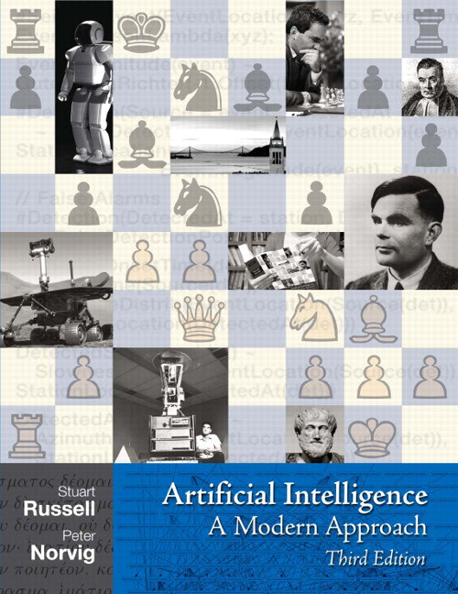
Intelligent Agents:
Automated Planning and Acting
Introduction

Slide 2
Organisational Stuff: Lecture
Topic: Automated Planning and Acting
Goal:
  Get to know a set of deliberation methods for automated planning and acting
  Bring you up to speed on the foundations of current research
    Most research on planning and acting is in English ➝ lecture in English
  So, the goal is at the end of semester to be able to understand and explain
    what inputs are necessary, what is output, and how does a method proceed on a high level,
    what advantages and shortcomings exist,
    when which method works in contrast to other methods.

Slide 3
Literature
Automated Planning and Acting
  Malik Ghallab, Dana Nau, Paolo Traverso
  Main source for the first half of the lecture
http://www.laas.fr/planning

Slide 4
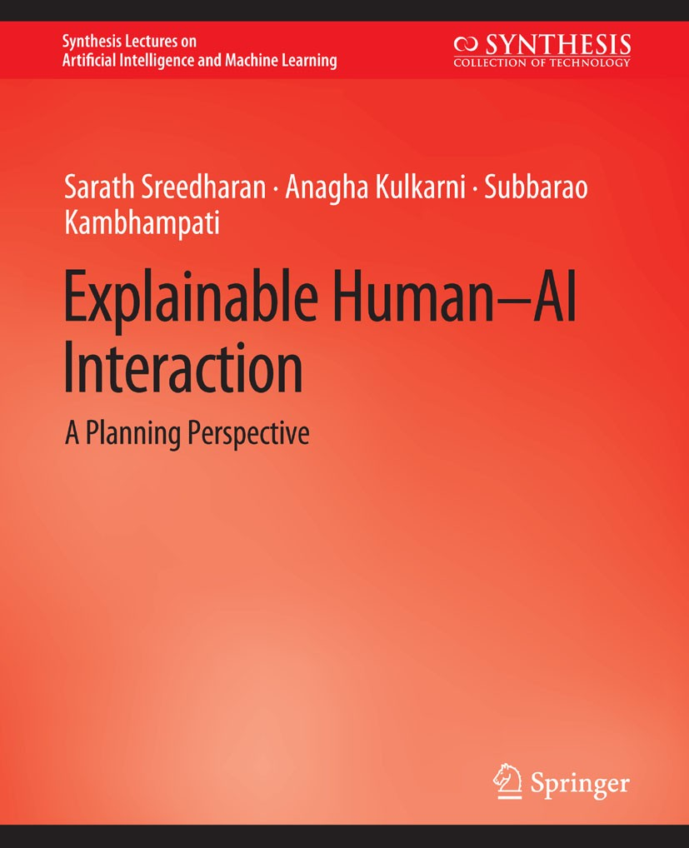
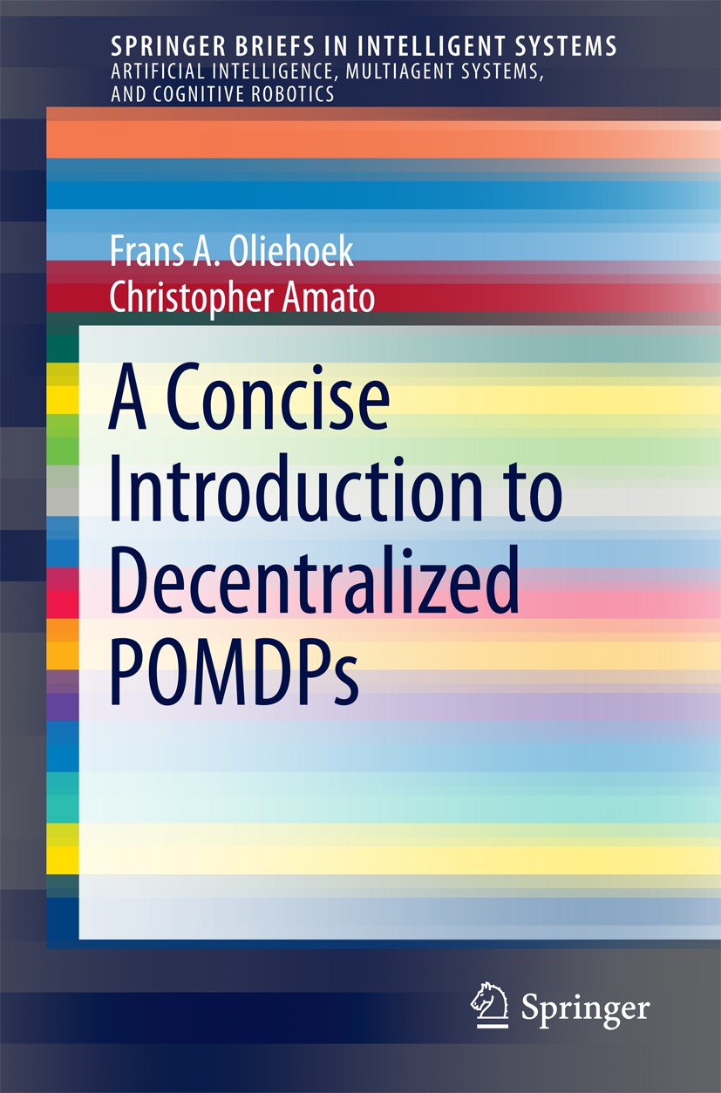
Literature
Second half presents different directions research has taken
Content based on
  Artificial Intelligence: A Modern Approach (3rd ed.; abbreviation: AIMA)
    Stuart Russell, Peter Norvig
    Decision making (Chs. 16 + 17), reinforcement learning (Ch. 21)
  A Concise Introduction to Decentralized POMDPs (DecPOMDP)
    Frans A. Oliehoek, Christopher Amato
  Explainable Human-AI Interaction: A Planning Perspective (HA-AI)
    Sarath Sreedharan, Anagha Kulkarni, Subbarao Kambhampati
  Further research papers announced in lectures
I do not expect you to read all the books!
http://aima.cs.berkeley.edu
https://link.springer.com/book/10.1007/978-3-319-28929-8
https://link.springer.com/book/10.1007/978-3-031-03767-2

Slide 5
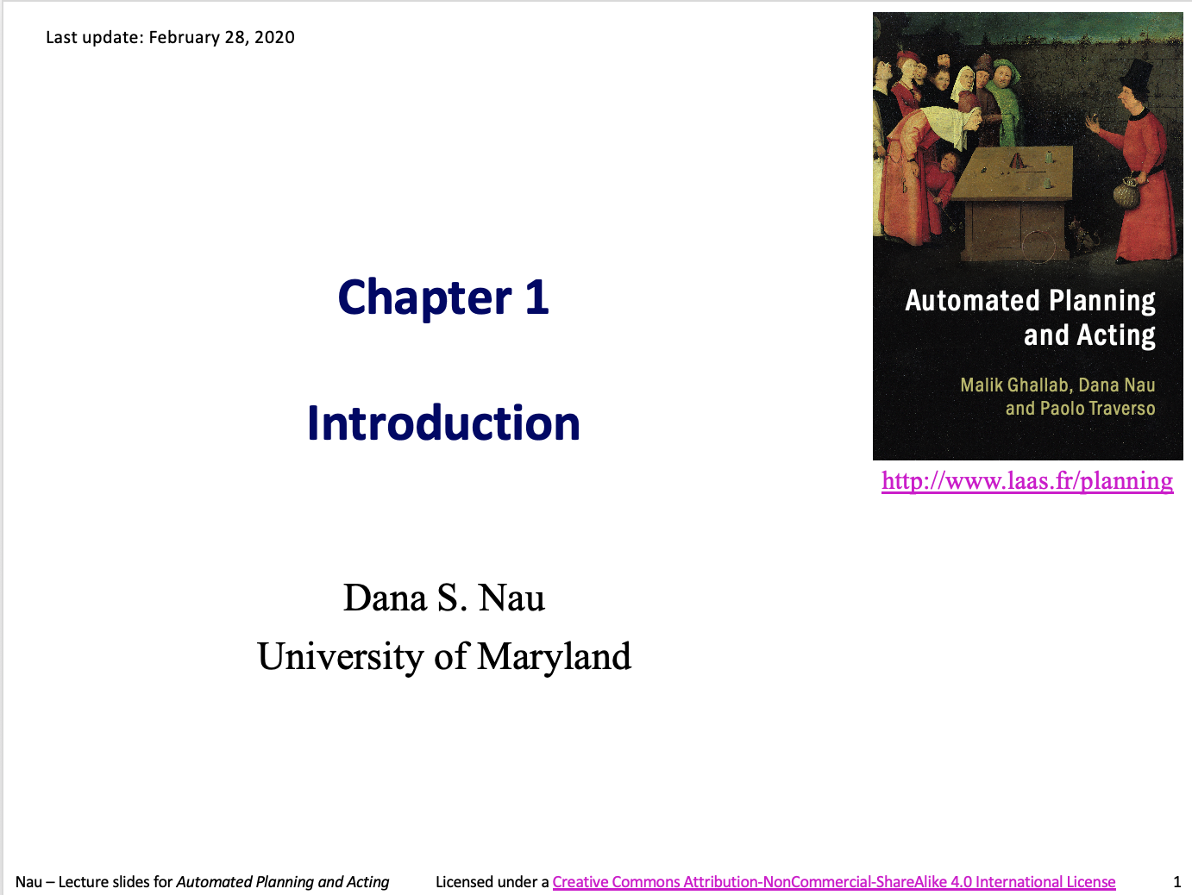
Acknowledgements
For the first half, slides are adapted from material provided by Dana Nau
  After that, it is a mix of different sources and own material
  The slides are taken from Tanya Braun, University of Münster, who adapted them in the first place
http://www.laas.fr/planning

Slide 6
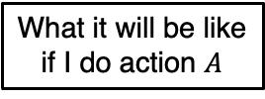
General Agent Setting
Agent
Environment
Sensors
State
What the world
is like now
How the world evolves
What my actions do
What it will be like
if I do action $A$
Goals
What action I
should do now
Actuators
AIMA, Russell/Norvig

Slide 7
Setting Specific to Planning and Acting
Actor: agent that performs actions
Deliberation functions
  Planning
    What actions to perform
  Acting
    How to perform them
Actor
Deliberation components
Objectives
Queries
Planning
Other
actors
Acting
Plans
Messages
Commands
Percepts
Execution platform
Actuations
Signals
External world

Slide 8



Planning
Relies on prediction + search
Uses descriptive models of the actions
  Predict what the actions will do, but don’t tell how to do them
Search over predicted states and possible organizations of feasible actions
Different types of actions
  Different predictive models
  Different planning problems and techniques
  Motion and manipulation pl.
  Perception planning
  Navigation planning
  Communication planning
  Task planning
$$a$$
Most AI planning
$$s$$
$$s^{′}=γ\left(s,a\right)$$
• • •

Slide 9
Acting
Traditional “AI planning” view does not consider acting specially:
  Carrying out an action is just execution
  Doesn’t require the actor to think about how
Sometimes that’s true
  If the environment has been engineered to make it true
Usually acting is more complicated
Actor
Deliberation components
Objectives
Queries
Planning
Other
actors
Acting
Plans
Messages
Commands
Percepts
Execution platform
Actuations
Signals
External world

Slide 10

Acting as Execution
Notes:
Warehouse distribution center. Automated platforms to bring cabinets to people preparing orders.
Platforms follow a precise network of guides painted on the floor. Don’t need to deliberate about how to act;
environment engineered to cover all cases they’ll need to cope with.

Slide 11
Deliberative Acting
Actor is situated in a dynamic unpredictable environment
  Adapt actions to current context
  React to events
Relies on
  Operational models telling how to perform the actions
  Observations of current state
Planning stage
Acting stage

Slide 12
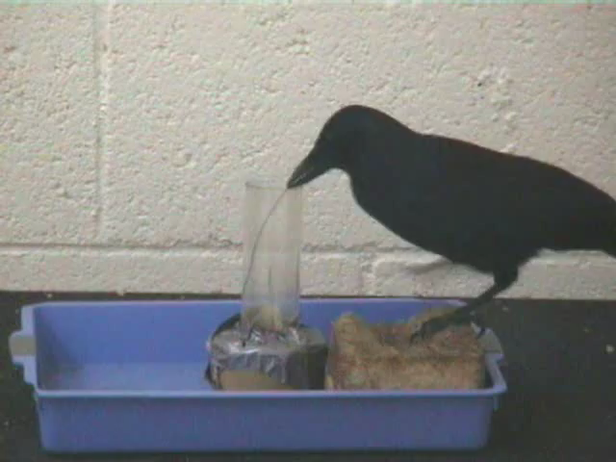
Deliberative Acting
Notes:
New Caledonian crow trying to use a piece of wire to get food that’s out of reach, figures out it won’t work
Figures out how to brace the wire to bend it into a hook, uses the hook to get the food

Slide 13
General Characteristics
Multiple levels of abstraction
  Actors are organised into physical subsystems
Heterogeneous reasoning
  Different techniques
    At different levels
    In different subsystems at same level
Continual online planning
  Can’t plan everything in advance
  Plans are abstract and partial until more detail is needed
Actor
Deliberation components
Objectives
Queries
Planning
Other
actors
Acting
Plans
Messages
Commands
Percepts
Execution platform
Actuations
Signals
External world
Notes:
Deliberation reflects levels

Slide 14
Example: Service Robot
Multiple levels of abstraction
  Higher levels: more planning
  Lower levels: more acting
Heterogeneous reasoning
  bring o7 to room2: abstract steps
  navigate to room1: path planning
  open door: reactive
Continual online planning
  Is o7 really in room1?
  What kind of door?
  Close enough to the doorknob?
respond to user requests
…
bring o7 to loc2
…
go to
hallway
navigate
to loc1
fetch
o7
navigate
to loc2
deliver
o7
Planning Acting
…
…
…
…
move to door
open door
get out
close door
…
…
…
identify
type
of
door
move
close
to
knob
grasp
knob
turn
knob
maintain
move
back
ungrasp
pull
monitor
pull
monitor

Slide 15
Example: Harbour Management
Importing/exporting cars
  Based on Bremen Harbour
Multiple levels of abstraction
  Reflect physical
  organization of harbour
Heterogeneous reasoning
  Different components work in different ways
  Online synthesis of automata to control their interactions
Continual online planning
  Top level can be planned offline
  The rest is online, based
  on current conditions
manage incoming shipment
unload
unpack
store
await order
prepare
deliver
…
…
…
…
…
registration
manager
storage
assignment
manager
storage area A manager
Planning Acting
storage area B
manager
…
…
storage area
C manager
…
booking
manager
navigation
release
manager
…
…
…

Slide 16
Content: Planning and Acting
With Deterministic Models
  Conventional AI planning
With Temporal Models
  Reasoning about time constraints
With Nondeterministic Models
  Actions with multiple possible outcomes
With Probabilistic Models
  Actions with multiple possible outcomes, with probabilities
By Decision Making
  Foundations
    Utility theory, Markov decision process (MDP)
    Reinforcement learning
  Extensions
    Partially observable MDP (POMDP)
    Decentralised POMDP (decPOMDP)
  Structure
    Lifted decPOMDP
    Factored MDP, relational MDP
    Situation calculus, first-order MDP
With Human-awareness
  Planning with a human in the loop
Notes:
1-5: Planning book
6: AIMA, DecPOMDP book, own, Boutelier / Sanner
7: Human-aware book

