Slide 1
Web-Mining Agents
Prof. Dr. Ralf Möller
Universität zu Lübeck
Institut für Informationssysteme
Karsten Martiny (Übungen)

Slide 2
Inductive Learning
Chapter 18
Material adopted from Yun Peng, Chuck Dyer, Gregory Piatetsky-Shapiro & Gary Parker

Slide 3
Chapters 3 and 4
Acknowledgements for the slides

Slide 4
Inductive Learning Framework
Induce a conclusion from the examples
Raw input data from sensors are preprocessed to obtain a feature vector, X, that adequately describes all of the relevant features for classifying examples.
Each x is a list of (attribute, value) pairs. For example,
X = [Person:Sue, EyeColor:Brown, Age:Young, Sex:Female]
The number of attributes (aka features) is fixed (finite).
Each attribute has a fixed, finite number of possible values.
Each example can be interpreted as a point in an n-dimensional feature space, where n is the number of attributes.

Slide 5
Inductive Learning by Nearest-Neighbor Classification
One simple approach to inductive learning is to save each training example as a point in feature space
Classify a new example by giving it the same classification (+ or -) as its nearest neighbor in Feature Space.
A variation involves computing a weighted sum of class of a set of neighbors where the weights correspond to distances
The problem with this approach is that it doesn't necessarily generalize well if the examples are not well "clustered."

Slide 6
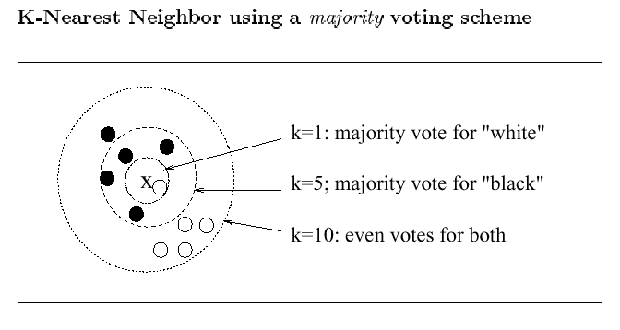
KNN example

Slide 7
Simplicity first
Simple algorithms often work very well!
There are many kinds of simple structure, eg:
One attribute does all the work
All attributes contribute equally & independently
A weighted linear combination might do
Instance-based: use a few prototypes
Use simple logical rules
Success of method depends on the domain

Slide 8
Inferring rudimentary rules
1R: learns a 1-level decision tree
I.e., rules that all test one particular attribute
Basic version
One branch for each value
Each branch assigns most frequent class
Error rate: proportion of instances that don’t belong to the majority class of their corresponding branch
Choose attribute with lowest error rate
(assumes nominal attributes)

Slide 9
Evaluating the weather attributes
Classification
Outlook | Temp | Humidity | Windy | Play
Sunny | Hot | High | False | No
Sunny | Hot | High | True | No
Overcast | Hot | High | False | Yes
Rainy | Mild | High | False | Yes
Rainy | Cool | Normal | False | Yes
Rainy | Cool | Normal | True | No
Overcast | Cool | Normal | True | Yes
Sunny | Mild | High | False | No
Sunny | Cool | Normal | False | Yes
Rainy | Mild | Normal | False | Yes
Sunny | Mild | Normal | True | Yes
Overcast | Mild | High | True | Yes
Overcast | Hot | Normal | False | Yes
Rainy | Mild | High | True | No
Attribute | Rules | Errors | Total errors
Outlook | Sunny → No | 2/5 | 4/14
 | Overcast → Yes | 0/4
 | Rainy → Yes | 2/5
Temp | Hot → No* | 2/4 | 5/14
 | Mild → Yes | 2/6
 | Cool → Yes | 1/4
Humidity | High → No | 3/7 | 4/14
 | Normal → Yes | 1/7
Windy | False → Yes | 2/8 | 5/14
 | True → No* | 3/6
* indicates a tie

Slide 10
Dealing with numeric attributes
Discretize numeric attributes
Divide each attribute’s range into intervals
Sort instances according to attribute’s values
Place breakpoints where the class changes (the majority class)
This minimizes the total error
Example: temperature from weather data
64 65 68 69 70 71 72 72 75 75 80 81 83 85 Yes | No | Yes Yes Yes | No No Yes | Yes Yes | No | Yes Yes | No

Slide 11
The problem of overfitting
This procedure is very sensitive to noise
One instance with an incorrect class label will probably produce a separate interval
Also: time stamp attribute will have zero errors
Simple solution: enforce minimum number of instances in majority class per interval

Slide 12
Discretization example
Example (with min = 3):
Final result for temperature attribute
64 65 68 69 70 71 72 72 75 75 80 81 83 85 Yes | No | Yes Yes Yes | No No Yes | Yes Yes | No | Yes Yes | No
64 65 68 69 70 71 72 72 75 75 80 81 83 85 Yes No Yes Yes Yes | No No Yes Yes Yes | No Yes Yes No

Slide 13
With overfitting avoidance
Resulting rule set:
Attribute | Rules | Errors | Total errors
Outlook | Sunny → No | 2/5 | 4/14
 | Overcast → Yes | 0/4
 | Rainy → Yes | 2/5
Temperature | ≤ 77.5 → Yes | 3/10 | 5/14
 | > 77.5 → No* | 2/4
Humidity | ≤ 82.5 → Yes | 1/7 | 3/14
 | > 82.5 and ≤ 95.5 → No | 2/6
 | > 95.5 → Yes | 0/1
Windy | False → Yes | 2/8 | 5/14
 | True → No* | 3/6

Slide 14
Discussion of 1R
1R was described in a paper by Holte (1993)
Contains an experimental evaluation on 16 datasets (using cross-validation so that results were representative of performance on future data)
Minimum number of instances was set to 6 after some experimentation
1R’s simple rules performed not much worse than much more complex decision trees
Simplicity first pays off!
Robert C. Holte, Very Simple Classification Rules Perform Well on Most Commonly Used Datasets, Journal Machine Learning Volume 11, Issue 1 , pp 63-90, 1993

Slide 15
Decision trees
An internal node is a test on an attribute.
A branch represents an outcome of the test, e.g., Color=red.
A leaf node represents a class label or class label distribution.
At each node, one attribute is chosen to split training examples into distinct classes as much as possible
A new case is classified by following a matching path to a leaf node.

Slide 16
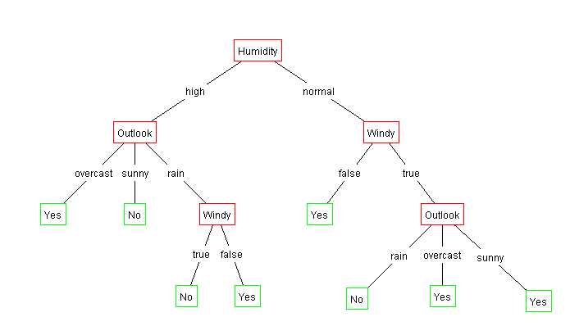
Example Tree for “Play?”
Outlook | Temperature | Humidity | Windy | Play?
sunny | hot | high | false | No
sunny | hot | high | true | No
overcast | hot | high | false | Yes
rain | mild | high | false | Yes
rain | cool | normal | false | Yes
rain | cool | normal | true | No
overcast | cool | normal | true | Yes
sunny | mild | high | false | No
sunny | cool | normal | false | Yes
rain | mild | normal | false | Yes
sunny | mild | normal | true | Yes
overcast | mild | high | true | Yes
overcast | hot | normal | false | Yes
rain | mild | high | true | No

Slide 17
Building Decision Tree [Q93]
Top-down tree construction
At start, all training examples are at the root.
Partition the examples recursively by choosing one attribute each time.
Bottom-up tree pruning
Remove subtrees or branches, in a bottom-up manner, to improve the estimated accuracy on new cases.
R. Quinlan, Learning efficient classification procedures, Machine Learning: an artificial intelligence approach, Michalski, Carbonell & Mitchell (eds.), Morgan Kaufmann, p. 463-482., 1983

Slide 18
Choosing the Best Attribute
The key problem is choosing which attribute to split a given set of examples.
Some possibilities are:
Random: Select any attribute at random
Least-Values: Choose the attribute with the smallest number of possible values
Most-Values: Choose the attribute with the largest number of possible values
Information gain: Choose the attribute that has the largest expected information gain, i.e. select attribute that will result in the smallest expected size of the subtrees rooted at its children.

Slide 19
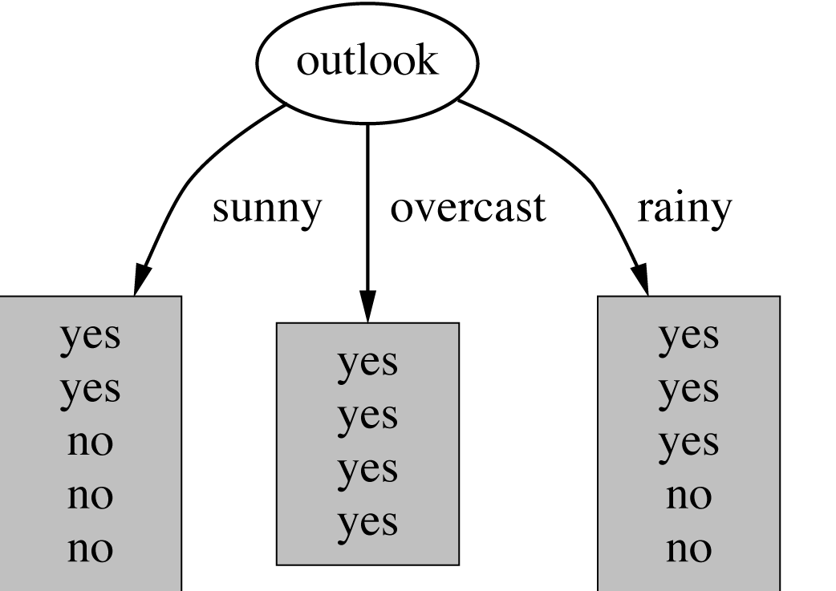
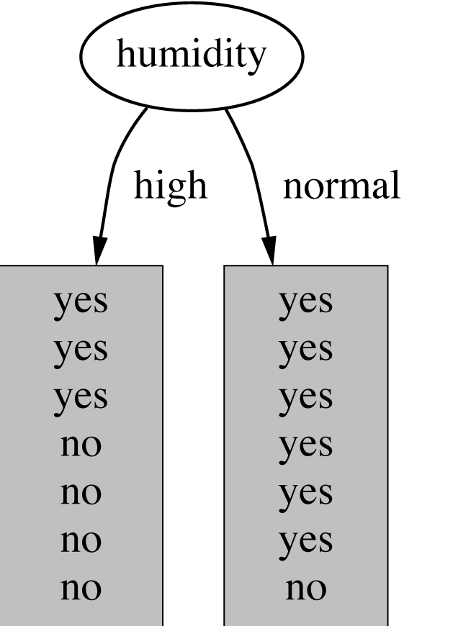
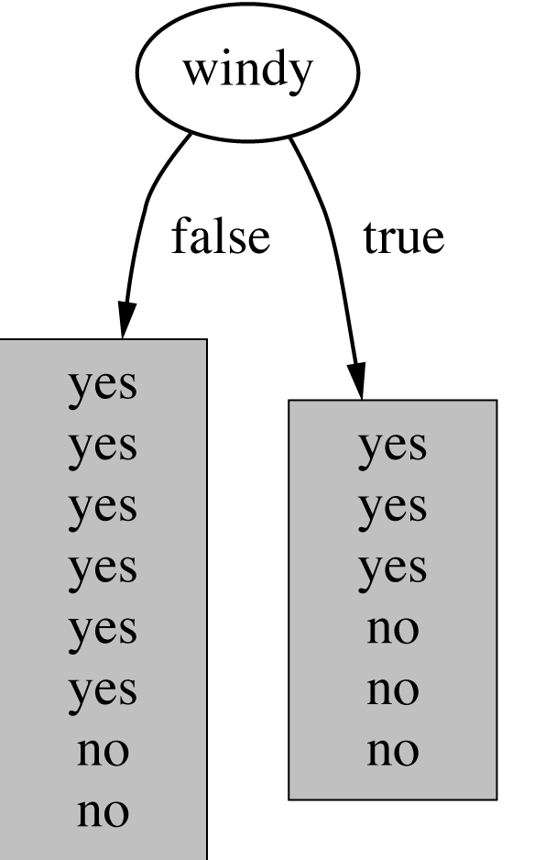
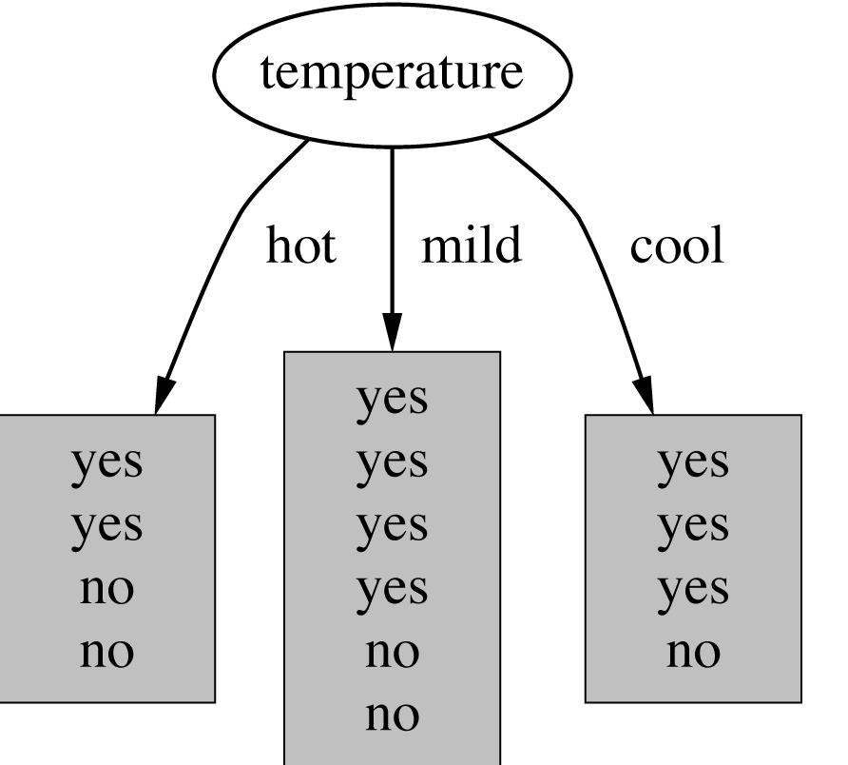
Which attribute to select?

Slide 20
A criterion for attribute selection
Which is the best attribute?
The one which will result in the smallest tree
Heuristic: choose the attribute that produces the “purest” nodes
Popular impurity criterion: information gain
Information gain increases with the average purity of the subsets that an attribute produces
Strategy: choose attribute that results in greatest information gain

Slide 21
Choosing the Splitting Attribute
At each node, available attributes are evaluated on the basis of separating the classes of the training examples. A goodness function is used for this purpose.
Typical goodness functions used for DTrees:
information gain (ID3/C4.5)
information gain ratio
gini index (CART)

Slide 22
Preference Bias: Ockham's Razor
Aka Occam’s Razor, Law of Economy, or Law of Parsimony
Principle stated by William of Ockham (1285-1347/49), an English philosopher, that
“non sunt multiplicanda entia praeter necessitatem”
or, entities are not to be multiplied beyond necessity.
The simplest explanation that is consistent with all observations is the best.
Therefore, the smallest decision tree that correctly classifies all of the training examples is the best.
Finding the provably smallest decision tree is intractable (NP-hard), so instead of constructing the absolute smallest tree consistent with the training examples, construct one that is pretty small.

Slide 23
Inductive Learning and Bias
Suppose that we want to learn a function f(x) = y and we are given some sample (x,y) pairs, as points in figure (a).
There are several hypotheses we could make about this function, e.g.: (b), (c) and (d).
A preference for one over the others reveals the bias of our learning technique, e.g.:
prefer piece-wise functions
prefer a smooth function
prefer a simple function and treat outliers as noise

Slide 25
Example: Huffman code
In 1952 MIT student David Huffman devised, in the course of doing a homework assignment, an elegant coding scheme which is optimal in the case where all symbols’ probabilities are integral powers of 1/2.
A Huffman code can be built in the following manner:
Rank all symbols in order of probability of occurrence.
Successively combine the two symbols of the lowest probability to form a new composite symbol; eventually we will build a binary tree where each node is the probability of all nodes beneath it.
Trace a path to each leaf, noticing the direction at each node.

Slide 26
Huffman code example
1
0
1
.5
.5
D
0
1
.25
.25
C
1
If we need to send many messages (A,B,C or D) and they have this probability distribution and we use this code, then over time, the average bits/message should approach 1.75
0
.125
.125
A
B

Slide 27
Information Theory Background
If there are n equally probable possible messages, then the probability p of each is 1/n
Information conveyed by a message is -log(p) = log(n)
Eg, if there are 16 messages, then log(16) = 4 and we need 4 bits to identify/send each message.
In general, if we are given a probability distribution
P = (p1, p2, .., pn)
the information conveyed by distribution (aka entropy of P) is:
I(P) = -(p1*log(p1) + p2*log(p2) + .. + pn*log(pn))
= - ∑_{i} pi*log(pi)

Slide 28
Information Theory Background
Information conveyed by distribution (aka Entropy of P) is:
I(P) = -(p1*log(p1) + p2*log(p2) + .. + pn*log(pn))
Examples:
if P is (0.5, 0.5) then I(P) is 1
if P is (0.67, 0.33) then I(P) is 0.92,
if P is (1, 0) or (0,1) then I(P) is 0.
The more uniform is the probability distribution, the greater is its information.
The entropy is the average number of bits/message needed to represent a stream of messages.

Slide 29
Example: attribute “Outlook”, 1
Outlook | Temperature | Humidity | Windy | Play?
sunny | hot | high | false | No
sunny | hot | high | true | No
overcast | hot | high | false | Yes
rain | mild | high | false | Yes
rain | cool | normal | false | Yes
rain | cool | normal | true | No
overcast | cool | normal | true | Yes
sunny | mild | high | false | No
sunny | cool | normal | false | Yes
rain | mild | normal | false | Yes
sunny | mild | normal | true | Yes
overcast | mild | high | true | Yes
overcast | hot | normal | false | Yes
rain | mild | high | true | No

Slide 30
Example: attribute “Outlook”, 2
“Outlook” = “Sunny”:
“Outlook” = “Overcast”:
“Outlook” = “Rainy”:
Expected information for attribute:
Note: log(0) is not defined, but we evaluate 0*log(0) as zero

Slide 31
Computing the information gain
Information gain:
(information before split) – (information after split)

Slide 32
Computing the information gain
Information gain:
(information before split) – (information after split)
Information gain for attributes from weather data:

Slide 33
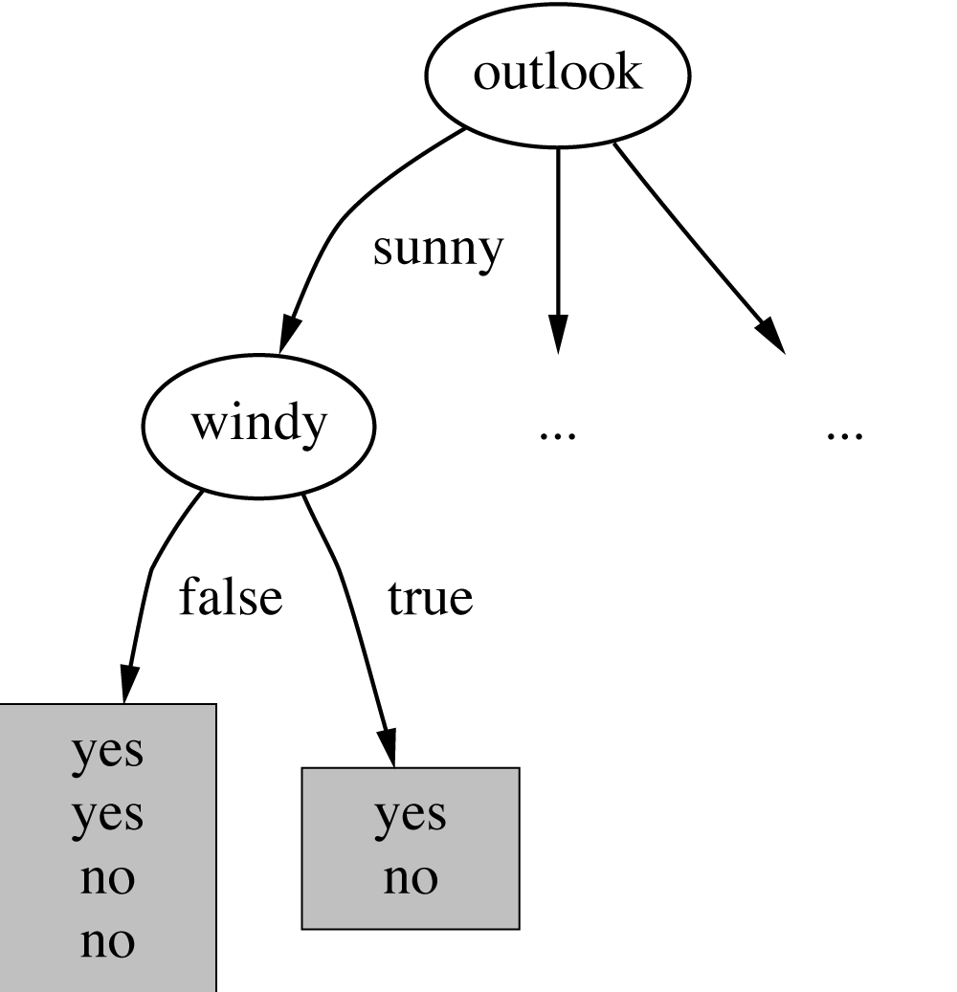
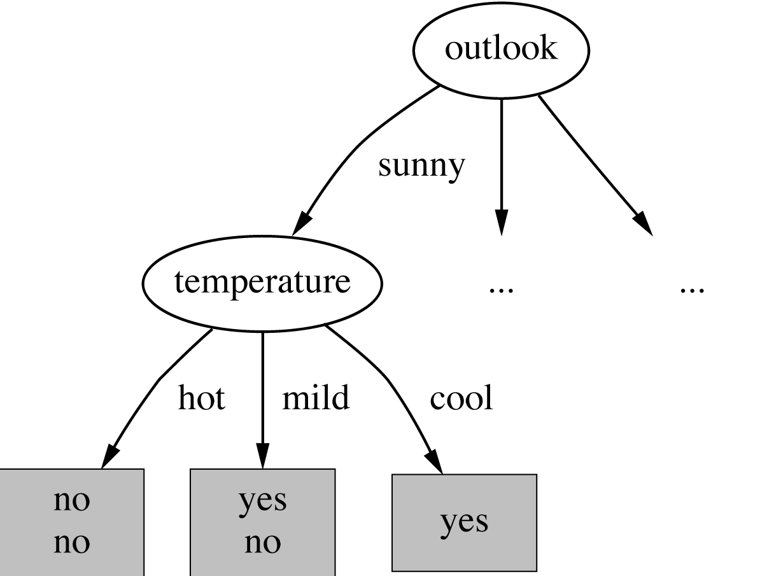
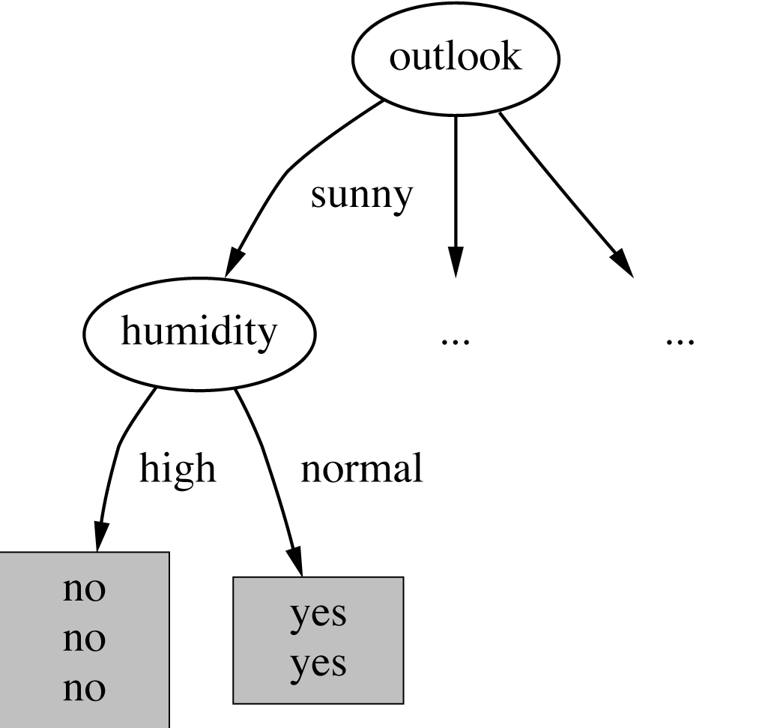
Continuing to split

Slide 34
Schematicly
Root
Play: 9 ¬Play: 5
Info: 0.94
Outlook
Play: 9 ¬Play: 5
Info: 0.94
sunny
overcast
rainy
1
2
3
Play: 2 ¬Play: 3
Play: 4 ¬Play: 0
Play: 3 ¬Play: 2
Info: 0.971
Info: 0
Info: 0.971

Slide 35
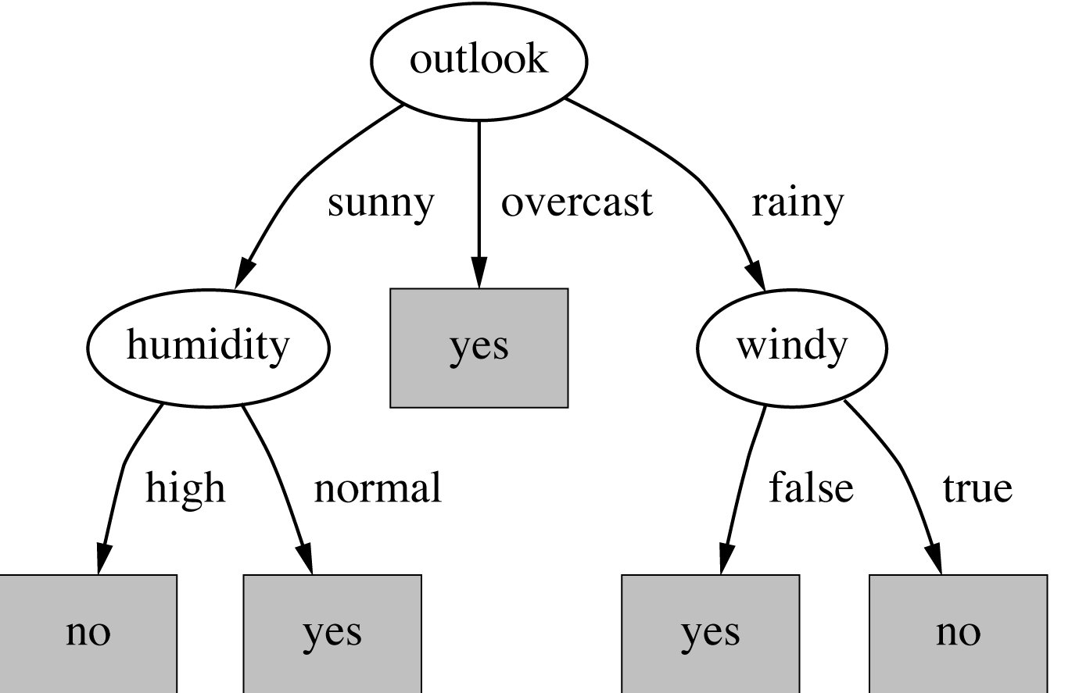
The final decision tree
Note: not all leaves need to be pure; sometimes identical instances have different classes
⇒ Splitting stops when data can’t be split any further

Slide 36
*Wish list for a purity measure
Properties we require from a purity measure:
When node is pure, measure should be zero
When impurity is maximal (i.e. all classes equally likely), measure should be maximal
Measure should obey multistage property (i.e. decisions can be made in several stages):
Entropy is a function that satisfies all three properties!

Slide 37
*Properties of the entropy
The multistage property:
Simplification of computation:
Note: instead of maximizing info gain we could just minimize information

Slide 38
outlook
play

Slide 39
How well does it work?
Many case studies have shown that decision trees are at least as accurate as human experts.
A study for diagnosing breast cancer had humans correctly classifying the examples 65% of the time, and the decision tree classified 72% correct.
British Petroleum designed a decision tree for gas-oil separation for offshore oil platforms that replaced an earlier rule-based expert system.
Cessna designed an airplane flight controller using 90,000 examples and 20 attributes per example.

Slide 40
Highly-branching attributes
Problematic: attributes with a large number of values (extreme case: ID code)
Subsets are more likely to be pure if there is a large number of values
Information gain is biased towards choosing attributes with a large number of values
This may result in overfitting (selection of an attribute that is non-optimal for prediction)

Slide 41
Weather Data with ID code
ID | Outlook | Temperature | Humidity | Windy | Play?
A | sunny | hot | high | false | No
B | sunny | hot | high | true | No
C | overcast | hot | high | false | Yes
D | rain | mild | high | false | Yes
E | rain | cool | normal | false | Yes
F | rain | cool | normal | true | No
G | overcast | cool | normal | true | Yes
H | sunny | mild | high | false | No
I | sunny | cool | normal | false | Yes
J | rain | mild | normal | false | Yes
K | sunny | mild | normal | true | Yes
L | overcast | mild | high | true | Yes
M | overcast | hot | normal | false | Yes
N | rain | mild | high | true | No

Slide 42
Split for ID Code Attribute
Entropy of split = 0 (since each leaf node is “pure”, having only one case.
Information gain is maximal for ID code.
Customers are not different because of different credit car numbers.

Slide 43
Schematicly
Root
Play: 9 ¬Play: 5
Info: 0.94
ID code
Play: 9 ¬Play: 5
Info: 0.94
A
B
N
no
no
Play: 0 ¬Play: 1
Play: 0 ¬Play: 1
no
Play: 0 ¬Play: 1
…
Info: 0
Info: 0
Info: 0

Slide 44
Gain ratio
Gain ratio: a modification of the information gain that reduces its bias on high-branch attributes
Gain ratio should be
Large when data is evenly spread
Small when all data belong to one branch
Gain ratio takes number and size of branches into account when choosing an attribute
It corrects the information gain by taking the intrinsic information of a split into account (i.e., how much info do we need to tell which branch an instance belongs to)
J. R. Quinlan, Simplifying decision trees, International Journal of Man-Machine Studies 27 (3): 221, 1987

Slide 45
Gain Ratio and Intrinsic Info./Split Info
Intrinsic information: entropy of distribution of instances into branches
For Information Gain we summed over the info of each resulting node not the info of the split
Gain ratio (Quinlan’86) normalizes info gain by:

Slide 46
Computing the gain ratio
Example: intrinsic information for ID code
Importance of attribute decreases as intrinsic information gets larger
Example of gain ratio:
Example:

Slide 47
Schematicly
Root
Play: 9 ¬Play: 5
Info: 0.94
Take into account how much information is needed to identify where an object goes to
ID code
Play: 9 ¬Play: 5
Info: 0.94
{
Approximately 3.807
N
A
B
no
…
Play: 0 ¬Play: 1
Play: 0 ¬Play: 1
no
Play: 0 ¬Play: 1
no
Info: 0
Info: 0
Info: 0

Slide 48
Gain ratios for weather data
Outlook |  | Temperature
Info: | 0.693 | Info: | 0.911
Gain: 0.940-0.693 | 0.247 | Gain: 0.940-0.911 | 0.029
Split info: info([5,4,5]) | 1.577 | Split info: info([4,6,4]) | 1.362
Gain ratio: 0.247/1.577 | 0.156 | Gain ratio: 0.029/1.362 | 0.021
Humidity |  | Windy
Info: | 0.788 | Info: | 0.892
Gain: 0.940-0.788 | 0.152 | Gain: 0.940-0.892 | 0.048
Split info: info([7,7]) | 1.000 | Split info: info([8,6]) | 0.985
Gain ratio: 0.152/1 | 0.152 | Gain ratio: 0.048/0.985 | 0.049

Slide 49
More on the gain ratio
“Outlook” still comes out top
However: “ID code” has high gain ratio
Standard fix: ad hoc test to prevent splitting on that type of attribute
Problem with gain ratio: it may overcompensate
May choose an attribute just because its intrinsic information is very low. Note how close humidity and outlook became. Maybe that's not such a good thing?
Standard fix:
First, only consider attributes with greater than average information gain
Then, compare them on gain ratio

Slide 50
Gini Index: Measure of Diversity
Suppose we randomly draw an object from node t and give it the class i. What is the error for picking an object of class i if the intended object is of class j? p(i|t) p(j|t)
The more homogeneous a set the smaller the error
We get the expected error (for all classes j) if we compute this for all possible misclassifications: For 3 classes: (p1p2+p1p3+p1p1)+(p2p1+p2p3+p2p2)+(p3p1+p3p2+p3p3) = p1²+p2²+p3²+ 2p1p2+2p1p3+2p2p3 = (p1+p2+p3)²
Gini, C. (1912). "Italian: Variabilità e mutabilità" 'Variability and Mutability', C. Cuppini, Bologna, 156 pages. Reprinted in Memorie di metodologica statistica (Ed. Pizetti E, Salvemini, T). Rome: Libreria Eredi Virgilio Veschi (1955).
=1

Slide 51
_{Gini Index}
After splitting T into two subsets T1 and T2 with sizes N1 and N2, the gini index of the split data is defined as
The attribute providing smallest gini_{split}(T) is chosen to split the node
Used in the CART Learner (Classification and Regression Tree)
Properties of the goodness function:
F(0.5,0.5) = max
F(0,1) = F(1,0) = 0
Increasing for [0;0.5] decreasing for [0.5;1]
L. Breiman, J. H. Friedman, R. A. Olshen, C. J. Stone: CART: Classification and Regression Trees. Wadsworth: Belmont, CA, 1983.

Slide 52
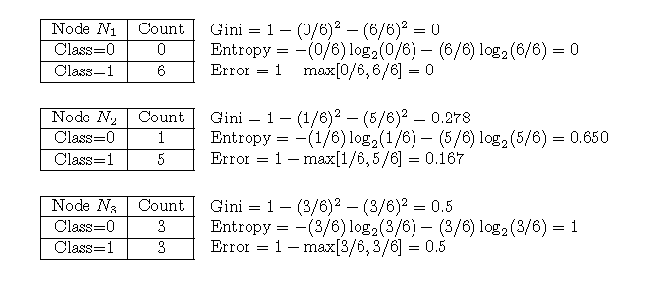
Gini, Entropy, Error Examples for a Single Node

Slide 53
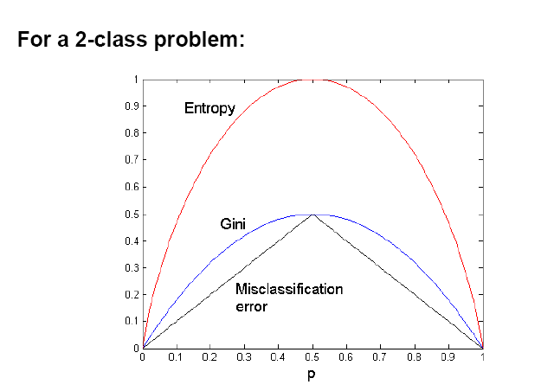
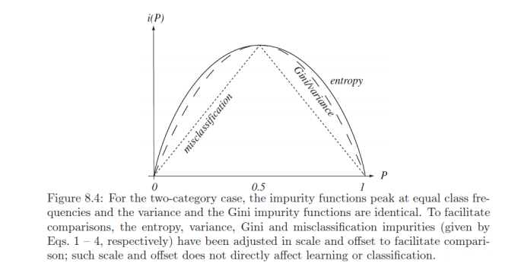
Goodness functions

Slide 54
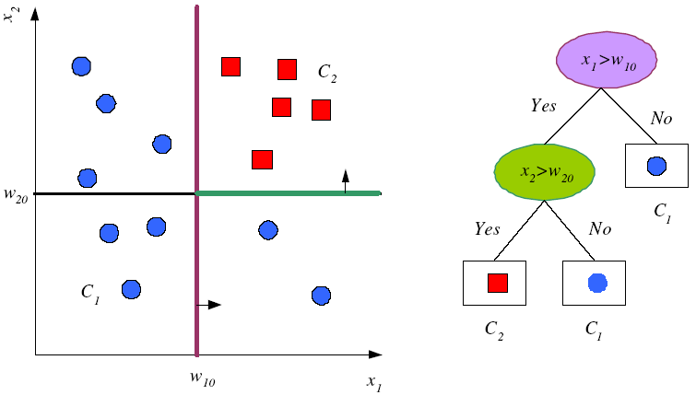
Univariate Splits

Slide 55
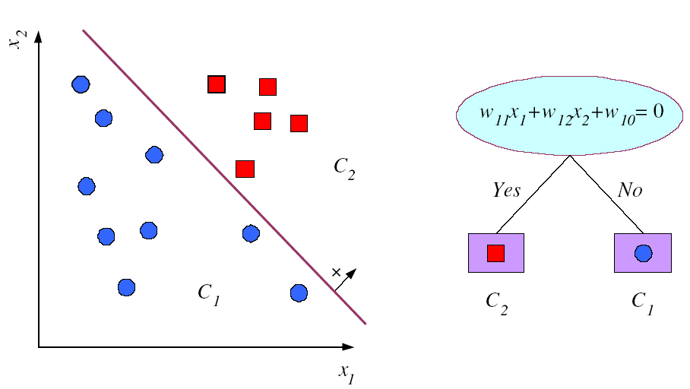
Multivariate Splits

Slide 56
Noisy data and Overfitting
Many kinds of "noise" that could occur in the examples:
Two examples have same attribute/value pairs, but different classifications
Some values of attributes are incorrect because of errors in the data acquisition process or the preprocessing phase
The classification is wrong (e.g., + instead of -) because of some error
Some attributes are irrelevant to the decision-making process, e.g., color of a die is irrelevant to its outcome.

Slide 57
Noisy data and Overfitting
The last problem, irrelevant attributes, can result in overfitting
if hypothesis space has many dimensions because of a large number of attributes, we may find meaningless regularity in the data that is irrelevant to the true, important, distinguishing features.
Fix by pruning lower nodes in the decision tree (see C4.5 next section)
For example, if Gain of the best attribute at a node is below a threshold, stop and make this node a leaf rather than generating children nodes.

Slide 58
Summary: Decision Trees
Top-Down Decision Tree Construction
Choosing the Splitting Attribute
Information Gain biased towards attributes with a large number of values
Gain Ratio takes number and size of branches into account when choosing an attribute
Gini Index measure the misclassification ratio
Many other impurity measures are available but no general better solution

Slide 59
From Decision Trees to Rules
It is easy to derive a rule set from a decision tree: write a rule for each path in the decision tree from the root to a leaf.
In that rule the left-hand side is easily built from the label of the nodes and the labels of the arcs.
The resulting rules set can be simplified:
Let LHS be the left hand side of a rule.
Let LHS' be obtained from LHS by eliminating some conditions.
We can certainly replace LHS by LHS' in this rule if the subsets of the training set that satisfy respectively LHS and LHS' are equal.
A rule may be eliminated by using meta-conditions such as "if no other rule applies".
Notes:
59

Slide 60
From Decision Trees To Rules
Rules are mutually exclusive and exhaustive
Rule set contains as much information as the tree
Notes:
60

Slide 61
Rules Can Be Simplified
Initial Rule: (Refund=No) ∧ (Status=Married) → No
Simplified Rule: (Status=Married) → No
Notes:
61

Slide 62
Industrial-strength algorithms
For an algorithm to be useful in a wide range of real-world applications it must:
Permit numeric attributes with adaptive discretization
Allow missing values
Be robust in the presence of noise
Be able to approximate arbitrary concept descriptions (at least in principle)
Basic schemes need to be extended to fulfill these requirements

Slide 63
C4.5 History
ID3, CHAID – 1960s
C4.5 innovations (Quinlan):
permit numeric attributes
deal sensibly with missing values
pruning to deal with noisy data
C4.5 - one of best-known and most widely-used learning algorithms
Last research version: C4.8, implemented in Weka as J4.8 (Java)
Commercial successor: C5.0 (available from Rulequest)

Slide 64
Numeric attributes
Standard method: binary splits
E.g. temp < 45
Unlike nominal attributes, every attribute has many possible split points
Solution is straightforward extension:
Evaluate info gain (or other measure) for every possible split point of attribute
Choose “best” split point
Info gain for best split point is info gain for attribute
Computationally more demanding

Slide 65
Example
Split on temperature attribute:
E.g. temperature < 71.5: yes/4, no/2 temperature ≥ 71.5: yes/5, no/3
Info([4,2],[5,3]) = 6/14 info([4,2]) + 8/14 info([5,3]) = 0.939 bits
Place split points halfway between values
Can evaluate all split points in one pass!
64 65 68 69 70 71 72 72 75 75 80 81 83 85 Yes No Yes Yes Yes No No Yes Yes Yes No Yes Yes No

Slide 66
Avoid repeated sorting!
Sort instances by the values of the numeric attribute
Time complexity for sorting: O (n log n)
Q. Does this have to be repeated at each node of the tree?
A: No! Sort order for children can be derived from sort order for parent
Time complexity of derivation: O (n)
Drawback: need to create and store an array of sorted indices for each numeric attribute

Slide 67
Example
Sort order of temperature created on startup
outlook
sunny
sunny
sunny
sunny
sunny
temperature tuple number
We decide to split on outlook first (sunny, rainy, overcast)

Slide 68
More speeding up
Entropy only needs to be evaluated between points of different classes (Fayyad & Irani, 1992)
value
class
64 65 68 69 70 71 72 72 75 75 80 81 83 85 Yes No Yes Yes Yes No No Yes Yes Yes No Yes Yes No
X
Potential optimal breakpoints
Breakpoints between values of the same class cannot
be optimal

Slide 69
Missing as a separate value
Missing value denoted “?” in C4.X (Null value)
Simple idea: treat missing as a separate value
Q: When this is not appropriate?
A: When values are missing due to different reasons
Example 1: blood sugar value could be missing when it is very high or very low
Example 2: field IsPregnant missing for a male patient should be treated differently (no) than for a female patient of age 25 (unknown)

Slide 70
Missing values - advanced
Questions:
How should tests on attributes with different unknown values be handled?
How should the partitioning be done in case of examples with unknown values?
How should an unseen case with missing values be handled?

Slide 71
Missing values - advanced
Info gain with unknown values during learning
Let T be the training set and X a test on an attribute with unknown values and F be the fraction of examples where the value is known.
Rewrite the gain: Gain(X) = probability that A is known ∗ (info(T) – info_{X}(T))+ probability that A is unknown ∗ 0 = F ∗ (info(T) – info_{X}(T))

Slide 72
Missing values - advanced
Assume splitting is done with respect to attribute X
Consider instances w/o missing values
Split w.r.t. those instances
Distribute instances with missing values proportionally

Slide 73
Pruning
Goal: Prevent overfitting to noise in the data
Two strategies for “pruning” the decision tree:
Postpruning - take a fully-grown decision tree and discard unreliable parts
Prepruning - stop growing a branch when information becomes unreliable
Postpruning preferred in practice—prepruning can “stop too early”

Slide 74
Post-pruning
First, build full tree
Then, prune it
Fully-grown tree shows all attribute interactions
Two pruning operations:
Subtree replacement
Subtree raising

Slide 75
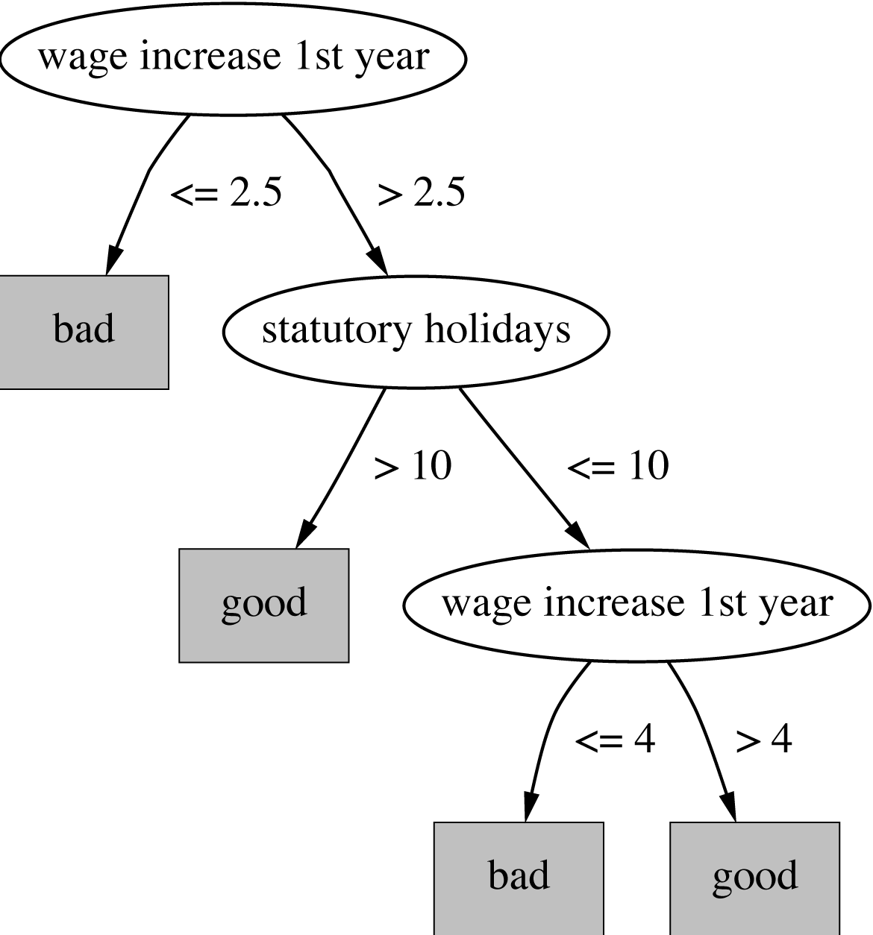
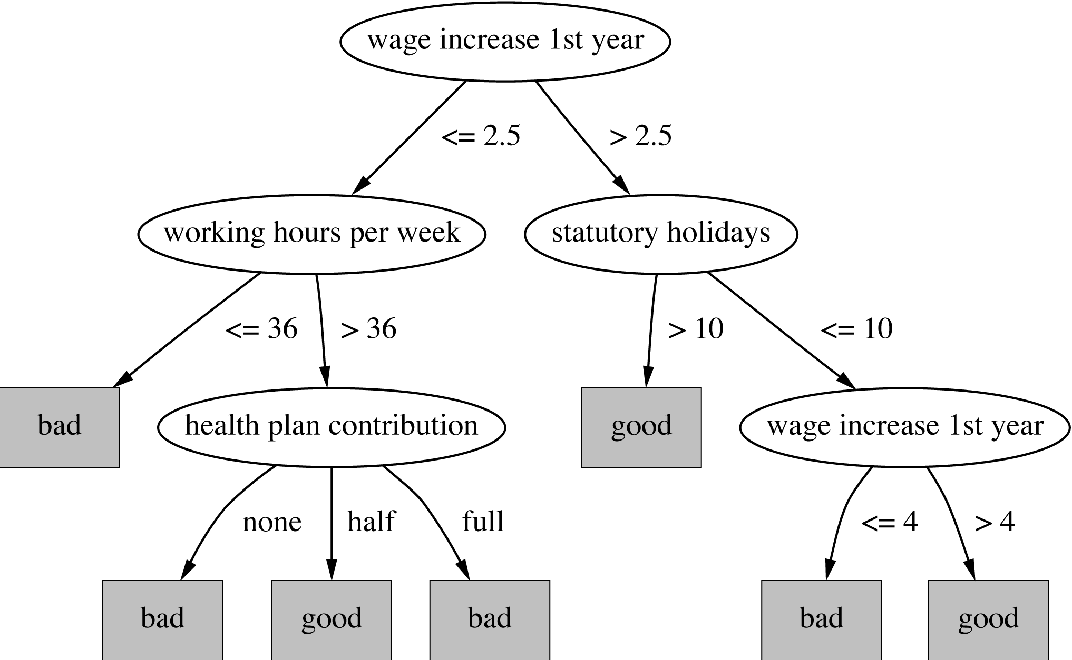
Subtree replacement
Bottom-up
Consider replacing a tree only after considering all its subtrees

Slide 76
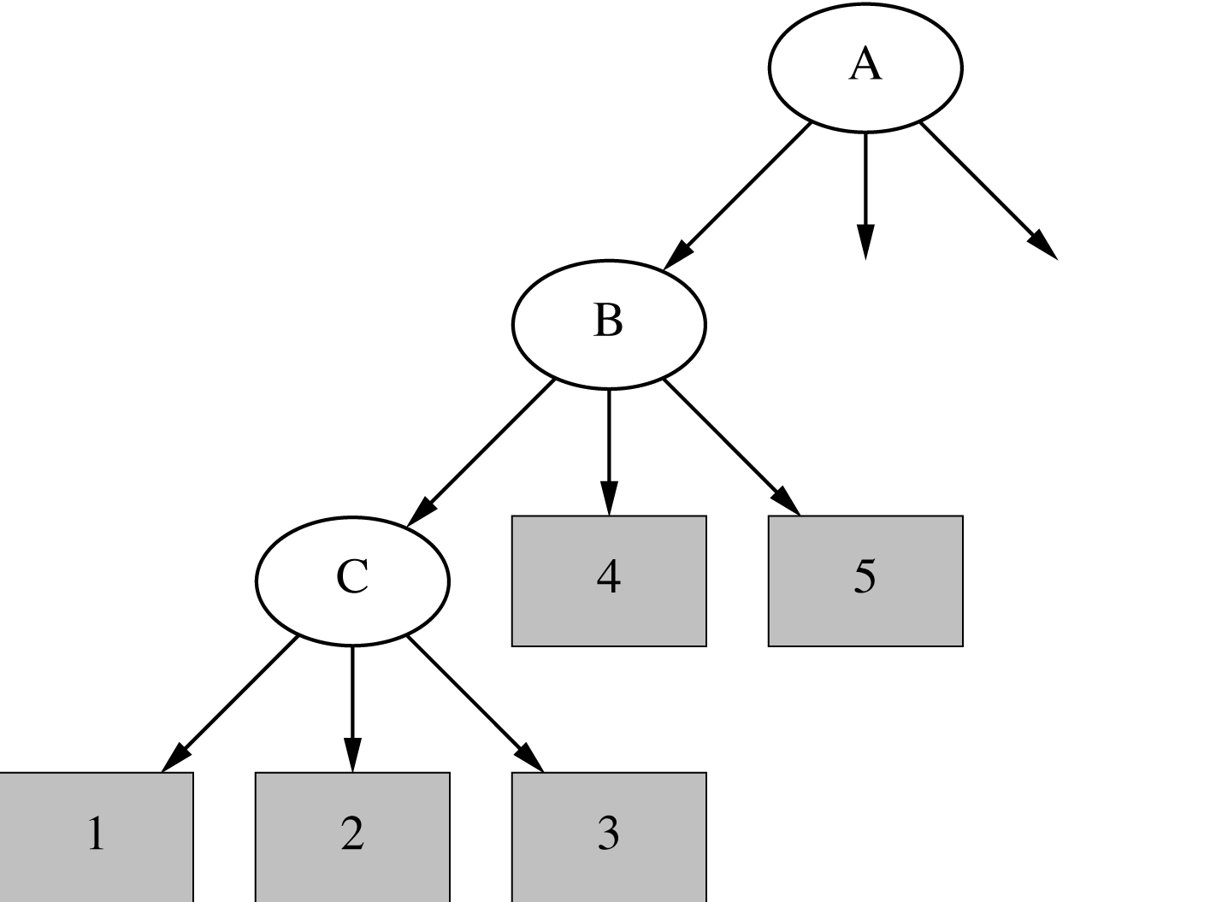
*Subtree raising
Delete node
Redistribute instances
Slower than subtree replacement
(Worthwhile?)
X

Slide 77
Estimating error rates
Prune only if it reduces the estimated error
Error on the training data is NOT a useful estimator Q: Why would it result in very little pruning?
Use hold-out set for pruning (“reduced-error pruning”)

Slide 78
Expected Error Pruning
Approximate expected error assuming that we prune at a particular node.
Approximate backed-up error from children assuming we did not prune.
If expected error is less than backed-up error, prune.

Slide 79
Static Expected Error
If we prune a node, it becomes a leaf labeled, C
What will be the expected classification error at this leaf? S is the set of examples in a node k is the number of classes N examples in S C the majority class in S n out of N examples in S belong to C This is called Laplace error estimate – it is based on the assumption that the distribution of probabilities that examples will belong to different classes is uniform.

Slide 80
Backed-Up Error
For a non-leaf node
Let children of Node be Node1, Node2, etc Probabilities can be estimated by relative frequencies of attribute values in sets of examples that fall into child nodes

Slide 81
Example Calculation
b [4,2]
[3,2]
[1,0]

Slide 82
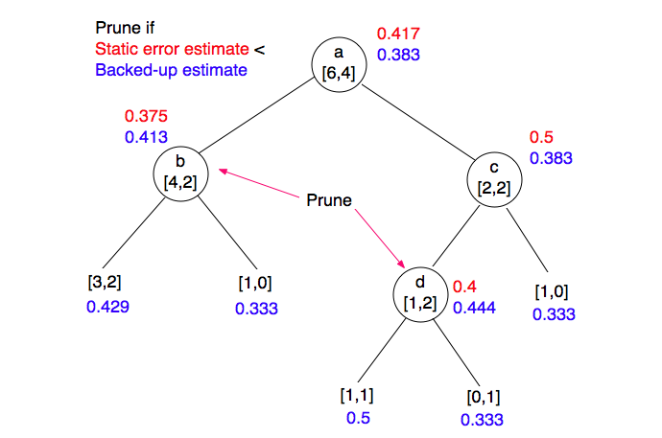
Example

Slide 83
*Complexity of tree induction
Assume
m attributes
n training instances
tree depth O (log n)
Building a tree O (m n log n)
Subtree replacement O (n)
Subtree raising O (n (log n)²)
Every instance may have to be redistributed at every node between its leaf and the root: O (n log n)
Cost for redistribution (on average): O (log n)
Total cost: O (m n log n) + O (n (log n)²)

Slide 84
Windowing
ID3 can deal with very large data sets by performing induction on subsets or windows onto the data
Select a random subset of the whole set of training instances
Use the induction algorithm to form a rule to explain the current window
Scan through all of the training instances looking for exceptions to the rule
Add the exceptions to the window
Repeat steps 2 to 4 until there are no exceptions left

Slide 85
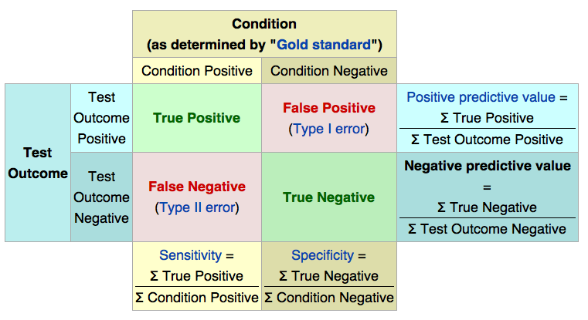

Slide 86
Incremental inductive learning
Chapter 19
Slides for Ch. 19 by J.C. Latombe

Slide 87
Learning logical descriptions
The process of constructing a decision tree can be seen as searching the hypothesis space H. The goal is to construct an hypothesis H that explains the data in the training set.
The hypothesis H is a logical description of the form:
H: H₁ \/ H₂ \/ … \/ H_{n}
H_{i}: ∀x Q(x) <=> C_{i}(x)
where Q(x) is the goal predicate and C_{i}(x) are candidate definitions.

Slide 88
Current-best-hypothesis Search
Key idea:
Maintain a single hypothesis throughout.
Update the hypothesis to maintain consistency as a new example comes in.

Slide 89
Definitions
Positive example: an instance of the hypothesis
Negative example: not an instance of the hypothesis
False negative example: the hypothesis predicts it should be a negative example but it is in fact positive
False positive example: classified to be positive but should be classified as negative.

Slide 90
Current best learning algorithm
function Current-Best-Learning(examples) returns hypothesis H
H := hypothesis consistent with first example
for each remaining example e in examples do
if e is false positive for H then
H := choose a specialization of H consistent with already seen examples
else if e is false negative for H then
H := choose a generalization of H consistent with already seen examples
if no consistent generalization/specialization found then fail
end
return H
Note: choose operations are nondeterministic
and indicate backtracking points.

Slide 91
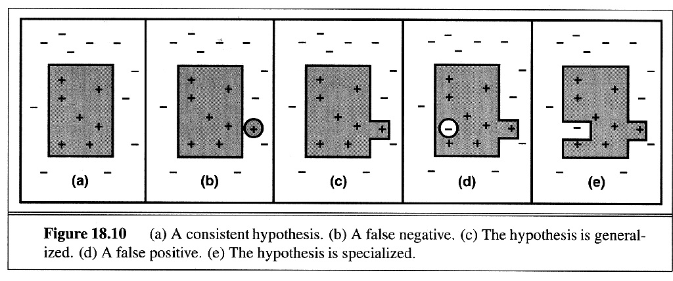
Specialization and generalization
generalization
specialization
+ indicates positive examples
- indicates negative examples
Circled + and - indicates
the example being added

Slide 92
How to Generalize
Replacing Constants with Variables: Object(Animal,Bird-1) → Object (X,Bird-1)
Dropping Conjuncts: Object(Animal,Bird-1) & Feature(Animal,Wings) → Object(Animal,Bird-1)
Adding Disjuncts: Feature(Animal,Feathers) → Feature(Animal,Feathers) v Feature(Animal,Fly)
http://www.pitt.edu/~suthers/infsci1054/8.html

Slide 93
How to Specialize
Replacing Variables with Constants: Object (X, Bird-1) → Object(Animal, Bird-1)
Adding Conjuncts: Object(Animal,Bird-1) → Object(Animal,Bird-1) & Feature(Animal,Wings)
Dropping Disjuncts: Feature(Animal,Feathers) v Feature(Animal,Fly) → Feature(Animal,Fly)
http://www.pitt.edu/~suthers/infsci1054/8.html

Slide 94
Discussion
The choice of initial hypothesis and specialization and generalization is nondeterministic (use heuristics)
Problems
Changes not necessarily lead to the simplest hypothesis.
May lead to an unrecoverable situation where no simple modification of the hypothesis is consistent with all of the examples.
What heuristics to use?
Could be inefficient (need to check consistency with all examples), and perhaps backtrack or restart
Handling noise is difficult

Slide 95
Version spaces
READING: Russell & Norvig, 19.1 alt: Mitchell, Machine Learning, Ch. 2 (through section 2.5)
Hypotheses are represented by a set of logical sentences.
Incremental construction of hypothesis.
Prior “domain” knowledge can be included/used.
Enables using the full power of logical inference.

Slide 96
Version Spaces
The “version space” is the set of all hypotheses that are consistent with the training instances processed so far.
An algorithm:
V := H ;; the version space V is ALL hypotheses H
For each example e:
Eliminate any member of V that disagrees with e
If V is empty, FAIL
Return V as the set of consistent hypotheses

Slide 97
Version Spaces: The Problem
PROBLEM: V is huge!!
Suppose you have N attributes, each with k possible values
Suppose you allow a hypothesis to be any disjunction of instances
There are k^{N} possible instances → |H| = 2^{kN}
If N=5 and k=2, |H| = 2³²!!
How many boolean functions can you write for 1 attribute? 2²¹=4

Slide 98
Number of hypotheses for unary boolean functions
 | 0 | x | ¬x | 1
x | h1 | h2 | h3 | h4
0 | 0 | 0 | 1 | 1
1 | 0 | 1 | 0 | 1

Slide 99
Version Spaces: The Tricks
First Trick: Don’t allow arbitrary disjunctions
Organize the feature values into a hierarchy of allowed disjunctions, e.g.
any-color
dark
pale
black
blue
white
yellow
Now there are only 7 “abstract values” instead of 16 disjunctive combinations (e.g., “black or white” isn’t allowed)
Second Trick: Define a partial ordering on H (“general to specific”) and only keep track of the upper bound and lower bound of the version space
RESULT: An incremental, efficient algorithm!

Slide 100
Why partial ordering?

Slide 101
Card Example: Guess a Concept
(r=1) v … v (r=10) v (r=J) v (r=Q) v (r=K) ⇔ ANY-RANK(r) (r=1) v … v (r=10) ⇔ NUM(r) (r=J) v (r=Q) v (r=K) ⇔ FACE(r) (s=♠) v (s=♣) v (s=♦) v (s=♥) ⇔ ANY-SUIT(s) (s=♠) v (s=♣) ⇔ BLACK(s) (s=♦) v (s=♥) ⇔ RED(s)
A hypothesis is any sentence of the form: R(r) ∧ S(s)
where:
R(r) is ANY-RANK(r), NUM(r), FACE(r), or (r=x)
S(s) is ANY-SUIT(s), BLACK(s), RED(s), or (s=y)
Notes:
Jack
Spade, Diamond, Clubs, Heart

Slide 102
Simplified Representation
For simplicity, we represent a concept by rs, with:
r ∈ {a, n, f, 1, …, 10, j, q, k}
s ∈ {a, b, r, ♣, ♠, ♦, ♥} For example:
n♠ represents: NUM(r) ∧ (s=♠)
aa represents:
ANY-RANK(r) ∧ ANY-SUIT(s)
Notes:
Jake spade club Quee

Slide 103
Extension of a Hypothesis
The extension of a hypothesis h is the set of objects that satisfies h
Examples:
The extension of f♠ is: {j♠, q♠, k♠}
The extension of aa is the set of all cards

Slide 104
More General/Specific Relation
Let h1 and h2 be two hypotheses in H
h1 is more general than h2 iff the extension of h1 is a proper superset of the extension of h2
Examples:
aa is more general than f♦
f♥ is more general than q♥
fr and nr are not comparable

Slide 105
More General/Specific Relation
Let h1 and h2 be two hypotheses in H
h1 is more general than h2 iff the extension of h1 is a proper superset of the extension of h2
The inverse of the “more general” relation is the “more specific” relation
The “more general” relation defines a partial ordering on the hypotheses in H

Slide 106
Example: Subset of Partial Order
aa
na
ab
4a
nb
a♣
4b
n♣
4♣

Slide 107
G-Boundary / S-Boundary of V
A hypothesis in V is most general iff no hypothesis in V is more general
G-boundary G of V: Set of most general hypotheses in V

Slide 108
G-Boundary / S-Boundary of V
A hypothesis in V is most general iff no hypothesis in V is more general
G-boundary G of V: Set of most general hypotheses in V
A hypothesis in V is most specific iff no hypothesis in V is more specific
S-boundary S of V: Set of most specific hypotheses in V
all inconsistent
G1 G2 G3
S1 S2 S3
all inconsistent

Slide 109
Example: G-/S-Boundaries of V
G
aa
aa
na
ab
We replace every hypothesis in S whose extension does not contain 4♣ by its generalization set
Now suppose that 4♣ is given as a positive example
4a
nb
a♣
4b
n♣
…
…
S
1♠
4♣
4♣
k♥

Slide 110
Example: G-/S-Boundaries of V
G
aa
na
ab
Here, both G and S have size 1.
This is not the case in general!
4a
nb
a♣
4b
n♣
S
4♣

Slide 111
Example: G-/S-Boundaries of V
The generalization set of an hypothesis h is the set of the hypotheses that are immediately more general than h
aa
na
ab
4a
nb
a♣
4b
n♣
Let 7♣ be the next (positive) example
Generalization
set of 4♣
4♣

Slide 112
Example: G-/S-Boundaries of V
aa
na
ab
4a
nb
a♣
4b
n♣
Let 7♣ be the next (positive) example
4♣

Slide 113
Example: G-/S-Boundaries of V
Specialization set of aa
aa
na
ab
nb
a♣
n♣
Let 5♥ be the next (negative) example

Slide 114
Example: G-/S-Boundaries of V
G and S, and all hypotheses in between form exactly the version space
ab
nb
a♣
n♣

Slide 115
Example: G-/S-Boundaries of V
At this stage …
ab
No
Yes
nb
a♣
Maybe
n♣
Do 8♣, 6♦, j♠ satisfy CONCEPT?

Slide 116
Example: G-/S-Boundaries of V
ab
nb
a♣
n♣
Let 2♠ be the next (positive) example

Slide 117
Example: G-/S-Boundaries of V
ab
nb
Let j♠ be the next (negative) example

Slide 118
Example: G-/S-Boundaries of V
+ 4♣ 7♣ 2♠
– 5♥ j♠
nb
NUM(r) ∧ BLACK(s)

Slide 119
Example: G-/S-Boundaries of V
Let us return to the
version space …
… and let 8♣ be the next (negative) example
ab
nb
a♣
The only most specific
hypothesis disagrees with
this example, so no
hypothesis in H agrees with all examples
n♣

Slide 120
Example: G-/S-Boundaries of V
Let us return to the
version space …
… and let j♥ be the next (positive) example
ab
nb
a♣
The only most general
hypothesis disagrees with
this example, so no
hypothesis in H agrees with all examples
n♣

Slide 121
Version Space Update
x ← new example
If x is positive then (G,S) ← POSITIVE-UPDATE(G,S,x)
Else (G,S) ← NEGATIVE-UPDATE(G,S,x)
If G or S is empty then return failure

Slide 122
POSITIVE-UPDATE(G,S,x)
Eliminate all hypotheses in G that do not agree with x

Slide 123
POSITIVE-UPDATE(G,S,x)
Eliminate all hypotheses in G that do not agree with x
Minimally generalize all hypotheses in S until they are consistent with x
Using the generalization sets of the hypotheses

Slide 124
POSITIVE-UPDATE(G,S,x)
Eliminate all hypotheses in G that do not agree with x
Minimally generalize all hypotheses in S until they are consistent with x
Remove from S every hypothesis that is neither more specific than nor equal to a hypothesis in G
This step was not needed in the card example

Slide 125
POSITIVE-UPDATE(G,S,x)
Eliminate all hypotheses in G that do not agree with x
Minimally generalize all hypotheses in S until they are consistent with x
Remove from S every hypothesis that is neither more specific than nor equal to a hypothesis in G
Remove from S every hypothesis that is more general than another hypothesis in S
Return (G,S)

Slide 126
NEGATIVE-UPDATE(G,S,x)
Eliminate all hypotheses in S that do agree with x
Minimally specialize all hypotheses in G until they are consistent with (exclude) x
Remove from G every hypothesis that is neither more general than nor equal to a hypothesis in S
Remove from G every hypothesis that is more specific than another hypothesis in G
Return (G,S)

Slide 127
Example-Selection Strategy
Suppose that at each step the learning procedure has the possibility to select the object (card) of the next example
Let it pick the object such that, whether the example is positive or not, it will eliminate one-half of the remaining hypotheses
Then a single hypothesis will be isolated in O(log |H|) steps

Slide 128
Example
aa
na
ab
9♣?
j♥?
j♣?
nb
a♣
n♣

Slide 129
Example-Selection Strategy
Suppose that at each step the learning procedure has the possibility to select the object (card) of the next example
Let it pick the object such that, whether the example is positive or not, it will eliminate one-half of the remaining hypotheses
Then a single hypothesis will be isolated in O(log |H|) steps
But picking the object that eliminates half the version space may be expensive

Slide 130
Noise
If some examples are misclassified, the version space may collapse
Possible solution: Maintain several G- and S-boundaries, e.g., consistent with all examples, all examples but one, etc…

Slide 131
VSL vs DTL
Decision tree learning (DTL) is more efficient if all examples are given in advance; else, it may produce successive hypotheses, each poorly related to the previous one
Version space learning (VSL) is incremental
DTL can produce simplified hypotheses that do not agree with all examples
DTL has been more widely used in practice
Notes:
Meta Dendral – Molecul breaking rules for mass spectrometer
Lex – symbolic integration problems

