Slide 1
Web-Mining Agents First-Order Knowledge in Learning
Prof. Dr. Ralf Möller
Universität zu Lübeck
Institut für Informationssysteme
Karsten Martiny (Übungen)

Slide 2
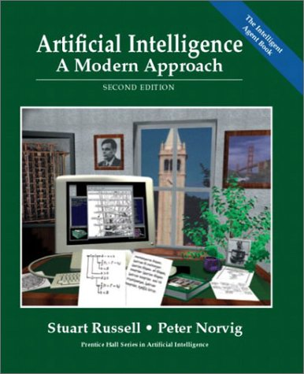
Acknowledgements
Slides adapted from an AIMA presentation by Reijer Grimbergen
AIMA - Chapter 19

Slide 3
Logical description of learning
Examples are composed of descriptions and classifications
Objective is to find a hypothesis that explains the classification of the examples, given their descriptions
Entailment constraint
Hypothesis ∧ Descriptions ⊨ Classifications
Example: a decision tree that is consistent with all the examples will satisfy the entailment constraint
Note: Use Ockham’s razor to avoid Hypothesis = Classifications

Slide 4
Knowledge-based Learning
Prior
knowledge
Knowledge-based learning
Hypothesis
Observations
Predictions

Slide 5
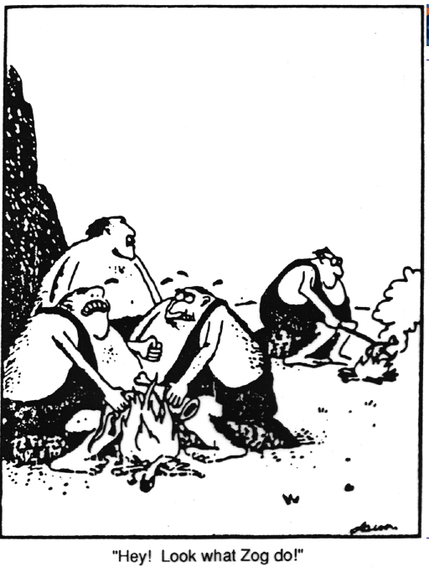
Caveman Zog

Slide 6
Cumulative or Incremental Development
To use background knowledge, a method to obtain background knowledge is needed
This must be a learning process
Use knowledge to learn more effectively
Question: How to do this?
Examples where use of background knowledge is vital
Caveman Zog and the lizard on a stick
Density and conductance of copper can be generalized, but not mass
Inferring a general rule about antibiotic being effective for a particular type of infections

Slide 7
Adding Background Knowledge
Explanation-based learning (EBL)
Relevance-based learning (RBL)
Knowledge-based inductive learning (KBIL)

Slide 8
Explanation-based Learning
Use explanation of success to infer a general rule
General rule follows logically from the background knowledge
Hypothesis ∧ Descriptions ⊨ Classifications
Background ⊨ Hypothesis
Does not learn anything factually new
Converting first-principles theories into useful, special purpose knowledge

Slide 9
Relevance-based Learning
The prior knowledge concerns the relevance of a set of features to the goal predicate
Example: In a given country most people speak the same language, but do not have the same name
Hypothesis ∧ Descriptions ⊨ Classifications
Background ∧ Descriptions ∧ Classifications ⊨ Hypothesis
Deductive learning: Makes use of the observations, but does not produce hypothesis beyond the background knowledge and the observations

Slide 10
Knowledge-based Inductive Learning
The background knowledge and the new hypothesis combine to explain the examples
Example
Inferring disease D from the symptoms is not enough to explain the prescription of medicine M
A rule that M is effective against D is needed
Background ∧ Hypothesis ∧ Descriptions ⊨ Classifications

Slide 11
Inductive Logic Programming
Main field of study for KBIL algorithms
Prior knowledge plays two key roles
The effective hypothesis space is reduced to include only those theories that are consistent with what is already known
Prior knowledge can be used to reduce the size of the hypothesis explaining the observations
Smaller hypotheses are easier to find
ILP systems can formulate hypotheses in first-order logic
Can learn in environments not understood by simpler systems

Slide 12
Explanation-based Learning
Extracting general rules from individual observations
Example: differentiating and simplifying algebraic expressions
Differentiate X² with respect to X to get 2X
Logical reasoning system
Ask(Derivative(X², X)=d, KB) with solution d = 2X
Solving this for the first time using standard rules of differentiation gives 1 × (2 × (X ⁽²⁻¹⁾))
Takes a first-time program 136 proof steps with 99 dead end branches
Memoization
Speed up by saving the results of computation
Create a database of input/output pairs

Slide 13
Creating general rules
Memoization in explanation-based learning
Create general rules that cover an entire class of cases
Example: extract the general rule
ArithmeticUnknown(u) ⇒ Derivative(u², u) = 2u
Once something is understood, it can be generalized and reused in other circumstances
“Civilization advances by extending the number of important operations that we can do without thinking about them”
Explaining why something is a good idea is much easier than coming up with the idea in the first place
Watch caveman Zog roast his lizard vs. thinking about putting the lizard on a stick

Slide 14
Extracting rules from examples
Basic idea behind EBL
Construct an explanation of the observation using prior knowledge
Establish a definition of the class of cases for which the same explanation can be used
Example: simplifying 1 × (0 + X) using a knowledge base with the following rules
Rewrite(u, v) ∧ Simplify(v, w) ⇒ Simplify(u, w)
Primitive(u) ⇒ Simplify(u, u)
ArithmeticUnknown(u) ⇒ Primitive(u)
Number(u) ⇒ Primitive(u)
Rewrite(1 × u, u)
Rewrite(0 + u, u)
…

Slide 15
Proof tree for original problem
Simplify(1 × (0 + X), w)
Rewrite(1 × (0 + X), v)
Simplify(0 + X, w)
Yes, {v / 0 + X}
Rewrite(0 + X, v’)
Simplify(X, w)
Yes, {v’ / X}
{w / X}
Primitive(X)
ArithmeticUnkown(X)
Yes, {}

Slide 16
Generalized proof tree
Simplify(x × (y + z), w)
Rewrite(x × (y + z), v)
Simplify(y + z, w)
Yes, {x / 1, v/ y + z}
Rewrite(y + z, v’)
Simplify(z, w)
Yes, {y / 0, v’ / z}
{w / z}
Primitive(z)
ArithmeticUnkown(z)
Yes, {}

Slide 17
Generalizing proofs
The variabilized proof proceeds using exactly the same rule applications
May lead to variable instantiation
Take the leaves of the generalized proof tree to get the general rule
Rewrite(1 × (0 + z), 0 + z) ∧ Rewrite(0 + z, z) ∧ ArithmeticUnknown(z) ⇒ Simplify(1 × (0 + z), z)
The first two conditions are independent of z, so this becomes
ArithmeticUnknown(z) ⇒ Simplify(1 × (0 + z), z)
Recap
Use background knowledge to construct a proof for the example
In parallel, construct a generalized proof tree
New rule is the conjunction of the leaves of the proof tree and the variabilized goal
Drop conditions that are true regardless of the variables in the goal

Slide 18
Improving efficiency
Pruning the proof tree to get more general rules
Primitive(z) ⇒ Simplify(1 × (0 + z), z)
Simplify(y + z, w) ⇒ Simplify(1 × (y + z), w)
Problem: Which rules to choose?
Adding large numbers of rules to the knowledge base slows down the reasoning process (increases the branching factor of the search space)
To compensate, the derived rules must offer significant speed increases
Derived rules should be as general as possible to apply to the largest possible set of cases

Slide 19
Improving efficiency
Operationality of subgoals in the rule
A subgoal must be “easy” to solve
Primitive(z) is easy to solve, but Simplify(y + z, w) leads to an arbitrary amount of inference
Keep operational subgoals and prune the rest of the tree
Trade-off between operationality and generality
More specific subgoals are easier to solve but cover fewer cases
How many steps are still called operational?
Cost of a subgoal depends on the rules in the knowledge base
Maximizing the efficiency of an initial knowledge base
is a complex optimization problem

Slide 20
Improving efficiency
Empirical analysis of efficiency
Average-case complexity on a population of problems that needs to be solved
By generalizing from past example problems, EBL makes the knowledge base more efficient for the kind of problems that it is reasonable to expect
Works if the distribution of past problems is roughly the same as for future problems
Can lead to great improvement
Swedish to English translator was made 1200 times faster by using EBL

Slide 21
Recap: Relevance-based Learning
The prior knowledge concerns the relevance of a set of features to the goal predicate
Example: In a given country most people speak the same language, but do not have the same name
Hypothesis ∧ Descriptions ⊨ Classifications
Background ∧ Descriptions ∧ Classifications ⊨ Hypothesis
Deductive learning: Makes use of the observations, but does not produce hypothesis beyond the background knowledge and the observations

Slide 22
Relevance-based Learning
Functional dependencies or determinations
Background knowledge in Brazil example
Therefore, from
it follows
Special syntax

Slide 23
Determining the hypothesis space
Determinations limit the hypothesis space
Only consider the important features (i.e. not day of the week, hair style of David Beckham)
Determinations specify a sufficient basis vocabulary from which to construct hypotheses
Reduction of the hypothesis space makes it easier to learn the target predicate
Learning boolean functions of n variables in CNF: Size of the hypothesis space |H| = O(2^{2n})
For boolean functions log(|H|) examples are needed in a |H| size hypothesis space: Without restrictions, this is O(2^{n}) examples
If the determination contains d predicates on the left, only O(2^{d}) examples are needed
Reduction of size O(2^{n–d})

Slide 24
Learning relevance information
Prior knowledge also needs to be learned
Learning algorithm for determinations
Find the simplest determination consistent with the observations
A determination says that if examples match P they must also match Q
A determination is consistent with a set of examples if every pair that matches on the predicates on the left-hand side also matches on the target predicate

Slide 25
Learning relevance information
Sample | Mass | Temp | Material | Size | Conductance
S1 | 12 | 26 | Copper | 3 | 0.59
S1 | 12 | 100 | Copper | 3 | 0.57
S2 | 24 | 26 | Copper | 6 | 0.59
S3 | 12 | 26 | Lead | 2 | 0.05
S3 | 12 | 100 | Lead | 2 | 0.04
S4 | 24 | 26 | Lead | 4 | 0.05
Minimal consistent determination
Non-minimal consistent determination

Slide 26
Learning relevance information
function Minimimal-Consistent-Det(E, A) returns a determination
inputs: E, a set of examples
A, a set of attributes, of size n
for i ← 1, …, n do
for each subset A_{i} of A of size i do
if Consistent-Det?(A_{i} ,E) then return A_{i}
end
end
function Consistent-Det?(A, E) returns a truth-value
inputs: A, a set of attributes
E, a set of examples
local variables: H, a hash table
for each example e in E do
if some example in H has the same value as e for the attributes A but a different classification then return False
store the class of e in H, indexed by the values for attributes A of the example e
end
return True

Slide 27
Complexity
Time complexity depends on the size of the minimal consistent determination
In case of p attributes and a total of n attributes, the algorithm has to search all subsets of A of size p
There are O(n^{p}) of these, so the algorithm is exponential
The general problem is NP-complete
In most domains there is sufficient local structure to make p small

Slide 28
Deriving Hypotheses
Use decision tree learning for computing hypotheses
Goal: Minimize size of hypotheses
Idea: Use relevance-based decision tree learning

Slide 29
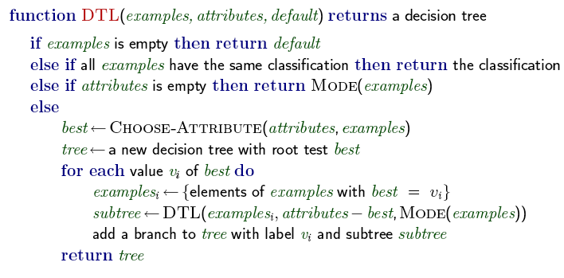
Relevance-based Decision Tree Learning
function RBDTL(E, A, v) returns a decision tree
return DTL(E, Minimal-Consistent-Det(E,A), v)
MODE(.) = Majority(.)

Slide 30
Exploiting Knowledge
RBDTL simultaneously learns and uses relevance information to minimize its hypothesis space
Declarative bias
How can prior knowledge be used to identify the appropriate hypothesis space to search for the correct target definition?
Unanswered questions
How to handle noise?
How to use other kinds of prior knowledge besides determinations?
How can the algorithms be generalized to cover any first-order theory?

Slide 31
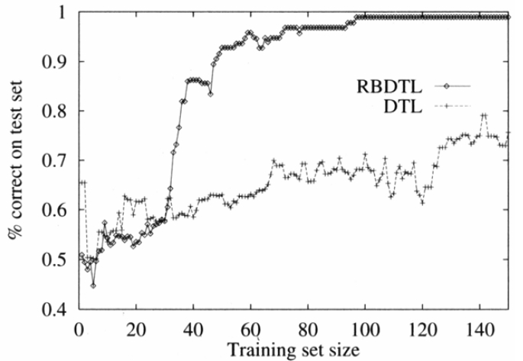
RBDTL vs. DTL

Slide 32
Inductive Logic Programming
Combines inductive methods with the power of first-order representations
Offers a rigorous approach to the general KBIL problem
Offers complete algorithms for inducing general, first-order theories from examples

Slide 33
ILP: An example
General knowledge-based induction problem
Background ∧ Hypothesis ∧ Descriptions ⊨ Classifications
Example: Learning family relations from examples
Observations are an extended family tree
Mother, Father and Married relations
Male and Female properties
Target predicates: Grandparent, BrotherInLaw, Ancestor

Slide 34
Example (prob. not up to date)
George |><| Mum
Spencer |><| Kydd
Elizabeth |><| Philip
Margaret
Diana |><| Charles
Anne |><| Mark
Andrew |><| Sarah
Edward
William
Harry
Peter
Zara
Beatrice
Eugenie

Slide 35
Example
Descriptions include facts like
Father(Philip, Charles)
Mother(Mum, Margaret)
Married(Diana, Charles)
Male(Philip)
Female(Beatrice)
Sentences in Classifcations depend on the target concept being learned (in the example: 12 positive, 388 negative)
Grandparent(Mum, Charles)
¬Grandparent(Mum, Harry)
Goal: find a set of sentences for Hypothesis such that the entailment constraint is satisfied
Without background knowledge this is for example

Slide 36
Why Attribute-based Learning Fails
Decision-Tree-Learning will get nowhere
To express Grandparent as a (boolean) attribute, pairs of people need to be objects
Grandparent(<Mum,Charles>)
But then the example descriptions can not be represented
FirstElementIsMotherOfElizabeth(<Mum,Charles>)
A large disjunction of specific cases without any hope of generalization to new examples
Attribute-based learning algorithms are incapable
of learning relational predicates
Notes:
Attribute 属性 ぞくせい
Example description 例記述 れいきじゅつ
Large 膨大 ぼうだい
Disjunction 選言 せんげん
Generalize 一般化される いっぱんかされる
Attribute-based 属性に基づく ぞくせいにもとづく
Relation predicate 関係述語 かんけいじゅつご

Slide 37
Background knowledge
A little bit of background knowledge helps a lot
Background knowledge contains
Grandparent is now reduced to
Constructive induction algorithm
Create new predicates to facilitate the expression of explanatory hypotheses
Example: introduce a predicate Parent to simplify the definitions of the target predicates
Notes:
Background knowledge 背景知識 はいけいちしき
Reduce 簡単化される たんかんかされる
Constructive induction 構成的帰納 こうせいてききのう
Create 作り出す つくりだす
New predicate 新述語 しんじゅつご
Express 表現する ひょうげんする
Explanatory hypotheses 説明仮説 せつめいかせつ
Simplify 単純化する たんじんかする
Definition 定義 ていぎ
Target predicate 目標概念 もくひょうがいねん

Slide 38
Top-down inductive learning
Top-down learning method
Decision-tree learning: start from the observations and work backwards
Decision tree is gradually grown until it is consistent with the observations
Top-down learning: start from a general rule and specialize it

Slide 39
Top-Down Inductive Learning: FOIL
Split positive and negative examples
Positive: <George, Anne>, <Philip, Peter>, <Spencer, Harry>
Negative: <George, Elizabeth>, <Harry, Zara>, <Charles, Philip>
Construct a set of Horn clauses with Grandfather(x,y) as the head with the positive examples instances of the Grandfather relationship
Start with a clause with an empty body
⇒ Grandfather(x,y)
All examples are now classified as positive, so specialize to rule out the negative examples: Here are 3 potential additions:
1) Father(x,y) ⇒ Grandfather(x,y) 2) Parent(x,z) ⇒ Grandfather(x,y)
3) Father(x,z) ⇒ Grandfather(x,y)
The first one incorrectly classifies the 12 positive examples
The second one is incorrect on a larger part of the negative examples
Prefer the third clause and specialize
Father(x,z) ∧ Parent(z,y) ⇒ Grandfather(x,y)

Slide 40
FOIL
function Foil(examples, target) returns a set of Horn clauses
inputs: examples, set of examples
target, a literal for the goal predicate
local variables: clauses, set of clauses, initially empty
while examples contains positive examples do
clause ← New-Clause(examples, target)
remove examples covered by clause from examples
add clause to clauses
return clauses

Slide 41
FOIL
function New-Clause(examples, target) returns a Horn clause
local variables:
clause, a clause with target as head and an empty body
l, a literal to be added to the clause
extended-examples, a set of examples with values for new
variables
extended-examples ← examples
while extended-examples contains negative examples do
l ← Choose-Literal(New-Literals(clause), extended-examples)
append l to the body of clause
extended-examples ← set of examples created by applying
Extend-Example to each example in extended-examples
return clause

Slide 42
FOIL
function Extend-Example(example, literal) returns
if example satisfies literal
then return the set of examples created
by extending example with each
possible constant value for each new
variable in literal
else return the empty set

Slide 43
FOIL
New-Literals
Takes a clause and constructs all possible “useful” literals
Example: Father(x,z) ⇒ Grandfather(x,y)
Add literals using predicates
Negated or unnegated
Use any existing predicate (including the goal)
Arguments must be variables
Each literal must include at least one variable from an earlier literal or from the head of the clause
Valid: Mother(z,u), Married(z,z), Grandfather(v,x)
Invalid: Married(u,v)
Equality and inequality literals
E.g. z ≠ x, empty list
Arithmetic comparisons
E.g. x > y, threshold values

Slide 44
FOIL
The way New-Literal changes the clauses leads to a very large branching factor
Improve performance by using type information
E.g., Parent(x,n) where x is a person and n is a number
Choose-Literal uses a heuristic similar to information gain
Ockham’s razor to eliminate hypotheses
If the clause becomes longer than the total length of the positive examples that the clause explains, this clause is not a valid hypothesis
Most impressive demonstration
Learn the correct definition of list-processing functions in Prolog from a small set of examples, using previously learned functions as background knowledge

Slide 45
Inverse Resolution
Inverse resolution
Classifications follows from
Background ∧ Hypothesis ∧ Descriptions
This can be proven by resolution
Run the proof backwards to find Hypothesis
Problem: How to run the proof backwards?

Slide 46
Generating Inverse Proofs
Ordinary resolution
Take two clauses C₁ and C₂ and resolve them to produce the resolvent C
Inverse resolution
Take resolvent C and produce two clauses C₁ and C₂
Take C and C₁ and produce C₂

Slide 47
Generating Inverse Proofs
Parent(Elizabeth, y) ⇒ Grandparent(George, y)
True ⇒ Parent(Elizabeth, Anne)
[y/Anne]
True ⇒ Grandparent(George, Anne)
Grandparent(George, Anne) ⇒ False
True ⇒False

Slide 48
Generating Inverse Proofs
Inverse resolution is a search
For any C and C₁ there can be several or even an infinite number of clauses C₂
Instead of Parent(Elizabeth,y) ⇒ Grandparent(George,y) there were numerous alternatives
Parent(Elizabeth,Anne) ⇒ Grandparent(George,Anne)
Parent(z,Anne) ⇒ Grandparent(George,Anne)
Parent(z,y) ⇒ Grandparent(George,y)
The clauses C₁ that participate in each step can be chosen from Background, Descriptions, Classifications or from hypothesized clauses already generated
ILP needs restrictions to make the search manageable
Eliminate function symbols
Generate only the most specific hypotheses
Use Horn clauses
All hypothesized clauses must be consistent with each other
Each hypothesized clause must agree with the observations

Slide 49
New Predicates and New Knowledge
An inverse resolution procedure is a complete algorithm for learning first-order theories
If some unknown Hypothesis generates a set of examples, then an inverse resolution procedure can generate Hypothesis from the examples
Can inverse resolution infer the law of gravity from examples of falling bodies?
Yes, given suitable background mathematics
Monkey and typewriter problem: How to overcome the large branching factor and the lack of structure in the search space?

Slide 50
New Predicates and New Knowledge
Inverse resolution is capable of generating new predicates
Resolution of C₁ and C₂ into C eliminates a literal that C₁ and C₂ share
This literal might contain a predicate that does not appear in C
When working backwards, one possibility is to generate a new predicate from which to construct the missing literal

Slide 51
New Predicates and New Knowledge
Father(George,y) ⇒ P(x,y)
P(George,y) ⇒ Ancestor(George,y)
[x/George]
Father(George,y) ⇒ Ancestor(George,y)
P can be used in later inverse resolution steps
Example: Mother(x,y) ⇒ P(x,y) or Father(x,y) ⇒ P(x,y) leading to the “Parent” relationship
Inventing new predicates is important to reduce the size of the definition of the goal predicate
Some of the deepest revolutions in science come from the invention of new predicates (e.g. Galileo’s invention of acceleration)

Slide 52
Applications
ILP systems have outperformed knowledge-free methods in a number of domains
Molecular biology: the GOLEM system has been able to generate high-quality predictions of protein structures and the therapeutic efficacy of various drugs
GOLEM is a completely general-purpose program that is able to make use of background knowledge about any domain

Slide 53
Knowledge in Learning: Summary
Cumulative learning
Improve learning ability as new knowledge is acquired
Prior knowledge helps to eliminate hypothesis and fills in explanations, leading to shorter hypotheses
Entailment constraints
Logical definition of different learning types
Explanation-based learning (EBL)
Explain the examples and generalize the explanation
Relevance-base learning (RBL)
Use prior knowledge in the form of determinations to identify the relevant attributes
Knowledge-based inductive learning (KBIL)
Finds inductive hypotheses that explain sets of observations
Inductive logic programming (ILP)
Perform KBIL using knowledge expressed in first-order logic
Generates new predicates with which concise new theories can be expressed

