Slide 1
Web-Mining Agents
Prof. Dr. Ralf Möller
Universität zu Lübeck
Institut für Informationssysteme
Tanya Braun (Übungen)

Slide 2
Classification
Artificial Neural Networks
SVMs
R. Moeller
Institute of Information Systems
University of Luebeck

Slide 3
Agenda
Neural Networks
Single-layer networks (Perceptrons)
  Perceptron learning rule
  Easy to train
    Fast convergence, few data required
  Cannot learn „complex“ functions
Support Vector Machines
Multi-Layer networks
  Backpropagation learning
  Hard to train
    Slow convergence, many data required
Deep Learning

Slide 4
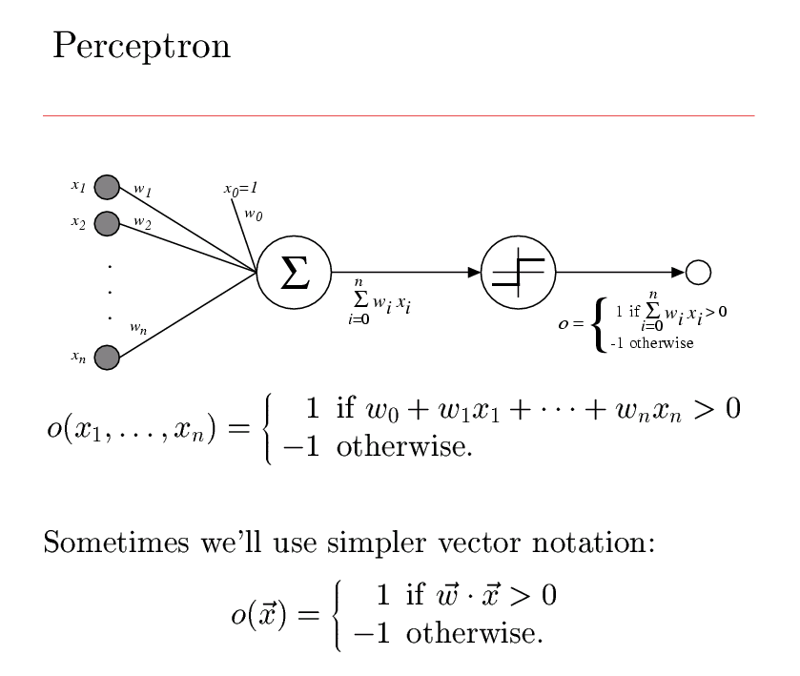

Slide 5
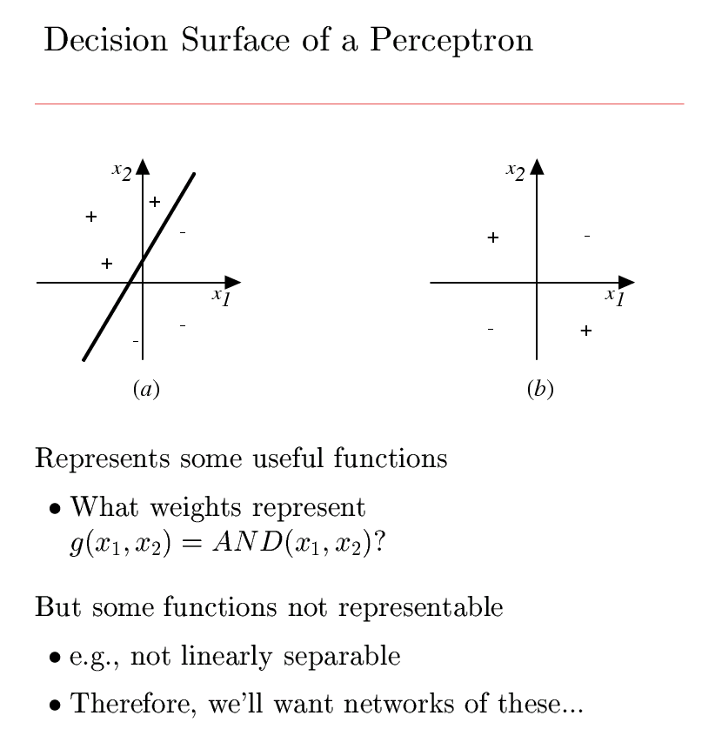
Notes:
What about multiclass

Slide 6
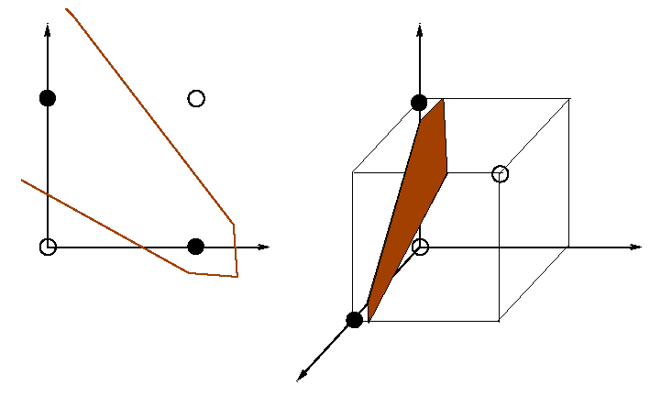
XOR problem

Slide 7
XOR problem

Slide 8
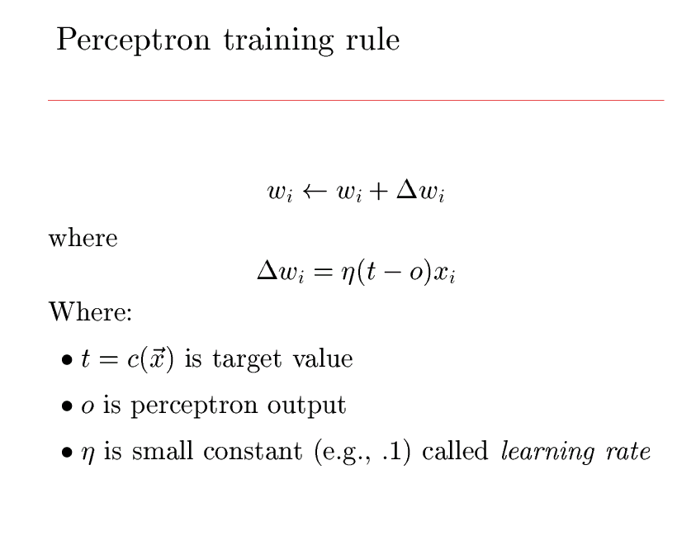

Slide 9
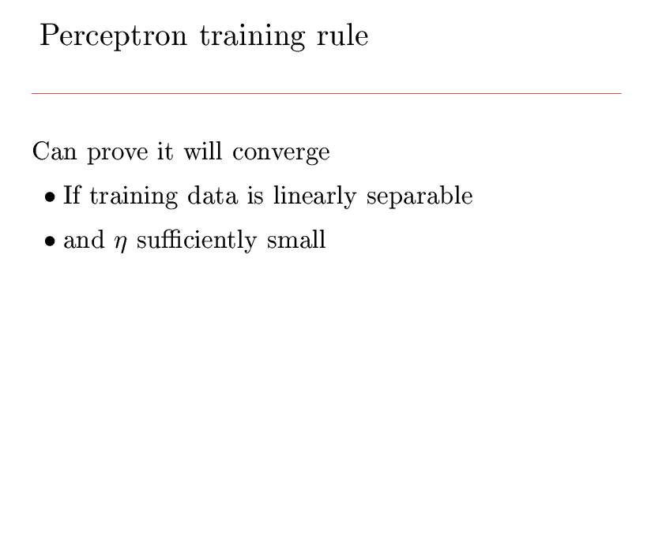
(learning rate)
Proof omitted since neural networks
are not in the focus of this lecture

Slide 10
Support Vector Machine Classifier
Basic idea
  Mapping the instances from the two classes into a space where they become linearly separable. The mapping is achieved using a kernel function that operates on the instances near to the margin of separation.
Parameter: kernel type

Slide 11
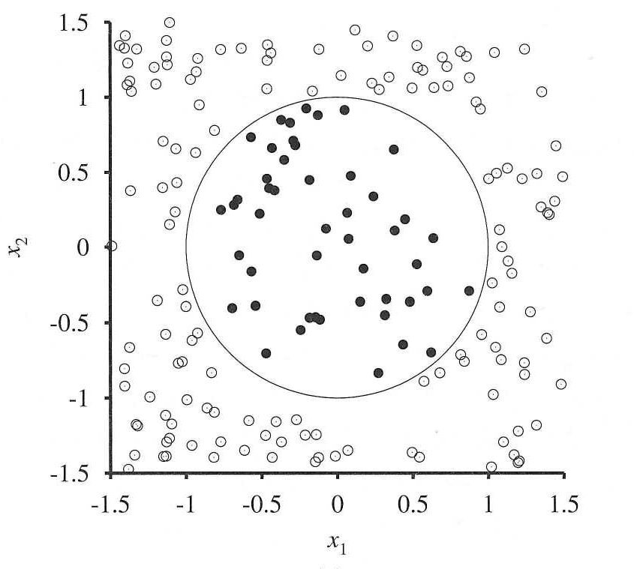
Nonlinear Separation
y = -1
y = +1

Slide 12
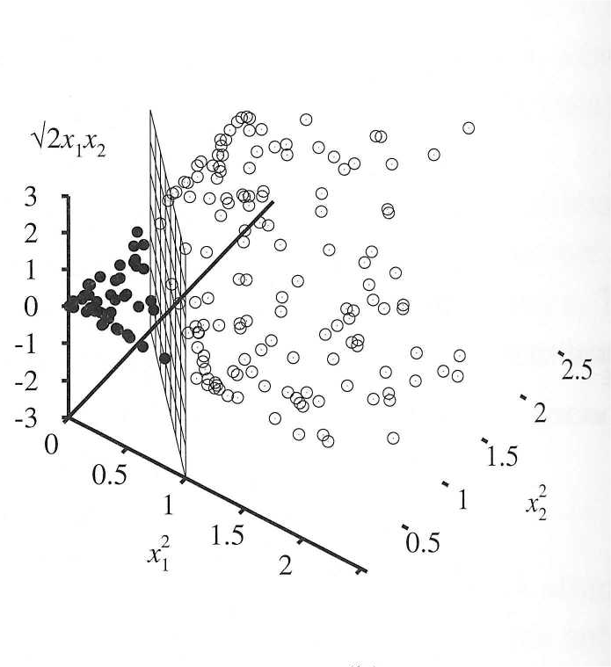

Slide 13
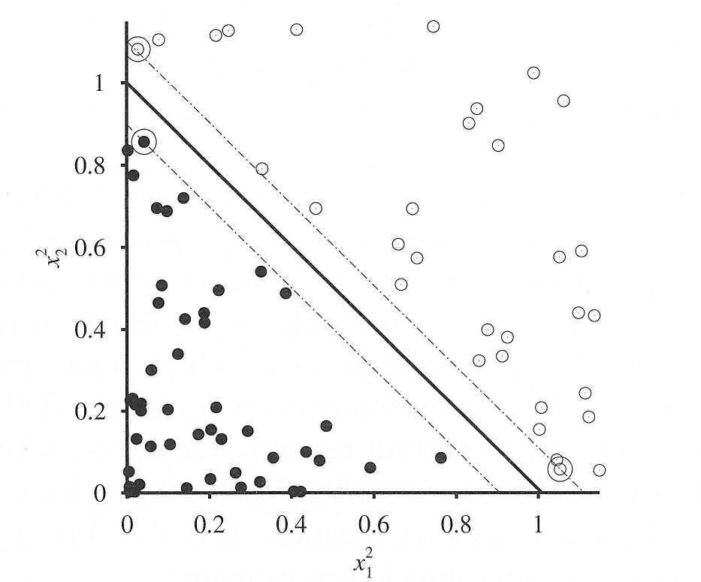
Support Vectors
margin
separator
support vectors

Slide 14

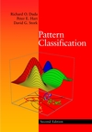
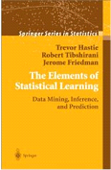
Literature
Mitchell (1989). Machine Learning. http://www.cs.cmu.edu/~tom/mlbook.html
Duda, Hart, & Stork (2000). Pattern Classification. http://rii.ricoh.com/~stork/DHS.html
Hastie, Tibshirani, & Friedman (2001). The Elements of Statistical Learning. http://www-stat.stanford.edu/~tibs/ElemStatLearn/

Slide 15
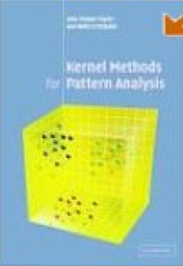
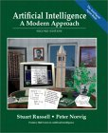
Literature (cont.)
Shawe-Taylor & Cristianini. Kernel Methods for Pattern Analysis.
http://www.kernel-methods.net/
Russell & Norvig (2004). Artificial Intelligence.
http://aima.cs.berkeley.edu/

Slide 16
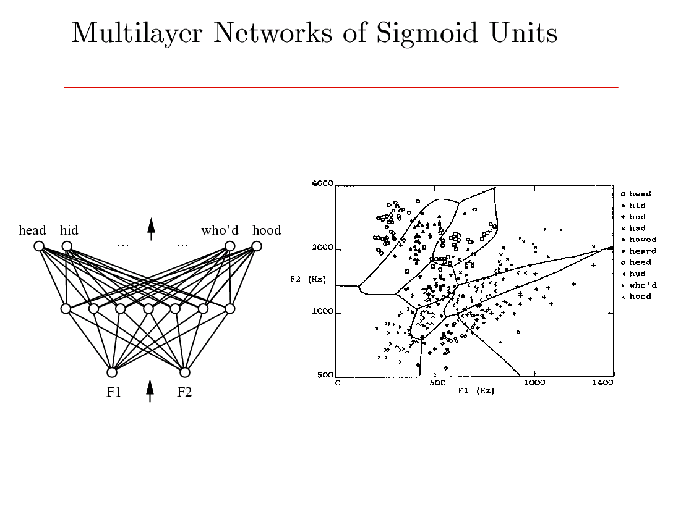

Slide 17
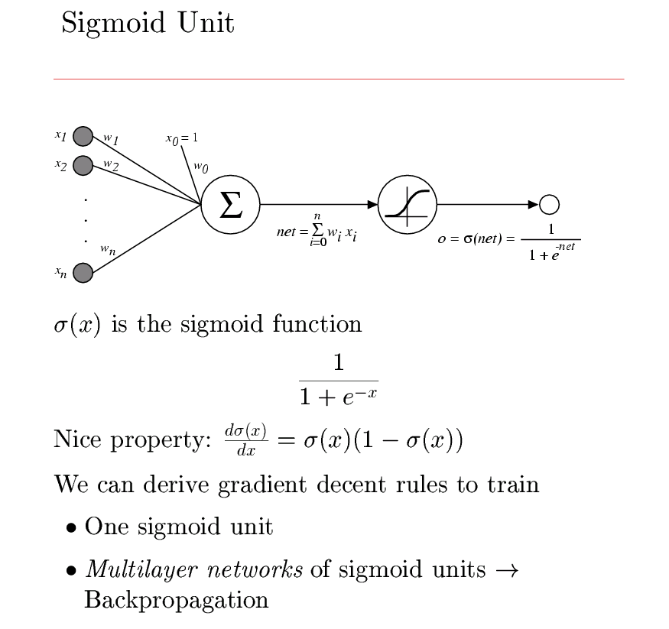

Slide 18
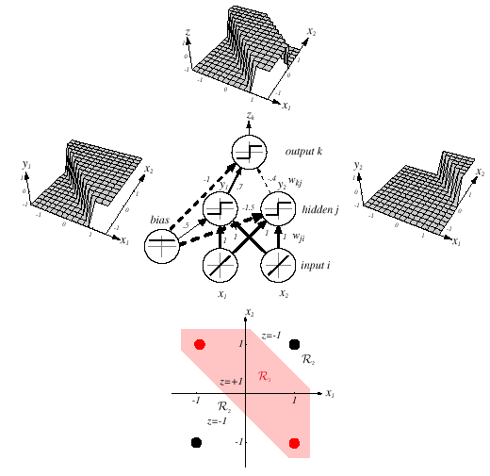
Z = y1 AND NOT y2 = (x1 OR x2) AND NOT(x1 AND x2)

Slide 19
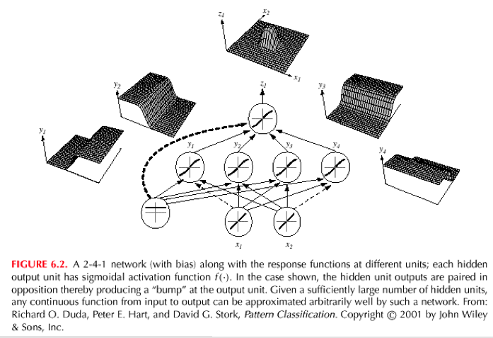

Slide 20
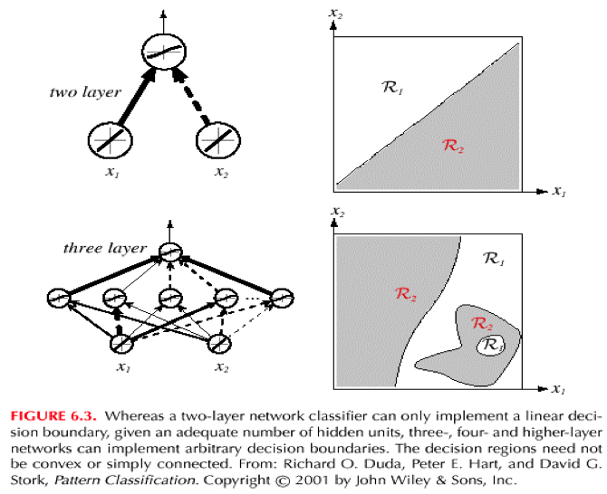

Slide 21
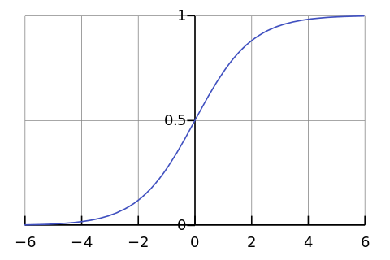

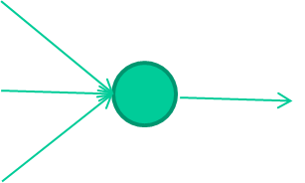
-0.06
W1
W2
f(x)
-2.5
W3
1.4
David Corne: Open Courseware

Slide 22
-0.06
2.7
-8.6
f(x)
-2.5
0.002
x = -0.06×2.7 + 2.5×8.6 + 1.4×0.002 = 21.34
1.4
David Corne: Open Courseware

Slide 23
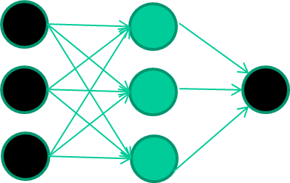
A dataset
Fields class
1.4 2.7 1.9 0
3.8 3.4 3.2 0
6.4 2.8 1.7 1
4.1 0.1 0.2 0
etc …
David Corne: Open Courseware

Slide 24
Training the neural network
Fields class
1.4 2.7 1.9 0
3.8 3.4 3.2 0
6.4 2.8 1.7 1
4.1 0.1 0.2 0
etc …
David Corne: Open Courseware

Slide 25
Training data
Fields class
1.4 2.7 1.9 0
3.8 3.4 3.2 0
6.4 2.8 1.7 1
4.1 0.1 0.2 0
etc …
Initialise with random weights
David Corne: Open Courseware

Slide 26
Training data
Fields class
1.4 2.7 1.9 0
3.8 3.4 3.2 0
6.4 2.8 1.7 1
4.1 0.1 0.2 0
etc …
Present a training pattern
1.4
2.7
1.9
David Corne: Open Courseware

Slide 27
Training data
Fields class
1.4 2.7 1.9 0
3.8 3.4 3.2 0
6.4 2.8 1.7 1
4.1 0.1 0.2 0
etc …
Feed it through to get output
1.4
2.7 0.8
1.9
David Corne: Open Courseware

Slide 28
Training data
Fields class
1.4 2.7 1.9 0
3.8 3.4 3.2 0
6.4 2.8 1.7 1
4.1 0.1 0.2 0
etc …
Compare with target output
1.4
2.7 0.8
0
1.9 error 0.8
David Corne: Open Courseware

Slide 29


Training data
Fields class
1.4 2.7 1.9 0
3.8 3.4 3.2 0
6.4 2.8 1.7 1
4.1 0.1 0.2 0
etc …
Adjust weights based on error
1.4
2.7 0.8
0
1.9 error 0.8
David Corne: Open Courseware

Slide 30
Training data
Fields class
1.4 2.7 1.9 0
3.8 3.4 3.2 0
6.4 2.8 1.7 1
4.1 0.1 0.2 0
etc …
Present a training pattern
6.4
2.8
1.7
David Corne: Open Courseware

Slide 31
Training data
Fields class
1.4 2.7 1.9 0
3.8 3.4 3.2 0
6.4 2.8 1.7 1
4.1 0.1 0.2 0
etc …
Feed it through to get output
6.4
2.8 0.9
1.7
David Corne: Open Courseware

Slide 32
Training data
Fields class
1.4 2.7 1.9 0
3.8 3.4 3.2 0
6.4 2.8 1.7 1
4.1 0.1 0.2 0
etc …
Compare with target output
6.4
2.8 0.9
1
1.7 error -0.1
David Corne: Open Courseware

Slide 33
Training data
Fields class
1.4 2.7 1.9 0
3.8 3.4 3.2 0
6.4 2.8 1.7 1
4.1 0.1 0.2 0
etc …
Adjust weights based on error
6.4
2.8 0.9
1
1.7 error -0.1
David Corne: Open Courseware

Slide 34
Training data
Fields class
1.4 2.7 1.9 0
3.8 3.4 3.2 0
6.4 2.8 1.7 1
4.1 0.1 0.2 0
etc …
And so on ….
6.4
2.8 0.9
1
1.7 error -0.1
Repeat this thousands, maybe millions of times – each time
taking a random training instance, and making slight
weight adjustments
Algorithms for weight adjustment are designed to make
changes that will reduce the error
David Corne: Open Courseware

Slide 35
The decision boundary perspective…
Initial random weights
David Corne: Open Courseware

Slide 36
The decision boundary perspective…
Present a training instance / adjust the weights
David Corne: Open Courseware

Slide 37
The decision boundary perspective…
Present a training instance / adjust the weights
David Corne: Open Courseware

Slide 38
The decision boundary perspective…
Present a training instance / adjust the weights
David Corne: Open Courseware

Slide 39
The decision boundary perspective…
Present a training instance / adjust the weights
David Corne: Open Courseware

Slide 40
The decision boundary perspective…
Eventually ….
David Corne: Open Courseware

Slide 41
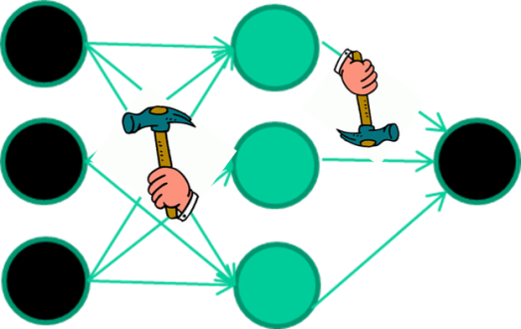
The point I am trying to make
Weight-learning algorithms for NNs are dumb
They work by making thousands and thousands of tiny adjustments, each making the network do better at the most recent pattern, but perhaps a little worse on many others
But, by dumb luck, eventually this tends to be good enough to learn effective classifiers for many real applications
David Corne: Open Courseware

Slide 42
Some other points
If f(x) is non-linear, a network with 1 hidden layer can, in theory, learn perfectly any classification problem. A set of weights exists that can produce the targets from the inputs. The problem is finding them.
David Corne: Open Courseware

Slide 43
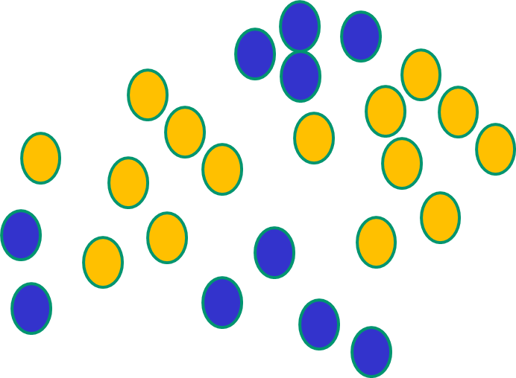
Some other ‘by the way’ points
If f(x) is linear, the NN can only draw straight decision boundaries (even if there are many layers of units)
David Corne: Open Courseware

Slide 44
Some other ‘by the way’ points
NNs use nonlinear f(x) so they
can draw complex boundaries,
but keep the data unchanged
David Corne: Open Courseware

Slide 45
Some other ‘by the way’ points
NNs use nonlinear f(x) so they SVMs only draw straight lines,
can draw complex boundaries, but they transform the data first
but keep the data unchanged in a way that makes that OK
David Corne: Open Courseware

Slide 46
Deep Learning
aka or related to
Deep Neural Networks
Deep Structural Learning
Deep Belief Networks
etc,

Slide 47
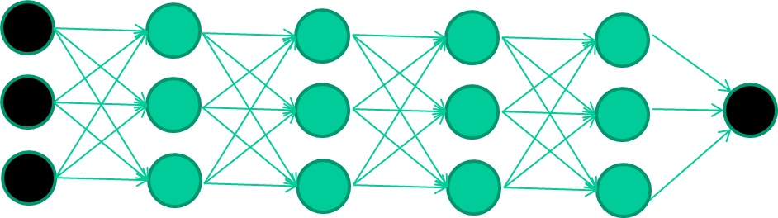
The new way to train multi-layer NNs…
David Corne: Open Courseware

Slide 48
The new way to train multi-layer NNs…
Train this layer first
David Corne: Open Courseware

Slide 49
The new way to train multi-layer NNs…
Train this layer first
then this layer
David Corne: Open Courseware

Slide 50
The new way to train multi-layer NNs…
Train this layer first
then this layer
then this layer
David Corne: Open Courseware

Slide 51
The new way to train multi-layer NNs…
Train this layer first
then this layer
then this layer
then this layer
David Corne: Open Courseware

Slide 52
The new way to train multi-layer NNs…
Train this layer first
then this layer
then this layer
then this layer
finally this layer
David Corne: Open Courseware

Slide 53
The new way to train multi-layer NNs…
EACH of the (non-output) layers is trained to be an auto-encoder
Basically, it is forced to learn good features that describe what comes from the previous layer
David Corne: Open Courseware

Slide 54
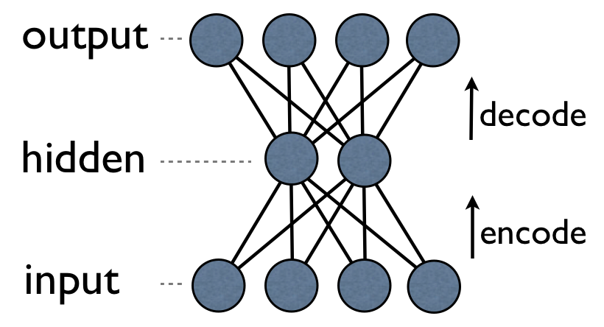
an auto-encoder is trained, with an absolutely standard weight-adjustment algorithm to reproduce the input
David Corne: Open Courseware

Slide 55
an auto-encoder is trained, with an absolutely standard weight-adjustment algorithm to reproduce the input
By making this happen with (many) fewer units than the inputs, this forces the ‘hidden layer’ units to become good feature detectors
David Corne: Open Courseware

Slide 56
intermediate layers are each trained to be auto encoders (or similar)
David Corne: Open Courseware

Slide 57
Final layer trained to predict class based on outputs from previous layers
David Corne: Open Courseware

