Slide 1
Web-Mining Agents
Topic Analysis: pLSI and LDA
Tanya Braun
Universität zu Lübeck
Institut für Informationssysteme

Slide 2
Recap
Agents
  Task/goal: Information retrieval
  Environment: Documents
  Means: Vector space or probability based retrieval
    Dimension reduction (vector model)
    Topic models (probability model)
Today: Topic models
  Probabilistic LSI (pLSI)
  Latent Dirichlet Allocation (LDA)
Soon: What agents can take with them

Slide 3
Acknowledgements
Pilfered from: Ramesh M. Nallapati
Machine Learning applied to Natural Language Processing
Thomas J. Watson Research Center, Yorktown Heights, NY USA
from his presentation on
Generative Topic Models for Community Analysis

Slide 4
Objectives
Cultural literacy for ML:
  Q: What are “topic models”?
  A₁: popular indoor sport for machine learning researchers
  A₂: a particular way of applying unsupervised learning of Bayes nets to text
Topic Models: statistical methods that analyze the words of the original texts to
  Discover the themes that run through them (topics)
  How those themes are connected to each other
  How they change over time

Slide 5
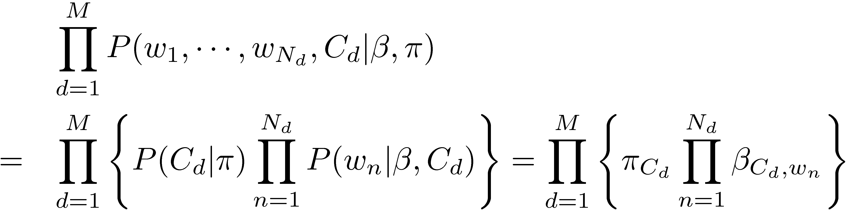
Introduction to Topic Models
Multinomial Naïve Bayes
π
For each document d = 1,☹, M
  Generate C_{d} ~ Mult( ∙ | π)
  For each position n = 1,☹, N_{d}
    Generate w_{n} ~ Mult( ∙ | β, C_{d})
C
…..
W₁
W₂
W₃
W_{N}
M
β

Slide 6
Introduction to Topic Models
Naïve Bayes Model: Compact representation
π
π
C
C
…..
W₁
W₂
W₃
W_{N}
M
W
N
β
M
β

Slide 7
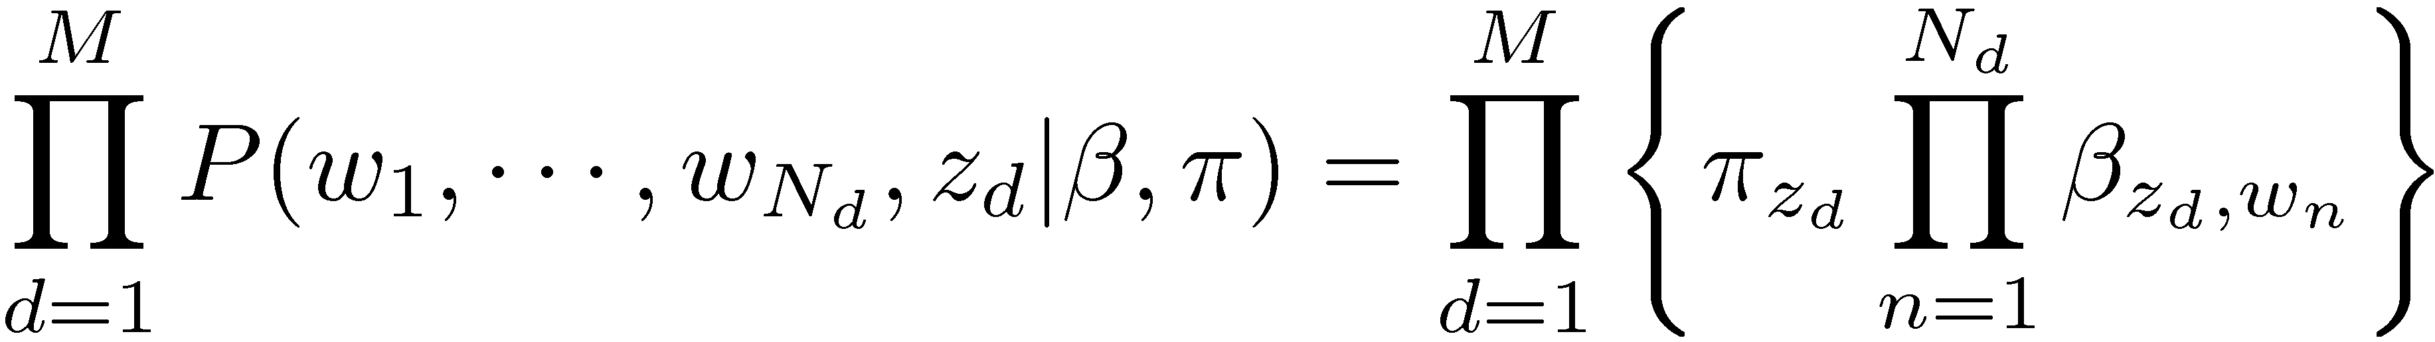
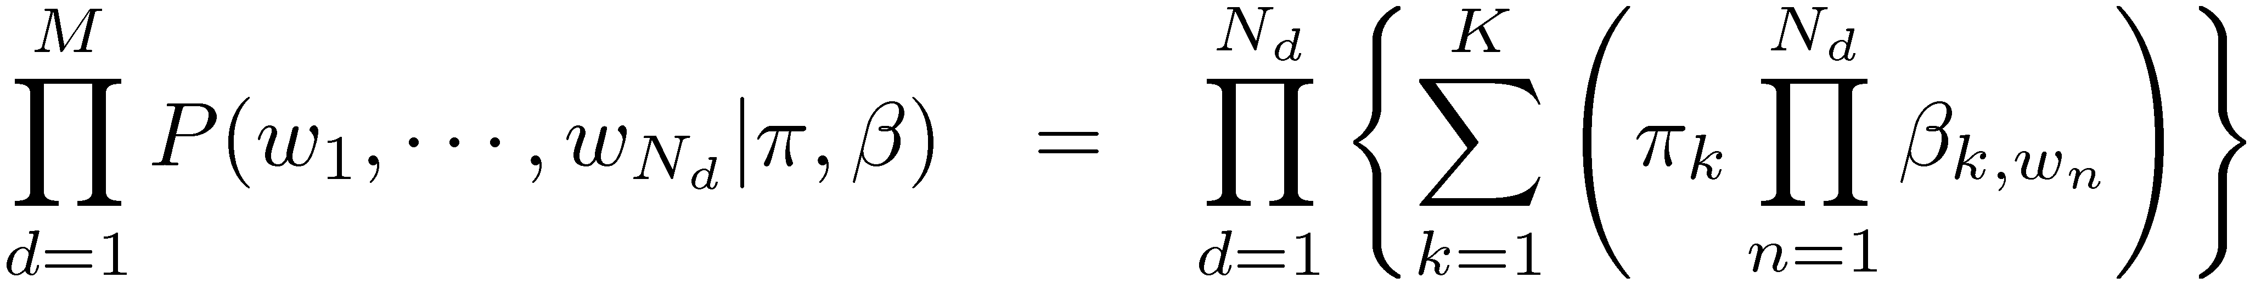
Introduction to Topic Models
Mixture model: unsupervised naïve Bayes model
π
Joint probability of words and classes:
But classes are not visible:
C
Z
W
N
M
β

Slide 8
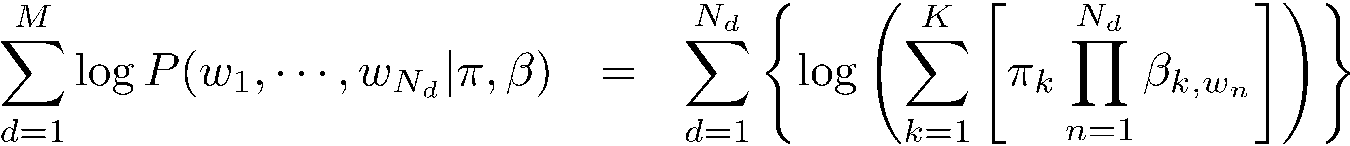
Introduction to Topic Models
Mixture model: learning
  Not a convex function
    No global optimum solution
  Solution: Expectation Maximization
    Iterative algorithm
    Finds local optimum
    Guaranteed to maximize a lower-bound on the log-likelihood of the observed data

Slide 9
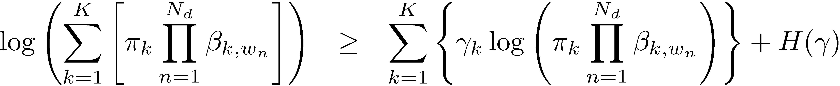
Introduction to Topic Models
log(0.5x₁+0.5x₂)
Quick summary of EM:
  Log is a concave function
  Lower-bound is convex!
  Optimize this lower-bound w.r.t. each variable instead
0.5log(x₁)+0.5log(x₂)
X₁
X₂
0.5x₁+0.5x₂
H(γ)

Slide 10
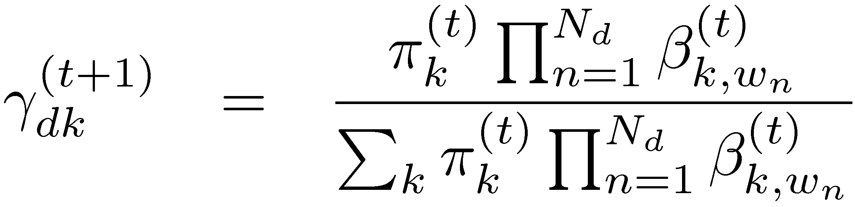

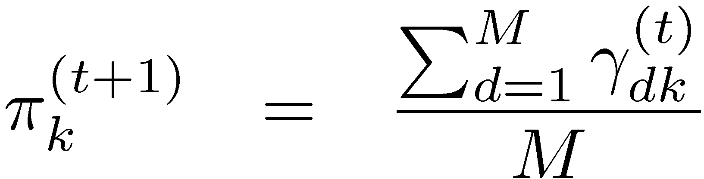
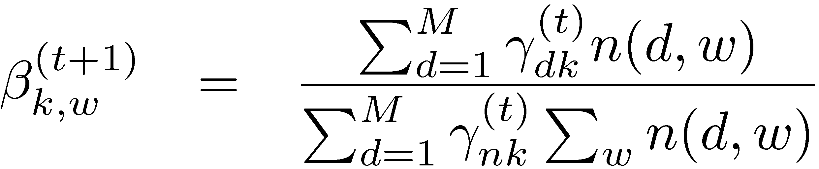
Introduction to Topic Models
Mixture model: EM solution
E-step:
M-step:

Slide 11
Mixture of Unigrams (traditional)
_{Zi}
w_{i1}
w_{2i}
w_{3i}
w_{4i}
Mixture of Unigrams Model (this is just Naïve Bayes)
For each of M documents,
Choose a topic z.
Choose N words by drawing each one independently from a multinomial conditioned on z.
In the Mixture of Unigrams model, we can only have one topic per document!

Slide 12
The pLSI Model
_{d}
For each word of document d in the training set,
Choose a topic z according to a multinomial conditioned on the index d.
Generate the word by drawing from a multinomial conditioned on z.
In pLSI, documents can have multiple topics.
z_{d1}
z_{d2}
z_{d3}
z_{d4}
w_{d1}
w_{d2}
w_{d3}
w_{d4}
Probabilistic Latent Semantic Indexing (pLSI) Model

Slide 13
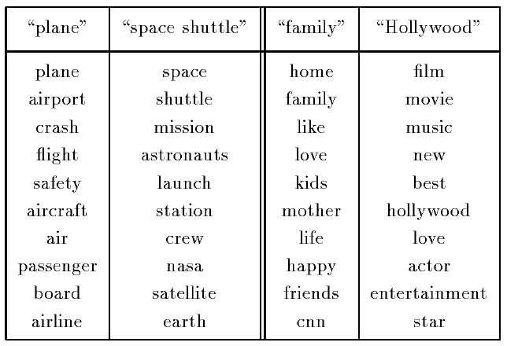
Introduction to Topic Models
PLSA topics (TDT-1 corpus)

Slide 14
Introduction to Topic Models
Probabilistic Latent Semantic Analysis Model
  Learning using EM
  Not a complete generative model
    Has a distribution π over the training set of documents: no new document can be generated!
  Nevertheless, more realistic than mixture model
    Documents can discuss multiple topics!

Slide 15
LSI: Simplistic picture
The “dimensionality” of a corpus is the number of distinct topics represented in it.
  if A has a rank k approximation of low Frobenius error, then there are no more than k distinct topics in the corpus.
Topic 1
Topic 2
Topic 3
15

Slide 16
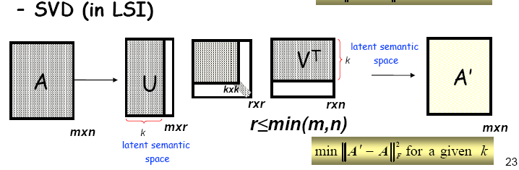
Cutting the dimensions with the least singular values

Slide 17

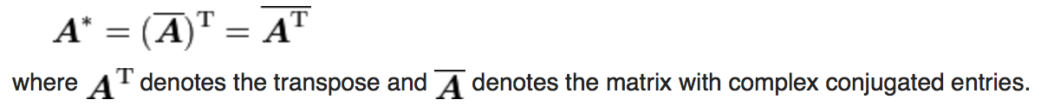
LSI and PLSI
LSI: find the k-dimensions that minimize the Frobenius norm of A-A’.
  Frobenius norm of A:
pLSI: defines one’s own objective function to minimize (maximize)

Slide 18
pLSI – a probabilistic approach
k = number of topics
V = vocabulary size
M = number of documents

Slide 19

pLSI
Assume a multinomial distribution
Distribution of topics (z)
Question: How to determine z ?

Slide 20
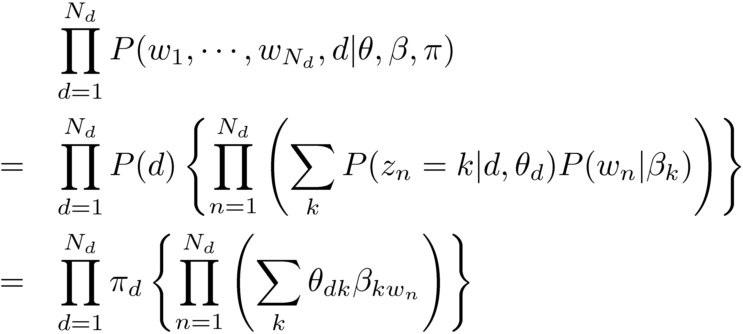
Introduction to Topic Models
Probabilistic Latent Semantic Analysis Model
θ_{d}
d
π
Select document d ~ Mult(π)
  For each position n = 1,☹, N_{d}
    generate z_{n} ~ Mult( ∙ | θ_{d})
    generate w_{n} ~ Mult( ∙ | β_{zn})
Topic distribution
z
w
N
M
β

Slide 21
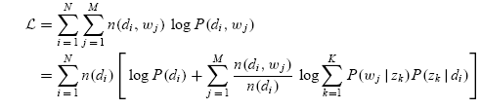
Using EM
Likelihood
E-step
M-step

Slide 22
Relation with LSI
Relation
Difference:
  LSI: minimize Frobenius (L-2) norm ~ additive Gaussian noise assumption on counts
  pLSI: log-likelihood of training data ~ cross-entropy / Kullback-Leibler divergence

Slide 23
pLSI – a generative model
Markov Chain Monte Carlo, EM

Slide 24
Problem of pLSI
It is not a proper generative model for document:
  Document is generated from a mixture of topics
The number of topics may grow linearly with the size of the corpus
Difficult to generate a new document

Slide 25
Introduction to Topic Models
Latent Dirichlet Allocation
  Overcomes the issues with PLSA
    Can generate any random document
  Parameter learning:
    Variational EM
      Numerical approximation using lower-bounds
      Results in biased solutions
      Convergence has numerical guarantees
    Gibbs Sampling
      Stochastic simulation
      unbiased solutions
      Stochastic convergence

Slide 26
Dirichlet Distributions
In the LDA model, we would like to say that the topic mixture proportions for each document are drawn from some distribution.
So, we want to put a distribution on multinomials. That is, k-tuples of non-negative numbers that sum to one.
The space is of all of these multinomials has a nice geometric interpretation as a (k-1)-simplex, which is just a generalization of a triangle to (k-1) dimensions.
Criteria for selecting our prior:
  It needs to be defined for a (k-1)-simplex.
  Algebraically speaking, we would like it to play nice with the multinomial distribution.

Slide 27
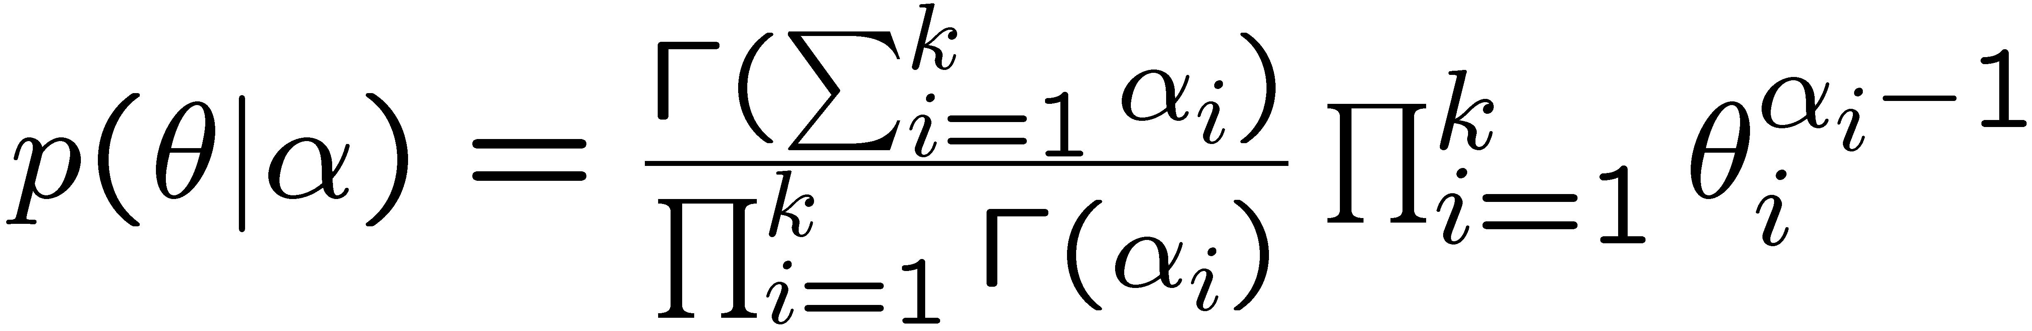
Dirichlet Distributions
Useful Facts:
  This distribution is defined over a (k-1)-simplex. That is, it takes k non-negative arguments which sum to one. Consequently it is a natural distribution to use over multinomial distributions.
  In fact, the Dirichlet distribution is the conjugate prior to the multinomial distribution. (This means that if our likelihood is multinomial with a Dirichlet prior, then the posterior is also Dirichlet!)
  The Dirichlet parameter α_{i} can be thought of as a prior count of the i^{th} class.

Slide 28
The LDA Model
α
θ
θ
θ
z₁
z₂
z₃
z₄
z₁
z₂
z₃
z₄
z₁
z₂
z₃
z₄
w₁
w₂
w₃
w₄
w₁
w₂
w₃
w₄
w₁
w₂
w₃
w₄
For each document,
Choose θ~Dirichlet(α)
For each of the N words w_{n}:
  Choose a topic z_{n}» Multinomial(θ)
  Choose a word w_{n} from p(w_{n}|z_{n},β), a multinomial probability conditioned on the topic z_{n}.
β

Slide 29
The LDA Model
For each document,
Choose θ» Dirichlet(α)
For each of the N words w_{n}:
  Choose a topic z_{n}» Multinomial(θ)
  Choose a word w_{n} from p(w_{n}|z_{n},β), a multinomial probability conditioned on the topic z_{n}.

Slide 30
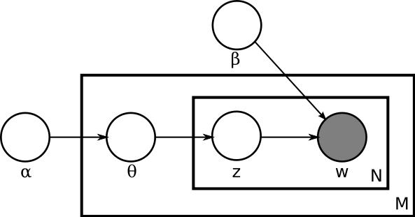
LDA (Latent Dirichlet Allocation)
Document = mixture of topics (as in pLSI), but according to a Dirichlet prior
  When we use a uniform Dirichlet prior, pLSI=LDA
A word is also generated according to another variable β:

Slide 33
Variational Inference
  In variational inference, we consider a simplified graphical model with variational parameters γ, φ and minimize the KL Divergence between the variational and posterior distributions.

Slide 35
Use of LDA
A widely used topic model
Complexity is an issue
Use in IR:
  Interpolate a topic model with traditional LM
  Improvements over traditional LM,
  But no improvement over Relevance model (Wei and Croft, SIGIR 06)

Slide 38
Use of LDA: Social Network Analysis
“follow relationship” among users often looks unorganized and chaotic
follow relationships are created haphazardly by each individual user and not controlled by a central entity
Provide more structure to this follow relationship
  by “grouping” the users based on their topic interests
  by “labeling” each follow relationship with the identified topic group

Slide 39
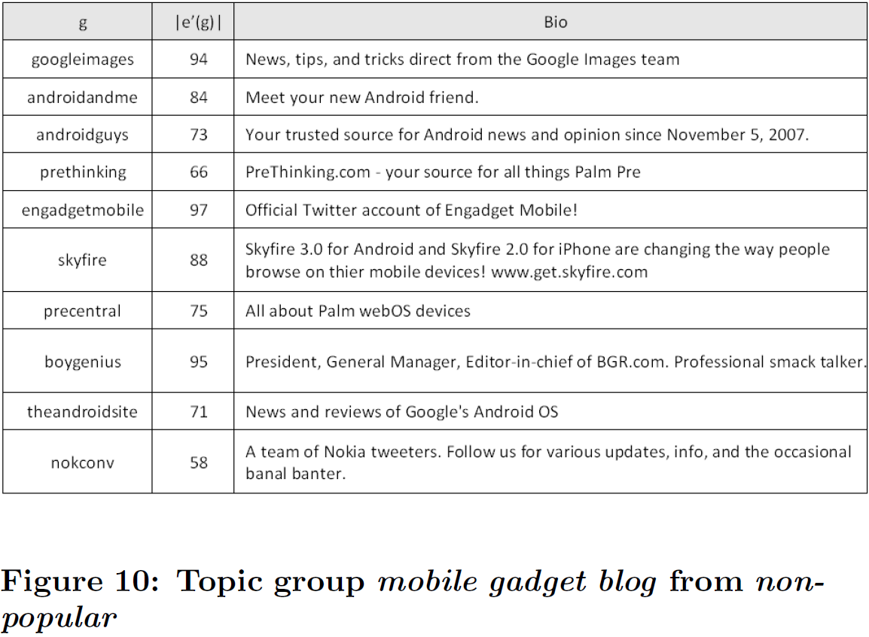
Use of LDA: Social Network Analysis

Slide 40
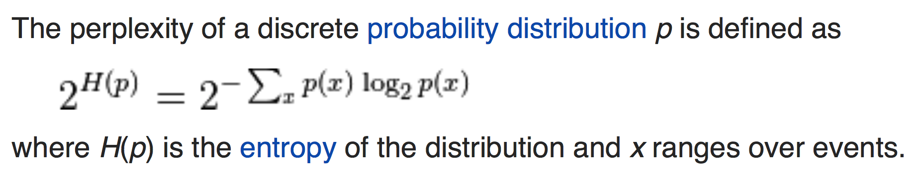
Perplexity
In information theory, perplexity is a measurement of how well a probability distribution or probability model predicts a sample
Perplexity of a random variable X may be defined as the perplexity of the distribution over its possible values x.
In natural language processing, perplexity is a way of evaluating language models. A language model is a probability distribution over entire sentences or texts.
[Wikipedia]

Slide 41
Introduction to Topic Models
Perplexity comparison of various models
Unigram
Mixture model
PLSA
Lower is better
LDA

Slide 42
References
LSI
  Improving Information Retrieval with Latent Semantic Indexing, Deerwester, S., et al, Proceedings of the 51st Annual Meeting of the American Society for Information Science 25, 1988, pp. 36–40.
  Using Linear Algebra for Intelligent Information Retrieval, Michael W. Berry, Susan T. Dumais and Gavin W. O'Brien, UT-CS-94-270,1994
pLSI
  Probabilistic Latent Semantic Indexing, Thomas Hofmann, Proceedings of the Twenty-Second Annual International SIGIR Conference on Research and Development in Information Retrieval (SIGIR-99), 1999
LDA
  Latent Dirichlet allocation. D. Blei, A. Ng, and M. Jordan. Journal of Machine Learning Research, 3:993-1022, January 2003.
  Finding Scientific Topics. Griffiths, T., & Steyvers, M. (2004). Proceedings of the National Academy of Sciences, 101 (suppl. 1), 5228-5235.
  Hierarchical topic models and the nested Chinese restaurant process. D. Blei, T. Griffiths, M. Jordan, and J. Tenenbaum In S. Thrun, L. Saul, and B. Scholkopf, editors, Advances in Neural Information Processing Systems (NIPS) 16, Cambridge, MA, 2004. MIT Press.
LDA and Social Network Analysis
  Social-Network Analysis Using Topic Models. Youngchul Cha and Junghoo Cho, Proceedings of the 35th international ACM SIGIR conference on Research and development in information retrieval (SIGIR '12), 2012
Also see Wikipedia articles on LSI, pLSI and LDA

