Slide 1
Web-Mining Agents Agents and Rational Behavior Decision-Making under Uncertainty Simple Decisions
Ralf Möller
Universität zu Lübeck
Institut für Informationssysteme

Slide 2
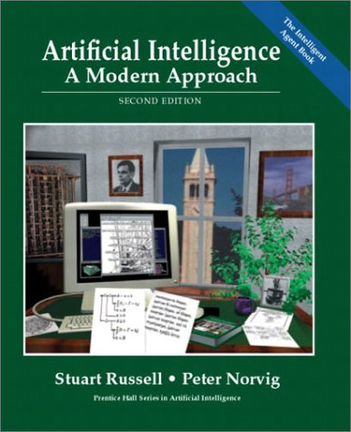
Literature
Chapter 16
Material from Lise Getoor, Jean-Claude Latombe, Daphne Koller, and Stuart Russell

Slide 3
Decision Making Under Uncertainty
Many environments have multiple possible outcomes
Some of these outcomes may be good; others may be bad
Some may be very likely; others unlikely
What’s a poor agent going to do??

Slide 4
Non-Deterministic vs. Probabilistic Uncertainty
?
?
a
b
c
a
b
c
{a,b,c}
decision that is best for worst case
{a(pa),b(pb),c(pc)}
decision that maximizes expected utility value
Non-deterministic model
Probabilistic model
~ Adversarial search

Slide 5
Expected Utility
Random variable X with n values x₁,…,x_{n} and distribution (p₁,…,p_{n}) E.g.: X is the state reached after doing an action A under uncertainty
Function U of X E.g., U is the utility of a state
The expected utility of A is EU[A=a] = Σ_{i=1,…,n} p(x_{i}|A=a)U(x_{i})

Slide 6
One State/One Action Example
s0
U(S0) = 100 x 0.2 + 50 x 0.7 + 70 x 0.1
= 20 + 35 + 7
= 62
A1
s1
s2
s3
0.2
0.7
0.1
100
50
70

Slide 7
One State/Two Actions Example
s0
U1(S0) = 62
U2(S0) = 74
U(S0) = max{U1(S0),U2(S0)}
= 74
A1
A2
s1
s2
s3
s4
0.2
0.7
0.2
0.1
0.8
100
50
70
80

Slide 8
Introducing Action Costs
s0
U1(S0) = 62 – 5 = 57
U2(S0) = 74 – 25 = 49
U(S0) = max{U1(S0),U2(S0)}
= 57
A1
A2
-5
-25
s1
s2
s3
s4
0.2
0.7
0.2
0.1
0.8
100
50
70
80

Slide 9
MEU Principle
A rational agent should choose the action that maximizes agent’s expected utility
This is the basis of the field of decision theory
The MEU principle provides a normative criterion for rational choice of action
AI is Solved!!!

Slide 10
Not quite…
Must have complete model of:
Actions
Utilities
States
Even if you have a complete model, it might be computationally intractable
In fact, a truly rational agent takes into account the utility of reasoning as well---bounded rationality
Nevertheless, great progress has been made in this area recently, and we are able to solve much more complex decision-theoretic problems than ever before

Slide 11
We’ll look at
Decision-Theoretic Planning
Simple decision making (ch. 16)
Sequential decision making (ch. 17)

Slide 12
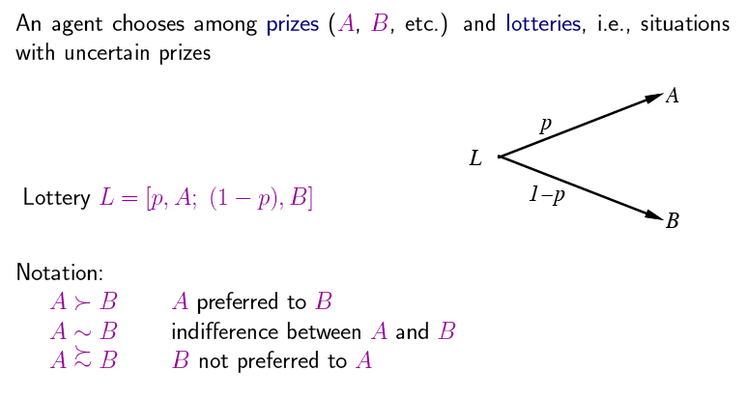
Preferences
A and B can be lotteries again: Prizes are special lotteries: [1, X; 0, not X]

Slide 13
Rational preferences

Slide 14
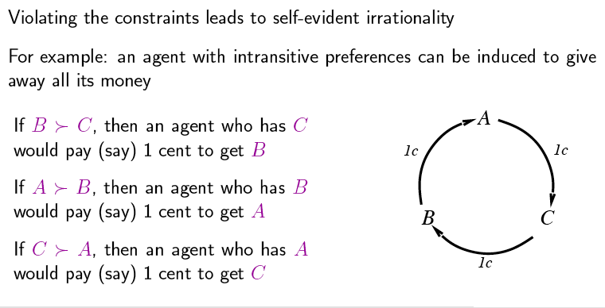
Rational preferences contd.

Slide 15
Axioms of Utility Theory
Orderability ({<, >, ~} is JEPD)
(A>B) ∨ (A<B) ∨ (A~B)
Transitivity
(A>B) ∧ (B>C) ⇒ (A>C)
Continuity
A>B>C ⇒ ∃p [p,A; 1-p,C] ~ B
Substitutability
A~B ⇒ [p,A; 1-p,C]~[p,B; 1-p,C]
Monotonicity
A>B ⇒ (p≥q ⇔ [p,A; 1-p,B] >~ [q,A; 1-q,B])
Decomposability
[p,A; 1-p, [q,B; 1-q, C]] ~ [p,A; (1-p)q, B; (1-p)(1-q), C]
Decomposability: There is no fun in gambling

Slide 16
And then there was utility

Slide 17
Utilities
-and-continue -as-before

Slide 18
Utility scales
U(pay $30...) = 0.999999

Slide 19
Money

Slide 20
Money Versus Utility
Money <> Utility
More money is better, but not always in a linear relationship to the amount of money
Expected Monetary Value
Risk-averse – U(L) < U(S_{EMV(L)})
Risk-seeking – U(L) > U(S_{EMV(L)})
Risk-neutral – U(L) = U(S_{EMV(L)})

Slide 21
Value Functions
Provides a ranking of alternatives, but not a meaningful metric scale
Also known as an “ordinal utility function”

Slide 22
Multiattribute Utility Theory
A given state may have multiple utilities
...because of multiple evaluation criteria
...because of multiple agents (interested parties) with different utility functions

Slide 23
Strict dominance

Slide 24
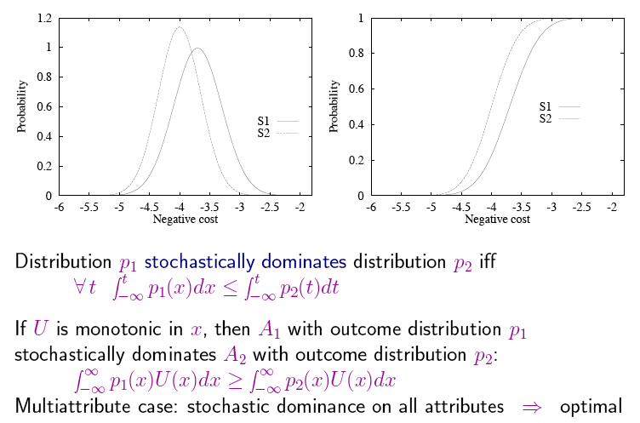
Stochastic dominance
Continuous random variable S₁ stochastically dominates S₂ iff
t . P(S₁ ≥ t) ≥ P(S₂ ≥ t)

Slide 25
Stochastic Dominance

Slide 26
Stochastic Dominance

Slide 27
Stochastic Dominance

Slide 28
Preference structure: Deterministic
month > vs.
month >
V(x₁, ..., v_{n}) = 𝚺_{i} V_{i}(x_{i})

Slide 29
Preference structure: Stochastic

Slide 30
Decision Networks
Extend BNs to handle actions and utilities
Also called influence diagrams
Use BN inference methods to solve
Perform Value of Information calculations

Slide 31
Decision Networks cont.
Chance nodes: random variables, as in BNs
Decision nodes: actions that decision maker can take
Utility/value nodes: the utility of the outcome state.

Slide 32
R&N example

Slide 33
Umbrella Network
take/don’t take
P(rain) = 0.4
umbrella
weather
have umbrella
P(have|take) = 1.0
P(~have|~take)=1.0
forecast
happiness
f w p(f|w)
sunny rain 0.3
rainy rain 0.7
sunny no rain 0.8
rainy no rain 0.2
U(have,rain) = -25
U(have,~rain) = 0
U(~have, rain) = -100
U(~have, ~rain) = 100

Slide 34
Evaluating Decision Networks
Set the evidence variables for current state
For each possible value of the decision node:
Set decision node to that value
Calculate the posterior probability of the parent nodes of the utility node, using BN inference
Calculate the resulting utility for action
Return the action with the highest utility

Slide 35
Decision Making: Umbrella Network
Should I take my umbrella??
take/don’t take
P(rain) = 0.4
umbrella
weather
have umbrella
P(have|take) = 1.0
P(~have|~take)=1.0
forecast
happiness
f w p(f|w)
sunny rain 0.3
rainy rain 0.7
sunny no rain 0.8
rainy no rain 0.2
U(have,rain) = -25
U(have,~rain) = 0
U(~have, rain) = -100
U(~have, ~rain) = 100

Slide 36
Value of information

Slide 37
General formula

Slide 38
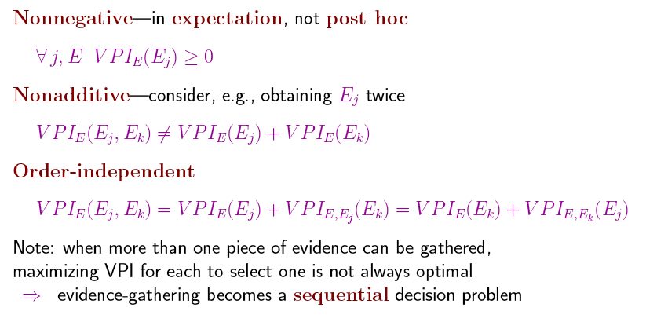
Properties of VPI

Slide 39
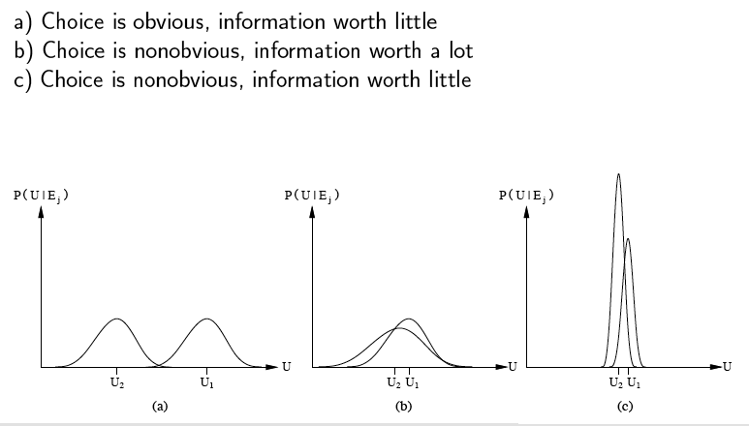
Qualitative behaviors

Slide 40
Information Gathering Agent
Ask questions Request(E_{j}) in a reasonable order
Avoid irrelevant questions
Take into account imporance of piece of information j in relation to Cost(E_{j})

