Slide 1
Web-Mining Agents
Topic Analysis: pLSI and LDA
Tanya Braun
Universität zu Lübeck
Institut für Informationssysteme

Slide 2
Acknowledgements
Pilfered from: Ramesh M. Nallapati
Machine Learning applied to Natural Language Processing
Thomas J. Watson Research Center, Yorktown Heights, NY USA
from his presentation on
Generative Topic Models for Community Analysis
&
David M. Blei
MLSS 2012
from his presentation on Probabilistic Topic Models
&
Sina Miran
CS 290D Paper Presentation on
Probabilistic Latent Semantic Indexing (PLSI)

Slide 3
Recap
Agents
  Task/goal: Information retrieval
  Environment: Documents
  Means: Vector space or probability based retrieval
    Dimension reduction (vector model)
    Topic models (probability model)
Today: Topic models
  Probabilistic LSI (pLSI)
  Latent Dirichlet Allocation (LDA)
Soon: What agents can take with them

Slide 4
LSI: Simplistic picture
The “dimensionality” of a corpus is the number of distinct topics represented in it.
  if A has a rank k approximation of low Frobenius error, then there are no more than k distinct topics in the corpus.
Topic 1
Topic 2
Topic 3
4
Notes:
Assuption: Topic implies word distribution

Slide 5
Objectives
Topic Models: statistical methods that analyze the words of the original texts to
  Discover the themes that run through them (topics)
  How those themes are connected to each other
  How they change over time

Slide 6
Example: Topics and How They Are Connected

Slide 7
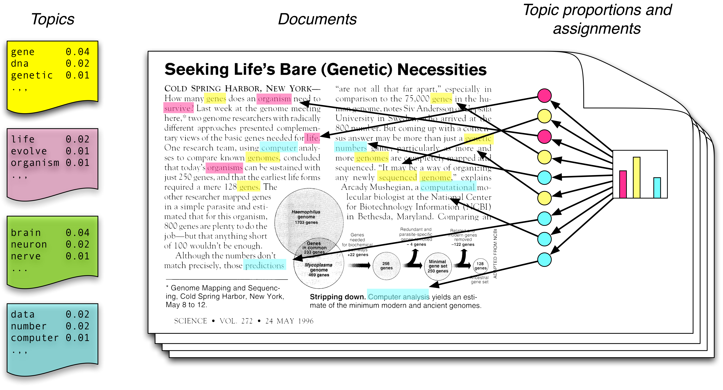
Topic Modeling Scenario
Each topic is a distribution over words.
Each document is a mixture of corpus-wide topics.
Each word is drawn from one of those topics.

Slide 8
Topic Modeling Scenario
In reality, we only observe the documents.
The other structures are hidden variables.
Topic modelling algorithms infer these variables from data.

Slide 9
Plate Notation
Naïve Bayes Model: Compact representation
  C = topic (distribution)
  N = number of words in corpus
  W_{i} one specific word in corpus
  M documents, W now words in document
C
C
W
…..
w₁
w₂
w₃
w_{N}
N
M
M

Slide 10
Generative Models
Generative models: Learn P(x,y)
  Tasks:
    Transform P(x,y) into P(y | x) for classification
    Use the model to predict (infer) new data
  Advantages
    Assumptions and model are explicit
    Use well-known algorithms (e.g., MCMC, EM)
Descriptive models: Learn P(y | x)
  Task: Classify data
  Advantages
    Fewer parameters to learn
    Better performance for classification
Notes:
So discriminative algorithms try to learn p ( y | x ) directly from the data and then try to classify data. On the other hand, generative algorithms try to learn
p ( x , y ) which can be transformed into p ( y | x ) later to classify the data. One of the advantages of generative algorithms is that you can use p ( x , y ) to generate new data similar to existing data. On the other hand, discriminative algorithms generally give better performance in classification tasks.

Slide 11
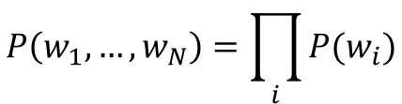
Earlier Topic Models: Topics Known
Unigram
  No context information
W
N
$$P\left(w_{1},…,w_{N}\right)=\prod_{i}{P(w_{i})}$$
Automatically Generated Sentences from a Unigram Model
Notes:
Just all words over all documents

Slide 12
Back to Topic Modeling Scenario

Slide 13
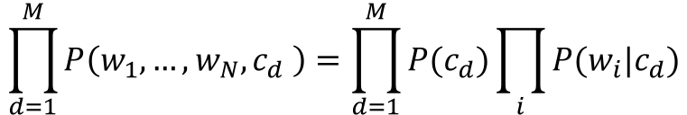
Earlier Topic Models: Topics Known
Unigram
  No context information
Mixture of Unigrams
  One topic per document
W
N
$$P\left(w_{1},…,w_{N}\right)=\prod_{i}{P(w_{i})}$$
C
$$\prod_{d=1}^{M}{P\left(w_{1},…,w_{N},c_{d} \right)}=\prod_{d=1}^{M}{P(c_{d})}\prod_{i}{P(w_{i}|c_{d})}$$
W
N
M
Notes:
Topic per document ->

Slide 14

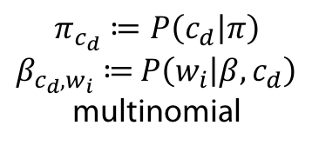
Multinomial Mixture of Unigrams
Multinomial Naïve Bayes
  For each document d = 1, …, M
    Generate c_{d} ~ Mult( ∙ | π)
    For each position i = 1, ... , N_{d}
      Generate w_{i} ~ Mult( ∙ | β, c_{d})
π
C
$$\prod_{d=1}^{M}{P\left(w_{1},…,w_{N_{d}},c_{d} | β,π\right)}$$
$$=\prod_{d=1}^{M}{P(c_{d}|π)}\prod_{i=1}^{N_{d}}{P\left(w_{i} | β,c_{d}\right)}=\prod_{d=1}^{M}{π_{c_{d}}\prod_{i=1}^{N_{d}}{β_{c_{d},w_{i}}}}$$
W
N
M
β
$$π_{c_{d}}≔P\left(c_{d} | π\right)$$
$β_{c_{d},w_{i}}≔$ $P\left(w_{i} | β,c_{d}\right)$
multinomial
Notes:
Binomial distribution, where n experiments, prob p of success (n=1: Bernoulli)
K successes: n over k p^k (1-p)^(n-k)
Multinomial distribution: generalization of binomial with k outcomes instead of 2

Slide 15
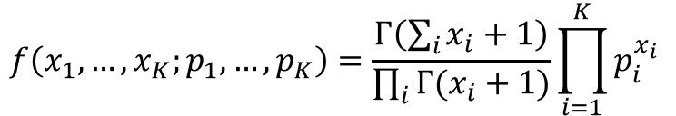

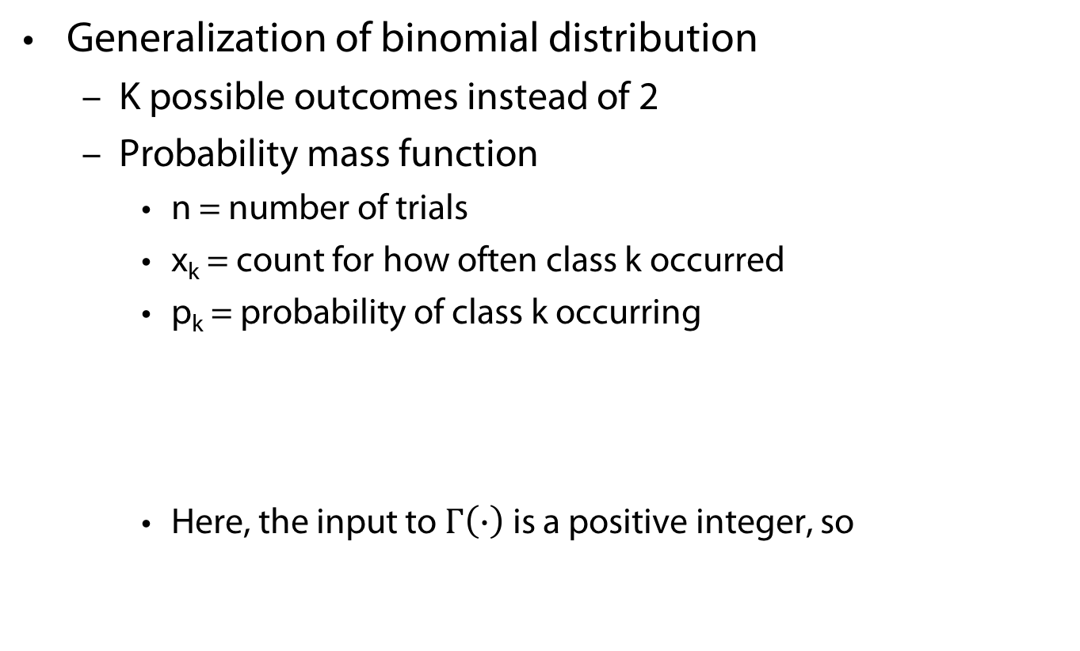
Multinomial Distribution
Generalization of binomial distribution
  K possible outcomes instead of 2
  Probability mass function
    n = number of trials
    x_{k} = count for how often class k occurred
    p_{k} = probability of class k occurring
    Here, the input to $Γ\left(∙\right)$ is a positive integer, so
$$f\left(x_{1},…,x_{K};p_{1},…,p_{K}\right)=\frac{Γ\left(\sum_{i}{x_{i}+1}\right)}{\prod_{i}{Γ(x_{i}+1)}}\prod_{i=1}^{K}{p_{i}^{x_{i}}}$$
$$Γ\left(n\right)=\left(n−1\right)!$$

Slide 16
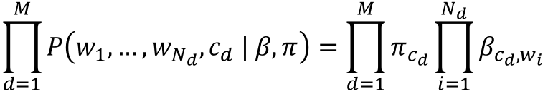
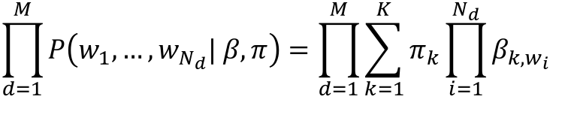
Mixture of Unigrams: Unknown Topics
Topics/classes are hidden
  Joint probability of words and classes
  Sum over topics (K = number of topics)
π
$$\prod_{d=1}^{M}{P\left(w_{1},…,w_{N_{d}},c_{d} | β,π\right)}=\prod_{d=1}^{M}{π_{c_{d}}\prod_{i=1}^{N_{d}}{β_{c_{d},w_{i}}}}$$
Z
W
N
M
$$\prod_{d=1}^{M}{P\left(w_{1},…,w_{N_{d}}| β,π\right)}=\prod_{d=1}^{M}{\sum_{k=1}^{K}{π_{k}\prod_{i=1}^{N_{d}}{β_{k,w_{i}}}}}$$
β

Slide 17
Back to Topic Modeling Scenario

Slide 18

Mixture of Unigrams: Generative Model
_{Zi}
w_{i1}
w_{2i}
w_{3i}
w_{4i}
Mixture of Unigrams Model (Without Parameters $π$ and $β)$
For each of L documents to generate
  Choose a topic z by drawing one from a multinomial conditioned on $π$.
  Choose N words by drawing each one independently from a multinomial conditioned on z and $β$.

Slide 19


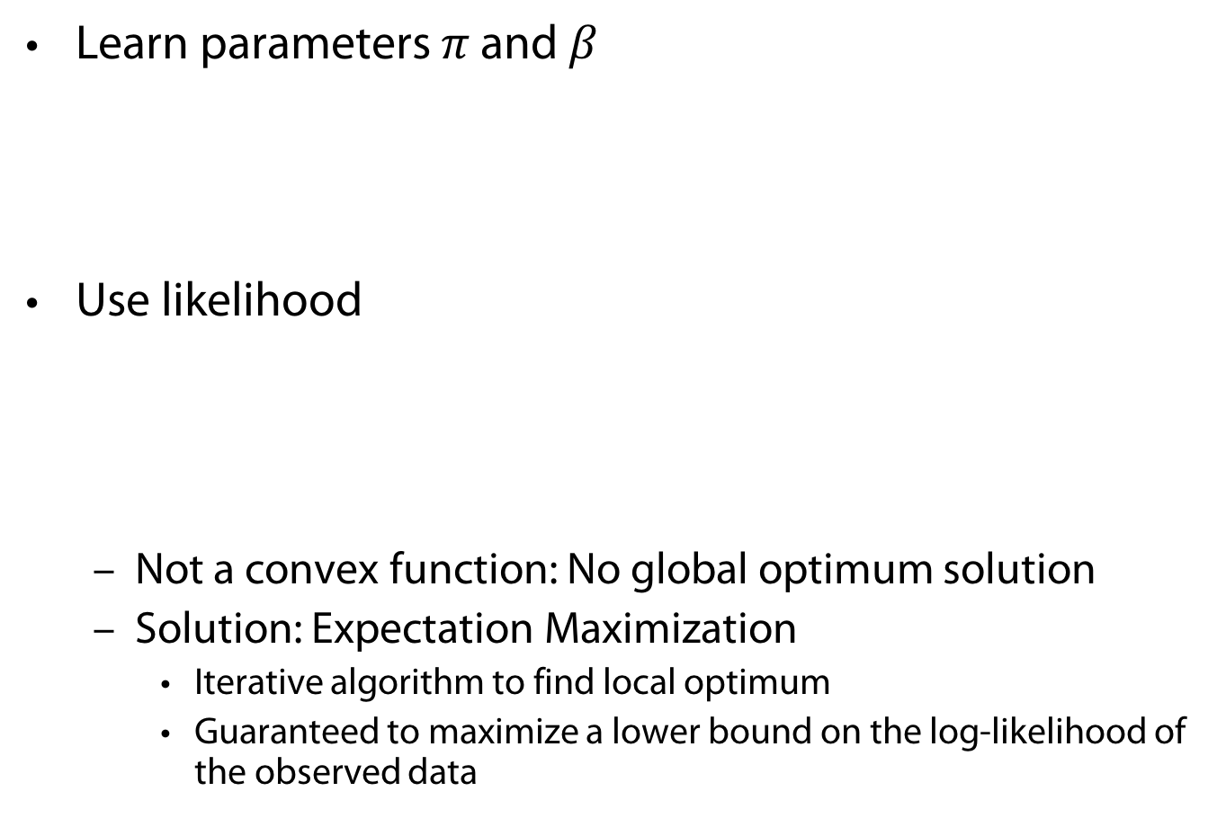
Mixture of Unigrams: Learning
Learn parameters $π$ and $β$
Use likelihood
  Not a convex function: No global optimum solution
  Solution: Expectation Maximization
    Iterative algorithm to find local optimum
    Guaranteed to maximize a lower bound on the log-likelihood of the observed data
$$\prod_{d=1}^{M}{P\left(w_{1},…,w_{N_{d}}| β,π\right)} =\prod_{d=1}^{M}{\sum_{k=1}^{K}{π_{k}\prod_{i=1}^{N_{d}}{β_{k,w_{i}}}}}$$
$$\sum_{d=1}^{M}{\log{P\left(w_{1},…,w_{N_{d}}| β,π\right)}}=\sum_{d=1}^{M}{\log{\sum_{k=1}^{K}{π_{k}\prod_{i=1}^{N_{d}}{β_{k,w_{i}}}}}}$$

Slide 20
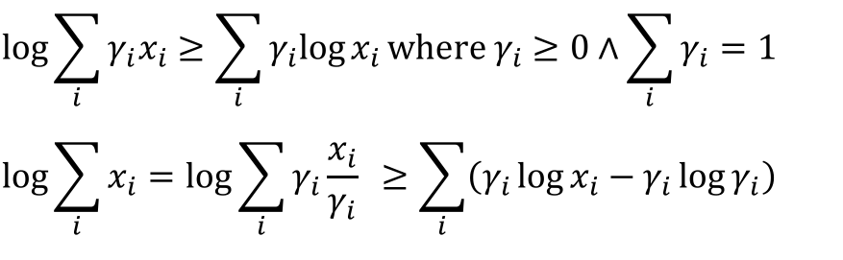
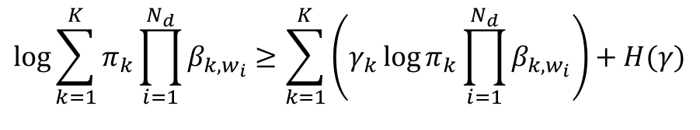
Mixture of Unigrams: Learning
Quick summary of log and EM:
  Log is a concave function
  Lower bound is convex
  Optimize this lower bound w.r.t. each variable instead
Likelihood for one document
$$\log{\sum_{i}{γ_{i}x_{i}}}≥\sum_{i}{γ_{i}log{x_{i}}}\text{where} γ_{i}≥0∧\sum_{i}{γ_{i}=1}$$
$$\log{\sum_{i}{x_{i}}}=\log{\sum_{i}{γ_{i}{\frac{x_{i}}{γ_{i}}}} ≥\sum_{i}{\left(γ_{i}\log{x_{i}−γ_{i}\log{γ_{i}}}\right)}}$$
H(γ)
$$\log{\sum_{k=1}^{K}{π_{k}\prod_{i=1}^{N_{d}}{β_{k,w_{i}}}}}≥\sum_{k=1}^{K}{\left(γ_{k}\log{π_{k}\prod_{i=1}^{N_{d}}{β_{k,w_{i}}}}\right)}+H(γ)$$

Slide 21
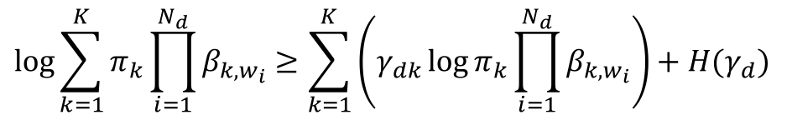


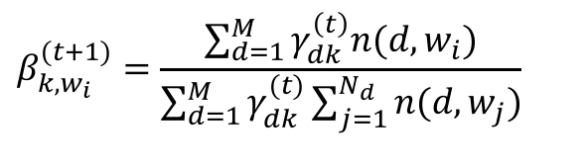
Mixture of Unigrams: Learning
For each document d
EM solution
  E step
  M step
$$\log{\sum_{k=1}^{K}{π_{k}\prod_{i=1}^{N_{d}}{β_{k,w_{i}}}}}≥\sum_{k=1}^{K}{\left(γ_{dk}\log{π_{k}\prod_{i=1}^{N_{d}}{β_{k,w_{i}}}}\right)}+H(γ_{d})$$
$$γ_{dk}^{(t+1)}=\frac{π_{k}^{(t)}\sum_{i=1}^{N_{d}}{β_{k,w_{i}}^{\left(t\right)}}}{\sum_{j=1}^{K}{π_{j}^{(t)}\prod_{i=1}^{N_{d}}{β_{k,w_{i}}^{(t)}}}}$$
$$π_{k}^{(t+1)}=\frac{\sum_{d=1}^{M}{γ_{dk }^{\left(t\right)}}}{M}$$
$$β_{k,w_{i}}^{(t+1)}=\frac{\sum_{d=1}^{M}{γ_{dk }^{\left(t\right)}n(d,w_{i})}}{\sum_{d=1}^{M}{γ_{dk}^{(t)}\sum_{j=1}^{N_{d}}{n(d,w_{j})}}}$$
Notes:
E: compute gamma based on current model (parameters)
M: update model parameters pi, beta given current gamma

Slide 22
Back to Topic Modeling Scenario

Slide 23
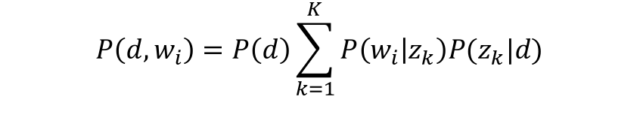
Probabilistic LSI
Select a document d with probability P(d)
For each word of d in the training set
  Choose a topic z with probability
  P(z | d)
  Generate the word with probability
  P(w | z)
Documents can have multiple topics
d
z
w
N
$$P\left(d,w_{i}\right)=P\left(d\right)\sum_{k=1}^{K}{P\left(w_{i} | z_{k}\right)P(z_{k}|d)}$$
M
  Thomas Hofmann, Probabilistic Latent Semantic Indexing, Proceedings of the Twenty-Second Annual International SIGIR Conference on Research and Development in Information Retrieval (SIGIR-99), 1999
Notes:
Joint probability distribution

Slide 24

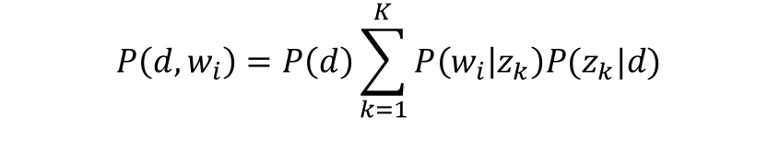
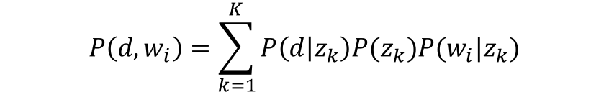

pLSA
d
Joint probability for all documents, words
Distribution for document d, word w_{i}
Reformulate $P(z_{k}|d)$ with Bayes’ Rule
P(d)
$$\prod_{d=1}^{M}{\prod_{i=1}^{N_{d}}{P{\left(d,w_{i}\right)}^{n(d,w_{i})}}}$$
z_{k}
P(z_{k}|d)
$$P\left(d,w_{i}\right)=P\left(d\right)\sum_{k=1}^{K}{P\left(w_{i} | z_{k}\right)P(z_{k}|d)}$$
w_{i}
P(w_{i}|z_{k})
z_{k}
P(z_{k})
$$P\left(d,w_{i}\right)=\sum_{k=1}^{K}{P\left(d | z_{k}\right)P(z_{k})P(w_{i}|z_{k})}$$
d
w_{i}
P(d|z_{k})
P(z_{k}|w_{i})
Notes:
Bayes rule on P(z|d)

Slide 25
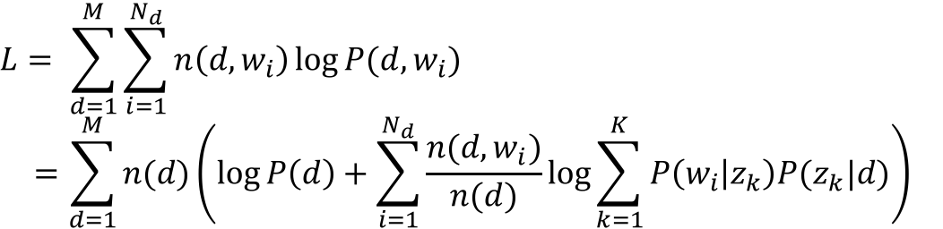
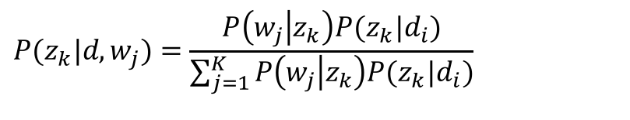

pLSA: Learning Using EM
Likelihood
EM solution
  E step
  M step
$$L= \sum_{d=1}^{M}{\sum_{i=1}^{N_{d}}{n\left(d,w_{i}\right)\log{P(d,w_{i})}}}$$
$$=\sum_{d=1}^{M}{n(d)\left(\log{P\left(d\right)}+\sum_{i=1}^{N_{d}}{\frac{n(d,w_{i})}{n(d)}\log{\sum_{k=1}^{K}{P\left(w_{i} | z_{k}\right)P(z_{k}|d)}}}\right)}$$
$$P(z_{k}|d,w_{j})=\frac{P\left(w_{j} | z_{k}\right)P(z_{k}|d_{i})}{\sum_{j=1}^{K}{P\left(w_{j} | z_{k}\right)P(z_{k}|d_{i})}}$$
$$P\left(w_{i} | z_{k}\right) =\frac{\sum_{d=1}^{M}{n\left(d,w_{i}\right)P\left(z_{k} | d,w_{i}\right)}}{\sum_{d=1}^{M}{\sum_{j=1}^{N_{d}}{n\left(d,w_{j}\right)P\left(z_{k} | d,w_{j}\right)}}}$$
$$P\left(z_{k} | d\right) =\frac{\sum_{i=1}^{N_{d}}{n\left(d,w_{i}\right)P(z_{k}|d,w_{i})}}{n(d)}$$

Slide 26
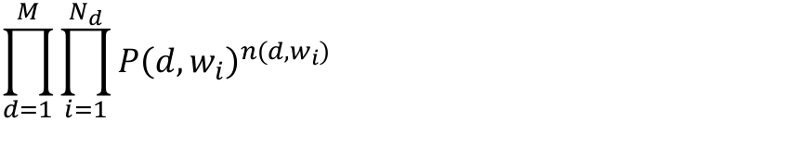
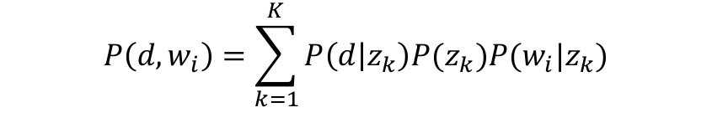




pLSA: Learning Using EM
Model
Likelihood
Parameters to learn (M step)
  (E step)
$$P\left(d,w_{i}\right)=\sum_{k=1}^{K}{P\left(d | z_{k}\right)P(z_{k})P(w_{i}|z_{k})}$$
$$\prod_{d=1}^{M}{\prod_{i=1}^{N_{d}}{P{\left(d,w_{i}\right)}^{n(d,w_{i})}}}$$
$$L= \sum_{d=1}^{M}{\sum_{i=1}^{N_{d}}{n\left(d,w_{i}\right)\log{P(d,w_{i})}}}=\sum_{d=1}^{M}{\sum_{i=1}^{N_{d}}{n(d,w_{i})\log{\sum_{k=1}^{K}{P\left(d | z_{k}\right)P(z_{k})P(w_{i}|z_{k})}}}}$$
  $$P(d|z_{k})$$
  $$P\left(z_{k}\right)$$
$$P\left(w_{i} | z_{k}\right)$$
$$P\left(z_{k} | d,w_{i}\right)$$

Slide 27
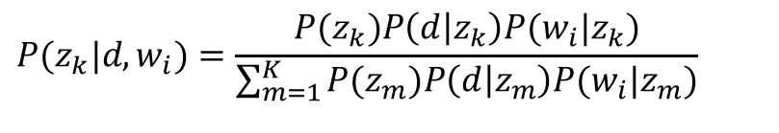

pLSA: Learning Using EM
EM solution
  E step
  M step
$$P(z_{k}|d,w_{i})=\frac{P(z_{k})P\left(d | z_{k}\right)P(w_{i}|z_{k})}{\sum_{m=1}^{K}{P(z_{m})P\left(d | z_{m}\right)P(w_{i}|z_{m})}}$$
$$P\left(w_{i} | z_{k}\right) =\frac{\sum_{d=1}^{M}{n\left(d,w_{i}\right)P\left(z_{k} | d,w_{i}\right)}}{\sum_{d=1}^{M}{\sum_{j=1}^{N_{d}}{n\left(d,w_{j}\right)P\left(z_{k} | d,w_{j}\right)}}}$$
$$P\left(d | z_{k}\right) =\frac{\sum_{i=1}^{N_{d}}{n\left(d,w_{i}\right)P\left(z_{k} | d,w_{i}\right)}}{\sum_{c=1}^{M}{\sum_{i=1}^{N_{c}}{n\left(c,w_{i}\right)P\left(z_{k} | c,w_{i}\right)}}}$$
$$P\left(z_{k}\right) =\frac{1}{R}\sum_{d=1}^{M}{\sum_{i=1}^{N_{d}}{n\left(d,w_{i}\right)P\left(z_{k} | d,w_{i}\right), }}R=\sum_{d=1}^{M}{\sum_{i=1}^{N_{d}}{n\left(d,w_{i}\right)}}$$

Slide 28
pLSA: Overview
Not a complete generative model
  Has a prior distribution over the training set of documents: no new document can be generated!
Nevertheless, more realistic than mixture model
  Documents can discuss multiple topics!
Problems
  Too many parameters
  Overfitting
Notes:
Mixture parameters for each document
Poor generalization

Slide 29
LSI and pLSI
LSI: find the k-dimensions that minimize the Frobenius norm of A-A’.
pLSI: defines one’s own objective function to minimize (maximize)
  Models each word as a sample from a mixture model
  Thomas Hofmann, Probabilistic Latent Semantic Indexing, Proceedings of the Twenty-Second Annual International SIGIR Conference on Research and Development in Information Retrieval (SIGIR-99), 1999

Slide 30
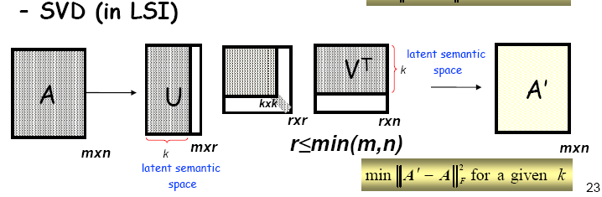
Cutting the dimensions with the least singular values

Slide 31
pLSI
k = number of topics
V = vocabulary size
M = number of documents

Slide 32
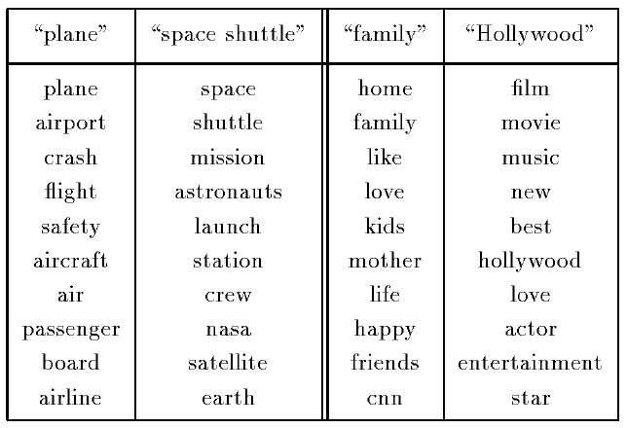
pLSA Testrun
PLSA topics (TDT-1 corpus)
  Approx. 7 million words, 15863 documents, K = 128
The two most probable
topics that generate the
term “flight” (left) and
“love” (right).
List of most probable
words per topic, with
decreasing probability
going down the list.

Slide 33
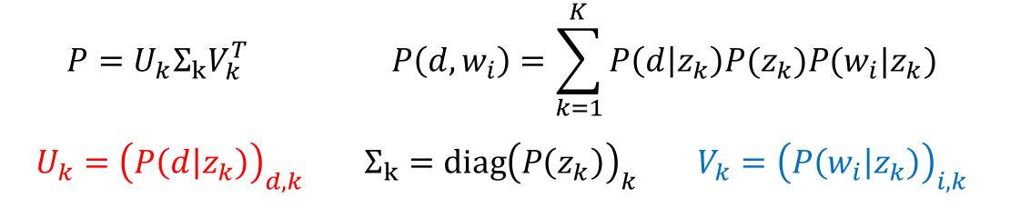
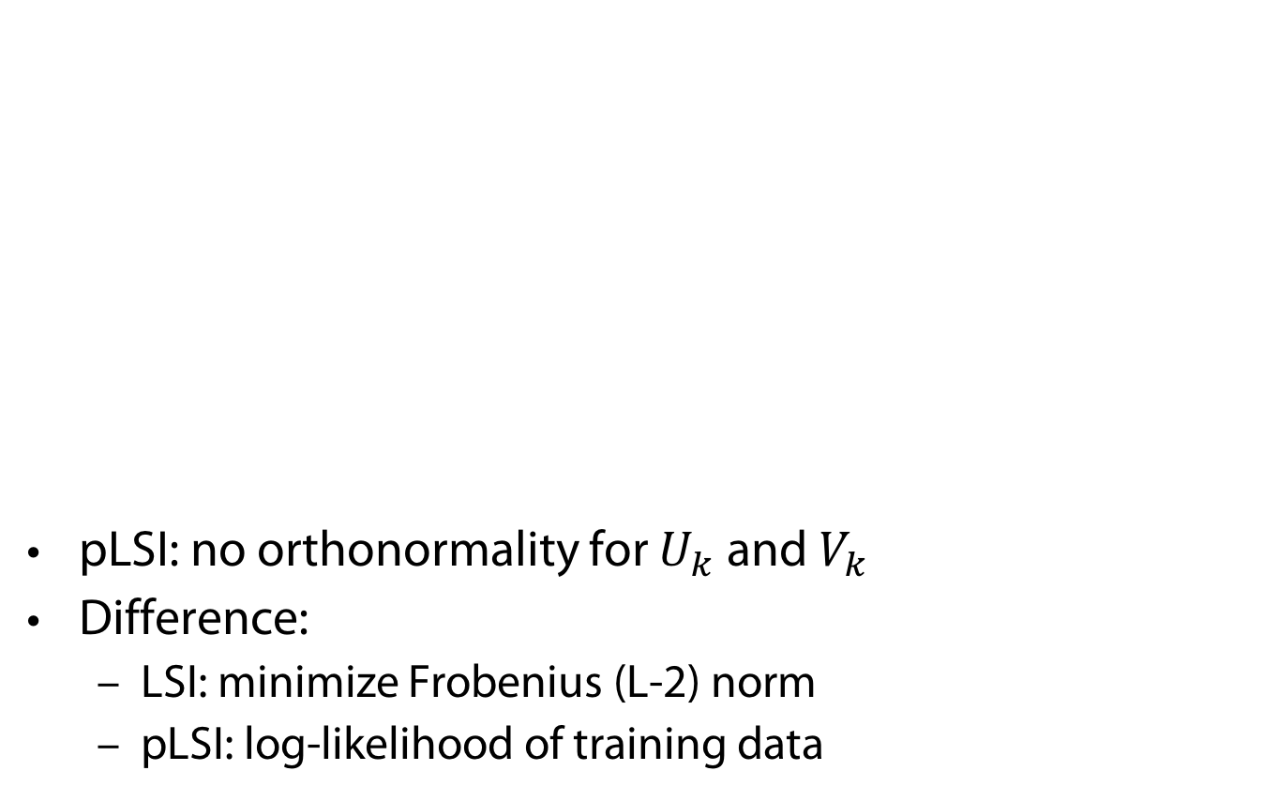
Relation with LSI
pLSI: no orthonormality for $U_{k}$ and $V_{k}$
Difference:
  LSI: minimize Frobenius (L-2) norm
  pLSI: log-likelihood of training data
$$P=U_{k}Σ_{k}V_{k}^{T} P\left(d,w_{i}\right)=\sum_{k=1}^{K}{P\left(d | z_{k}\right)P(z_{k})P(w_{i}|z_{k})}$$
$$U_{k}={\left(P\left(d | z_{k}\right)\right)}_{d,k} Σ_{k}=diag{\left(P\left(z_{k}\right)\right)}_{k} V_{k}={\left(P\left(w_{i} | z_{k}\right)\right)}_{i,k}$$

Slide 34


pLSA with Multinomials
π
Multinomial Naïve Bayes
  Select document d ~ Mult( ∙ | π)
    For each position i = 1, ... , N_{d}
      Generate z_{i} ~ Mult(∙ | d, $θ_{d}$)
      Generate w_{i} ~ Mult( ∙ | z_{i}, β_{k})
θ_{d}
d
z
$$\prod_{d=1}^{M}{P\left(w_{1},…,w_{N_{d}},d | β,θ,π\right)}$$
$$=\prod_{d=1}^{M}{P(d)}\prod_{i=1}^{N_{d}}{\sum_{k=1}^{K}{P(z_{i}=k|d,θ_{d})P\left(w_{i} | β_{k} \right)}}$$
$$=\prod_{d=1}^{M}{π_{d}\prod_{i=1}^{N_{d}}{\sum_{k=1}^{K}{{θ_{d,k}β}_{k,w_{i}}}}}$$
w
N
M
β

Slide 35
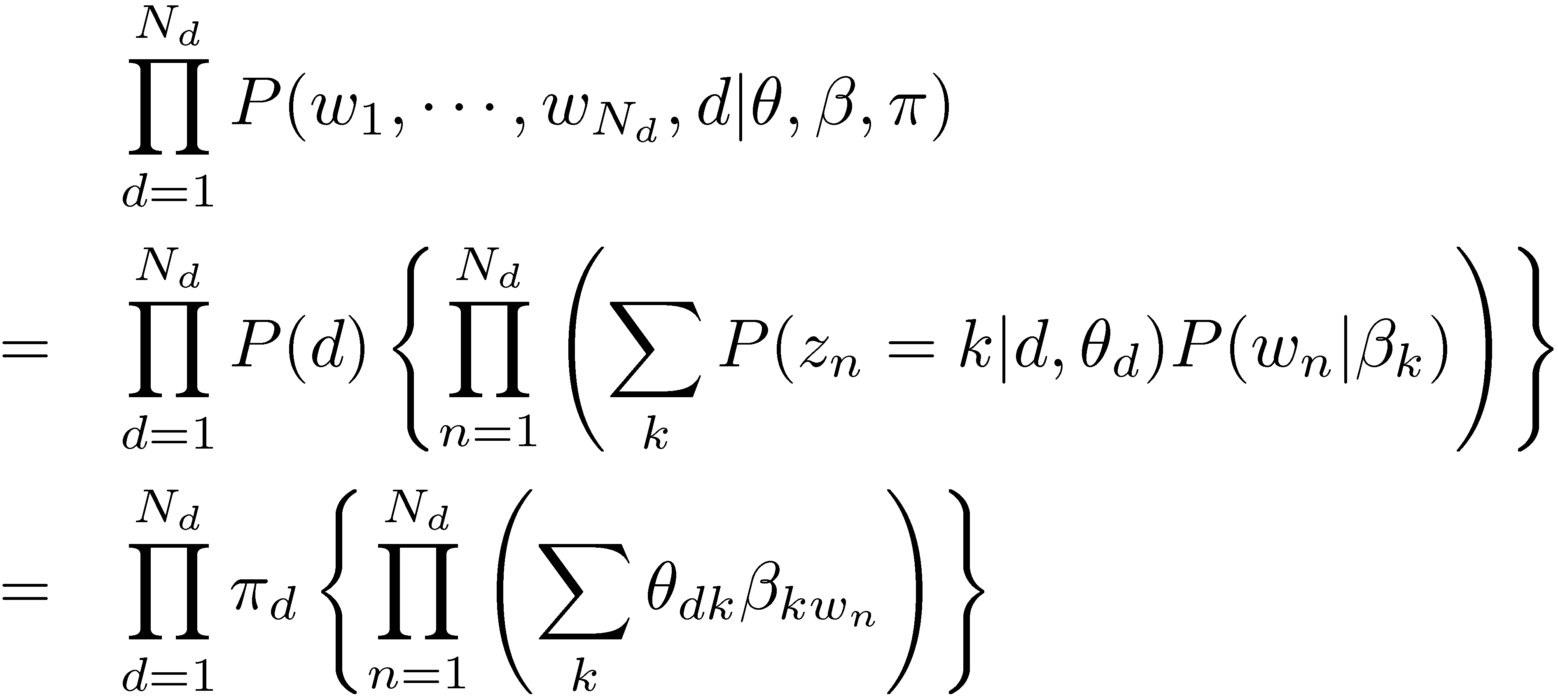
Introduction to Topic Models
Probabilistic Latent Semantic Analysis Model
θ_{d}
d
π
Select document d ~ Mult(π)
  For each position n = 1,☹, N_{d}
    generate z_{n} ~ Mult( ∙ | θ_{d})
    generate w_{n} ~ Mult( ∙ | β_{zn})
Topic distribution
z
w
N
M
β
  Thomas Hofmann, Probabilistic Latent Semantic Indexing, Proceedings of the Twenty-Second Annual International SIGIR Conference on Research and Development in Information Retrieval (SIGIR-99), 1999

Slide 36
Problem of pLSI
It is not a proper generative model for document:
  Document is generated from a mixture of topics
The number of topics may grow linearly with the size of the corpus
Difficult to generate a new document

Slide 37
Back to Topic Modeling Scenario

Slide 38
Prior Distribution for Topic Mixture
Goal: topic mixture proportions for each document are drawn from some distribution.
  Distribution on multinomials (k-tuples of non-negative numbers that sum to one)
The space is of all of these multinomials can be interpreted geometrically as a (k-1)-simplex
  Generalization of a triangle to (k-1) dimensions
Criteria for selecting our prior:
  It needs to be defined for a (k-1)-simplex.
  Algebraically speaking, we would like it to play nice with the multinomial distribution.

Slide 39
Latent Dirichlet Allocation
Document = mixture of topics (as in pLSI), but according to a Dirichlet prior
  When we use a uniform Dirichlet prior, pLSI=LDA
Overcomes the issues with pLSA
  Can generate any random document
D. Blei, A. Ng, and M. Jordan. Latent Dirichlet allocation.
Journal of Machine Learning Research, 3:993-1022, January 2003

Slide 40
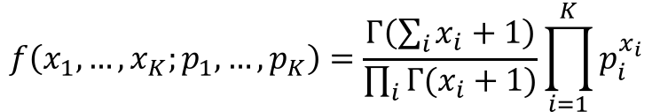
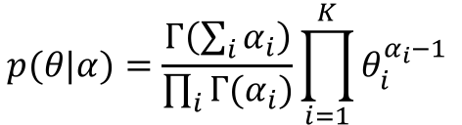
Dirichlet Distributions
$$p(θ|α)=\frac{Γ\left(\sum_{i}{α_{i}}\right)}{\prod_{i}{Γ(α_{i})}}\prod_{i=1}^{K}{θ_{i}^{α_{i}−1}}$$
Defined over a (k-1)-simplex
  Takes K non-negative arguments which sum to one.
  Consequently it is a natural distribution to use over multinomial distributions.
The Dirichlet parameter α_{i} can be thought of as a prior count of the i^{th} class
Conjugate prior to the multinomial distribution
  Conjugate prior: if our likelihood is multinomial with a Dirichlet prior, then the posterior is also a Dirichlet
$$f\left(x_{1},…,x_{K};p_{1},…,p_{K}\right)=\frac{Γ\left(\sum_{i}{x_{i}+1}\right)}{\prod_{i}{Γ(x_{i}+1)}}\prod_{i=1}^{K}{p_{i}^{x_{i}}}$$

Slide 41
LDA Model
α
θ
θ
θ
z₁
z₂
z₃
z₄
z₁
z₂
z₃
z₄
z₁
z₂
z₃
z₄
w₁
w₂
w₃
w₄
w₁
w₂
w₃
w₄
w₁
w₂
w₃
w₄
β

Slide 42
LDA Model – Parameters
α
Proportions parameter
Per-document topic distribution
Per-word topic assignment
Observed word
Word “prior”
θ
z
w
N
M
β

Slide 43
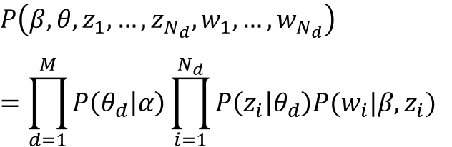
LDA Model – Plate Notation
α
For each document d,
  Generate θ_{d} ~ Dirichlet(α)
  For each position i = 1, ... , N_{d}
    Generate a topic z_{i} ~ Mult(θ_{d})
    Generate a word w_{i} ~ Mult(z_{i},β)
θ
z
$$P\left(β,θ,z_{1},…,z_{N_{d}},w_{1},…,w_{N_{d}}\right)$$
$$=\prod_{d=1}^{M}{P\left(θ_{d} | α\right)\prod_{i=1}^{N_{d}}{P\left(z_{i} | θ_{d}\right)P(w_{i}|β,z_{i}) }}$$
w
N
M
β

Slide 44


Corpus-level Parameter $α$
Set $α=1$
Per-document topic distribution: K = 10, D = 15

Slide 45


Corpus-level Parameter $α$
$α=10$
$α=100$

Slide 46


Corpus-level Parameter $α$
$α=0.1$
$α=0.01$

Slide 47
Back to Topic Modeling Scenario

Slide 48
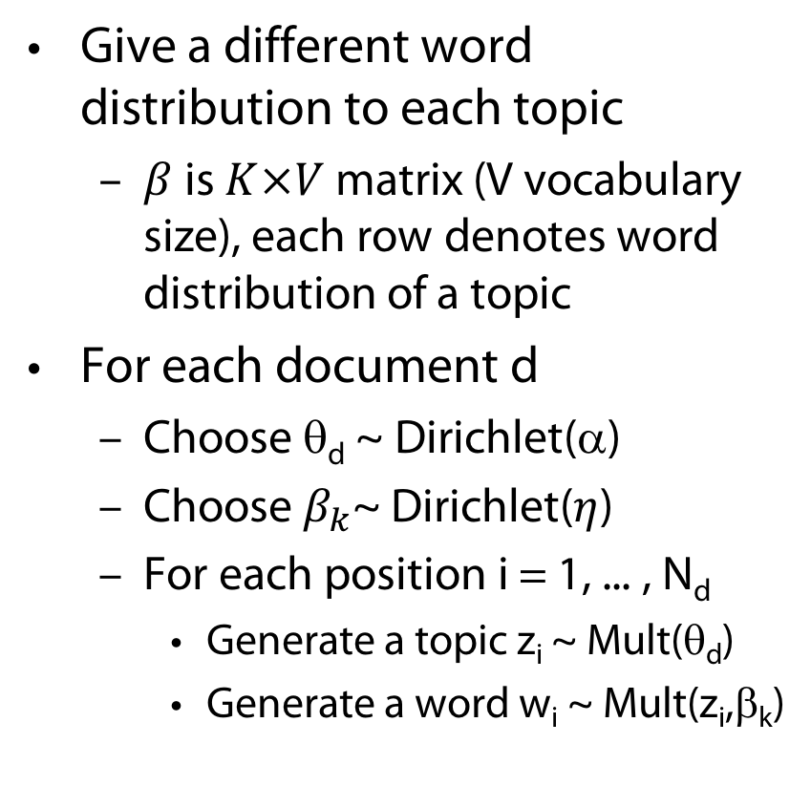
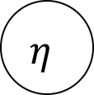
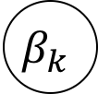
Smoothed LDA Model
Give a different word distribution to each topic
  $β$ is $K×V$ matrix (V vocabulary size), each row denotes word distribution of a topic
For each document d
  Choose θ_{d} ~ Dirichlet(α)
  Choose $β_{k}$~ Dirichlet($η$)
  For each position i = 1, ... , N_{d}
    Generate a topic z_{i} ~ Mult(θ_{d})
    Generate a word w_{i} ~ Mult(z_{i},β_{k})
α
θ
$$η$$
z
w
$$β_{k}$$
N
K
M

Slide 49
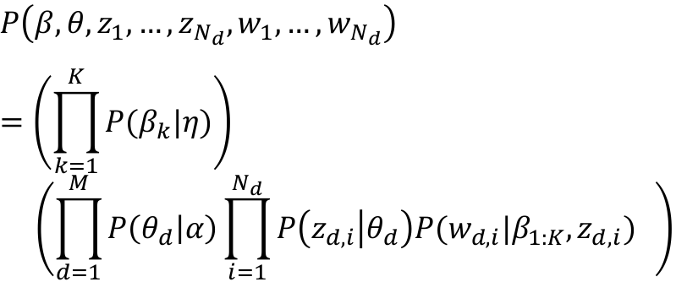
Smoothed LDA Model
α
θ
$$P\left(β,θ,z_{1},…,z_{N_{d}},w_{1},…,w_{N_{d}}\right)$$
$$=\left(\prod_{k=1}^{K}{P(β_{k}|η)}\right)$$
$$\left(\prod_{d=1}^{M}{P\left(θ_{d} | α\right)\prod_{i=1}^{N_{d}}{P\left(z_{d,i} | θ_{d}\right)P(w_{d,i}|β_{1:K},z_{d,i}) }} \right)$$
$$η$$
z
w
$$β_{k}$$
N
K
M

Slide 50
Back to Topic Modeling Scenario
But…

Slide 51
Why does LDA “work”?
Trade-off between two goals
  For each document, allocate its words to as few topics as possible.
  For each topic, assign high probability to as few terms as possible.
These goals are at odds.
  Putting a document in a single topic makes #2 hard:
  All of its words must have probability under that topic.
  Putting very few words in each topic makes #1 hard:
  To cover a document’s words, it must assign many topics to it.
Trading off these goals finds groups of tightly co-occurring words

Slide 52
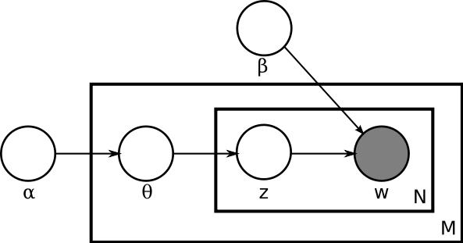
LDA (Latent Dirichlet Allocation)
Document = mixture of topics (as in pLSI), but according to a Dirichlet prior
  When we use a uniform Dirichlet prior, pLSI=LDA
A word is also generated according to another variable β:

Slide 54

Inference: The Problem
To which topics does a given document belong to?
  Compute the posterior distribution of the hidden variables given a document:
$$P\left(θ,z | w,α,β\right)=\frac{P\left(θ,z,w | α,β\right)}{P\left(w | α,β\right)}$$
$$P\left(θ,z,w | α,β\right)=P(θ|α)\prod_{i=1}^{N}{P\left(z_{i} | θ\right)P(w_{i}|z_{i},β)}$$
$$P\left(w | α,β\right)=\frac{Γ\left(\sum_{i}{α_{i}}\right)}{\prod_{i}{Γ(α_{i})}}\int{\left(\prod_{k=1}^{K}{θ_{k}^{α_{k}−1}}\right)\left(\prod_{i=1}^{N}{\sum_{k=1}^{K}{\prod_{j=1}^{V}{{\left(θ_{k}β_{kj}\right)}^{w_{i}^{j}}}}}\right)ⅆθ}$$

Slide 55
LDA Learning
Parameter learning:
  Variational EM
    Numerical approximation using lower-bounds
    Results in biased solutions
    Convergence has numerical guarantees
  Gibbs Sampling
    Stochastic simulation
    unbiased solutions
    Stochastic convergence
D. Blei, A. Ng, and M. Jordan. Latent Dirichlet allocation.
Journal of Machine Learning Research, 3:993-1022, January 2003

Slide 56
Variational Inference
  In variational inference, we consider a simplified graphical model with variational parameters γ, φ and minimize the KL Divergence between the variational and posterior distributions.

Slide 57
LDA: Variational Inference
Replace LDA model with simpler one
Minimize the Kullback-Leibler divergence between the two distributions.
Notes:
Not a sampling approach where one samples from the posterior distribution, but rather we try to find a tightest lower bound
Coupling between \theta and \beta not present in simpler model

Slide 58

LDA: Gibbs Sampling
MCMC algorithm
  Fix all current values but one and sample that value, e.g, for z
  Eventually converges to true posterior
$$P(z_{i}=k|z_{−i},w)$$

Slide 59
Variational Inference vs. Gibbs Sampling
Gibbs sampling is slower (takes days for mod.-sized datasets), variational inference takes a few hours.
Gibbs sampling is more accurate.
Gibbs sampling convergence is difficult to test, although quite a few machine learning approximate inference techniques also have the same problem.

Slide 60
Use of LDA
A widely used topic model
Complexity is an issue
Use in IR:
  Interpolate a topic model with traditional LM
  Improvements over traditional LM,
  But no improvement over Relevance model (Wei and Croft, SIGIR 06)
  T. Griffiths, M. Steyvers, Finding Scientific Topics.
  Proceedings of the National Academy of Sciences,
  101 (suppl. 1), 5228-5235. 2004

Slide 61
LDA Application: Reuters Data
Setup
  100-topic LDA trained on a 16,000 documents corpus of news articles by Reuters
  Some standard stop words removed
Top words from some of the P(w|z)

Slide 62
LDA Application: Reuters Data
Inference on a held-out document

Slide 63
LDA for Social Network Analysis
“follow relationship” among users often looks unorganized and chaotic
  created haphazardly by each individual user and not controlled by a central entity
Provide more structure to this relationship
  by “grouping” the users based on their topic interests
  by “labeling” each follow relationship with the identified topic group
Uses Gibbs sampling, tested on Twitter data
  Youngchul Cha and Junghoo Cho, Social-Network Analysis Using Topic Models. Proceedings of the 35th international ACM SIGIR conference on Research and development in information retrieval (SIGIR '12), 2012

Slide 64
LDA for Social Network Analysis
Specific topic group
  g: user, |e’(g)|: follower count, Bio: twitter bio
Notes:
Cycle, popular user noise

Slide 65
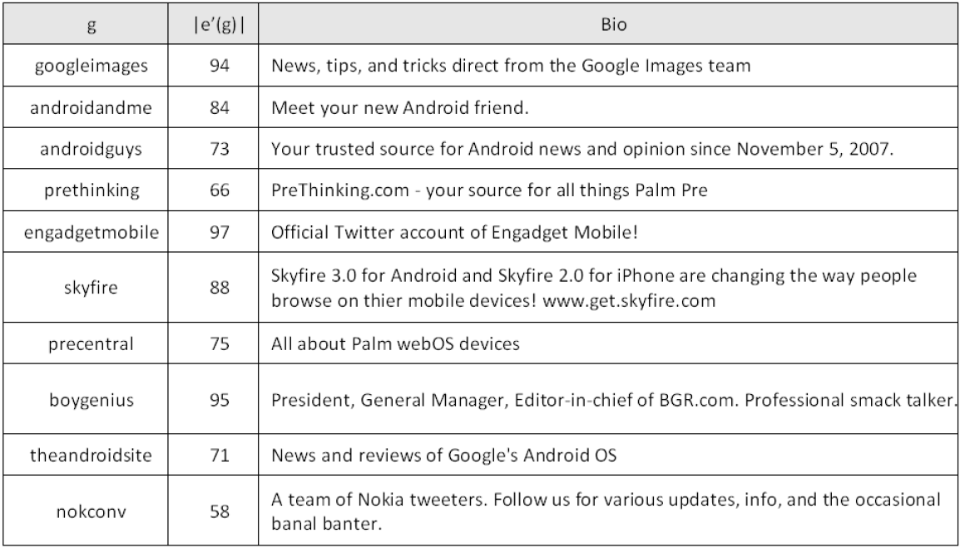
LDA for Social Network Analysis
Topic group “mobile gadget blog” from “non-popular” data set
  Twitter users with more than 100 followers removed
Notes:
Popular users are like stopwords -> generate noise

Slide 66


Measuring Performance: Perplexity
How well a probability distribution or probability model predicts a sample
  q: Model of an unknown probability distribution p based on a training sample drawn from p
  Evaluate q by asking how well it predicts a separate test sample $x_{1},…,x_{N}$ also drawn from p
  Perplexity of q defined as
  (b customarily 2)
  A better model q will tend to assign higher probabilities $q\left(x_{i}\right)$ → lower perplexity (“less surprised by sample”)
$$b^{−\frac{1}{N}\sum_{i=1}^{N}{\log_{b}{q\left(x_{i}\right)}}}$$
[Wikipedia]

Slide 67
Perplexity of Various Models
Unigram
Mixture of Unigrams
PLSA
LDA

Slide 68
References
LSI
  Improving Information Retrieval with Latent Semantic Indexing, Deerwester, S., et al, Proceedings of the 51st Annual Meeting of the American Society for Information Science 25, 1988, pp. 36–40.
  Using Linear Algebra for Intelligent Information Retrieval, Michael W. Berry, Susan T. Dumais and Gavin W. O'Brien, UT-CS-94-270,1994
pLSI
  Probabilistic Latent Semantic Indexing, Thomas Hofmann, Proceedings of the Twenty-Second Annual International SIGIR Conference on Research and Development in Information Retrieval (SIGIR-99), 1999
LDA
  Latent Dirichlet allocation. D. Blei, A. Ng, and M. Jordan. Journal of Machine Learning Research, 3:993-1022, January 2003.
  Finding Scientific Topics. Griffiths, T., & Steyvers, M. (2004). Proceedings of the National Academy of Sciences, 101 (suppl. 1), 5228-5235.
  Hierarchical topic models and the nested Chinese restaurant process. D. Blei, T. Griffiths, M. Jordan, and J. Tenenbaum In S. Thrun, L. Saul, and B. Scholkopf, editors, Advances in Neural Information Processing Systems (NIPS) 16, Cambridge, MA, 2004. MIT Press.
LDA and Social Network Analysis
  Social-Network Analysis Using Topic Models. Youngchul Cha and Junghoo Cho, Proceedings of the 35th international ACM SIGIR conference on Research and development in information retrieval (SIGIR '12), 2012
Also see Wikipedia articles on LSI, pLSI and LDA

