Slide 1
Web-Mining Agents Probabilistic Reasoning over Sequential Structures
Prof. Dr. Ralf Möller
Universität zu Lübeck
Institut für Informationssysteme
Tanya Braun (Übungen)

Slide 2
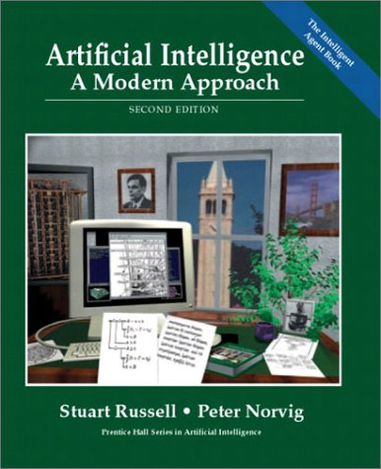
Literature
Structures (ordinal, interval, ratio scale)
Temporal structures
Sentence structures
…
Genomic structures
…
http://aima.cs.berkeley.edu

Slide 3
Temporal Probabilistic Agent
sensors
?
environment
agent
actuators
t₁, t₂, t₃, …

Slide 4
Probabilistic Temporal Models
Dynamic Bayesian Networks (DBNs)
Hidden Markov Models (HMMs)
Kalman Filters

Slide 5
Time and Uncertainty
The world changes, we need to track and predict it
Examples: diabetes management, traffic monitoring
Basic idea: copy state and evidence variables for each time step
X_{t} – set of unobservable state variables at time t
e.g., BloodSugar_{t}, StomachContents_{t}
E_{t} – set of evidence variables at time t
e.g., MeasuredBloodSugar_{t}, PulseRate_{t}, FoodEaten_{t}
Assumes discrete time steps

Slide 6
States and Observations
Process of change viewed as series of snapshots, each describing the state of the world at a particular time
Time slice involves a set of random variables indexed by t:
the set of unobservable state variables X_{t}
the set of observable evidence variable E_{t}
The observation at time t is E_{t} = e_{t} for some set of values e_{t}
The notation X_{a:b} denotes the set of variables from X_{a} to X_{b}

Slide 7
Dynamic Bayesian Networks
How can we model dynamic situations with a Bayesian network?
Example: Is it raining today?
next step: specify dependencies among the variables.
The term “dynamic” means we are modeling a dynamic system, not that
the network structure changes over time.

Slide 8
DBN - Representation
Problem:
Necessity to specify an unbounded number of conditional probability tables, one for each variable in each slice,
Each one might involve an unbounded number of parents.
Solution:
Assume that changes in the world state are caused by a stationary process (unmoving process over time).
is the same for all t

Slide 9
Generalization of DBNs
Time is just one sequential structures
Can generalize to any dynamic structure "expansion"
Sentences
Spatial structures
…

Slide 10
DBN - Representation
Solution cont.:
2. Use Markov assumption - The current state depends on only in a finite history of previous states. Using the first-order Markov process:
Transition Model
In addition to restricting the parents of the state variable Xt, we must restrict the parents of the evidence variable Et
Sensor Model

Slide 11
Stationary Process/Markov Assumption
Markov Assumption: X_{t} depends on some previous X_{i}s
First-order Markov process: P(X_{t}|X_{0:t-1}) = P(X_{t}|X_{t-1})
kth order: depends on previous k time steps
Sensor Markov assumption: P(E_{t}|X_{0:t}, E_{0:t-1}) = P(E_{t}|X_{t})
Assume stationary process: transition model:
P(X_{t}|X_{t-1}) and sensor model P(E_{t}|X_{t}) are the same for all t
Changes in the world state governed by laws not changing over time

Slide 12
Dynamic Bayesian Networks
There are two possible fixes if the approximation is too inaccurate:
Increasing the order of the Markov process model. For example, adding as a parent of , which might give slightly more accurate predictions.
Increasing the set of state variables. For example, adding to allow to incorporate historical records of rainy seasons, or adding , and Pressure to allow to use a physical model of rainy conditions.

Slide 13
Dynamic Bayesian Network
Bayesian network structure corresponding to a first-order of Markov process with state defined by the variables Xt.
A second order of Markov process

Slide 14
Complete Joint Distribution
Given:
Transition model: P(X_{t}|X_{t-1})
Sensor model: P(E_{t}|X_{t})
Prior probability: P(X₀)
Then we can specify complete joint distribution:

Slide 15
Example
R_{t-1} | P(R_{t}|R_{t-1})
T F | 0.7 0.3
Rain_{t-1}
Rain_{t}
Rain_{t+1}
Umbrella_{t-1}
Umbrella_{t}
Umbrella_{t+1}
R_{t} | P(U_{t}|R_{t})
T F | 0.9 0.2

Slide 16
Inference Tasks
Filtering: What is the probability that it is raining today, given all the umbrella observations up through today?
Prediction: What is the probability that it will rain the day after tomorrow, given all the umbrella observations up through today?
Smoothing: What is the probability that it rained yesterday, given all the umbrella observations through today?
Most likely explanation / most probable explanation: if the umbrella appeared the first three days but not on the fourth, what is the most likely weather sequence to produce these umbrella sightings?

Slide 17
DBN – Basic Inference
Filtering or Monitoring:
Compute the belief state - the posterior distribution over the current state, given all evidence to date.
Filtering is what a rational agent needs to do in order to keep track of the current state so that the rational decisions can be made.

Slide 18
DBN – Basic Inference
Filtering cont.
Given the results of filtering up to time t, one can easily compute the result for t+1 from the new evidence
(for some function f)
(dividing up the evidence)
(using Bayes’ Theorem)
(by the Markov property of evidence)
α is a normalizing constant used to make probabilities sum up to 1.

Slide 19
DBN – Basic Inference
Filtering cont.
The second term represents a one-step prediction of the next step, and the first term updates this with the new evidence.
Now we obtain the one-step prediction for the next step by conditioning on the current state Xt:
(using the Markov property)

Slide 20
Forward Messages

Slide 21
Example
R_{t-1} | P(R_{t}|R_{t-1})
T F | 0.7 0.3
Rain_{t-1}
Rain_{t}
Rain_{t+1}
Umbrella_{t-1}
Umbrella_{t}
Umbrella_{t+1}
R_{t} | P(U_{t}|R_{t})
T F | 0.9 0.2

Slide 22
DBN – Basic Inference
Illustration for two steps in the Umbrella example:
On day 1, the umbrella appears so U1=true. The prediction from t=0 to t=1 is
and updating it with the evidence for t=1 gives
On day 2, the umbrella appears so U2=true. The prediction from t=1 to t=2 is
and updating it with the evidence for t=2 gives

Slide 23
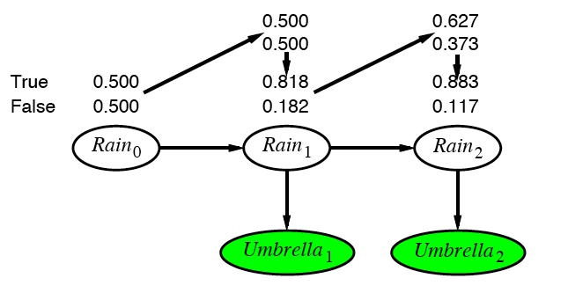
Example cntd.

Slide 24
DBN – Basic Inference
Prediction:
Compute the posterior distribution over the future state, given all evidence to date.
for some k>0
The task of prediction can be seen simply as filtering without the addition of new evidence.

Slide 25
DBN – Basic Inference
Smoothing or hindsight:
Compute the posterior distribution over the past state, given all evidence up to the present.
for some k such that 0 ≤ k < t.
Hindsight provides a better estimate of the state than was available at the time, because it incorporates more evidence.

Slide 26
Smoothing

Slide 27
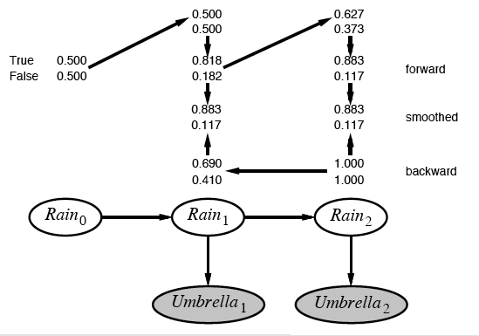
Example contd.

Slide 28
DBN – Basic Inference
Most likely explanation:
Compute the sequence of states that is most likely to have generated a given sequence of observation.
Algorithms for this task are useful in many applications, including, e.g., speech recognition.

Slide 29
Web-Mining Agents Probabilistic Reasoning over Time
Prof. Dr. Ralf Möller
Universität zu Lübeck
Institut für Informationssysteme
Tanya Braun (Übungen)

Slide 30
Most-likely explanation

Slide 31
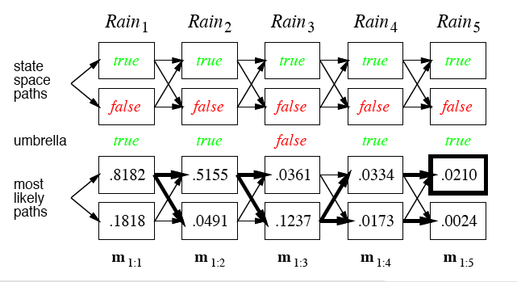
Rain/Umbrella Example

Slide 32
The occasionally dishonest casino
A casino uses a fair die most of the time, but occasionally switches to a loaded one
Fair die: Prob(1) = Prob(2) = . . . = Prob(6) = 1/6
Loaded die: Prob(1) = Prob(2) = . . . = Prob(5) = 1/10, Prob(6) = ½
These are the emission probabilities
Transition probabilities
Prob(Fair → Loaded) = 0.01
Prob(Loaded → Fair) = 0.2
Transitions between states modeled by a Markov process
Slide by Changui Yan

Slide 33
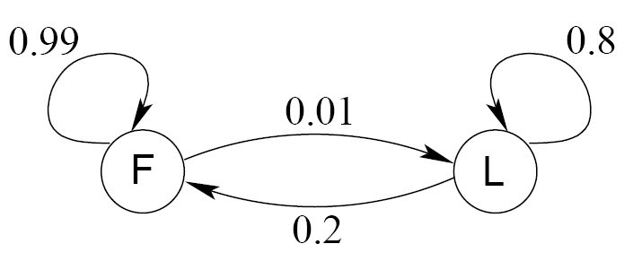
Transition model for the casino
Slide by Changui Yan

Slide 34
The occasionally dishonest casino
Known:
The structure of the model
The transition probabilities
Hidden: What the casino did
FFFFFLLLLLLLFFFF...
Observable: The series of die tosses
3415256664666153...
What we must infer:
When was a fair die used?
When was a loaded one used?
The answer is a sequence FFFFFFFLLLLLLFFF...
Slide by Changui Yan

Slide 35
Making the inference
Model assigns a probability to each explanation of the observation: P(326|FFL) = P(3|F)·P(F→F)·P(2|F)·P(F→L)·P(6|L) = 1/6 · 0.99 · 1/6 · 0.01 · ½
Maximum Likelihood: Determine which explanation is most likely
Find the path most likely to have produced the observed sequence
Total probability: Determine probability that observed sequence was produced by the model
Consider all paths that could have produced the observed sequence
Slide by Changui Yan

Slide 36
Notation
x is the sequence of symbols emitted by model
x_{i} is the symbol emitted at time i
A path, π, is a sequence of states
The i-th state in π is π_{i}
a_{kr} is the probability of making a transition from state k to state r:
e_{k}(b) is the probability that symbol b is emitted when in state k
Slide by Changui Yan

Slide 37
A “parse” of a sequence
1
1
1
1
…
1
2
2
2
2
2
…
2
0
0
…
…
…
…
K
K
K
K
…
K
x₁
x₂
x₃
x_{L}
Slide by Changui Yan

Slide 38
The occasionally dishonest casino
Slide by Changui Yan

Slide 39
The most probable path
The most likely path π* satisfies
To find π*, consider all possible ways the last symbol of x could have been emitted
Let
Then
Slide by Changui Yan

Slide 40
The Viterbi Algorithm
Initialization (i = 0)
Recursion (i = 1, . . . , L): For each state k
Termination:
To find π*, use trace-back, as in dynamic programming
Slide by Changui Yan

Slide 41
Viterbi: Example
x
2
ε
6
6
0
B
1
0
0
(1/6)×(1/2)
= 1/12
(1/6)×max{(1/12)×0.99,
(1/4)×0.2}
= 0.01375
(1/6)×max{0.01375×0.99,
0.02×0.2}
= 0.00226875
F
0
π
(1/2)×(1/2)
= 1/4
(1/10)×max{(1/12)×0.01,
(1/4)×0.8}
= 0.02
(1/2)×max{0.01375×0.01,
0.02×0.8}
= 0.08
L
0
Slide by Changui Yan

Slide 42
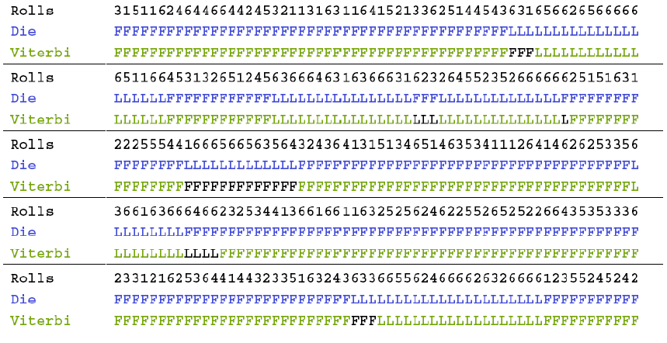
Viterbi gets it right more often than not
Slide by Changui Yan

Slide 43
Dynamic Bayesian Networks
Learning requires the full smoothing inference, rather than filtering, because it provides better estimates of the state of the process.
Learning the parameters of a BN is done using Expectation – Maximization (EM) Algorithms. Iterative optimization method to estimate some unknowns parameters.

Slide 44
Acknowledgements: The following slides are taken from CS 388 Natural Language Processing: Part-Of-Speech Tagging, Sequence Labeling, and Hidden Markov Models (HMMs)
Raymond J. Mooney
University of Texas at Austin
Notes:
44

Slide 45
Application 1: Part Of Speech Tagging
Annotate each word in a sentence with a part-of-speech marker.
Lowest level of syntactic analysis.
Useful for subsequent syntactic parsing and word sense disambiguation.
John saw the saw and decided to take it to the table.
NNP VBD DT NN CC VBD TO VB PRP IN DT NN

Slide 46
English Parts of Speech
Noun (person, place or thing)
Singular (NN): dog, fork
Plural (NNS): dogs, forks
Proper (NNP, NNPS): John, Springfields
Personal pronoun (PRP): I, you, he, she, it
Wh-pronoun (WP): who, what
Verb (actions and processes)
Base, infinitive (VB): eat
Past tense (VBD): ate
Gerund (VBG): eating
Past participle (VBN): eaten
Non 3rd person singular present tense (VBP): eat
3rd person singular present tense: (VBZ): eats
Modal (MD): should, can
To (TO): to (to eat)

Slide 47
English Parts of Speech (cont.)
Adjective (modify nouns)
Basic (JJ): red, tall
Comparative (JJR): redder, taller
Superlative (JJS): reddest, tallest
Adverb (modify verbs)
Basic (RB): quickly
Comparative (RBR): quicker
Superlative (RBS): quickest
Preposition (IN): on, in, by, to, with
Determiner:
Basic (DT) a, an, the
WH-determiner (WDT): which, that
Coordinating Conjunction (CC): and, but, or,
Particle (RP): off (took off), up (put up)

Slide 48
In General: Sequence Labeling Problem
Many NLP problems can viewed as sequence labeling.
Each token in a sequence is assigned a label.
Labels of tokens are dependent on the labels of other tokens in the sequence, particularly their neighbors (not i.i.d).
foo bar blam zonk zonk bar blam

Slide 49
Application 2: Information Extraction
Identify phrases in language that refer to specific types of entities and relations in text.
Named entity recognition is the task of identifying names of people, places, organizations, etc. in text.
people organizations places
Michael Dell is the CEO of Dell Computer Corporation and lives in Austin Texas.
Extract pieces of information relevant to a specific application, e.g. used car ads:
make model year mileage price
For sale, 2002 Toyota Prius, 20,000 mi, $15K or best offer. Available starting July 30, 2006.

Slide 50
Semantic Role Labeling
For each clause, determine the semantic role played by each noun phrase that is an argument to the verb.
agent patient source destination instrument
John drove Mary from Austin to Dallas in his Toyota Prius.
The hammer broke the window.
Also referred to a “case role analysis,” “thematic analysis,” and “shallow semantic parsing”

Slide 51
Application 3: Bioinformatics
Sequence labeling also valuable in labeling genetic sequences in genome analysis.
extron intron
AGCTAACGTTCGATACGGATTACAGCCT

Slide 52
Back to App1: Sequence Labeling as Classification
Classify each token independently but use as input features, information about the surrounding tokens (sliding window).
John saw the saw and decided to take it to the table.
classifier
NNP

Slide 53
Sequence Labeling as Classification
Classify each token independently but use as input features, information about the surrounding tokens (sliding window).
John saw the saw and decided to take it to the table.
classifier
VBD

Slide 54
Sequence Labeling as Classification
Classify each token independently but use as input features, information about the surrounding tokens (sliding window).
John saw the saw and decided to take it to the table.
classifier
DT

Slide 55
Sequence Labeling as Classification
Classify each token independently but use as input features, information about the surrounding tokens (sliding window).
John saw the saw and decided to take it to the table.
classifier
NN

Slide 56
Sequence Labeling as Classification
Classify each token independently but use as input features, information about the surrounding tokens (sliding window).
John saw the saw and decided to take it to the table.
classifier
CC

Slide 57
Sequence Labeling as Classification
Classify each token independently but use as input features, information about the surrounding tokens (sliding window).
John saw the saw and decided to take it to the table.
classifier
VBD

Slide 58
Sequence Labeling as Classification
Classify each token independently but use as input features, information about the surrounding tokens (sliding window).
John saw the saw and decided to take it to the table.
classifier
TO

Slide 59
Sequence Labeling as Classification
Classify each token independently but use as input features, information about the surrounding tokens (sliding window).
John saw the saw and decided to take it to the table.
classifier
VB

Slide 60
Sequence Labeling as Classification
Classify each token independently but use as input features, information about the surrounding tokens (sliding window).
John saw the saw and decided to take it to the table.
classifier
PRP

Slide 61
Sequence Labeling as Classification
Classify each token independently but use as input features, information about the surrounding tokens (sliding window).
John saw the saw and decided to take it to the table.
classifier
IN

Slide 62
Sequence Labeling as Classification
Classify each token independently but use as input features, information about the surrounding tokens (sliding window).
John saw the saw and decided to take it to the table.
classifier
DT

Slide 63
Sequence Labeling as Classification
Classify each token independently but use as input features, information about the surrounding tokens (sliding window).
John saw the saw and decided to take it to the table.
classifier
NN

Slide 64
Sequence Labeling as Classification
Using Outputs as Inputs
Better input features are usually the categories of the surrounding tokens, but these are not available yet.
Can use category of either the preceding or succeeding tokens by going forward or back and using previous output.

Slide 65
Forward Classification
John saw the saw and decided to take it to the table.
classifier
NNP

Slide 66
Forward Classification
NNP
John saw the saw and decided to take it to the table.
classifier
VBD

Slide 67
Forward Classification
NNP VBD
John saw the saw and decided to take it to the table.
classifier
DT

Slide 68
Forward Classification
NNP VBD DT
John saw the saw and decided to take it to the table.
classifier
NN

Slide 69
Forward Classification
NNP VBD DT NN
John saw the saw and decided to take it to the table.
classifier
CC

Slide 70
Forward Classification
NNP VBD DT NN CC
John saw the saw and decided to take it to the table.
classifier
VBD

Slide 71
Forward Classification
NNP VBD DT NN CC VBD
John saw the saw and decided to take it to the table.
classifier
TO

Slide 72
Forward Classification
NNP VBD DT NN CC VBD TO
John saw the saw and decided to take it to the table.
classifier
VB

Slide 73
Forward Classification
NNP VBD DT NN CC VBD TO VB
John saw the saw and decided to take it to the table.
classifier
PRP

Slide 74
Forward Classification
NNP VBD DT NN CC VBD TO VB PRP
John saw the saw and decided to take it to the table.
classifier
IN

Slide 75
Forward Classification
NNP VBD DT NN CC VBD TO VB PRP IN
John saw the saw and decided to take it to the table.
classifier
DT

Slide 76
Forward Classification
NNP VBD DT NN CC VBD TO VB PRP IN DT
John saw the saw and decided to take it to the table.
classifier
NN

Slide 77
Backward Classification
Disambiguating “to” in this case would be even easier backward.
John saw the saw and decided to take it to the table.
classifier
NN

Slide 78
Backward Classification
Disambiguating “to” in this case would be even easier backward.
NN
John saw the saw and decided to take it to the table.
classifier
DT

Slide 79
Backward Classification
Disambiguating “to” in this case would be even easier backward.
DT NN
John saw the saw and decided to take it to the table.
classifier
IN

Slide 80
Backward Classification
Disambiguating “to” in this case would be even easier backward.
IN DT NN
John saw the saw and decided to take it to the table.
classifier
PRP

Slide 81
Backward Classification
Disambiguating “to” in this case would be even easier backward.
PRP IN DT NN
John saw the saw and decided to take it to the table.
classifier
VB

Slide 82
Backward Classification
Disambiguating “to” in this case would be even easier backward.
VB PRP IN DT NN
John saw the saw and decided to take it to the table.
classifier
TO

Slide 83
Backward Classification
Disambiguating “to” in this case would be even easier backward.
TO VB PRP IN DT NN
John saw the saw and decided to take it to the table.
classifier
VBD

Slide 84
Backward Classification
Disambiguating “to” in this case would be even easier backward.
VBD TO VB PRP IN DT NN
John saw the saw and decided to take it to the table.
classifier
CC

Slide 85
Backward Classification
Disambiguating “to” in this case would be even easier backward.
CC VBD TO VB PRP IN DT NN
John saw the saw and decided to take it to the table.
classifier
NN

Slide 86
Backward Classification
Disambiguating “to” in this case would be even easier backward.
VBD CC VBD TO VB PRP IN DT NN
John saw the saw and decided to take it to the table.
classifier
DT

Slide 87
Backward Classification
Disambiguating “to” in this case would be even easier backward.
DT VBD CC VBD TO VB PRP IN DT NN
John saw the saw and decided to take it to the table.
classifier
VBD

Slide 88
Backward Classification
Disambiguating “to” in this case would be even easier backward.
VBD DT VBD CC VBD TO VB PRP IN DT NN
John saw the saw and decided to take it to the table.
classifier
NNP

Slide 89
DBN – Special Cases
Hidden Markov Model (HMMs):
Temporal probabilistic model in which the state of the process is described by a single discrete random variable. (The simplest kind of DBN )
Kalman Filter Models (KFMs):
Estimate the state of a physical system from noisy observations over time. Also known as linear dynamical systems (LDSs).

Slide 90
DBN – Basic Inference
Filtering
Smoothing
Most likely sequence

Slide 91
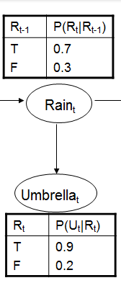
Hidden Markov Models
new state
old state
(
0.1 | 0
0 | 0.8
)
U₃ = false O₃ =

Slide 92
Country Dance Algorithm

Slide 93
Country Dance Algorithm

Slide 94
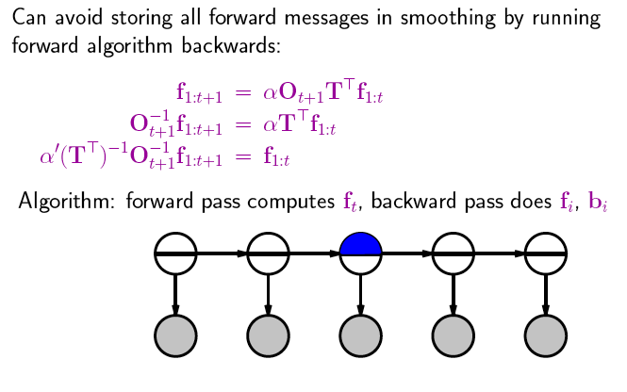
Country Dance Algorithm

Slide 95
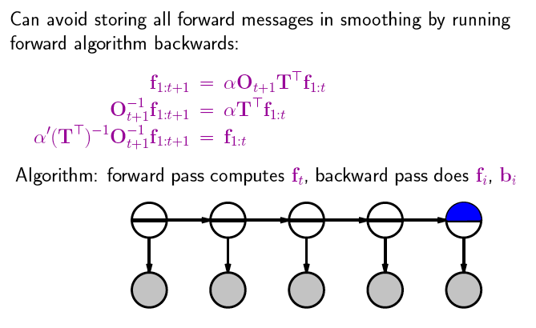
Country Dance Algorithm

Slide 96
Country Dance Algorithm

Slide 97
Country Dance Algorithm

Slide 98
Example
(
)
U₂ = true O₂ =
0.9 | 0
0 | 0.2
(
)
(
)
O₂⁻¹ =
0.2 | 0
0 | 0.9
1.1 | 0
0 | 4.95
(
)
5.5
=
T^{T} =
0.7 | 0.3
0.3 | 0.7
(
)
(
)
(T^{T})⁻¹ =
0.7 | -0.3
-0.3 | 0.7
=
1.75 | -0,75
-0,75 | 1.75
2.5
(
)
(
)
(
)
(
)
1,925 | -3.7125
-0,825 | 8.6625
0.883
0.117
1.265
0,285
0.817
0,183
=
α = 0,64497
→

Slide 99
(
)
0.817
0,183

Slide 100
State View: Hidden Markov models
Set of states:
Process moves from one state to another generating a sequence of states :
Markov chain property: probability of each subsequent state depends only on what was the previous state:
States are not visible, but each state randomly generates one of M observations (or visible states)

Slide 101
State View: Hidden Markov models
To define a hidden Markov model, the following probabilities have to be specified:
Matrix of transition probabilities A=(a_{ij}), a_{ij}= P(s_{j} | s_{i}) ,
Matrix of observation probabilities B=(b_{i} (v_{m} )), b_{i}(v_{m} ) = P(v_{m} | s_{i}) and a
Vector of initial probabilities π=(π_{i}), π_{i} = P(s_{i}) .
Model is represented by M=(A, B, π).

Slide 102
Example of Hidden Markov Model
0.3
0.7
Low
High
0.2
0.8
0.6
0.6
0.4
0.4
Rain
Dry

Slide 103
State View: Learning problem (1)
Given some training observation sequences O=o₁ o₂ ... o_{K} and general structure of HMM (numbers of hidden and visible states), determine HMM parameters M=(A, B, π) that best fit training data, that is maximizes P(O | M) .

Slide 104
State View: Learning problem (2)
If training data has information about sequence of hidden states, then use maximum likelihood estimation of parameters:
a_{ij}= P(s_{j} | s_{i}) =
Number of transitions from state s_{i} to state s_{j}
Number of transitions out of state s_{i}
Number of times observation v_{m} occurs in state s_{i}
Number of times in state s_{i}
b_{i}(v_{m} ) = P(v_{m} | s_{i})=
Otherwise: Use iterative expectation-maximization algorithm to find local maximum of P(O | M): Baum-Welch Algorithm.

Slide 105
Baum-Welch algorithm
General idea:
Expected number of transitions from state s_{i} to state s_{j}
Expected number of transitions out of state s_{i}
a_{ij}= P(s_{j} | s_{i}) =
Expected number of times observation v_{m} occurs in state s_{i}
Expected number of times in state s_{i}
b_{i}(v_{m} ) = P(v_{m} | s_{i})=
π_{i} = P(s_{i}) = Expected frequency in state s_{i} at time k=1.

Slide 106
Baum-Welch algorithm: Expectation step(1)
Define variable ξ_{k}(i,j) as the probability of being in state s_{i} at time k and in state s_{j} at time k+1, given the observation sequence o₁ o₂ ... o_{T} with k < T
ξ_{k}(i,j) = P(q_{k}= s_{i} , q_{k+1}= s_{j} | o₁ o₂ ... o_{T})
P(q_{k}= s_{i} , q_{k+1}= s_{j} , o₁ o₂ ... o_{T})
P(o₁ o₂ ... o_{T})
ξ_{k}(i,j) =
=
P(q_{k}= s_{i} , o₁ o₂ ... o_{k}) a_{ij} b_{j} (o_{k+1} ) P(o_{k+2} ... o_{T} | q_{k+1}= s_{j} )
P(o₁ o₂ ... o_{T})
=
α forward_{k}(i) a_{ij} b_{j} (o_{k+1} ) backward_{k+1}(j)

Slide 107
Baum-Welch algorithm: Expectation step(2)
Define variable γ_{k}(i) as the probability of being in state s_{i} at time k, given the observation sequence o₁ o₂ ... o_{T} .
γ_{k}(i)= P(q_{k}= s_{i} | o₁ o₂ ... o_{T})
P(q_{k}= s_{i} , o₁ o₂ ... o_{T})
P(o₁ o₂ ... o_{T})
γ_{k}(i)=
=
α forward_{k}(i) backward_{k}(i)

Slide 108
Baum-Welch algorithm: Expectation step(3)
We calculated ξ_{k}(i,j) = P(q_{k}= s_{i} , q_{k+1}= s_{j} | o₁ o₂ ... o_{T})
and γ_{k}(i)= P(q_{k}= s_{i} | o₁ o₂ ... o_{T})
Expected number of transitions from state s_{i} to state s_{j} =
= Σ_{k} ξ_{k}(i,j)
Expected number of transitions out of state s_{i} = Σ_{k} γ_{k}(i)
Expected number of times observation v_{m} occurs in state s_{i} =
= Σ_{k} γ_{k}(i) , k is such that o_{k}= v_{m}
Expected frequency in state s_{i} at time k=1 : γ₁(i) .

Slide 109
Baum-Welch algorithm: Maximization step
Expected number of transitions from state s_{j} to state s_{i}
Expected number of transitions out of state s_{j}
Σ_{k} ξ_{k}(i,j)
Σ_{k} γ_{k}(i)
a_{ij} =
=
Σ_{k} ξ_{k}(i,j)
Σk,o_{k}= v_{m} γ_{k}(i)
b_{i}(v_{m} ) =
Expected number of times observation v_{m} occurs in state s_{i}
Expected number of times in state s_{i}
=
π_{i} = (Expected frequency in state s_{i} at time k=1) = γ₁(i).

Slide 110
DBN – Special Cases
Hidden Markov Model (HMMs):
Temporal probabilistic model in which the state of the process is described by a single discrete random variable. (The simplest kind of DBN )
Kalman Filter Models (KFMs):
Estimate the state of a physical system from noisy observations over time. Also known as linear dynamical systems (LDSs).

Slide 111
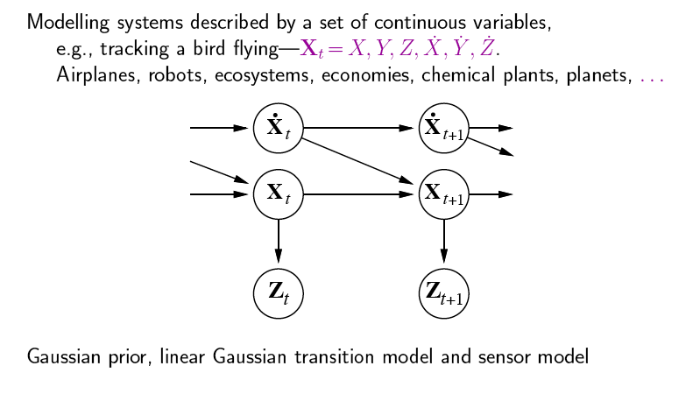
Kalman Filters

Slide 112
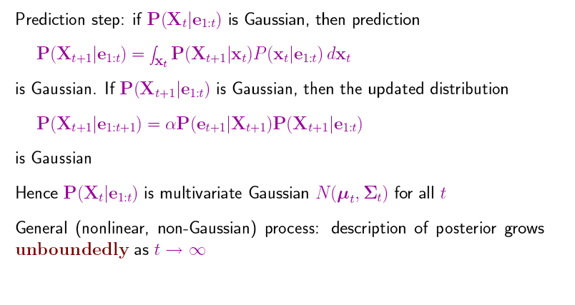
Updating Gaussian Distributions

Slide 113
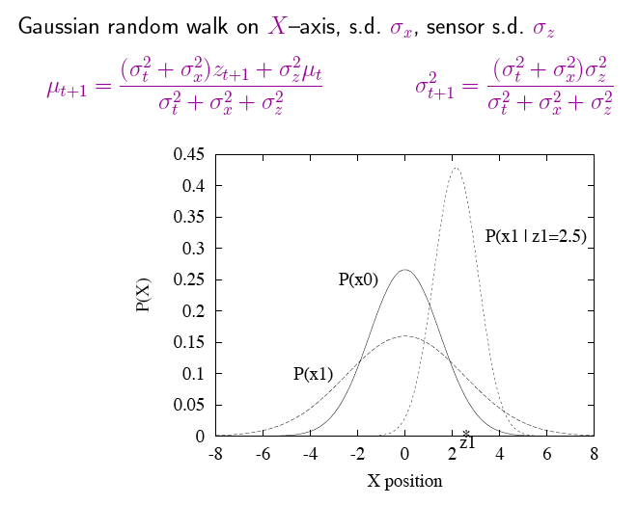
Simple 1-D Example
z1: first observation
s.d.= standard deviation

Slide 114
General Kalman Update
Left for your studies

Slide 115
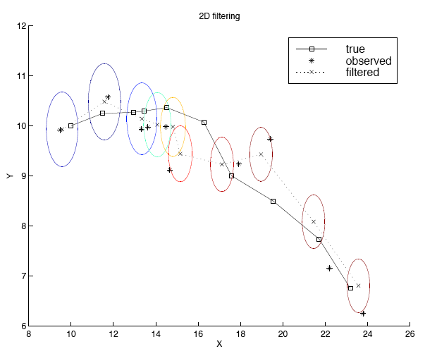
2-D Tracking: Filtering
Notes:
Radar tracking of planes or missles any phsiyal systems ocean currents from sattelite surface measurments

Slide 116
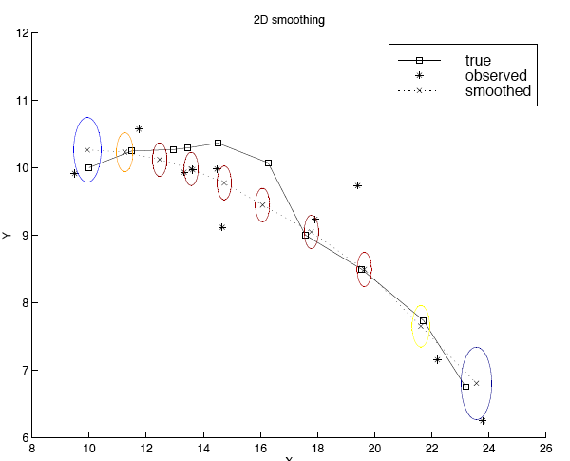
2-D Tracking: Smoothing

Slide 117
Where it breaks
Standard solution: switching Kalman filter
Keeping track of many objects: Identity uncertainty

Slide 118
Web-Mining Agents Probabilistic Reasoning over Sequential Structures
Prof. Dr. Ralf Möller
Universität zu Lübeck
Institut für Informationssysteme
Tanya Braun (Übungen)

Slide 119
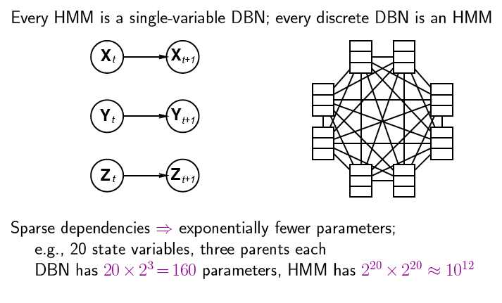
DBNs vs. HMMs
Consider the transition model
Notes:
2 hoch 20 zustände

Slide 120
Learning (1)
The techniques for learning DBN are mostly straightforward extensions of the techniques for learning BNs
Parameter learning
The transition model P(X_{t} | X_{t-1}) / The observation model P(Y_{t} | X_{t})
Offline learning
Parameters must be tied across time-slices
The initial state of the dynamic system can be learned independently of the transition matrix
Online learning
Add the parameters to the state space and then do online inference (filtering)
The usual criterion is maximum-likelihood(ML)
The goal of parameter learning is to compute
θ*_{ML} = argmax_{θ}P( Y| θ) = argmax_{θ}log P( Y| θ)
θ*_{MAP} = argmax_{θ}log P( Y| θ) + logP(θ)
Two standard approaches: gradient ascent and EM(Expectation Maximization)

Slide 121
Learning (2)
Structure learning
Intra-slice connectivity: Structural EM
Inter-slice connectivity: For each node in slice t, we must choose its parents from slice t-1
Given structure is unrolled to a certain extent, the inter-slice connectivity is identical for all pairs of slices:
Constraints on Structural EM

Slide 122
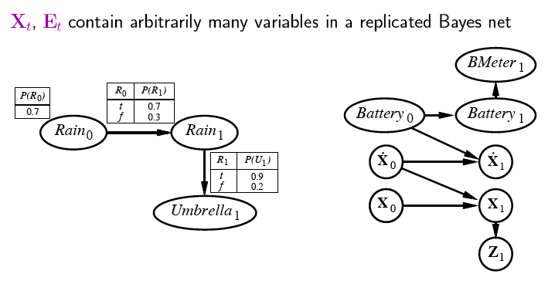
Constructing Dynamic Bayesian Networks
Battery-powered robot on x-y plane
X_{t} = (X_{t}, Y_{t}), Z_{t} = measurements

Slide 123
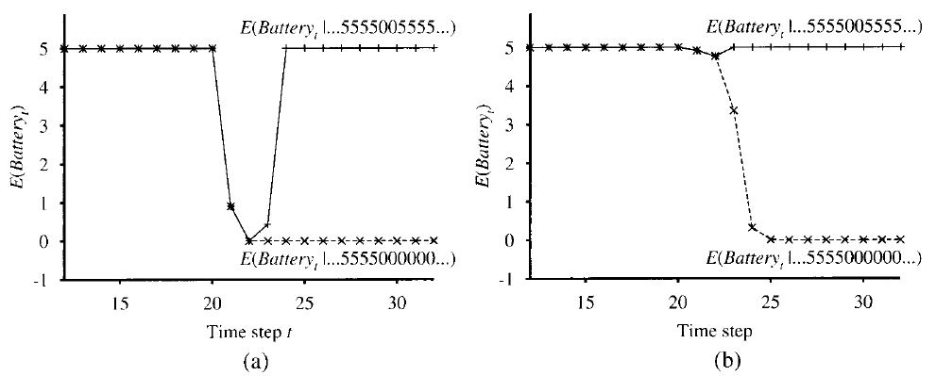
DBNs transient failure
For simplicity we assume that BMeter_{t} and Battery_{t} are taken from 0..5.
Generic gaussian error model
produces “overreaction“
Explicit transient failure model required:

Slide 124
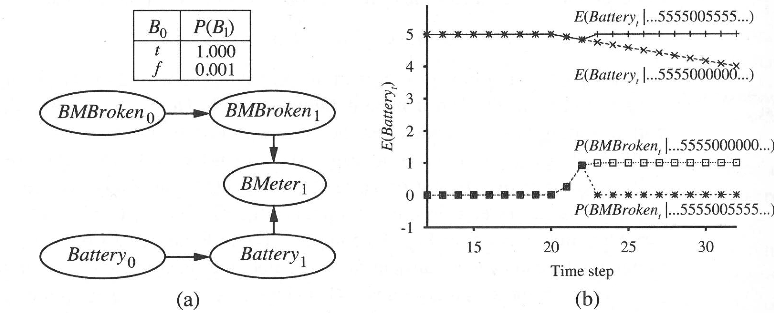
DBNs persistent failure
Additional variable required: BMBroken_{t}
Upper curve: transient failure with different observation sequences
Lower curve: persistent failure with two different observation sequences

Slide 125
Learning DBN pattern structures?
Difficult
Need “deep” domain knowledge

Slide 126
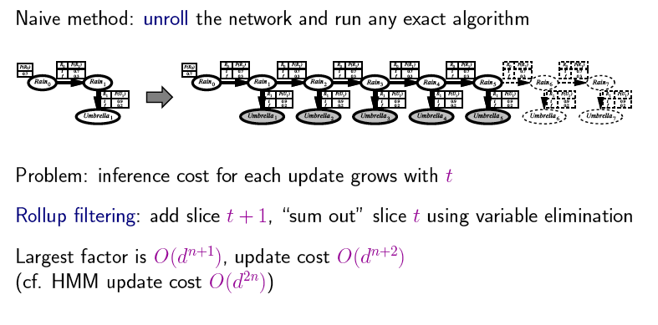
Recap: Exact Inference in DBNs
for the whole BN
Example: 20 state variables with 4 values each means 4²⁰⁺¹ =4.398.046.511.104
d = possible values for variables n = number of states
Employ forward chaining (constant per time update but exponential in the number of variables per state)

Slide 127
Inference: Algorithms
Exact Inference algorithms
Forwards-backwards smoothing algorithm (on any discrete-state DBN)
Kalman filtering and smoothing (for continuous variables)
The Frontier Algorithm (sweep a Markov blanket, the frontier set F, across the DBN, first forwards and then backwards)
The Interface Algorithm (use only the set of nodes with outgoing arcs to the next time slice to d-separate the past from the future)
Approximate algorithms:
The Boyen-Koller (BK) algorithm (approximate the joint distribution over the interface as a product of marginals)
Factored Frontier (FF) Algorithm / Loopy propagation algorithm (LBP)
Stochastic sampling algorithm:
Importance sampling or MCMC (offline inference)
Particle filtering (PF) (online)

Slide 128
Approximate inference in DBNs
Central idea:
Create N initial-state examples (from prior dist P(X₀))
Based on the transition model, each sample is propagated forward by sampling the next state value x_{t+1} given the current value x_{t}
Each sample is weighted by the likelihood it assigns to the new evidence P(e_{t+1} | x_{t+1})
Resample to generate new population of N samples
Select new sample based on its weight
Samples are called particles (→ Particle Filtering)

Slide 129
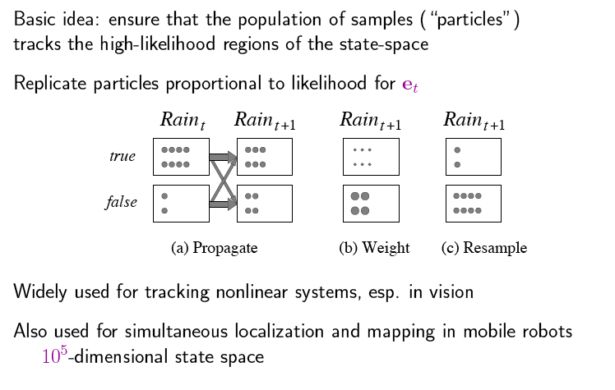
Particle Filtering

Slide 130
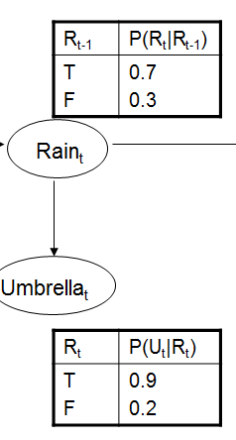
Example
N(r_{t+1}|e) = Σ _{xt} P(x_{t+1}|x_{t}) N(x_{t}|e) For rain = 0.7*8+0.3*2= 6.2 => 6 For not rain = 0.3 *8 + 0.7*2= 3.8 => 4
Suppose no umbrella for t+1 total weight(rain particles) = 0.1 * 6= 0.6
total weight(not rain) = 0.8 * 4= 3.2
Normalized =<0.17, 0.83>

Slide 131
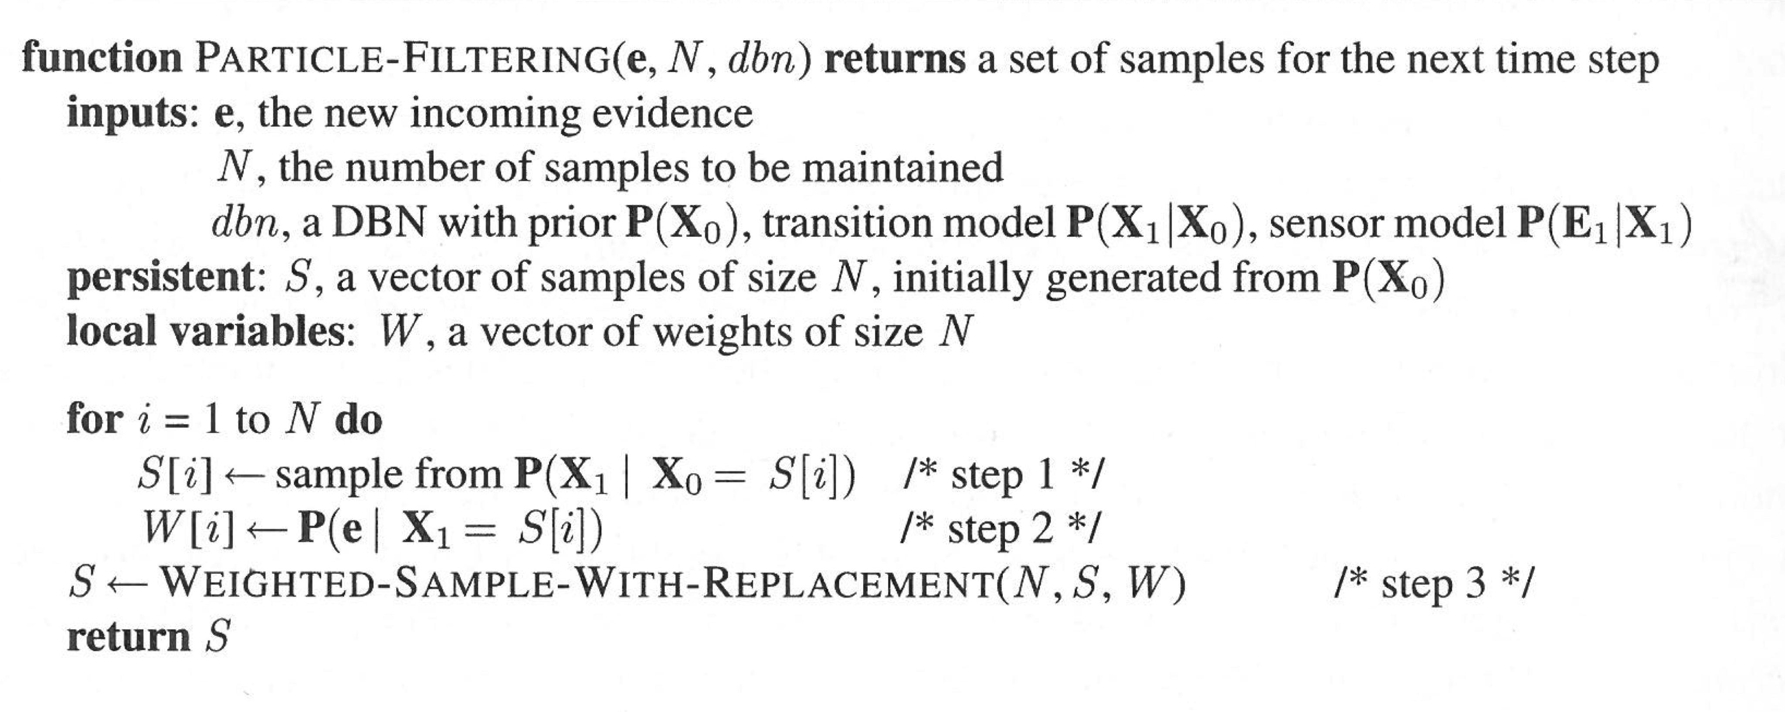
Particle Filtering

Slide 132
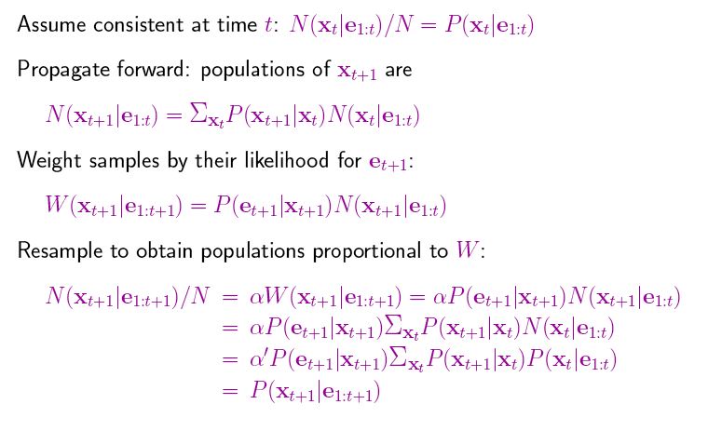
Particle Filtering (cntd.)

Slide 133
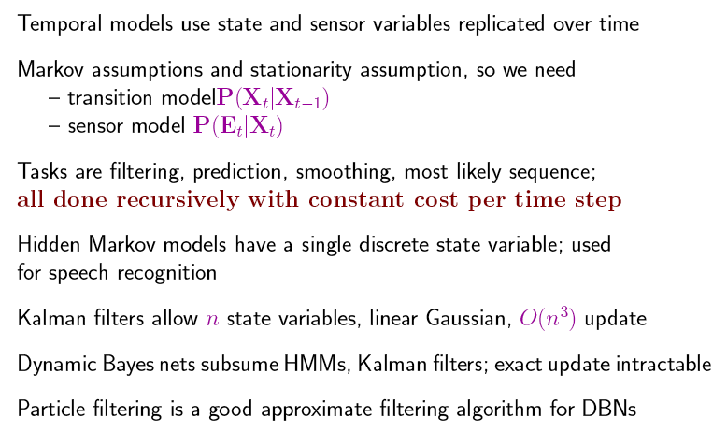
Summary

Slide 134
HMM-LDA
In traditional topic modeling, such as LDA, we remove most syntactic words (e.g., stopwords) since we are only interested in meaning.
In doing so, we discard much of the structure, and all of the order the original author intended.
In topic modeling, we are concerned long-range topic dependencies rather document structure.
Thomas L. Griffiths, Mark Steyvers, David M. Blei, and Joshua B. Tenenbaum. Integrating topics and syntax. In Proc. of NIPS'04, pp. 537-544. 2004.

Slide 135
Introduction
HMMs are useful for segmenting documents into different types of words, regardless of meaning.
For example, all nouns will be grouped together because they play the same role in different passages/documents.
Syntactic dependencies last at most for a sentence.
The standardized nature of grammar means that it stays fairly constant across different contexts.

Slide 136
Combining syntax and semantics 1
All words (both syntactic and semantic) exhibit short range dependencies.
Only content words exhibit long range semantic dependencies.
This leads to the HMM-LDA.
HMM-LDA is a composite model, in which an HMM decides the parts of speech, and a topic model (LDA) extracts topics only those words which are deemed semantic.

Slide 137
Generative Process 1
Definitions
Words
form document d where each word is one of W words
Topic assignments for each word, where each taking one of T topics
Class assignments for each word, where each taking one of C word classes
Multinomial distribution over topics for document d
Multinomial distribution over semantic words for topic indicated by z.
Multinomial distribution over non-semantic words for class indicated by class c.
Transition probability from to

Slide 138
Generative Process 2
~
~
~
Where is the row of the transition matrix indicated by c.
~
For document d
Draw topic distribution
Draw a topic for word i
Draw a class for word i from transition matrix
Semantic class
Draw a semantic word
OR
Draw a syntactic word

Slide 139
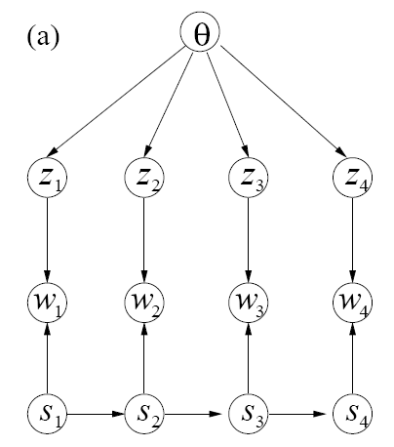
Graphical Model 1
LDA
HMM

Slide 140
Simple Example 1
Semantic Class
Preposition class
Verb Class
The HMM allocates words which vary across context to the semantic class, since grammar is fairly standardized but content is not.

Slide 141
Model Inference 1
MCMC inference
Topic indicators
is the number of words in document assigned to topic
is the number of words in topic that are the same as
All counts include only words for which and exclude word

Slide 142
Model Inference 2
Class indicators
is the number of words in document assigned to topic
is the number of words in topic that are the same as
is the number of words in class that are the same as
is the number of transitions from class to class
is an indicator variable which equals 1 if argument is true
All counts exclude transitions to and from

Slide 143
Extreme Cases 1
If we set the number of semantic topics to T = 1, then the model reduces to an HMM parts of speech tagger.
If we set the number of HMM classes to C = 2, where one state is for punctuation, the the model reduces to LDA.

Slide 144
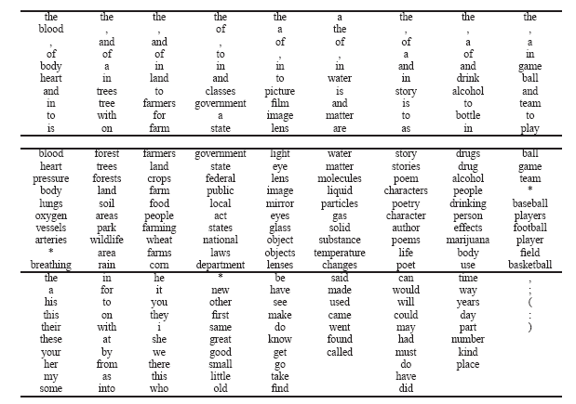
Results 1
Brown + TASA corpus: 38,151 documents; Vocab Size = 37,202;
number of word tokens = 13,328,397 words
LDA only
HMM-LDA Semantic Topics
HMM-LDA Syntactic Classes

Slide 145
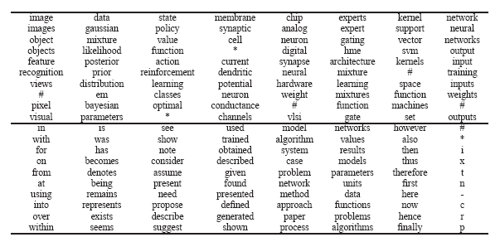
Results 2
NIPS Papers 1713 documents; Vocabulary Size: 17268;
Number of word tokens = 4,321,614
Syntactic Words
Semantic Words

Slide 146
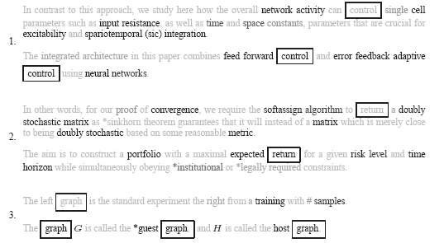
Results 2 (cont’d)
NIPS Papers 1713 documents; Vocabulary Size: 17268;
Number of word tokens = 4,321,614
Black words are semantic, Graylevel words are syntactic. Boxed words are semantic on one passsage and syntactic in another. Asterisked words have low frequency and not considered.

Slide 147
Results 3
Log Marginal probabilities of the data

Slide 148
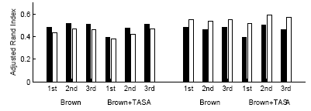
Results 4
Parts of speech tagging
Black bars indicate performance on a fine tagset (297 word types), white bars indicate performance on coarse tagset (10 word types).
HMM
Composite Model

Slide 149
Conclusion
HMM-LDA is a composite topic model which considers both long range semantic dependencies and short range syntactic dependencies.
The model is quite competitive with a traditional HMM parts of speech tagger, and outperforms LDA when stopwords and punctuation are not removed.

Slide 150
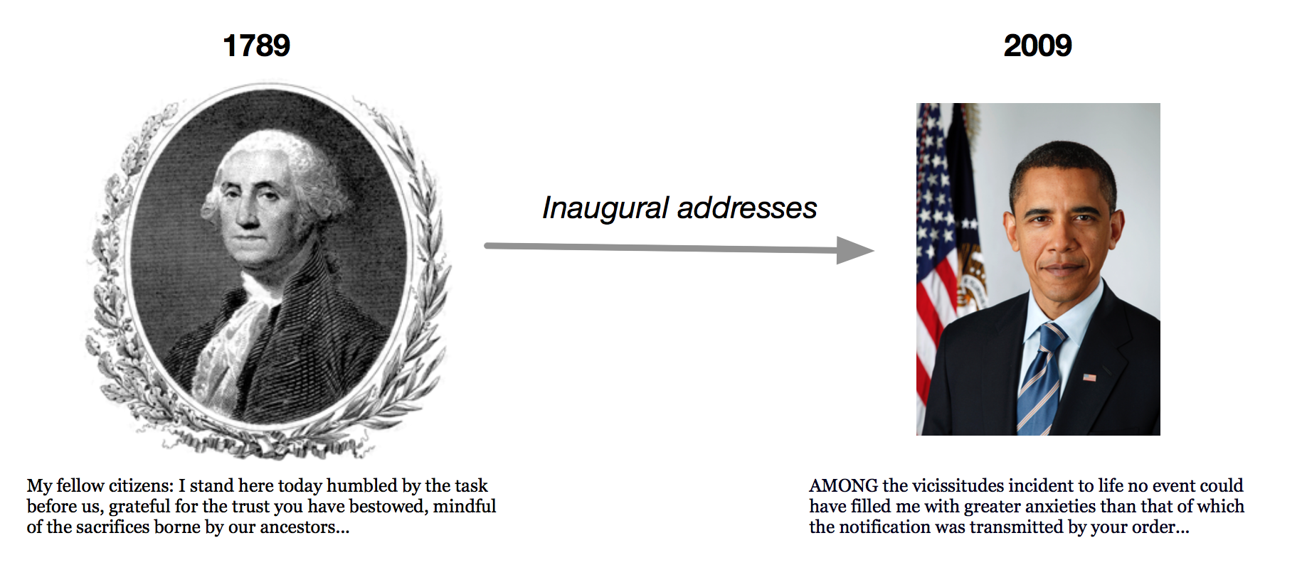
Dynamic Topic Models
In LDA the order of documents does not matter
Not appropriate for sequential corpora (e.g., that span hundreds of years)
Further, we may want to track how language changes over time
Let the topics drift in a sequence.
David M. Blei and John D. Lafferty. Dynamic topic models. In Proc. ICML '06. pp. 113-120. 2006.

Slide 151
Recap: Smoothed LDA Model
Give a different word distribution to each topic
$β$ is $K×V$ matrix (V vocabulary size), each row denotes word distribution of a topic
For each document d
Choose θ_{d} ~ Dirichlet(∙ | α)
Choose $β_{k}$~ Dirichlet($η\text{∙}\text{ |}$)
For each position i = 1, ... , N_{d}
Generate a topic z_{i} ~ Mult(∙ | θ_{d})
Generate a word w_{i} ~ Mult(∙ | z_{i},β_{k})
α
θ
$$η$$
z
w
$$β_{k}$$
N
K
M

Slide 152
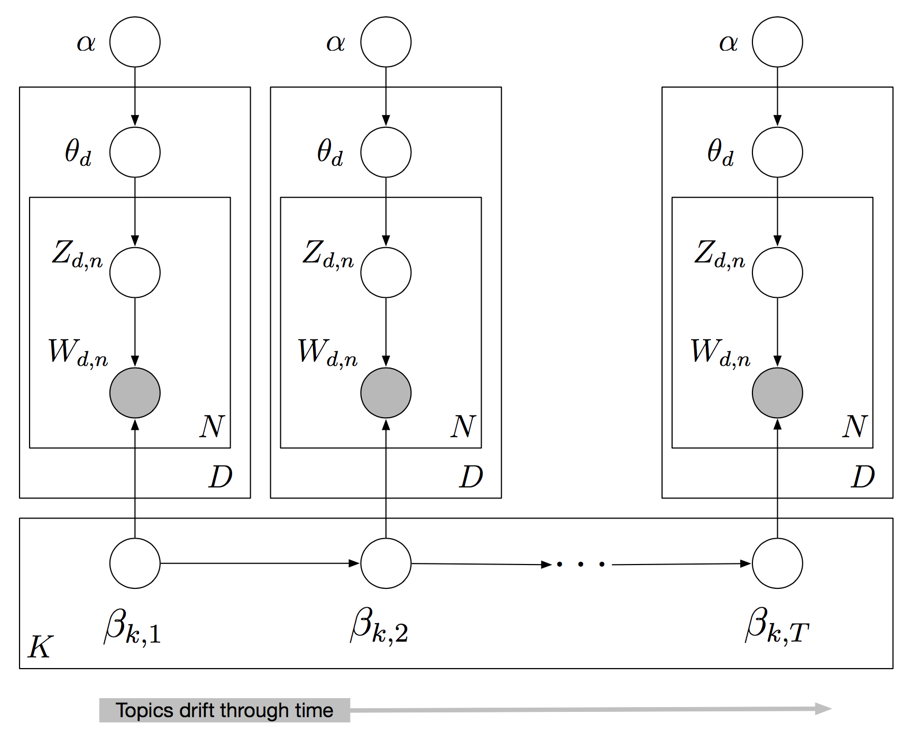

Slide 153
Dynamic Topic Models
Use a logistic normal distribution to model topics evolving over time
Embed it in a state-space model on the log of the topic distribution
Lets us make inferences about sequences of documents

Slide 154
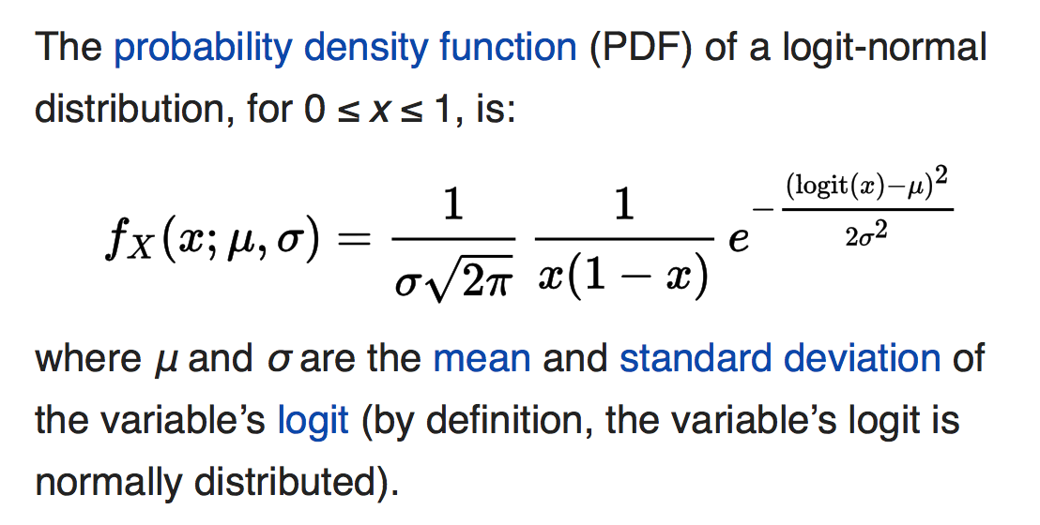
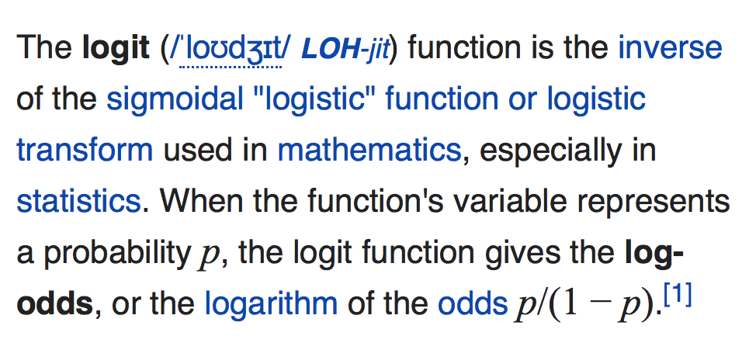
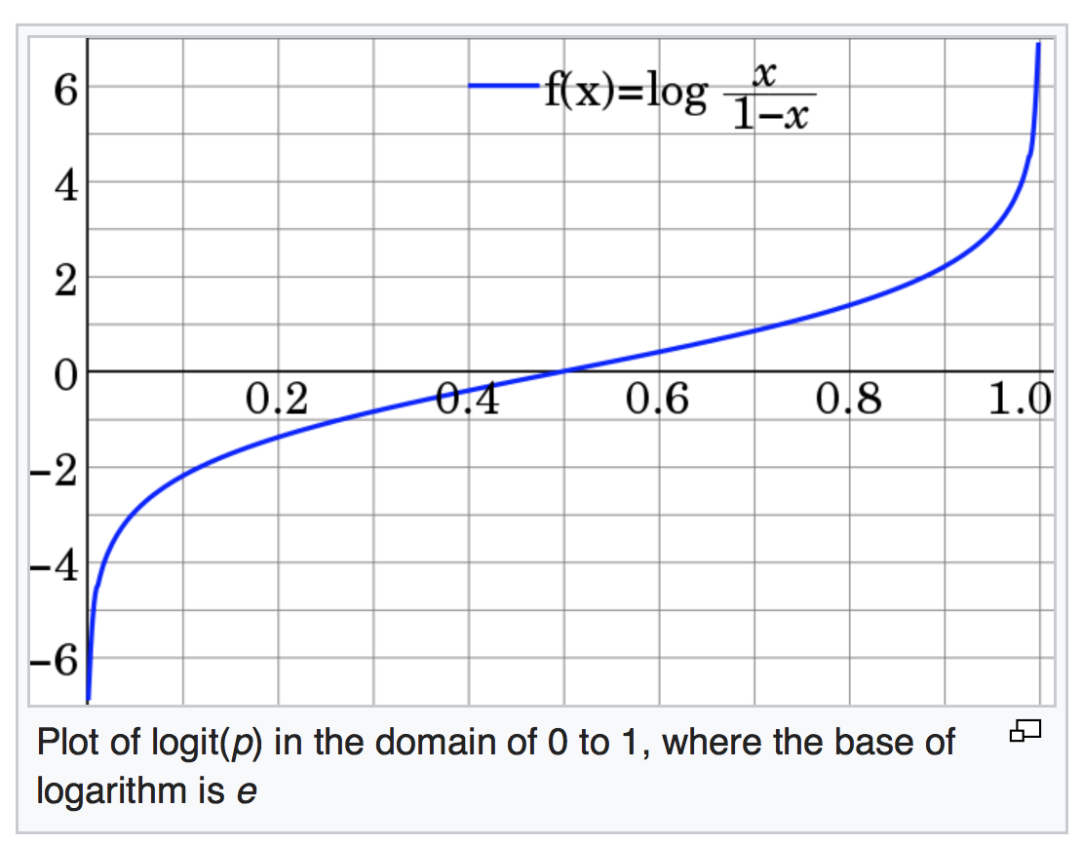
Logit Normal Distribution
[Wikipedia]

Slide 155
Dynamic Topic Models

Slide 156
Dynamic Topic Models

Slide 157
Dynamic Topic Models

Slide 158
Dynamic Topic Models
Wang, Chong; Blei, David; Heckerman, David. "Continuous Time Dynamic Topic Models". Proceedings of ICML'08, 2008.

Slide 159
Dynamic Topic Models
Time-corrected similarity shows a new way of using the posterior.
Consider the expected Hellinger distance between the topic proportions of two documents,
Uses the latent structure to define similarity
Time has been factored out because the topics associated to the components are different from year to year.
Similarity based only on topic proportions
[Wikipedia]

Slide 160
Dynamic Topic Models

Slide 161
Dynamic Topic Models

Slide 162
Dynamic Topic Models: Summary
The Dirichlet assumption on topics and topic proportions makes strong conditional independence assumptions about the data.
The dynamic topic model uses a logistic normal in a linear dynamic model to capture how topics change over time.

Slide 163
Gartner Hype Cycle

Slide 164
Gartner Hype Cycle 2015

Slide 165
Gartner Hype Cycle

Slide 166
Gartner Hype Cycle

