Slide 1
Non-Standard-Datenbanken
Bayesian Networks, Inference, and Learning
Prof. Dr. Ralf Möller
Universität zu Lübeck
Institut für Informationssysteme

Slide 2
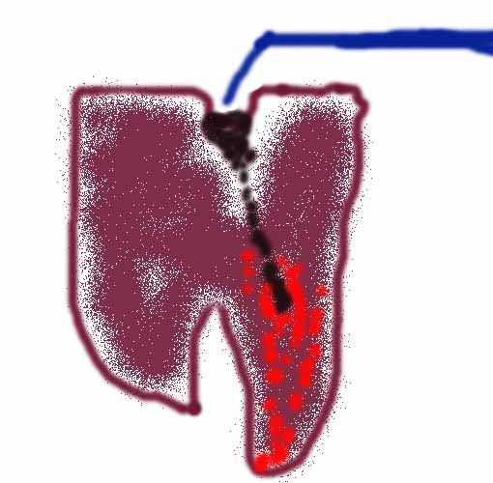

Beispiel
Zahnarzt-Problem mit vier Variablen:
Toothache (Sind besagte Schmerzen wirklich Zahnschmerzen?)
Cavity (Es könnte ein Loch sein?)
Catch (Stahlinstrument erzeugt Testschmerz?)
Weather (Wetter: sunny,rainy,cloudy,snow)
Nachfolgende Präsentationen enthalten Material aus Kapitel 14
(Sektion 1 and 2)

Slide 3
Prior probability
Prior or unconditional probabilities of propositions
  e.g., P(Cavity = true) = 0.1 and P(Weather = sunny) = 0.72 correspond to belief prior to arrival of any (new) evidence
Probability distribution
gives values for all possible assignments:
  P(Weather) = <0.72, 0.1, 0.08, 0.1>
  (normalized, i.e., sums to 1 because one condition must be the case)
Notes:
Prior can come from statistical date or other insights e.g. dice (computational)

Slide 4
Full joint probability distribution
Joint probability distribution for a set of random variables gives the probability of every atomic event on those random variables
  P(Weather,Cavity) is a 4 × 2 matrix of values:
Weather = sunny rainy cloudy snow
Cavity = true 0.144 0.02 0.016 0.02
Cavity = false 0.576 0.08 0.064 0.08
Full joint probability distribution: all random variables involved
  P(Toothache, Catch, Cavity, Weather)
Every query about a domain can be answered by the full joint distribution

Slide 5
Discrete random variables: Notation
Dom(Weather) = {sunny, rainy, cloudy, snow} and Dom(Weather) disjoint from domain of other random variables:
  Atomic event Weather=rainy often written as rainy
  Example: P(rainy), the random variable Weather is implicitly defined by the value rainy
Boolean variable Cavity
  Atomic event Cavity=true written as cavity
  Atomic event Cavity=false written as ¬cavity
  Examples: P(cavity) or P(¬cavity)

Slide 6
Conditional probability
Conditional or posterior probabilities
  e.g., P(cavity | toothache) = 0.8
  or: <0.8>
  i.e., given that toothache is all I know
(Notation for conditional distributions:
  P(Cavity | Toothache) is a 2-element vector of 2-element vectors
If we know more, e.g., cavity is also given, then we have
  P(cavity | toothache, cavity) = 1
New evidence may be irrelevant, allowing simplification, e.g.,
  P(cavity | toothache, sunny) = P(cavity | toothache) = 0.8
This kind of inference, sanctioned by domain knowledge, is crucial

Slide 7
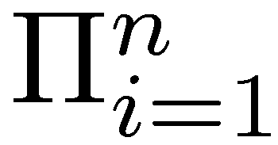
Conditional probability
Definition of conditional probability (in terms of uncond. prob.):
  P(a | b) = P(a ∧ b) / P(b) if P(b) > 0
Product rule gives an alternative formulation (∧ is commutative):
  P(a ∧ b) = P(a | b) P(b) = P(b | a) P(a)
A general version holds for whole distributions, e.g.,
  P(Weather,Cavity) = P(Weather | Cavity) P(Cavity)
View as a set of 4 × 2 equations, not matrix mult.
(1,1) P(Weather=sunny |Cavity=true) P(Cavity=true)
(1,2) P(Weather=sunny |Cavity=false) P(Cavity=false), ….
Chain rule is derived by successive application of product rule:
  P(X₁, …,X_{n}) = P(X₁,...,X_{n-1}) P(X_{n} | X₁,...,X_{n-1})
  = P(X₁,...,X_{n-2}) P(X_{n-1} | X₁,...,X_{n-2}) P(X_{n} | X₁,...,X_{n-1})
  = …
  = P(X_{i} | X₁, … ,X_{i-1})
Notes:
Proofable Rules are important for algorithmically rewriting of statements.
First rules makes sense because we know that b=true we can rule out other worlds. Reduce view of the world sum also to one because
Sum must be one.Therefore the fraction.

Slide 8

Inference by enumeration
Start with the joint probability distribution:
For any proposition φ, sum the probability
where it is true: P(φ) = Σ_{ω:ω╞φ} P(ω)
P(toothache) = 0.108 + 0.012 + 0.016 + 0.064 = 0.2
Unconditional or marginal probability of toothache
Process is called marginalization or summing out
  Ax₃: P(A ∪ B) = P(A) + P(B)
  for disjoint events A, B ⊆ Ω

Slide 9
Marginalization and conditioning
Let Y, Z be sequences of random variables s.th.
Y ∪ Z denotes all random variables describing the world
Marginalization
  P(Y) = Σ_{z ∈ Z}P(Y,z)
Conditioning
  P(Y) = Σ_{z ∈ Z}P(Y|z)P(z)

Slide 10

Inference by enumeration
Start with the joint probability distribution:
For any proposition φ, sum the atomic events where it is true:
P(φ) = Σ_{ω:ω⊨φ} P(ω)
P(cavity ∨ toothache) = 0.108 + 0.012 + 0.072 + 0.008+ 0.016 + 0.064 = 0.28
(P(cavity ∨ toothache) = P(cavity) + P(toothache) – P(cavity ∧ toothache))

Slide 11

Inference by enumeration
Start with the joint probability distribution:
Can also compute conditional probabilities:
P(¬cavity | toothache) = P(¬cavity ∧ toothache)
P(toothache)
= 0.016+0.064
0.108 + 0.012 + 0.016 + 0.064
= 0.08/0.2 = 0.4
P(cavity | toothache) = (0.108+0.012)/0.2 = 0.6
Product rule

Slide 12
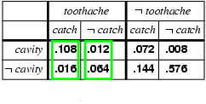
Normalization
Denominator P(z) (or P(toothache) in the example before) can be viewed as a normalization constant α
P(Cavity | toothache) = α P(Cavity,toothache)
  = α [P(Cavity,toothache,catch) + P(Cavity,toothache,¬ catch)]
  = α [<0.108,0.016> + <0.012,0.064>]
  = α <0.12,0.08> = <0.6,0.4>
General idea: compute distribution on query variable by fixing evidence variables (Toothache) and summing over hidden variables (Catch)

Slide 13
Inference by enumeration, contd.
Typically, we are interested in
the posterior joint distribution of the query variables Y
given specific values e for the evidence variables E
(X are all variables of the modeled world)
Let the hidden variables be H = X - Y – E then the required summation of joint entries is done by summing out the hidden variables:
  P(Y | E = e) = αP(Y,E = e) = αΣ_{h}P(Y,E= e, H = h)
The terms in the summation are joint entries because Y, E and H together exhaust the set of random variables (X)
Obvious problems:
  Worst-case time complexity O(d^{n}) where d is the largest arity and n denotes the number of random variables
  Space complexity O(d^{n}) to store the joint distribution
  How to find the numbers for O(d^{n}) entries?

Slide 14
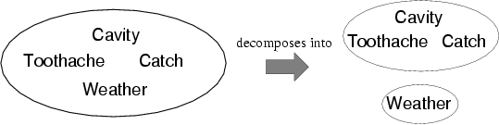
Independence
A and B are independent iff
P(A|B) = P(A) or P(B|A) = P(B) or P(A, B) = P(A) P(B)
  P(Toothache, Catch, Cavity, Weather)
  = P(Toothache, Catch, Cavity) P(Weather)
32 entries reduced to 12;
Absolute independence powerful but rare
Dentistry is a large field with hundreds of variables, none of which are independent. What to do?

Slide 15
Conditional independence
P(Toothache, Cavity, Catch) has 2³ – 1 = 7 independent entries
If I have a cavity, the probability that the probe catches in it doesn't depend on whether I have a toothache:
  (1) P(catch | toothache, cavity) = P(catch | cavity)
The same independence holds if I haven't got a cavity:
  (2) P(catch | toothache,¬cavity) = P(catch | ¬cavity)
Catch is conditionally independent of Toothache given Cavity:
  P(Catch | Toothache,Cavity) = P(Catch | Cavity)
Equivalent statements:
  P(Toothache | Catch, Cavity) = P(Toothache | Cavity)
  P(Toothache, Catch | Cavity) = P(Toothache | Cavity) P(Catch | Cavity)

Slide 16
Conditional independence contd.
Write out full joint distribution using chain rule:
P(Toothache, Catch, Cavity)
  = P(Toothache | Catch, Cavity) P(Catch, Cavity)
  = P(Toothache | Catch, Cavity) P(Catch | Cavity) P(Cavity)
  conditional independence
  = P(Toothache | Cavity) P(Catch | Cavity) P(Cavity)
i.e., 2 + 2 + 1 = 5 independent numbers
In most cases, the use of conditional independence reduces the size of the representation of the joint distribution
from exponential in n to linear in n
Conditional independence is our most basic and robust form of knowledge about uncertain environments

Slide 17
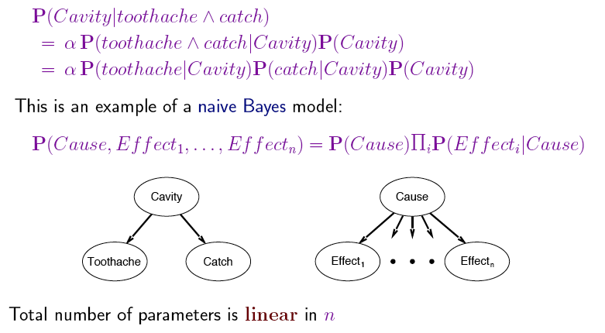
Naïve Bayes Model
Usually, the assumption that effects are independent is wrong,
but works well in practice

Slide 18
Bayesian networks
A simple, graphical notation for conditional independence assertions and hence for compact specification of full joint distributions
Syntax:
  a set of nodes, one per variable
  a directed, acyclic graph (link ≈ "directly influences")
  a conditional distribution for each node given its parents:
    P (X_{i} | Parents (X_{i}))
In the simplest case, conditional distribution represented as a conditional probability table (CPT) giving the distribution over X_{i} for each combination of parent values

Slide 19
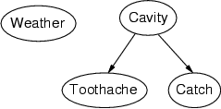
Example
Topology of network encodes conditional independence assertions:
Weather is independent of the other variables
Toothache and Catch are conditionally independent given Cavity

Slide 20
Example
I'm at work, neighbor John calls to say my alarm is ringing, but neighbor Mary doesn't call. Sometimes it's set off by minor earthquakes. Is there a burglary?
Variables: Burglary, Earthquake, Alarm, JohnCalls, MaryCalls
Network topology reflects "causal" knowledge:
  A burglar can set the alarm off
  An earthquake can set the alarm off
  The alarm can cause Mary to call
  The alarm can cause John to call
Notes:
Burglar alarm system installed. Judea Pearl researcher and living in LA

Slide 21
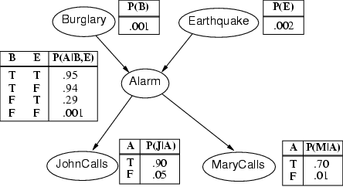
Example contd.
Notes:
John nearly calls ervery time the alarm is ringing but sometimes confuses whether it is the telephone or the alarm.
Mary often hears loud music. J & M only Alarm means we assume that they can not directly observe burglars and minor earthquakes.
Rows sum up to one because they represent all the cases for a variable. One must be the case. Any irrelevant attributes are encoded in prob-> laziness, ignorance

Slide 22
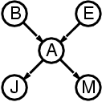
Compactness of Full Joint Encoding Due to Network Sparseness
A CPT for Boolean X_{i} with k Boolean parents has 2^{k} rows for the combinations of parent values
Each row requires one number p for X_{i} = true
(the number for X_{i} = false is just 1-p)
If each variable has no more than k parents,
the complete network requires n · 2^{k} numbers
i.e., grows linearly with n, vs. 2^{n} for the full joint distribution
For burglary net, 1 + 1 + 4 + 2 + 2 = 10 numbers (vs. 2⁵-1 = 31)

Slide 23
Semantics
The full joint distribution is defined as the product of the local conditional distributions:
P (X₁, … ,X_{n}) = π_{i = 1} P (X_{i} | Parents(X_{i}))
e.g., P(j ∧ m ∧ a ∧ ¬b ∧ ¬e)
= P (j | a) P (m | a) P (a | ¬b, ¬e) P (¬b) P (¬e)
= 0.90x0.7x0.001x0.999x0.998
≈ 0.00063
n

Slide 24
Noisy-OR-Representation
A
B
A
B
0.8
0.1
C
Meaning
C
A
B
c
f
f
0.0
f
t
0.1
t
f
0.8
t
t
0.1+0.8 - 0.1*0.8
Substantial reduction of the probabilities to be stored

Slide 25
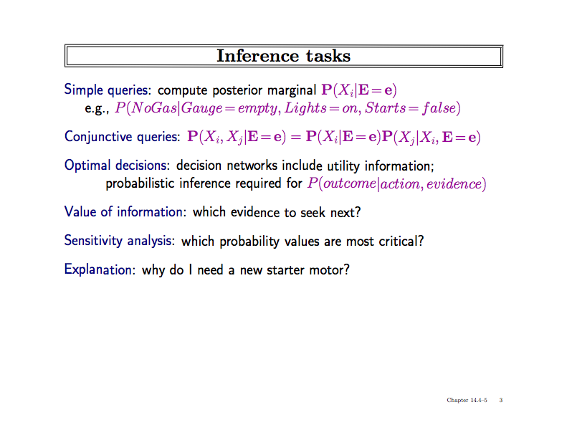
what must be true to allow for a certain (desired) conclusion?

Slide 26
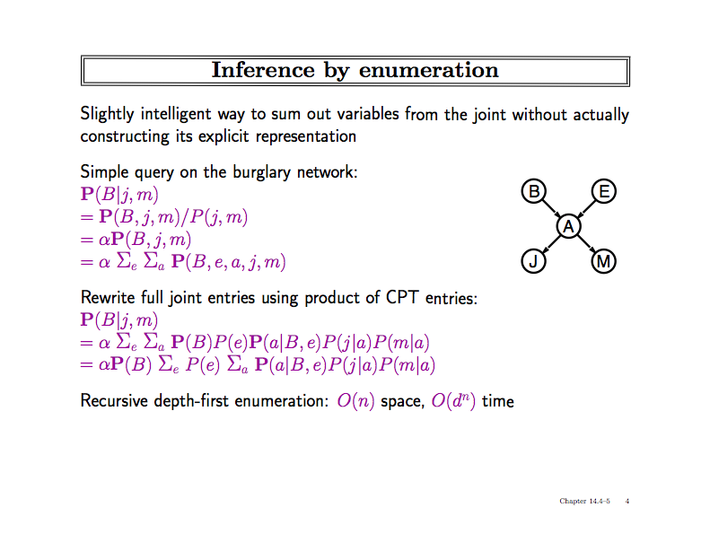
(Calculation over tree sum-product evaluation tree
with path length n (=number of RVs) and degree d
(=maximal number domain elements) )

Slide 27
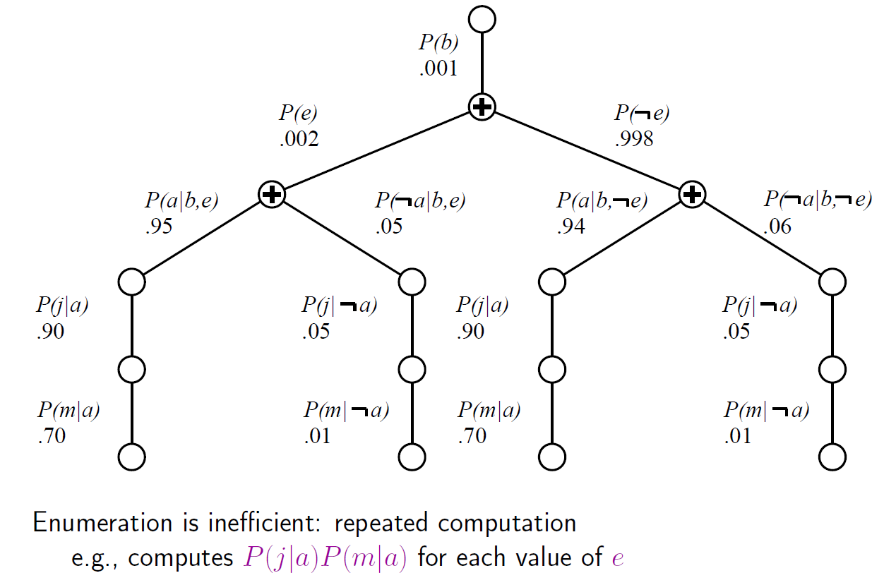
Evaluation Tree
Can do better with Variable Elimination (VE)

Slide 28
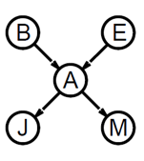
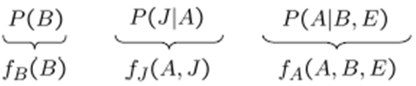
Basic Objects of VE
Track objects called factors
(right-to-left, in tree: bottom up)
Initial factors are local CPTs
During elimination create new factors
Form of Dynamic Programming
P(M|A)
f_{M}(A)

Slide 29
Basic Operations: Pointwise Product
Pointwise product of factors f₁ and f₂
  for example: f₁(A,B) * f₂(B,C)= f(A,B,C)
  in general:
  f₁(X₁,...,X_{j},Y₁,…,Y_{k}) *f₂(Y₁,…,Y_{k},Z₁,…,Z_{l})= f(X₁,...,X_{j},Y₁,…,Y_{k},Z₁,…,Z_{l})
  has 2^{j+k+l} entries (if all variables are binary)

Slide 30

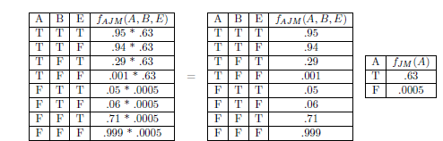
Join by pointwise product

Slide 31
Basic Operations: Summing out
Summing out a variable from a product of factors
  Move any constant factors outside the summation
  Add up submatrices in pointwise product of remaining factors
  𝛴_{x} f₁* …*f_{k} = f₁*…*f_{i}*𝛴_{x} f_{i+1}*…*f_{k}
  = f₁*…*f_{i}* f_{X}
  assuming f₁, …, f_{i} do not depend on X

Slide 32
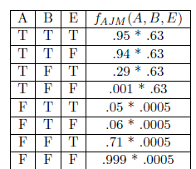
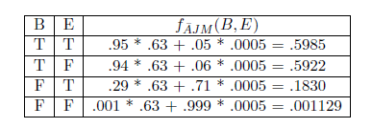
Summing out
Summing out a

Slide 33
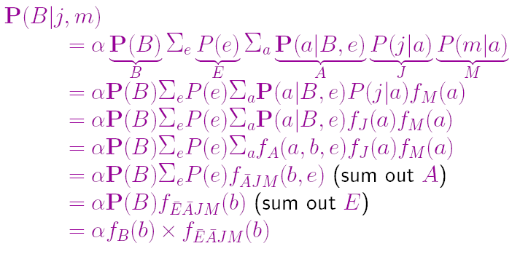
VE result for Burglary Example

Slide 34
Further Optimization by Finding Irrelevant Variables
{Alarm, Earthquake, Burglary}
Irrelevant variables can be identified by a graph theoretical criterion on the associated moral graph by m-separation
Many other inference algorithms and optimizations known
→ Discussed in detail in course on Bayesian Knowledge Representation

Slide 35
Acknowledgements
Slides from AIMA book provided by Cristina Conati, UBC

Slide 36
Data Mining Bayesian Networks
Full Bayesian Learning
MAP learning
Maximum Likelihood Learning
Learning Bayesian Networks
  Fully observable
  With hidden (unobservable) variables

Slide 37
Full Bayesian Learning
In the learning methods we have seen so far, the idea was always to find the best model that could explain some observations
In contrast, full Bayesian learning sees learning as Bayesian updating of a probability distribution over the hypothesis space, given data
  H is the hypothesis variable
  Possible hypotheses (values of H) h₁…, h_{n}
  P(H) = prior probability distribution over hypothesis space
j_{th} observation d_{j} gives the outcome of random variable D_{j}
  training data d= d₁,..,d_{k}

Slide 38
Non-Standard-Datenbanken
Bayesian Networks, Inference, and Learning
Prof. Dr. Ralf Möller
Universität zu Lübeck
Institut für Informationssysteme

Slide 39
Example contd.
Notes:
John nearly calls ervery time the alarm is ringing but sometimes confuses whether it is the telephone or the alarm.
Mary often hears loud music. J & M only Alarm means we assume that they can not directly observe burglars and minor earthquakes.
Rows sum up to one because they represent all the cases for a variable. One must be the case. Any irrelevant attributes are encoded in prob-> laziness, ignorance

Slide 40
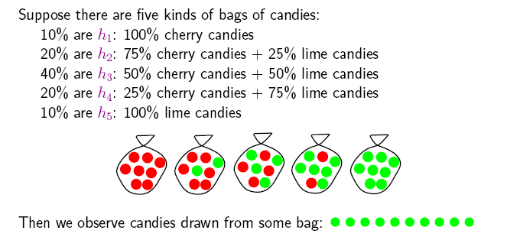
Example
Suppose we have 5 types of candy bags
  10% are 100% cherry candies (h₁₀₀)
  20% are 75% cherry + 25% lime candies (h₇₅)
  40% are 50% cherry + 50% lime candies (h₅₀)
  20% are 25% cherry + 75% lime candies (h₂₅)
  10% are 100% lime candies (h₀)
Then we observe candies drawn from some bag
Let‘s call 𝜃 the parameter that defines the fraction of cherry candy in a bag, and h_{𝜃} the corresponding hypothesis
Which of the five kinds of bag has generated my 10 observations? P(h _{𝜃} |d).
What flavour will the next candy be? Prediction P(X|d)

Slide 41
Full Bayesian Learning
Given the data so far, each hypothesis h_{i} has a posterior probability:
  P(h_{i} |d) = αP(d| h_{i}) P(h_{i}) (Bayes theorem)
  where P(d| h_{i}) is called the likelihood of the data under each hypothesis
Predictions over a new entity X are a weighted average over the prediction of each hypothesis:
  P(X|d) =
  = ∑_{i} P(X, h_{i} |d)
  = ∑_{i} P(X| h_{i},d) P(h_{i} |d)
  = ∑_{i} P(X| h_{i}) P(h_{i} |d)
  ~ ∑_{i} P(X| h_{i}) P(d| h_{i}) P(h_{i})
  The weights are given by the data likelihood and prior of each h
+ No need to pick one best-guess hypothesis!
- Need to iterate over all hypotheses
The data does not add anything to a prediction given a hypothesis

Slide 42
Example
If we re-wrap each candy and return it to the bag, our 10 observations are independent and identically distributed, i.i.d, so
  P(d| h_{𝜃}) = ∏_{j} P(d_{j}| h_{𝜃}) for j=1,..,10
For a given h_{𝜃} , the value of P(d_{j}| h_{𝜃}) is
  P(d_{j} = cherry| h_{𝜃}) = 𝜃; P(d_{j} = lime|h_{𝜃}) = (1-𝜃)
And given N observations, of which c are cherry and l = N-c lime
  Binomial distribution: probability of # of successes in a sequence of N independent trials with binary outcome, each of which yields success with probability 𝜃.
For instance, after observing 3 lime candies in a row:
  P([lime, lime, lime] | h ₅₀) = 0.5³ because the probability of seeing lime for each observation is 0.5 under this hypotheses

Slide 43
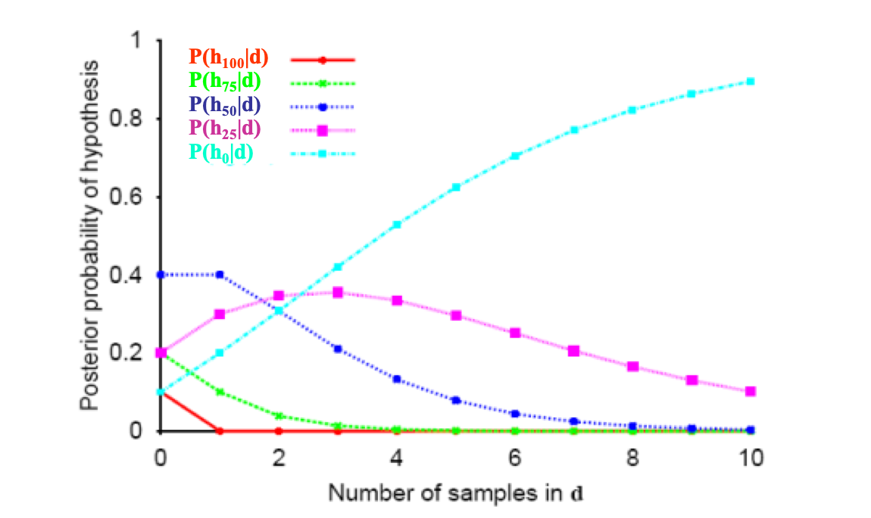
All-limes: Posterior Probability of H
P(h_{i} |d) = αP(d| h_{i}) P(h_{i})
Initially, the h_{p} with higher priors dominate (h₅₀ with prior = 0.4)
As data comes in, the finally best hypothesis (h₀) starts dominating, as the probability of seeing this data given the other hypotheses gets increasingly smaller
  After seeing three lime candies in a row, the probability that the bag is the all-lime one starts taking off

Slide 44
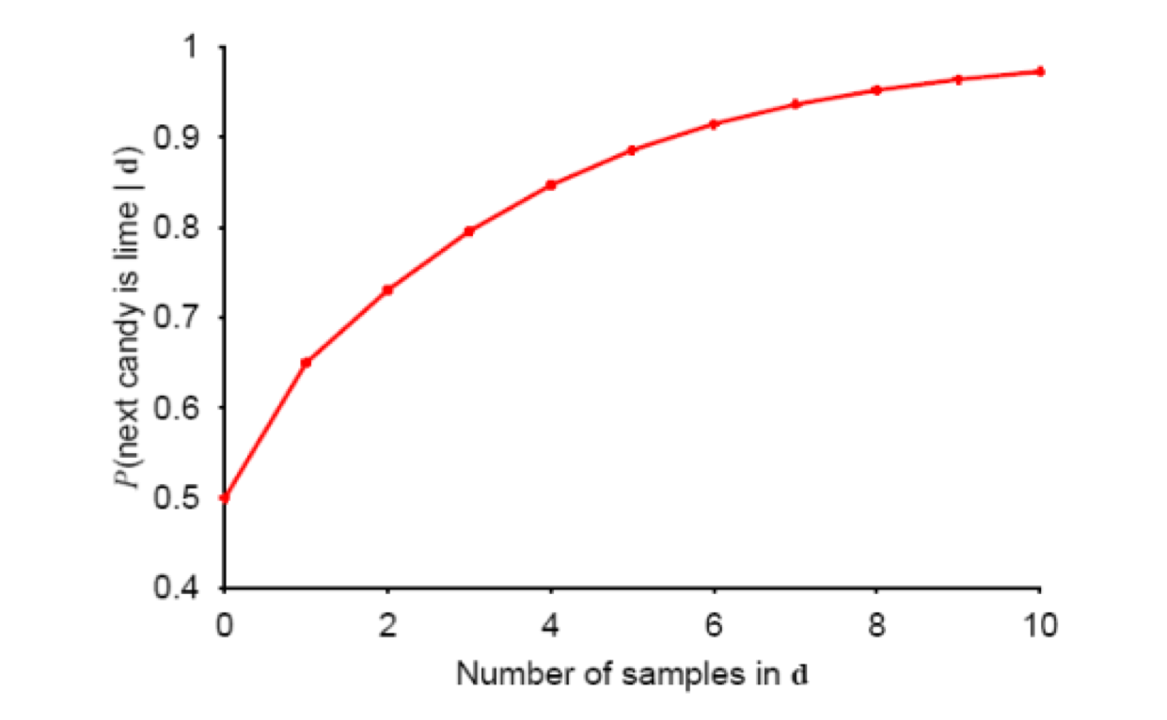
Prediction Probability
∑_{i} P(next candy is lime| h_{i}) P(h_{i} |d)
The probability that the next candy is lime increases with the probability that the bag is an all-lime one

Slide 45
Overview
Full Bayesian Learning
MAP learning
Maximum Likelihood Learning
Learning Bayesian Networks
  Fully observable
  With hidden (unobservable) variables

Slide 46
MAP approximation
Full Bayesian learning seems like a very safe bet, but unfortunately it does not work well in practice
  Summing over the hypothesis space is often intractable (e.g., 18,446,744,073,709,551,616 Boolean functions of 6 attributes)
Very common approximation: Maximum a posterior (MAP) learning:
  Instead of doing prediction by considering all possible hypotheses , as in
    P(X|d) = ∑_{i} P(X| h_{i}) P(h_{i} |d)
  Make predictions based on h_{MAP} that maximises P(h_{i} |d)
    I.e., maximize P(d| h_{i}) P(h_{i})
    P(X|d) ≈ P(X| h_{MAP} )

Slide 47
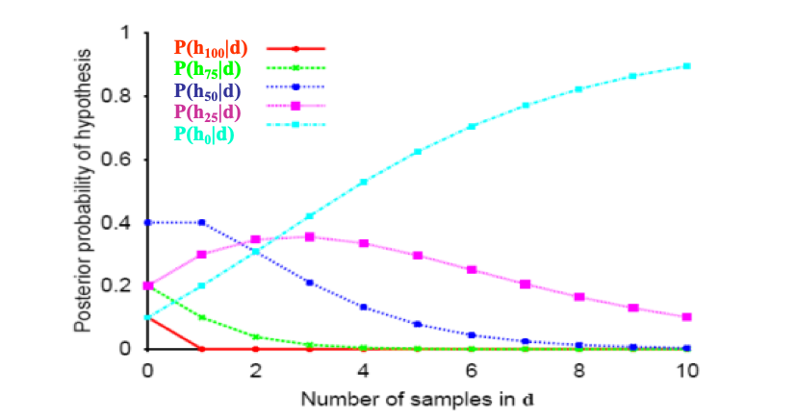
MAP approximation
MAP is a good approximation when P(X |d) ≈ P(X| h_{MAP})
  In our example, h_{MAP} is the all-lime bag after only 3 candies, predicting that the next candy will be lime with p =1
  The Bayesian learner gave a prediction of 0.8, safer after seeing only 3 candies

Slide 48
Bias
As more data arrive, MAP and Bayesian prediction become closer, as MAP’s competing hypotheses become less likely
Often easier to find MAP (optimization problem) than deal with a large summation problem
P(H) plays an important role in both MAP and Full Bayesian Learning (defines learning bias)
Used to define a tradeoff between model complexity and its ability to fit the data
  More complex models can explain the data better => higher P(d| h_{i}) danger of overfitting
  But they are less likely a priory because there are more of them than simpler model => lower P(h_{i})
  I.e. common learning bias is to penalize complexity

Slide 49
Overview
Full Bayesian Learning
MAP learning
Maximum Likelihood Learning
Learning Bayesian Networks
  Fully observable
  With hidden (unobservable) variables

Slide 50
Maximum Likelihood (ML)Learning
Further simplification over full Bayesian and MAP learning
  Assume uniform priors over the space of hypotheses
  MAP learning (maximize P(d| h_{i}) P(h_{i})) reduces to maximize P(d| h_{i})
When is ML appropriate?
Howard, R.: Decision analysis: Perspectives on inference, decision, and experimentation. Proceedings of the IEEE 58(5), 632-643, 1970

Slide 51
Maximum Likelihood (ML) Learning
Further simplification over Full Bayesian and MAP learning
  Assume uniform prior over the space of hypotheses
  MAP learning (maximize P(d| h_{i}) P(h_{i})) reduces to maximize P(d| h_{i})
When is ML appropriate?
  Used in statistics as the standard (non-bayesian) statistical learning method by those who distrust subjective nature of hypotheses priors
  When the competing hypotheses are indeed equally likely (e.g. have same complexity)
  With very large datasets, for which P(d| h_{i}) tends to overcome the influence of P(h_{i})

Slide 52
Overview
Full Bayesian Learning
MAP learning
Maximum Likelihood Learning
Learning Bayesian Networks
  Fully observable (complete data)
  With hidden (unobservable) variables

Slide 53
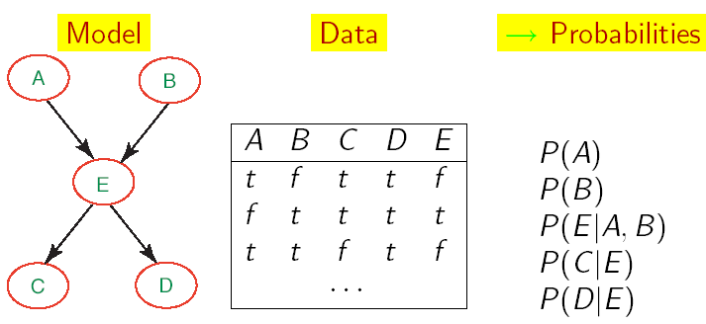
Learning BNets: Complete Data
We will start by applying ML to the simplest type of BNets learning:
  known structure
  Data containing observations for all variables
    All variables are observable, no missing data
The only thing that we need to learn are the network’s parameters

Slide 54
Maximum-Likelihood-Parameterschätzung
Nehme an, die Struktur eines BNs sei bekannt
Ziel: Schätze BN-Parameter 𝜃
  Einträge in CPTs, P(X | Parents(X))
Eine Parametrierung 𝜃 ist gut, falls hierdurch die beobachteten Daten wahrscheinlich generiert werden:
Maximum Likelihood Estimation
(MLE) Prinzip: Wähle 𝜃* so,
dass P(D| 𝜃*) maximiert wird
Gleichverteilte, unabhängige Stichprobem
(i.i.d. samples)
54

Slide 55
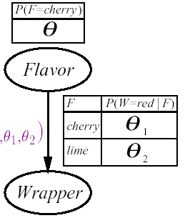
Anwendungsbeispiel Bonbonfabrik
Ein Hersteller wählt die Farbe des Bonbonpapiers mit einer bestimmten Wahrscheinlichkeit je nach Geschmack, wobei die entsprechende Verteilung nicht bekannt sei
  Wenn Geschmack=cherry, wähle rotes Papier mit W'keit 𝜃₁
  Wenn Geschmack=lime, wähle rotes Papier mit W'keit 𝜃₂
Das Bayessche Netzwerk enthält drei zu lernende Parameter
  𝜃 𝜃 ₁ 𝜃 ₂

Slide 56
Anwendungsbeispiel Bonbonfabrik
P( W=green, F = cherry| h_{𝜃𝜃1𝜃2}) = (*)
= P( W=green|F = cherry, h_{𝜃𝜃1𝜃2}) P( F = cherry| h_{𝜃𝜃1𝜃2})
= 𝜃 (1-𝜃 ₁)
Wir packen N Bonbons aus
  c sind cherry und l sind lime
  r^{c} cherry mit rotem Papier, g^{c} cherry mit grünem Papier
  r^{l} lime mit rotem Papier, g ^{l} lime mit grünem Papier
  Jeder Versuch liefert eine Kombination aus Papier und Geschmack wie bei (*)
P(d| h_{𝜃𝜃1𝜃2})
= ∏_{j} P(d_{j}| h_{𝜃𝜃1𝜃2}) = 𝜃^{c} (1-𝜃) ^{l} (𝜃 ₁) ^{rc} (1-𝜃 ₁) ^{gc} (𝜃 ₂) ^{r l} (1-𝜃 ₂) ^{g l}

Slide 57
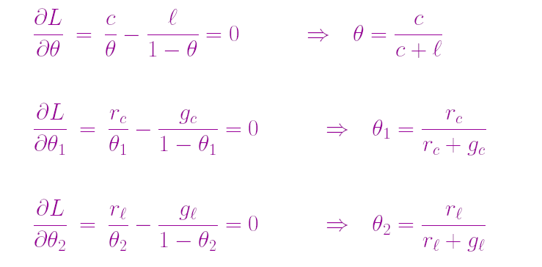
Anwendungsbeispiel Bonbonfabrik
Maximierung des Logarithmus der Zielfunktion
  clog𝜃 + l log(1- 𝜃) + r^{c} log 𝜃 ₁ + g^{c} log(1- 𝜃 ₁) + r^{l} log 𝜃 ₂ + g ^{l} log(1- 𝜃 ₂)
Bestimmung der Ableitungen bzgl. 𝜃, 𝜃 ₁ ,𝜃 ₂
  Ausdrücke ohne Term, nach dem abgeleitet wird, verschwinden

Slide 58
Maximum-Likelihood-Parameterschätzung
Schätzung durch Bildung relativer Häufigkeiten
Dieser Prozess ist auf jedes voll beobachtbare BN anwendbar
Mit vollständigen Daten und Maximum-Likelihood-Parameterschätzung:
  Parameterlernen zerfällt in separate Lernprobleme für jeden Parameter (CPT) durch Logarithmierung
  Jeder Parameter wird durch die relative Häufigkeit eines Knotenwertes bei gegebenen Werten der Elternknoten bestimmt

Slide 59
Beliebte Anwendung: Naives Bayes-Modell
C
Naïve Bayes-Modell: Sehr einfaches
Bayessches Netzwerk zur Klassifikation
  Klassenvariable C (vorherzusagen) bildet Wurzel
  Attributvariablen X_{i} (Beobachtungen) sind Blätter
Naiv, weil angenommen wird, dass die Attributwerte bedingt unabhängig sind, wenn die Klasse gegeben ist
Deterministische Vorhersagen können durch Wahl der wahrscheinlichsten Klasse erreicht werden
Skalierung auf realen Daten sehr gut:
  2n + 1 Parameter benötigt
X_{n}
X₁
X₂

Slide 60
Überblick
Volles Bayessches Lernen (BMA)
MAP-Lernen
Maximum-Likelihood-Lernen
  Vollständig beobachtbar (vollständige Daten)
  Mit versteckten (unbeobachtbaren) Variablen

Slide 61
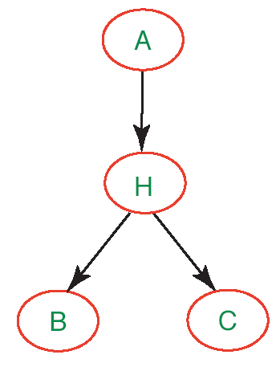
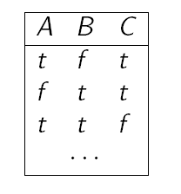
Parameterlernen mit versteckten Variablen
Bisher haben wir angenommen, Daten für jede Variable des BNs stehen zur Verfügung
Was machen wir, wenn das nicht der Fall ist, d.h. es gibt versteckte (hidden) Variablen im Netzwerk?
Den Ansatz mit relativen Häufigkeiten können wir nicht so einfach übernehmen (keine Zähler für Variable H bekannt)

Slide 62
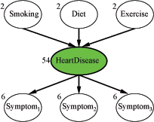
Vermeintliche Lösung
Vermeide versteckte Variablen
Könnte klappen bei kleinen Netzwerken
Doch was machen wir hier?
  Jede Variable habe 3 Werte (low, moderate, high)
  Die Zahlen an den Knoten repräsentieren, wie viele Parameter für die CPT des betreffenden Knotens bestimmt werden müssen
  78 Wahrscheinlichkeitswerte insgesamt

Slide 63
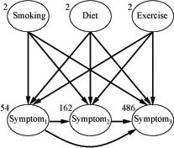
HeartDisease wegzulassen ist gar keine gute Lösung!
Die Symptome sind nicht länger bedingt unabhängig
gegeben die Elternknotenwerte
  Sehr viel mehr Kanten, sehr viel mehr Wahrscheinlichkeiten zu spezifizieren: 708 insgesamt
  Wir brauchen sehr viel mehr Daten,
  um diese ganzen Werte vernünftig zu lernen

Slide 64
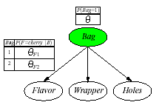
Beispiel: Bonbonfabrik wieder einmal
Zwei Bonbontüten (1 and 2) wurden vermischt
Bonbons werden durch drei Eigenschaften beschrieben: Flavor und Wrapper wie vorher, plus Hole (ob ein Loch in der Mitte ist)
Die Merkmale von Bonbon hängen mit bestimmten Wahrscheinlichkeiten von der Tüte ab, aus der sie kommen
Wir wollen für jedes Bonbon vorhersagen, aus welcher Tüte es kam, je nach vorgefundenen Eigenschaften: Naïve-Bayes-Modell
𝜃= P(Bag = 1)
𝜃_{Fj} = P(Flavor = cherry|Bag = j)
𝜃_{Wj} = P(Wrapper = red|Bag = j)
𝜃_{Hj} = P(Hole = yes|Bag = j)
j =1,2

Slide 65
Expectation-Maximization (EM)
Wenn wir versteckte Variablen beibehalten und die Netzwerkparameter aus Daten lernen wollen, haben wir eine Form des unüberwachten Lernens (unsupervised learning)
  Die Daten geben nicht über alle Aspekte von Datenpunkten Auskunft
Expectation-Maximization
  Genereller Algorithmus zum Lernen von Modellparametern bei unvollständigen Daten
  Hier für diskrete Datenwerte im BN-Kontext gezeigt

Slide 66
EM: Generelle Idee
Falls wir Daten für alle Variablen im BN hätten, könnten wir die Parameter mit ML- (oder MAP-) Ansätzen lernen
  Relative Häufigkeiten bestimmen, wie vorher besprochen
Falls wir die Parameter hätten, könnten wir die Posterior-Wahrscheinlichkeiten jedes Ereignisses schätzen:
  P(H|A,B,C)
Dempster, A.P., Laird. N.M., Rubin, D.B.: Maximum-Likelihood from incomplete data via the EM algorithm. Journal of the Royal Statistical Society, 1977

Slide 67
EM: Generelle Idee
Der Algorithmus startet mit "erfundenen" (zufällig generierten) Informationen, um das Lernproblem zu lösen:
  Erfundene Netzwerkparameterwerte (virtuell notiert in den CPTs)
Dann werden die Initialwerte in zwei Schritten verfeinert:
  Expectation (E): Aktualisiere die Daten (virtuell) mit aus dem aktuellen Modell hergeleiteten Erwartungen
  Maximization (M): Gegeben die aktualisierten Daten, aktualisieren die Parameter des BNs mitteln Maximum Likelihood (ML) Ansatz
    Das ist der gleiche Schritt, wie im voll beobachtbaren Fall
CPT: Conditional Probability Table

Slide 68
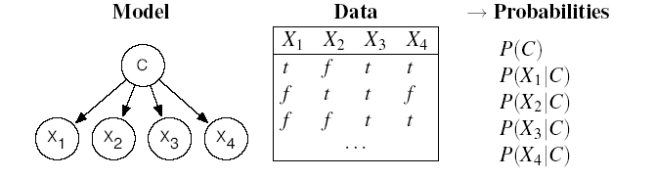
EM: Wie funktioniert das mit Naive Bayes-Modelen
Betrachtet die folgenden Daten, …
  N Beispiele mit Booleschen Attributen X₁, X₂, X₃, X₄
… die wir kategorisieren wollen mit möglichen Werten einer Klasse C = {1,2,3}
Wir verwenden einen naiven Bayes-Klassifikator mit versteckter Variable C
?
?
?
?
?

Slide 69
EM: Initialisierung
Der Algorithmus startet mit "erfundenen" (zufällig generierten) Informationen, um das Lernproblem zu lösen:
  Erfundene Netzwerkparameterwerte (virtuell notiert in den CPTs)
?
?
?
?
?
Definiere
zufällige
Parameter

Slide 70
EM: Expectation-Schritt (Bestimmung der erwarteter Zahlen)
?
?
?
?
?
Was benötigen wir, um die Netzwerkparameter mit dem
Maximum-Likelihood-Ansatz zu lernen?
  Für P(C) = Anzahl(Datenpunkte mit C=i) / Anzahl (alle Datenpunkte) i=1,2,3
  Für P(X_{h}|C) = Anzahl(Daten mit X_{h} = val_{k} und C=i) / Anzahl(Daten mit C=i)
  für alle Werte val_{k} von X_{h} und i=1,2,3

Slide 71
EM: Expectation-Schritt (Bestimmung der erwarteter Zahlen)
Bislang haben wir nur: N = Anzahl(Datenpunkte)
Wir approximieren alle weiteren Zähler mit erwarteten Zählerwerten, die aus dem Modell mit den "erfundenen" Parametern abgeleitet werden
Der erwartete Zähler ist die Summe, über alle N Beispieldaten, der Wahrscheinlichkeiten, dass jedes Beispiel in Kategorie i fällt
Attribute von Beispiel e_{j} )

Slide 72
EM: Expectation-Schritt (Bestimmung der erwarteter Zahlen)
Wie erhalten wir die notwendigen Werte aus dem Modell?
Leicht mit naivem Bayesschen Netzwerk
Attribute von Beispiel e_{j} )
Auch direkt aus Netzwerk bestimmbar.
Übungsaufgabe
Erfundene Parameter für das Netzwerk

Slide 73
EM: Expectation-Schritt (Bestimmung der erwarteter Zahlen)
Durch einen ähnlichen Schritt erhalten wir die erwarteten Zähler für Beispiele mit Attribut X_{h}= val_{k} und Kategorie i
Diese werden später benötigt zur Schätzung von P(X_{h} | C):
  für alle Werte val_{k} von X_{h} und i=1,2,3
Zum Beispiel
Wiederum erhalten wir diese W'keiten
aus dem aktuellen Modell

Slide 74
EM: Generelle Idee
Der Algorithmus startet mit "erfundenen" (zufällig generierten) Informationen, um das Lernproblem zu lösen:
  Erfundene Netzwerkparameterwerte (virtuell notiert in den CPTs)
Dann werden die Initialwerte in zwei Schritten verfeinert:
  Expectation (E): Aktualisiere die Daten (virtuell) mit aus dem aktuellen Modell hergeleiteten Erwartungen
  Maximization (M): Gegeben die aktualisierten Daten, aktualisieren die Parameter des BNs mitteln Maximum Likelihood (ML) Ansatz
    Das ist der gleiche Schritt, wie im voll beobachtbaren Fall
CPT: Conditional Probability Table

Slide 75
Maximization-Schritt: (Verfeinerung der Parameter)
Nun verfeinern wir die Netzwerkparameter mittels
Maximum-Likelihood-Lernen auf den erwarteten Zählern
  für alle Werte val_{k} von X_{j} und i=1,2,3

Slide 76
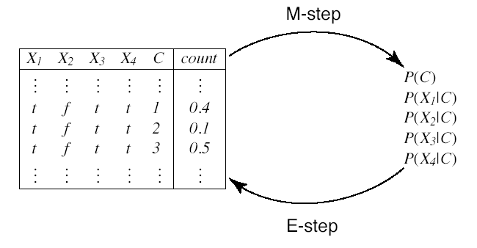
EM-Zyklus
Nun kann der E-Schritt wiederholt werden
Erwartete Zähler
(“Augmented data”)
Wahrscheinlichkeiten

Slide 77
Beispiel: Bonbonfabrik wieder einmal
Zwei Bonbontüten (1 and 2) wurden vermischt
Bonbons werden durch drei Eigenschaften beschrieben: Flavor und Wrapper wie vorher, plus Hole (ob ein Loch in der Mitte ist)
Die Merkmale von Bonbon hängen mit bestimmten Wahrscheinlichkeiten von der Tüte ab, aus der sie kommen
Wir wollen für jedes Bonbon vorhersagen, aus welcher Tüte es kam, je nach vorgefundenen Eigenschaften: Naïve-Bayes-Modell
𝜃= P(Bag = 1)
𝜃_{Fj} = P(Flavor = cherry|Bag = j)
𝜃_{Wj} = P(Wrapper = red|Bag = j)
𝜃_{Hj} = P(Hole = yes|Bag = j)
j =1,2

Slide 78
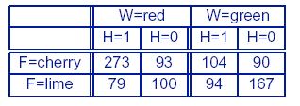
Daten
Nehmen wir an, die wahren Parameter seien:
  𝜃= 0.5;
  𝜃_{F1} = 𝜃_{W1} = 𝜃_{H1} = 0.8;
  𝜃_{F2} = 𝜃_{W2} = 𝜃_{H2} = 0.3;
Annahme: Die folgenden Zähler werden "gesampelt" aus P(C, F, W, H) (N = 1000): Wir haben einen Datensatz
Wir wollen nun die wahren Parameter aus diesen Daten mittels EM rekonstruieren

Slide 79
EM: Initialisierung
Weise Parametern zufällige Initialwerte zu
  Zu Vereinfachung der Darstellung verwenden wir hier:
Nun durchlaufen wir einen EM-Zyklus
zur Berechnung von 𝜃^{(1).}

Slide 80
E-Schritt
Zuerst brauchen wir die erwarteten Zähler für Bonbon von Tüte 1:
  Addiere die Wahrscheinlichkeiten, dass jedes der N Datenpunkte aus Tüte 1 kommt
  Seien flavor_{j}, wrapper_{j}, hole_{j} die Werte der entsprechenden Attribute für den j-ten Datenpunkt

Slide 81
E-step
Die Summation kann in die 8 Bonbongruppen aus der Tabelle
aufgebrochen werden.
  Zum Beispiel ergibt die Summe über 273 cherry-Bonbons mit rotem Papier und einem Loch (erster Eintrag in der Tabelle)

Slide 82
M-Schritt
Mit der Berechnung der anderen 7 Bonbongruppe erhalten wir
Nun führen wir den M-Schritt aus, um 𝜃 zu verfeinern. Hierzu nehmen wir den erwarteten Zählerwert der Datenpunkte aus Tüte 1

Slide 83
Noch ein Parameter…
Wir machen das gleiche für den Parameter 𝜃_{F1}
E-Schritt: Bestimme erwarteten Zählerwert von cherry-Bonbons aus Tüte 1
Bestimmbar aus naivem Bayesschen Modell wie vorher besprochen
Als Übung…
M-Schritt: Verfeinere 𝜃_{F1} durch Bestimmung der relativen Häufigkeiten

Slide 84
Lernergebnis
Nach einem vollen Zyklus über alle Parameter haben wir
Für jeden Satz von Parametern können wir die Log-Likelihood bestimmen wie auch schon früher
Man kann zeigen, dass dieser Wert mit jeder EM-Iteration steigt (Konvergenz)
EM mit Maximum-Likelihood bleibt aber bei lokalen Maxima hängen bleiben (ggf. mehrere Startwerte nehmen, Priors berücksichtigen oder MAP nehmen)

Slide 85
Lernergebnis
Nach einem vollen Zyklus über alle Parameter haben wir
Für jeden Satz von Parametern können wir die Log-Likelihood bestimmen wie auch schon früher
Wir können zeigen, das die Log-Likelihood in jeder Iteration ansteigt, so dass die initiale Likelihood schon nach drei Iterationen überflügelt wird

Slide 86
EM: Diskussion
Für komplexere BNs ist der Algorithmus der gleiche
  Im allgemeinen müssen wir die CPT-Einträge für jede Variable X_{i} gegeben die Elternknotenwerte Pa_{i} berechnen
  𝜃_{ijk}= P(X_{i} = x_{ij}|Pa_{i =} pa_{ik})
Die erwarteten Zählerwerte werden durch Summierung über die Beispiele berechnet, nachdem all notwendigen
P(X_{i} = x_{ij},Pa_{i =} pa_{ik}) mittels BN-Algorithmen bestimmt sind
Das Verfahren kann in eine kombinatorische Explosion laufen (hierfür gibt es dann Approximationstechniken)

Slide 87
Learning Bayesian network structures
Given training set
Find model that best matches D
  model selection
  parameter estimation
B
E
Inducer
A
C
Data D
Some of the following slides from an AI course „Graphical models“
by Burgard/De Raedt/Kersting/Nebel

Slide 88
Model selection
Goal: Select the best network structure, given the data
Input:
  Training data
  Scoring function
Output:
  A network that maximizes the score

Slide 89
Structure selection: Scoring
Bayesian: prior over parameters and structure
  get balance between model complexity and fit to data as a byproduct
Score_{D} (G) = log P(G|D) = α log [P(D|G) P(G)]
Marginal likelihood just comes from our parameter estimates
Prior on structure can be any measure we want; typically a function of the network complexity (MDL principle)
Can we learn G’s params from D?
Does G explain D with ML?
Prior w.r.t. MDL
Same key property: Decomposability
Score(structure) = Σ_{i} Score(substructure of X_{i})
Notes:
Remember: MDL = minimum description length, here network complexity; the more complex a system the lesser its probability.

Slide 90
Heuristic search
B
E
Add E→C
A
B
E
Δscore(C)
A
C
Reverse E→A
C
Δscore(A)
Delete E→A
B
E
Δscore(A)
B
E
A
A
C
C

Slide 91
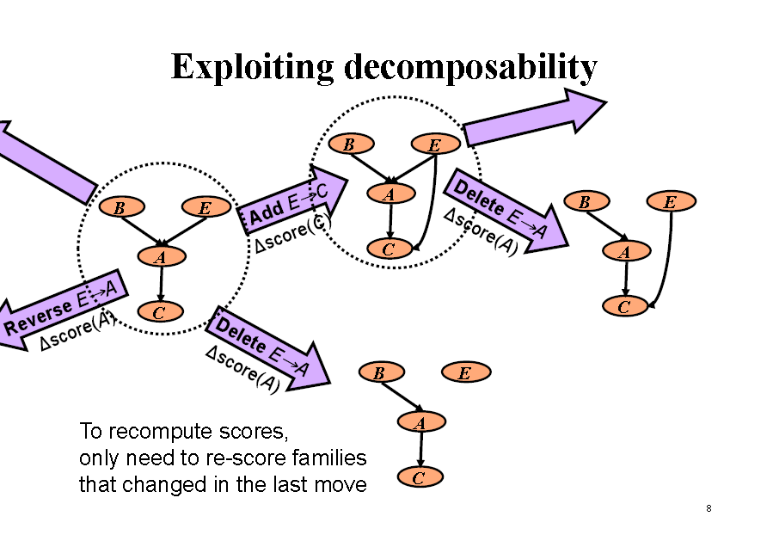
That‘s fine.
But what to do if we have
non-complete data??
Cannot use decomposability
=> Reran parameter estimation

Slide 92
Local Search in Practice
Perform EM for each candidate graph
Parameter space
G₃
G₂
G₁
Parametric optimization (EM)
Local Maximum
G₄
G_{n}

Slide 93
Local Search in Practice
Perform EM for each candidate graph
Parameter space
G₃
G₂
G₁
Parametric optimization (EM)
Local Maximum
G_{n}
Computationally expensive:
  Parameter optimization via EM — non-trivial
  Need to perform EM for all candidate structures
  Spend time even on poor candidates
⇒ In practice, considers only a few candidates
G₄

Slide 94
Structural EM [Friedman et al. 98]
Recall, in complete data we had
  Decomposition ⇒ efficient search
Idea:
Instead of optimizing the real score…
Find decomposable alternative score
Such that maximizing new score
    ⇒ improvement in real score

Slide 95
Structural EM
Idea:
Use current model to help evaluate new structures
Outline:
Perform search in (Structure, Parameters) space
At each iteration, use current model for finding either:
  Better scoring parameters: “parametric” EM step
  or
  Better scoring structure: “structural” EM step
Nir Friedman. The Bayesian structural EM algorithm. In Proceedings of the 14th conference on Uncertainty in artificial intelligence (UAI'98), 129-138. 1998

Slide 96
Score for structure G and parameterization 𝜃 given data over observed RVs O
Score_{O} (G, 𝜃) = log P(O:G,𝜃) – Pen(G, 𝜃,O)
Handle hiddens H (non-observed) by conditionalizing (like in full bayesian learning) using current structure G* and parameterization 𝜃*
Q(G, 𝜃 :G*, 𝜃*) = E_{h~P(h|O:G*, 𝜃*)}[logP(O,h:G, 𝜃)] – Pen(G, 𝜃,O)
Alternating model selecetion EM
Choose G⁰ and 𝜃⁰ randomly
Loop for n= 0,1, … until convergence
Find G^{n+1}, 𝜃^{n+1} s.t. Q(G^{n+1}, 𝜃^{n+1}: G^{n}, 𝜃^{n}) > Q(G^{n}, 𝜃^{n}: G^{n}, 𝜃^{n})

Slide 97
Structural EM
Reiterate
Score
&
Parameterize
Computation
Expected Counts
N(X₁)
N(X₂)
N(X₃)
N(H, X₁, X₁, X₃)
N(Y₁, H)
N(Y₂, H)
N(Y₃, H)
X₁
X₂
X₃
X₁
X₂
X₃
H
H
Y₁
Y₂
Y₃
Y₁
Y₂
Y₃
+
Training
Data
N(X_{2,}X₁)
N(H, X₁, X₃)
N(Y₁, X₂)
N(Y₂, Y₁, H)
X₁
X₂
X₃
H
Y₁
Y₂
Y₃

Slide 98
Structure Learning: incomplete data
Data
E
S X D C B
<? 0 1 0 1>
<1 1 ? 0 1>
<0 0 0 ? ?>
<? ? 0 ? 1>
………
B
A
Expectation
Inference:
P(S|X=0,D=1,C=0,B=1)
Current model
Expected
counts
Maximization
Parameters
S X D C B
1 0 1 0 1
1 1 1 0 1
0 0 0 0 0
1 0 0 0 1
………..
EM-algorithm:
iterate until convergence

Slide 99
Structure Learning: incomplete data
E
B
Data
E
S X D C B
<? 0 1 0 1>
<1 1 ? 0 1>
<0 0 0 ? ?>
<? ? 0 ? 1>
………
A
A
Expectation
B
Inference:
P(S|X=0,D=1,C=0,B=1)
Current model
Expected
counts
Maximization
Parameters
S X D C B
1 0 1 0 1
1 1 1 0 1
0 0 0 0 0
1 0 0 0 1
………..
Maximization
Structure
SEM-algorithm:
iterate until convergence
E
B
E
E
A
A
A
B
B

Slide 100
Variations on a theme
Known structure, fully observable: only need to do parameter estimation
Known structure, hidden variables:
use expectation maximization (EM) to estimate parameters
Unknown structure, fully observable: do heuristic search through structure space, then parameter estimation
Unknown structure, hidden variables: structural EM

Slide 101




Big Datasets Destroy Simple Abstractions
SELECT *
FROM RAWDATA
INPUT FILE
time | id | temp
10am | 1 | 20
10am | 2 | 21
.. | .. | …
10am | 7 | 29
time | id | temp
10am | 1 | 20
10am | 2 | 21
.. | .. | …
10am | 7 | 29
…
Raw Data Tables
OUTPUT FILE
Sensor/RFID streams
(+ metadata, floor plans, …)
Relational DBMS
HeisenData -- Towards a Next-Generation Uncertain Data Management System
Project Funding: FP7 Marie-Curie International Reintegration Grants
(FP7-PEOPLE-2009-RG, Reference No. 249217)
Project Duration: 1/3/2010 - 28/2/2014
Fellow & Scientist-in-Charge: Prof. Minos Garofalakis
Managing Large, Uncertain Data
Repositories with Probabilistic Graphical Models
Daisy Zhe Wang+, Eirinaios Michelakis+, Minos Garofalakis*+, Joseph M. Hellerstein+ University of California Berkeley+, Yahoo! Research*
25th August 2008, VLDB
Minos Garofalakis, Projekt HeisenData

Slide 102
BayesStore Data Model
Incomplete Relation -- R^{p}
Distribution over Possible Worlds – F
Sensor1(Time(T), Room(R), Sid, Temperature(Tp) ^{p}, Light(L) ^{p})
Incomplete Relation of
Sensor1^{p}
Probabilistic Distribution of Sensor1^{p}
F = Pr [X₁, …, X₇ ]
N: number of missing values
|X|: size of the domain
t1 t2 t3
t4 t5 t6
T | R | Sid | Tp^{p} | _{L}p
1 | 1 | 1 | Hot | X1
1 | 1 | 2 | Cold | Drk
1 | 1 | 3 | X2 | X3
1 | 2 | 1 | X4 | Brt
1 | 2 | 2 | Hot | X5
1 | 2 | 3 | X6 | X7
|F| = Θ(|X|^{N})
Daisy Zhe Wang, Eirinaios Michelakis, Minos Garofalakis, and Joseph M. Hellerstein. "BAYESSTORE: Managing Large, Uncertain Data Repositories with Probabilistic Graphical Models", Proceedings of VLDB'2008 (PVLDB, Vol. 1), 2008.
http://heisendata.softnet.tuc.gr

Slide 103



The Skyscrapers Example
For all sensor in all rooms at all timestamp, Light and Temperature readings are correlated.
Light Temperature
http://heisendata.softnet.tuc.gr

Slide 104





Definitions
Stripe: A family of random variables from the same probabilistic attribute.
First-order Factor: A family of local models, which share the same structure and conditional probability table(CPT).
BayesStore Data Type: The input and output abstract data type of queries in BayesStore, which consists of data and model.
Possible Worlds
http://heisendata.softnet.tuc.gr

Slide 105



F as a First-order Bayesian Network (I)
Sensor1^{p} Stripe (FO Variable) Definitions
T | R | Sid | Tp^{p} | _{L}p
1 | 1 | 1 | H | X1
1 | 1 | 2 | Cold | Drk
1 | 1 | 3 | X2 | X3
1 | 2 | 1 | X | Brt
1 | 2 | 2 | Hot | X5
1 | 2 | 3 | X6 | X7
2 | 1 | 1 |  | X8
2 | 1 | 2 | Cold | Drk
2 | 1 | 3 | X9 | X10
2 | 2 | 1 | X | Brt
2 | 2 | 2 | Hot | X12
2 | 2 | 3 | X13 | X14
t1 t2 t3
t4 t5 t6
t7 t8 t9
t10 t11 t12
All Tp values in Sensor1^{p} with Sid=1
ot
4
Hot
11
http://heisendata.softnet.tuc.gr

Slide 106









F as a First-order Bayesian Network (I)
Sensor1^{p} Stripe (FO Variable) Definitions
T | R | Sid | Tp^{p} | _{L}p
1 | 1 | 1 |  | X
1 | 1 | 2 | d | Dr
1 | 1 | 3 | X | X
1 | 2 | 1 | X | B
1 | 2 | 2 |  | X
1 | 2 | 3 | X | X
2 | 1 | 1 |  | X
2 | 1 | 2 | d | Dr
2 | 1 | 3 | X | X
2 | 2 | 1 | X | B
2 | 2 | 2 |  | X
2 | 2 | 3 | X | X1
t1 t2 t3
t4 t5 t6
t7 t8 t9
t10 t11 t12
All Tp values in Sensor1^{p} with Sid=1
Hot
1
Col
k
2
3
All Tp values in Sensor1^{p} with Sid=2
4
rt
Hot
5
6
7
All Tp values in Sensor1^{p} with Sid !=2
Hot
8
Col
k
9
10
All Tp values in Sensor1^{p}
11
rt
Hot
12
All L values in Sensor1^{p}
13
4
http://heisendata.softnet.tuc.gr

Slide 107



F as a First-order Bayesian Model
Mapping between Stripes
All Tp values All L values
All Tp values
All L values
….
….
All Tp values with Sid=1
All Tp values with Sid=1
All Tp values with Sid=2
All Tp values with Sid=2
….
http://heisendata.softnet.tuc.gr

Slide 108
F as a First-order Bayesian Model
First-order Factor Definitions
All Tp values
All L values
Tp | L | p
Cold | Brt | 0.1
Hot | Brt | 0.9
Hot | Drk | 0.1
Cold | Drk | 0.9
All Tp values with Sid=1
All Tp values with Sid=2
Tp1 | Tp2 | p
Cold | Cold | 0.1
Cold | Hot | 0.9
Hot | Hot | 0.1
Hot | Cold | 0.9
All Tp values with Sid !=2
Tp | p
Cold | 0.6
Hot | 0.4
http://heisendata.softnet.tuc.gr

Slide 109
Query Semantics
<R^{p},F_{FOBN}>
Resulting
<R^{p},F_{FOBN}>
Relational and Inference Queries
(I)
(II)
Represent (IV)
Represent
^{(III)} Relational and
Inference Queries
Resulting Possible Worlds And Distribution
Possible Worlds And Distribution
http://heisendata.softnet.tuc.gr

Slide 110

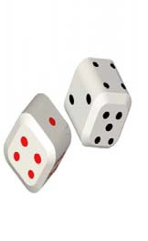
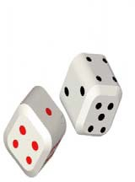
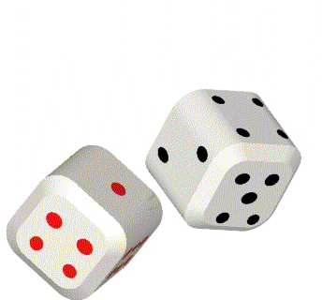
Query Algebra
Relational Queries
ML Inference Queries
Full Distribution Queries
http://heisendata.softnet.tuc.gr

Slide 111
Selection
Selection over Incomplete Relation R^{p}
Selection over Model M_{FOBN}
Sensor1^{p}
Sensor1^{p}
T | R | Sid | Tp^{p} | _{L}p
1 | 1 | 1 | Hot | X1
1 | 1 | 2 | Cold | Drk
1 | 1 | 3 | X2 | X3
1 | 2 | 1 | X4 | Brt
1 | 2 | 2 | Hot | X5
1 | 2 | 3 | X6 | X7
t1 t2 t3
t4 t5 t6
σ Tp=Cold
http://heisendata.softnet.tuc.gr

Slide 112
Selection
Selection over Incomplete Relation R^{p}
Selection over Model M_{FOBN}
Sensor1^{p}
Sensor1^{p}
T | R | Sid | Tp^{p} | _{L}p
1 | 1 | 1 | Hot | X1
1 | 1 | 2 | Cold | Drk
1 | 1 | 3 | X2 | X3
1 | 2 | 1 | X4 | Brt
1 | 2 | 2 | Hot | X5
1 | 2 | 3 | X6 | X7
t1 t2 t3
t4 t5 t6
σ Tp=Cold
T | R | Sid | Tp ^{p} | _{L}p
1 | 1 | 2 | Cold | Drk
1 | 1 | 3 | X2 | X3
1 | 2 | 1 | X4 | Brt
1 | 2 | 3 | X6 | X7
t2 t3
t4 t6
http://heisendata.softnet.tuc.gr

Slide 113
Selection
Selection over Incomplete Relation R^{p}
Selection over Model M_{FOBN}
Sensor1^{p}
Sensor1^{p}
T | R | Sid | Tp^{p} | _{L}p
1 | 1 | 1 | Hot | X1
1 | 1 | 2 | Cold | Drk
1 | 1 | 3 | X2 | X3
1 | 2 | 1 | X4 | Brt
1 | 2 | 2 | Hot | X5
1 | 2 | 3 | X6 | X7
t1 t2 t3
t4 t5 t6
σ Tp=Cold
T | R | Sid | Tp ^{p} | _{L}p
1 | 1 | 2 | Cold | Drk
1 | 1 | 3 | X2 | X3
1 | 2 | 1 | X4 | Brt
1 | 2 | 3 | X6 | X7
t2 t3
t4 t6
http://heisendata.softnet.tuc.gr

Slide 114

Selection
Selection over Incomplete Relation R^{p}
Selection over Model M_{FOBN}
Sensor1^{p}
T | R | Sid | Tp^{p} | _{L}p
1 | 1 | 1 | Hot | X1
1 | 1 | 2 | Cold | Drk
1 | 1 | 3 | X2 | X3
1 | 2 | 1 | X4 | Brt
1 | 2 | 2 | Hot | X5
1 | 2 | 3 | X6 | X7
Tuple Correlation Graph (TCG) for F_{FOBN} (Sensor1)
t1 t2
t3 t4 t5 t6
t1 t4
t2 t5
t3 t6
^{σ}Tp=Cold|Null
T | R | Sid | Tp^{p} | _{L}p
1 | 1 | 1 | Hot | X1
1 | 1 | 2 | Cold | Drk
1 | 1 | 3 | X2 | X3
1 | 2 | 1 | X4 | Brt
1 | 2 | 2 | Hot | X5
1 | 2 | 3 | X6 | X7
Compute Transitive Closure over TCG
t1
t2 t3 t4 t5 t6
T | R | Sid | Tp^{p} | _{L}p
1 | 1 | 2 | Cold | Drk
1 | 1 | 3 | X2 | X3
1 | 2 | 1 | X4 | Brt
1 | 2 | 3 | X6 | X7
t2
t3 t4 t6
http://heisendata.softnet.tuc.gr

Slide 115
Selection
Selection over Incomplete Relation R^{p}
Selection over Model M_{FOBN}
Probabilistic Distribution F_{FOBN} of Sensor1^{p}
All Tp values
All L values
Tp | L | p
Cold | Brt | 0.1
Hot | Brt | 0.9
Hot | Drk | 0.1
Cold | Drk | 0.9
σ
Tp=Cold
All Tp values with Sid=1
All Tp values
with Sid=2
Tp1 | Tp2 | p
Cold | Cold | 0.9
Cold | Hot | 0.1
Hot | Hot | 0.9
Hot | Cold | 0.1
F
FOBN
| Tp=Cold
All Tp values with Sid !=2
Tp | p
Cold | 0.6
Hot | 0.4
http://heisendata.softnet.tuc.gr

Slide 116
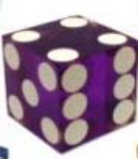
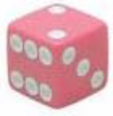
Selection
Selection over Incomplete Relation R^{p}
Selection over Model M_{FOBN}
F_{FOBN} of Sensor1^{p}
Sensor1(T, R, Sid, Tp^{p}, L^{p},Exist(E)^{p})
All Tp values All L values
Tp | L | p
Cold | Brt | 0.1
Hot | Brt | 0.9
σ Tp=Cold
σ Tp=Cold
Hot Drk 0.1
Cold Drk 0.9
All Exist values
All Tp values
All Tp values with Sid=1
All Tp values
with Sid=2
Tp1
Tp2 p
Cold 0.
Cold
9
Cold
Hot
0.1
Hot
Hot 0.9
Cold 0.1
pr(E=1)=1 iff Tp=Cold pr(E=0) iff Tp=Hot
All Tp values
Hot
with Sid !=2
Tp | p
Cold | 0.6
Hot | 0.4
http://heisendata.softnet.tuc.gr

Slide 117
Project & Join
Project
  Project over Incomplete Relation – projected attributes and correlated attributes
  Project over Model – retrieve only part of the model relevant to the projected attributes
Join
  Join over Incomplete Relations with deterministic join condition (e.g. Sensor1.Sid = Sensor2.Sid)
  Join over Models by merging the local models for Exist^{p} attribute
  Probabilistic selection with probabilistic join condition
(e.g. Sensor1.Light^{p} = Sensor2.Light^{p})
http://heisendata.softnet.tuc.gr

Slide 118

Non-Standard-Datenbanken
Bayessche Netze, Infererenz, Lernen, Relationale Erweiterung
Verbundwahrscheinlichkeiten, Bayes Regel
Bayessche Netze
Anfragebeantwortung
Erweiterung auf Relationale
Datenmodelle
Lernverfahren, BME, MAP, ML
EM, Structural EM

Slide 119
Ausblick
Vertiefung zum Thema
Probabilistische Relationale Modellierung
im Master-Programm
Vorlesung Web-Mining-Agents

