Slide 1
Non-Standard Datenbanken und Data Mining Deep Learning Embedding Representations
Prof. Dr. Ralf Möller
Universität zu Lübeck
Institut für Informationssysteme

Slide 2
Übersicht
Einführung, Klassifikation vs. Regression, parametrisches und nicht-parametrisches überwachtes Lernen
Netze aus differenzierbaren Modulen („neuronale“ Netze), Support-Vektor-Maschinen
Häufungsanalysen, Warenkorbanalyse, Empfehlungen
Statistische Grundlagen: Stichproben, Schätzer, Verteilung, Dichte, kumulative Verteilung, Skalen: Nominal-, Ordinal-, Intervall- und Verhältnisskala, Hypothesentests, Konfidenzintervalle, Reliabilität, Interne Konsistenz, Cronbach Alpha, Trennschärfe
Bayessche Statistik, Bayessche Netze zur Spezifikation von diskreten Verteilungen, Anfragen, Anfragebeantwortung, Lernverfahren für Bayessche Netze bei vollständigen Daten
Induktives Lernen: Versionsraum, Informationstheorie, Entscheidungsbäume, Lernen von Regeln
Ensemble-Methoden, Bagging, Boosting, Random Forests
Clusterbildung, K-Means, Analyse der Variation (Analysis of Variation, ANOVA), Inter-Cluster-Variation, Intra-Cluster-Variation, F-Statistik, Bonferroni-Korrektur, MANOVA
Analyse Sozialer Strukturen
Deep Learning, Einbettungstechniken
Zusammenfassung

Slide 3
Acknowledgments
Slides have been taken from
“Improving Distributional Similarity with Lessons Learned from Word Embeddings”
Omer Levy, Yoav Goldberg, Ido Dagan
Stanford CS224d: Deep Learning for NLP
Richard Socher
Rensselaer: Natural Language Processing
Heng Li

Slide 4
Word-Word Associations in Document Retrieval
Recap bag-of-words approaches
Client profiles, TF-IDF
Words are not independent of each other
Need to represent some aspects of word semantics
Church, K.W., Hanks, P.: Word association norms mutual information, and lexicography. Comput. Linguist. 1(1), 22–29, 1990

Slide 5
Point(wise) Mutual Information: PMI
Measure of association used in information theory and statistics
Positive PMI: PPMI(x, y) = max( pmi(x, y), 0 )
Quantifies the discrepancy between the probability of their coincidence given their joint distribution and their individual distributions, assuming independence
Finding collocations and associations between words
Countings of occurrences and co-occurrences of words in a text corpus can be used to approximate the probabilities p(x) or p(y) and p(x,y) respectively
[Wikipedia]

Slide 6
PMI – Example
Counts of pairs of words getting the most and the least PMI scores in the first 50 millions of words in Wikipedia (dump of October 2015)
Filtering by 1,000 or more co-occurrences.
The frequency of each count can be obtained by dividing its value by 50,000,952. (Note: natural log is used to calculate the PMI values in this example, instead of log base 2)
[Wikipedia]

Slide 7
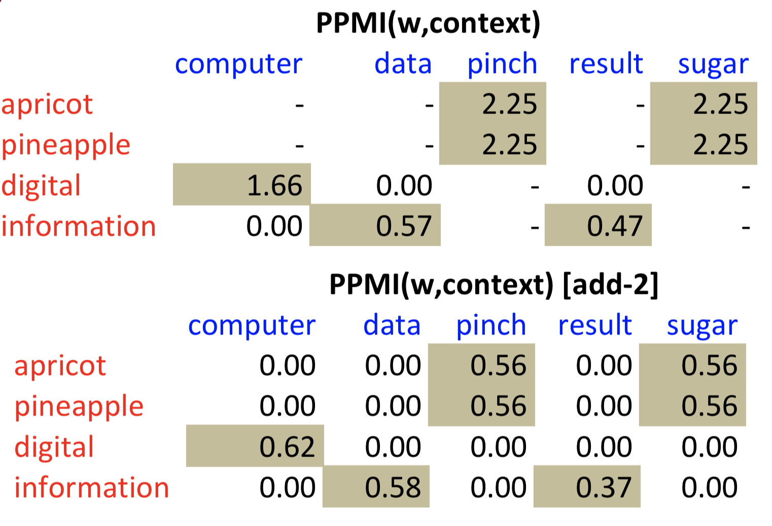
PMI – Co-occurrence Matrix
Count(w, context)

Slide 8
Embedding Approaches to Word Semantics
Represent each word with a low-dimensional vector
Word similarity = vector similarity
Key idea: Predict surrounding words of every word

Slide 9
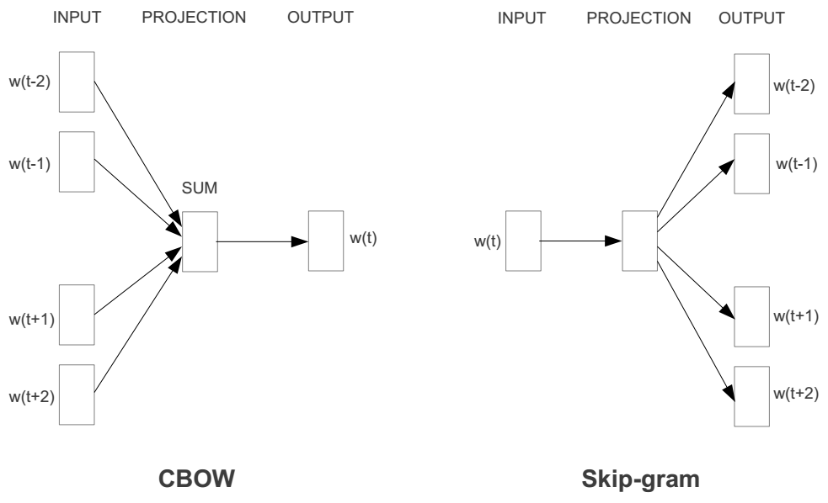
Represent the meaning of words – word2vec
2 basic structural models:
Continuous Bag of Words (CBOW): use a window of words to predict the middle word
Skip-gram (SG): use a word to predict the surrounding ones in window.

Slide 10
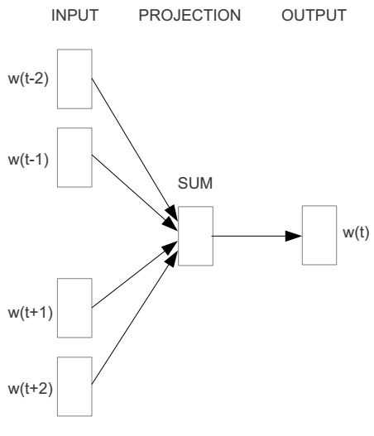
Word2vec – Continuous Bag of Word
E.g. “The cat <sat> on floor”
Window size = 2
the
cat
sat
on
floor

Slide 11
Input layer
Index of cat in vocabulary
0
1
0
cat
0
Hidden layer
Output layer
0
0
0
0
0
0
…
0
0
0
one-hot
vector
0
sat
one-hot
vector
0
0
0
0
1
0
…
1
0
on
0
0
0
0
…
0

Slide 12
We must learn W and W’
Input layer
0
1
0
cat
0
$$W_{V×N}$$
Hidden layer
Output layer
0
0
0
0
0
0
V-dim
…
0
0
$${W′}_{N×V}$$
0
0
sat
0
0
0
0
1
0
$$W_{V×N}$$
N-dim
…
V-dim
1
0
on
0
0
0
0
V-dim
…
N will be the size of word vector
0

Slide 13
Deep Learning
Hidden layer represents feature space
Making explicit features in the data…
… that are relevant for a certain task
Determine features automatically
Learning suitable mappings into feature space
Deep learning also known as representation learning

Slide 14
$$W_{V×N}^{T} ×x_{cat}=v_{cat}$$
0.1 | 2.4 | 1.6 | 1.8 | 0.5 | 0.9 | … | … | … | 3.2
0.5 | 2.6 | 1.4 | 2.9 | 1.5 | 3.6 | … | … | … | 6.1
… | … | … | … | … | … | … | … | … | …
… | … | … | … | … | … | … | … | … | …
0.6 | 1.8 | 2.7 | 1.9 | 2.4 | 2.0 | … | … | … | 1.2
0
2.4
2.6
…
…
1.8
Input layer
1
$$×$$
0
$$=$$
0
0
1
0
0
0
x_{cat}
0
0
Output layer
0
0
0
$$W_{V×N}^{T}×x_{cat}=v_{cat}$$
…
0
0
0
0
0
V-dim
…
0
0
$$\hat{v}=\frac{v_{cat}+v_{on}}{2}$$
0
+
0
sat
0
0
0
0
$$W_{V×N}^{T}×x_{on}=v_{on}$$
1
0
…
V-dim
1
Hidden layer
0
x_{on}
0
0
N-dim
0
0
V-dim
…
0

Slide 15
$$W_{V×N}^{T} ×x_{on}=v_{on}$$
0.1 | 2.4 | 1.6 | 1.8 | 0.5 | 0.9 | … | … | … | 3.2
0.5 | 2.6 | 1.4 | 2.9 | 1.5 | 3.6 | … | … | … | 6.1
… | … | … | … | … | … | … | … | … | …
… | … | … | … | … | … | … | … | … | …
0.6 | 1.8 | 2.7 | 1.9 | 2.4 | 2.0 | … | … | … | 1.2
0
1.8
2.9
…
…
1.9
Input layer
0
$$×$$
0
$$=$$
0
1
1
0
0
0
x_{cat}
0
0
Output layer
0
0
0
$$W_{V×N}^{T}×x_{cat}=v_{cat}$$
…
0
0
0
0
0
V-dim
…
0
0
$$\hat{v}=\frac{v_{cat}+v_{on}}{2}$$
0
+
0
sat
0
0
0
0
$$W_{V×N}^{T}×x_{on}=v_{on}$$
1
0
…
V-dim
1
Hidden layer
0
x_{on}
0
0
N-dim
0
0
V-dim
…
0

Slide 16
Input layer
0
1
0
cat
0
$$W_{V×N}$$
Hidden layer
Output layer
0
0
0
0
0
0
V-dim
…
0
0
$$W_{N×V}^{′}×\hat{v}=z$$
0
$$\hat{y}=softmax(z)$$
0
0
0
0
0
$$\hat{v}$$
1
0
$$W_{V×N}$$
…
1
N-dim
0
on
0
${\hat{y}}_{sat}$
0
0
V-dim
0
V-dim
…
N will be the size of word vector
0

Slide 17
Logistic function
[Wikipedia]

Slide 18
softmax(z)
The
[Wikipedia]

Slide 19
Input layer
0
We would prefer $\hat{y}$ close to ${\hat{y}}_{sat}$
1
0
cat
0
$$W_{V×N}$$
Hidden layer
Output layer
0
0
0
0
0.01
0.02
0.00
0.02
0.01
0.02
0.01
0.7
…
0.00
0
0
V-dim
…
0
0
$$W_{N×V}^{′}×\hat{v}=z$$
$$\hat{y}=softmax(z)$$
0
0
0
0
0
0
$$\hat{v}$$
1
0
$$W_{V×N}$$
…
1
N-dim
0
on
0
${\hat{y}}_{sat}$
0
0
V-dim
0
V-dim
…
N will be the size of word vector
$\hat{y}$
0

Slide 20
$$W_{V×N}^{T}$$
0.1 | 2.4 | 1.6 | 1.8 | 0.5 | 0.9 | … | … | … | 3.2
0.5 | 2.6 | 1.4 | 2.9 | 1.5 | 3.6 | … | … | … | 6.1
… | … | … | … | … | … | … | … | … | …
… | … | … | … | … | … | … | … | … | …
0.6 | 1.8 | 2.7 | 1.9 | 2.4 | 2.0 | … | … | … | 1.2
Contains word vectors
Input layer
0
1
0
x_{cat}
0
Output layer
0
0
$$W_{V×N}^{}$$
0
0
0
0
V-dim
…
0
0
$$W_{N×V}^{′}$$
0
0
sat
0
0
0
0
1
0
$$W_{V×N}^{}$$
…
1
0
V-dim
x_{on}
0
Hidden layer
0
N-dim
0
0
V-dim
…
0
Consider either W or W’ as the word’s representation.
Notes:
W contains input word vectors.
W’ contains output word vectors.
We can consider either W or W’ as the word’s representation. Or even take the average.

Slide 21
Word Analogies
||w_{x}||

Slide 22
The Picture: CBOW and Skip-Gram (SG)
SG
CBOW
V_{c}
$$PMI\left(w,c\right)−\log{k}$$
V_{w}
“Neural Word Embeddings as Implicit Matrix Factorization”
Levy & Goldberg, NIPS 2014

Slide 23
Deep Learning

