Slide 1
Einführung in Web- und Data-Science
Prof. Dr. Ralf Möller
Universität zu Lübeck
Institut für Informationssysteme
Tanya Braun (Übungen)

Slide 2
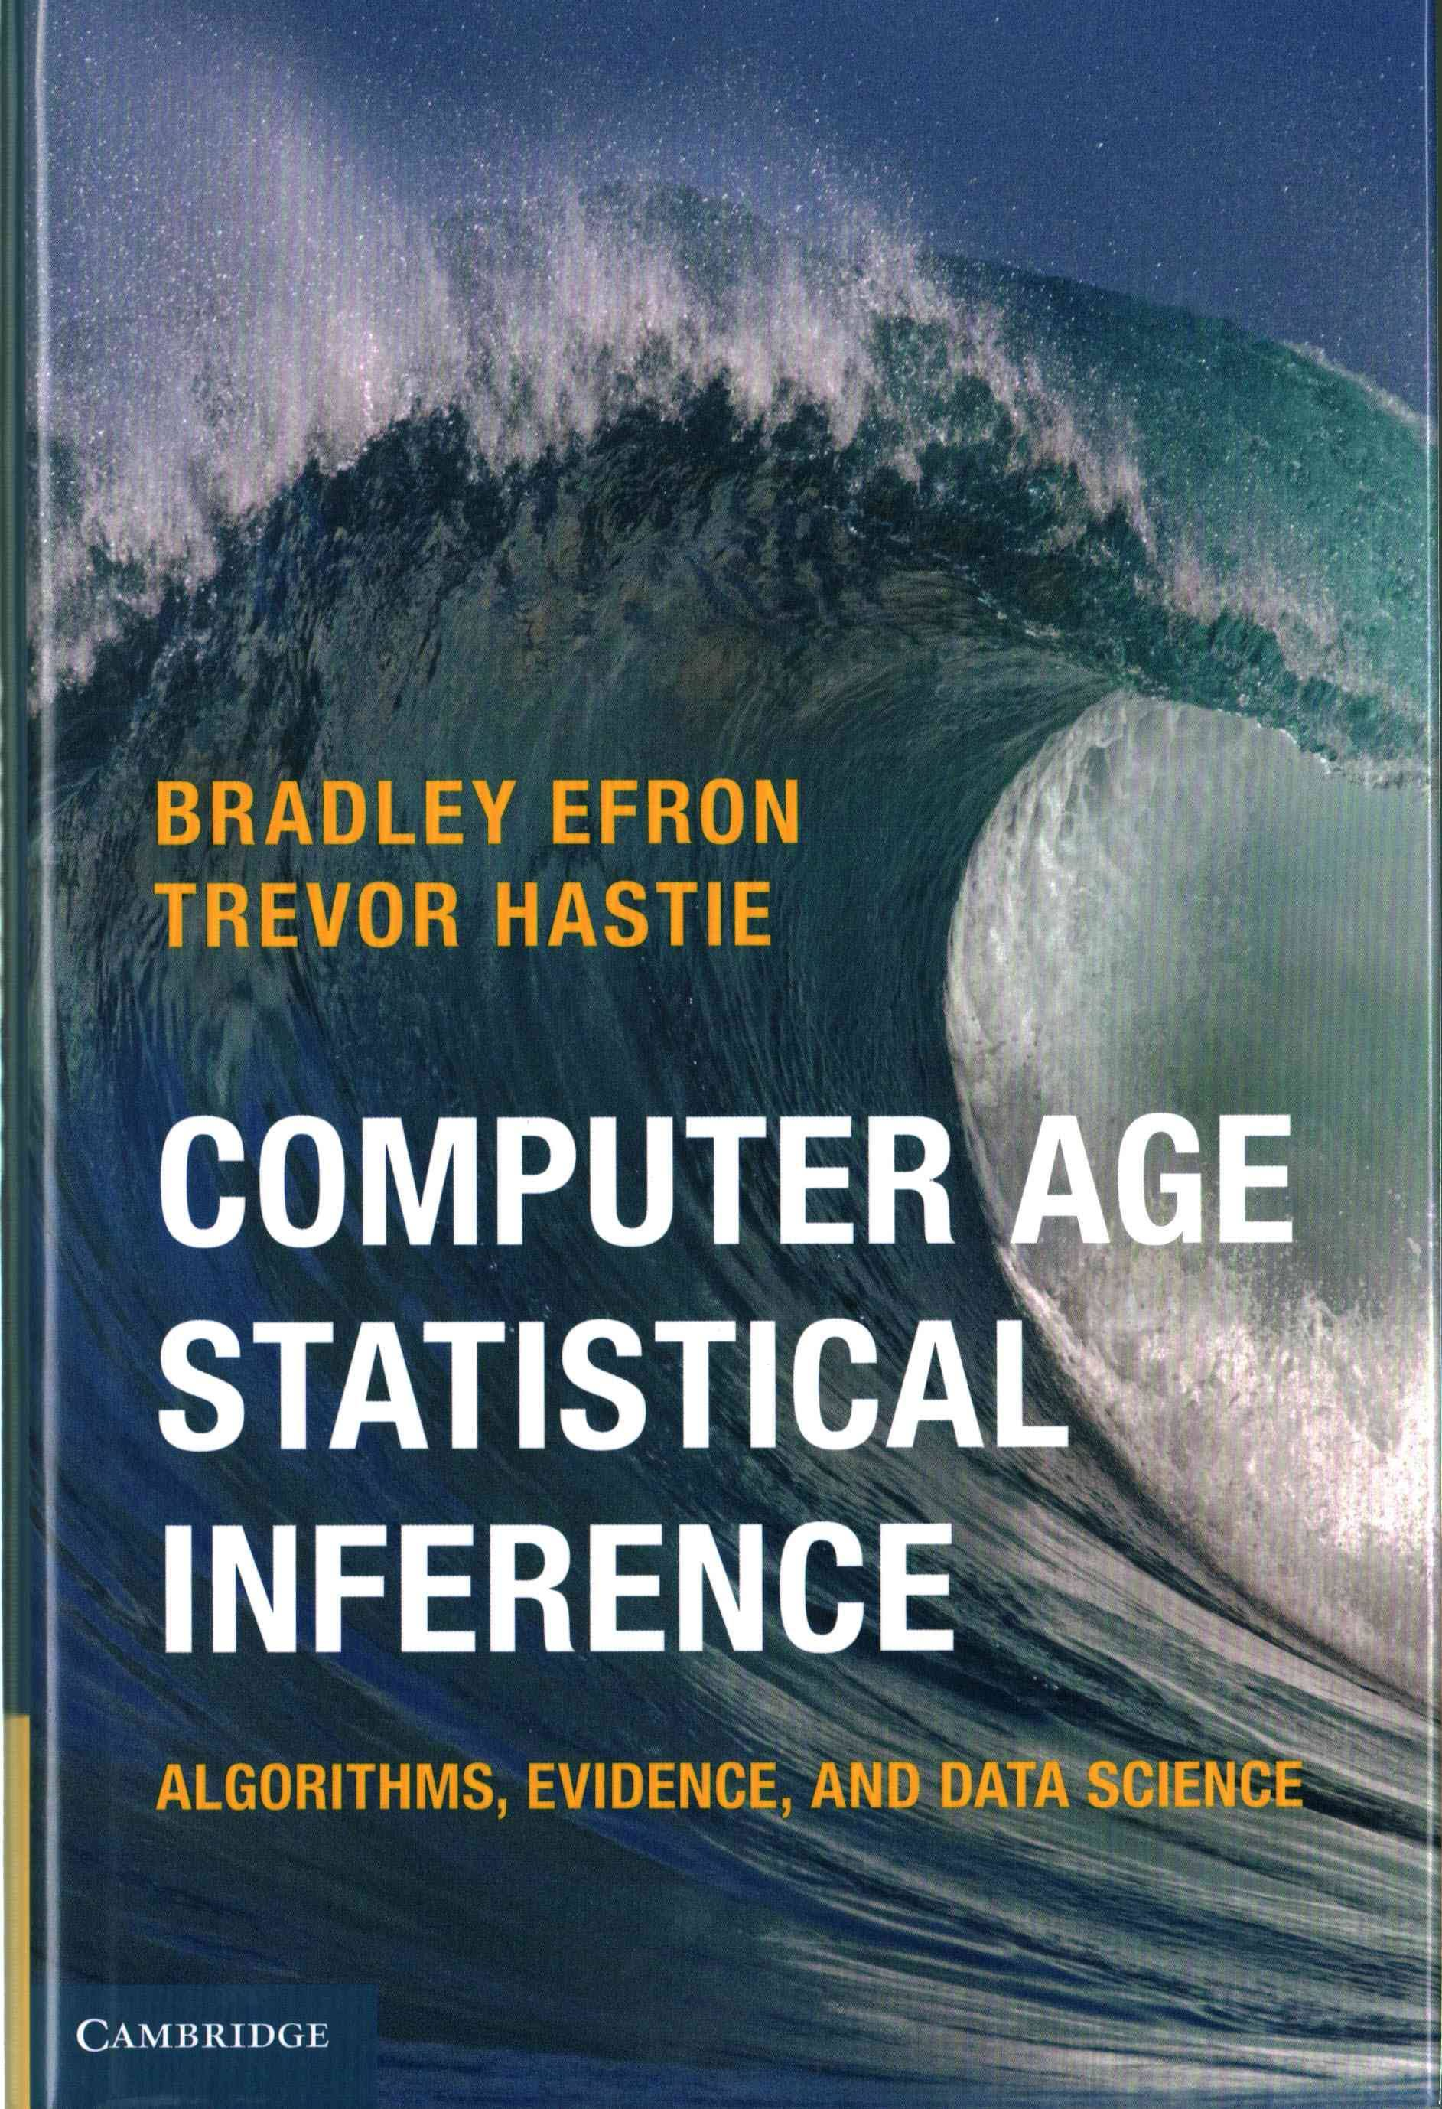
Statistics and Data Science [CASI 2017, p. 446 ff.]
Statistical Inference:
Deals with the why
Mathematical foundations
Algorithmics & Data Science as CASI sees it:
Deals with the how
Just pragmatism? (→ side blow at computer science)
Decision problems clearly identified in computer science w.r.t. semantics of representation formalisms
Correctness of algorithms (the why) is very well an issue in computer science (and data science as subfield)
Tractability issues added by CS

Slide 3
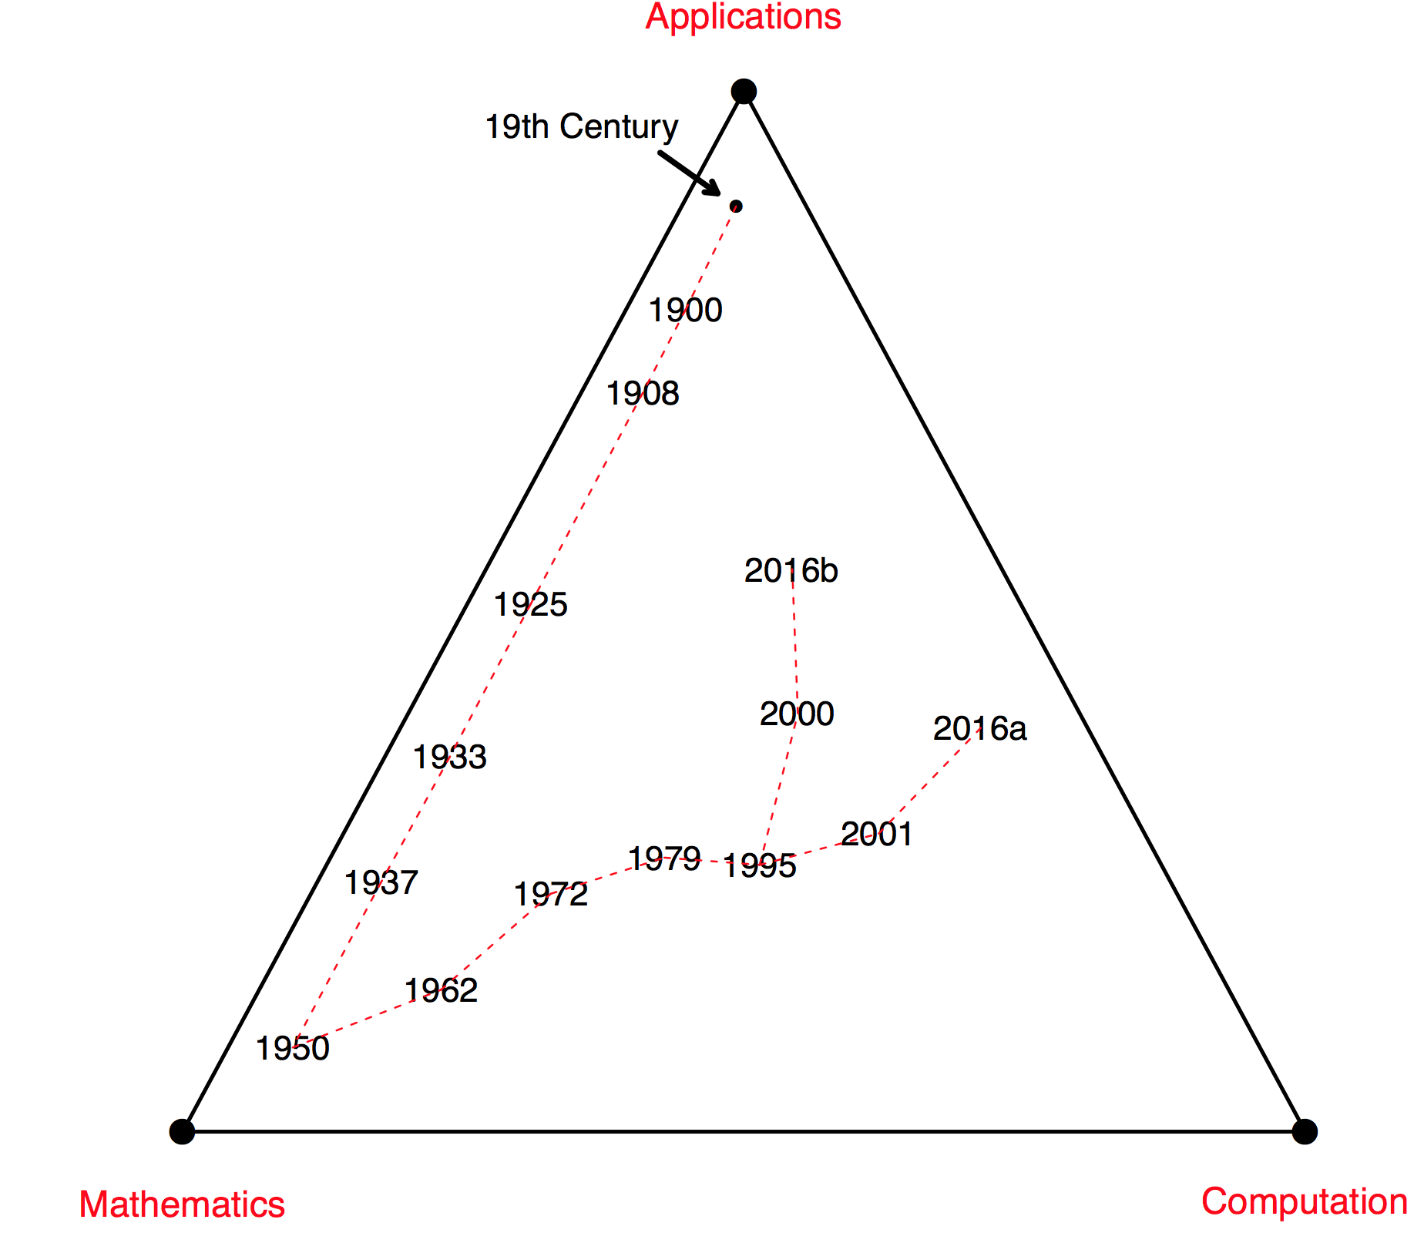
From Statistical Inference to Data Science…

Slide 4
From Statistical Inference to Data Science
1900
Karl Pearson’s chi-square paper
Applied a new mathematical tool, matrix theory, in the service of statistical methodology.
Pearson and Weldon went on to found Biometrika in 1901, the first recognizably modern statistics journal.
Pearson’s paper, and Biometrika, launched the statistics discipline on a fifty-year march toward the mathematics pole of the triangle

Slide 5
From Statistical Inference to Data Science
1908
Student’s t statistic
Crucial first result in small-sample “exact” inference
Major influence on statistical thinking

Slide 6
From Statistical Inference to Data Science
1925
Fisher’s estimation paper
Fundamental ideas: sufficiency, efficiency, Fisher information, maximum likelihood theory, and the notion of optimal estimation
Optimality is a mark of maturity in mathematics, …
... making 1925 the year statistical inference went from a collection of ingenious techniques to a coherent discipline

Slide 7
From Statistical Inference to Data Science
1933
Neyman and Pearson’s paper on optimal hypothesis testing.
Logical completion of Fisher’s program, it nevertheless aroused his strong antipathy (concern that mathematization was squeezing intuitive correctness out of statistical thinking)

Slide 8
From Statistical Inference to Data Science
1937
Neyman’s seminal paper on confidence intervals
Mathematical treatment of statistical inference was a predecessor of decision theory
1950
Wald’s Statistical Decision Functions
Decision theory completed the full mathematization of statistical inference

Slide 9
From Statistical Inference to Data Science
1962
Tukey’s paper “The future of data analysis” argued for a more application- and computation-oriented discipline
Mosteller and Tukey later suggested changing the field’s name to data analysis, a prescient hint of today’s data science
1972
Cox’s proportional hazards paper
Growing interest in biostatistical applications and particularly survival analysis

Slide 10
From Statistical Inference to Data Science
1979
The bootstrap, and later the widespread use of MCMC
Electronic computation used for the extension of classic statistical inference.

Slide 11
From Statistical Inference to Data Science
1995
This stands for false-discovery rates and, a year later, the lasso
Both are computer-intensive algorithms, firmly rooted in the ethos of statistical inference

Slide 12
From Statistical Inference to Data Science
2000
Microarray technology inspires enormous interest in large-scale inference, both in theory and as applied to the analysis of microbiological data.
2001
Random forests
Joins boosting and the resurgence of neural nets in the ranks of machine learning prediction algorithms

Slide 13
From Statistical Inference to Data Science
2016a
Data science: a more popular successor to Tukey and Mosteller’s “data analysis”
At one extreme it seems to represent a statistics discipline without parametric probability models or formal inference.
Data Science Association defines a practitioner as one who “. . . uses scientific methods to liberate and create meaning from raw data”
In practice the emphasis is on
algorithmic processing of large data sets
for the extraction of useful information,
with prediction algorithms as exemplars

Slide 14
From Statistical Inference to Data Science
2016b
This represents the traditional line of statistical thinking, but now energized with a renewed focus on applications
Of particular applied interest are biology and genetics
Genome-wide association studies (GWAS) show a different face of big data.
Prediction is important here, but not sufficient for the scientific understanding of disease

Slide 15
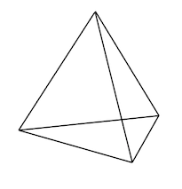
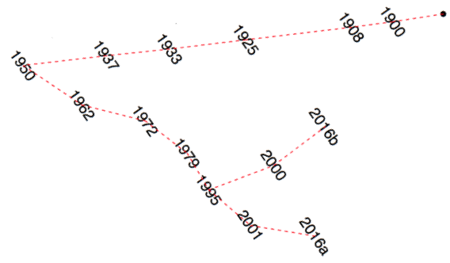
Computer Science and Data Science
Since 1950
Logic
Probability Theory
Representation and Query Language
Databases
Algorithms and Data Structures
Programming
Systems (HW/SW)
…
Computer Science
Efficient algorithms
and suitable data structures
Application
Mathematics
Computation (Aufgaben als Optimierungsprobleme dargestellt)

