Slide 1
Intelligent Agents Web-Mining Agents
Prof. Dr. Ralf Möller
Dr. Tanya Braun
Universität zu Lübeck
Institut für Informationssysteme

Slide 2
Acknowledgements
Some slides have been designed by PD Dr. Özgür Özcep. Since Özgür works in my group, those slides are not explicitly marked. Thank you nevertheless, Özgür.
Other slides have been take from lecture material provided by researchers on the web. I hope this material is indicated appropriately. Thank you all.

Slide 3
Artificial Intelligence and Intelligent Agents
Artificial intelligence (AI) is the science of systematic synthesis and analysis of computational agents that act intelligently
Agents are central to AI (and vice versa)
Intelligent agent = computational agent that acts intelligently
Talking about AI w/o talking about agents misses the point (and vice versa)
Need to technically define the notion of “acting intelligently”
AI = Science of Intelligent Systems
Systems are called computational agents in AI, or agents for short

Slide 4
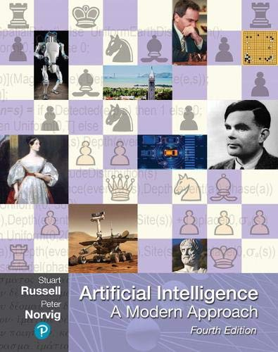
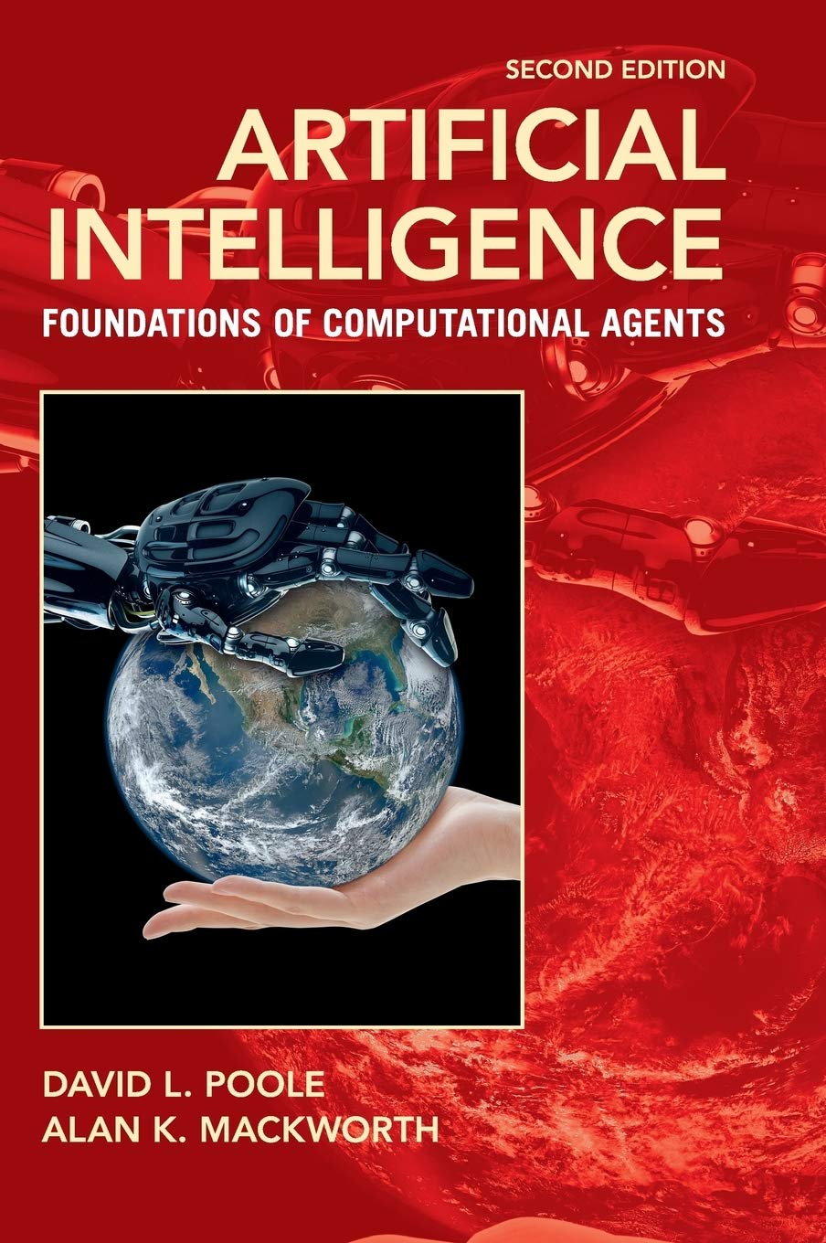
Literature
http://aima.cs.berkeley.edu (AIMA, 1st edition 1995)
http://artint.info
(AIFCA, 1st edition 2010)

Slide 5
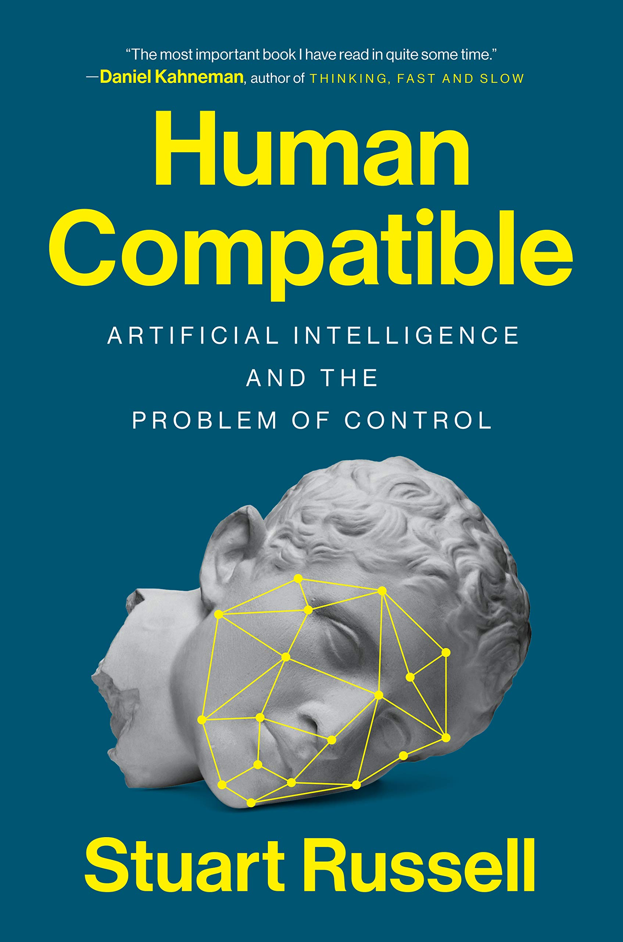
Literature

Slide 6
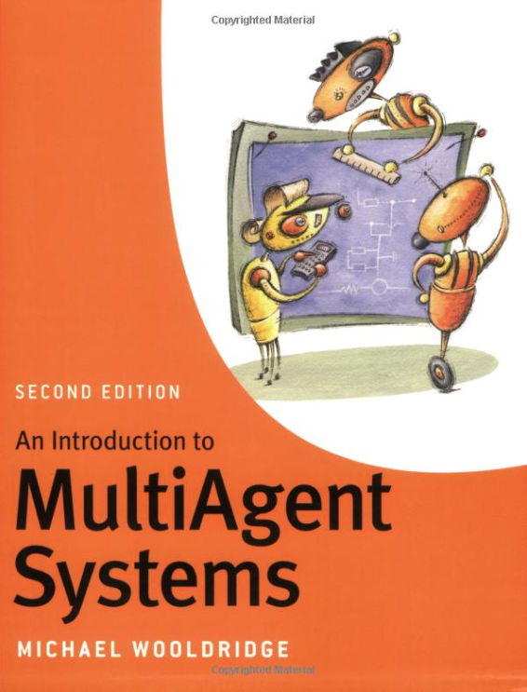
Literature

Slide 7
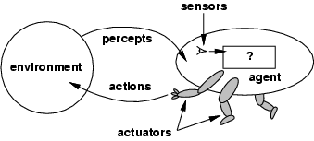
What is an Agent?
Anything that can be viewed as perceiving its environment through sensors and acting upon that environment through actuators [AIMA-Def]
Human agent eyes, ears, and other organs for sensors; hands, legs, mouth, and other body parts for actuators
Robotic agent cameras and infrared range finders for sensors; various motors for actuators
Software agent interfaces, data integration, interpretation, data manipulation/output
Sensors
Percepts
?
Environment
Agent
Actions
Actuators

Slide 8
Abstractions: Agents and Environments
The agent function maps from percept histories to actions:
[f: P* → A]
The agent program runs on a physical architecture to produce f
Agent = architecture + program
Sensors
Percepts
?
Environment
Agent
Actions
Actuators
Really insist on functional behavior?

Slide 9
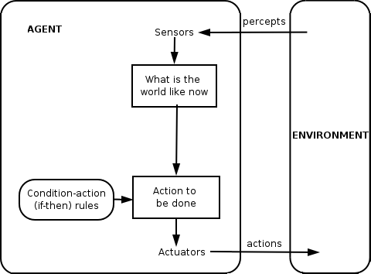
Reactive vs. Goal-based Agents

Slide 10
Reactive vs. Goal-based Agents

Slide 11
Balancing Reactive and Goal-Oriented Behavior
We want our agents to be reactive, responding to changing conditions in an appropriate fashion (e.g., timely)
We want our agents to systematically work towards long-term goals
These two considerations can be at odds with one another
Designing an agent that can balance the two remains an open research problem
Achieve maximum freedom of action if there is no specific short-term goal (e.g., keep batteries charged)

Slide 12
Social Ability
The real world is a multi-agent environment: we cannot go around attempting to achieve goals without taking others into account
Some goals can only be achieved with the cooperation of others
Social ability in agents is the ability to interact with other agents (and possibly humans) via some kind of agent-communication language …
... with the goal to let other agents to make commitments (of others) or reinforcements (about its own behavior)
Need to represent and reason about beliefs about other agents

Slide 13
Rational Agents
Rational Agent: For each possible percept sequence, a rational agent
should select an action
that is expected to maximize its local performance measure,
given the evidence provided by the percept sequence and
whatever built-in knowledge the agent has
Rational = Intelligent ?
There is more to intelligence than meets rationality

Slide 14
Autonomous Agents
Rationality is distinct from omniscience (all-knowing with infinite knowledge)
Computing the best action usually intractable
Rationality is bounded
Agents can perform actions in order to modify future percepts so as to obtain useful information (information gathering, exploration)
An agent is autonomous if its behavior is determined by its own "experience" (with ability to learn and adapt)
What matters for the "experience" is the
percept sequence (which the agents can determine), the
state representation, and the
"computational success" of computing the best action as well as learning and adapting for the future

Slide 15
Human-compatible Behavior
Agents act on behalf of humans, who specify the goals
Agent should consider its initial goals to be uncertain (and to be challenged due to underspecification)
Agent should be able to prove their behavior is beneficial to humans
Artificial intelligence, agents, and ethics
Agents must act in an ethical way (and those, who develop agents, possibly too)
Developers should be able to prove … … that agents are able to prove … that they (the agents) act in an ethical way
Simple technology assessment is not enough

Slide 16
Human-aware Behavior
Agents interact with humans
Selected actions must match human expectations
Maybe the presumably expected action might not be the best (for the human or the agent, or both)
Selected actions that are assumed to not match human expectations must be explained

Slide 17
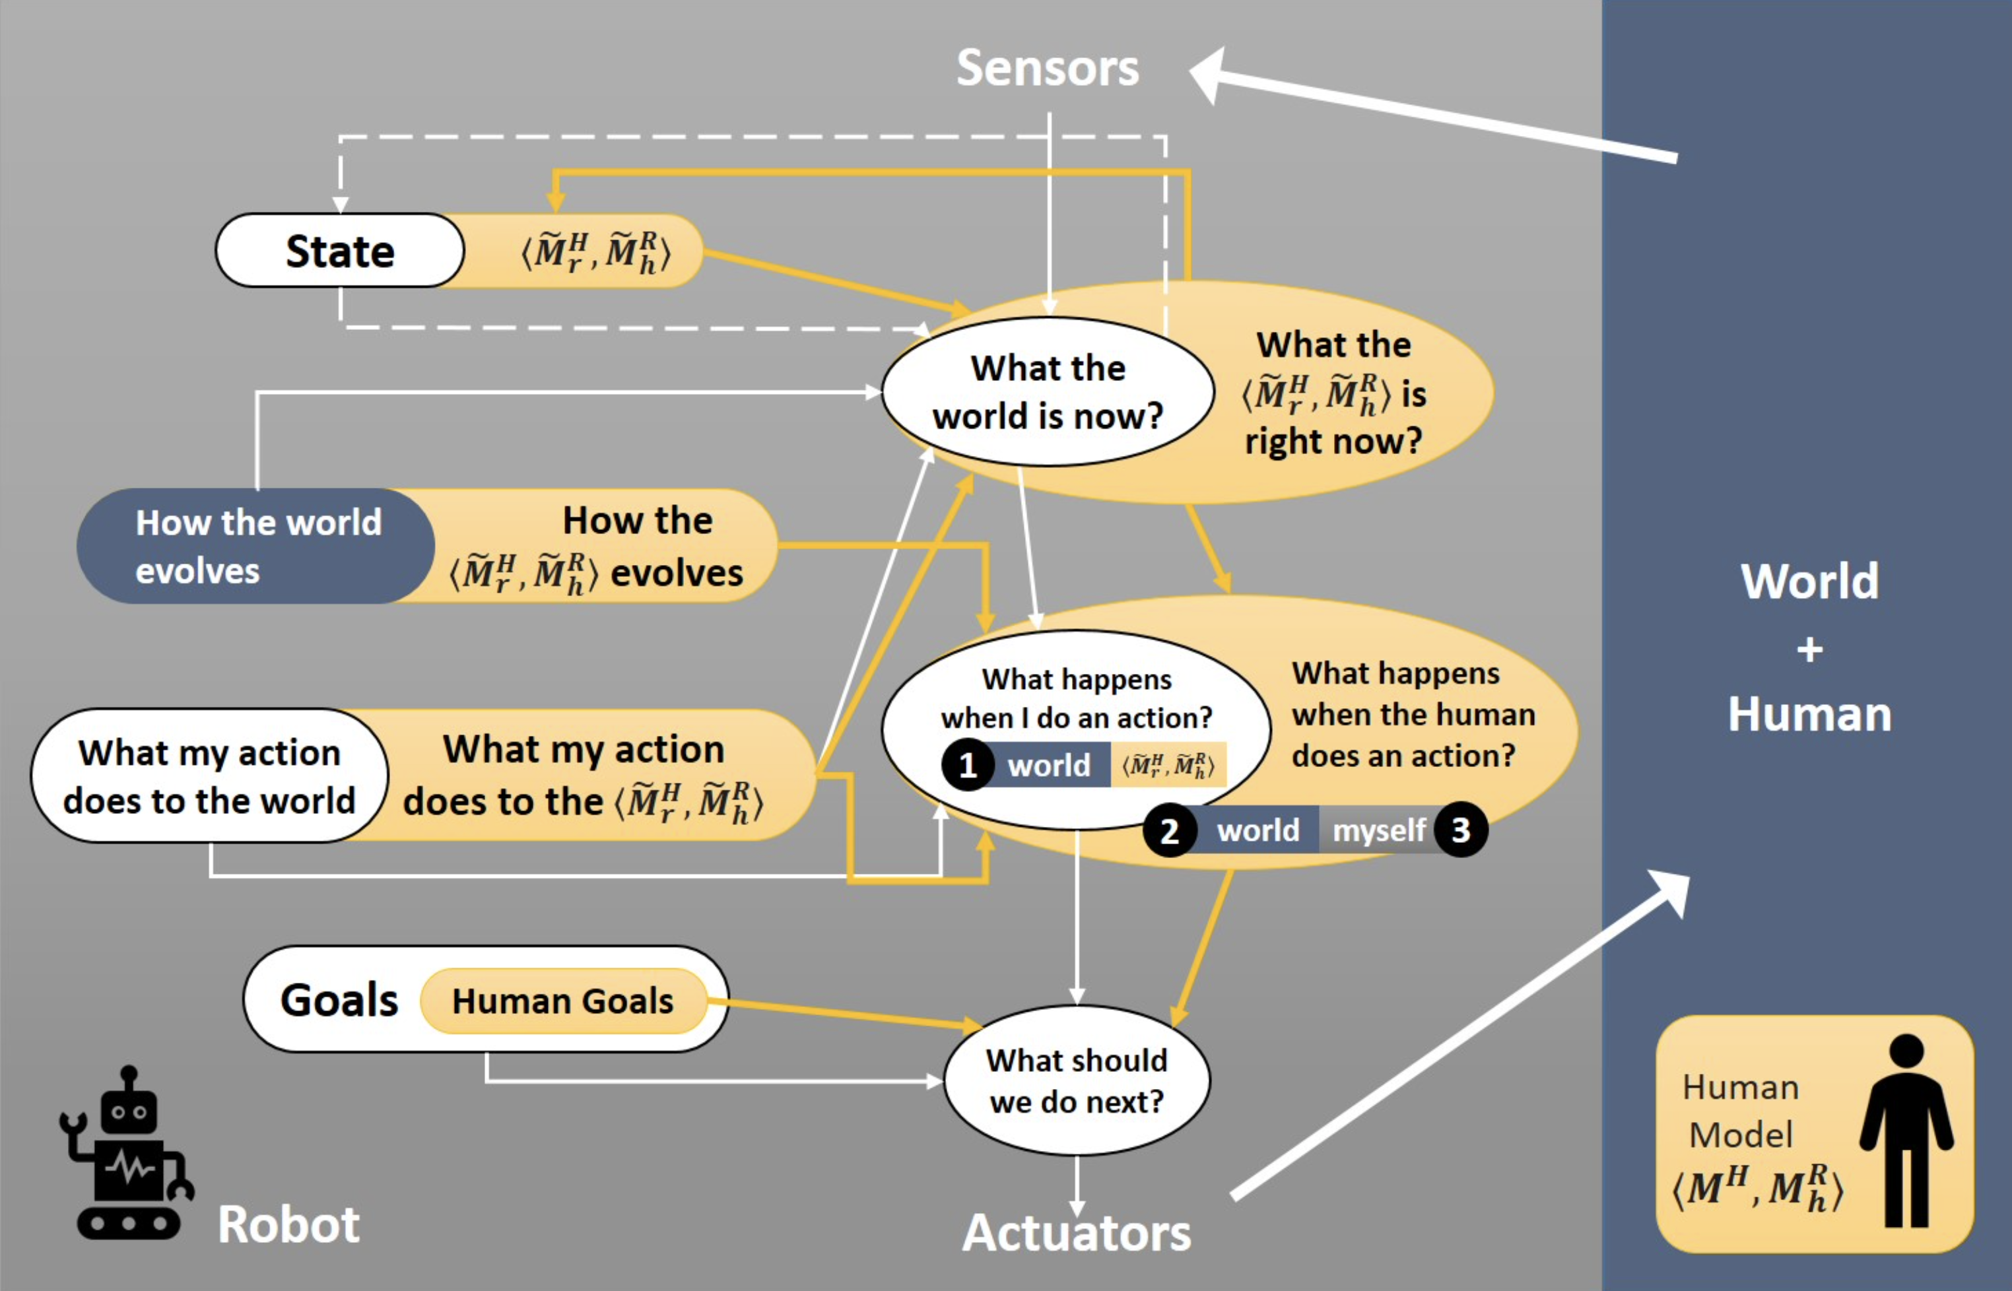
Agent Model vs. Human Model
Challenges of Human-Aware AI Systems: Subbarao Kambhampati

Slide 18
Learning Agents (Online)
Ever extented percept sequence (incl. more or less explicitly encoded reinforcement feedback or rewards) is …
… sparse (no big data), but gives rise to model updates
… with the aim to better (faster) achieve goals
We say: Agents learn (and we mean: while acting, or online)
Optimize a performance measure
Setting up agents’ online learning engines
Dedicated knowledge about online learning required
Setting up an agent’s initial model by exploiting data:
Dedicated knowledge of machine learning required
Also basically optimizing a performance measure

Slide 19
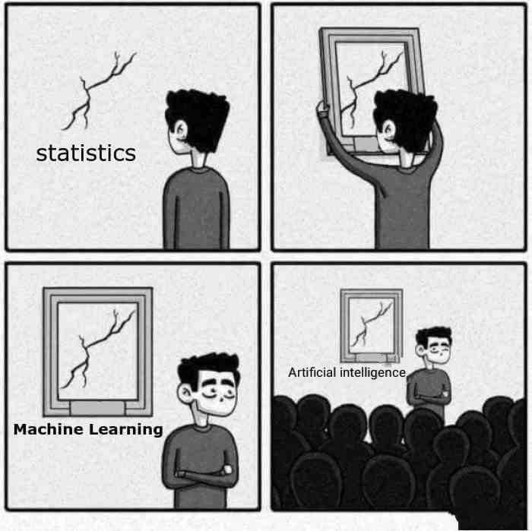
Machine Learning (ML): Offline
Statistics vs. Data Science vs. Machine Learning
Machine learning scales, but can only do so much
All fields have evolved and still do evolve
“When you’re fundraising, it’s AI. When you’re hiring, it’s ML. When you’re implementing, it’s logistic regression.”
It is clear that claiming AI is machine learning or “contains” machine learning does not make much sense!

Slide 20
Reactive vs. Goal-based Agents

Slide 21
Misunderstandings
Applying ML to implement a function f some people say: “I have used ML technique X to create an AI”
Unconsciously, AI is used as a synonym for agent, but … … mostly a very simple one
f : P → A
Claiming that f is “an AI” is an indication of lack of understanding …
… even if the last n percepts are considered
f : P × …× P → A
One is lost w/o an understanding of intelligent agents
f : P* → A

Slide 22
Frame Agents
Assume that machine learning techniques are used to build models at agent setup time
Runtime behavior of agent always depends on last n elements of percept sequence only f : P × …× P → A
No interaction w/ environment, no feedback
Agent is fake (simply a frame around standard SW/HW)
Also holds when setup training data is camouflaged as initial percepts (but no actions towards goals are computed until training completed)
Maybe even enlightening for practical applications, but agent idea …
… does not show its full potential

Slide 23
Learning-based Software Development
There is no need to deliberately conflate machine learning with agents and AI !
No need to invent frame agents !
Can build extremely cool SW/HW w/ machine learning techniques (e.g., for industrial image processing applications)
→ Probabilistic Differential Programming (CS5071-KP04)
→ Deep Learning Lab (CS5071-KP04)
There are caveats, however:

Slide 24
Issues

Slide 25
Back to the Future: Human-guided Learning
Develop machine learning techniques that achieve good performace w/o too much training material
Exploit human capabilities
Artificial agents and human agents cooperate
Machine learning becomes agent online learning
Motivation for studying agents!
Machine learning cannot go w/o agents in the future
Agents allow for more or less learning (incl. no learning)
Next: Proper agent with no learning

Slide 26
Proper Agent: An Example

Slide 27
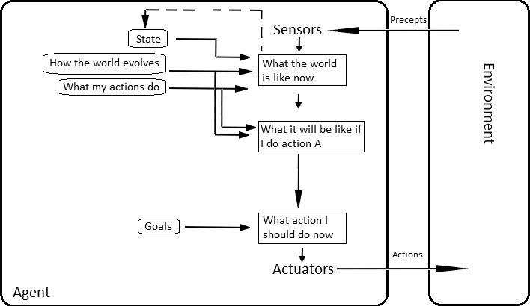
Proper Agent: An Example
Given:
Current state of the environment
Description of goal state
Set of action descriptions
Find sequence of actions (a plan) for transforming current state into goal state
Select first action, and hope that plan can be completed

Slide 28
STRIPS Formalism
States modeled as set of ground atoms (database)
Current state as well as goal state
Example: Blocks World
On_Table(A), On_Table(B), On_Table(C)
On_Block(C, B), On_Block(B, A)
STRIPS = Stanford Research Institute Problem Solver (1971)

Slide 29
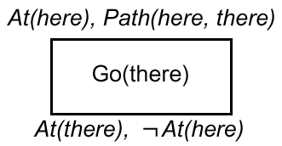
STRIPS Planning Operators

Slide 30
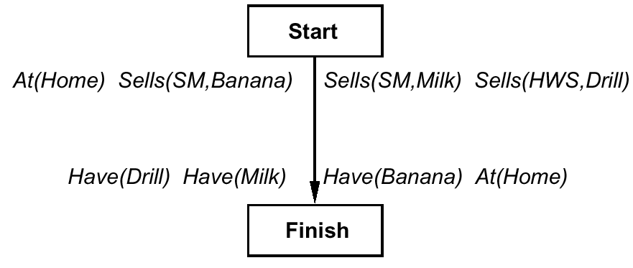
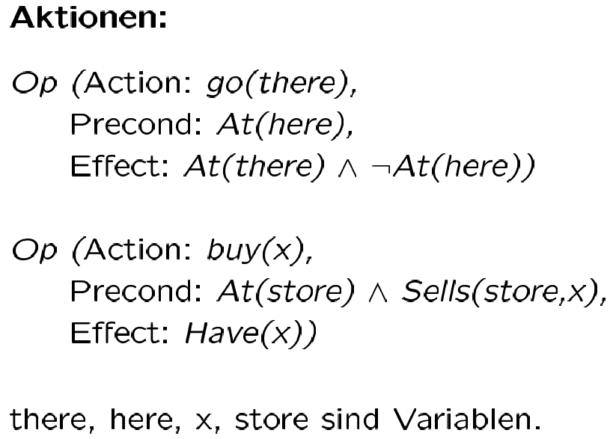
Complete Plan
are variables

Slide 31
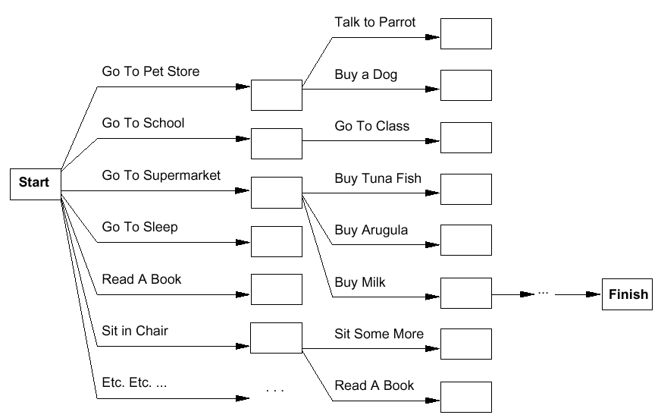
Planning as Search
Forward
Backward

Slide 32
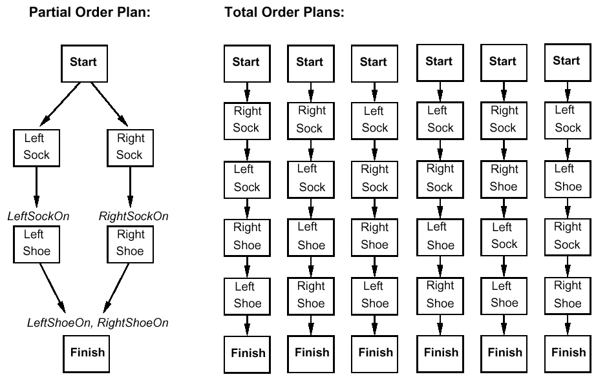
Plan = Sequence of Actions?
Apply principle of Least Commitment

Slide 33
Representation of Partial-Order Plans
Plan step = STRIPS Operator
Plan consists of
Plan step with partial order (<), where S_{i} < S_{j} iff S_{i} is to be executed before S_{j}
Set of variable assignments x = t , where x is a variable and t is a constant or variable
Set of causal relations: S_{i} →^{c} S_{j} means S_{i} creates the precondition c of S_{j} (implies S_{i} < S_{j})
Solutions to planning problems … … must satisfy certain conditions
STRIPS = Stanford Research Institute Problem Solver (1971)

Slide 34
Completeness and Consistency
Complete plan
Every precondition of a step is fulfilled
∀S_{j} with c ∈ Precond(S_{j}),
∃S_{i} s.t. S_{i} < S_{j} and c ∈ Effects(S_{i}), and
for every linearization it holds that:
∀S_{k} with S_{i} < S_{k} < S_{j} , ¬c ∉ Effects(S_{k})
Consistent plan
If S_{i} < S_{j} , then S_{j} ≮ S_{i} and
If x = A, then x ≠ B for different A and B for variable x (Unique Names Assumption)
Solution of the planning problem: complete and consistent plan

Slide 35
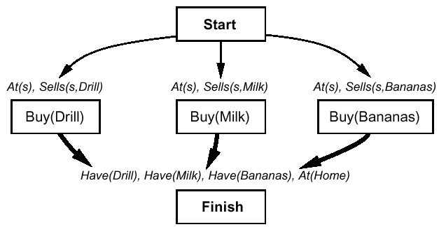
Plan Refinement (1)
Backward planning
Thin arrows = <
Fat arrows = causal relation + <

Slide 36
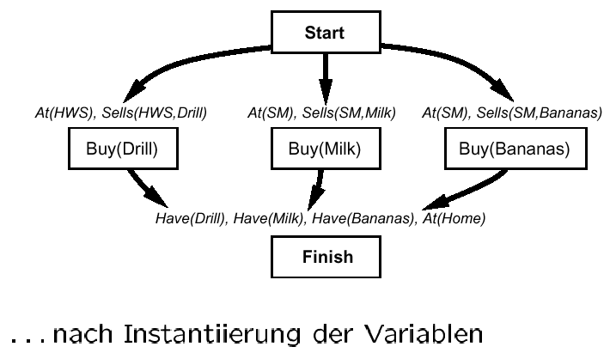
Plan Refinement (1)
after variable instantiation

Slide 37
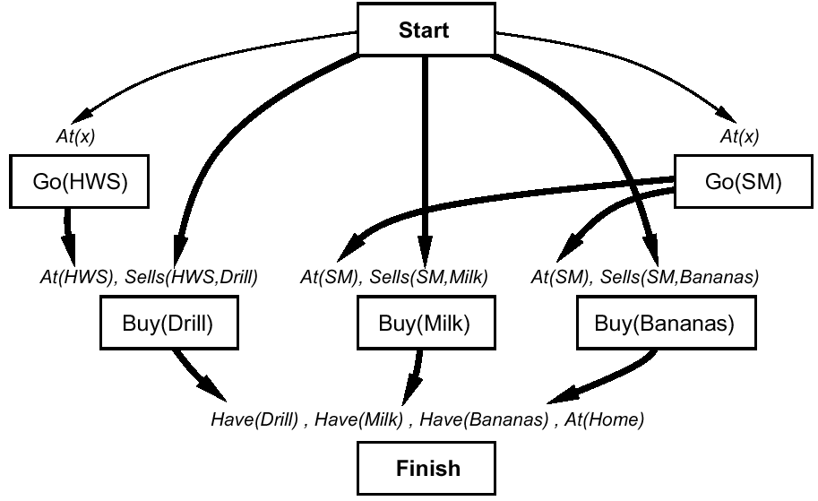
Plan Refinement (2)
... buy at the right store

Slide 38
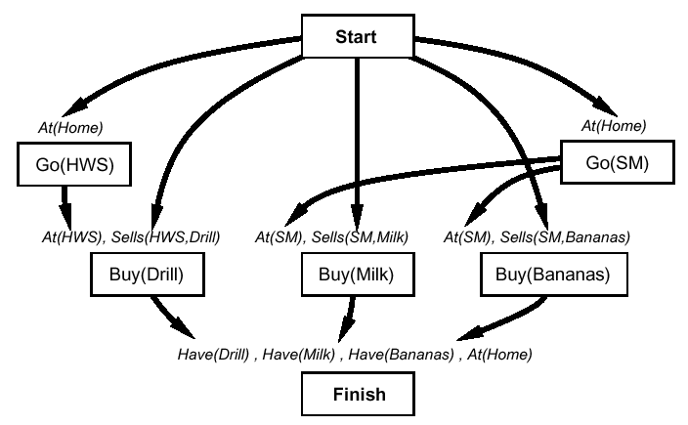
Plan Refinement (3)
... but you must get there

Slide 39
Plan Refinement (3)
Note: Up to now no search, but simple „backward chaining“
Now: Conflict! After go(HWS) is executed, At(Home) no longer holds (similarly for go(SM))

Slide 40
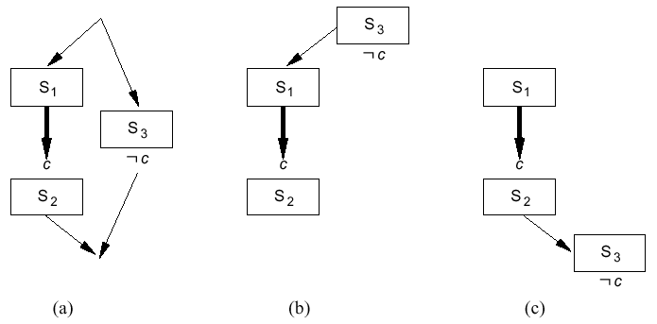
Protection of Causal Relations

Slide 41
Protection of Causal Relations
Conflict:
S3 “threatens“ causal relation between S1 and S2
Conflict resolution:
Promotion: Put threat before causal relation
Demotion: Put threat after causal relation

Slide 42
Another Plan Refinement …
Assumption: Cannot resolve conflict by protection
Made a wrong step during plan refinement
Alternative
Select x = HWS (with causal relation) while instantiating At(x) in go(SM)

Slide 43
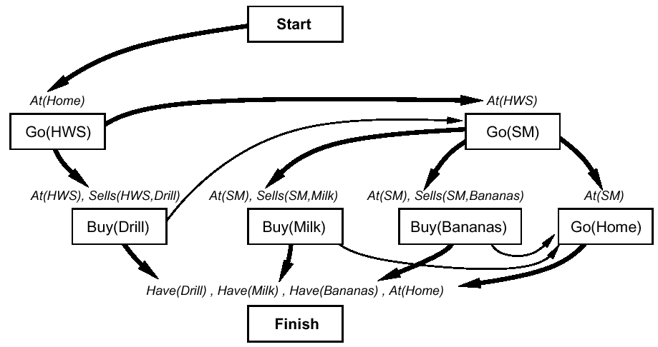
Another Plan Refinement …

Slide 44
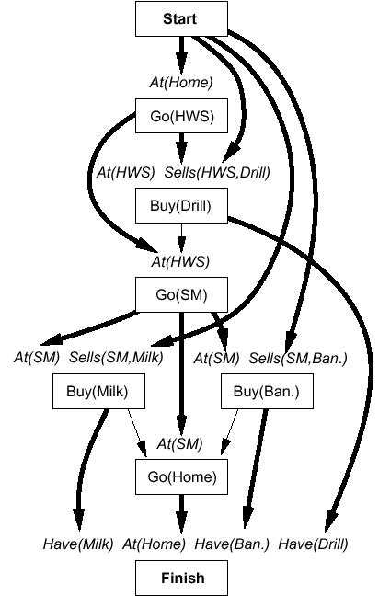
The Complete Solution …
… with all links
Computation by POP Algorithm
Complete
… and correct
Addtionally, not considered here, correct treatment of variables

Slide 46
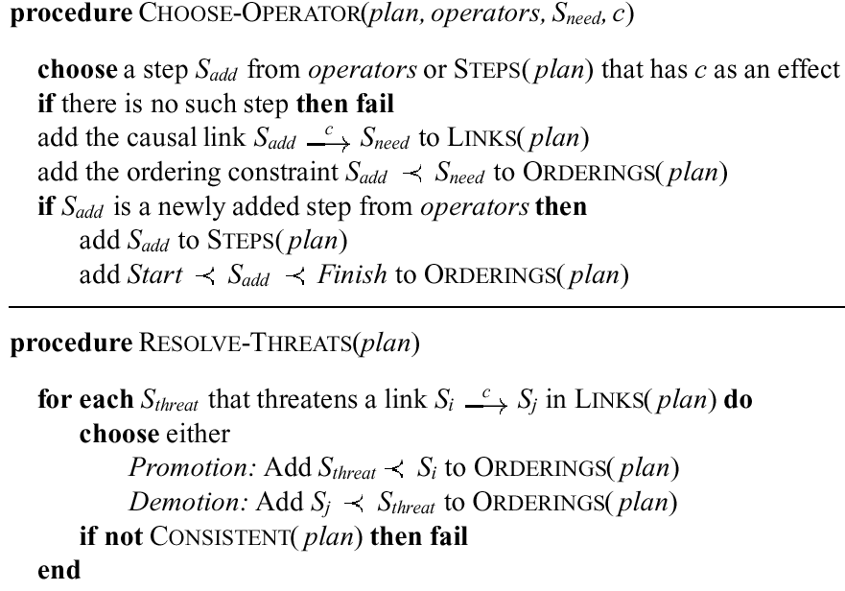

Slide 47
Last Century Planning Systems (Last Decade!)
UCPOP (Weld, UW) (http://www.cs.washington.edu/ai/ucpop.html )
Sensory Graphplan (Weld, Blum, and Furst: UW) (http://aiweb.cs.washington.edu/ai/sgp.html )
IPP (Köhler and Nebel: Univ. Freiburg) (https://idw-online.de/de/news5468)
Prodigy: Planning and Learning (Veloso: CMU) (http://www-2.cs.cmu.edu/afs/cs.cmu.edu/project/prodigy/Web/prodigy-home.html )
All systems have found interesting applications

Slide 48
Planning is an Active Field of Research
More powerful successors
Systems learn how to plan fast for specific problem instances
Can deal with uncertainty
About state estimation
About effects of actions
Very powerful problem solvers can be set up …
w/ less effort/knowledge than with mathematical optimization theory and respective tools
→Automated Planning and Acting (CS5072-KP04) ( https://www.ifis.uni-luebeck.de/index.php?id=dski-aktuell-ss20&L=2 )

Slide 49
Back to Intelligent Agents / Acting Intelligently
Rational agents that:
Act autonomously and are persistent
Achieve goals surprisingly fast (despite bounded rationality)
Learn how to behave in a clever way (even learn computational strategies)
Can adapt their goals to anticipate humans needs and expectations
Human compatibility, human awareness
Can learn new models online to
Keep high performance over time
Support human-guided machine learning

Slide 50
Perspectives
There are no specific “AI methods” applied by agents
Agents solve application problems (e.g., information retrieval)
Constructing agents humans solve AI problems
Intelligence attributed to agents by humans from the outside
It is agents that can be intelligent, not functions (no framing desired)
If different agents can achieve a certain goal easily,
Win 1000 of 1000 chess games
… i.e., solve a certain application problem perfectly
… then, intelligence attribution becomes less and less likely
NB: Different agents!
Cheating, i.e., sometimes showing stupidity to just not loose intelligence label, is not a dominant strategy for agents

Slide 51
Goals…

Slide 52
… or Utilities
Goals can change, and so can utility measures

