Slide 1
Intelligent Agents Probabilistic Information Retrieval
Prof. Dr. Ralf Möller
Universität zu Lübeck
Institut für Informationssysteme

Slide 2
Acknowledgements
Next 8 slides taken from:
Synthesizing Explainable and Deceptive Behavior for Human-AI Interaction Subbarao Kambhampati
http://bit.ly/3bno2io

Slide 3
Agents
Challenges of Human-Aware AI Systems: Subbarao Kambhampati

Slide 4
Classical planning
Challenges of Human-Aware AI Systems: Subbarao Kambhampati

Slide 5
Joint planning
Challenges of Human-Aware AI Systems: Subbarao Kambhampati

Slide 6
Agent model for human behavior anticipation
~
~
Challenges of Human-Aware AI Systems: Subbarao Kambhampati

Slide 7
Agent model for human exceptation anticipation
Challenges of Human-Aware AI Systems: Subbarao Kambhampati

Slide 8
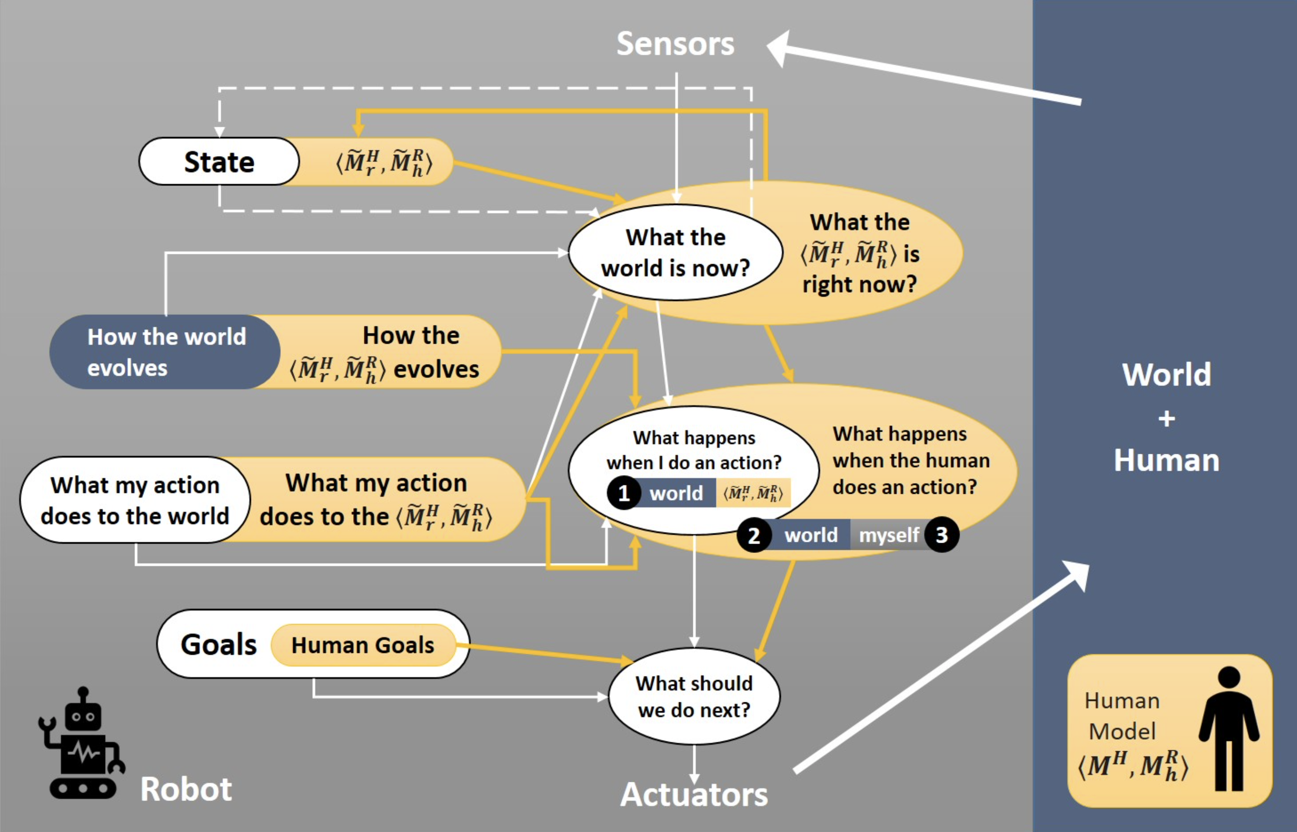
Human specifies goal: Solve a certain problem
“Mental models”
M^{R}
M^{H} human model of the problem to be solved
M^{R}_{h} is the human’s understanding of the robot’s M^{R}
M^{R} robot model of the problem to be solved
M^{H}_{r} is the robot’s understanding of M^{H} (anticipate human behavior)
M^{R}_{h} is the robot’s understanding of M^{R}_{h} (anticipate human’s expectations)
~
~
Challenges of Human-Aware AI Systems: Subbarao Kambhampati

Slide 9
What causes differences in mental models?
Expectations on capabilities / actions
Human may have misconceptions about robot’s actions
Certain actions in human’s mental model may not be feasible for the robot
Expected state of the world
Human may assume certain facts are true in the world (even if they are not true)
Expected goals
Human may have misconceptions about the robot’s goals/intentions
Sensor model differences
Human may have partial observability of the robot’s activities
Human may have incorrect beliefs about robot’s observational capabilities
Challenges of Human-Aware AI Systems: Subbarao Kambhampati

Slide 10
Where do mental models come from?
In certain applications mental models are known beforehand
Learning simple models for generating explanations/explicability
This will be covered later
Learning full models (transition functions, rewards)
Through interaction with the users

Slide 11
Goal Specification
For specific problem classes M^{H}, goal specification languages must be developed to specify M^{R}
If goal specifications cannot sensibly be provided by humans for a certain application domain, AI researchers do need to continue their work
We will consider …
how information retrieval (IR) goals can be represented and communicated to a web-mining agent (IR agent)
how uncertainty about IR goals can be reduced
how reinforcement feedback can be collected by the IR agent

Slide 12
Recap: Document and query representation
Only represent occurrences of terms with incidence matrix?
Use word counts?
Use word frequencies?
What about terms that occur in certain documents but seldomly in the corpus?

Slide 13
Recap: TF.IDF
Introduction to Web and Data Science Non-standard Databases and Data Mining
f_{ij} = relative number of terms t_{i} in document d_{j}
n_{i} = Number of documents with term i
N = Total number of documents
TF.IDF measure w_{ij} = TF_{ij} ⋅ IDF_{i}
TF_{ij} = f_{ij} / number of terms in d_{j}

Slide 14
Acknowledgements
Some slides taken from:
Introduction to Information Retrieval Christopher Manning and Prabhakar Raghavan

Slide 15
How exact is the
representation of the document ?
How well is query
matched to data?
How exact is the
representation of the query ?
How relevant is the result
to the query ?
Query
representation
Query
Document Representation
TYPICAL IR
PROBLEM
Query
Answer
Document collection
15

Slide 16
Why probabilities in IR?
User
Information Need
Query
Representation
Understanding
of user need is
uncertain
How to match?
Document
Representation
Uncertain guess of
whether document has relevant content
Documents
In traditional IR systems, matching between each document and
query is attempted in a semantically imprecise space of index terms
Probabilities provide a principled foundation for uncertain reasoning
Can we use probabilities to quantify our uncertainties?

Slide 17
Probability Ranking Principle
Collection of Documents
User issues a query
A set of documents is found and needs to be returned
Question: In what order to present documents to user ?
Need a formal way to judge the “goodness” of documents w.r.t. queries
Idea: Probability of relevance of the documents w.r.t. query
Ben He, Probability Ranking Principle, Reference Work Entry, Encyclopedia of Database Systems, Ling Liu, Tamer, Öszu (Eds.), 2168-2169, Springer, 2009.

Slide 18
Probabilistic Approaches to IR
Probability Ranking Principle (Robertson, 70ies; Maron, Kuhns, 1959)
IR as Probabilistic Inference (van Rijsbergen & et al., since 70ies)
Probabilistic IR (Croft, Harper, 70ies)
Probabilistic Indexing (Fuhr & et al., late 80ies-90ies)
Robertson S.E. The probability ranking principle in IR. J. Doc., 33:294–304, 1977.
M. E. Maron and J. L. Kuhns. On Relevance, Probabilistic Indexing and Information Retrieval. J. ACM 7, 3, 216-244, 1960.
van Rijsbergen C.J. Inform. Retr.. Butterworths, London, 2nd edn., 1979.
Croft W.B. and Harper D.J. Using probabilistic models of document retrieval without relevance information. J. Doc., 35:285–295, 1979.
Norbert Fuhr. 1989. Models for retrieval with probabilistic indexing. Inf. Process. Manage. 25, 1, 55-72, 1989.

Slide 19
Let us recap probability theory
Bayesian probability formulas
Odds:

Slide 20
Odds vs. Probabilities

Slide 21
Probability Ranking Principle
Let x be a document in the retrieved collection.
Let R represent Relevance=true of a document w.r.t. given (fixed)
query and let NR represent Relevance=false.
Need to find p(R|x) - probability that a retrieved document x
is relevant.
p(R),p(NR) - prior probability
of retrieving a relevant or non-
relevant document, respectively
p(x|R), p(x|NR) - probability that if a relevant or non-relevant
document is retrieved, it is x.
van Rijsbergen, Cornelis Joost. Information Retrieval, 2nd edition. Butterworths, 1979
21

Slide 22
Probability Ranking Principle
Ranking Principle (Bayes’ Decision Rule):
If p(R|x) > p(NR|x) then x is relevant,
If p(R|x) ≤ p(NR|x) then x is not relevant
Note:
22

Slide 23
Probability Ranking Principle
Claim: PRP minimizes the average probability of error
If we decide NR
If we decide R
Expected overall error
p(error) is minimal when all p(error|x) are minimal
Bayes’ decision rule minimizes each p(error|x).
Ranking Principle (Bayes’ Decision Rule):
If p(R|x) > p(NR|x) then x is relevant,
If p(R|x) ≤ p(NR|x) then x is not relevant
23

Slide 24
Probability Ranking Principle
More complex case: retrieval costs
C : cost of retrieval of relevant document
C’ : cost of retrieval of non-relevant document
d : a document
Documents d are ranked according the to the Probability Ranking Principle when it holds that : If for any other d’ not yet retrieved, then d is the next document to be retrieved

Slide 25
Relevance models
Given: PRP to be applied
“Relevance” of each document is independent of relevance of other documents
Need to estimate probability: P(R|q,d)
Binary Independence Retrieval (BIR):
Many documents D - one query q
Estimate P(R|q,d) by considering whether d ∈ D is relevant for q
Binary Independence Indexing (BII):
One document d - many queries Q
Estimate P(R|q,d) by considering whether a document d is relevant for a query q ∈ Q

Slide 26
Binary Independence Retrieval
“Binary” = Boolean: documents are represented as binary vectors of terms:
iff term i is present in document x.
“Independence”: terms occur in documents independently
Different documents can be modeled as same vector.

Slide 27
Binary Independence Retrieval
Queries: binary vectors of terms
Given query q,
for each document d need to compute p(Relevant=true|q,d)
replace with computing p(Relevant=true|q,x) where x is vector representing d
Interested only in ranking
Will use odds (the higher, the better):

Slide 28
Binary Independence Retrieval
Constant for each query
Needs estimation
Using Independence Assumption:
So :
28

Slide 29
Binary Independence Retrieval
Since xi is either 0 or 1:
Let
Assume, for all terms not occurring in the query (qi=0)
Then...
29

Slide 30
Binary Independence Retrieval
All matching terms
Non-matching query terms (too many)
All matching terms
All query terms
30

Slide 31
Binary Independence Retrieval
Constant for
each query
Only quantity to be estimated
for rankings
Optimize Retrieval Status Value (RSV):
31

Slide 32
Binary Independence Retrieval
All boils down to computing RSV.
For all query terms i: Find docs containing term i (→ inverted index)
Non-standard Databases and Data Mining
So, how do we compute ci’s from our data ?
32

Slide 33
Binary Independence Retrieval
Estimating RSV coefficients: Groundtruth for subset of docs
It is known wether docs are relevant or not
For each term i look at the following table:
Estimates:
33

Slide 34
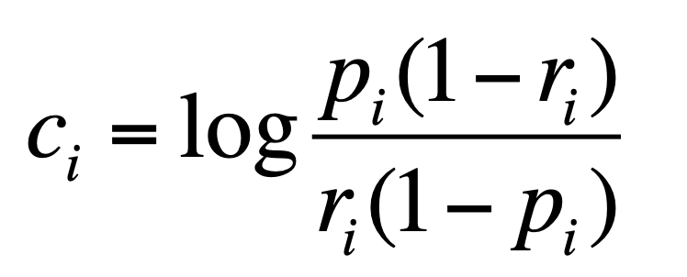
Binary Independence Retrieval
Estimating RSV coefficients.
For each term i look at the following table:
Estimates:
34

Slide 35
Avoid division by 0
35

Slide 36
Estimation in practice
If non-relevant documents are approximated by the whole collection (S=s=0), then r_{i} (prob. of occurrence term i in non-relevant documents for query) is n/N and
log (1– r_{i})/r_{i} = log (N – n)/n ≈ log(1+ (N –n)/n) = log N/n = IDF
Idea cannot be easily extended to p_{i}
Estimate p_{i} (probability of occurrence of term i in relevant docs):
From relevant documents if we know some
Use constant 0.5 – then just get idf weighting of terms (p_{i} and 1-p_{i} cancel out)
…
We have a nice theoretical foundation of TF.IDF (in the binary case: TF=1 or TF=0)
Karen Sparck Jones. A statistical interpretation of term specificity and its application in retrieval. In Document retrieval systems, Vol. 3. Taylor Graham Publishing, London, UK, UK 132-142. 1988.
Greiff, Warren R., A Theory of Term Weighting Based on Exploratory Data Analysis. In: Proceedings of the 21st Annual International ACM SIGIR Conference on Research and Development in Information Retrieval, pp. 11-19, 1998.
Robertson S.E., Understanding inverse document frequency: On
theoretical arguments for idf. J. Doc., 60:503–520, 2004.

Slide 37
Iteratively estimating p_{i}
Expectation Maximization:
Assume that p_{i} constant over all q_{i} in query
p_{i} = 0.5 (even odds) for any given doc
Determine guess of relevant document set from subset V:
V is fixed size set of highest ranked documents on this model
We need to improve our guesses for p_{i} and r_{i}, so
Use distribution of q_{i} in docs in V. Let V_{i} be set of documents containing q_{i}
p_{i} = |V_{i}| / |V|
Assume if not retrieved then not relevant
r_{i} = (n_{i} – |V_{i}|) / (N – |V|)
Go to 2. until convergence then return ranking

Slide 38
Probabilistic Relevance Feedback
Guess a preliminary probabilistic description of R and use it to retrieve a first set of documents V, as above.
Interact with the user to refine the description: learn some definite members of R and NR
Reestimate p_{i} and r_{i} on the basis of these
Or can combine new information with original guess (use Bayesian prior):
Repeat, thus generating a succession of approximations to R.
𝜆 is
prior
weight
Notes:
explicit Bayesian smoothing with a prior

Slide 39
Binary Independence Indexing
“Learning” from queries
More queries: better results
p(q|x,R) - probability that if document x had been deemed relevant, query q had been asked
The rest of the framework is similar to BIR

Slide 40
Binary Independence Retrieval vs. Binary Independence Indexing
BIR
BII
Many Documents, One Query
Bayesian Probability:
Varies: document representation
Constant: query (representation)
One Document, Many Queries
Bayesian Probability
Varies: query
Constant: document
40

Slide 41
PRP and BIR/BII: The lessons
Getting reasonable approximations of probabilities is possible.
Simple methods work only with restrictive assumptions:
term independence
terms not in query do not affect the outcome
boolean representation of documents/queries
document relevance values are independent
Some of these assumptions can be removed

Slide 42
Acknowledgment
Some of the next slides are based on a presentation "An Overview of Bayesian Network-based Retrieval Models" by Juan Manuel Fernández Luna

Slide 43
Bayesian Nets in IR
Introduction to Web and Data Science Non-standard Databases and Data Mining
Inference Network Model
Belief Network Model
Bayesian Network Retrieval Model
Some subsequent slides are based on a presentation "An Overview of Bayesian Network-based Retrieval Models" by Juan Manuel Fernández Luna
Howard Turtle, and W. Bruce Croft. Inference networks for document retrieval. In Proc. SIGIR, pp. 1-24. ACM Press. 1989.
Howard Turtle, and W. Bruce Croft. Evaluation of an inference network-based retrieval model. TOIS 9 (3): 187-222. 1991.
Berthier A. N. Ribeiro and Richard Muntz. A belief network model for IR. In Proceedings of the 19th annual international ACM SIGIR conference on Research and development in information retrieval (SIGIR '96). ACM, New York, NY, USA, 253-260. 1996.
Luis M.de Campos, Juan M.Fernández-Luna, Juan F.Huete, Clustering terms in the Bayesian network retrieval model: a new approach with two term-layers, Applied Soft Computing, Volume 4, Issue 2, Pages 149-158, May 2004.

Slide 44
Inference Network Model
Document Network
d1
d2
di -documents
dn
Large, but
compute once for each
document collection
ri - document representations
ti - “terms”
r1
r2
rn’
rn
t1
t2
tk
t3
ci - query terms
cm
c1
c2
Small, compute once for
every query
qi – boolean operators
q2
q1
Query Network
I
I - goal node
44

Slide 45
Inference Network Model: “reason trouble –two”
Hamlet
Macbeth
Document
Network
reason
trouble
double
Thesaurus lookup Prob. estimates
reason
trouble
two
Query
Network
OR
NOT
CPTs for crisp boolean operators can easily be defined
User query

Slide 46
Inference Network Model
Construct document network (once !)
For each query
Construct query network (on the fly !)
Attach it to document network
Find doc subset d_{i}s maximizing P(Q | d_{i}s) (best subset)
Retrieve these d_{i}s as the answer to query.
But:
Powerset of docs defines huge search space
Exact answers for queries P(Q | d_{i}s) rather "expensive"
BN structure has loops (no polytree)
Howard Turtle, and W. Bruce Croft. Inference networks for document retrieval. In Proc. SIGIR, pp. 1-24. ACM Press. 1989.
Howard Turtle, and W. Bruce Croft. Evaluation of an inference network-based retrieval model. TOIS 9 (3): 187-222. 1991.

Slide 47
Belief Network Model
Q
t₁
t₂
t₃
t_{m}
d₁
d₂
d_{j-1}
d_{j}
Probability Distributions:
Term nodes: p(t_{j})=1/m, p(¬t_{j})=1-p(t_{j})
Document nodes: p(D_{j} | Pa(D_{j})), ∀D_{j}
p(d_{j}| Q) = p(d_{j}, Q) / p(Q) = 𝛼 p(d_{j}, Q) = 𝛼 𝛴_{𝜏} p(d_{j}, Q, 𝜏)
= 𝛼 𝛴_{𝜏} p(d_{j} |𝜏) p(Q | 𝜏) p(𝜏 )
𝜏 = ( t₁, … , t_{m})
But... If a document has been indexed by, say, 30 "most important" terms, we need to estimate (and store) 2³⁰ probabilities.
Berthier A. N. Ribeiro and Richard Muntz. A belief network model for IR. In Proceedings of the 19th annual international ACM SIGIR conference on Research and development in information retrieval (SIGIR '96). ACM, New York, NY, USA, 253-260. 1996.

Slide 48
Summary
Refinement of the agent architecture
Mental models
Human specifies goal of the agents
Example IR agent – Human specifies query
Agent’s goal: Satisfy information need defined by query
Foundations of IR
Probability ranking principle
IR with probabilistic models (BNs)
Example: Inference network model
Example: Belief network model
Next: BN Retrieval Model (with recommendations)
Uncertainty about goal: re-estimate information need

Slide 49
Intelligent Agents Probabilistic Information Retrieval
Prof. Dr. Ralf Möller
Universität zu Lübeck
Institut für Informationssysteme

Slide 50
Bayesian Network Retrieval Model
Mentioned or not mentioned
T_{i} ∈{¬t_{i}, t_{i}}
Term Subnetwork
Document
Subnetwork
D_{j} ∈{¬d_{j}, d_{j}}
Relevant or not relevant
Luis M.de Campos, Juan M.Fernández-Luna, Juan F.Huete, Clustering terms in the Bayesian network retrieval model: a new approach with two term-layers, Applied Soft Computing, Volume 4, Issue 2, Pages 149-158, May 2004.

Slide 51
Bayesian Network Retrieval Model
Removing the term independency restriction:
We are interested in representing the main relationships among terms in the collection.
Term
Subnetwork
T₅
T₂
T₄
T₆
T₁
T₃
Document
Subnetwork
D₁
D₂
D₃
D₄

Slide 52
PRP and Recommendations
Those who retrieved d_{i} were also interested in d_{j}
Term Subnetwork
D₁
D₂
D₃
D₄
D₅
D₆
D₇
D`₁
D`₂
D`₃
D´₄
D´₅
D´₆
D´₇

Slide 53
Summary: Probabilistic Information Retrieval
PRP defines a well-defined framework for IR
Can understand pragmatic approaches (e.g., TF.IDF)
Can be used for formalizing IR (What is the IR problem?)
Provides for means to compute ranking of results
Agents can use different models and different QA strategies for IR
We will see soon:
Agents can update internal models by reinforcement feedback
Agents can adapt strategies to new user queries (new goals to be expected)

Slide 54
Recap: Agent architecture M^{R} = IR(Q)
Action: Return retrieved docs
Waiting for feedback
(possibly with follow-up queries)
Retrieved docs to be evaluated by human
M^{R}
Challenges of Human-Aware AI Systems: Subbarao Kambhampati

Slide 55
Confusion Matrix (e.g., for Classification)
Understanding where an agent has deficiencies
(Direct) feedback:
Present confusion matrix to an agent
Reinforcement:
Relevance feedback for retrieval results (agent might build confusion matrix internally)
55

Slide 56
Unranked retrieval evaluation: Precision and Recall
retrieved & irrelevant
Not retrieved & irrelevant
Entire document collection
irrelevant
Relevant documents
Retrieved documents
retrieved & relevant
not retrieved but relevant
relevant
retrieved
not retrieved

Slide 57
Unranked retrieval evaluation: Precision and Recall
Precision: fraction of retrieved docs that are relevant = P(retr&rel|retrieved)
Recall: fraction of relevant docs that are retrieved = P(retr&rel|relevant in repos)
Precision = tp/(tp + fp)
Recall = tp/(tp + fn)
 | Relevant | Not Relevant
Retrieved | true positives (tp) | false positives (fp)
Not Retrieved | false negatives (fn) | true negatives (tn)
57

Slide 58
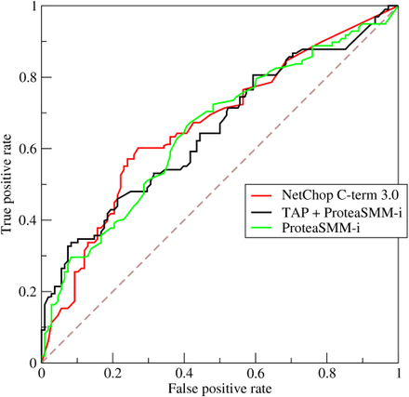
Relative operating characteristic (ROC)
What if goal specification involves control parameters?
E.g., for strategies
Investigate effects of parameter adjustments
Compare TP rate and FP rate
Example w/ three strategies
Measure: Area under curve (AUC) curve = ROC
Strategy 1
Strategy 2
Strategy 3
Wikipedia

Slide 59
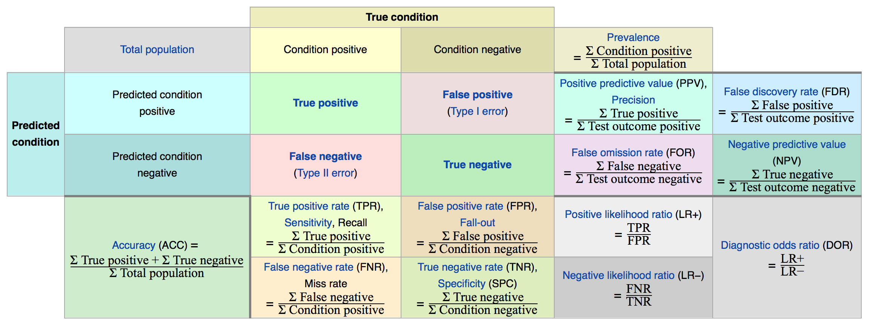
Overview on evaluation measures
[Wikipedia]
https://en.wikipedia.org/wiki/Evaluation_measures_(information_retrieval)#Mean_average_precision

Slide 60
Precision and Recall
Determining Recall can be difficult
Total number of relevant items is sometimes not available – use pooling
Sample across the database and perform relevance judgment on these items
Apply different retrieval algorithms to the same database for the same query. The aggregate of relevant items is taken as the total relevant set
First instruct agent to do IR on known corpus (train agent to use best QA strategy)
Then send it out.
Information Retrieval and Web Search, IR Evaluation and IR Standard Text Collections, Rada Mihalcea

Slide 61
Standard Methodology for Measuring Relevance in IR
To measure relevance effectiveness of ad-hoc IR, we need:
A document collection.
A suite of information needs, expressible as queries.
Must be representative of actual user needs.
Sample from query logs, if available.
Binary assessments of either Relevant or Nonrelevant for each query and each document.
Can be more nuanced, e.g., 0, 1, 2, 3, …
Use pooling, when it is unfeasible to assess every (q, d) pair.
Information Retrieval and Web Search, IR Evaluation and IR Standard Text Collections, Rada Mihalcea

Slide 62
The TREC Benchmark
TREC: Text REtrieval Conference (http://trec.nist.gov/)
Became an annual conference in 1992, co-sponsored by the National Institute of Standards and Technology (NIST) and DARPA.
Participants are given parts of a standard set of documents and TOPICS (from which queries have to be derived) in different stages for training and testing.
Participants submit the P/R values for the final document and query corpus and present their results at the conference.
Information Retrieval and Web Search, IR Evaluation and IR Standard Text Collections, Rada Mihalcea

Slide 63
Trade-off between Recall and Precision
Returns relevant documents but
misses many useful ones too
The ideal
1
Precision
0
1
Recall
Returns most relevant
documents but also
includes lots of
Irrelevant documents
Precision and Recall are inverse proportional
Information Retrieval and Web Search, IR Evaluation and IR Standard Text Collections, Rada Mihalcea

Slide 64
F-measure
Introduction to Web and Data Science
One measure of performance that takes into account both recall and precision.
Harmonic mean of recall and precision:
Compared to arithmetic mean, both need to be high for harmonic mean to be high.
Information Retrieval and Web Search, IR Evaluation and IR Standard Text Collections, Rada Mihalcea

Slide 65
Ranked Retrieval Measures
Binary relevance:
11-point Interpolated Precision-Recall Curve
R-precision
Precision@K (P@K) and Recall@K (R@K)
Mean Average Precision (MAP)
Information Retrieval and Web Search, IR Evaluation and IR Standard Text Collections, Rada Mihalcea

Slide 66
Recall-Precision Curves: An Example
Let total # of relevant docs = 6
Check each new recall point:
R=1/6=0.167; P=1/1=1
R=2/6=0.333; P=2/2=1
R=3/6=0.5; P=3/4=0.75
R=4/6=0.667; P=4/6=0.667
Missing one
relevant document.
Never reach
100% recall
R=5/6=0.833; p=5/13=0.38
Information Retrieval and Web Search, IR Evaluation and IR Standard Text Collections, Rada Mihalcea

Slide 67
Interpolating a Recall/Precision Curve
Interpolate a precision value for each standard recall level:
r_{j} ∈{0.0, 0.1, 0.2, 0.3, 0.4, 0.5, 0.6, 0.7, 0.8, 0.9, 1.0}
r₀ = 0.0, r₁ = 0.1, …, r₁₀=1.0
The interpolated precision at the j-th standard recall level is the maximum known precision at any recall level between the j-th and (j + 1)-th level:
Information Retrieval and Web Search, IR Evaluation and IR Standard Text Collections, Rada Mihalcea

Slide 68
Interpolating a Recall/Precision Curve: An Example
Precision
1.0
0.8
0.6
0.4
0.2
0.2
0.4
0.6
0.8
1.0
Recall
Information Retrieval and Web Search, IR Evaluation and IR Standard Text Collections, Rada Mihalcea

Slide 69
Average Recall/Precision Curve
Typically average performance over a large set of queries.
Compute average precision at each standard recall level across all queries.
Plot average precision/recall curves to evaluate overall system performance on a document/query corpus.
Average:
Micro-average: compute P/R/F once for the entire set of queries
Macro-average: average of within-query precision/recall
Information Retrieval and Web Search, IR Evaluation and IR Standard Text Collections, Rada Mihalcea

Slide 70
How To Compare Two or More Systems
The curve closest to the upper right-hand corner of the graph indicates the best performance
Information Retrieval and Web Search, IR Evaluation and IR Standard Text Collections, Rada Mihalcea

Slide 71
R-precision
Precision at the R-th position in the ranking of results for a query that has R relevant documents.
R = # of relevant docs = 6
R-Precision = 4/6 = 0.67
Information Retrieval and Web Search, IR Evaluation and IR Standard Text Collections, Rada Mihalcea

Slide 72
Precision@K
Set a rank threshold K.
Compute % of documents relevant in top K.
Ignores documents ranked lower than K.
Example:
Prec@3 of 2/3
Prec@4 of 2/4
Prec@5 of 3/5
In a similar way we have Recall@K
Information Retrieval and Web Search, IR Evaluation and IR Standard Text Collections, Rada Mihalcea

Slide 73
Mean Average Precision (MAP)
Consider rank position of each of the R relevant docs:
K₁, K₂, … K_{R}
Compute Precision@K for each K₁, K₂, … K_{R}.
Average precision = average of P@K.
Example: has AvgPrec of
MAP is Average Precision across multiple queries.
Information Retrieval and Web Search, IR Evaluation and IR Standard Text Collections, Rada Mihalcea

Slide 74
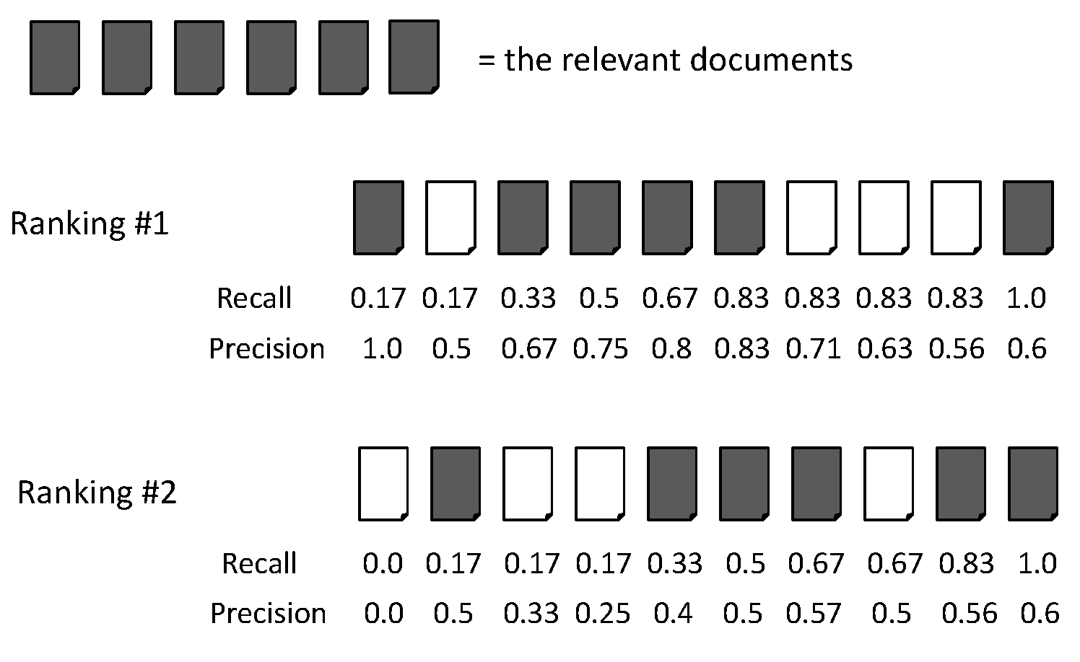
Average Precision
Ranking #1 = (1.0+0.67+0.75+0.8+0.83+0.6) /6 = 0.78
Ranking #2 = (0.5+0.4+0.5+0.57+0.56+0.6) /6 = 0.5
Information Retrieval and Web Search, IR Evaluation and IR Standard Text Collections, Rada Mihalcea

Slide 75
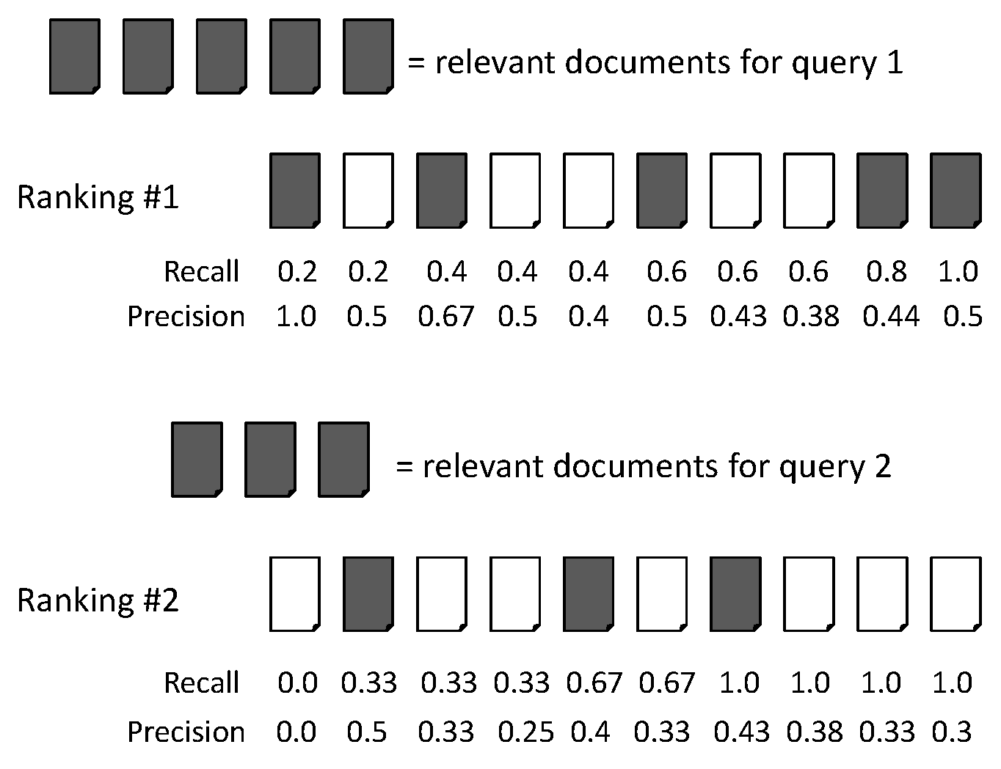
Mean Average Precision (MAP)
Average precision query 1 = (1.0+0.67+0.5+0.44+0.5)/5 = 0.62
Average precision query 2 = (0.5+0.4+0.43)/3 = 0.44
MAP = (0.62 + 0.44)/2 = 0.53
Information Retrieval and Web Search, IR Evaluation and IR Standard Text Collections, Rada Mihalcea

Slide 76
Mean Average Precision (MAP)
If a relevant document never gets retrieved, we assume the precision corresponding to that relevant document to be zero.
MAP is macro-averaging: each query counts equally.
A commonly used measure in current IR research, along with P/R/F
Information Retrieval and Web Search, IR Evaluation and IR Standard Text Collections, Rada Mihalcea

Slide 77
Back to IR: Language Models
A new approach to probabilistic IR, derived from work in automatic speech recognition, OCR and MT
Statistically model the use of language in a collection to estimate the probability that a query was generated from a particular document
If the query could have come from the document, then that document is likely to be relevant
Acknowledgment: Slides taken from a presentation on "Principles of Information Retrieval" by Ray Larson
Jay M. Ponte and W. Bruce Croft. A language modeling approach to information retrieval. In Proceedings of the 21st annual international ACM SIGIR conference on Research and development in information retrieval (SIGIR '98). ACM, New York, NY, USA, 275-281. 1998.

Slide 78
Ponte and Croft LM
For the original Ponte and Croft Language Models the goal is to estimate:
That is, the probability of a query given the language model of document d. One approach would be to use:
Maximum likelihood estimate of the probability of term t in document d, where tf_{(t,d)} is the term frequency of t in doc d
tf_{t,d}

Slide 79
Ponte and Croft LM
The ranking formula then could be:
For each document d in the collection…
There are problems with this (not least of which is that it is zero for any document that doesn’t contain all query terms)
A robust estimator might be the mean probability of t in documents containing it (df_{t} is the document frequency of t)

Slide 80
Ponte and Croft LM
There are still problems with this estimator, in that it treats each document with t as if it came from the SAME language model
The final form with a “risk adjustment” for a term t in a document d is as follows…

Slide 81
Ponte and Croft LM
Let,
Where the risk is
i.e. the geometric distribution, f_{t} is the mean term frequency of term t in the docs where t occurs and cf_{t} is the raw term count of t in the collection and cs is the collection size (in #term tokens)
Then,
*#terms(d)

Slide 82
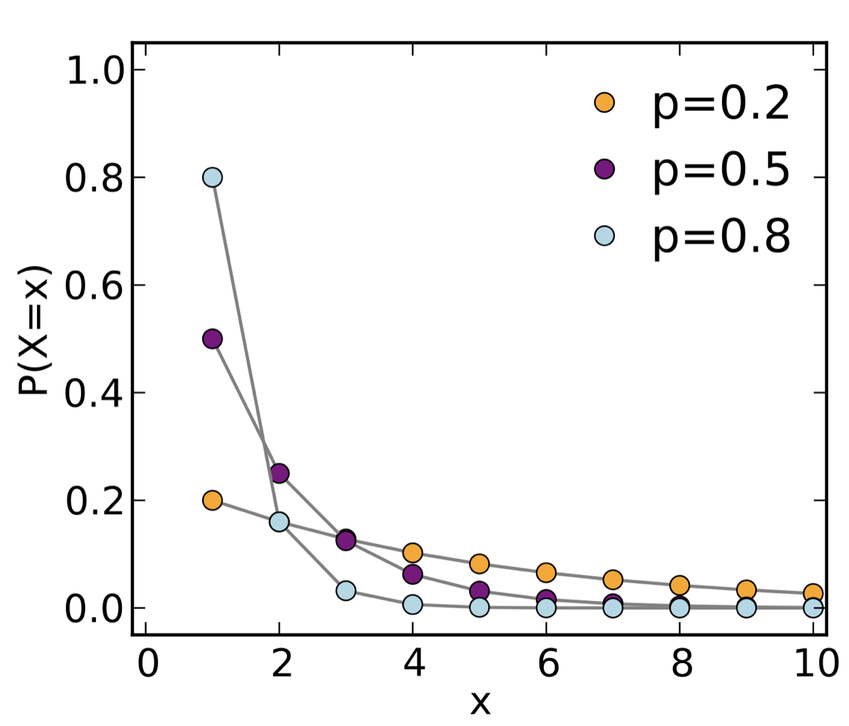
Geometric Distribution
The geometric distribution gives the probability that the first occurrence of success requires k independent trials, each with success probability p. If the probability of success on each trial is p, then the probability that the kth trial (out of k trials) is the first success is
for k = 1, 2, 3, ....
1 – 1/(1+x) = (1+x)/(1+x) – 1/(1+x) = x / (1+x)

Slide 83
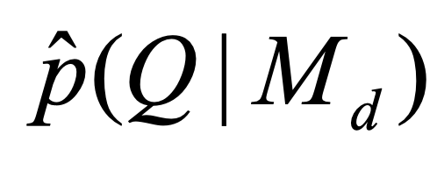
Ponte and Croft IR
Given: Query Q
Iterate over all docs d: Rank according to
Possibly return only k best docs
When compared to a fairly standard TF.IDF retrieval on the TREC collection …
… the Ponte and Croft language model provided significantly better performance
5% more relevant documents were retrieved overall,
with about a 20% increase in mean average precision
But: Notion of relevance is lacking

Slide 84
Lavrenko and Croft LM
Reclaim ideas of the probability of relevance from earlier probabilistic models and includes them into the language modeling framework with its effective estimation techniques
Victor Lavrenko and W. Bruce Croft. Relevance based language models. In Proceedings of the 24th annual international ACM SIGIR conference on Research and development in information retrieval (SIGIR '01). ACM, New York, NY, USA, 120-127. 2001.

Slide 85
BIR vs. Ponte and Croft
The basic form of the older probabilistic model (Binary independence model) is
While the Ponte and Croft Language Model is very similar
t
t

Slide 86
Lavrenko and Croft LM
What distinguishes the two is how the individual word (term) probabilities are estimated
Basically they estimate the probability of observing a word in the relevant set using the probability of co-occurrence between the words and the query adjusted by collection level information
Where λ is a parameter derived from a test collection
Lurking danger of overtraining (word like “the”, “of”, “and” or misspellings): focus on modeling terms distinguishing the model from the general model of a collection [Zaragoza et al. 03]
Zaragoza, H., Hiemstra, D., Tipping, M., & Robertson, S. E. Bayesian Extension to the Language Model for Ad Hoc Information Retrieval. 4-9. 2003

Slide 87
Good and Bad News
Standard Vector Space Model
Empirical for the most part; success measured by results
Few properties provable
Probabilistic Models
Advantages
Based on a firm theoretical foundation
But: construction of the BN is engineering work
Theoretically justified optimal ranking scheme
Disadvantages
Binary word-in-doc weights (not using term frequencies)
Often: Independence of terms (can be alleviated)
Amount of computation required is high
Has never worked convincingly better in practice

Slide 88
Dimension Reduction
Introduction to Web and Data Science Non-standard Databases and Data Mining
Dealing with terms directly in PRP context leads to a rather large computational effort
Vector space approaches benefit from dimension reduction (and need it indeed)
We will cover probabilistic dimension reduction soon: Compute "topics"

Slide 89
Back to IR agents
Agents make decisions about which documents to select and report to the agents‘ creators
Recommend the k top-ranked documents
Ranking according to PRP or LM as explained before
How to evaluate an agent‘s performance
Externally (agent creator’s satisfaction)
Internally (relevance feedback, reinforcement)

Slide 90
Web Mining Agents
Mining in complex networks requires the management of
Distributed work (problem decomposition)
Autonomous work (no central control, proactive agents)
Collaboration between agents (solution sharing, "collective intelligence in the small")
Feedback and adaptation (learning by reinforcement)
Weiss, G. "A Multiagent Perspective of Parallel and Distributed Machine Learning". Agents 98: 226–230, 1998.
Klusch, M.; Lodi, S.; Moro, G.. "Agent-Based Distributed Data Mining". LNCS 2586: 104–122, 2003.
Cao, Longbing; Gorodetsky, Vladimir; Mitkas, Pericles A. "Agent Mining: The Synergy of Agents and Data Mining,". IEEE Intelligent Systems. 24 (3): 64–72, 2009.
Cao, Longbing; Weiss, Gerhard; Yu, Philip. "A Brief Introduction to Agent Mining". Journal of Autonomous Agents and Multi-Agent Systems. 25: 419–424, 2012.

Slide 91
Collaboration: Measure for inter-judge (dis)agreement
Kappa measure
(Dis)Agreement measure among judges
Designed for categorical judgments
Corrects for chance agreement
𝜅 = [ P(A) – P(E) ] / [ 1 – P(E) ]
P(A) – proportion of time judges agree (observed)
P(E) – what agreement would be by chance (hypothetical)
𝜅 = 0 for chance agreement, 1 for total agreement
In statistics many other measures are defined
Cohen, Jacob, "A coefficient of agreement for nominal scales". Educational and Psychological Measurement 20 (1): 37–46, 1960
91
Notes:
91

Slide 92
Kappa Measure: Example
P(A)? P(E)?
Number of docs | Judge 1 | Judge 2
300 | Relevant | Relevant
70 | Nonrelevant | Nonrelevant
20 | Relevant | Nonrelevant
10 | Nonrelevant | Relevant
92
Notes:
92

Slide 93
Kappa Example
P(A) = 370/400 = 0.925
P(nonrelevant) = (10+20+70+70)/800 = 0.2125
P(relevant) = (10+20+300+300)/800 = 0.7878
P(E) = 0.2125² + 0.7878² = 0.665
𝜅 = (0.925 – 0.665)/(1-0.665) = 0.776
𝜅 > 0.8 = good agreement
0.67 < 𝜅 < 0.8 -> “tentative conclusions”
Depends on purpose of study
For >2 judges: average pairwise 𝜅s
Carletta, J. C., Assessing agreement on classification tasks: The kappa statistic. Computational Linguistics, 22(2), 249-254, 1996
93
Notes:
93

Slide 94
Relevance Feedback: Rocchio Algorithm
The Rocchio algorithm incorporates relevance feedback information into the vector space model.
Want to maximize sim(Q, C_{r}) - sim(Q, C_{nr}) where C_{r} and C_{nr} denote relevant and non-relevant doc vectors, respectively
The optimal query vector for separating relevant and non-relevant documents (with cosine sim.):
Q_{opt} = optimal query; C_{r} = set of rel. doc vectors in corpus; N = collection size
Unrealistic definition: We don’t know relevant documents in corpus
94
Notes:
94
Q = query, Cr = relevant documents Cnr = not relevant documents

Slide 95
The Theoretically Best Query
x
x
x
x
o
x
x
x
x
x
x
x
x
o
x
o
x
o
x
x
Δ
o
o
x
x
x non-relevant documents
o relevant documents
Optimal query
95

Slide 96
Rocchio 1971 Algorithm (SMART System)
Useful in practice:
q_{m} = modified query vector; q₀ = original query vector; α,β,γ: weights (hand-chosen or set empirically); D_{r} = set of known relevant doc vectors; D_{nr} = set of known irrelevant doc vectors
New query moves toward relevant documents and away from irrelevant documents
Tradeoff α vs. β/γ : If we have a lot of judged documents, we want a higher β/γ.
Term weight can go negative
Negative term weights are ignored (set to 0)
Wikipedia: Gerard Salton, The SMART (System for the Mechanical Analysis and Retrieval of Text or Salton’s Magic Automatic Retriever of Text) Information Retrieval System is an information retrieval system, developed at Cornell University in the 1960s. Many important concepts in information retrieval were developed as part of research on the SMART system, including the vector space model, relevance feedback, and Rocchio algorithm.
Salton, G. (Ed.). The SMART retrieval system: Experiments in automatic document processing. Englewood Cliffs, NJ: Prentice-Hall. 1971.
96
Notes:
96
SMART: Cornell (Salton) IR system of 1970s to 1990s.

Slide 97
Relevance feedback on initial query
Initial query
x
x
x
o
x
x
x
x
Δ
x
x
x
o
x
o
x
Δ
x
o
x
o
o
x
x
x
x
Revised query
x known non-relevant documents
o known relevant documents
97
Notes:
Salton, G. (1968). Automatic information organization and retrieval. New York: McGraw-Hill Book Company.
Salton, G. (Ed.). (1971). The SMART retrieval system: Experiments in automatic document processing. Englewood Cliffs, NJ: Prentice-Hall.

Slide 98
Positive vs Negative Feedback
Positive feedback is more valuable than negative feedback (so, set 𝛾 < 𝛽; e.g. 𝛾 = 0.25, 𝛽 = 0.75).
Why?
Many systems only allow positive feedback (𝛾=0).
98
Notes:
98
It’s harder for user to give negative feedback (absence of evidence is not evidence of absence). It’s also harder to use since relevant documents can often form tight cluster, but non-relevant documents rarely do. Usually there are very many non-relevant documents (and rather few relevant ones). Thus, non-relevant ones give less specific information due to a larger prior.

Slide 99
Relevance feedback in vector spaces
We can modify the query based on relevance feedback and apply standard vector space model.
Use only the docs that were marked.
Relevance feedback can improve recall and precision
Any idea for relevance feedback in probabilistic IR?
99
Notes:
99
Just as we modified the query in the vector space model, we can also modify it here. I’m not aware of work that uses language model based Ir this way.

Slide 100
IR Agents: Summary
Goal: Fulfill information need of human user
Information need specified in various ways (e.g., query vector)
Agent employs strategies to best fulfill its goal(s)
Agent receives reinforcement feedback (“reward”) (e.g., as relevance feedback)
Agent changes its goal fulfillment strategies for dealing with the same or similar goals
E.g., by applying the Rocchio Algorithm
Agent possibly extends its model of the user
Agent could refine goals to meet expectations
Reduce uncertainty
Agent could contact other agents to acquire new information

