Slide 1
Intelligent Agents Probabilistic Models for Sequential Structures
Prof. Dr. Ralf Möller
Universität zu Lübeck
Institut für Informationssystem

Slide 2
Motivation: Part Of Speech Tagging
Annotate each word in a sentence with a part-of-speech (POS) tags.
Lowest level of syntactic analysis.
Useful for subsequent syntactic parsing and word sense disambiguation
Topic modeling as discussed before could be extended to better consider POS tags
John saw the saw and decided to take it to the table.
NNP VBD DT NN CC VBD TO VB PRP IN DT NN
Abbreviations: https://sites.google.com/site/partofspeechhelp/home
CS 388 Natural Language Processing: Raymond J. Mooney

Slide 3
Information Extraction
Identify phrases in language that refer to specific types of entities and relations in text.
Named entity recognition is the task of identifying names of people, places, organizations, etc. in text.
people organizations places
Michael Dell is the CEO of Dell Computer Corporation and lives in Austin Texas.
Extract pieces of information relevant to a specific application, e.g. used car ads:
make model year mileage price
For sale, 2002 Toyota Prius, 20,000 mi, $15K or best offer. Available starting July 30, 2006.
CS 388 Natural Language Processing: Raymond J. Mooney

Slide 4
Semantic Role Labeling
For each clause, determine the semantic role played by each noun phrase that is an argument to the verb.
agent patient source destination instrument
John drove Mary from Austin to Dallas in his Toyota Prius.
The hammer broke the window.
Also referred to a “case role analysis,” “thematic analysis,” and “shallow semantic parsing”
CS 388 Natural Language Processing: Raymond J. Mooney

Slide 5
Sequence Labeling as Classification
Using Outputs as Inputs
Better input features are usually the categories of the surrounding tokens, but these are not available yet.
Can use category of either the preceding or succeeding tokens by going forward or back and using previous output.
CS 388 Natural Language Processing: Raymond J. Mooney

Slide 6
Forward Classification
John saw the saw and decided to take it to the table.
classifier
NNP
CS 388 Natural Language Processing: Raymond J. Mooney

Slide 7
Forward Classification
NNP
John saw the saw and decided to take it to the table.
classifier
VBD
CS 388 Natural Language Processing: Raymond J. Mooney

Slide 8
Forward Classification
NNP VBD
John saw the saw and decided to take it to the table.
classifier
DT
CS 388 Natural Language Processing: Raymond J. Mooney

Slide 9
Forward Classification
NNP VBD DT
John saw the saw and decided to take it to the table.
classifier
NN
CS 388 Natural Language Processing: Raymond J. Mooney

Slide 10
Forward Classification
NNP VBD DT NN
John saw the saw and decided to take it to the table.
classifier
CC
CS 388 Natural Language Processing: Raymond J. Mooney

Slide 11
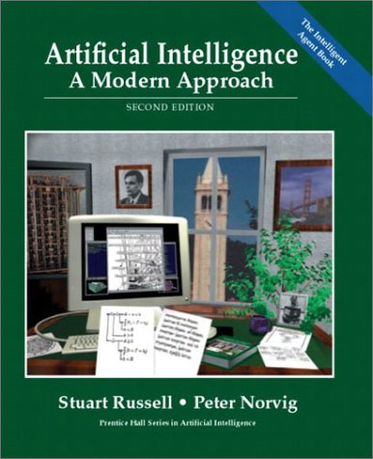
More general perspective…
sensors
?
environment
agent
actuators
t₁, t₂, t₃, …

Slide 12
Time and Uncertainty
The world changes, we need to track and predict it
Examples: diabetes management, traffic monitoring
Uncertainty is everywhere
Need temporal probabilistic graphical models
Basic idea: copy state and evidence variables for each time step
X_{t} – set of unobservable state variables at time t
e.g., BloodSugar_{t}, StomachContents_{t}
E_{t} – set of evidence variables at time t
e.g., MeasuredBloodSugar_{t}, PulseRate_{t}, FoodEaten_{t}
Assumes discrete time steps

Slide 13
States and Observations
Process of change viewed as series of snapshots, each describing the state of the world at a particular time
Time slice involves a set of random variables indexed by t:
the set of unobservable state variables X_{t}
the set of observable evidence variable E_{t}
The observation at time t is E_{t} = e_{t} for some set of values e_{t}
The notation X_{a:b} denotes the set of variables from X_{a} to X_{b}

Slide 14
Dynamic Bayesian Networks
How can we model dynamic situations with a Bayesian network?
Example: Is it raining today?
next step: specify dependencies among the variables.
The term “dynamic” means we are modeling a dynamic system, not that
the network structure changes over time.

Slide 15
Example
Rain_{t}
Umbrella_{t}

Slide 16
DBN - Representation
Problem: all previous random variables could have an influence on those of the current timestamp
Necessity to specify an unbounded number of conditional probability tables, one for each variable in each slice,
Each one might involve an unbounded number of parents.
Solution:
Assume that changes in the world state are caused by a stationary process (unmoving process over time).
is the same for all t

Slide 17
Stationary Process/Markov Assumption
Markov Assumption: X_{t} depends on some parent X_{i}s
First-order Markov process: P(X_{t}|X_{0:t-1}) = P(X_{t}|X_{t-1})
kth order: depends on previous k time steps
Sensor Markov assumption: P(E_{t}|X_{0:t}, E_{0:t-1}) = P(E_{t}|X_{t})
Assume stationary process: transition model:
P(X_{t}|X_{t-1}) and sensor model P(E_{t}|X_{t}) are the same for all t
Changes in the world state governed by laws not changing over time
Transition Model
Sensor Model

Slide 18
Dynamic Bayesian Networks
There are two possible fixes if the approximation is too inaccurate:
Increasing the order of the Markov process model. For example, adding as a parent of , which might give slightly more accurate predictions.
Increasing the set of state variables. For example, adding to allow to incorporate historical records of rainy seasons, or adding , and Pressure to allow to use a physical model of rainy conditions.

Slide 19
Dynamic Bayesian Network
Bayesian network structure corresponding to a first-order of Markov process with state defined by the variables Xt.
A second order of Markov process

Slide 20
Example
R_{t-1} | P(R_{t}|R_{t-1})
T F | 0.7 0.3
Rain_{t-1}
Rain_{t}
Rain_{t+1}
Umbrella_{t-1}
Umbrella_{t}
Umbrella_{t+1}
R_{t} | P(U_{t}|R_{t})
T F | 0.9 0.2

Slide 21
Complete Joint Distribution: Markov-1
Given:
Transition model: P(X_{t}|X_{t-1})
Sensor model: P(E_{t}|X_{t})
Prior probability: P(X₀)
Then we can specify complete joint distribution:

Slide 22
Inference Tasks
Filtering: What is the probability that it is raining today, given all the umbrella observations up through today?
Prediction: What is the probability that it will rain the day after tomorrow, given all the umbrella observations up through today?
Smoothing: What is the probability that it rained yesterday, given all the umbrella observations through today?
Most likely explanation / most probable explanation: if the umbrella appeared the first three days but not on the fourth, what is the most likely weather sequence to produce these umbrella sightings?

Slide 23
DBN – Basic Inference
Filtering or Monitoring:
Compute the belief state - the posterior distribution over the current state, given all evidence to date.
Filtering is what a rational agent needs to do in order to keep track of the current state so that the rational decisions can be made.

Slide 24
DBN – Basic Inference
Filtering cont.
Given the results of filtering up to time t, one can easily compute the result for t+1 from the new evidence
(for some function f)
(dividing up the evidence)
(using Bayes’ Theorem)
(by the Markov property of evidence)
α is a normalizing constant used to make probabilities sum up to 1.

Slide 25
Bayes Rule
P(A | B) = P(A, B) / P(B)
P(A,B) = P(A | B) P(B) = P(B | A) P(A) = P(B, A)

Slide 26
Application of Bayes Rule
P(A | B, C) = P(A, B, C) / P(B, C)
= P(C, A, B) / P(B, C)
= P(C | A, B) P(A, B) / P(B, C)
= P(C | A, B) P(A | B) P(B) / (P(C | B) P(B))
= 𝛼 P(C | A, B) P(A | B)
=

Slide 27
DBN – Basic Inference
Filtering cont.
Given the results of filtering up to time t, one can easily compute the result for t+1 from the new evidence
(for some function f)
(dividing up the evidence)
(using Bayes’ Theorem)
(by the Markov property of evidence)
α is a normalizing constant used to make probabilities sum up to 1.

Slide 28
Application of Bayes Rule
P(A | B) = 𝛴_{c} P(A, c | B)
= 𝛴_{c} P(A, c, B) / P(B)
= 𝛴_{c} P(A | c, B) P(c, B) / P(B)
= 𝛴_{c} P(A | c, B) P(c | B) P(B) / P(B)
= 𝛴_{c} P(A | c, B) P(c | B)
=

Slide 29
DBN – Basic Inference
Filtering cont.
The second term represents a one-step prediction of the next step, and the first term updates this with the new evidence.
Now we obtain the one-step prediction for the next step by conditioning on the current state Xt:
(using the Markov property)

Slide 30
Forward Messages

Slide 31
Example P(Rain₀) = (0.5 0.5)^{T}
R_{t-1} | P(R_{t}|R_{t-1})
T F | 0.7 0.3
Rain_{t-1}
Rain_{t}
Rain_{t+1}
Umbrella_{t-1}
Umbrella_{t}
Umbrella_{t+1}
R_{t} | P(U_{t}|R_{t})
T F | 0.9 0.2

Slide 32
DBN – Basic Inference
Illustration for two steps in the umbrella example:
On day 1, the umbrella appears, so U1=true. The prediction from t=0 to t=1 is
and updating it with the evidence for t=1 gives
On day 2, the umbrella appears, so U2=true. The prediction from t=1 to t=2 is
and updating it with the evidence for t=2 gives

Slide 33
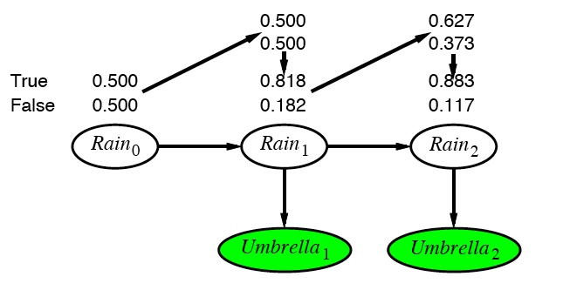
Example cntd.

Slide 34
DBN – Basic Inference
Prediction:
Compute the posterior distribution over the future state, given all evidence to date.
for some k>0
The task of prediction can be seen simply as filtering without the addition of new evidence.

Slide 35
DBN – Basic Inference
Smoothing or hindsight:
Compute the posterior distribution over the past state, given all evidence up to the present.
for some k such that 0 ≤ k < t.
Hindsight provides a better estimate of the state than was available at the time, because it incorporates more evidence.

Slide 36
Smoothing

Slide 37
Application of Bayes Rule
P(A | B, C) = P(A, B, C) / P(B, C)
= P(C, A, B) / P(B, C)
= P(C | A, B) P(A, B) / P(B, C)
= P(C | A, B) P(A | B) P(B) / (P(C | B) P(B))
= 𝛼 P(C | A, B) P(A | B)

Slide 38
Smoothing

Slide 39
Application of Bayes Rule
P(A | B) = 𝛴_{c} P(A, c | B)
= 𝛴_{c} P(A, c, B) / P(B)
= 𝛴_{c} P(A | c, B) P(c, B) / P(B)
= 𝛴_{c} P(A | c, B) P(c | B) P(B) / P(B)
= 𝛴_{c} P(A | c, B) P(c | B)

Slide 40
Smoothing

Slide 41
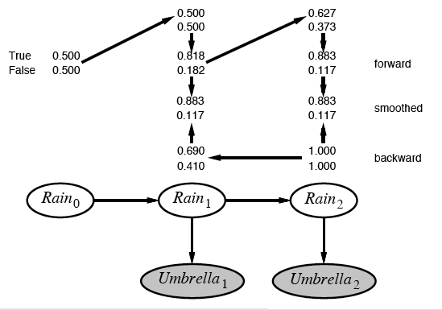
Example contd.

Slide 42
DBN – Basic Inference
Filtering cont.
The second term represents a one-step prediction of the next step, and the first term updates this with the new evidence.
Now we obtain the one-step prediction for the next step by conditioning on the current state Xt:
(using the Markov property)

Slide 43
DBN – Basic Inference
Most likely explanation:
Compute the sequence of states that is most likely to have generated a given sequence of observation.
Algorithms for this task are useful in many applications, including, e.g., speech recognition.

Slide 44
Most-likely explanation

Slide 45
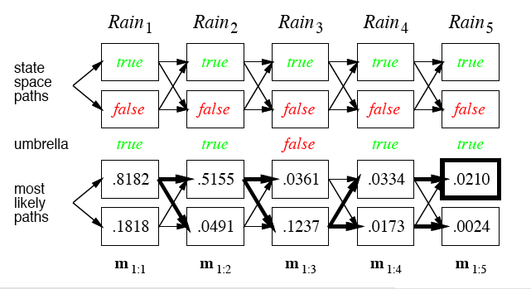
Rain/Umbrella Example

Slide 46
Hidden Markov Model (HMM)
Consider special case of a dynamic Bayesian Network:
Use vector of independent state variables X_{t}
Use vector of independent evidence variables E_{t}
This was already used in the rain-umbrella example
For high-dimensional vectors the transition and sensor models become quite complex: O(d²) space
NB:
In a general dynamic Bayesian network, state variables are not necessarily independent
Even evidence variable might be dependent on one another (naïve Bayes does not work)

Slide 47
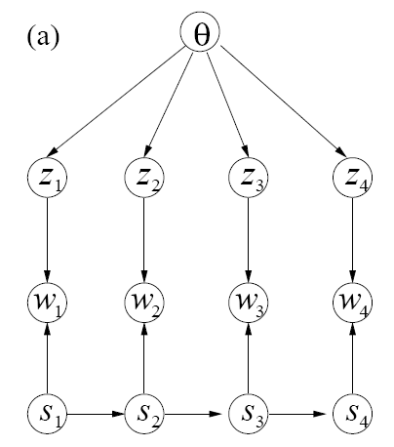
How to Incorporate Context into LDA?
𝛼
LDA
HMM (e.g. for POS tagging)

Slide 48
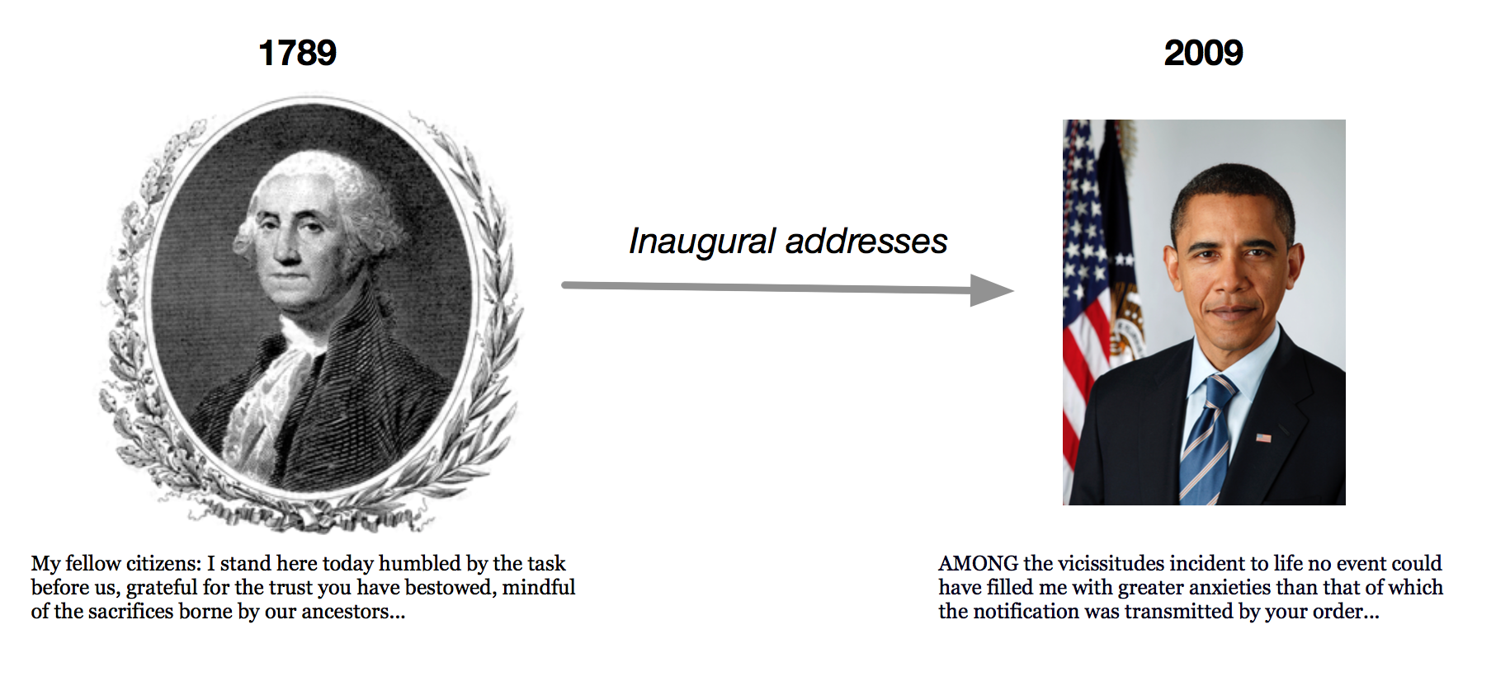
Dynamic Topic Models
In LDA the order of documents does not matter
Not appropriate for sequential corpora (e.g., that span hundreds of years)
Further, we may want to track how language changes over time
Let the topics drift in a sequence.
David M. Blei and John D. Lafferty. Dynamic topic models. In Proc. ICML '06. pp. 113-120. 2006.

Slide 49
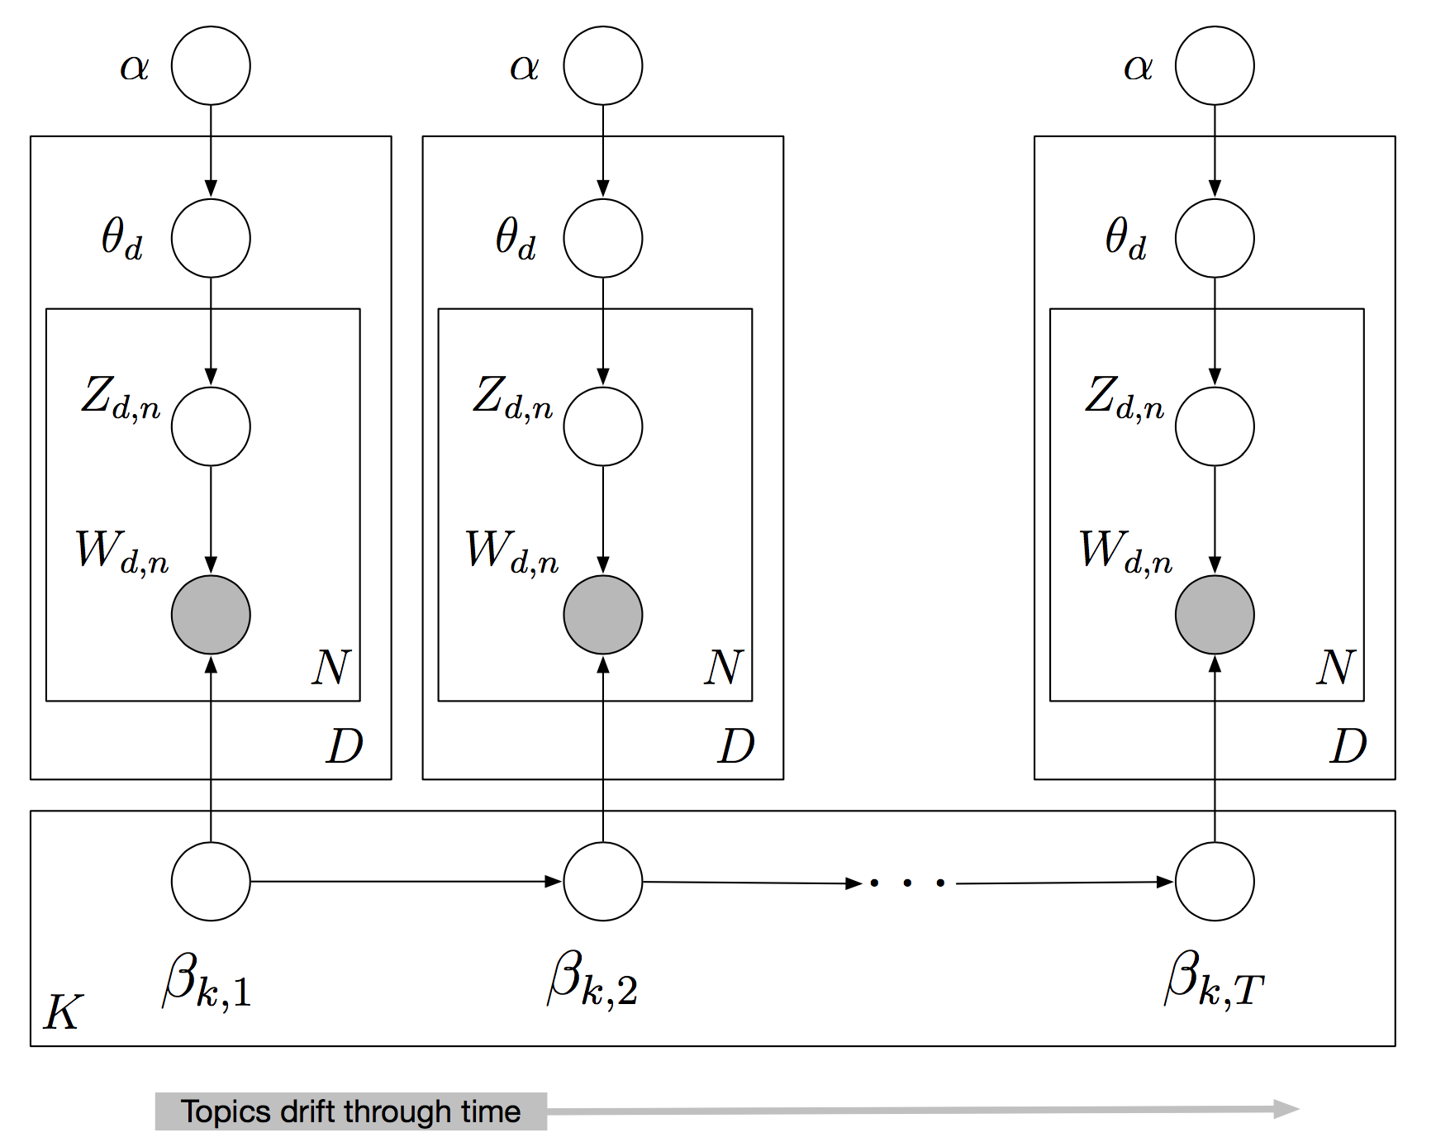

Slide 50
Intelligent Agents Probabilistic Models for Sequential Structures
Prof. Dr. Ralf Möller
Universität zu Lübeck
Institut für Informationssystem

Slide 51
LDA
Probabilistic Topic Models, David Blei, 2013

Slide 52
Using and Embedding LDA
LDA model used to infer posterior distribution
$P\left(Z \right| wd)$
Based on $Z$ one can find and rank related documents
Infer $P\left(Relevantd \right| Zq )$ for $d$ being the documents in a repository and $q$ being the query document
Previously introduced models for information retrieval can be extended with topic information
Works for books, articles, images, videos, and other media
LDA can be embedded in more complicated models
Model further intuitions about the structure of texts
Links, citations (“relational” topic models), …

Slide 53
LDA
Traditional topic modeling (e.g., LDA):
Interested in meaning
Remove most syntactic words (e.g., stopwords)
Discard much of the structure, and all order information that the original author intended
Concerned about long-range topic dependencies rather document structure
Not always easy to decide which words to remove
Keep only nouns? Example: saw vs. saw

Slide 54
HMM
For natural language text: POS tagging
The standardized nature of grammar means that it stays fairly constant across different contexts
HMMs are useful for segmenting text documents into different classes of words, regardless of meaning
For example, all nouns can be grouped together because they play the same role in different passages/documents.
Syntactic dependencies last at most for a sentence

Slide 55
Combining Syntax and Semantics: HMM-LDA
All words (both syntactic and semantic) exhibit short range dependencies.
Only content (semantic) words exhibit long range semantic dependencies.
This leads to the HMM-LDA
HMM-LDA is a composite model, in which an HMM decides the parts of speech, and a topic model (LDA) extracts topics from only those words which are deemed semantic
Thomas L. Griffiths, Mark Steyvers, David M. Blei, and Joshua B. Tenenbaum. Integrating topics and syntax. In Proc. of NIPS'04, pp. 537-544. 2004.

Slide 56
Generative Process 1
Definitions
Words
form document d where each word is one of W words
Topic assignments for each word, where each taking one of T topics
Class assignments for each word, where each taking one of C word classes
Multinomial distribution over topics for document d
Multinomial distribution over semantic words for topic indicated by z.
Multinomial distribution over non-semantic words for class indicated by class c.
Transition probability from to

Slide 57
How to Incorporate Context into LDA?
𝛼
LDA
c₁
c₂
c₃
c₄
HMM (e.g. for POS tagging)

Slide 58
Dirichlet Distribution
Probabilistic Topic Models, David Blei, 2013

Slide 59
Generative Process 2
~
~
~
Where is the row of the transition matrix indicated by c.
~
For document d
Draw topic distribution
Draw a topic for word i
Draw a class for word i from transition matrix
Semantic class
Draw a semantic word
OR
Draw a syntactic word

Slide 60
Simplified Example
One “semantic” class
Preposition class
Verb class

Slide 61
LDA-HMM: Summary
HMM-LDA is a composite topic model
Long range semantic dependencies
Short-range syntactic dependencies
Quite competitive with traditional HMM POS tagger
Outperforms LDA when stop-words and punctuation are not removed

Slide 62
Dynamic Topic Models
In LDA the order of documents does not matter
Not appropriate for sequential corpora (e.g., that span hundreds of years)
Further, we may want to track how language changes over time
Let the topics drift in a sequence.
David M. Blei and John D. Lafferty. Dynamic topic models. In Proc. ICML '06. pp. 113-120. 2006.

Slide 63
Recap: Smoothed LDA Model
Give a different word distribution to each topic
$β$ is $K×V$ matrix (V vocabulary size), each row denotes word distribution of a topic
For each document d
Choose θ_{d} ~ Dirichlet(α)
Choose $β_{k}$~ Dirichlet($η$)
For each position i = 1, ... , N_{d}
Generate a topic z_{i} ~ Mult(∙ | θ_{d})
Generate a word w_{i} ~ Mult(∙ | z_{i},β_{k})
α
θ
$$η$$
z
w
$$β_{k}$$
N
K
M

Slide 65
Dynamic Topic Models
Use a logit normal distribution to model topics evolving over time
Embed it in a state-space model on the log of the topic distribution
Lets us make inferences about sequences of documents
Probabilistic Topic Models, David Blei, 2013

Slide 66
Logistic Normal Distribution

Slide 67
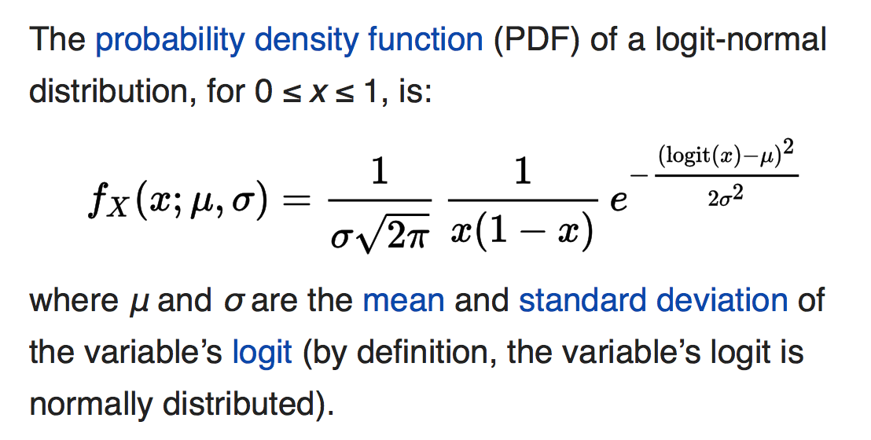
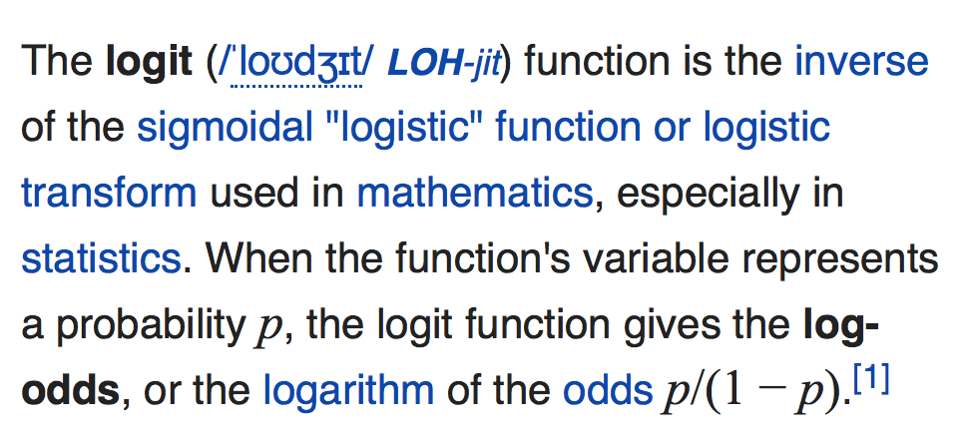
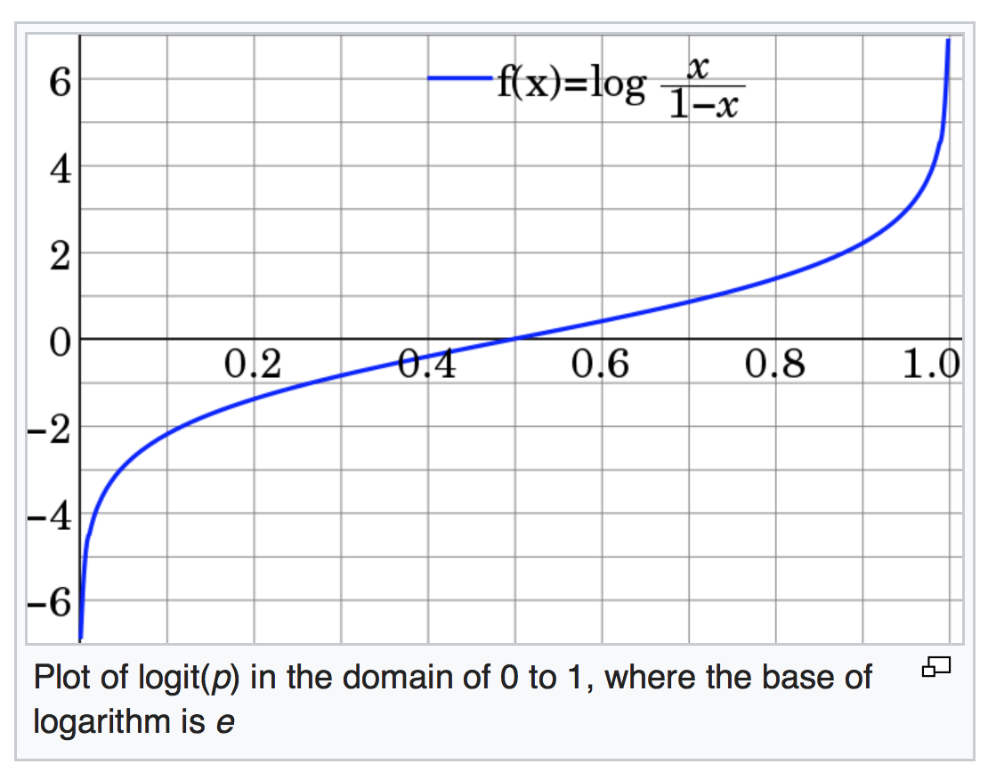
Logit Normal Distribution
Normal Distribution
𝜇 =
𝜇 =
Logit = log of odds
[Wikipedia]

Slide 68
Dynamic Topic Models
Probabilistic Topic Models, David Blei, 2013

Slide 69
Dynamic Topic Models
Probabilistic Topic Models, David Blei, 2013

Slide 70
Dynamic Topic Models
Probabilistic Topic Models, David Blei, 2013

Slide 71
Dynamic Topic Models
David M. Blei and John D. Lafferty. Dynamic topic models. In Proc. ICML '06. pp. 113-120. 2006.
Probabilistic Topic Models, David Blei, 2013

Slide 72
Dynamic Topic Models
Understand developments
Distributions of topics over time
Discretization of time might be a problem
Runtime increases dramatically
Continuous dynamic topic models
Many applications
E.g., comparison of science areas, analysis of scientific work
How can we compare distributions?
Wang, Chong; Blei, David; Heckerman, David. "Continuous Time Dynamic Topic Models". Proceedings of ICML'08, 2008.

Slide 73
Recap: Huffman code example
1
Exp. len
0
1
.5
.5
D
0
1
.25
.25
C
1
If we need to send many messages (A,B,C or D) and they have this probability distribution and we use this code, then over time, the average bits/message should approach 1.75
0
.125
.125
A
B

Slide 74
Recap: Information Theory Background
Assume that you need to send messages from a repertoire of n messages
If there are n equally probable possible messages, then the probability p of each is 1/n or n = 1/p
Information (number of bits) conveyed by a message is log(n) = log(1/p)= -log(p)
E.g., if there are 16 messages, then log(16) = 4 and we need 4 bits to identify/send each message.
In general, if we are given a probability distribution
P = (p₁, p₂, .., p_{n})
Information conveyed by distribution (aka entropy of P) is:
I(P) = -(p₁*log(p₁) + p₂*log(p₂) + .. + p_{n}*log(p_{n}))
= - ∑_{i} p_{i}*log(p_{i}) = ∑_{i} p_{i}*log(1/p_{i})

Slide 75
The KL Divergence
The cross-entropy, or Kullback-Leibler divergence, between two distributions p and q measures the expected information gain (reduction in average number of bits per event) due to replacing the “wrong” distribution q with the “right” distribution p:
Not symmetric

Slide 76
Hellinger Distance
The Hellinger distance is a symmetric measure of distance between two distributions that is popular in machine learning applications:
Sometimes value should be in [0, 1]
∈ [0, $\sqrt{2}$]
[Wikipedia]

Slide 77
Dynamic Topic Models
Time-corrected similarity shows a new way of using the posterior
Consider the expected Hellinger distance between the topic proportions of two documents,
Uses the latent structure to define similarity
Time has been factored out because the topics associated to the components are different from year to year
Similarity of documents based only on topic proportions

Slide 78
Dynamic Topic Models

Slide 79
Dynamic Topic Models

Slide 80
Dynamic Topic Models: Summary
Can model changes of topics (= word distributions) in corpora over time
Uses HMM as a technique for modeling temporal influences
As a by-product we have discussed techniques for comparing distributions

