Slide 1
Intelligent Agents BERT, GPT and Further Developments for Natural Language Inference
Ralf Möller
Universität zu Lübeck
Institut für Informationssysteme

Slide 2
Recap: From ELMo via Transformers to BERT
Language modeling is the “ultimate” NLP task
I.e., a perfect language model is also a perfect question answering/entailment/sentiment analysis model
Training a massive language model learns millions of latent features which are useful for these other NLP tasks
E.g., for natural language inference
No internal “logical” representation
Use language directly to infer new propositions
What kind of a thing is the meaning of a sentence?
What concrete phenomena do you have to deal with to understand a sentence?
https://nlitutorial.github.io

Slide 3
BERT and Add-ons: 2019 Success Stories on SQuAD 2.0
Exact Match and F1 scores
DAE stands for “Data augmentation” and “Domain adaption”
AoA stands for “Attention-over-Attention”
https://rajpurkar.github.io/SQuAD-explorer/
Notes:
屠榜

Slide 4
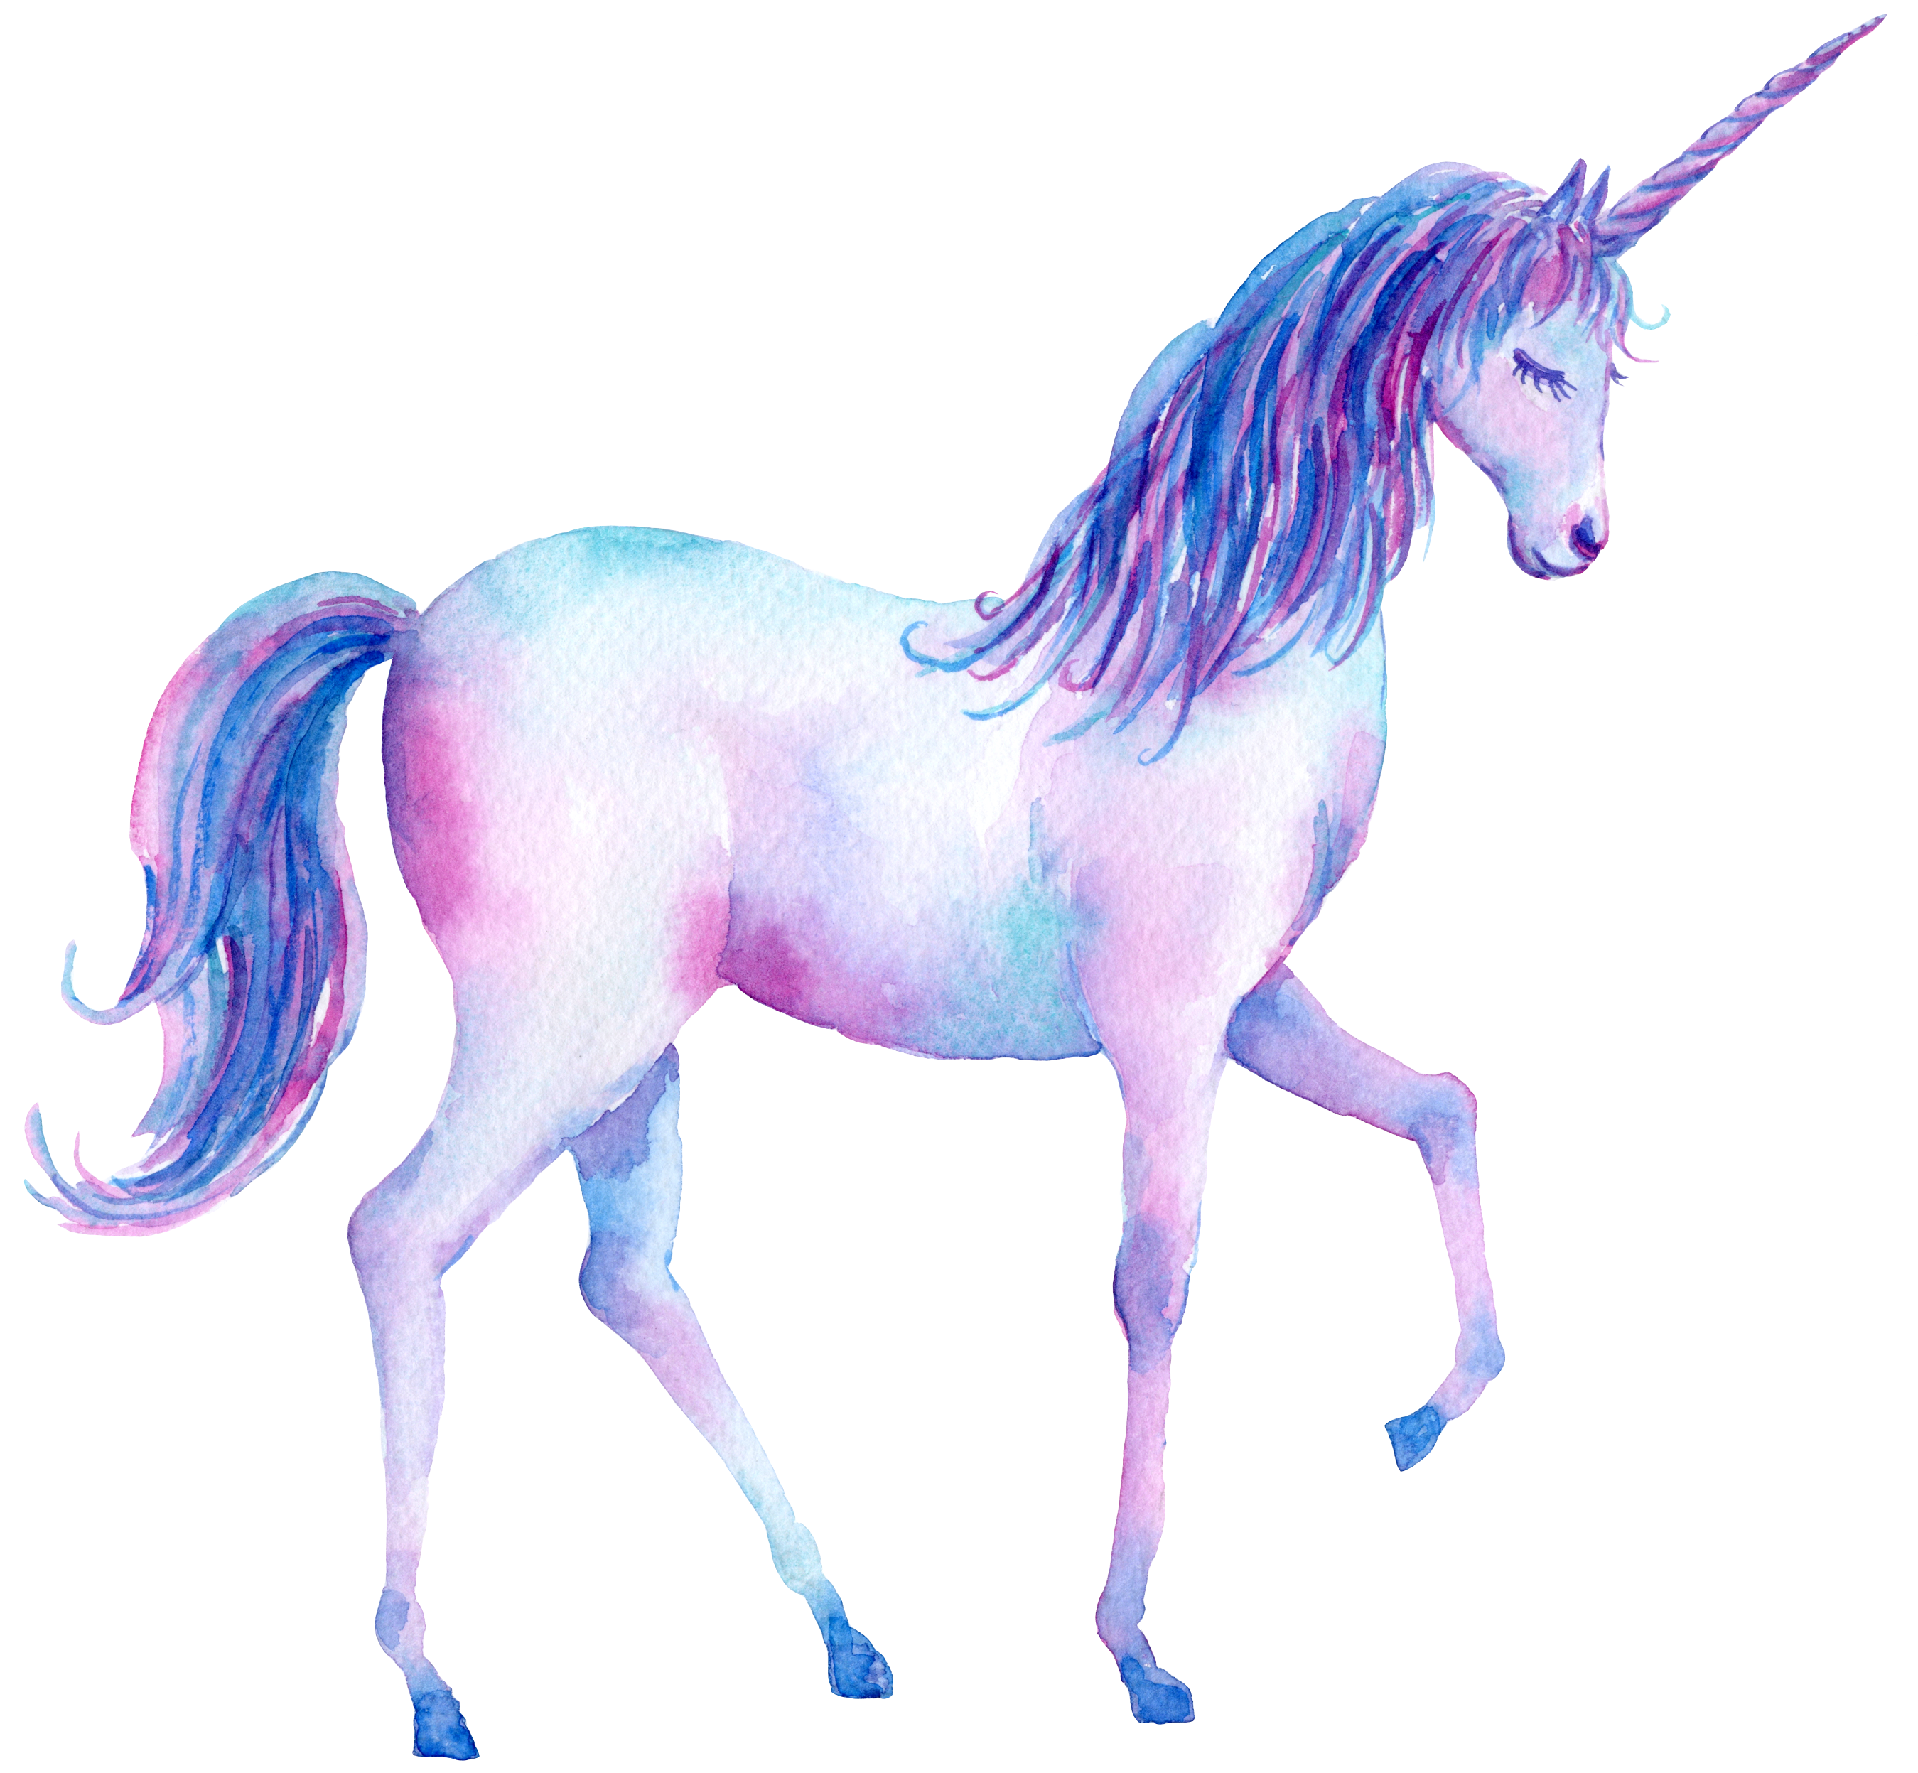
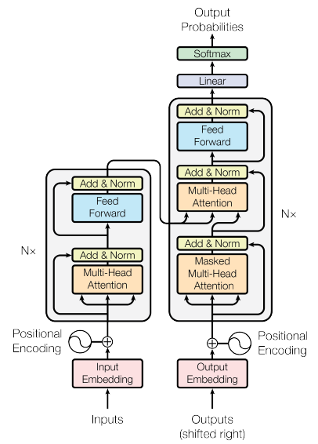
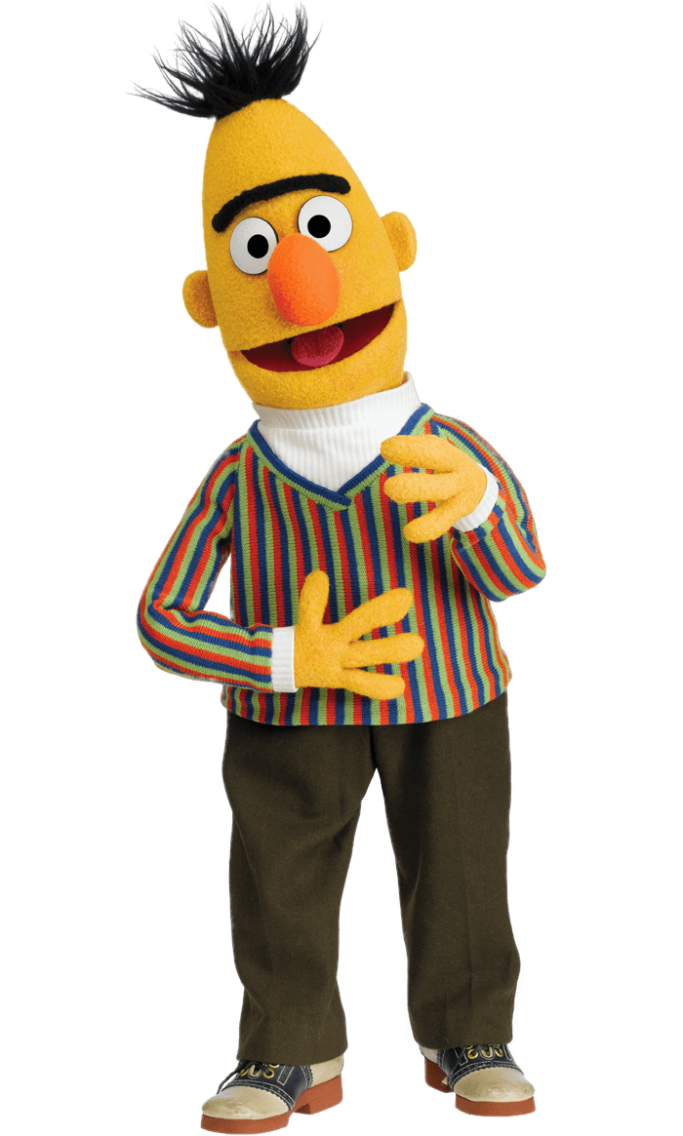
Generative Pre-Training (GPT)
Transformer Decoder
BERT (340M)
ELMO (94M)
GPT-2 (1.5B)
https://d4mucfpksywv.cloudfront.net/better-language-models/language_models_are_unsupervised_multitask_learners.pdf
Notes:
93.6M
340M
1542M
40 GB

Slide 5
Generative Pre-Training (GPT)
退了
Many Layers …
AutoregressionAR(1)
$$b^{2}$$
$${\hat{α}}_{2,1}$$
$${\hat{α}}_{2,2}$$
$$q^{1}$$
$$k^{1}$$
$$v^{1}$$
$$q^{2}$$
$$k^{2}$$
$$v^{2}$$
$$q^{3}$$
$$k^{3}$$
$$v^{3}$$
$$q^{4}$$
$$k^{4}$$
$$v^{4}$$
$$a^{1}$$
$$a^{2}$$
$$a^{3}$$
$$a^{4}$$
<BOS>
潮水
退了
http://speech.ee.ntu.edu.tw/~tlkagk/courses_ML20.html

Slide 6
Generative Pre-Training (GPT)
就
Many Layers …
$$b^{3}$$
$${\hat{α}}_{3,1}$$
$${\hat{α}}_{3,2}$$
$${\hat{α}}_{3,3}$$
$$q^{1}$$
$$k^{1}$$
$$v^{1}$$
$$q^{2}$$
$$k^{2}$$
$$v^{2}$$
$$q^{3}$$
$$k^{3}$$
$$v^{3}$$
$$q^{4}$$
$$k^{4}$$
$$v^{4}$$
$$a^{1}$$
$$a^{2}$$
$$a^{3}$$
$$a^{4}$$
<BOS>
潮水
退了
就
http://speech.ee.ntu.edu.tw/~tlkagk/courses_ML20.html

Slide 7
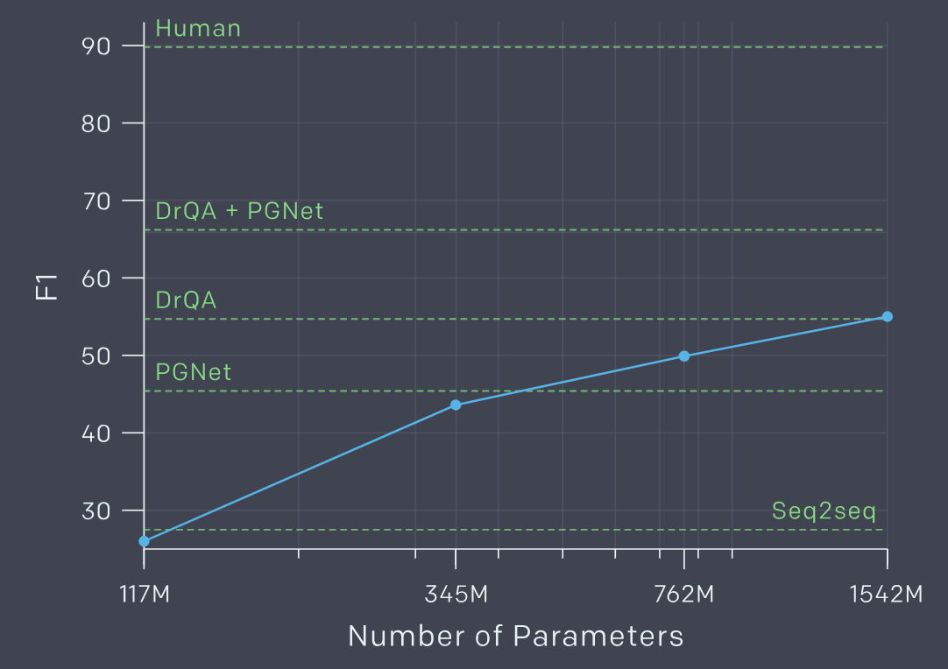
One-shot or Few-shot Learning? GPT-3 175B
Reading Comprehension
$d_{1},d_{2},⋯,d_{N}$,
”Q:”, $q_{1},q_{2},⋯,q_{N}$, “A:”
CoQA
Summarization
$d_{1},d_{2},⋯,d_{N}$,”TL;DR:”
TL;DR=Too long; didn’t read.
English sentence 1
=
French sentence 1
Translation
English sentence 2
=
French sentence 2
Tom B. Brown et al. Language Models are Few-Shot Learners.
https://arxiv.org/abs/2005.14165.
2020.
English sentence 3
=
http://speech.ee.ntu.edu.tw/~tlkagk/courses_ML20.html
Notes:
展現神蹟

Slide 8
Examples
https://blog.inten.to/gpt-3-language-models-are-few-shot-learners-a13d1ae8b1f9

Slide 9
Evaluation
https://blog.inten.to/gpt-3-language-models-are-few-shot-learners-a13d1ae8b1f9

Slide 10
Acknowledgements
Contextual Word Representations with BERT and Other Pre-trained Language Models
Jacob Devlin Google AI Language
10

Slide 11
SQuAD 2.0 (2020)
https://rajpurkar.github.io/SQuAD-explorer/

Slide 12
SQuAD 1.1 (2020)

Slide 13
RoBERTA
RoBERTa: A Robustly Optimized BERT Pretraining Approach (Liu et al, University of Washington and Facebook, 2019)
Trained BERT for more epochs and/or on more data
Showed that more epochs alone helps, even on same data
More data also helps
Masking and pre-training data slightly improved
Liu, Y., Ott, M., Goyal, N., Du, J., Joshi, M., Chen, D., Levy, O., Lewis, M., Zettlemoyer, L., & Stoyanov, V. RoBERTa: A Robustly Optimized BERT Pretraining Approach. ArXiv, abs/1907.11692. 2019.
Contextual Word Representations with BERT and Other Pre-trained Language Models

Slide 14
XLNet
XLNet: Generalized Autoregressive Pretraining for Language Understanding (Yang et al, CMU and Google, 2019)
Innovation #1: Relative position embeddings
Sentence: John ate a hot dog
Absolute attention: “How much should dog attend to hot (in any position), and how much should dog in position 4 attend to the word in position 3? (Or 508 attend to 507, …)”
Relative attention: “How much should dog attend to hot (in any position) and how much should dog attend to the previous word?”
Zhilin Yang, Zihang Dai, Yiming Yang, Jaime Carbonell, Russ R. Salakhutdinov, Quoc V. Le. XLNet: Generalized Autoregressive Pretraining for Language Understanding. In: Proc. NeurIPS-19. 2019.
Contextual Word Representations with BERT and Other Pre-trained Language Models

Slide 15
XLNet
Innovation #2: Permutation Language Modeling
In a left-to-right language model, every word is predicted based on all of the words to its left
Instead: Randomly permute the order for every training sentence
Equivalent to masking, but many more predictions per sentence
Can be done efficiently with Transformers
Contextual Word Representations with BERT and Other Pre-trained Language Models

Slide 16
XLNet
Also used more data and bigger models, but showed that innovations improved on BERT even with same data and model size
XLNet results:
Multi-Genre Natural-Language-Inference
Contextual Word Representations with BERT and Other Pre-trained Language Models

Slide 17
ALBERT
ALBERT: A Lite BERT for Self-supervised Learning of Language Representations (Lan et al, Google and TTI Chicago, 2019)
Innovation #1: Factorized embedding parameterization
Break down token embeddingsinto two small embedding matrixes. After applying this decomposition, embeddings parameters can be reduced from (number of tokens * hidden layer size) to (number of tokens * token embedding size + token embedding size * hidden layer size).
1024
x 100k
128
x 100k
1024
x 128
vs.
⨉
Zhenzhong Lan, Mingda Chen, Sebastian Goodman, Kevin Gimpel, Piyush Sharma, Radu Soricut. ALBERT: A Lite BERT for Self-supervised Learning of Language Representations. In: Proc. ICLR 2019.
Contextual Word Representations with BERT and Other Pre-trained Language Models

Slide 18
ALBERT
Innovation #2: Cross-layer parameter sharing
Share all parameters between Transformer layers
Results:
ALBERT is light in terms of parameters, not speed
Contextual Word Representations with BERT and Other Pre-trained Language Models

Slide 19
T5
Exploring the Limits of Transfer Learning with a Unified Text-to-Text Transformer (Raffel et al, Google, 2019)
Ablated many aspects of pre-training:
Model size
Amount of training data
Domain/cleanness of training data
Pre-training objective details (e.g., span length of masked text)
Ensembling
Finetuning recipe (e.g., only allowing certain layers to finetune)
Multi-task training
Raffel, Colin & Shazeer, Noam & Roberts, Adam & Lee, Katherine & Narang, Sharan & Matena, Michael & Zhou, Yanqi & Li, Wei & Liu, Peter. Exploring the Limits of Transfer Learning with a Unified Text-to-Text Transformer. 2019.
Contextual Word Representations with BERT and Other Pre-trained Language Models

Slide 20
T5
Conclusions:
Scaling up model size and amount of training data helps a lot
Best model is 11B parameters (BERT-Large is 330M), trained on 120B words of cleaned common crawl text
Exact masking/corruptions strategy doesn’t matter that much
Mostly negative results for better finetuning and multi-task strategies
Contextual Word Representations with BERT and Other Pre-trained Language Models

Slide 21
ELECTRA
ELECTRA: Pre-training Text Encoders as Discriminators Rather Than Generators (Clark et al, 2020)
Train model to discriminate locally plausible text from real text
Used, e.g., with ALBERT
Clark, K., Luong, M., Le, Q.V., & Manning, C.D.. ELECTRA: Pre-training Text Encoders as Discriminators Rather Than Generators. ArXiv, abs/2003.10555. 2020.
Contextual Word Representations with BERT and Other Pre-trained Language Models

Slide 22
Applying Models to Production Services?
BERT and other pre-trained language models are extremely large and expensive
How are companies applying them to low-latency production services?
Contextual Word Representations with BERT and Other Pre-trained Language Models

Slide 23
Distillation
Answer: Distillation (a.k.a., model compression)
Idea has been around for a long time:
Model Compression (Bucila et al, 2006)
Distilling the Knowledge in a Neural Network (Hinton et al, 2015)
Simple technique:
Train “Teacher”: Use SOTA pre-training + fine-tuning technique to train model with maximum accuracy
Label a large amount of unlabeled input examples with Teacher
Train “Student”: Much smaller model (e.g., 50x smaller) which is trained to mimic Teacher output
Student objective is typically Mean Square Error or Cross Entropy
Contextual Word Representations with BERT and Other Pre-trained Language Models

Slide 24
Distillation
Example distillation results
50k labeled examples, 8M unlabeled examples
Well-Read Students Learn Better: On the Importance of Pre-training Compact Models (Turc et al, 2020)
Distillation works much better than pre-training + fine-tuning with smaller model
Contextual Word Representations with BERT and Other Pre-trained Language Models

Slide 25
Why does distillation work so well?
A hypothesis:
Finetuning mostly just picks up and tweaks existing latent features
This requires an oversized model, because only a subset of the features are useful for any given task
Distillation allows the model to only focus on those features
Supporting evidence: Simple self-distillation of a small model (e.g., distilling a smaller BERT model) doesn’t work very well
Contextual Word Representations with BERT and Other Pre-trained Language Models

Slide 26
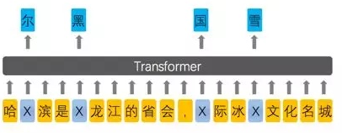
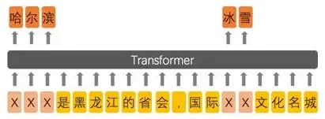
Enhanced Representation through Knowledge Integration (ERNIE)
Incorporation of knowledge graphs
Designed for Chinese (ERNIE-baidu)
BERT
ERNIE
http://speech.ee.ntu.edu.tw/~tlkagk/courses_ML20.html
Zhengyan Zhang, Xu Han, Zhiyuan Liu, Xin Jiang, Maosong Sun, Qun Liu.
ERNIE: Enhanced Language Representation with Informative Entities. In: Proc. ACL-19, 1441–1451. 2019. https://arxiv.org/abs/1904.09223
Notes:
From 擺渡https://zhuanlan.zhihu.com/p/59436589

Slide 27
Knowledge-aware Pretrained Language Models
Bert
Bert-wwm
ERNIE-baidu
SpanBert
ERNIE-thu
KnowBert
K-Bert
KEPLER
GLM
Knowledge-aware PLMs guided by KG
Knowledge-aware KG-enhanced QA
KagNet
CSQA
PG
MHGRN
BERT: Pre-training of deep bidirectional transformers for language understanding (NAACL 19)
Bert-wwm: Pre-Training with Whole Word Masking for Chinese BERT (Arxiv 19)
SpanBERT: Improving Pre-training by Representing and Predicting Spans (TACL 20)
ERNIE-baidu: Enhanced representation through knowledge integration (Arxiv 19)
ERNIE 2.0: A Continual Pre-Training Framework for Language Understanding (AAAI 20)
ERNIE-thu: Enhanced Language Representation with Informative Entities (ACL 19)
K-BERT: Enabling Language Representation with Knowledge Graph (AAAI 20)
KnowBert: Knowledge enhanced contextual word representations (EMNLP 19)
KEPLER: A Unified Model for Knowledge Embedding and Pre-trained Language Representation (Arxiv 19)
GLM: Exploiting Structured Knowledge in Text via Graph-Guided Representation Learning (Arxiv 20)
KagNet: Knowledge-Aware Graph Networks for Commonsense Reasoning (EMNLP 19)
CSQA: Graph-Based Reasoning over Heterogeneous External Knowledge for Common sense Question Answering (AAAI 20)
PG: Connecting the Dots: A Knowledgeable Path Generator for Commonsense Question Answering (EMNLP 2020 finding)
MHGRN: Scalable Multi-Hop Relational Reasoning for Knowledge-Aware Question Answering (EMNLP 2020)

Slide 28
Unified Architecture in KG-enhanced QA
Graph Encoder: GNN, Relational Network…
Text Encoder: Bert, XLNet…
Next topic: Graph encoding

