Slide 1
Non-Standard Databases and Data Mining Dynamic Bayesian Networks
Prof. Dr. Ralf Möller
Universität zu Lübeck
Institut für Informationssystem

Slide 2
Time and Uncertainty
The world changes, we need to track and predict it
Examples: diabetes management, traffic monitoring
Uncertainty is everywhere
Need temporal probabilistic graphical models
Basic idea: copy state and evidence variables for each time step
X_{t} – set of unobservable state variables at time t
e.g., BloodSugar_{t}, StomachContents_{t}
E_{t} – set of evidence variables at time t
e.g., MeasuredBloodSugar_{t}, PulseRate_{t}, FoodEaten_{t}
Assumes discrete time steps

Slide 3
States and Observations
Process of change viewed as series of snapshots, each describing the state of the world at a particular time
Time slice involves a set of random variables indexed by t:
the set of unobservable state variables X_{t}
the set of observable evidence variable E_{t}
The observation at time t is E_{t} = e_{t} for some set of values e_{t}
The notation X_{a:b} denotes the set of variables from X_{a} to X_{b}

Slide 4
Dynamic Bayesian Networks
How can we model dynamic situations with a Bayesian network?
Example: Is it raining today?
next step: specify dependencies among the variables.
The term “dynamic” means we are modeling a dynamic system, not that
the network structure changes over time.

Slide 5
Example
Rain_{t}
Umbrella_{t}

Slide 6
DBN - Representation
Problem: all previous random variables could have an influence on those of the the current timestamp
Necessity to specify an unbounded number of conditional probability tables, one for each variable in each slice,
Each one might involve an unbounded number of parents.
Solution:
Assume that changes in the world state are caused by a stationary process (unmoving process over time).
is the same for all t

Slide 7
Stationary Process/Markov Assumption
Markov Assumption: X_{t} depends on some parent X_{i}s
First-order Markov process: P(X_{t}|X_{0:t-1}) = P(X_{t}|X_{t-1})
kth order: depends on previous k time steps
Sensor Markov assumption: P(E_{t}|X_{0:t}, E_{0:t-1}) = P(E_{t}|X_{t})
Assume stationary process: transition model:
P(X_{t}|X_{t-1}) and sensor model P(E_{t}|X_{t}) are the same for all t
Changes in the world state governed by laws not changing over time
Transition Model
Sensor Model

Slide 8
Dynamic Bayesian Networks
There are two possible fixes if the approximation is too inaccurate:
Increasing the order of the Markov process model. For example, adding as a parent of , which might give slightly more accurate predictions.
Increasing the set of state variables. For example, adding to allow to incorporate historical records of rainy seasons, or adding , and Pressure to allow to use a physical model of rainy conditions.

Slide 9
Dynamic Bayesian Network
Bayesian network structure corresponding to a first-order of Markov process with state defined by the variables Xt.
A second order of Markov process

Slide 10
Example
R_{t-1} | P(R_{t}|R_{t-1})
T F | 0.7 0.3
Rain_{t-1}
Rain_{t}
Rain_{t+1}
Umbrella_{t-1}
Umbrella_{t}
Umbrella_{t+1}
R_{t} | P(U_{t}|R_{t})
T F | 0.9 0.2

Slide 11
Complete Joint Distribution: Markov-1
Given:
Transition model: P(X_{t}|X_{t-1})
Sensor model: P(E_{t}|X_{t})
Prior probability: P(X₀)
Then we can specify complete joint distribution:

Slide 12
Inference Tasks
Filtering: What is the probability that it is raining today, given all the umbrella observations up through today?
Prediction: What is the probability that it will rain the day after tomorrow, given all the umbrella observations up through today?
Smoothing: What is the probability that it rained yesterday, given all the umbrella observations through today?
Most likely explanation / most probable explanation: if the umbrella appeared the first three days but not on the fourth, what is the most likely weather sequence to produce these umbrella sightings?

Slide 13
DBN – Basic Inference
Filtering or Monitoring:
Compute the belief state - the posterior distribution over the current state, given all evidence to date
Filtering is what a rational agent needs to do in order to keep track of the current state so that the rational decisions can be made

Slide 14
DBN – Basic Inference
Filtering cont.
Given the results of filtering up to time t, one can easily compute the result for t+1 from the new evidence
(for some function f)
(dividing up the evidence)
(using Bayes’ Theorem)
(by the Markov property of evidence)
α is a normalizing constant used to make probabilities sum up to 1.

Slide 15
Bayes Rule
P(A | B) = P(A, B) / P(B)
P(A,B) = P(A | B) P(B) = P(B | A) P(A) = P(B, A)

Slide 16
Application of Bayes Rule
P(A | B, C) = P(A, B, C) / P(B, C)
= P(C, A, B) / P(B, C)
= P(C | A, B) P(A, B) / P(B, C)
= P(C | A, B) P(A | B) P(B) / (P(C | B) P(B))
= 𝛼 P(C | A, B) P(A | B)
=

Slide 17
DBN – Basic Inference
Filtering cont.
Given the results of filtering up to time t, one can easily compute the result for t+1 from the new evidence
(for some function f)
(dividing up the evidence)
(using Bayes’ Theorem)
(by the Markov property of evidence)
α is a normalizing constant used to make probabilities sum up to 1.

Slide 18
Application of Bayes Rule
P(A | B) = 𝛴_{c} P(A, c | B)
= 𝛴_{c} P(A, c, B) / P(B)
= 𝛴_{c} P(A | c, B) P(c, B) / P(B)
= 𝛴_{c} P(A | c, B) P(c | B) P(B) / P(B)
= 𝛴_{c} P(A | c, B) P(c | B)
=

Slide 19
DBN – Basic Inference
Filtering cont.
The second term represents a one-step prediction of the next step, and the first term updates this with the new evidence.
Now we obtain the one-step prediction for the next step by conditioning on the current state Xt:
(using the Markov property)

Slide 20
Forward Messages

Slide 21
Example P(Rain₀) = (0.5 0.5)^{T}
R_{t-1} | P(R_{t}|R_{t-1})
T F | 0.7 0.3
Rain_{t-1}
Rain_{t}
Rain_{t+1}
Umbrella_{t-1}
Umbrella_{t}
Umbrella_{t+1}
R_{t} | P(U_{t}|R_{t})
T F | 0.9 0.2

Slide 22
DBN – Basic Inference
Illustration for two steps in the umbrella example:
On day 1, the umbrella appears, so U1=true. The prediction from t=0 to t=1 is
and updating it with the evidence for t=1 gives
On day 2, the umbrella appears, so U2=true. The prediction from t=1 to t=2 is
and updating it with the evidence for t=2 gives

Slide 23
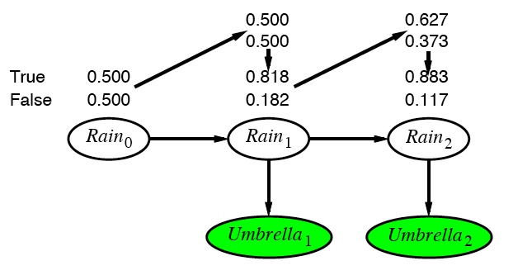
Example cntd.

Slide 24
DBN – Basic Inference
Prediction:
Compute the posterior distribution over the future state, given all evidence to date.
for some k>0
The task of prediction can be seen simply as filtering without the addition of new evidence.

Slide 25
DBN – Basic Inference
Smoothing or hindsight:
Compute the posterior distribution over the past state, given all evidence up to the present.
for some k such that 0 ≤ k < t.
Hindsight provides a better estimate of the state than was available at the time, because it incorporates more evidence.

Slide 26
Smoothing

Slide 27
Application of Bayes Rule
P(A | B, C) = P(A, B, C) / P(B, C)
= P(C, A, B) / P(B, C)
= P(C | A, B) P(A, B) / P(B, C)
= P(C | A, B) P(A | B) P(B) / (P(C | B) P(B))
= 𝛼 P(C | A, B) P(A | B)

Slide 28
Smoothing

Slide 29
Application of Bayes Rule
P(A | B) = 𝛴_{c} P(A, c | B)
= 𝛴_{c} P(A, c, B) / P(B)
= 𝛴_{c} P(A | c, B) P(c, B) / P(B)
= 𝛴_{c} P(A | c, B) P(c | B) P(B) / P(B)
= 𝛴_{c} P(A | c, B) P(c | B)

Slide 30
Smoothing

Slide 31
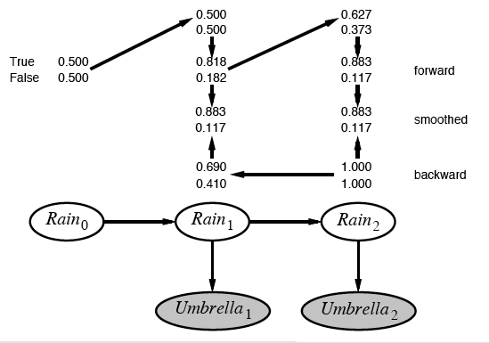
Example contd.

Slide 32
DBN – Basic Inference
Filtering cont.
The second term represents a one-step prediction of the next step, and the first term updates this with the new evidence.
Now we obtain the one-step prediction for the next step by conditioning on the current state Xt:
(using the Markov property)

Slide 33
DBN – Basic Inference
Most likely explanation:
Compute the sequence of states that is most likely to have generated a given sequence of observation.
Algorithms for this task are useful in many applications, including, e.g., speech recognition.

Slide 34
Most-likely explanation

Slide 35
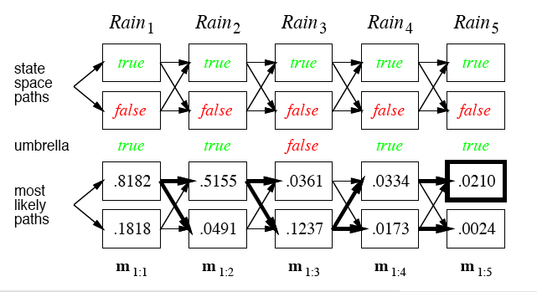
Rain/Umbrella Example

Slide 36
Hidden Markov Model (HMM)
Consider special case of a dynamic Bayesian Network:
Use vector of independent state variables X_{t}
Use vector of independent evidence variables E_{t}
This was already used in the rain-umbrella example
For high-dimensional vectors the transition and sensor models become quite complex: O(d²) space
NB:
In a general dynamic Bayesian network, state variables are not necessarily independent
Even evidence variables might be dependent on one another (naïve Bayes does not work)

Slide 37
The occasionally dishonest casino
A casino uses a fair die most of the time, but occasionally switches to a loaded one
Fair die: Prob(1) = Prob(2) = . . . = Prob(6) = 1/6
Loaded die: Prob(1) = Prob(2) = . . . = Prob(5) = 1/10, Prob(6) = ½
These are the emission probabilities
Transition probabilities
Prob(Fair → Loaded) = 0.01
Prob(Loaded → Fair) = 0.2
Transitions between states modeled by a Markov process
Slide by Changui Yan

Slide 38
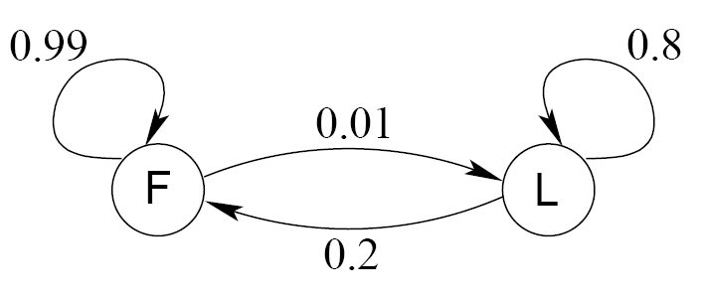
Transition model for the casino
Slide by Changui Yan

Slide 39
The occasionally dishonest casino
Known:
The structure of the model
The transition probabilities
Hidden: What the casino did
FFFFFLLLLLLLFFFF...
Observable: The series of die tosses
3415256664666153...
What we must infer:
When was a fair die used?
When was a loaded one used?
The answer is a sequence FFFFFFFLLLLLLFFF...
Slide by Changui Yan

Slide 40
Making the inference
Model assigns a probability to each explanation of the observation: P(326|FFL) = P(3|F)·P(F→F)·P(2|F)·P(F→L)·P(6|L) = 1/6 · 0.99 · 1/6 · 0.01 · ½
Maximum Likelihood: Determine which explanation is most likely
Find the path most likely to have produced the observed sequence
Total probability: Determine probability that observed sequence was produced by the model
Consider all paths that could have produced the observed sequence
Slide by Changui Yan

Slide 41
Notation
x is the sequence of symbols emitted by model
x_{i} is the symbol emitted at time i
A path, π, is a sequence of states
The i-th state in π is π_{i}
a_{kr} is the probability of making a transition from state k to state r:
e_{k}(b) is the probability that symbol b is emitted when in state k
Slide by Changui Yan

Slide 42
A “parse” of a sequence
1
1
1
1
…
1
2
2
2
2
2
…
2
0
0
…
…
…
…
K
K
K
K
…
K
x₁
x₂
x₃
x_{L}
Slide by Changui Yan

Slide 43
The occasionally dishonest casino
Slide by Changui Yan

Slide 44
The most probable path
The most likely path π* satisfies
To find π*, consider all possible ways the last symbol of x could have been emitted
Let
Then
Slide by Changui Yan

Slide 45
The Viterbi Algorithm
Initialization (i = 0)
Recursion (i = 1, . . . , L): For each state k
Termination:
To find π*, use trace-back, as in dynamic programming
Slide by Changui Yan

Slide 46
Viterbi: Example
x
2
ε
6
6
0
B
1
0
0
(1/6)×(1/2)
= 1/12
(1/6)×max{(1/12)×0.99,
(1/4)×0.2}
= 0.01375
(1/6)×max{0.01375×0.99,
0.02×0.2}
= 0.00226875
F
0
π
(1/2)×(1/2)
= 1/4
(1/10)×max{(1/12)×0.01,
(1/4)×0.8}
= 0.02
(1/2)×max{0.01375×0.01,
0.02×0.8}
= 0.08
L
0
Slide by Changui Yan

Slide 47
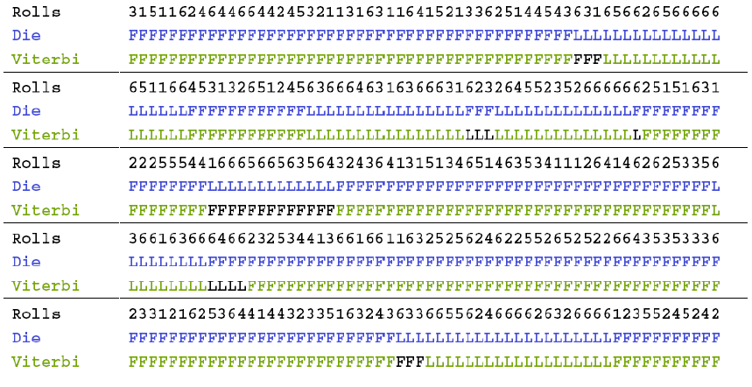
Viterbi gets it right more often than not
Slide by Changui Yan

