Slide 1
Intelligent Agents
1d-CNNs LSTMs ELMo Transformers BERT GPT
Ralf Möller
Universität zu Lübeck
Institut für Informationssysteme

Slide 2
Acknowledgements
Some slides are based on
  CS546: Machine Learning in NLP (Spring 2020)
    http://courses.engr.illinois.edu/cs546/
    Julia Hockenmaier http://juliahmr.cs.illinois.edu
    RNs, LSTMs, ELMo, Transformers
  Machine Learning (Spring 2020)
    http://speech.ee.ntu.edu.tw/~tlkagk/courses_ML20.html
    李宏毅 (Hung-yi Lee ) http://speech.ee.ntu.edu.tw/~tlkagk/
    ELMo, BERT: http://speech.ee.ntu.edu.tw/~tlkagk/courses/ML_2019/Lecture/BERT%20(v3).pdf
Respective sources are indicated in the gray line at the bottom
Slides have been modified
  All errors are mine

Slide 3
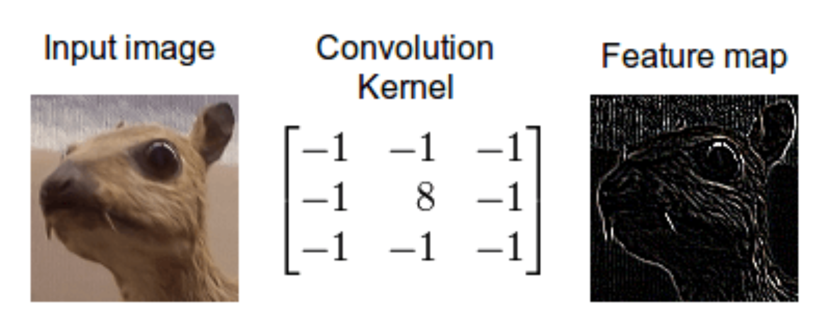
Recap: Convolution

Slide 4
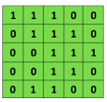
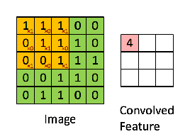

Recap: Convolutional Networks (CNs)
Convolutional
3x3 filter
Input matrix
Main ConvNet idea for text:
Compute vectors for n-grams and group them afterwards
Example: “this takes too long” compute vectors for:
This takes, takes too, too long, this takes too, takes too long, this takes too long
http://deeplearning.stanford.edu/wiki/index.php/Feature_extraction_using_convolution
Notes:
http://www.asimovinstitute.org/neural-network-zoo/

Slide 5
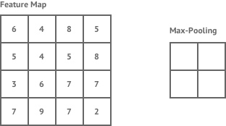
Recap: ConvNets (CNs)
max pool
2x2 filters
and stride 2
Dimension reduction
Main ConvNet idea for text:
Compute vectors for n-grams and group them afterwards
https://shafeentejani.github.io/assets/images/pooling.gif

Slide 6
1d-CNNs for text
Text is a (variable-length) sequence of words (word vectors)
We can use a 1d-CNN to slide a window of n tokens across:
— filter size n = 3, stride = 1, no padding
The | quick | brown | fox | jumps | over | the | lazy | dog
The | quick | brown | fox | jumps | over | the | lazy | dog
The | quick | brown | fox | jumps | over | the | lazy | dog
The | quick | brown | fox | jumps | over | the | lazy | dog
The | quick | brown | fox | jumps | over | the | lazy | dog
The | quick | brown | fox | jumps | over | the | lazy | dog
— filter size n = 2, stride = 2, no padding:
The | quick | brown | fox | jumps | over | the | lazy | dog
The | quick | brown | fox | jumps | over | the | lazy | dog
The | quick | brown | fox | jumps | over | the | lazy | dog
The | quick | brown | fox | jumps | over | the | lazy | dog
CNNs (w/ ReLU and maxpool) can be used for classifying (parts of) the text
CS546 Machine Learning in NLP

Slide 7
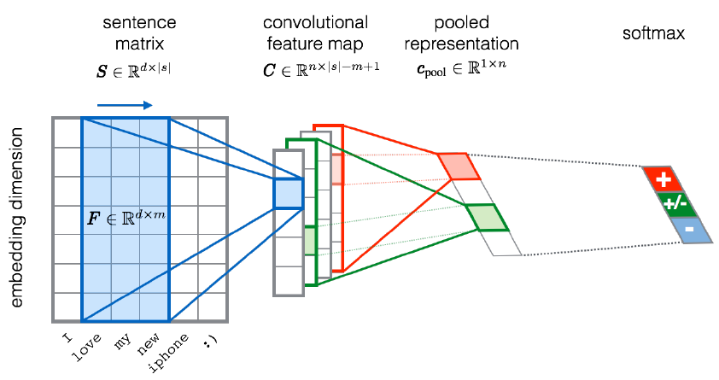
CNNs for sentiment analysis
Entities and relations
not really considered…
Severyn, Aliaksei, and Alessandro Moschitti. "UNITN: Training Deep Convolutional Neural Network for Twitter Sentiment Classification." SemEval@ NAACL-HLT. 2015.
Notes:
the width m of the convolution filters is set to 5
n = 300 feature maps
first layer embeds words into low-dimensional vectors.

Slide 8
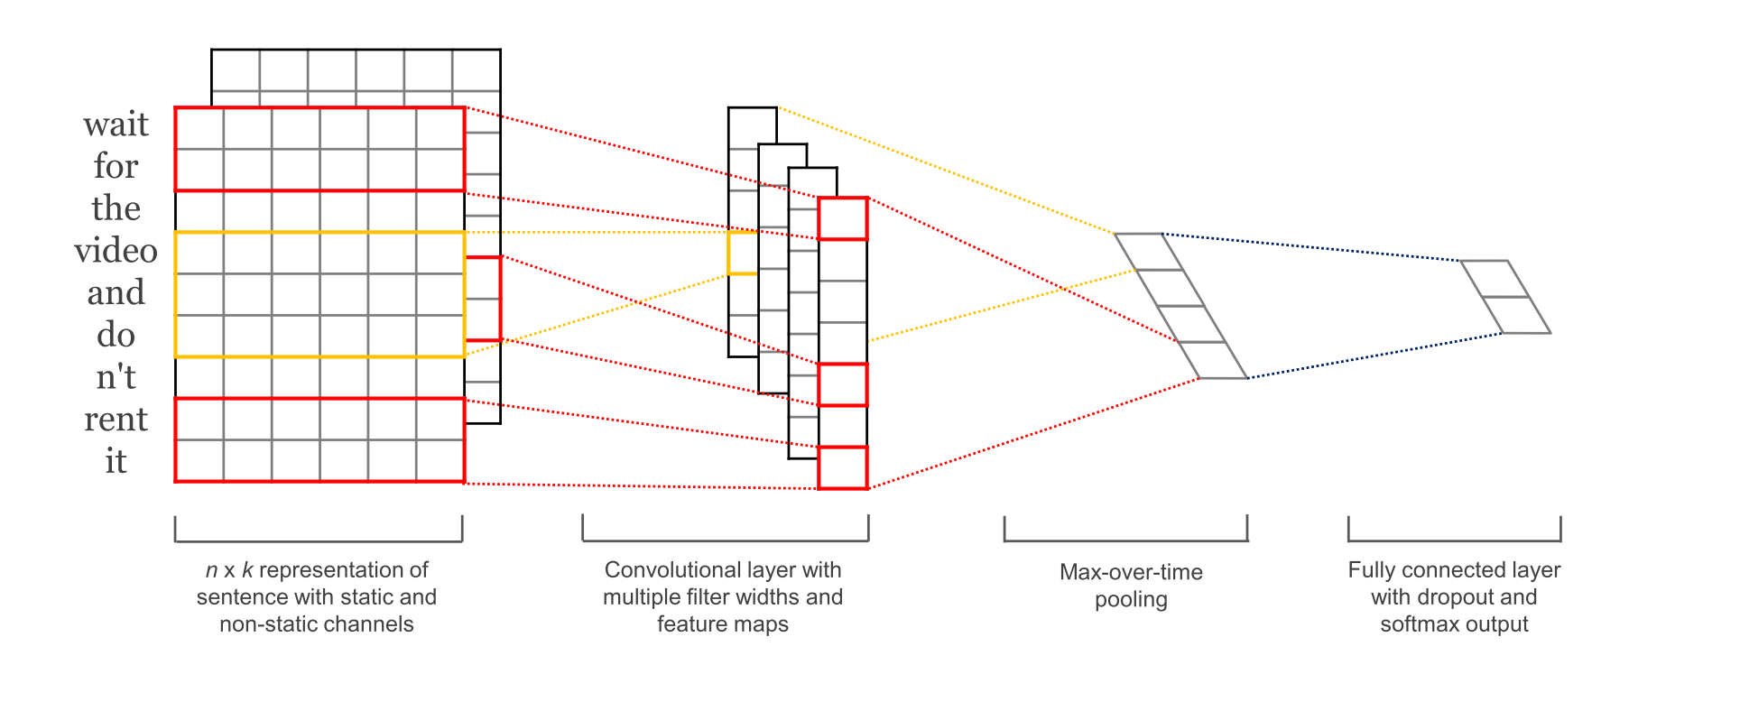
CNNs for sentence/text classification
Pretrained and task-specific embeddings: Multiple Channels
Kim, Y. “Convolutional Neural Networks for Sentence Classification”, EMNLP (2014)
sliding over 3, 4 or 5 words at a time
Static = pre-trained, non-static = task-specific

Slide 9
Fasttext (https://fasttext.cc )
Library for word embeddings and text classification
  static word embeddings and ngram features
  that get averaged together in one hidden layer
  hierarchical softmax output over class labels
Enriching word vectors with subword information
  Skipgram model where each word is a sum of character ngram embeddings and its own embedding
  Each word is deterministically mapped to ngrams
Piotr Bojanowski, Edouard Grave, Armand Joulin, Tomas Mikolov. Enriching Word Vectors with Subword Information. Transactions of the Association for Computational Linguistics, Volume 5. 135-146. 2017.
Armand Joulin, Edouard Grave, Piotr Bojanowski, Tomas Mikolov, Bag of Tricks for Efficient Text Classification. Proceedings of the 15th Conference of the European Chapter of the Association for Computational Linguistics: Volume 2, Short Papers. 427-431. 2017.
Alon Jacovi, Oren Sar Shalom, Yoav Goldberg. Understanding Convolutional Neural Networks for Text Classification. In Proceedings of the 2018 EMNLP Workshop BlackboxNLP: Analyzing and Interpreting Neural Networks for NLP. 2018.
CS546 Machine Learning in NLP

Slide 10









Recursive Networks – Or: Copying the Pattern
Basic computational network copied per time slice
Input: previous hidden state, output: next hidden state
Compare with HMM (or CRF):
Computational model
output
hidden input
Declarative model (generative)
R_{t-1} | P(R_{t}|R_{t-1})
T F | 0.7 0.3
Rain_{t-1}
Rain_{t}
Rain_{t+1}
R_{t} | P(U_{t}|R_{t})
T F | 0.9 0.2
Umbrella_{t-1}
Umbrella_{t}
Umbrella_{t+1}
CS546 Machine Learning in NLP

Slide 11
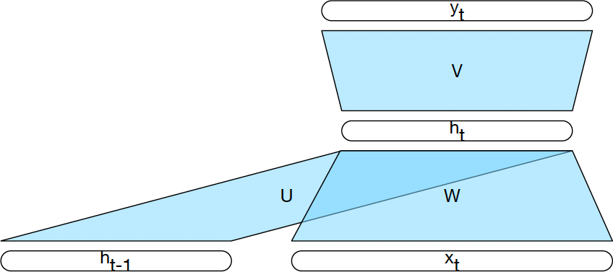
Computing the Hidden State

Slide 12
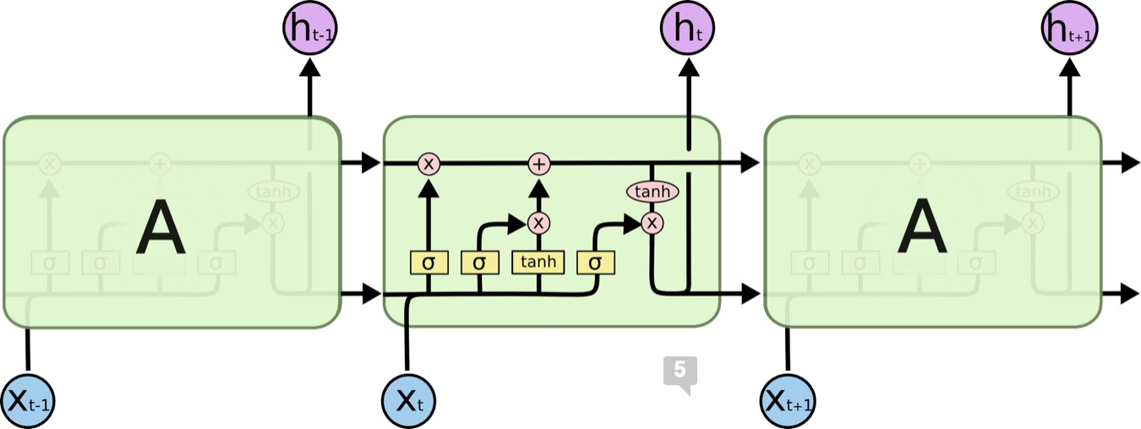
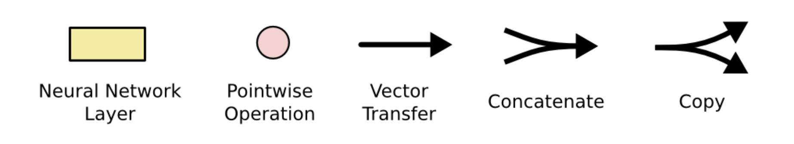
Long Short Term Memory Networks (LSTMs)
https://colah.github.io/posts/2015-08-Understanding-LSTMs/
CS546 Machine Learning in NLP

Slide 13
Recap: Activation Functions
Sigmoid (logistic function):
σ(x) = 1/(1 + e^{−x})
3
1/(1+exp(-x))
tanh(x) max(0,x)
2.5
2
Returns values bound above and below ^{1.5}
in the 0,1 range
Hyperbolic tangent:
tanh(x) = (e^{2x −1})/(e^{2x+1})
1
0.5
0
-0.5
-1
-3
-2
-1
0
1
2
3
Returns values bound above and below in the −1, +1 range
Rectified Linear Unit:
ReLU(x) = max(0, x)
Returns values bound below in the 0, +∞ range
CS546 Machine Learning in NLP

Slide 14
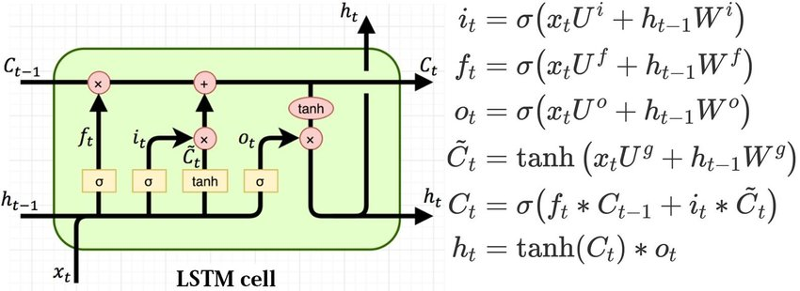
Long Short Term Memory Networks (LSTMs)
t
At time , the LSTM cell reads in
— a c-dimensional previous cell state vector c
t−1
— an h-dimensional previous hidden state vector h_{t−1}
— a d-dimensional current input vector At time , the LSTM cell returns
t
— a c-dimensional previous cell state vector c_{t}
— an h-dimensional previous hidden state vector h_{t} (which may also be passed to an output layer)
https://colah.github.io/posts/2015-08-Understanding-LSTMs/
CS546 Machine Learning in NLP

Slide 15
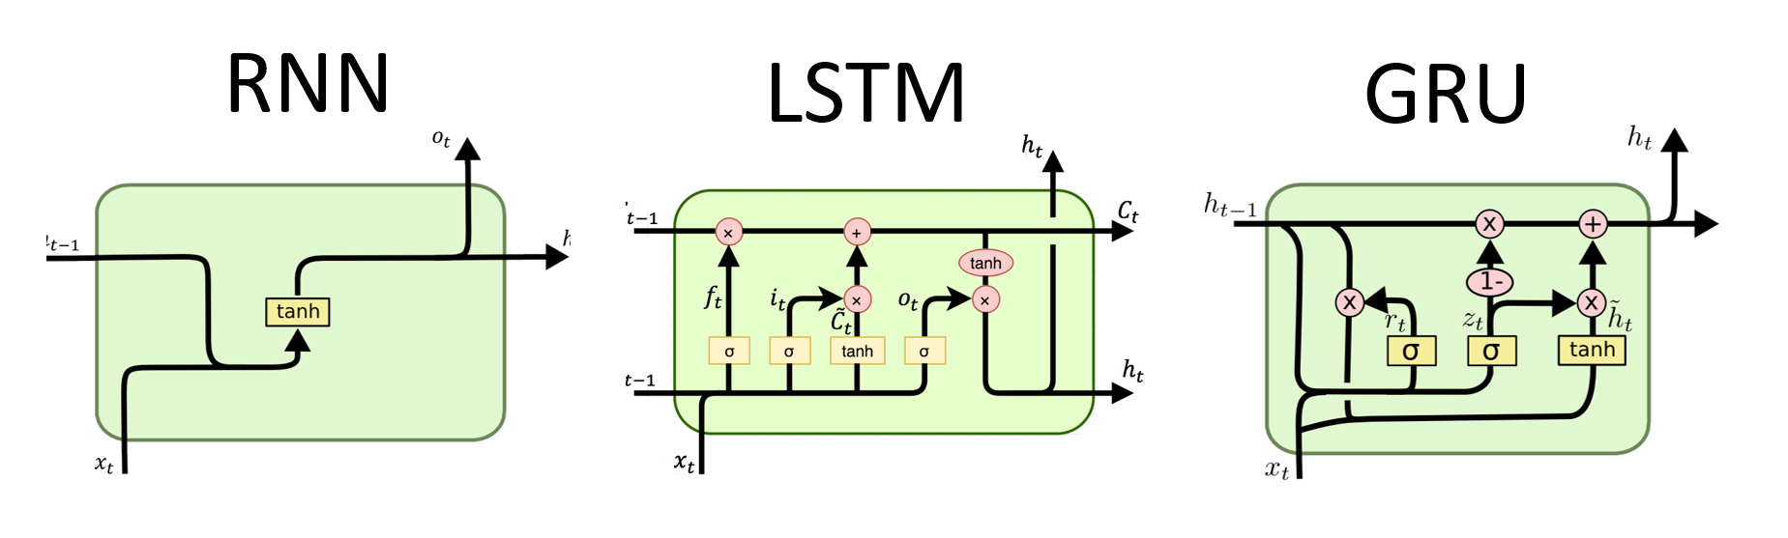




Repetitive Variants: LSTMs, GRUs
Long Short Term Memory networks (LSTMs) are RNs with a more complex architecture to combine the last hidden state with the current input.
Gated Recurrent Units (GRUs) are a simplification of LSTMs
Both contain “gates” to control how much of the input or past hidden state to forget or remember
$$h_{t}$$
$$C_{t−1}$$
$$h_{t−1}$$
$$h_{t−1}$$
CS546 Machine Learning in NLP

Slide 16
Gates
A gate performs element-wise multiplication of
  the output of a d-dimensional sigmoid layer
  (all elements between 0 and 1), and
  a d-dimensional input vector
Result: a d-dimensional output vector which is like the input, except some dimensions have been (partially) “forgotten”
CS546 Machine Learning in NLP

Slide 17
Basic RNs for Sequence Labeling
Each time step has a distribution over output classes
RN
Janet
will
back
the
bill
Extension: add a HMM/CRF layer to capture dependencies among labels of adjacent tokens.
CS546 Machine Learning in NLP

Slide 18
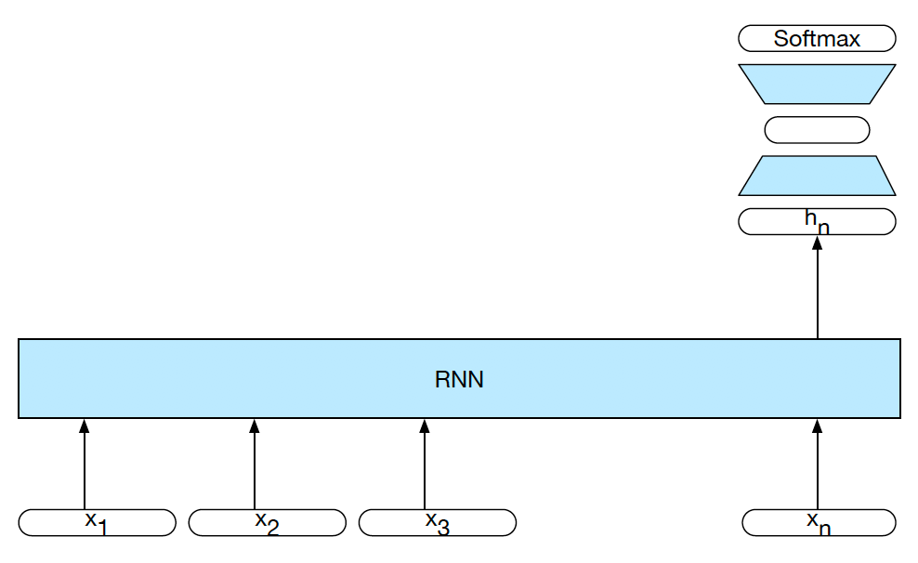
RNs for Sequence Classification
CS546 Machine Learning in NLP

Slide 19
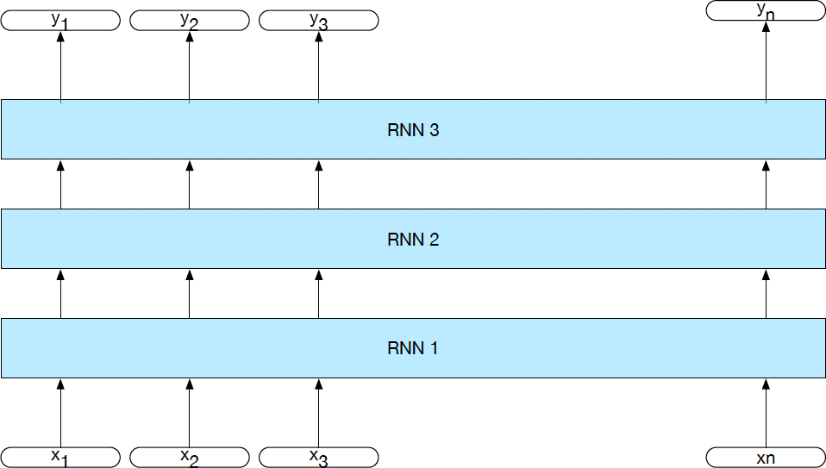
Stacked RNs
We can create an RN that has “vertical” depth (at each time step) by stacking multiple RNs:
RN 3
RN 2
RN 1
19
CS546 Machine Learning in NLP

Slide 20
Bidirectional RNs
+
^{h}1_back
RN 2 (Right to Left)
w
RN 1 (Left to Right)
^{h}n_for
x₁
x₂
x₃
x_{n}
CS546 Machine Learning in NLP

Slide 21


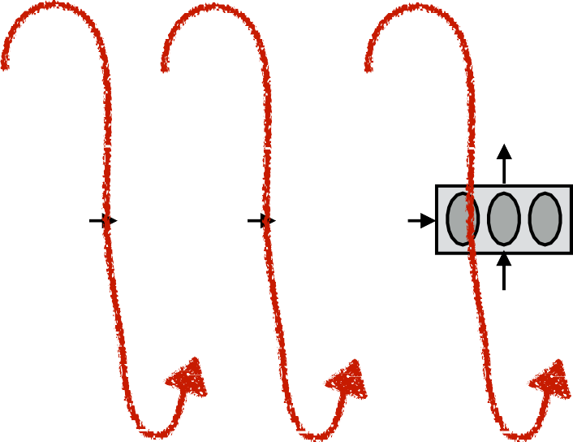




Encoder-Decoder (seq2seq) model
Task: Read an input sequence and return an output sequence
  Machine translation: translate source into target language
  Dialog system/chatbot: generate a response
Reading the input sequence: RN Encoder
Generating the output sequence: RN Decoder
Encoder Decoder
output
hidden
input
<s>
CS546 Machine Learning in NLP

Slide 22
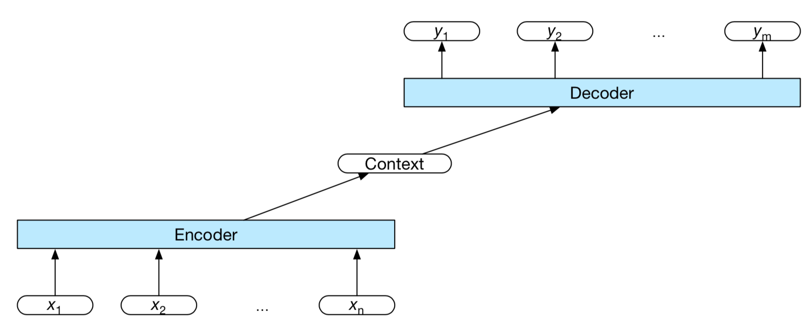
A More General View of seq2seq
In general, any function over the encoder’s output can be used as a representation of the context we want to condition the decoder on.
We can feed the context in at any time step during decoding (not just at the beginning).
CS546 Machine Learning in NLP

Slide 23
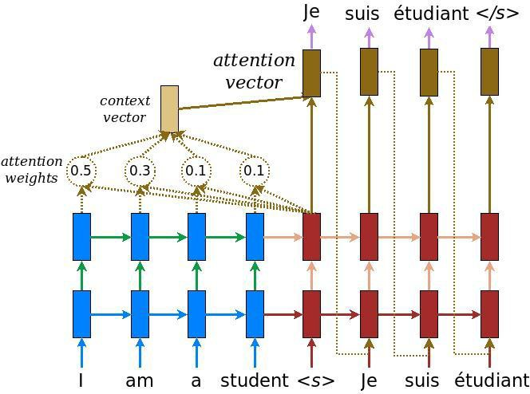
Attention Mechanisms
Dzmitry Bahdanau, Kyunghyun Cho, Yoshua Bengio:
Neural Machine Translation by Jointly Learning to Align and Translate. ICLR 2015
Ashish Vaswani, Noam Shazeer, Niki Parmar, Jakob Uszkoreit, Llion Jones, Aidan N. Gomez, Łukasz Kaiser, and Illia Polosukhin. 2017. Attention is all you need. In Proceedings of the 31st International Conference on Neural Information Processing Systems (NIPS'17). Curran Associates Inc., Red Hook, NY, USA, 6000–6010. 2017
Parallelize with
GPUs
CS546 Machine Learning in NLP

Slide 24
Embeddings from Language Models
Replace static embeddings (lexicon lookup) with context-dependent embeddings (produced by a deep language model)
=> Each token’s representation is a function of the entire input sentence, computed by a deep (multi-layer) bidirectional language model
=> Return for each token a (task-dependent) linear combination of its representation across layers.
=> Different layers capture different information
CS546 Machine Learning in NLP

Slide 25
Embeddings from Language Model (ELMO)
RN-based language models (trained from lots of sentences)
e.g., given “潮水 退了 就 知道 誰 沒穿 褲子”
潮水
退了
就
潮水
退了
就
RN
RN
RN
…
…
RN
RN
RN
…
RN
RN
RN
…
…
RN
RN
RN
…
<BOS>
潮水
退了
退了
就
知道
潮水 退了 就 知道 誰 沒穿 褲子 = When the tide goes out, you know who's not wearing pants.
https://arxiv.org/abs/1802.05365
  http://speech.ee.ntu.edu.tw/~tlkagk/courses_ML20.html

Slide 26
ELMO
Each layer in deep LSTM can generate a latent representation.
Which one should we use???
…
…
…
…
…
…
RN
RN
RN
…
…
RN
RN
RN
…
$$h_{2}$$
RN
RN
RN
…
…
RN
RN
RN
…
RN
RN
RN
…
…
RN
RN
RN
…
$$h_{1}$$
<BOS>
潮水
退了
退了
就
知道
  http://speech.ee.ntu.edu.tw/~tlkagk/courses_ML20.html

Slide 27


ELMO
High computational effort, word2vec to the rescue?
=
$$α_{1}$$
+
$$α_{2}$$
ELMO
Learned with the
down-stream tasks
潮水
退了
就
知道
……
  http://speech.ee.ntu.edu.tw/~tlkagk/courses_ML20.html

Slide 28
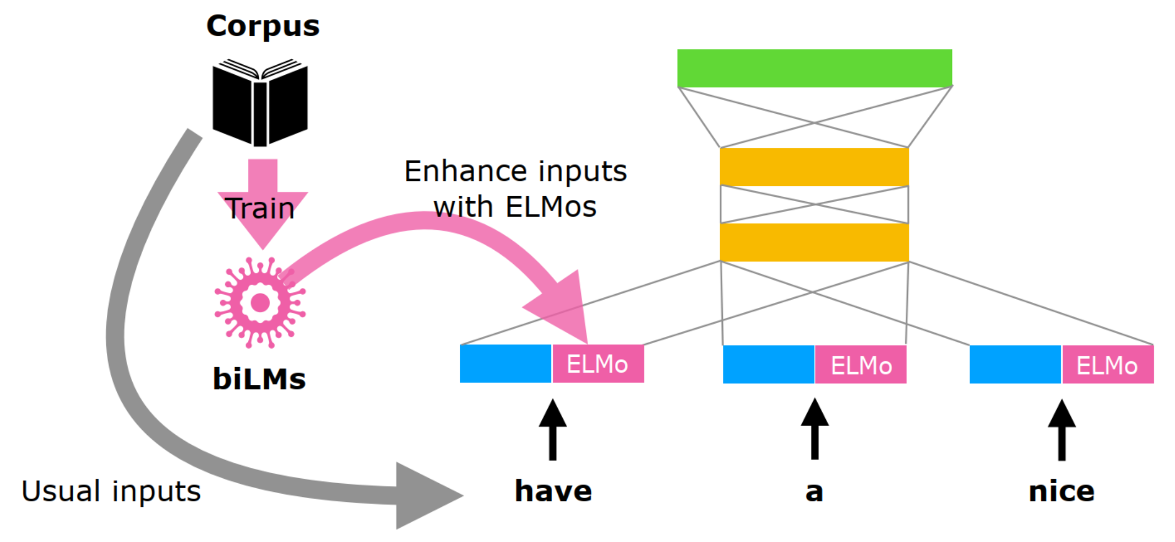
Integrate ELMos into other embeddings
https://www.slideshare.net/shuntaroy/a-review-of-deep-contextualized-word-representations-peters-2018

Slide 29
Tricks: Subtoken Encoding
03
Byte Pair Encoding (BPE)
Word embedding sometimes is too high level, pure character embedding too low level. For example, if we have learned
old older oldest
We might also wish the computer to infer
smart smarter smartest
But at the whole word level, this might not be so direct. Thus, the idea is to break the words up into pieces like er, est, and embed frequent fragments of words.
GPT adapts this BPE scheme.
CS 886 Deep Learning for Biotechnology, Ming Li

Slide 30
Tricks: Subtoken Encoding
03
Byte Pair Encoding (BPE)
GPT uses BPE scheme. The subwords are calculated by:
Split word to sequence of characters (add </w> char)
Joining the highest frequency pattern.
Keep doing step 2, until it hits the pre-defined maximum number of sub-words or iterations.
Example (5, 2, 6, 3 are number of occurrences)
{‘l o w </w>’: 5, ‘l o w e r </w>’: 2, ‘n e w e s t </w>’: 6, ‘w i d e s t </w>’: 3 }
{‘l o w </w>’: 5, ‘l o w e r </w>’: 2, ‘n e w es t </w>’: 6, ‘w i d es t </w>’: 3 }
{‘l o w </w>’: 5, ‘l o w e r </w>’: 2, ‘n e w est </w>’: 6, ‘w i d est </w>’: 3 } (“est” freq. 9)
{‘lo w </w>’: 5, ‘lo w e r </w>’: 2, ‘n e w est</w>’: 6, ‘w i d est</w>’: 3 } (“lo” freq 7)
…..
CS 886 Deep Learning for Biotechnology, Ming Li

Slide 31
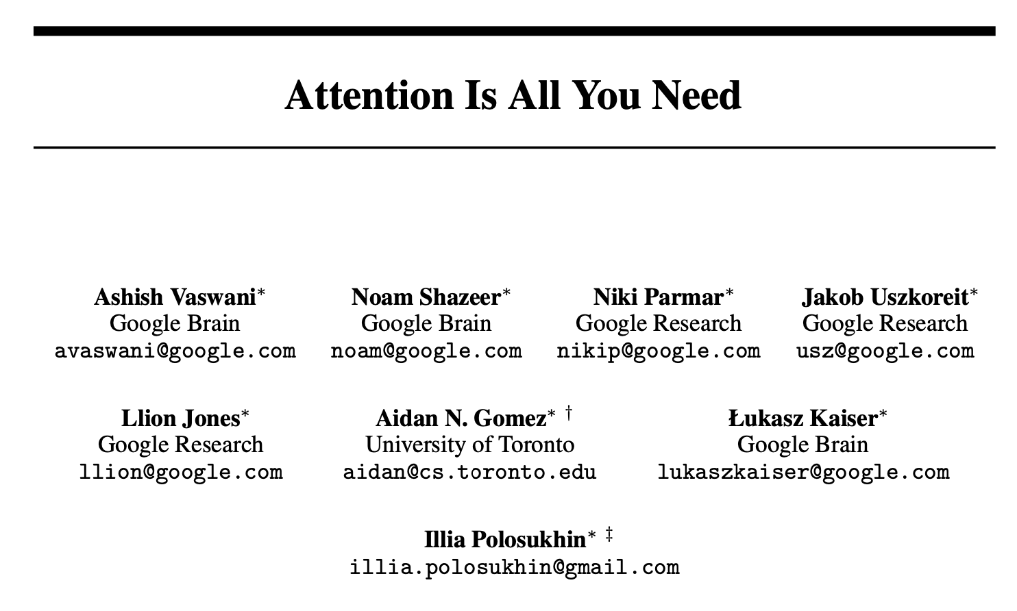
The end of the neural AI era: Postneural AI
Ashish Vaswani, Noam Shazeer, Niki Parmar, Jakob Uszkoreit, Llion Jones, Aidan N. Gomez, Łukasz Kaiser, and Illia Polosukhin. Attention is all you need. In Proceedings of the 31st International Conference on Neural Information Processing Systems (NIPS'17), 6000–6010. 2017.

Slide 32









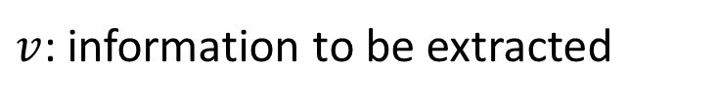





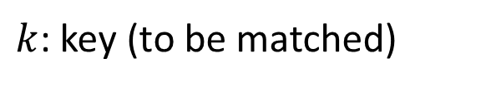


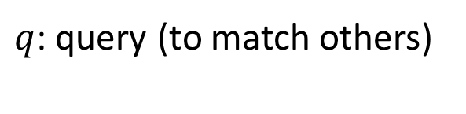








Self-attention
$q$: query (to match others)
$$q^{i}=W^{q}a^{i}$$
$k$: key (to be matched)
$$k^{i}=W^{k}a^{i}$$
$v$: information to be extracted
$$v^{i}=W^{v}a^{i}$$
$$q^{1}$$
$$k^{1}$$
$$v^{1}$$
$$q^{2}$$
$$k^{2}$$
$$v^{2}$$
$$q^{3}$$
$$k^{3}$$
$$v^{3}$$
$$q^{4}$$
$$k^{4}$$
$$v^{4}$$
$$a^{1}$$
$$a^{2}$$
$$a^{3}$$
$$a^{4}$$
$$a^{i}=Wx^{i}$$
$$x^{1}$$
$$x^{2}$$
$$x^{3}$$
$$x^{4}$$
Transformer by 李宏毅 Hung-yi Lee

Slide 33






Self-attention
Take each query q, go to each key k, do attention
d is the dim of $q$ and $k$
Scaled Dot-Product Attention:
$$α_{1,i}=q^{1}∙k^{i}/\sqrt{d}$$
dot product
$$α_{1,1}$$
$$α_{1,2}$$
$$α_{1,3}$$
$$α_{1,4}$$
$$q^{1}$$
$$k^{1}$$
$$v^{1}$$
$$q^{2}$$
$$k^{2}$$
$$v^{2}$$
$$q^{3}$$
$$k^{3}$$
$$v^{3}$$
$$q^{4}$$
$$k^{4}$$
$$v^{4}$$
$$a^{1}$$
$$a^{2}$$
$$a^{3}$$
$$a^{4}$$
$$x^{1}$$
$$x^{2}$$
$$x^{3}$$
$$x^{4}$$
Transformer by 李宏毅 Hung-yi Lee

Slide 34




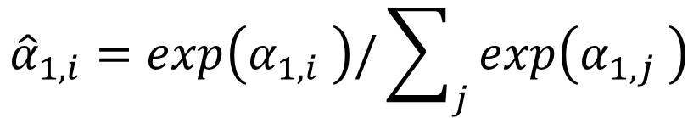
Self-attention
$${\hat{α}}_{1,i}=exp\left(α_{1,i} \right)/\sum_{j}{exp\left(α_{1,j} \right)}$$
$${\hat{α}}_{1,1}$$
$${\hat{α}}_{1,2}$$
$${\hat{α}}_{1,3}$$
$${\hat{α}}_{1,4}$$
Soft-max
$$α_{1,1}$$
$$α_{1,2}$$
$$α_{1,3}$$
$$α_{1,4}$$
$$q^{1}$$
$$k^{1}$$
$$v^{1}$$
$$q^{2}$$
$$k^{2}$$
$$v^{2}$$
$$q^{3}$$
$$k^{3}$$
$$v^{3}$$
$$q^{4}$$
$$k^{4}$$
$$v^{4}$$
$$a^{1}$$
$$a^{2}$$
$$a^{3}$$
$$a^{4}$$
$$x^{1}$$
$$x^{2}$$
$$x^{3}$$
$$x^{4}$$
Transformer by 李宏毅 Hung-yi Lee

Slide 35






Self-attention
$$b^{1}=\sum_{i}{{\hat{α}}_{1,i}v^{i} }$$
Considering the whole sequence
$$b^{1}$$
$${\hat{α}}_{1,1}$$
$${\hat{α}}_{1,2}$$
$${\hat{α}}_{1,3}$$
$${\hat{α}}_{1,4}$$
$$q^{1}$$
$$k^{1}$$
$$v^{1}$$
$$q^{2}$$
$$k^{2}$$
$$v^{2}$$
$$q^{3}$$
$$k^{3}$$
$$v^{3}$$
$$q^{4}$$
$$k^{4}$$
$$v^{4}$$
$$a^{1}$$
$$a^{2}$$
$$a^{3}$$
$$a^{4}$$
$$x^{1}$$
$$x^{2}$$
$$x^{3}$$
$$x^{4}$$
Transformer by 李宏毅 Hung-yi Lee
Notes:
Relation between attention and CNN
Global receptive field (compared to convolutional architectures)

Slide 36






Self-attention
$$b^{2}=\sum_{i}{{\hat{α}}_{2,i}v^{i} }$$
Take each query q, go to each key k, do attention
$$b^{2}$$
$${\hat{α}}_{2,1}$$
$${\hat{α}}_{2,2}$$
$${\hat{α}}_{2,3}$$
$${\hat{α}}_{2,4}$$
$$q^{1}$$
$$k^{1}$$
$$v^{1}$$
$$q^{2}$$
$$k^{2}$$
$$v^{2}$$
$$q^{3}$$
$$k^{3}$$
$$v^{3}$$
$$q^{4}$$
$$k^{4}$$
$$v^{4}$$
$$a^{1}$$
$$a^{2}$$
$$a^{3}$$
$$a^{4}$$
$$x^{1}$$
$$x^{2}$$
$$x^{3}$$
$$x^{4}$$
Transformer by 李宏毅 Hung-yi Lee
Notes:
Relation between attention and CNN
Global receptive field (compared to convolutional architectures)

Slide 37



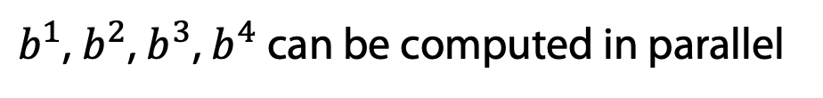


Self-attention
$b^{1}$, $b^{2}$, $b^{3}$, $b^{4}$ can be computed in parallel
$$b^{1}$$
$$b^{2}$$
$$b^{3}$$
$$b^{4}$$
Self-Attention Layer
$$a^{1}$$
$$a^{2}$$
$$a^{3}$$
$$a^{4}$$
$$x^{1}$$
$$x^{2}$$
$$x^{3}$$
$$x^{4}$$
Transformer by 李宏毅 Hung-yi Lee
Notes:
Relation between attention and CNN
Global receptive field (compared to convolutional architectures)

Slide 38




































Self-attention
$$q^{1}$$
$$q^{2}$$
$$q^{3}$$
$$q^{4}$$
$$a^{1}$$
$$a^{2}$$
=
$$a^{3}$$
$$W^{q}$$
$$a^{4}$$
$$Q$$
$$I$$
$$a^{1}$$
$$a^{2}$$
$$k^{1}$$
$$a^{3}$$
$$k^{2}$$
$$a^{4}$$
$$k^{3}$$
$$q^{i}=W^{q}a^{i}$$
$$k^{4}$$
=
$$W^{k}$$
$$K$$
$$I$$
$$k^{i}=W^{k}a^{i}$$
$$a^{1}$$
$$a^{2}$$
$$a^{3}$$
$$v^{1}$$
$$a^{4}$$
$$v^{2}$$
$$v^{3}$$
$$v^{4}$$
=
$$W^{v}$$
$$v^{i}=W^{v}a^{i}$$
$$V$$
$$I$$
$$q^{1}$$
$$k^{1}$$
$$v^{1}$$
$$q^{2}$$
$$k^{2}$$
$$v^{2}$$
$$q^{3}$$
$$k^{3}$$
$$v^{3}$$
$$q^{4}$$
$$k^{4}$$
$$v^{4}$$
$$a^{1}$$
$$a^{2}$$
$$a^{3}$$
$$a^{4}$$
$$x^{1}$$
$$x^{2}$$
$$x^{3}$$
$$x^{4}$$
Transformer by 李宏毅 Hung-yi Lee

Slide 39












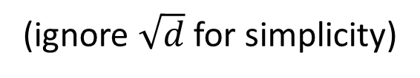










Self-attention
$$b^{1}$$
$${\hat{α}}_{1,1}$$
$${\hat{α}}_{1,2}$$
$${\hat{α}}_{1,3}$$
$${\hat{α}}_{1,4}$$
$$q^{1}$$
$$k^{1}$$
$$v^{1}$$
$$q^{2}$$
$$k^{2}$$
$$v^{2}$$
$$q^{3}$$
$$k^{3}$$
$$v^{3}$$
$$q^{4}$$
$$k^{4}$$
$$v^{4}$$
$$α_{1,1}=$$
$$k^{1}$$
$$q^{1}$$
$$α_{1,2}=$$
$$k^{2}$$
$$q^{1}$$
$$α_{1,1}$$
$$k^{1}$$
$$α_{1,2}$$
$$k^{2}$$
$$α_{1,3}=$$
$$k^{3}$$
$$q^{1}$$
$$α_{1,4}=$$
$$k^{4}$$
$$q^{1}$$
$$=$$
$$q^{1}$$
$$α_{1,3}$$
$$k^{3}$$
$$α_{1,4}$$
$$k^{4}$$
(ignore $\sqrt{d}$ for simplicity)
Transformer by 李宏毅 Hung-yi Lee
Notes:
Relation between attention and CNN
Global receptive field (compared to convolutional architectures)

Slide 40














































Self-attention
$$b^{2}=\sum_{i}{{\hat{α}}_{2,i}v^{i} }$$
$$b^{2}$$
$${\hat{α}}_{2,1}$$
$${\hat{α}}_{2,2}$$
$${\hat{α}}_{2,3}$$
$${\hat{α}}_{2,4}$$
$$q^{1}$$
$$k^{1}$$
$$v^{1}$$
$$q^{2}$$
$$k^{2}$$
$$v^{2}$$
$$q^{3}$$
$$k^{3}$$
$$v^{3}$$
$$q^{4}$$
$$k^{4}$$
$$v^{4}$$
$${\hat{α}}_{1,1}$$
$${\hat{α}}_{2,1}$$
$${\hat{α}}_{3,1}$$
$${\hat{α}}_{4,1}$$
$$α_{1,1}$$
$$α_{2,1}$$
$$α_{3,1}$$
$$α_{4,1}$$
$$k^{1}$$
$${\hat{α}}_{1,2}$$
$${\hat{α}}_{2,2}$$
$${\hat{α}}_{3,2}$$
$${\hat{α}}_{4,2}$$
$$α_{1,2}$$
$$α_{2,2}$$
$$α_{3,2}$$
$$α_{4,2}$$
$$k^{2}$$
$${\hat{α}}_{1,3}$$
$${\hat{α}}_{2,3}$$
$${\hat{α}}_{3,3}$$
$$=$$
$$q^{1}$$
$$q^{2}$$
$$q^{3}$$
$$q^{4}$$
$${\hat{α}}_{4,3}$$
$$α_{1,3}$$
$$α_{2,3}$$
$$α_{3,3}$$
$$α_{4,3}$$
$$k^{3}$$
$${\hat{α}}_{1,4}$$
$${\hat{α}}_{2,4}$$
$${\hat{α}}_{3,4}$$
$${\hat{α}}_{4,4}$$
softmax
$$α_{1,4}$$
$$α_{2,4}$$
$$α_{3,4}$$
$$Q$$
$$α_{4,4}$$
$$k^{4}$$
$$\hat{A}$$
$$A$$
$$K^{T}$$
Transformer by 李宏毅 Hung-yi Lee
Notes:
Relation between attention and CNN
Global receptive field (compared to convolutional architectures)

Slide 41



























Self-attention
$$b^{2}=\sum_{i}{{\hat{α}}_{2,i}v^{i} }$$
$$b^{2}$$
$${\hat{α}}_{2,1}$$
$${\hat{α}}_{2,2}$$
$${\hat{α}}_{2,3}$$
$${\hat{α}}_{2,4}$$
$$q^{1}$$
$$k^{1}$$
$$v^{1}$$
$$q^{2}$$
$$k^{2}$$
$$v^{2}$$
$$q^{3}$$
$$k^{3}$$
$$v^{3}$$
$$q^{4}$$
$$k^{4}$$
$$v^{4}$$
$${\hat{α}}_{1,1}$$
$${\hat{α}}_{2,1}$$
$${\hat{α}}_{3,1}$$
$${\hat{α}}_{4,1}$$
$${\hat{α}}_{1,2}$$
$${\hat{α}}_{2,2}$$
$${\hat{α}}_{3,2}$$
$${\hat{α}}_{4,2}$$
$$b^{1}$$
=
$$b^{2}$$
$$b^{3}$$
$$b^{4}$$
$$v^{1}$$
$$v^{2}$$
$$v^{3}$$
$$v^{4}$$
$${\hat{α}}_{1,3}$$
$${\hat{α}}_{2,3}$$
$${\hat{α}}_{3,3}$$
$${\hat{α}}_{4,3}$$
$$O$$
$$V$$
$${\hat{α}}_{1,4}$$
$${\hat{α}}_{2,4}$$
$${\hat{α}}_{3,4}$$
$${\hat{α}}_{4,4}$$
$$\hat{A}$$
Transformer by 李宏毅 Hung-yi Lee
Notes:
Relation between attention and CNN
Global receptive field (compared to convolutional architectures)

Slide 42
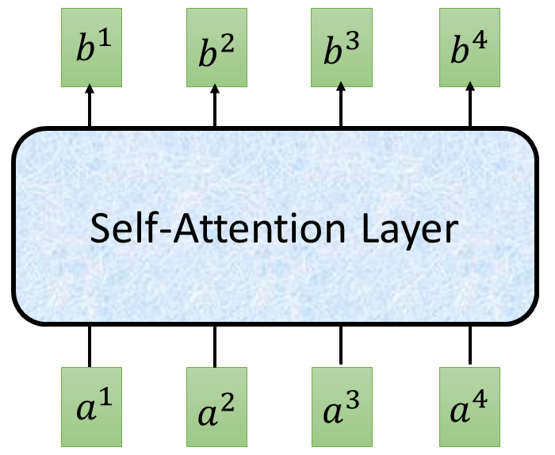


















Self-attention
$$O$$
$$Q$$
=
$$I$$
$$W^{q}$$
$$K$$
=
$$I$$
$$W^{k}$$
$$V$$
=
$$I$$
$$I$$
$$W^{v}$$
$$\hat{A}$$
$$A$$
=
$$Q$$
$$K^{T}$$
softmax
$$\hat{A}$$
$$O$$
=
$$V$$
Can be optimized with GPUs
Transformer by 李宏毅 Hung-yi Lee

Slide 43
























Multi-head Self-attention
(2 heads as example)
$$q^{i,1}=W^{q,1}q^{i}$$
$$b^{i,1}$$
$$q^{i,2}=W^{q,2}q^{i}$$
$$q^{i,1}$$
$$q^{i,2}$$
$$k^{i,1}$$
$$k^{i,2}$$
$$v^{i,1}$$
$$v^{i,2}$$
$$q^{j,1}$$
$$q^{j,2}$$
$$k^{j,1}$$
$$k^{j,2}$$
$$v^{j,1}$$
$$v^{j,2}$$
$$q^{i}$$
$$k^{i}$$
$$v^{i}$$
$$q^{j}$$
$$k^{j}$$
$$v^{j}$$
$$q^{i}=W^{q}a^{i}$$
$$a^{i}$$
$$a^{j}$$
Transformer by 李宏毅 Hung-yi Lee

Slide 44


Multi-head Self-attention
(2 heads as example)
$$q^{i,1}=W^{q,1}q^{i}$$
$$b^{i,1}$$
$$q^{i,2}=W^{q,2}q^{i}$$
$$b^{i,2}$$
$$q^{i,1}$$
$$q^{i,2}$$
$$k^{i,1}$$
$$k^{i,2}$$
$$v^{i,1}$$
$$v^{i,2}$$
$$q^{j,1}$$
$$q^{j,2}$$
$$k^{j,1}$$
$$k^{j,2}$$
$$v^{j,1}$$
$$v^{j,2}$$
$$q^{i}$$
$$k^{i}$$
$$v^{i}$$
$$q^{j}$$
$$k^{j}$$
$$v^{j}$$
$$q^{i}=W^{q}x^{i}$$
$$a^{i}$$
$$a^{j}$$
Transformer by 李宏毅 Hung-yi Lee

Slide 45





Multi-head Self-attention
(2 heads as example)
$$b^{i,1}$$
$$b^{i}$$
$$b^{i,1}$$
$$b^{i,2}$$
$$b^{i}$$
=
$$W^{O}$$
$$b^{i,2}$$
$$q^{i,1}$$
$$q^{i,2}$$
$$k^{i,1}$$
$$k^{i,2}$$
$$v^{i,1}$$
$$v^{i,2}$$
$$q^{j,1}$$
$$q^{j,2}$$
$$k^{j,1}$$
$$k^{j,2}$$
$$v^{j,1}$$
$$v^{j,2}$$
$$q^{i}$$
$$k^{i}$$
$$v^{i}$$
$$q^{j}$$
$$k^{j}$$
$$v^{j}$$
$$a^{i}$$
$$a^{j}$$
Transformer by 李宏毅 Hung-yi Lee

Slide 46



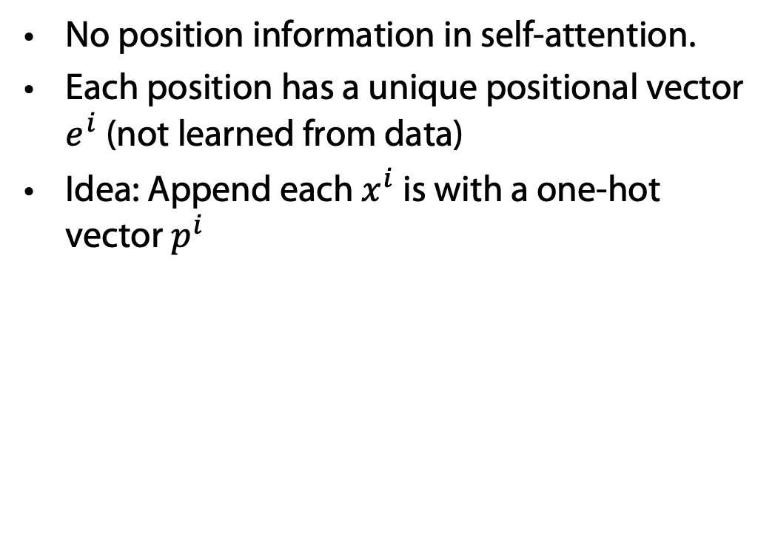















Positional Encoding
$$q^{i}$$
$$k^{i}$$
$$v^{i}$$
No position information in self-attention.
Each position has a unique positional vector $e^{i}$ (not learned from data)
Idea: Append each $x^{i}$ is with a one-hot vector $p^{i}$
$$e^{i}$$
+
$$a^{i}$$
$$x^{i}$$
More clever solution used in the original paper
$$x^{i}$$
$$a^{i}$$
$$W$$
=
$$W^{I}$$
$$x^{i}$$
$$p^{i}$$
$$W^{I}$$
$$W^{P}$$
$$p^{i}=$$
……
0
$$e^{i}$$
1
i-th dim
$$W^{P}$$
+
$$p^{i}$$
0
…
Transformer by 李宏毅 Hung-yi Lee

Slide 47
















Seq2seq with Attention
$$c^{1}$$
$$c^{2}$$
$$o^{1}$$
$$o^{2}$$
$$o^{3}$$
$$h^{1}$$
$$h^{2}$$
$$h^{3}$$
$$h^{4}$$
Self-Attention Layer
Self-Attention Layer
$$x^{1}$$
$$x^{2}$$
$$x^{3}$$
$$x^{4}$$
$$c^{1}$$
$$c^{2}$$
$$c^{3}$$
Encoder
Decoder
Transformer by 李宏毅 Hung-yi Lee

Slide 48
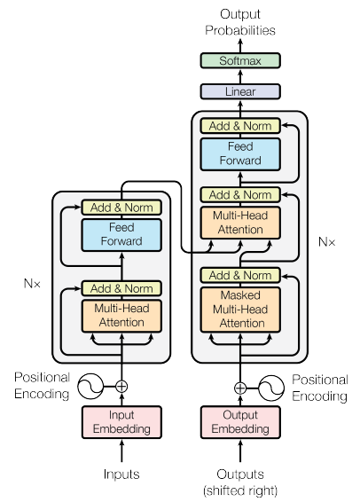
Transformer
machine
learning
Using Chinese to English translation as example
Encoder
Decoder
機 器 學 習
<BOS>
machine
Transformer by 李宏毅 Hung-yi Lee

Slide 49




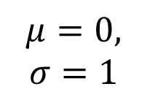
Transformer
Layer Norm:
https://arxiv.org/abs/1607.06450
Batch Size
Layer
Norm
$$b^{′}$$
Batch Norm:
$$μ=0,$$
$$σ=1$$
https://www.youtube.com/watch?v=BZh1ltr5Rkg
+
Batch
$$b$$
$$μ=0,σ=1$$
Layer
…
$$a$$
attend on the input sequence
Masked: attend on the generated sequence [MASK]
Transformer by 李宏毅 Hung-yi Lee
Notes:
(two layer2, with one relu)

Slide 50
Masked Multihead Attention
Decoder should work in parallel as well
During training all output tokens are known
Copy output #token times
For each position use [MASK] token in copies
Attention becomes possible during training also for decoding
Train decoder such that [MASK] is replaced correctly while paying attention to the overall output training data

Slide 51
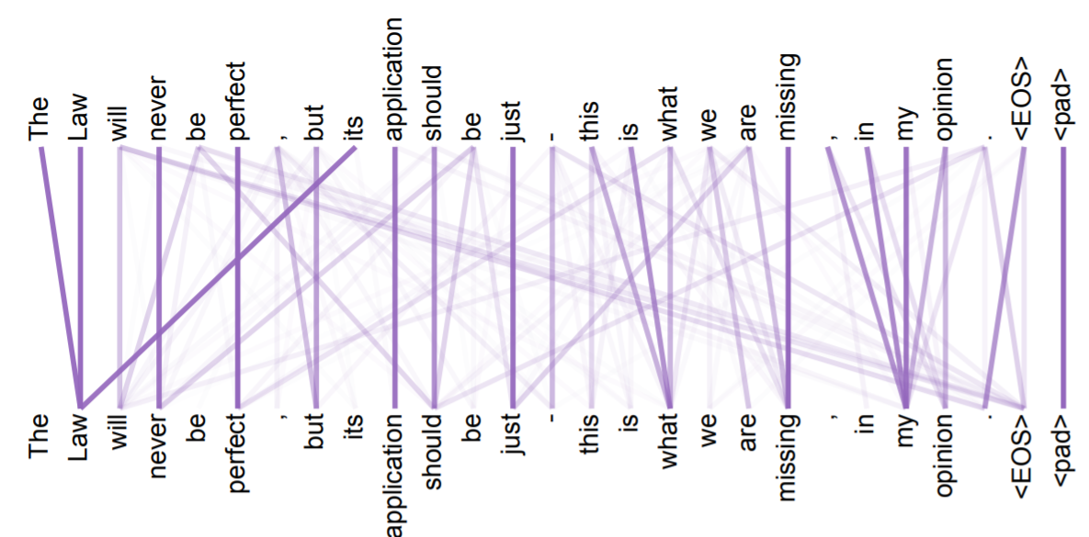
Attention Visualization
https://arxiv.org/abs/1706.03762
Transformer by 李宏毅 Hung-yi Lee

Slide 52
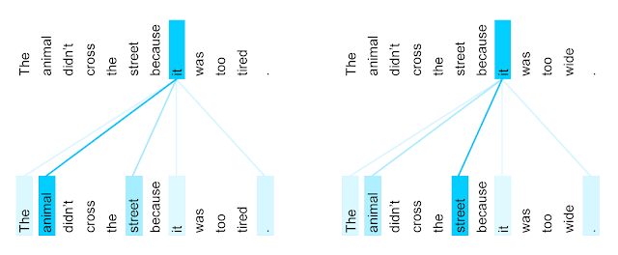
Attention Visualization
The encoder self-attention distribution for the word “it” from the 5th to the 6th layer of a Transformer trained on English to French translation (one of eight attention heads).
https://ai.googleblog.com/2017/08/transformer-novel-neural-network.html
Transformer by 李宏毅 Hung-yi Lee

Slide 53
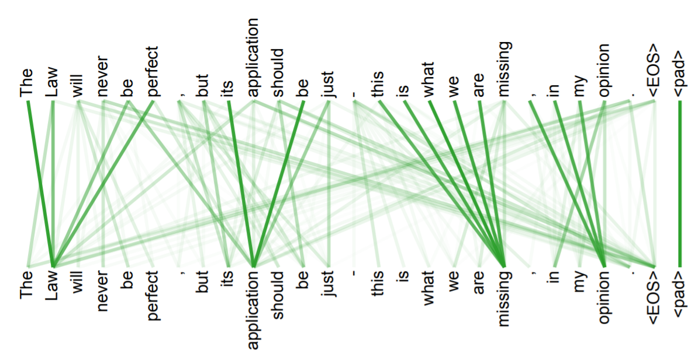
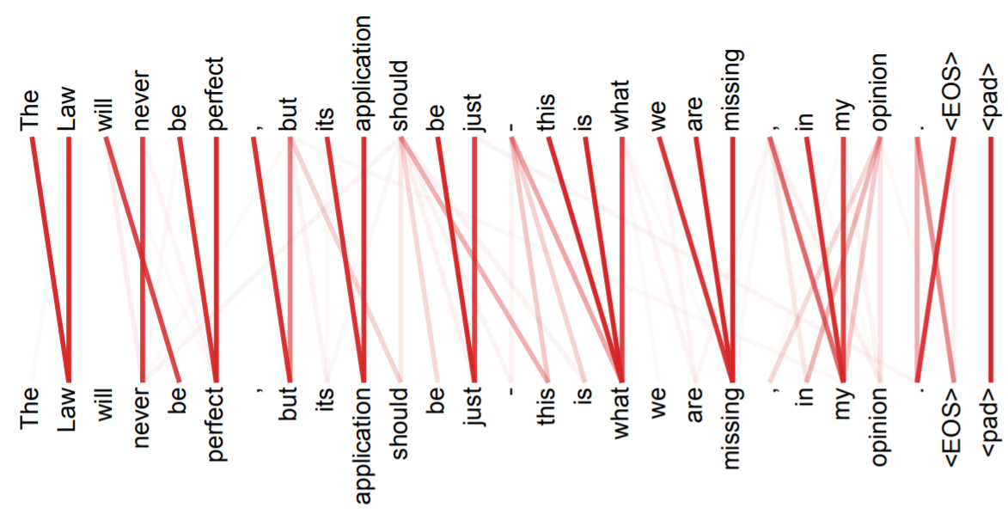
Multi-head
Attention
Transformer by 李宏毅 Hung-yi Lee

Slide 54
Pre-Training & Fine Tuning
1) Download LM
pre-trained on large corpus (in self-supervised fashion)
2) Feature-based training ("fine-tuning")
on target task (supervised learning)
Pretrained
Model
Embedding
One or more layers
Usually frozen after pre-training

Slide 55
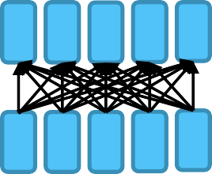
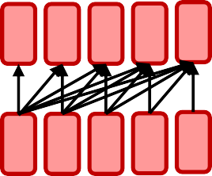
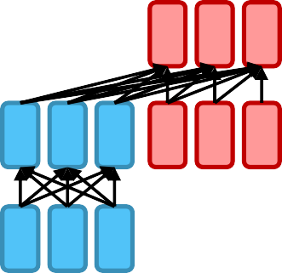
²Model Pre-Training
Encoder
  Bidirectional context
  Examples: BERT and its variants
Decoder
  Language modeling; better for generation
  Example: GPT-2, GPT-3, LaMDA
Encoder-Decoder
  Sequence-to-sequence model
  Examples: Transformer, BART, T5

Slide 56
³Model Pre-Training
Encoder
  Bidirectional context
  Examples: BERT and its variants
◉ Decoder
○ Language modeling; better for generation
○ Example: GPT-2, GPT-3, LaMDA
◉ Encoder-Decoder
○ Sequence-to-sequence model
○ Examples: Transformer, BART, T5

Slide 57
Bidirectional Encoder Representations from Transformers (BERT)
BERT = Encoder of Transformer
Learned from a large amount of text without annotation
Encoder
……
BERT
潮水
退了
就
知道
……
  http://speech.ee.ntu.edu.tw/~tlkagk/courses_ML20.html

Slide 58
Training of BERT
vocabulary size
Predicting the masked word
Approach 1:
Masked LM
Linear Multi-class
Classifier
……
BERT
潮水
[MASK]
……
退了
就
知道
  http://speech.ee.ntu.edu.tw/~tlkagk/courses_ML20.html
Notes:
Can we compare BERT and ELMO??

Slide 59
Training of BERT – Approach 2: Next Sentence Prediction
yes
[CLS]: the position that outputs classification results
Linear Binary
Classifier
[SEP]: the boundary of two sentences
Approaches 1 and 2 are used at the same time.
BERT
[CLS]
醒醒
吧
[SEP]
你
沒有
妹妹
Wake up , you have no sister
  http://speech.ee.ntu.edu.tw/~tlkagk/courses_ML20.html

Slide 60
Training of BERT – Approach 2: Next Sentence Prediction
No
[CLS]: the position that outputs classification results
Linear Binary
Classifier
[SEP]: the boundary of two sentences
Approaches 1 and 2 are used at the same time.
BERT
[CLS]
醒醒
吧
[SEP]
眼睛
業障
重
Wake up , eyes have heavy karma
  http://speech.ee.ntu.edu.tw/~tlkagk/courses_ML20.html

Slide 61
How to use BERT – Case 1
class
Linear Classifier
Trained from Scratch
Input: single sentence,
output: class
Example:
Sentiment analysis,
Document Classification
BERT
Fine-tune
[CLS]
w₁
w₂
w₃
sentence
  http://speech.ee.ntu.edu.tw/~tlkagk/courses_ML20.html
Notes:
(https://arxiv.org/abs/1805.12471)

Slide 62
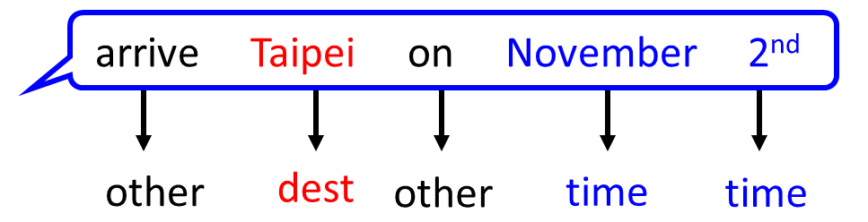
How to use BERT – Case 2
class
class
class
Linear Cls
Linear Cls
Linear Cls
Input: single sentence,
output: class of each word
Example: Semantic role labelling
BERT
[CLS]
w₁
w₂
w₃
sentence
  http://speech.ee.ntu.edu.tw/~tlkagk/courses_ML20.html
Notes:
(https://arxiv.org/abs/1805.12471)

Slide 63
How to use BERT – Case 3
Class
Input: two sentences, output: class
Example: Natural Language Inference
Linear Classifier
Given a “premise”, determining whether a “hypothesis” is T/F/ unknown.
BERT
[CLS]
w₁
w₂
[SEP]
w₃
w₄
w₅
Sentence 1
Sentence 2
  http://speech.ee.ntu.edu.tw/~tlkagk/courses_ML20.html
Notes:
determining whether a “hypothesis” is true (entailment), false (contradiction), or undetermined (neutral) given a “premise”.

Slide 64
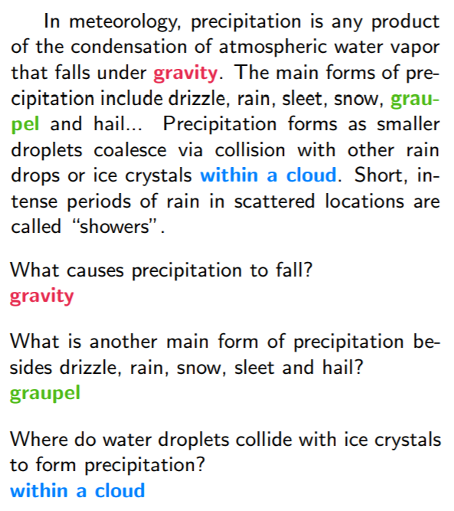




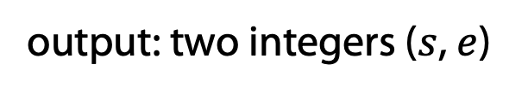





How to use BERT – Case 4
https://rajpurkar.github.io/SQuAD-explorer/
Extraction-based Question Answering (QA) (E.g. SQuAD)
17
Document:
$$D=\left\{d_{1},d_{2},⋯,d_{N}\right\}$$
Query:
$$Q=\left\{q_{1},q_{2},⋯,q_{N}\right\}$$
77
79
$$D$$
QA
Model
$$s$$
$$e$$
$$s=17,e=17$$
$$Q$$
output: two integers ($s$, $e$)
Answer:
$$A=\left\{q_{s}, ⋯,q_{e}\right\}$$
$$s=77,e=79$$
S=start, e=end
  http://speech.ee.ntu.edu.tw/~tlkagk/courses_ML20.html

Slide 65
How to use BERT – Case 4
Learned from scratch
0.3
0.5
0.2
s = 2, e = 3
Softmax
The answer is “d₂ d₃”.
dot product
BERT
[CLS]
q₁
q₂
[SEP]
d₁
d₂
d₃
question
document
  http://speech.ee.ntu.edu.tw/~tlkagk/courses_ML20.html
Notes:
determining whether a “hypothesis” is true (entailment), false (contradiction), or undetermined (neutral) given a “premise”.

Slide 66

BERT Pre-Training & Fine Tuning
Keep BERT frozen after pre-training
Create BERT embeddings for labeled dataset for "downstream task" and train new model on these embeddings
1) Download BERT pre-trained on large corpus (in self-supervised fashion)
2) Feature-based training ("fine-tuning")
on target task (supervised learning)
BERT
Model
Embedding
One or more layers

Slide 67
How to use BERT – Case 4
Learned from scratch
0.1
0.2
0.7
s = 2, e = 3
Softmax
The answer is “d₂ d₃”.
dot product
BERT
[CLS]
q₁
q₂
[SEP]
d₁
d₂
d₃
question
document
  http://speech.ee.ntu.edu.tw/~tlkagk/courses_ML20.html
Notes:
determining whether a “hypothesis” is true (entailment), false (contradiction), or undetermined (neutral) given a “premise”.

Slide 68


Example Application: Summarization
Summarizer
Document Set
Can BERT be used to summarize text?
https://arxiv.org/abs/1801.10198
Transformer by 李宏毅 Hung-yi Lee

Slide 69
BERT as a Markov Random Field Language Model
Wang et al. show that BERT
(as described by Devlin et al., 2018)
is essentially a Markov random field language model
Alex Wang, Kyunghyun Cho. BERT has a Mouth, and It Must Speak: BERT as a Markov Random Field Language Model. Volume:
In Proc. of the Workshop on Methods for Optimizing and Evaluating Neural Language Generation, June 2019.
https://arxiv.org/abs/1902.04094
  http://speech.ee.ntu.edu.tw/~tlkagk/courses_ML20.html

Slide 70
Recap: From word2vec/ELMo via Transformers to BERT
Language modeling is the “ultimate” NLP task
  I.e., a perfect language model is also a perfect question answering/entailment/sentiment analysis model
  Training a massive language model learns millions of latent features which are useful for these other NLP tasks
E.g., for natural language inference
  No internal “logical” representation
  Use language directly to infer new propositions
    What kind of a thing is the meaning of a sentence?
    What concrete phenomena do you have to deal with to understand a sentence?
BERT was just a start – many extensions in the literature
https://nlitutorial.github.io

Slide 71
Intelligent Agents
1d-CNNs LSTMs ELMo Transformers BERT GPT
Ralf Möller
Universität zu Lübeck
Institut für Informationssysteme

Slide 72
⁶ Model Pre-Training
◉ Encoder
○ Bidirectional context
○ Examples: BERT and its variants
Decoder
  Language modeling; better for generation
  Example: GPT-2, GPT-3, LaMDA
◉ Encoder-Decoder
○ Sequence-to-sequence model
○ Examples: Transformer, BART, T5
LaMDA: Language Models for Dialog Applications. LaMDA is a family of Transformer- based neural language models specialized for dialog, which have up to 137B parameters and are pre-trained on 1.56T words of public dialog data and web text

Slide 73
GPT (Generative Pre-trained Transformer)
Developed by OpenAI
Unidirectional: trained to predict next word in a sentence
GPT (110 million parameters)
Radford, A., Narasimhan, K., Salimans, T., & Sutskever, I. (2018). Improving language understanding by generative pre-training. https://cdn.openai.com/research-covers/language-unsupervised/ language_understanding_paper.pdf
GPT-2 1.5 billion parameters)
Radford, A., Wu, J., Child, R., Luan, D., Amodei, D., & Sutskever, I. (2019). Language models are unsupervised multitask learners. OpenAI blog, 1(8), 9.
https://cdn.openai.com/better-language-models/language_models_are_unsupervised_multitask_learners.pdf
GPT-3 (175 billion parameters)
Brown, T. B., Mann, B., Ryder, N., Subbiah, M., Kaplan, J., Dhariwal, P., ... & Amodei, D. (2020). Language models are few-shot learners. arXiv preprint arXiv:2005.14165. https://arxiv.org/abs/2005.14165

Slide 74
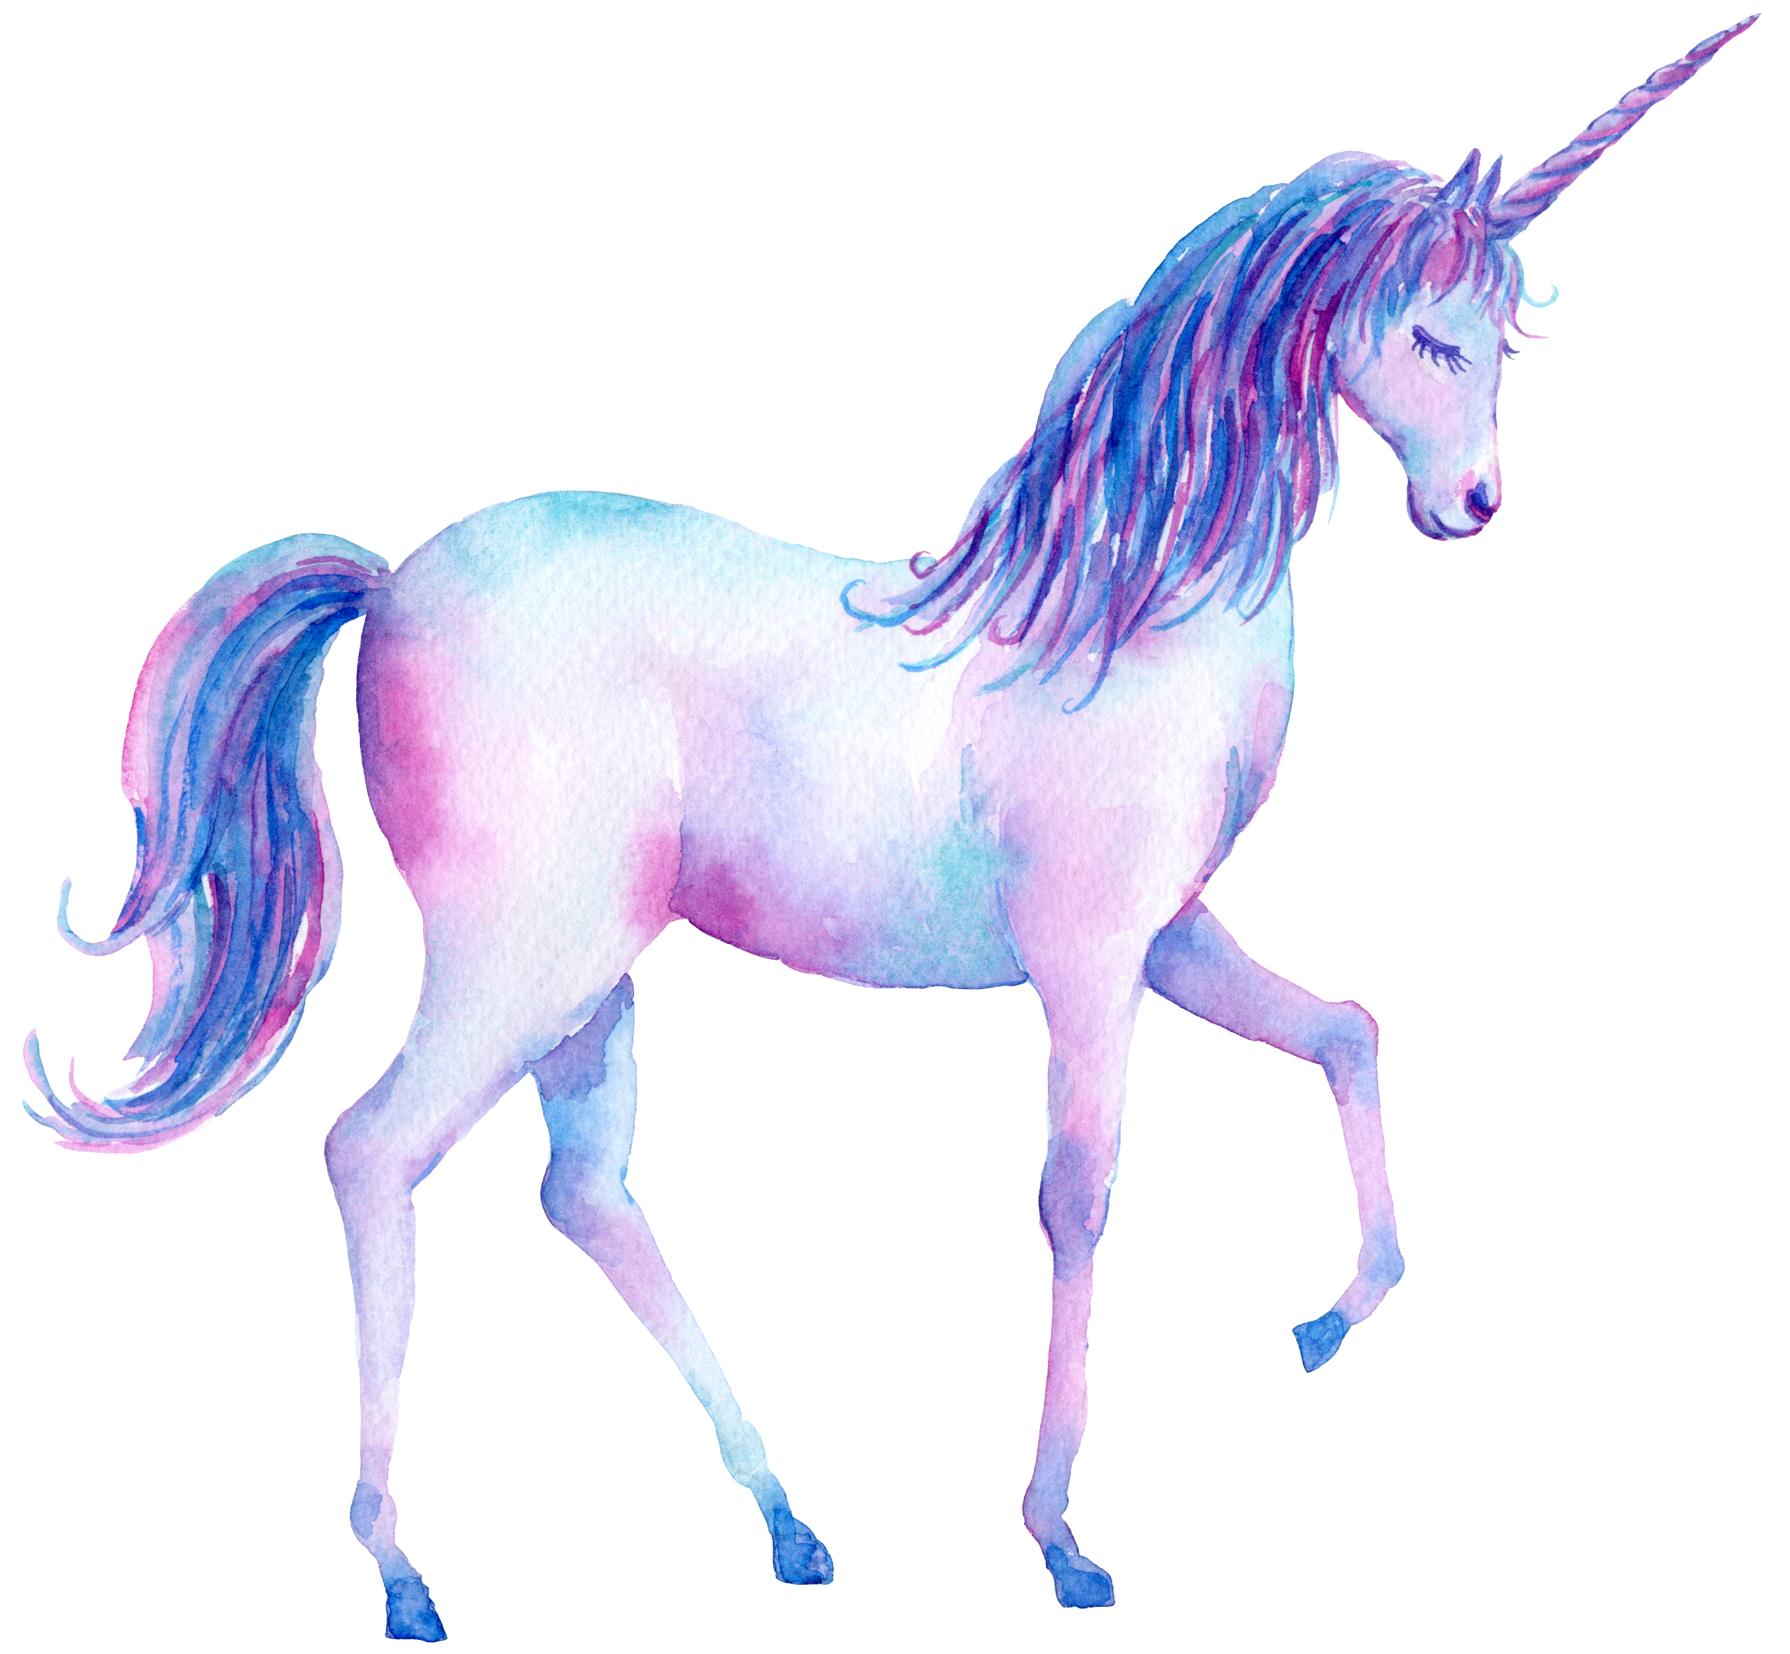


Generative Pre-Training (GPT)
Transformer Decoder
BERT (340M)
ELMO (94M)
GPT-2 (1.5B)
https://d4mucfpksywv.cloudfront.net/better-language-models/language_models_are_unsupervised_multitask_learners.pdf
Notes:
93.6M
340M
1542M
40 GB

Slide 75
Generative Pre-Training (GPT)
退了
Many Layers …
AutoregressionAR(1)
$$b^{2}$$
$${\hat{α}}_{2,1}$$
$${\hat{α}}_{2,2}$$
$$q^{1}$$
$$k^{1}$$
$$v^{1}$$
$$q^{2}$$
$$k^{2}$$
$$v^{2}$$
$$q^{3}$$
$$k^{3}$$
$$v^{3}$$
$$q^{4}$$
$$k^{4}$$
$$v^{4}$$
$$a^{1}$$
$$a^{2}$$
$$a^{3}$$
$$a^{4}$$
<BOS>
潮水
退了
  http://speech.ee.ntu.edu.tw/~tlkagk/courses_ML20.html

Slide 76
Generative Pre-Training (GPT)
就
Attention on generated sequence as a whole
Many Layers …
$$b^{3}$$
$${\hat{α}}_{3,1}$$
$${\hat{α}}_{3,2}$$
$${\hat{α}}_{3,3}$$
$$q^{1}$$
$$k^{1}$$
$$v^{1}$$
$$q^{2}$$
$$k^{2}$$
$$v^{2}$$
$$q^{3}$$
$$k^{3}$$
$$v^{3}$$
$$q^{4}$$
$$k^{4}$$
$$v^{4}$$
$$a^{1}$$
$$a^{2}$$
$$a^{3}$$
$$a^{4}$$
<BOS>
潮水
退了
就
  http://speech.ee.ntu.edu.tw/~tlkagk/courses_ML20.html

Slide 77
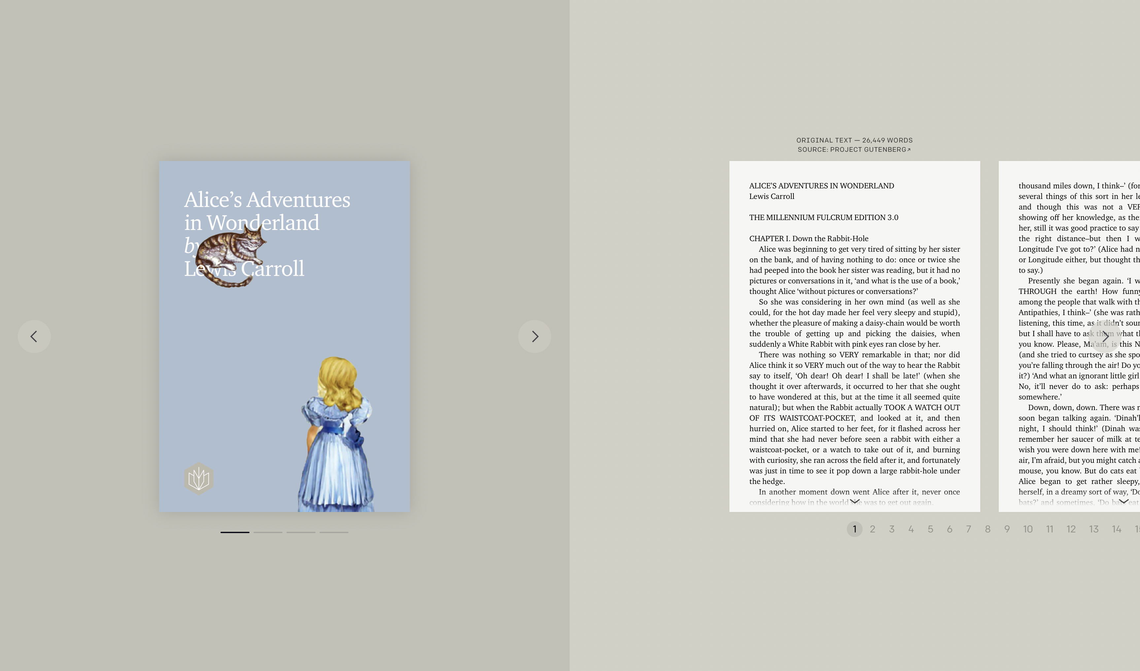
Application: Summaries (Open AI)

Slide 78


Slide 79


Slide 80


Slide 81
LLMs of the GPT family
Generate term papers
Generate code
Generate Powerpoint presentations
Generate useful completions of texts in Word?
…
The latest version is GPT-4V

Slide 83
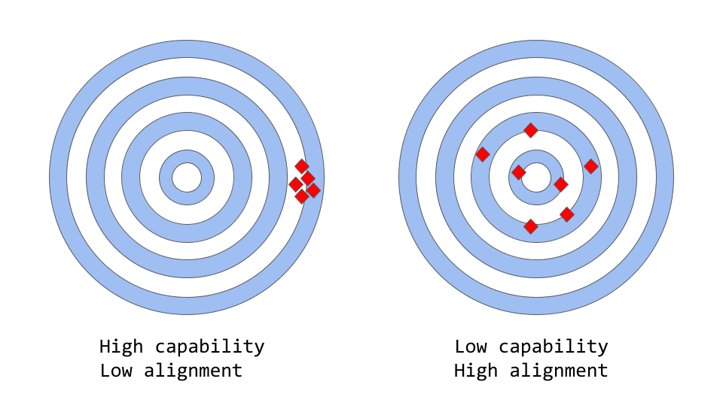
Compatibility vs. Alignment in LLMs
A model's capability is typically evaluated by how well it is able to optimize its objective function, the mathematical expression that defines the goal of the model
Alignment, on the other hand, is concerned with what we actually want the model to do versus what it is being trained to do
Models like the original GPT-3 are misaligned

Slide 84
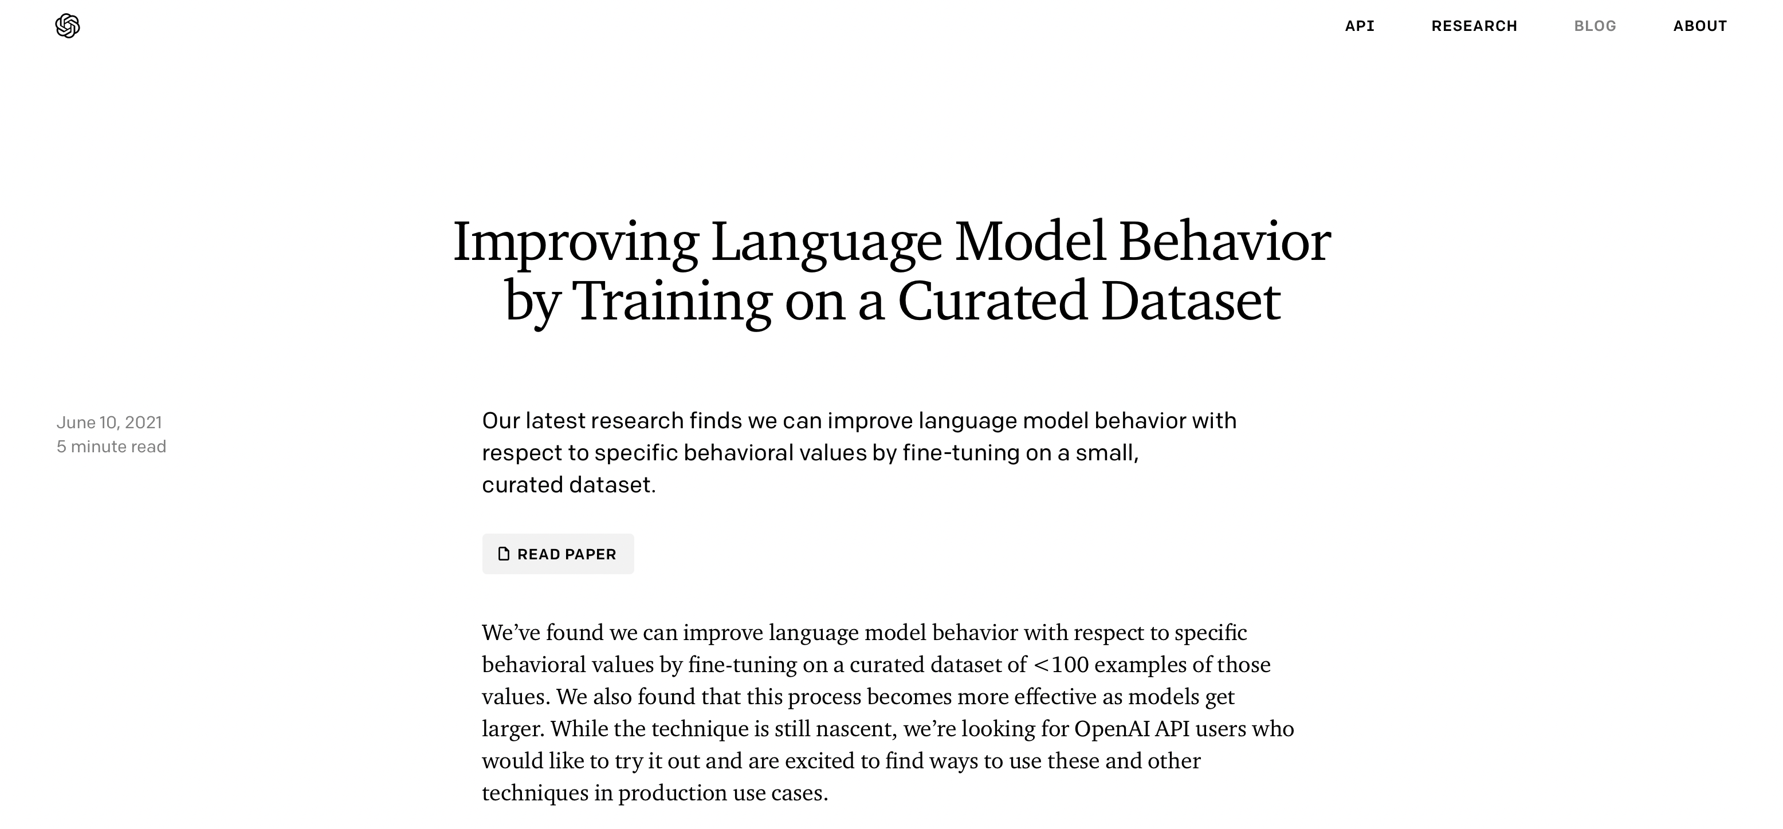

Slide 85
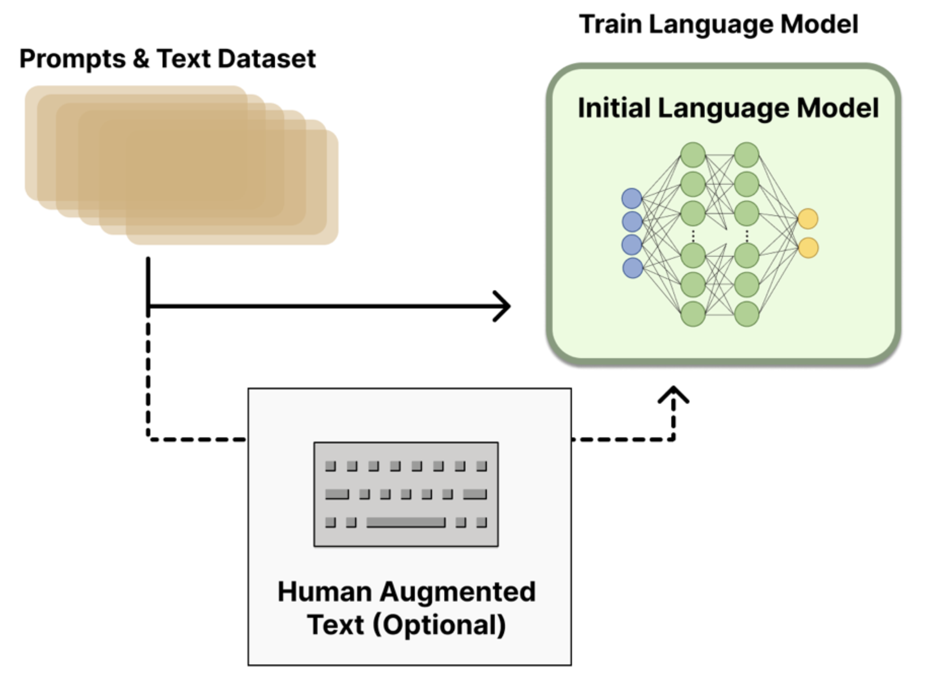
Train on Curated Dataset

Slide 86
Pre-Training & Fine Tuning
1) Download LM
pre-trained on large corpus (in self-supervised fashion)
2) Feature-based training ("fine-tuning")
on target task (supervised learning)
Pretrained
Model
Trained
Transfer
Fix
Embedding
One or more layers
Embedding & Training for Downstream Tasks

Slide 87
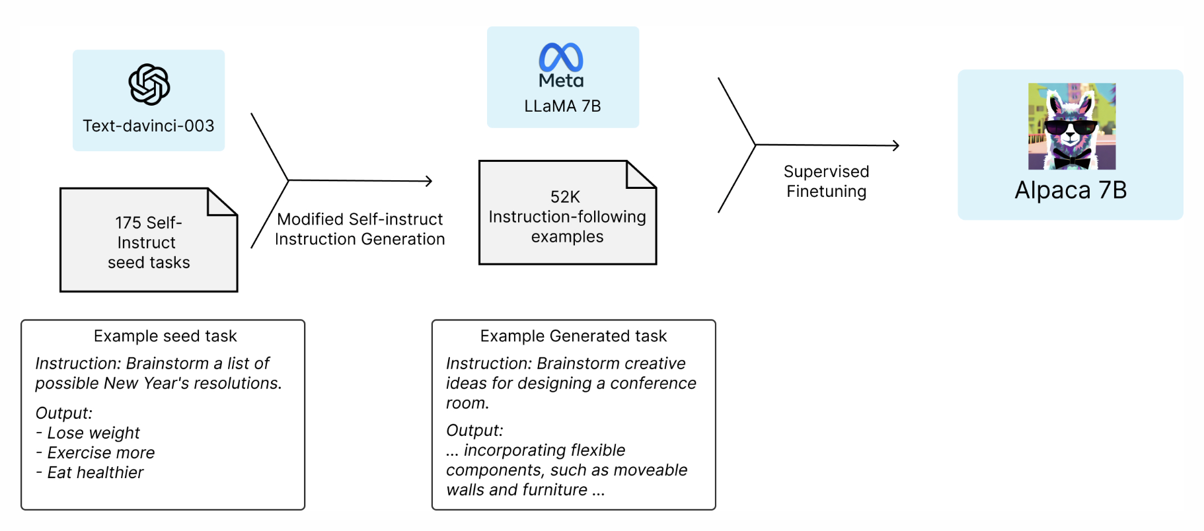
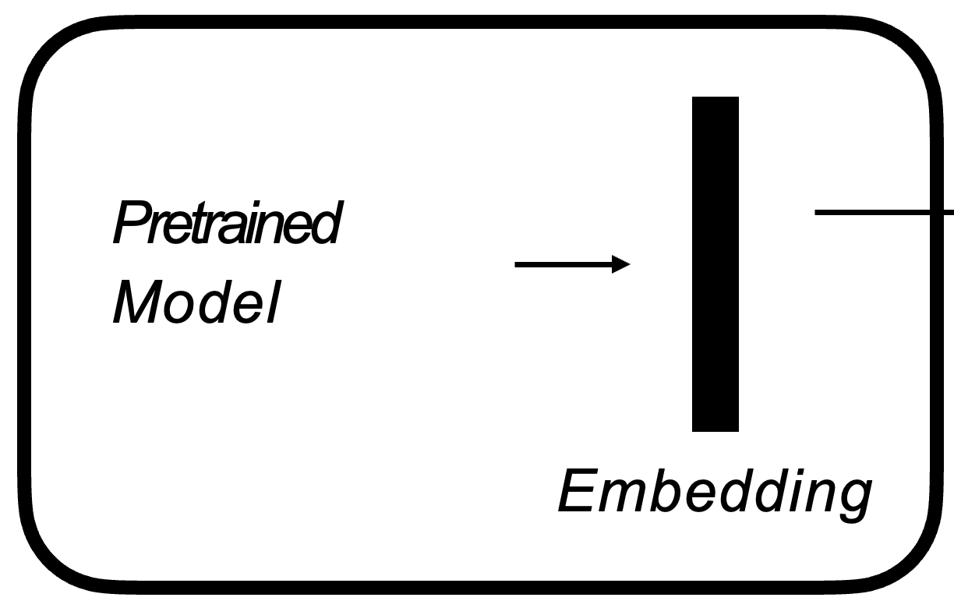


LLaMA vs Alpaca
RLHF Training
SFT Training
7B
170B
7B
Few-Shot
Relatively simple
Notes:
The figure illustrates how we obtained the Alpaca model. For the data, we generated instruction-following demonstrations by building upon the self-instruct method. We started with the 175 human-written instruction-output pairs from the self-instruct seed set. We then prompted text-davinci-003 to generate more instructions using the seed set as in-context examples. We improved over the self-instruct method by simplifying the generation pipeline (see details in GitHub) and significantly reduced the cost. Our data generation process results in 52K unique instructions and the corresponding outputs
Equipped with this instruction-following dataset, we then fine-tuned the LLaMA models using Hugging Face’s training framework, taking advantage of techniques like Fully Sharded Data Parallel and mixed precision training. For our initial run, fine-tuning a 7B LLaMA model took 3 hours on 8 80GB A100s, which costs less than $100 on most cloud compute providers.

Slide 88


Slide 89
InstructGPT: Reinforcement Learning from Human Feedback (RLHF)
Pretraining a language model (LM),
  OpenAI used a smaller version of GPT-3 for its first popular RLHF model, InstructGPT
Gathering data and training a reward model (RM, aka preference model), and
  Get a model that takes in a sequence of text, and returns a scalar reward which should numerically represent the human preference
  The training dataset of prompt-generation pairs for the RM is generated by sampling a set of prompts from a predefined dataset
Fine-tuning the LM with reinforcement learning
https://huggingface.co/blog/rlhf

Slide 90

Train a Reward (Preference) Model
ELO rating: https://en.wikipedia.org/wiki/Elo_rating_system

Slide 91
Reinforcement Learning
Policy is a language model that takes in a prompt and returns a sequence of text (or just probability distributions over text).
The action space of this policy is all the tokens corresponding to the vocabulary of the language model (often on the order of 50k tokens) and
the observation space is the possible input token sequences, which is also quite large (size of vocabulary ^ number of input tokens).
The reward function is a combination of the preference model and a constraint on policy shift.
Fine-tuning some or all of the parameters of a copy of the initial LM with a policy-gradient RL algorithm, Proximal Policy Optimization (PPO)
Parameters of the LM are frozen because fine-tuning an entire 10B or 100B+ parameter model is prohibitively expensive (for more, see Low-Rank Adaptation (LoRA) for LMs or the Sparrow LM from DeepMind)
https://huggingface.co/blog/rlhf

Slide 92

RLHF
https://huggingface.co/blog/rlhf

Slide 93

Credits: Hung-yi Lee

Slide 94

Credits: Hung-yi Lee

Slide 95

Credits: Hung-yi Lee

Slide 96

Credits: Hung-yi Lee

Slide 97

Credits: Hung-yi Lee

Slide 98

Credits: Hung-yi Lee

Slide 99

Credits: Hung-yi Lee

Slide 100

Credits: Hung-yi Lee

Slide 101

Credits: Hung-yi Lee

Slide 102

AE and AR
Autoencoding(AE) Language Modeling:
The AE language model aims to reconstruct the original data from corrupted input.
Corrupted input: The corrupted input means we use [MASK] to replace the original token
Can be implemented with self-attention
Example:
BERT

Slide 103


AE and AR
An autoregressive model’s output h_{t} at time t depends on not just x_{t}, but also all x_{s} from previous time steps.
Autoregressive (AR) language modeling:
given a text sequence x = (x1, · · · , xT ), AR language modeling factorizes the likelihood into a forward product.$\text{p}\text{(}\text{x}\text{)}=\prod{\text{p}\text{(}\text{xt}\text{ | }\text{x}\text{<}\text{t}\text{)}}$
Examples:
GPT , ELMO
Can also be implemented with attention
(GPT, not ELMO)

Slide 104
GPT: Temperature&Top-p-sampling

Slide 105


Slide 106

NLP with Deep Learning CS224N/Ling284 Xiang Lisa Li

Slide 107

NLP with Deep Learning CS224N/Ling284 Xiang Lisa Li

Slide 108

NLP with Deep Learning CS224N/Ling284 Xiang Lisa Li

Slide 109

NLP with Deep Learning CS224N/Ling284 Xiang Lisa Li

Slide 110

NLP with Deep Learning CS224N/Ling284 Xiang Lisa Li

Slide 111

NLP with Deep Learning CS224N/Ling284 Xiang Lisa Li

Slide 112

NLP with Deep Learning CS224N/Ling284 Xiang Lisa Li

Slide 113

NLP with Deep Learning CS224N/Ling284 Xiang Lisa Li

Slide 114

NLP with Deep Learning CS224N/Ling284 Xiang Lisa Li

Slide 115

NLP with Deep Learning CS224N/Ling284 Xiang Lisa Li

Slide 116
Summarization
Extractive Text Summarization
  The traditional method with the main objective to identify the significant sentences of the text and add them to the summary. Note that the summary obtained contains exact sentences from the original text data.
  Can be done with encoder (e.g., BERT)
Abstractive Text Summarization
  The advanced method, with the approach to identify the important sections, interpret the context and reproduce the text in a new way. This ensures that the core information is conveyed through the shortest text possible. Note that here, the sentences, in summary, are generated by the model, not just extracted from the original text data.
  Need Decoder (e.g., GPT-x, PEGASUS)
https://medium.com/analytics-vidhya/text-summarization-using-bert-gpt2-xlnet-5ee80608e961
https://ai.googleblog.com/2020/06/pegasus-state-of-art-model-for.html

Slide 117
Summarization with attention-based AE + AR
No recurrence in transformers???
Document Set
Summarizer

Slide 118

Universal Transformer
https://arxiv.org/abs/1807.03819

Slide 119

Universal Transformer
https://ai.googleblog.com/2018/08/moving-beyond-translation-with.html
Notes:
Why it is named universal ?
https://medium.com/@pocheng0118/a-brief-overview-vanilla-transformer-v-s-universal-transformer-%E7%84%A1%E6%89%80%E4%B8%8D%E8%83%BD%E7%9A%84%E9%80%9A%E7%94%A8%E8%A8%88%E7%AE%97%E6%A8%A1%E5%9E%8B-d9e89dcef080

Slide 120
Intelligent Agents
1d-CNNs LSTMs ELMo Transformers BERT GPT
Ralf Möller
Universität zu Lübeck
Institut für Informationssysteme

Slide 121
Interim Conclusion
Transformers: Efficient, multi-modal data processors
  Based on embedding technology
Postneural AI: Finally, AI becomes effective
  How much of our thoughts and conversation are just filling the gap reasoning?
  How much of our thoughts and conversation are just next word prediction?
  We just do not care as long as we have a real cool computing device
  Example: GPT
Recap the GPT family

Slide 122
GPT-1 (2018)
Pre-cursor to BERT (2019)
Similar architecture and training procedures
  117M parameters in GPT1 vs. 340M for BERT Large
Pre-training: Maximize data likelihood as a product of conditional probabilities, trained on Books Corpus
  Predict each token based on the k tokens (the “context”) that came before
To be fine-tuned for each task while also retaining the generative objective
Training and fine-tuning based on gradient descent
Foundation Models: “Applied Machine Learning” Derek Hoiem

Slide 123

Gradient-Based function minimization (GD):
Function: y = f(x) e.g. y=x²
Minimize function:
  min f(x) – find smallest f(x) value
  argmin f(x) – find x^{min} s.t. f(x^{min}) is smallest value
^{tachin - le ear}
Could be a loss function
123
123

Slide 124

Gradient-Based function minimization (GD):
Function: y = f(x) e.g. y=x²
Minimize function:
  min f(x) – find smallest f(x) value
  argmin f(x) – find x^{min} s.t. f(x^{min}) is smallest value
Gradient: y’ = f(x)’ = 2x – slope or direction, where function grows
For simplification, gradient can be though as -1 or +1
Transformers are composed of simple, differentiable functions: Gradient backpropagation yields informed search for a parametrization with loss minimization
124
124

Slide 125

Gradient-Based function minimization (GD):
Function: y = f(x) e.g. y=x²
Minimize function:
  min f(x) – find smallest f(x) value
  argmin f(x) – find x^{min} s.t. f(x^{min}) is smallest value
Gradient: y’ = f(x)’ = 2x – slope or direction, where function grows
For simplification, gradient can be though as -1 or +1
Gradient descent (naïve version):
lr = 0.01 # learning rate i.e. step size
x = 15 # start from random starting point
for i in range(200): # repeat until convergence
gradient = 2*x # Compute gradient
x = x - gradient * lr # Update parameter
^{tachin - le ear}
125
125

Slide 126

Generalization: Vector input and output

Slide 127
Probabilistic and Differential Programming
Introduction
Gradient descent
Deep networks and Deep learning I: basic concepts
Deep networks and Deep learning II: RNNs, Reservoir
Embeddings: word2vec, knowledge graph embeddings, logic of cones
Deep networks and Deep learning III: autoencoders (AEs), variational autoencoders (VAEs), generative adversarial networks (GANs)
Automatic Differentiation of Programs
Probabilistic Programming I
Probabilistic Programming II
Probabilistic Circuits I (Learning)
Probabilistic Circuits II (Learning)
Probabilistic Circuits III
Very nice lecture!
Only lecture on deep learning with new results such as differential programming in Lübeck

Slide 128
Gradient Descent
Would you update with loss from one new input datum?
Compute average gradient from training dataset containing many inputs
How to handle multiple layers during backpropagation?
  Gradient may vanish (stop the update?)
  Gradient might also explode
  (depending on the loss function)
Autoencoder to the rescue?

Slide 129

Autoencoder
Reconstruction-optimal encoding?
Map data into vector space: Embedding representation
Understanding VQ-VAE (DALL-E Explained Pt. 1)). Charlie Snell

Slide 130

Stochastic Gradient Descent (SGD)
GD: all the points in the training set are used to calculate the loss and its derivative
SGD: only a single point or a small subset of points is used randomly for this purpose.
SGD much faster and more suitable for large-scale datasets, …
… but it is only an
approximation of GD
… due to the introduction
of more noise and variance
in the gradient estimate

Slide 131

GPT-2: Multiple tasks supported

Slide 132

GPT-2
A general systems should learn to model $P(output|input, task)$
The task can be specified in natural language, so language tasks can be framed as sequence-to-sequence text processing
  Find task by prompt classification (could be done with BERT)
Sequence-to-sequence: A problem formulated as receiving input in some modality and producing output in some modality (instead of e.g. predicting probability for labels in a specific task)
GPT-2 is generatively trained on WebText data and not initially fine-tuned on anything else
GPT-2 needs to be fine-tuned for handling specific contexts well
Foundation Models: “Applied Machine Learning” Derek Hoiem

Slide 133

Larger and larger models: E.g. GPT-3
3
https://www.economist.com/interactive/briefing/2022/06/11/huge-foundation-models-are-turbo-charging-ai-progress
Foundation Models: “Applied Machine Learning” Derek Hoiem

Slide 134

Trained on more and more data
# tokens seen during training
https://babylm.github.io/
Foundation Models: “Applied Machine Learning” Derek Hoiem

Slide 135

http://arxiv.org/abs/2004.08900
Costs: Not for the faint-hearted
$2.5k - $50k (110 million parameter model)
$10k - $200k (340 million parameter model)
$80k - $1.6m (1.5 billion parameter model)

Slide 136
Distillation to the rescue?
A.k.a. model compression
Idea has been around for a long time:
  Model Compression (Bucila et al, 2006)
  Distilling the Knowledge in a Neural Network (Hinton et al, 2015)
Simple technique:
  Train “Teacher”: Use SOTA pre-training + fine-tuning technique to train model with maximum accuracy
  Label a large amount of unlabeled input examples with Teacher
  Train “Student”: Much smaller model (e.g., 50x smaller) which is trained to mimic Teacher output
  Student objective is typically Mean Square Error or Cross Entropy
Contextual Word Representations with BERT and Other Pre-trained Language Models

Slide 137

Distillation
Example distillation results
  50k labeled examples, 8M unlabeled examples
Well-Read Students Learn Better: On the Importance of Pre-training Compact Models (Turc et al, 2020)
Distillation works much better than pre-training + fine-tuning with smaller model
Contextual Word Representations with BERT and Other Pre-trained Language Models

Slide 138
Why does distillation work so well?
A hypothesis:
Finetuning mostly just picks up and tweaks _existing_ latent features
This requires an oversized model, because only a subset of the features are useful for any given task
Distillation allows the model to only focus on those features
Supporting evidence: Simple self-distillation of a small model
(e.g., distilling a smaller BERT model) doesn’t work very well
Contextual Word Representations with BERT and Other Pre-trained Language Models

Slide 139
GPT-3: Add RLHF with PPO (Recap)
https://huggingface.co/blog/rlhf

Slide 140

Limitations of RL + Reward Modeling
Human preferences are unreliable!
  ”Reward hacking” is a common problem in RL
  Chatbots are rewarded to produce
  responses that seem authoritative
  and helpful, regardless of truth
    This can result in making up facts
    + hallucinations
Models of human preferences are
even more unreliable!
There is a real concern of
AI mis(alignment)!
https://openai.com/blog/faulty-reward-functions/

Slide 141
GPT-3 Even more versatile w/ few-shot learning

Slide 142

Example
In-context learning is competitive with models trained with much more labeled data and is state-of-the-art on LAMBADA (commonsense sentence completion) and TriviaQA (question answering)
Other examples: Writing code from natural language descriptions, helping with app design mockups, and generalizing spreadsheet functions
https://ai.stanford.edu/blog/understanding-incontext/

Slide 143




¹¹ GPT-3 “In-Context” Learning
Zero-Shot
Traditional Fine-Tuning
One-Shot
Few-Shot

Slide 144
In-context learning: Analysis
In-context learning describes a different paradigm of “learning”
where the model is fed input normally as if it were a black box,
and the input to the model describes a new task with some possible examples
while the resulting output of the model reflects that new task as if the model had “learned”
How does this new paradigm compare to
“pretrain + finetune”?

Slide 145

TriviaQA

Slide 146


Slide 147
What does this mean?

Slide 148
More Powerful Pre-Trained Model – GPT 3
Pretraining and Fine-tuning
Pre-Training & Fine-Tuning
Pre-Training & In-Context Learning
unannotated data
Model
Model
pre-train
pre-train
Instruct GPT
Model
Model
task-specific
annotated data
fine-tune
no learning
Model
Model
fine-tune
no learning
Need to store new params

Slide 149
Understanding context learning
An Explanation of In-context Learning as Implicit Bayesian Inference
  https://arxiv.org/abs/2111.02080
Rethinking the Role of Demonstrations: What Makes In-Context Learning Work?
  https://arxiv.org/abs/2202.12837
Can the context be given by principals when giving task descriptions that are passed to agents?
Can in-context learning help us with dialogues?

Slide 150


Instruction finetuning
Collect examples of (instruction, output) pairs across many tasks and finetune an LM
Evaluate on unseen tasks
41
[FLAN-T5; Chung et al., 2022]

Slide 151


Summarization
Prompt
> Summarise the impact of gall ink on manuscript production as reported in the journal "manuscript cultures" edited by the Center of the Studies of Manuscript Cultures in Hamburg.
Perpexity.AI

Slide 152


Too Long; Didn’t Read – TL;DR:
Prompt
>
Promt text from: “Agency: How Manuscripts Affect and Create Social Realities” by Michael Kohs and Sabine Kienitz | Hamburg
…

Slide 153

Follow-up questions as prompt inspiration
Perpexity.AI

Slide 154



Chain-of-thought prompting
Think step by step and explain the calculation step by step.
[Wei et al., 2022; also see Nye et al., 2021]

Slide 155



Chain-of-thought prompting
Emergent property of model scale
Middle school math word problems
[Wei et al., 2022; also see Nye et al., 2021]

Slide 156

Chain-of-thought prompting
Do we even need examples of reasoning?
Can we just ask the model to reason through things?
[Wei et al., 2022; also see Nye et al., 2021]

Slide 157

Zero-shot chain-of-thought prompting
Q: A juggler can juggle 16 balls. Half of the balls are golf balls, and half of the golf balls are blue. How many blue golf balls are there?
A: Let’s think step by step. There are 16 balls in total. Half of the balls are golf balls. That means there are 8 golf balls.
Half of the golf balls are blue. That means there are 4 blue golf balls.
[Kojima et al., 2022]

Slide 158


Zero-shot chain-of-thought prompting
Greatly outperforms zero-shot
Manual CoT still better
[Kojima et al., 2022]

Slide 159


Zero-shot chain-of-thought prompting
LM-Designed
New dark art of prompt engineering?
[Zhou et al., 2022; Kojima et al., 2022]

Slide 160
ChatGPT: Add conversation data
Interactive, conversational model
Part of GPT-3.5 family
  fine-tuned mostly on programming code
ChatGPT
  is a sibling model to InstructGPT
    ChatGPT is similar but not identical
    slight differences in the data collection setup
  a fine-tuned version of GPT-3.5 that’s essentially
  a general-purpose chatbot
Dialogue format of ChatGPT makes it possible for ChatGPT to answer followup questions, admit its mistakes, challenge incorrect premises, and reject inappropriate requests

Slide 161

Language models as multitask assistants?
We’ve finally (mostly) answered how we get from this
Stanford University is located in
to this

Slide 162

Data in LM’s parameter space?
DB
(figure from Petroni et al., 2019)
Scott Wen-tau Yih, Meta AI - FAIR

Slide 163

Retrieval-Augmented Generation (RAG)
(e.g., RAG (Lewis, et al. 2020))

Slide 164


Information Fusion: REPLUG
https://arxiv.org/abs/2301.12652

Slide 165
Back to Agents
Why is few-shot learning important?
Agents can use pretrained model
Few-shot learning for specifying dedicated tasks!
From language models to general intelligence?

Slide 166

Language models as world models?
Language models may do rudimentary modeling of agents, beliefs, and actions:
Language Models as Agent Models [Andreas, 2022]

Slide 167


Language models as multitask assistants?
[Microsoft Bing]
(Also see OpenAI’s ChatGPT,
Google’s Bard, Anthropic’s Claude)

Slide 168

Special case of AutoGPT – more abstract

Slide 169


Slide 170

Abilities
Abilities are the gears and levers that enable the agent to interact with tasks at hand
Example: Web page fetcher
AutoGPT:
Coding-oriented

Slide 171
OpenAI: GPT Builder
GPTs
Custom versions of ChatGPT created by OpenAI users
  All you have to do is tell the GPT builder, in plain English, what you want to create, and the builder will take it from there.
https://help.openai.com/en/articles/8554397-creating-a-gpt
https://help.openai.com/en/articles/8770868-gpt-builder

Slide 172


