Slide 1
Intelligent Agents Language-Vision-Models: DALL-E
Prof. Dr. Ralf Möller
Universität zu Lübeck
Institut für Informationssysteme

Slide 2
Generate Images from Text – Naïve Approach
Concatenate the set of text tokens with the unrolled set of pixel values in a corresponding image (typically unrolled top left to bottom right).
Given this sequence of text and pixel values, we can factor the distribution p(x∣y) autoregressively: p(x∣y) = p(x1, x2, x3, ...∣y) = p(x1∣y)p(x2∣x1, y)p(x3∣x1, x2, y)... Here xi is the ith pixel value in the unrolled image.
We now estimate p(x∣y) by running maximum likelihood estimation on any autoregressive sequence model (e.g. LSTM or Transformer) over each of these p(xi∣xi−1, xi−2, ..., x2, x1, y) factors. That is to say, we want to train a model to predict the next pixel value in an image, given some text and all previous pixel values.
How is it so good ? (DALL-E Explained Pt. 2). Charlie Snell

Slide 3
Use RNN decoder to generate images??
An armchair in the shape of […]
How is it so good ? (DALL-E Explained Pt. 2). Charlie Snell

Slide 4
Generate Images from Text – Naïve Approach
Not realistic
Concatenate the set of text tokens with the unrolled set of pixel values in a corresponding image (typically unrolled top left to bottom right).
Given this sequence of text and pixel values, we can factor the distribution p(x∣y) autoregressively: p(x∣y) = p(x1, x2, x3, ...∣y) = p(x1∣y)p(x2∣x1, y)p(x3∣x1, x2, y)... Here xi is the ith pixel value in the unrolled image.
We now estimate p(x∣y) by running maximum likelihood estimation on any autoregressive sequence model (e.g. LSTM or Transformer) over each of these p(xi∣xi−1, xi−2, ..., x2, x1, y) factors. That is to say, we want to train a model to predict the next pixel value in an image, given some text and all previous pixel values.
How is it so good ? (DALL-E Explained Pt. 2). Charlie Snell

Slide 5
Acknowledgements
Zero-Shot Text-to-Image Generation
Authors: Aditya Ramesh, Mikhail Pavlov, Gabriel Goh, Scott Gray, Chelsea Voss, Alec Radford, Mark Chen, and Ilya Sutskever
Open AI (ICML 2021)
Presentation from: Adam Kutchak, George Lu, Fernando Treviño, and Sarah Wilson
Zero-Shot Text-to-Image Generation. Aditya Ramesh, Mikhail Pavlov, Gabriel Goh, Scott Gray, Chelsea Voss, Alec Radford, Mark Chen, Ilya Sutskever Proceedings of the 38th International Conference on Machine Learning, PMLR 139:8821-8831, 2021.

Slide 6
Introduction
Generate Images from text captions
12 billion parameters version of GPT-3
Dataset comprised of 3.3 million text - image pairs
Combine unrelated concepts

Slide 7
Related Works
Autoencoder - (encoder - decoder)
Variational Autoencoders (continuous state space)
Vector Quantized-Variational AutoEncoder VQ-VAE (discrete quantized state space)

Slide 8
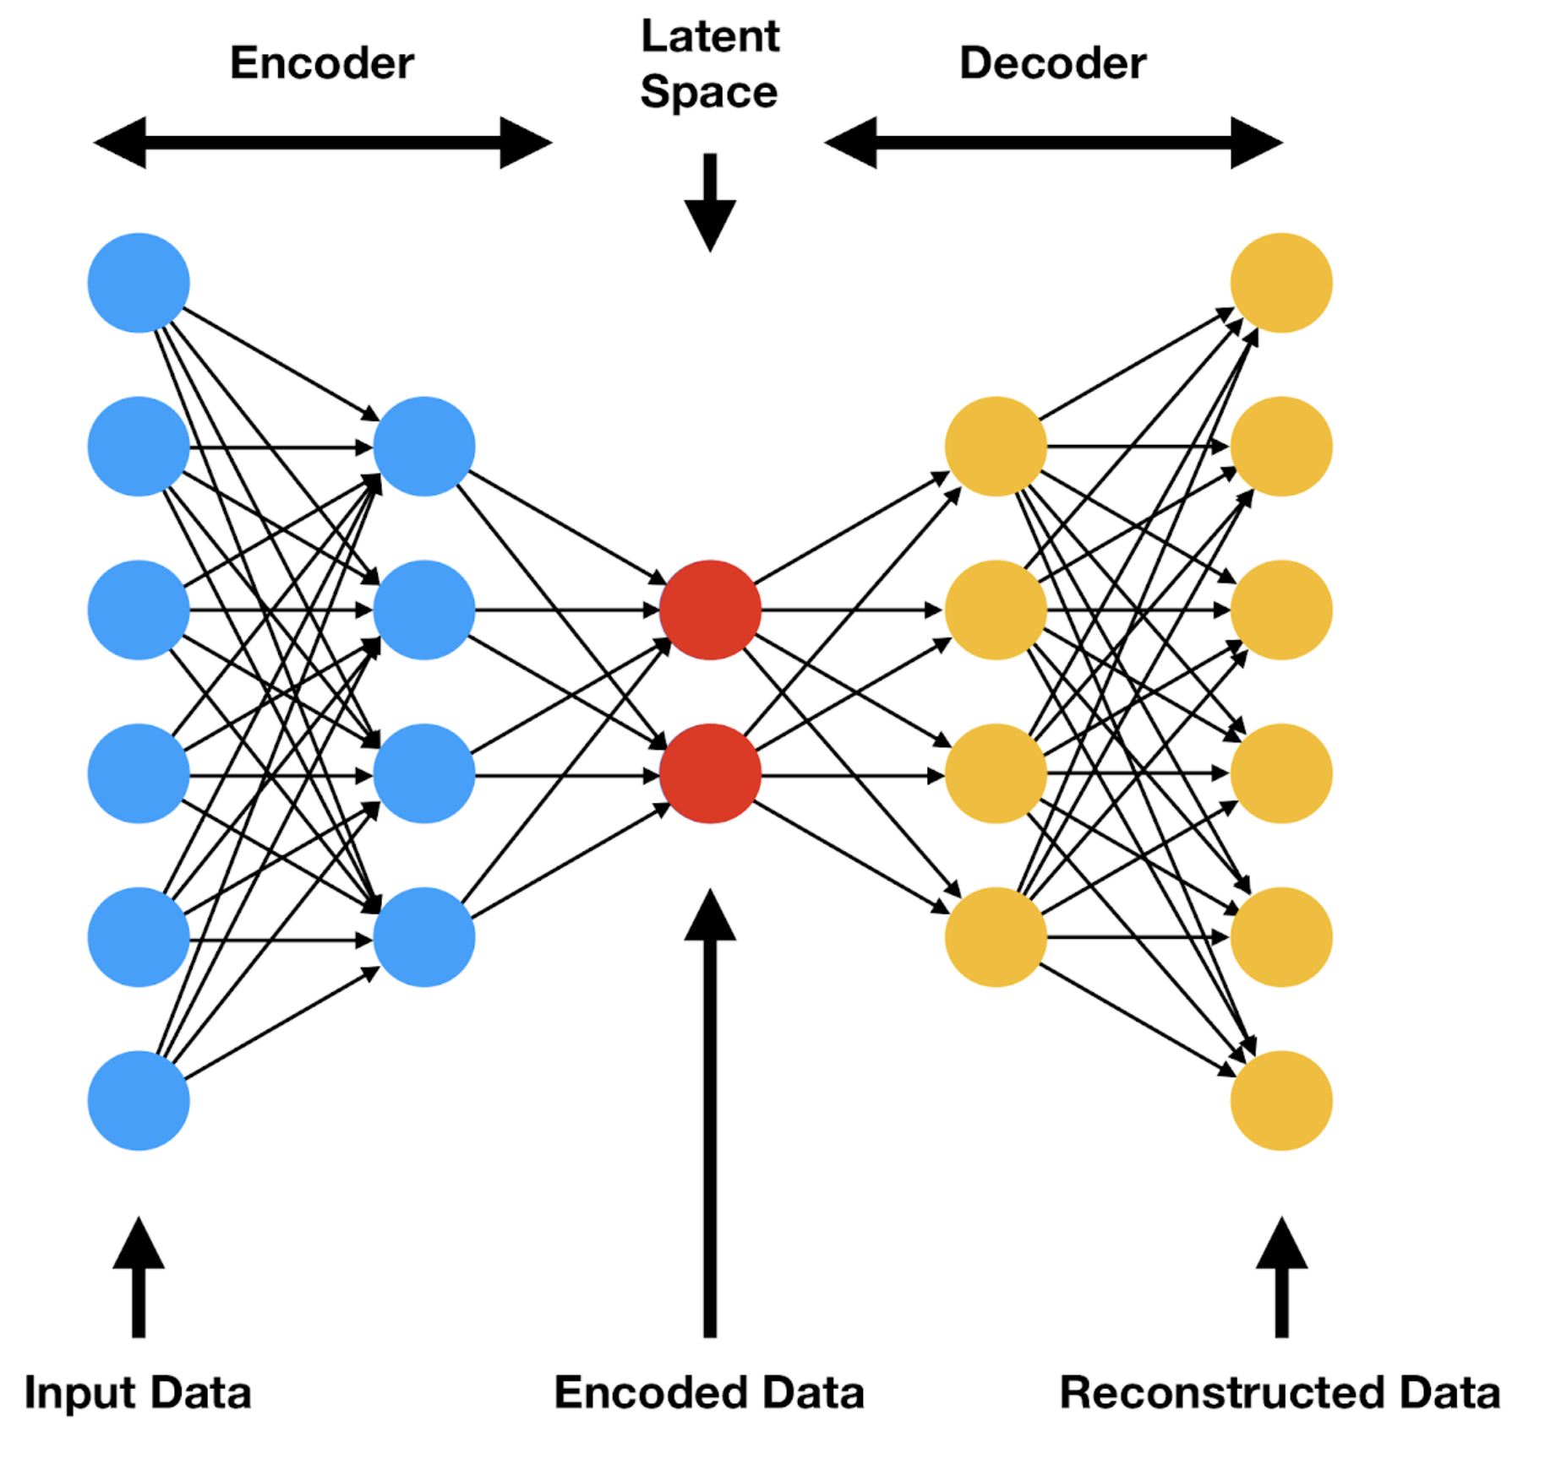
Related Work - Autoencoder
Understanding VQ-VAE (DALL-E Explained Pt. 1)). Charlie Snell

Slide 9
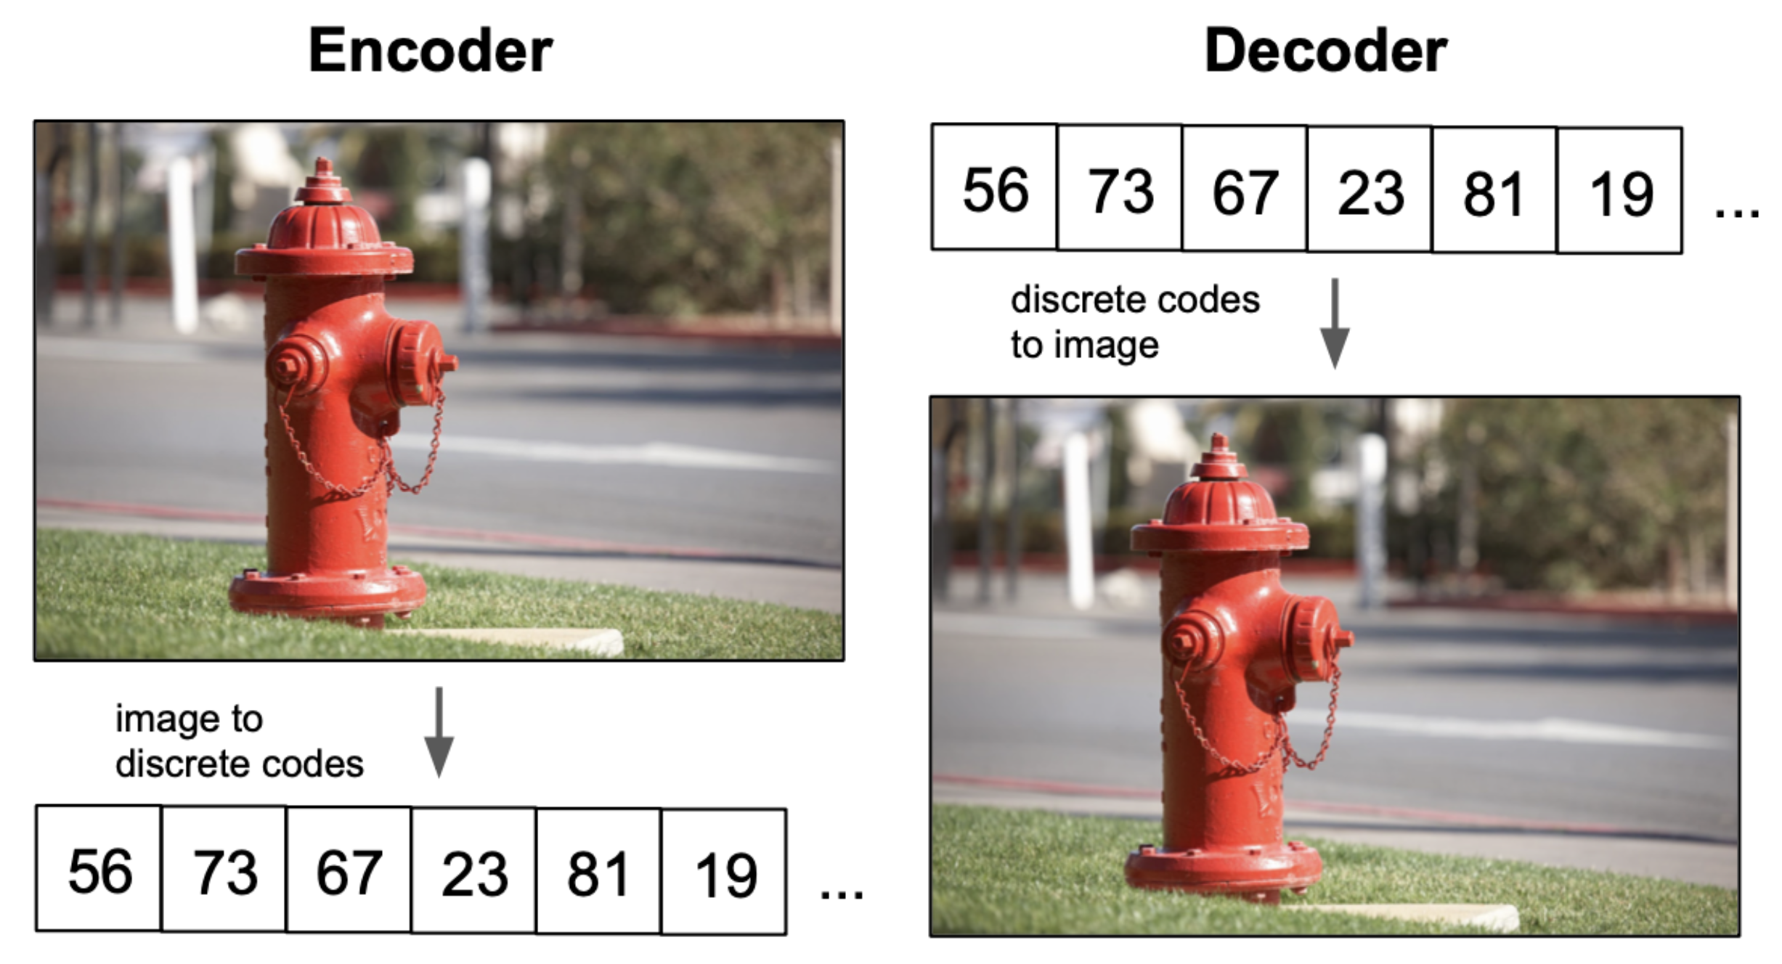
Related Work - Autoencoder
Understanding VQ-VAE (DALL-E Explained Pt. 1)). Charlie Snell

Slide 10
Related Work - Autoencoder problem
Continuous latent space, but…

Slide 11
Related Work - Variational Autoencoder
Consider our latent space z as a random variable
First let’s enforce a prior $p(z)$ on our latents, in most VAEs this is typically just a standard gaussian distribution $𝒩(0, 1)$
Given a raw datapoint x, we also define a posterior for the latent space as $p(z∣x)$
The goal is to compute this posterior for the data, which we culd express using Bayes’ rule as
But… $p(x)$ is intractable, so this does not work directly
Need approximation
Understanding VQ-VAE (DALL-E Explained Pt. 1)). Charlie Snell

Slide 12
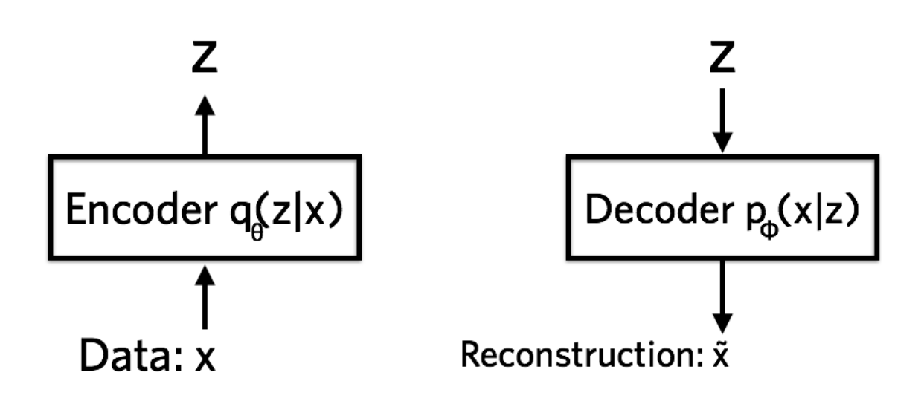
Related Work - Variational Autoencoder
Restrict approximation of the posterior to a specific family of distributions: independent gaussians. Call this approximated distribution q(z∣x)
VAE: Add a prior to the autoencoder latent space: Approximate $p(z)$ with $q(z|x)$
Derive loss function:
ELBO: See course on Probabilistic and Differential Programming
Understanding VQ-VAE (DALL-E Explained Pt. 1)). Charlie Snell

Slide 13
KL-Divergence
From an information theory perspective,
… the Kullback-Leibler divergence indicates how much space per character is wasted on average
… when a character based on Q-based coding is applied to an information source
… that follows the actual distribution P.

Slide 14
Variational Autoencoder as a Generator

Slide 15
Related Work - Autoencoder vs. VAE

Slide 16
Variational Autoencoder as a Generator

Slide 17
Variational Autoencoder as a Generator

Slide 18
Related Work - VQ-VAE
Want discrete latent space?
Vector Quantized VAE

Slide 19
DALL-E – Central Idea

Slide 20
Training
1. Stage: Visual Codebook

Slide 21
Training
2. Stage: Learning of autoregressive generation of image codes

Slide 22
Stage One: Learning the Visual Codebook
Discrete Variational Autoencoder (dVAE)
Similar to VQ-VAE but uses distribution instead of nearest neighbor

Slide 23
Stage One: Learning the Visual Codebook
Discrete Variational Autoencoder (dVAE) encoder
Latent vector 1’s distribution
Latent vector 2’s distribution

Slide 24
Stage One: Learning the Visual Codebook
Discrete Variational Autoencoder (dVAE) decoder
Gumbel softmax distribution becomes categorical over training schedule

Slide 25
Stage One: Learning the Visual Codebook
Discrete Variational Autoencoder (dVAE) encoder
Issue: Can’t differentiate backprop through category distribution of the bottleneck
Solution: Relax the bottleneck to include vectors from convex hull of set of codebook vectors

Slide 26
Stage One: Learning the Visual Codebook
Gumbel Softmax Relaxation
Sample: z = codebook[argmax_{i}[g_{i} + log(q(e_{i}|x))
Gives weights y_{i}
Sampled latent vector is the sum of the weighted codebook vectors
Differentiable
Relaxation temperature annealing schedule for hyperparameter 𝛕

Slide 27
Stage Two: Learning Prior Distribution
Transformer
Predict distribution for next token
Sample distribution and repeat until 1024 image tokens

Slide 28
Nice Applications. But…
How can agents use text-descriptive image generation?
Agent could generate “internal images” and interpret them to optimally carry out tasks
Planning might get easier with “mental imagery”
Mental imagery (aka visual imagery) has a long tradition in cognitive psychology
→ Imagery Debate
Propositional or visual/”perceptive” reasoning
”Pylyshyn vs. Kosslyn”

Slide 29
Mental Rotation

Slide 30
Mental Scanning
Island stimulus for mental scanning used in (Kosslyn, Ball, & Reiser, 1978). The island contains different locations that differ in their distance to each other. In the lower left corner a hut, a well, a lake, and a tree are visible. On the top is a rock and further locations include grass and a beach.
Kosslyn, S. M., Ball, T. M., & Reiser, B. J., Visual images preserve metric spatial information: evidence from studies of image scanning. Journal of experimental psychology: Human Perception and Performance, 4(1), 47, 1978.

Slide 31
Mental Scanning
Using their mental image, participants are asked to shift their attention from one entity in the image to another entity.
It turned out that participants take significantly longer for attention shift between, for example, the hut and the rock, …
… than they do for a shift between the hut and the well
Strong linear correlation between the time it takes to scan between two entities in the mental image and the distance between these two entities in the original stimulus

Slide 32
Mental Reinterpretation
(a) The first figure in each line is described to the participants verbally who then mentally transform their mental images according to verbal instructions so that the depicted intermediate figures should result.
(b) The respectively left one is briefly shown to the participants who then have to find an alternative interpretation of just the right side of the stimulus using their mental image.

Slide 33
Dual coding theory
Human cognition divided into two processing systems: visual and verbal.
The visual system deals with graphical information processing and the verbal system deals with linguistic processing
These two systems are separate and are activated by different information
GenAI: Text→Image/Video
GenAI: Image/Video→Caption as text
Use CLIP principles for mental images?
YOLO for mental videos?
Sadoski, Mark; Paivio, Allan, "A Dual Coding Theoretical Model of Reading", Theoretical Models and Processes of Reading, DE: International Reading Association, Cognitive psychology. Cengage Learning. pp. 1329–1362, 2016.

Slide 34
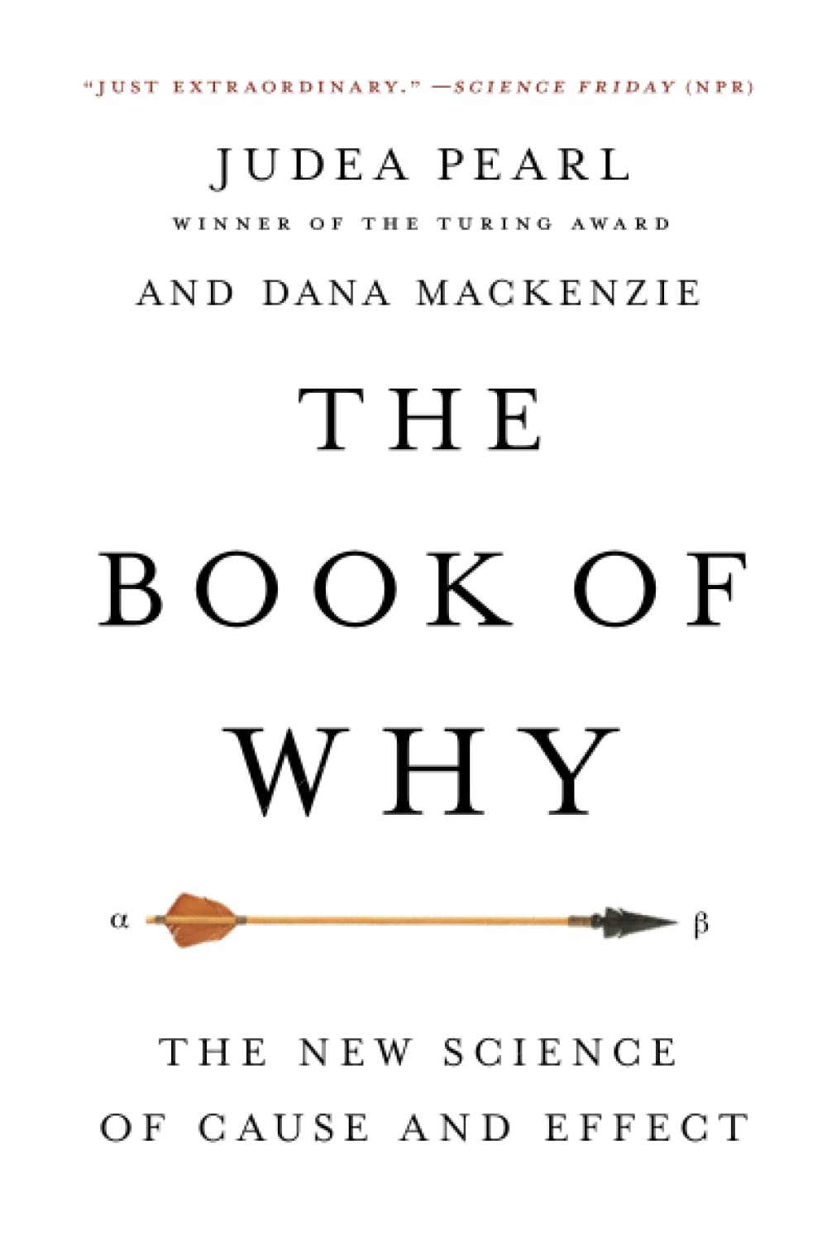
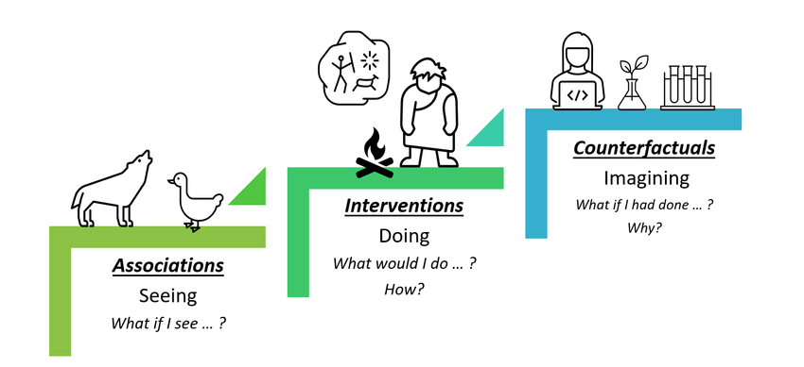
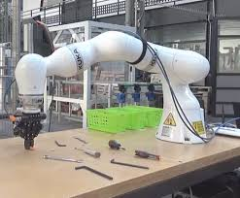
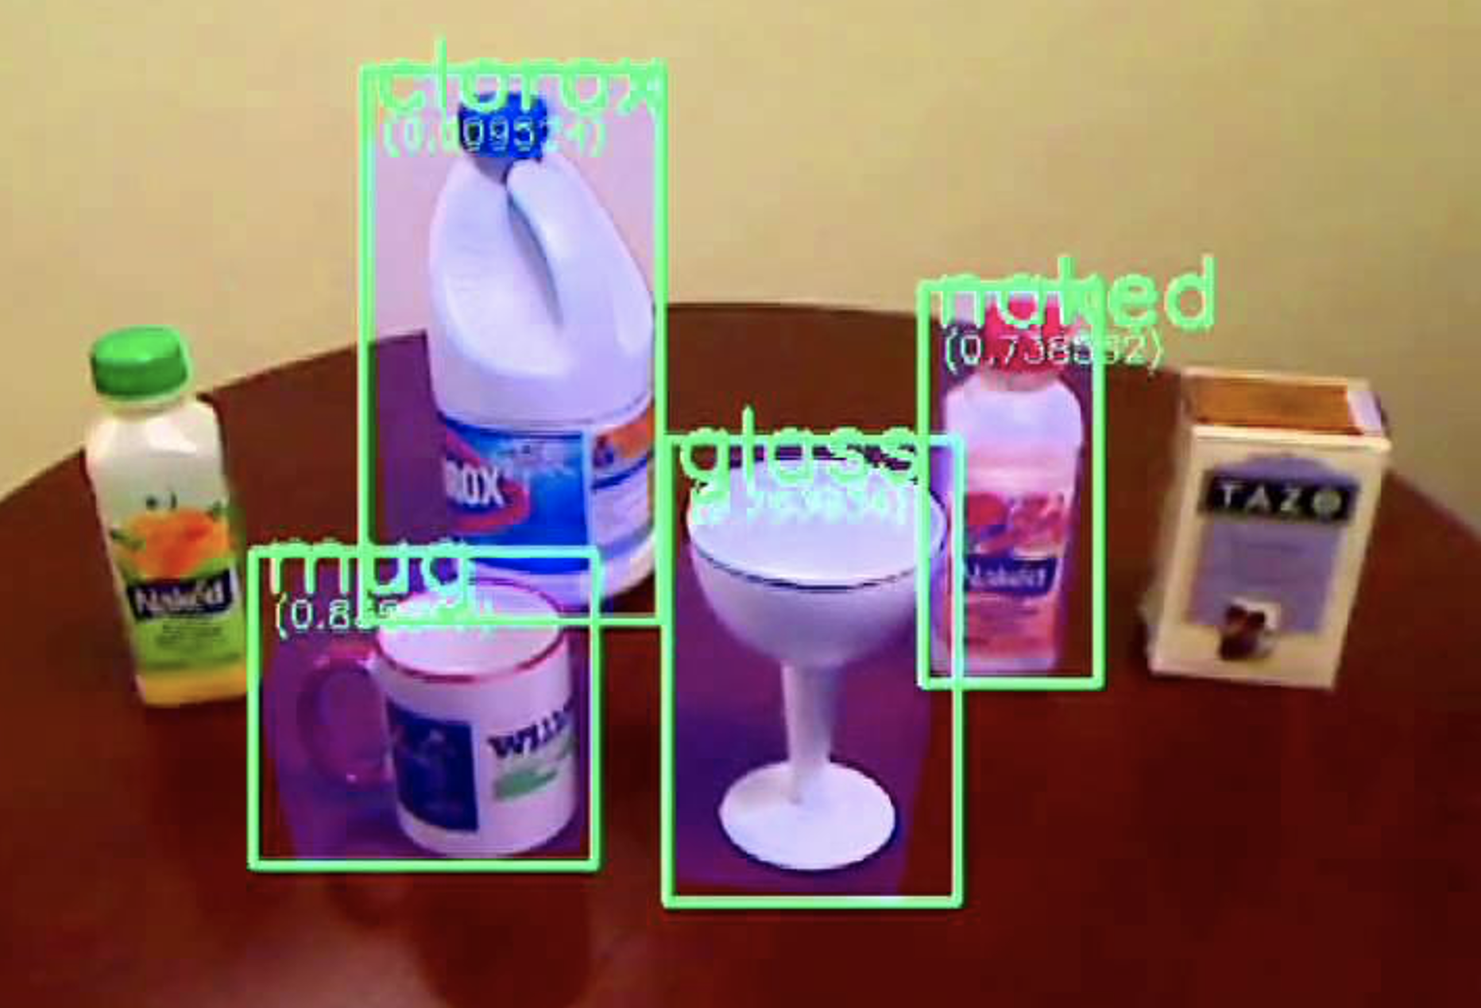
Counterfactuals and Causality

