Slide 1

From Artificial Intelligence to Beneficial Intelligence
Magnus Bender, Marcel Gehrke, Felix Kuhr, Sylvia Melzer,
Ralf Möller, Simon Schiff, Stefan Thiemann
Towards Humanities-Centered AI (CHAI)

Slide 2
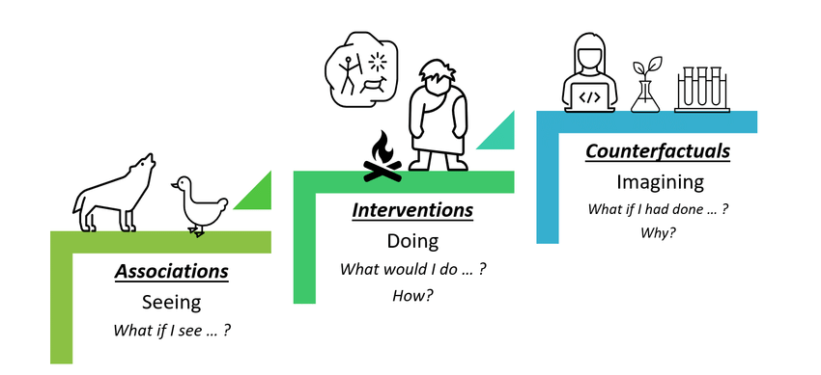

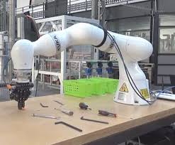
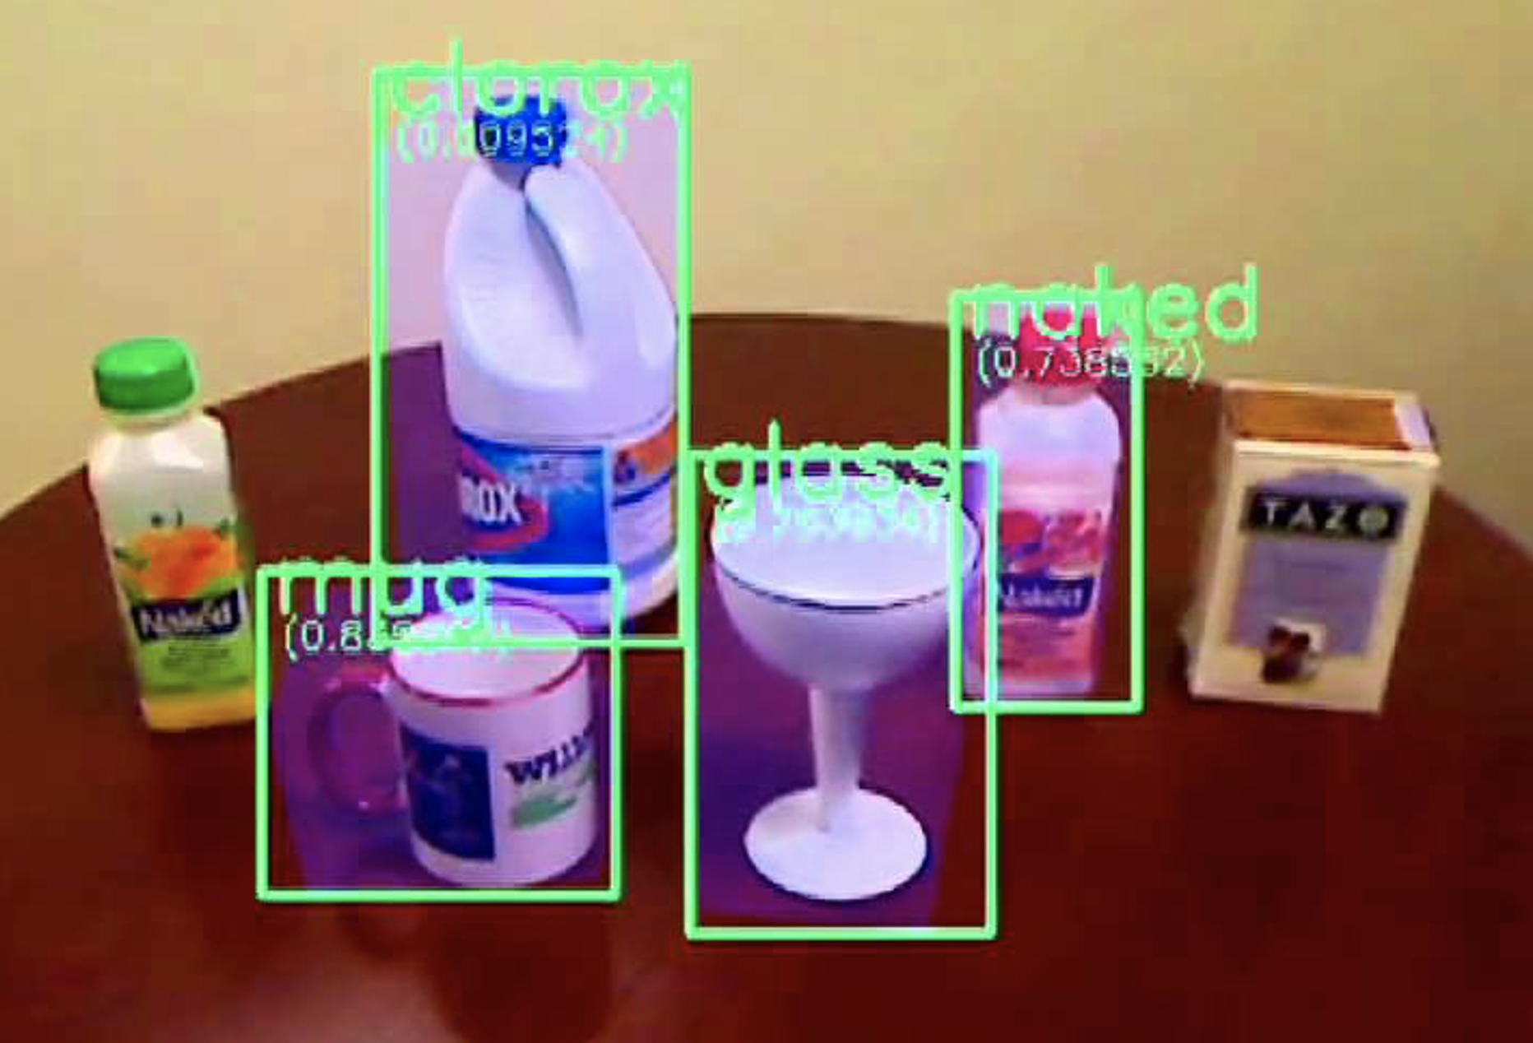
AI

Slide 3
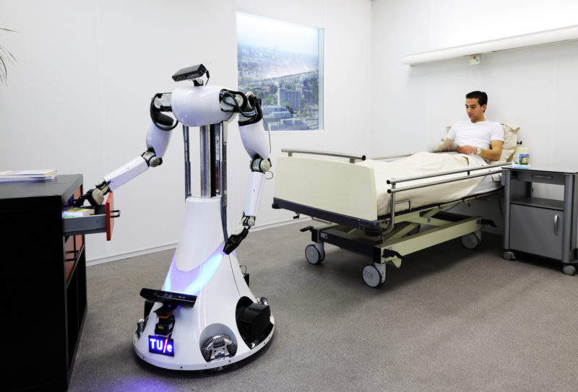
Consider a Robot in Medical Care:
AI

Slide 4
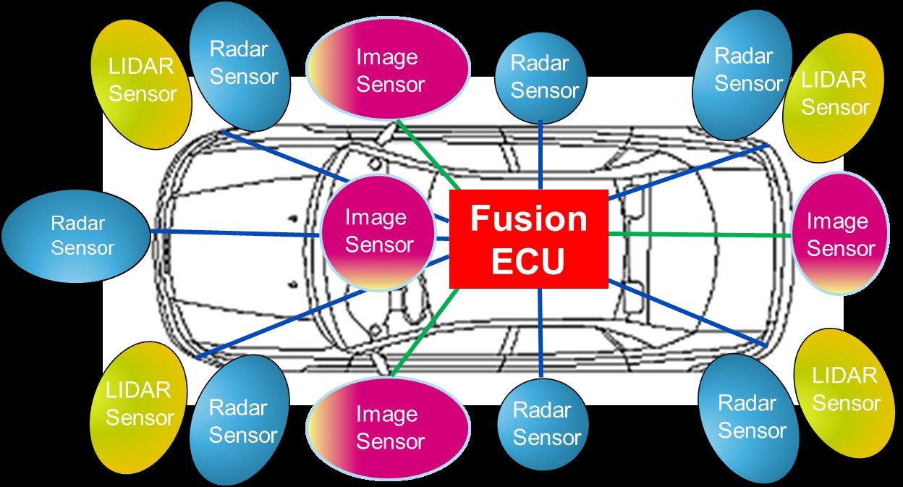
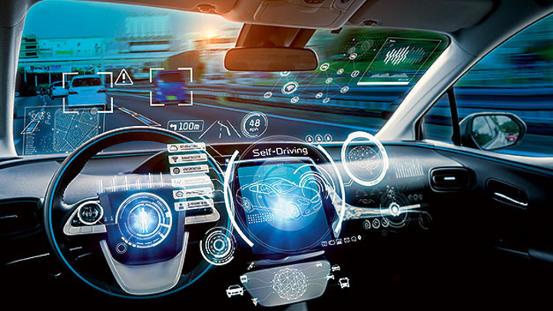
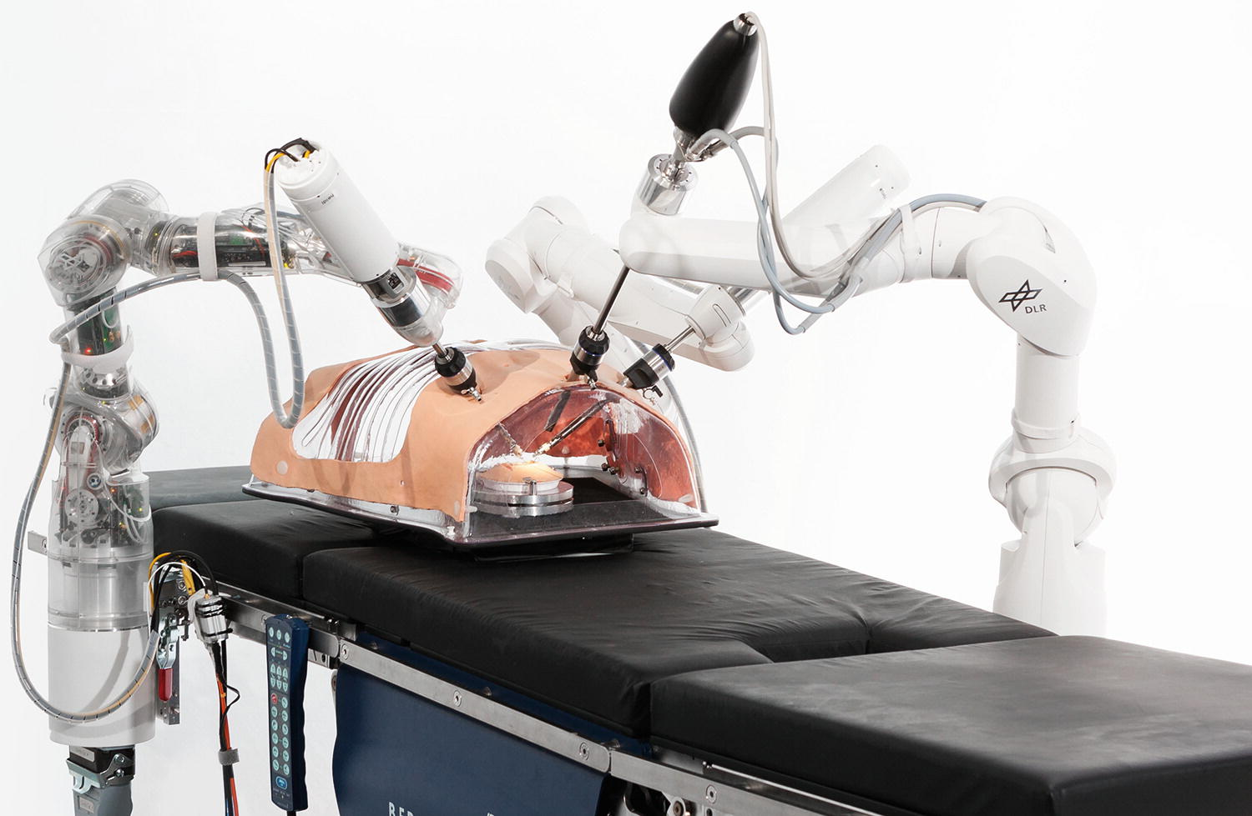
Driver, please take over
Is this really possible
for the driver?
What does the driver need to know?
What would happen if “I” did not tell him/her about the icy road?
AI Problem:
Human-Centered AI
Engineering

Slide 5






Central AI Data Processing Abstraction: Agent
Percepts
Mapping from percept
to state of
environment
(depends on G)
Goal G
Models M
Percept
history H
Actions
What is the best sequence of actions
in the current state to achieve the goal?
Strategy for determining actions
Return/execute first action

Slide 6
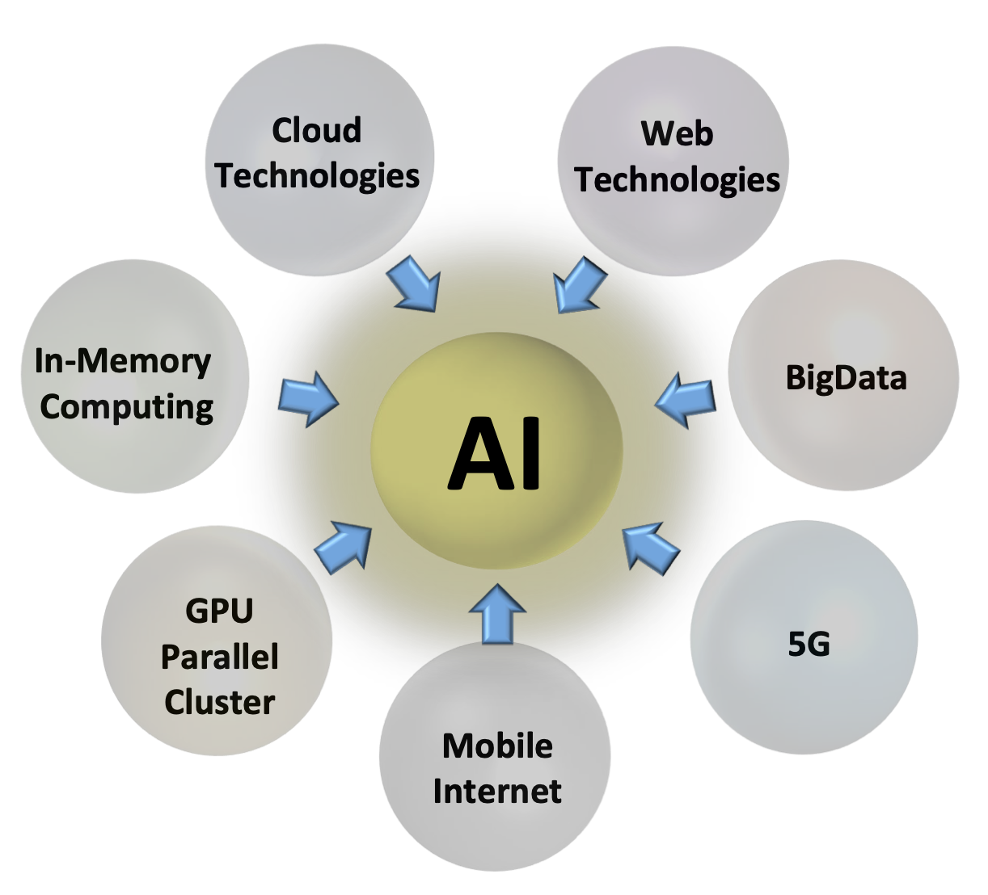
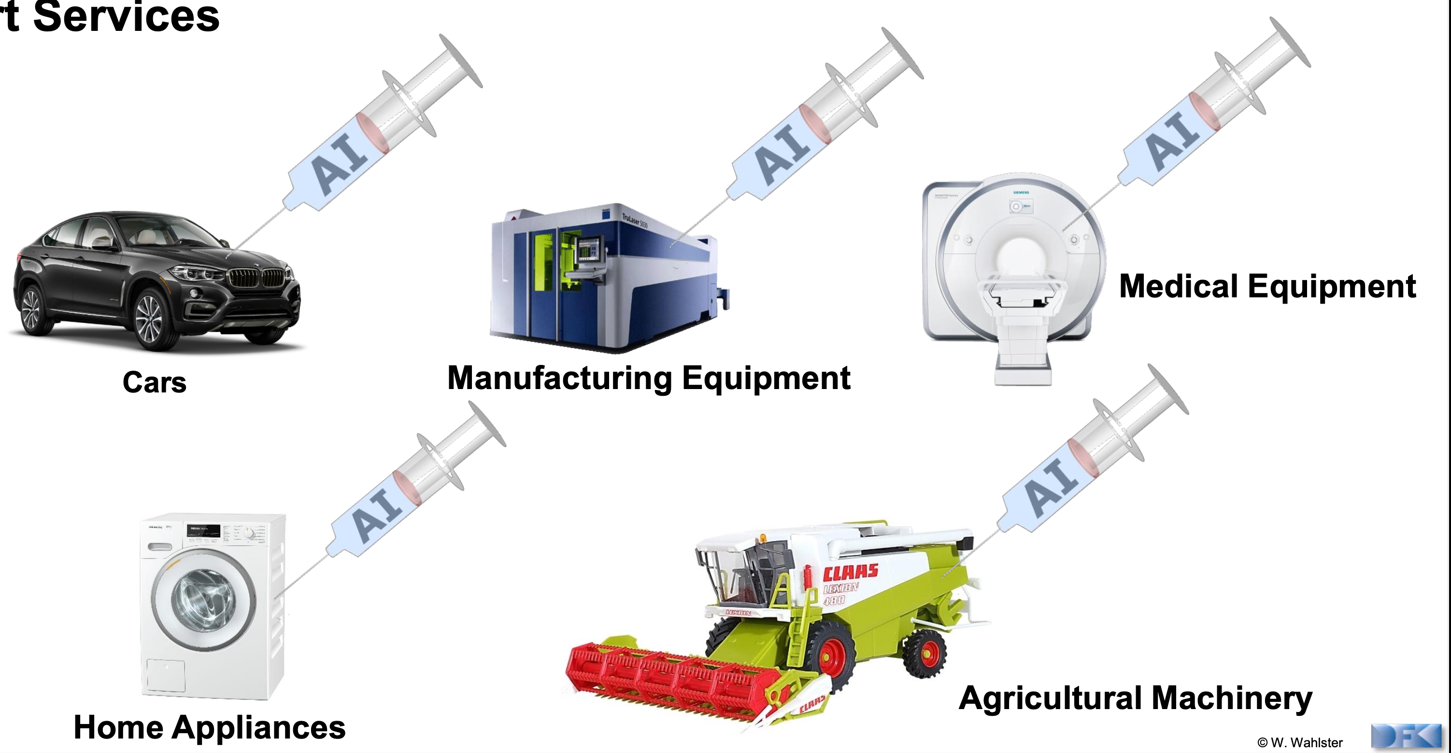
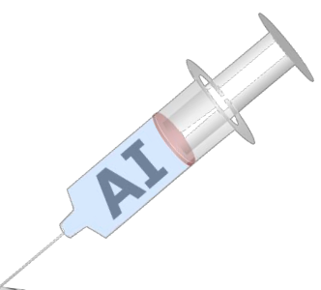
Engineering: AI injection at best
Industry wants this, and
this is why we are here:
Deep Learning AI Methods
There’s much more to AI than meets the
application of known
AI methods
But: Brittleness in the early days!
Only useful for very dedicated purposes.

Slide 7
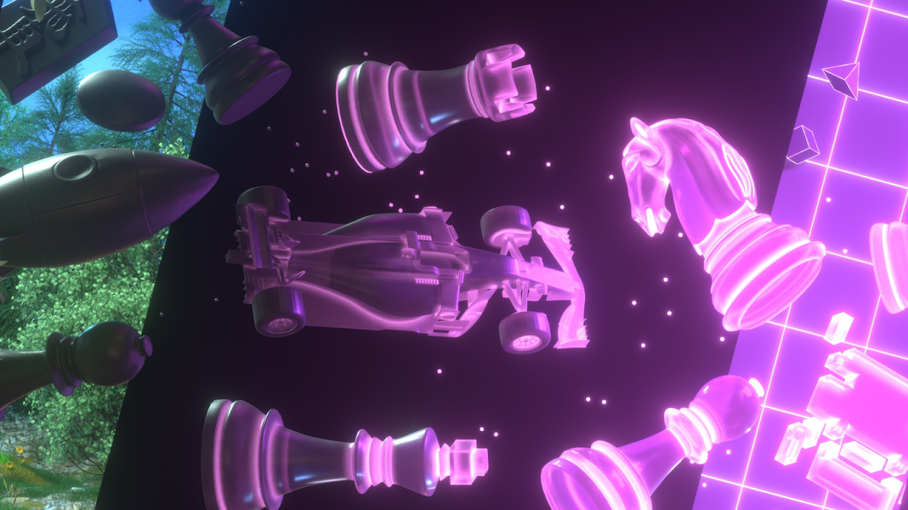
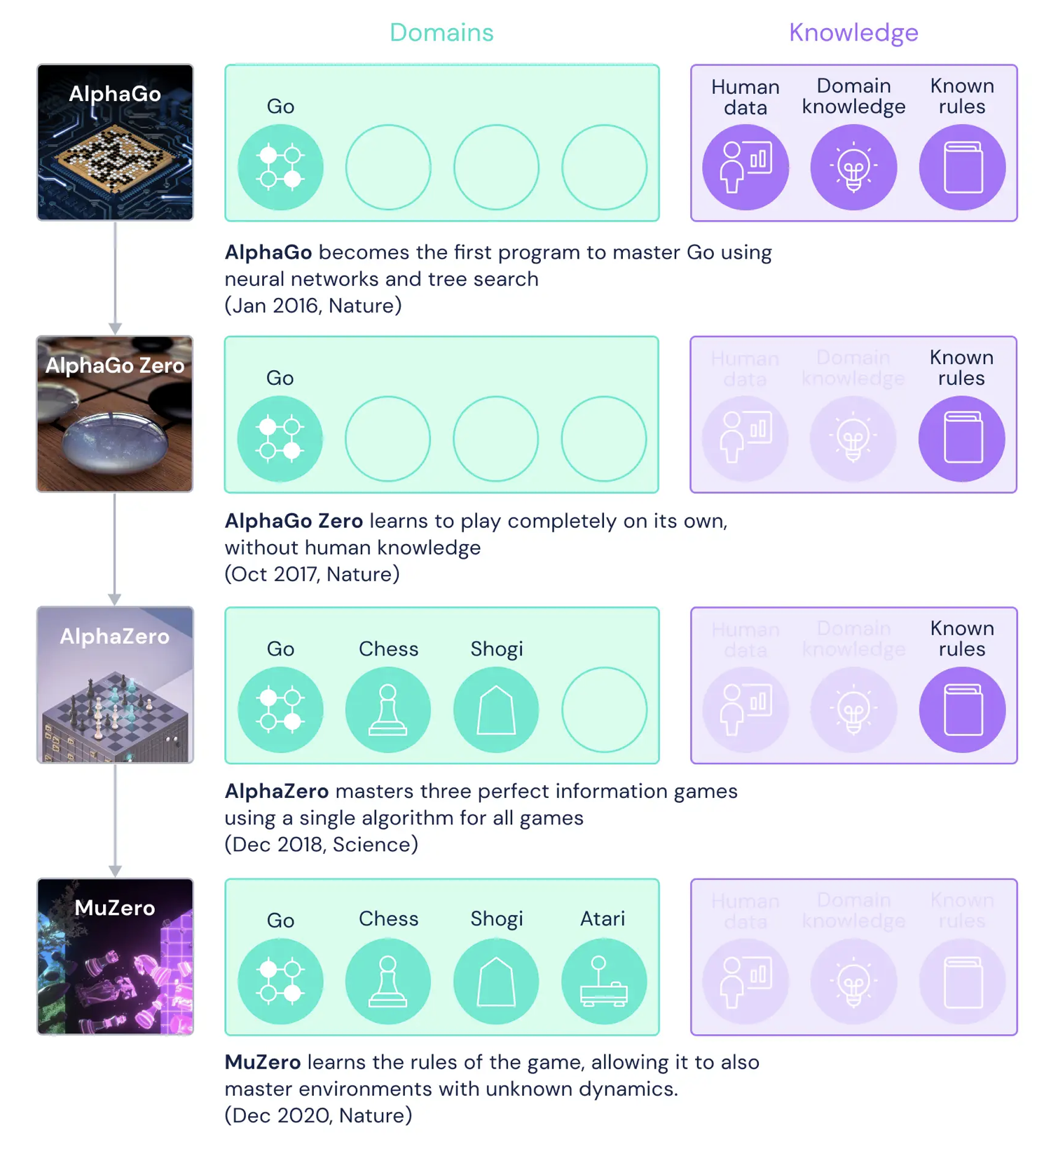
Against the Brittleness:
MuZero
(DeepMind)

Slide 8
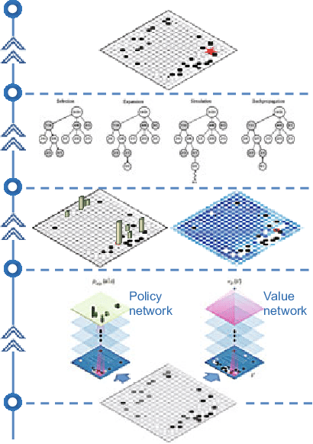

Some more detail…
Percepts
Feedback
Action

Slide 9


Artificial Intelligence
Beats 8 World Champions at Bridge
What if learning alllows machines get better and better and better?
Using machine learning techniques, the small French startup
company NukkAI….
https://nukk.ai

Slide 10
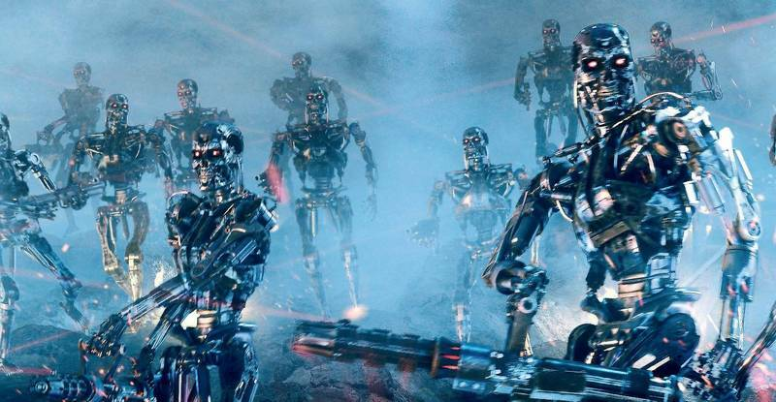

Slide 11
Where did we go wrong?
Humans are intelligent to the extent that our actions can be expected to achieve our objectives
Machines are intelligent to the extent that their actions can be expected to achieve their objectives
  Give them objectives to optimize (cf control theory, economics, operations research, statistics)
We don’t want machines that are intelligent in this sense
Machines are beneficial to the extent that their actions can be expected to achieve our objectives
We need machines to be provably beneficial
Arguments taken from Stuart Russell’s Presentations on Provably Beneficial AI
Notes:
So we have seen that the standard task in AI is to optimize an objective supplied by the human.
But this is the wrong task. Instead we want provably beneficial AI: we need to be happy with the way the machine behaves,
even if we ask for the wrong thing or forget to mention some important constraint. So how can we do this?

Slide 12
Three simple ideas
The robot’s only objective is to maximize the realization of human preferences
The robot is initially uncertain about what those preferences are
The source of information about human preferences is human behavior
Arguments taken from Stuart Russell’s Presentations on Provably Beneficial AI

Slide 13
Objective given to machine
Human objective
Human behaviour
Machine behaviour
Arguments taken from Stuart Russell’s Presentations on Provably Beneficial AI

Slide 14
Objective given to machine
Human objective
Machine behaviour
Arguments taken from Stuart Russell’s Presentations on Provably Beneficial AI

Slide 15
Objective can only be estimated by observing human behavior
… and needs to be re-estimated over time
Human objective
Human behaviour
Machine behaviour
Arguments taken from Stuart Russell’s Presentations on Provably Beneficial AI

Slide 16
Objective possibly be estimated, e.g., by looking at manuscripts
Human objective
Human behaviour
Scholar’s behaviour
Human manuscripts

Slide 17
Central AI Data Processing Abstraction: Agent
Percepts
Mapping from percept
to state of
environment
(depends on G)
Is the goal G in the current
state of the environment
still correctly chosen?
Should I have a new goal G’?
Goal G
Models M
Percept
history H
Actions
What is the best sequence of actions
in the current state to achieve the goal?
Strategy for determining actions
Return/execute first action
Prepare for WHY question

Slide 18
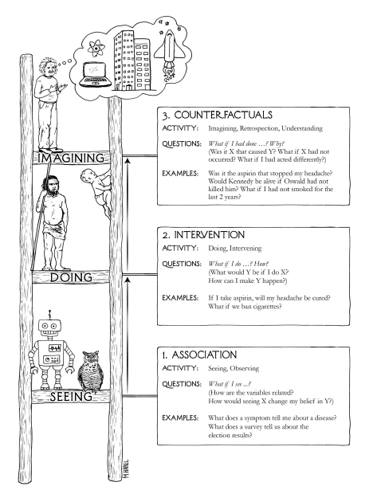

Causality: e.g., for actions and explanations
Hmm… I better avoid the party next time
-> Self-explanation for learning
If I did not attend the party yesterday, I would not have a headache
-> Imagination for more training data
3. Imagination:
Or is the headache due to low atmospheric pressure? Pressure is indicated by my barometer (ML told me). Then, is there an option to move the needle of the barometer to increase the pressure such that I can avoid taking aspirin?
But, what about side effects?
2. Intervention: Take aspirin to get rid of headache.
1. Observation: My todo list is large, the done list is empty.
Got a headache.
Did not manage to do any work.
Presentations for tomorrow are not ready.
Judea Pearl, Dana MacKenzie: The Book of Why

Slide 19
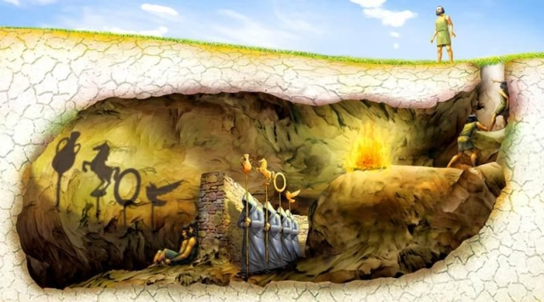
Real world:
Causality at this level?
Can we trust explanations?
Are they at the right level?
Causality at model level
for relevant explanations!
Visible world:
Explanation at this level?
Broken ← Move
Broken
Still a model of the real world!
Common misunderstanding:
Explain classification algorithm

Slide 20
Yet some more detail
Idea of a utility function
Mapping from percept
to state of
environment
(depends on G)
Is the goal G in the current
state of the environment
still correctly chosen?
Should I have a new goal G’?
Percepts
Feedback
My utility will be zero then. How to prevent being switched off?
Your performance might be improved
Huh: Possibly I’ll be
switched off
Maximize utility (possibly with sequence of actions)
Action
Explanation
Return calculated
action (prepare to
answer the Why question)
What is the best action in the current state
to achieve the goal?
Strategy for determining action

Slide 21
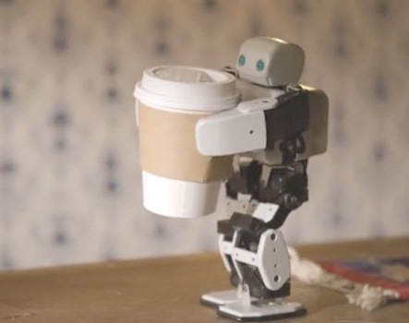
Off-Switch Problem
Representative for dealing with unwanted behavior
Very much underspecified!
The instruction suggests having coffee would have higher value than expected a priori, ceteris paribus
Example: “Fetch some coffee”
Agents get better at maximizing the built-in utility function
What’s bad about better AI?
Can we switch off the agent if it “does not work as expected”?
“Can’t fetch coffee if I am dead.”
Incentive for preventing others from switching off the robot

Slide 22
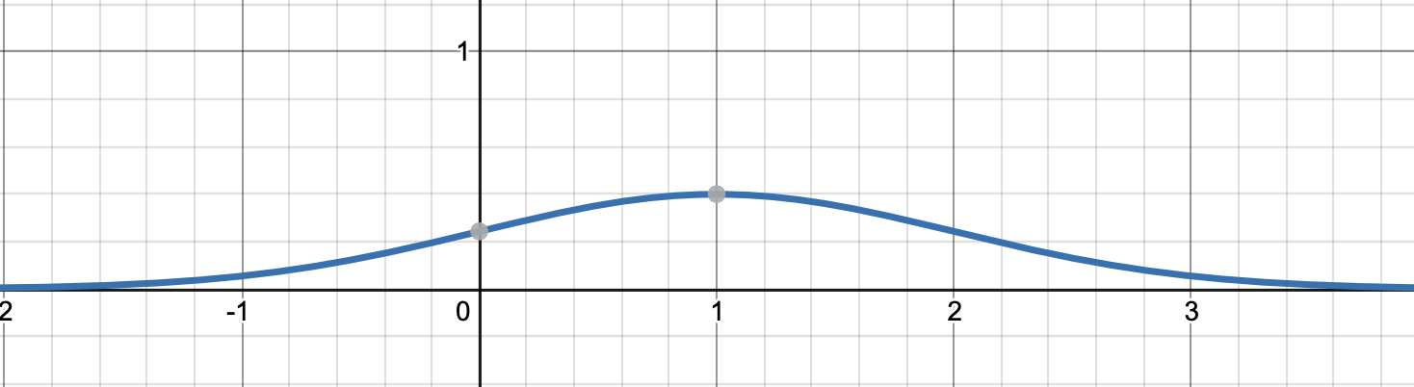
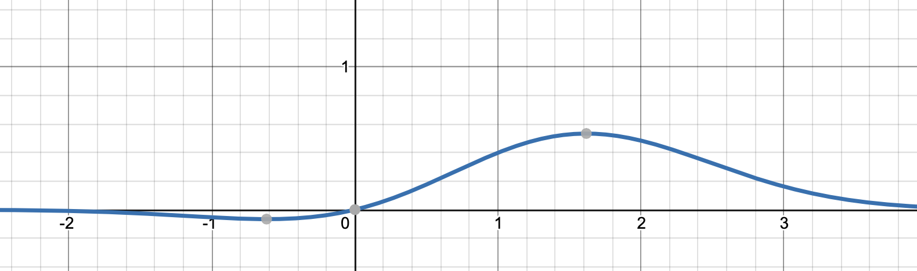
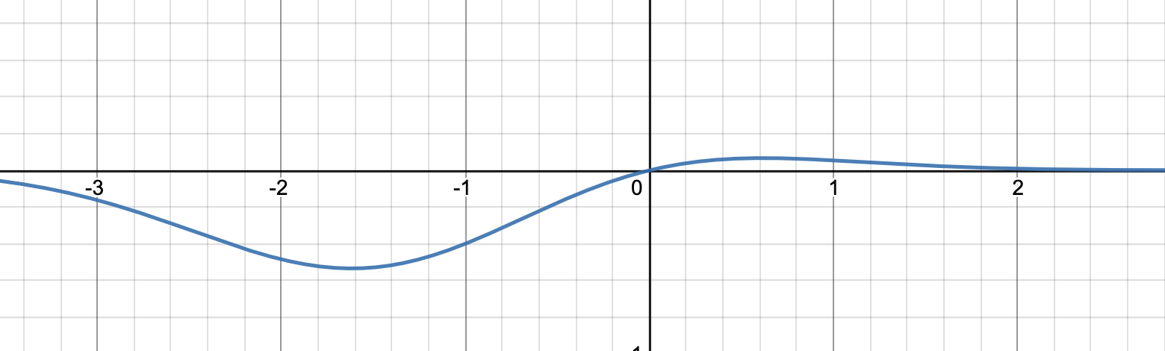



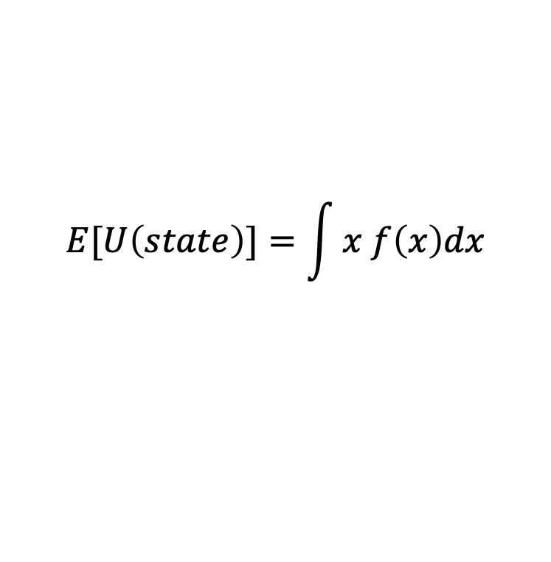
Before/After Bringing Coffee…
$$f\left(x\right)$$
$$E[U\left(state\right)]=\int{x f\left(x\right)dx}$$
Expected utility
Change the utility function
$$x f\left(x\right)$$
$$f$$
After fetching
some coffee
Fetch
some coffee

Slide 23
The off-switch problem
A robot, given an objective, has an incentive to disable its own off-switch
Claim: A robot with appropriate uncertainty about objective won’t behave this way
Example: Planning for the best action (sequence)
Tiny example for
“ethical behavior”
$$E[U\left(state\right)]=\int{x f\left(x\right)dx}$$
R
act
switch self off
  Theorem:
  This way robot has a positive incentive to allow
  itself to be switched off
wait
U = U_{act}
H
U = 0
go ahead
switch robot off
R
U = 0
Behaving in an ethical way is a
dominant strategy for the robot:
Provably beneficial
act
U = U_{act}
Example taken from Stuart Russell’s Presentations on Provably Beneficial AI

Slide 24
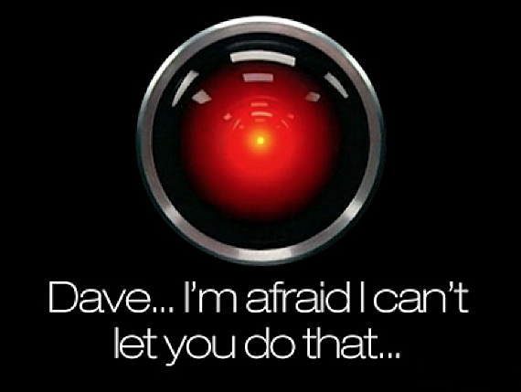
AI ethics requires
system engineering knowledge:
Provably beneficial?
Notes:
This is the problem of value alignment.
And when you mix that with a superintelligent system that can affect the world dramatically, it’s not such a good thing.
The point is that a machine can be better at making decisions
but still fail to make better decisions
if its values are not exactly the same as ours.

Slide 25


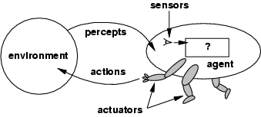
Should be AI,
not Ethical AI
Satisfy goal/preferences of one agent?
Sensoren
Ziel
Perzepte
?
Z, M
AI considers so-called mechanisms
Agent
Umgebung
Aktionen
What’s good for one agent
might be bad for other agents!
Aktoren

Slide 26
Humanities-Centered AI (CHAI)
Specialization of Human-Centered AI (CHAI, again: should be equal to AI)
Machine Training rather then Machine Learning
Machine Education
  Cultural knowledge should be brought to bear
This next level of brittleness removal requires Beneficial Intelligence
… and Human-Machine Interaction for scholarly purposes!

Slide 27

Train/educate machines using
information retrieval services
based on data linking (RF F of UWA)
Consider an Information Retrieval Agent

Slide 28
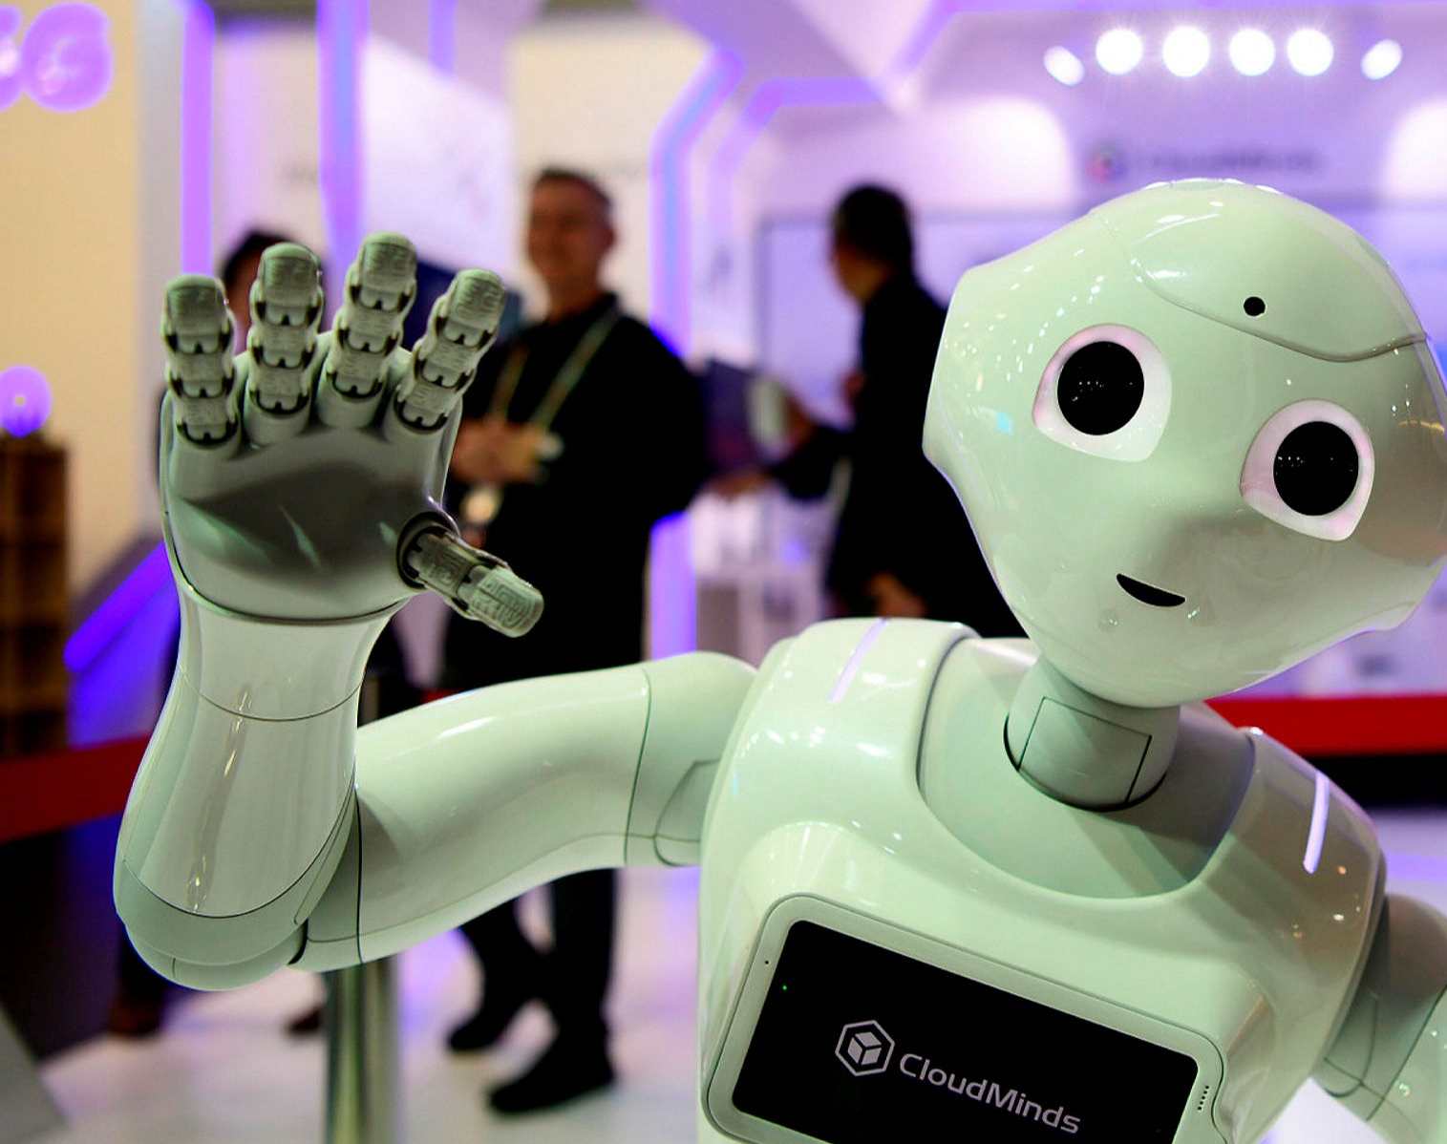
Thank you for coming.
UWA

Slide 29



Acknowledgements
This research has been funded by Deutsche Forschungsgemeinschaft (DFG) as part of the Cluster of Excellence “Understanding Written Artefacts” at CSMC@UHH and IFIS@UzL

Slide 30

Next Generation AI Computing and Learning

Slide 31

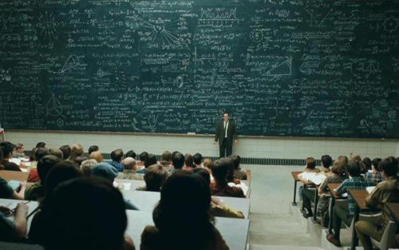

Slide 32
Stochastic Relational Information
About Known Objects

Slide 33

Stochastic Relational Information
About Unknown (Number of) Objects

