Slide 1
KI: Märchen, Mythen, Möglichkeiten
Prof. Dr. Ralf Möller
Direktor Institut für Informationssysteme, UzL Forschungsbereichsleiter Human-Centered AI, DFKI Lübeck

Slide 2
Märchen
“Die KI”
Klassifikation / Regression
Prädiktion
Diagnose …

Slide 3
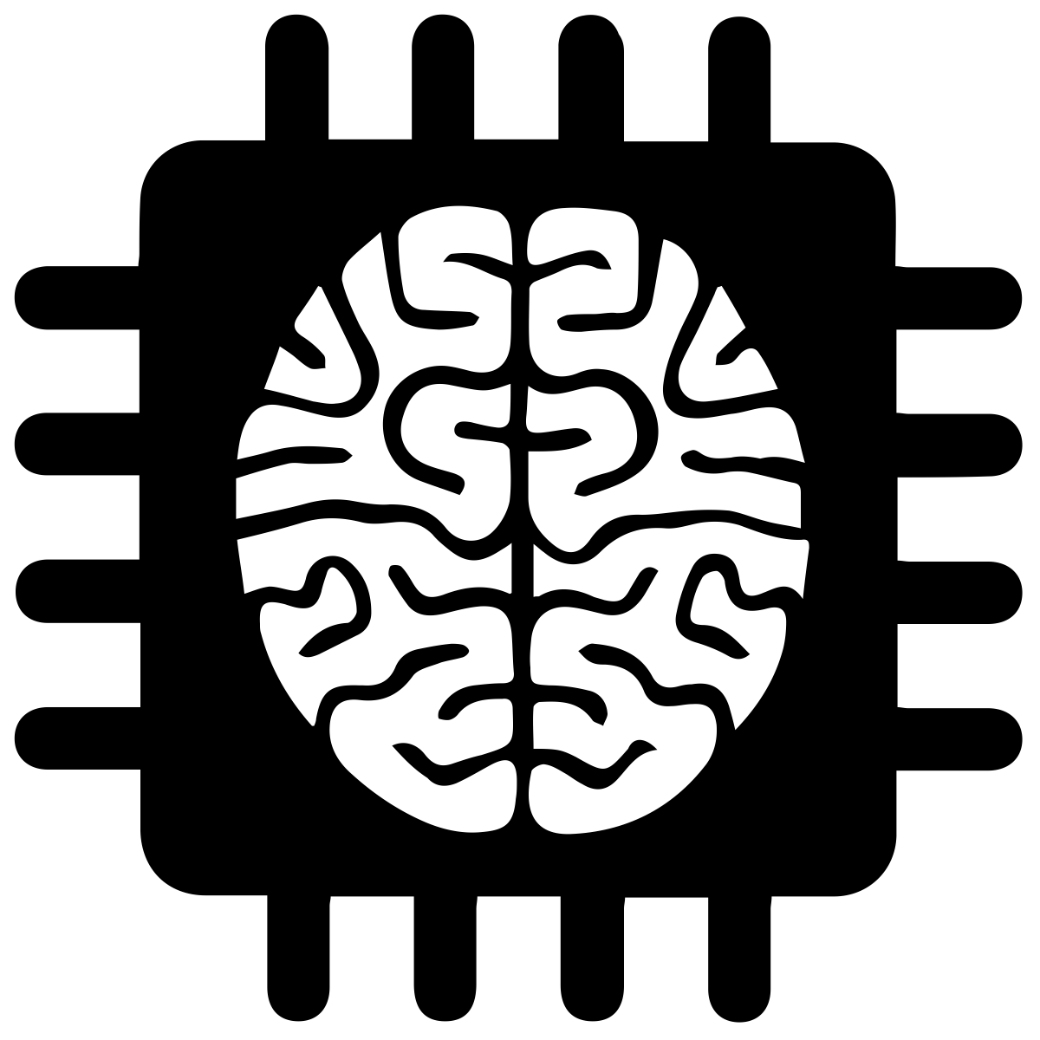
Mythen: KI-Methoden
Klassifikation / Regression
Prädiktion
Diagnose …
Machine Learning
“Eine KI”

Slide 4
Mythen: KI-Methoden
Machine Learning Komponente
“Eine KI”
“Selbstlernende KI”

Slide 5
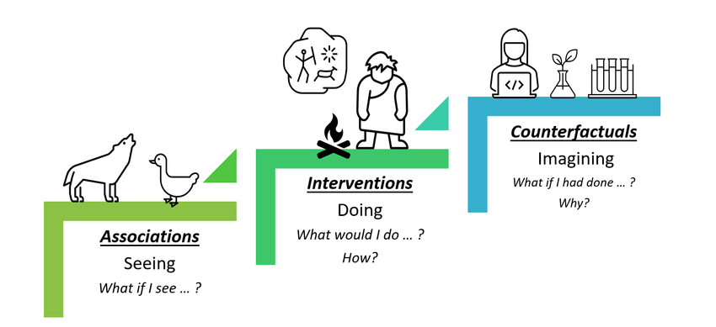
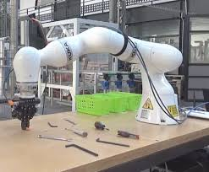
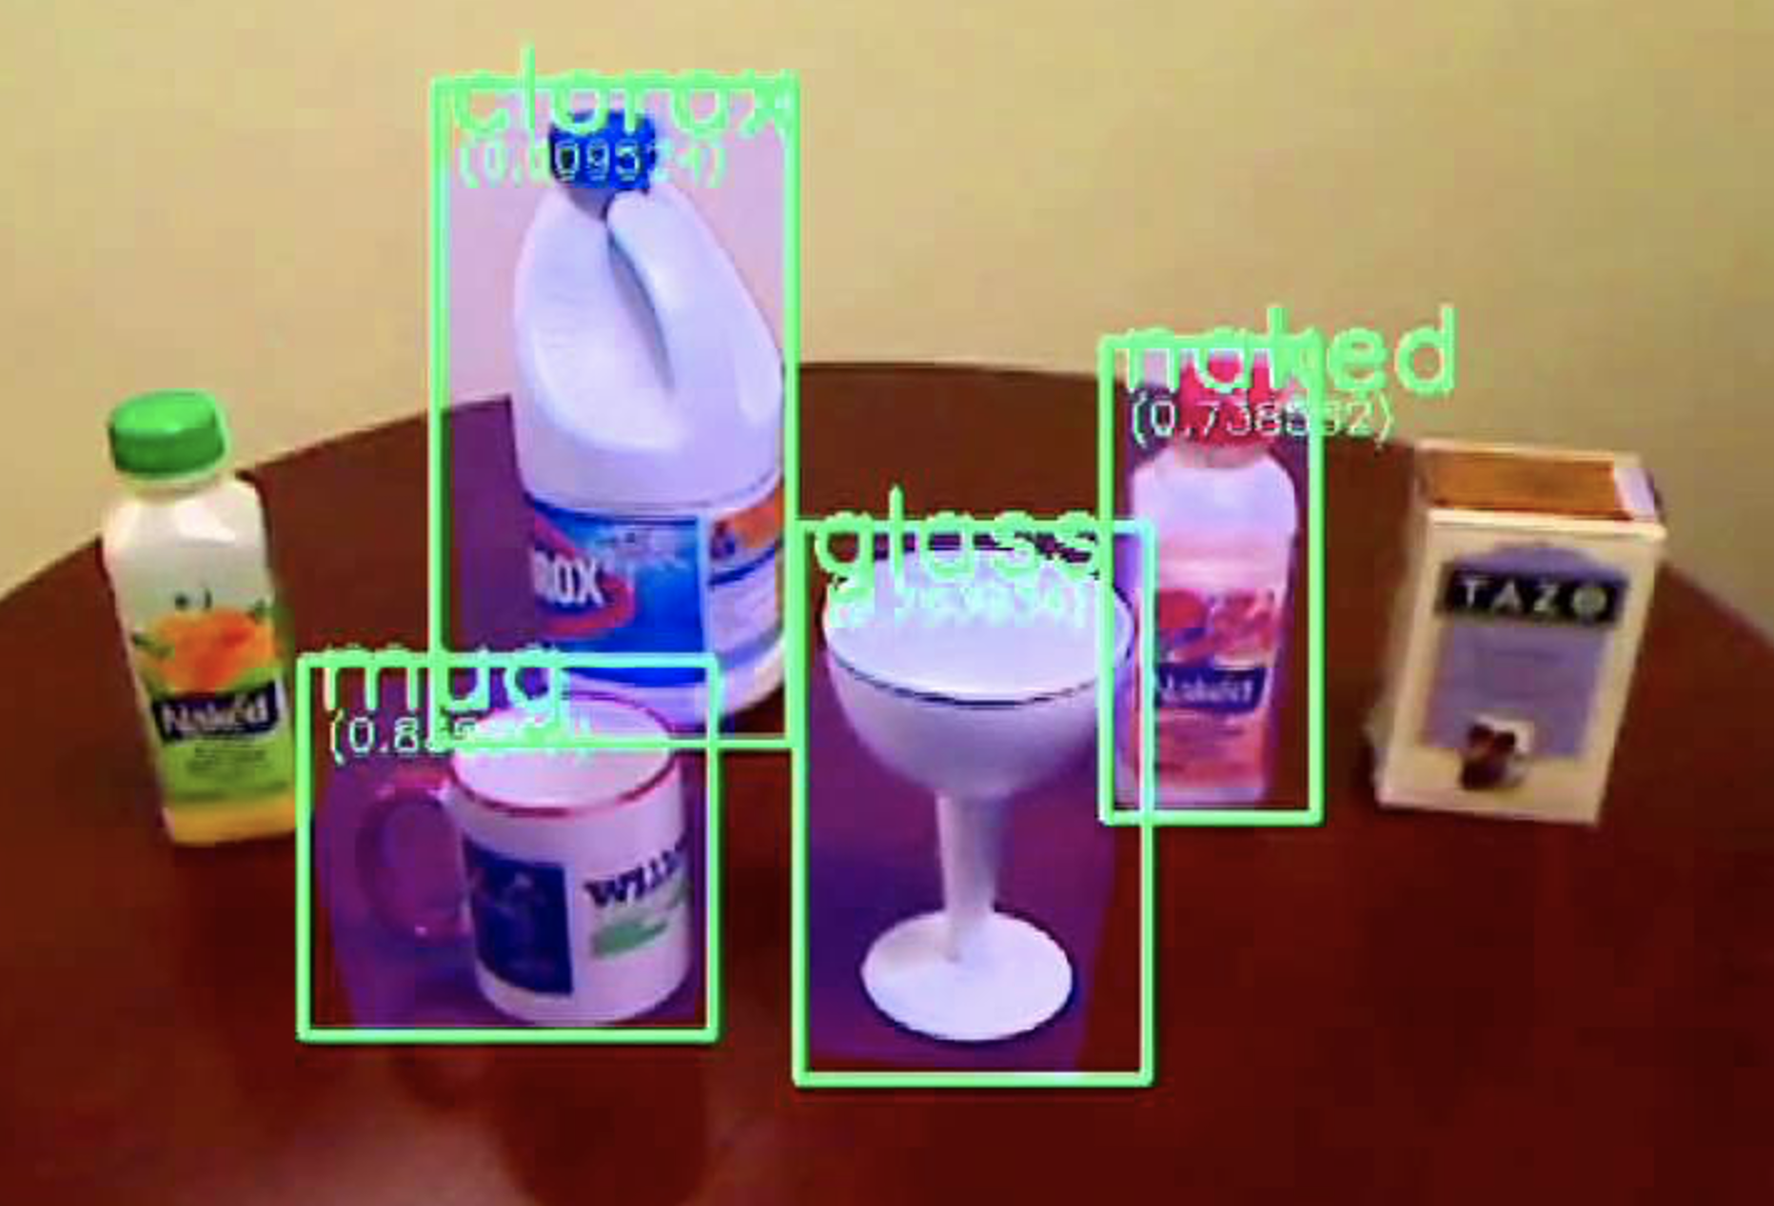
AI: Möglichkeiten
Was könnte man besser machen?
Interne Generierung von “Daten” bisher nicht immer betrachtet
Man verlässt sich zu sehr auf “externe” Daten

Slide 6
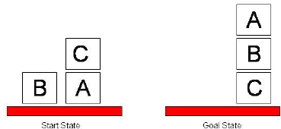
Meine These
KI ist nicht nur Datenanalyse (Data Science) mit sog. “KI-Methoden”
Nur, wenn wir Systeme betrachten, die auch handeln …
… wird die KI wird richtig interessant
Brittleness-Problem der initialen Handlungsmodelle

Slide 7
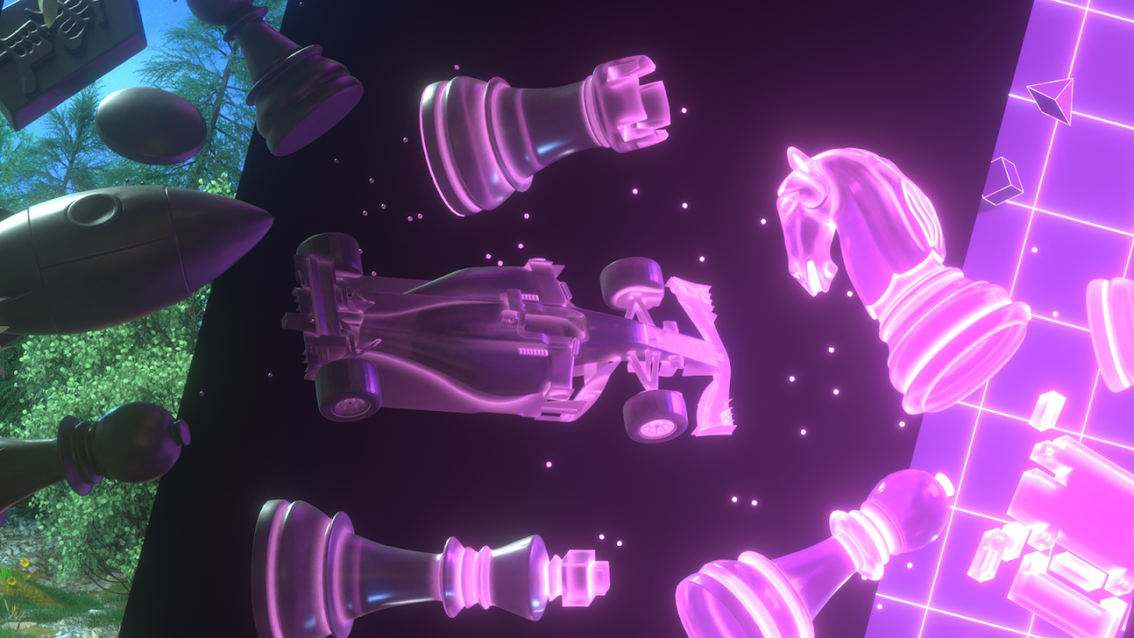
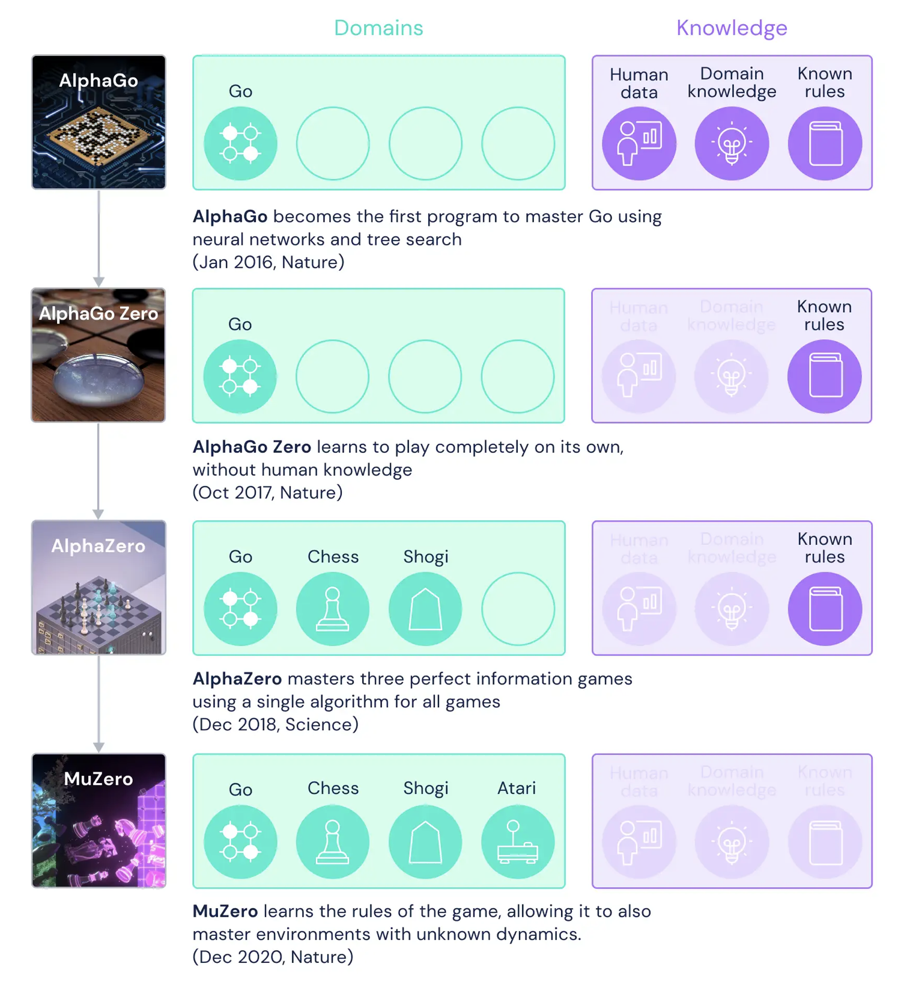
Modell der Anwendung
(initial viele prozedurale Anteile)
Nur deklaratives Modell der Anwendung
Against the Brittleness: MuZero (DeepMind)
Modellfreiheit: Ob Modellfreiheit wirklich nötig ist, sei dahingestellt:
Anwendungswisssen kann durchaus deklarativ spezifiziert werden

Slide 8
Some more detail…
Nicht immer wird der beste Zug genommen (Exploration/Counterfactuals: Hätte ich das und das gemacht, was wäre die Konsequenz?)
Lernen unumgänglich:
Reinforcement Lernen
Percepts
Feedback
Goal G Models M
Action

Slide 9
2016
Facebook, CMU
Offline- + Online-Lernen
Spielerverhalten nur online verfügbar
Artificial intelligence has now pretty much conquered poker
Called Pluribus, the AI is a formidable opponent at six-player no-limit Texas Hold’em

Slide 10
2022
Artificial Intelligence Beats 8 World Champions at Bridge
Using machine learning techniques, the small French startup company NukkAI….
https://nukk.ai

Slide 11
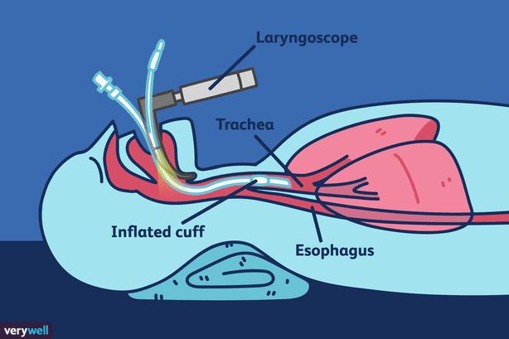
Ein ganz anderes Beispiel
Discrete state
inactive
active
Time [s]
Anwendung: Synchronisation der autom. Beatmung mit sporadischer oder einsetzender Spontanatmung
Real-time biomedical activity recognition with hybrid probabilistic graphical models (factor graphs)
sEMG-Sensordaten → diskreter Zustand
Einatmen / Ausatmen
Handlung:
Steuerung der autom. Beatmung
Alarm bei Überschreitung eigener Kompentenz
…
sEMG activity [µV]
Time [s]

Slide 12
Ein ganz anderes Beispiel
Discrete state
inactive
active
Time [s]
Anwendung: Synchronisation der autom. Beatmung mit sporadischer oder einsetzender Spontanatmung
Real-time biomedical activity recognition with hybrid probabilistic graphical models (factor graphs)
Handlung:
Steuerung der autom. Beatmung
Alarm bei Überschreitung eigener Kompentenz
…
Reinforcement-Lernen durch Verwendung eines Simulationsmodells des Menschen (Wissensrepräsentation für Human-centered AI)
Antizipation von bisher nicht betrachteten Signalmustern und Steuerungsmöglichkeiten?
sEMG activity [µV]
Time [s]

Slide 13
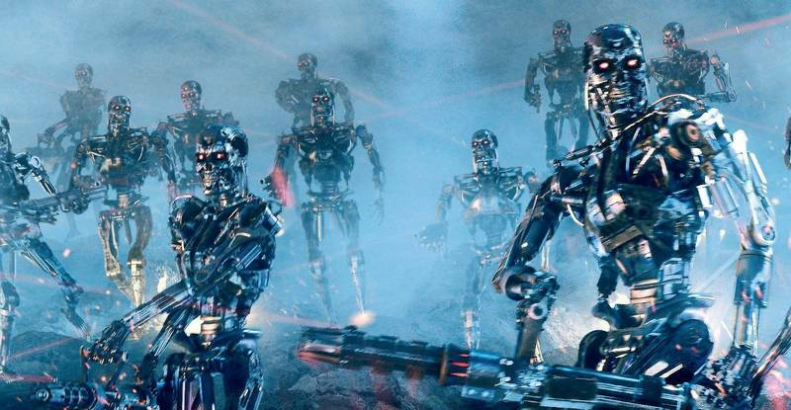

Slide 14
Where did we go wrong?
Humans are intelligent to the extent that our actions can be expected to achieve our objectives
Machines are intelligent to the extent that their actions can be expected to achieve their objectives
Give them objectives to optimize (cf control theory, economics, operations research, statistics)
We don’t want machines that are intelligent in this sense
Machines are beneficial to the extent that their actions can be expected to achieve our objectives
We need machines to be provably beneficial
Maschinen unsicher bzgl. “unserer” Präferenzen: Hinterfragen der eigenen Ziele
Arguments taken from Stuart Russell’s Presentations on Provably Beneficial AI
Notes:
So we have seen that the standard task in AI is to optimize an objective supplied by the human.
But this is the wrong task. Instead we want provably beneficial AI: we need to be happy with the way the machine behaves,
even if we ask for the wrong thing or forget to mention some important constraint. So how can we do this?

Slide 15
Yet some more detail
Idea of a utility function
Mapping from percept to state of environment (depends on G)
Is the goal G in the current state of the environment still correctly chosen? Should I have a new goal G’?
Percepts
Feedback
My utility will be zero then. How to prevent being switched off?
Your performance might be improved
Huh: Possibly I’ll be switched off
Maximize utility (possibly with sequence of actions)
Action Explanation
Return calculated action (prepare to answer the Why question)
What is the best action in the current state to achieve the goal? Strategy for determining action

Slide 16
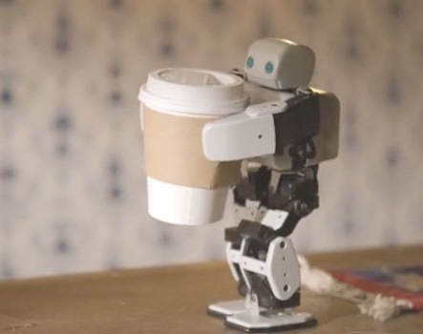
Off-Switch Problem
Representative for dealing with unwanted behavior
Very much underspecified!
The instruction suggests having coffee would have higher value than expected a priori, ceteris paribus
Example: “Fetch some coffee”
Agents get better at maximizing the built-in utility function
What’s bad about better AI?
Can we switch off the agent if it “does not work as expected”?
“Can’t fetch coffee if I am dead.”
Incentive for preventing others from switching off the robot

Slide 17
Before/after bringing coffee…
$$E[U\left(state\right)]=\int{x f\left(x\right)dx}$$
Expected utility
Change the utility function
$$f$$

Slide 18
The off-switch problem
A robot, given an objective, has an incentive to disable its own off-switch
Claim: A robot with appropriate uncertainty about objective won’t behave this way
Example: Planning for the best action (sequence)
Tiny example for “ethical behavior”
$$E[U\left(state\right)]=\int{x f\left(x\right)dx}$$
R
act
switch self off
Theorem:
This way robot has a positive incentive to allow itself to be switched off
wait
U = U_{act}
H
U = 0
go ahead
switch robot off
Do not just talk about ethics! Verify it!
R
U = 0
Behaving in an ethical way is a dominant strategy for the robot: Provably beneficial
act
U = U_{act}
Example taken from Stuart Russell’s Presentations on Provably Beneficial AI

Slide 19
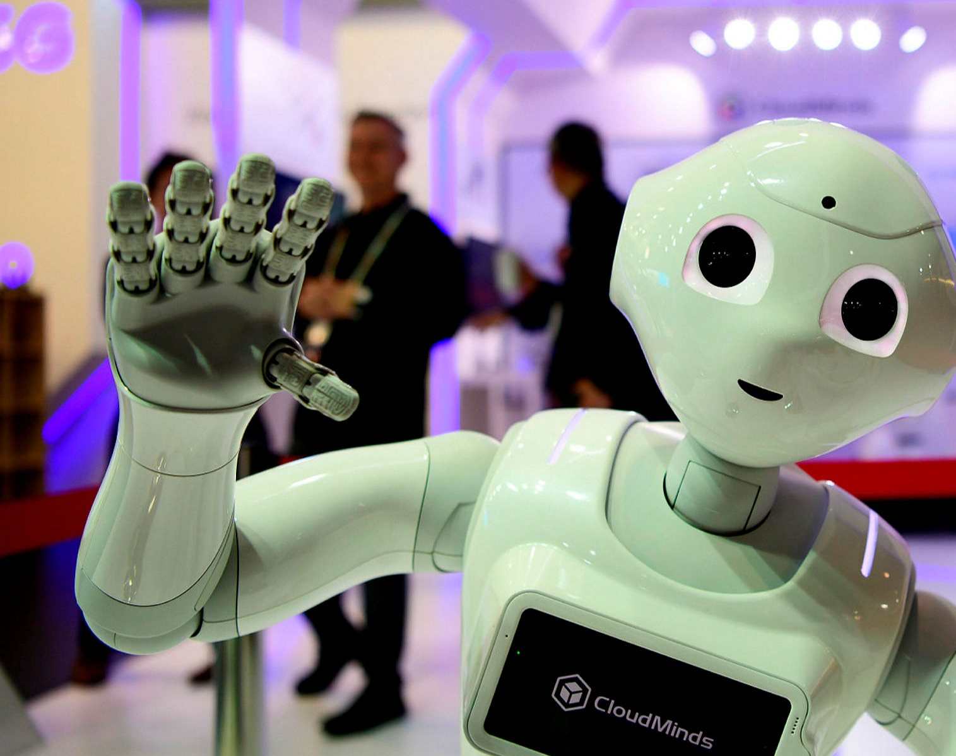
Thank you for coming.
AI
Most exciting science.
Most relevant for companies.
Just about to start.
UzL

