Slide 1
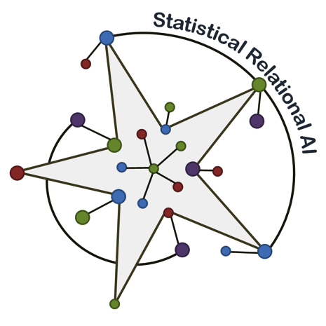
Dynamic StarAI
Dynamic Models and Statistical Relational AI
AI Colloquium Oct. 14 Universität zu Lübeck
Tanya Braun, Marcel Gehrke, Ralf Möller Universität zu Lübeck
https://www.uni-luebeck.de/forschung/themen/informatiktechnik/artificial-intelligence.html

Slide 2
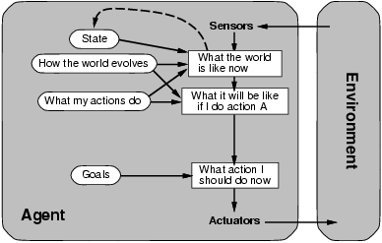
AI: What is it all about?
Web Mining Agents Setting: Relational Data String Data
…
WMA Setting: Inform User Cooperate w/ Agent 2
…
[Russell & Norvig 16]
[Poole & Macworth 17]

Slide 3
Agenda
Probabilistic relational models (PRMs)
Application example
Basic semantics, static vs. dynamic behavior
Query answering
Variants: raw PRMs, MLNs, PSL, …
For details and for learning see
https://www.ifis.uni-luebeck.de/index.php?id=612
For more on learning see
https://www.ifis.uni-luebeck.de/~moeller/StarAI/
Goal: Overview of central ideas

Slide 4
Application: Epidemics
Atoms: Parameterised random variables = PRVs
With logical variables
E.g., $X$, $M$
Possible values (domain):
$$𝒟\left(X\right)=\{alice, eve, bob\}$$
$$𝒟\left(M\right)=\{injection, tablet\}$$
With range
E.g., Boolean
range(Travel(X)) r(Travel(X))
$$Nat(A)$$
$$Man(W)$$
$$Epid$$
$$Travel(X)$$
$$Treat(X,M)$$
$$Sick(X)$$

Slide 5
Encoding the Joint Distribution
Factors with PRVs = parfactors
(Graphical) Model G
E.g., $g_{2}$
Sparse encoding of joint distribution
$$Travel(X)$$ | $$Epid$$ | $$Sick(X)$$ | $$g_{2}$$
false | false | false | 5
false | false | true | 0
false | true | false | 4
false | true | true | 6
true | false | false | 4
true | false | true | 6
true | true | false | 2
true | true | true | 9
$$Nat(D)$$
$$Man(W)$$
$$g_{1}$$
$$Epid$$
$$Travel(X)$$
$$Treat(X,M)$$
$$g_{2}$$
$$g_{3}$$
$$Sick(X)$$
Nat(D) = natural disaster (D)
Man(W) = man-made disaster (W)
${3∙2}^{3}=24$ entries in 3 parfactors, 6 PRVs

Slide 6
Factors
Grounding
E.g., ${gr(g}_{2})=\left\{f_{2}^{1},f_{2}^{2},f_{2}^{3}\right\}$
$$Travel(eve)$$ | $$Epid$$ | $$Sick(eve)$$ | $$f_{2}^{1}$$
false | false | false | 5
false | false | true | 0
false | true | false | 4
false | true | true | 6
true | false | false | 4
true | false | true | 6
true | true | false | 2
true | true | true | 9
$$Travel(bob)$$ | $$Epid$$ | $$Sick(bob)$$ | $$f_{2}^{3}$$
false | false | false | 5
false | false | true | 0
false | true | false | 4
false | true | true | 6
true | false | false | 4
true | false | true | 6
true | true | false | 2
true | true | true | 9
$$Travel(X)$$ | $$Epid$$ | $$Sick(X)$$ | $$g_{2}$$
false | false | false | 5
false | false | true | 0
false | true | false | 4
false | true | true | 6
true | false | false | 4
true | false | true | 6
true | true | false | 2
true | true | true | 9
$$Nat(D)$$
$$Man(W)$$
$$g_{1}$$
$$Travel(alice)$$ | $$Epid$$ | $$Sick(alice)$$ | $$f_{2}^{2}$$
false | false | false | 5
false | false | true | 0
false | true | false | 4
false | true | true | 6
true | false | false | 4
true | false | true | 6
true | true | false | 2
true | true | true | 9
$$Epid$$
$$Travel(X)$$
$$Treat(X,M)$$
$$g_{2}$$
$$g_{3}$$
$$Sick(X)$$

Slide 7
Semantics of a PRM
Joint probability distribution $P_{G}$ by grounding
$$Nat(D)$$
$$Man(W)$$
$$g_{1}$$
$$Epid$$
$$P_{G}= \frac{1}{Z}\prod_{f∈gr(G)}{f}$$
$$Z=\sum_{v∈r(rv\left(gr(G)\right))}{\prod_{f∈gr(G)}{f_{i}(π_{rv\left(f_{i}\right)}(v))}}$$
$$Travel(X)$$
$$Treat(X,M)$$
$$g_{2}$$
$$g_{3}$$
$$Sick(X)$$
$πvariables(v)$ = projection of v onto variables
Notes:
What did we win?
Use lifted representation during computations, AVOID GROUNDING

Slide 8
Multiplication
Multiplication: „join“ over shared randvars and a product of potentials
$$f_{2}^{2}\left(Travel\left(eve\right), Epid, Sick\left(eve\right)\right)∙f_{3}^{2}\left(Epid, Sick\left(eve\right),Treat\left(eve,m_{1}\right)\right)$$
$$=f_{23}\left(Travel\left(eve\right), Epid, Sick\left(eve\right), Treat\left(eve\right)\right)$$
$$Travel(eve)$$ | $$Epid$$ | $$Sick(eve)$$ | $$f_{2}^{2}$$
false | false | false | 5
false | false | true | 0
false | true | false | 4
false | true | true | 6
true | false | false | 4
true | false | true | 6
true | true | false | 2
true | true | true | 9
$$Epid$$ | $$Sick(eve)$$ | $$Treat(eve,m_{1})$$ | $$f_{3}^{2}$$
false | false | false | 9
false | false | true | 1
false | true | false | 4
false | true | true | 2
true | false | false | 2
true | false | true | 6
true | true | false | 6
true | true | true | 9
$$∙$$
Notes:
Argmax and sum not commutative

Slide 9
Multiplication: Join and Product
$$Travel(eve)$$ | $$Epid$$ | $$Sick(eve)$$ | $$f_{2}^{2}$$
false | false | false | 5
false | false | true | 0
false | true | false | 4
false | true | true | 6
true | false | false | 4
true | false | true | 6
true | true | false | 2
true | true | true | 9
$$Epid$$ | $$Sick(eve)$$ | $$Treat(eve,m_{1})$$ | $$f_{3}^{2}$$
false | false | false | 9
false | false | true | 1
false | true | false | 4
false | true | true | 2
true | false | false | 2
true | false | true | 6
true | true | false | 6
true | true | true | 9
$$∙$$
$$Travel(eve)$$ | $$Epid$$ | $$Sick(eve)$$ | $$Treat(eve,m_{1})$$ | $$f_{23}$$
false | false | false | false | $$5∙9$$
Notes:
Argmax and sum not commutative

Slide 10
Multiplication: Join and Product
$$Travel(eve)$$ | $$Epid$$ | $$Sick(eve)$$ | $$f_{2}^{2}$$
false | false | false | 5
false | false | true | 0
false | true | false | 4
false | true | true | 6
true | false | false | 4
true | false | true | 6
true | true | false | 2
true | true | true | 9
$$Epid$$ | $$Sick(eve)$$ | $$Treat(eve,m_{1})$$ | $$f_{3}^{2}$$
false | false | false | 9
false | false | true | 1
false | true | false | 4
false | true | true | 2
true | false | false | 2
true | false | true | 6
true | true | false | 6
true | true | true | 9
$$∙$$
$$Travel(eve)$$ | $$Epid$$ | $$Sick(eve)$$ | $$Treat(eve,m_{1})$$ | $$f_{23}$$
false | false | false | false | $$5∙9$$
false | false | false | true | $$5∙1$$
Notes:
Argmax and sum not commutative

Slide 11
Result
$$Travel(eve)$$ | $$Epid$$ | $$Sick(eve)$$ | $$Treat(eve,m_{1})$$ | $$f_{23}$$
false | false | false | false | 45
false | false | false | true | 5
false | false | true | false | 0
false | false | true | true | 0
false | true | false | false | 8
false | true | false | true | 8
false | true | true | false | 24
false | true | true | true | 36
true | false | false | false | 36
true | false | false | true | 4
true | false | true | false | 24
true | false | true | true | 12
true | true | false | false | 4
true | true | false | true | 12
true | true | true | false | 54
true | true | true | true | 81
Notes:
Argmax and sum not commutative

Slide 12
Queries
Marginal distribution
$P\left(Sick(eve)\right)$
$P\left(Travel(eve,) Treat(eve,m_{1})\right)$
Conditional distribution
$P\left(Sick(eve)\right|Epid)$
$P\left(Epid\right|Sick\left(eve\right)=true)$
Assignment queries
MPE
MAP
Avoid groundings!
$$Nat(D)$$
$$Man(W)$$
$$g_{1}$$
$$Epid$$
$$Travel(X)$$
$$Treat(X,M)$$
$$g_{2}$$
$$g_{3}$$
$$Sick(X)$$
Notes:
Argmax and sum not commutative

Slide 13
QA: Lifted Variable Elimination (LVE)
[Poole 03, de Salvo Braz et al. 05, 06, Milch et al. 08, Taghipour et al. 13, 13a]
Eliminate all variables not appearing in query
Lifted summing out
Sum out representative instance as in propositional variable elimination
Exponentiate result for isomorphic instances
$$Nat(D)$$
$$Man(W)$$
$$g_{1}$$
$$Epid$$
$$Travel(X)$$
$$Treat(X,M)$$
$$g_{2}$$
$$g_{3}$$
$$Sick(X)$$
Avoid groundings!

Slide 14
QA: LVE in Detail
E.g., marginal
$P\left(Travel(eve)\right)$
Split atoms $P\left(…, X, …\right)$ w.r.t. $eve$ if $eve$ in D($X)$
Shattering
$$Travel(eve)$$
$$Nat(D)$$
$$Man(W)$$
$$g_{2}$$
$$g_{1}$$
$$Sick(eve)$$
$$Epid$$
$$g_{3}$$
$$Treat(eve,M)$$
$$Travel(X)$$
$$Treat(X,M)$$
$$g_{2}$$
$$g_{3}$$
$$X∈\{alice, bob)$$
$$X∈\{alice, bob)$$
$$Sick(X)$$

Slide 15
QA: LVE in Detail
E.g., marginal
$P\left(Travel(eve)\right)$
Split atoms $P\left(…, X, …\right)$ w.r.t. $eve$ if $eve$ in Domain($X)$
Eliminate all non-query variables
$$Travel(eve)$$
$$Nat(D)$$
$$Man(W)$$
$$g_{2}$$
$$g_{1}$$
$$Sick(eve)$$
$$Epid$$
$$g_{3}$$
$$Treat(eve,M)$$
$$Travel(X)$$
$$Treat(X,M)$$
$$g_{2}$$
$$g_{3}$$
$$Sick(X)$$

Slide 16
QA: LVE in Detail
Eliminate $Treat(X,M)$
Appears in only one $g$: $g_{3}$
Contains all logical variables of $g_{3}$: $X, M$
For each $X$ constant: the same number of $M$ constants
Preconditions of lifted summing out fulfilled, lifted summing out possible
$$Travel(eve)$$
$$Nat(D)$$
$$Man(W)$$
$$g_{2}$$
$$g_{1}$$
$$Sick(eve)$$
$$Epid$$
$$g_{3}$$
$$Treat(eve,M)$$
$$Travel(X)$$
$$Treat(X,M)$$
$$g_{2}$$
$$g_{3}$$
$$Sick(X)$$

Slide 17
LVE in Detail: Lifted Summing Out
Eliminate $Treat\left(X,M\right)$ by lifted summing out
Sum out representative
Exponentiate for indistinguishable objects
$${\left(\sum_{t∈r\left(Treat\left(X,M\right)\right)}{g_{3}\left(Epid=e,Sick\left(X\right)= s,Treat\left(X,M\right)=t\right)}\right)}^{|M|}$$
$$Travel(eve)$$
$$Nat(D)$$
$$Man(W)$$
$$g_{2}$$
$$g_{1}$$
$$Sick(eve)$$
$$Epid$$
$$g_{3}$$
$$Treat(eve,M)$$
$$Travel(X)$$
$$Treat(X,M)$$
$$g_{2}$$
$$g_{3}$$
$$Sick(X)$$

Slide 18
LVE in Detail: Lifted Summing Out
Eliminate $Treat\left(X,M\right)$
Sum out representative
Exponentiate for indistinguishable objects
$${\left(\sum_{t∈r\left(Treat\left(X,M\right)\right)}{g_{3}\left(e,s,t\right)}\right)}^{|M|}$$
$$Epid$$ | $$Sick\left(X\right)$$ | $$Treat(X,M)$$ | $$g_{3}$$
false | false | false | 5
false | false | true | 1
false | true | false | 3
false | true | true | 2
true | false | false | 5
true | false | true | 4
true | true | false | 1
true | true | true | 7
$$Epid$$ | $$Sick\left(X\right)$$ | $$g_{3}^{′}$$
$$g_{3}^{′′}$$
+
$$false$$ | $$false$$ | $$6$$
$$6^{2}=36$$
+
$$false$$ | $$true$$ | $$5$$
$$5^{2}=25$$
+
$$true$$ | $$false$$ | $$9$$
$$9^{2}=81$$
+
$$true$$ | $$true$$ | $$8$$
$$8^{2}=64$$

Slide 19
QA: LVE in Detail
After eliminating $Treat(X,M)$
Eliminate $Travel\left(X\right)$
Does not eliminate logical variable (unlike $M$)
Yields $g_{2}^{′}\left(Epid, Sick\left(X\right)\right)$
$$Travel(eve)$$
$$Nat(D)$$
$$Man(W)$$
$$g_{2}$$
$$g_{1}$$
$$Sick(eve)$$
$$Epid$$
$$g_{3}$$
$$Treat(eve,M)$$
$$Travel(X)$$
$$g_{2}$$
$$g_{3}^{′′}$$
$$Sick(X)$$

Slide 20
QA: LVE in Detail
After eliminating $Treat\left(X,M\right), Travel\left(X\right)$
Eliminate $Sick(X)$
Requires multiplication of $g_{2}^{′}$ and $g_{3}^{′′}$
Eliminates $X$
Yields $g_{23}^{′′}$
$$Travel(eve)$$
$$Nat(D)$$
$$Man(W)$$
$$g_{2}$$
$$g_{1}$$
$$Sick(eve)$$
$$Epid$$
$$g_{3}$$
$$Treat(eve,M)$$
$$g_{2}^{′}$$
$$g_{3}^{′′}$$
$$Sick(X)$$

Slide 21
Lifted Multiplication
Multiplication: „join“ over shared randvars and a product of potentials
Consider number of instances represented by each parfactor ➝ rescale if necessary (i.e., if parfactors represent different numbers)
$$g_{2}^{′}\left(Epid, Sick\left(X\right)\right)∙g_{3}^{′′}\left(Epid, Sick\left(X\right)\right)=g_{23}^{′′}\left(Epid, Sick\left(X\right)\right)$$
$$Epid$$ | $$Sick(X)$$ | $$g_{2}^{′}$$
false | false | 5
false | true | 0
true | false | 4
true | true | 6
$$Epid$$ | $$Sick(X)$$ | $$g_{3}^{′′}$$
false | false | 9
false | false | 1
false | true | 4
false | true | 2
$$Epid$$ | $$Sick(X)$$ | $$g_{23}^{′′}$$
false | false | $$5∙9$$
false | false | $$0∙1$$
false | true | $$4∙4$$
false | true | $$6∙2$$
$$∙$$
$$=$$
Notes:
Argmax and sum not commutative

Slide 22
Many Queries: LJT
Set of queries
$P\left(Travel(eve)\right)$
$P\left(Sick(bob)\right)$
$P\left(Treat(eve,m_{1}\right))$
$P\left(Epid\right)$
$P\left(Nat(flood)\right)$
$P\left(Man(virus)\right)$
Combinations of variables
Under evidence
$Sick\left(X^{′}\right)=true$
$X^{′}∈\{alice, eve\}$
Challenges:
Do not start from scratch for every query
Support QA on subset of atoms
Avoid groundings
$$Nat(D)$$
$$Man(M)$$
$$g_{1}$$
$$Epid$$
$$Travel(X)$$
$$Treat(X,P)$$
$$g_{2}$$
$$g_{3}$$
$$Sick(X)$$
Challenges (among others) mastered as part of Tanya‘s dissertation

Slide 23
Dynamic PRMs
Marginal distribution query: $P\left(A_{π}^{i} \right|E_{0:t})$ w.r.t. the model:
Hindsight: $π<t$(Was there an epidemic $t−π$ days ago?)
Filtering: $π=t$(Is there an currently an epidemic?)
Prediction: $π>t$(Is there an epidemic in $π−t$ days?)
MPE, MAP on temporal sequence
$$g_{}^{E}$$
$${Epid}_{t−1}$$
$${Epid}_{t}$$
$${Travel\text{(}\text{X}\text{)}}_{t−1}$$
$$Treat{\text{(}\text{X}\text{,}\text{M}\text{)}}_{t−1}$$
$$g_{t−1}^{2}$$
$$g_{t−1}^{3}$$
$$g_{t}^{2}$$
$$g_{t}^{3}$$
$${Travel\text{(}\text{X}\text{)}}_{t}$$
$$Treat{\text{(}\text{X}\text{,}\text{M}\text{)}}_{t}$$
$${Sick(X)}_{t−1}$$
$${Sick(X)}_{t}$$
Define the interface for relational case (avoid groundings)
Taming reasoning w.r.t. evidence over time (avoid creeping groundings)
Challenges mastered as part of Marcel‘s dissertion

Slide 24
PRMs and Variants
Probabilistic Relational Models (raw PRMs) [Poole 03, Taghipour et al. 13, Braun & M 16-19, Gehrke, Braun & M 18-19]
Markov Logic Networks (MLNs) [Richardson & Domingos 06]
Use logical formulas to specify potential functions
Probabilistic Soft Logic (PSL) [Bach et al. 17]
Use density functions to specify potential functions

Slide 25
PRMs and Variants
Probabilistic Relational Models (raw PRMs) [Poole 03, Taghipour et al. 13, Braun & M 16-19, Gehrke, Braun & M 18-19]
Markov Logic Networks (MLNs) [Richardson & Domingos 06]
Use logical formulas to specify potential functions
Probabilistic Soft Logic (PSL) [Bach et al. 17]
Use density functions to specify potential functions

Slide 26
Markov Logic Networks (MLNs)
Weighted formulas for modelling constraints [Richardson & Domingos 06]
An MLN is a set of constraints $\left(w, Γ(x)\right)$
$w=$ weight
$Γ\left(x\right)=$FO formula
$weight$ of a world = product of $\exp\left(w\right)$ terms
for all MLN rules $\left(w, Γ(x)\right)$ and groundings $Γ\left(a\right)$ that hold in that world
Probability of a world $=\frac{weight}{Z}$
$Z=$sum of weights of all worlds (no longer a simple expression!)
∞
Presents(X,P,C) => Attends(X,C)
exp(3.75)
3.75
Publishes(X,C) ∧ FarAway(C) => Attends(X,C)

Slide 27
Why exp?
Factorization
Log-linear models
Let $D$ be a set of constants and $ω ∈ \{0,1\}m$ a world with $m$ atoms w.r.t. $D$
$$weight\left(ω\right)= \prod_{\left\{\left(w, Γ(x)\right)∈MLN | ∃a∈D^{n} : ω⊨Γ\left(a\right)\right\}}{\exp\left(w\right)}$$
$$\ln\left(weight\left(ω\right)\right)=\sum_{\left\{\left(w, Γ(x)\right)∈MLN | ∃a∈D^{n} : ω ⊨ Γ\left(a\right)\right\}}{w}$$
Sum allows for component-wise optimization during weight learning
$Z= \sum_{ω∈{\left\{0,1\right\}}^{m}}{\ln\left(weight\left(ω\right)\right)}$
$P\left(ω\right)=\frac{\ln\left(weight\left(ω\right)\right)}{Z}$
Log-linear representation

Slide 28
MLN Reasoning
Answering queries for m discrete atoms
Approximated lifted reasoning for MLNs Lifted Weighted Model Counting [Gogate & Domingos 11] Lifted MAP [Sarkhel et al. 14]
Reasoning: Google AI approach [Cohen et al. 17]
Translation to Tensorflow: TensorLog
QA based on belief propagation (fast but only approximate)
𝛴 _{𝜔 ∈ {FALSE,TRUE}}m ∧ _{𝜔 ⊨ Attends(alice)} P(𝜔)
P(Attends(alice)) =

Slide 29
Transforming MLNs into PRMs …
[van den Broeck 13]
∞
Presents(X,P,C) => Attends(X,C)
exp(3.75)
3.75
Publishes(X,C) ∧ FarAway(C) => Attends(X,C)
Presents(X,P,C)
Presents(X,P,C) | Attends(X,C) | g1
TRUE | TRUE | 1000
TRUE | FALSE | 1
FALSE | TRUE | 1000
FALSE | FALSE | 1000
g1
(X, P, C) ∈ Dom(X) × Dom(P) × Dom(C)
Attends(X,C)
Possibly shattering required

Slide 30
Transforming MLNs into PRMs …
[van den Broeck 13]
∞
Presents(X,P,C) => Attends(X,C)
exp(3.75)
3.75
Publishes(X,C) ∧ FarAway(C) => Attends(X,C)
Publishes(X,C)
Publishes(X,C) | FarAway(C) | Attends(X,C) | g2
TRUE | TRUE | TRUE | exp(3.75)
TRUE | FALSE | FALSE | exp(3.75)
FALSE | TRUE | FALSE | exp(3.75)
FALSE | FALSE | TRUE | exp(3.75)
TRUE | TRUE | FALSE | 1
TRUE | FALSE | TRUE | exp(3.75)
FALSE | TRUE | TRUE | exp(3.75)
FALSE | FALSE | FALSE | exp(3.75)
FarAway(C)
g2
Attends(X,C)

Slide 31
Encoding a Joint Distribution
$$Travel(X)$$ | $$Epid$$ | $$Sick(X)$$ | $$g_{2}$$
false | false | false | 5
false | false | true | 0
false | true | false | 4
false | true | true | 6
true | false | false | 4
true | false | true | 6
true | true | false | 2
true | true | true | 9
$$Nat(D)$$
$$Man(W)$$
$$g_{1}$$
$$Epid$$
$$Travel(X)$$
$$Treat(X,M)$$
$$g_{2}$$
$$g_{3}$$
$$Sick(X)$$
Nat(D) = natural disaster (D)
Man(W) = man-made disaster (W)
Prefer 0 potentials

Slide 32
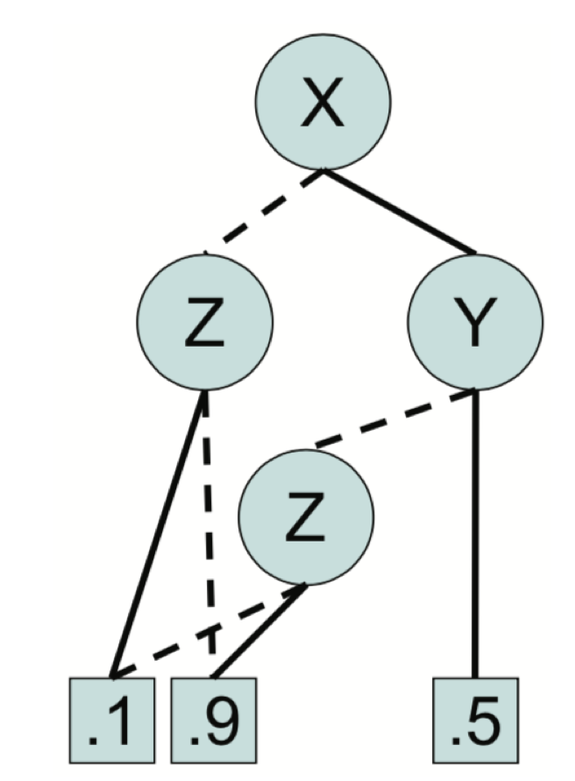
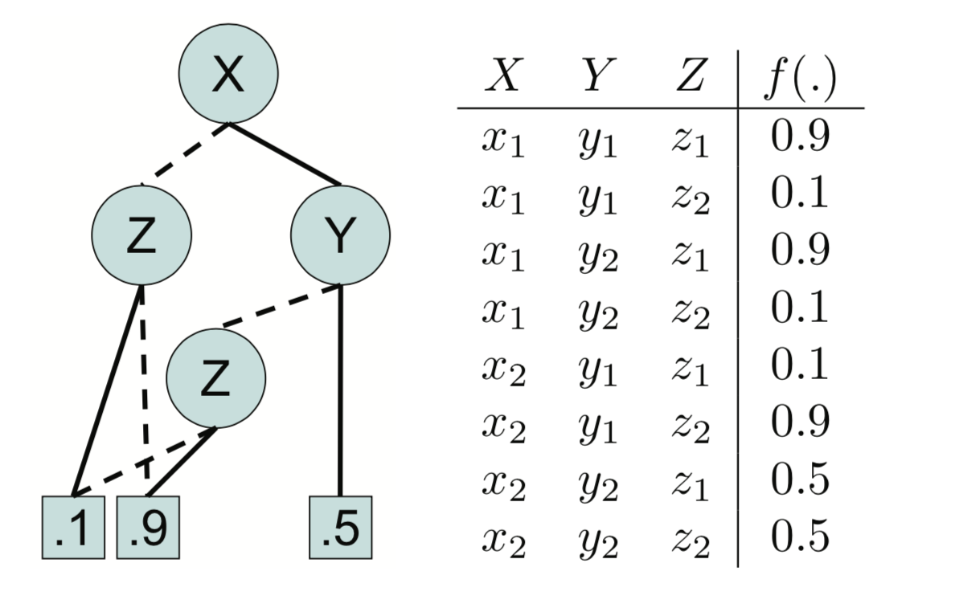
Encoding a Joint Distribution
Alternative: Represent potential functions using algebraic decision diagrams (ADDs) [Chavira & Darwiche 07]
Requires “multiplications” used for elimination to be defined over ADDs
$$X$$ | $$Y$$ | $$Z$$ | $$g_{2}$$
false | false | false | 5
false | false | true | 0
false | true | false | 4
false | true | true | 6
true | false | false | 4
true | false | true | 6
true | true | false | 2
true | true | true | 9

Slide 33
MLNs to PRMs and back?
Represent/approximate potential functions using formulas with parfactor input atoms, e.g., for (approximate) explanation purposes
Publishes(X,C)
Publishes(X,C) | FarAway(C) | Attends(X,C) | g2
TRUE | TRUE | TRUE | exp(3.75)
TRUE | FALSE | FALSE | exp(3.75)
FALSE | TRUE | FALSE | exp(3.75)
FALSE | FALSE | TRUE | exp(3.75)
TRUE | TRUE | FALSE | 1
TRUE | FALSE | TRUE | exp(3.75)
FALSE | TRUE | TRUE | exp(3.75)
FALSE | FALSE | FALSE | exp(3.75)
FarAway(C)
g2
Attends(X,C)
∞
Presents(X,P,C) => Attends(X,C)
exp(3.75)
3.75
Publishes(X,C) ∧ FarAway(C) => Attends(X,C)

Slide 34
MLNs to PRMs and back?
Represent/approximate potential functions using formulas with parfactor input atoms, e.g., for (approximate) explanation purposes
Presents(X,P,C)
Presents(X,P,C) | Attends(X,C) | g1
TRUE | TRUE | 1000
TRUE | FALSE | 1000
FALSE | TRUE | 1
FALSE | FALSE | 1000
g1
(X, P, C) ∈ Dom(X) × Dom(P) × Dom(C)
Attends(X,C)
∞
Presents(X,P,C) => Attends(X,C)
exp(3.75)
3.75
Publishes(X,C) ∧ FarAway(C) => Attends(X,C)

Slide 35
Learning PRMs
Learn an MLN and transform [Singla & Domingos 08]
If grounded PRM given
Coloring for generating a lifted version (belief propagation)
If database given [Dissertation of Maurice Sambale]
PRM normal form
Networks (diagrams) or logical formulas can be derived for clever encoding of potential functions
If natural language text given [Dissertation of Felix Kuhr]
Sequences of most-specific context descriptions
Generate ground formulas plus PRM(s)
[Kersting et al. 09, Ahmadi et al. 13]

Slide 36
AI: Where are PRMs used?

Slide 37
Conclusion: StaRAI
Backbone of AI: mathematics (modeling languages, semantics) & computer science (algorithms and data structures for QA and ML)
E.g., probability theory, linear algebra, logic, database theory, …
Today: Tour from numbers to logic
Future: Logic for explaining behavior, abstraction building, and application-specific reasoning (e.g., using abduction principles)
Soon: Tour from logic to numbers (embedding spaces, Özgür)
Logic as a basis machine learning
Brought to you from IFIS later:
Maximum Entropy Semantics (incomplete models)
Probabilistic Soft Logic (continuous variables)
Dempster-Shafer Theory of Evidence (belief and plausibility)
Changing Domains / Transfer Learning
Sequential Decision Making

Slide 38
Bibliography
[Ahmadi et al. 13] Babak Ahmadi, Kristian Kersting, Martin Mladenov, and Sriraam Natarajan. Exploiting Symmetries for Scaling Loopy Belief Propagation and Relational Training. In Machine Learning. 92(1):91-132, 2013
[Bach, Broecheler, Huang, Getoor 17] Stephen H. Bach, Matthias Broecheler, Bert Huang, Lise Getoor. Hinge-Loss Markov Random Fields and Probabilistic Soft Logic. In: J. Mach. Learn. Res. 18:. 109:1-109:67, 2017
[Chavira and Darwiche 07] Mark Chavira, Adnan Darwiche. Compiling Bayesian Networks Using Variable Elimination. In: Proc. IJCAI 2007: 2443-2449
[Cohen et al. 17] Cohen, William W., Fan Yang and Kathryn Mazaitis. “TensorLog: Deep Learning Meets Probabilistic DBs.” ArXiv abs/1707.05390 (2017)
[De Salvo Braz et al. 05] Rodrigo de Salvo Braz, Eyal Amir, and Dan Roth. Lifted First-order Probabilistic Inference. IJCAI-05 Proceedings of the 19th International Joint Conference on Artificial Intelligence, 2005
[De Salvo Braz et al. 06] Rodrigo de Salvo Braz, Eyal Amir, and Dan Roth. MPE and Partial Inversion in Lifted Probabilistic Variable Elimination. AAAI-06 Proceedings of the 21st Conference on Artificial Intelligence, 2006
[Gogate and Domingos 11] Vibhav Gogate and Pedro Domingos. Probabilistic Theorem Proving. In: Proc. UAI 2011: 256–265
[Kersting et al. 09] Kristian Kersting, Babak Ahmadi, and Sriraam Natarajan. Counting Belief Propagation. In UAI-09 Proceedings of the 25th Conference on Uncertainty in Artificial Intelligence, 2009
[Milch et al. 08] Brian Milch, Luke S. Zettelmoyer, Kristian Kersting, Michael Haimes, and Leslie Pack Kaelbling. Lifted Probabilistic Inference with Counting Formulas. In AAAI-08 Proceedings of the 23rd AAAI Conference on Artificial Intelligence, 2008
[Poole 03] David Poole. First-order probabilistic inference. IJCAI 2003: 985-991
[Poole & Mackworth 03] David Poole, Alan Mackworth. Artificial Intelligence: Foundations of Computational Agents, 2nd Edition, Cambridge University Press, 2017

Slide 39
Bibliography
[Richardson & Domingos 06] Matthew Richardson, Pedro Domingos. Markov logic networks. In: J. Machine Learning. Band 62. Nr. 1-2. 2006. 107–136
[Russell & Norvig 16] Stuart Russell, Peter Norvig, Artificial Intelligence: A Modern Approach, Pearson, 2016
[Sarkhel, Venugopal et al. 14] Somdeb Sarkhel, Deepak Venugopal, Parag Singla, Vibhav Gogate:. Lifted MAP Inference for Markov Logic Networks. AISTATS 2014: 859-867
[Singla and Domingos 08] Parag Singla and Pedro Domingos. Lifted First-order Belief Propagation. In AAAI-08 Proceedings of the 23rd AAAI Conference on Artificial Intelligence, 2008
[Tagipour et al. 13] Nima Taghipour, Daan Fierens, Jesse Davis, and Hendrik Blockeel. Lifted Variable Elimination: Decoupling the Operators from the Constraint Language. Journal of Artificial Intelligence Research, 47(1):393–439, 2013
[Taghipour et al. 13a] Nima Taghipour, Daan Fierens, Jesse Davis, and Hendrik Blockeel. Lifted Variable Elimination: Decoupling the Operators from the Constraint Language. Journal of Artificial Intelligence Research, 47(1):393–439, 2013
[van den Broeck 13] Guy Van den Broeck. Lifted Inference and Learning in Statistical Relational Models, PhD thesis, KU Leuven, 2013

Slide 40
Bibliography
[Braun & Möller 16] Tanya Braun and Ralf Möller. Lifted Junction Tree Algorithm. In Proceedings of KI 2016: Advances in Artificial Intelligence, pages 30–42, 2016
[Braun & Möller 17] Tanya Braun and Ralf Möller. Preventing Groundings and Handling Evidence in the Lifted Junction Tree Algorithm. In Proceedings of KI 2017: Advances in Artificial Intelligence, pages 85–98, 2017
[Braun & Möller 17a] Tanya Braun and Ralf Möller. Counting and Conjunctive Queries in the Lifted Junction Tree Algorithm. In Postproceedings of the 5th International Workshop on Graph Structures for Knowledge Representation and Reasoning, 2017
[Braun & Möller 18] Tanya Braun and Ralf Möller. Adaptive Inference on Probabilistic Relational Models. In Proceedings of the 31st Australasian Joint Conference on Artificial Intelligence, 2018
[Braun & Möller 18a] Tanya Braun and Ralf Möller. Parameterised Queries and Lifted Query Answering. In IJCAI-18 Proceedings of the 27th International Joint Conference on Artificial Intelligence, 2018
[Braun & Möller 18b] Tanya Braun and Ralf Möller. Lifted Most Probable Explanation. In Proceedings of the International Conference on Conceptual Structures, 2018
[Braun & Möller 18c] Tanya Braun and Ralf Möller. Fusing First-order Knowledge Compilation and the Lifted Junction Tree Algorithm. In Proceedings of KI 2018: Advances in Artificial Intelligence, 2018
[Braun & Möller 19] Tanya Braun, Ralf Möller: Exploring Unknown Universes in Probabilistic Relational Models, in: Proceedings of AI 2019: Advances in Artificial Intelligence, 2019

Slide 41
Bibliography
[Gehrke et al. 18] Marcel Gehrke, Tanya Braun, and Ralf Möller. Lifted Dynamic Junction Tree Algorithm. In Proceedings of the International Conference on Conceptual Structures, 2018
[Gehrke et al. 18b] Marcel Gehrke, Tanya Braun, and Ralf Möller. Towards Preventing Unnecessary Groundings in the Lifted Dynamic Junction Tree Algorithm. In Proceedings of KI 2018: Advances in Artificial Intelligence, 2018
[Gehrke et al. 18c] Marcel Gehrke, Tanya Braun, and Ralf Möller. Preventing Unnecessary Groundings in the Lifted Dynamic Junction Tree Algorithm. In Proceedings of the AI 2018: Advances in Artificial Intelligence, 2018
[Gehrke et al. 19] Marcel Gehrke, Tanya Braun, and Ralf Möller. Relational Forward Backward Algorithm for Multiple Queries. In FLAIRS-32 Proceedings of the 32nd International Florida Artificial Intelligence Research Society Conference, 2019
[Gehrke et al. 19b] Marcel Gehrke, Tanya Braun, Ralf Möller, Alexander Waschkau, Christoph Strumann, and Jost Steinhäuser. Lifted Maximum Expected Utility. In Artificial Intelligence in Health, 2019
[Gehrke et al. 19c] Marcel Gehrke, Tanya Braun, and Ralf Möller. Lifted Temporal Maximum Expected Utility. In Proceedings of the 32nd Canadian Conference on Artificial Intelligence, Canadian AI 2019, 2019
[Gehrke et al. 19d] Marcel Gehrke, Tanya Braun, and Ralf Möller. Lifted Temporal Most Probable Explanation In Proceedings of the International Conference on Conceptual Structures, 2019
[Gehrke et al. 19e] Marcel Gehrke, Tanya Braun, and Ralf Möller. Lifted Taming Reasoning in Temporal Probabilistic Relational Models Technical report
[Gehrke et al. 19f] Marcel Gehrke, Tanya Braun, and Ralf Möller. Uncertain Evidence in Probabilistic Relational Models. In Proceedings of the 32nd Canadian Conference on Artificial Intelligence, Canadian AI 2019, 2019

Slide 42
The End
*
*PRMs are a true backbone of AI, and this tutorial emphasized only some central topics. We definitely have not cited all publications relevant to the whole field of PRMs here. We would like to thank all our colleagues for making their slides available (see some of the references to papers for respective credits). Slides or parts of it are almost always modified.

