Slide 1
Web-Mining Agents
Prof. Dr. Ralf Möller (Web Mining)
Dr. Özgür Özçep (Data Mining)
Universität zu Lübeck
Institut für Informationssysteme
Tanya Braun (Exercises)

Slide 2
Organizational Issues: Assignments
Start: Wed, 19.10., 2-4pm, AM S 1 (thereafter IFIS 2032), Class also Thu 2-4pm, Seminar room 2/3 (Cook/Karp) or IFIS 2032
Lab: Fr. 2-4pm, Building 64, IFIS 2035 (3rd floor) (registration via Moodle right after this class)
Assignments provided via Moodle after class on Thu.
Submission of solutions by Wed 2pm, small kitchen IFIS (one week after provision of assignments)
Work on assignments can/should be done in groups of 2 (pls. indicate name&group on submitted solution sheets)
In lab classes on Friday, we discuss assignments from current week and understand solutions for assignments from previous week(s)

Slide 3
Organizational Issues: Exam
Registration in class required to be able to participate in oral exam at the end of the semester (2 slots)
Prerequisite to participate in exam: 50% of all points of the assignments

Slide 4
Search Engines: State of the Art
Input: Strings (typed or via audio), images, ...
Public services:
Links to web pages plus mini synopses via GUI
Presentations of structured information via GUI excerpts from the Knowledge Vault http://videolectures.net/kdd2014_murphy_knowledge_vault/ (previously known as Knowledge Graph)
NSA services: ?
Methods: Information retrieval, machine learning
Data: Grabbed from free resources (win-win suggested)

Slide 5
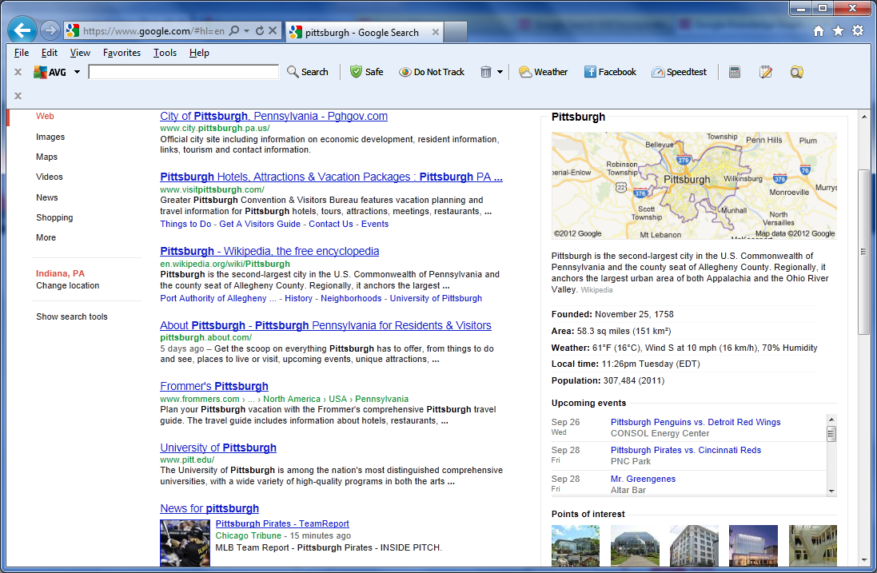
Search Results
Web Results have not changed

Slide 6
Search Results
This is what’s new
Map
General info
Upcoming Events
Points of interest
*The type of information that appears in this panel depends on what you are searching for

Slide 7
Search Engines: State of the Art
Input: Strings (typed or via audio), images, ...
Public services:
Links to web pages plus mini synopses via GUI
Presentations of structured information via GUI excerpts from the Knowledge Vault (previously known as Knowledge Graph)
NSA services: ?
Methods: Information retrieval, machine learning
Data: Grabbed from many resources (win-win suggested):
Web, Wikipedia (DBpedia, Wikidata, …), DBLP, Freebase, ...

Slide 8
Search Engines
Find documents: Papers, articles, presentations, ...
Extremely cool
But…
Hardly any support for interpreting documents w.r.t. certain goals (Knowledge Vault is just a start)
No support for interpreting data
Claim: Standard search engines provide services but copy documents (and possibly data)
Why can’t individuals provide similar services on their document collections and data?
Notes:
For sure „interpretation“ is quite vague but this gives it the flexibility to describe many aspects of getting the things out of the data you are interested in.
First, there is some who interprets (an agent);
second; there is the semantical aspect;
third there is the utitliy aspect (to what end do collect the data)
Fourth you have the context dependency;
Fifth you have complex processes and algorithms that analyze and built something on top of your data
Finding structural Patterns in order to explain something or to predict somethig

Slide 9
Personalized Information Engines
Keep data, provide information
Invite „agents“ to „view“ (i.e., interpret) local documents and data, without giving away all data
Let agents take away „their“ interpretation of local documents and data (just like in a reference library).
Doc/data provider benefits from other agents by (automatically) interacting with them
Agents should be provided with incentives to have them „share“ their interpretations
No GUI-based interaction, but … … semantic interaction via agents

Slide 10
Courses@IFIS
Web and Data Science
Module: Web-Mining Agents
Machine Learning / Data Mining (Wednesdays)
Agents / Information Retrieval (Thursdays)
Requirements:
Algorithms and Data Structures, Logics, Databases, Linear Algebra and Discrete Structures, Stochastics
Module: Foundations of Ontologies and Databases
(Wednesdays 16.00-18.30)
Web-based Information Systems
Data Management
Mobile and Distributed Databases
Semantic Web

Slide 11
Complementary Courses@UzL
Algorithmics, Logics, and Complexity
Signal Processing / Computer Vision
Machine Learning
Pattern Recognition
Artificial Neural Networks (Deep Learning)

Slide 12
Web-Mining Agents (Data Mining)
Prof. Dr. Ralf Möller
Dr. Özgür Özçep (Data Mining)
Universität zu Lübeck
Institut für Informationssysteme
Tanya Braun (Exercises)

Slide 13
Literature
Stuart Russell, Peter Norvig, Artificial Intelligence – A Modern Approach, Pearson, 2009 (or 2003 ed.)
Ian H. Witten, Eibe Frank, Mark A. Hall, Data Mining: Practical Machine Learning Tools and Techniques, Morgan Kaufmann, 2011
Ethem Alpaydin, Introduction to Machine Learning, MIT Press, 2009
Numerous additional books, presentations, and videos

Slide 14
Why and When “Learn” ?
Machine learning is programming computers to optimize a performance criterion using example data or “past experience”
Simple form of data interpretation
There is no need to “learn” to calculate payrolls
Learning is used in the following cases:
No human expertise (navigating on planet X)
Humans are unable to explain their expertise (speech recognition)
Solution changes in time (routing on a computer network)
Solution needs to be adapted to particular cases (user biometrics)
Notes:
If directly programming a task is not possible then machine learning can be applied, or if problem changes over time.
We have a model defined up to some parameters. And then, learning is the execution of a computer program to optimize the parameters of the model using training data or past experience.
The model may be predictive to make prediction for the near future or descriptive to gain knowledge from the data.
SPEECH: Different people utter the same word differently due to difference in age, gender, or accent.
NT: quality of service for max path
INTELLIGENT USER INTERFACE: adapt to user accent, handwriting, working habits.

Slide 15
What We Mean by “Learning”
Learning general models from data of particular examples
Data might be cheap and abundant: Data warehouse (data mart) maintained by company
Example in retail: Customer transactions to consumer behavior:
People who bought “Da Vinci Code” also bought
“The Five People You Meet in Heaven”
(www.amazon.com)
Build a model that is a good and useful approximation of the data
Notes:
Data warehouse: mostly a long term db feeded by different sources with different data models (integration)
Super markt 100 of stores selling thousands of goods to millions of customers → gigabytes of records per day. Valuable only if analysed, model and prediction
Chips and beer, in summer; ice cream and spices for Glühwein in winter
By the way: Why do we aim only at approximations? Why not describe exactly with that model?
Answer: we want a general model that could be used also for other data (we do not want to model noise ); and: we want it to be good also regarding time and space resources

Slide 16
Data Mining
Application of machine learning methods to large databases is called ‘’Data mining”.
Retail: Market basket analysis, customer relationship management (CRM, also relevant for wholesale)
Finance: Credit scoring, fraud detection
Manufacturing: Optimization, troubleshooting
Medicine: Medical diagnosis
Telecommunications: Quality of service optimization
Bioinformatics: Sequence or structural motifs, alignment
Web mining: Search engines
...
Notes:
Application of machine learning methods to large databases is called “Data mining”. The analogy is that al large volume of earth and raw material is extracted from a mine, which when processed leads to a small amount of very precious material; similarly in data mining, a large volume of data is processed to construct a simple model with valuable use, for example, having high predictive accuracy.
Through the model we assume that the prediction based on the latest model characterizes the behavior of the near future.

Slide 17
What is Machine Learning?
Optimize a performance criterion using example data or past experience.
Role of Statistics: Building mathematical models, core task is inference from a sample
Role of Computer Science: Efficient algorithms to
solve the optimization problem
and represent and evaluate the model for inference
Notes:
Statistics to build mathematical models for making predictions

Slide 18
Sample of ML Applications
Learning Associations
Supervised Learning
Classification
Regression
Unsupervised Learning
Reinforcement Learning

Slide 19
Learning Associations
Basket analysis P (Y | X ) probability that somebody who buys X also buys Y where X and Y are products/services.
Example: P ( chips | beer ) = 0.7
If we know more about customers or make a distinction among them:
P (Y | X, D ) where D is the customer profile (age, gender, marital status, …)
In case of a web portal, items correspond to links to be shown/prepared/downloaded in advance

Slide 20
Classification
Example: Credit scoring
Differentiating between low-risk and high-risk customers from their income and savings
Discriminant: IF income > θ₁ AND savings > θ₂
THEN low-risk ELSE high-risk
Notes:
Multi attributes: income, savings, collaterals, profession, age, past financial history, ….
The bank has a record of past loans containing such customer data and whether the loan was paid back or not. From this data, the aim is to infer a general rule coding the associations between a customers attributes and the risk.
That is, the machine learning system fits a model to the past data to be able to calculate the risk for a new application and then decides to accept or refuse it accordingly.

Slide 21
Classification: Applications
Aka Pattern recognition
Character recognition: Different handwriting styles.
Face recognition: Pose, lighting, occlusion (glasses, beard), make-up, hair style
Speech recognition: Temporal dependency
Use of a dictionary for the syntax of the language
Sensor fusion: Combine multiple modalities; e.g., visual (lip image) and acoustic for speech
Medical diagnosis: From symptoms to illnesses
Reading text:
...
Notes:
There are many applications of machine learning in pattern recognition. One is optical character recognition, which is recognizing character codes from their images. This is an example where there are multiple classes, as many as there are characters we would like to recognize. Especially interesting is the case when the characters are handwritten. People have different handwriting styles; characters may be written small or large, slanted, with a pen or pencil, and there are many possible images corresponding to the same character. Though writing is a human invention, we do not have any system that is as accurate as a human reader. We do not have a formal description of ‘A’ that covers all ‘A’s and none of the non-‘A’s. Not having it, we take samples from writers and learn a definition of A-ness from these examples. But though we do not know what it is that makes an image an ‘A’, we are certain that all those distinct ‘A’s have something in common, which is what we want to extract from the examples. We know that a character image is not just a collection of random dots; it is a collection of strokes and has a regularity that we can capture by a learning program. lf we are reading a text, one factor we can make use of is the redundancy in human languages. A word is a sequence of characters and successive characters are not independent but are constrained by the words of the language. This has the advantage that even if we cannot recognize a character, we can still read t?e word. Such contextual dependencies may also occur in higher levels, between words and sentences, through the syntax and semantics of the language. There are machine learning algorithms to learn sequences and model such dependencies. In the case of face recognition, the input is an image, the classes are people to be recognized, and the learning program should learn to associate the face images to identities. This problem is more difficult than optical character recognition because there are more classes, input image is larger, and a face is three—dimensional and differences in pose andlighting cause significant changes in the image. There may also be occlusion of certain inputs; for example, glasses may hide the eyes and eyebrows, and a beard may hide the chin. In medical diagnosis, the inputs are the relevant information we have about the patient and the classes are the illnesses. The inputs contain the patient’s age, gender, past medical history, and current symptoms. Some tests may not have been applied to the patient, and thus these inputs would be missing. Tests take time, may be costly, and may inconvenience the patient so we do not want to apply them unless we believe that they will give us valuable information. In the case of a medical diagnosis, a wrong decision may lead to a wrong or no treatment, and in cases of doubt it is preferable that the classifier reject and defer decision to a human expert. In speech recognition, the input is acoustic and the classes are words that can be uttered. This time the association to be learned is from an acoustic signal to a word of some language. Different people, because of differences in age, gender, or accent, pronounce the same word differently, which makes this task rather difficult. Another difference of speech is that the input is temporal; words are uttered in time as a sequence of speech phonemes and some words are longer than others. A recent approach in speech recognition involves the use of lip movements as recorded by a camera as a second source of information in recognizing speech. This requires sensor fusion, which is the integration of inputs from different modalities, namely, acoustic and visual.

Slide 22
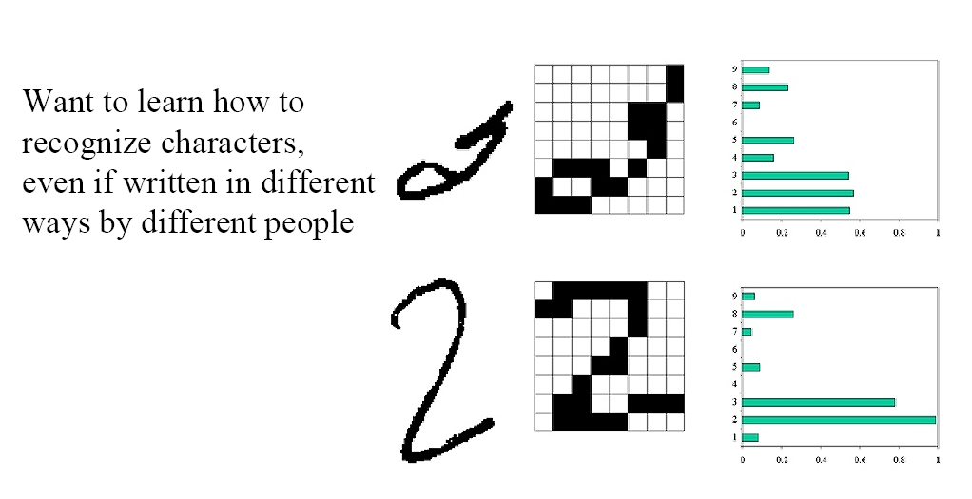
Character Recognition
Notes:
On the right you see the probabilities assigned to the character (actually one of the numerals 1,...,9)

Slide 23
Face Recognition
Training examples of a person
Test images
AT&T Laboratories, Cambridge UK
Notes:
But not necessarily do you give only positive instances for a category as in the first line

Slide 25
Medical diagnosis

Slide 27
Regression
Example: Price of a used car
x : car attribute
y : price
y = g (x | θ )
g ( ) model,
θ parameters
y = wx+w₀
Notes:
Let us say we want to have a system that can predict the price of a used car. Inputs are the car attributes—brand, year, engine capacity, milage, and other information—that we believe affect a car’s worth. The output is the price of the car. Such problems where the output is a number are regression problems. X denote the car attributes and Y be the price of the car. Again surveying the past transactions, we can collect a training data and the machine learning program fits a function to this data to learn Y as a function of X. An example is given in figure 1.2 where the fitted function is of the form for suitable values of w and wo. Both regression and classification are supervised learning problems where there is an input, X, an output, Y, and the task is to learn the mapping from the input to the output. The approach in machine learning is that we assume a model defined up to a set of parameters: where g(-) is the model and theta are its parameters. Y is a number in regression and is a class code (e.g., O/1) in the case of classification. g(-) is the regression function or in classification, it is the discriminant function separating the instances of different classes. The machine learning program optimizes the parameters, theta, such that the approximation error is minimized, that is, our estimates are as close as possible to the correct values given in the training set. For example in figure 1.2, the model is linear and w and wo are the parameters optimized for best fit to the training data. In cases where the linear model is too restrictive, one can use for example a quadratic or a higher-order polynomial, or any other nonlinear function of the input, this time optimizing its parameters for best fit.

Slide 28
Supervised Learning: Uses
Prediction of future cases: Use the rule to predict the output for future inputs
Knowledge extraction: The rule is easy to understand
Compression: The rule is simpler than the data it explains
Outlier detection: Exceptions that are not covered by the rule, e.g., fraud
Notes:
In speech recognition, the input is acoustic and the classes are words that can be uttered. This time the association to be learned is from an acoustic signal to a word of some language. Different people, because of differences in age, gender, or accent, pronounce the same word differently, which makes this task rather difficult. Another difference of speech is that the input is temporal; words are uttered in time as a sequence of speech phonemes and some words are longer than others. A recent approach in speech recognition involves the use of lip movements as recorded by a camera as a second source of information in recognizing speech. This requires sensor fusion, which is the integration of inputs from different modalities, namely, acoustic and visual. Learning a rule from data also allows knowledge extraction. The rule is a simple model that explains the data, and looking at this model we have an explanation about the process underlying the data. For example, once we learn the discriminant separating low-risk and high-risk customers, we have the knowledge of the properties of low-risk customers. We can then use this information to target potential low-risk customers more efficiently, for example, through advertising. Learning also performs compression in that by fitting a rule to the data, we get an explanation that is simpler than the data, requiring less memory to store and less computation to process. Once you have the rules of addition, you do not need to remember the sum of every possible pair of numbers. Another use of machine learning is outlier detection, which is finding the instances that do not obey the rule and are exceptions. In this case, after learning the rule, we are not interested in the rule but the exceptions not covered by the rule, which may imply anomalies requiring attention- for example, fraud.

Slide 29
Unsupervised Learning
Learning “what normally happens”
No output (we do not know the right answer)
Clustering: Grouping similar instances
Example applications
Customer segmentation in CRM (customer relationship manag.)
Company may have different marketing approaches for different groupings of customers
Image compression: Color quantization
Instead of using 24 bits to represent 16 million colors, reduce to 6 bits and 64 colors, if the image only uses those 64 colors
Bioinformatics: Learning motifs (sequences of amino acids in proteins)
Document classification in unknown domains
Notes:
In supervised learning, the aim is to learn a mapping from the input to an output whose correct values are provided bv a supervisor. ln unsupervised learning, there is no such supervisor and we only have input data. The aim is to find the regularities in the input. There is a structure to the input space such that certain patterns occur more often than others, and we want to see what generally happens and what does not. In statistics, this is called density estimation.
One method for density estimation is clustering where the aim is to find clusters or groupings of input. In the case of a company with a data of past customers, the customer data contains the demographic information as well as the past transactions with the company, and the company may want to see the distribution of the profile of its customers, to see what type of customers frequently occur. ln such a case, a clustering model allocates customers similar in their attributes to the same group, providing the company with natural groupings of its customers. Once such groups are found, the company may decide strategies, for example, services and products, specific to different groups. Such a grouping also allows identifying those who are outliers, namely, those who are different from other customers, which may imply a niche in the market that can be further exploited by the company. Machine learning methods are also used in bioinformatics. DNA in our genome is the "blueprint of life" and is a sequence of bases, namely, A, G,C, and T. RNA is transcribed from DNA, and proteins are translated from the RNA. Proteins are what the living body is and does. Just as a DNA is a sequence of bases, a protein is a sequence of amino acids (as defined by bases). One application area of computer science in molecular biology
is alignment, which is matching one sequence to another. This is a difficult string matching problem because strings may be quite long, there
are many template strings to match against, and there may be deletions,insertions, and substitutions. Clustering is used in learning motifs, which are sequences of amino acids that occur repeatedly in proteins. Motifs are of interest because they may correspond to structural or functional elements within the sequences they characterize. The analogy is that if the amino acids are letters and proteins are sentences, motifs are like words, namely, a string of letters with a particular meaning occurringfrequently in different sentences.

Slide 30
Reinforcement Learning
Learning a policy: A sequence of actions/outputs
No supervised output but delayed reward
Credit assignment problem
Game playing
Robot in a maze
Multiple agents, partial observability, ...
Notes:
In some applications, the output of the system is a sequence of actions. In such a case, a single action is not important; what is important is the policy that is the sequence of correct actions to reach the goal. There is no such thing as the best action in any intermediate state; an action is good if it is part of a good policy. In such a case, the machine learning program should be able to assess the goodness of policies and learn from past good action sequences to be able to generate a policy. Such learning methods are called reinforcement learning algorithms. A good example is game playing where a single move by itself is not that important; it is the sequence of right moves that is good. A move is good if it is part of a good game playing policy. Game playing is an important research area in both artificial intelligence and machine learning. This is because games are easy to describe and at the same time, they are quite difficult to play well. A game like chess has a small number of rules but it is very complex because of the large number of possible moves a teach state and the large number of moves that a game contains. Once we have good algorithms that can learn to play games well, we can also apply them to applications with more evident economic utility. A robot navigating in an environment in search of a goal location is another application area of reinforcement learning. At any time, the robot can move in one of a number of directions. After a number of trial runs, it should learn the correct sequence of actions to reach to the goal state from an initial state, doing this as quickly as possible and without hitting any of the obstacles. One factor that makes reinforcement learning harder is when the system has unreliable and partial sensory information. For example, a robot equipped with a video camera has incomplete information and thus at any time is in a partially observable state and should decide taking into account this uncertainty. A task may also re-quire a concurrent operation of multiple agents that should interact and cooperate to accomplish a common goal. An example is a team of robot splaying soccer.

Slide 31
An Extended Example
“Sorting incoming fish on a conveyor according to species using optical sensing”
Sea bass (cheap)
Species
Salmon (expensive)

Slide 32
Problem Analysis
Set up a camera and take some sample images to extract features
Length
Lightness
Width
Number and shape of fins
Position of the mouth, etc…
This is the set of all suggested features to explore for use in our classifier!

Slide 33
Preprocessing
Use a segmentation operation to isolate fishes from one another and from the background
Information from a single fish is sent to a feature extractor whose purpose is to reduce the data by measuring certain features
The features are passed to a classifier

Slide 35
Classification
Now we need (expert) information to find features that enable us to distinguish the species.
“Select the length of the fish as a possible feature for discrimination”

Slide 37
The length is a poor feature alone!
→ Cost of decision
Select the lightness as a possible feature.

Slide 39
Threshold decision boundary and cost relationship
Move our decision boundary toward smaller values of lightness in order to minimize the cost (reduce the number of sea bass that are classified salmon!)
Task of decision theory

Slide 40
Adopt the lightness and add the width of the fish
Fish x^{T} = [x₁, x₂]
Lightness
Width

Slide 42
We might add other features that are not correlated with the ones we already have.
Precaution should be taken not to reduce the performance by adding such “noisy features”
Ideally, the best decision boundary should be the one which provides an optimal performance

Slide 43
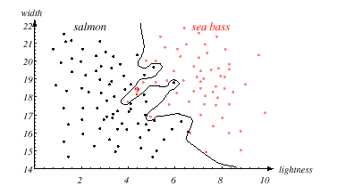

Slide 44
However, our satisfaction is premature because the central aim of designing a classifier is to correctly classify novel input
Issue of generalization!

Slide 46
New Trends in ML
Resume: Finding the right features is not trivial
Learn features automatically
(-> Deep Learning)
Find (computationally) appropriate feature space
Transform (reduce) feature space
(-> SVMs, Kernels)

Slide 47
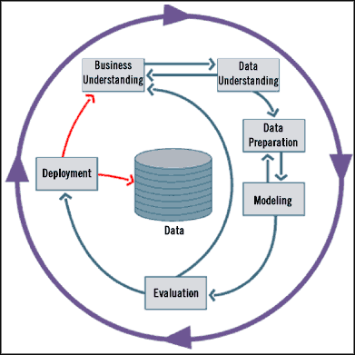
Standard data mining life cycle
It is an iterative process with phase dependencies
Consists of six phases:
Notes:
Business Understanding
Understand project objectives and requirements
Formulation of a data mining problem definition
Data Understanding
Data collection
Evaluate the quality of the data
Perform exploratory data analysis
Data Preparation
Clean, prepare, integrate, and transform the data
Select appropriate attributes and variables
Modeling
Select and apply appropriate modeling techniques
Calibrate/learn model parameters to optimize results
If necessary, return to data preparation phase to satisfy model's data format
Evaluation
Determine if model satisfies objectives set in phase 1
Identify business issues that have not been addressed
Deployment
Organize and present the model to the “user”
Put model into practice
Set up for continuous mining of the data
Fish example: Business Understanding: Want to make money with identifying pricy fish
Data mining: Build classifier for sea brass vs. salmon
Data Understanding: produce data by camera (understand it)
Data Preparation: Identify fish etc; find appropriate attributes

Slide 48
Fallacies of Data Mining (1)
Fallacy 1: There are data mining tools that automatically find the answers to our problem
Reality: There are no automatic tools that will solve your problems “while you wait”
Fallacy 2: The DM process requires little human intervention
Reality: The DM process require human intervention in all its phases, including updating and evaluating the model by human experts
Fallacy 3: Data mining have a quick ROI
Reality: It depends on the startup costs, personnel costs, data source costs, and so on
Notes:
From the lyrics of “Wir sind Gross” (Mark Forster): “Unsere besten Fehler, ich lass sie laminieren”

Slide 49
Fallacies of Data Mining (2)
Fallacy 4: DM tools are easy to use
Reality: Analysts must be familiar with the model
Fallacy 5: DM will identify the causes to the business problem
Reality: DM tools only identify patterns in your data, analysts must identify the cause
Fallacy 6: Data mining will clean up a data repository automatically
Reality: Sequence of transformation tasks must be defined by analysts during early DM phases
* Fallacies described by Jen Que Louie, President of Nautilus Systems, Inc.

Slide 50
Remember
Problems suitable for Data Mining:
Require to discover knowledge to make right decisions
Current solutions are not adequate
Expected high-payoff for the right decisions
Have accessible, sufficient, and relevant data
Have a changing environment
IMPORTANT:
ENSURE privacy if personal data is used!
Not every data mining application is successful!

Slide 51
Overview Supervised Learning

Slide 52
Learning a Class from Examples
Class C of a “family car”
Prediction: Is car x a family car?
Knowledge extraction: What do people expect from a family car?
Output:
Positive (+) and negative (–) examples
Input representation:
x₁: price, x₂ : engine power
Notes:
LET Us say we want to learn the class, C, of a "family car." We have a set of examples of cars, and we have a group of people that we survey to whom we show these cars. The people look at the cars we show them and label them; the cars that they believe are family cars are positive examples and the other cars are negative examples. Class learning is finding a description that is shared by all positive examples and none of the negative examples. Doing this, we can make a prediction: Given a car that we have not seen before, by checking with the description learned, we will be able to say whether it is a family car or not. Or we can do knowledge extraction: This study may be sponsored by a car company, and the aim may be to understand what people expect from a family car. After some discussions with experts in the field, let us say that we reach the conclusion that among all features a car may have, the features that separate a family car from other cars are the price and engine power. These two attributes are the inputs to the class recognizer. Note that when we decide on this particular input representation, we are ignoring various other attributes as irrelevant. Though one may think of other attributes such as seating capacity and color that might be important for distinguishing among car types, we will consider only price and engine power to keep this example simple.

Slide 53
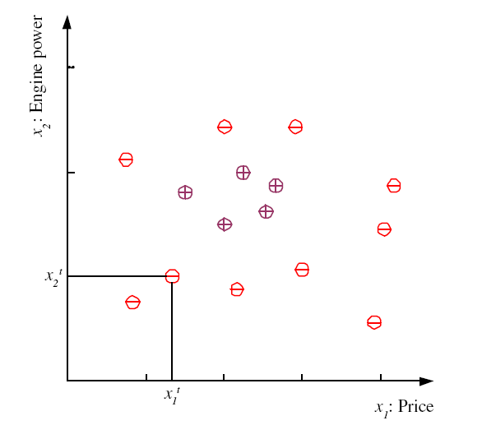
Training set X

Slide 54
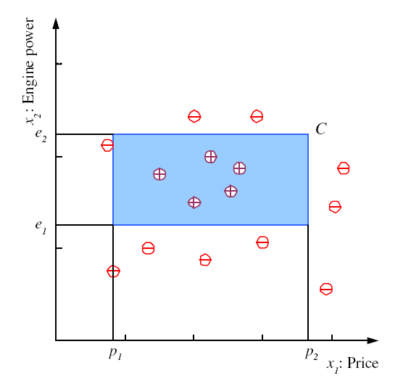
Class C

Slide 55
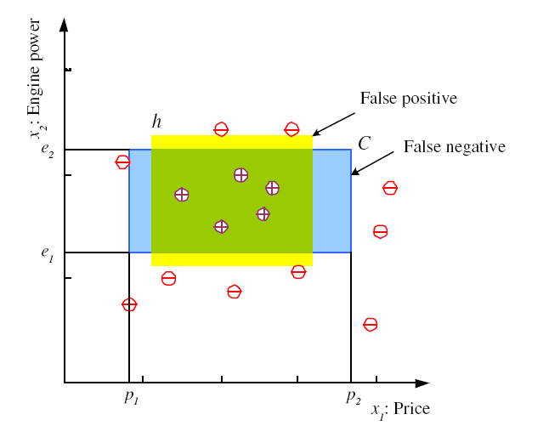
Hypothesis class H
Later we also study a generalized approach
via bounds in version spaces (Mitchell)
Error of h on Χ
(a ≠ b) = 1 if ≠, 0 otherwise

Slide 56
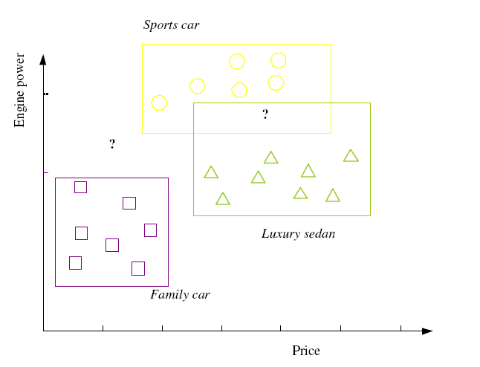
Multiple Classes, C_{i} i=1,...,K
Train hypotheses
h_{i}(x), i =1,...,K:
Notes:
But note that we not necessarily have to have always the same features for all classification. (But makes them at least comparable).
The definitions make sense for disjoint classes Ci (Actually all Ci are assuemd to be pairwise disjoint and jointly exhuastive)

Slide 57
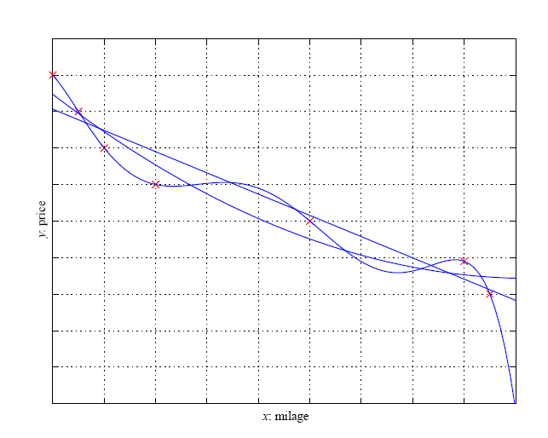
Regression
Partial derivatives of E w.r.t w₁ and w₀ and setting them to 0 -> minimize error
Notes:
Why square?: Bigger differences are weighted more than smaller differences.
Local extremum test: set partial derivative w.r.t. w0 of E(.) to zero and solve equation w.r.t. w0; then set partial derivative w.r.t. w1 of E to 0 and use equation for w0.
overline stands for arithmetical mean

Slide 58
Dimensions of a Supervised Learner
Model:
Loss function:
Optimization procedure:
In most of ML: It‘s all about optimization

Slide 59
Model Selection & Generalization
Learning is an ill-posed problem; data is not sufficient to find a unique solution
The need for inductive bias, assumptions about H
Generalization: How well a model performs on new data
Overfitting: H more complex than concept C or
function f
Underfitting: H less complex than C or f
Notes:
Inductive bias is the set of assumptions that enables learning. For example the family car we assumed a rectangle == inductive bias reducing the set of possible hypothesis. In regression assuming a linear function would also be an inductive bias.
The question how to choose the right inductive bias is called model selection.
a union of two non overlapping rectangles has higher capacity, but it hypotheses are more complex. Similarly in regression, as we increase the order of the polynomial, the capacity and complexity increase. The question now is to decide where to stop. Thus learning is not possible without inductive bias, and now the question is how to choose the right bias. This is called model selection. In answering this question, we should remember that the aim of machine learning is rarely to replicate the training data but the prediction for new cases. That is we would like to be able to generate the right output for an input instance outside the training set, one for which the correct output is not given in the training set. How well a model trained on the training set predicts the right output for new instances is called generalization. For best generalization, we should match the complexity of the hypothesis with the complexity of the function underlying the data. If the hypothesis is less complex than the function, we have underfitting, for example, when trying to fit a line to data sampled from a third-order polynomial. In such a case, as we increase the complexity, both the training error and the validation error decrease. But if we have a hypothesis that is too complex, the data is not enough to constrain it and we may end up with a bad hypothesis, for example, when fitting two rectangles to data sampled from one rectangle. Or if there is noise, an overcomplex hypothesis may learn not only the underlying function but also the noise in the data and may make a bad fit, for example, when fitting a sixth- order polynomial to noisy data sampled from a third-order polynomial. This is called ovefitting. In such a case, having more training data helps but only up to a certain point. We can summarize our discussion citing the triple trade-off (Dietterich 2003). ln all learning algorithms that are trained from example data,

Slide 60
Triple Trade-Off
There is a trade-off between three factors (Dietterich, 2003):
Complexity of H, c (H),
Training set size, N,
Generalization error, E, on new data
As N, E↓
As c (H), first E↓ and then E
Dietterich, T. G. 2003. “Machine Learning.” In Nature Encyclopedia of Cognitive
Science. London: Macmillan
Notes:
there is a trade-off between three factors:
- the complexity of the hypothesis we fit to data, namely, the capacity
of the hypothesis class,
- the amount of training data, and
- the generalization error on new examples.
As the amount of training data increases, the generalization(= error on new data, not training data) error decreases. As the complexity of the model increases, the generalization error decreases first and then starts to increase (the latter: overfitting: at some point you only registrate noise). The generalization error of an overcomplex hypothesis can be kept in check by increasing the amount of training data but only up to a point.

Slide 61
Cross-Validation
To estimate generalization error, we need data unseen during training. We split the data as
Training set (50%)
[ training, say, n models g₁(θ*₁), … g_{n}(θ*_{n}) ]
Validation set (25%)
[ choosing best model:
g_{j}(θ*_{j}) = min arg_{gi(θ*i)} E(g_{i}(θ*_{i})| VS) ]
Test (publication) set (25%)
[ estimating generalization error of best model:
E(g(θ*_{j}) | TS) ]
Resampling when there is few data
Notes:
We can measure the generalization ability of a hypothesis, namely, the quality of its inductive bias, if we have access to data outside the training set. We simulate this by dividing the training set we have into two parts. We use one part for training (i.e., to find a hypothesis), and the remaining part is called the validation set and is used to test the generalization ability. Assuming large enough training and validation sets, the hypothesis that is the most accurate on the validation set is the best one (the one that has the best inductive bias). This process is called cross-validation. So, for example, to find the right order in polynomial regression, given a number of candidate polynomials of different orders, we find their coefficcients on the training set, calculate their errors on the validation set, and take the one that has the least validation error as the best polynomial. Note that if we need to report the error to give an idea about the expected error of our best model, we should not use the validation error. We have used the validation set to choose the best model, and it has effectively become a part of the training set. We need a third set, a test set, sometimes also called the publication set, containing examples not used in training or validation. An analogy from our lives is when we are taking a course: The example problems that the instructor solves in class while teaching a subject form the training set; exam questions are the validation set; and the problems we solve in our later, professional life are the test set.

