Slide 1
Web-Mining Agents
Data Mining
Prof. Dr. Ralf Möller
Dr. Özgür L. Özçep
Universität zu Lübeck
Institut für Informationssysteme
Tanya Braun (Exercises)

Slide 2

Literature
Chapter 14 (Section 1 and 2)

Slide 3
Outline
Agents
Uncertainty
Probability
Syntax and Semantics
Inference
Independence and Bayes' Rule
Bayesian Networks

Slide 4
Issues
If a state is described by n propositions, then a belief space contains 2^{n} states for boolean domains (possibly, some have probability 0)
→ Modeling difficulty: many numbers must be entered in the first place
→ Computational issue: memory size and time

Slide 5
 | pcatch | ¬pcatch | pcatch | ¬pcatch
cavity | 0.108 | 0.012 | 0.072 | 0.008
¬cavity | 0.016 | 0.064 | 0.144 | 0.576
toothache
¬toothache
Toothache and Pcatch are independent given cavity (or ¬cavity), but this relation is hidden in the numbers ! [you can verify this]
Bayesian networks explicitly represent independence among propositions to reduce the number of probabilities defining a belief state

Slide 6
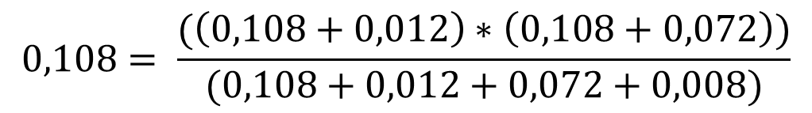
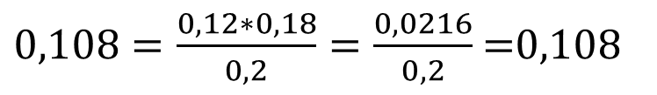
 | pcatch | ¬pcatch | pcatch | ¬pcatch
cavity | 0.108 | 0.012 | 0.072 | 0.008
¬cavity | 0.016 | 0.064 | 0.144 | 0.576
toothache
¬toothache

Slide 7
Bayesian networks
A simple, graphical notation for conditional independence assertions and hence for compact specification of full joint distributions
Syntax:
  a set of nodes, one per variable
  a directed, acyclic graph (link ≈ "directly influences")
  a conditional distribution for each node given its parents:
    P (X_{i} | Parents (X_{i}))
In the simplest case, conditional distribution represented as a conditional probability table (CPT) giving the distribution over X_{i} for each combination of parent values

Slide 8
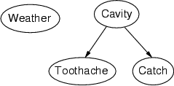
Example
Topology of network encodes conditional independence assertions:
Weather is independent of the other variables
Toothache and Catch are conditionally independent given Cavity

Slide 9
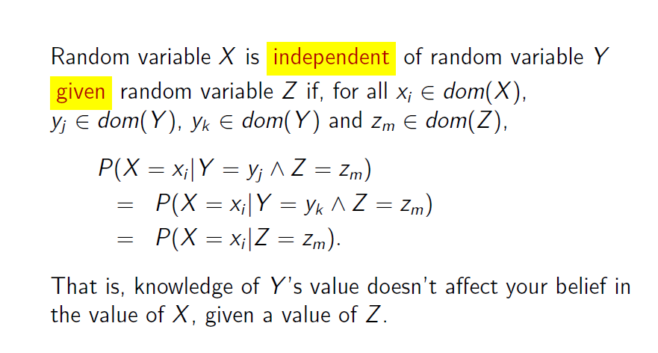
Remember: Conditional Independence

Slide 10
Example
I'm at work, neighbor John calls to say my alarm is ringing, but neighbor Mary doesn't call. Sometimes it's set off by minor earthquakes. Is there a burglar?
Variables: Burglary, Earthquake, Alarm, JohnCalls, MaryCalls
Network topology reflects "causal" knowledge:
  A burglar can set the alarm off
  An earthquake can set the alarm off
  The alarm can cause Mary to call
  The alarm can cause John to call
Notes:
Burglar alarm system installed. Judea Pearl researcher and living in LA

Slide 11
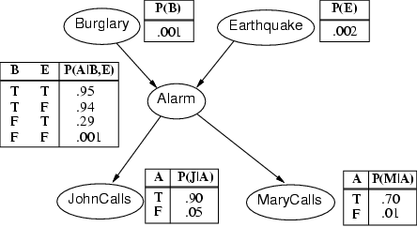
Example contd.
Notes:
John nearly calls ervery time the alarm is ringing but sometimes confuses whether it is the telephone or the alarm.
Mary often hears loud music. J & M only Alarm means we assume that they can not directly observe burglars and minor earthquakes.
Rows sum up to one because they represent all the cases for a variable. One must be the case. Any irrelevant attributes are encoded in prob-> laziness, ignorance

Slide 12
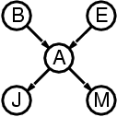
Compactness
A CPT for Boolean X_{i} with k Boolean parents has 2^{k} rows for the combinations of parent values
Each row requires one number p for X_{i} = true
(the number for X_{i} = false is just 1-p)
If each variable has no more than k parents, the complete network requires O(n · 2^{k}) numbers
i.e., grows linearly with n, vs. O(2^{n}) for the full joint distribution
For burglary net, 1 + 1 + 4 + 2 + 2 = 10 numbers (vs. 2⁵-1 = 31)
Notes:
Note that the complexity consideration explicitly requires a bound k on the number of parents which may be appropriate for most scenarios: one has many different components with high depth but bounded degree.

Slide 13
Semantics
The full joint distribution is defined as the product of the local conditional distributions:
P (X₁, … ,X_{n}) = π_{i = 1} P (X_{i} | Parents(X_{i}))
e.g., P(j ∧ m ∧ a ∧ ¬b ∧ ¬e)
= P (j | a) P (m | a) P (a | ¬b, ¬e) P (¬b) P (¬e)
= 0.90x0.7x0.001x0.999x0.998
≈ 0.00063
n

Slide 14
Constructing Bayesian networks
1. Choose an ordering of variables X₁, … ,X_{n}
2. For i = 1 to n
  add X_{i} to the network
  select parents from X₁, … ,X_{i-1} such that
  P (X_{i} | Parents(X_{i})) = P (X_{i} | X₁, ... X_{i-1})
This choice of parents guarantees:
(chain rule)
P (X₁, … ,X_{n}) = π_{i =1} P (X_{i} | X₁, … , X_{i-1})
(by construction)
= π_{i =1}P (X_{i} | Parents(X_{i}))
n
n

Slide 15
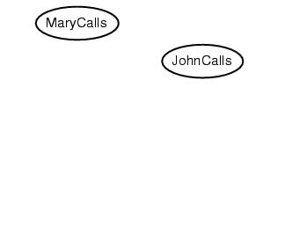
Example
Suppose we choose the ordering M, J, A, B, E
P(J | M) = P(J)?

Slide 16
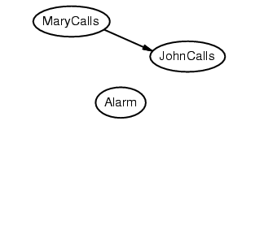
Example
Suppose we choose the ordering M, J, A, B, E
P(J | M) = P(J)? No
P(A | J, M) = P(A | J)? P(A | J, M) = P(A)?

Slide 17
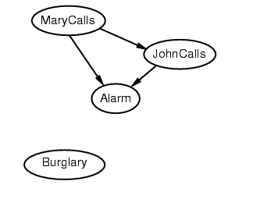
Example
Suppose we choose the ordering M, J, A, B, E
P(J | M) = P(J)? No
P(A | J, M) = P(A | J)? P(A | J, M) = P(A)? No
P(B | A, J, M) = P(B | A)?
P(B | A, J, M) = P(B)?

Slide 18
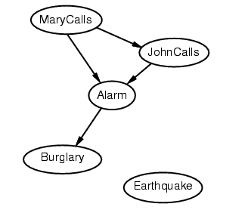
Example
Suppose we choose the ordering M, J, A, B, E
P(J | M) = P(J)? No
P(A | J, M) = P(A | J)? P(A | J, M) = P(A)? No
P(B | A, J, M) = P(B | A)? Yes
P(B | A, J, M) = P(B)? No
P(E | B, A ,J, M) = P(E | A)?
P(E | B, A, J, M) = P(E | A, B)?

Slide 19
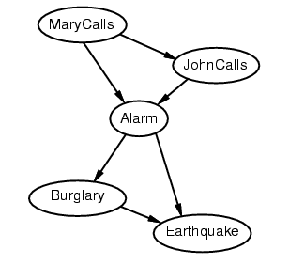
Example
Suppose we choose the ordering M, J, A, B, E
P(J | M) = P(J)? No
P(A | J, M) = P(A | J)? P(A | J, M) = P(A)? No
P(B | A, J, M) = P(B | A)? Yes
P(B | A, J, M) = P(B)? No
P(E | B, A ,J, M) = P(E | A)? No
P(E | B, A, J, M) = P(E | A, B)? Yes

Slide 20
Example contd.
Deciding conditional independence is hard in non-causal directions
(Causal models and conditional independence seem hardwired for humans!)
Network is less compact: 1 + 2 + 4 + 2 + 4 = 13 numbers needed
instead of 10.

Slide 21
Efficient Representation of CPTs
Sometimes specifying CPTs is too costy
Usually relationship of parents to child show some (logical) pattern
Example: Northamerican iff Canadian or Mexican or US
Canadian
Mexican
US
NorthAmerican
But this is a deterministic relationship
Instead of strict logical „or“ use „noisy or“
allows to express inhibitance of causes

Slide 22
Noisy-OR-Representation
Example: cold, flu and malaria may cause fever.
But sometimes these causes may be inhibited (due to independent exclusive reasons).
Specification of inhibition sufficient to determine CPT
  P(¬fever) | cold, ¬flu, ¬malaria) = 0.6
  P(¬fever) | ¬cold, flu, ¬malaria) = 0.2
  P(¬fever) | ¬cold, ¬flu, malaria) = 0.1
E.g.: P(¬ fever |¬cold, flu, malaria ) = 0.2 x 0.1
  Etc.

Slide 23
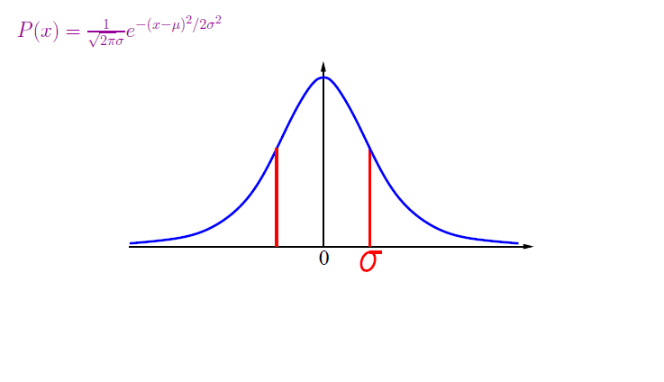
Gaussian density
μ

Slide 24
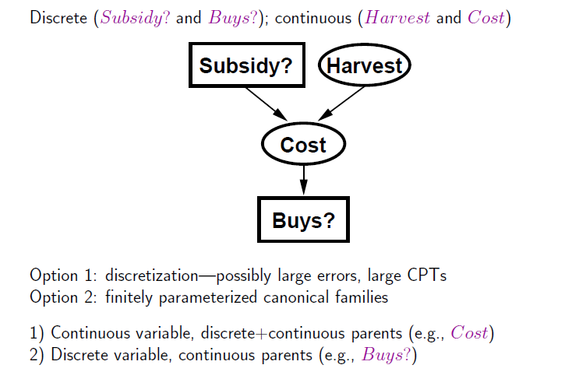
Hybrid (discrete+continuous) networks

Slide 25
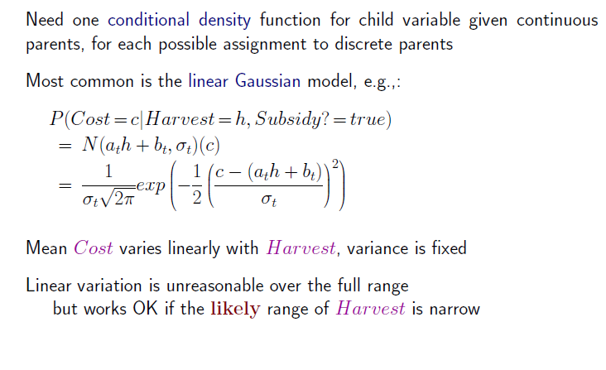
Continuous child variables

Slide 26
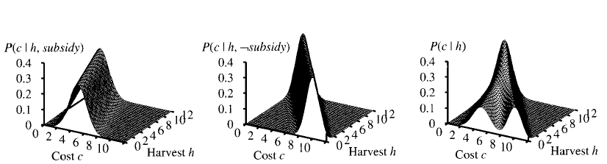
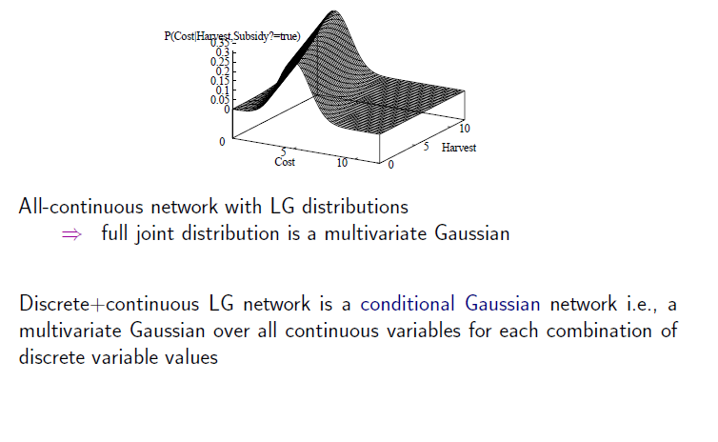
Continuous child variables

Slide 27
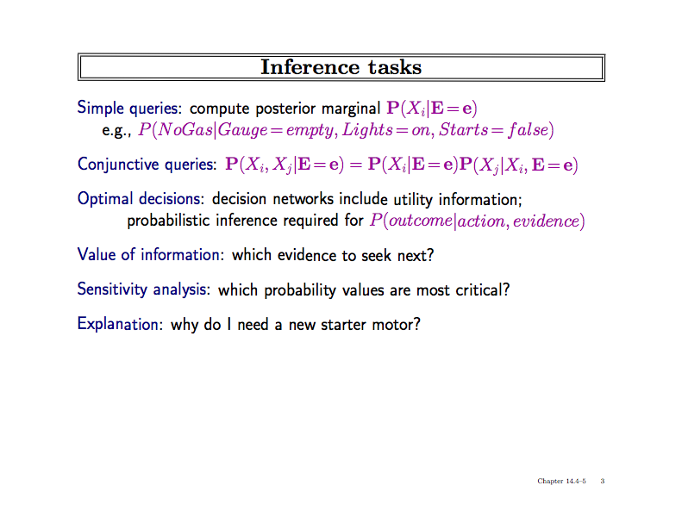

Slide 28
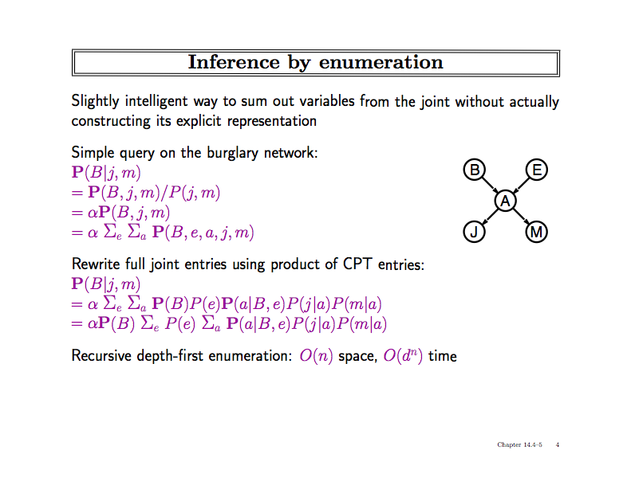

Slide 29
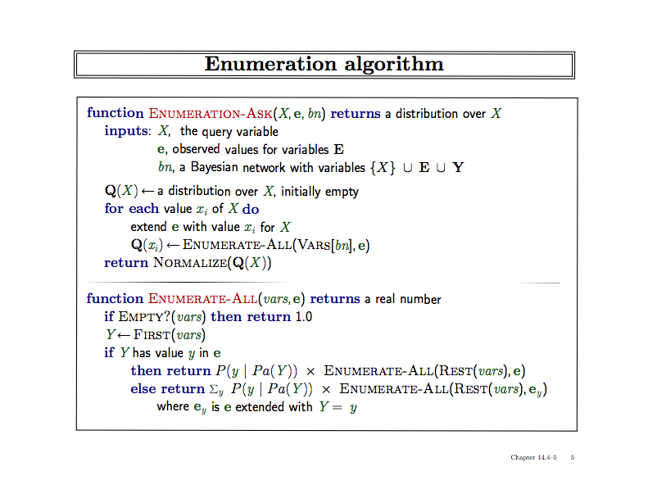

Slide 30
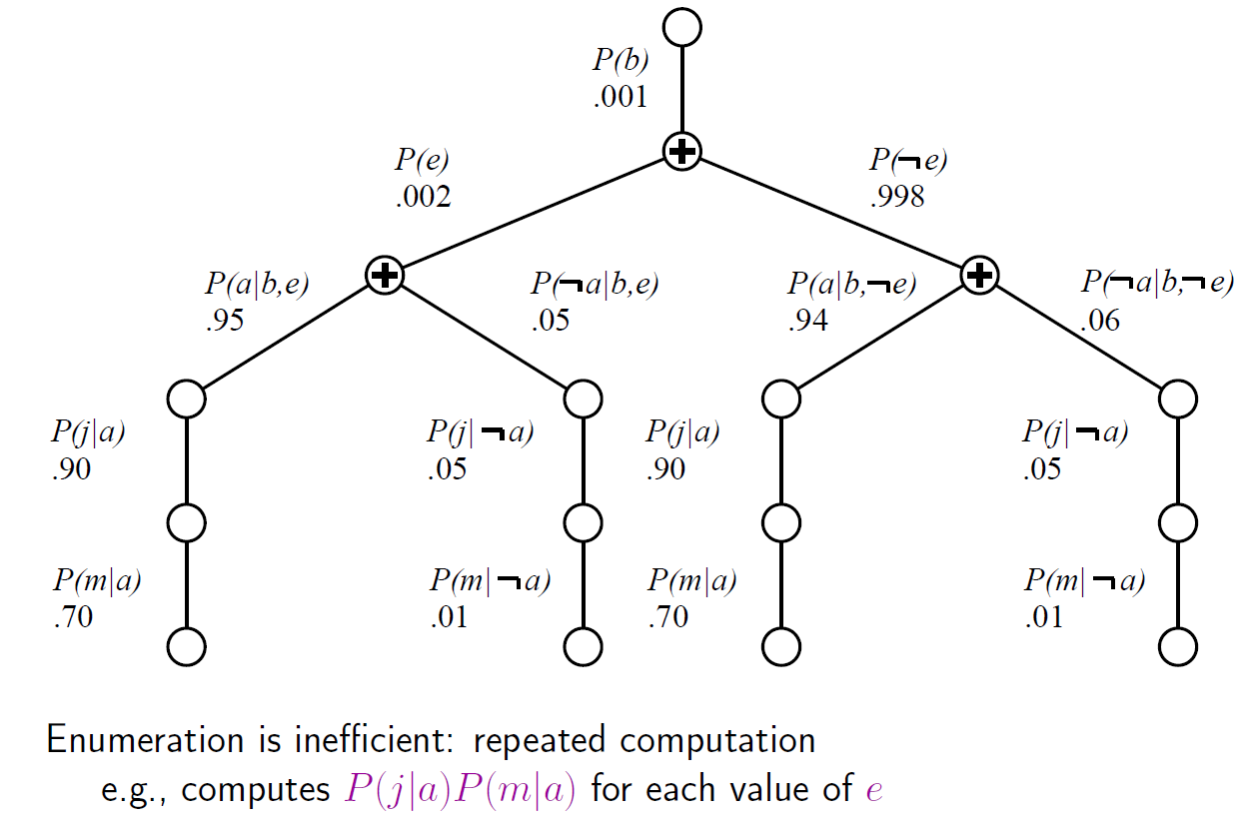
Evaluation Tree

Slide 31
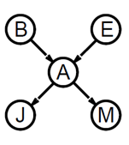
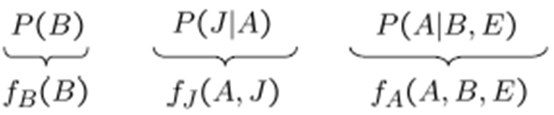
Basic Objects
Track objects called factors
Initial factors are local CPTs
During elimination create new factors

Slide 32
Basic Operations: Pointwise Product
Pointwise Product of factors f₁ and f₂
  for example: f₁(A,B) * f₂(B,C)= f(A,B,C)
  in general:
  f₁(X₁,...,X_{j},Y₁,…,Y_{k}) *f₂(Y₁,…,Y_{k},Z₁,…,Z_{l})= f(X₁,...,X_{j},Y₁,…,Y_{k},Z₁,…,Z_{l})
  has 2^{j+k+l} entries (if all variables are binary)

Slide 33

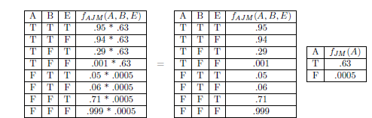
Join by pointwise product

Slide 34
Basic Operations: Summing out
Summing out a variable from a product of factors
  Move any constant factors outside the summation
  Add up submatrices in pointwise product of remaining factors
  𝛴_{x} f₁* …*f_{k} = f₁*…*f_{i}*𝛴_{x} f_{i+1}*…*f_{k}
  = f₁*…*f_{i}* f_{X}
  assuming f₁, …, f_{i} do not depend on X

Slide 35
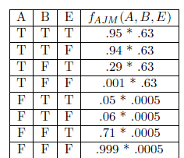
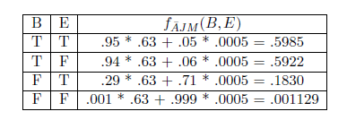
Summing out
Summing out a

Slide 36
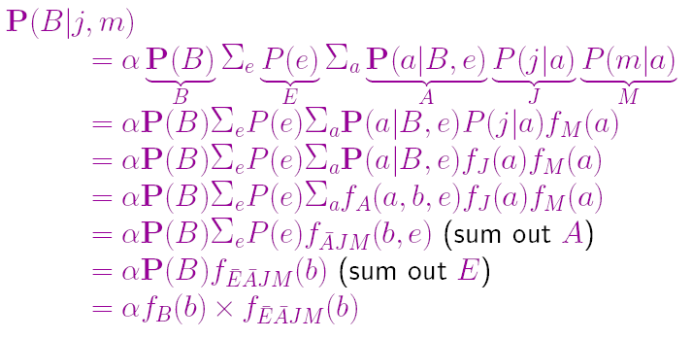
What we have done

Slide 37
Variable ordering
Different selection of variables lead to different factors of different size.
Every choice yields a valid execution
  Different intermediate factors
Time and space requirements depend on the largest factor constructed
Heuristic may help to decide on a good ordering
What else can we do?????

Slide 38
Irrelevant variables
{Alarm, Earthquake,Burglary}

Slide 39
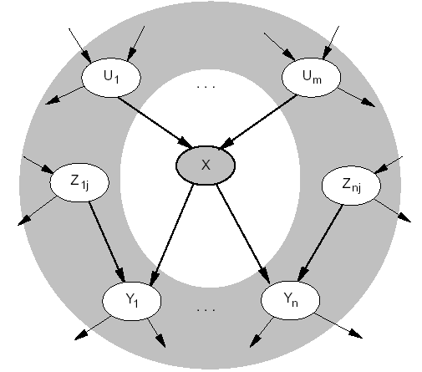
Markov Blanket
Markov blanket: Parents + children + children’s parents
Node is conditionally independent of all other nodes in network, given its Markov Blanket
Notes:
The second item follows

Slide 40
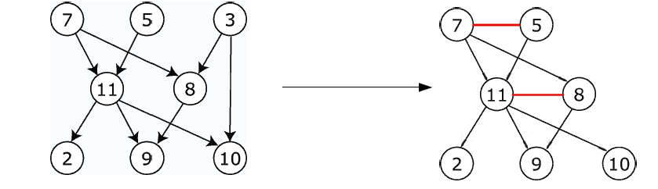
Moral Graph
The moral graph is an undirected graph that is obtained as follows:
  connect all parents of all nodes (resp.)
  make all directed links undirected
Note:
  the moral graph connects each node to all nodes of its Markov blanket
    it is already connected to parents and children
    now it is also connected to the parents of its children

Slide 41
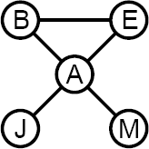

Irrelevant variables continued:
m-separation:
  A is m-separated from B by C iff it is separated by C in the moral graph
  A is m-separated from set Z by C iff for all B
  in Z: A is m-separated from all B by C in Z
Example:
  J is m-separated from E by A
  (Remember: Query P(X | E)
Example:
Theorem 2: Y is irrelevant if it is m-separated from X by E

Slide 42
Approximate Inference in Bayesian Networks
Monte Carlo algorithm
  Widely used to estimate quantities that are difficult to calculate exactly (Remember: for BNs NP-hardness)
  Randomized sampling algorithm
  Accuracy depends on the number of samples
  Two families
    Direct sampling
    Markov chain sampling

Slide 43
Inference by stochastic simulation

Slide 44
Example in simple case
P(C)=.5
Sampling
Cloudy
[Cloudy, Sprinkler, Rain, WetGrass]
C P(R|C)
________
t .80
f .20
C P(S|C)
________
t .10
f .50
[true, , , ]
[true, false, , ]
Sprinkler
Rain
[true, false, true, ]
[true, false, true, true]
S R P(W|S,R)
______________
t t .99
t f .90
f t .90
f f .00
WetGrass
Estimating
N = 1000 (# generated samples)
N(Rain=true) = N([ _ , _ , true, _ ]) = 511
(# of samples for this event)
P(Rain=true) = 0.511 (approximated probability)
Notes:
N(e) = Number of samples generated for event e
Explanation of algorithm on next slide. Note that N = 511 is the outcome of the random sampling; it is not calculated.

Slide 45
Sampling from empty network
Generating samples from a network that has no evidence associated with it (empty network)
Basic idea
  sample a value for each variable in topological order
  using the specified conditional probabilities

Slide 46
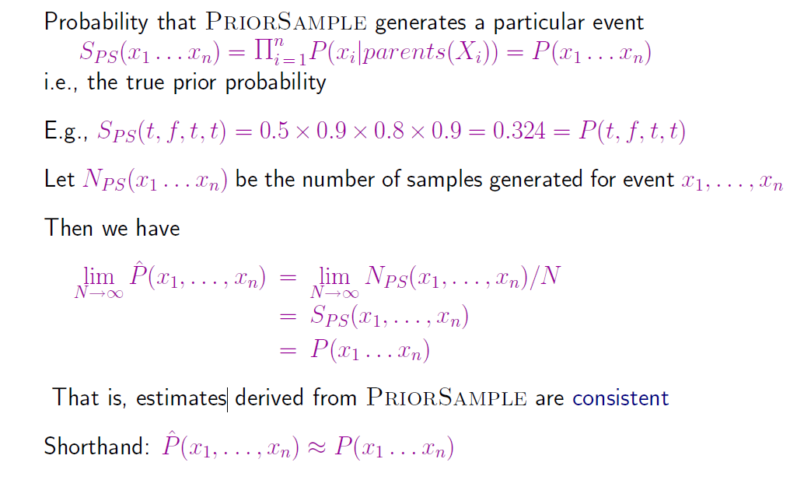
Properties
Notes:
Note: second probability is 0.9 = 1 – 0.1 = 1 – P(S|C)

Slide 47
What if evidence is given?
Sampling as defined above would generate cases that cannot be used

Slide 48
Rejection Sampling
Used to compute conditional probabilities
Procedure
  Generating sample from prior distribution specified by the Bayesian Network
  Rejecting all that do not match the evidence
  Estimating probability

Slide 49
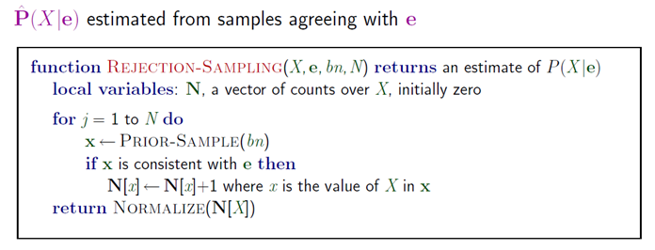
Rejection Sampling

Slide 50
Rejection Sampling Example
Let us assume we want to estimate P(Rain|Sprinkler = true) with 100 samples
100 samples
  73 samples => Sprinkler = false
  27 samples => Sprinkler = true
    8 samples => Rain = true
    19 samples => Rain = false
P(Rain|Sprinkler = true) = NORMALIZE((8,19)) = (0.296,0.704)
Problem
  It rejects too many samples

Slide 51
Analysis of rejection sampling
Notes:
So, many many runs will have to be discarded as the events have small probability

Slide 52
Likelihood Weighting
Goal
  Avoiding inefficiency of rejection sampling
Idea
  Generating only events consistent with evidence
  Each event is weighted by likelihood that the event accords to the evidence

Slide 53
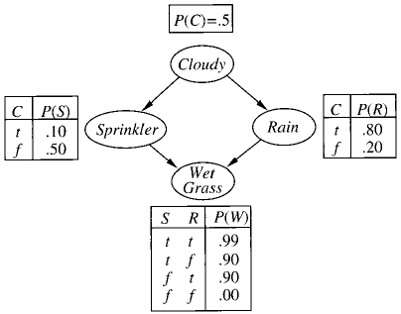
Likelyhood Weighting: Example
P(Rain|Sprinkler=true,
WetGrass = true)?
Sampling
  The weight is set to 1.0
  Sample from P(Cloudy) = (0.5,0.5) => true
  Sprinkler is an evidence variable with value true
  w ⬅ w * P(Sprinkler=true | Cloudy = true) = 0.1
  Sample from P(Rain|Cloudy=true)=(0.8,0.2) => true
  WetGrass is an evidence variable with value true
  w ⬅w * P(WetGrass=true |Sprinkler=true, Rain = true) = 0.099
  [true, true, true, true] with weight 0.099
Estimating
  Accumulating weights to either Rain=true or Rain=false
  Normalize
Notes:
Weight is low because its a cloudy day what makes sprinkler unlikley

Slide 54
Likelyhood Weighting: Example
P(Rain|Cloudy=true,
WetGrass = true)?
Sampling
  Cloudy is an evidence
  w ⬅ w * P(Cloudy = true) = 0.5
  Sprinkler no evidence
  Sample from P(Sprinkler| Cloudy=true)=(0.1, 0.9) false
  Sample from P(Rain|Cloudy=true)=(0.8,0.2) => true
  WetGrass is an evidence variable with value true
  w ⬅w * P(WetGrass=true |Sprinkler=false, Rain = true) = 0.45
  [true, false, true, true] with weight 0.45
Notes:
Weight is high because its a cloudy day and now sprinkler=fase

Slide 55
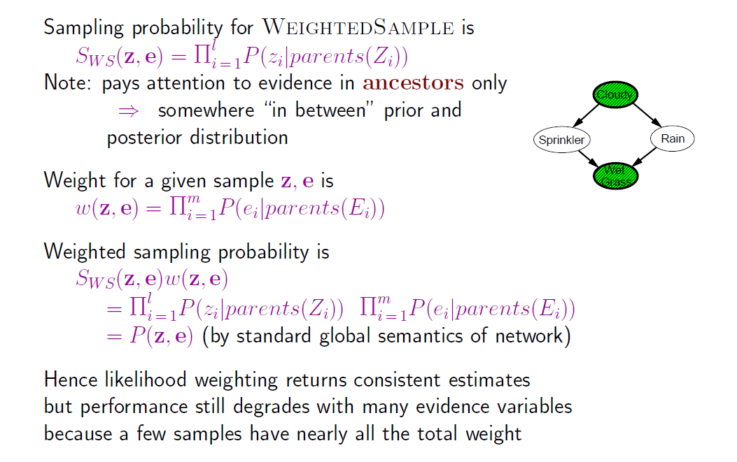
Likelihood analysis

Slide 56
Likelihood weighting

Slide 57
Markov Chain Monte Carlo
Let’s think of the network as being in a particular current state specifying a value for every variable
MCMC generates each event by making a random change to the preceding event
The next state is generated by randomly sampling a value for one of the nonevidence variables X_{i}, conditioned on the current values of the variables in the MarkovBlanket of X_{i}
Likelihood Weighting only takes into account the evidences of the parents.

Slide 58
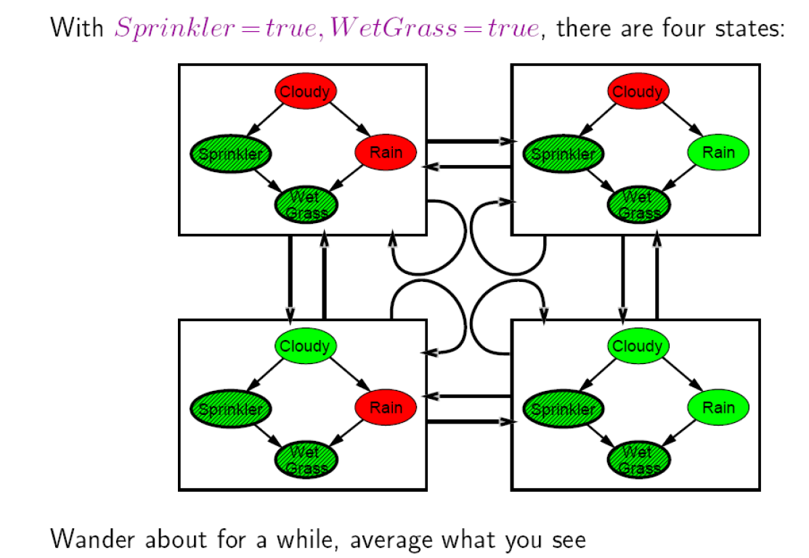

Slide 59
Markov Chain Monte Carlo: Example
Query P(Rain|Sprinkler = true, WetGrass = true)
Initial state is [true, true, false, true] [Cloudy,Sprinkler,Rain,WetGrass]
The following steps are executed repeatedly:
  Cloudy is sampled, given the current values of its MarkovBlanket variables
  So, we sample from P(Cloudy|Sprinkler= true, Rain=false)
  Suppose the result is Cloudy = false.
  Now current state is [false, true, false, true] and counts are updated
  Rain is sampled, given the current values of its MarkovBlanket variables
  So, we sample from P(Rain|Cloudy=false,Sprinkler=true, WetGrass=true)
  Suppose the result is Rain = true.
  Then current state is [false, true, true, true]
After all the iterations, let’s say the process visited 20 states where rain is true and 60 states where rain is false then the answer of the query is NORMALIZE((20,60))=(0.25,0.75)

Slide 60
MCMC

Slide 61
Summary
Bayesian networks provide a natural representation for (causally induced) conditional independence
Topology + CPTs = compact representation of joint distribution
Generally easy for domain experts to construct
Exact inference by variable elimination
  polytime on polytrees, NP-hard on general graphs
  space can be exponential as well
Approximate inference based on sampling and counting help to overcome complexity of exact inference

