Slide 1
PROBABILISTIC AND DIFFERENTIABLE PROGRAMMING
V2: Gradient Descent
Özgür L. Özçep
Universität zu Lübeck
Institut für Informationssysteme

Slide 2
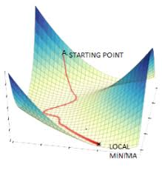
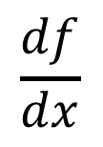
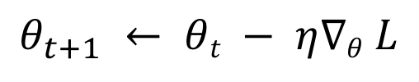
Agenda for today‘s lecture
Gradient descent (GD)
1. Differentiation
2. Basic GD and variants
$$\frac{df}{dx}$$
$$θ_{t+1} ← θt − η∇θ L$$
3. Backpropagation

Slide 3
The big idea: follow the gradient
Fundamentally, we’re interested in machines that we train by
  optimising parameters
How do we select those parameters?
In deep learning/differentiable programming we typically define an objective function to optimize
  minimise (in case of error or loss say) or
  maximise with respect to those parameters
We’re looking for points at which the gradient of the objective function is zero w.r.t. the parameters

Slide 4
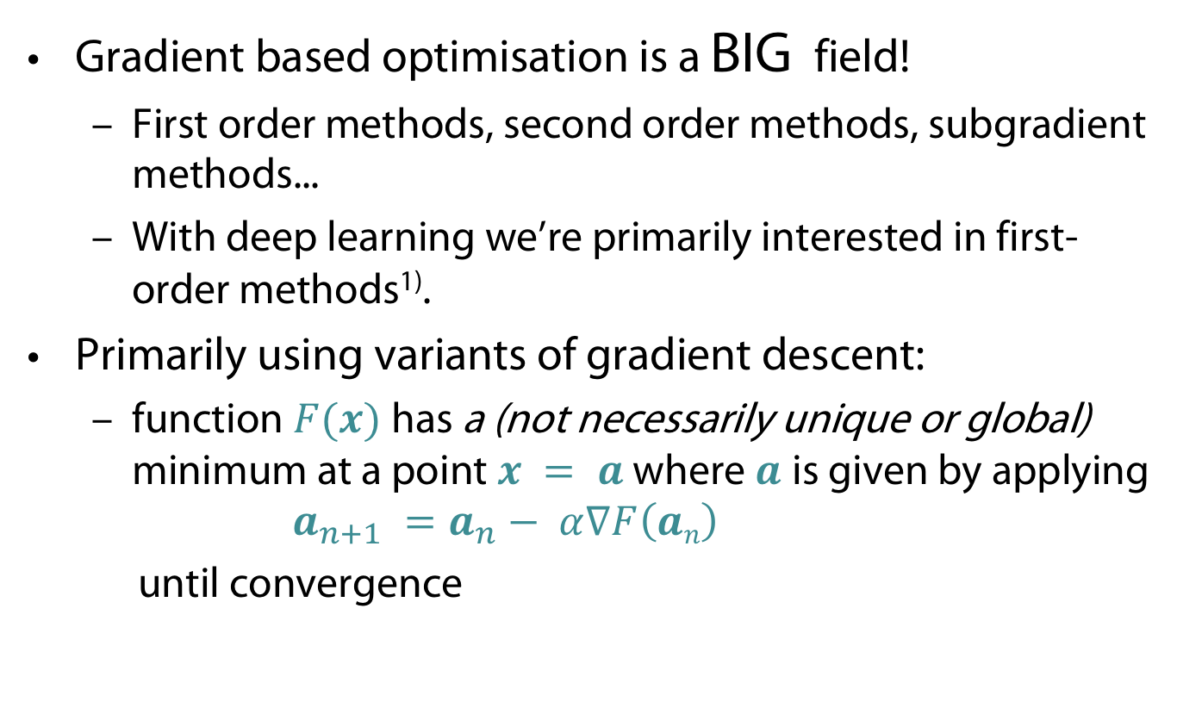
The big idea: follow the gradient
Gradient based optimisation is a BIG field!
  First order methods, second order methods, subgradient methods...
  With deep learning we’re primarily interested in first-order methods¹⁾.
Primarily using variants of gradient descent:
  function $F(x)$has a (not necessarily unique or global) minimum at a point $x = a$where $a$ is given by applying
  $a_{n+1} =a_{n}− α∇F\left(an\right)$
  until convergence
1) Second order gradient optimisers are potentially better, but for systems with many variables are currently impractical as they equire computing the Hessian.

Slide 5
DiFferentiation

Slide 6
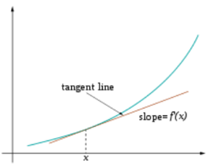


Gradient in one dimension
secant line
Tangent line
Gradient of a straight line is $∆y /∆x$
For arbitrary real-valued function $f(x$)
  approximate the derivative, $\frac{df}{dx}(a)$ using the gradient of the secant line trough $(a,f(a))$and $(a+h,f(a+h))$for small $h$
  $f^{′}\left(a\right)=\frac{df}{dx}(a)≈$ $\frac{Δf}{Δa}≈ \frac{f\left(a+h\right)−f(a)}{h}$ (Newton‘s difference quotient)
  $\frac{df}{dx}(a)= \lim_{h→0}{\frac{f\left(a+h\right)−f(a)}{h}}$ (Derivate of $f$ at $a$)
Slope $\frac{df}{da}(a)$
a

Slide 7

Example: Derivative of a quadratic function
$$y =x2 \\ \frac{dy}{dx}=\lim_{h → 0}{\frac{{\left(x+h\right)}^{2}−x^{2}}{h}}{ } \\ \frac{dy}{dx}=\lim_{h → 0}{\frac{x^{2}+2hx+h^{2}−x^{2}}{h}}{ } \\ \frac{dy}{dx}=\lim_{h → 0}{\frac{2hx+h^{2}}{h}}{ } \\ \frac{dy}{dx}=\lim_{h → 0}{2x+h}{ } \\ \frac{dy}{dx} = 2x$$

Slide 8
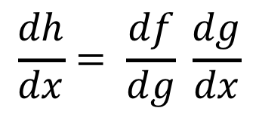
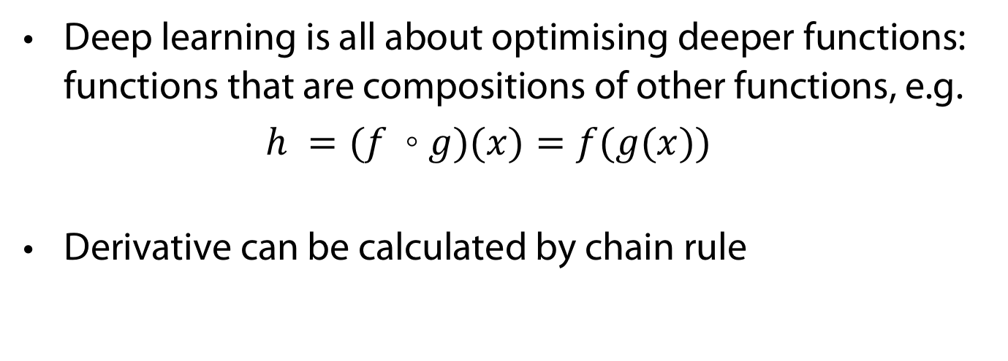

Derivatives of „deeper“ functions
Deep learning is all about optimising deeper functions: functions that are compositions of other functions, e.g.
$h =(f ◦g)(x)=f(g(x))$
Derivative can be calculated by chain rule
Chain rule (1-dim)
$$\frac{dh}{dx}= \frac{df}{dg} \frac{dg}{dx}$$
for
$h\left(x\right)=f(g(x))$

Slide 9


Example for chain rule
$$h\left(x\right)=x^{4}={{(x}^{2})}^{2 }=f\left(g\left(x\right)\right) \\ \frac{dh}{dx}=2 ∙x^{2}∙2x={4x}^{3}$$
You may verify this also directly
$$\frac{dh}{dx}= \lim_{h→0}{\frac{{\left(x+h\right)}^{4}−x^{4}}{h}} \\ \frac{dh}{dx}= \lim_{h→0}{\frac{h^{4}+4h^{3}x+6h^{2}x^{2}+4hx^{3}+x^{4} −x^{4}}{h}} \\ \frac{dh}{dx}= \lim_{h→0}{h^{3}+4h^{2}x+6hx^{2}+4x^{3} =4x^{3} }$$

Slide 10
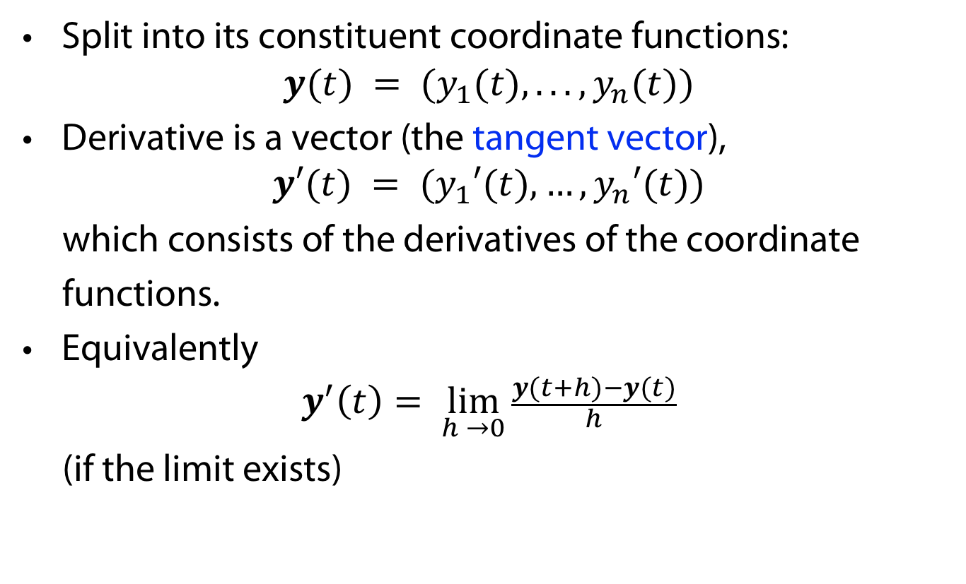

Generalization: Vector functions $y(t)$
Split into its constituent coordinate functions:
$y(t) = (y_{1}(t), . . . , y_{n}(t))$
Derivative is a vector (the tangent vector),
$y′(t) = (y_{1}′(t),…,y_{n}′(t))$
which consists of the derivatives of the coordinate
functions.
Equivalently
$$y^{′}\left(t\right)= \lim_{h →0}{\frac{y(t+h)−y(t)}{h}}$$
(if the limit exists)

Slide 11
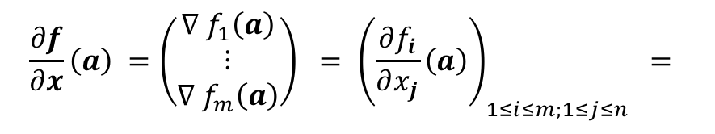
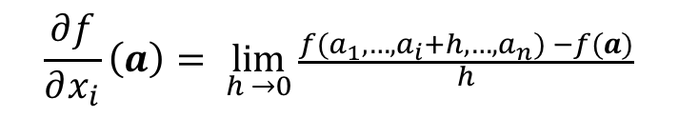


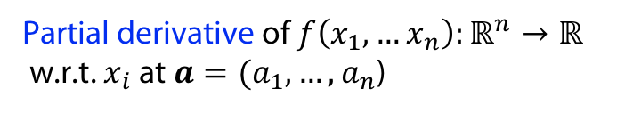

Differentiation with multiple variables
$$f\left(x,y\right)=x^{2}+xy+y^{2} \\ \frac{∂f}{∂x}=2x+y \\ \frac{∂f}{∂y}=x+2y$$
Partial derivative of$f\left(x_{1},…x_{n}\right):ℝ^{n}→ℝ$
w.r.t. $x_{i}$ at $a=(a_{1}, …, a_{n}$)
$$\frac{∂f}{∂x_{i}}\left(a\right)= \lim_{h →0}{\frac{f(a_{1},…, a_{i}+h, …, a_{n}) −f(a)}{h}}$$
Gradient of $f\left(x_{1},…x_{n}\right):ℝ^{n}→ℝ$at $a=(a_{1}, …, a_{n}$)
$$∇ f\left(a\right)=(\frac{∂f}{∂x_{1}}(a), …,\frac{∂f}{∂x_{n}}(a))$$
Jacobian of $f\left(x_{1},…x_{n}\right):ℝ^{n}→ℝ^{m}$at $a=(a_{1}, …, a_{n}$)
$$\left(\begin{matrix}\frac{∂f_{1}}{∂x_{1}}\left(a\right) & ⋯ & \frac{∂f_{1}}{∂x_{n}}\left(a\right) \\ ⋮ & ⋱ & ⋮ \\ \frac{∂f_{m}}{∂x_{1}}\left(a\right) & ⋯ & \frac{∂f_{m}}{∂x_{n}}\left(a\right)\end{matrix}\right)$$
$$\frac{∂f}{∂x}\left(a\right) ={\left(\begin{matrix}∇ f_{1}\left(a\right) \\ ⋮ \\ ∇ f_{m}\left(a\right)\end{matrix}\right) = \left(\frac{∂f_{i}}{∂x_{j}}\left(a\right)\right)}_{1≤i≤m;1≤j≤n } =$$

Slide 12
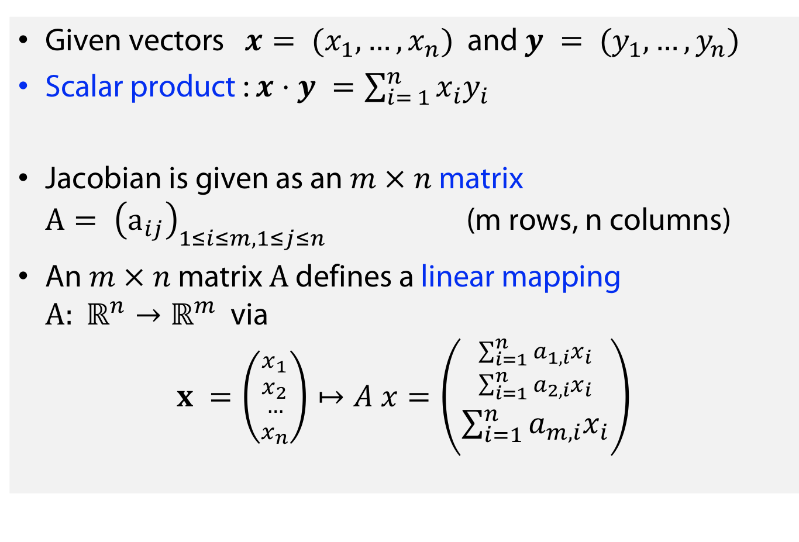
Linear algebra reminder
Given vectors $x= (x_{1}, …, x_{n})$ and $y = (y_{1}, …, y_{n})$
Scalar product : $x⋅y =\sum_{i= 1}^{n}{x_{i}y_{i}}$
Jacobian is given as an $m × n$ matrix ${A= \left(a_{ij}\right)}_{1≤i≤m, 1≤j≤n }$ (m rows, n columns)
An $m × n$ matrix $A$ defines a linear mapping $A: ℝ^{n}→ℝ^{m}$ via
$$x =\left({{x_{1} \atop x_{2}} \atop {… \atop x_{n}}}\right)↦A x=\left({{\sum_{i=1}^{n}{{a_{1,i}x}_{i}} \atop \sum_{i=1}^{n}{{a_{2,i}x}_{i}}} \atop \sum_{i=1}^{n}{{a_{m,i}x}_{i}}}\right)$$
...
(Linearity: $A\left(λx+μy\right)=λAx+μAy$ where x,$y$vectors and $λ, μ$scalars

Slide 13
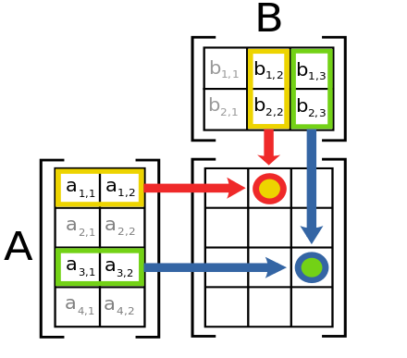
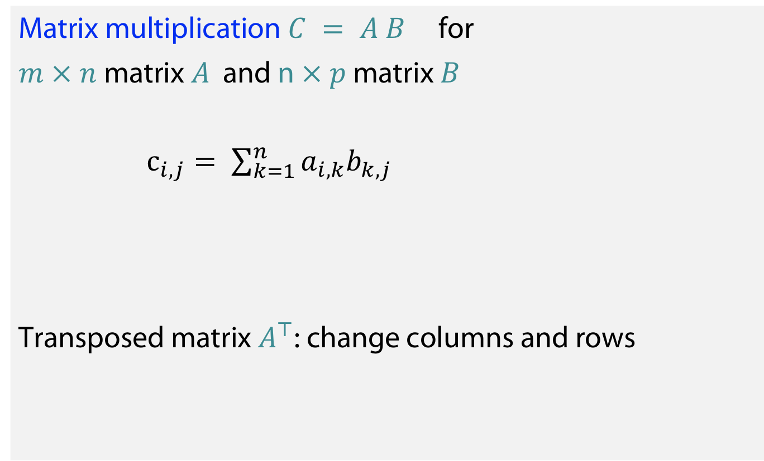
Linear algebra reminder
Matrix multiplication $C = A B$ for
$m × n$ matrix $A$ and n$× p$ matrix $B$
$c_{i,j}= \sum_{k=1}^{n}{{a_{i,k}b}_{k,j}}$
Transposed matrix $A^{⊤}$: change columns and rows

Slide 14
Gradients in Machine Learning
The kinds of functions (and programs) that are usually optimized in ML have following properties:
They are scalar-valued
There are multiple losses, but ultimately we can just consider optimising with respect to the sum of the losses.
They involve multiple variables, which are often wrapped up in the form of vectors or matrices, and more generally tensors.
How will we find the gradients of these?

Slide 15
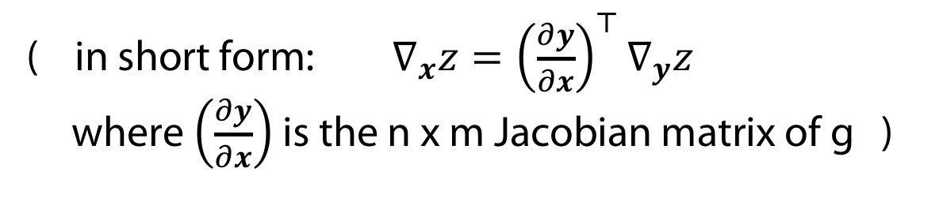
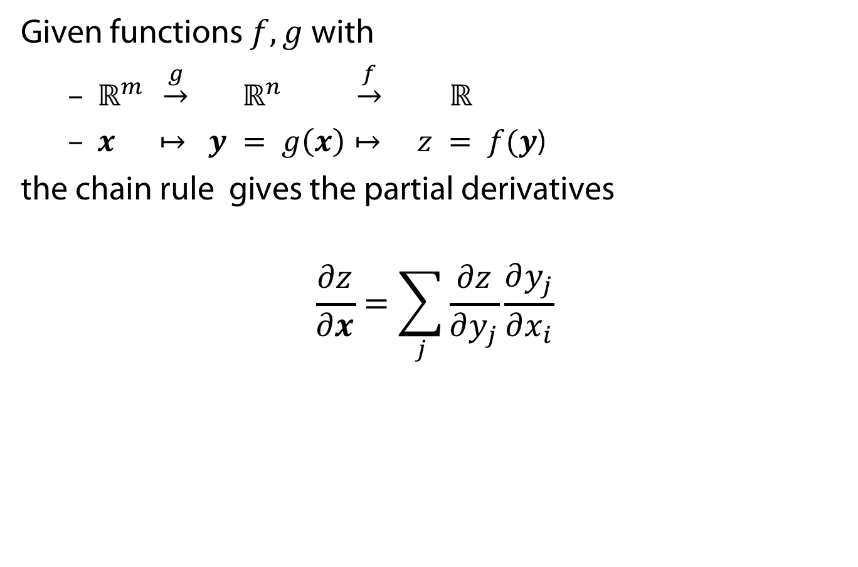
The chain rule for vectors
Given functions $f, g$with
  $ℝ^{m} \underset{→}{g} ℝ^{n} \underset{→}{f} ℝ$
  $x ↦ y = g\left(x\right)↦ z = f(y$)
the chain rule gives the partial derivatives
$$\frac{∂z}{∂x}=\sum_{j}{\frac{∂z}{∂y_{j}}\frac{∂y_{j}}{∂x_{i}}}$$
( in short form: $∇_{x}z={\left(\frac{∂y}{∂x}\right)}^{⊤}∇_{y}z$
where $\left(\frac{∂y}{∂x}\right)$ is the n x m Jacobian matrix of g )

Slide 16
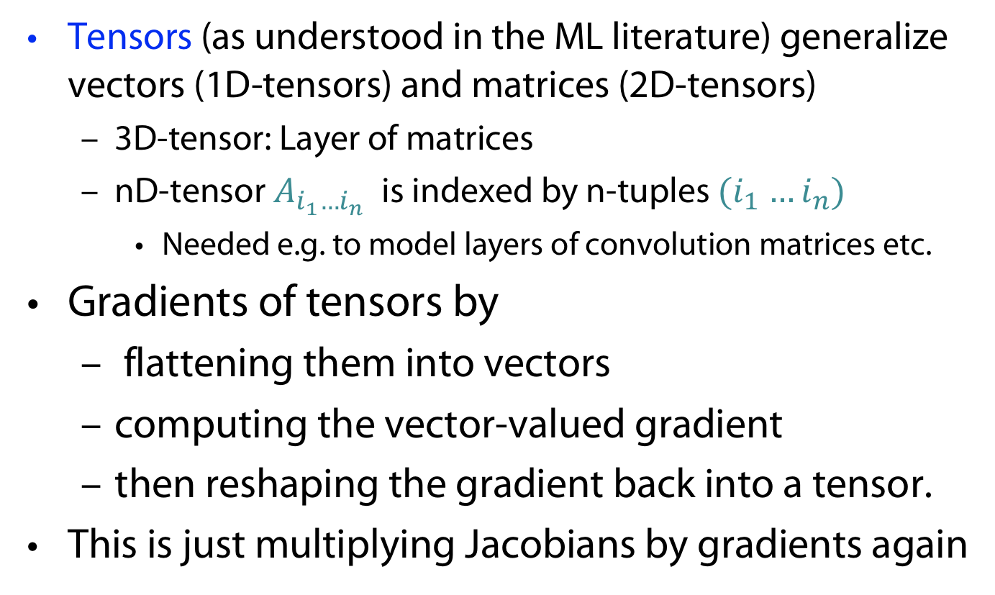
Chain rule for Tensors (Informal)
Tensors (as understood in the ML literature) generalize vectors (1D-tensors) and matrices (2D-tensors)
  3D-tensor: Layer of matrices
  nD-tensor $A_{i_{1}…i_{n}}$ is indexed by n-tuples ${(i}_{1} …i_{n})$
    Needed e.g. to model layers of convolution matrices etc.
Gradients of tensors by
  flattening them into vectors
  computing the vector-valued gradient
  then reshaping the gradient back into a tensor.
This is just multiplying Jacobians by gradients again

Slide 17
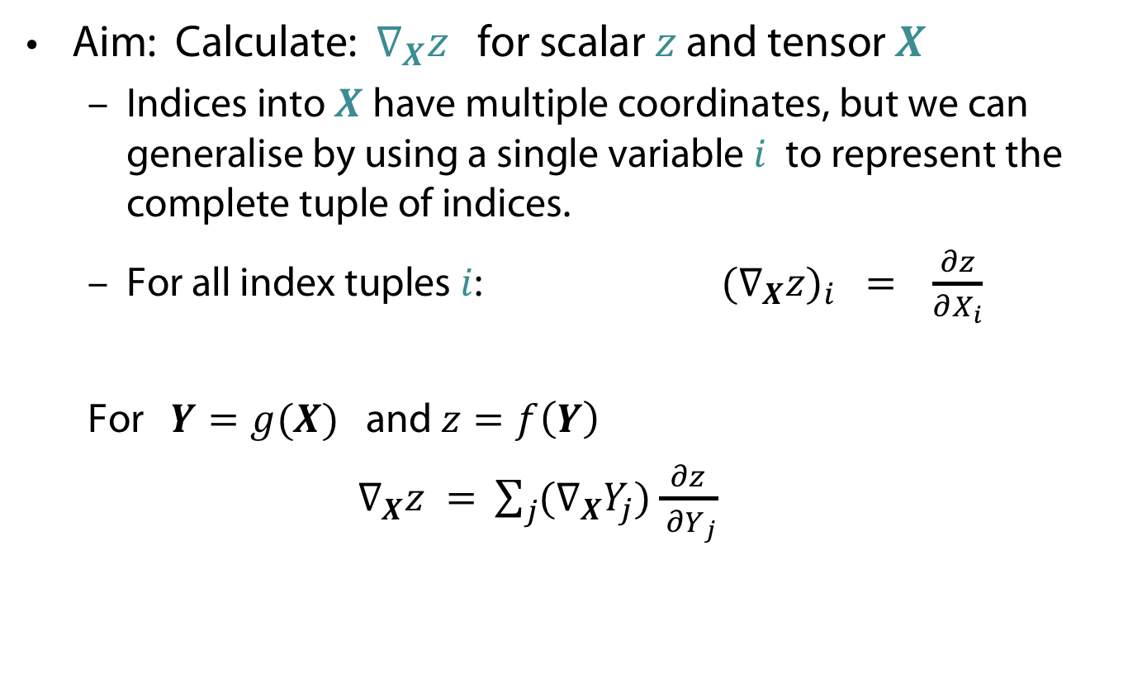
The chain rule für tensors (formally)
Aim: Calculate: $∇_{X}z$ for scalar $z$ and tensor $X$
  Indices into $X$ have multiple coordinates, but we can generalise by using a single variable $i$ to represent the complete tuple of indices.
  For all index tuples $i$: ${{(∇}_{X}z)}_{i} =$ $\frac{∂z}{∂X_{i}}$
  For $Y=g(X)$ and $z=f\left(Y\right)$
  ${ ∇}_{X}z =$ $\sum_{j}{{(∇}_{X}Y_{j})\frac{∂z}{ ∂Y_{j}} }$

Slide 18

Example for tensor chain rule
Let $D = XW$where the rows of X ∈ $ℝ^{n ×m }$contains some fixed features, and W ∈ $ℝ^{m×h }$is a matrix of weights.
Also let $L = f (D)$be some scalar function of $D$ that we wish to minimise.
What are the derivatives of $L$ with respect to the weights $W$?

Slide 19
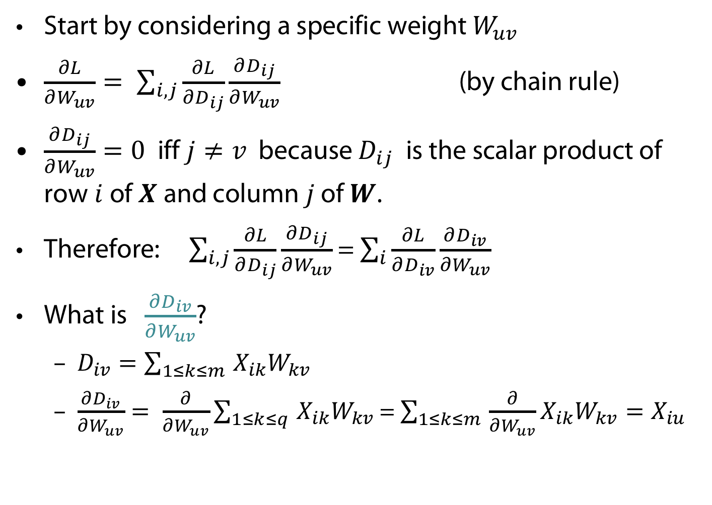
Start by considering a specific weight $W_{uv}$
$\frac{∂L}{∂W_{uv}}= \sum_{i,j}{\frac{∂L}{∂D_{ij}}\frac{∂D_{ij}}{∂W_{uv}}}$ (by chain rule)
$\frac{∂D_{ij}}{∂W_{uv}}=0$ iff $j≠v$ because $D_{ij}$is the scalar product of row$i$of $X$ and column $j$ of $W$.
Therefore: $\sum_{i,j}{\frac{∂L}{∂D_{ij}}\frac{∂D_{ij}}{∂W_{uv}}}$ = $\sum_{i}{\frac{∂L}{∂D_{iv}}\frac{∂D_{iv}}{∂W_{uv}}}$
What is $\frac{∂D_{iv}}{∂W_{uv}}$?
  $D_{iv}=\sum_{1≤k≤m }{X_{ik}W_{kv}}$
  $\frac{∂D_{iv}}{∂W_{uv}}= \frac{∂}{∂W_{uv}}\sum_{1≤k≤q }{X_{ik}W_{kv}}$ = $\sum_{1≤k≤m }{{\frac{∂}{∂W_{uv}}X}_{ik}W_{kv}=X_{iu}}$

Slide 20
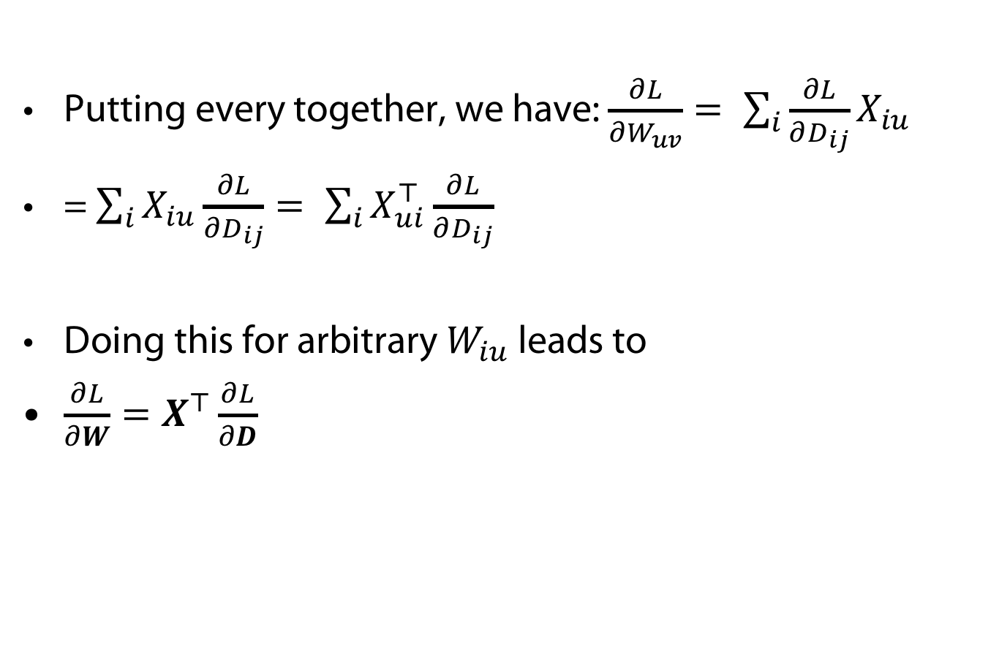
Putting every together, we have: $\frac{∂L}{∂W_{uv}}= \sum_{i}{\frac{∂L}{∂D_{ij}}X_{iu}}$
= $\sum_{i}{X_{iu}\frac{∂L}{∂D_{ij}}}= \sum_{i}{X_{ui}^{⊤}\frac{∂L}{∂D_{ij}}}$
Doing this for arbitrary $W_{iu}$ leads to
$\frac{∂L}{∂W}=X^{⊤}\frac{∂L}{∂D}$

Slide 21
VanilLa Gradient DESCENT, Variants anD BEyond

Slide 22
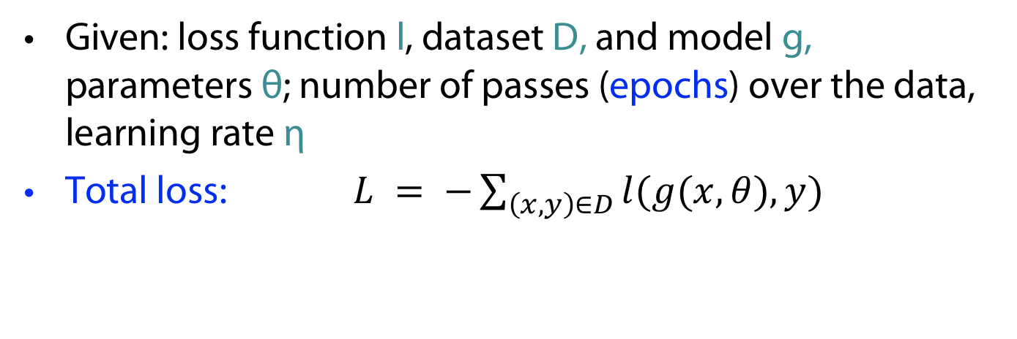
Vanilla Gradient Descent (VGD)
Given: loss function l, dataset D, and model g, parameters θ; number of passes (epochs) over the data, learning rate η
Total loss: $L = −\sum_{\left(x,y\right)∈D}{l(g(x,θ),y)}$
VGD: $θ_{t+1} ← θt − η∇θL$
+ Good statistical properties (very low variance)
Very data inefficient (particularly when data
has many similarities)
- Doesn’t scale to infinite data (online learning)
Problems of *GD
- ...

Slide 23
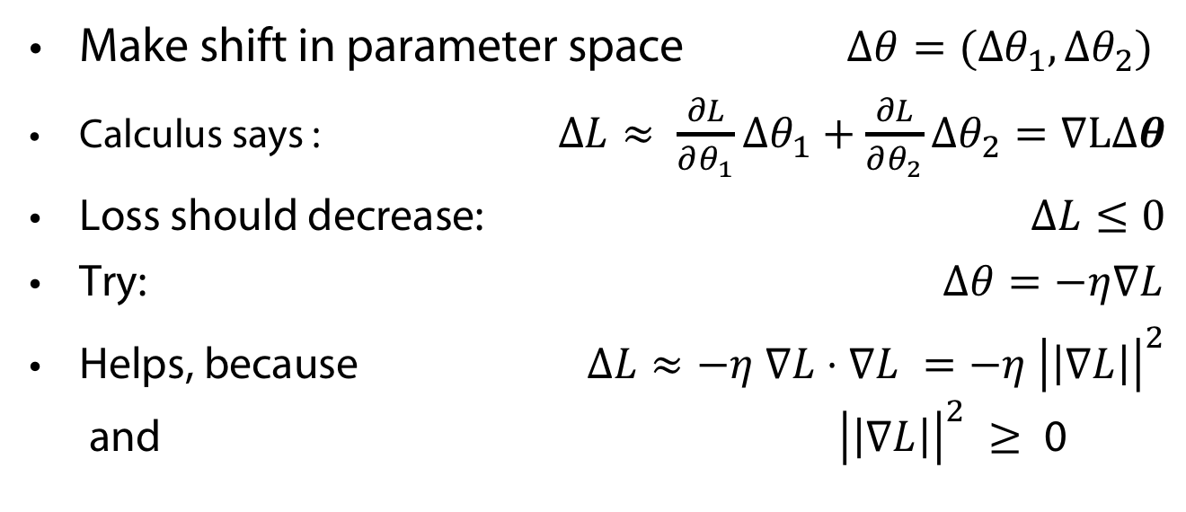

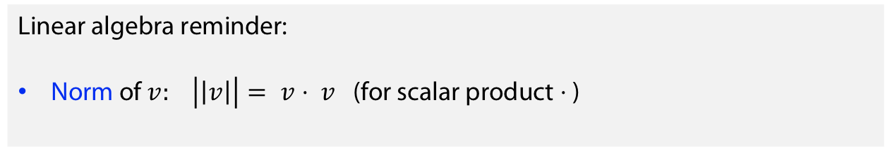
Why the hell follow the gradient?
Make shift in parameter space $Δθ=({Δθ}_{1}, Δθ_{2})$
Calculus says : $ΔL≈ \frac{∂L}{∂θ_{1}}Δθ_{1}+\frac{∂L}{∂θ_{2}}Δθ_{2}=∇LΔθ$
Loss should decrease: $ΔL≤0$
Try: $Δθ=−η∇L$
Helps, because $ΔL≈−η ∇L⋅∇L =−η {\left|\left|∇L\right|\right|}^{2}$
and ${\left|\left|∇L\right|\right|}^{2} ≥\text{ 0 }$
Linear algebra reminder:
Norm of $v: \left|\left|v\right|\right|= v⋅ v$ (for scalar product $⋅$ )
$$Δθ=−η∇L$$

Slide 24
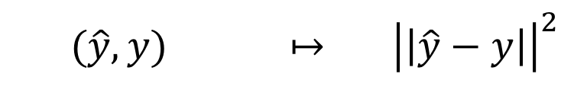
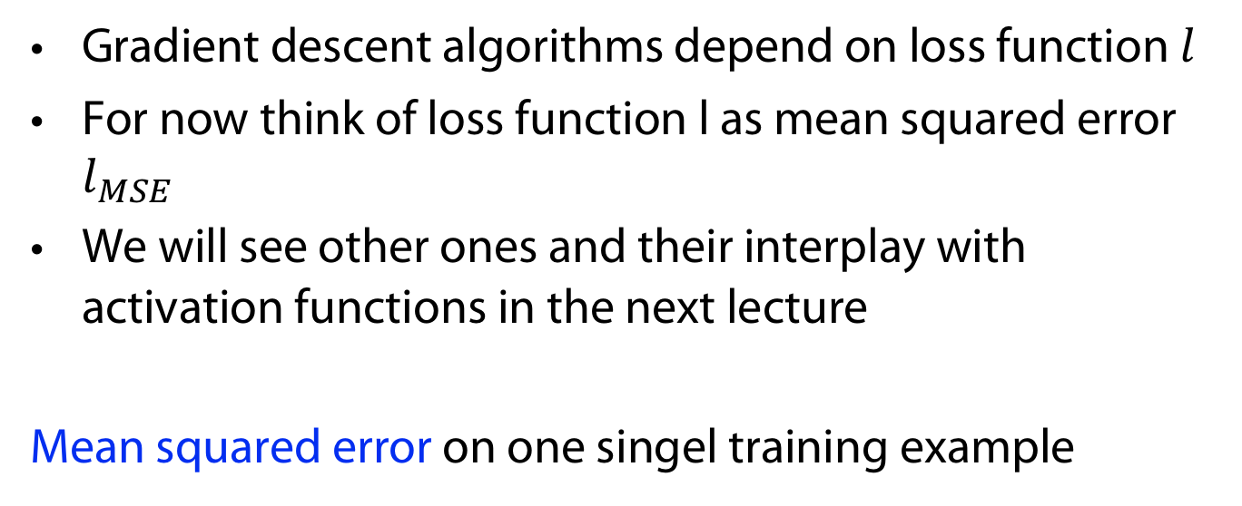
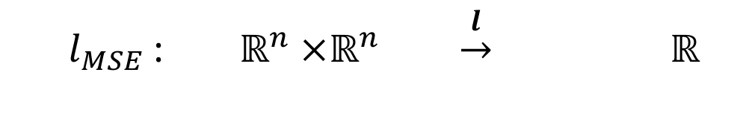
Let‘s talk abut loss – only roughly for now
Gradient descent algorithms depend on loss function $l$
For now think of loss function l as mean squared error $l_{MSE}$
We will see other ones and their interplay with activation functions in the next lecture
Mean squared error on one singel training example
  $l_{MSE}$: $ℝ^{n} ×ℝ^{n} \underset{→}{l} ℝ^{}$
  $$(\hat{y}, y) ↦ {\left|\left|\hat{y}−y\right|\right|}^{2}$$

Slide 25
Stochastic Gradient Descent (SGD)
Given: loss function l, dataset D, model g, parameters θ, number of epochs, learning rate η
SGD : $θ_{t+1} ← θ_{t} − η∇θ l(g(x, θ_{t}),y)$
+ Faster than VGD
+ Online learning
- Poor statistical properties (high fluctuation)
computational inefficiency
Problems of *GD
- ...

Slide 26

Mini-Batch SGD (MGD)
Given: mini-batch size m (common: 50-256), loss function l, dataset D, model g, parameters θ, number of epochs , learning rate η
Batch loss: $L_{b(t)}= \sum_{\left(x,y\right)∈b(t)}{l\left(g\left(x,θ\right),y\right)}$
where $d\left(t\right)‚$ a subset of D of cardinality m.
MSGD : $θ_{t+1} ← θ_{t} − η∇_{θ_{t}} L_{d(t)}$
+ reduces the parameter-updates’ variance
+ stable convergencevery
+ computational efficiency
Problems of *GD
How to choose rate
No learning rate schedules
Trapping in local minima
Inefficient for sparse data set

Slide 27
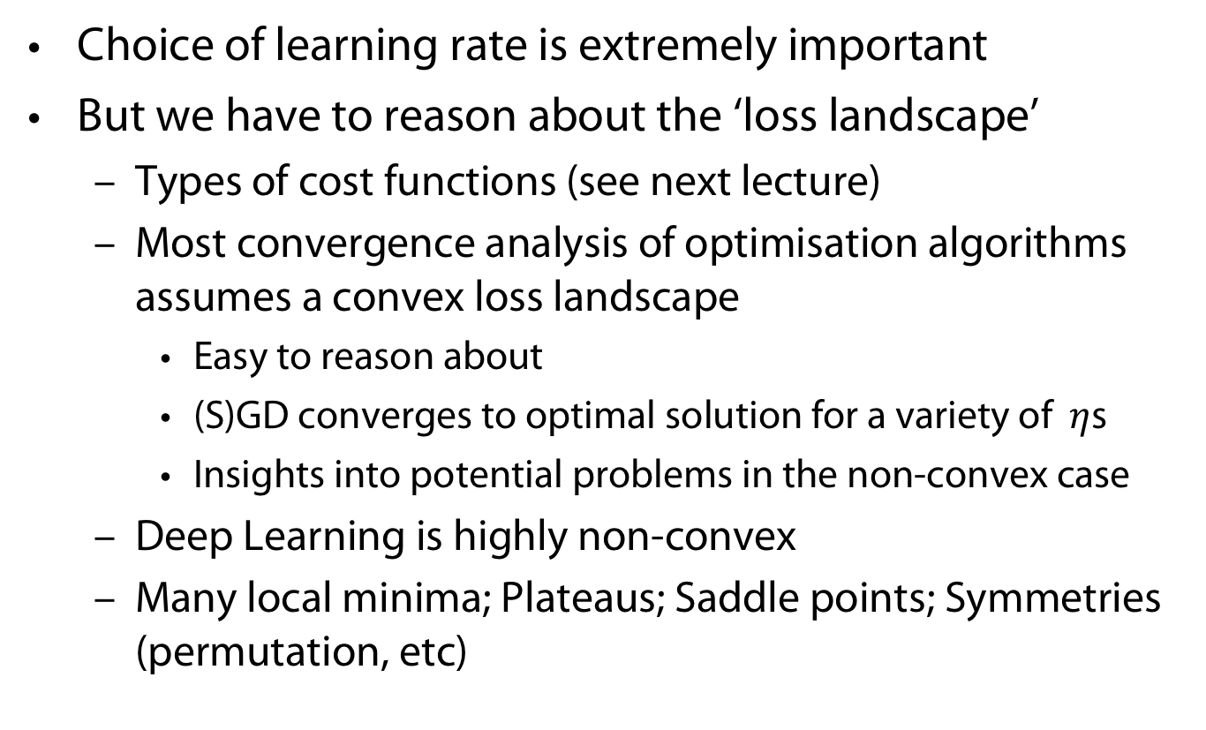
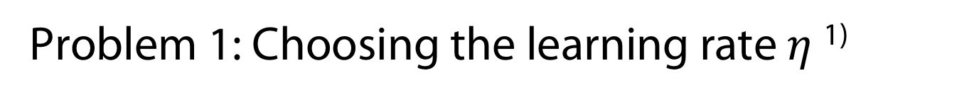
Problem 1: Choosing the learning rate $η$¹⁾
Choice of learning rate is extremely important
But we have to reason about the ‘loss landscape’
  Types of cost functions (see next lecture)
  Most convergence analysis of optimisation algorithms assumes a convex loss landscape
    Easy to reason about
    (S)GD converges to optimal solution for a variety of $η$s
    Insights into potential problems in the non-convex case
  Deep Learning is highly non-convex
  Many local minima; Plateaus; Saddle points; Symmetries (permutation, etc)
1) One form of hyper-parameter magic

Slide 28
„Beyond“: Accelerated Gradient Methods
Accelerated gradient methods use a leaky average of the gradient, rather than the instantaneous gradient estimate at each time step
A physical analogy would be one of the momentum a ball picks up rolling down a hill...
Helps addressing the *GD problems
Notes:
The momentum method allows to accumulate velocity in directions of low curvature that persist across multiple iterations
This leads to accelerated progress in low curvature directions compared to gradient descent

Slide 29
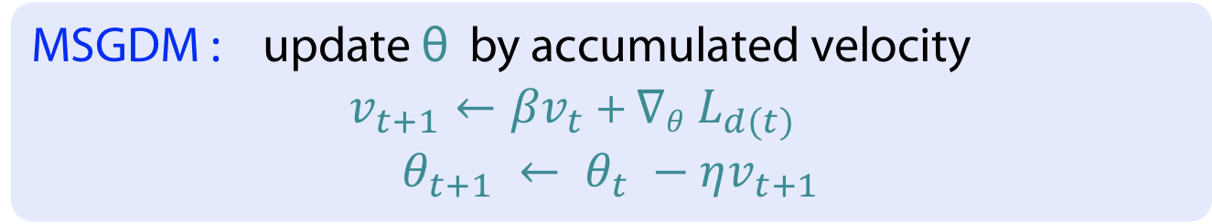

Mini-Batch SGD with Momentum (MSGDM)
Given: momentum parameter $β$ (0,9 is good choice), batch size m, batch loss L_{d(t)}, number of epochs, learning rate η
MSGDM : update θ by accumulated velocity
$v_{t+1}←{βv}_{t}$ + $∇θ L_{d(t)}$
$$θ_{t+1} ← θ_{t} −ηv_{t+1}$$
+ The momentum method allows to accumulate velocity in directions
of low curvature that persist across multiple iterations
+ This leads to accelerated progress in low curvature directions
compared to gradient descent

Slide 30
Problem 2: Scheduling learning rates
In practice you want to decay your learning rate over time
Smaller steps will help you get closer to the minima
But don’t do it to early, else you might get stuck Something of an art form!
‘Grad Student Descent’ or GDGS (‘Gradient Descent by Grad Student‘)
Tackling Plateaus (Common Heuristic approach)
  if the loss hasn’t improved (within some tolerance) for k epochs then drop the lr by a factor of 10

Slide 31
Problem 3: Stucking into local minima
Cycle the learning rate up and down (possibly annealed), with a different lr on each batch
See L. N. Smith. Cyclical Learning Rates for Training Neural Networks. arXiv e-prints, page https://arxiv.org/abs/1506.01186 , June 2015.

Slide 32
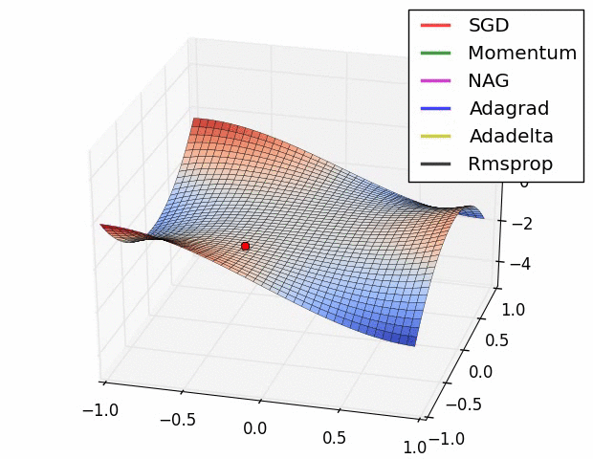
SOTA: More advanced optimisers
Here only name dropping and some fancy gif from here
  Adagrad (dynamic decrease, second moment used)
  RMSProp (decouple learning rate from gradient)
  Adam (BestOf(RMSProp,MSDGM) )
J. Hare says:
  If you’re in a hurry to get results use Adam
  If you have time (or a Grad Student at hand), then use SGD (with momentum) and work on tuning the learning rate
  If you’re implementing something from a paper, then follow what they did!

Slide 33
BACKPROPagation

Slide 34




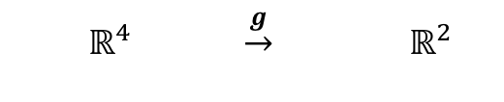

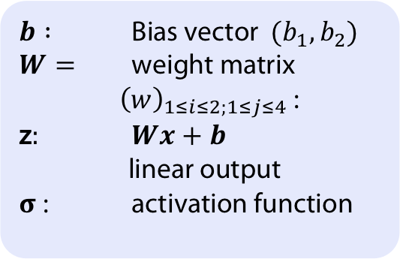



Network view of single function¹⁾
Input
$$W$$
Output
Network model
x₁
$b :$ Bias vector $(b_{1},b_{2})$
$W=$ weight matrix ${\left(w\right)}_{1≤i≤2;1≤j≤4}$:
z$:$ $Wx+b$
linear output
𝛔 : activation function
$$w_{11}$$
x₂
o₁
$$\hat{y1}$$
x₃
$$w_{14}$$
o₂
$$\hat{y2}$$
x₄
$$w_{24}$$
  $$ℝ^{4} \underset{→}{g} ℝ^{2}$$
Vector-valued function in
four arguments
  $$x ↦ \hat{y}= g={(g}_{1}\left(x\right),g_{2}\left(x\right))$$
Decomposition into
linear and activation part
$$\hat{y}= g (x ;W,b)$$
$$=σ \left(Wx +b \right)=σ\left(z\right)$$
1) You may find this also under the term perceptron in the literature

Slide 35

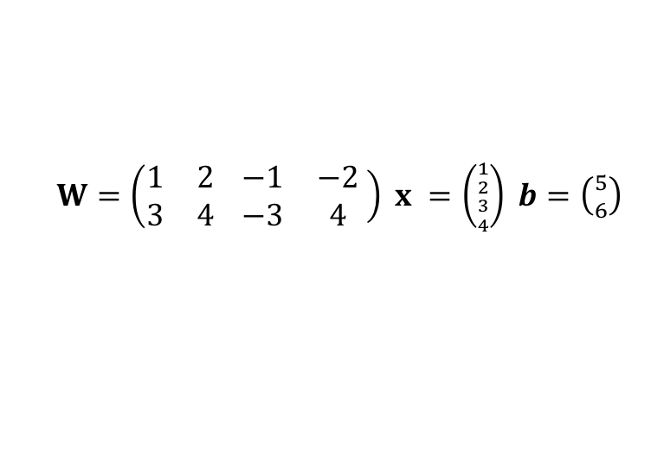
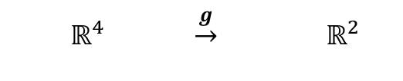
Network view of single function
Input
$$W$$
Output
Example linear output
x₁
$W=\left(\begin{matrix}1 & 2 \\ 3 & 4\end{matrix} \left.\begin{matrix}−1 & −2 \\ −3 & 4\end{matrix} \right) x =\left({{1 \atop 2} \atop {3 \atop 4}}\right) b=\left({5 \atop 6}\right) \right.$
$$w_{11}$$
x₂
o₁
$$\hat{y1}$$
$$Wx =\left({1⋅1+2⋅2+−1⋅3−2⋅4 \atop 3⋅1+4⋅2+−3⋅3+4⋅4}\right) \\ =\left({−6 \atop 18}\right)$$
$Wx+b = \left({−6 \atop 18}\right)+\left({5 \atop 6}\right)=\left({−1 \atop 24}\right)$
x₃
$$w_{14}$$
o₂
$$\hat{y2}$$
x₄
$$w_{24}$$
  $$ℝ^{4} \underset{→}{g} ℝ^{2}$$
Vector-valued function in
four arguments
  $$x ↦ \hat{y}= g={(g}_{1}\left(x\right),g_{2}\left(x\right))$$
Decomposition into
linear and activation part
$$\hat{y}= g (x ;W,b)$$
$$=σ \left(Wx +b \right)=σ\left(z\right)$$

Slide 36



Network view of single function
Input
$$W$$
Output
x₁
Sometimes just write
biases into state
$$w_{11}$$
x₂
$$b_{1}$$
$$\hat{y1}$$
x₃
$$w_{14}$$
$$b_{2}$$
$$\hat{y2}$$
x₄
$$w_{24}$$
  $$ℝ^{4} \underset{→}{g} ℝ^{2}$$
Vector-valued function in
four arguments
  $$x ↦ \hat{y}= g={(g}_{1}\left(x\right),g_{2}\left(x\right))$$
Decomposition into
linear and activation part
$$\hat{y}= g (x ;W,b)$$
$$=σ \left(Wx +b \right)=σ\left(z\right)$$

Slide 37



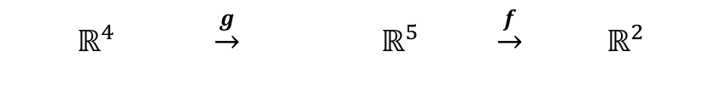
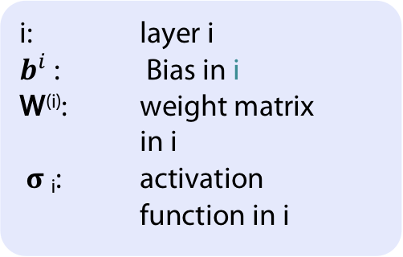

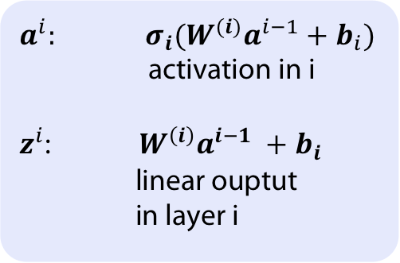
Network view of composed functions1)
Input layer
Hidden layer(s)
Output layer
i: layer i
$b^{i}$: Bias in i
W^{(i)}: weight matrix in i
𝛔 _{i}: activation function in i
w⁽¹⁾_{ij}
h₁
w⁽²⁾_{ij}
x₁
h₂
o₁
$$\hat{y1}$$
x₂
h₃
x₃
o₂
$$\hat{y2}$$
$a^{i}:$ ${σ_{i}(W^{(i)}a}^{i−1}+b_{i})$
activation in i
$z^{i}$: $W^{\left(i\right)}a^{i−1} +b_{i}$
linear ouptut
in layer i
h₄
x₄
h₅
  $$ℝ^{4} \underset{→}{g} ℝ^{5} \underset{→}{f} ℝ^{2}$$
  $$x ↦ h ↦ \hat{y}$$
$$\hat{y}= f (g (x ; W^{\left(1\right)} ,b^{1} ); W^{\left(2\right)} ,b^{2})$$
$$= σ2 (W^{\left(2\right)} σ 1(W^{\left(1\right)}x +b^{1} ) + b^{2})$$
1) You may find this also under the term multilayer perceptron in the literature

Slide 38
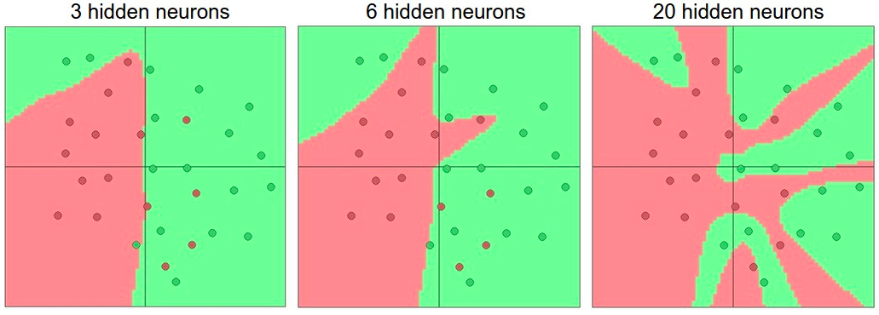

Activation functions
Non-linearities needed to learn complex (non-linear) representations of data, otherwise the network would be just a linear function
More layers and neurons can approximate more complex functions
$W_{1}W_{2}x=Wx$
http://cs231n.github.io/assets/nn1/layer_sizes.jpeg
Full list: https://en.wikipedia.org/wiki/Activation_function

Slide 39
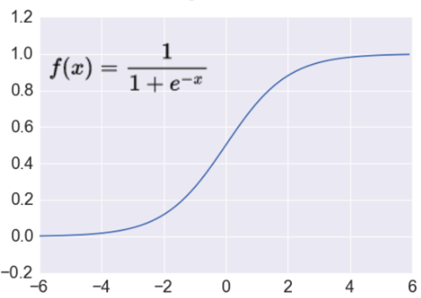





Activation functions
http://adilmoujahid.com/images/activation.png
Sigmoid
$$ℝ^{n}→\left[0,1\right]$$
Takes a real-valued number and “squashes” it into range between 0 and 1.
Earliest used activation function (neuron)
Leads to vanishing gradient problem
Tanh: $ℝ^{n}→\left[−1,1\right]$
Takes a real-valued number and “squashes” it into range between -1 and 1
Same probem of vanishing gradient
$\tanh\left(x\right)=2sigm\left(2x\right)−1$
Rectified Linear Unit ReLu: $ℝ^{n}→ℝ_{+}^{n}$
Takes a real-valued number and thresholds it at zero
Used in Deep Learning
No vanishing gradient
But: it is not differentiable (need relaxation)
Dying ReLU

Slide 40


Backprop: efficient implementation of gradient descent
V2
Sample labeled data
(batch)
Forward it through the network, get predictions
Back-propagate the errors
Update the network weights
Backpropagation idea
Generate error signal that measures difference between predictions and target values
Use error signal to change the weights and get more accurate predictions backwards
Underlying mathematics: chain rule
Chain rule (1-dim)
$$\frac{dh}{dx}= \frac{df}{dg} \frac{dg}{dx}$$
( for
$h\left(x\right)=f(g(x))$ )

Slide 41












Computational graph perspective
Function f
Partial Derivatives
Chain rule applied
$$f\left(x,y,z\right)=\left(x+y\right) ∙z$$
$=qz$
for $q =x+y$
$$\frac{∂f}{∂z}=q \\ \frac{∂q}{∂x}=1$$
$$\frac{∂f}{∂q}=z \\ \frac{∂q}{∂y}=1$$
$$\frac{∂f}{∂x}=\frac{∂f}{∂q}\frac{∂q}{∂x}=z \\ \frac{∂f}{∂y}=\frac{∂f}{∂q}\frac{∂q}{∂y}=z$$
Gradient
$$∇_{x,y,z}f=(z,z,q)$$
(In particular:
($∇_{x,y,z}f)\left(−2,5,−4\right)=\left(−4,−4, 3\right))$
-2
$$(q,\frac{∂q}{∂x},\frac{∂q}{∂y})$$
Forward pass:
function values and local gradients
Backward: chain rule
x
-4
$$\frac{∂f}{∂x}$$
(3,1,1)
+
5
-4
$(f,\frac{∂f}{∂q},\frac{∂f}{∂z}$ )
_{y}
-4
$$\frac{∂f}{∂y}$$
(-12,-4,3)
*
-4
1
$$\frac{∂f}{∂f}$$
z
3
$$\frac{∂f}{∂z}$$

Slide 42
What this example tells us about backprop
Every operation in the computational graph given its inputs can immediately compute two things:
  its output value and
  local gradients of its inputs
The chain rule tells us literally that each operation should take its local gradients and multiply them by the gradient that flows backwards into it
Backprop is an instance of ‘Reverse Mode Automatic Differentiation’

Slide 43

Backpropagation: requirements on cost (loss)
Cost $C$ (we named it $L$ before) on whole data is sum of costs on training instances
Cost is a function of the output $\hat{y}$
Backpropagation in the following described for cost on single training example
With 1. assumption backpropagation can be combined with gradiend descent.
In the following going to use Hadamard product $⨀$
$$\left({a \atop b}\right)⨀\left({c \atop d}\right)=\left({ac \atop bd}\right)$$

Slide 44


Propagation of errors
Backpropagation works on errors
(from these in the end one gets $∇_{W,b} C$)
$δ_{j}^{l} ≔\frac{∂C}{∂z_{j}^{l}}$ error in j^{th} component in layer l
Demon changes $z_{j}^{l}$ to${ z}_{j}^{l}+ Δz_{j}^{l}$
Resulting cost $C$ changes by $\frac{∂C}{∂z_{j}^{l}}Δz_{j}^{l}$

Slide 45

Backpropagation algorithm (on single instance)
Input: Initialize input vector $x = a^{0}$
Feedforward: For i = 1,2, ... , M
    $z^{i}= W^{\left(i\right)}a^{i−1} +b_{i}$ and $a^{i}=σ_{i}\left(z^{i}\right)$
Compute error on last layer $δ^{M}=∇_{\hat{y}}C⨀{σ^{′}(z^{M}) }$ (BP1)
Backpropagate error: For i = M-1, M-2, ..., ${ δ}^{i}={{(w}^{i+1})}^{⊤}δ^{i+1}⨀{σ^{′}(z^{i}) }$ (BP2)
Compute gradients
  $\frac{∂C}{∂w_{jk}^{i}}= a_{k}^{i−1}δ_{j}^{i}$ and $\frac{∂C}{∂b_{j}^{i}}=δ_{j}^{i}$ (BP3/4)

Slide 46

Proof of (BP1) in backprop
$δ_{j}^{M} = \frac{∂C}{∂z_{j}^{M}}$ (by definition)
$δ_{j}^{M}= \sum_{k }{\frac{∂C}{∂a_{k}^{M}}\frac{∂a_{k}^{M}}{∂z_{j}^{M}}}$ (chain rule; k over all components in output)
$δ_{j}^{M}=\frac{∂C}{∂a_{j}^{M}}\frac{∂a_{j}^{M}}{∂z_{j}^{M}}$ ($\frac{∂a_{k}^{M}}{∂z_{j}^{M}}$ vanishes wenn $k≠ j$)
$δ_{j}^{M}=\frac{∂C}{∂a_{j}^{M}}σ^{′}(z_{j}^{M})$ ($a_{j}^{M}=σ(z_{j}^{M})$)

Slide 47

Backpropagation algorithm (within MSGD)
Input: mini-batch of m training examples x
For each training example set corresponding activation $a^{x,1}$ and do the following
  Feedforward: For i = 1,2, ... , M
    $z^{x,i}= W^{\left(i\right)}a^{x,i−1} +b_{i}$ and $a^{x,i}=σ_{i}\left(z^{x,i}\right)$
  Compute error on last layer $δ^{x,M}=∇_{\hat{y}}C_{x}⨀{σ^{′}(z^{x,M}) }$
  Backpropagate error: For i = M-1, M-2, ..., ${ δ}^{i}={{(w}^{i+1})}^{⊤}δ^{x,i+1}⨀{σ^{′}(z^{x,i}) }$
Gradient descent:
  $w^{i} = w^{i} − \frac{η}{m}\sum_{x}{δ^{x,i}}{\left(a^{x,i−1}\right)}^{⊤}$and $b^{i} = b^{i} −\frac{η}{m}\sum_{x}{δ^{x,i}}$

Slide 48







Problem: Vanishing gradient for sigmoid $σ$
Gradient of sigmoid: $σ′(x) = σ(x)(1 − σ(x))$
Max{$σ^{′}\left(x\right)\}$
$$=0.25$$
Gradients in linear network of depth 4
$≤$0,25
$≤$0,25
$≤$0,25
Assume $|wi | ≤ 1$(e.g. $w_{i} \sim N(0,1)$)
Then: | $\left|wiσ^{′}(z_{i})\right|≤$0,25
Exponential decrease from later derivatives to earlier ones due to chain rule
Gradient vanishes moving backwards

Slide 49

Problem: Vanishing gradient with large input
Gradient of sigmoid: $σ′(x) = σ(x)(1 − σ(x))$
Max{$σ^{′}\left(x\right)\}$
$$=0.25$$
Gradients in linear network of depth 4
If $|x|$ very large , then $σ(x)$or (1-- $σ(x$)) becomes zero
So $σ′(x)$ becomes zero
Gradient vanishes for large inputs to activation functions

Slide 50
NEARLY THE END

Slide 51
Take Home Message
Follow the gradient – with care

Slide 52
APPENDIX
Uhhh, a lecture with a hoepfully useful

Slide 53
Color Convention in this Course
Formulae, when occurring inline
Newly introduced terminology and definitions
Important results (observations, theorems) as well as emphasizing some aspects
Examples are given with standard orange with possibly light orange frame
Comments and notes in nearly opaque post-it
Algorithms
Reminders (in the grey fog of your memory)

Slide 54
Todays lecture is based on the following
Jonathon Hare: Lectures 2,3,4,6 of course „COMP6248 Differentiable Programming (and some Deep Learning“) http://comp6248.ecs.soton.ac.uk/
Nielsen: Neural Networks and Deep Learning. http://neuralnetworksanddeeplearning.com/, chapters 1,2
https://medium.com/@ramrajchandradevan/the-evolution-of-gradient-descend-optimization-algorithm-4106a6702d39
I. Lorentzou: Introduction to Deep Learning, link

