Slide 1
PROBABILISTIC AND DIFFERENTIABLE PROGRAMMING
V3: Deep Learning I
Özgür L. Özçep
Universität zu Lübeck
Institut für Informationssysteme

Slide 2
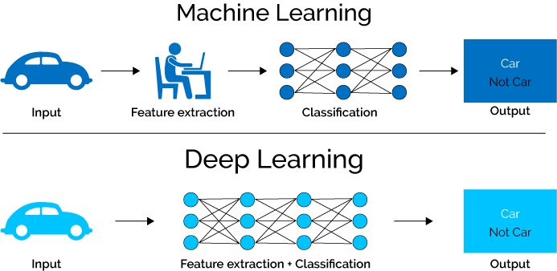
Today‘s Agenda
1. Need for Deep
Tackling Deep Problems
  2.1 Instable Gradient
  2.2 Overfitting
3. Convolutional
networks

Slide 3
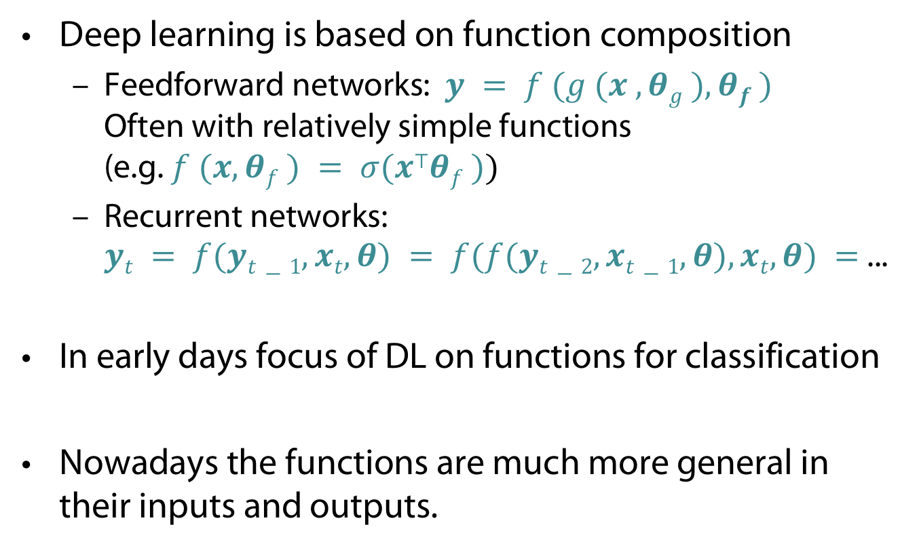
What is Deep Learning (DL)?
Deep learning is based on function composition
  Feedforward networks: $y = f (g (x , θg ), θf )$
  Often with relatively simple functions (e.g. $f (x, θf ) = σ(x⊤θf ))$
  Recurrent networks:
  $yt = f(yt−1,xt,θ) = f(f(yt−2,xt−1,θ),xt,θ) =$...
In early days focus of DL on functions for classification
Nowadays the functions are much more general in their inputs and outputs.

Slide 4
Network view of composed functions
Input layer
Hidden layer(s)
Output layer
w⁽¹⁾_{ij}
h₁
w⁽²⁾_{ij}
i: layer i
b_{i}: Bias in i
W^{(i)}: weight matrix in i
𝛔 _{i}: activation function in i
x₁
h₂
o₁
y‘₁
x₂
h₃
x₃
o₂
y‘₂
h₄
x₄
h₅
x
h
y‘
„States“
g
f
Functions
y‘ = f (g (x ; W ⁽¹⁾ ,b₁); W ⁽²⁾ ,b₂) = 𝛔₂ (W⁽²⁾ 𝛔 ₁(W⁽¹⁾ x +b₁ ) + b₂)

Slide 5
DL is based on Deep networks
Input layer
Hidden layer(s)
Output layer
h₁
w_{ij}
w^{(n-1)}_{ij}
w_{ij}
k₁
l₁
w^{(n)}_{ij}
x₁
h₂
k₂
l₂
o₁
x₂
h₃
k₃
l₃
...
x₃
o₂
h₄
k₄
l₄
x₄
h₅
k₅
l₅
k₆
x
h
k
l

Slide 6

Do we need to go deep?
Universal Approximation Theorem
Given
  $σ: ℝ →ℝ$ , nonconstant, bounded, continuous function
  $I_{m}$: m-dimensional hypercube ${\left[0,1\right]}^{m}$
  $C(I_{m})$: real-valued continuous functions on $I_{m}$
Any function $f∈C(I_{m})$can be approximated by a function of the form $F\left(x\right)= \sum_{i=1}^{N}{v_{i}}σ\left(w_{i}^{⊤}x+b_{i}\right)$
        (constants $v_{i}, b_{i} ,$vectors $w_{i}$)
i.e. $|F(x)−f(x)|<ε$for all $x ∈I_{m}$.
Hence : single-layer networks can represent a wide
variety of interesting functions

Slide 7
You need to go deep!
High precision (small ε) leads to large number of components in single layer (very large N).
  worst-case: exponential blow up
  E.g., parity function better implemented in a deep structure
All to good approximation not always good:
  Overfitting and missing generalizability (still holds for DL)
We should care about the data generating distribution
  Real-world data has significant structure
  Model this structure with hierarchy of increasingly more abstract latent (hidden) factors
Experience shows: Deeper networks better to handle

Slide 8
Slide reminder: What is Deep Learning?
Deep learning systems are neural network models similar to those popular in the ’80s and ’90s, with:
  some architectural and algorithmic innovations (e.g. many layers, ReLUs, dropout, LSTMs)
  vastly larger data sets (web-scale)
  vastly larger-scale compute resources (GPU, cloud)
  much better software tools (Theano, Torch, TensorFlow)
  vastly increased industry investment and media hype
Let‘s have a look into some of the innovations
mentioned above in 1.

Slide 9
No problem - no innovation
We already saw some problems in DL
We look again into them and others
  Gradient descent is hard
    Slow learning with MSE
    vanishing/exploding gradient
  Overfitting
  (Horrible symmetries in the data)

Slide 10
Instable Gradient

Slide 11
Lets talk about loss
The choice of loss function depends on the task (e.g. classification/regression/something else)
Depends also on the activation function of the last layer
  For numerical reasons many times the activation is computed directly within the loss rather than being part of the model
  Some classification losses require raw outputs (e.g. a linear layer) of the network as their input (logits)
  There are are different loss functions for different tasks (MSE, Cross-Entropy, ...)

Slide 12

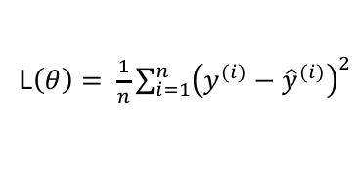

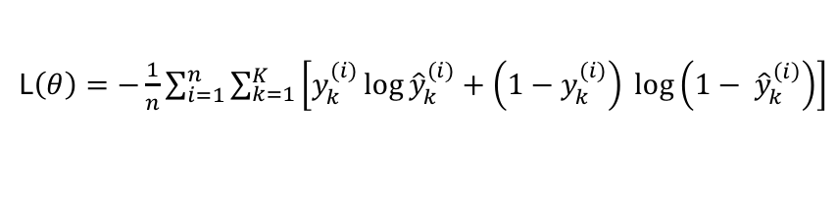
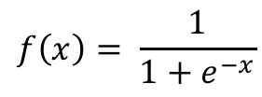

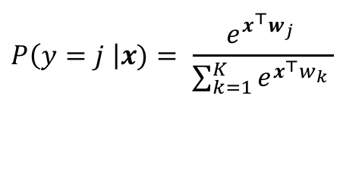

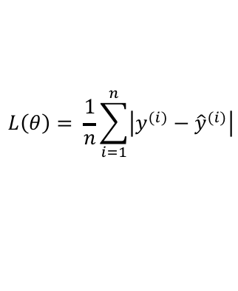
Loss functions and output
Multilabel (overlapping)/
Multiclass (disjoint) Classification
Regression
Training
examples
$$ℝn xℝm$$
$ℝn$x {class_1, ..., class_n}
Sigmoid
$$f\left(x\right)= \frac{1}{1+e^{−x}}$$
Output
Layer
Linear (Identity)
or Sigmoid
Soft-max [map $ℝn$ to a probability distribution]
$$P\left(y=j \right|x)= \frac{e^{x^{⊤}w_{j} }}{\sum_{k=1}^{K}{e^{x^{⊤}w_{k} }}}$$
f(x)=x
Cost (loss)
function
Cross-entropy
Mean Squared Error
L$\left(θ\right)= \frac{1}{n}\sum_{i=1}^{n}{{\left(y^{(i)}−{\hat{y}}^{(i)}\right)}^{2}}$
L$\left(θ\right)=−\frac{1}{n}\sum_{i=1}^{n}{\sum_{k=1}^{K}{\left[y_{k}^{(i)}\log{{\hat{y}}_{k}^{(i)}+\left(1−y_{k}^{(i)}\right) }\log\left(1− {\hat{y}}_{k}^{\left(i\right)}\right)\right]}}$
Mean Absolute Error
$$L\left(θ\right)= \frac{1}{n}\sum_{i=1}^{n}{\left|y^{(i)}−{\hat{y}}^{(i)}\right|}$$
Notes:
Exponentiate to make it positive
MSE has nice mathematical properties which makes it easier to compute the gradient
Because of the square, large errors have relatively greater influence on MSE.
Therefore, MAE is more robust to outliers since it does not make use of square.

Slide 13
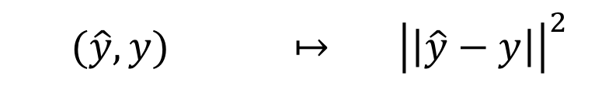
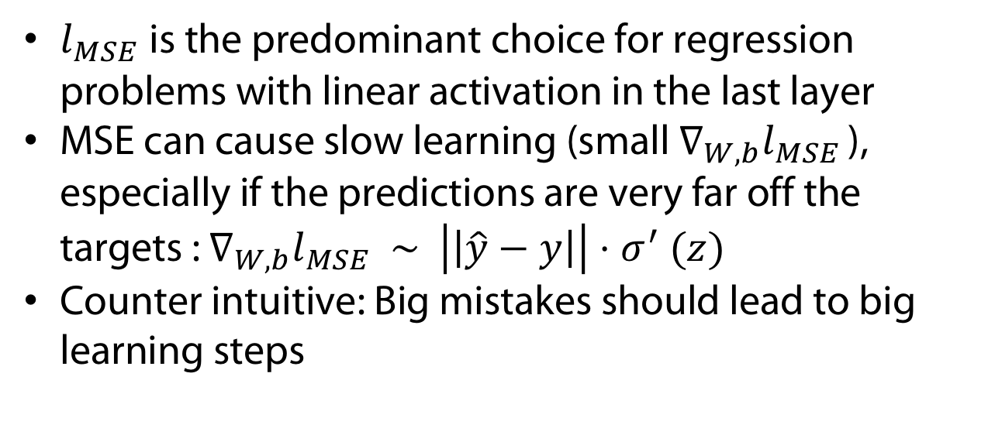
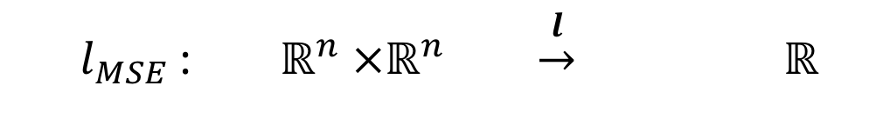
Slow learning with MSE
Mean squared error on one single training example
  $l_{MSE}$: $ℝ^{n} ×ℝ^{n} \underset{→}{l} ℝ^{}$
  $$(\hat{y}, y) ↦ {\left|\left|\hat{y}−y\right|\right|}^{2}$$
$l_{MSE}$is the predominant choice for regression problems with linear activation in the last layer
MSE can cause slow learning (small $∇_{W,b}l_{MSE }$), especially if the predictions are very far off the targets : $∇_{W,b}l_{MSE }∼$ $\left|\left|\hat{y}−y\right|\right|{⋅σ}^{′}(z)$
Counter intuitive: Big mistakes should lead to big learning steps

Slide 14
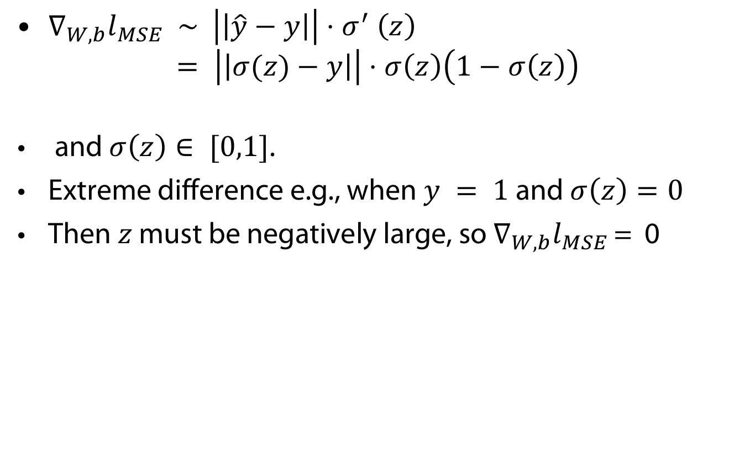
If you are curious: the argument in detail
$∇_{W,b}l_{MSE }∼$ $\left|\left|\hat{y}−y\right|\right|{⋅σ}^{′}\left(z\right)$
$= \left|\left|σ(z)−y\right|\right|⋅σ\left(z\right)\left(1−σ\left(z\right)\right)$
and $σ\left(z\right)∈ [0,1]$.
Extreme difference e.g., when $y = 1$and $σ\left(z\right)=0$
Then $z$ must be negatively large, so $∇_{W,b}l_{MSE }$= 0

Slide 15
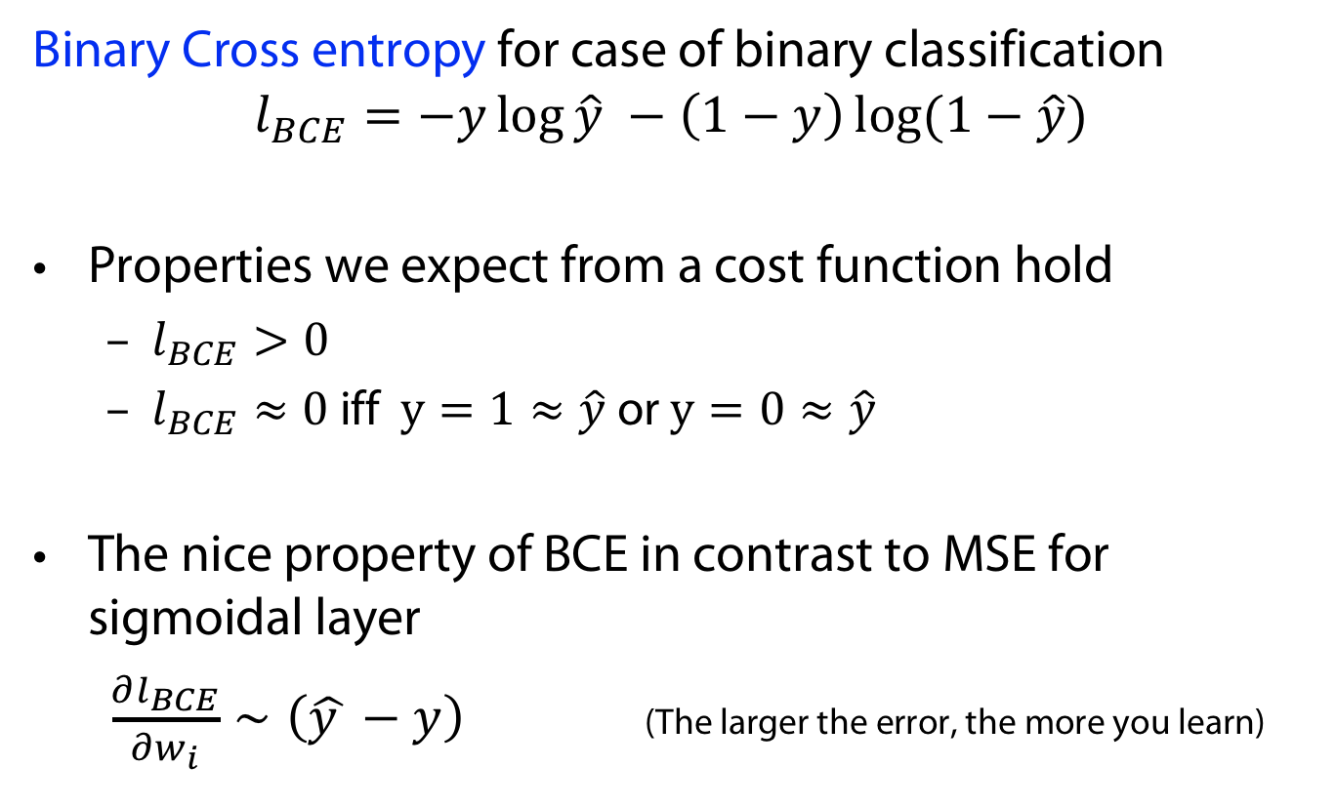
Better Choice: Binary Cross-Entropy
Binary Cross entropy for case of binary classification
$$l_{BCE}=−y\log{\hat{y} −\left(1−y\right)\log{(1−\hat{y})}}$$
Properties we expect from a cost function hold
  $l_{BCE}>0$
  $l_{BCE}≈0$ iff $y=1≈\hat{y}$or $y=0≈\hat{y}$
The nice property of BCE in contrast to MSE for sigmoidal layer
$\frac{∂l_{BCE}}{∂w_{i}}∼\left(\hat{y }−y\right)$ (The larger the error, the more you learn)

Slide 16
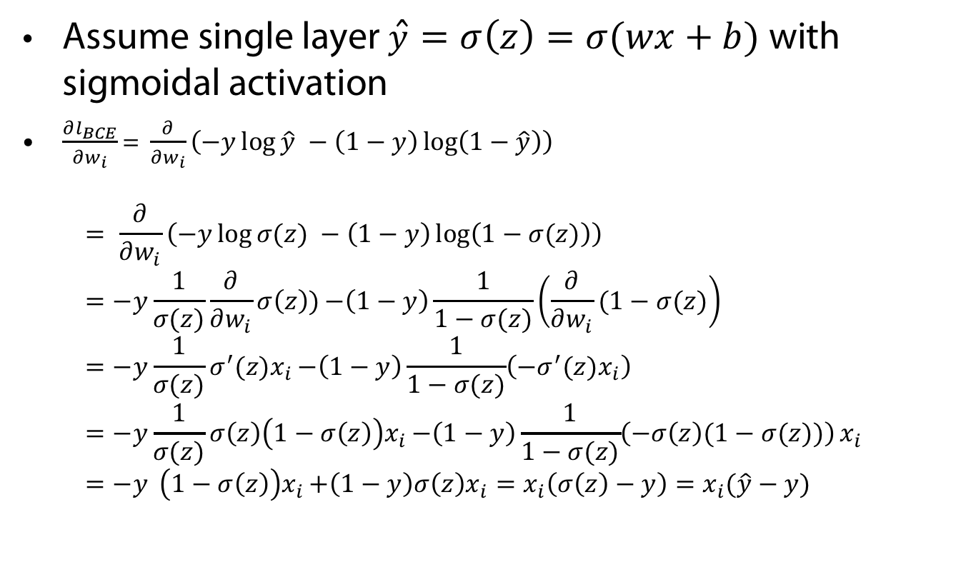

If you are curious $\frac{∂l_{BCE}}{∂w_{i}}∼(\hat{y }−y)$
Assume single layer $\hat{y}=σ\left(z\right)=σ(wx+b)$with sigmoidal activation
$\frac{∂l_{BCE}}{∂w_{i}}$ = $\frac{∂}{∂w_{i}}\left(−y\log{\hat{y} −\left(1−y\right)\log\left(1−\hat{y}\right)}\right)$
$= \frac{∂}{∂w_{i}}\left(−y\log{σ(z) −\left(1−y\right)\log\left(1−σ(z)\right)}\right)$
$=−y\frac{1}{σ(z)}\frac{∂}{∂w_{i}}σ\left(z\right)){−\left(1−y\right)\frac{1}{1−σ(z)}\left(\frac{∂}{∂w_{i}}(1−σ(z)\right)}$
$=−y\frac{1}{σ(z)}σ^{′}(z)x_{i}{−\left(1−y\right)\frac{1}{1−σ(z)}\left(−σ^{′}(z)x_{i}\right)}$
$=−y\frac{1}{σ(z)}σ\left(z\right)\left(1−σ\left(z\right)\right)x_{i}{−\left(1−y\right)\frac{1}{1−σ(z)}\left(−σ\left(z\right)(1−σ(z))\right)}x_{i}$
$=−y\left(1−σ\left(z\right)\right)x_{i}{+\left(1−y\right)σ\left(z\right)x_{i}}=x_{i}\left(σ\left(z\right)−y\right)=x_{i}(\hat{y}−y)$

Slide 17
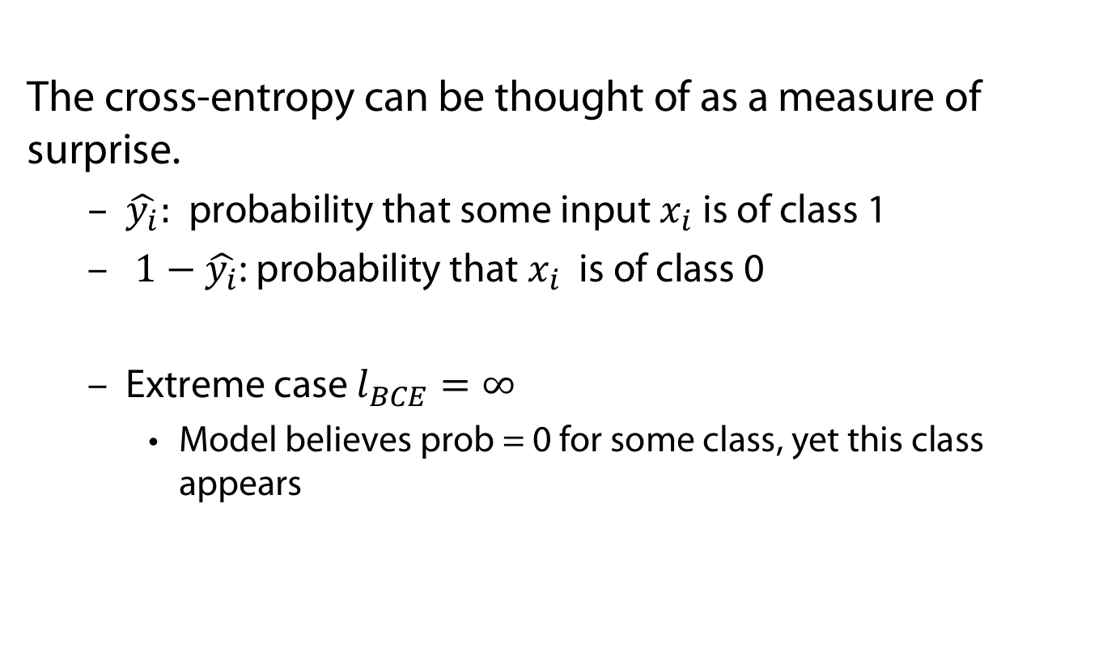
BCE: Intuition
The cross-entropy can be thought of as a measure of surprise.
  $\hat{y_{i}}:$probability that some input $x_{i}$ is of class 1
  $1−\hat{y_{i}}$: probability that $x_{i}$ is of class 0
  Extreme case $l_{BCE}=∞$
    Model believes prob = 0 for some class, yet this class appears

Slide 18
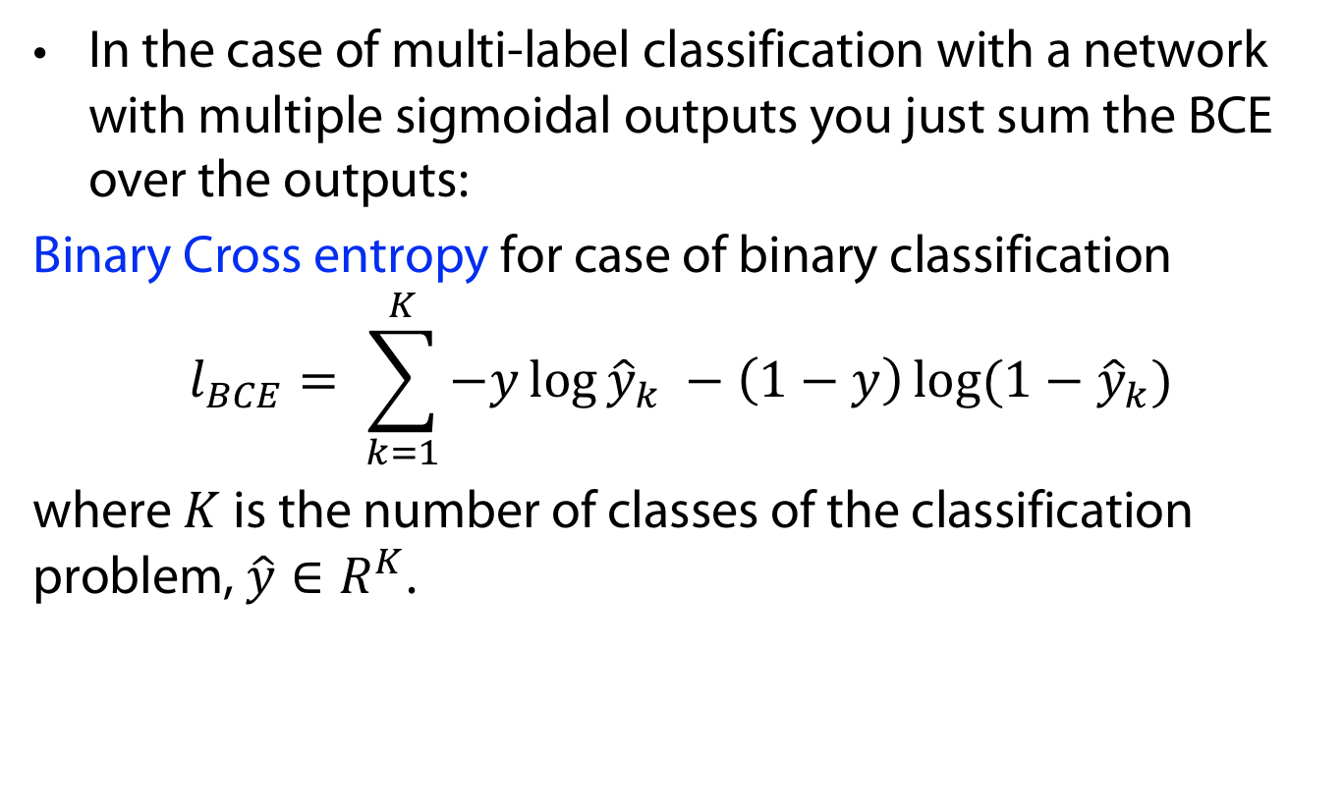
BCE for multiple labels
In the case of multi-label classification with a network with multiple sigmoidal outputs you just sum the BCE over the outputs:
Binary Cross entropy for case of binary classification
$$l_{BCE}= \sum_{k=1}^{K}{−y\log{{\hat{y}}_{k} −\left(1−y\right)\log{(1−{\hat{y}}_{k})}}}$$
where $K$ is the number of classes of the classification problem, $\hat{y}∈R^{K}$.

Slide 19
Vanishing and exploding (unstable) gradients
In training, the gradient may become vanishingly small (or large), effectively preventing the weight from changing its value (or exploding in value).
This leads to the neural network not being able to train.
This issue affects many-layered networks (feed-forward), as well as recurrent networks.
In principle, optimisers that rescale the gradients of each weight should be able to deal with this issue

Slide 20

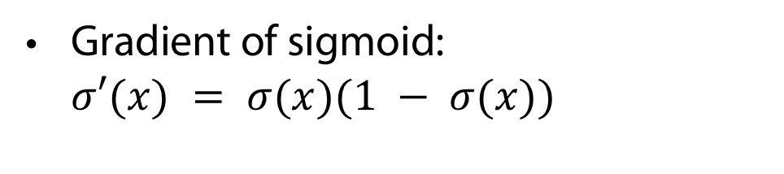

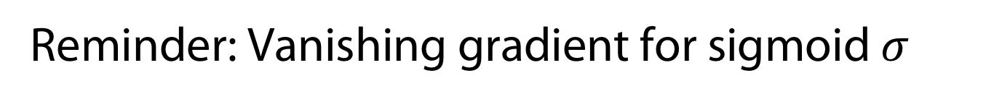

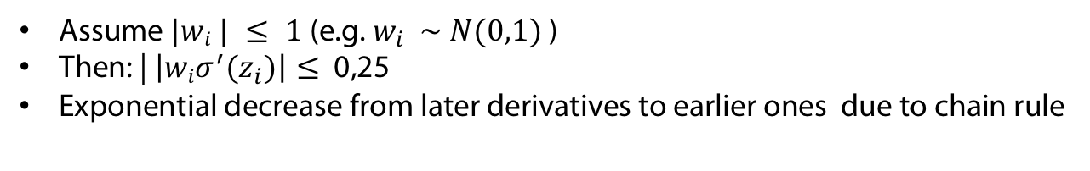

Reminder: Vanishing gradient for sigmoid $σ$
Gradient of sigmoid: $σ′(x) = σ(x)(1 − σ(x))$
Max{$σ^{′}\left(x\right)\}$
$$=0.25$$
Gradients in linear network of depth 4
$≤$0,25
$≤$0,25
$≤$0,25
Assume $|wi | ≤ 1$(e.g. $w_{i} \sim N(0,1)$)
Then: | $\left|wiσ^{′}(z_{i})\right|≤$0,25
Exponential decrease from later derivatives to earlier ones due to chain rule
Gradient vanishes moving backwards

Slide 21


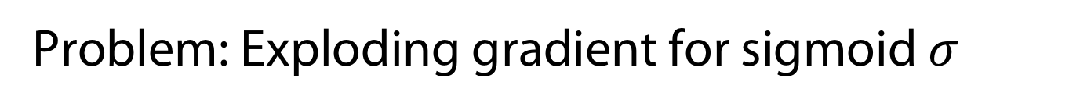
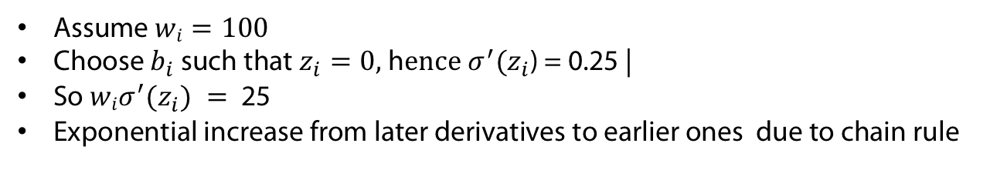

Problem: Exploding gradient for sigmoid $σ$
Gradient of sigmoid: $σ′(x) = σ(x)(1 − σ(x))$
Max{$σ^{′}\left(x\right)\}$
$$=0.25$$
Gradients in linear network of depth 4
=25
$=$25
$$=25$$
But the main point is instabiliy!
In large networks no
easily balanceing out learning
Rates due to multiplicaiton
Assume $wi=100$
Choose $b_{i}$ such that $z_{i}=0,$h$ence{ σ}^{′}(z_{i}$) = 0.25 |
So $wiσ^{′}(z_{i}) =$25
Exponential increase from later derivatives to earlier ones due to chain rule
Gradient explodes moving backwards

Slide 22
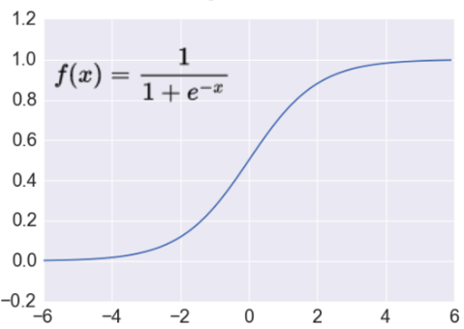
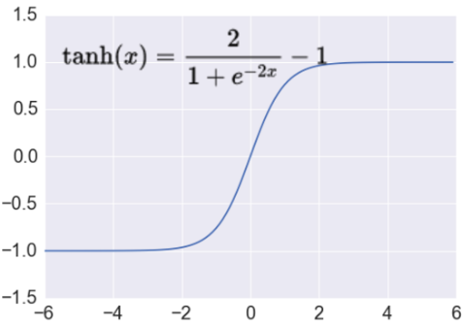
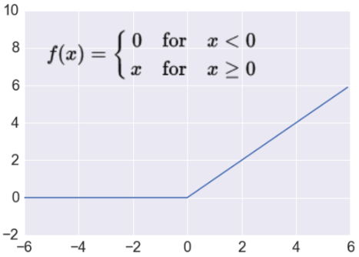
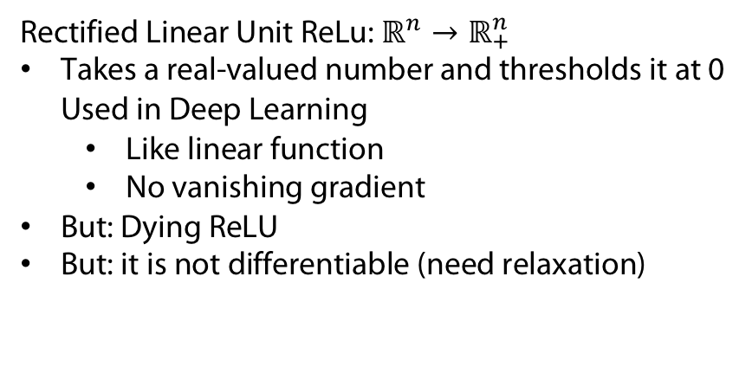
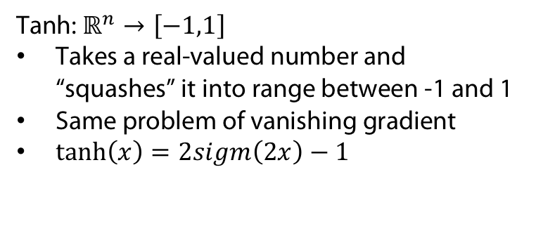

Tackling vanishing gradients II
http://adilmoujahid.com/images/activation.png
Sigmoid
$$ℝ^{n}→\left[0,1\right]$$
Takes a real-valued number and “squashes” it into range between 0 and 1.
Earliest used activation function (neuron)
Leads to vanishing gradient problem
Tanh: $ℝ^{n}→\left[−1,1\right]$
Takes a real-valued number and “squashes” it into range between -1 and 1
Same problem of vanishing gradient
$\tanh\left(x\right)=2sigm\left(2x\right)−1$
Rectified Linear Unit ReLu: $ℝ^{n}→ℝ_{+}^{n}$
Takes a real-valued number and thresholds it at 0 Used in Deep Learning
  Like linear function
  No vanishing gradient
But: Dying ReLU
But: it is not differentiable (need relaxation)
Because no saturation
(for positive x)

Slide 23
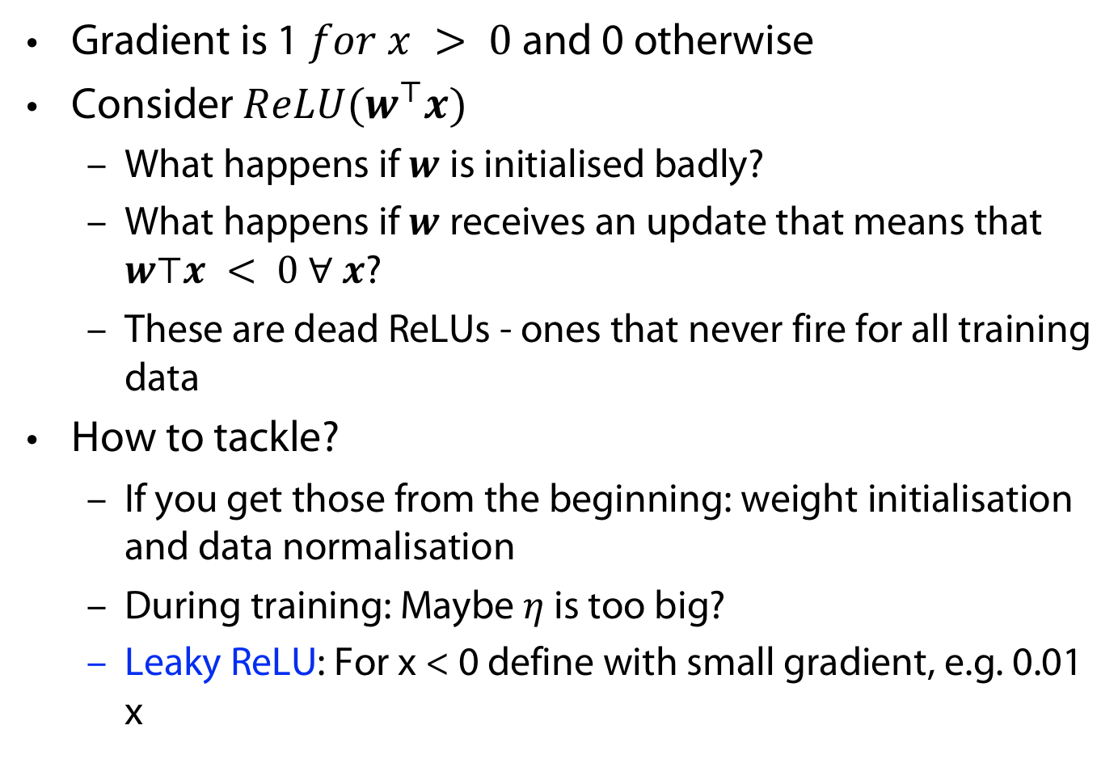
Problem: Dying ReLUs
Gradient is 1 $for x > 0$and 0 otherwise
Consider $ReLU(w^{⊤}x)$
  What happens if $w$ is initialised badly?
  What happens if $w$ receives an update that means that $w⊤x < 0 ∀ x$?
  These are dead ReLUs - ones that never fire for all training data
How to tackle?
  If you get those from the beginning: weight initialisation and data normalisation
  During training: Maybe $η$ is too big?
  Leaky ReLU: For x < 0 define with small gradient, e.g. 0.01 x

Slide 24
Tackling vanishing gradients II
Residual Networks (ResNets ) use skip connections to jump over layers.
The vanishing gradient problem is mitigated in ResNets by reusing activations from a previous layer.
Is this the full story though? Skip connections also break symmetries, which could be much more important...
K. He, X. Zhang, S. Ren, and J. Sun. Deep Residual Learning for Image Recognition. arXiv e-prints, page arXiv:1512.03385, Dec. 2015.

Slide 25
Overfitting

Slide 26
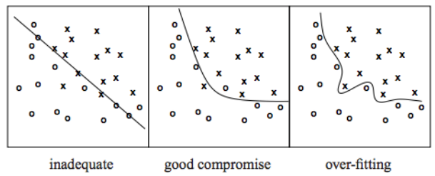
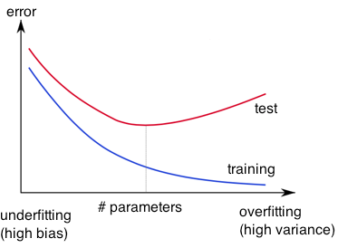
Overfitting
http://wiki.bethanycrane.com/overfitting-of-data
Learned hypothesis may fit the training data very well, even outliers (noise) but fail to generalize to new examples (test data)
https://www.neuraldesigner.com/images/learning/selection_error.svg

Slide 27
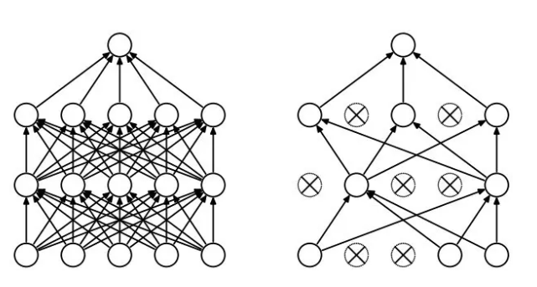
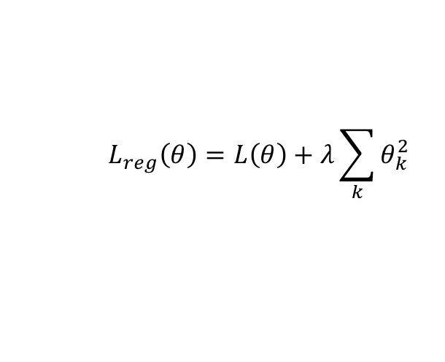
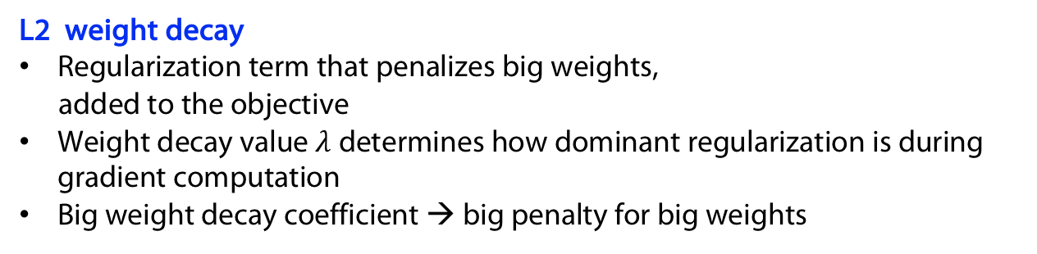
Against Overfitting: Regularization
Dropout
Randomly drop units (along with their connections) during training
Each unit retained with fixed probability p, independent of other units
Hyper-parameter p to be chosen (tuned)
Srivastava, Nitish, et al. "Dropout: a simple way to prevent neural networks from overfitting." Journal of machine learning research (2014)
L2 weight decay
Regularization term that penalizes big weights,
added to the objective
Weight decay value $λ$determines how dominant regularization is during gradient computation
Big weight decay coefficient → big penalty for big weights
$$L_{reg}\left(θ\right)=L\left(θ\right)+λ\sum_{k}{θ_{k}^{2}}$$
Early-stopping
Use validation error to decide when to stop training
Stop when monitored quantity has not improved after n (patience) subsequent epochs
Smooting landscape
E.g. batch normalisation

Slide 28
How and why Dropout works
HOW
  In the learning phase, we set a dropout probability for each layer in the network.
  For each batch we then randomly decide whether or not a given neuron in a given layer is removed.
WHY
  Neurons cannot co-adapt to other units (they cannot assume that all of the other units will be present)
  By breaking co-adaptation, each unit will ultimately find more general features

Slide 29
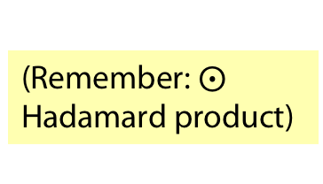
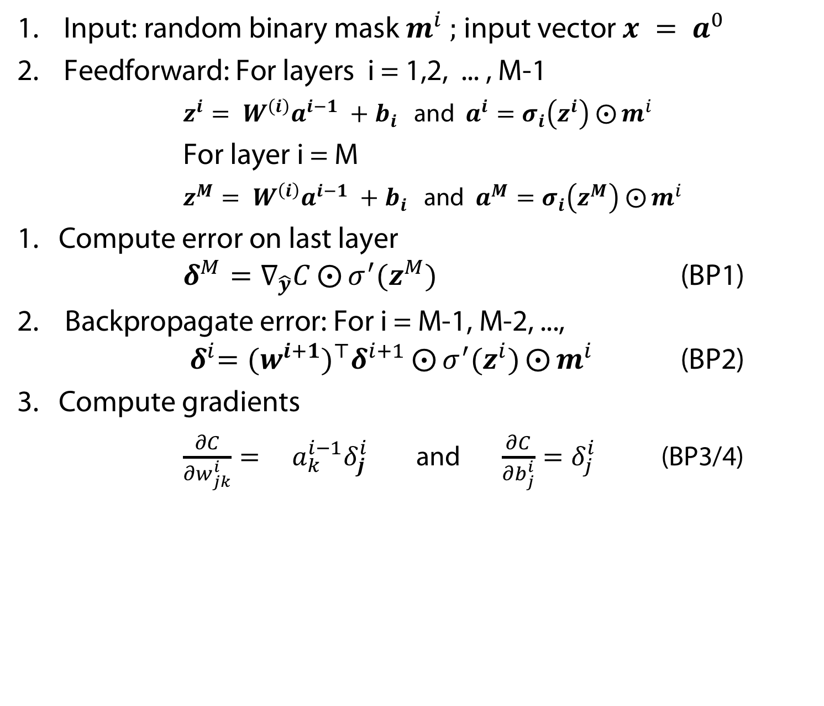
Dropout = Backprop with random masking
Input: random binary mask $m^{i} ;$input vector $x = a^{0}$
Feedforward: For layers i = 1,2, ... , M-1
    $z^{i}= W^{\left(i\right)}a^{i−1} +b_{i}$ and $a^{i}=σ_{i}\left(z^{i}\right)$ $⨀{m^{i} }$
For layer i = M
    $z^{M}= W^{\left(i\right)}a^{i−1} +b_{i}$ and $a^{M}=σ_{i}\left(z^{M}\right)$ $⨀{m^{i} }$
Compute error on last layer $δ^{M}=∇_{\hat{y}}C⨀{σ^{′}(z^{M}) }$ (BP1)
Backpropagate error: For i = M-1, M-2, ..., ${ δ}^{i}={{(w}^{i+1})}^{⊤}δ^{i+1}⨀{σ^{′}(z^{i})⨀{m^{i} }}$ (BP2)
Compute gradients
  $\frac{∂C}{∂w_{jk}^{i}}= a_{k}^{i−1}δ_{j}^{i}$ and $\frac{∂C}{∂b_{j}^{i}}=δ_{j}^{i}$ (BP3/4)
(Remember:
Hadamard product)

Slide 30
Convolutional Networks

Slide 31
Deep Learning (ad 1.)
Example family car: we presumed features
price and mileage
Classical Machine Learning
Deep Learning
Adapted from https://www.xenonstack.com/blog/static/public/uploads/media/machine-learning-vs-deep-learning.png

Slide 32
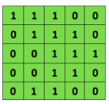
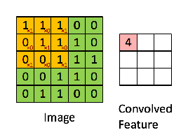

Convolutional networks
More structure: structure of input, local receptive fields (the 1. “rf”)
Less parameters:
  weight tying (replication features 2. “rf”),
  pooling
Convolutional
3x3 filter
Input matrix
http://deeplearning.stanford.edu/wiki/index.php/Feature_extraction_using_convolution
Notes:
http://www.asimovinstitute.org/neural-network-zoo/

Slide 33
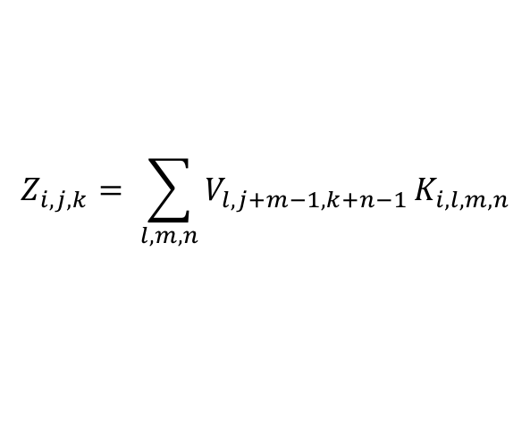
Realization in network: structure of input
Work with tensors of any number of dimensions
  (Audio-mono (1D, 1 Channel); audio stereo (1D, 2 channels) colour-video data (3D, color-dim)
  input is,say, N x P x Q
    N is the “channels” dimension
    P , Q are the spatial dimensions,
  Define convolutional kernel of size N x K x L
Usually more than single feature -> many kernels -> many feature maps
We can just add another dimension to the kernel tensor to incorporate convolution with all kernels in one operation:
$$Z_{i,j,k}= \sum_{l,m,n}{V_{l,j+m−1,k+n−1}}K_{i,l,m,n}$$

Slide 34
Realization in network: RF and weight tying
Receptive field: no full meshing inbetween layers
  In case of example at each step of sliding:
    consider only 3 x 3 submatrix of input matrix with (formally other weights are set to zero)
  The weights for all the 3x3 submatrices of the input matrix get the same (!) weight (given by the convolutional filter/kernel)
  Considering all timesteps instantaneously gives you a single layer (restructured as matrix „Convoluted Feature“ with smaller dimension)
Considering many kernels gives you stacked layers

Slide 35
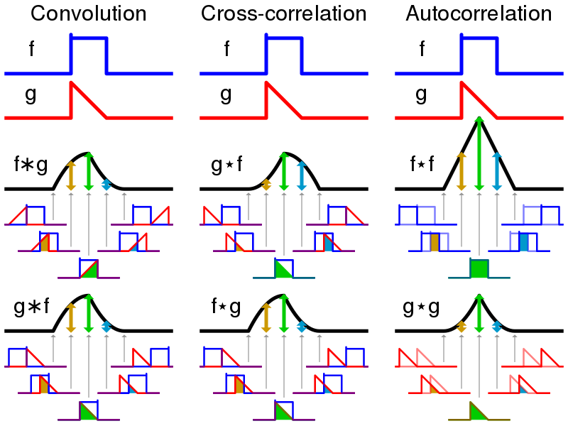
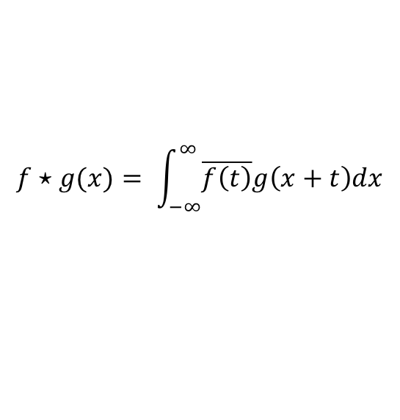
Terminology stems from signal processing
But: „Convolution“ in neural networks corresponds to cross-correlation
$$f⋆g(x)= \int_{−∞}^{∞}{\overline{f\left(t\right)}g\left(x+t\right)dx}$$

Slide 36
The replicated feature approach
(currently the dominant approach for neural networks)
Use many different copies of the same feature detector with different positions.
  Could also replicate across scale and orientation (tricky and expensive)
  Replication greatly reduces the number of free parameters to be learned.
Use several different feature types, each with its own map of replicated detectors.
  Allows each patch of image to be represented in several ways.
The red connections all have the same weight.

Slide 37
Why replicating the feature detectors?
Equivariant activities: The activities are translation equivariant.
Invariant knowledge: If a feature is useful in some locations during training, detectors for that feature will be available in all locations during testing.
Mathematically: f is equivariant w.r.t. g iff f(g(x)) = g(f(x)) (diagram above commutes)
representation by active neurons
g
translated representation
f
f
g
translated image
image

Slide 38
Pooling and Striding
Get a small amount of translational invariance at each level by averaging four neighboring replicated detectors to give a single output to the next level.
  This reduces the number of inputs to the next layer of feature extraction, thus allowing us to have many more different feature maps.
  Taking the maximum of the four works slightly better.
Modern deep networks also use striding as dimension reduction: sliding kernel window with slide/step larger than 1
Maxpool with
Stride 2

Slide 39
Le Net
Yann LeCun and his collaborators developed a really good recognizer for handwritten digits by using backpropagation in a feedforward net with:
  Many hidden layers
  Many maps of replicated units in each layer.
  Pooling of the outputs of nearby replicated units.
  A wide net that can cope with several characters at once even if they overlap.
  A clever way of training a complete system, not just a recognizer.
This net was used for reading ~10% of the checks in North America.
Look the impressive demos of LENET at http://yann.lecun.com

Slide 40
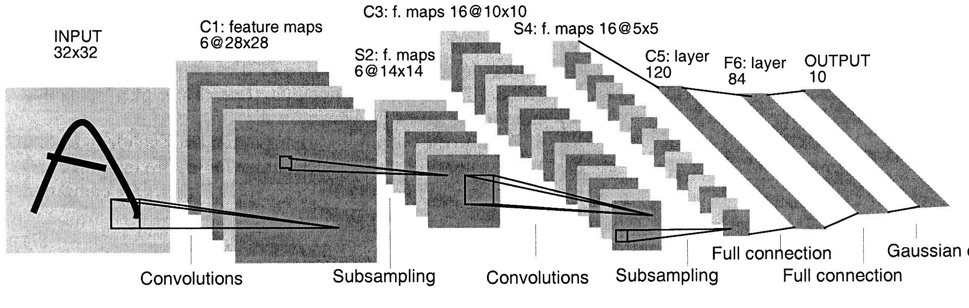
The architecture of LeNet5

Slide 41
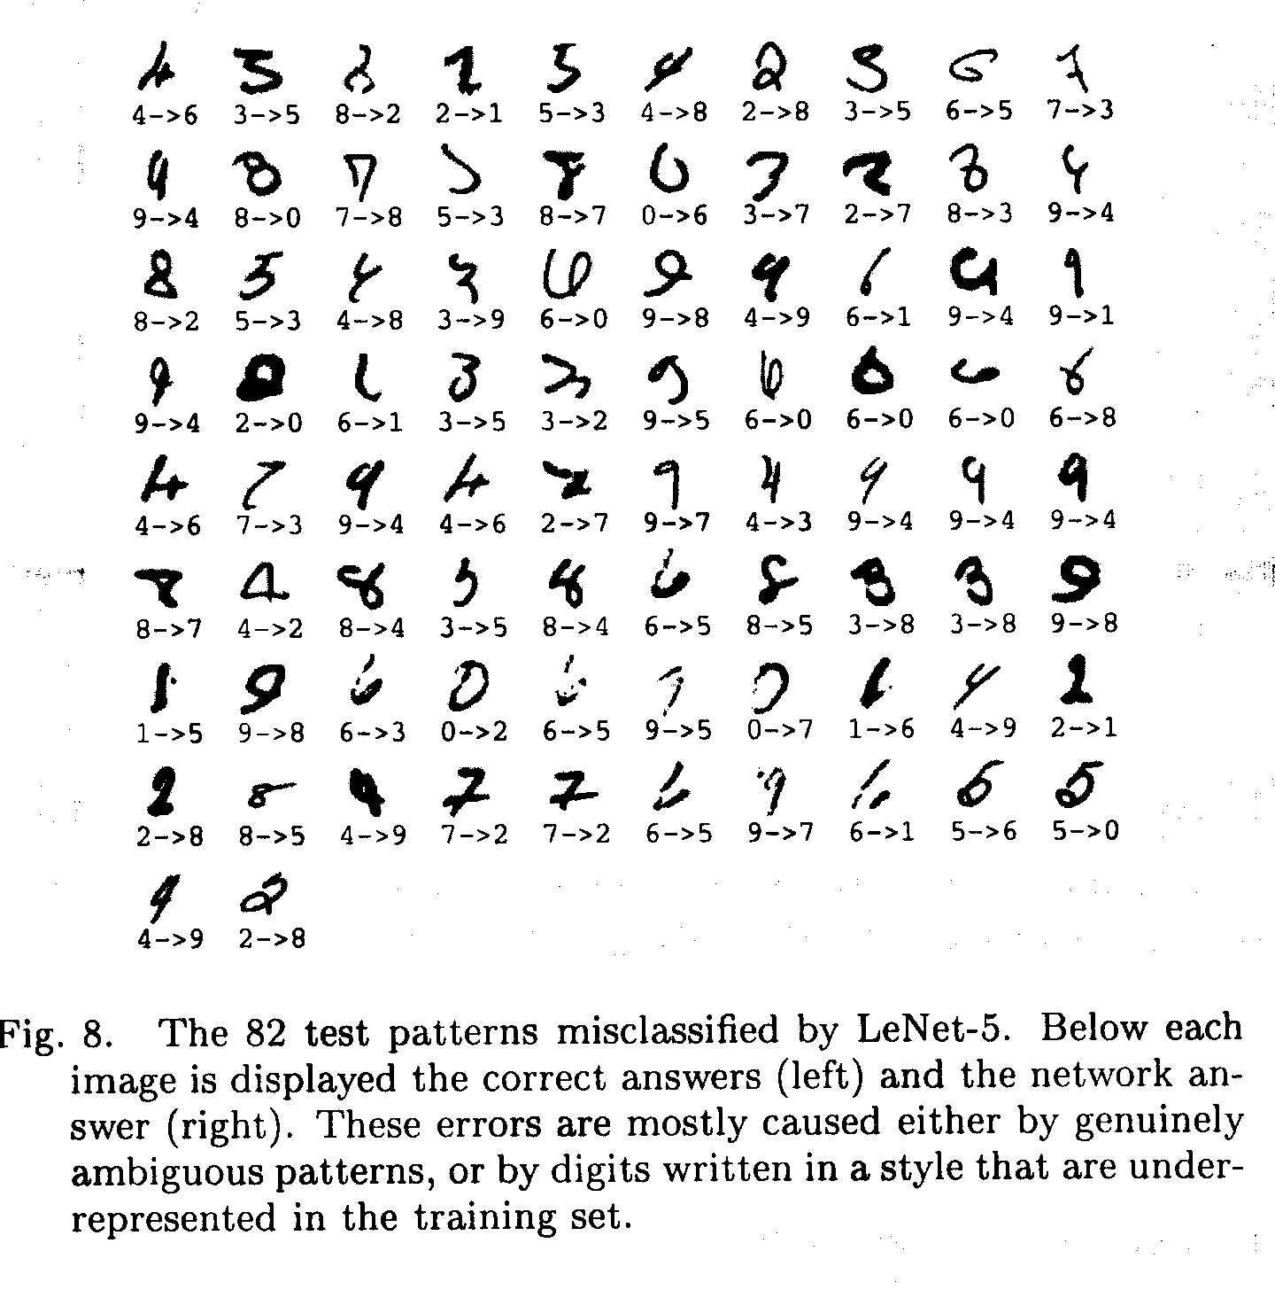
The 82 errors made by LeNet5
Notice that most of the errors are cases that people find quite easy.
The human error rate is probably 20 to 30 errors but nobody has had the patience to measure it.
There has been many further improvements
with this application in mind
Ranzato 2008: use tricks to lower to 40
Ciresan et al. 2010: Enlarge dataset

Slide 42
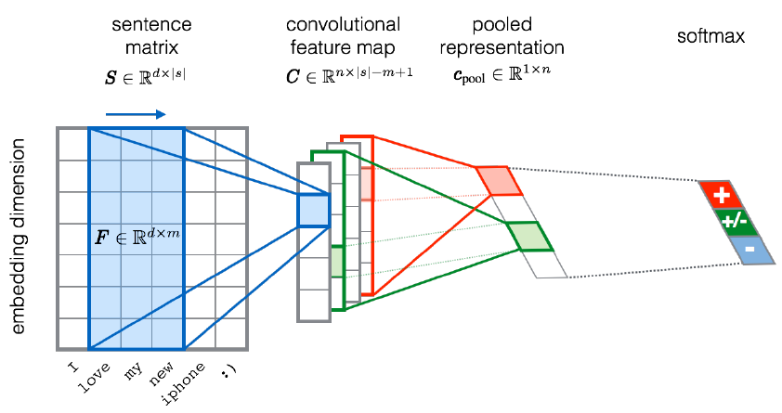
CNN for text classification
Severyn, Aliaksei, and Alessandro Moschitti. "UNITN: Training Deep Convolutional Neural Network for Twitter Sentiment Classification." SemEval@ NAACL-HLT. 2015.
Notes:
the width m of the convolution filters is set to 5
n = 300 feature maps
first layer embeds words into low-dimensional vectors.

Slide 43
APPENDIX
Uhhh, a lecture with a hoepfully useful

Slide 44
Color Convention in this course
Formulae, when occurring inline
Newly introduced terminology and definitions
Important results (observations, theorems) as well as emphasizing some aspects
Examples are given with standard orange with possibly light orange frame
Comments and notes
Algorithms

Slide 45
Todays lecture is based on the following
Jonathon Hare: Lectures 2,7,10 of course „COMP6248 Differentiable Programming (and some Deep Learning)“ http://comp6248.ecs.soton.ac.uk/
Nielsen: Neural Networks and Deep Learning. http://neuralnetworksanddeeplearning.com/, chapter 6
Geoofrey Hinton: Lecture 6a,
Convolutional neural networks for hand-written digit recognition CSC2535: Advanced Machine Learning

