Slide 1
PROBABILISTIC AND DIFFERENTIABLE PROGRAMMING V6: Deep Learning III (Autoencoders, GANs)
Özgür L. Özçep
Universität zu Lübeck
Institut für Informationssysteme

Slide 2
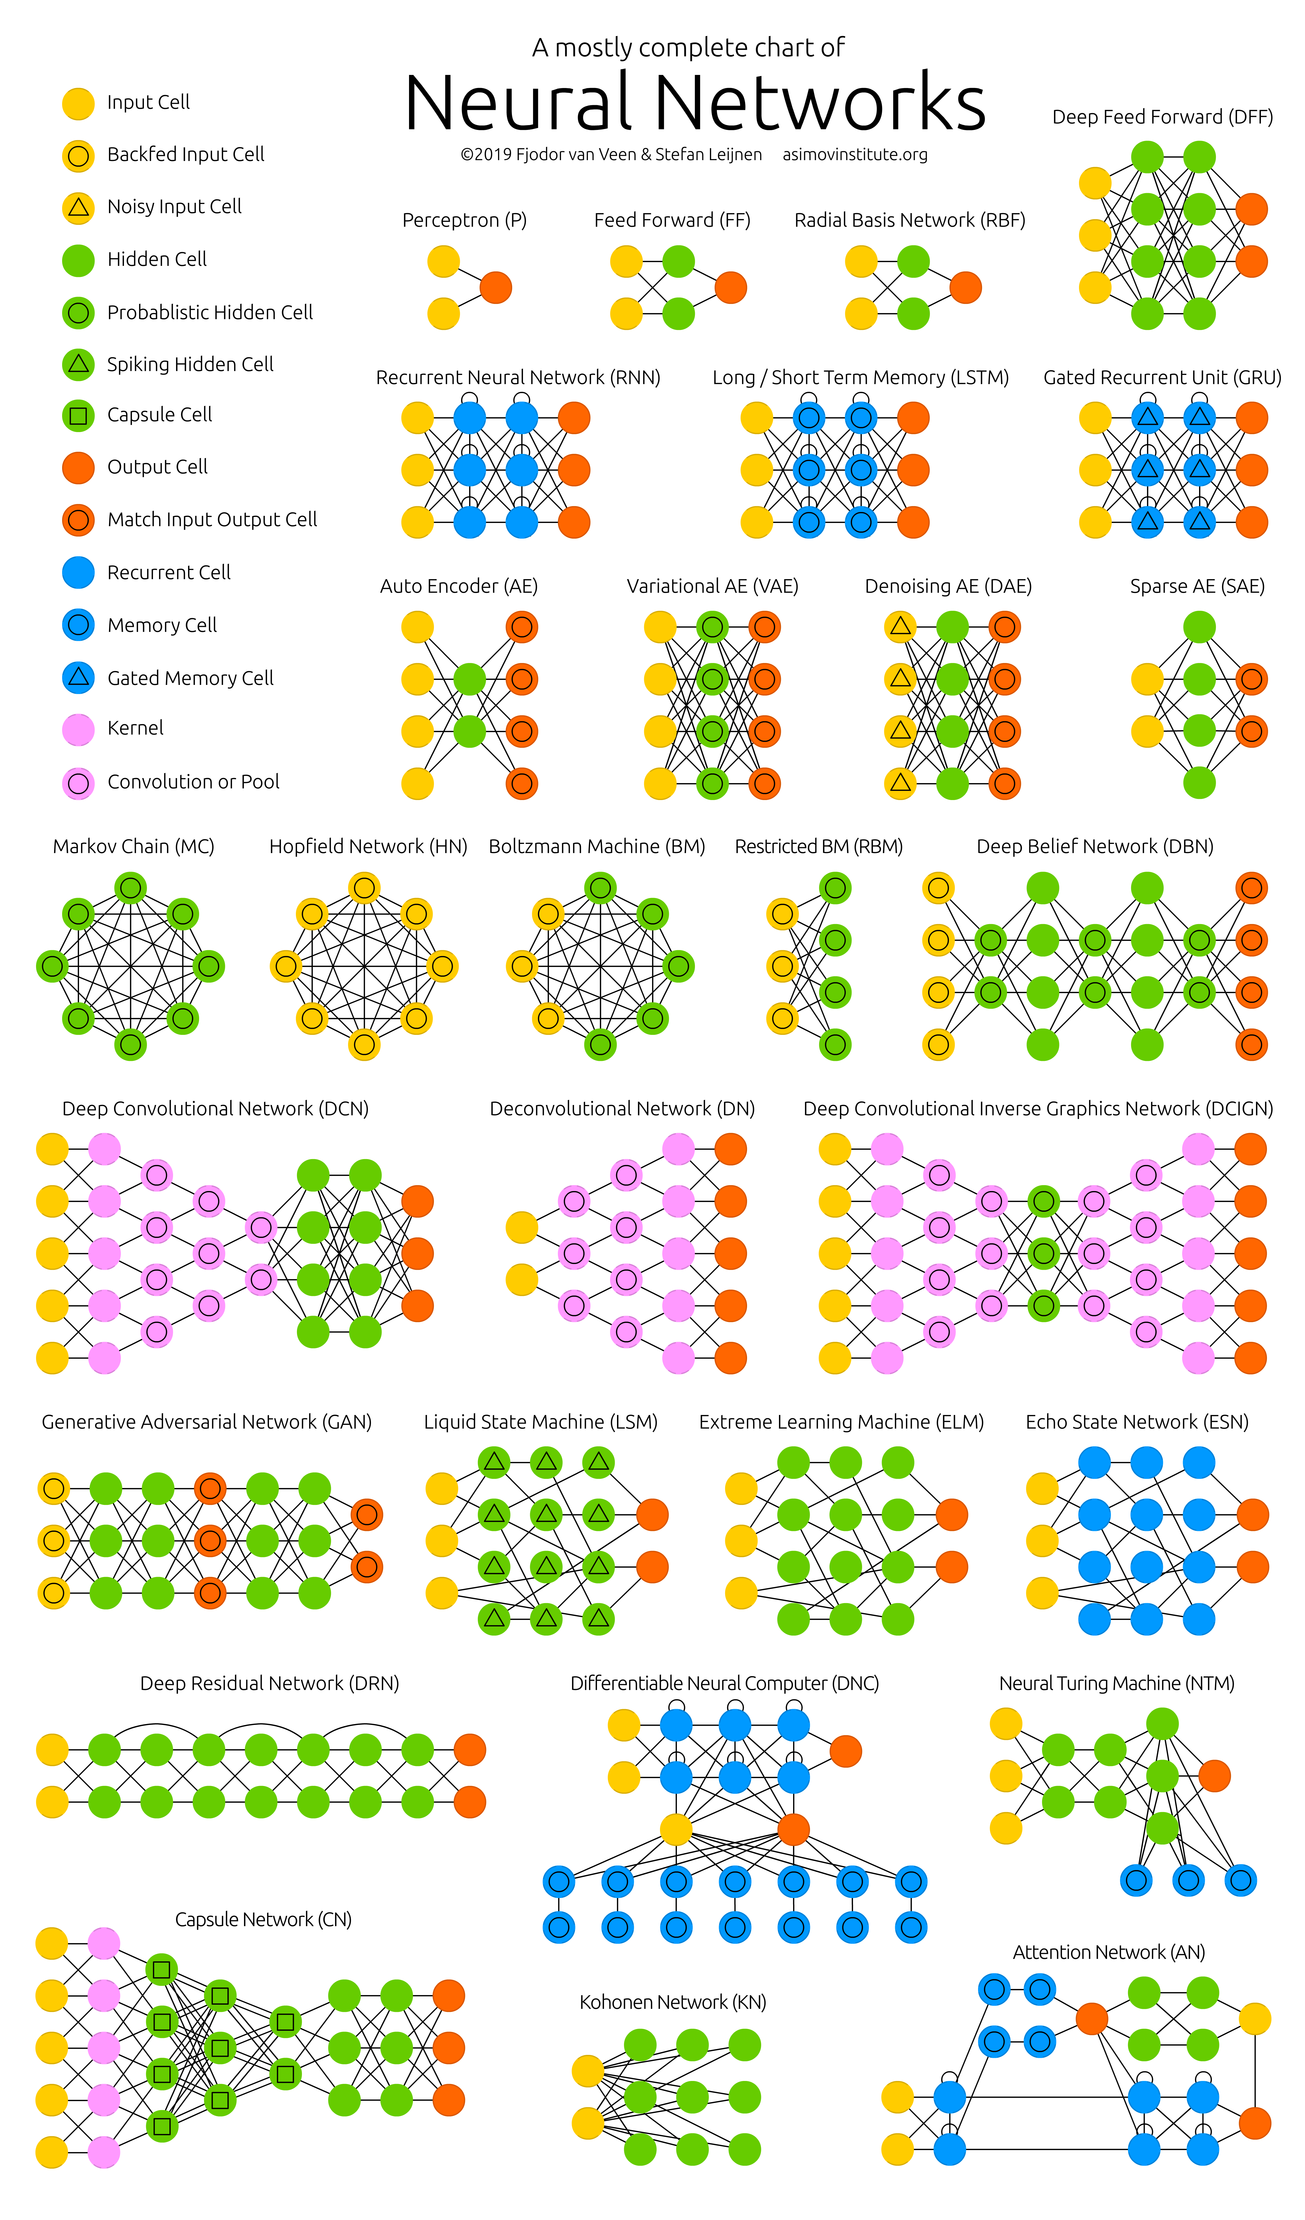
Today‘s Agenda
Deep⁺⁺ Networks
1. Same-Same but different:
Autoencoders
2. Imagine me GAN:
Generative adverserial networks

Slide 3
Autoencoders

Slide 4
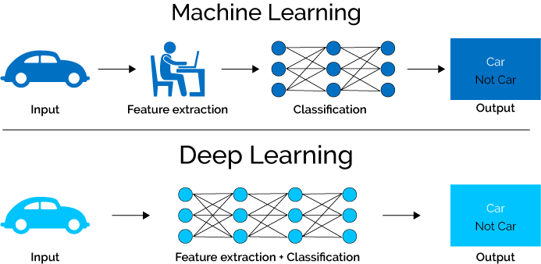
Autoencoders for Feature Extraction
Example family car: we presumed features
price and mileage
Classical Machine Learning
Deep Learning
Adapted from https://www.xenonstack.com/blog/static/public/uploads/media/machine-learning-vs-deep-learning.png

Slide 5
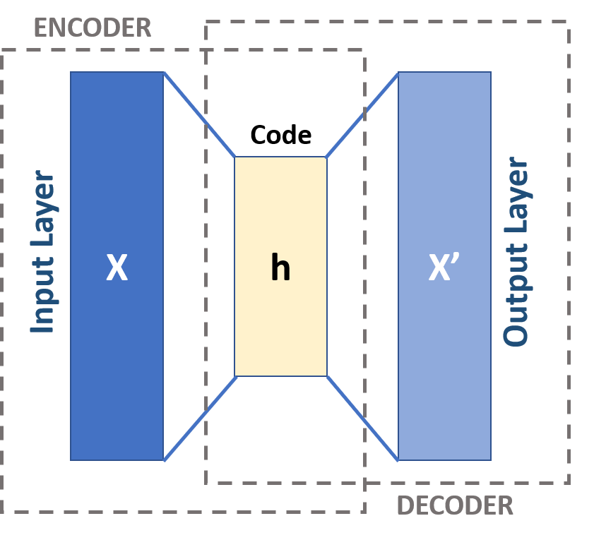
An autoencoder is a network that is trained to copy its input to its output
Internally there is some hidden vector $h$ that describes a code that represents the input.
Conceptually it consists of two parts
Encoder $h = f(x)$
Decoder $r = g(h)$
and has loss that tries to minimise the reconstruction error (typically MSE)
f
g

Slide 6
Autoencoder constraints (Same-same but different)
A linear autoencoder with a sufficient number of weights (e.g. if the dimension of $h$ was greater than or equal to that of $x$) could learn $g(f(x)) = x$, but this wouldn’t be useful!
In practice we apply restrictions (inductive biases) to stop this happening.
The objective is to use these restrictions to force the autoencoder to learn useful properties of the data.

Slide 7
Undercomplete Autoencoders - linear
Undercomplete autoencoders have
$$dim⁡(h) << dim⁡(x)$$ This forces the encoder to learn a compressed representation of the input.
The representation will capture the most salient features of the input data.

Slide 8
Undercomplete Autoencoders - linear
Consider the single-hidden layer linear autoencoder network given by:
$h = W_{e}x + b_{e}$
$r = W_{d}h + b_{d}$
where $x∈ℝ^{n} , h∈ℝ^{m}$ and $m<n$.
With the MSE loss, this autoencoder will learn to span the same subspace as PCA for a given set of training data.
Note that the autoencoder weights are not however constrained to be orthogonal (like they would be in PCA)

Slide 9
Reminder: PCA, SVD, LSI
PCA= Principal Component Analysis
Find principal components of a linear mapping given by a matrix A
SVD: Singular Value Decomposition
Other name with emphasis on the singular values of $A$
Based on these: LSI: Latent Semantic Indexing
Document matrix $A$
Documents
Terms

Slide 10
Reminder: Decomposition
$A$
$A$
[Wikipedia]

Slide 11
Reminder: Low-rank Approximation
SVD can be used to compute optimal low-rank approximations for a matrix $A$ of rank $r$
Approximation problem: Find $Ak$ of rank $k$ such that
$Ak$ and $X$ are both $mn$ matrices
Typically, want $k << r$
Frobenius norm

Slide 12
Reminder: Low-rank Approximation
Solution via SVD
set smallest r-k
singular values to zero
C. Eckart, G. Young, The approximation of a matrix by another of lower rank. Psychometrika, 1, 211-218, 1936

Slide 13
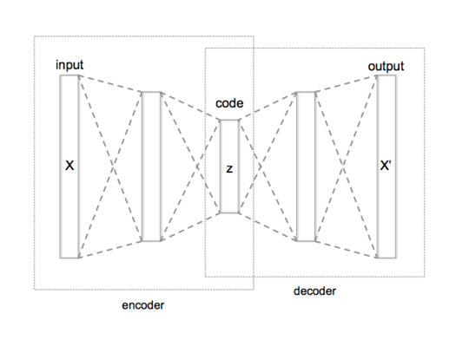
Undercomplete Autoencoders — deeper and nonlinear
A linear autoencoder with one or more hidden layery learns to map into the same subspace as PCA.
What happens if you introduce non-linearity?
Single hidden layer network with non-linear activations on the encoder (keeping the decoder linear) and MSE loss also just learns to span the PCA subspace (Bourlard/Kamp 88)!
But, if you add more hidden layers with non-linear activations (to either the encoder, decoder or both) you can effectively perform a powerful non-linear generalisation of PCA

Slide 14
Deep Autoencoders - caveat
There is a slight catch: if you give the deep autoencoder network too much capacity (too many weights) it will learn to perform the copying task without extracting anything useful about the data.
Of course this means that will likely not generalise to unseen data.
Extreme example:
Consider a powerful encoder that maps $x$ to $h ∈ℝ^{1}$ Each training example $x(i)$could e.g. be mapped to $i$.
The decoder just needs to memorise the training examples so that it can map back from $i$.

Slide 15
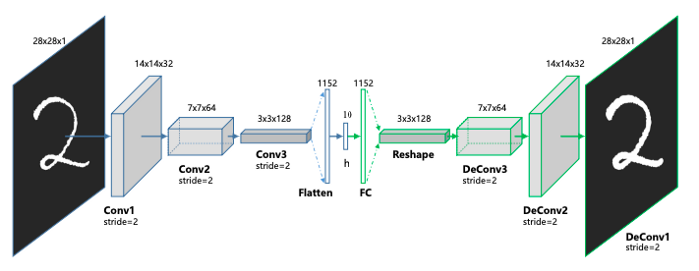
Undercomplete Autoencoders - Convolutional
Thus far, we only considered autoencoders with vector inputs/outputs and fully-connected layers.
There is nothing stopping us using any other kinds of layers though...
If we’re working with image data, where we know that much of the structure is ‘local’, then using convolutions in both the decoder makes sense
Encoder
Decoder
https://towardsdatascience.com/convolutional-autoencoders-for-image-noise-reduction-32fce9fc1763

Slide 16
Regularised Autoencoders
Rather than (necessarily) forcing the hidden vector to have a lower dimensionality than the input, we could instead utilise some form of regularisation to force the network to learn interesting representations...
Many ways to do this; let’s look at two of them:
Denoising Autoencoders
Sparse Autoencoders

Slide 17
Denoising autoencoders
Denoising autoencoders (DAEs) take a partially corrupted input and train to recover the original undistorted input.
To train an autoencoder to denoise data, it is necessary to perform a preliminary stochastic mapping to corrupt the data ($x →\tilde{x}$).
E.g. by adding Gaussian noise.
The loss is computed between the reconstruction (computed from the noisy input) against the original noise-free data.

Slide 18
Sparse Autoencoders
In a sparse autoencoder, there can be more hidden units than inputs, but only a small number of the hidden units are allowed to be active at the same time.
This is simply achieved with a regularised loss function:
$$l = l_{MSE} + Ω(h)$$
A popular choice would be to use an l₁ penalty
$Ω(h) = λ \sum_{i}{|h_{i}|}$
This choice can be justified by considering autoencoders as a means to approximatting maximum likelihood training of generative models

Slide 19
Autoencoder Applications
Any basic AE (or its variant) can be used to learn a compact representation of data.
You can learn useful features from data without the need for labelled data.
Denoising can help generalise over the test set since the data is distorted by adding noise.
Pretraining networks
Anomaly Detection
Machine translation
Semantic segmentation

Slide 20
Stochastic Encoders and Decoders
Consider encoders and decoders as distributions (general strategy useful for, e.g., determining cost functions and more generative models)
In particular decoder learn $p_{decoder}(x′|h)$ by minimising negative log-likelihood $− log⁡(p(x′|h)$.
$$P(h|x)$$
$$P(x‘|h)$$

Slide 21
Generative Models

Slide 22
Sub-Agenda
What is generative modelling and why do we do it?
Differentiable Generator Networks
Variational Autoencoders
Generative Adversarial Networks

Slide 23
Generative Models (GMs)
(for the relevant basics of probability
theory appendix)
Learn (conditional) models of the data: $p(x)$ (resp. $p(x|y = y))$
Some GMs allow calculation of propabilities $p(X = x)$
Some GMs allow sampling of probability distributions $x ∼ p(X)$
Some GMS can do both of the above
e.g. a Gaussian Mixture Model is an explicit model of the data using $k$ Gaussians
The likelihood of data $x$ is the weighted sum of the likelihood from each of the $k$ Gaussians
Sampling can be achieved by sampling the categorical distribution of $k$ weights followed by sampling a data point from the corresponding Gaussian

Slide 24
Why generative modelling?
Try to understand the processes through which the data was itself generated
Probabilistic latent variable models like VAEs or topic models (PLSA, LDA, ...) for text
Models that try to disentangle latent factors (like β-VAE)
Understand how likely a new or previously unseen piece of data is
outlier prediction, anomaly detection, . . .
Make ‘new’ data
Make ‘fake’ data to use to train large supervised models?
‘Imagine’ new, but plausible, things?

Slide 25
Differentiable Generator Networks
GMs not new (-> probabilistic graphical models)
...But difficult to train and scale to real data
Recent advances along four loose strands:
Invertible density estimation - A way to specify complex generative models by transforming a simple latent distribution with a series of invertible functions.
Autoregressive models - Another way to model$p(x)$is to break the model into a series of conditional distributions: $p(x) = p(x_{1})p(x_{2}|x_{1})p(x_{3}|x_{2}, x_{1}) .$
Variational autoencoders – see following slides
Generative adversarial networks – see following slides
Common thread in recent advances is that the loss functions are end-to-end differentiable.

Slide 26
Diffentiable Generator Networks
We’re interested in models that transform samples of latent variables $z$ to
samples $x$, or,
distributions over samples $x$
The model is a (differentiable) function $g(z,θ)$
typically $g$ is a neural network.

Slide 27
Example: Samples from normal distribution
Consider a simple generator network with a single affine layer that maps samples $𝒩(0,I)$ to $𝒩(μ,Σ)$:
$$z ∼ 𝒩\left(0,I\right) \underset{→}{g_{θ }(z)}x ∼𝒩\left(μ,Σ\right)$$
Note: Exact solution is $x = g_{θ}\left(z\right)= μ + Lz$
where $L$ is the Cholesky decomposition of $Σ: Σ = LL^{⊤}$, lower triangular $L$.

Slide 28
Generating samples
More general: $g$ is a nonlinear transformation of a distribution over $z$ to a distribution over $x$
$$p_{z}\left(z\right) \underset{→}{g(z)}{ p}_{x}(x)$$
Calculus says: For any invertible, differentiable, continuous $g$:
$p_{z}\left(z\right)=p_{x}\left(g\left(z\right)\right) |\det{\frac{∂g}{∂z}}|$
Hence one gets probability distribution over $x$
$$p_{x}\left(x\right)=p_{z}\left(g^{−1}\left(x\right)\right){\left|\det{\frac{∂g}{∂z}}\right|}^{−1}$$

Slide 29
Generating Distributions
Rather than use $g$ to provide a sample of $x$ directly, we could instead use g to define a conditional distribution over $x, p(x|z)$
For example, $g$ might produce the parameters of a particular distribution - e.g.:
means of Bernoulli
mean and variance of a Gaussian
The distribution over $x$ is imposed by marginalising $z$: $p(x) = 𝔼_{z}p(x|z$)

Slide 30
Distribution vs. Samples
In both cases one can use reparameterisation tricks for training models
Needed, because we want to use backpropagation; and how to do this with random nodes in network?
Generating distributions:
Plus: works for both continuous and discrete data
Minus: need to specfify the form of the output distribution
Generating samples:
Plus: works for continuous data
(also discrete data with some additional trick)
Plus: don‘t need to specify distribution in explicit form

Slide 31
Reparameterisation trick
Assume $y∼𝒩\left(μ, σ^{2}\right)$
Want to calculate $\frac{∂y}{∂μ }$ and $\frac{∂y}{∂σ }$
Idea: Factor out the random part. In this case
$y=μ+σz$ where $z∼𝒩\left(0,1\right)$
$y$ now is a function of a deterministic operation with variables $μ$ and $σ$ with an extra input $z$
And, importantly, is not a function of $μ$ or $σ$ (and vice versa)
This works also for other distributions under similar constraints

Slide 32
Complexity of Generative Modelling
In classification both input and output are given
Optimization only needs to learn the mapping
Generative modelling is more complex than classification because
learning requires optimizing intractable criteria
data does not specify both input $z$ and output $x$ of the generator network
learning procedure needs to determine how to arrange $z$ space in a useful way and how to map $z$ to $x$

Slide 33
Variational Autoencoders

Slide 34
Variational Autoencoders (VAEs)
VAEs based on following generative process
$$z ∼p_{model}(z) \underset{→}{p_{model}\left(x\right|z;θ)=p_{model}\left(x\right|g_{θ}(z))}x ∼p_{model}(x|z;θ)$$
Learning problem: Find $argmax_{θ}p(x)$ for each $x$ in the training set under$p\left(x\right)=\int{p\left(x\right|z;θ )}p\left(z\right)dz$
Often: $p_{model}\left(z\right)=𝒩\left(0,I\right)$
Often: $p_{model}\left(x|z\right)$ chosen according to data; typically Gaussian for real-valued or Bernoulli for binary data
Intuition: Don‘t want exactly create the training data but things like training examples

Slide 35
Variational Autoencoders
First try: $p\left(x\right)≈\sum{p\left(x \right|z_{i};θ)}$ for $n$ samples $\{z_{1},…, z_{n}\}$ of $z$
But intractable in practice; $n$ would be extremely big
For most $z ,$ $p(x|z)$ will be nearly zero, hence no significant contribution to $p(x)$
Key idea of VAE: Learn to sample values of $z$ that are likely to have produced $x$ and compute $p(x)$ from them
Define weighting function $q(z|x)$
Space of $z$ values likely under $q$ should be much smaller than the space under prior $p(z)$
We can now compute $𝔼_{z∼q}p\left(x\right|z;θ)$
But how does this help if $q$ is not a normal distribution?
How does expectation relate to $p(x)$?

Slide 36
Deriving ELBO: Evidence Lower Bound
$$\log{p\left(x\right)=\log{\int{p\left(x\right|z )}p\left(z\right)dz}} \\ \log{p\left(x\right)= }\log{\int{p\left(x\right|z)\frac{p\left(z\right)}{q(z|x)}}q\left(z | x\right)dz} \\ \log{p\left(x\right)≥\int{q\left(z | x\right)\log{p\left(x\right|z)\frac{p\left(z\right)}{q(z|x)}}}dz} \\ \log{p\left(x\right)≥\int{q\left(z | x\right)\log{p\left(x\right|z) }}dz −} \\ \int{q\left(z | x\right)\log{p\left(x\right|z )\frac{q(z|x)}{p\left(z\right)}}}dz \\ \log{p\left(x\right)≥𝔼_{z∼q\left(z | x\right)}\log{p\left(x | z\right)− }D_{KL}(q\left(z | x\right)||p(z))}$$
Log-probability
Propososal
Jensens‘s Inequality
$$\log{\int{p(x)g(x)}dx≥\int{p\left(x\right)\log{g(x)}}dx}$$
Rearrange
$$\log{a⋅b}=\log{a}+\log{b}$$
$${\begin{aligned}a^{−b}=−b\log{a} \\ \frac{a}{b}={\left(\frac{b}{a}\right)}^{−1} \\ \end{aligned}}$$
ELBO
$D_{KL}$: Kullback-Leibler divergence
Measures difference of probability distributions

Slide 37
The cornerstone of VAEs: ELBO
ELBO
$${L\left(q\right)= 𝔼}_{z∼q\left(z | x\right)}\log{p\left(x | z\right)− }D_{KL}\left(q\left(z | x\right)\right|\left|p\left(z\right)\right)≤\log{p\left(x\right)}$$
Maximize $L(q)$ to maximize $log p(x)$
Expectation term is like a reconstruction of log-lieklihood found in normal autoencoders
If $p_{model}\left(x | z\right)$ is Gaussian, then this is MSE between the true training $x$ and generated sample computed from $z$, averaged across many $z$’s (each a function of x)
The KL term is forcing the approximate posterior $q(z|x)$towards the prior $p_{model}\left(z\right).$

Slide 38
Why is it called an autoencoder?
$q(z|x)$ is considered as encoder ($z$ are the hiddens $h$)
$p_{model }(x;g_{θ}(z))$ is a decoder network; it takes a $z$ and decodes it into a target $x$
From a practical standpoint, a VAE is a normal autoencoder with two key differences:
the encoder generates a distribution that must be sampled
the network produces the sufficient statistics of the distribution (e.g. means and diagonal co-variances for a typical VAE with Gaussian $q(z|x)$)
the decoder generates a distribution, which, during training the negative log-likelihood of the true data $x$ is compared against

Slide 39
VAE
without reparameterization
with reparameterization
From Carl Doersch’s Tutorial on VAEs - https://arxiv.org/pdf/1606.05908.pdf

Slide 40
VAE Models and Performance
VAEs can be used with any kind of data
the distributions and network architecture just need to be set
e.g. it’s common to use convolutions in the encoder and transpose convolutions in (Gaussian) decoder for image data
VAEs tend to be easy to optimise with stable convergence
VAEs have a reputation for producing blurry reconstructions of images
Supposed to be due to a side effect of maximum-likelihood training
VAEs tend to only utilise a small subset of dimensions of $z$
Pro: automatic latent variable selection
Con: better reconstructions should be possible given the available code-space

Slide 41
Generative Adverserial netwOrks

Slide 42
The idea of GANs
Pitch a generator and a discriminator against each other
Generator tries to draw samples from $p(x)$
Discriminator tries to tell if sample came from the generator (fake) or the real world
Both discriminator and generator are deep networks (differentiable functions)
LeCun himself again: ‘GANs, the most interesting idea in the last ten years in machine learning‘

Slide 43
General Architecture
(w.r.t.
discriminator
error)
(w.r.t. generator error)

Slide 44
GANs formally
The generator $x = g(z)$
Input: sample $z∈ℝ^{n}, z∼ 𝒩\left(0,I\right) or z∼U(0,I)$
Output: sample $x∈ℝ^{d, }x ∼data distrib.$, $n << d$
The discriminator $y = d\left(x\right)$
Input: sample $x$
Out: probability $y∈\left[0,1\right]$for query: is $x$ fake or real?

Slide 45
GANs practically
Training a standard GAN is difficult and often results in two undesirable behaviours
Oscillations without convergence. No guarantee that the loss will actually decrease...
It has been shown that a GAN has saddle-point solution, rather than local minima.
The mode collapse problem, when the generator models very well a small sub-population, concentrating on a few modes.
Additionally, performance is hard to assess and often boils down to heuristic observations.

Slide 46
Deep Convolutional GANs (DCGANs)
Motivates the use of GANS to learn reusable feature representations from large unlabelled datasets
GANs known to be unstable to train, often resulting in generators that produce “nonsensical outputs”
Model exploration to identify architectures that result in stable training across datasets with higher resolution and deeper models.

Slide 47
Coping with the problems: architecture guidelines
Replace pooling layers with strided convolutions in the discriminator and fractional-strided (transpose) convolutions in the generator.
This will allow the network to learn its own spatial downsampling.
Use batchnorm in both the generator and the discriminator.
This helps deal with training problems due to poor initialisation and helps the gradient flow.
Eliminate fully connected hidden layers for deeper architectures.
Use ReLU activation in the generator for all layers except for the output, which uses tanh.
Use LeakyReLU activation in the discriminator for all layers

Slide 48
Summary on generative modelling
Generative modelling is a massive field with a long history
Differentiable generators have had a profound impact in making models that work with real data at scale
VAEs and GANs are currently the most popular approaches to training generators for spatial data
We’ve only scratched the surface of generative modelling
Auto-regressive approaches are popular for sequences (e.g. language modelling).
But also for images (e.g. PixelRNN, PixelCNN)
typically RNN-based
but not necessarily - e.g. WaveNet is a convolutional auto-regressive generative model

Slide 49
APPENDIX
Uhhh, a lecture with a hopefully useful

Slide 50
Probability theory basics reminder
Random variable (RV)
possible worlds defined by assignment of values to random variables.
Boolean random variables
e.g., Cavity (do I have a cavity?). Domain is < true , false >
Discrete random variables
e.g., possible value of Weather is one of < sunny, rainy, cloudy, snow >
Domain values must be exhaustive and mutually exclusive
Elementary propositions are constructed by assignment of a value to a random variable: e.g.,
Cavity = false (abbreviated as ¬cavity)
Cavity = true (abbreviated as cavity)
(Complex) propositions formed from elementary propositions and standard logical connectives, e.g., Weather = sunny ∨ Cavity = false
Probabilities
Axioms (for propositions $a,b, ⊤= (a∨ ➢a)$, and $⊥ = ➢ ⊤$):
$0 ≤ P\left(a\right)≤ 1; P(⊤)= 1; P(⊥) = 0$
$(P(a∨b) = P(a) + P(b) − P(a∧b)$
Joint probability distribution of $X=\{X_{1}, …, X_{n}\}$
$P\left(X_{1},…, X_{n}\right)$
gives the probability of every atomic event on $X$
Conditional probability $P(a | b) = P(a∧ b) / P(b) if P(b) > 0$
Chain rule
$$P\left(X_{1},…, X_{n}\right)= \prod_{i=1}^{n}{P(X_{i}|X_{1},…, X_{i−1})}$$
Marginalization: $P\left(Y\right)= \sum_{z∈Z }{P(Y,z)}$
Conditioning on $Z$:
$P\left(Y\right)= \sum_{z∈Z }{P\left(Y | z\right)P(z)}$ (discrete)
$P\left(Y\right)= \int{P\left(Y | z\right)P\left(z\right)dz}$ (continuous) = $𝔼_{z∼P(z)}$P(Y|z) (expected value notation)
Bayes‘ Rule
$$P\left(H | D\right)= \frac{P(D|H)∙P(H)}{P(D)} =\frac{P(D|H)∙P(H)}{\sum_{h}{P\left(D|h\right)P(h) }}$$

Slide 51
Reminder: Multivariate Gaussians
Then define
to mean
Co-variance matrix
where the Gaussian’s parameters have…
One can show: E[X] = μ and Cov[X] = Σ.

Slide 52
Reminder: Why Gaussian?
Andrew Moore: “Gaussians are as natural as Orange Juice and Sunshine”
(http://www.cs.cmu.edu/~awm/tutorials)
Proves useful to model RVs that are combinations of many (non)-measured influences
Makes life easy because
Efficient representation
Substitute probabilities by expectations
52

Slide 53
Color Convention in this Course
Formulae, when occurring inline
Newly introduced terminology and definitions
Important results (observations, theorems) as well as emphasizing some aspects
Examples are given with standard orange with possibly light orange frame
Comments and notes in nearly opaque post-it
Algorithms
Reminders (in the grey fog of your memory)

Slide 54
Today‘s lecture is based on the following
Jonathon Hare: Lectures 15, 17 of course „COMP6248 Differentiable Programming (and some Deep Learning)“ http://comp6248.ecs.soton.ac.uk/

Slide 55
References
H. Bourlard and Y. Kamp. Auto-association by multilayer perceptrons and singular value decomposition. Biological Cybernetics, 59(4):291–294, 1988.

