Slide 1
PROBABILISTIC AND DIFFERENTIABLE PROGRAMMING
V7: Automatic Differentiation (AD)
Özgür L. Özçep
Universität zu Lübeck
Institut für Informationssysteme

Slide 2

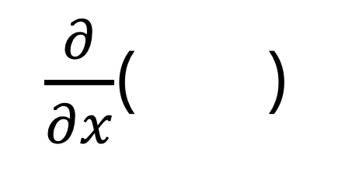
Today‘s Agenda
$\frac{∂}{∂x}$( )

Slide 3
Why you NeeD AD

Slide 4
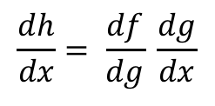

Reminder: Backprop = AD in reverse mode
Sample labeled data
(batch)
Forward it through the network, get predictions
Back-propagate the errors
Update the network weights
Backpropagation idea
Generate error signal that measures difference between predictions and target values
Use error signal to change the weights and get more accurate predictions backwards
Underlying mathematics: chain rule
Chain rule (1-dim)
$$\frac{dh}{dx}= \frac{df}{dg} \frac{dg}{dx}$$
( for
$h\left(x\right)=f(g(x))$ )

Slide 5





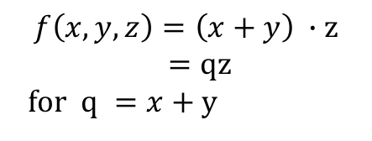


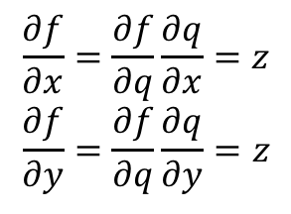

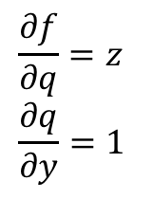
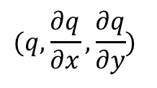
Reminder: Computational graph perspective
Function f
Partial Derivatives
Chain rule applied
$$f\left(x,y,z\right)=\left(x+y\right) ∙z$$
$=qz$
for $q =x+y$
$$\frac{∂f}{∂z}=q \\ \frac{∂q}{∂x}=1$$
$$\frac{∂f}{∂q}=z \\ \frac{∂q}{∂y}=1$$
$$\frac{∂f}{∂x}=\frac{∂f}{∂q}\frac{∂q}{∂x}=z \\ \frac{∂f}{∂y}=\frac{∂f}{∂q}\frac{∂q}{∂y}=z$$
Gradient
$$∇_{x,y,z}f=(z,z,q)$$
(In particular:
($∇_{x,y,z}f)\left(−2,5,−4\right)=\left(−4,−4, 3\right))$
-2
$$(q,\frac{∂q}{∂x},\frac{∂q}{∂y})$$
Forward pass:
function values and local gradients
Backward: chain rule
x
-4
$$\frac{∂f}{∂x}$$
(3,1,1)
+
5
-4
$(f,\frac{∂f}{∂q},\frac{∂f}{∂z}$ )
_{y}
-4
$$\frac{∂f}{∂y}$$
(-12,-4,3)
*
-4
1
$$\frac{∂f}{∂f}$$
z
3
$$\frac{∂f}{∂z}$$

Slide 6
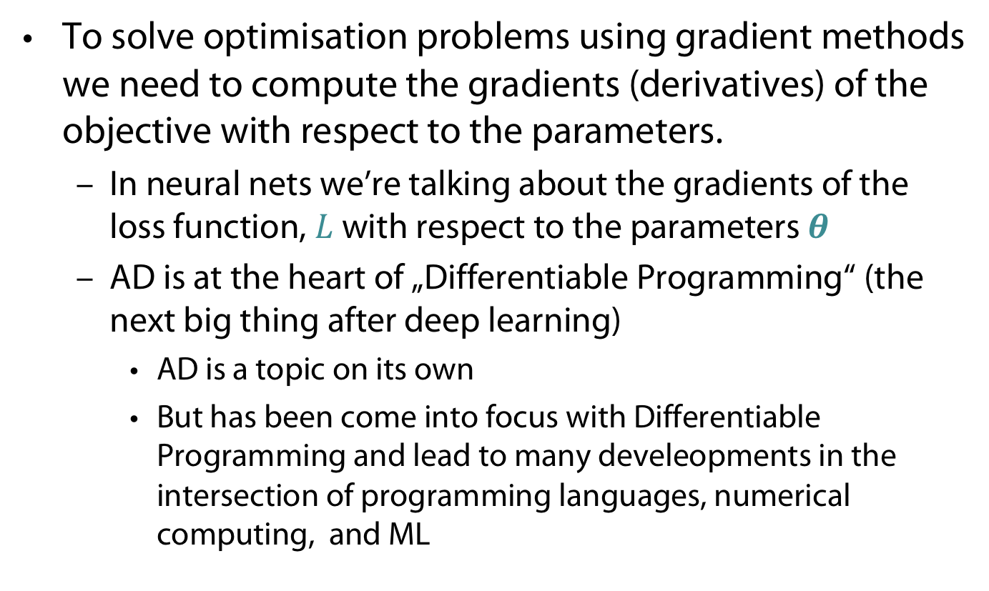
To solve optimisation problems using gradient methods we need to compute the gradients (derivatives) of the objective with respect to the parameters.
  In neural nets we’re talking about the gradients of the loss function, $L$ with respect to the parameters $θ$
  AD is at the heart of „Differentiable Programming“ (the next big thing after deep learning)
    AD is a topic on its own
    But has been come into focus with Differentiable Programming and lead to many develeopments in the intersection of programming languages, numerical computing, and ML

Slide 7
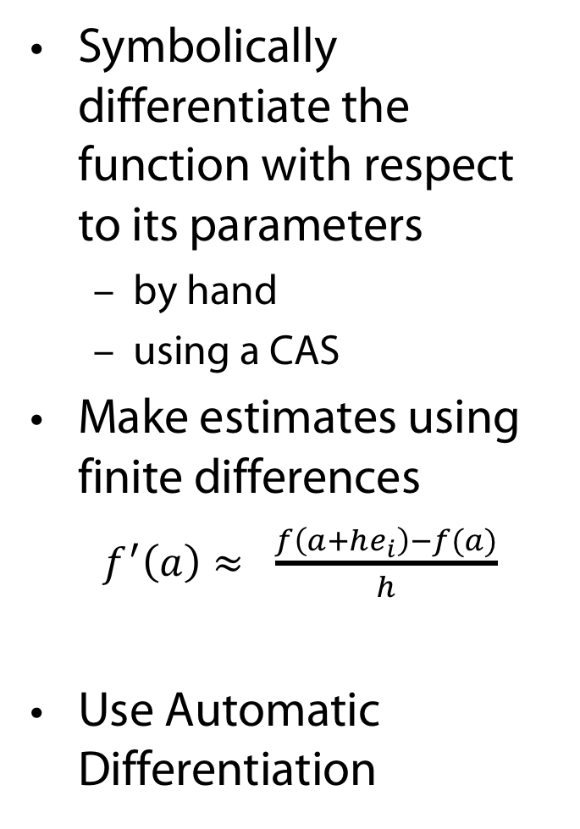
Symbolically differentiate the function with respect to its parameters
  by hand
  using a CAS
Make estimates using finite differences
  $f^{′}\left(a\right)≈ \frac{f\left(a+he_{i}\right)−f(a)}{h}$
Use Automatic Differentiation
Problem: Static, expression swell. Can‘t differentiate algorithms
Problem: Numerical errors (such as rounding and truncation errors)

Slide 8

Problem with symbolic computation
$\frac{d(f\left(x\right)∙g(x))}{dx}=\frac{d f\left(x\right)}{dx}g\left(x\right)+\frac{d g\left(x\right)}{dx}f\left(x\right)$ (Product rule)
  $h(x) : = g(x)∙f(x)$
  $\frac{dh(x)}{dx}$ and $h$ have two components in common
  This may also be the case for$f$.
  Symbollicaly calculating $f$ won‘t profit from common parts of $f$and $\frac{df(x)}{dx}$

Slide 9
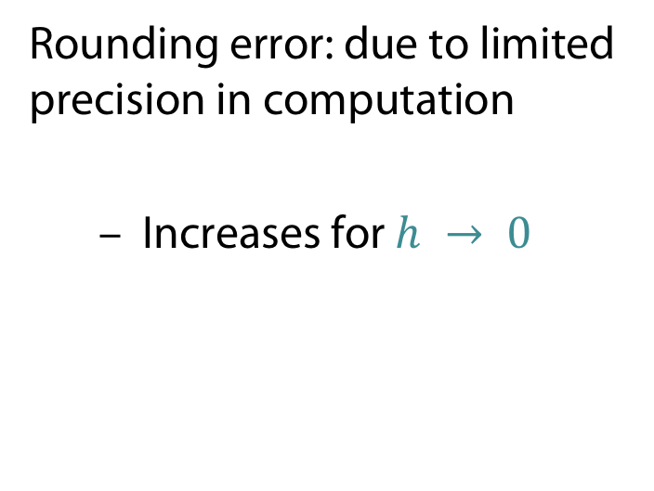
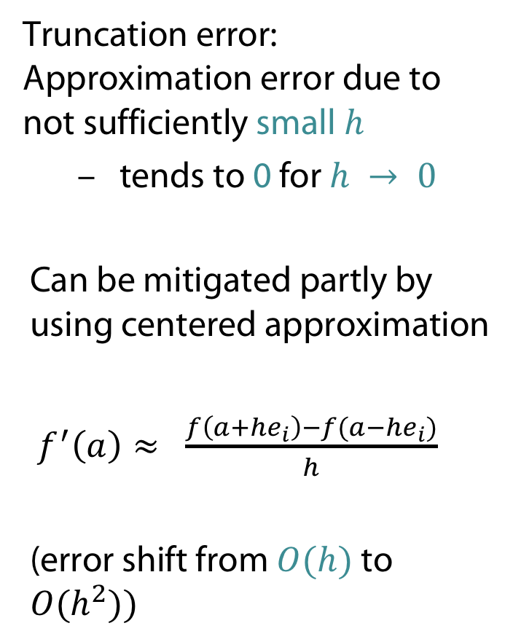
Problems with numerical calculation
Truncation error: Approximation error due to not sufficiently small$h$
  tends to 0 for $h → 0$
Can be mitigated partly by using centered approximation
$f^{′}\left(a\right)≈ \frac{f\left(a+he_{i}\right)−f(a−he_{i})}{h}$
(error shift from $O(h)$ to $O(h^{2}))$
Rounding error: due to limited precision in computation
  Increases for $h → 0$

Slide 10
Automatic Differentiation is a method to get exact derivatives efficiently, by storing information as you go forward that you can reuse as you go backwards.
  Takes code that computes a function and uses that to compute the derivative of that function.
  The goal isn’t to obtain closed-form solutions, but to be able to write a program that efficiently computes the derivatives.

Slide 11
No one has
time for manual
computation
Gives you smell
of the expression
swell
Can directly reuse
program with
for-loop -
no need for
closed-form
Small h (as we have
seen) does not help
w.r.t. rounding errors
Ex: Baydin et al. 2017

Slide 12
Automatization

Slide 13

From Differentiation to Programming
Example (Math)
  $$x= ? \\ y= ? \\ a=xy \\ b=\sin\left(x\right) \\ z=a+b$$
Example (code)
  x=?
  Y= ?
  a = x * y
  b = sin(x)
  z = a + b

Slide 14
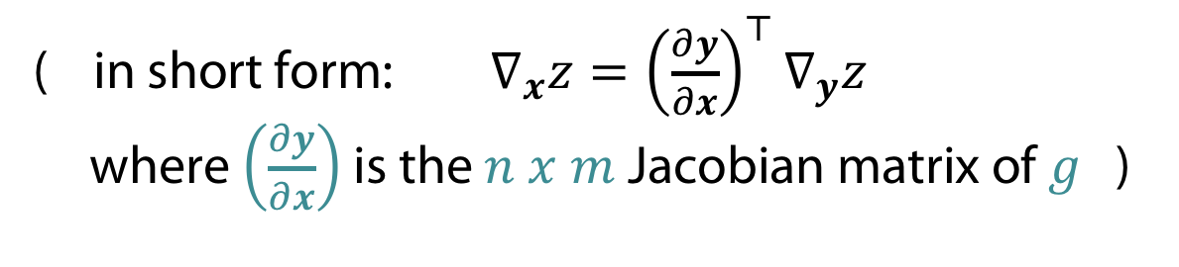
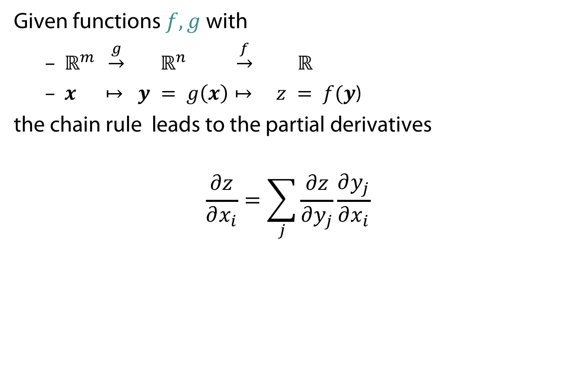
The chain rule for vectors
Given functions $f, g$with
  $ℝ^{m} \underset{→}{g} ℝ^{n} \underset{→}{f} ℝ$
  $x ↦ y = g\left(x\right)↦ z = f(y$)
the chain rule leads to the partial derivatives
$$\frac{∂z}{∂x_{i}}=\sum_{j}{\frac{∂z}{∂y_{j}}\frac{∂y_{j}}{∂x_{i}}}$$
( in short form: $∇_{x}z={\left(\frac{∂y}{∂x}\right)}^{⊤}∇_{y}z$
where $\left(\frac{∂y}{∂x}\right)$ is the $n x m$Jacobian matrix of $g$ )

Slide 15
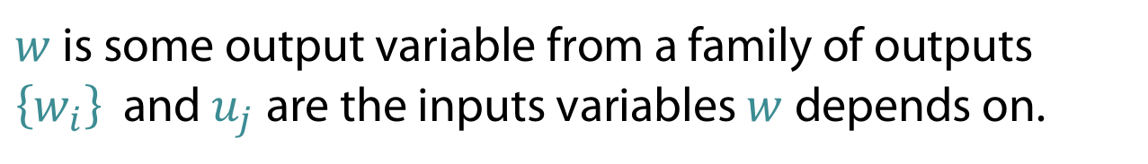

Let us rename for the following
Given functions $f, g$with
  $ℝ^{m} \underset{→}{g} ℝ^{n} \underset{→}{f} ℝ$
  t$↦ u = g\left(x\right)↦ w = f(u$)
the chain rule leads to the partial derivatives
$$\frac{∂w}{∂t }=\sum_{j}{\frac{∂w}{∂u_{j}}\frac{∂u_{j}}{∂t}}$$
$w$ is some output variable from a family of outputs $\left\{w_{i}\right\}$ and $u_{j}$are the inputs variables $w$ depends on.

Slide 16


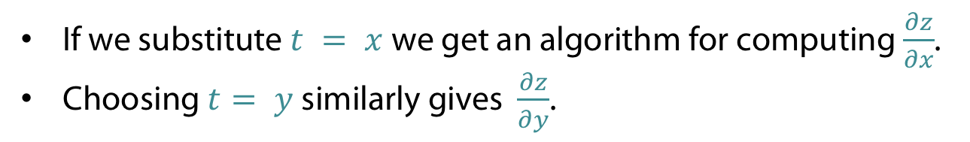
Applying the chain rule
Example expression
  $$x= ? \\ y= ? \\ a=xy \\ b=\sin\left(x\right) \\ z=a+b$$
Derivatives w.r.t. some yet to be given variable $t$
$$\frac{∂x}{∂t}= ? \\ \frac{∂y}{∂t}= ? \\ \frac{∂a}{∂t}=x\frac{∂y}{∂t}+y\frac{∂x}{∂t} \\ \frac{∂b}{∂t}=\cos{x}\frac{∂x}{∂t} \\ \frac{∂z}{∂t}=\frac{∂a}{∂t}+\frac{∂b}{∂t}$$
If we substitute $t = x$we get an algorithm for computing $\frac{∂z}{∂x}$.
Choosing $t= y$similarly gives $\frac{∂z}{∂y}$.

Slide 17


Translating to code
Derivatives as programs
  dx=?
  dY= ?
  da = y * dx + x * dy
  db = cos(x)*dx
  dz = da + db
  (Using the notation
  dx = $\frac{∂x}{∂t}$, dy = $\frac{∂y}{∂t}, …$ )
Substituting $t = x$
  dx= 1
  dy= 0
  da = y * dx + x * dy
  db = cos(x)*dx
  dz = da + db
So, to compute $\frac{∂z}{∂x}$ just seed algorithm with
dx = 1, dy = 0

Slide 18


Translating to code
Derivatives as programs
  dx=?
  dY= ?
  da = y * dx + x * dy
  db = cos(x)*dx
  dz = da + db
  (Using the notation
  dx = $\frac{∂x}{∂t}$, dy = $\frac{∂y}{∂t}, …$ )
Substituting $t =y$
  dx= 0
  dy= 1
  da = y * dx + x * dy
  db = cos(x)*dx
  dz = da + db
So, to compute $\frac{∂z}{∂y}$ just seed algorithm with
dx = 0, dy = 1

Slide 19
Making Rules
Idea of the examples can be generalized to arbitrary functions
Need to describe rules for translation
program evaluating expression => program evaluating derivates
These are just rules known from mathematics for calculating derivates, e.g.
  c = a + b => dc = da + db
  c = a * b => dc = b * da + a * db
  c = sin(a) => dc = cos(a) * da
Note: These rules are used on number-level (not for symbolic computation of derivatives)

Slide 20

Further Rules
  c = a - b => dc = da - db
  c = a / b => dc = da/b –a*db/b**2
  c = a**b => dc = b*a**(b-1)*da + log(a)*a**b*db
  c = cos(a) => dc = -sin(a) * da
  c = tan(a) => dc = da/cos(a)**2
  (a**b stands for $a^{b})$

Slide 21
Forward Mode

Slide 22
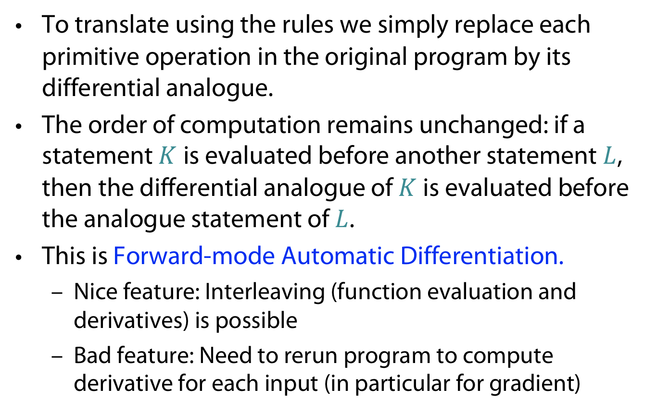
Forward Mode AD
To translate using the rules we simply replace each primitive operation in the original program by its differential analogue.
The order of computation remains unchanged: if a statement $K$is evaluated before another statement $L$, then the differential analogue of $K$ is evaluated before the analogue statement of $L$.
This is Forward-mode Automatic Differentiation.
  Nice feature: Interleaving (function evaluation and derivatives) is possible
  Bad feature: Need to rerun program to compute derivative for each input (in particular for gradient)

Slide 23
Interleave computing expression and derivatives
  x = ?
  dx = ?
  y = ?
  dy = ?
  a = x * y
  da = y * dx + x * dy
  b = sin(x)
  db = cos(x)*dx
  z = a + b
  dz = da + db
Can keep track of value and gradient at the same time
Can be mathematically founded using “dual numbers“
Leads to direct simple implementation of AD

Slide 24
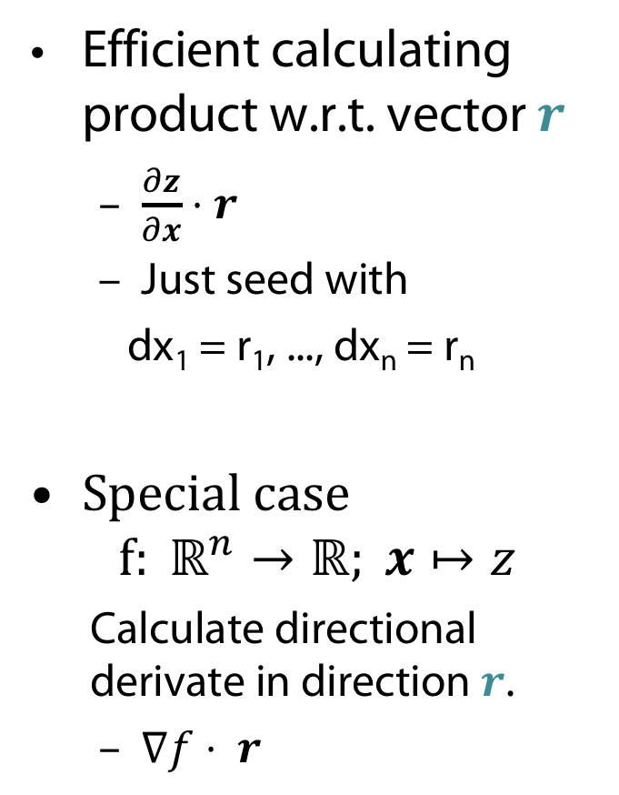
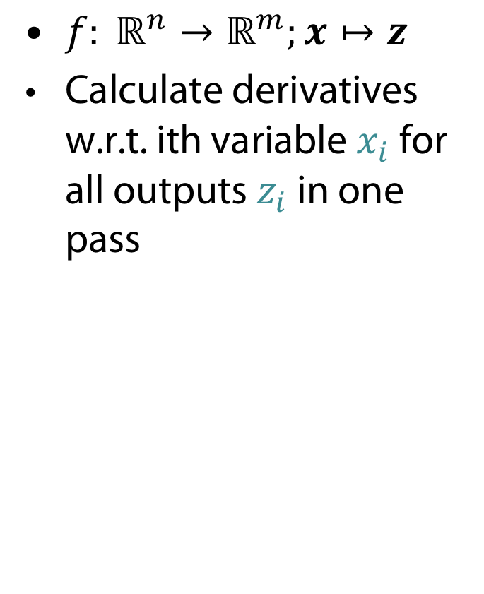
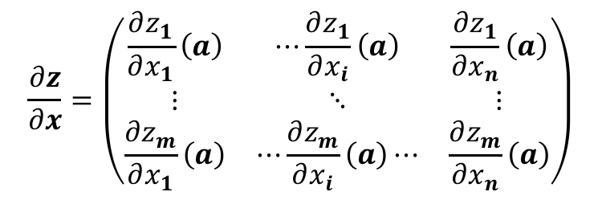
The Jacobian in Forward Mode AD
${f: ℝ}^{n}→ℝ^{m};x↦z$
Calculate derivatives w.r.t. ith variable $x_{i}$ for all outputs $z_{i}$ in one pass
Efficient calculating product w.r.t. vector $r$
  $\frac{∂z}{∂x}⋅r$
  Just seed with
  dx₁ = r₁, ..., dx_{n} = r_{n}
Special case
$$f: ℝ^{n}→ℝ; x↦z$$
  Calculate directional derivate in direction $r$.
  $∇f⋅ r$
$$\frac{∂z}{∂x}=\left(\begin{matrix}\frac{∂z_{1}}{∂x_{1}}\left(a\right) & ⋯\frac{∂z_{1}}{∂x_{i}}\left(a\right) & \frac{∂z_{1}}{∂x_{n}}\left(a\right) \\ ⋮ & ⋱ & ⋮ \\ \frac{∂z_{m}}{∂x_{1}}\left(a\right) & ⋯\frac{∂z_{m}}{∂x_{i}}\left(a\right)⋯ & \frac{∂z_{m}}{∂x_{n}}\left(a\right)\end{matrix}\right)$$

Slide 25
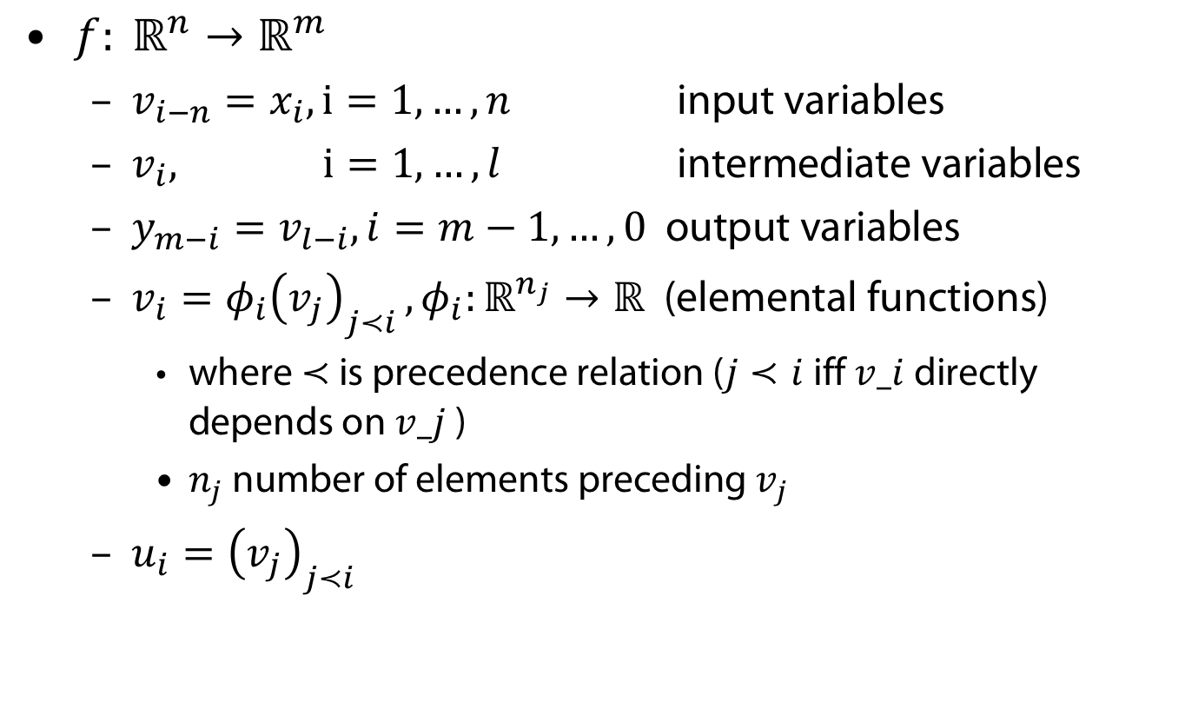
Another view on AD
${f: ℝ}^{n}→ℝ^{m}$
  $v_{i−n}=x_{i}, i=1, …, n$ input variables
  $v_{i}, i=1, …, l$ intermediate variables
  $y_{m−i}=v_{l−i}, i=m−1, …,0$ output variables
  $v_{i}=φ_{i}{\left(v_{j}\right)}_{j≺i }, φ_{i}:ℝ^{n_{j}}→ℝ$ (elemental functions)
    where $≺$ is precedence relation ($j≺i$iff $v_i$ directly depends on $v_j$ )
    $n_{j}$ number of elements preceding $v_{j}$
  $u_{i}={\left(v_{j}\right)}_{j≺i }$

Slide 26

Forward mode AD = Tangents mapping
Assume you have time-depending paths $x\left(t\right), y(t)$
Forward mode AD is mapping function evaluation (F: $x↦y$) plus tangents mapping $\dot{F}: \dot{x}↦\dot{y}$
$\left[v_{i−n},{\dot{v}}_{i−n}\right]={[x}_{i}, {\dot{x}}_{i}]$ for $i=1, …,n$
$\left[v_{i},{\dot{v}}_{i}\right]=[φ_{i}\left(u_{i}\right),\dot{φ_{i}}(u_{i}, \dot{u_{i}})]$ for $i=1, …,l$
$\left[y_{m−i}, {\dot{y}}_{m−i}\right]={[v}_{l−i},{\dot{v}}_{l−i}]$ for $i =0, …, m−1$

Slide 27
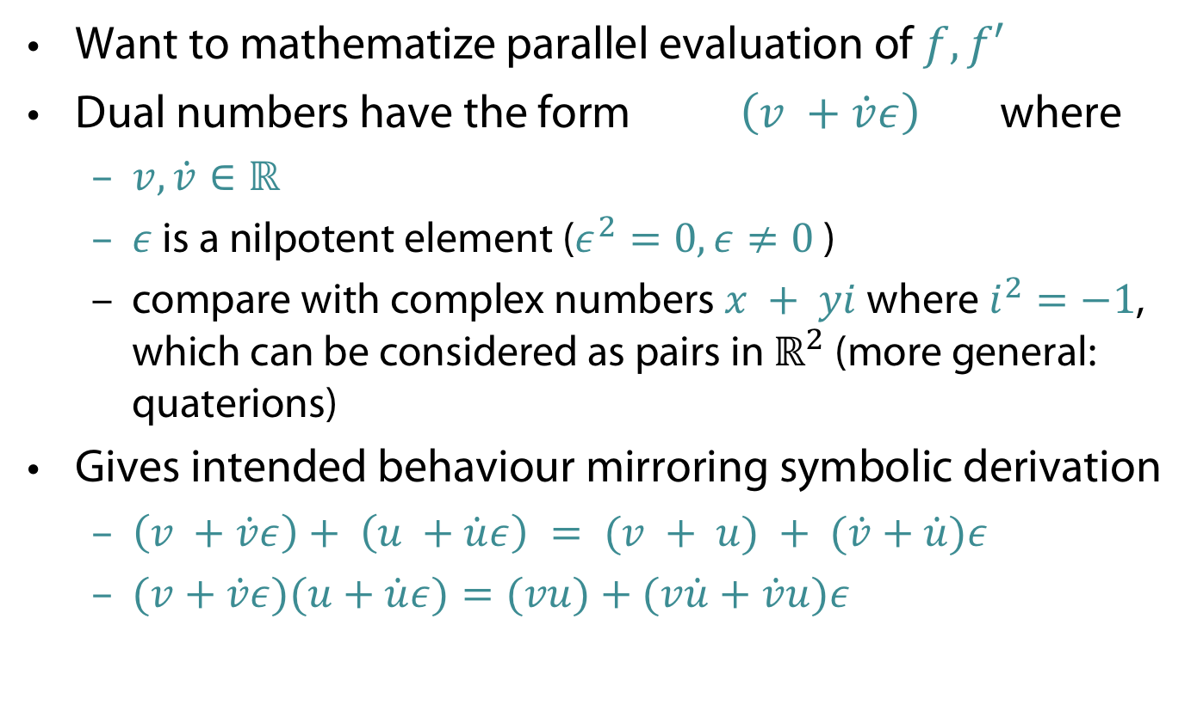
Dual numbers (Clifford 1873)
Want to mathematize parallel evaluation of $f,f′$
Dual numbers have the form $\left(v +\dot{v}ε\right)$ where
  $v, \dot{v}∈ℝ$
  $ε$ is a nilpotent element ($ε^{2}=0, ε≠0$)
  compare with complex numbers $x + yi$ where $i^{2}=−1$, which can be considered as pairs in $ℝ^{2}$ (more general: quaterions)
Gives intended behaviour mirroring symbolic derivation
  $\left(v +\dot{v}ε\right)+ \left(u +\dot{u}ε\right) = (v + u) + (\dot{v}+\dot{u})ε$
  $(v+\dot{v}ε)(u+\dot{u}ε)=(vu)+(v\dot{u}+\dot{v}u)ε$

Slide 28
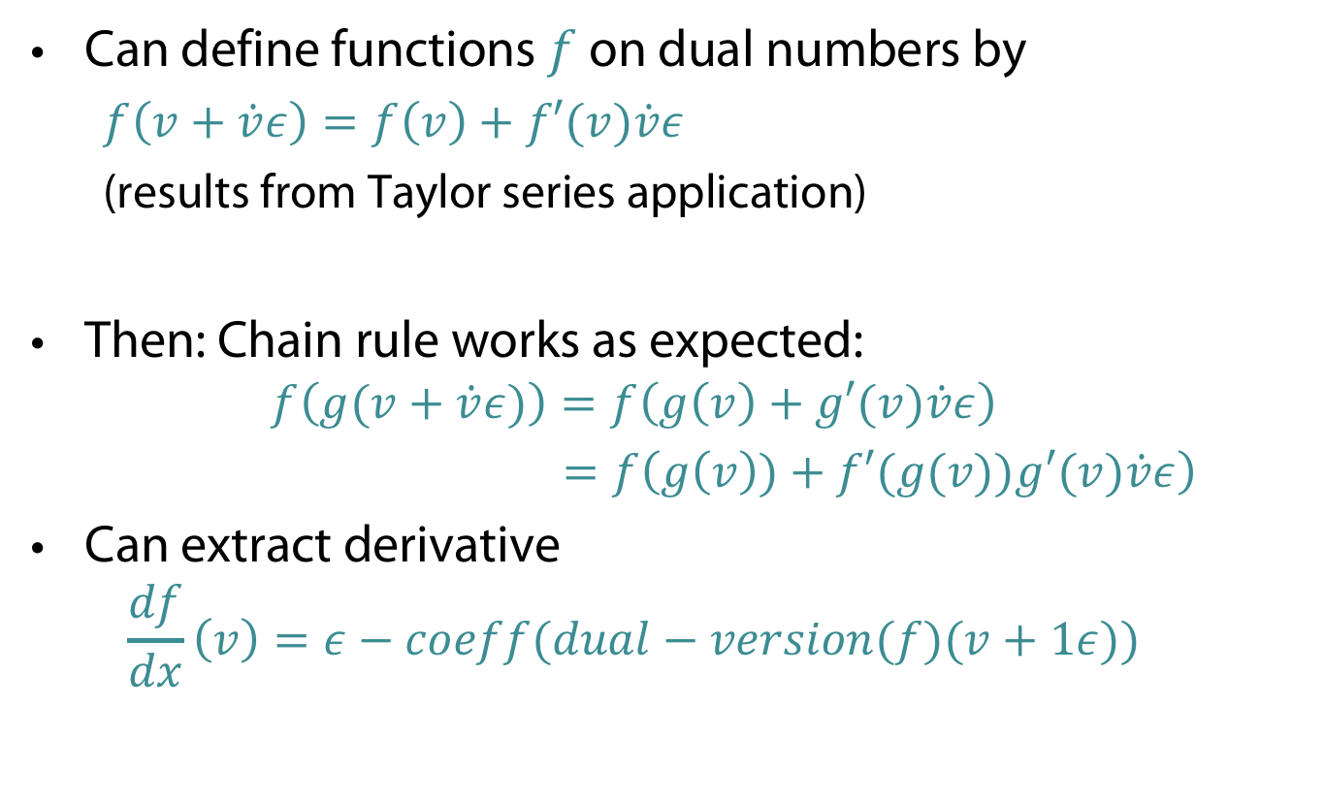
Dual numbers (Clifford 1873)
Can define functions $f$ on dual numbers by
  $f\left(v+\dot{v}ε\right)=f\left(v\right)+f′(v)\dot{v}ε$
  (results from Taylor series application)
Then: Chain rule works as expected:
  $$f\left(g(v+\dot{v}ε)\right)=f\left(g\left(v\right)+g′(v)\dot{v}ε\right)$$
  $=f\left(g\left(v\right))+f′(g(v))g′(v)\dot{v}ε\right)$
Can extract derivative
  $$\frac{df}{dx}\left(v\right)=ε−coeff(dual−version(f)(v+1ε))$$

Slide 29
Reverse MOde

Slide 30
Reverse Mode AD
Whilst Forward-mode AD is easy to implement, it comes with a very big disadvantage. . .
For every variable we wish to compute the gradient with respect to, we have to run the complete program again.
This is obviously going to be a problem if we’re talking about the gradients of a function with very many parameters (e.g. a deep network).
A solution is Reverse Mode Automatic Differentiation.

Slide 31
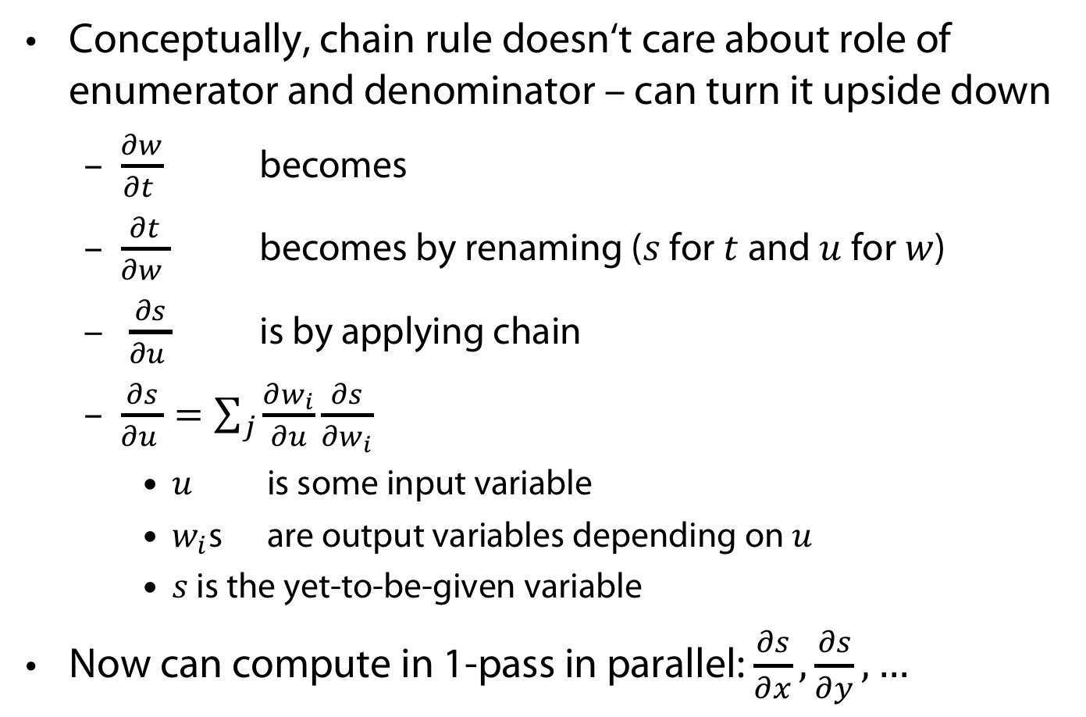
Reversing the Chain Rule
Conceptually, chain rule doesn‘t care about role of enumerator and denominator – can turn it upside down
  $\frac{∂w}{∂t }$ becomes
  $\frac{∂t}{∂w }$ becomes by renaming ($s$ for $t$ and $u$ for $w$)
  $\frac{∂s}{∂u }$ is by applying chain
  $\frac{∂s}{∂u }=\sum_{j}{\frac{∂w_{i}}{∂u}\frac{∂s}{∂w_{i}}}$
    $u$ is some input variable
    $w_{i}$s are output variables depending on $u$
    $s$ is the yet-to-be-given variable
Now can compute in 1-pass in parallel: $\frac{∂s}{∂x},\frac{∂s}{∂y}, …$

Slide 32

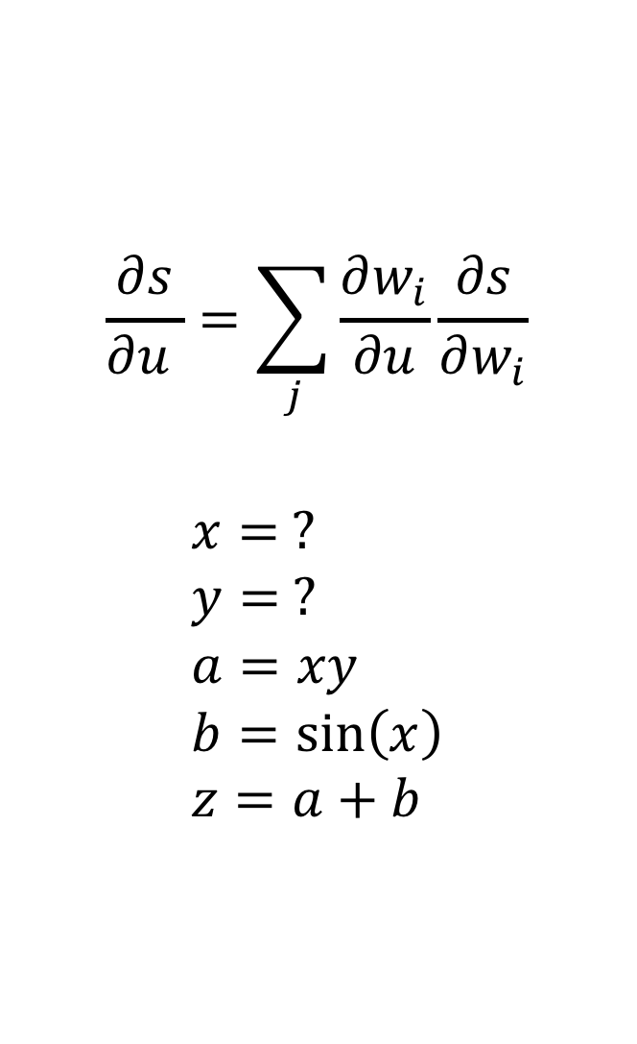
Example
$$\frac{∂s}{∂u }=\sum_{j}{\frac{∂w_{i}}{∂u}\frac{∂s}{∂w_{i}}}$$
$$x= ? \\ y= ? \\ a=xy \\ b=\sin\left(x\right) \\ z=a+b$$
$$\frac{∂s}{∂z}=? \\ \frac{∂s}{∂b}=\frac{∂z}{∂b}\frac{∂s}{∂z}=\frac{∂s}{∂z} \\ \frac{∂s}{∂a}=\frac{∂z}{∂a}\frac{∂s}{∂z}=\frac{∂s}{∂z} \\ \frac{∂s}{∂y}=\frac{∂a}{∂y}\frac{∂s}{∂a}=x\frac{∂s}{∂a} \\ \frac{∂s}{∂y}=\frac{∂a}{∂x}\frac{∂s}{∂a}+\frac{∂b}{∂x}\frac{∂s}{∂b} \\ =y\frac{∂s}{∂a}+\cos{x}\frac{∂s}{∂b} \\ =(y+\cos{x})\frac{∂s}{∂z}$$

Slide 33
Visualising dependencies
Differentiating in reverse can be quite mind-bending: instead of asking what input variables an output depends on, we have to ask what output variables a given input variable can affect.
We can see this visually by drawing a dependency graph of the expression (e.g. x effects a and b):
y
a
*
x
z
+
b
sin

Slide 34
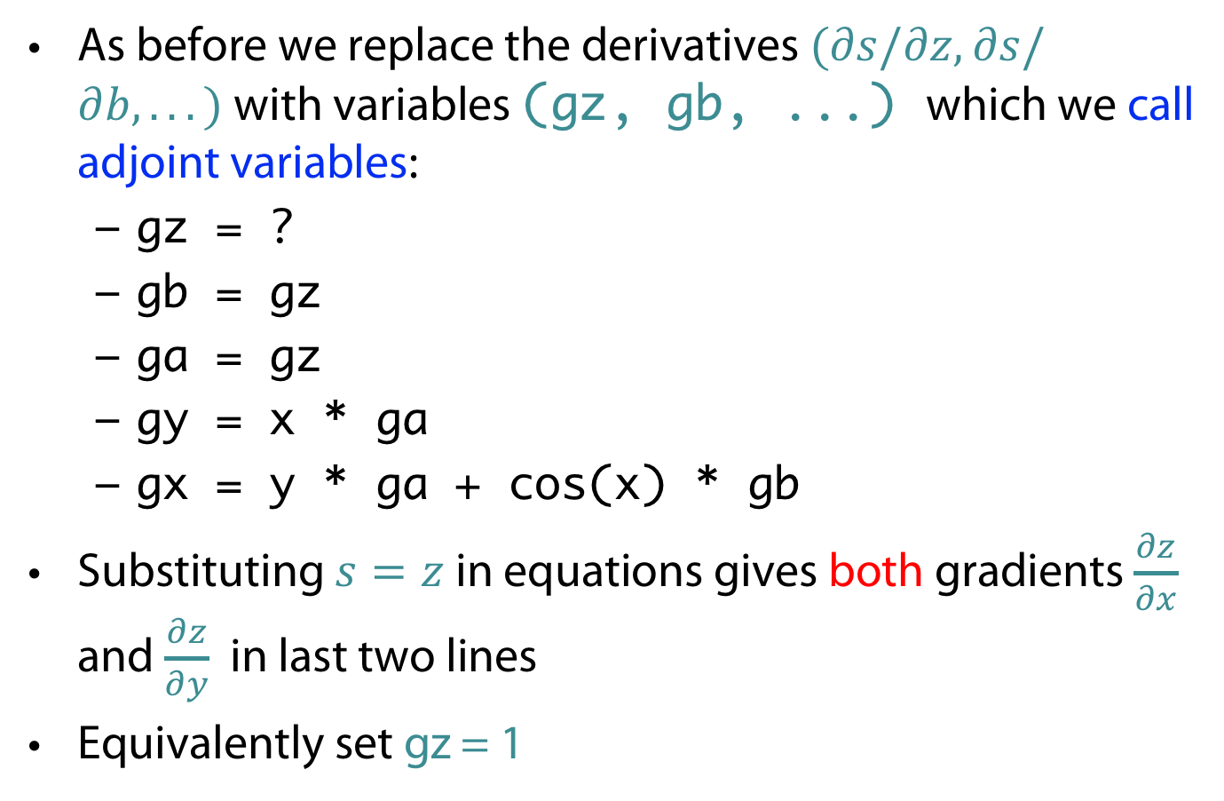
Translating to Code
As before we replace the derivatives $(∂s/∂z, ∂s/∂b, . . . )$with variables (gz, gb, ...) which we call adjoint variables:
  gz = ?
  gb = gz
  ga = gz
  gy = x * ga
  gx = y * ga + cos(x) * gb
Substituting $s=z$in equations gives both gradients $\frac{∂z}{∂x}$ and $\frac{∂z}{∂y}$ in last two lines
Equivalently set gz = 1
We need only 1 pass for
Calculating all derivatives

Slide 35
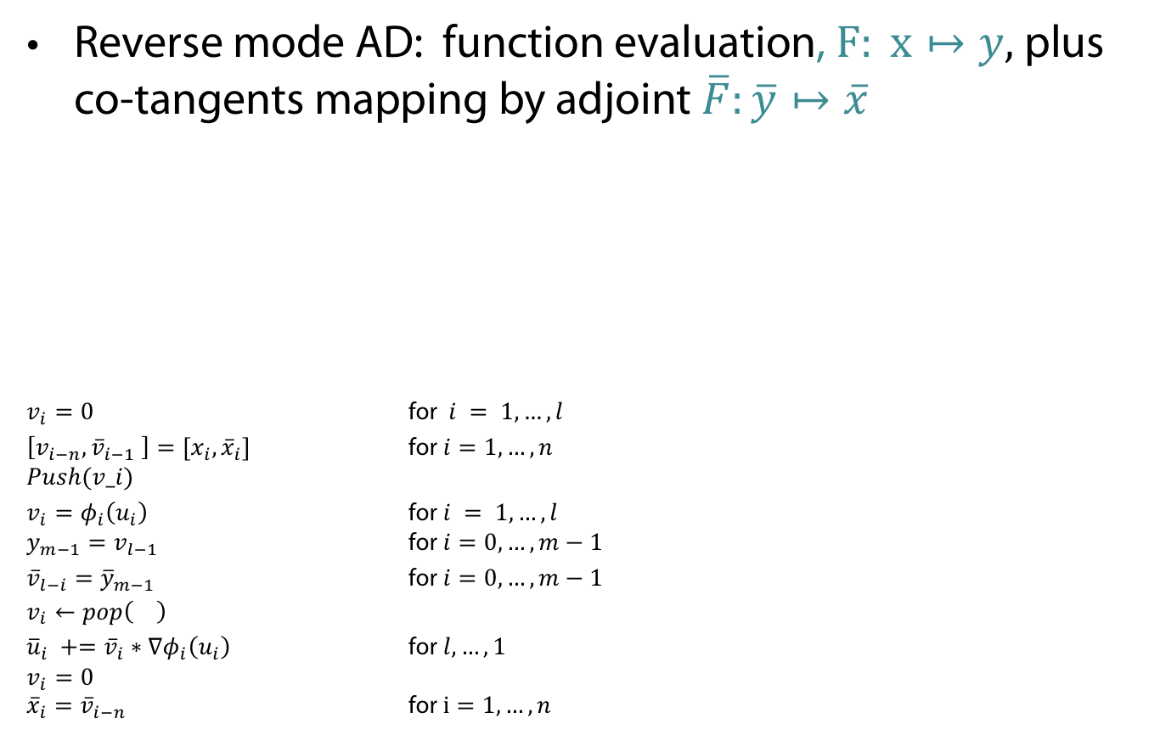

Reverse mode AD = Co-tangents mapping
Reverse mode AD: function evaluation, $F: x↦y,$ plus co-tangents mapping by adjoint $\overline{F}:\overline{y}↦\overline{x}$
$v_{i}=0$ for $i = 1, …, l$
$\left[v_{i−n}, {\overline{v}}_{i−1} \right]={[x}_{i},{\overline{x}}_{i}]$ for $i=1, …,n$
$$Push(v_i)$$
$v_{i}=φ_{i}\left(u_{i}\right)$ for $i = 1, …, l$
$y_{m−1}=v_{l−1}$ for $i=0, …, m−1$
${{\overline{v}}_{l−i}={\overline{y}}_{m−1}}_{}$ for $i=0, …, m−1$
$$v_{i}←pop\left(\right)$$
${\overline{u}}_{i} +={\overline{v}}_{i}∗∇φ_{i}\left(u_{i}\right)$ for $l, …, 1$
$$v_{i}=0$$
${\overline{x}}_{i}={\overline{v}}_{i−n}$ for $i=1, …, n$
$$\overline{F}\left(x,\overline{y}\right)≔{\overline{y}}^{⊤}F^{′}\left(x\right)=\overline{x}$$
(simple algorithm
without sophisticated
memory management:
just using stack)

Slide 36
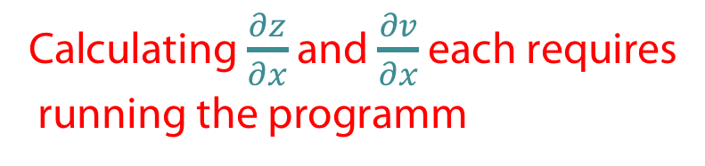
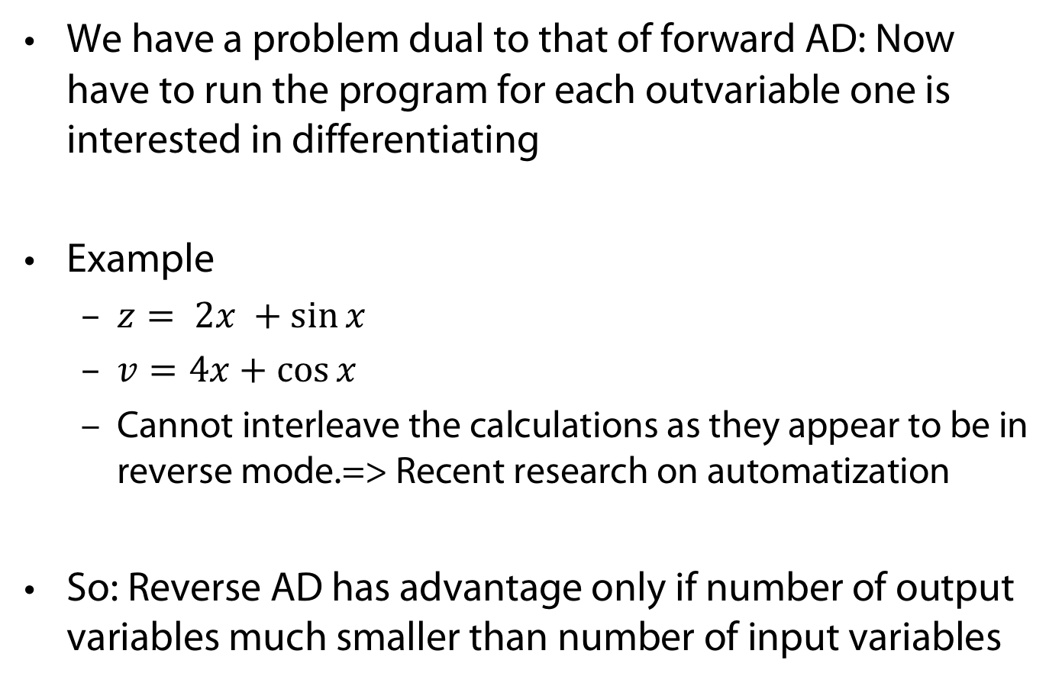
But wait... Limitations of Reverse Mode AD
We have a problem dual to that of forward AD: Now have to run the program for each outvariable one is interested in differentiating
Example
  $z= 2x +\sin{x}$
  $v=4x+\cos{x}$
  Cannot interleave the calculations as they appear to be in reverse mode.=> Recent research on automatization
So: Reverse AD has advantage only if number of output variables much smaller than number of input variables
Calculating $\frac{∂z}{∂x}$ and $\frac{∂v}{∂x}$ each requires
running the programm

Slide 37
Implementing Reverse Mode AD
There are two ways to implement Reverse AD:
We can parse the original program and generate the adjoint program that calculates the derivatives.
  Potentially hard to do.
  Static, so can only be used to differentiate algorithms that have parameters predefined.
  But, efficient (lots of opportunities for optimisation)
We can make a dynamic implementation by constructing a graph that represents the original expression as the program runs.

Slide 38
Constructing an expression graph (in Python)
Goal: get a graph as
Root of the graph are independent variables x, y
Can have children (initially empty): nodes that depending on parent
  class Var:
  def __init__(self, value):
  self.value = value self.children = [] ...
  ...
  x = Var (0.5)
  y = Var (4.2)
y
a
*
x
z
+
b
sin

Slide 39
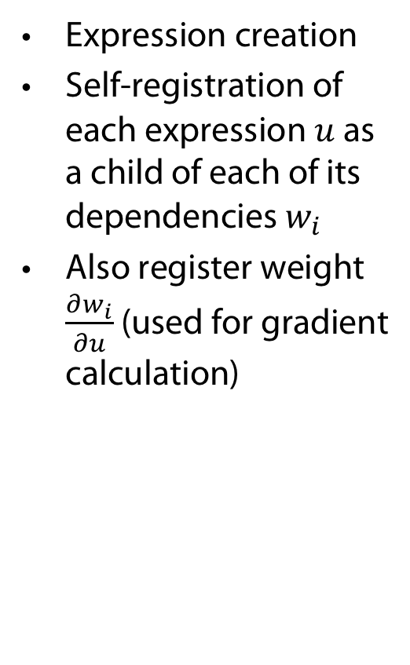
Building expressions
Expression creation
Self-registration of each expression $u$ as a child of each of its dependencies $w_{i}$
Also register weight $\frac{∂w_{i}}{∂u}$(used for gradient calculation)
class Var:
...
def __mul__(self, other):
z = Var(self.value * other.value)
# weight = dz/dself = other.value
self.children.append((other.value, z))
# weight = dz/dother = self.value
other.children.append((self.value, z))
return z
...
...
# "a" is a new Var that is a child of both x and y
# a=x*y
y
a
*
x
z
+
b
sin

Slide 40
Computing gradients
Propagate Derivatives
Cache derivatives in grad_value
class Var:
def __init__(self):
...
self.grad_value = None
def grad(self):
if self.grad_value is None:
# using chain rule
self.grad_value =
sum(weight * var.grad()
for weight, var in self.children)
return self.grad_value ...
...
a.grad_value = 1.0 print("da/dx␣=␣{}".format(x.grad()))
y
a
*
x
z
+
b
sin

Slide 41
Optimising reverse Mode AD
The outline implemntation not very space efficient
  Instead of children direclty store in indices (Wengert list, tape)
Space efficiency for reverse AD is challenging hence research topic
  Count-Trailing-Zeros CTZ): trade-off computation for memory of caches (Griewank 92).
  But, in reality memory is relatively cheap (if managed well)

Slide 42
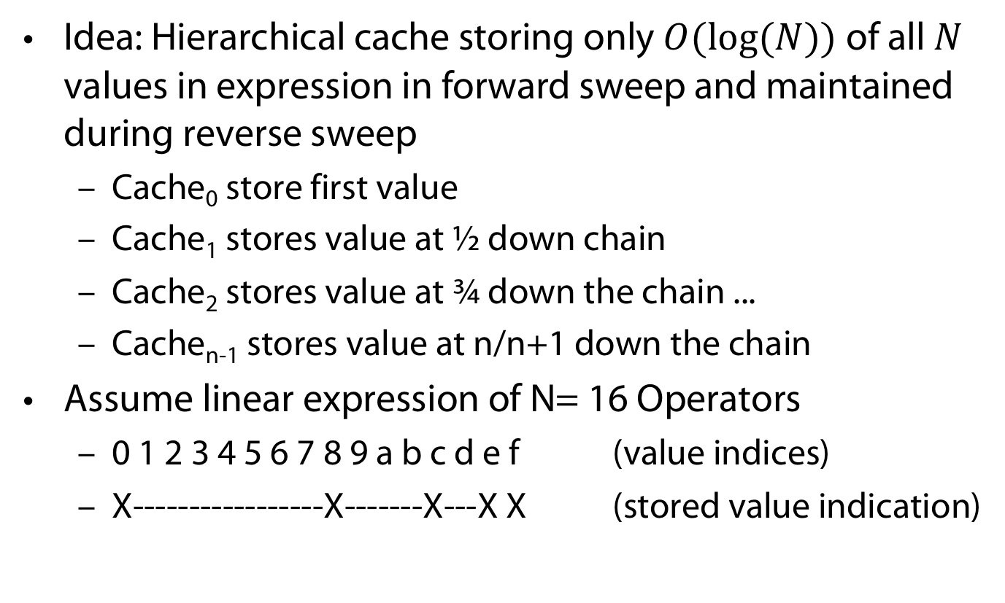
CTZ example
Idea: Hierarchical cache storing only $O(log⁡(N))$of all $N$ values in expression in forward sweep and maintained during reverse sweep
  Cache₀ store first value
  Cache₁ stores value at ½ down chain
  Cache₂ stores value at ¾ down the chain ...
  Cache_{n-1} stores value at n/n+1 down the chain
Assume linear expression of N= 16 Operators
  0 1 2 3 4 5 6 7 8 9 a b c d e f (value indices)
  X-----------------X-------X---X X (stored value indication)

Slide 43
CTZ example (continued)
Reverse sweep (with head postion _)
  0 1 2 3 4 5 6 7 8 9 a b c d e f _ (can swee over e,f)
  X-----------------X-------X---X X
  0 1 2 3 4 5 6 7 8 9 a b c d e f (d not cached, recalculate)
  X-----------------X-------X---X X
  0 1 2 3 4 5 6 7 8 9 a b c d e f (d not cached, recalculate)
  X-----------------X-------X---X X from cached c)
    +-X

Slide 44
CTZ example (continued)
Reverse sweep (with head postion _)
  0 1 2 3 4 5 6 7 8 9 a b c d e f (sweep over c, missing b,
  X-----------------X-------X---X X sweep to 8 and cache a)
    +-X
  0 1 2 3 4 5 6 7 8 9 a b c d e f (recompute 9 from 8,
  X-----------------X-------X---X X then 7to be recomputed
  +--X-X+-X move to 0, store along 6,4)
  0 1 2 3 4 5 6 7 8 9 a b c d e f ( and so on ...)
  X-----------------X-------X---X X
  +-------X--X-X-+---X-X+-X
  +-X

Slide 45
CTZ example (continued)
In the end
  0 1 2 3 4 5 6 8 9 a b c d e f
  X-----------------X-------X---X X
  +-------X--X-X-+---X-X+-X
  +---X-X +-X
  +-X

Slide 46
APPENDIX
Uhhh, a lecture with a hopefully useful

Slide 47
Color Convention in this Course
Formulae, when occurring inline
Newly introduced terminology and definitions
Important results (observations, theorems) as well as emphasizing some aspects
Examples are given with standard orange with possibly light orange frame
Comments and notes in nearly opaque post-it
Algorithms and program code
Reminders (in the grey fog of your memory)

Slide 48
Today‘s lecture is based on the following
Jonathon Hare: Lecture 5 of course „COMP6248 Differentiable Programming (and some Deep Learning)“ http://comp6248.ecs.soton.ac.uk/
Blog post by Rufflewind: Reverse-mode automatic differentiation: a tutorial https://rufflewind.com/2016- 12- 30/reverse- mode- automatic- differentiation
A. G. Baydin, B. A. Pearlmutter, A. A. Radul, and J. M. Siskind. Automatic differentiation in machine learning: A survey. J. Mach. Learn. Res., 18(1):5595–5637, Jan. 2017.
A. H. Gebremedhin and A. Walther. An introduction to algorithmic differentiation. WIREs Data Mining and Knowledge Discovery, 10(1):e1334, 2020.

Slide 49
References
W. K. Clifford. Preliminary sketch of bi-quaternions. Proceedings of the London Mathematical Society, pages 381—395, 1873.
A. Griewank. Achieving logarithmic growth of temporal and spatial complexity in reverse automatic differentiation. Optimization Methods and Software, 1(1):35–54, 1992.

