Slide 1
PROBABILISTIC AND DIFFERENTIABLE PROGRAMMING
V8: Probabilistic Programming I
Özgür L. Özçep
Universität zu Lübeck
Institut für Informationssysteme

Slide 2
Today‘s Agenda (in classical linear form)
Premotivation: Probabilities
Motivation: Probabilistic Programming
Running Example
Semantics of Probabilistic Programs
Nonparametrics
Landscape of Probabilistic Programming Languages

Slide 3
Premotivation: Probabilities

Slide 4
Remember: Problems with deep neural networks
Very data hungry (e.g. often millions of examples)
Very compute-intensive to train and deploy
Poor at representing uncertainty
Easily fooled by adversarial examples
Finicky to optimise: non-convex + choice of architecture, learning procedure, expertise required
Uninterpretable black-boxes, lacking in trasparency, difficult to trust
=> Amongst others, these problems lead to developments towards generative models (lecture V6)

Slide 5
Bayes‘ rule to rule them all ...
If we use the mathematics of probability theory to express all forms of uncertainty and noise associated with our model ...
... then inverse probability (-> Bayes rule) allows us to infer unknown quantities, adapt our models, make predictions, and learn from data.
$$P\left(H | D\right)= \frac{P(D|H)∙P(H)}{P(D)} =\frac{P(D|H)∙P(H)}{\sum_{h}{P\left(D|h\right)P(h) }}$$
H = hypothesis, model
D = data, observation
Bayes‘ Rule

Slide 6
„
ph“
1)
1) Yes, a slide, quoting a slide

Slide 7
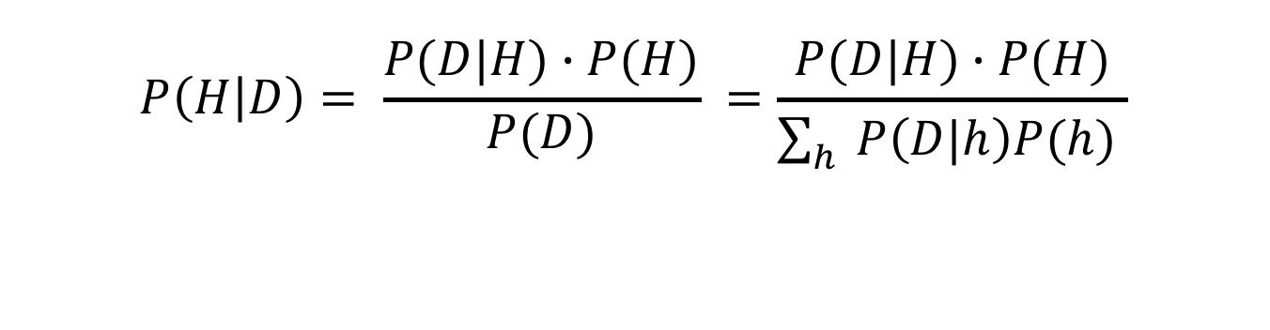
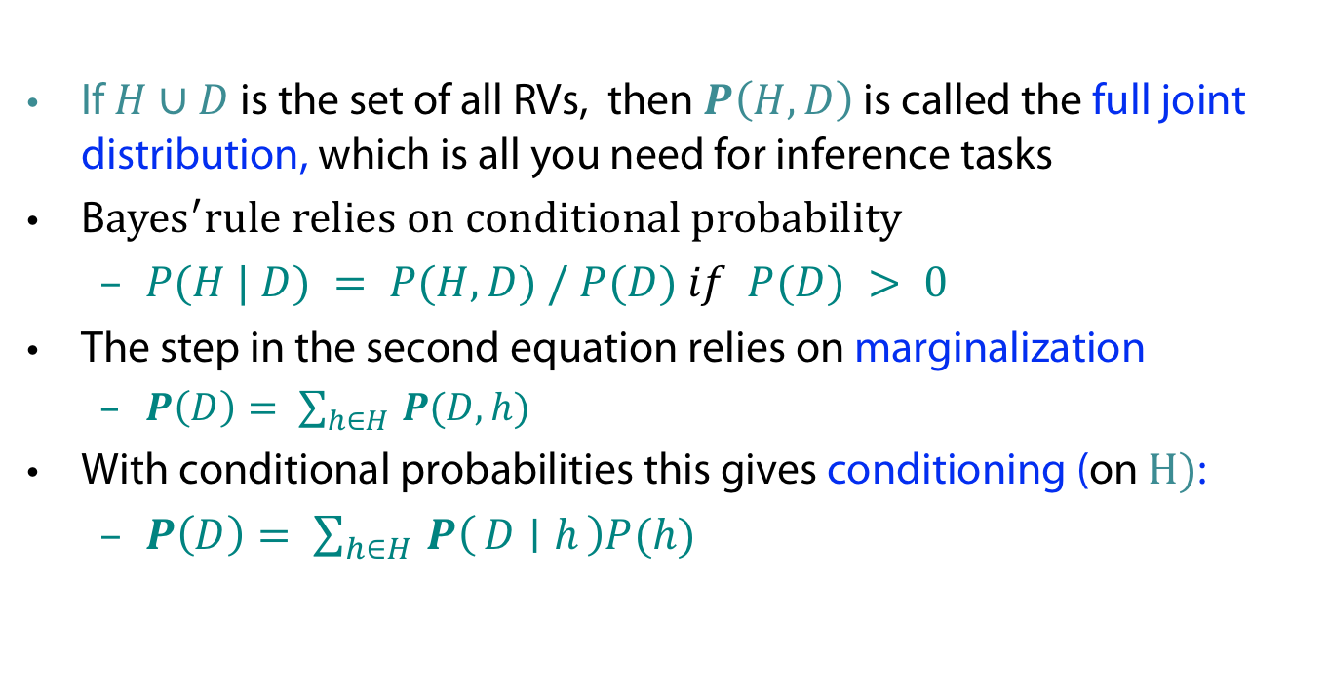
Reminder on basics of w.r.t. Bayes‘ Rule
$$P\left(H | D\right)= \frac{P(D|H)∙P(H)}{P(D)} =\frac{P(D|H)∙P(H)}{\sum_{h}{P\left(D|h\right)P(h) }}$$
If $H∪D$ is the set of all RVs, then $P\left(H,D\right)$ is called the full joint distribution, which is all you need for inference tasks
B${ayes}^{′}rule relies on conditional probability$
  $P(H | D) = P(H,D) / P(D) if P(D) > 0$
The step in the second equation relies on marginalization
  $P\left(D\right)= \sum_{h∈H }{P(D,h)}$
With conditional probabilities this gives conditioning (on $H)$:
  $P\left(D\right)= \sum_{h∈H }{P\left(D ∣ h\right)P(h)}$

Slide 8

Reminder: Bayes Net/Probabilistic Graphical Model (PGM)
Idea: Encode efficiently (factorize)
full joint probabilities
Defines full joint distribution
  $P \left(X1, … ,Xn\right)=\prod_{i=1}^{n}{P (X_{i}∣Parents(X_{i})) }$
  Here:
  $$P\left(S,C,R,W\right)= P\left(C\right)P\left(S | C\right)P\left(R | C\right)P(W|S,R)$$
  Gives, e.g.,
  $$P\left(c,s,¬ r,w\right)= 0.5⋅ 0.1⋅ 0.2⋅ 0.9$$
Graph topology encodes independencies of variables (efficiency!); e.g.
$S$ independent of $R$ given $C$:
$P(S|C) = P(S|C,R)$
P(C)=.5
C P(S|C)
________
t .10
f .50
C P(R|C)
________
t .80
f .20
Cloudy
Sprinkler
Rain
WetGrass
S R P(W|S,R)
______________
t t .99
t f .90
f t .90
f f .00
For in-depth treatment of (other) PGMs see (Koller/Friedman 2019)

Slide 9
Why then not stick to probabilities & PGMs
Problem 1: Probabilistic model development and the derivation of inference algorithms is time-consuming and error-prone.
Problem 2: Exact (and approximate inference) hard due to normalization)
Solution to 1
  Develop Probabilistic Programming (PP) Languages for expressing probabilistic models as computer programs that generate data (i.e. simulators).
  Derive Universal Inference Engines for these languages that do inference over program traces given observed data (Bayes rule on computer programs).

Slide 10
MotivaTIOn: Probabilistic Programming

Slide 11
A „Vennified“ Overview on Role of PP
Bayesian/Probabilistic Machine Learning
IFIS Course Intelligent Agents; V8
Deep Learning
V3-V6
Profits from
Generative DL V6
Profits from
exemplifies
Probabilistic Programming
V8, V9
Gradient Descent/
Automatic Differentiation V3,V7
Efficient representation of
probabilities
V10- V12

Slide 12
(Even more Vennification)
ML: Algorithms &
Applications
Statistics:
Inference & Theroy
PP
PL:
Compilers,
Semantics,
Transformations

Slide 13
Of course this is also a reason ...

Slide 14
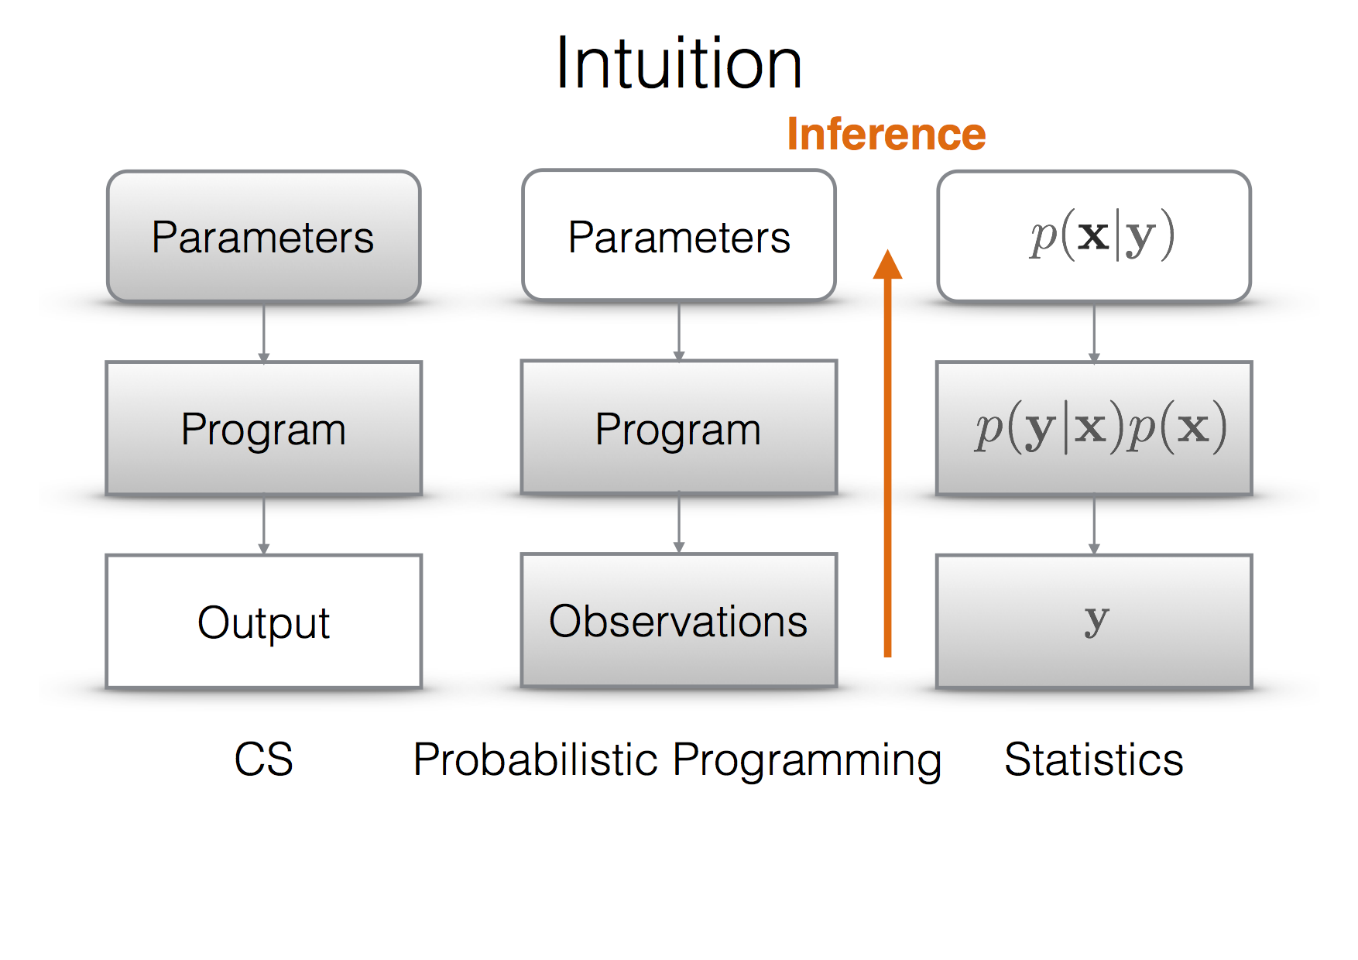
Comparison
OeOe: Note the „inverted“
use of variables x and y
Ex: F. Wood: Probabilistic Programming, PPAML Summer School, Portland 2016

Slide 15
Running Example

Slide 16
A probabilistic program (PP) is any program that can depend on random choices.
  Can be written in any language that has a random number generator.
  You can specify any computable prior by simply writing down a PP that generates samples.
  A probabilistic program implicitly defines a distribution over its output.
There are many different PP languages based on different paradigms: imperative, functional, and logical
Here we illustrate PPs with a lightweight approach for imperative programming based on MATLAB

Slide 17
An Example Probabilistic Program
flip = rand < 0.5
% flip is 1 if random number from [0,1] smaller 0,5
if flip
  x = randg + 2 % Random draw from Gamma(1,1)
else
  x = randn % Random draw from standard Normal
end
Implied distributions over variables

Slide 18
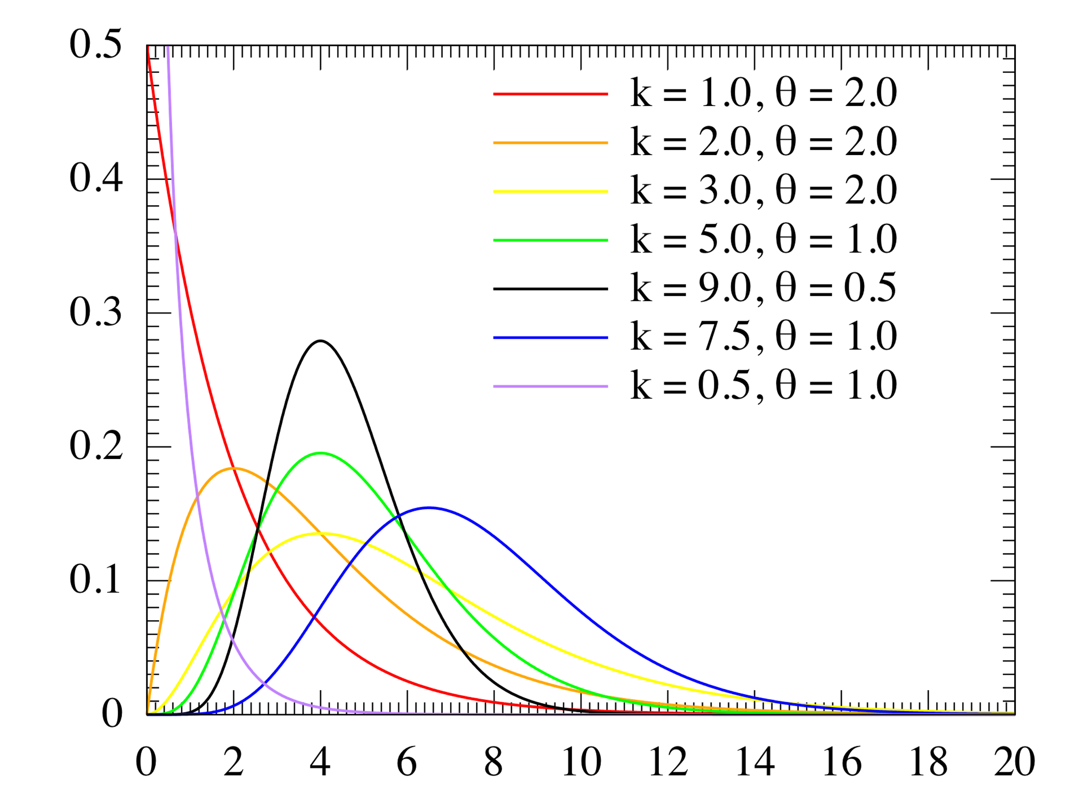
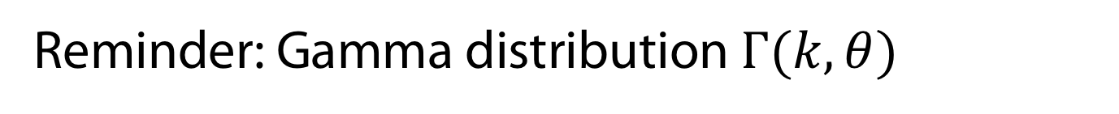

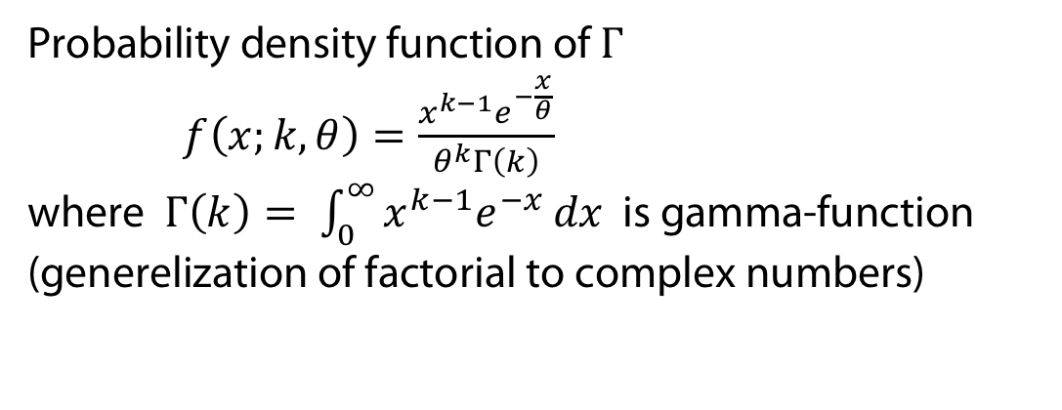
Reminder: Gamma distribution $Γ(k, θ)$
$$f\left(x;k,θ\right)$$
Probability density function of $Γ$
$f\left(x;k,θ\right)=\frac{x^{k−1}e^{−\frac{x}{θ}}}{θ^{k}Γ\left(k\right)}$
where $Γ\left(k\right)= \int_{0}^{∞}{x^{k−1}e^{−x}}dx$ is gamma-function
(generelization of factorial to complex numbers)

Slide 19
An Example Probabilistic Program
flip = rand < 0.5
% flip is 1 if random number from [0,1] smaller 0,5
if flip
  x = randg + 2 % Random draw from Gamma(1,1)
else
  x = randn % Random draw from standard Normal
end
Implied distributions over variables

Slide 20
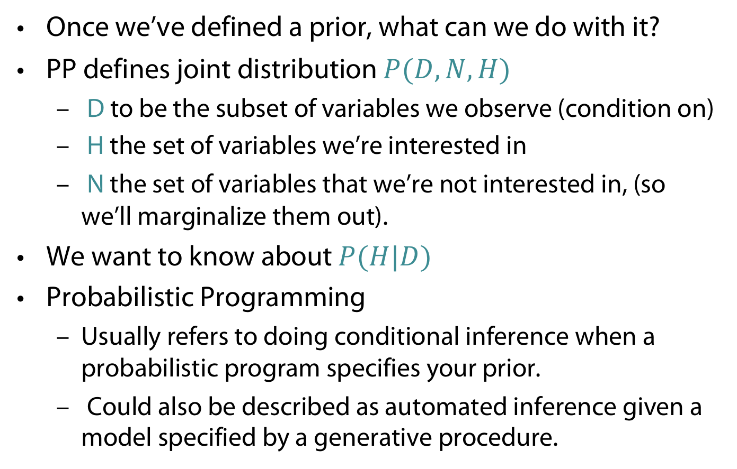
Conditioning
Once we’ve defined a prior, what can we do with it?
PP defines joint distribution $P(D, N, H)$
  D to be the subset of variables we observe (condition on)
  H the set of variables we’re interested in
  N the set of variables that we’re not interested in, (so we’ll marginalize them out).
We want to know about $P(H|D)$
Probabilistic Programming
  Usually refers to doing conditional inference when a probabilistic program specifies your prior.
  Could also be described as automated inference given a model specified by a generative procedure.

Slide 21
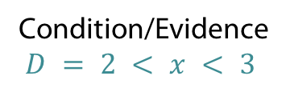
Conditioning with Probabilistic Program
flip = rand < 0.5
% flip is 1 if random number from [0,1] smaller 0,5
if flip
  x = randg + 2 % Random draw from Gamma(1,1)
else
  x = randn % Random draw from standard Normal
end
Implied distributions over variables
Condition/Evidence
$D = 2 < x < 3$

Slide 22
Semantics of Probabilistic Programs

Slide 23
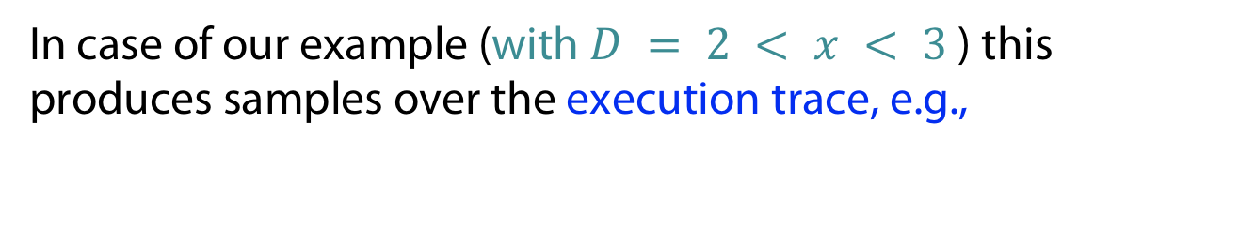
Can we develop generic inference for all PPs?
Rejection sampling
  Run the program with fresh source of random numbers
  If condition D is true, record H as a sample; else ignore the sample
  Repeat
flip = rand < 0.5
if flip
  x = randg + 2
else
x = randn
end
>> True
>> 2.7
In case of our example (with $D = 2 < x < 3$) this produces samples over the execution trace, e.g.,
(True, 2.7)

Slide 24
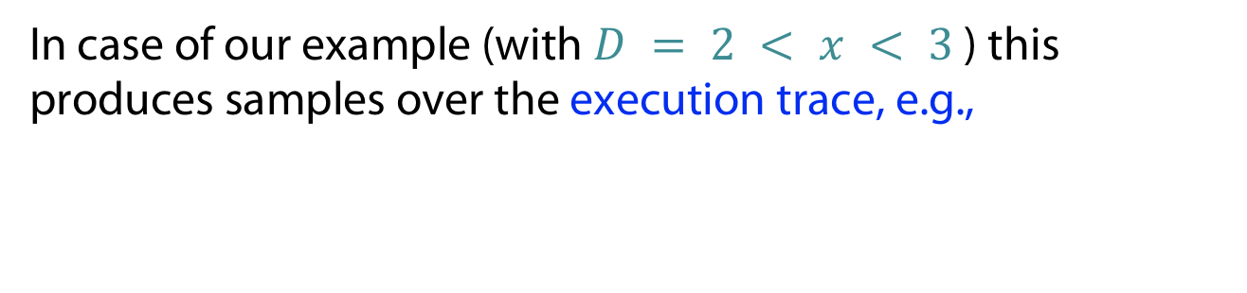
Can we develop generic inference for all PPs?
Rejection sampling
  Run the program with fresh source of random numbers
  If condition D is true, record H as a sample; else ignore the sample
  Repeat
flip = rand < 0.5
if flip %
  x = randg + 2
else %
x = randn
end
>> True
>> 3.2
Sample
(True, 3.2)
rejected
In case of our example (with $D = 2 < x < 3$) this produces samples over the execution trace, e.g.,
(True, 2.7)

Slide 25
Can we develop generic inference for all PPs?
Rejection sampling
  Run the program with fresh source of random numbers
  If condition D is true, record H as a sample; else ignore the sample
  Repeat
flip = rand < 0.5
if flip
  x = randg + 2
else
x = randn
end
>> True
>> 2.1
In case of our example (with $D = 2 < x < 3$) this produces samples over the execution trace, e.g.,
(True, 2.7)
(True, 2.1)

Slide 26
Can we develop generic inference for all PPs?
Rejection sampling
  Run the program with fresh source of random numbers
  If condition D is true, record H as a sample; else ignore the sample
  Repeat
flip = rand < 0.5
if flip
  x = randg + 2
else
x = randn
end
>> False
>> -1.3
Sample
(False, -1.3)
rejected
In case of our example (with $D = 2 < x < 3$) this produces samples over the execution trace, e.g.,
(True, 2.7)
(True, 2.1)

Slide 27
Can we develop generic inference for all PPs?
Rejection sampling
  Run the program with fresh source of random numbers
  If condition D is true, record H as a sample; else ignore the sample
  Repeat
flip = rand < 0.5
if flip
  x = randg + 2
else
x = randn
end
>> False
>> 2.3
In case of our example (with $D = 2 < x < 3$) this produces samples over the execution trace, e.g.,
(True, 2.7)
(True, 2.1)
(False, 2.3),...

Slide 28
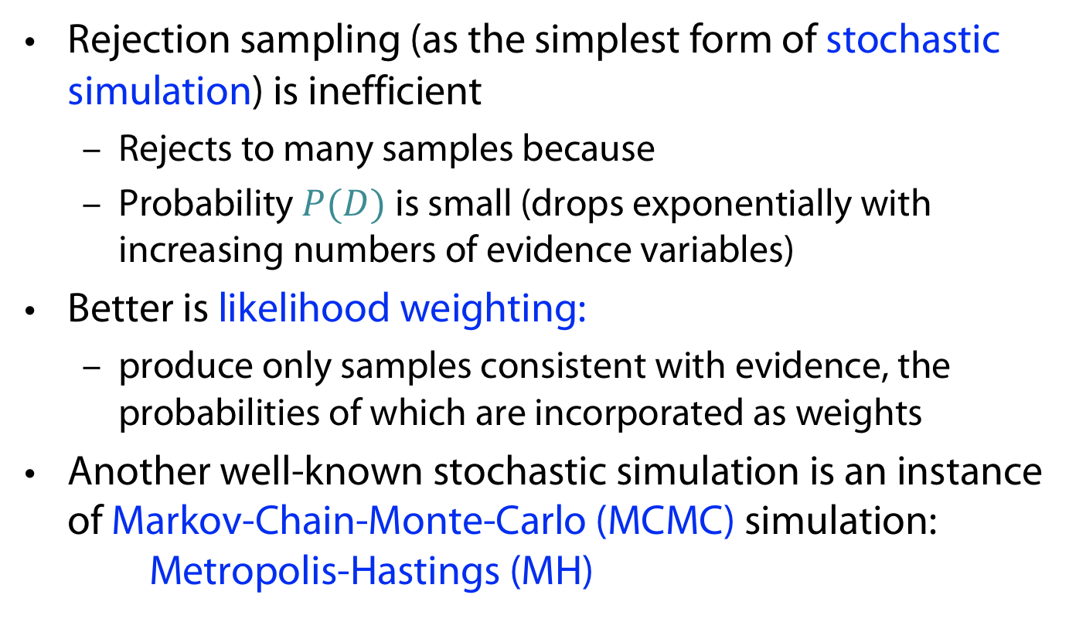
Of course we can do better
Rejection sampling (as the simplest form of stochastic simulation) is inefficient
  Rejects to many samples because
  Probability $P(D)$ is small (drops exponentially with increasing numbers of evidence variables)
Better is likelihood weighting:
  produce only samples consistent with evidence, the probabilities of which are incorporated as weights
Another well-known stochastic simulation is an instance of Markov-Chain-Monte-Carlo (MCMC) simulation: Metropolis-Hastings (MH)

Slide 29

Reminder: Likelihood Weighting for Bayes Nets
P(Rain|Sprinkler=true, WetGrass = true) = ?
Sampling
  w = 1.0 (weight initialized)
  Sample $P(Cloudy) = (0.5,0.5) => true$
  Sprinkler is an evidence variable with value true
  w ⬅ w * P(Sprinkler=true | Cloudy = true) = 0.1
  Sample P(Rain|Cloudy=true)=(0.8,0.2) => true
  WetGrass is an evidence variable with value true
  w ⬅w * P(WetGrass=true |Sprinkler=true, Rain = true) = 0.099
  [true, true, true, true] with weight 0.099
Estimating
  Accumulating weights to either Rain=true or Rain=false
  Normalize (= divide by sum of weights)
P(C)=.5
C P(S|C)
________
t .10
f .50
Cloudy
C P(R|C)
________
t .80
f .20
Sprinkler
Rain
S R P(W|S,R)
______________
t t .99
t f .90
f t .90
f f .00
WetGrass
Notes:
Weight is low because its a cloudy day what makes sprinkler unlikley

Slide 30
Reminder: Markov Chain Monte Carlo (MCMC)
Let’s think of the network as being in a particular current state specifying a value for every variable
MCMC generates each event by making a random change to the preceding event
The next state is generated by randomly sampling a value for one of the non-evidence variables X_{i}, conditioned on the current values of the variables in the Markov blanket of X_{i}
Note: Likelihood Weighting only takes into account the evidences of the parents. (Problematic if evidence on leaves).

Slide 31
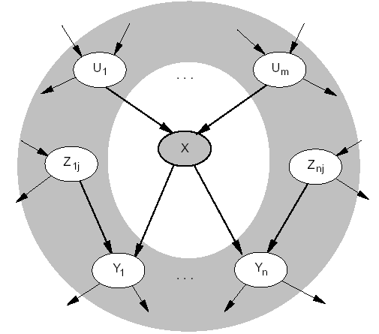
Reminder: Markov Blanket
Markov blanket: Parents + children + children’s parents
Node is conditionally independent of all other nodes in network, given its Markov Blanket

Slide 32
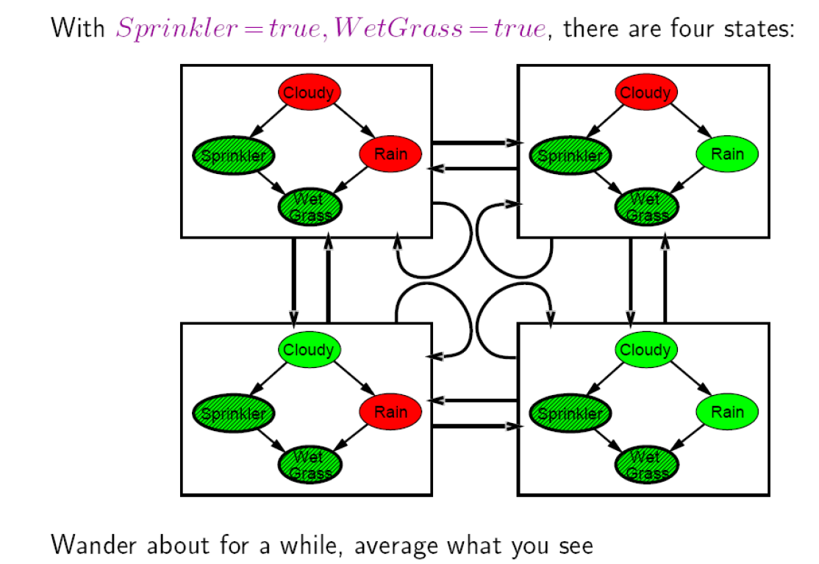
Reminder: MCMC
Arrows describe transition probabilities; leads to a (the Markov) chain of states

Slide 33

Reminder: Markov Chain Monte Carlo: Example
$P(Rain|Sprinkler = true, WetGrass = true) = ?$
States [Cloudy,Sprinkler,Rain,WetGrass]
Initial state is [true, true, false, true]
The following steps are executed repeatedly:
  Cloudy $∼$P(Cloudy|Sprinkler= true, Rain=false) => Cloudy = false
  State update: [false, true, false, true]
  Rain $∼$ P(Rain|Cloudy=false,Sprinkler=true, WetGrass=true) => Rain = true
  State update: [false, true, true, true]
After all the iterations, let’s say the process visited 20 states where Rain is true and 60 states where Rain is false then the answer of the query is NORMALIZE((20,60))=(0.25,0.75)
C P(S|C)
________
t .10
f .50
P(C)=.5
C P(R|C)
________
t .80
f .20
Cloudy
Sprinkler
Rain
WetGrass
S R P(W|S,R)
______________
t t .99
t f .90
f t .90
f f .00

Slide 34
Example: Metropolis-Hastings
Start with a trace
Change one random decision, discarding subsequent decisions
Sample subsequent decisions
Accept with appropriate MCMC acceptance probability
(True, 2.3)
(False,)
(False, -0,9)
Reject, does not satisfy observation

Slide 35
Example: Metropolis-Hastings
Start with at race
Change one random decision, discarding subsequent decisions
Sample subsequent decisions
Accept with appropriate MCMC acceptance probability
(True, 2.3)
(True, 2.9)
Nothing to do
Accept, maybe

Slide 36
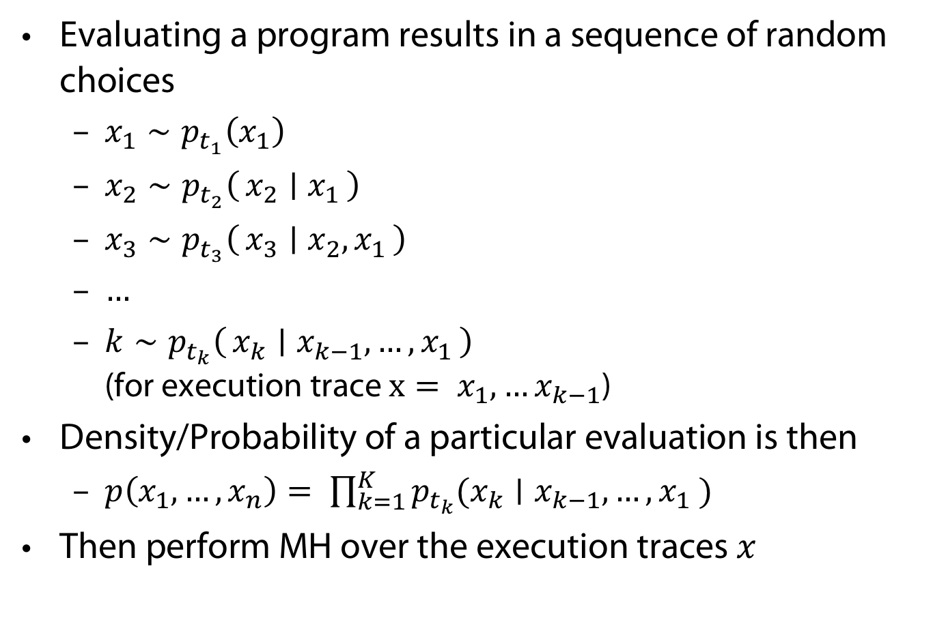
Semantics of PP via MH - Notation
Evaluating a program results in a sequence of random choices
  $x_{1}∼p_{t_{1}}\left(x_{1}\right)$
  $x_{2}∼p_{t_{2}}\left(x_{2} ∣ x_{1}\right)$
  $x_{3}∼p_{t_{3}}\left(x_{3} ∣ x_{2},x_{1}\right)$
  $…$
  $k∼p_{t_{k}}\left(x_{k} ∣ x_{k−1}, …, x_{1}\right)$ (for execution trace $x= {x_{1},…x}_{k−1}$)
Density/Probability of a particular evaluation is then
  $p\left(x_{1}, …, x_{n}\right)= \prod_{k=1}^{K}{p_{t_{k}}(x_{k}∣x_{k−1}, …, x_{1} )}$
Then perform MH over the execution traces $x$

Slide 37
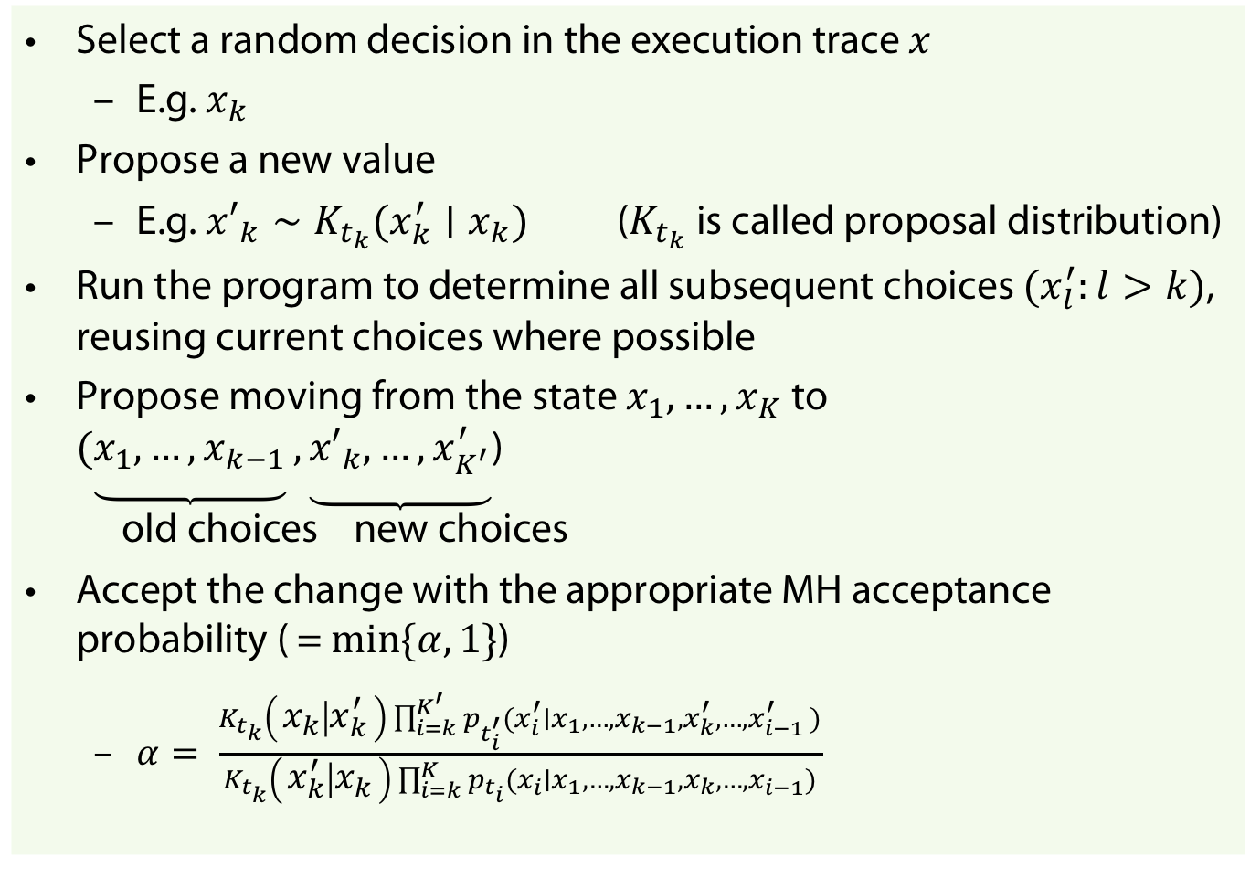
MH over traces
Select a random decision in the execution trace $x$
  E.g. $x_{k}$
Propose a new value
  E.g. ${x′}_{k}∼K_{t_{k}}(x_{k}^{′}∣x_{k})$ ($K_{t_{k}}$ is called proposal distribution)
Run the program to determine all subsequent choices $(x_{l}^{′}:l>k)$, reusing current choices where possible
Propose moving from the state $x_{1},…, x_{K}$ to $(\underbrace{x_{1},…, x_{k−1}},\underbrace{{x′}_{k},…, x_{K^{′}}^{′}}$)
old choices new choices
Accept the change with the appropriate MH acceptance probability ( = $min\{α, 1\}$)
  $α= \frac{K_{t_{k}}\left(x_{k} ∣ x_{k}^{′}\right)\prod_{i=k}^{K^{′}}{p_{t_{i}^{′}}(x_{i}^{′}∣x_{1}, …, x_{k−1}, x_{k}^{′}, …, x_{i−1 }^{′})}}{K_{t_{k}}\left(x_{k}^{′} ∣ x_{k}\right)\prod_{i=k}^{K}{p_{t_{i}}(x_{i}∣x_{1}, …, x_{k−1},x_{k}, …,x_{i−1})}}$

Slide 38
Nonparametrics

Slide 39
Works also for non-parametric models
If we can sample from the prior of a nonparametric model using finite resources with probability 1, then we can perform inference automatically using the techniques described thus far
We can sample from a number of nonparametric processes/models with finite resources (with probability 1) using a variety of techniques
  Gaussian processes via marginalisation
  Dirichlet processes via stick breaking
  Indian Buffet processes via urn schemes
<=

Slide 40
Tackling non-parametric models
Non-parametric models: Allow distributions over arbitrary functions to learn a target function
Typical Example: Gaussian Process (GP)
Prior
Posterior

Slide 41
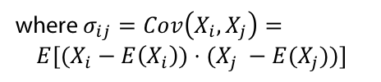
Reminder: Multivariate Gaussians
Then define
to mean
Co-variance matrix
where the Gaussian’s parameters have…
where $σ_{ij}=Cov\left(X_{i}, X_{j}\right)=$
$$E[(X_{i}−E\left(X_{i}\right))⋅(X_{j} −E(X_{j}))]$$
One can show: E[X] = μ and Cov[X] = Σ.

Slide 42
Reminder: Gaussians
The class of Gaussians is invariant both under conditionalizing and marginalizing

Slide 43

Tackling non-parametric models
Gaussian Process (GPs)
  A Gaussian process is a collection of random variables, any finite number of which have (consistent) Gaussian distributions
  GPs generalize of multivariate Gaussians to infinitely many variables (and infinitely long vector = function)
A Gaussian distribution $N(μ, Σ)$ is specified by mean vector $μ$ and covariance matrix $Σ$
A GP is fully specified by a mean function $μ(x)$ and a covariance function $k(x,x′)$

Slide 44
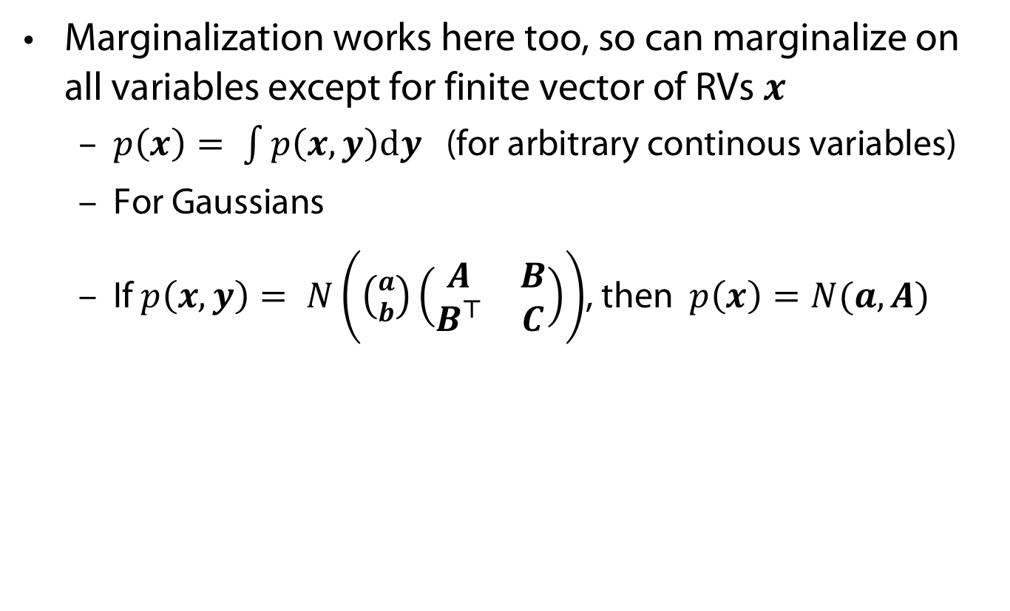
Doing the sampling finitely
Marginalization works here too, so can marginalize on all variables except for finite vector of RVs $x$
  $p\left(x\right)= \int{p\left(x,y\right)dy }$ (for arbitrary continous variables)
  For Gaussians
  If $p\left(x,y\right)= N\left(\left({a \atop b}\right)\left(\begin{matrix}A & B \\ B^{⊤} & C\end{matrix}\right)\right)$, then $p\left(x\right)=N(a,A)$

Slide 45
Advanced Automatic Inference
Now that we have separated inference and model design, can use any inference algorithm.
Free to develop inference algorithms independently of specific models.
Once graphical models identified as a general class, many model-agnostic inference methods:
  Belief Propagation
  Pseudo-likelihood
  Mean-field Variational
  MCMC
What generic inference algorithms can we implement for more expressive generative models?

Slide 46
Landscape of Probabilistic ProgrAMMING Languages

Slide 47
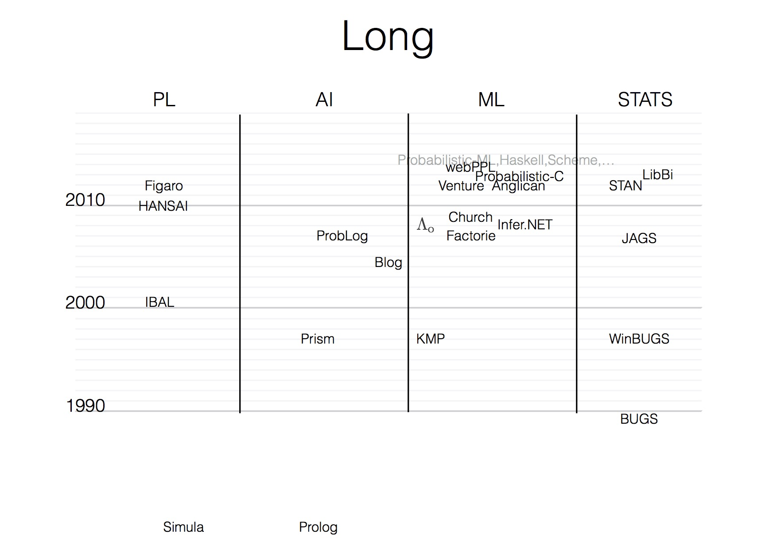
History of PP with Programming Languages

Slide 48
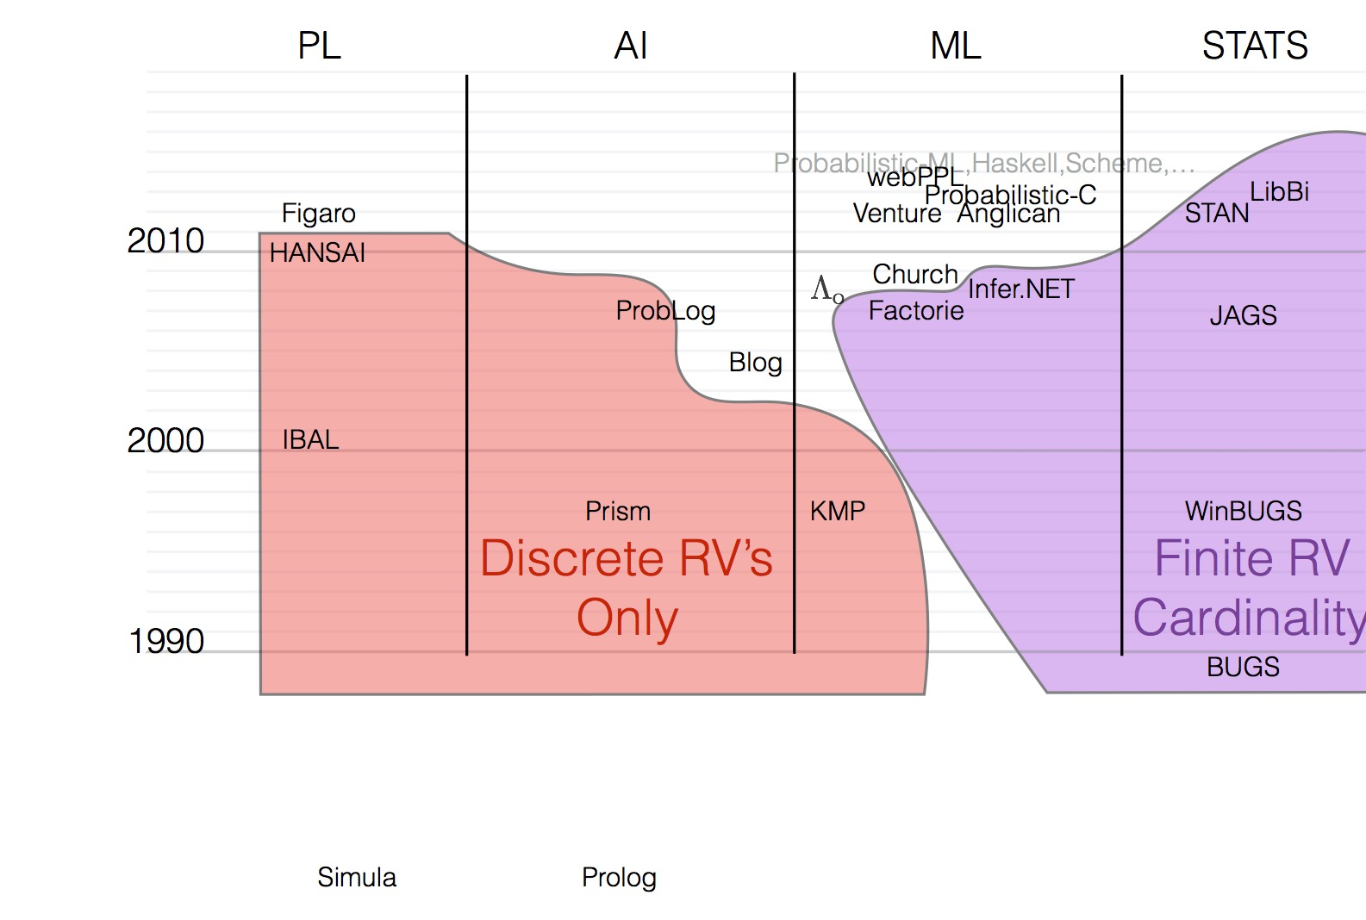
First-Order PP languages

Slide 49
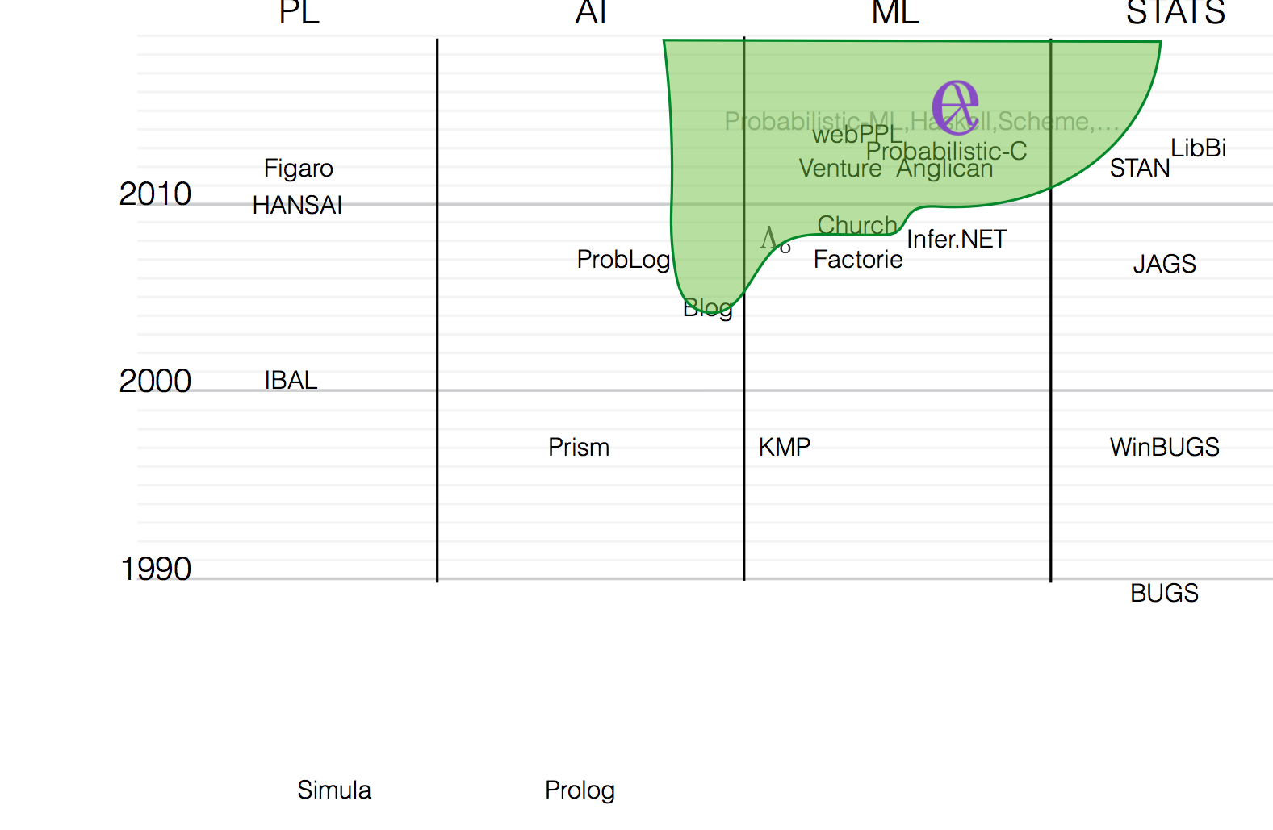
Higher-Order PP Languages

Slide 50
The Church Family
Lisp like constructs extended with two main functions
  Sample
  Observe
For a book-lengthy treatment see (Van de Ment et al 2018)
  In particular, describes a formal grammar, astonishingly simple grammar

Slide 51
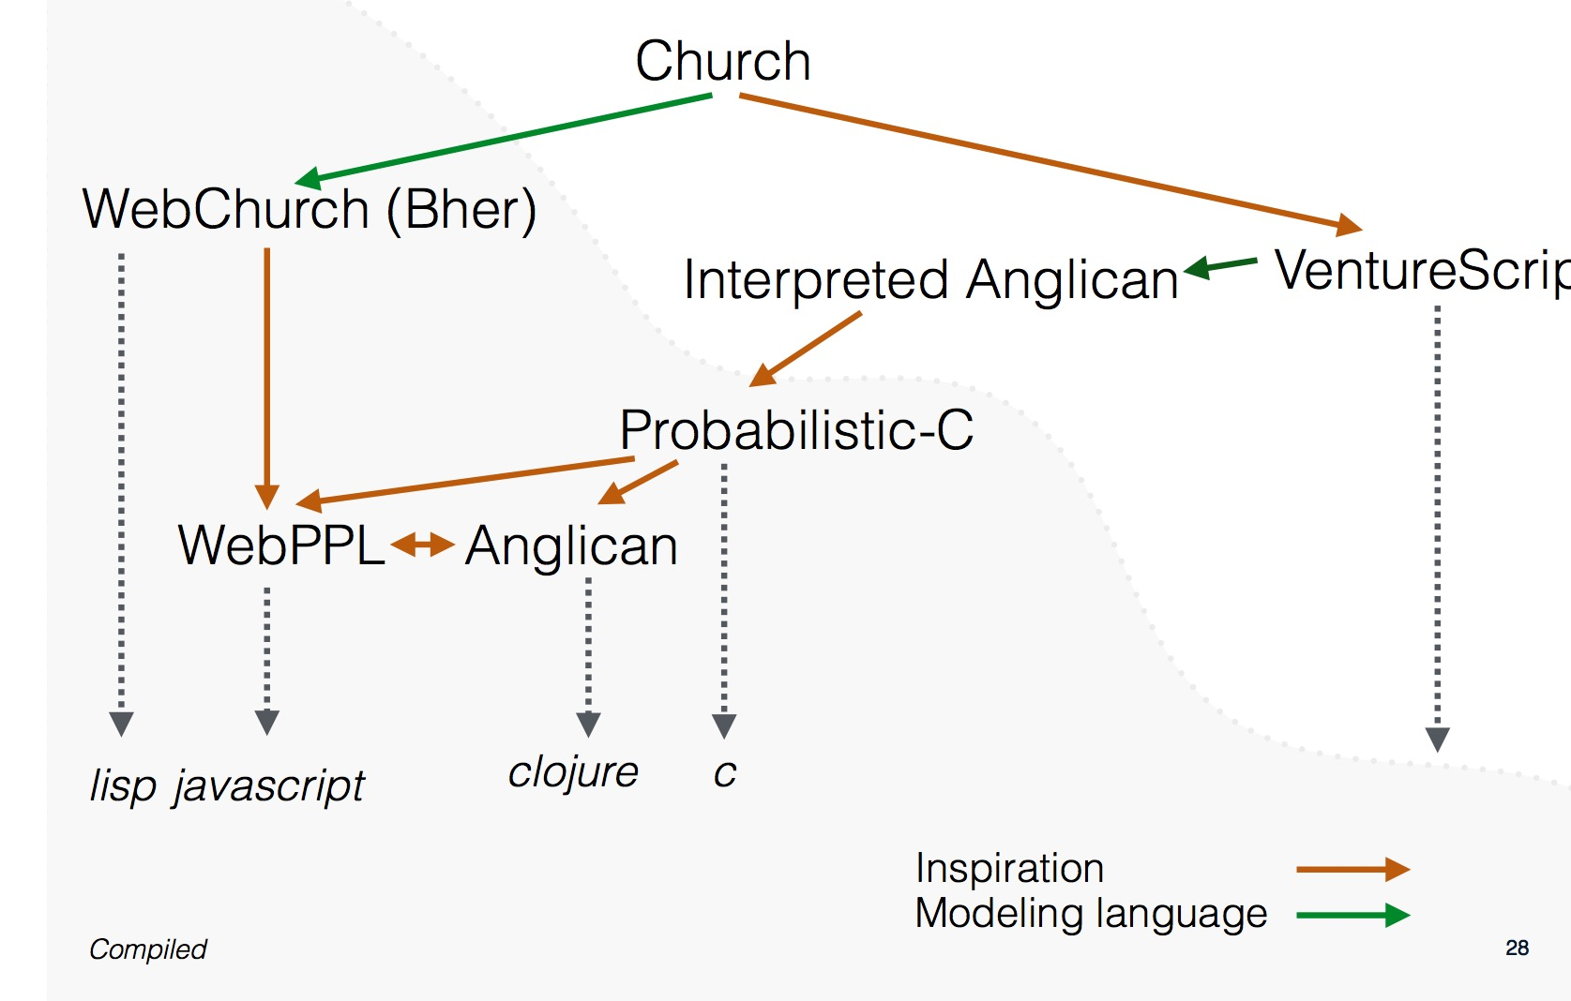
The church family

Slide 52
Example: Bayes Net in Anglican
P(C)=.5
C P(S|C)
________
t .10
f .50
C P(R|C)
________
t .80
f .20
Cloudy
Sprinkler
Rain
S R P(W|S,R)
______________
t t .99
t f .90
f t .90
f f .00
WetGrass

Slide 53
Example Application: CAPTCHA Breaking
OeOe: Note the „inverted“ use of variables x and y

Slide 54
Examle Application: Scene interpretation
(Masinghka et al 2013)
(Kulkarni et al. 2015) et al 2013)

Slide 55
Next week
„Probabilistic Programming“ is sometimes used in narrow sense for probabilistically enhanced imperative or functional languages (Gordon et al. 14)
We use it in a broader sense to include also probabilistic logic programs – the topic of next week

Slide 56
APPENDIX
Uhhh, a lecture with a hopefully useful

Slide 57
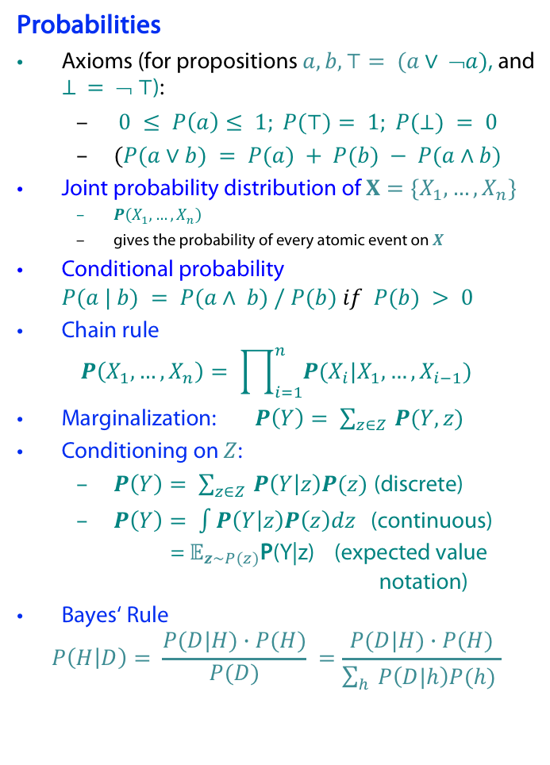
Probability theory basics reminder
Random variable (RV)
possible worlds defined by assignment of values to random variables.
Boolean random variables
  e.g., Cavity (do I have a cavity?). Domain is < true , false >
Discrete random variables
  e.g., possible value of Weather is one of < sunny, rainy, cloudy, snow >
Domain values must be exhaustive and mutually exclusive
Elementary propositions are constructed by assignment of a value to a
random variable: e.g.,
  Cavity = false (abbreviated as ¬cavity)
  Cavity = true (abbreviated as cavity)
(Complex) propositions formed from elementary propositions and standard logical connectives, e.g., Weather = sunny ∨ Cavity = false
Probabilities
Axioms (for propositions $a,b, ⊤= (a∨ ➢a)$, and $⊥ = ➢ ⊤$):
  $0 ≤ P\left(a\right)≤ 1; P(⊤)= 1; P(⊥) = 0$
  $(P(a∨b) = P(a) + P(b) − P(a∧b)$
Joint probability distribution of $X=\{X_{1}, …, X_{n}\}$
  $P\left(X_{1},…, X_{n}\right)$
  gives the probability of every atomic event on $X$
Conditional probability $P(a | b) = P(a∧ b) / P(b) if P(b) > 0$
Chain rule
$$P\left(X_{1},…, X_{n}\right)= \prod_{i=1}^{n}{P(X_{i}|X_{1},…, X_{i−1})}$$
Marginalization: $P\left(Y\right)= \sum_{z∈Z }{P(Y,z)}$
Conditioning on $Z$:
  $P\left(Y\right)= \sum_{z∈Z }{P\left(Y | z\right)P(z)}$ (discrete)
  $P\left(Y\right)= \int{P\left(Y | z\right)P\left(z\right)dz}$ (continuous)
  = $𝔼_{z∼P(z)}$P(Y|z) (expected value notation)
Bayes‘ Rule
$$P\left(H | D\right)= \frac{P(D|H)∙P(H)}{P(D)} =\frac{P(D|H)∙P(H)}{\sum_{h}{P\left(D|h\right)P(h) }}$$

Slide 58
Color Convention in this Course
Formulae, when occurring inline
Newly introduced terminology and definitions
Important results (observations, theorems) as well as emphasizing some aspects
Examples are given with standard orange with possibly light orange frame
Comments and notes in nearly opaque post-it
Algorithms and program code
Reminders (in the grey fog of your memory)

Slide 59
Today‘s lecture is based on the following
Mainly
  D. Duvenaud/J. Loyd: Introduction toProbabilistic Programming. Talk given at Computational and Biological Learning Lab, University of Cambridge, March 2013 (https://jamesrobertlloyd.com/talks)
A little bit of
  Zoubin Ghahramani: Probabilistic Machine Learning and AI, Microsoft AI Summer School Cambridge 2017 http://mlss.tuebingen.mpg.de/2017/speaker_slides/Zoubin1.pdf
  F. Wood: Probabilistic Programming, PPAML Summer School, Portland 2016, link

Slide 60
References
Gordon, Henzinger, Nori, and Rajamani
“Probabilistic programming.” In Proceedings of On The Future of Software Engineering (2014).
Mansinghka,, Kulkarni, Perov, and Tenenbaum
“Approximate Bayesian image interpretation using generative probabilistic graphics programs." NIPS (2013).
J.-W. van de Meent, B. Paige, H. Yang, and F. Wood. An Introduction to Probabilistic Programming. arXiv e-prints, page arXiv:1809.10756, Sept. 2018.
T. D. Kulkarni, P. Kohli, J. B. Tenenbaum, and V. K. Mansinghka. Picture: A probabilistic programming language for scene perception. In Proceedings of CVPR 2015, 2015, pages 4390–4399.
D. Koller and N. Friedman. Probabilistic Graphical Models: Principles and Techniques - Adaptive Com- putation and Machine Learning. The MIT Press, 2009.

