Slide 1
PROBABILISTIC AND DIFFERENTIABLE PROGRAMMING
V9: Probabilistic Programming II
Özgür L. Özçep
Universität zu Lübeck
Institut für Informationssysteme

Slide 2
Probabilistic Logic Programs (PLP)
devised by Poole and Sato in the 90s.
built on top of the programming language Prolog
upgrade directed graphical models
Generalises probabilistic databases (Suciu et al.)
combines the advantages / expressive power of programming languages (Turing equivalent) and graphical models
Implementations: see next page

Slide 3
PLP Systems
PRISM https://www.prismmodelchecker.org/
ProbLog2 http://dtai.cs.kuleuven.be/problog/
Yap Prolog https://github.com/vscosta/yap-6.3 includes
  ProbLog1
  cplint
  CLP(BN)
  LP2
PITA in XSB Prolog http://xsb.sourceforge.net/
AILog2 http://artint.info/code/ailog/ailog2.html
SLPs http://stoics.org.uk/~nicos/sware/pepl
contdist http://www.cs.sunysb.edu/~cram/contdist/
DC https://code.google.com/p/distributional-clauses
WFOMC http://dtai.cs.kuleuven.be/ml/systems/wfomc

Slide 4
Today‘s Agenda (in classical linear form)
Probabilistic Logic Programming
Modeling
Reasoning
Learning

Slide 5
Modeling

Slide 6
Motivation (suffering from Vennitis)
Dealing with Uncertainty
Reasoning with
Relational data
Various
formalisms
Here: PLP
Learning

Slide 7
Motivation (suffering from Vennitia)
Several possible worlds
0.8::stress(ann).
0.6::influences(ann,bob).
0.2::influences(bob,carl).
Distribution Semantics (Sato, 95):
probabilistic choices + logic program
→ distribution over possible worlds
Atoms as RVs
Prolog/ logic
programming
Various
formalisms
Here: PLP
Parameter learning,
Adapted relational
Learning techniques
One world
stress(ann).
influences(ann,bob).
influences(bob,carl).
smokes(X) :- stress(X).
smokes(X) :- influences(Y,X), smokes(Y).

Slide 8
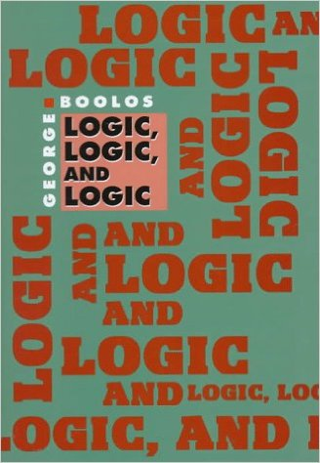
The motto: Logic everywhere
See also IFIS course Information systems

Slide 9
The Logic programming (LP) paradigm
The other big three paradigms of programming
  Imperative (e.g. C)
  Functional (e.g., Lisp)
  Object-oriented (e.g. Java)
Distinguishing feature of LP: Problem solving by specifying the „What“ not the “How to“
Abstracting from
  Control structures
  Memory layout
  Process direction
Prominent examples: Prolog, Datalog, ASP (Answer set programing)

Slide 10
Logic
Science of logic investigates mathematical structures (static and dynamic) and formal languages to describe them by specifying a logic given by
syntax (well-formed formula)
semantics (truth conditions for sentences, entailment notion)
calculus (provability, inference)
Introductory logic texbooks with CS in mind
(Huth,Ryan 00)
(Ben-Ari 01)

Slide 11
Where is the logic in logic programming?
Specification of a domain with a set of formula (sometimes called a knowledge base)
  Formula specifed by truth-condition semantics as in logic
  In Prolog: formula are facts or rules
Specifcation of the problem as a query (also a formula)
  Query is Boolean or has variables to be bound
Solving a problem according a logical calculus
  try to infer (bindings for) query w.r.t. the knowledge base using rules
  In Prolog use resolution

Slide 12
Prolog
Prolog: Programmation en Logique
Invented around 1970 when there was high interest in
  Theorem proving
  Language processing with formal grammars
Protagonists
  R. Kowalski: Theoretical contribution with SL-Resolution
  A. Colmerauer and P. Roussel: developer

Slide 13

A bit of gambling with ProbLog
Toss (biased) coin & draw ball from each urn
win if (heads and a red ball) or (two balls of same color)
0.4 :: heads.
0.3 :: col(1,red); 0.7 :: col(1, blue).
0.2 :: col(2,red); 0.3 :: col(2,green);
0.5 :: col(2,blue).
win :- heads, col(_,red).
win :- col(1,C), col(2,C).
Probabilistic fact: Heads with probability 0.4
annotated disjunction: first ball is red with probability 0.3 and blue with 0.7
annotated disjunction: second ball is red with probability 0.2, green with 0.3, and blue with 0.5
Logical rule encoding background knowledge
Probabilistic choices
consequences

Slide 14
Queries
0.4 :: heads.
0.3 :: col(1,red); 0.7 :: col(1, blue).
0.2 :: col(2,red); 0.3 :: col(2,green); 0.5 :: col(2,blue).
win :- heads, col(_,red).
win :- col(1,C), col(2,C).
Probability of win? (marginal propability)
Probability of win given col(2,green)?
(conditional propability )
Most probable world where win is true?
(Most probable explanation (MPE))

Slide 15
Possible Worlds
0.4 :: heads.
0.3 :: col(1,red); 0.7 :: col(1, blue).
0.2 :: col(2,red); 0.3 :: col(2,green); 0.5 :: col(2,blue).
win :- heads, col(_,red).
win :- col(1,C), col(2,C).
0.4
x 0.3
x 0.3
H
R
G
W

Slide 16
Possible Worlds
0.4 :: heads.
0.3 :: col(1,red); 0.7 :: col(1, blue).
0.2 :: col(2,red); 0.3 :: col(2,green); 0.5 :: col(2,blue).
win :- heads, col(_,red).
win :- col(1,C), col(2,C).
0.4
x 0.3
x 0.3
(1-0.4)
x 0.3
x 0.2
(1-0.4)
x 0.3
x 0.3
H
R
G
R
R
R
G
W
W

Slide 17
All Possible Worlds
0.024
0.036
0.056
0.084
H
R
R
R
R
H
B
R
B
R
W
W
W
0.036
0.054
0.084
0.126
H
R
G
R
G
H
B
G
B
G
W
0.060
0.090
0.140
0.210
H
R
B
R
B
H
B
B
B
B
W
W
W
(remember the discussion in V8 on traces)

Slide 18
Most likely world with W (win = true)?
0.024
0.036
0.056
0.084
H
R
R
R
R
H
B
R
B
R
W
W
W
0.036
0.054
0.084
0.126
H
R
G
R
G
H
B
G
B
G
W
0.060
0.090
0.140
0.210
H
R
B
R
B
H
B
B
B
B
W
W
W
MPE inference

Slide 19
P(win = true)= P(win) = $Σ_{world with w=true}$ = 0.562
0.024
0.036
0.056
0.084
H
R
R
R
R
H
B
R
B
R
W
W
W
0.036
0.054
0.084
0.126
H
R
G
R
G
H
B
G
B
G
W
0.060
0.090
0.140
0.210
H
R
B
R
B
H
B
B
B
B
W
W
W
Marginal Probability

Slide 20
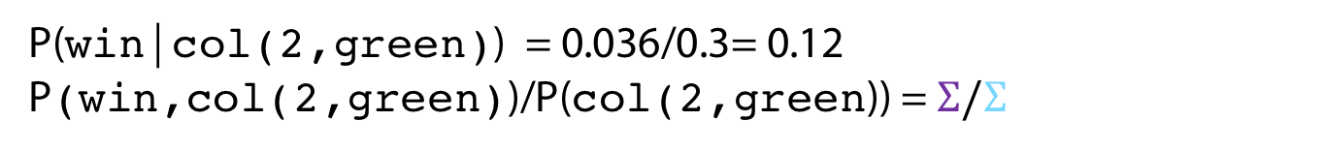
P(win|col(2,green)) = 0.036/0.3= 0.12
P(win,col(2,green))/P(col(2,green)) = $Σ/Σ$
0.024
0.036
0.056
0.084
H
R
R
R
R
H
B
R
B
R
W
W
W
0.036
0.054
0.084
0.126
H
R
G
R
G
H
B
G
B
G
W
0.060
0.090
0.140
0.210
H
R
B
R
B
H
B
B
B
B
W
W
W
Conditional Probability

Slide 21
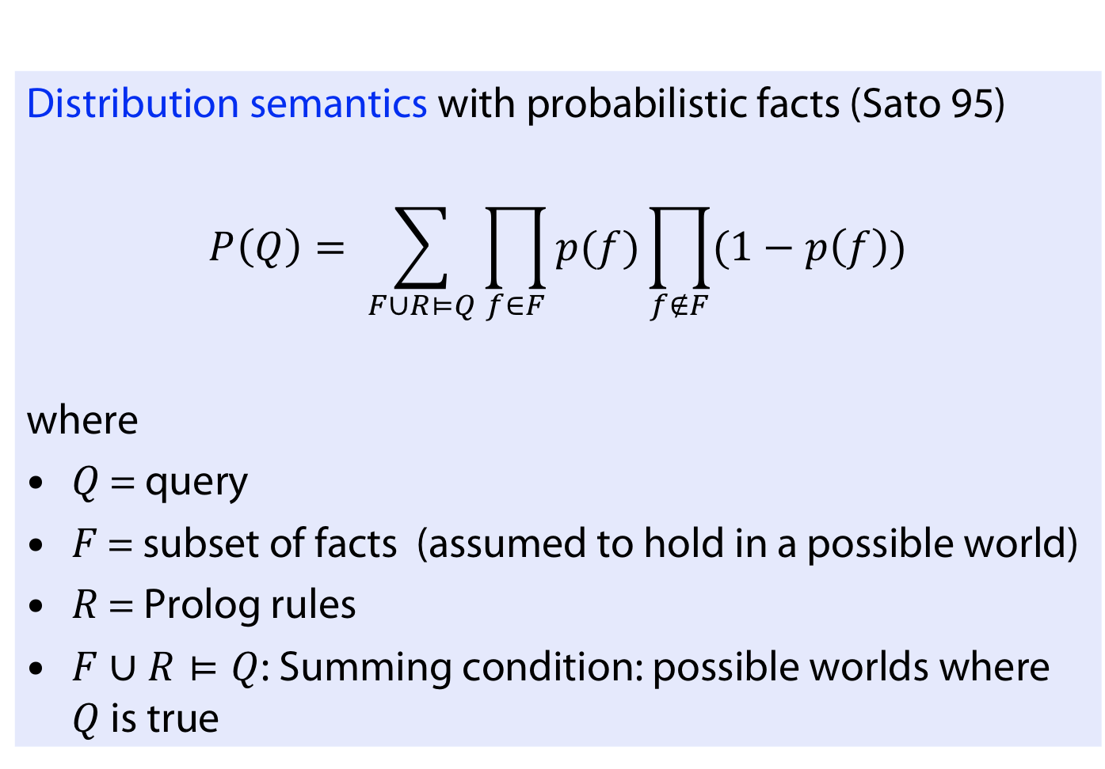
Distribution semantics (Sato, 95)
Distribution semantics with probabilistic facts (Sato 95)
$$P\left(Q\right)= \sum_{F∪R⊨Q}{\prod_{f∈F}{p(f)}\prod_{f∉F}{(1−p\left(f\right))}}$$
where
$Q$ = query
$F$ = subset of facts (assumed to hold in a possible world)
$R$ = Prolog rules
$F∪R⊨Q$: Summing condition: possible worlds where $Q$ is true
Probability of possible world

Slide 22
Inference

Slide 23
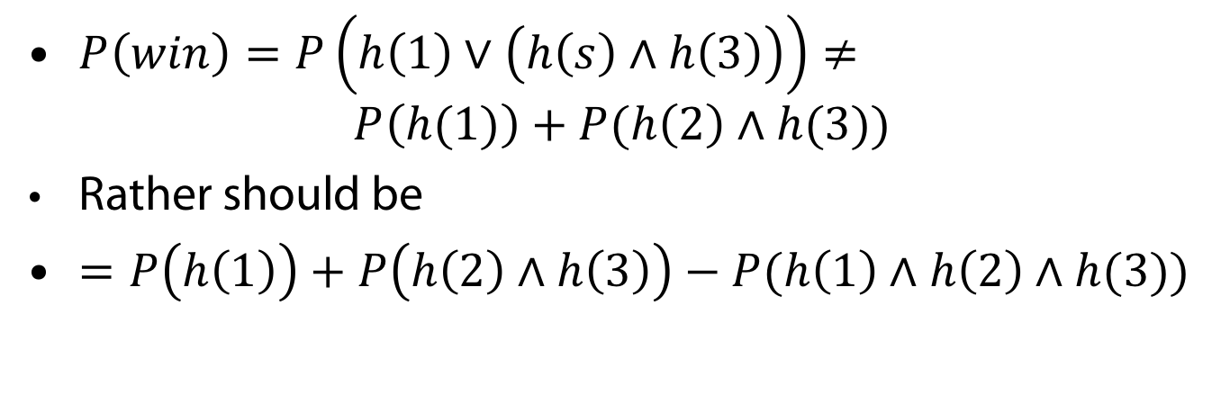
The challenge: disjoint sum problem
0.4 :: heads(1).
0.7 :: heads(2).
0.5 :: heads(3).
win :- heads(1).
win :- heads(1), heads(3). % win <-> h(1) v (h(2) & h(3))
$P\left(win\right)=P\left(h\left(1\right)∨\left(h\left(s\right)∧h\left(3\right)\right)\right)≠$
$P\left(h(1)\right)+P(h\left(2\right)∧h(3))$
Rather should be
$=P\left(h\left(1\right)\right)+P\left(h\left(2\right)∧h\left(3\right)\right)−P(h\left(1\right)∧h\left(2\right)∧h(3))$

Slide 24
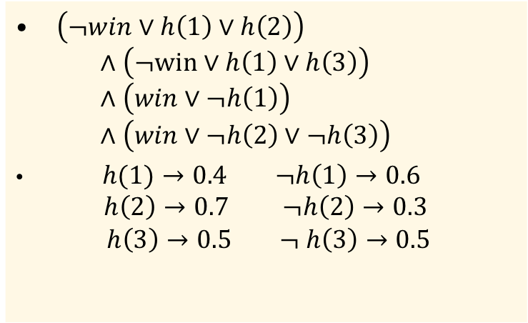
Idea: Weighted Model Counting (WMC)
0.4 :: heads(1).
0.7 :: heads(2).
0.5 :: heads(3).
win :- heads(1).
win :- heads(1), heads(3). % win <-> h(1) v (h(2) & h(3))
Ground out
Put formula in CNF (conjunctive normal form)
Weights
Call WMC
$\left(¬win∨h\left(1\right)∨h\left(2\right)\right)$
$∧\left(¬win∨h\left(1\right)∨h\left(3\right)\right)$
$∧\left(win∨¬h\left(1\right)\right)$
$∧\left(win∨¬h\left(2\right)∨¬h\left(3\right)\right)$
$h(1)→0.4 ¬h\left(1\right)→0.6$
$$h\left(2\right)→0.7 ¬h\left(2\right)→0.3$$
$$h\left(3\right)→0.5 ¬ h\left(3\right)→0.5$$

Slide 25
Recap on some terminlogy from logic
A propositional formula is in conjunctive normal form (CNF) iff it is a conjunction of disjunctions of literals
Literals = proposition symbol or its negation
Every propositional formula can be transformed into CNF (using distribution, de Morgan rules and double negation elimination)

Slide 26
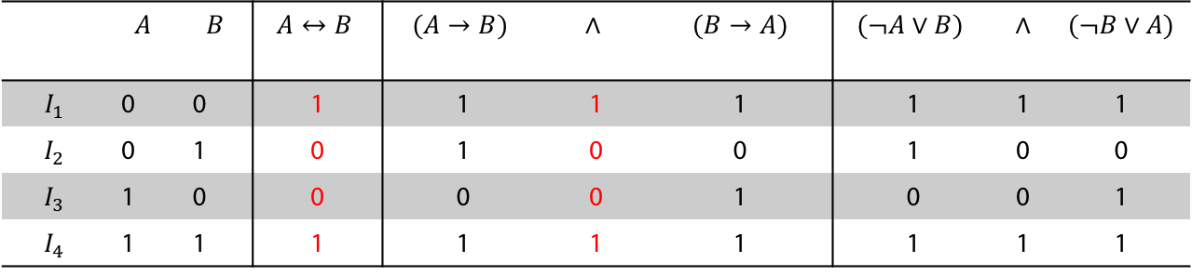
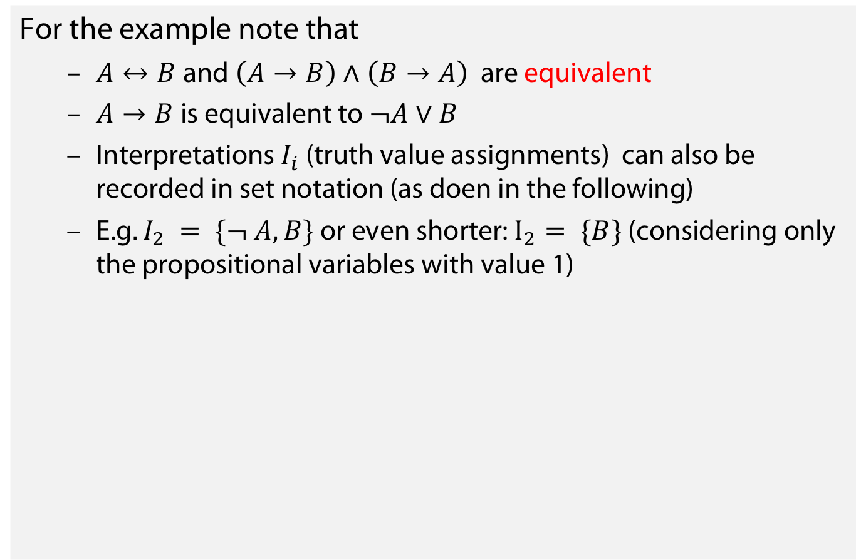
Recap on some terminlogy from logic
For the example note that
  $A↔B$and $\left(A→B\right)∧\left(B→A\right)$ are equivalent
  $A→B$is equivalent to $¬A∨B$
  Interpretations $I_{i}$ (truth value assignments) can also be recorded in set notation (as doen in the following)
  E.g$. I_{2} = \{¬ A, B\}$ or even shorter: $I_{2}= \{B\}$ (considering only the propositional variables with value 1)
in CNF
 | $$A$$ | $$B$$ | $$A↔B$$ | $$(A→B)$$ | $$∧$$ | $(B→A)$ | $$(¬A∨B)$$ | $∧$ | $$(¬B∨A)$$
$$I_{1}$$ | 0 | 0 | 1 | 1 | 1 | 1 | 1 | 1 | 1
$$I_{2}$$ | 0 | 1 | 0 | 1 | 0 | 0 | 1 | 0 | 0
$$I_{3}$$ | 1 | 0 | 0 | 0 | 0 | 1 | 0 | 0 | 1
$$I_{4}$$ | 1 | 1 | 1 | 1 | 1 | 1 | 1 | 1 | 1

Slide 27
Recap on some terminology from logic
Grounding
  Idea: „Propositionalize“ rules
  Technically: Instantiate all variables with all possible constant combinations
  E.g. successfulStudent(X):- lovesLogic(X) over constants {a,b}
    successfulStudent(a):- lovesLogic(a),
    successfulStudent(b):- lovesLogic(b)
  (Grounding not used actually on the slides before, as rules contained no variables)

Slide 28
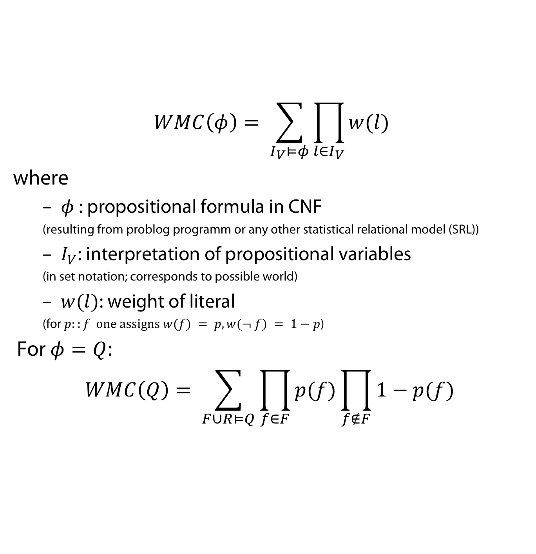
Weighted Model Counting
$$WMC\left(φ\right)= \sum_{I_{V}⊨φ}{\prod_{l∈I_{V}}{w(l)}}$$
where
  $φ$: propositional formula in CNF
  (resulting from problog programm or any other statistical relational model (SRL))
  $I_{V}$: interpretation of propositional variables
  (in set notation; corresponds to possible world)
  $w(l)$: weight of literal
  (for $p::f one assigns w(f) = p, w(¬ f) = 1−p$)
For $φ=Q$:
$$WMC\left(Q\right)= \sum_{F∪R⊨Q}{\prod_{f∈F}{p(f)}\prod_{f∉F}{1−p(f)}}$$

Slide 29
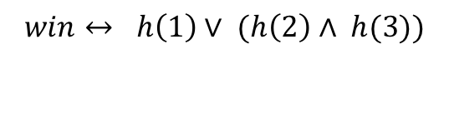
Weighted Model Counting
Simple WMC solvers based on a generalisation of DPLL algorithm for SAT (Davis Putnam Logeman Loveland algorithm)
Current solvers often use knowledge compilation – here an OBDD (ordered binary decision diagram), many variations s-dDNNF, SDDs, (see also following lectures V10-V13)
false
h(1)
$$win↔ h\left(1\right)∨ (h\left(2\right)∧ h(3))$$
h(2)
true
h(3)
0
1
win?

Slide 30
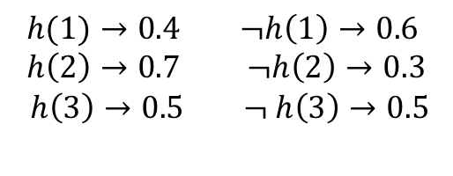

Weighted Model Counting
Simple WMC solvers based on a generalisation of DPLL algorithm for SAT (Davis Putnam Logeman Loveland algorithm)
Current solvers often use knowledge compilation – here an OBDD (ordered binary decision diagram), many variations s-dDNNF, SDDs, (see also following lectures V10-V13)
0.6
h(1)
0.4
$$win↔ h\left(1\right)∨ (h\left(2\right)∧ h(3))$$
h(2)
0.7
0.3
h(3)
$$h(1)→0.4 ¬h\left(1\right)→0.6$$
$$h\left(2\right)→0.7 ¬h\left(2\right)→0.3$$
$$h\left(3\right)→0.5 ¬ h\left(3\right)→0.5$$
0.5
0.5
0
1

Slide 31
More inference
Many variations / extensions
Approximate inference
Lifted inference (lifting from propositional to first order)
  infected(X) :- contact(X,Y), sick(Y).

Slide 32
Learning

Slide 33
Parameter Learning: an example
Webpage classification model
For each Class1, Class2 and each Word
?? :: link_class(Source,Target, Class1, Class2).
?? :: word_class(Word,Class).
class(Page,C) :- has_word(Page,W), word_class(W,C).
class(Page,C) :- links_to(OtherPage,Page), class(OtherPage,OtherClass),
link_class(OtherPage,Page,OtherClass,C).

Slide 34
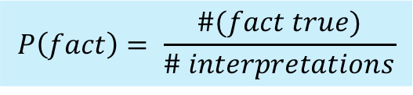
Sampling interpretations
$$P\left(fact\right)= \frac{\#(fact true)}{\# interpretations}$$

Slide 35
Partial interpretations
Not all facts are observed
  Note: this is different from some
  facts Being false
Use for this some form of the
EM-algorithm (Expectation maximization)
  Expected count used instead of count
  P(Q|E) –conditional queries

Slide 36
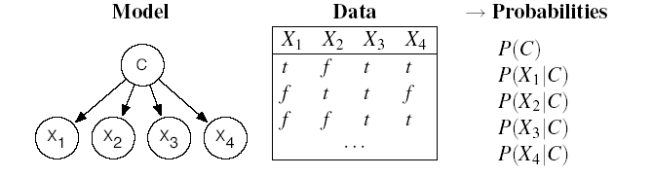
Reminder: EM: How it Works on Naive Bayes
Consider the following data,
  N examples with Boolean attributes X1, X2, X3, X4
which we want to categorize in one of three possible values of class C = {1,2,3} (hidden, no observations given)
We use a Naive Bayes classifier with hidden variable C
?
?
?
?
?

Slide 37
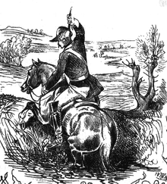
Reminder: EM: General Idea
The algorithm starts from “invented” (e.g., randomly generated) information to solve the learning problem, i.e.
  Determine the network parameters (CPT in Bayesian networks)
It then refines this initial guess by cycling through two basic steps
  Expectation (E): update the data with predictions generated via the current model
  Maximization (M): given the updated data, update the model parameters using the Maximum Likelihood (ML) approach
    This is the same step that is used for learning parameters for fully observable networks

Slide 38
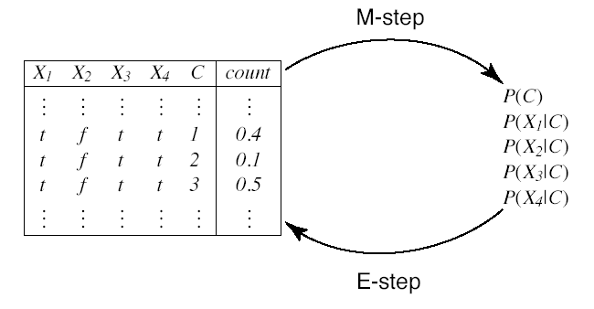
EM Cycle
Expected Counts
(“Augmented data”)
Probabilities
Note: Actually you never
generate any data in E-step
but expected counts

Slide 39
Learning Rules/Structures

Slide 40
ProbFOIL
Upgrade rule-learning to a probabilistic setting within a relational learning / inductive logic programming setting
  Works with a probabilistic logic program instead of a deterministic one.
Introduce ProbFOIL, an adaption of Quinlan’s FOIL
Apply to probabilistic databases like NELL

Slide 41
Example in Pro Log
surfing(X) :- not rain(X), windOK(X). %H
surfing(X) :- not rain(X), sunshine(X).
rain(e1). %B
windOK(e1).
sunshine(e1).
?- surfing(e1). % Query
No % Answer no, because surfing(e1) does not follow from H u B

Slide 42
Example in ProbLog
p1 :: surfing(X) :- not rain(X), windOK(X). % H
p2 ::surfing(X) :- not rain(X), sunshine(X).
0.2 :: rain(e1). % B
0.7 :: windOK(e1).
0.6 :: Sunshine(e1).
?- P(surfing(e1)). % Query
% gives asnwer probability P(B U H |= e) =
% (1-0.2) x 0.7 x p1 + (1-0.2) x 0.6 x (1-0.7) x p2
% no rain x windok x p1 + no rain x sunshine x not windOk x p2
Note: probabilities $p_{1}, p_{2}$ in front of rules are syntactic sugar.

Slide 43
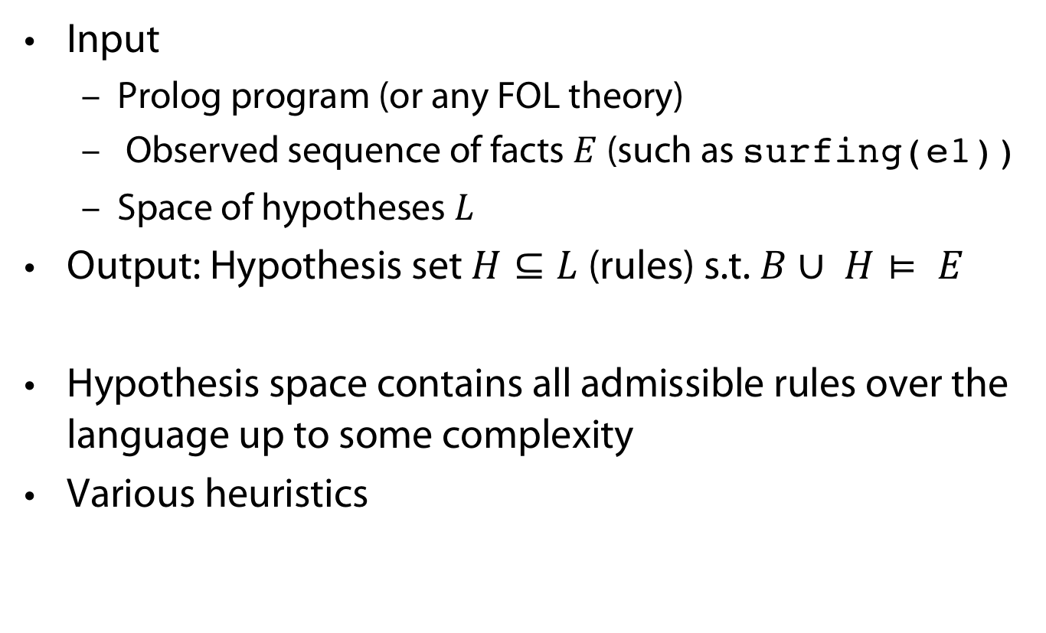
Classical FOIL (Quinlan)
Input
  Prolog program (or any FOL theory)
  Observed sequence of facts $E$(such as surfing(e1))
  Space of hypotheses $L$
Output: Hypothesis set $H⊆L$ (rules) s.t. $B∪ H⊨ E$
Hypothesis space contains all admissible rules over the language up to some complexity
Various heuristics

Slide 44
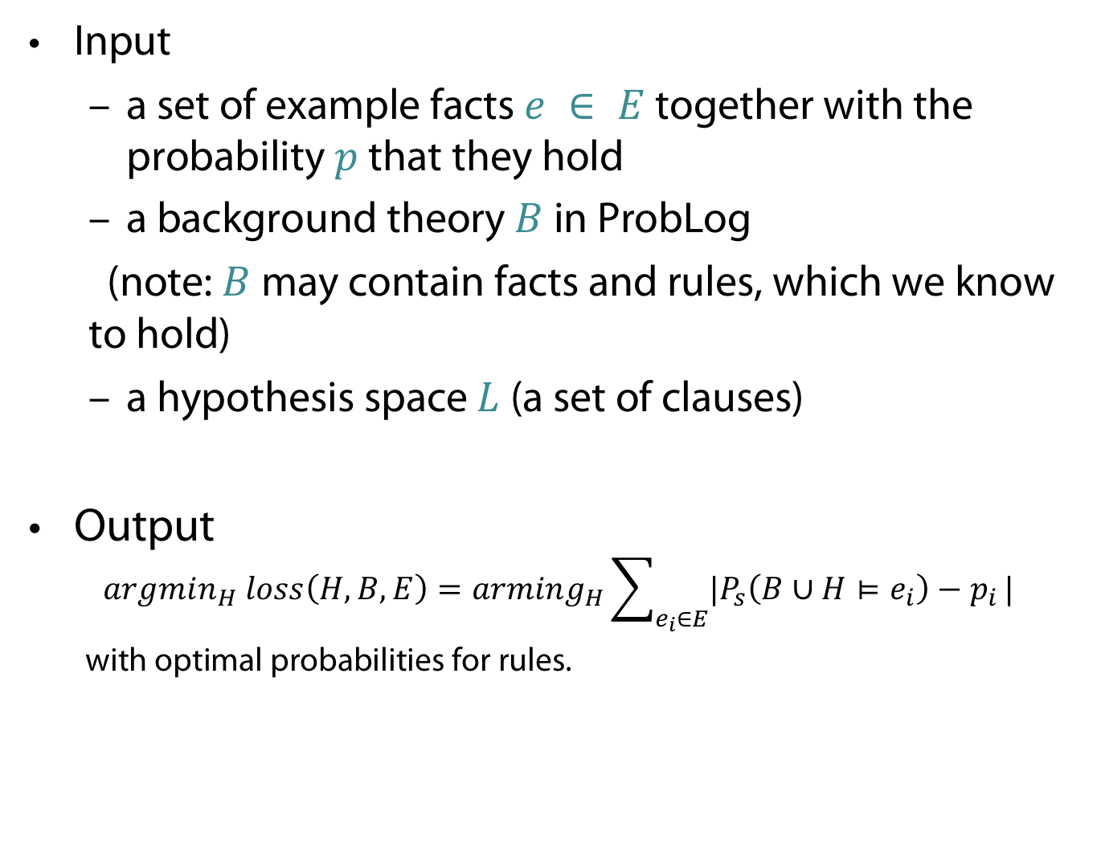
Inductive Probabilistic Logic Programming
Input
  a set of example facts $e ∈ E$ together with the probability $p$ that they hold
  a background theory $B$ in ProbLog
  (note: $B$ may contain facts and rules, which we know to hold)
  a hypothesis space $L$ (a set of clauses)
Output
$$argmin_{H} loss\left(H,B,E\right)=arming_{H}\sum_{e_{i}∈E}{{|P}_{s}\left(B∪H⊨e_{i}\right)−p_{i}}|$$
with optimal probabilities for rules.

Slide 45
Next weeks
More details on the efficient representation of probabilities and formula.

Slide 46
APPENDIX
Uhhh, a lecture with a hopefully useful

Slide 47
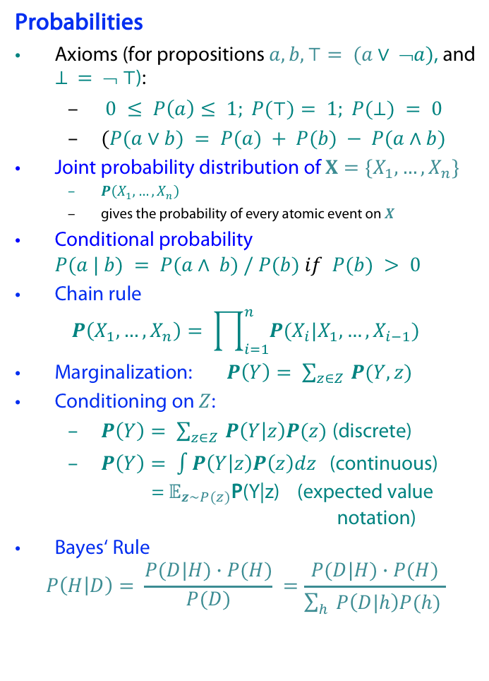
Probability theory basics reminder
Random variable (RV)
possible worlds defined by assignment of values to random variables.
Boolean random variables
  e.g., Cavity (do I have a cavity?). Domain is < true , false >
Discrete random variables
  e.g., possible value of Weather is one of < sunny, rainy, cloudy, snow >
Domain values must be exhaustive and mutually exclusive
Elementary propositions are constructed by assignment of a value to a
random variable: e.g.,
  Cavity = false (abbreviated as ¬cavity)
  Cavity = true (abbreviated as cavity)
(Complex) propositions formed from elementary propositions and standard logical connectives, e.g., Weather = sunny ∨ Cavity = false
Probabilities
Axioms (for propositions $a,b, ⊤= (a∨ ➢a)$, and $⊥ = ➢ ⊤$):
  $0 ≤ P\left(a\right)≤ 1; P(⊤)= 1; P(⊥) = 0$
  $(P(a∨b) = P(a) + P(b) − P(a∧b)$
Joint probability distribution of $X=\{X_{1}, …, X_{n}\}$
  $P\left(X_{1},…, X_{n}\right)$
  gives the probability of every atomic event on $X$
Conditional probability $P(a | b) = P(a∧ b) / P(b) if P(b) > 0$
Chain rule
$$P\left(X_{1},…, X_{n}\right)= \prod_{i=1}^{n}{P(X_{i}|X_{1},…, X_{i−1})}$$
Marginalization: $P\left(Y\right)= \sum_{z∈Z }{P(Y,z)}$
Conditioning on $Z$:
  $P\left(Y\right)= \sum_{z∈Z }{P\left(Y | z\right)P(z)}$ (discrete)
  $P\left(Y\right)= \int{P\left(Y | z\right)P\left(z\right)dz}$ (continuous)
  = $𝔼_{z∼P(z)}$P(Y|z) (expected value notation)
Bayes‘ Rule
$$P\left(H | D\right)= \frac{P(D|H)∙P(H)}{P(D)} =\frac{P(D|H)∙P(H)}{\sum_{h}{P\left(D|h\right)P(h) }}$$

Slide 48
Color Convention in this Course
Formulae, when occurring inline
Newly introduced terminology and definitions
Important results (observations, theorems) as well as emphasizing some aspects
Examples are given with standard orange with possibly light orange frame
Comments and notes in nearly opaque post-it
Algorithms and program code
Reminders (in the grey fog of your memory)

Slide 49
Today‘s lecture is based on the following
Mainly
  Luc de Raedt: Probabilistic Logic Programming and its Applications. Tutorial given at The Turing, London, September 11, 2017
  https://logic-data-science.github.io/Slides/DeRaedt.pdf
  L. De Raedt and A. Kimmig. Probabilistic (logic) programming concepts. Machine Learning, 100(1):5–47, 2015.
A little bit
  Tutorial on
  https://dtai.cs.kuleuven.be/problog/tutorial.html
  Book: L. D. Raedt. Logical and relational learning. Cognitive Technologies. Springer, 2008.

Slide 50
References
T. Sato. A statistical learning method for logic programs with distribution semantics. In IN PROCEED- INGS OF THE 12TH INTERNATIONAL CONFERENCE ON LOGIC PROGRAMMING (ICLP’95, pages 715–729. MIT Press, 1995.
[1] M. Huth and M. Ryan. Logic in Computer Science: Modelling and Reasoning about Systems. Cambridge University Press, 2000.
M. Ben-Ari. Mathematical Logic for Computer Science. Springer, 2. edition, 2001.

