Slide 1
PROBABILISTIC AND DIFFERENTIABLE PROGRAMMING
V13: ROUND-UP
Özgür L. Özçep
Universität zu Lübeck
Institut für Informationssysteme

Slide 2
What this course was about
Differentiable Programming and
Probabilistic Programming for
Machine Learning

Slide 3
What this lecture V₁₃ is about
Nearly the same as V1, but even shorter

Slide 4
Now you should understand this – if this was not already the case before
„
ph“
1)

Slide 5
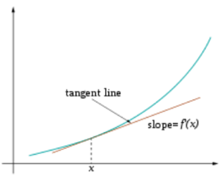
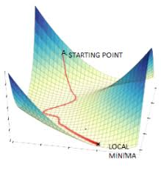
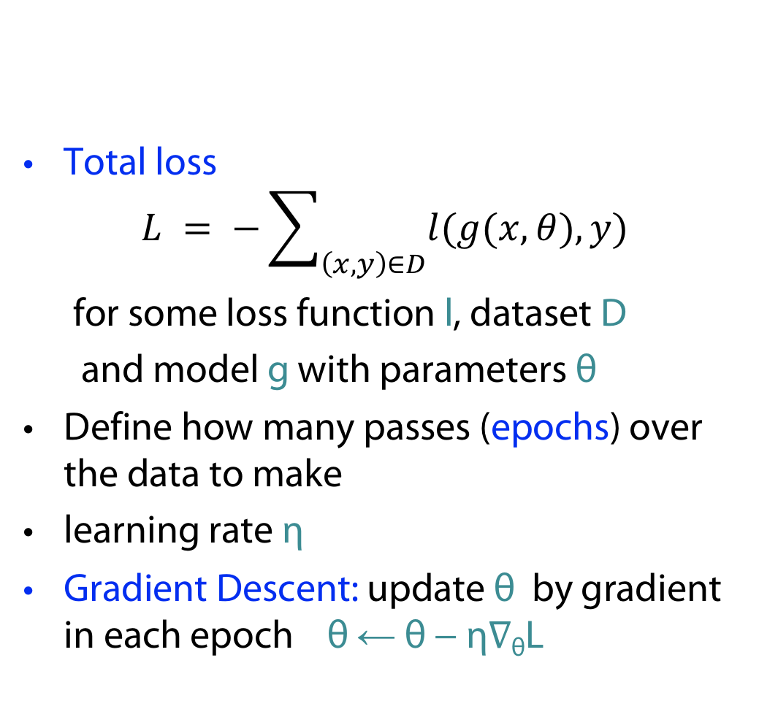
Gradient Descent
V2
Total loss
$$L = −\sum_{\left(x,y\right)∈D}{l(g(x,θ),y)}$$
for some loss function l, dataset D
and model g with parameters θ
Define how many passes (epochs) over the data to make
learning rate η
Gradient Descent: update θ by gradient in each epoch θ ← θ − η∇_{θ}L

Slide 6
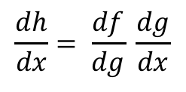

Backprop: efficient implementation of gradient descent
V2
Sample labeled data
(batch)
Forward it through the network, get predictions
Back-propagate the errors
Update the network weights
Backpropagation idea
Generate error signal that measures difference between predictions and target values
Use error signal to change the weights and get more accurate predictions backwards
Underlying mathematics: chain rule
Chain rule (1-dim)
$$\frac{dh}{dx}= \frac{df}{dg} \frac{dg}{dx}$$
( for
$h\left(x\right)=f(g(x))$ )

Slide 7
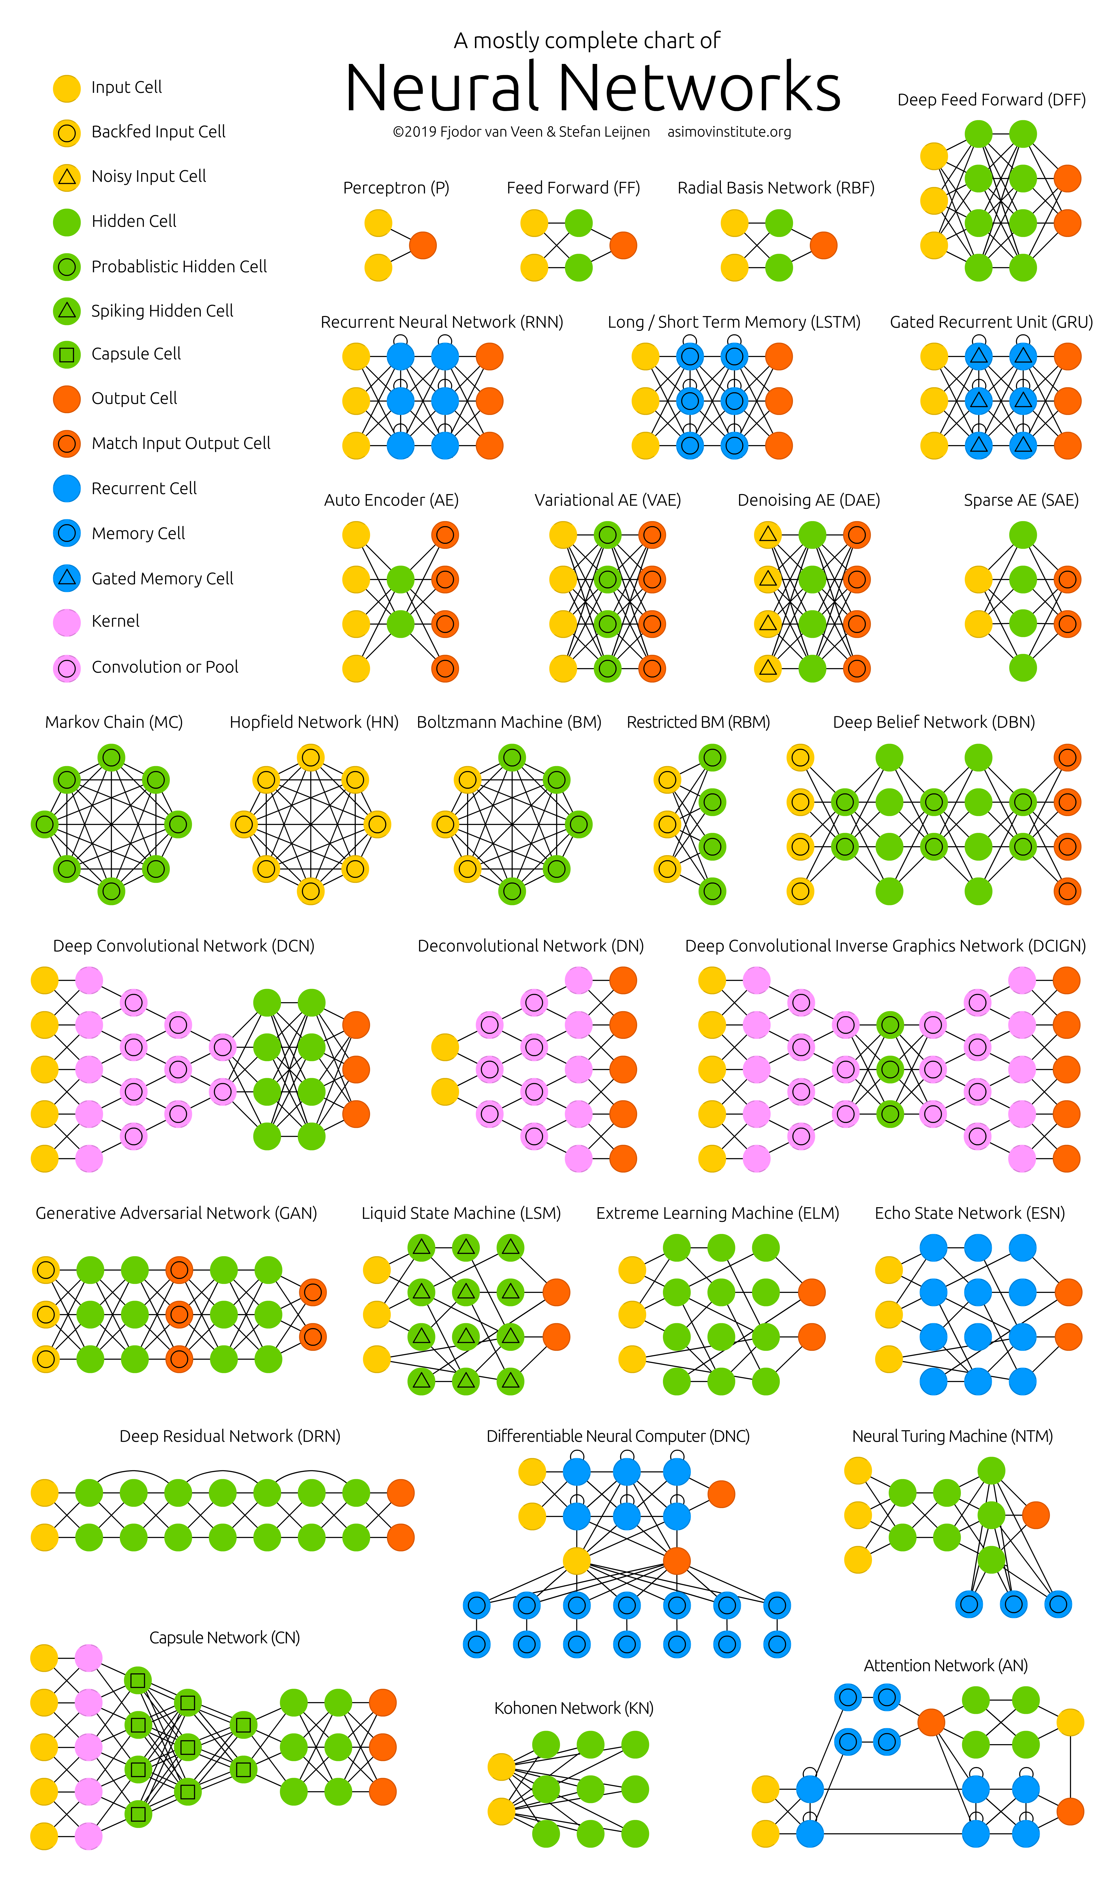
V3
V4
V6
(V8)
V3
V6
V4
(V3)
https://www.asimovinstitute.org/neural-network-zoo/

Slide 8
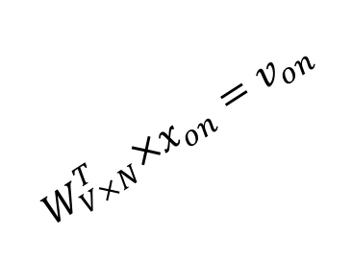

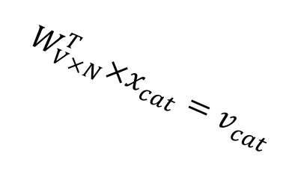



$$W_{V×N}^{T} ×x_{cat}=v_{cat}$$
V6
0.1 | 2.4 | 1.6 | 1.8 | 0.5 | 0.9 | … | … | … | 3.2
0.5 | 2.6 | 1.4 | 2.9 | 1.5 | 3.6 | … | … | … | 6.1
… | … | … | … | … | … | … | … | … | …
… | … | … | … | … | … | … | … | … | …
0.6 | 1.8 | 2.7 | 1.9 | 2.4 | 2.0 | … | … | … | 1.2
0
2.4
2.6
…
…
1.8
Input layer
1
$$×$$
0
$$=$$
Word embedding a la word2vec
0
0
1
0
0
0
x_{cat}
0
0
0
0
Output layer
0
$$W_{V×N}^{T}×x_{cat}=v_{cat}$$
…
0
0
0
0
0
V-dim
…
0
0
$$\hat{v}=\frac{v_{cat}+v_{on}}{2}$$
0
+
0
sat
0
0
0
0
$$W_{V×N}^{T}×x_{on}=v_{on}$$
1
0
…
V-dim
1
Hidden layer
0
x_{on}
0
0
N-dim
0
0
Woman
V-dim
…
r
0
Man
r
Aunt
Uncle
r
Queen
Knowledge graph embedding
King

Slide 9

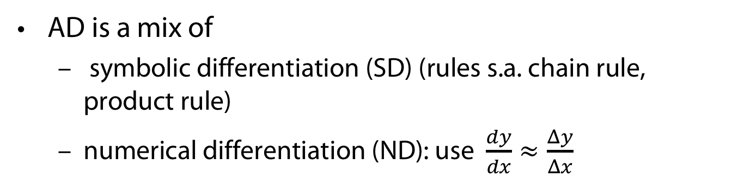
Automatic Differentiation (AD)
V7
AD is a mix of
  symbolic differentiation (SD) (rules s.a. chain rule, product rule)
  numerical differentiation (ND): use $\frac{dy}{dx}≈\frac{Δy}{Δx}$
$\frac{d(f\left(x\right)∙g(x))}{dx}=\frac{d f\left(x\right)}{dx}g\left(x\right)+\frac{d g\left(x\right)}{dx}f\left(x\right)$ (Product rule)
  $h(x) : = g(x)∙f(x)$
  $\frac{dh(x)}{dx}$ and $h$ have two components in common
  This may also be the case for$f$.
  Symbollicaly calculating $f$ won‘t profit from common parts of $f$and $\frac{df(x)}{dx}$

Slide 10
V7

Slide 11
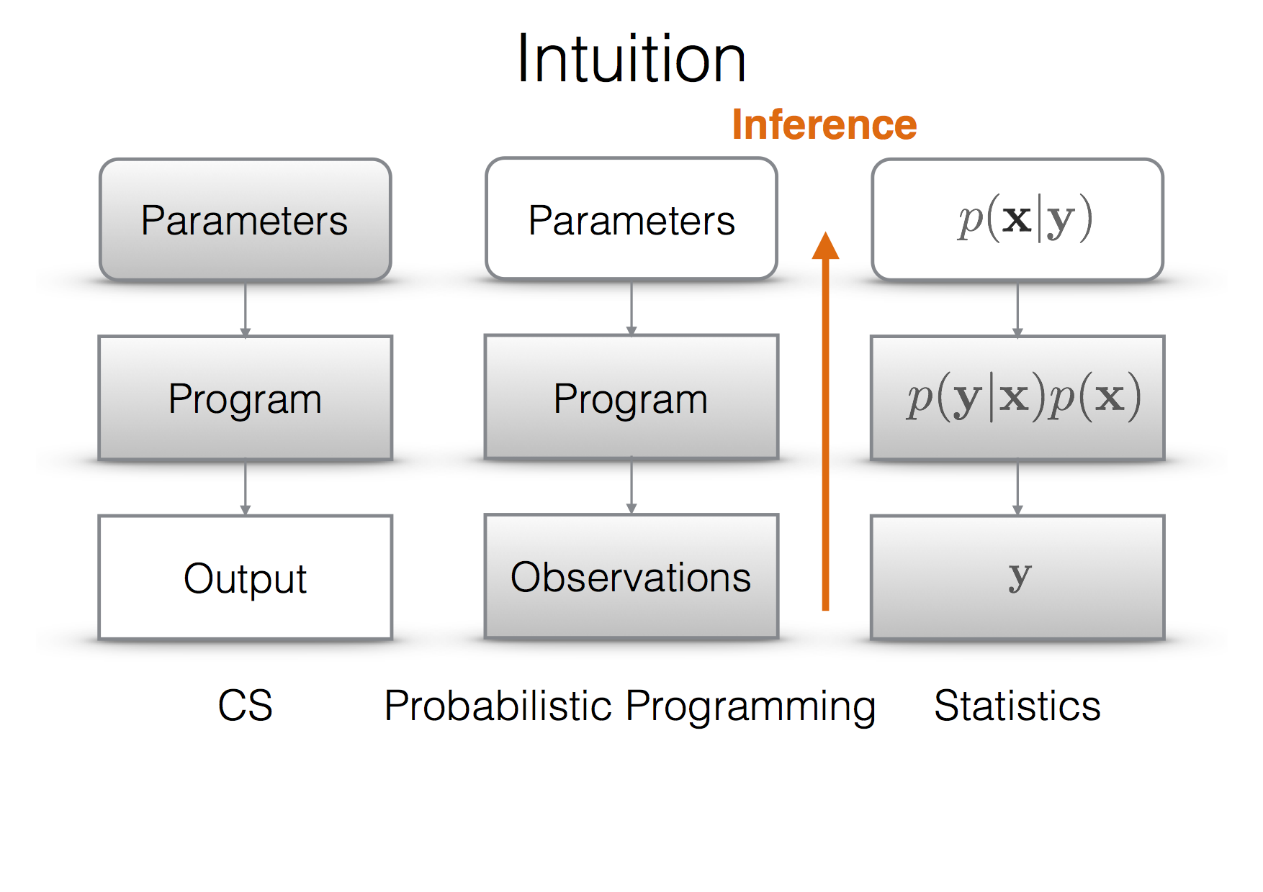
Comparison
V8/9
Ex: F. Wood: Probabilistic Programming, PPAML Summer School, Portland 2016

Slide 12
Probabilistic Programming Example
V8/9
Hidden markov model in Julia

Slide 13
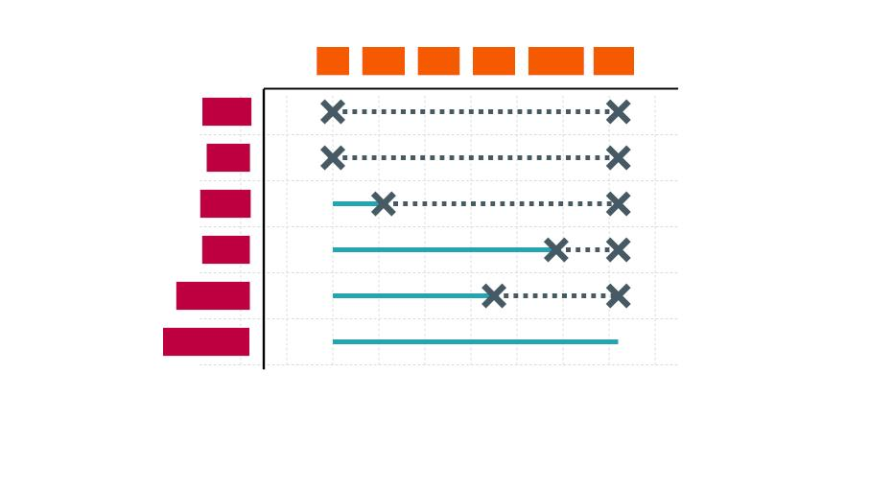
V10-12
Q: ^{EVI} MAR CON MAP MMAP ADV
M
GANs
VAEs
Flows
Use these as
building blocks
I
I
I
Trees
(Sum-node)
Mixtures
Factorized
I
I
(Product Node)
„Eat the cake and have it“
tractable bands

Slide 14
V10-12
Use of structural
constraints
Can use efficiency also in learning

Slide 15

Thanks for your interest!

