Slide 1
PROBABILISTIC AND DIFFERENTIABLE PROGRAMMING
V2: Gradient Descent - Summary
Özgür L. Özçep
Universität zu Lübeck
Institut für Informationssysteme

Slide 2
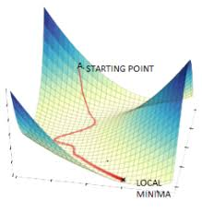
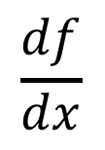
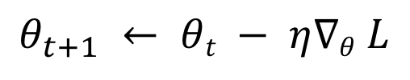
Agenda for today‘s lecture
Gradient descent (GD)
1. Differentiation
2. Basic GD and variants
$$\frac{df}{dx}$$
$$θ_{t+1} ← θt − η∇θ L$$
3. Backpropagation

Slide 3
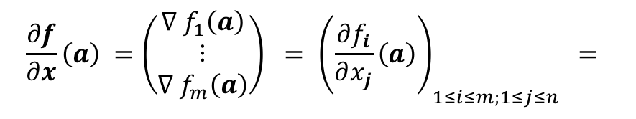
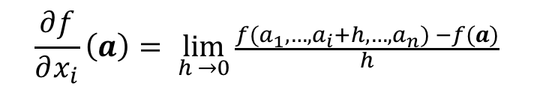


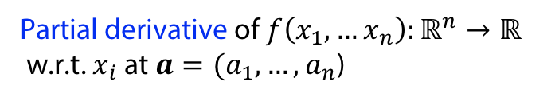

Differentiation with multiple variables
$$f\left(x,y\right)=x^{2}+xy+y^{2} \\ \frac{∂f}{∂x}=2x+y \\ \frac{∂f}{∂y}=x+2y$$
Partial derivative of$f\left(x_{1},…x_{n}\right):ℝ^{n}→ℝ$
w.r.t. $x_{i}$ at $a=(a_{1}, …, a_{n}$)
$$\frac{∂f}{∂x_{i}}\left(a\right)= \lim_{h →0}{\frac{f(a_{1},…, a_{i}+h, …, a_{n}) −f(a)}{h}}$$
Gradient of $f\left(x_{1},…x_{n}\right):ℝ^{n}→ℝ$at $a=(a_{1}, …, a_{n}$)
$$∇ f\left(a\right)=(\frac{∂f}{∂x_{1}}(a), …,\frac{∂f}{∂x_{n}}(a))$$
Jacobian of $f\left(x_{1},…x_{n}\right):ℝ^{n}→ℝ^{m}$at $a=(a_{1}, …, a_{n}$)
$$\left(\begin{matrix}\frac{∂f_{1}}{∂x_{1}}\left(a\right) & ⋯ & \frac{∂f_{1}}{∂x_{n}}\left(a\right) \\ ⋮ & ⋱ & ⋮ \\ \frac{∂f_{m}}{∂x_{1}}\left(a\right) & ⋯ & \frac{∂f_{m}}{∂x_{n}}\left(a\right)\end{matrix}\right)$$
$$\frac{∂f}{∂x}\left(a\right) ={\left(\begin{matrix}∇ f_{1}\left(a\right) \\ ⋮ \\ ∇ f_{m}\left(a\right)\end{matrix}\right) = \left(\frac{∂f_{i}}{∂x_{j}}\left(a\right)\right)}_{1≤i≤m;1≤j≤n } =$$

Slide 4
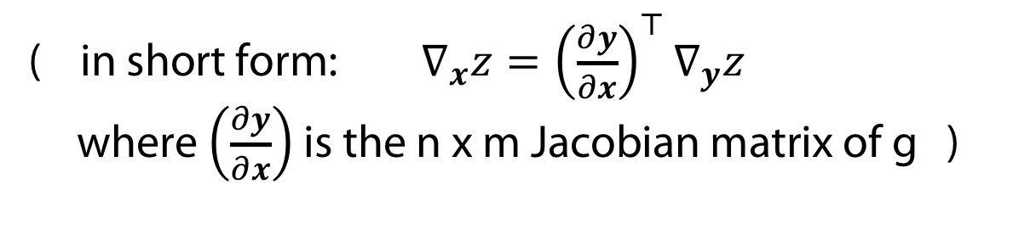
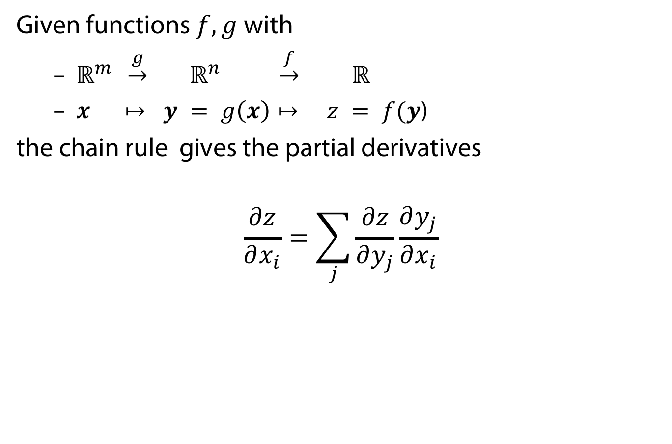
The chain rule for vectors
Given functions $f, g$with
  $ℝ^{m} \underset{→}{g} ℝ^{n} \underset{→}{f} ℝ$
  $x ↦ y = g\left(x\right)↦ z = f(y$)
the chain rule gives the partial derivatives
$$\frac{∂z}{∂x_{i}}=\sum_{j}{\frac{∂z}{∂y_{j}}\frac{∂y_{j}}{∂x_{i}}}$$
( in short form: $∇_{x}z={\left(\frac{∂y}{∂x}\right)}^{⊤}∇_{y}z$
where $\left(\frac{∂y}{∂x}\right)$ is the n x m Jacobian matrix of g )

Slide 5
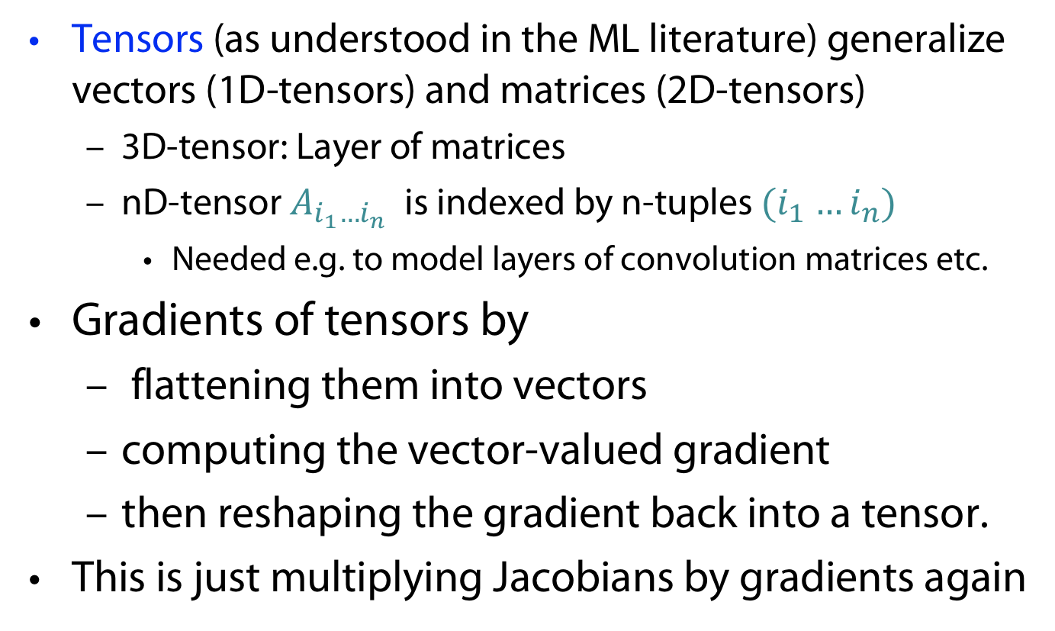
Chain rule for Tensors (Informal)
Tensors (as understood in the ML literature) generalize vectors (1D-tensors) and matrices (2D-tensors)
  3D-tensor: Layer of matrices
  nD-tensor $A_{i_{1}…i_{n}}$ is indexed by n-tuples ${(i}_{1} …i_{n})$
    Needed e.g. to model layers of convolution matrices etc.
Gradients of tensors by
  flattening them into vectors
  computing the vector-valued gradient
  then reshaping the gradient back into a tensor.
This is just multiplying Jacobians by gradients again

Slide 6
VanilLa Gradient DESCENT, Variants anD BEyond

Slide 7
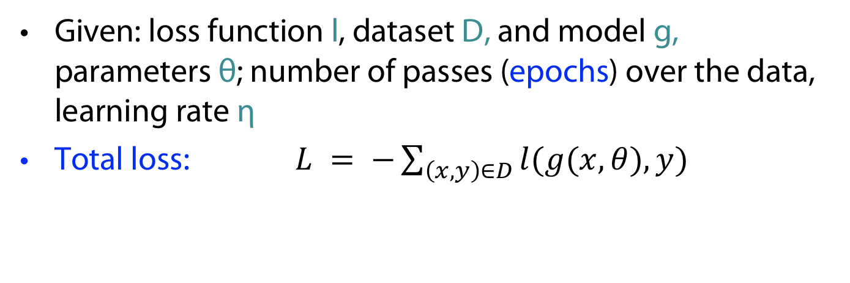
Vanilla Gradient Descent (VGD)
Given: loss function l, dataset D, and model g, parameters θ; number of passes (epochs) over the data, learning rate η
Total loss: $L = −\sum_{\left(x,y\right)∈D}{l(g(x,θ),y)}$
VGD: $θ_{t+1} ← θt − η∇θL$
+ Good statistical properties (very low variance)
Very data inefficient (particularly when data
has many similarities)
- Doesn’t scale to infinite data (online learning)
Problems of *GD
- ...

Slide 8
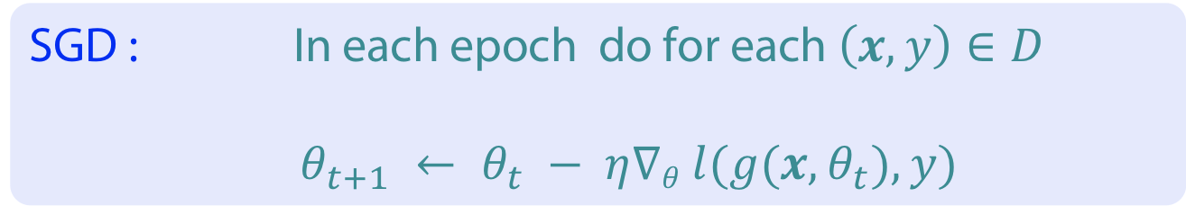
Stochastic Gradient Descent (SGD)
Given: loss function l, dataset D, model g, parameters θ, number of epochs, learning rate η
SGD : In each epoch do for each $\left(x,y\right)∈D$
$θ_{t+1} ← θ_{t} − η∇θ l(g(x, θ_{t}),y)$
+ Faster than VGD
+ Online learning
- Poor statistical properties (high fluctuation)
computational inefficiency
Problems of *GD
- ...

Slide 9

Mini-Batch SGD (MGD)
Given: mini-batch size m (common: 50-256), loss function l, dataset D, model g, parameters θ, number of epochs , learning rate η
Batch loss: $L_{b(t)}= \sum_{\left(x,y\right)∈b(t)}{l\left(g\left(x,θ\right),y\right)}$
where $b\left(t\right)$ a subset of D of cardinality m.
MSGD : $θ_{t+1} ← θ_{t} − η∇_{θ_{t}} L_{b(t)}$
+ reduces the parameter-updates’ variance
+ stable convergencevery
+ computational efficiency
Problems of *GD
How to choose rate
No learning rate schedules
Trapping in local minima
Inefficient for sparse data set

Slide 10
BACKPROPagation

Slide 11



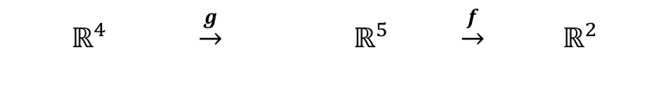
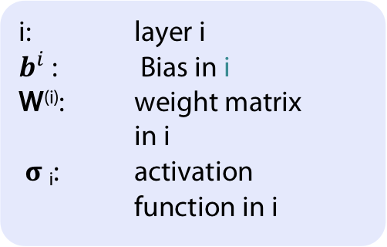

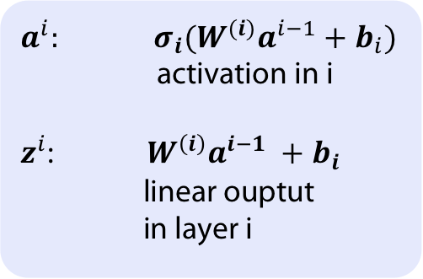
Network view of composed functions1)
Input layer
Hidden layer(s)
Output layer
i: layer i
$b^{i}$: Bias in i
W^{(i)}: weight matrix in i
𝛔 _{i}: activation function in i
w⁽¹⁾_{ij}
h₁
w⁽²⁾_{ij}
x₁
h₂
o₁
$$\hat{y1}$$
x₂
h₃
x₃
o₂
$$\hat{y2}$$
$a^{i}:$ ${σ_{i}(W^{(i)}a}^{i−1}+b_{i})$
activation in i
$z^{i}$: $W^{\left(i\right)}a^{i−1} +b_{i}$
linear ouptut
in layer i
h₄
x₄
h₅
  $$ℝ^{4} \underset{→}{g} ℝ^{5} \underset{→}{f} ℝ^{2}$$
  $$x ↦ h ↦ \hat{y}$$
$$\hat{y}= f (g (x ; W^{\left(1\right)} ,b^{1} ); W^{\left(2\right)} ,b^{2})$$
$$= σ2 (W^{\left(2\right)} σ 1(W^{\left(1\right)}x +b^{1} ) + b^{2})$$
1) You may find this also under the term multilayer perceptron in the literature

Slide 12
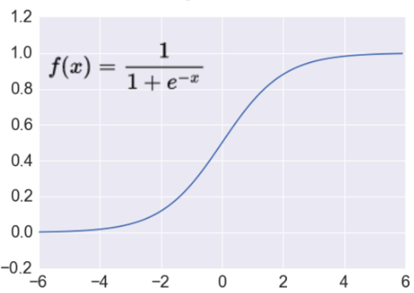
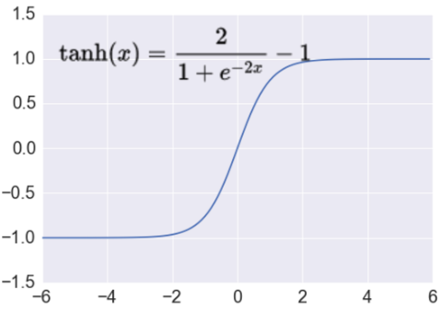
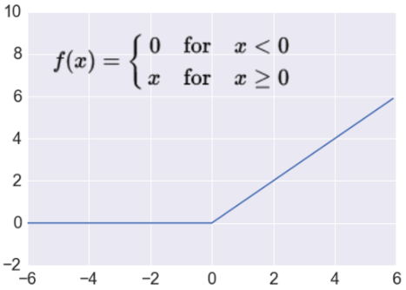
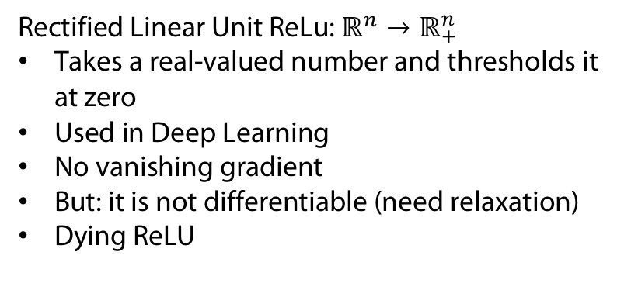
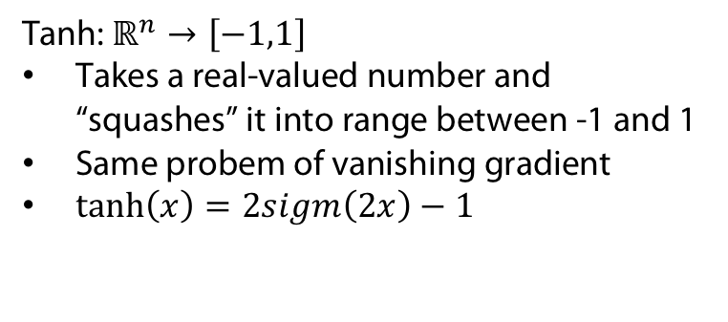

Activation Functions
http://adilmoujahid.com/images/activation.png
Sigmoid
$$ℝ^{n}→\left[0,1\right]$$
Takes a real-valued number and “squashes” it into range between 0 and 1.
Earliest used activation function (neuron)
Leads to vanishing gradient problem
Tanh: $ℝ^{n}→\left[−1,1\right]$
Takes a real-valued number and “squashes” it into range between -1 and 1
Same probem of vanishing gradient
$\tanh\left(x\right)=2sigm\left(2x\right)−1$
Rectified Linear Unit ReLu: $ℝ^{n}→ℝ_{+}^{n}$
Takes a real-valued number and thresholds it at zero
Used in Deep Learning
No vanishing gradient
But: it is not differentiable (need relaxation)
Dying ReLU

Slide 13
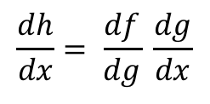

Backprop: efficient implementation of gradient descent
V2
Sample labeled data
(batch)
Forward it through the network, get predictions
Back-propagate the errors
Update the network weights
Backpropagation idea
Generate error signal that measures difference between predictions and target values
Use error signal to change the weights and get more accurate predictions backwards
Underlying mathematics: chain rule
Chain rule (1-dim)
$$\frac{dh}{dx}= \frac{df}{dg} \frac{dg}{dx}$$
( for
$h\left(x\right)=f(g(x))$ )

Slide 14





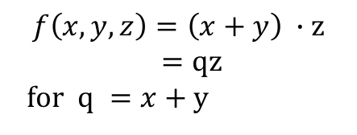


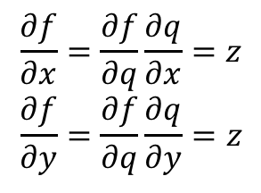

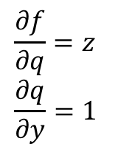
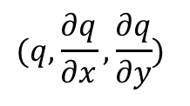
Computational graph perspective
Function f
Partial Derivatives
Chain rule applied
$$f\left(x,y,z\right)=\left(x+y\right) ∙z$$
$=qz$
for $q =x+y$
$$\frac{∂f}{∂z}=q \\ \frac{∂q}{∂x}=1$$
$$\frac{∂f}{∂q}=z \\ \frac{∂q}{∂y}=1$$
$$\frac{∂f}{∂x}=\frac{∂f}{∂q}\frac{∂q}{∂x}=z \\ \frac{∂f}{∂y}=\frac{∂f}{∂q}\frac{∂q}{∂y}=z$$
Gradient
$$∇_{x,y,z}f=(z,z,q)$$
(In particular:
($∇_{x,y,z}f)\left(−2,5,−4\right)=\left(−4,−4, 3\right))$
-2
$$(q,\frac{∂q}{∂x},\frac{∂q}{∂y})$$
Forward pass:
function values and local gradients
Backward: chain rule
x
-4
$$\frac{∂f}{∂x}$$
(3,1,1)
+
5
-4
$(f,\frac{∂f}{∂q},\frac{∂f}{∂z}$ )
_{y}
-4
$$\frac{∂f}{∂y}$$
(-12,-4,3)
*
-4
1
$$\frac{∂f}{∂f}$$
z
3
$$\frac{∂f}{∂z}$$

Slide 15

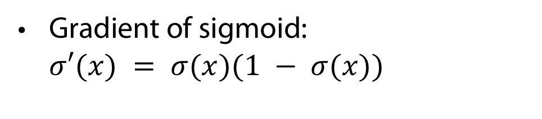



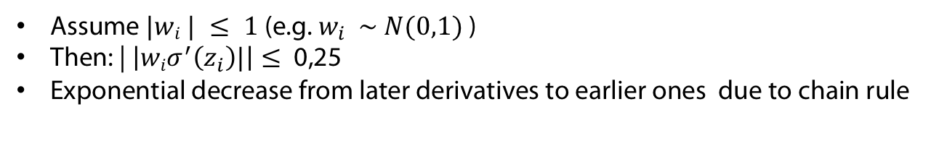

Problem: Vanishing gradient for sigmoid $σ$
Gradient of sigmoid: $σ′(x) = σ(x)(1 − σ(x))$
Max{$σ^{′}\left(x\right)\}$
$$=0.25$$
Gradients in linear network of depth 4
$≤$0,25
$≤$0,25
$≤$0,25
Assume $|wi | ≤ 1$(e.g. $w_{i} \sim N(0,1)$)
Then: | $\left|wiσ^{′}\left(z_{i}\right)|\right|≤$0,25
Exponential decrease from later derivatives to earlier ones due to chain rule
Gradient vanishes moving backwards

Slide 16
Questions and Discussion

Slide 17
Two Addenda to last week‘s discussion
Learning rectangulars in car example:
  Question from the audience: Does one not have always error E = 0 in this case?
  Answer 1: Yes, if no outliers. But usually you have them.
  Answer 2: In fact one has infinitely many solutions for which E = 0; can incorporate other principles (and maybe encode them in the loss function).
Learning with Bayes‘ rule and priors
  What about apriori probabilities of hypothesis?
  Sometimes one just does not have the probabilities ->
  Solomonoff: There is a a universal prior
  -> Algorithmic Probability & Kolomogorov Complexity

Slide 18
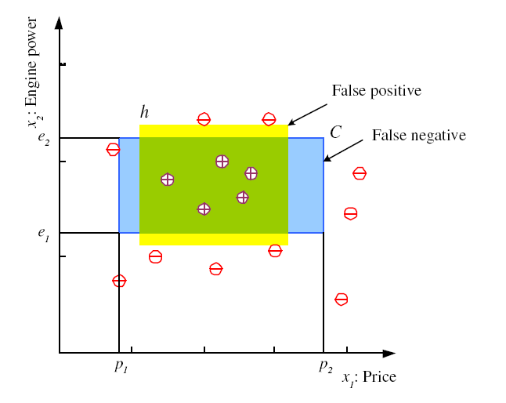

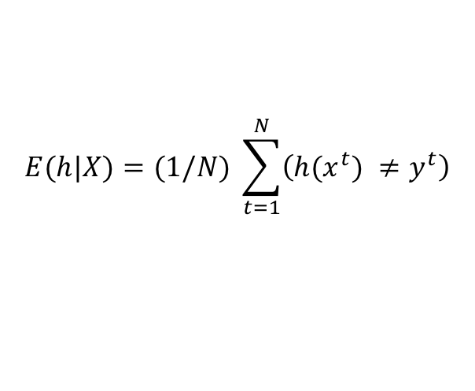
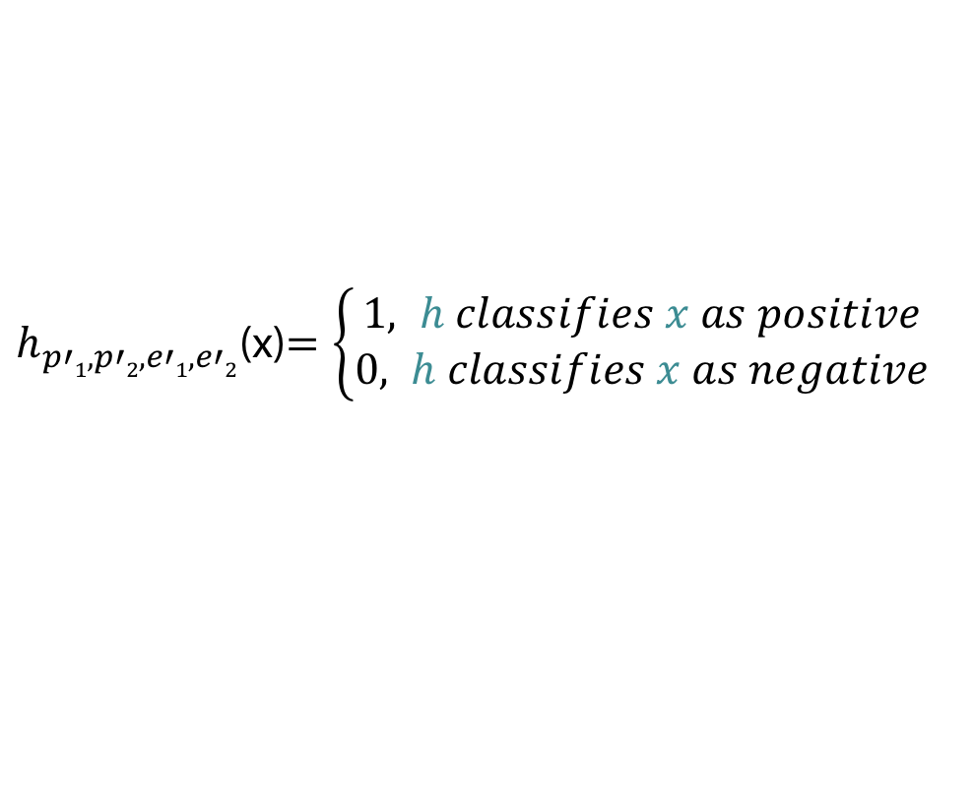
Hypothesis class H
$h_{p′1,p′2,e′1,e′2}$(x)$=\left\{\begin{aligned}1, h classifies x as positive \\ &0, h classifies x as negative\end{aligned}\right.$
Error of h on X
$$E(h|X)=(1/N) \sum_{t=1}^{N}{\left(h(x^{t}) {≠y}^{t}\right)}$$
Optimization
$$argminp_{1}^{′}p_{2}^{′}e_{1}^{′}e_{2}^{′}E(h|X)$$
But how to find optimum (in particular if one has outliers)?

Slide 19

Chain-rule for vectors
$g\left(x_{1},x_{2},x_{3}\right)=(x_{1}+x_{2}⋅x_{3}, x_{1}^{2})$
$f\left(y_{1},y_{2}\right)=2y_{1}+2y_{2}$
$\frac{\begin{aligned}∂f∘g \\ \end{aligned}}{∂x_{}}\left(x\right)= ?$

Slide 20

Chain-rule for vectors (Answer)
$f\left(g(x_{1},x_{2},x_{3})\right)=2\left(x_{1}+x_{2}⋅x_{3}\right)+2x_{1}^{2}$
Chain rule $\frac{∂z}{∂x_{i}}=\sum_{j}{\frac{∂z}{∂y_{j}}\frac{∂y_{j}}{∂x_{i}}}$
In more detail: $\frac{\begin{aligned}∂f∘g \\ \end{aligned}}{∂x_{i}}\left(x\right)= \sum_{j}{\frac{∂f}{∂y_{j}}(g(x))\frac{∂g_{j}}{∂x_{i}}(x)}$
$\frac{∂f\left(g\left(x_{1},x_{2},x_{3}\right)\right)}{∂x_{1}}\left(x\right)=2⋅ 1+ 2⋅2x_{1}=2+4x_{1}$
$\frac{∂f\left(g\left(x_{1},x_{2},x_{3}\right)\right)}{∂x_{2}}\left(x\right)=2$
$\frac{∂f\left(g\left(x_{1},x_{2},x_{3}\right)\right)}{∂x_{3}}\left(x\right)=2$
$\frac{\begin{aligned}∂f∘g \\ \end{aligned}}{∂x_{}}\left(x\right)=(2+4x_{1}, 2,2)$

Slide 21
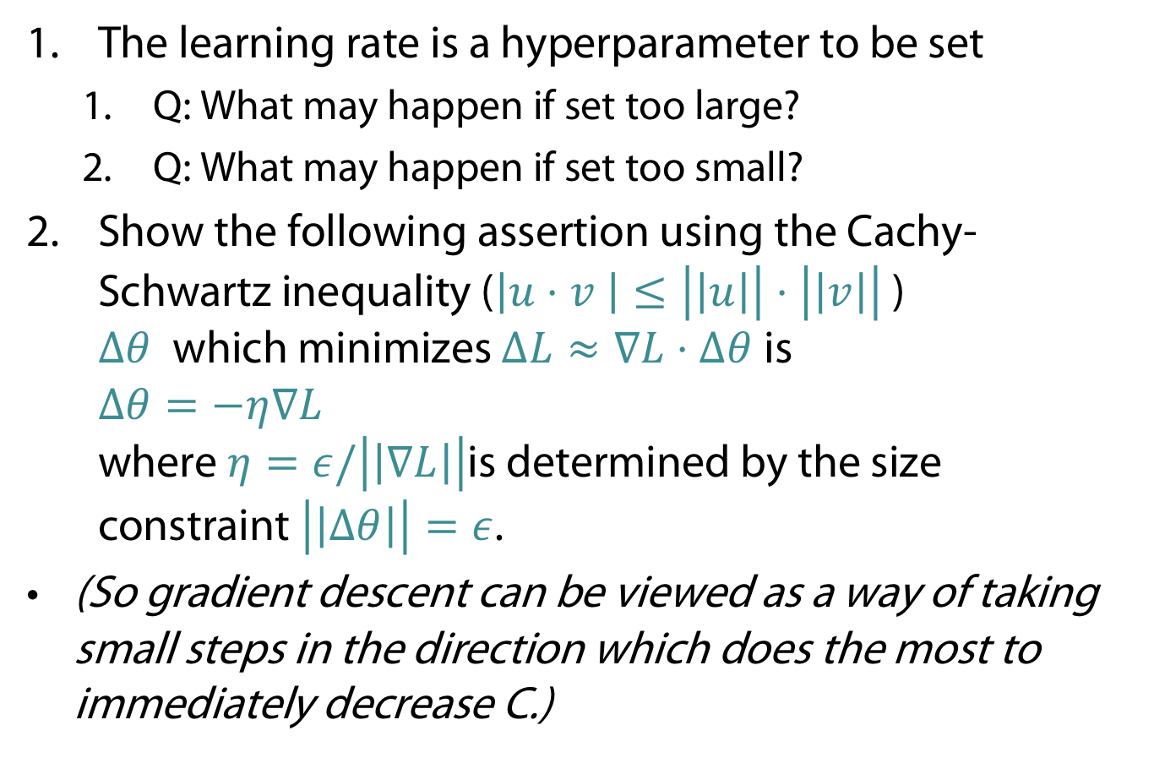
Gradient descent
The learning rate is a hyperparameter to be set
  Q: What may happen if set too large?
  Q: What may happen if set too small?
Show the following assertion using the Cachy-Schwartz inequality ($\left|u⋅v \right|≤\left|\left|u\right|\right|⋅\left|\left|v\right|\right|$)
$Δθ$which minimizes $ΔL≈∇L⋅Δθ$is
$Δθ=−η∇L$
where $η=ε/\left|\left|∇L\right|\right|$is determined by the size constraint $\left|\left|Δθ\right|\right|=ε$.
(So gradient descent can be viewed as a way of taking small steps in the direction which does the most to immediately decrease C.)

Slide 22
Gradient descent (Answer)
The learning rate is a hyperparameter to be set
  Q: What may happen if set too large?
  A: May miss minimum
  Q: What may happen if set too small?
  A: Learning convergence too small

Slide 23
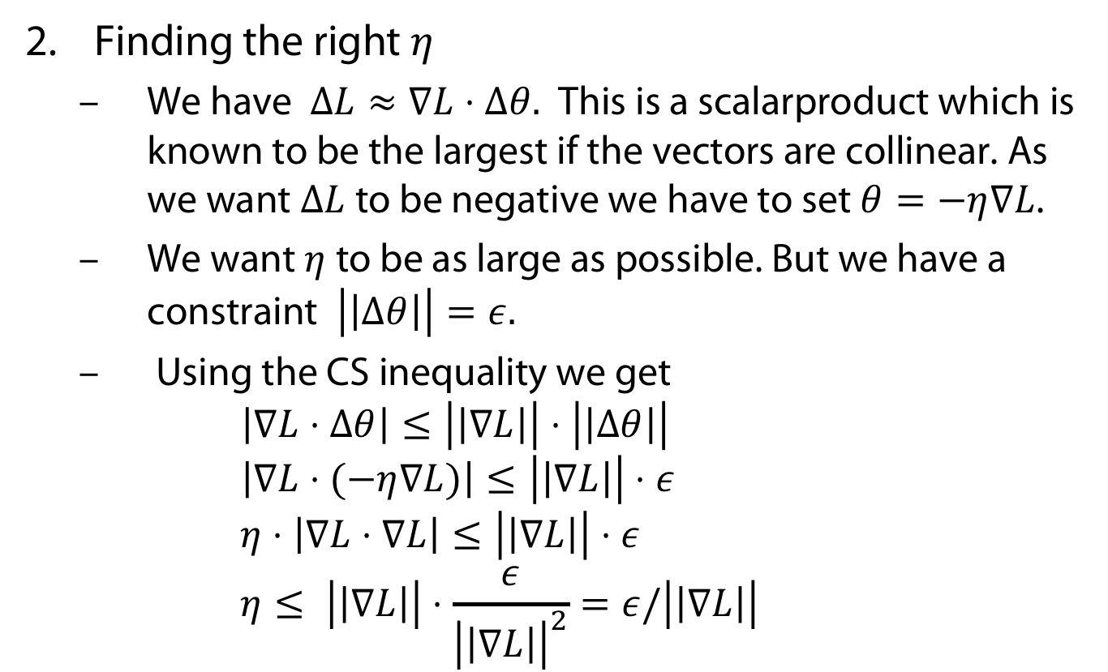
Gradient descent (Answer)
Finding the right $η$
  We have $ΔL≈∇L⋅Δθ.$ This is a scalarproduct which is known to be the largest if the vectors are collinear. As we want $ΔL$ to be negative we have to set $θ=−η∇L$.
  We want $η$ to be as large as possible. But we have a constraint $\left|\left|Δθ\right|\right|=ε.$
  Using the CS inequality we get
  $\left|∇L⋅Δθ\right|≤\left|\left|∇L\right|\right|⋅\left|\left|Δθ\right|\right|$
  $\left|∇L⋅(−η∇L)\right|≤\left|\left|∇L\right|\right|⋅ε$
  $η⋅\left|∇L⋅∇L\right|≤\left|\left|∇L\right|\right|⋅ε$
  $η≤ \left|\left|∇L\right|\right|⋅\frac{ε}{{\left|\left|∇L\right|\right|}^{2}}=ε/\left|\left|∇L\right|\right|$

