Slide 1
PROBABILISTIC AND DIFFERENTIABLE PROGRAMMING
V1: INTRODUCTION
Özgür L. Özçep
Universität zu Lübeck
Institut für Informationssysteme

Slide 2
What this course is about
Differentiable Programming and
Probabilistic Programming for
Machine Learning¹⁾
1) Yes, this is a footnote on a slide, believe it or not. The three lines summarizing the topic of the course is the optimal outcome w.r.t my subjective measure - using a non-gradient optimziation procedure starting from the original course name: Probabilistic Differential Programming -> Probabilistic and Differential Programming -> Probabilistic and Differentiable Programming ->Differentiable and Probabilistic Programming

Slide 3
What this lecture V₁ is about
Agenda
2.
Differentiable Programming and
Probabilistic Programming for
Machine Learning¹⁾
3.
1.
Pointers to lectures in this fancy format.
1) Yes, this is a footnote on a slide, believe it or not. The three lines summarizing the topic of the course is the optimal outcome w.r.t my subjective measure - using a non-gradient optimziation procedure starting from the original course name: Probabilistic Differential Programming -> Probabilistic and Differential Programming -> Probabilistic and Differentiable Programming ->Differentiable and Probabilistic Programming

Slide 4
MACHINE LEARNING

Slide 5
What We Mean by “Learning”
Machine learning (ML) is programming algorithms for
  optimizing a performance criterion
  using example (training) data
  by constructing general(izable) models
  that are good approximations of the data
Role of Mathematics
Building mathematical model
core task is inference from a sample
Role of CS: Efficient algorithms
solve the optimization problem
represent and evaluate the model for inference

Slide 6
Differentiable Programming
Machine learning (ML) is programming algorithms for
  optimizing a performance criterion
  using example (training) data
  by constructing general(izable) models
  that are good approximations of the data
Role of Mathematics
Programming differentiable model
core task is inference from a sample
Role of CS: Efficient algorithms
solve the optimization problem
represent and evaluate the model for inference

Slide 7
Probabilistic Programming
Machine learning (ML) is programming algorithms for
  optimizing a performance criterion
  using example (training) data
  by constructing general(izable) models
  that are good approximations of the data
Role of Mathematics
Programming probabilistic model
core task is inference from a sample
Role of CS: Efficient algorithms
solve the optimization problem
represent and evaluate the model for inference

Slide 8
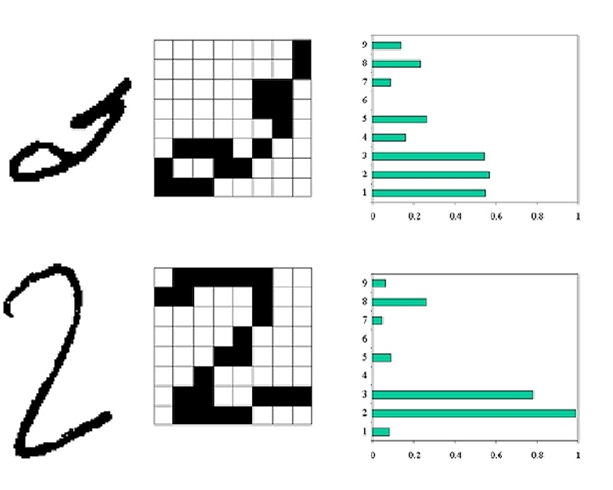
Types of learning (classically)
Supervised Learning learn to predict an output for input vector after training with labelled data
Unsupervised Learning discover a good internal representation of the input
Reinforcement Learning learn to select an action to maximize the expectation of future rewards (payoff)

Slide 9
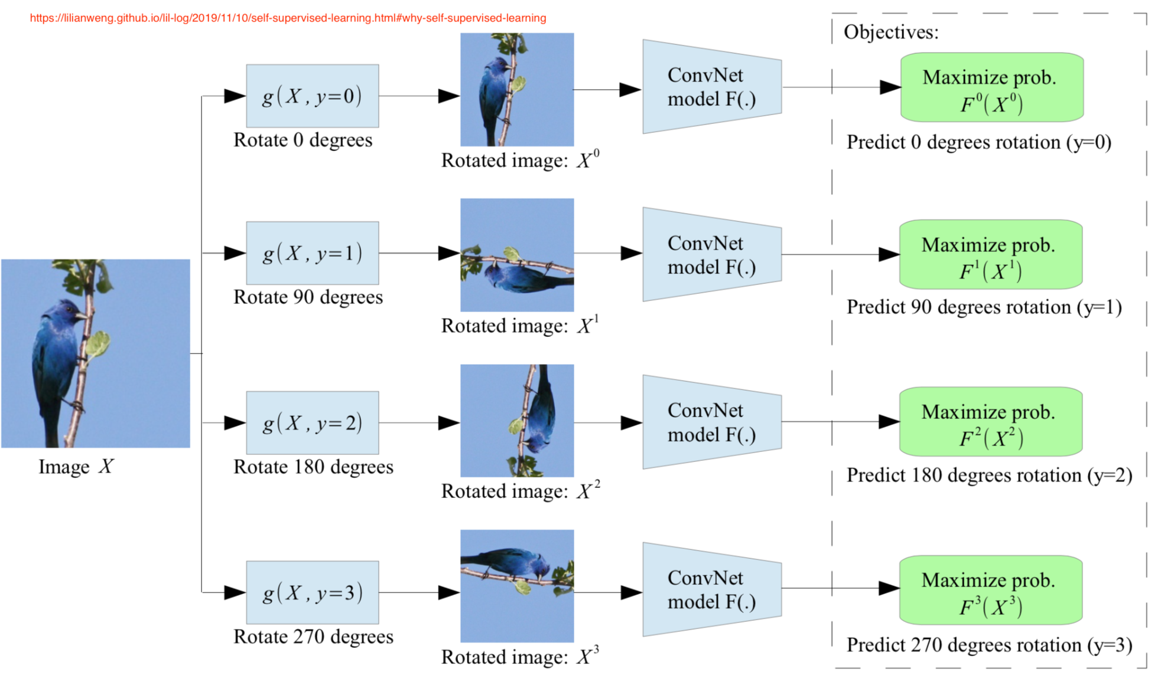
Subtypes of unsupervised l. (in Deep Learning context)
Self-supervised (Self-taught) Learning - learn with targets induced by a prior on the unlabelled training data
Semi-supervised Learning learn with few labelled examples and many unlabelled ones (same distribution for labelled & non-labelled data)
Notes:
„For example, we might rotate images at random and train a model to predict how each input image is rotated. The rotation prediction task is made-up, so the actual accuracy is unimportant, like how we treat auxiliary tasks. But we expect the model to learn high-quality latent variables for real-world tasks, such as constructing an object recognition classifier with very few labeled samples.
Broadly speaking, all the generative models can be considered as self-supervised, but with different goals: Generative models focus on creating diverse and realistic images, while self-supervised representation learning care about producing good features generally helpful for many tasks. ..

Slide 10
Generative vs. Discriminative/descriptive
Many unsupervised and self-supervised models can be classed as ‘generative models’.
  Given unlabelled data X, a unsupervised generative model learns full joint probability distribution P(X,Y).
  These are characterised by an ability to ‘sample’ the model to ‘create’ new data
In contrast: Discriminative models learn P(Y|X) (which can be calculated in a generative model, too, using Bayes‘s rule but not vice versa)
(X: observations, data, Y: categories, classes, non-observed)

Slide 11
Example Supervised Learning: Classification
Class C of a “family car”
  Prediction: Is car x a family car?
  Knowledge extraction: What do people expect from a family car?
Output:
  Positive (+) and negative (–) examples
Input representation by two features:
x₁: price, x₂: engine power
Notes:
LET Us say we want to learn the class, C, of a "family car." We have a set of examples of cars, and we have a group of people that we survey to whom we show these cars. The people look at the cars we show them and label them; the cars that they believe are family cars are positive examples and the other cars are negative examples. Class learning is finding a description that is shared by all positive examples and none of the negative examples. Doing this, we can make a prediction: Given a car that we have not seen before, by checking with the description learned, we will be able to say whether it is a family car or not. Or we can do knowledge extraction: This study may be sponsored by a car company, and the aim may be to understand what people expect from a family car. After some discussions with experts in the field, let us say that we reach the conclusion that among all features a car may have, the features that separate a family car from other cars are the price and engine power. These two attributes are the inputs to the class recognizer. Note that when we decide on this particular input representation, we are ignoring various other attributes as irrelevant. Though one may think of other attributes such as seating capacity and color that might be important for distinguishing among car types, we will consider only price and engine power to keep this example simple.

Slide 12
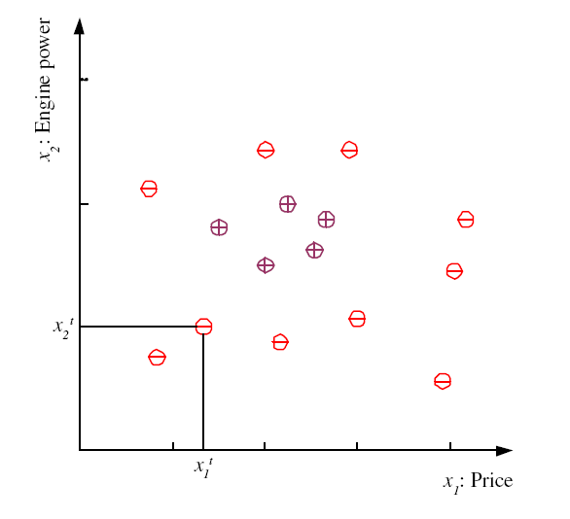

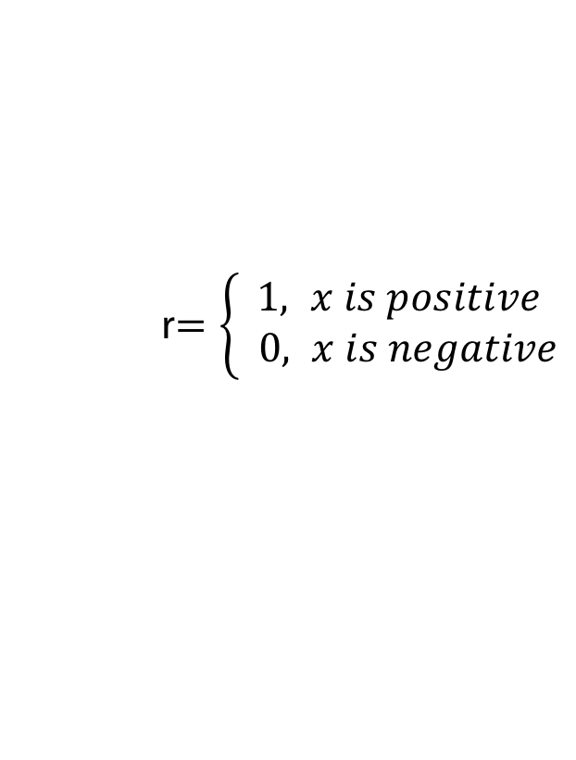

Training set X
Labelled
Data
$$X{=\{ \left(x^{t},r^{t}\right) \}}_{t=1}^{N}$$
r$=\left\{\begin{aligned}1, x is positive \\ & 0, x is negative\end{aligned}\right.$
Labels
Feature
vector
$$x={(x}_{1},x_{2})$$

Slide 13
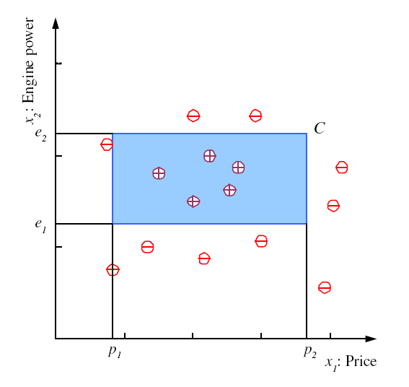
Class C
${(p}_{1}≤price≤p_{2}) AND{ (e}_{1}≤engine power≤e_{2}$)

Slide 14
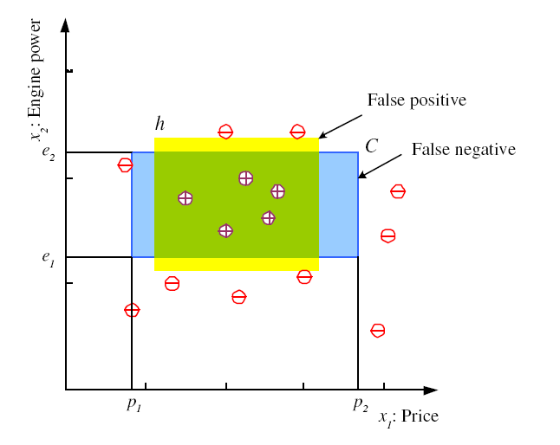

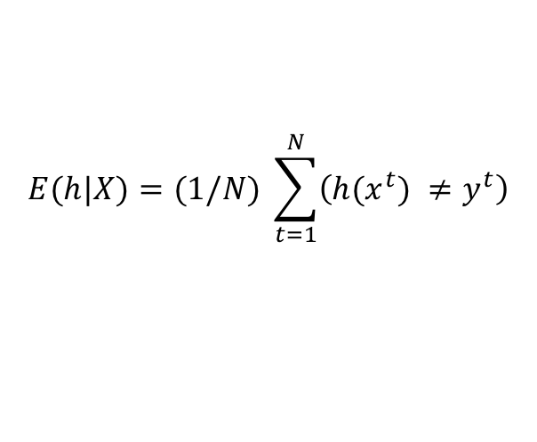
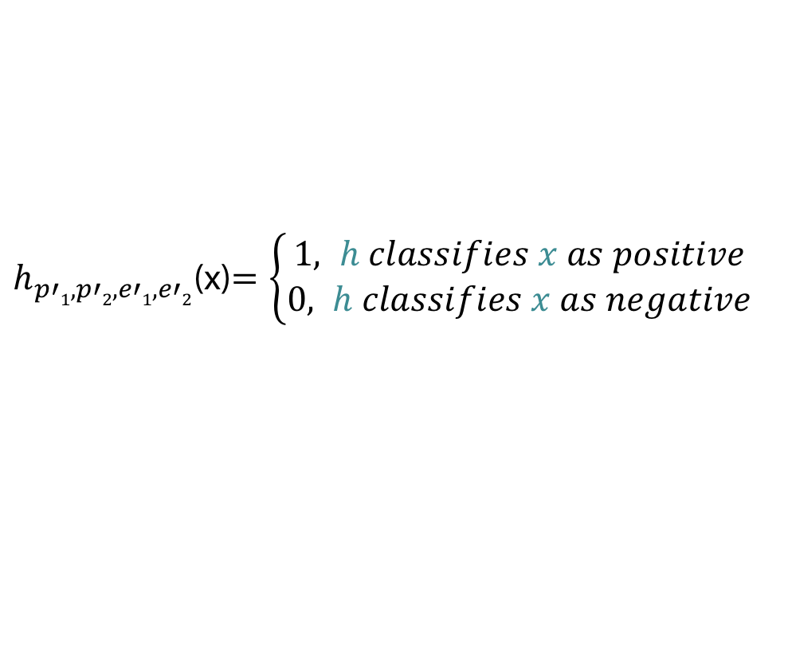
Hypothesis class H
$h_{p′1,p′2,e′1,e′2}$(x)$=\left\{\begin{aligned}1, h classifies x as positive \\ &0, h classifies x as negative\end{aligned}\right.$
Error of h on X
$$E(h|X)=(1/N) \sum_{t=1}^{N}{\left(h(x^{t}) {≠y}^{t}\right)}$$
Optimization
$$argminp_{1}^{′}p_{2}^{′}e_{1}^{′}e_{2}^{′}E(h|X)$$
But how to find optimum?

Slide 15
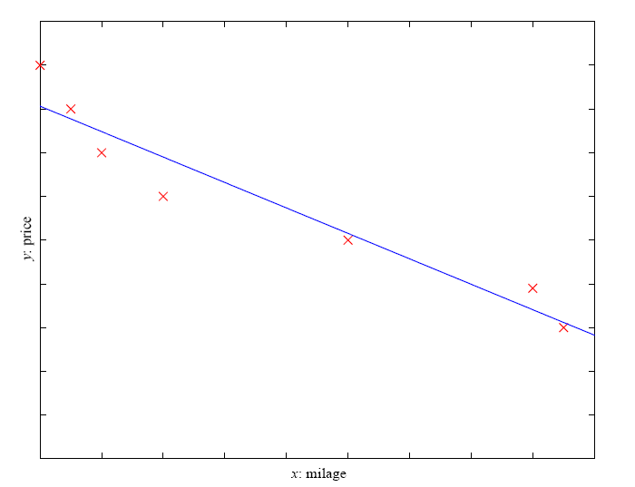
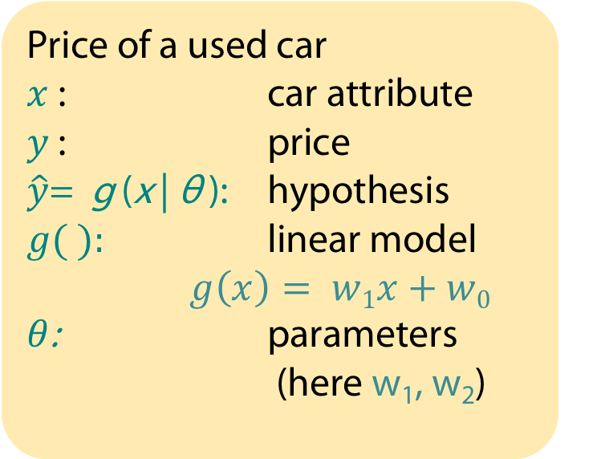
Example Supervised Learning: Regression
Price of a used car
$x$ : car attribute
$y$ : price
$\hat{y}$= g (x | θ ): hypothesis
$g( ):$ linear model
$g\left(x\right)= w1x+w0$
$θ$: parameters (here w₁, w₂)

Slide 16
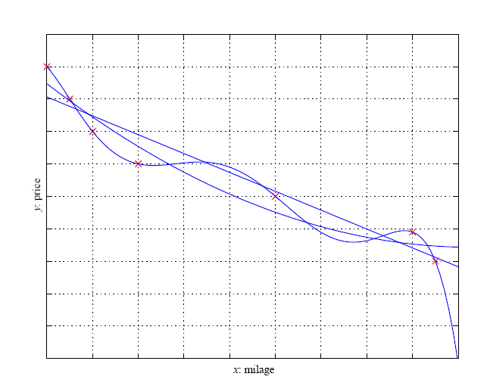
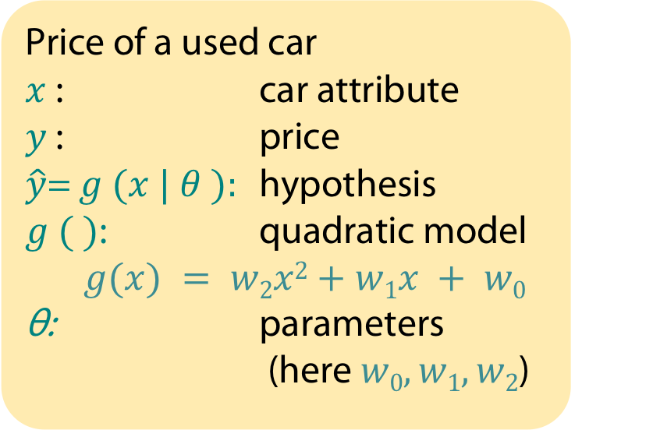
Example Supervised Learning: Regression
Price of a used car
$x$ : car attribute
$y$ : price
$\hat{y}$= $g (x | θ ):$ hypothesis
$g ( )$: quadratic model
$g(x) = w2x2+w1x + w0$
θ: parameters (here $w0, w1, w2$)

Slide 17
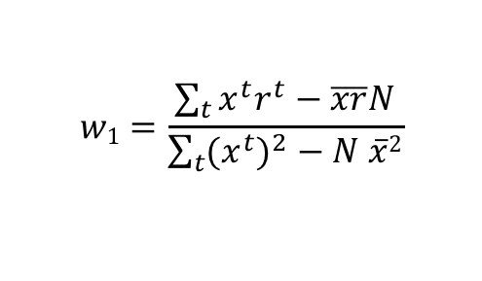
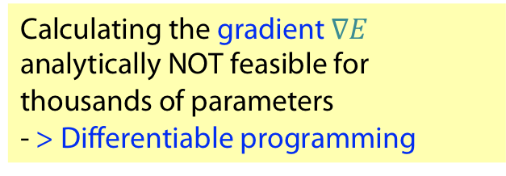
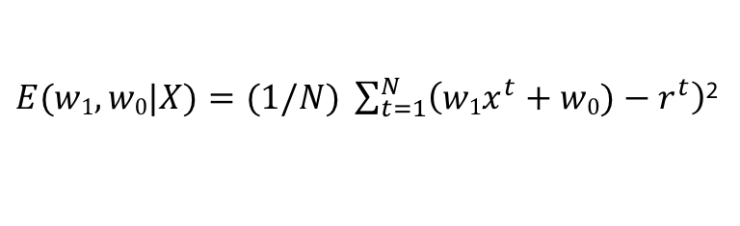
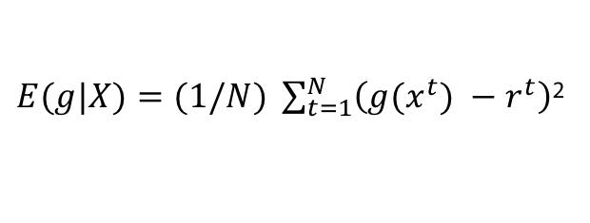

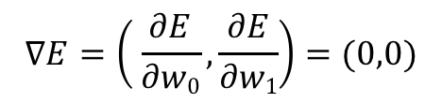


Example Supervised Learning: Regression
$$X{=\{ \left(x^{t},r^{t}\right) \}}_{t=1}^{N}$$
$$r^{t} {=f\left(x^{t}\right)∈ℝ}_{}^{}$$
Mean squared error
for general and linear hypothesis g
$E(g|X)=(1/N) \sum_{t=1}^{N}{\left(g(x^{t}) {− r}^{t}\right)}$²
$E(w1,w0|X)=(1/N) \sum_{t=1}^{N}{\left(w1x^{t}+w0){− r}^{t}\right)}$²
Optimization:
$$∇E=\left( \frac{∂E}{∂w0},\frac{∂E}{∂w1}\right)=(0,0)$$
Calculating the gradient $∇E$
analytically NOT feasible for thousands of parameters
- > Differentiable programming
$$w1=\frac{\sum_{t}{x^{t}r^{t}−\overline{xr}N}}{\sum_{t}{{{(x}^{t})}^{2}−N \overline{x}2}}$$
$$w0=\overline{r} −w1 \overline{x}$$
Notes:
Why square?: Bigger differences are weighted more than smaller differences.
Local extremum test: set partial derivative w.r.t. w0 of E(.) to zero and solve equation w.r.t. w0; then set partial derivative w.r.t. w1 of E to 0 and use equation for w0.
overline stands for arithmetical mean

Slide 18
DiFferentiable Programming

Slide 19
What is Differentiable Programming (DP)?
„Yeah, Differentiable Programming is little more than a rebranding of the modern collection Deep Learning techniques, the same way Deep Learning was a rebranding of the modern incarnations of neural nets with more than two layers. The important point is that people are now building a new kind of software by assembling networks of parameterized functional blocks and by training them from examples using some form of gradient-based optimization….It’s really very much like a regular program, except it’s parameterized, automatically differentiated, and trainable/optimizable. ...
(Part of a post of Yann Lecun, somewhere in Facebook, found at https://gist.github.com/halhenke/872708ccea42ee8cafd950c6c2069814)

Slide 20
DP is a significant generalization of DL!
„Yeah, Differentiable Programming is little more than a rebranding of the modern collection Deep Learning techniques, the same way Deep Learning was a rebranding of the modern incarnations of neural nets with more than two layers. The important point is that people are now building a new kind of software by assembling networks of parameterized functional blocks and by training them from examples using some form of gradient-based optimization….It’s really very much like a regular program, except it’s parameterized, automatically differentiated, and trainable/optimizable. ...
(Part of a post of Yann Lecun, somewhere in Facebook, found at https://gist.github.com/halhenke/872708ccea42ee8cafd950c6c2069814)

Slide 21
What is Deep Learning (DL)?
V2
Deep learning is based on function composition
  Feedforward networks: y = f (g (x , θ_{g} ), θ_{f} )
  Often with relatively simple functions (e.g. f (x, θ_{f} ) = σ(x⊤θ_{f} ))
  Recurrent networks:
  y_{t} = f(y_{t−1},x_{t},θ) = f(f(y_{t−2},x_{t−1},θ),x_{t},θ) = ...
In early days focus of DL on functions for classification
Nowadays the functions are much more general in their inputs and outputs.

Slide 22
Network view of composed functions
V2
Input layer
Hidden layer(s)
Output layer
w⁽¹⁾_{ij}
h₁
w⁽²⁾_{ij}
i: layer i
b_{i}: Bias in i
W^{(i)}: weight matrix in i
𝛔 _{i}: activation function in i
x₁
h₂
o₁
y‘₁
x₂
h₃
x₃
o₂
y‘₂
h₄
x₄
h₅
x
h
y‘
„States“
g
f
Functions
y‘ = f (g (x ; W ⁽¹⁾ ,b₁); W ⁽²⁾ ,b₂) = 𝛔₂ (W⁽²⁾ 𝛔 ₁(W⁽¹⁾ x +b₁ ) + b₂)

Slide 23
Deep networks
V2
Input layer
Hidden layer(s)
Output layer
h₁
w_{ij}
w^{(n)}_{ij}
w_{ij}
k₁
l₁
w⁽²⁾_{ij}
x₁
h₂
k₂
l₂
o₁
x₂
h₃
k₃
l₃
...
x₃
o₂
h₄
k₄
l₄
x₄
h₅
k₅
l₅
k₆
x
h
k
l

Slide 24
DP follows the gradient!
„Yeah, Differentiable Programming is little more than a rebranding of the modern collection Deep Learning techniques, the same way Deep Learning was a rebranding of the modern incarnations of neural nets with more than two layers. The important point is that people are now building a new kind of software by assembling networks of parameterized functional blocks and by training them from examples using some form of gradient-based optimization….It’s really very much like a regular program, except it’s parameterized, automatically differentiated, and trainable/optimizable. ...
(Part of a post of Yann Lecun, somewhere in Facebook, found at https://gist.github.com/halhenke/872708ccea42ee8cafd950c6c2069814)

Slide 25
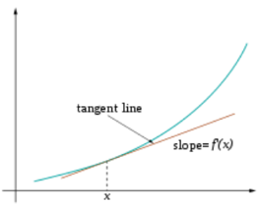
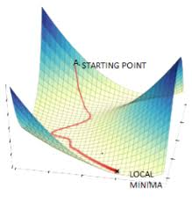
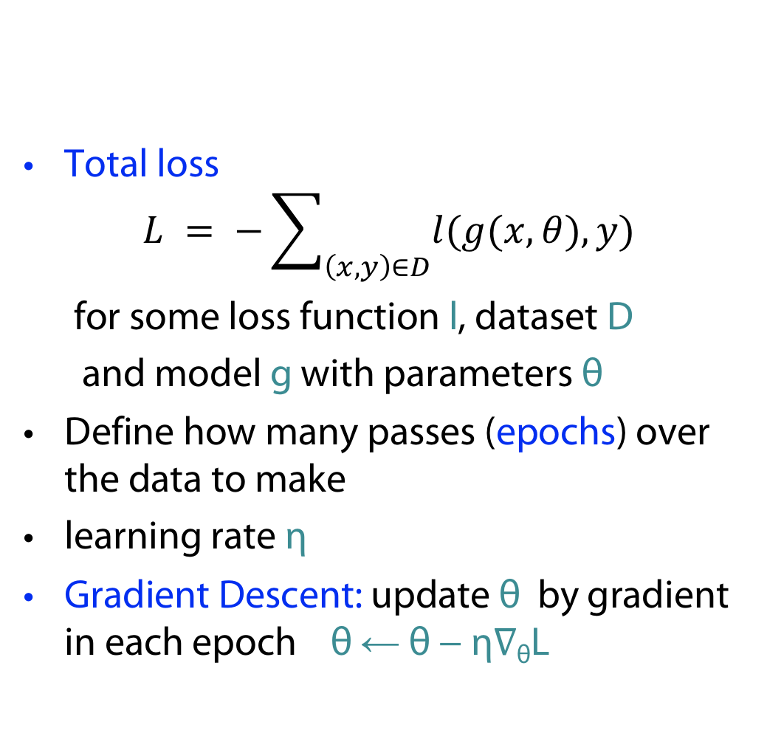
Gradient Descent
V2
Total loss
$$L = −\sum_{\left(x,y\right)∈D}{l(g(x,θ),y)}$$
for some loss function l, dataset D
and model g with parameters θ
Define how many passes (epochs) over the data to make
learning rate η
Gradient Descent: update θ by gradient in each epoch θ ← θ − η∇_{θ}L

Slide 26
Pros and Cons
Gradient Descent has good statistical properties (very low variance)
But is very data inefficient (particularly when data has many similarities)
Doesn’t scale to effectively infinite data (e.g. with augmentation)

Slide 27
Stochastic Gradient Descent (SGD)
Define loss function l, dataset D and model g with learnable parameters θ.
Define how many passes over the data to make (each one known as an Epoch)
Define a learning rate η
Stochastic Gradient Descent updates the parameters θ by moving them in the direction of the negative gradient with respect to the loss of a single item l by the learning rate η multiplied by the gradient:
for each Epoch:
for each (x,y)∈D:
θ ← θ − η∇θl

Slide 28
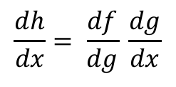

Backprop: efficient implementation of gradient descent
V2
Sample labeled data
(batch)
Forward it through the network, get predictions
Back-propagate the errors
Update the network weights
Backpropagation idea
Generate error signal that measures difference between predictions and target values
Use error signal to change the weights and get more accurate predictions backwards
Underlying mathematics: chain rule
Chain rule (1-dim)
$$\frac{dh}{dx}= \frac{df}{dg} \frac{dg}{dx}$$
( for
$h\left(x\right)=f(g(x))$ )

Slide 29
Deep networks
Input layer
Hidden layer(s)
Output layer
h₁
w_{ij}
w^{(n)}_{ij}
w_{ij}
k₁
l₁
x₁
h₂
k₂
l₂
o₁
x₂
h₃
k₃
l₃
...
x₃
o₂
h₄
k₄
l₄
x₄
h₅
k₅
l₅
k₆
x
h
k
l
Problem: Many, many parameters, no structure

Slide 30
What is Deep Learning?
V3
Deep learning systems are neural network models similar to those popular in the ’80s and ’90s, with:
  some architectural and algorithmic innovations (e.g. many layers, ReLUs, dropout, LSTMs)
  vastly larger data sets (web-scale)
  vastly larger-scale compute resources (GPU, cloud)
  much better software tools (Theano, Torch, TensorFlow)
  vastly increased industry investment and media hype

Slide 31
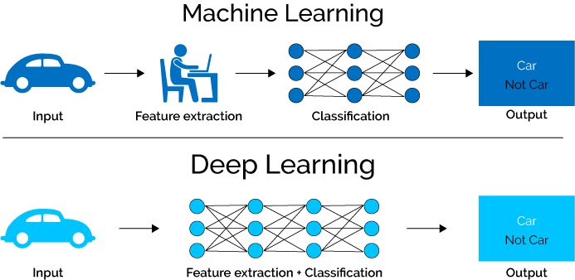
Deep Learning (ad 1.)
V3
Example family car: we presumed features
price and mileage
Classical Machine Learning
Deep Learning
Adapted from https://www.xenonstack.com/blog/static/public/uploads/media/machine-learning-vs-deep-learning.png

Slide 32
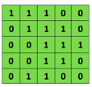
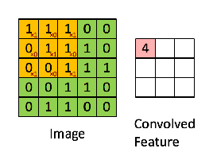

Deep Learning (also ad 1.)
V3
Example: Convolutional Neural Networks (CNN)
More structure: local receptive fields
Less parameters: weight tying, pooling
Convolutional
3x3 filter
Input matrix
http://deeplearning.stanford.edu/wiki/index.php/Feature_extraction_using_convolution
Notes:
http://www.asimovinstitute.org/neural-network-zoo/

Slide 33
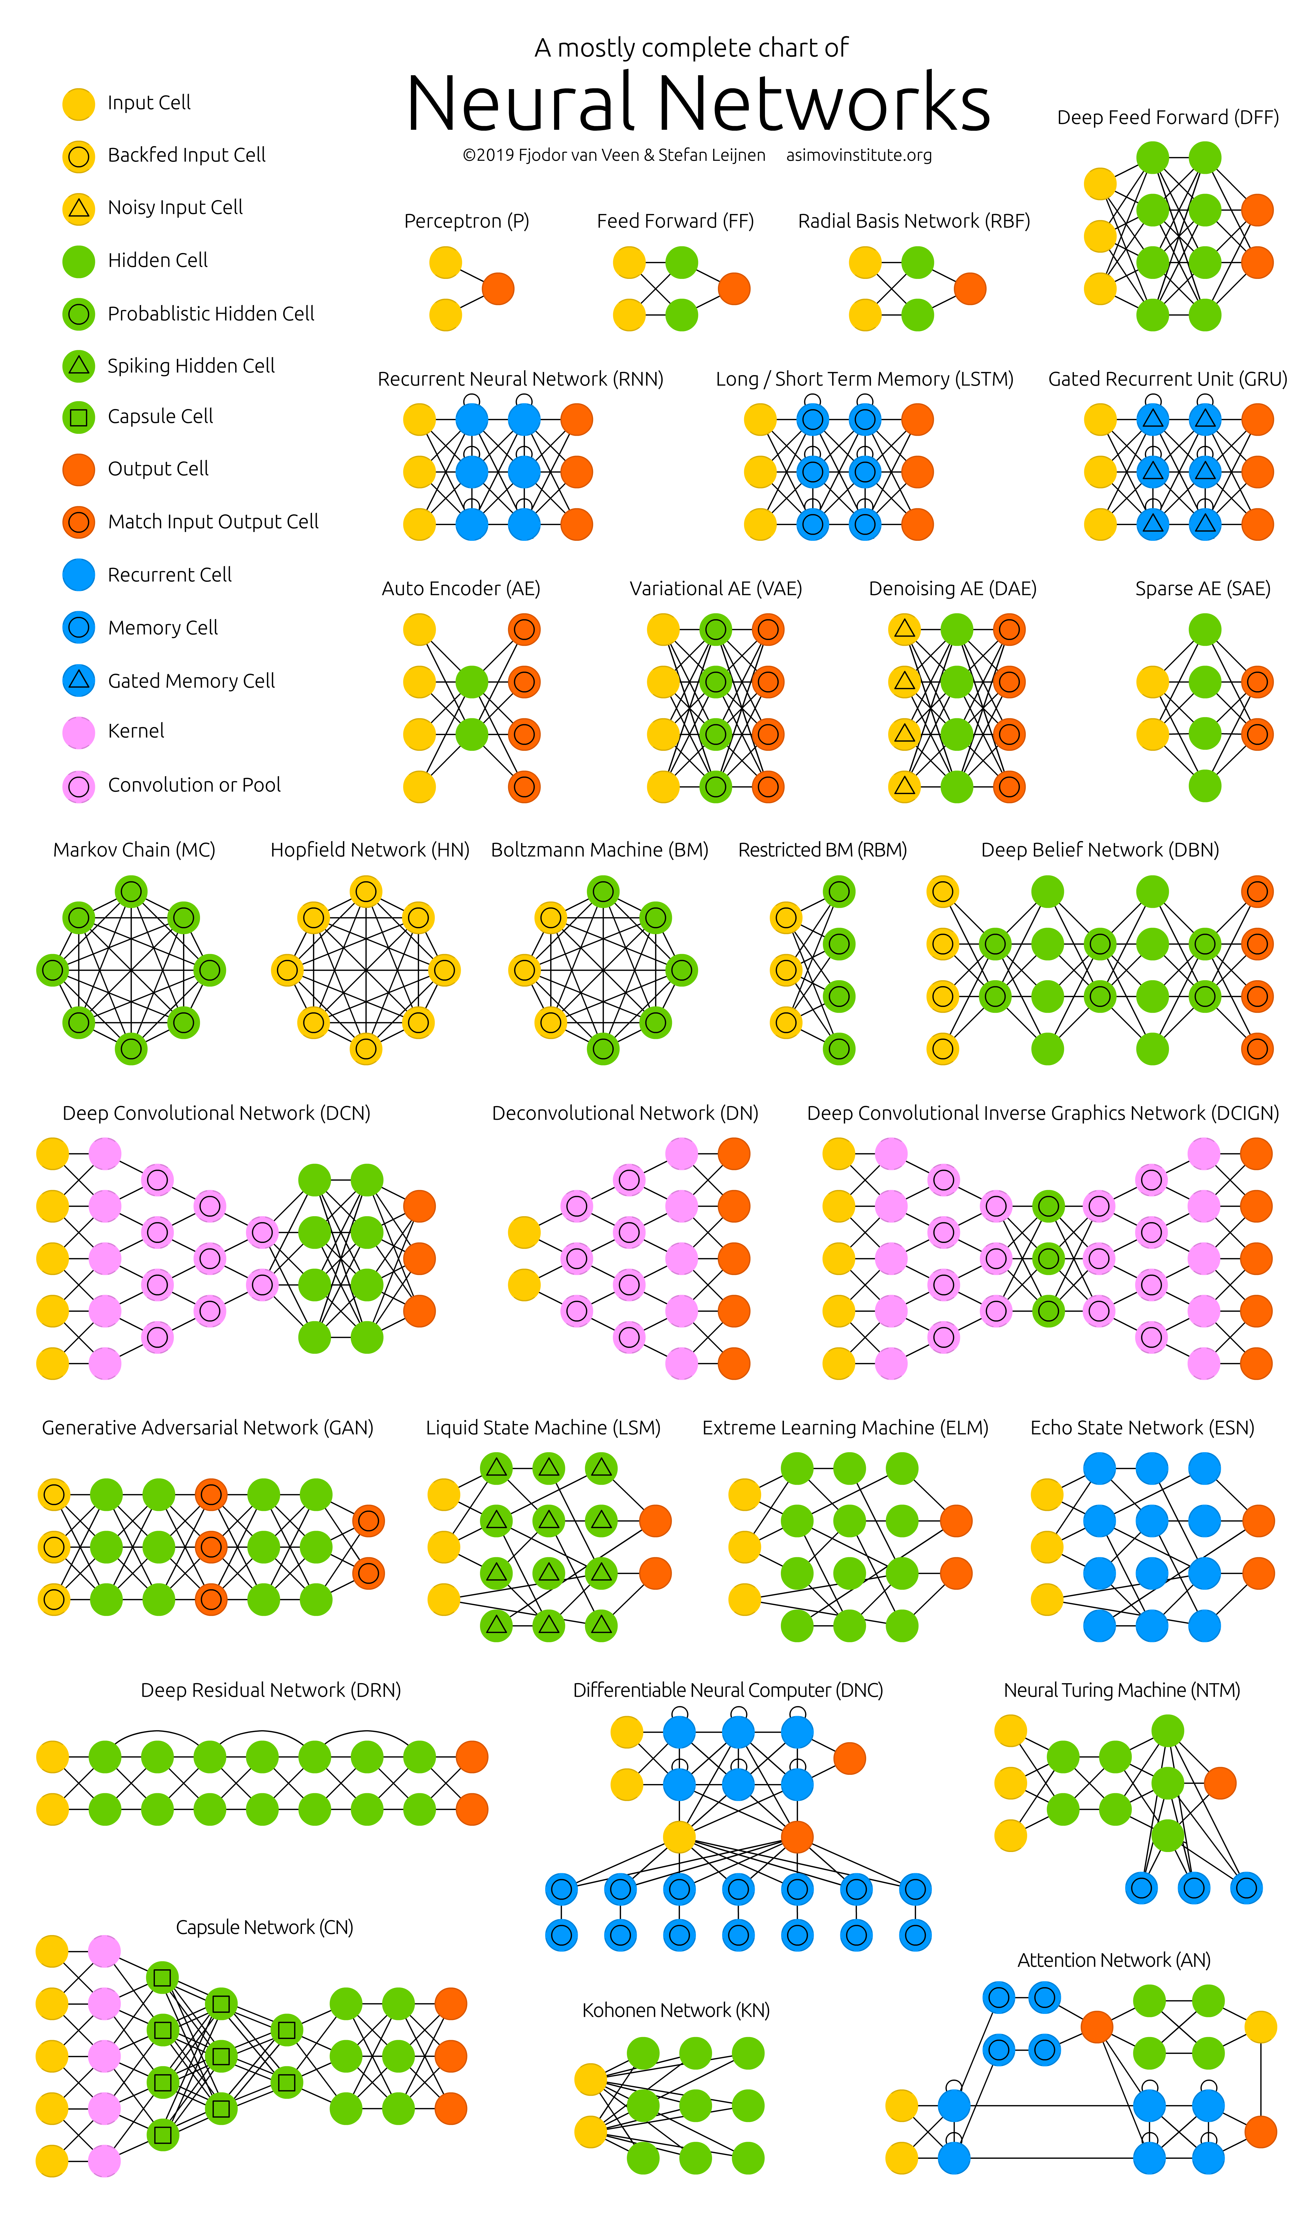
V4
Why care about DL and study those structures?
Amazing performance
on many benchmark tasks
https://www.asimovinstitute.org/neural-network-zoo/

Slide 34
DP uses automatic differentation (AD)
V5/6
„Yeah, Differentiable Programming is little more than a rebranding of the modern collection Deep Learning techniques, the same way Deep Learning was a rebranding of the modern incarnations of neural nets with more than two layers. The important point is that people are now building a new kind of software by assembling networks of parameterized functional blocks and by training them from examples using some form of gradient-based optimization….It’s really very much like a regular program, except it’s parameterized, automatically differentiated, and trainable/optimizable. ...
(Part of a post of Yann Lecun, somewhere in Facebook, found at https://gist.github.com/halhenke/872708ccea42ee8cafd950c6c2069814)

Slide 35

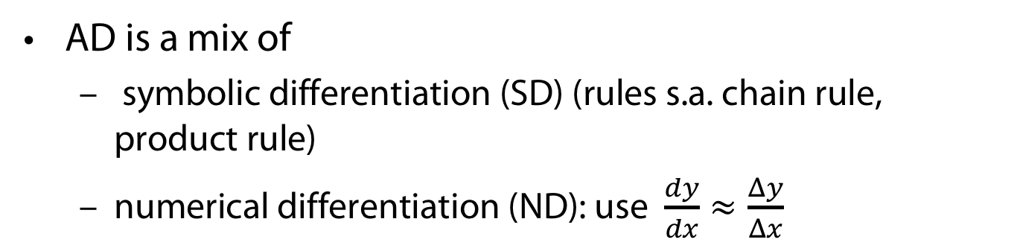
Automatic Differentiation (AD)
V5/6
AD is a mix of
  symbolic differentiation (SD) (rules s.a. chain rule, product rule)
  numerical differentiation (ND): use $\frac{dy}{dx}≈\frac{Δy}{Δx}$
$\frac{d(f\left(x\right)∙g(x))}{dx}=\frac{d f\left(x\right)}{dx}g\left(x\right)+\frac{d g\left(x\right)}{dx}f\left(x\right)$ (Product rule)
  $h(x) : = g(x)∙f(x)$
  $\frac{dh(x)}{dx}$ and $h$ have two components in common
  This may also be the case for$f$.
  Symbollicaly calculating $f$ won‘t profit from common parts of $f$and $\frac{df(x)}{dx}$

Slide 36
V5/6

Slide 37
PROBABILITIES

Slide 38
„
ph“
1)
1) Yes, a slide, quoting a slide

Slide 39
Problems with deep (neural) networks (Ghahramani)
Very data hungry (e.g. often millions of examples)
Very compute-intensive to train and deploy (cloud GPU resources)
Poor at representing uncertainty
Easily fooled by adversarial examples
Finicky to optimise: non-convex + choice of architecture, learning procedure, initialisation, etc, require expert knowledge and experimentation
Uninterpretable black-boxes, lacking in trasparency, difficult to trust

Slide 40
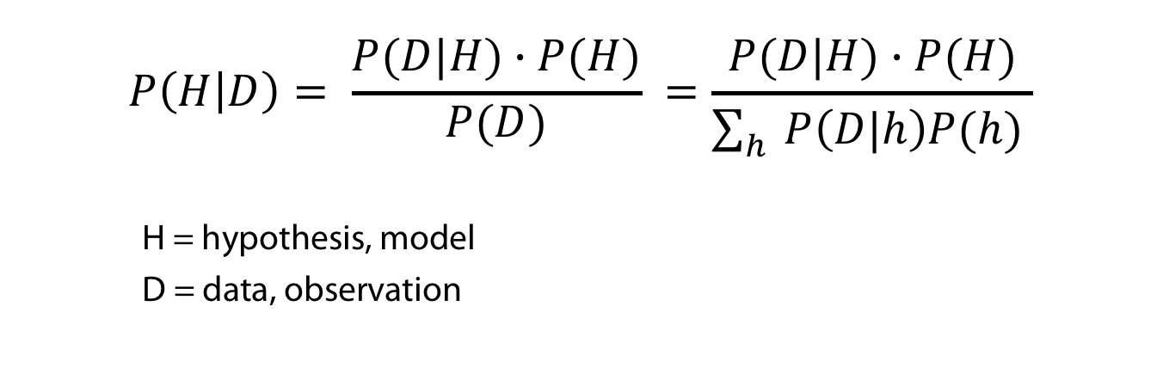
Bayes rule to rule them all ...
V7
If we use the mathematics of probability theory to express all forms of uncertainty and noise associated with our model...
...then inverse probability (i.e. Bayes rule) allows us to infer unknown quantities, adapt our models, make predictions and learn from data.
$$P\left(H | D\right)= \frac{P(D|H)∙P(H)}{P(D)} =\frac{P(D|H)∙P(H)}{\sum_{h}{P\left(D|h\right)P(h) }}$$
H = hypothesis, model
D = data, observation
Bayes Rule

Slide 41
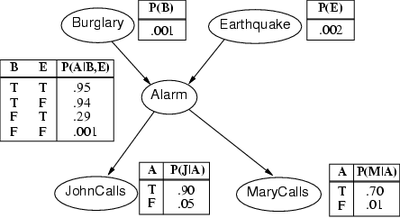
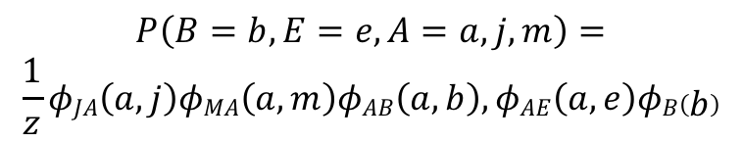
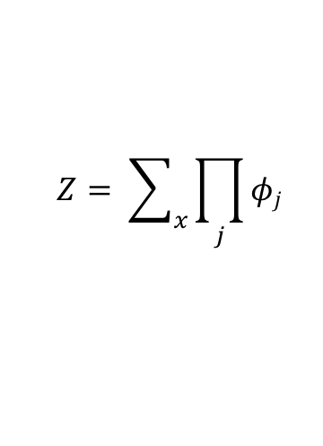
Probabilistic graphical models
V7
Encode efficiently full joint probabilities
Directed graphs
(Bayesian networks,
Hidden Markov models ...)
undirected graphs
(Markov networks... )
Mixed models
Factor graphs
A | J | ϕ(a,j)
F | F | 20
F | T | 1
T | F | 0.1
T | T | 0.4
x
x
x
x
Requires Normalization
$$P\left(B=b, E=e, A=a, j,m\right)=$$
$$\frac{1}{z}φJA\left(a,j\right)φMA\left(a,m\right)φAB\left(a,b\right),φAE\left(a,e\right)φB\left(b\right)$$
$$Z= \sum_{x}{\prod_{j}{φj} }$$
Partition function

Slide 42
PROBABILISTIC PROGRAMMING

Slide 43
Why then not stick to probabilities
V8
Problem 1: Probabilistic model development and the derivation of inference algorithms is time-consuming and error-prone.
Problem 2: Exact (and approximate inference) hard due to normalization: partition function Z)
Solution to 1
  Develop Probabilistic Programming Languages for expressing probabilistic models as computer programs that generate data (i.e. simulators).
  Derive Universal Inference Engines for these languages that do inference over program traces given observed data (Bayes rule on computer programs).

Slide 44
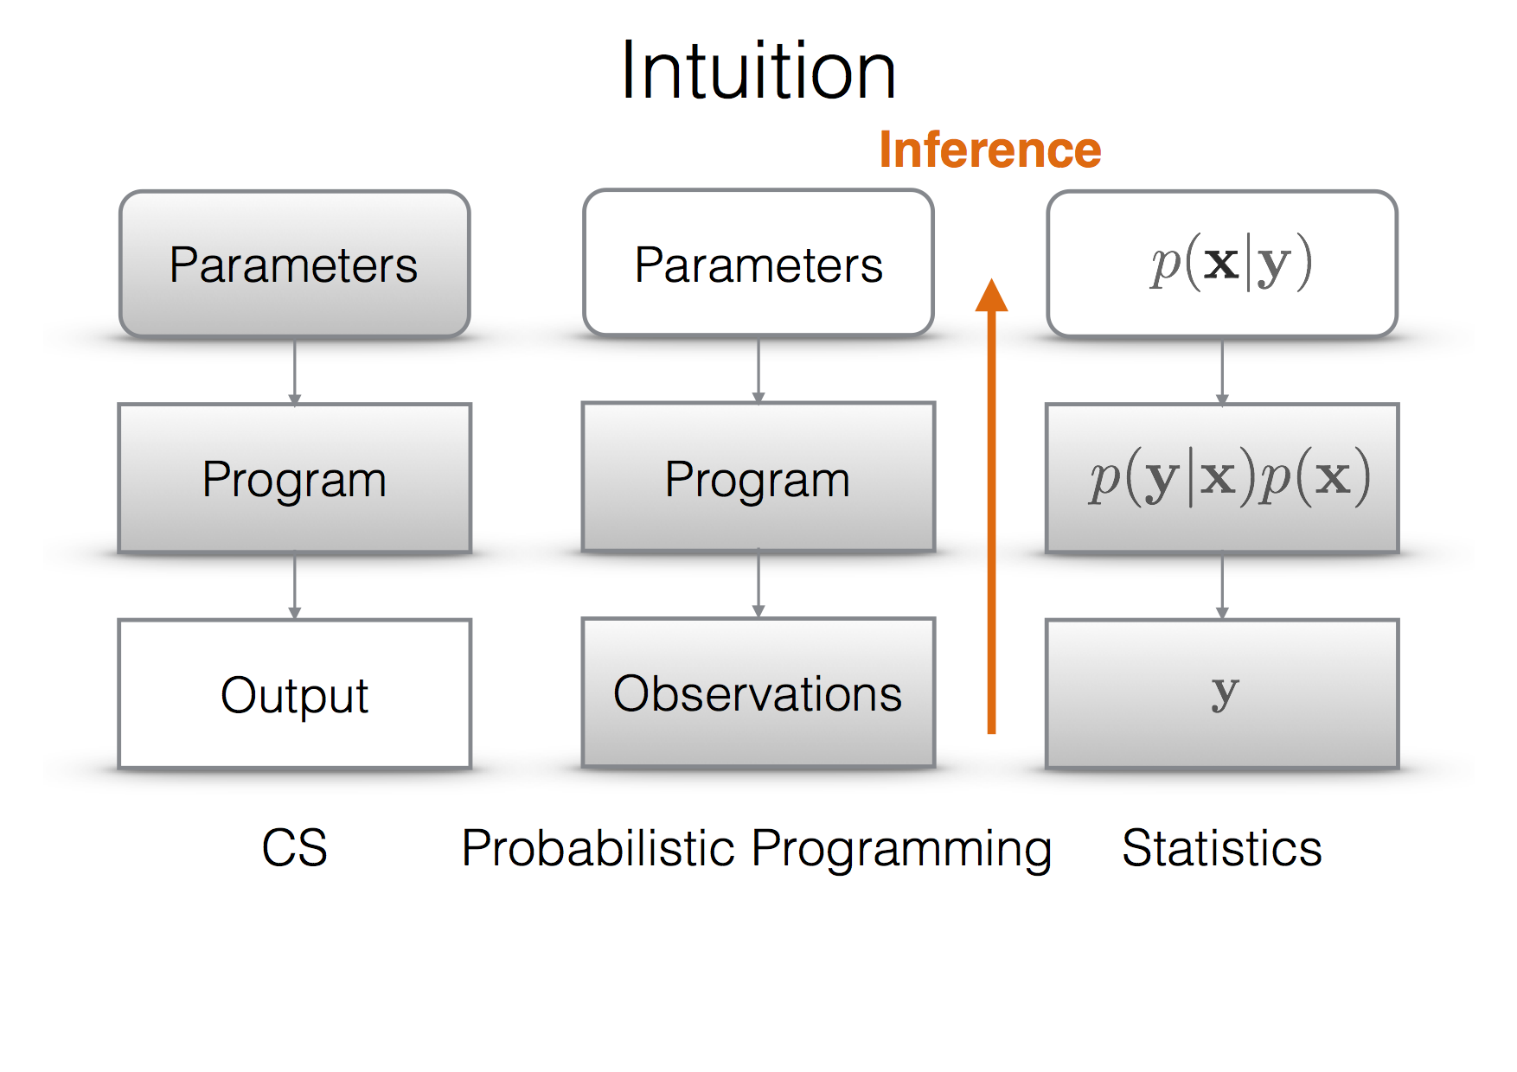
Comparison
V8
Ex: F. Wood: Probabilistic Programming, PPAML Summer School, Portland 2016

Slide 45
Probabilistic Programming Example
V8
Hidden markov model in Julia

Slide 46
Adequate deep Structures

Slide 47
Problem 2 of probabilistic graphical models
Exact (and even approxiate) inference not tractable for general probabilistic models (problem: normalization function Z).
Restricting the models in expressivity is possible (thin junction trees and so on) - but not desirable
Find a better compromise of expressivity and feasibility: sum-product networks/probabilisitc boolean circuits

Slide 48
Programming with Adequate Deep Structures
Machine learning (ML) is programming algorithms for
  optimizing a performance criterion
  using example (training) data
  by constructing general(izable) models
  that are good approximations of the data
Role of Mathematics
Building mathematical model
core task is inference from a sample
Role of CS: Efficient algorithms
solve the optimization problem
represent (expressively) and evaluate (feasibily) the model for inference

Slide 49
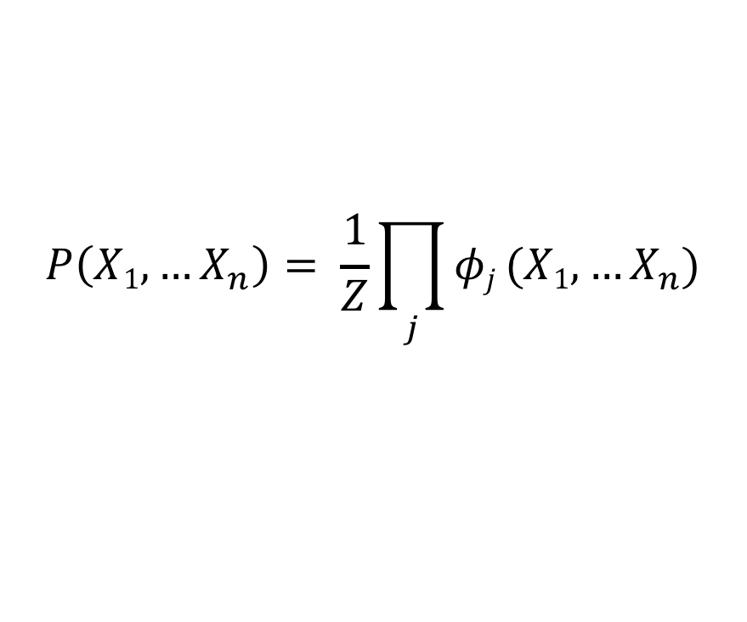
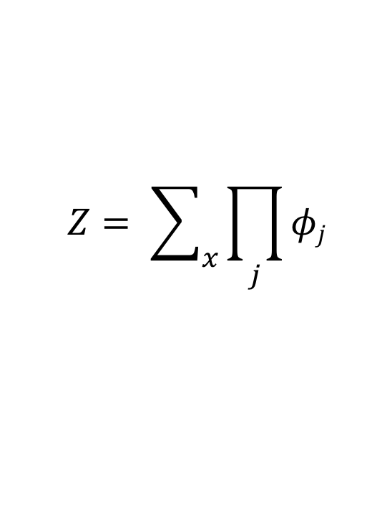
Why Is Inference Hard?
V9/10
$$P\left(X1, …X_{n}\right)= \frac{1}{Z}\prod_{j}{φj}(X1, …X_{n})$$
Bottleneck: Summing out variables
E.g.: Partition function
Sum of exponentially many products
$$Z= \sum_{x}{\prod_{j}{φj} }$$
Notes:
Before introducing SPN, let’s consider why inf is difficult in a GM.
Computing prob is actually easy up to a proportion; we simply multiply the potentials of factors.
What makes inf hard is to sum out variables, which requires summing over an exp num of comb.
The extreme case is the part func Z, which requires summing out all variables.

Slide 50
Alternative Representation
V9/10
X₁ | X₂ | P(X)
1 | 1 | 0.4
1 | 0 | 0.2
0 | 1 | 0.1
0 | 0 | 0.3
P(X) = 0.4 ⋅ X₁ ⋅ X₂
+ 0.2 ⋅ X₁ ⋅ X₂
+ 0.1 ⋅ X₁ ⋅ X₂
+ 0.3 ⋅ X₁ ⋅ X₂
⎯
⎯
⎯
⎯
Network Polynomial [Darwiche, 2003]
Notes:
To make things less cumbersome, we can use the following shorthands, where …

Slide 51
Sum Out Variables
V9/10
e: X₁ = 1
X₁ | X₂ | P(X)
1 | 1 | 0.4
1 | 0 | 0.2
0 | 1 | 0.1
0 | 0 | 0.3
P(e) = 0.4 ⋅ X₁ ⋅ X₂
+ 0.2 ⋅ X₁ ⋅ X₂
+ 0.1 ⋅ X₁ ⋅ X₂
+ 0.3 ⋅ X₁ ⋅ X₂
⎯
⎯
⎯
⎯
⎯
⎯
Set X₁ = 1, X₁ = 0, X₂ = 1, X₂ = 1
Easy: Set both indicators to 1
Easy: Partition function: Set all indicators to 1
Notes:
The good news is that summing out a variable in this repr is easy:
Suppose we want to comp the marginal of X1=1, which requires sum out X2.
We can do this by simply setting both … to 1.
Intuitively, setting an indicator to 1 will include that val into summation.
In part, to comp part func Z, we can just set all ind to 1.
This sounds great, except for one problem, there are exponentially many terms.

Slide 52
Graphical Representation
V9/10
X₁ | X₂ | P(X)
1 | 1 | 0.4
1 | 0 | 0.2
0 | 1 | 0.1
0 | 0 | 0.3
⊕
0.4
0.3
0.2
0.1
⊗
⊗
⊗
⊗
X₁
⎯
⎯
X₁
X₂
X₂
But in general may lead to exponentially large networks (e.g. parity).
Solution: Make a deep dive (reuse computations)
with Sum-Product networks
Notes:
We can visualize this problem graphically by putting sum node for wt summation and prod nodes for multi.

Slide 53
Sum-Product Networks (SPNs)
V9/10
V11/12
Rooted DAG
Nodes: Sum, product, input indicator
Weights on edges from sum to children
More general class: Probabilistic Boolean Circuits
⊕
0.7
0.3
⊗
⊗
⊕
⊕
⊕
⊕
0.4
0.9
0.7
0.2
0.6
0.1
0.3
0.8
X₁
⎯
X₂
⎯
X₁
X₂
Notes:
This leads us to introduce spns.
An SPN is a DAG with a root. The leaves are input, and the internal nodes are sums and prods. A sum outputs the wt sum of child, …

Slide 54
NearlY THE END

Slide 55
Topic progress of course in short
It‘s from discriminative to generative models
It‘s from pure functions to algorithms to algorithms over semi-declarative structures (and some logic)
It‘s from non-probabilities to probabilities (and some logic)

Slide 56
APPENDIX
Uhhh, a lecture with a hoepfully useful

Slide 57
Todays lecture is based on the following slides
Jonathon Hare: Lecture 1,2 of course „COMP6248 Differentiable Programming (and some Deep Learning“) http://comp6248.ecs.soton.ac.uk/
Zoubin Ghahramani: Probabilistic Machine Learning and AI, Microsoft AI Summer School Cambridge 2017 http://mlss.tuebingen.mpg.de/2017/speaker_slides/Zoubin1.pdf
Hoifung Poon: Sum-Product Networks: A New Deep Architecture https://www.microsoft.com/en-us/research/wp-content/uploads/2017/05/spn11.pdf
E. Alpaydin: Course on machine learning, introductory slides, https://www.cmpe.boun.edu.tr/~ethem/i2ml2e/2e_v1-0/i2ml2e-chap1-v1-0.pptx
I. Lorentzou: Introduction to Deep Learnin, link
F. Wood: Probabilistic Programming, PPAML Summer School, Portland 2016, link

Slide 58
Color Convention in this course
Formulae, when occurring inline
Newly introduced terminology and definitions
Important results (observations, theorems) as well as emphasizing some aspects
Examples are given with standard orange with possibly light orange frame
Comments and notes
Algorithms

Slide 59
Books for topics covered in this lecture (1)
Nielsen: Neural Networks and Deep Learning. http://neuralnetworksanddeeplearning.com/
Zhang et al.: Dive into Deep Learning https://d2l.ai/
I. Goodfellow, Y. Bengio, and A. Courville. Deep Learning. MIT Press, 2016.
D. Koller and N. Friedman. Probabilistic Graphical Models: Principles and Techniques - Adaptive Com- putation and Machine Learning. The MIT Press, 2009.
L. D. Raedt, K. Kersting, and S. Natarajan. Statistical Relational Artificial Intelligence: Logic, Probability, and Computation. Morgan & Claypool Publishers, 2016.

Slide 60
Books for topics covered in this lecture (2)
J.-W. van de Meent, B. Paige, H. Yang, and F. Wood. An Introduction to Probabilistic Programming. arXiv e-prints, arXiv:1809.10756, Sept. 2018.
U. Naumann. The Art of Differentiating Computer Programms. Siam, 2012.
K. Murphy. Machine Learning: A Probabilistic Perspective. Adaptive Computation and Machine Learn- ing series. MIT Press, 2012.
S. J. Russell and P. Norvig. Artificial Intelligence – A Modern Approach. Prentice Hall, 1995.

