Slide 1
Intelligent Agents
Dr. Mattis Hartwig
Prof. Dr. Ralf Möller
PD Dr. Özgür Özçep
Universität zu Lübeck
Institut für Informationssysteme

Slide 2
Acknowledgements
Some slides have been taken from lecture material provided by researchers on the web. We hope this material is indicated appropriately. Thank you all.

Slide 3
Organization
Module Intelligent Agents (CS4514-KP12):
Agents, Mechanism, and Collaboration (lecture)
Agent Perception (Language and Vision) (lecture)
Agent Planning, Causality, and Reinforcement Learning (lecture)
Project
Mode of all lectures: classically, on site, with integrated exercises
Lecture slides and videos partly available from last term, but new material produced on the run
Today: overview of the general idea
More details in Moodle (https://moodle.uni-luebeck.de/course/view.php?id=8294)

Slide 4
Organization
Agents, Mechanisms, and Collaboration
Wednesdays, 14:15 - 15:45 Uhr, IFIS Seminarraum 2035,
Start: 19.10.2022
Lecturer: Özgür Özcep
Agent Perception (Language and Vision)
Thursdays 14:15 - 15:45 Uhr, IFIS Seminarraum 2035
Start: 20.10.2022
Lecturer: Ralf Möller
Agent Planning, Causality, and Reinforcement Learning
Fridays, 10:15 - 11:45 Uhr, IFIS Besprechungsraum 2032
Start: 21.10.2022 Lecturers: Mattis Hartwig & Ralf Möller
Project
Fridays, 12:15 - 13:45 Uhr, IFIS Seminarraum 2035
Start: 21.10.2022

Slide 5
Artificial Intelligence and Intelligent Agents
Artificial intelligence (AI) is the science of systematic synthesis and analysis of computational agents that act intelligently
Agents are central to AI (and vice versa)
Intelligent agent = computational agent that acts intelligently
Talking about AI w/o talking about agents misses the point (and vice versa)
Need to technically define the notion of “acting intelligently”
Systems are called computational agents in AI, or agents for short

Slide 6
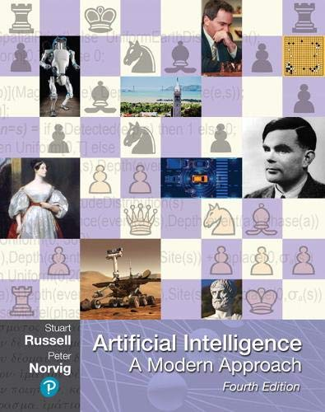
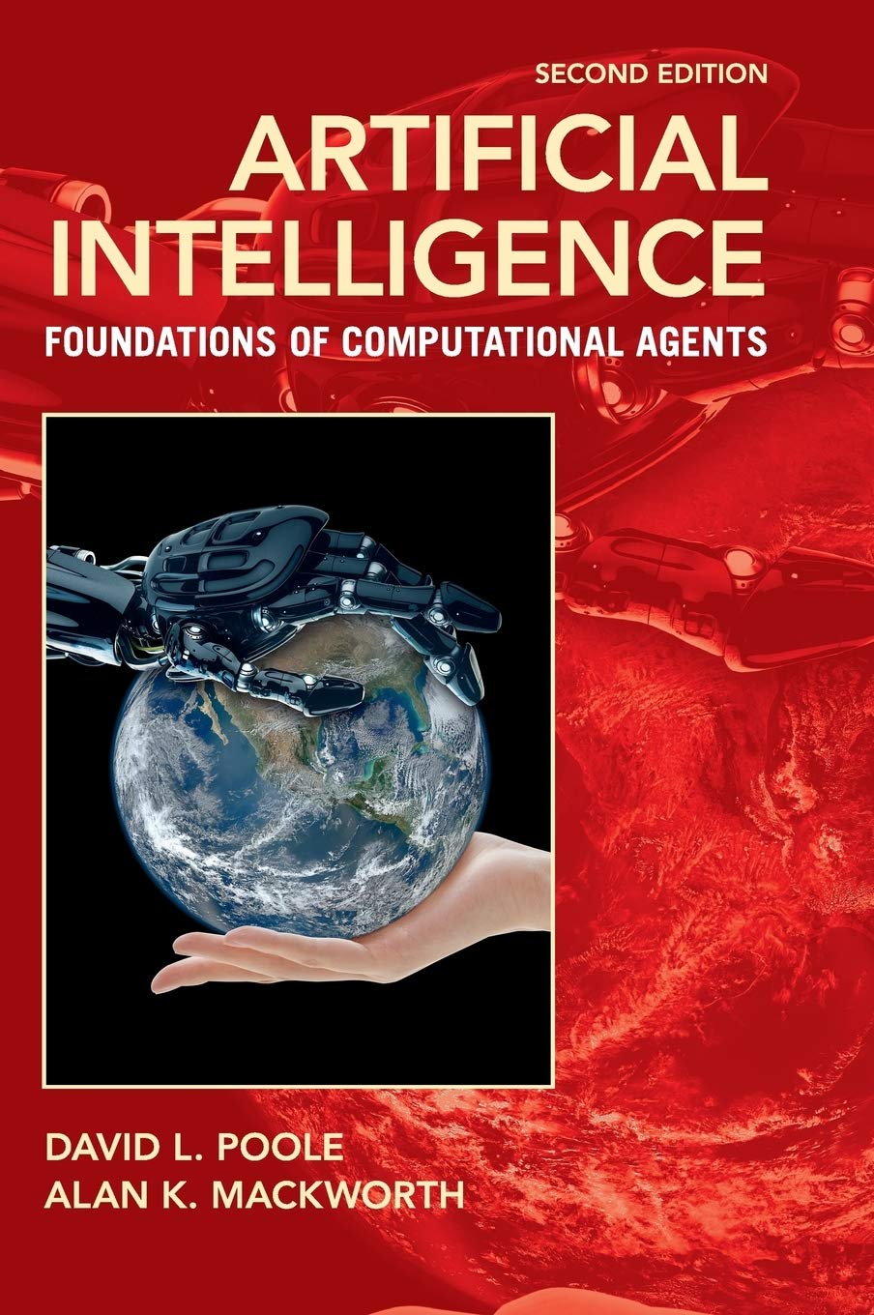
Literature
http://aima.cs.berkeley.edu (AIMA, 1st edition 1995)
http://artint.info
(AIFCA, 1st edition 2010)

Slide 7
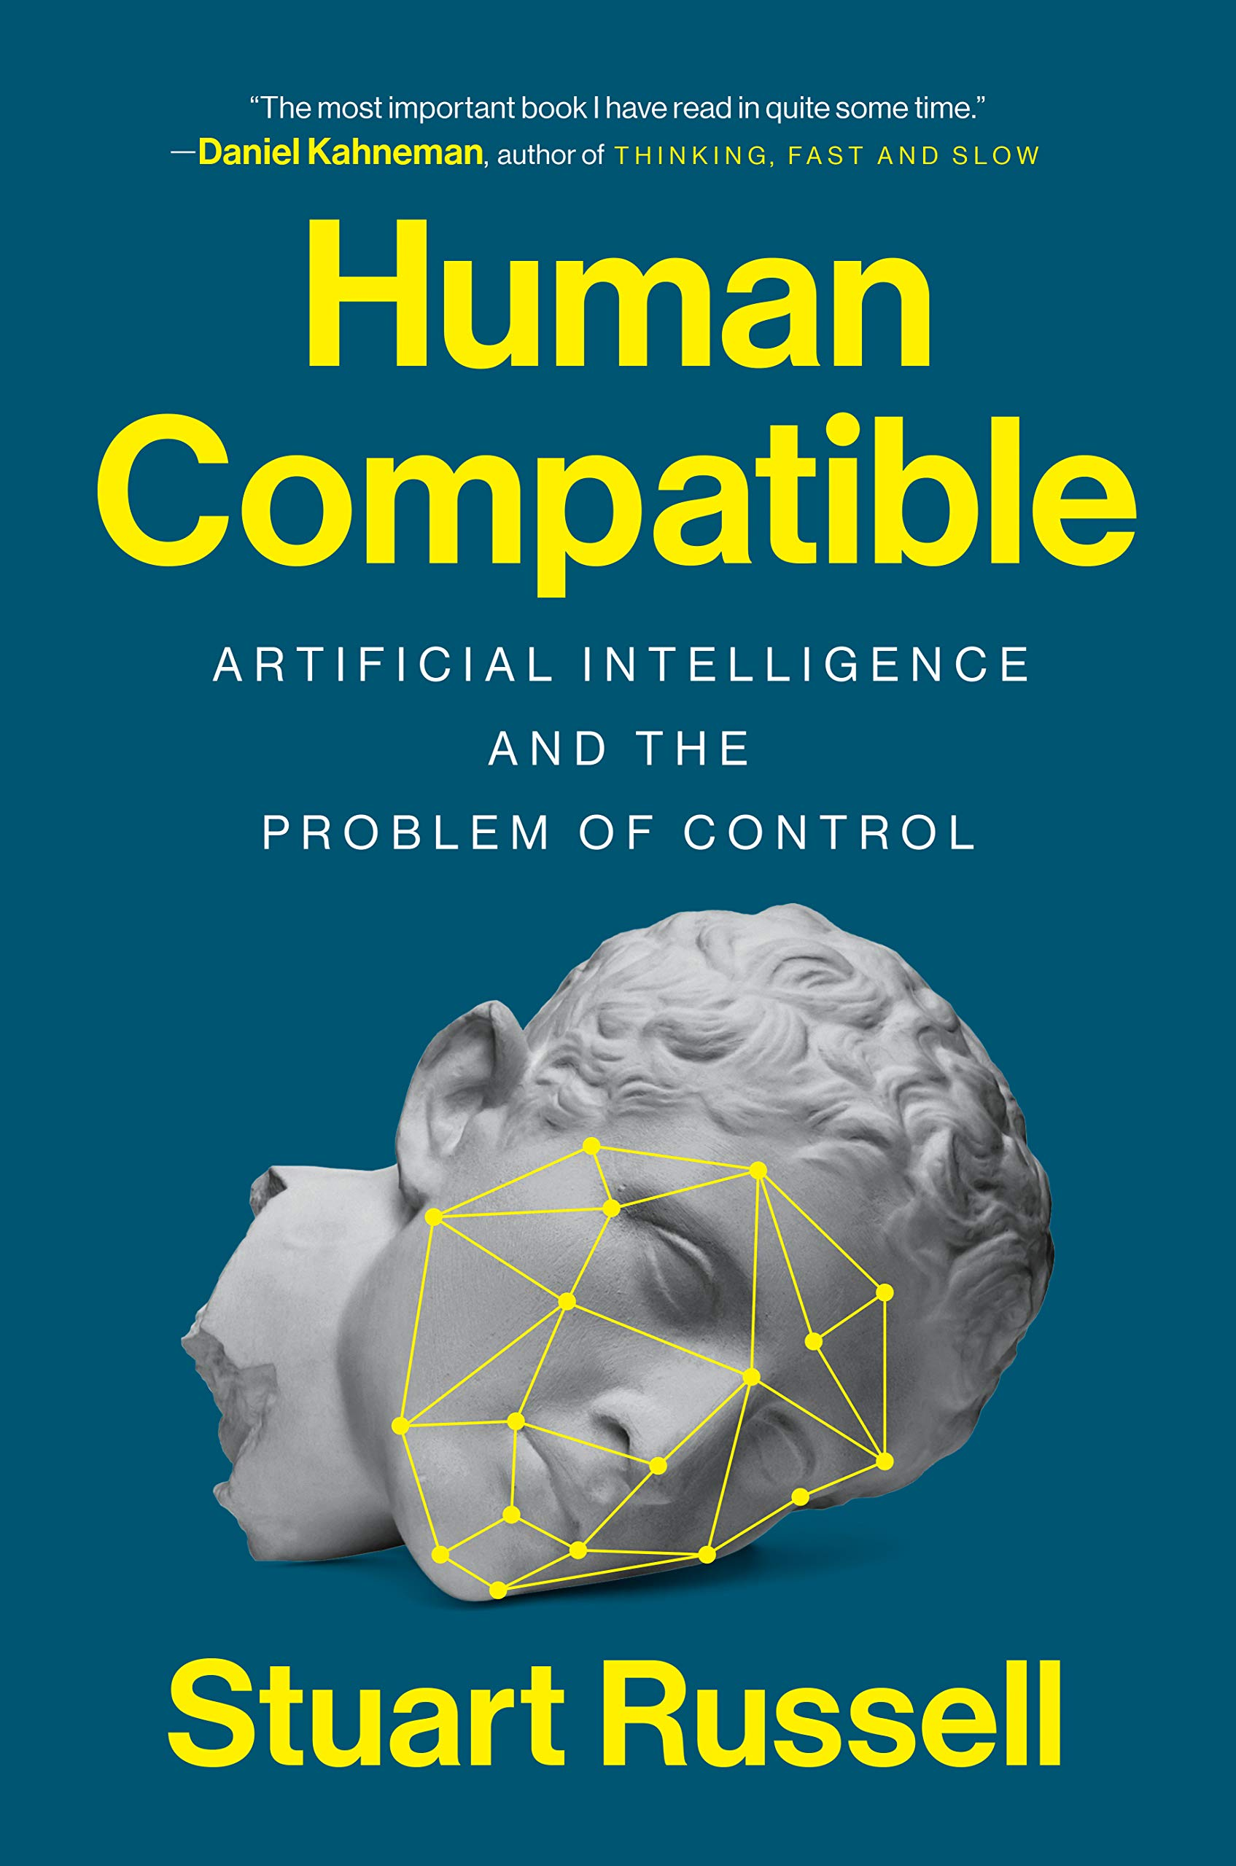
Literature

Slide 8
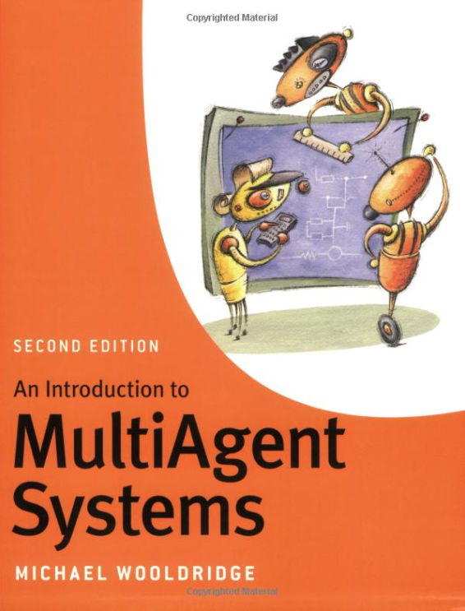
Literature

Slide 9
Literature

Slide 10
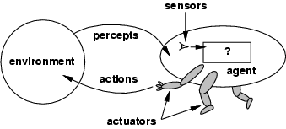
What is an Agent?
Anything that can be viewed as perceiving its environment through sensors and acting upon that environment through actuators [AIMA-Def]
Human agent eyes, ears, and other organs for sensors; hands, legs, mouth, and other body parts for actuators
Robotic agent cameras and infrared range finders for sensors; various motors for actuators
Software agent interfaces, data integration, interpretation, data manipulation/output
Sensors
Percepts
?
Environment
Agent
Actions
Actuators

Slide 11
Abstractions: Agents and Environments
The agent function maps from percept histories to actions:
[f: P* → A]
The agent program runs on a physical architecture to produce f
Agent = architecture + program
Sensors
Percepts
?
Environment
Agent
Actions
Actuators
Really insist on functional behavior?

Slide 12
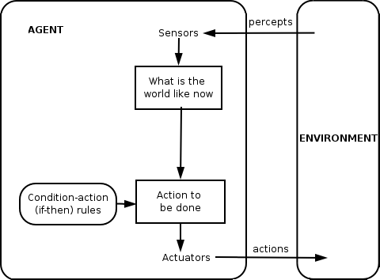
Reactive vs. Goal-based Agents

Slide 13
Reactive vs. Goal-based Agents
Agent Perception (Language and Vision)
Agent Planning, Causality, Reinforcement Learning

Slide 14
Balancing Reactive and Goal-Oriented Behavior
We want our agents to be reactive, responding to changing conditions in an appropriate fashion (e.g., timely)
We want our agents to systematically work towards long-term goals
These two considerations can be at odds with one another
Designing an agent that can balance the two remains an open research problem
Achieve maximum freedom of action if there is no specific short-term goal (e.g., keep batteries charged)

Slide 15
Social Ability
The real world is a multi-agent environment: we cannot try achieving goals without taking others into account
Some goals can only be achieved with the cooperation of others
Social ability in agents is the ability to interact with other agents (and possibly humans) via some kind of agent-communication language … -> Agent Perception (Language and Vision)
... with the goal to let other agents to make commitments (of others) or reinforcements (about its own behavior)
Need to represent and reason about beliefs about other agents -> Agents, Mechanism, and Collaboration

Slide 16
Rational Agents
Rational Agent: For each possible percept sequence, a rational agent
should select an action
that is expected to maximize its local performance measure,
given the evidence provided by the percept sequence and
whatever built-in knowledge the agent has
Rational = Intelligent ?
There is more to intelligence than to meet rationality

Slide 17
Autonomous Agents
Rationality is distinct from omniscience (all-knowing with infinite knowledge)
Computing the best action usually intractable
Rationality is bounded
Agents can perform actions in order to modify future percepts so as to obtain useful information (information gathering, exploration)
An agent is autonomous if its behavior is determined by its own "experience" (with ability to learn and adapt)
What matters for the "experience" is the
percept sequence (which the agents can determine), the
state representation, and the
"computational success" of computing the best action as well as learning and adapting for the future

Slide 18
Human-compatible Behavior
Agents act on behalf of humans, whose goals the agents have to fufill (this is the single goal of agents)
Agent should consider its initial goals to be uncertain
Agent should be able to prove their behavior is beneficial to humans
Artificial intelligence, agents, and ethics
Agents (and their designer) must act in an ethical way Developers should be able to prove … … that agents are able to prove … that they (the agents) act in an ethical way
Simple technology assessment is not enough
And yes, there are formal ethics, there is deontic logic, ...

Slide 19
Human-aware Behavior
Agents interact with humans
Selected actions must match human expectations
Maybe the presumably expected action might not be the best (for the human or the agent, or both)
Selected actions that are assumed to not match human expectations must be explained

Slide 20
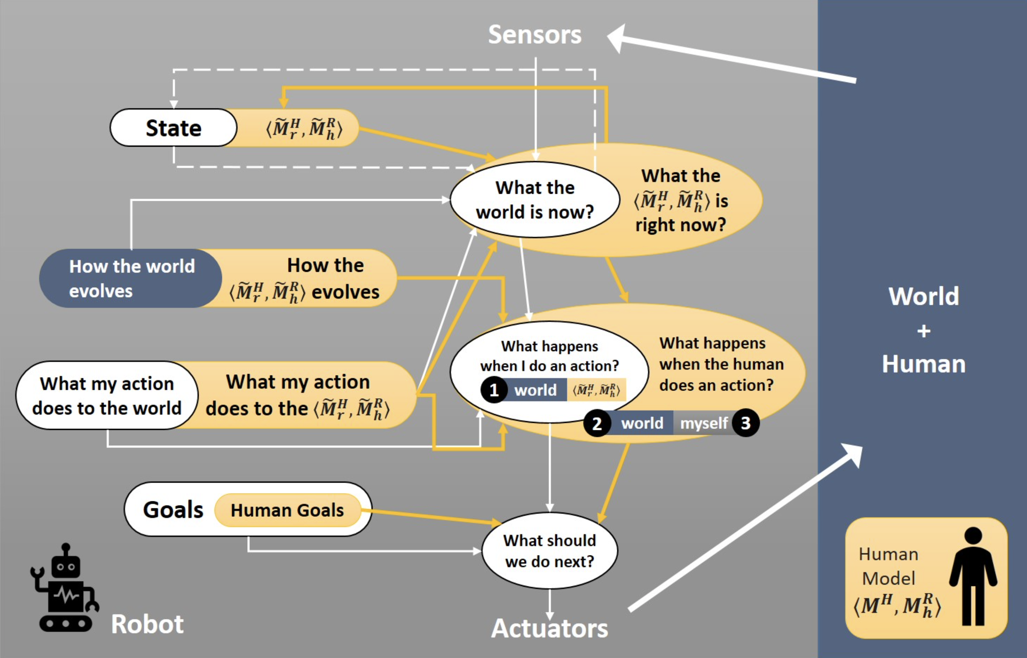
Agent Model vs. Human Model
Agents, Mechanism, and Collaboration (lecture)
Challenges of Human-Aware AI Systems: Subbarao Kambhampati

Slide 21
Learning Agents (Online)
Ever extended percept sequence (incl. more or less explicitly encoded reinforcement feedback or rewards) is …
… sparse (no big data), but gives rise to model updates
… with the aim to better (faster) achieve goals
We say: Agents learn (and we mean: while acting, or online)
Optimize a performance measure
Setting up agents’ online learning engines
Dedicated knowledge about online learning required
Setting up an agent’s initial model by exploiting data:
Dedicated knowledge of machine learning required
Also basically optimizing a performance measure

Slide 22
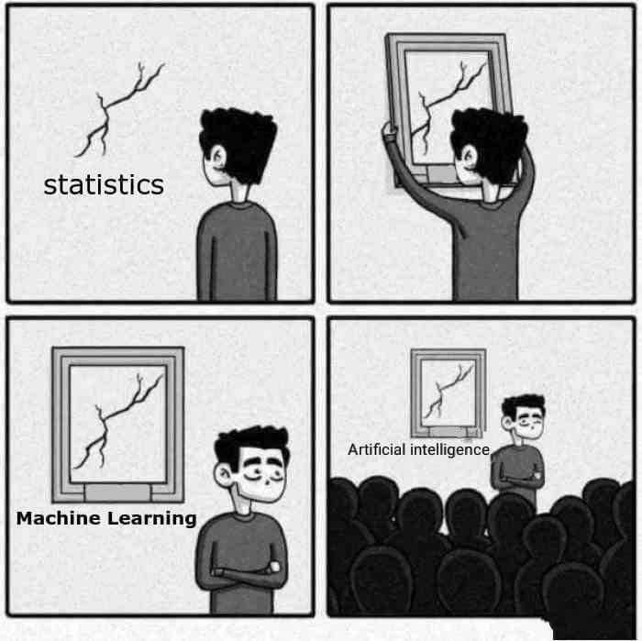
Machine Learning (ML): Offline
Machine learning scales, but can only do so much
All fields have evolved and still do evolve
“When you’re fundraising, it’s AI. When you’re hiring, it’s ML. When you’re implementing, it’s logistic regression.”
It is clear that claiming AI is machine learning or “contains” machine learning does not make much sense!

Slide 23
Reactive vs. Goal-based Agents

Slide 24
Misunderstandings
Applying ML to implement a function f some people say: “I have used ML technique X to create an AI”
Unconsciously, AI is used as a synonym for agent, but … … mostly a very simple one
f : P → A
Claiming that f is “an AI” is an indication of lack of understanding …
… even if the last n percepts are considered
f : P × …× P → A
One is lost w/o an understanding of intelligent agents
f : P* → A

Slide 25
Frame Agents
Assume that machine learning techniques are used to build models at agent setup time
Runtime behavior of agent always depends on last n elements of percept sequence only f : P × …× P → A
No interaction w/ environment, no feedback
Agent is fake (simply a frame around standard SW/HW)
Also holds when setup training data is camouflaged as initial percepts (but no actions towards goals are computed until training completed)
Maybe even enlightening for practical applications, but agent idea …
… does not show its full potential

Slide 26
Learning-based Software Development
There is no need to deliberately conflate machine learning with agents and AI !
No need to invent frame agents !
Can build extremely cool SW/HW w/ machine learning techniques (e.g., for industrial image processing applications)
→ Probabilistic Differential Programming (CS5071-KP04)
→ Deep Learning Lab (CS5071-KP04)
There are caveats, however:

Slide 27
Issues

Slide 28
Back to the Future: Human-guided Learning
Develop machine learning techniques that achieve good performace w/o too much training material
Exploit human capabilities
Artificial agents and human agents cooperate
Machine learning becomes agent online learning
Motivation for studying agents!
Machine learning cannot go w/o agents in the future
Agents allow for more or less learning (incl. no learning)
Next: Proper agent with no learning

Slide 29
Proper Agent: An Example

Slide 30
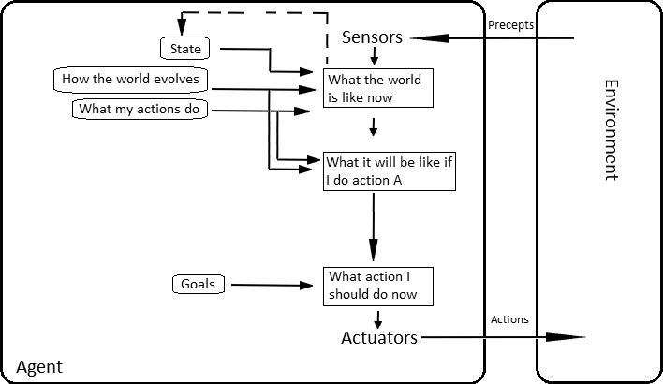
Proper Agent: An Example
Given:
Current state of the environment
Description of goal state
Set of action descriptions
Find sequence of actions (a plan) for transforming current state into goal state
Select first action, and hope that plan can be completed

Slide 31
STRIPS Formalism
States modeled as set of ground atoms (database)
Current state as well as goal state
Example: Blocks World
On_Table(A), On_Table(B), On_Table(C)
On_Block(C, B), On_Block(B, A)
Historical & name convention note
Nowadays STRIPS = representation language FOL
Part of PDDL (planning domain definition language)
Originally, STRIPS also denoted (linear, non-complete) hill-climbing style algorithm
We consider a different algorithm here based on partial order plans
STRIPS = Stanford Research Institute Problem Solver (1971)

Slide 32
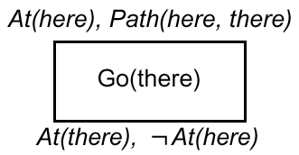
STRIPS Planning Operators

Slide 33
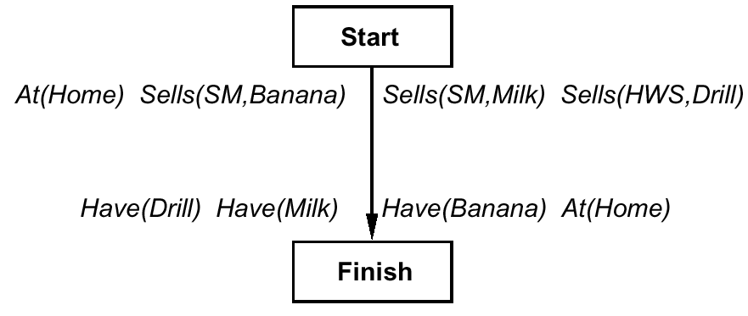
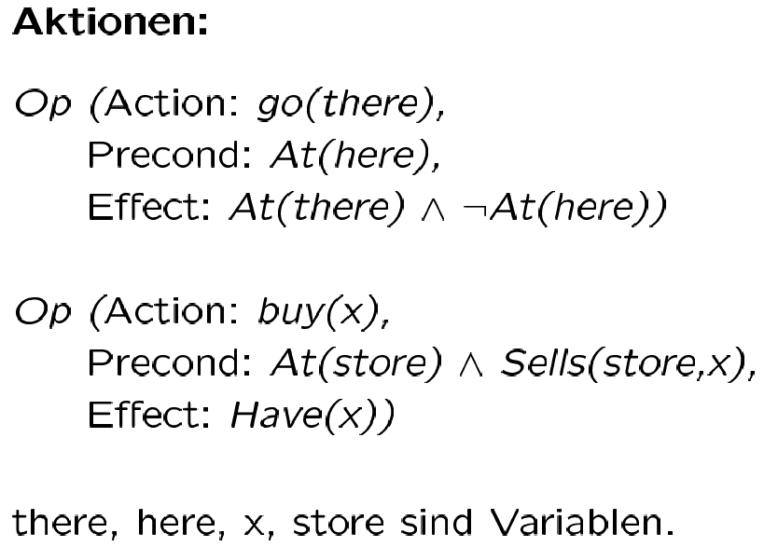
Initial Plan
Action(Type)s:
are variables

Slide 34
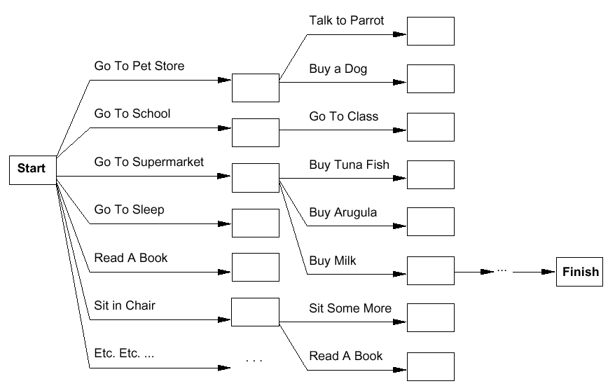
Planning as („Lifted“) Search
Forward
Backward

Slide 35
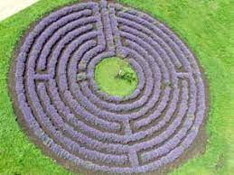
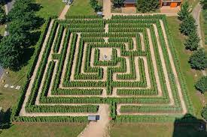
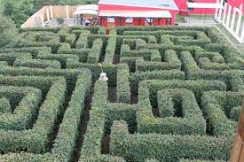
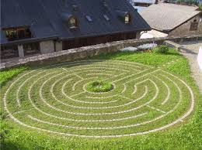
Classical Search vs. Planning
Problem solving by search
Problem = single state space
Program search algorithm
Problem solving by planning
Specify problem declaratively
Solve by general planning algorithm
E.g.: instead of go-to-SM1, go-to-HW
rather go(place)

Slide 36
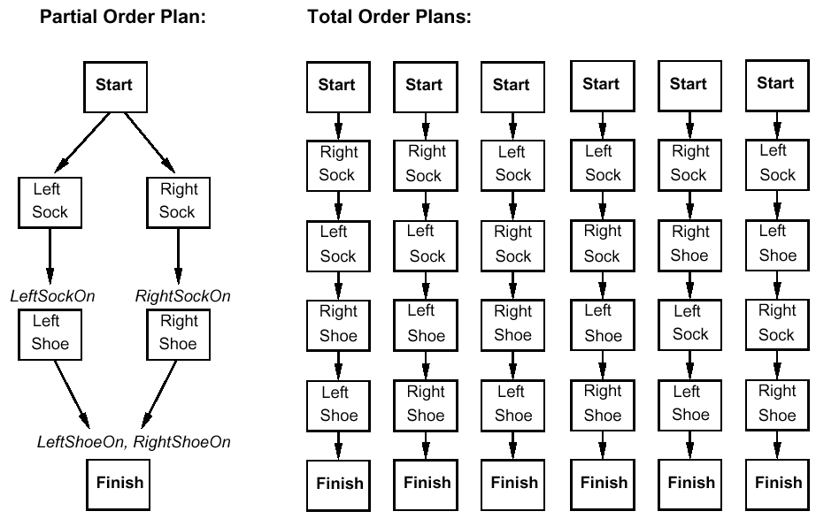
Plan = (Linear) sequence of Actions?
Apply principle of Least Commitment

Slide 37
Representation of Partial-Order Plans
Plan step = STRIPS Operator
Plan consists of
Plan steps with partial order (<), where S_{i} < S_{j} iff S_{i} is to be executed before S_{j}
Set of variable assignments x = t , where x is a variable and t is a constant or variable
Set of causal relations: S_{i} →^{c} S_{j} means S_{i} creates the precondition c of S_{j} (entails S_{i} < S_{j})
Solutions to planning problems … … must satisfy certain conditions
STRIPS = Stanford Research Institute Problem Solver (1971)

Slide 38
Completeness and Consistency
Complete plan
Every precondition of a step is fulfilled
∀S_{j} with c ∈ Precond(S_{j}),
∃S_{i} s.t. S_{i} < S_{j} and c ∈ Effects(S_{i}), and
for every linearization it holds that:
∀S_{k} with S_{i} < S_{k} < S_{j} , ¬c ∉ Effects(S_{k})
Consistent plan
If S_{i} < S_{j} , then S_{j} ≮ S_{i} and
If x = A, then x ≠ B for different A and B for variable x (Unique Names Assumption)
Solution of the planning problem: complete and consistent plan

Slide 39
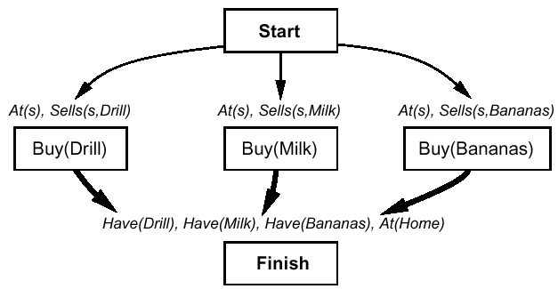
Plan Refinement (1)
Backward planning
Thin arrows = <
Fat arrows = causal relation + <

Slide 40
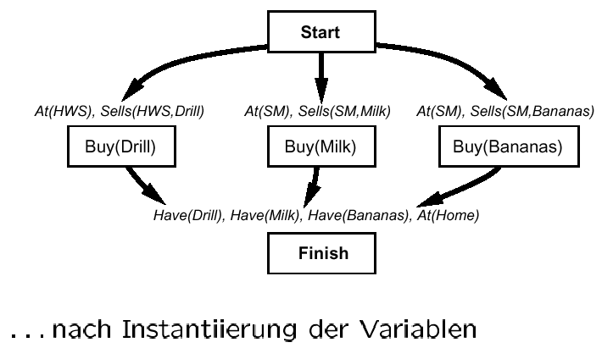
Plan Refinement (1)
after variable instantiation

Slide 41
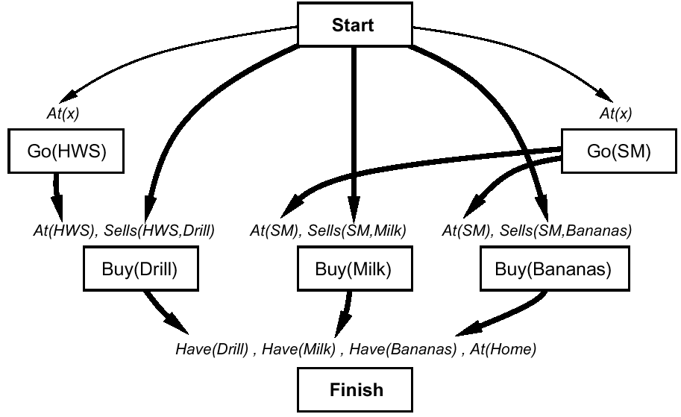
Plan Refinement (2)
... buy at the right store

Slide 42
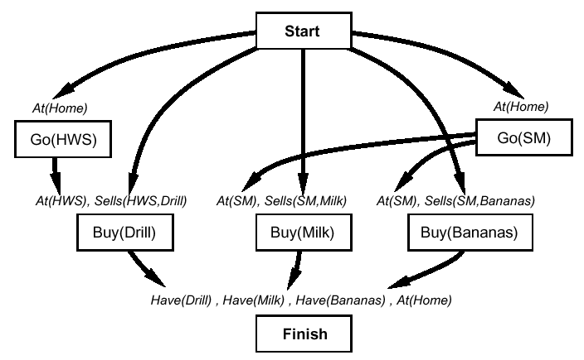
Plan Refinement (3)
... but you must get there

Slide 43
Plan Refinement (3)
Note: Up to now no search, but simple „backward chaining“
Now: Conflict! After go(HWS) is executed, At(Home) no longer holds (similarly for go(SM))

Slide 44
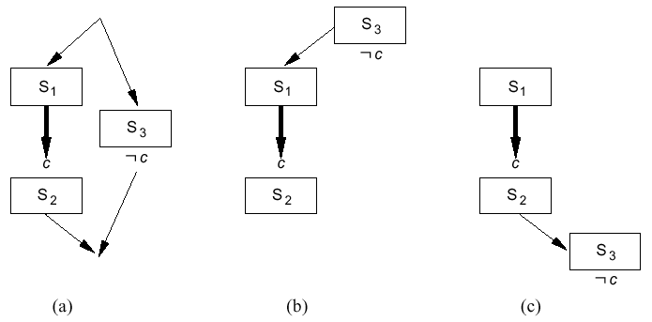
Protection of Causal Relations

Slide 45
Protection of Causal Relations
Conflict:
S3 “threatens“ causal relation between S1 and S2
Conflict resolution:
Promotion: Put threat before causal relation ( b )
Demotion: Put threat after causal relation ( c )
=> Dedicated lectures on causality in part Agent Planning, Causality, and Reinforcement Learning

Slide 46
Another Plan Refinement …
Assumption: Cannot resolve conflict by protection
Made a wrong step during plan refinement
Alternative
Select x = HWS (with causal relation) while instantiating At(x) in go(SM)

Slide 47
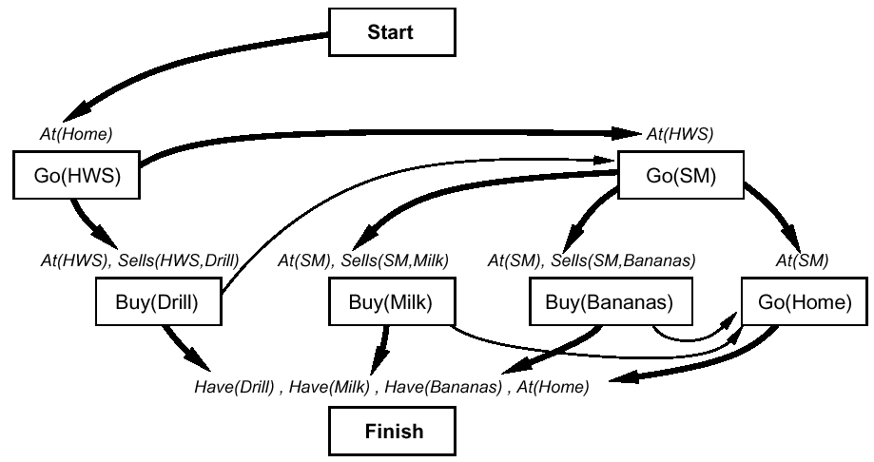
Another Plan Refinement …

Slide 48
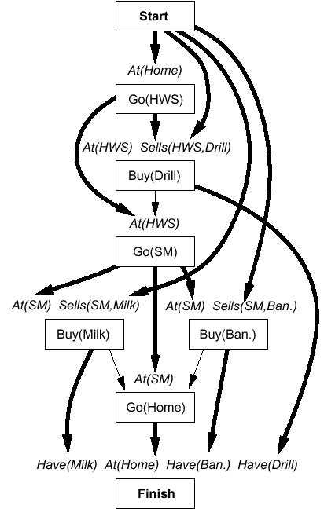
The Complete Solution …
… with all links
Computation by so-called POP Algorithm
Complete
… and correct
Additionally, not considered here, correct treatment of variables

Slide 50
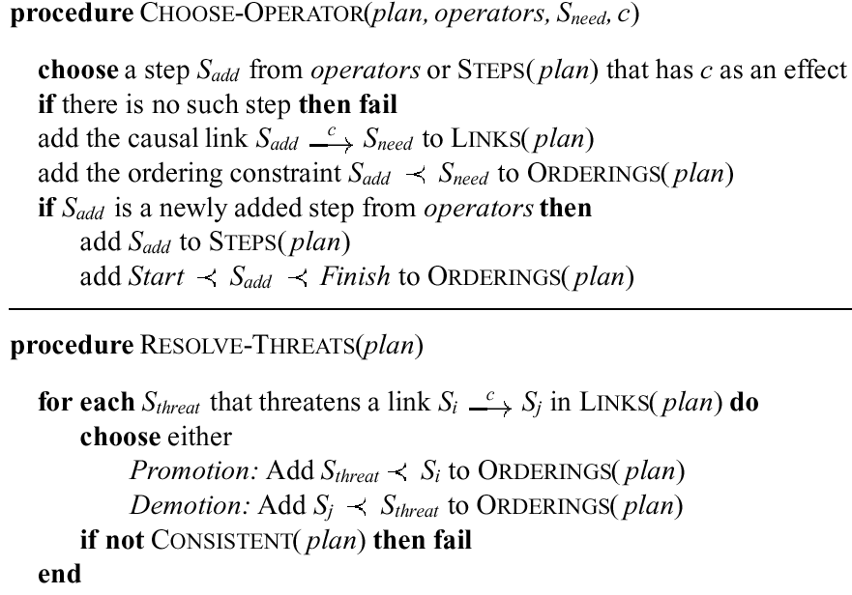

Slide 51
Last Century Planning Systems (Last Decade!)
UCPOP (Weld, UW) (http://www.cs.washington.edu/ai/ucpop.html )
Sensory Graphplan (Weld, Blum, and Furst: UW) (http://aiweb.cs.washington.edu/ai/sgp.html )
IPP (Köhler and Nebel: Univ. Freiburg) (https://idw-online.de/de/news5468)
Prodigy: Planning and Learning (Veloso: CMU) (http://www-2.cs.cmu.edu/afs/cs.cmu.edu/project/prodigy/Web/prodigy-home.html )
All systems have found interesting applications

Slide 52
Planning is an Active Field of Research
More powerful successors
Systems learn how to plan fast for specific problem instances
Can deal with uncertainty
About state estimation
About effects of actions
Very powerful problem solvers can be set up …
w/ less effort/knowledge than with mathematical optimization theory and respective tools
→ Lecture Agent Planning, Causality, and Reinforcement Learning of this module
(→ Automated Planning and Acting (CS5072-KP04) ( https://www.ifis.uni-luebeck.de/index.php?id=dski-aktuell-ss20&L=2 ))

Slide 53
Round-Up
Rational agents that:
Act autonomously and are persistent
Achieve goals surprisingly fast (despite bounded rationality)
Learn how to behave in a clever way (even learn computational strategies)
Can adapt their goals to anticipate humans needs and expectations
Human compatibility, human awareness
Can learn new models online to
Keep high performance over time
Support human-guided machine learning

