Slide 1
Subgraph Isomorphism w.r.t. Axioms for Defining Semantic Relations on Edge and Node Labels
Ralf Möller
Universität zu Lübeck
Institut für Informationssysteme

Slide 2
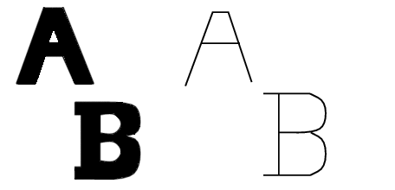
OCR- Motivation for Graphical Matching
Segmentation-> Thinning-> Graphical modeling:
Iddo Aviram, Optical Character Recognition: Using the Ullmann Algorithm for Graphical Matching

Slide 3
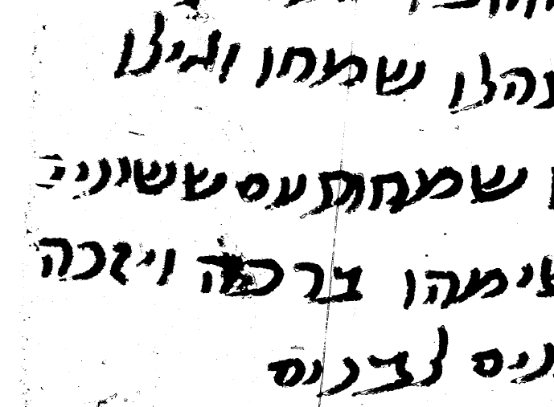
OCR- Motivation for Graphical Matching
By sub-graph matching we can find candidates:
Graphical modeling
Graphical matching
Iddo Aviram, Optical Character Recognition: Using the Ullmann Algorithm for Graphical Matching

Slide 4
Recap: Ullmann's Algorithm
J. R. Ullmann, An Algorithm for Subgraph Isomorphism, Journal of the ACM, 1976
Construction of a matrix M⁽⁰⁾ for matching possibilities:
Generation of all M’-s by setting to 0 all but one 1 in each row of M⁽⁰⁾
A subgraph isomorphism has been found if for M' it holds that: .
Iddo Aviram, Optical Character Recognition: Using the Ullmann Algorithm for Graphical Matching

Slide 5
Search Space: Ullmann's Algorithm
Root - M⁽⁰⁾
Inner Nodes – M-s
Leaves – M’-s
Iddo Aviram, Optical Character Recognition: Using the Ullmann Algorithm for Graphical Matching

Slide 6
Query answering A(x), S(x, y), B(y)
A
C
Subgraph isomorphism w.r.t. labeled graphs
S
A
R
j
S
B
i

Slide 7
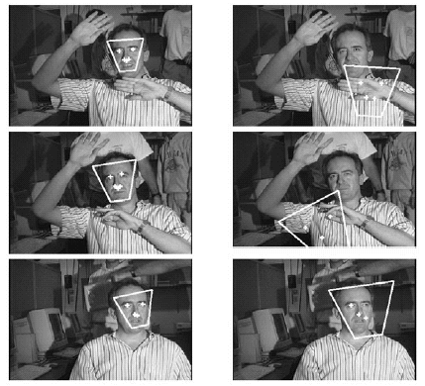
Can We Benefit From Labels?
Figure from, “Finding faces in cluttered scenes using random labelled graph matching,” by Leung, T. ;Burl, M and Perona, P., Proc. Int. Conf. on Computer Vision, 1995 copyright 1995, IEEE

Slide 8
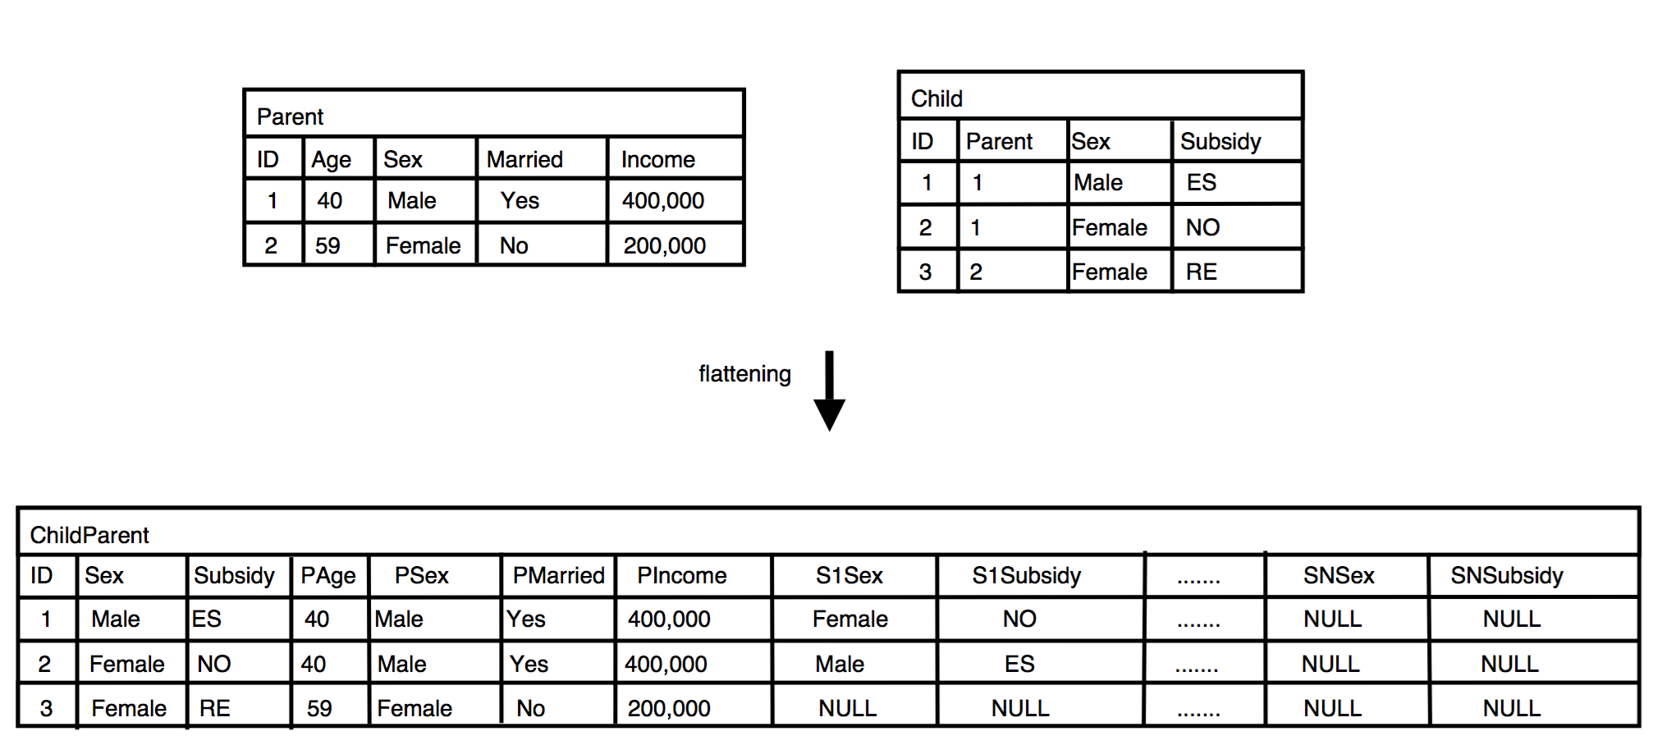
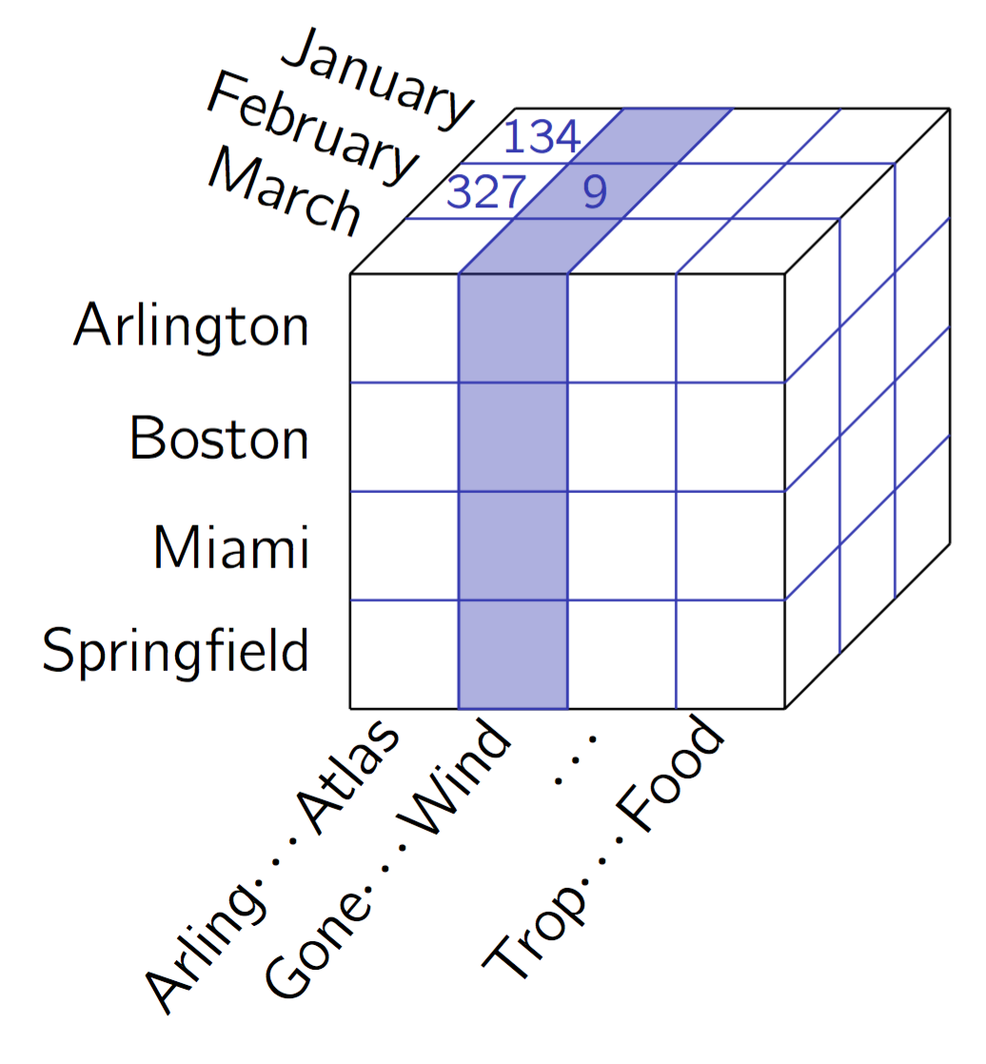
Relations or Just Feature Vectors?
Machine learning can go wrong with skewed data
Join for data integration
Redundancies! Frequency counting for maximum likelihood learning??

Slide 9
∀x. A(x) ⟶ B(x)
∀x,y. S(x,y) ⟶ R(x,y)
A
B
C
Query answering
B(x), R(x, y), B(y)
R
S
B
A
R
Subgraph isomorphism
w.r.t. labeled graphs and axioms
R
j
S
B
i

Slide 10
Graph QA w.r.t. Set of First-Order Logic Axioms
Syntactic restrictions to ensure decidability and/or "good" computational properties for standard decision problems
Example
Description logics (DLs)
Axiom set: Tbox (Terminology)
Labeled graph: Abox (Assertions)
Answering conjunctive queries (CQs)
For the sort of axioms discussed above
CQ answering w.r.t. DL Lite axioms is reducible to SQL query answering (PSPACE hard): "practical scalability"
Labeled subgraph isomorphism reducible to SQL QA?

Slide 11
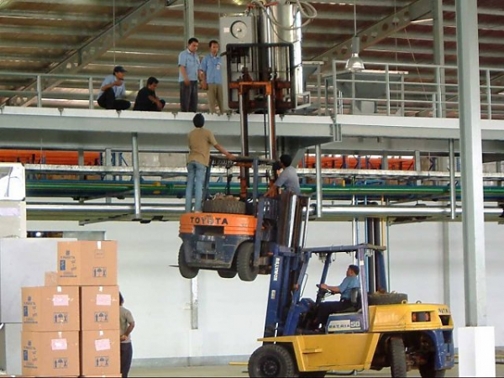
Subgraph isomorphism reduced to SQL?
SQL
Subgraph Isomorphism

Slide 12
High-Level Relational Matching
Subgraph isomorphism w.r.t. labeled graphs and axioms
Pattern: labeled graph
Query answering over labeled graphs w.r.t. axioms
Pattern: conjunctive query
Not always is it possible to match the complete pattern
Occlusion
Distortion due to noise
…

Slide 13
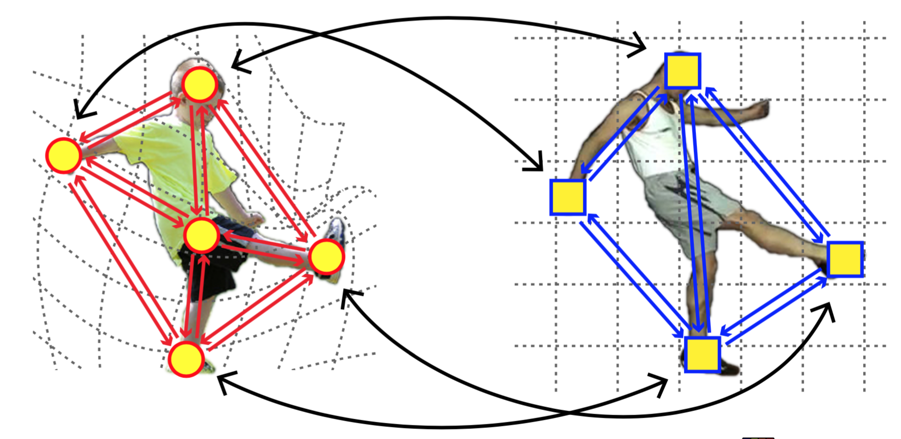
Partial Matching
Pattern
Data

Slide 14
High-Level Relational Matching
Subgraph isomorphism w.r.t. labeled graphs and axioms
Pattern: labeled graph
Query answering over labeled graphs w.r.t. axioms
Pattern: conjunctive query
Not always is it possible to match the complete pattern
"Partial subgraph isomorphism"
Abductive query answering
Provide instantiated conjuncts that do not match

Slide 15
∀x. A(x) ⟶ B(x)
∀x,y. S(x,y) ⟶ R(x,y)
A
B
C
Query answering
B(x), R(x, y), C(y)
R
S
B
→ x=i, y=j, assume C(j)
A
R
R
j
S
B
i

Slide 16
Abductive query answering
⟵

Slide 17
Partial Subgraph Isomorphism
See as "semantic" graph difference
Given two labeled graphs A, B, and a set of axioms T
Which minimal set 𝛥_{A,B} of "parts" of A must be added to B such that A is an isomorphic subgraph of B w.r.t. the axiom set T (side condition: B ∪ 𝛥_{A,B} is consistent)?
A: pattern graph that is partially subgraph-matched
B: data graph
Different view: Abox difference w.r.t. Tbox

Slide 18
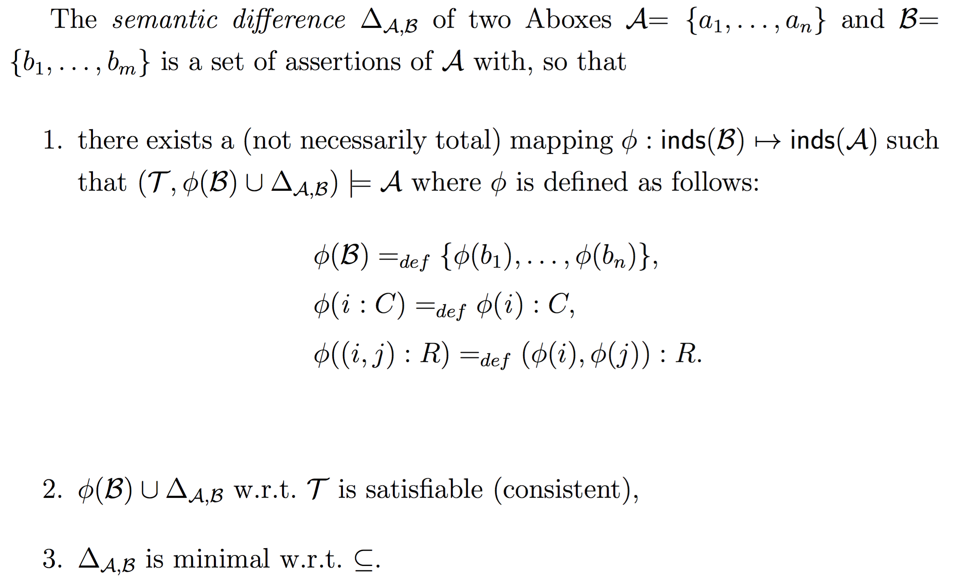
Abox difference w.r.t. Tbox

Slide 19
Abox difference reduced to Abductive QA
Treat A as a query and B as the queried Abox
Compute difference by abductive query answering
Way too slow for CV!??

Slide 20
Fight against complexity predator
who is gonna kill cool ideas
Stay calm, stick together, move a little

Slide 21
Depth-first abductive query evaluation

Slide 22
Score for comparing solutions

Slide 23
Illustration of partial scores

Slide 24
More formally
query)

Slide 25
Score-based cutoff

Slide 26
How effective is this?

Slide 27
New ideas: Ullmann's Algorithm revisited
≤
∈
Prune because we maximize score!

Slide 28
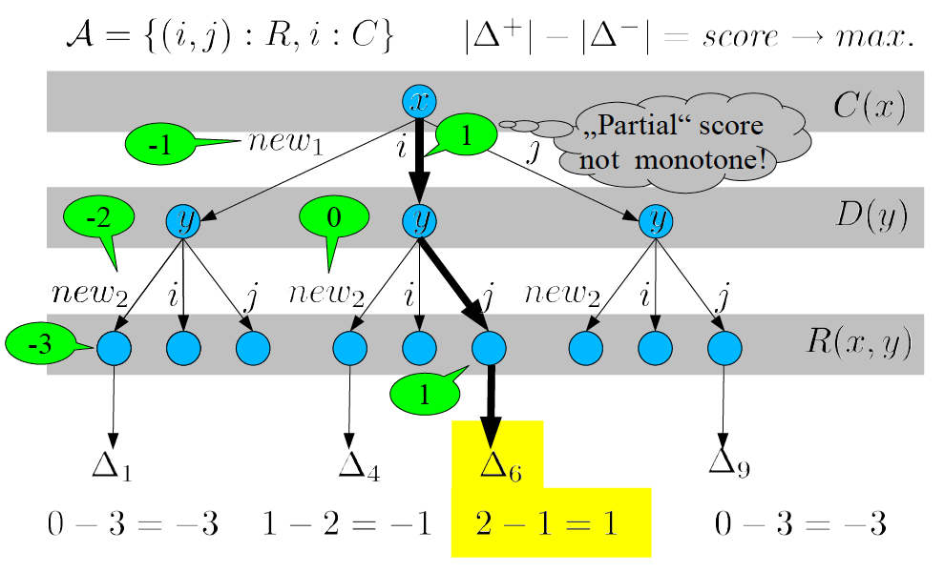
Further pruning possibilities
Prune because we maximize score!

Slide 29
Take home messages
Abductive QA for expressive relational matching
Integrate subgraph isomorphism algorithms for speed
Contact
Prof. Dr. rer. nat. Ralf Möller
Institute for Information Systems
Universität zu Lübeck
Ratzeburger Allee 160
Haus 64
23562 Lübeck
Tel: +49 451 3101 5700
moeller@uni-luebeck.de

