Slide 1
Semantic Web and Enterprise Systems Semantic Integration and Interpretation
Ralf Möller, Christian Neuenstadt, Özgür Özçep Institut für Informationssysteme, Universität zu Lübeck
Funded by European Commission with FP7 Projekt Optique optique-project.eu

Slide 2
Application: Business Intelligence
Acquisition and transformation of raw data into meaningful and useful information for business analysis purposes
Relevant also for, e.g., control room operators
who expect a shutdown of a machine
Compare actual sensor data with previous data to check out similar situations

Slide 3
Business Intelligence
Acquisition and transformation of raw data into meaningful and useful information for business analysis purposes
Additional analyses might indicate the time left to react appropriately

Slide 4
Business Intelligence: Operational and Strategic Issues
Real-time data processing in combination with comparisons to historical data
Data integration
Deal with possibly large datasets in the context of real-time data processing
Data interpretation for model acquisition

Slide 5
Data Integration Insights / Hypotheses
Canonical data model unlikely to be realistic
Must find and integrate data dynamically
Must interpret data according to application needs
These days, most data associated with time tags
System time
Valid time

Slide 6
Data Integration
Data Stream Processing
Real-time data processing
Continuous queries
Temporal data processing
Historical queries

Slide 7
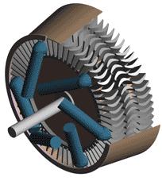
Optique: Window-based Data Processing
Application problem
We want to find similarity on measurements of two sensors, both measuring temperature on a Siemens turbine
Solution
We'd like to calculate the Pearson correlation coefficient between the two measurements, within a certain time window
Window
Similarity
01010101010101010010101010111110011010100101010101010101010101010101101010101101010100101010101010101001010101011111001101010010101010101010101010101010110101010110101010
010101010101010100101010101111100110101001010101010101010101010101011010101011010101001010101010101010010101010111110011010100101111001010101010101010101010110101010110101
0.7,0.8,0.3,0.9,0.4,0.6,0.5,0.9,0.4,0.9,0.3,-0.1,0.8
Notes:
Suppose that we have two sensors taking temperature measurements from a single Siemens turbine
-One interesting problem is to find if the two sensor readings are in accord
-To do this we create a window based on the last measurements and we calculate the similarity based on the Pearson correlation or the cosine distance

Slide 8
Optique: The Siemens Scenario
What happens when we want to compute all possible correlations between more than two sensors?
For 3 streams we need to compute 3 correlations per window
Similarity
01010101010101010010101010111110011010100101010101010101010101010101101010101101010100101010101010101001010101011111001101010010101010101010101010101010110101010110101010
010101010101010100101010101111100110101001010101010101010101010101011010101011010101001010101010101010010101010111110011010100101111001010101010101010101010110101010110101
010101010101010100101010101111100110101001010101010101010101010101011010101011010101001010101010101010010101010111110011010100101111001010101010101010101010110101010110101
0.7,0.8,0.3,0.9,0.4,0.6,0.5,0.9,0.4,0.9,0.3,-0.1,0.8
0.7,0.8,0.3,0.9,0.4,0.6,0.5,0.9,0.4,0.9,0.3,-0.1,0.8
0.6,0.5,-0.30.7,0.8,0.3,0.9,0.4,0.6,0.5,0.9,0.4,0.9
Notes:
The main question is what we can do when we have to find similarity between more than one streams arriving from multiple sensors located in the same or different turbines

Slide 9
Optique: Dealing with Many Streams
What happens when we want to compute all possible correlations between more than two sensors?
For 3 streams we need to compute 3 correlations per window
For 6 streams we need to compute 15 correlations per window
For 100 streams we need to compute 4950 correlations …
Use approximation techniques (e.g., locality sensitive hashing)
01010101010101010010101010111110011010100101010101010101010101010101101010101101010100101010101010101001010101011111001101010010101010101010101010101010110101010110101010
010101010101010100101010101111100110101001010101010101010101010101011010101011010101001010101010101010010101010111110011010100101111001010101010101010101010110101010110101
010101010101010100101010101111100110101001010101010101010101010101011010101011010101001010101010101010010101010111110011010100101111001010101010101010101010110101010110101
01010101010101010010101010111110011010100101010101010101010101010101101010101101010100101010101010101001010101011111001101010010101010101010101010101010110101010110101010
010101010101010100101010101111100110101001010101010101010101010101011010101011010101001010101010101010010101010111110011010100101111001010101010101010101010110101010110101
010101010101010100101010101111100110101001010101010101010101010101011010101011010101001010101010101010010101010111110011010100101111001010101010101010101010110101010110101
0.7,0.8,0.3,0.9,0.4,0.6,0.5,0.9,0.4,0.9,0.3,-0.1,0.8
0.7,0.8,0.3,0.9,0.4,0.6,0.5,0.9,0.4,0.9,0.3,-0.1,0.8
……………………………………………………………………….
……………………………………………………………………….
……………………………………………………………………….
0.6,0.5,-0.30.7,0.8,0.3,0.9,0.4,0.6,0.5,0.9,0.4,0.9
Similarity
Notes:
For 3 streams we need to compute 3 correlations per window
For 6 streams we need to compute 15 correlations per window
For 100 streams we need to compute 4950 correlations …
The number of correlations grows quadratically with the number of streams

Slide 10
Example: Stream(s) of Sensor Data

Slide 11
Describing Measurement Data Semantic Sensor Network Ontology
Semantic Sensor Network XG Final Report, W3C Incubator Group Report 28 June 2011

Slide 12
Mappings for Data Integration Relational Data Descriptions
Information need for
historical data (temporal query) with period of interest
reactive diagnosis
streamed data (continuous query)
proactive diagnosis
Goal: Use the same query language
For historical queries, windows can be processed in parallel with no real-time constraints
GAV Mapping

Slide 13
Optique: Relational Data Descriptions Ontology-based Data Access Query Answering w.r.t. Axioms

Slide 14
OBDA for Streams: State Sequences from Window Data

Slide 15
Windows over Multiple Streams

Slide 16
Static Data Added to Each State
mini bag (only virtually)

Slide 17
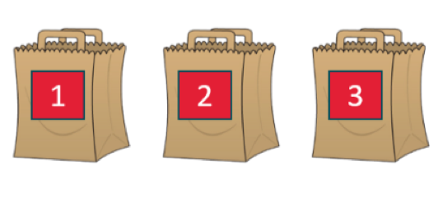
For Presentation Purposes: Simple Conceptual View on Data

Slide 18
Ontology Based Data Access
I use standardized domain ontology! No need to care about specific data representations ☺

Slide 19
Ontology Based Data Access
Generators with a turbine fault?
@t

Slide 20
Ontology Based Data Access
@t

Slide 21
Ontology Based Data Access
Generators with a turbine fault?
@t

Slide 22
Ontology Based Data Access
Generators with a turbine fault?
@t

Slide 23
Ontology Based Data Access
Generators with a turbine fault?
@t

Slide 24
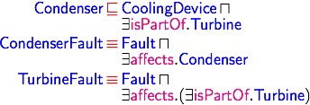
Ontology Based Data Access
Generators with a turbine fault?
@t

Slide 25
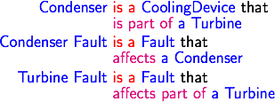
Ontology Based Data Access
Generators with a turbine fault?
@t

Slide 26
Ontology Based Data Access
Generators with a turbine fault?
@t

Slide 27
Ontology Based Data Access
Generators with a turbine fault?
@t

Slide 28
Ontology Based Data Access
Is a condenser fault a kind of turbine fault?
@t

Slide 29
Ontology Based Data Access
Is a condenser fault a kind of turbine fault?
@t

Slide 30
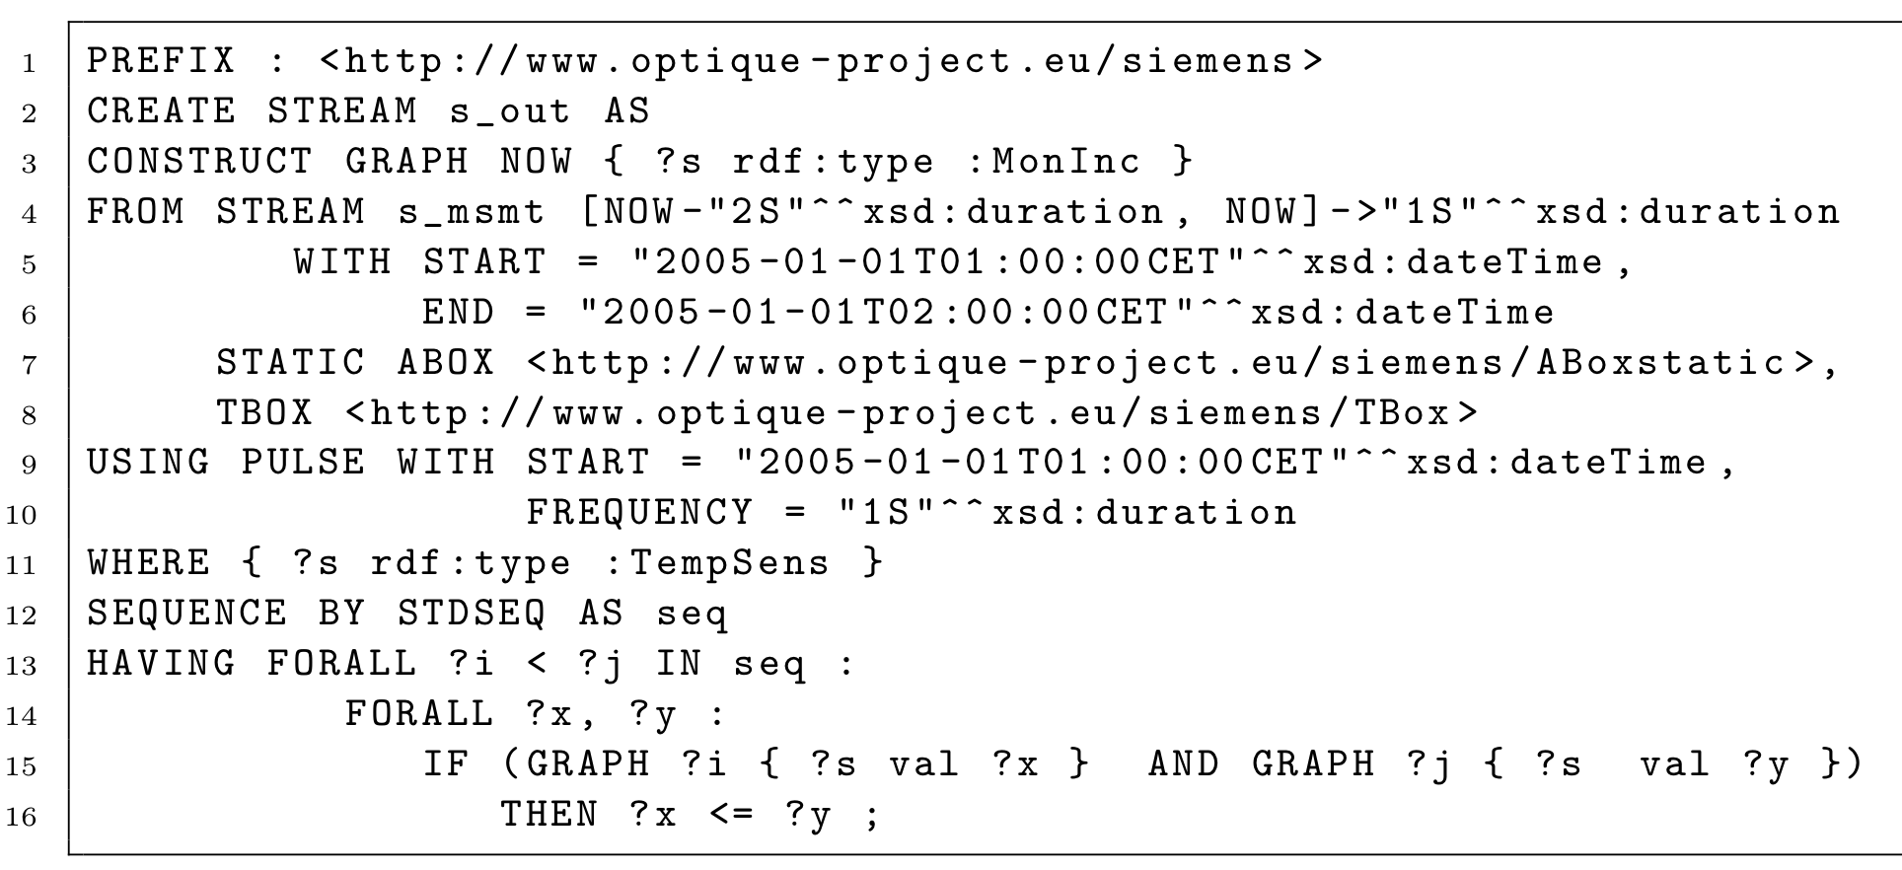
Representation in STARQL

Slide 31
Output Specification in Terms of SPARQL

Slide 32
Streams and Sequencing
s_msmt constructed from table STREAM_MEASUREMENT

Slide 33
WHERE and HAVING Extensions of SPARQL
TempSens(?s) also defined via SQL
{ ?x rdf:type :TempSens } in RDF
hasVal(?s, ?x)<?i> defined via SQL as described before
GRAPH ?i { ?s :val ?x } in RDF

Slide 34
What does the STARQL Compiler do?
For stream constructs
Generate code for relational backend data stream processing system
For local SPARQL fragments of a STARQL query
Rewrite query to capture ontology inferences (Ontop)
Establish mappings and optimize resulting query (Ontop)
Eliminate redundant joins etc. (Eliminate "Observeration" objects)
Globally optimize query
Compile away complex notions of, e.g., semantic sensor ontology
©R. Rosati
Ontop: http://ontop.inf.unibz.it

Slide 35
Backends for STARQL
SQL (PostgreSQL)
Exareme (cloud-based data management system)
Apache Spark (cluster computing)
Apache Flink (distributed stream and batch processing, soon)
With Apache Kafka or even Syslog for data collection
Data integration with mappings for each data source

Slide 36
Can we Rely on Simple Integration/Federation at the Mapping Layer???
To which data should a query refer?

Slide 37
Data integration revisited
Produces null values (⊥) in DB speak
Problem: All null values different in standard DBs
Better: Named nulls (or blank nodes in RDF)
We can have co-references
Existentials in logic
Blank nodes (or named nulls) denoted as ⊥ with subscript

Slide 38
Universal solutions
GAV Mapping

Slide 39
Universal solution (non-)existence

Slide 40
Problems and solutions
Undecidability of Universal Solution Existence Problem for general dependencies
Restrictions on expressivity of language for expressing dependencies
Leads to the definition of canonical solutions
Canonical solutions are non-unique
Want smallest solutions
Leads to definition of core solutions (cores)
Minimum skewing (cf. max entropy principle)

Slide 41
Canonical solutions: Redundancies
⊥₄

Slide 42
Cores: Smallest solutions
⊥₄
Ronald Fagin, Phokion G. Kolaitis, and Lucian Popa. 2005. Data exchange: getting to the core. ACM Trans. Database Syst. 30, 1, 174-210, 2005.
Georg Gottlob and Alan Nash. Data exchange: computing cores in polynomial time. In Proceedings of the twenty-fifth ACM SIGMOD-SIGACT-SIGART symposium on Principles of database systems (PODS '06), 2006

Slide 43
Data integration: Incomplete knowledge
Produces null values (missing data)
Algebra problematic with null values
(X and not X) for X=null?
By definition: null
What happens with nulls for answering queries?
Cores help to not introduce unwanted biases in integrated datasets
Biases (skewed data) spoil machine learning results
OBDA w.r.t. cores seems useful
Can we sensibly replace nulls in cores in order to get "plausible" answers?

Slide 44
Take-home messages
Data integration via streams: real-time and historical
Semantics of stream query language (STARQL)
OBDA for stream queries to ensure compact queries
OBDA via cores presented as a challenge
Contact
Prof. Dr. rer. nat. Ralf Möller
Institute for Information Systems
Universität zu Lübeck
Ratzeburger Allee 160 Haus 64
23562 Lübeck
Tel: +49 451 3101 5700
moeller@uni-luebeck.de

