Slide 1
Information Management for
Digital Humanities and Diplomatics
Ralf Möller
Universität zu Lübeck
Institut für Informationssysteme

Slide 2
Charters in Information Systems
Steganographic
representation

Slide 3
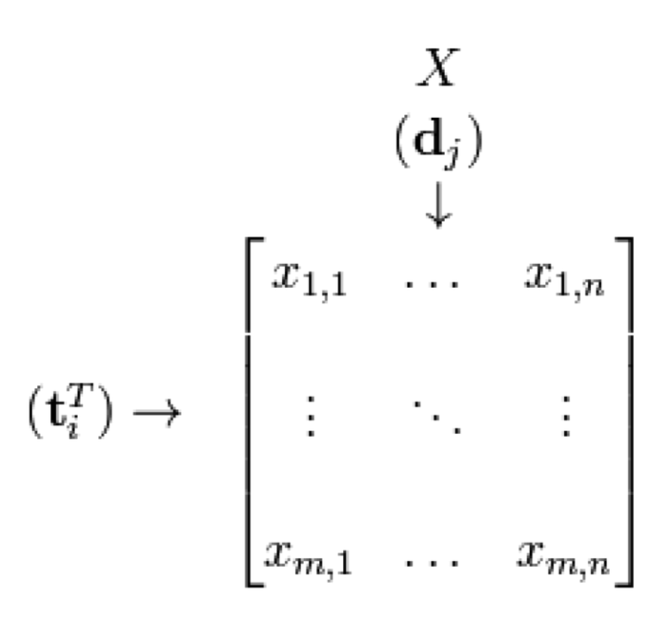
Document Representation
ring
jupiter
•••
space
voyager
car
company
•••
dodge
ford
car
company
•••
dodge
ford

Slide 4
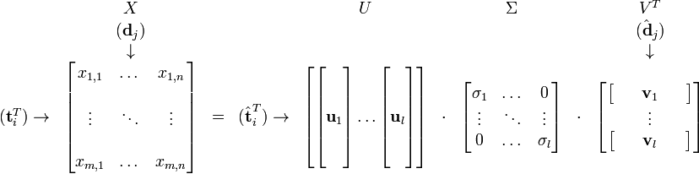
Matrix Representation
C. Eckart, G. Young, The approximation of a matrix by another of lower rank. Psychometrika, 1, 211-218, 1936

Slide 5
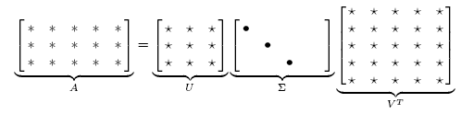
Principle Components
t ₃
d₂
set smallest r-k
singular values to zero
x₂
x₂
d₂
V_{k}^{T}
d₁
q
d₁
t ₁
x₁
x₁
t ₂
k
  Scott Deerwester, Susan Dumais, George Furnas, Thomas Landauer, Richard Harshman: Indexing by Latent Semantic Analysis. In: Journal of the American society for information science, 1990

Slide 6
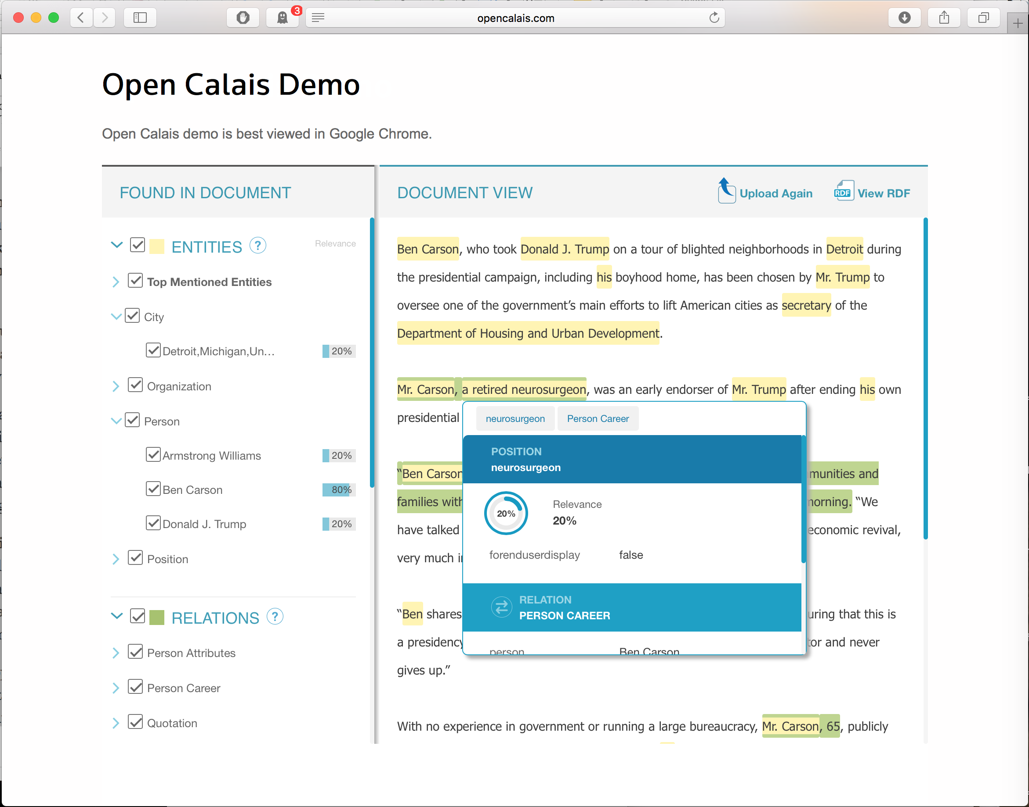
Tagging

Slide 7
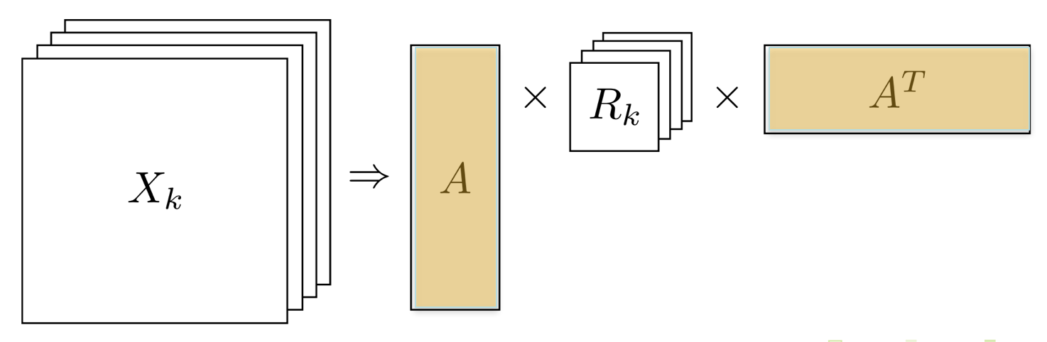
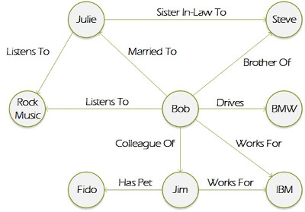
Matrix for Relational Structure
Maximilian Nickel, Volker Tresp, Hans-Peter Kriegel
A Three-Way Model for Collective Learning on Multi-Relational Data
In Proc. 28th International Conference on Machine Learning, 2011

Slide 8

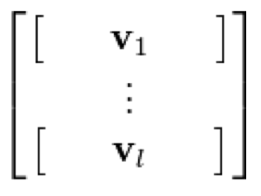

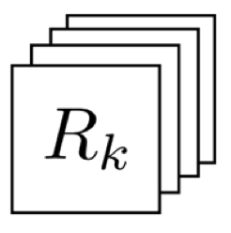
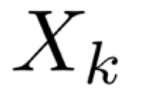
Documents and Representations
D. Blei, A. Ng, and M. Jordan. Latent Dirichlet allocation.
Journal of Machine Learning Research, 3:993-1022, January 2003
π
π
ring
jupiter
•••
space
voyager
car
company
•••
dodge
ford
C
Z
C
car
company
•••
dodge
ford
Z
W
W
N
M
N
M
β
β
Pseudo R_{k}

Slide 9
Latent Relational Structure: Generative Model
π
π
C
Z
C
Z
W
X_{kij}
N
M
NxNxk
M
β
β
Pseudo R_{k}

Slide 10
Charters in Information Systems
Steganographic
representation

Slide 11
Achievements / Short-Term Goals
Association of documents
  Certificate retrieval shows associated reports
  Added value for users
Structure building based on sensible document grouping due to steganographic data associated with picture documents
Relational descriptions for text sharpen associations
Goal: Compute relational descriptions automatically
  Latent relational structures behind text/images

Slide 12
Long-Term Goal:
Integrate Databases

Slide 13

Take home messages
Humanities researchers working on databases and
text documents and can benefit from ...
... new ambient services
Goal: compute underlying data automatically
Computer science researchers
help achieving these goals...
... in cooperation with
humanities researchers
Contact
Prof. Dr. rer. nat. Ralf Möller
Institute for Information Systems
Universität zu Lübeck
Ratzeburger Allee 160
Haus 64
23562 Lübeck
Tel: +49 451 3101 5700
moeller@uni-luebeck.de

