Slide 1
Model-based Data Science Causality, Learning, Adaptation
Heinz Handels, Karsten Keller, Ralf Möller, Philipp Rostalski MINT-Sektion, Universität zu Lübeck

Slide 2
Goal
Collaborative MINT research for solving central problems
occurring in various application areas
Ecology
Economy
Energy
Entertainment
Life Science
...
Sustainable problem solving requires data integration and interpretation for model building with a unifying view on representation formalisms
Models
Causality
Adaptation
Learning

Slide 3
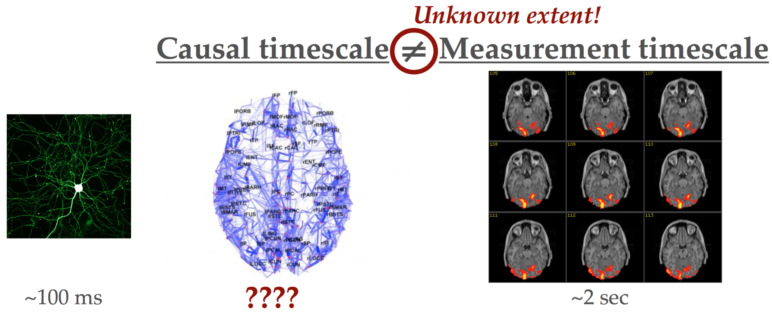
Problem 1 Causality from sparse data?
Data acquisition is slow
Causal inferences from largely under-sampled time series?
Extensive research on image processing
Need models to compensate for incomplete and uncertain information
Requires models based on probability theory (e.g., POMDP)

Slide 4
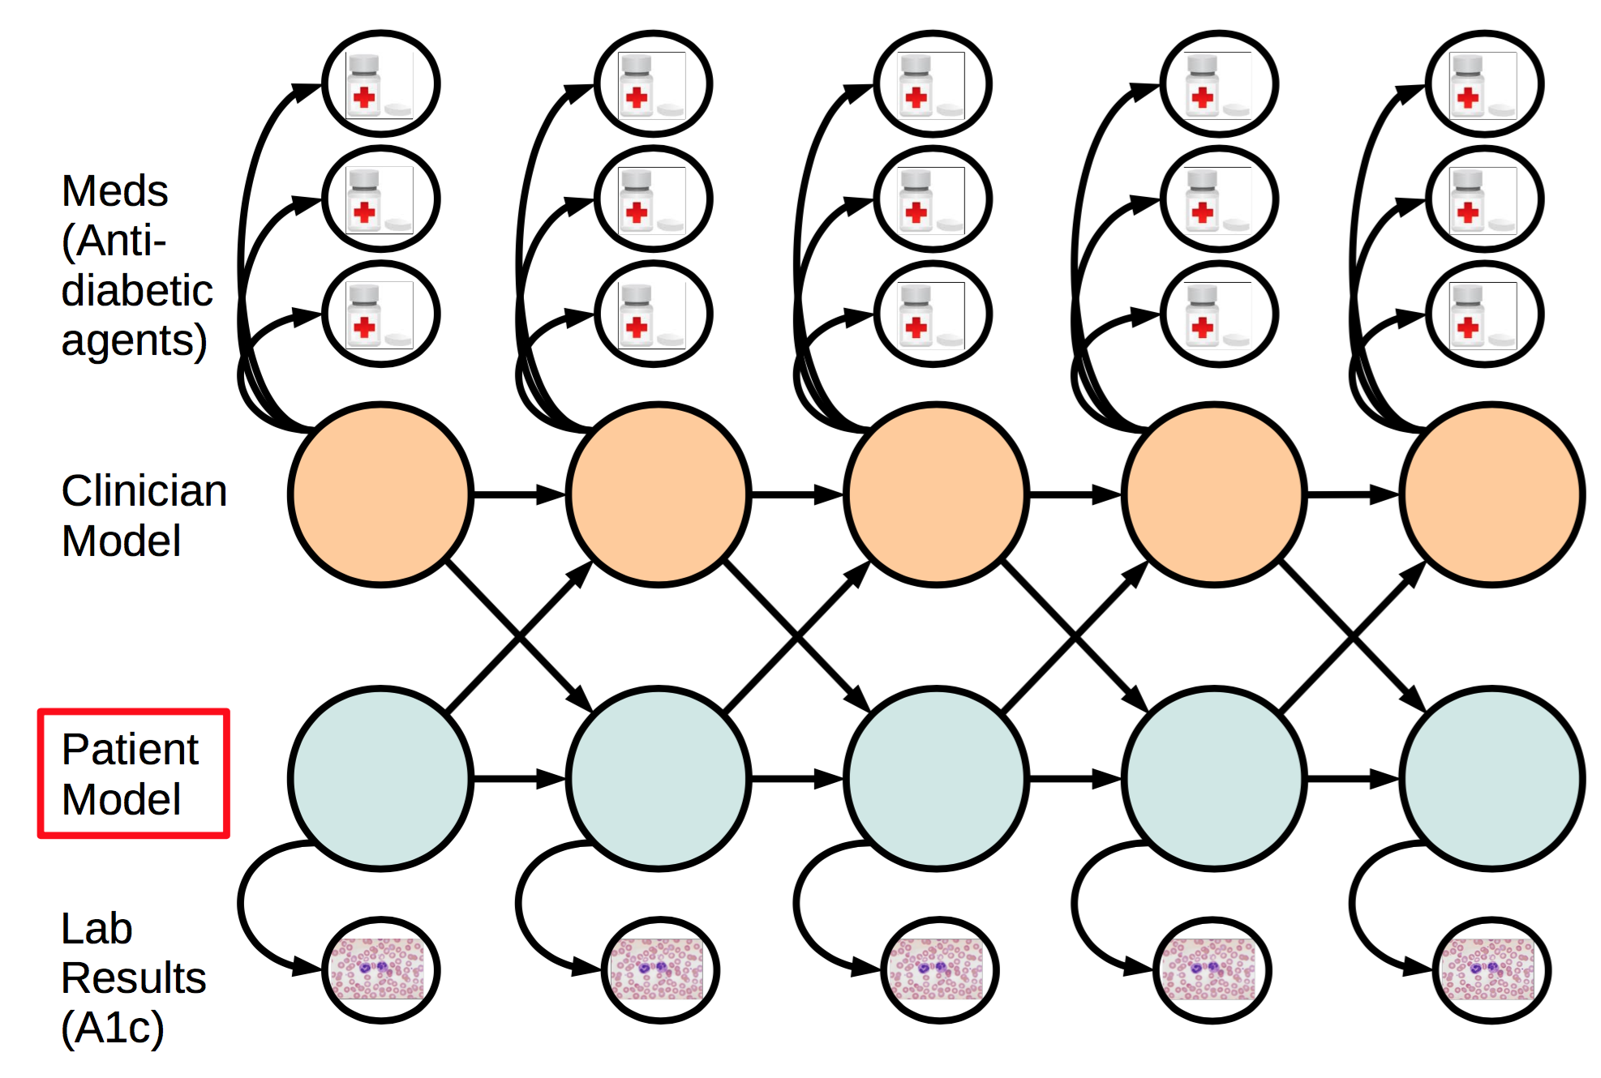
Application: Telemedicine
Results from remote data acquisition
Finale Doshi-Velez, NIPS 2013 Workshop on Causality

Slide 5
Problem 2 Continuous or discrete formalisms?
Continuous domains cannot always be easily discretized (or treated as piecewise linear)
Example: Decision support in state-based system contexts (POMDP)
Different optimal actions in different areas in probabilistic state space
Piecewise linear approximation possible but usually leads to combinatorial explosion when reasoning is required over non-trivial optimal action sequences
Hybrid representation formalisms
Non-linear continuous behavior sensibly combined with discrete (switched) behavior models
Need approximation and numerical algorithms
Discretization can indeed be useful
E.g., for time series analysis (symbolic dynamics, ordinal time series)

Slide 6
Problem 3 Data integration
Naïve data integration based on propositional representations can produce skewed data
Makes machine learning much more complex if not impossible
Propositional logic is often not enough
Or: Flat data (one table) is not enough
Or: Feature vectors are not enough
Need first-order logic (relational logic) combined with temporal probability theory

Slide 7
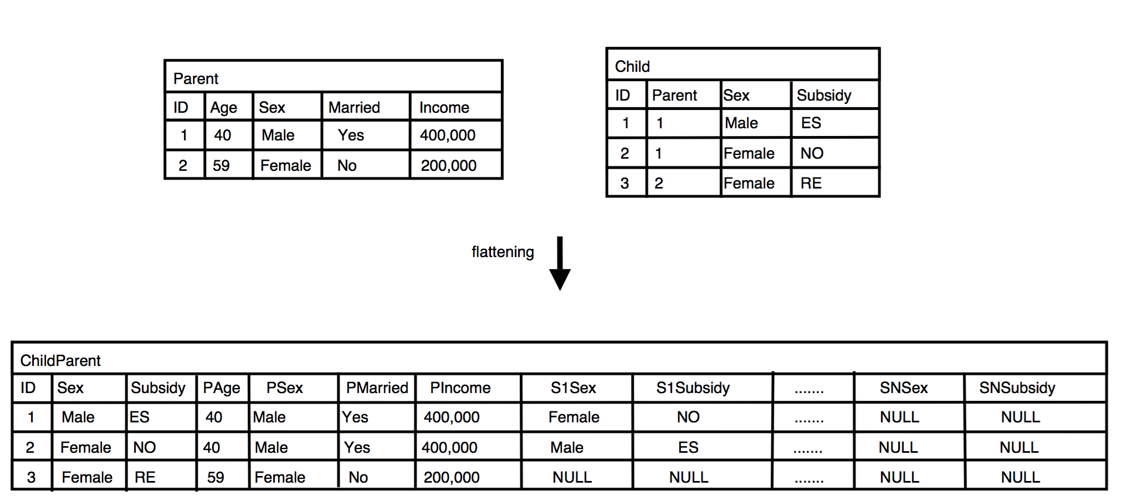
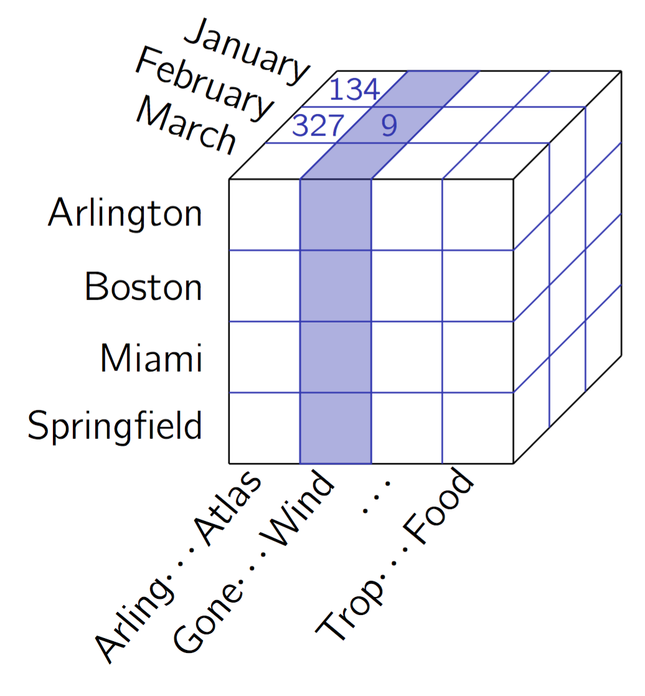
Avoid skewed data for inductive learning
Machine learning can go wrong with skewed data
Neither standards such as HL7 nor OLAP come to the rescue
Redundancies! Frequency counting for maximum likelihood learning??

Slide 8
Skewed data is a prevalent problem in data integration
What can we do?
Don't denormalize
Deal with relational structures in machine learning
Temporal relational probabilistic graphical structures: A new deep architecture
Labeled data for learning available?
Child
Parent
Has-parent

Slide 9
Problem 4 Labeled data is sparse Data characteristics change
Domain difference = performance drop
What if data characteristics change over time?
Requires autonomy in interpretation
Continuous integration: Maybe data turns out to be unlabeled
train
test
ideal setting
Classifier
NYT
NYT
85.5%
New York Times
New York Times
realistic setting
Classifier
NYT
Reuters
64.1%
Reuters
New York Times

Slide 10
Exploit unlabeled data: Transductive learning
+
_
+
_
+
_
+
_
+
_
+
_
SVM
supervised
unsupervised
Labeled data only
Transductive SVM
Need to support autonomy with relational transductive learning

Slide 11
Problem 5 Stationarity assumptions
How useful are simplifying assumptions about stationary systems?
Drift intended and/or ubiquitous
Medication/therapy, normal healing, coming-of-age …
Need to support autonomy with relational transfer learning
Automatic adaptation of models
New features possibly determined autonomously

Slide 12
Lighthouse application(s)
Applications in
medical research
medical decision making and decision support
Decision support with autonomous systems?
Requires explainable analysis/learning results
Requires expertise in human information processing
Human-computer interaction
Psychology
Requires secure data transmission and management
Telematics services
IT for clinical research

Slide 13
Thank you for your attention
Contact
Prof. Dr. rer. nat. Ralf Möller
Institute for Information Systems
Universität zu Lübeck
Ratzeburger Allee 160
Haus 64
23562 Lübeck
Tel: +49 451 3101 5700
moeller@uni-luebeck.de

