Slide 1
Data Integration and Interpretation Challenges and Solutions for Manufacturing Intelligence Applications
Ralf Möller, Christian Neuenstadt, Özgür Özçep Institut für Informationssysteme, Universität zu Lübeck

Slide 2
Enterprise Manufacturing Intelligence
Ziel:
Richtige Informationen zur richtigen Zeit an die richtigen Mitarbeiter zu bringen, …
… so dass Mitarbeiter optimale Entscheidungen treffen und Handlungen ableiten können
Voraussetzung:
Einheitliche Basis für die Gewinnung von nutzbringenden Informationen auf Basis verschiedener Datenquellen (Sensoren, Rohstoffpreislisten, Berichte, usw.)
Interpretation der Daten im Zusammenspiel
Aus: EMI Interview mit Ralf Sonnefeld, Siemens, IT&PRODUCTION, 09-2011

Slide 3
Enterprise Manufacturing Intelligence
Echtzeitdatenauswertung zur Entscheidungsfindung …
… und Rückgriff auf historische Szenarien
Echtzeit- und historische Daten auf den gleichen Aggregationslevel betrachten
Anlagenfahrer, der einen Anlagenstillstand befürchtet, kann als Vergleich auf Messdaten zurückblicken, die kurz vor einem ähnlichen Stillstand in der letzten Woche erfasst wurden
Zusätzliche Analysen können zeigen, wie viel Zeit ihm für eine Entscheidung zur Verfügung steht
Aus: EMI Interview mit Ralf Sonnefeld, Siemens, IT&PRODUCTION, 09-2011

Slide 4
Insights / Hypotheses
Canonical data model unlikely to be realistic
Must find and integrate data dynamically
Must interpret data according to application needs
These days, most data associated with time tags
System time
Valid time

Slide 5
Data Integration
Data Stream Processing
Real-time data processing
Continuous queries
Temporal data processing
Historical queries

Slide 6
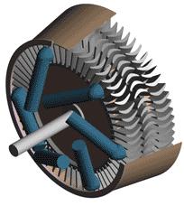
Optique: Window-based Data Processing
Problem
We want to find similarity on measurements of two sensors, both measuring temperature on a Siemens turbine
Solution
We calculate the Pearson correlation coefficient or cosine distance between the two measurements, within a certain time window
Window
Similarity
01010101010101010010101010111110011010100101010101010101010101010101101010101101010100101010101010101001010101011111001101010010101010101010101010101010110101010110101010
010101010101010100101010101111100110101001010101010101010101010101011010101011010101001010101010101010010101010111110011010100101111001010101010101010101010110101010110101
0.7,0.8,0.3,0.9,0.4,0.6,0.5,0.9,0.4,0.9,0.3,-0.1,0.8
Notes:
Suppose that we have two sensors taking temperature measurements from a single Siemens turbine
-One interesting problem is to find if the two sensor readings are in accord
-To do this we create a window based on the last measurements and we calculate the similarity based on the Pearson correlation or the cosine distance

Slide 7
Optique: The Siemens Scenario
What happens when we want to compute all possible correlations between more than two sensors?
For 3 streams we need to compute 3 correlations per window
Similarity
01010101010101010010101010111110011010100101010101010101010101010101101010101101010100101010101010101001010101011111001101010010101010101010101010101010110101010110101010
010101010101010100101010101111100110101001010101010101010101010101011010101011010101001010101010101010010101010111110011010100101111001010101010101010101010110101010110101
010101010101010100101010101111100110101001010101010101010101010101011010101011010101001010101010101010010101010111110011010100101111001010101010101010101010110101010110101
0.7,0.8,0.3,0.9,0.4,0.6,0.5,0.9,0.4,0.9,0.3,-0.1,0.8
0.7,0.8,0.3,0.9,0.4,0.6,0.5,0.9,0.4,0.9,0.3,-0.1,0.8
0.6,0.5,-0.30.7,0.8,0.3,0.9,0.4,0.6,0.5,0.9,0.4,0.9
Notes:
The main question is what we can do when we have to find similarity between more than one streams arriving from multiple sensors located in the same or different turbines

Slide 8
Optique: Dealing with Many Streams
What happens when we want to compute all possible correlations between more than two sensors?
For 3 streams we need to compute 3 correlations per window
For 6 streams we need to compute 15 correlations per window
For 100 streams we need to compute 4950 correlations …
The number of correlations grows quadratically with the number of streams
01010101010101010010101010111110011010100101010101010101010101010101101010101101010100101010101010101001010101011111001101010010101010101010101010101010110101010110101010
010101010101010100101010101111100110101001010101010101010101010101011010101011010101001010101010101010010101010111110011010100101111001010101010101010101010110101010110101
010101010101010100101010101111100110101001010101010101010101010101011010101011010101001010101010101010010101010111110011010100101111001010101010101010101010110101010110101
01010101010101010010101010111110011010100101010101010101010101010101101010101101010100101010101010101001010101011111001101010010101010101010101010101010110101010110101010
010101010101010100101010101111100110101001010101010101010101010101011010101011010101001010101010101010010101010111110011010100101111001010101010101010101010110101010110101
010101010101010100101010101111100110101001010101010101010101010101011010101011010101001010101010101010010101010111110011010100101111001010101010101010101010110101010110101
0.7,0.8,0.3,0.9,0.4,0.6,0.5,0.9,0.4,0.9,0.3,-0.1,0.8
0.7,0.8,0.3,0.9,0.4,0.6,0.5,0.9,0.4,0.9,0.3,-0.1,0.8
……………………………………………………………………….
……………………………………………………………………….
……………………………………………………………………….
0.6,0.5,-0.30.7,0.8,0.3,0.9,0.4,0.6,0.5,0.9,0.4,0.9
Similarity
Notes:
For 3 streams we need to compute 3 correlations per window
For 6 streams we need to compute 15 correlations per window
For 100 streams we need to compute 4950 correlations …
The number of correlations grows quadratically with the number of streams

Slide 9
Describing Measurement Data Semantic Sensor Network Ontology
Semantic Sensor Network XG Final Report, W3C Incubator Group Report 28 June 2011

Slide 10
Optique: Relational Data Descriptions Query Answering w.r.t. Axioms

Slide 11
Ontology Based Data Access

Slide 12
Ontology Based Data Access
Generators with a turbine fault?

Slide 13
Ontology Based Data Access

Slide 14
Ontology Based Data Access
Generators with a turbine fault?

Slide 15
Ontology Based Data Access
Generators with a turbine fault?

Slide 16
Ontology Based Data Access
Generators with a turbine fault?

Slide 17
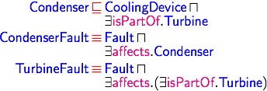
Ontology Based Data Access
Generators with a turbine fault?

Slide 18
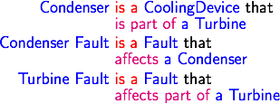
Ontology Based Data Access
Generators with a turbine fault?

Slide 19
Ontology Based Data Access
Generators with a turbine fault?

Slide 20
Ontology Based Data Access
Generators with a turbine fault?

Slide 21
Ontology Based Data Access
Is a condenser fault a kind of turbine fault?

Slide 22
Ontology Based Data Access
Is a condenser fault a kind of turbine fault?

Slide 23
Ontology Based Data Access
Why?

Slide 24
Ontology Based Data Access
Why?

Slide 25
OBDA for Streams: State Sequences from Window Data

Slide 26
Windows over Multiple Streams

Slide 27
Static Data Added to Each State
mini bag (only virtually)

Slide 28
Mappings for Data Integration
Information need for
historical data (temporal query) with period of interest
reactive diagnosis
streamed data (continuous query)
proactive diagnosis
Goal: Use the same query language
For historical queries, windows can be processed in parallel with no real-time constraints

Slide 29
Conceptual View on Data

Slide 30
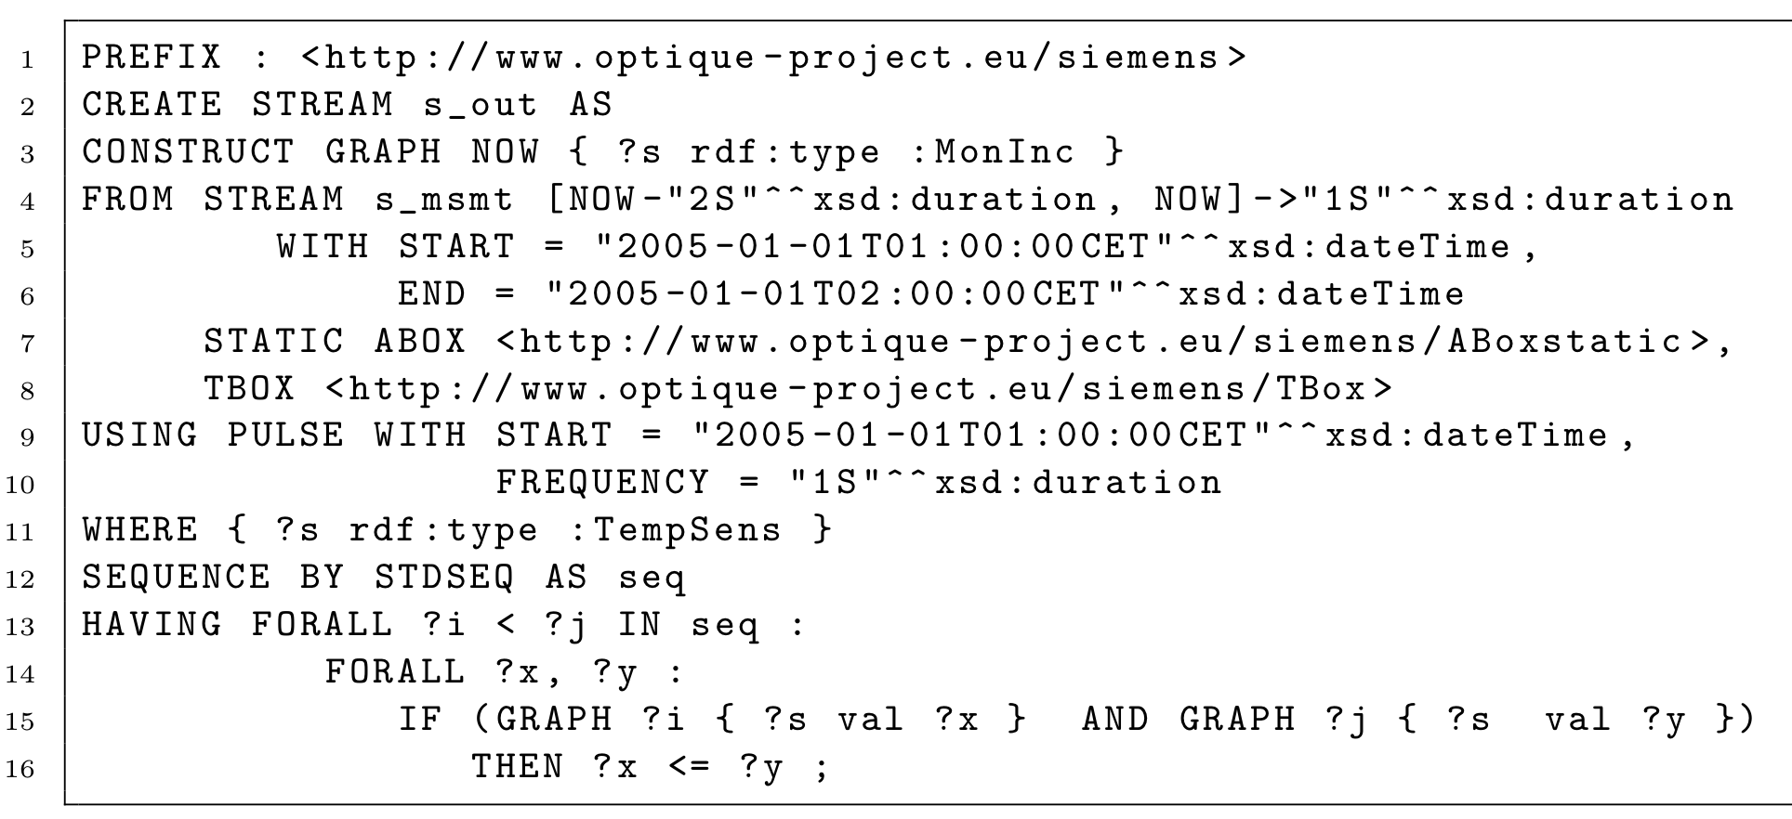
Representation in STARQL

Slide 31
Output Specification in Terms of SPARQL

Slide 32
Streams and Sequencing
s_msmt constructed from table STREAM_MEASUREMENT
Details of mappings omitted

Slide 33
WHERE and HAVING Extensions of SPARQL
TempSens(?s) also defined via SQL
{ ?x rdf:type :TempSens } in RDF
hasVal(?s, ?x)<?i> defined via SQL as described before
GRAPH ?i { ?s :val ?x } in RDF

Slide 34
Rewriting and Unfolding (e.g. with Ontop)

Slide 35
On top of Ontop: Sequencing

Slide 36
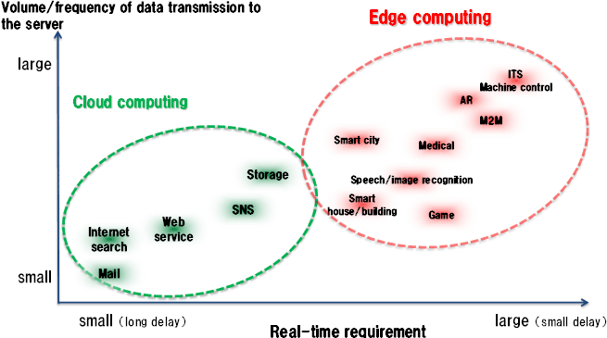
Backends for STARQL
SQL (PostgreSQL)
Exareme (cloud-based data management system)
Apache Spark (cluster computing)
Apache Flink (distributed stream and batch processing, soon)
Mobile Edge Computing / Fog computing platforms (later)

Slide 37
Smart City Applications
Ali Intizar, Insight Centre for Data Analytics, Federation over Streaming Linked Data, ISWC 2015

Slide 38
Biotech Applications

Slide 39
Challenges
Optimal Data Source Discovery
Streams are everywhere
Multiple data streams can answer the same query
Optimal data stream selection
Catering for user-defined constraints and preferences
On-Demand Stream Federation
Automated composition of primitive data streams for answering complex queries
Adaptation
Data source properties can change overtime
Make sure selected sources remain “optimal” throughout life cycle of the query
Ali Intizar, Insight Centre for Data Analytics, Federation over Streaming Linked Data, ISWC 2015

Slide 40
Challenges
What if events require complex predicates?
How to derive predicates for queries?
Query languages not always easy to use
Need for learning relevant queries
E.g., with Spark Mlib oder Flink ML

Slide 42
Understandability vs. Quality
Understandability
Quality
The more powerful a model is in terms of predictive quality, the more opaque it gets.

Slide 43
Labeled data is sparse
Domain difference = performance drop
train
test
ideal setting
Classifier
NYT
NYT
85.5%
New York Times
New York Times
realistic setting
Classifier
NYT
Reuters
64.1%
Reuters
New York Times

Slide 44
Data characteristics change
What if data characteristics change over time?
Data evolution = performance drop
Requires autonomy in interpretation
Continuous integration: Maybe data turns out to be unlabeled
train
test
Current setting
Classifier
NYT
NYT
85.5%
New York Times 2010
New York Times 2011
Future data Previous setting
NYT
64.1%
New York Times 2016

Slide 45
Unlabeled data
Huge datasets without any labels
Large unlabeled or partially (weakly) labeled datasets from same domain, possibly produced by data integration
Supervised learning + Additional unlabeled data
Transductive learning / semi-supervised learning
Unsupervised learning + Additional labeled data
Deep learning
Transfer learning
Domain adaptation
Leverage large, previously labeled data from a related domain
Task adaptation
Same domain, but slightly different task

Slide 46
Exploit unlabeled data: Transductive learning
+
+
+
+
+
+
+
_
+
–
+
+
_
+
_
_
_
+
_
+
_
–
+
_
+
_
+
–
–
–
–
–
SVM
supervised
unsupervised
Labeled data only
Transductive SVM

Slide 47
Deep Learning
aka or related to
Deep Structural Learning
Deep Belief Networks
Deep Neural Networks
etc,
→ Software: Deeplearning4j (works with Apache Spark)

Slide 48
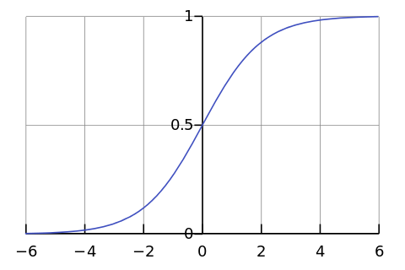
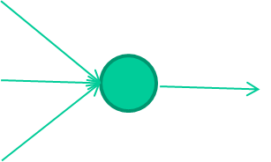
-0.06
W1
W2
f(x)
-2.5
W3
1.4
David Corne: Open Courseware

Slide 49
-0.06
2.7
-8.6
f(x)
-2.5
0.002
x = -0.06×2.7 + 2.5×8.6 + 1.4×0.002 = 21.34
1.4
David Corne: Open Courseware

Slide 50
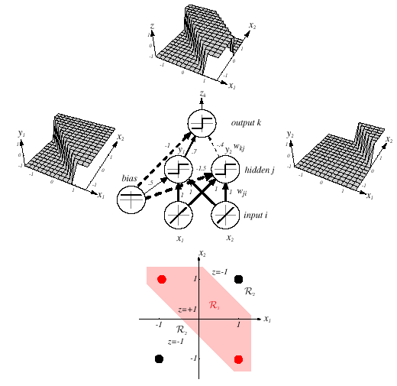
Z = y1 AND NOT y2 = (x1 OR x2) AND NOT(x1 AND x2)

Slide 51
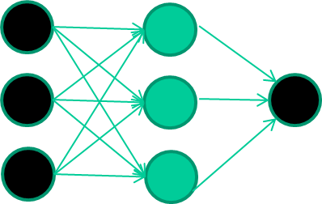
A dataset
Fields class
1.4 2.7 1.9 0
3.8 3.4 3.2 0
6.4 2.8 1.7 1
4.1 0.1 0.2 0
etc …
David Corne: Open Courseware

Slide 52
Training the network
Fields class
1.4 2.7 1.9 0
3.8 3.4 3.2 0
6.4 2.8 1.7 1
4.1 0.1 0.2 0
etc …
David Corne: Open Courseware

Slide 53
Training data
Fields class
1.4 2.7 1.9 0
3.8 3.4 3.2 0
6.4 2.8 1.7 1
4.1 0.1 0.2 0
etc …
Initialise with random weights
David Corne: Open Courseware

Slide 54
Training data
Fields class
1.4 2.7 1.9 0
3.8 3.4 3.2 0
6.4 2.8 1.7 1
4.1 0.1 0.2 0
etc …
Present a training pattern
1.4
2.7
1.9
David Corne: Open Courseware

Slide 55
Training data
Fields class
1.4 2.7 1.9 0
3.8 3.4 3.2 0
6.4 2.8 1.7 1
4.1 0.1 0.2 0
etc …
Feed it through to get output
1.4
2.7 0.8
1.9
David Corne: Open Courseware

Slide 56
Training data
Fields class
1.4 2.7 1.9 0
3.8 3.4 3.2 0
6.4 2.8 1.7 1
4.1 0.1 0.2 0
etc …
Compare with target output
1.4
2.7 0.8
0
1.9 error 0.8
David Corne: Open Courseware

Slide 57
Training data
Fields class
1.4 2.7 1.9 0
3.8 3.4 3.2 0
6.4 2.8 1.7 1
4.1 0.1 0.2 0
etc …
Adjust weights based on error
1.4
2.7 0.8
0
1.9 error 0.8
David Corne: Open Courseware

Slide 58
Training data
Fields class
1.4 2.7 1.9 0
3.8 3.4 3.2 0
6.4 2.8 1.7 1
4.1 0.1 0.2 0
etc …
Present a training pattern
6.4
2.8
1.7
David Corne: Open Courseware

Slide 59
Training data
Fields class
1.4 2.7 1.9 0
3.8 3.4 3.2 0
6.4 2.8 1.7 1
4.1 0.1 0.2 0
etc …
Feed it through to get output
6.4
2.8 0.9
1.7
David Corne: Open Courseware

Slide 60
Training data
Fields class
1.4 2.7 1.9 0
3.8 3.4 3.2 0
6.4 2.8 1.7 1
4.1 0.1 0.2 0
etc …
Compare with target output
6.4
2.8 0.9
1
1.7 error -0.1
David Corne: Open Courseware

Slide 61
Training data
Fields class
1.4 2.7 1.9 0
3.8 3.4 3.2 0
6.4 2.8 1.7 1
4.1 0.1 0.2 0
etc …
Adjust weights based on error
6.4
2.8 0.9
1
1.7 error -0.1
David Corne: Open Courseware

Slide 62
And so on ….
Training data
Fields class
1.4 2.7 1.9 0
3.8 3.4 3.2 0
6.4 2.8 1.7 1
4.1 0.1 0.2 0
etc …
6.4
2.8 0.9
1
1.7 error -0.1
Repeat this thousands, maybe millions of times – each time
taking a random training instance, and making slight
weight adjustments
Algorithms for weight adjustment are designed to make
changes that will reduce the error
David Corne: Open Courseware

Slide 63
The new way to train multi-layer nets …
David Corne: Open Courseware

Slide 64
The new way to train multi-layer nets …
Train this layer first
David Corne: Open Courseware

Slide 65
The new way to train multi-layer nets …
Train this layer first
then this layer
David Corne: Open Courseware

Slide 66
The new way to train multi-layer nets …
Train this layer first
then this layer
then this layer
David Corne: Open Courseware

Slide 67
The new way to train multi-layer nets …
Train this layer first
then this layer
then this layer
then this layer
David Corne: Open Courseware

Slide 68
The new way to train multi-layer nets …
Train this layer first
then this layer
then this layer
then this layer
finally this layer
David Corne: Open Courseware

Slide 69
The new way to train multi-layer nets …
EACH of the (non-output) layers is trained to be an auto-encoder
Basically, it is forced to learn good features that describe what comes from the previous layer
David Corne: Open Courseware

Slide 70
Final layer trained to predict class based on outputs from previous layers
Feature vectors
David Corne: Open Courseware

Slide 71
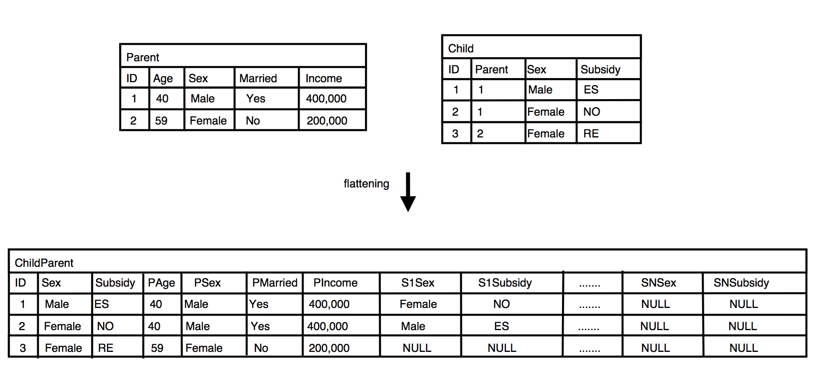
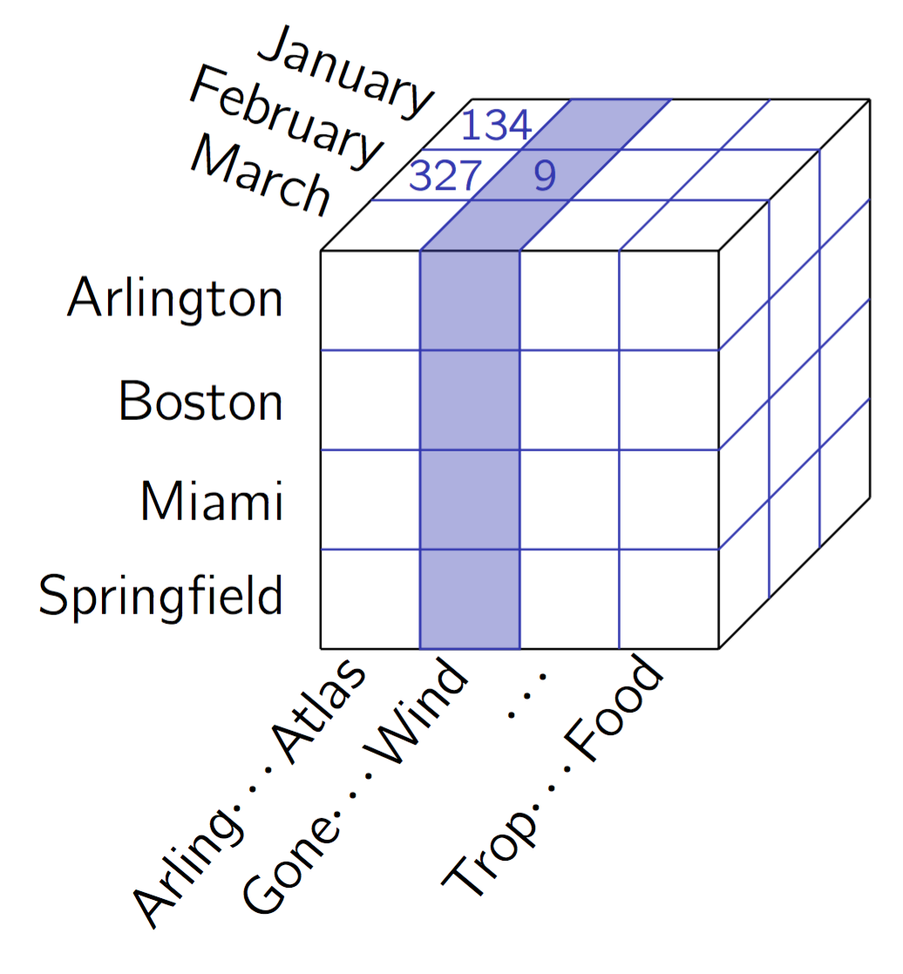
Are feature vectors enough? Avoid skewed data for learning
Machine learning can go wrong with skewed data
Neither standards such as HL7 nor OLAP come to the rescue
Redundancies! Frequency counting for maximum likelihood learning??

Slide 72
Skewed data is a prevalent problem in data integration
What can we do?
Don't denormalize: Simple feature vectors might skew data
Brute-force machine learning does not work (despite recent success in determining the right features)
Deal with relational structures in machine learning
Temporal relational probabilistic graphical structures: A new deep architecture
Child
Parent
Has-parent

Slide 73
Can we Rely on Simple Integration/Federation at the Mapping Layer???

Slide 74
Data integration revisited
Produces null values (⊥) in DB speak
Problem: All null values different in standard DBs
Better: Named nulls (or blank nodes in RDF)
We can have co-references
Existentials in logic
Blanks (or named nulls) denoted as ⊥ with subscript

Slide 75
Universal solutions

Slide 76
Universal solution (non-)existence

Slide 77
Problems and solutions
Problem: Undecidability of Universal Solution Existence Problem for general dependencies
Restrictions on expressivity of language for expressing dependencies
Leads to the definition of canonical solutions (results of successful chase sequences)
Problem: Canonical solutions are non-unique
Want smallest solutions
Leads to definition of core solutions (cores)
Minimum skewing (cf. max entropy principle)

Slide 78
Canonical solutions: Redundancies
⊥₄

Slide 79
Cores: Smallest solutions
Ronald Fagin, Phokion G. Kolaitis, and Lucian Popa. 2005. Data exchange: getting to the core. ACM Trans. Database Syst. 30, 1, 174-210, 2005.
Georg Gottlob and Alan Nash. Data exchange: computing cores in polynomial time. In Proceedings of the twenty-fifth ACM SIGMOD-SIGACT-SIGART symposium on Principles of database systems (PODS '06), 2006

Slide 80
Data integration: Incomplete knowledge
Produces null values (missing data)
Algebra problematic with null values
(X and not X) for X=null?
By definition: null
What happens with nulls for answering queries?
Cores help to not include unwanted biases in integrated data
Biases (skewed data) spoil machine learning results
Can we sensibly replace nulls in cores?
Integrate probability theory and first-order logic

Slide 81
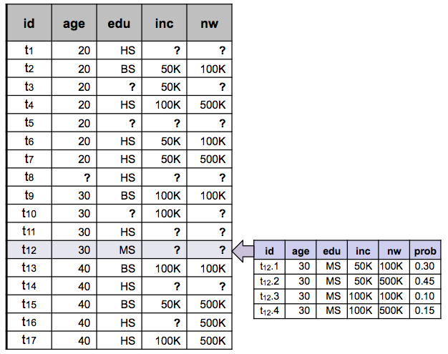
Models for missing data
Standard DB: NULL
Idea: Infer distribution for missing data
Probabilistic DB: Distribution on possible worlds
Stoyanovich, Davidson, Milo, Tannen: Deriving probabilistic databases with inference ensembles. ICDE 2011
Notes:
Stoyanovich, Davidson, Milo, Tannen
UPENN

Slide 82
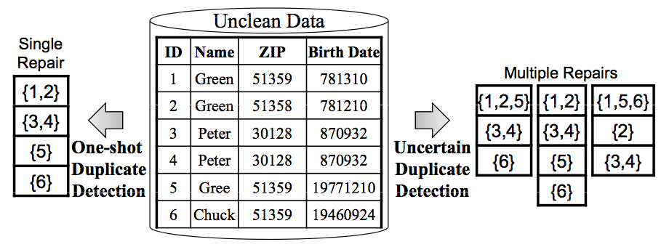
Data integration requires cleaning
Standard-DB Cleaning means selecting one repair
Probabilistic DB Store most/all repairs
Challenge: Representation of multiple repairs
Beskales, Soliman, Ilyas, Ben-David: Modeling and Querying Possible Repairs in Duplicate Detection. PVLDB 2009
Notes:
Beskales, Soliman, Ilyas, Ben-David
WATERLOO

Slide 83
Deal with multiple interpretations in information extraction
52-A Goregaon West Mumbai 400 076
Extraction
Standard DB: Store only most probably extraction
Probabilistic DB: Store most/all extraction in oder to increase recall
Core idea: Probabilities given for extraction correlate with precision of extraction
Gupta, Sarawagi: Creating Probabilistic Databases from Information Extraction Models. VLDB 2006
Notes:
IIT Bombay

Slide 84
Take-home messages
Data integration via streams is realistic
OBDA to ensure compact queries
Learning on streams is possible for big data
Feature vectors are not enough
Probabilistic relational representation & learning
OBDA via cores a challenge
Contact
Prof. Dr. rer. nat. Ralf Möller
Institute for Information Systems
Universität zu Lübeck
Ratzeburger Allee 160 Haus 64
23562 Lübeck
Tel: +49 451 3101 5700
moeller@uni-luebeck.de

Slide 85
Habilitations- und Doktorarbeiten am IFIS
Deep Ontological Modeling (Ö. Özcep – Habil)
Ontology-based data stream processing (Chr. Neuenstadt)
FPGA-supported SPARQL query answering for graph databases (D. Heinrich, S. Werner – Betreuer S. Groppe)
Data mining for security maintenance in critical infrastructures (M. Lange)
Causal probabilistic graphical models (A. Motzek)
Probabilistic Doxastic Logic (K. Martiny)
Lifted junction trees for multi-query answering in probabilistic relational models (T. Braun)

