Slide 1
Advanced Topics Data Science and AI
Automated Planning and Acting
Nondeterministic Models
Tanya Braun

Slide 2
Content
Planning and Acting with Deterministic Models
Planning and Acting with Refinement Methods
Planning and Acting with Temporal Models
Planning and Acting with Nondeterministic Models
  Planning Problem
  And/Or Graph Search
  Determinisation
  Online Approaches
Making Simple Decisions
Making Complex Decisions
Planning and Acting with Probabilistic Models
Provably Beneficial AI
Other: open world, perceiving, learning
  If time permits
Notes:
1-4, 7: Planning book
5: AIMA, IFIS papers on lifting
6: AIMA, relational planning, FO-POMDPs
8: Russell

Slide 3

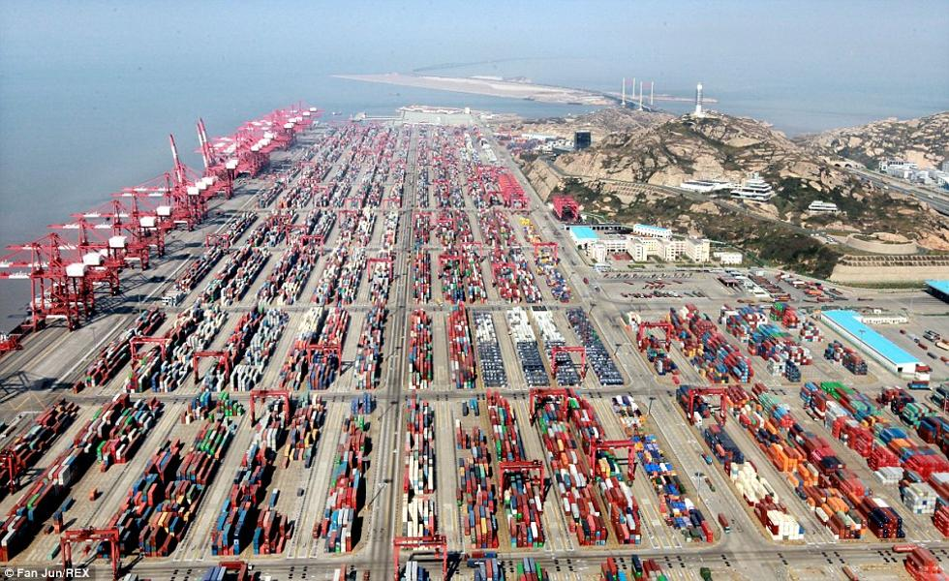
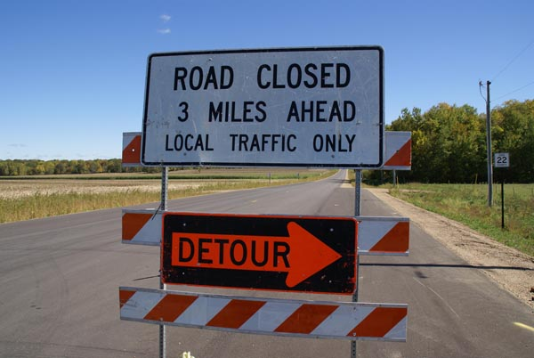
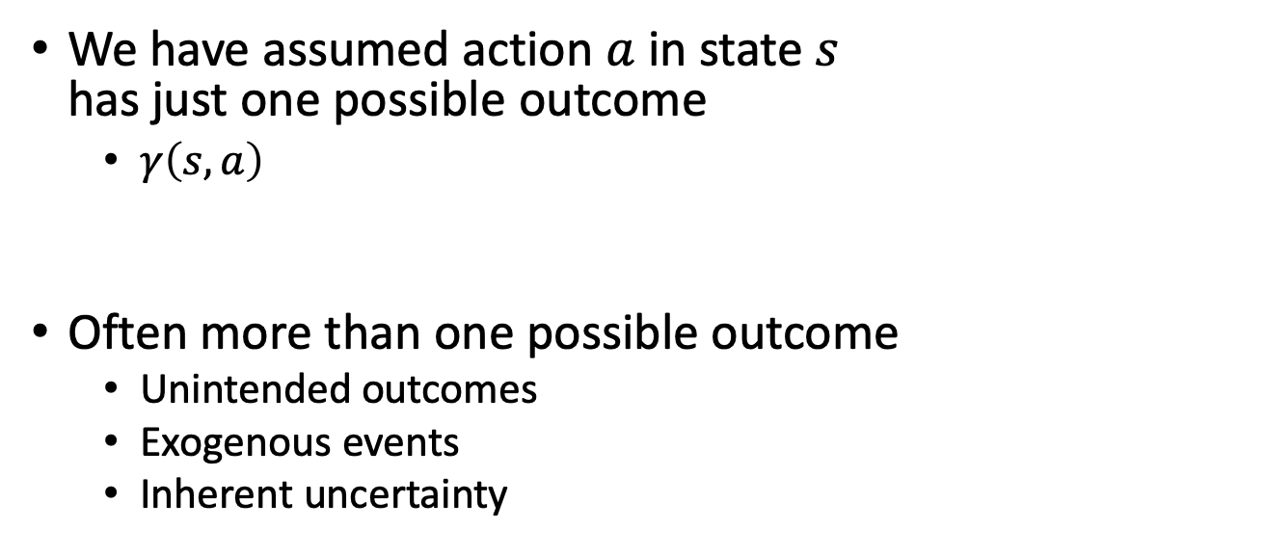
Motivation
We have assumed action $a$ in state $s$
has just one possible outcome
  $γ\left(s,a\right)$
Often more than one possible outcome
  Unintended outcomes
  Exogenous events
  Inherent uncertainty
c
a
b
grasp(c)
c
a
b
a
b
c

Slide 4
Outline per the Book
5.2 Planning Problem
  Planning domains
  Plans as policies
  Planning problems and solutions
5.3 And/Or Graph Search
  Planning by forward search
5.5 Determinisation Techniques
  Guided planning for safe solutions
  Planning for safe solutions by determinisation
5.6 Online Approaches
  Lookahead
  Lookahead by Determinisation
  Lookahead with a bounded number of steps
Notes:
5.1 Intro

Slide 5
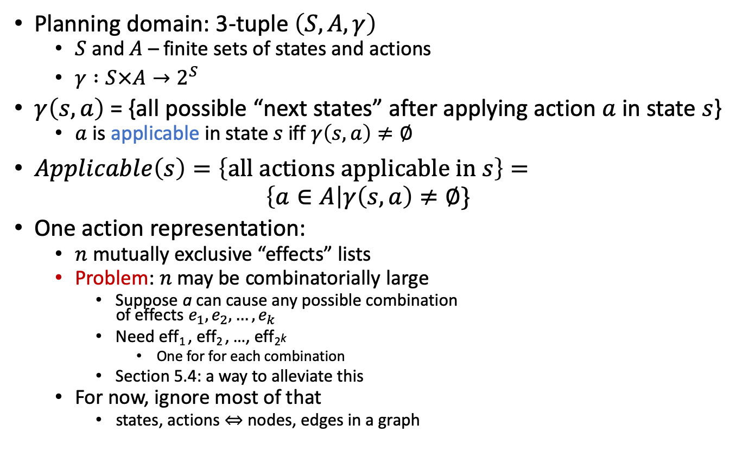
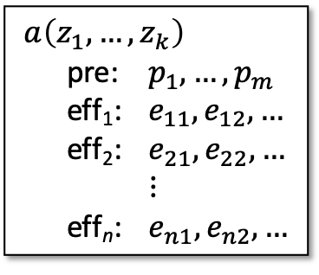
Nondeterministic Planning Domains
Planning domain: 3-tuple $\left(S,A,γ\right)$
  $S$ and $A$ – finite sets of states and actions
  $γ :S×A→2^{S}$
$γ\left(s,a\right)$ = {all possible “next states” after applying action $a$ in state $s$}
  $a$ is applicable in state $s$ iff $γ\left(s,a\right)≠∅$
$Applicable\left(s\right)=\left\{\text{all} \text{actions} \text{applicable} \text{in} s\right\}=$
$$\left\{a∈A\right|γ\left(s,a\right)≠∅\}$$
One action representation:
  $n$ mutually exclusive “effects” lists
  Problem: $n$ may be combinatorially large
    Suppose a can cause any possible combination
    of effects $e_{1}, e_{2}, …, e_{k}$
    Need eff₁ , eff₂ , …, eff₂k
      One for for each combination
    Section 5.4: a way to alleviate this
  For now, ignore most of that
    states, actions ⇔ nodes, edges in a graph
$a\left(z_{1}, …, z_{k}\right)$
pre: $p_{1}, …, p_{m}$
eff₁: $e_{11}, e_{12}, …$
eff₂: $e_{21}, e_{22}, …$
$⋮$
eff_{n}: $e_{n1}, e_{n2}, …$
Notes:
Section 5.4 Symbolic Model Checking Techniques (Malte)

Slide 6
Nondeterministic Planning Domains
For deterministic planning problems, search space was a graph
Now it’s an AND/OR graph
  OR branch:
    Several applicable actions,
    which one to choose?
  AND branch:
    Multiple
    possible
    outcomes
    Must
    handle
    all of
    them
Analogy to PSP
  OR branch ⇔ action selection
  AND branch ⇔ flaw selection

Slide 7
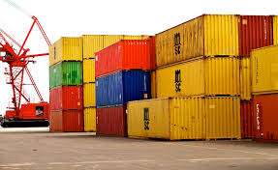
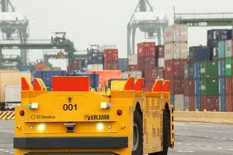
Example
Very simple harbor management domain
  Unload a single item from a ship
  Move it around a harbor

Slide 8
Example
One state variable: pos(item)
Five actions
  Deterministic:
    unload, back,
    (move in one state)
  Nondeterministic:
    park, move, deliver
Simplified names for states
  For {pos(item)=on_ship}
  write on_ship

Slide 9

Actions
Action:
$park$
pre: $pos\left(item\right)=at_harbor$
eff₁: $pos\left(item\right)←parking1$
eff₂: $pos\left(item\right)←parking2$
eff₃: $pos\left(item\right)←transit1$
Three possible outcomes
  Put item in
  $parking1$ or
  $parking2$
  if one of them
  has space or
  in $transit1$
  if there is
  no parking space

Slide 10

Plans Policies
Need something more general than a sequence of actions
  After park, what do we do next?
Policy: a partial function $π : S↦A$
  i.e., $Dom\left(π\right)⊆S$
  For every $s∈Dom\left(π\right)$,
  require $π\left(s\right)∈Applicable\left(s\right)$
Meaning:
  Perform $π\left(s\right)$
  whenever we are
  in state $s$
$π_{1}=\{\left(on\text{_}ship, unload\right), \left(at\text{_}harbor, park\right), \left(parking1, deliver\right)\}$
unload
park
deliver

Slide 11

Definitions Over Policies
Transitive closure:
{all states reachable from $s$ using $π$}
  $\hat{\text{γ}}\left(s,π\right)=S_{0}∪S_{1}∪S_{2}∪…$
    $S_{0}=\left\{s\right\}$
    $S_{i+1}=\bigcup{\{γ\left(s,π\left(s\right)\right) | s∈S_{i}\}}, i≥0$
Reachability graph $Graph(s,π) = (V,E)$
  $V=\hat{\text{γ}}\left(s,π\right)$
  $E=\left\{\left(s^{′},s^{′′}\right) \right| s^{′}∈V, s^{′′}∈γ\left(s^{′},π\left(s^{′}\right)\right)\}$
$π_{1}=\{\left(on\text{_}ship, unload\right), \left(at\text{_}harbor, park\right), \left(parking1, deliver\right)\}$
$Graph\left(on\text{_}ship,π_{1}\right)$

Slide 12

Definitions Over Policies
Transitive closure:
{all states reachable from $s$ using $π$}
  $\hat{\text{γ}}\left(s,π\right)=S_{0}∪S_{1}∪S_{2}∪…$
    $S_{0}=\left\{s\right\}$
    $S_{i+1}=\bigcup{\{γ\left(s,π\left(s\right)\right) | s∈S_{i}\}}, i≥0$
Reachability graph $Graph(s,π) = (V,E)$
  $V=\hat{\text{γ}}\left(s,π\right)$
  $E=\left\{\left(s^{′},s^{′′}\right) \right| s^{′}∈V, s^{′′}∈γ\left(s^{′},π\left(s^{′}\right)\right)\}$
$leaves\left(s,π\right)= \hat{\text{γ}}\left(s,π\right)\backslash Dom\left(π\right)$
  May be empty
$π_{1}=\{\left(on\text{_}ship, unload\right), \left(at\text{_}harbor, park\right), \left(parking1, deliver\right)\}$
  $leaves\left(on\text{_}ship,π_{1}\right)$ in yellow

Slide 13
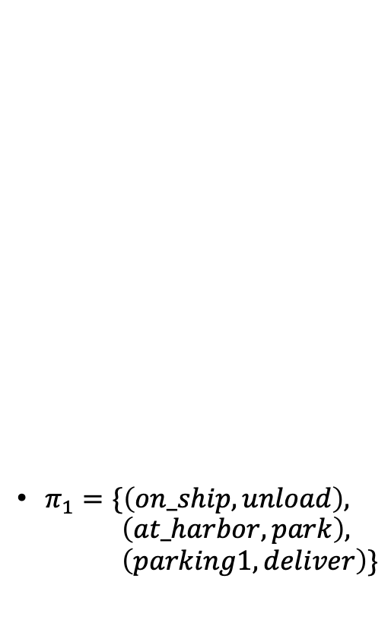
Performing a Policy
PerformPolicy(𝜋)
s ← observe current state
while s ∈ Dom(𝜋) do
perform action 𝜋(s)
s ← observe current state
$π_{1}=\{\left(on\text{_}ship, unload\right), \left(at\text{_}harbor, park\right), \left(parking1, deliver\right)\}$
unload
park
deliver

Slide 14



Planning Problems and Solutions
Planning problem $P=(Σ,s_{0},S_{g})$
  Planning domain $Σ=\left(S,A,γ\right)$
  Initial state $s_{0}∈S$
  Set of goal states $S_{g}⊆S$
  (shown in green)
$π$ is a solution if at least one execution ends at a goal
  $leaves\left(s,π\right)∩S_{g}≠∅$
$π_{1}=\{\left(on\text{_}ship, unload\right), \left(at\text{_}harbor, park\right), \left(parking1, deliver\right)\}$
$S_{g}$
Is $π_{1}$ a solution?
unload
park
deliver
Notes:
Yes
Two executions end in a state of Sg

Slide 15


Safe Solutions
A solution $π$ is safe if
$$∀s∈\hat{\text{γ}}\left(s_{0},π\right),$$
$$leaves\left(s,π\right)∩S_{g}≠∅$$
  all executions end at goals
  at every node of $Graph\left(s_{0},π\right)$,
  the goal is reachable
Otherwise, unsafe
$π_{1}=\{\left(on\text{_}ship, unload\right), \left(at\text{_}harbor, park\right), \left(parking1, deliver\right)\}$
$S_{g}$
unload
park
deliver
Is $π_{1}$ safe?
Notes:
No, parking2, transit1, transit2 states of transitive closure but do not lead to goal state
Leaf not a goal state X

Slide 16

Safe Solutions
$π_{2}=\{\left(on\text{_}ship, unload\right),$
$\left(at\text{_}harbor, park\right),$
$\left(parking1, deliver\right),$
$\left(parking2, deliver\right),$
$\left(transit1, move\right),$
$\left(transit2, move\right),$
$\left(transit3, move\right)\}$
Acyclic safe solution
  $Graph\left(s_{0},π\right)$ is acyclic and
  $leaves\left(s_{0},π\right)⊆S_{g}$
Guaranteed to reach a goal
move
deliver
$S_{g}$
unload
park
deliver
move
move

Slide 17

Safe Solutions
Cyclic safe solution
  $Graph\left(s_{0},π\right)$ is cyclic,
  $leaves\left(s_{0},π\right)⊆S_{g}$, and
  $∀s∈\hat{\text{γ}}\left(s_{0},π\right),$
  $leaves\left(s,π\right)∩S_{g}≠∅$
At every state, there is
an execution path
that ends at a goal
Will never get caught
in a dead end
$π_{3}=$
$\{\left(on\text{_}ship, unload\right), \left(at\text{_}harbor, park\right),$
$\left(parking1, deliver\right),\left(parking2, back\right),$
$\left(transit1, move\right), \left(transit2, move\right),$
$\left(gate1, back\right)\}$
back
back
$S_{g}$
unload
park
deliver
move
move

Slide 18
Kinds of Solutions
Goal
  acyclic
  solutions
  a
  safe solutions
  cyclic solutions
  c
  solutions
  unsafe solutions
  b

Slide 19
Intermediate Summary
Planning Problems
  Planning domains
  Plans as policies
  Planning problems and solutions
    Types of solutions: safe, unsafe, acyclic, cyclic

Slide 20
Outline per the Book
5.2 Planning Problem
  Planning domains
  Plans as policies
  Planning problems and solutions
5.3 And/Or Graph Search
  Planning by forward search
5.5 Determinisation Techniques
  Guided planning for safe solutions
  Planning for safe solutions by determinisation
5.6 Online Approaches
  Lookahead
  Lookahead by Determinisation
  Lookahead with a bounded number of steps
Notes:
4.1 Intro

Slide 21
Finding (Unsafe) Solutions
For comparison:
Forward-search with deterministic models
Forward-search(Σ,s₀,g)
s ← s₀
𝜋 ← ⟨⟩
loop
if s satisfies g then
return 𝜋
A′ ←{a ∈ A | a is applicable in s}
if A′ = ∅ then
return failure
nondeterministically choose a ∈ A′ s ← 𝛾(s,a)
𝜋 ← 𝜋.a
Find-Solution(Σ,s₀,S_{g})
s ← s₀
𝜋 ← ∅
Visited ← {s₀}
loop
if s ∈ S_{g} then
return 𝜋
A′ ← Applicable(s)
if A′ = ∅ then
return failure
nondeterministically choose a ∈ A′ nondeterministically choose s’ ∈ 𝛾(s,a)
if s’ ∈ Visited then
return failure
𝜋(s) ← a
Visited ← Visited ∪ {s’}
s ← s’
Decide which state to plan for
Cycle-checking

Slide 22
Example
Find-Solution(Σ,s₀,S_{g})
s ← s₀
𝜋 ← ∅
Visited ← {s₀}
...
s = on_ship
$S_{g}$
s
π = {}
Visited = {on_ship}

Slide 23
Example
Find-Solution(Σ,s₀,S_{g})
...
loop
if s ∈ S_{g} then
return 𝜋
...
nondeterministically choose a ∈ Applicable(s) nondeterministically choose s’ ∈ 𝛾(s,a)
...
𝜋(s) ← a
Visited ← Visited ∪ {s’}
s ← s’
s = on_ship, a = unload
γ(s,a) = {at_harbor}
s′ = at_harbor
$S_{g}$
a
unload
s
s'
π = {(on_ship, unload)}
Visited = {on_ship, at_harbor}

Slide 24
Example
Find-Solution(Σ,s₀,S_{g})
...
loop
if s ∈ S_{g} then
return 𝜋
...
nondeterministically choose a ∈ Applicable(s) nondeterministically choose s’ ∈ 𝛾(s,a)
...
𝜋(s) ← a
Visited ← Visited ∪ {s’}
s ← s’
s = at_harbor, a = park
γ(s,a) = {parking1, parking2, transit1}
s′ = parking1
$S_{g}$
a
unload
park
s
π = {(on_ship, unload),
(at_harbor, park)}
s'
Visited = {on_ship, at_harbor, parking1}

Slide 25
Example
Find-Solution(Σ,s₀,S_{g})
...
loop
if s ∈ S_{g} then
return 𝜋
...
nondeterministically choose a ∈ Applicable(s) nondeterministically choose s’ ∈ 𝛾(s,a)
...
𝜋(s) ← a
Visited ← Visited ∪ {s’}
s ← s’
s = parking1, a = deliver
γ(s,a) = {gate1, gate2, transit1}
s′ = gate1
$S_{g}$
s'
unload
park
a
deliver
π = {(on_ship, unload),
(at_harbor, park),
(parking1, deliver)}
s
Visited = {on_ship, at_harbor, parking1, gate1}

Slide 26
Example
Find-Solution(Σ,s₀,S_{g})
...
loop
if s ∈ S_{g} then
return 𝜋
...
nondeterministically choose a ∈ Applicable(s) nondeterministically choose s’ ∈ 𝛾(s,a)
...
𝜋(s) ← a
Visited ← Visited ∪ {s’}
s ← s’
s = gate1
$S_{g}$
s
Gate1 is a goal,
so return π
unload
park
deliver
π = {(on_ship, unload),
(at_harbor, park),
(parking1, deliver)}
Visited = {on_ship, at_harbor, parking1, gate1}

Slide 27
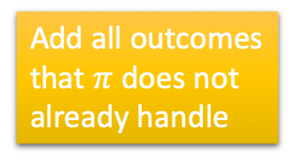
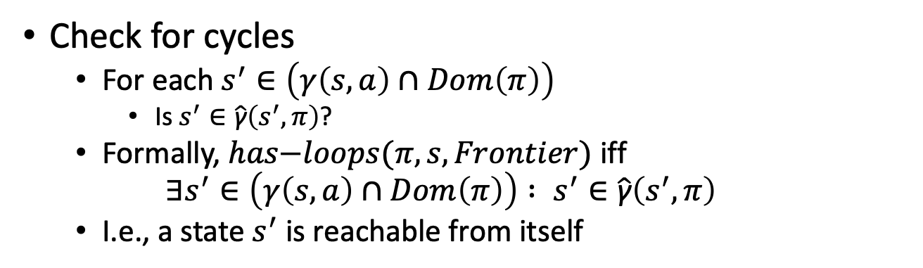
Finding Acyclic Safe Solutions
Find-Acyclic-Solution(Σ,s₀,S_{g})
𝜋 ← ∅
Frontier ← {s₀}
for every s ∈ Frontier \ S_{g} do
Frontier ← Frontier \ {s}
if Applicable(s) = ∅ then
return failure
nondeterministically choose a ∈ Applicable(s)
𝜋 ← 𝜋 ∪ (s,a)
Frontier ← Frontier ∪ (𝛾(s,a) \ Dom(𝜋))
if has-loops(𝜋,s,Frontier) then
return failure
return 𝜋
Keep track of
unexpanded
states, like A*
Add all outcomes that $π$ does not already handle
Cycle-checking
Check for cycles
  For each $s^{′}∈\left(γ\left(s,a\right)∩Dom\left(π\right)\right)$
    Is $s^{′}∈\hat{\text{γ}}\left(s^{′},π\right)$?
  Formally, $has\text{−}loops(π,s,Frontier)$ iff
  $$∃s^{′}∈\left(γ\left(s,a\right)∩Dom\left(π\right)\right) : s^{′}∈\hat{\text{γ}}\left(s^{′},π\right)$$
  I.e., a state $s^{′}$ is reachable from itself

Slide 28
Example
Find-Acyclic-Solution(Σ,s₀,S_{g})
𝜋 ← ∅
Frontier ← {s₀}
...
Frontier ∖ S_{g} = {on_ship}
$S_{g}$
π = {}

Slide 29
Example
Find-Acyclic-Solution(Σ,s₀,S_{g})
...
for every s ∈ Frontier \ S_{g} do
Frontier ← Frontier \ {s}
...
nondeterministically choose a ∈ Applicable(s)
𝜋 ← 𝜋 ∪ (s,a)
Frontier ← Frontier ∪ (𝛾(s,a) \ Dom(𝜋))
if has-loops(𝜋,s,Frontier) then
return failure
return 𝜋
s = on_ship
Frontier ∖ S_{g} = {at_harbor}
$S_{g}$
unload
π = {(on_ship, unload)}

Slide 30
Example
Find-Acyclic-Solution(Σ,s₀,S_{g})
...
for every s ∈ Frontier \ S_{g} do
Frontier ← Frontier \ {s}
...
nondeterministically choose a ∈ Applicable(s)
𝜋 ← 𝜋 ∪ (s,a)
Frontier ← Frontier ∪ (𝛾(s,a) \ Dom(𝜋))
if has-loops(𝜋,s,Frontier) then
return failure
return 𝜋
s = at_harbor
Frontier ∖ S_{g} = {parking1, parking2, transit1}
$S_{g}$
unload
park
π = {(on_ship, unload),
(at_harbor, park)}

Slide 31
Example
Find-Acyclic-Solution(Σ,s₀,S_{g})
...
for every s ∈ Frontier \ S_{g} do
Frontier ← Frontier \ {s}
...
nondeterministically choose a ∈ Applicable(s)
𝜋 ← 𝜋 ∪ (s,a)
Frontier ← Frontier ∪ (𝛾(s,a) \ Dom(𝜋))
if has-loops(𝜋,s,Frontier) then
return failure
return 𝜋
s = parking1
Frontier ∖ S_{g} = {parking2, transit1, transit2}
$S_{g}$
unload
park
deliver
π = {(on_ship, unload),
(at_harbor, park),
(parking1, deliver)}

Slide 32
Example
Find-Acyclic-Solution(Σ,s₀,S_{g})
...
for every s ∈ Frontier \ S_{g} do
Frontier ← Frontier \ {s}
...
nondeterministically choose a ∈ Applicable(s)
𝜋 ← 𝜋 ∪ (s,a)
Frontier ← Frontier ∪ (𝛾(s,a) \ Dom(𝜋))
if has-loops(𝜋,s,Frontier) then
return failure
return 𝜋
nondeterministically choose back or deliver
back ⇒ cycle, so return failure
deliver ⇒ no cycle, so continue
s = parking2
deliver
Frontier ∖ S_{g} = {transit1, transit2, transit3}
$S_{g}$
unload
park
deliver
π = {(on_ship, unload),
(at_harbor, park),
(parking1, deliver),
(parking2, deliver)}

Slide 33
Example
Find-Acyclic-Solution(Σ,s₀,S_{g})
...
for every s ∈ Frontier \ S_{g} do
Frontier ← Frontier \ {s}
...
nondeterministically choose a ∈ Applicable(s)
𝜋 ← 𝜋 ∪ (s,a)
Frontier ← Frontier ∪ (𝛾(s,a) \ Dom(𝜋))
if has-loops(𝜋,s,Frontier) then
return failure
return 𝜋
s = transit1
deliver
Frontier ∖ S_{g} = {transit2, transit3}
$S_{g}$
unload
park
deliver
π = {(on_ship, unload),
(at_harbor, park),
(parking1, deliver),
(parking2, deliver),
(transit1, move)}
move

Slide 34
Example
Find-Acyclic-Solution(Σ,s₀,S_{g})
...
for every s ∈ Frontier \ S_{g} do
Frontier ← Frontier \ {s}
...
nondeterministically choose a ∈ Applicable(s)
𝜋 ← 𝜋 ∪ (s,a)
Frontier ← Frontier ∪ (𝛾(s,a) \ Dom(𝜋))
if has-loops(𝜋,s,Frontier) then
return failure
return 𝜋
s = transit2
deliver
Frontier ∖ S_{g} = {transit3}
$S_{g}$
unload
park
deliver
π = {(on_ship, unload),
(at_harbor, park),
(parking1, deliver),
(parking2, deliver),
(transit1, move),
(transit2, move)}
move
move

Slide 35
Example
Find-Acyclic-Solution(Σ,s₀,S_{g})
...
for every s ∈ Frontier \ S_{g} do
Frontier ← Frontier \ {s}
...
nondeterministically choose a ∈ Applicable(s)
𝜋 ← 𝜋 ∪ (s,a)
Frontier ← Frontier ∪ (𝛾(s,a) \ Dom(𝜋))
if has-loops(𝜋,s,Frontier) then
return failure
return 𝜋
s = transit3
move
deliver
Frontier ∖ S_{g} = ∅
$S_{g}$
Found a solution,
so return π
unload
park
deliver
π = {(on_ship, unload),
(at_harbor, park),
(parking1, deliver),
(parking2, deliver),
(transit1, move),
(transit2, move),
(transit3, move)}
move

Slide 36
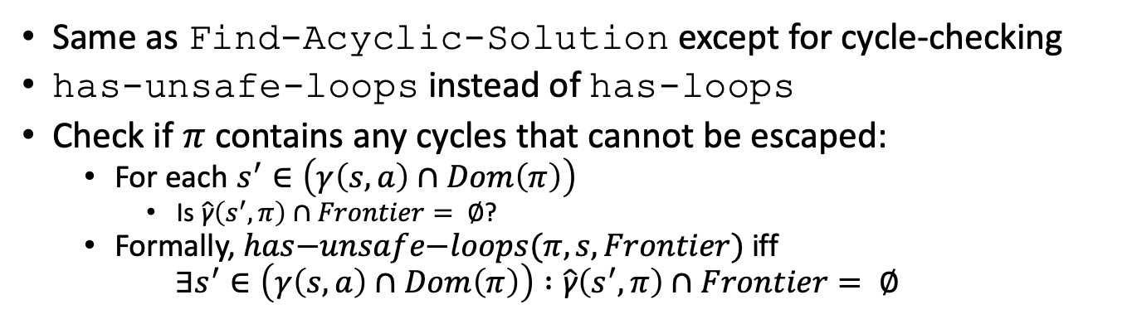
Finding Safe Solutions
Find-Safe-Solution(Σ,s₀,S_{g})
𝜋 ← ∅
Frontier ← {s₀}
for every s ∈ Frontier \ S_{g} do
Frontier ← Frontier \ {s}
if Applicable(s) = ∅ then
return failure
nondeterministically choose a ∈ Applicable(s)
𝜋 ← 𝜋 ∪ (s,a)
Frontier ← Frontier ∪ (𝛾(s,a) \ Dom(𝜋))
if has-unsafe-loops(𝜋,s,Frontier) then
return failure
return 𝜋
Different cycle-checking
Same as Find-Acyclic-Solution except for cycle-checking
has-unsafe-loops instead of has-loops
Check if $π$ contains any cycles that cannot be escaped:
  For each $s^{′}∈\left(γ\left(s,a\right)∩Dom\left(π\right)\right)$
    Is $\hat{\text{γ}}\left(s^{′},π\right)∩Frontier= ∅$?
  Formally, $has\text{−}unsafe\text{−}loops(π,s,Frontier)$ iff
  $$∃s^{′}∈\left(γ\left(s,a\right)∩Dom\left(π\right)\right) :\hat{\text{γ}}\left(s^{′},π\right)∩Frontier= ∅$$
Notes:
$has\text{−}loops(π,s,Frontier)$ iff
$$∃s^{′}∈\left(γ\left(s,a\right)∩Dom\left(π\right)\right) : s^{′}∈\hat{\text{γ}}\left(s^{′},π\right)$$

Slide 37
Example
Find-Safe-Solution(Σ,s₀,S_{g})
𝜋 ← ∅
Frontier ← {s₀}
...
Frontier ∖ S_{g} = {on_ship}
$S_{g}$
π = {}

Slide 38
Example
Find-Safe-Solution(Σ,s₀,S_{g})
...
for every s ∈ Frontier \ S_{g} do
Frontier ← Frontier \ {s}
...
nondeterministically choose a ∈ Applicable(s)
𝜋 ← 𝜋 ∪ (s,a)
Frontier ← Frontier ∪ (𝛾(s,a) \ Dom(𝜋))
if has-unsafe-loops(𝜋,s,Frontier) then
return failure
return 𝜋
s = on_ship
Frontier ∖ S_{g} = {at_harbor}
$S_{g}$
unload
π = {(on_ship, unload)}

Slide 39
Example
Find-Safe-Solution(Σ,s₀,S_{g})
...
for every s ∈ Frontier \ S_{g} do
Frontier ← Frontier \ {s}
...
nondeterministically choose a ∈ Applicable(s)
𝜋 ← 𝜋 ∪ (s,a)
Frontier ← Frontier ∪ (𝛾(s,a) \ Dom(𝜋))
if has-unsafe-loops(𝜋,s,Frontier) then
return failure
return 𝜋
s = at_harbor
Frontier ∖ S_{g} = {parking1, parking2, transit1}
$S_{g}$
unload
park
π = {(on_ship, unload),
(at_harbor, park)}

Slide 40
Example
Find-Safe-Solution(Σ,s₀,S_{g})
...
for every s ∈ Frontier \ S_{g} do
Frontier ← Frontier \ {s}
...
nondeterministically choose a ∈ Applicable(s)
𝜋 ← 𝜋 ∪ (s,a)
Frontier ← Frontier ∪ (𝛾(s,a) \ Dom(𝜋))
if has-unsafe-loops(𝜋,s,Frontier) then
return failure
return 𝜋
s = parking1
Frontier ∖ S_{g} = {parking2, transit1, transit2}
$S_{g}$
unload
park
deliver
π = {(on_ship, unload),
(at_harbor, park),
(parking1, deliver)}

Slide 41
Example
Find-Safe-Solution(Σ,s₀,S_{g})
...
for every s ∈ Frontier \ S_{g} do
Frontier ← Frontier \ {s}
...
nondeterministically choose a ∈ Applicable(s)
𝜋 ← 𝜋 ∪ (s,a)
Frontier ← Frontier ∪ (𝛾(s,a) \ Dom(𝜋))
if has-unsafe-loops(𝜋,s,Frontier) then
return failure
return 𝜋
nondeterministically choose back or deliver
back is okay: escapable cycle
s = parking2
back
Frontier ∖ S_{g} = {transit1, transit2}
$S_{g}$
unload
park
deliver
π = {(on_ship, unload),
(at_harbor, park),
(parking1, deliver),
(parking2, back)}

Slide 42
Example
Find-Safe-Solution(Σ,s₀,S_{g})
...
for every s ∈ Frontier \ S_{g} do
Frontier ← Frontier \ {s}
...
nondeterministically choose a ∈ Applicable(s)
𝜋 ← 𝜋 ∪ (s,a)
Frontier ← Frontier ∪ (𝛾(s,a) \ Dom(𝜋))
if has-unsafe-loops(𝜋,s,Frontier) then
return failure
return 𝜋
s = transit1
back
Frontier ∖ S_{g} = {transit2}
$S_{g}$
unload
park
deliver
π = {(on_ship, unload),
(at_harbor, park),
(parking1, deliver),
(parking2, back),
(transit1, move)}
move

Slide 43
Example
Find-Safe-Solution(Σ,s₀,S_{g})
...
for every s ∈ Frontier \ S_{g} do
Frontier ← Frontier \ {s}
...
nondeterministically choose a ∈ Applicable(s)
𝜋 ← 𝜋 ∪ (s,a)
Frontier ← Frontier ∪ (𝛾(s,a) \ Dom(𝜋))
if has-unsafe-loops(𝜋,s,Frontier) then
return failure
return 𝜋
s = transit2
back
Frontier ∖ S_{g} = ∅
$S_{g}$
Found a solution,
so return π
unload
park
deliver
π = {(on_ship, unload),
(at_harbor, park),
(parking1, deliver),
(parking2, back),
(transit1, move),
(transit2, move)}
move
move

Slide 44
Intermediate Summary
And/Or Graph Search
  Algorithms for each type of solution
    unsafe, cyclic safe, acyclic safe

Slide 45
Outline per the Book
5.2 Planning Problem
  Planning domains
  Plans as policies
  Planning problems and solutions
5.3 And/Or Graph Search
  Planning by forward search
5.5 Determinisation Techniques
  Guided planning for safe solutions
  Planning for safe solutions by determinisation
5.6 Online Approaches
  Lookahead
  Lookahead by Determinisation
  Lookahead with a bounded number of steps
Notes:
4.1 Intro

Slide 46
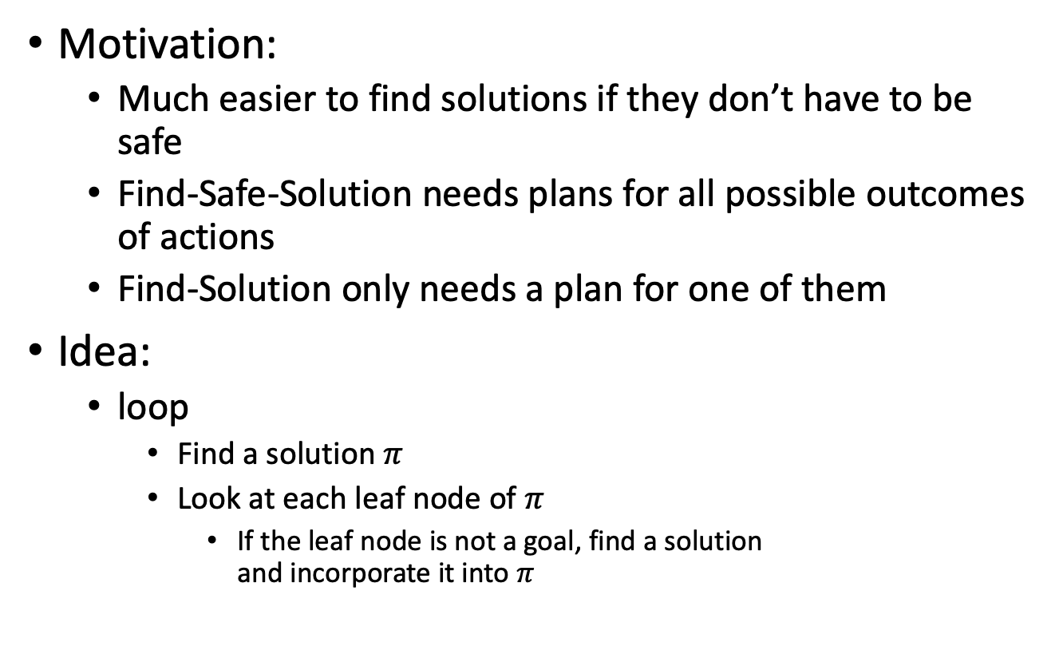
Guided-Find-Safe-Solution
Motivation:
  Much easier to find solutions if they don’t have to be safe
  Find-Safe-Solution needs plans for all possible outcomes of actions
  Find-Solution only needs a plan for one of them
Idea:
  loop
    Find a solution $π$
    Look at each leaf node of $π$
      If the leaf node is not a goal, find a solution
      and incorporate it into $π$

Slide 47
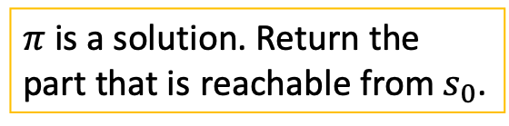

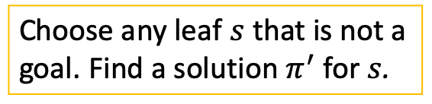
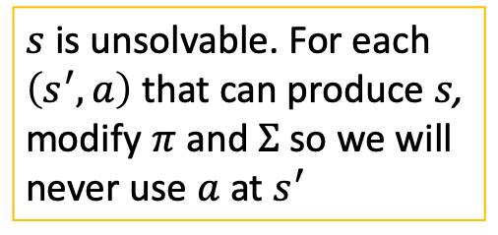
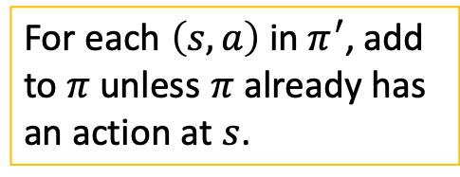
Guided-Find-Safe-Solution
Guided-Find-Safe-Solution(Σ,s₀,S_{g})
if s₀ ∈ S_{g} then
return ∅
if Applicable(s₀) = ∅ then
return failure
𝜋 ← ∅
loop
Q ← leaves(s₀,𝜋) \ S_{g}
if Q = ∅ then
𝜋 ← 𝜋 \ {(s,a) ∈ 𝜋 | s ∉ $\hat{\text{γ}}$(s₀,𝜋)}
return 𝜋
arbitrarily select s ∈ Q
𝜋′ ← Find-Solution(Σ,s,S_{g})
if 𝜋′ ≠ failure then
𝜋 ← 𝜋 ∪ {(s,a) ∈ 𝜋’ | s ∉ Dom(𝜋)}
else if s = s₀ then
return failure
else
for every s’ and a s.t. 𝛾(s’,a) do
𝜋 ← 𝜋 \ {(s’,a)}
make a not applicable in s’
$π$ is a solution. Return the part that is reachable from $s_{0}$.
Choose any leaf $s$ that is not a goal. Find a solution $π^{′}$ for $s$.
For each $\left(s,a\right)$ in $π^{′}$, add to $π$ unless $π$ already has an action at $s$.
⇐ not in the book
$s$ is unsolvable. For each $\left(s^{′},a\right)$ that can produce $s$, modify $π$ and $Σ$ so we will never use $a$ at $s^{′}$

Slide 48

Example
Guided-Find-Safe-Solution(Σ,s₀,S_{g})
...
loop
Q ← leaves(s₀,𝜋) \ S_{g}
if Q = ∅ then
𝜋 ← 𝜋 \ {(s,a) ∈ 𝜋 | s ∉ $\hat{\text{γ}}$(s₀,𝜋)}
return 𝜋
select arbitrarily s ∈ Q
𝜋′ ← Find-Solution(Σ,s,S_{g})
if 𝜋′ ≠ failure then
𝜋 ← 𝜋 ∪ {(s,a) ∈ 𝜋’ | s ∉ Dom(𝜋)}
else if s = s₀ then
return failure
else
for every s’ and a s.t. 𝛾(s’,a) do
𝜋 ← 𝜋 \ {(s’,a)}
make a not applicable in s’
foo
s₀ = on_ship
π = {}
Notes:
Q = {on_ship}

Slide 49
Example
Guided-Find-Safe-Solution(Σ,s₀,S_{g})
...
loop
Q ← leaves(s₀,𝜋) \ S_{g}
if Q = ∅ then
𝜋 ← 𝜋 \ {(s,a) ∈ 𝜋 | s ∉ $\hat{\text{γ}}$(s₀,𝜋)}
return 𝜋
select arbitrarily s ∈ Q
𝜋′ ← Find-Solution(Σ,s,S_{g})
if 𝜋′ ≠ failure then
𝜋 ← 𝜋 ∪ {(s,a) ∈ 𝜋’ | s ∉ Dom(𝜋)}
else if s = s₀ then
return failure
else
for every s’ and a s.t. 𝛾(s’,a) do
𝜋 ← 𝜋 \ {(s’,a)}
make a not applicable in s’
foo
π = {(on_ship, unload),
(at_harbor, park),
(parking1, deliver)}

Slide 50
Example
Guided-Find-Safe-Solution(Σ,s₀,S_{g})
...
loop
Q ← leaves(s₀,𝜋) \ S_{g}
if Q = ∅ then
𝜋 ← 𝜋 \ {(s,a) ∈ 𝜋 | s ∉ $\hat{\text{γ}}$(s₀,𝜋)}
return 𝜋
select arbitrarily s ∈ Q
𝜋′ ← Find-Solution(Σ,s,S_{g})
if 𝜋′ ≠ failure then
𝜋 ← 𝜋 ∪ {(s,a) ∈ 𝜋’ | s ∉ Dom(𝜋)}
else if s = s₀ then
return failure
else
for every s’ and a s.t. 𝛾(s’,a) do
𝜋 ← 𝜋 \ {(s’,a)}
make a not applicable in s’
foo
π = {(on_ship, unload),
(at_harbor, park),
(parking1, deliver).
(parking2, deliver)}

Slide 51
Example
Guided-Find-Safe-Solution(Σ,s₀,S_{g})
...
loop
Q ← leaves(s₀,𝜋) \ S_{g}
if Q = ∅ then
𝜋 ← 𝜋 \ {(s,a) ∈ 𝜋 | s ∉ $\hat{\text{γ}}$(s₀,𝜋)}
return 𝜋
select arbitrarily s ∈ Q
𝜋′ ← Find-Solution(Σ,s,S_{g})
if 𝜋′ ≠ failure then
𝜋 ← 𝜋 ∪ {(s,a) ∈ 𝜋’ | s ∉ Dom(𝜋)}
else if s = s₀ then
return failure
else
for every s’ and a s.t. 𝛾(s’,a) do
𝜋 ← 𝜋 \ {(s’,a)}
make a not applicable in s’
foo
π = {(on_ship, unload),
(at_harbor, park),
(parking1, deliver),
(parking2, deliver),
(transit3, move),
(foo, move)}

Slide 52
Example
Guided-Find-Safe-Solution(Σ,s₀,S_{g})
...
loop
Q ← leaves(s₀,𝜋) \ S_{g}
if Q = ∅ then
𝜋 ← 𝜋 \ {(s,a) ∈ 𝜋 | s ∉ $\hat{\text{γ}}$(s₀,𝜋)}
return 𝜋
select arbitrarily s ∈ Q
𝜋′ ← Find-Solution(Σ,s,S_{g})
if 𝜋′ ≠ failure then
𝜋 ← 𝜋 ∪ {(s,a) ∈ 𝜋’ | s ∉ Dom(𝜋)}
else if s = s₀ then
return failure
else
for every s’ and a s.t. 𝛾(s’,a) do
𝜋 ← 𝜋 \ {(s’,a)}
make a not applicable in s’
fail
foo
π = {(on_ship, unload),
(at_harbor, park),
(parking1, deliver),
(parking2, deliver),
(transit3, move),
(foo, move)}

Slide 53

Example
Guided-Find-Safe-Solution(Σ,s₀,S_{g})
...
loop
Q ← leaves(s₀,𝜋) \ S_{g}
if Q = ∅ then
𝜋 ← 𝜋 \ {(s,a) ∈ 𝜋 | s ∉ $\hat{\text{γ}}$(s₀,𝜋)}
return 𝜋
select arbitrarily s ∈ Q
𝜋′ ← Find-Solution(Σ,s,S_{g})
if 𝜋′ ≠ failure then
𝜋 ← 𝜋 ∪ {(s,a) ∈ 𝜋’ | s ∉ Dom(𝜋)}
else if s = s₀ then
return failure
else
for every s’ and a s.t. 𝛾(s’,a) do
𝜋 ← 𝜋 \ {(s’,a)}
make a not applicable in s’
Modify $Σ_{d}$ to make move inapplicable
foo
π = {(on_ship, unload),
(at_harbor, park),
(parking1, deliver),
(parking2, deliver),
(transit3, move),
(foo, move)}

Slide 54
Example
Guided-Find-Safe-Solution(Σ,s₀,S_{g})
...
loop
Q ← leaves(s₀,𝜋) \ S_{g}
if Q = ∅ then
𝜋 ← 𝜋 \ {(s,a) ∈ 𝜋 | s ∉ $\hat{\text{γ}}$(s₀,𝜋)}
return 𝜋
select arbitrarily s ∈ Q
𝜋′ ← Find-Solution(Σ,s,S_{g})
if 𝜋′ ≠ failure then
𝜋 ← 𝜋 ∪ {(s,a) ∈ 𝜋’ | s ∉ Dom(𝜋)}
else if s = s₀ then
return failure
else
for every s’ and a s.t. 𝛾(s’,a) do
𝜋 ← 𝜋 \ {(s’,a)}
make a not applicable in s’
fail
foo
π = {(on_ship, unload),
(at_harbor, park),
(parking1, deliver),
(parking2, deliver),
(foo, move)}

Slide 55
Example
Guided-Find-Safe-Solution(Σ,s₀,S_{g})
...
loop
Q ← leaves(s₀,𝜋) \ S_{g}
if Q = ∅ then
𝜋 ← 𝜋 \ {(s,a) ∈ 𝜋 | s ∉ $\hat{\text{γ}}$(s₀,𝜋)}
return 𝜋
select arbitrarily s ∈ Q
𝜋′ ← Find-Solution(Σ,s,S_{g})
if 𝜋′ ≠ failure then
𝜋 ← 𝜋 ∪ {(s,a) ∈ 𝜋’ | s ∉ Dom(𝜋)}
else if s = s₀ then
return failure
else
for every s’ and a s.t. 𝛾(s’,a) do
𝜋 ← 𝜋 \ {(s’,a)}
make a not applicable in s’
Modify $Σ_{d}$ to make move inapplicable
foo
π = {(on_ship, unload),
(at_harbor, park),
(parking1, deliver),
(foo, move)}

Slide 56
Example
Guided-Find-Safe-Solution(Σ,s₀,S_{g})
...
loop
Q ← leaves(s₀,𝜋) \ S_{g}
if Q = ∅ then
𝜋 ← 𝜋 \ {(s,a) ∈ 𝜋 | s ∉ $\hat{\text{γ}}$(s₀,𝜋)}
return 𝜋
select arbitrarily s ∈ Q
𝜋′ ← Find-Solution(Σ,s,S_{g})
if 𝜋′ ≠ failure then
𝜋 ← 𝜋 ∪ {(s,a) ∈ 𝜋’ | s ∉ Dom(𝜋)}
else if s = s₀ then
return failure
else
for every s’ and a s.t. 𝛾(s’,a) do
𝜋 ← 𝜋 \ {(s’,a)}
make a not applicable in s’
foo
π = {(on_ship, unload),
(at_harbor, park),
(parking1, deliver),
(foo, move),
(parking2, back)}

Slide 57
Example
Guided-Find-Safe-Solution(Σ,s₀,S_{g})
...
loop
Q ← leaves(s₀,𝜋) \ S_{g}
if Q = ∅ then
𝜋 ← 𝜋 \ {(s,a) ∈ 𝜋 | s ∉ $\hat{\text{γ}}$(s₀,𝜋)}
return 𝜋
select arbitrarily s ∈ Q
𝜋′ ← Find-Solution(Σ,s,S_{g})
if 𝜋′ ≠ failure then
𝜋 ← 𝜋 ∪ {(s,a) ∈ 𝜋’ | s ∉ Dom(𝜋)}
else if s = s₀ then
return failure
else
for every s’ and a s.t. 𝛾(s’,a) do
𝜋 ← 𝜋 \ {(s’,a)}
make a not applicable in s’
foo
π = {(on_ship, unload),
(at_harbor, park),
(parking1, deliver),
(foo, move),
(parking2, back),
(transit1, move)}

Slide 58
Example
Guided-Find-Safe-Solution(Σ,s₀,S_{g})
...
loop
Q ← leaves(s₀,𝜋) \ S_{g}
if Q = ∅ then
𝜋 ← 𝜋 \ {(s,a) ∈ 𝜋 | s ∉ $\hat{\text{γ}}$(s₀,𝜋)}
return 𝜋
select arbitrarily s ∈ Q
𝜋′ ← Find-Solution(Σ,s,S_{g})
if 𝜋′ ≠ failure then
𝜋 ← 𝜋 ∪ {(s,a) ∈ 𝜋’ | s ∉ Dom(𝜋)}
else if s = s₀ then
return failure
else
for every s’ and a s.t. 𝛾(s’,a) do
𝜋 ← 𝜋 \ {(s’,a)}
make a not applicable in s’
foo
π = {(on_ship, unload),
(at_harbor, park),
(parking1, deliver),
(foo, move),
(parking2, back),
(transit1, move),
(transit2, move)}

Slide 59
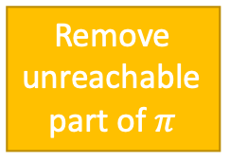
Example
Guided-Find-Safe-Solution(Σ,s₀,S_{g})
...
loop
Q ← leaves(s₀,𝜋) \ S_{g}
if Q = ∅ then
𝜋 ← 𝜋 \ {(s,a) ∈ 𝜋 | s ∉ $\hat{\text{γ}}$(s₀,𝜋)}
return 𝜋
select arbitrarily s ∈ Q
𝜋′ ← Find-Solution(Σ,s,S_{g})
if 𝜋′ ≠ failure then
𝜋 ← 𝜋 ∪ {(s,a) ∈ 𝜋’ | s ∉ Dom(𝜋)}
else if s = s₀ then
return failure
else
for every s’ and a s.t. 𝛾(s’,a) do
𝜋 ← 𝜋 \ {(s’,a)}
make a not applicable in s’
Remove unreachable part of $π$
foo
π = {(on_ship, unload),
(at_harbor, park),
(parking1, deliver),
(foo, move),
(parking2, back),
(transit1, move),
(transit2, move)}

Slide 60

Determinisation
Guided-Find-Safe-Solution(Σ,s₀,S_{g})
if s₀ ∈ S_{g} then
return ∅
if Applicable(s₀) = ∅ then
return failure
𝜋 ← ∅
loop
Q ← leaves(s₀,𝜋) \ S_{g}
if Q = ∅ then
𝜋 ← 𝜋 \ {(s,a) ∈ 𝜋 | s ∉ $\hat{\text{γ}}$(s₀,𝜋)}
return 𝜋
select arbitrarily s ∈ Q
𝜋′ ← Find-Solution(Σ,s,S_{g})
if 𝜋′ ≠ failure then
𝜋 ← 𝜋 ∪ {(s,a) ∈ 𝜋’ | s ∉ Dom(𝜋)}
else if s = s₀ then
return failure
else
for every s’ and a s.t. 𝛾(s’,a) do
𝜋 ← 𝜋 \ {(s’,a)}
make a not applicable in s’
How to implement it?
  Need implementation of Find-Solution
  Need it to be very efficient
    Called many times
Idea: instead, use a classical planner
  Any algorithm from Chapter 2
  Efficient algorithms, search heuristics
For that, determinise actions

Slide 61
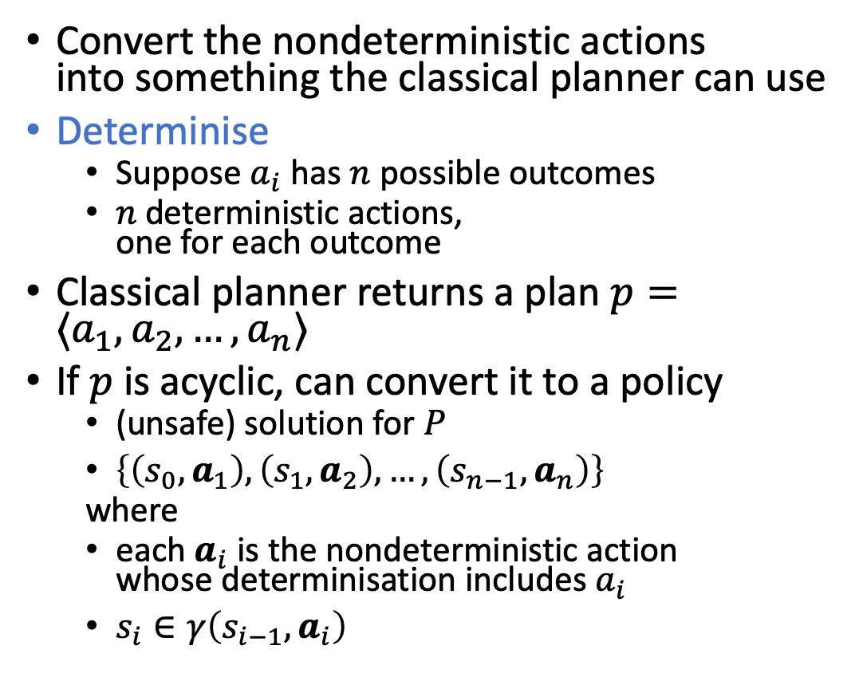
Determinisation
Convert the nondeterministic actions
into something the classical planner can use
Determinise
  Suppose $a_{i}$ has $n$ possible outcomes
  $n$ deterministic actions,
  one for each outcome
Classical planner returns a plan $p=⟨a_{1}, a_{2}, …, a_{n}⟩$
If $p$ is acyclic, can convert it to a policy
  (unsafe) solution for $P$
  $\left\{\left(s_{0},a_{1}\right), \left(s_{1},a_{2}\right), …, \left(s_{n−1},a_{n}\right)\right\}$
  where
  each $a_{i}$ is the nondeterministic action
  whose determinisation includes $a_{i}$
  $s_{i}∈γ\left(s_{i−1},a_{i}\right)$
at_harbor
park
parking1
transit1
parking2
at_harbor
park1
park3
park2
parking1
transit1
parking2

Slide 62
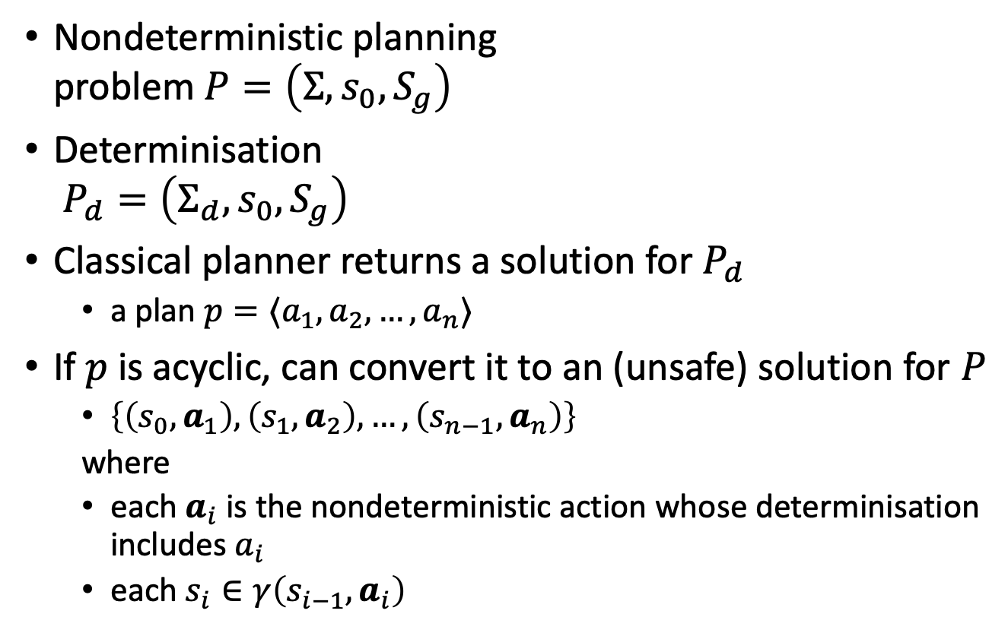
Determinisation
Nondeterministic planning
problem $P=\left(Σ, s_{0}, S_{g}\right)$
Determinisation
$P_{d}=\left(Σ_{d}, s_{0}, S_{g}\right)$
Classical planner returns a solution for $P_{d}$
  a plan $p=⟨a_{1}, a_{2}, …, a_{n}⟩$
If $p$ is acyclic, can convert it to an (unsafe) solution for $P$
  $\left\{\left(s_{0},a_{1}\right), \left(s_{1},a_{2}\right), …, \left(s_{n−1},a_{n}\right)\right\}$
  where
  each $a_{i}$ is the nondeterministic action whose determinisation includes $a_{i}$
  each $s_{i}∈γ\left(s_{i−1},a_{i}\right)$
Plan2policy(p=⟨a₁,...,a_{n}⟩,s)
𝜋 ← ∅
for i from 1 to n do
𝜋 ← 𝜋 ∪ {s,det2nondet(a_{i})}
s ← 𝛾_{d}(s,a_{i})
return π

Slide 63
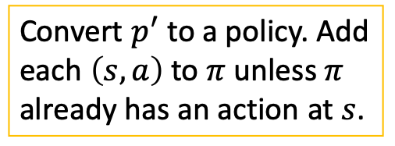

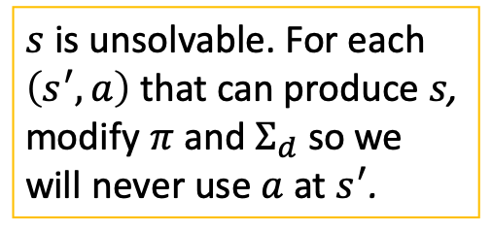
Guided-Find-Safe-Solution
Find-Safe-Solution-by-Determinisation(Σ,s₀,S_{g})
if s₀ ∈ S_{g} then
return ∅
if Applicable(s₀) = ∅ then
return failure
𝜋 ← ∅
Σ_{d} ← mk-deterministic(Σ)
loop
Q ← leaves(s₀,𝜋) \ S_{g}
if Q = ∅ then
𝜋 ← 𝜋 \ {(s,a) ∈ 𝜋 | s ∉ $\hat{\text{γ}}$(s₀,𝜋)}
return 𝜋
select arbitrarily s ∈ Q
p′ ← Forward-search(Σ_{d},s,S_{g})
if p′ ≠ fail then
𝜋 ← Plan2policy(p’,s)
𝜋 ← 𝜋 ∪ {(s,a) ∈ 𝜋’ | s ∉ Dom(𝜋)}
else if s = s₀ then
return failure
else
for every s’ and a s.t. 𝛾(s’,a) do
𝜋 ← 𝜋 \ {(s’,a)}
make the actions in the
determinisation not
applicable in s’
Same as Guided-Find-Safe-Solution.
Any classical planner that does not return cyclic plans.
Convert $p^{′}$ to a policy. Add each $\left(s,a\right)$ to $π$ unless $π$ already has an action at $s$.
$s$ is unsolvable. For each $\left(s^{′},a\right)$ that can produce $s$, modify $π$ and $Σ_{d}$ so we will never use $a$ at $s^{′}$.

Slide 64

Example
Find-Safe-Solution-by-Determinisation(Σ,s₀,S_{g})
...
Σ_{d} ← mk-deterministic(Σ)
loop
Q ← leaves(s₀,𝜋) \ S_{g}
if Q = ∅ then
𝜋 ← 𝜋 \ {(s,a) ∈ 𝜋 | s ∉ $\hat{\text{γ}}$(s₀,𝜋)}
return 𝜋
select arbitrarily s ∈ Q
p′ ← Forward-search(Σ_{d},s,S_{g})
if p′ ≠ fail then
𝜋 ← Plan2policy(p’,s)
𝜋 ← 𝜋 ∪ {(s,a) ∈ 𝜋’ | s ∉ Dom(𝜋)}
else if … else
for every s’ and a s.t. 𝛾(s’,a) do
𝜋 ← 𝜋 \ {(s’,a)}
make actions in determinisation
not applicable in s’
foo
Notes:
yellow: deterministic planning domain

Slide 65
Example
Find-Safe-Solution-by-Determinisation(Σ,s₀,S_{g})
...
Σ_{d} ← mk-deterministic(Σ)
loop
Q ← leaves(s₀,𝜋) \ S_{g}
if Q = ∅ then
𝜋 ← 𝜋 \ {(s,a) ∈ 𝜋 | s ∉ $\hat{\text{γ}}$(s₀,𝜋)}
return 𝜋
select arbitrarily s ∈ Q
p′ ← Forward-search(Σ_{d},s,S_{g})
if p′ ≠ fail then
𝜋 ← Plan2policy(p’,s)
𝜋 ← 𝜋 ∪ {(s,a) ∈ 𝜋’ | s ∉ Dom(𝜋)}
else if … else
for every s’ and a s.t. 𝛾(s’,a) do
𝜋 ← 𝜋 \ {(s’,a)}
make actions in determinisation
not applicable in s’
foo

Slide 66
Example
Find-Safe-Solution-by-Determinisation(Σ,s₀,S_{g})
...
Σ_{d} ← mk-deterministic(Σ)
loop
Q ← leaves(s₀,𝜋) \ S_{g}
if Q = ∅ then
𝜋 ← 𝜋 \ {(s,a) ∈ 𝜋 | s ∉ $\hat{\text{γ}}$(s₀,𝜋)}
return 𝜋
select arbitrarily s ∈ Q
p′ ← Forward-search(Σ_{d},s,S_{g})
if p′ ≠ fail then
𝜋 ← Plan2policy(p’,s)
𝜋 ← 𝜋 ∪ {(s,a) ∈ 𝜋’ | s ∉ Dom(𝜋)}
else if … else
for every s’ and a s.t. 𝛾(s’,a) do
𝜋 ← 𝜋 \ {(s’,a)}
make actions in determinisation
not applicable in s’
foo

Slide 67
Example
Find-Safe-Solution-by-Determinisation(Σ,s₀,S_{g})
...
Σ_{d} ← mk-deterministic(Σ)
loop
Q ← leaves(s₀,𝜋) \ S_{g}
if Q = ∅ then
𝜋 ← 𝜋 \ {(s,a) ∈ 𝜋 | s ∉ $\hat{\text{γ}}$(s₀,𝜋)}
return 𝜋
select arbitrarily s ∈ Q
p′ ← Forward-search(Σ_{d},s,S_{g})
if p′ ≠ fail then
𝜋 ← Plan2policy(p’,s)
𝜋 ← 𝜋 ∪ {(s,a) ∈ 𝜋’ | s ∉ Dom(𝜋)}
else if … else
for every s’ and a s.t. 𝛾(s’,a) do
𝜋 ← 𝜋 \ {(s’,a)}
make actions in determinisation
not applicable in s’
foo

Slide 68
Example
Find-Safe-Solution-by-Determinisation(Σ,s₀,S_{g})
...
Σ_{d} ← mk-deterministic(Σ)
loop
Q ← leaves(s₀,𝜋) \ S_{g}
if Q = ∅ then
𝜋 ← 𝜋 \ {(s,a) ∈ 𝜋 | s ∉ $\hat{\text{γ}}$(s₀,𝜋)}
return 𝜋
select arbitrarily s ∈ Q
p′ ← Forward-search(Σ_{d},s,S_{g})
if p′ ≠ fail then
𝜋 ← Plan2policy(p’,s)
𝜋 ← 𝜋 ∪ {(s,a) ∈ 𝜋’ | s ∉ Dom(𝜋)}
else if … else
for every s’ and a s.t. 𝛾(s’,a) do
𝜋 ← 𝜋 \ {(s’,a)}
make actions in determinisation
not applicable in s’
foo

Slide 69
Example
Find-Safe-Solution-by-Determinisation(Σ,s₀,S_{g})
...
Σ_{d} ← mk-deterministic(Σ)
loop
Q ← leaves(s₀,𝜋) \ S_{g}
if Q = ∅ then
𝜋 ← 𝜋 \ {(s,a) ∈ 𝜋 | s ∉ $\hat{\text{γ}}$(s₀,𝜋)}
return 𝜋
select arbitrarily s ∈ Q
p′ ← Forward-search(Σ_{d},s,S_{g})
if p′ ≠ fail then
𝜋 ← Plan2policy(p’,s)
𝜋 ← 𝜋 ∪ {(s,a) ∈ 𝜋’ | s ∉ Dom(𝜋)}
else if … else
for every s’ and a s.t. 𝛾(s’,a) do
𝜋 ← 𝜋 \ {(s’,a)}
make actions in determinisation
not applicable in s’
foo

Slide 70
Example
Find-Safe-Solution-by-Determinisation(Σ,s₀,S_{g})
...
Σ_{d} ← mk-deterministic(Σ)
loop
Q ← leaves(s₀,𝜋) \ S_{g}
if Q = ∅ then
𝜋 ← 𝜋 \ {(s,a) ∈ 𝜋 | s ∉ $\hat{\text{γ}}$(s₀,𝜋)}
return 𝜋
select arbitrarily s ∈ Q
p′ ← Forward-search(Σ_{d},s,S_{g})
if p′ ≠ fail then
𝜋 ← Plan2policy(p’,s)
𝜋 ← 𝜋 ∪ {(s,a) ∈ 𝜋’ | s ∉ Dom(𝜋)}
else if … else
for every s’ and a s.t. 𝛾(s’,a) do
𝜋 ← 𝜋 \ {(s’,a)}
make actions in determinisation
not applicable in s’
fail
foo

Slide 71
Example
Find-Safe-Solution-by-Determinisation(Σ,s₀,S_{g})
...
Σ_{d} ← mk-deterministic(Σ)
loop
Q ← leaves(s₀,𝜋) \ S_{g}
if Q = ∅ then
𝜋 ← 𝜋 \ {(s,a) ∈ 𝜋 | s ∉ $\hat{\text{γ}}$(s₀,𝜋)}
return 𝜋
select arbitrarily s ∈ Q
p′ ← Forward-search(Σ_{d},s,S_{g})
if p′ ≠ fail then
𝜋 ← Plan2policy(p’,s)
𝜋 ← 𝜋 ∪ {(s,a) ∈ 𝜋’ | s ∉ Dom(𝜋)}
else if … else
for every s’ and a s.t. 𝛾(s’,a) do
𝜋 ← 𝜋 \ {(s’,a)}
make actions in determinisation
not applicable in s’
Modify $Σ_{d}$ to make move inapplicable
foo

Slide 72
Example
Find-Safe-Solution-by-Determinisation(Σ,s₀,S_{g})
...
Σ_{d} ← mk-deterministic(Σ)
loop
Q ← leaves(s₀,𝜋) \ S_{g}
if Q = ∅ then
𝜋 ← 𝜋 \ {(s,a) ∈ 𝜋 | s ∉ $\hat{\text{γ}}$(s₀,𝜋)}
return 𝜋
select arbitrarily s ∈ Q
p′ ← Forward-search(Σ_{d},s,S_{g})
if p′ ≠ fail then
𝜋 ← Plan2policy(p’,s)
𝜋 ← 𝜋 ∪ {(s,a) ∈ 𝜋’ | s ∉ Dom(𝜋)}
else if … else
for every s’ and a s.t. 𝛾(s’,a) do
𝜋 ← 𝜋 \ {(s’,a)}
make actions in determinisation
not applicable in s’
fail
foo

Slide 73
Example
Find-Safe-Solution-by-Determinisation(Σ,s₀,S_{g})
...
Σ_{d} ← mk-deterministic(Σ)
loop
Q ← leaves(s₀,𝜋) \ S_{g}
if Q = ∅ then
𝜋 ← 𝜋 \ {(s,a) ∈ 𝜋 | s ∉ $\hat{\text{γ}}$(s₀,𝜋)}
return 𝜋
select arbitrarily s ∈ Q
p′ ← Forward-search(Σ_{d},s,S_{g})
if p′ ≠ fail then
𝜋 ← Plan2policy(p’,s)
𝜋 ← 𝜋 ∪ {(s,a) ∈ 𝜋’ | s ∉ Dom(𝜋)}
else if … else
for every s’ and a s.t. 𝛾(s’,a) do
𝜋 ← 𝜋 \ {(s’,a)}
make actions in determinisation
not applicable in s’
Modify $Σ_{d}$ to make move inapplicable
foo

Slide 74
Example
Find-Safe-Solution-by-Determinisation(Σ,s₀,S_{g})
...
Σ_{d} ← mk-deterministic(Σ)
loop
Q ← leaves(s₀,𝜋) \ S_{g}
if Q = ∅ then
𝜋 ← 𝜋 \ {(s,a) ∈ 𝜋 | s ∉ $\hat{\text{γ}}$(s₀,𝜋)}
return 𝜋
select arbitrarily s ∈ Q
p′ ← Forward-search(Σ_{d},s,S_{g})
if p′ ≠ fail then
𝜋 ← Plan2policy(p’,s)
𝜋 ← 𝜋 ∪ {(s,a) ∈ 𝜋’ | s ∉ Dom(𝜋)}
else if … else
for every s’ and a s.t. 𝛾(s’,a) do
𝜋 ← 𝜋 \ {(s’,a)}
make actions in determinisation
not applicable in s’
foo

Slide 75
Example
Find-Safe-Solution-by-Determinisation(Σ,s₀,S_{g})
...
Σ_{d} ← mk-deterministic(Σ)
loop
Q ← leaves(s₀,𝜋) \ S_{g}
if Q = ∅ then
𝜋 ← 𝜋 \ {(s,a) ∈ 𝜋 | s ∉ $\hat{\text{γ}}$(s₀,𝜋)}
return 𝜋
select arbitrarily s ∈ Q
p′ ← Forward-search(Σ_{d},s,S_{g})
if p′ ≠ fail then
𝜋 ← Plan2policy(p’,s)
𝜋 ← 𝜋 ∪ {(s,a) ∈ 𝜋’ | s ∉ Dom(𝜋)}
else if … else
for every s’ and a s.t. 𝛾(s’,a) do
𝜋 ← 𝜋 \ {(s’,a)}
make actions in determinisation
not applicable in s’
foo

Slide 76
Example
Find-Safe-Solution-by-Determinisation(Σ,s₀,S_{g})
...
Σ_{d} ← mk-deterministic(Σ)
loop
Q ← leaves(s₀,𝜋) \ S_{g}
if Q = ∅ then
𝜋 ← 𝜋 \ {(s,a) ∈ 𝜋 | s ∉ $\hat{\text{γ}}$(s₀,𝜋)}
return 𝜋
select arbitrarily s ∈ Q
p′ ← Forward-search(Σ_{d},s,S_{g})
if p′ ≠ fail then
𝜋 ← Plan2policy(p’,s)
𝜋 ← 𝜋 ∪ {(s,a) ∈ 𝜋’ | s ∉ Dom(𝜋)}
else if … else
for every s’ and a s.t. 𝛾(s’,a) do
𝜋 ← 𝜋 \ {(s’,a)}
make actions in determinisation
not applicable in s’
foo

Slide 77
Example
Find-Safe-Solution-by-Determinisation(Σ,s₀,S_{g})
...
Σ_{d} ← mk-deterministic(Σ)
loop
Q ← leaves(s₀,𝜋) \ S_{g}
if Q = ∅ then
𝜋 ← 𝜋 \ {(s,a) ∈ 𝜋 | s ∉ $\hat{\text{γ}}$(s₀,𝜋)}
return 𝜋
select arbitrarily s ∈ Q
p′ ← Forward-search(Σ_{d},s,S_{g})
if p′ ≠ fail then
𝜋 ← Plan2policy(p’,s)
𝜋 ← 𝜋 ∪ {(s,a) ∈ 𝜋’ | s ∉ Dom(𝜋)}
else if … else
for every s’ and a s.t. 𝛾(s’,a) do
𝜋 ← 𝜋 \ {(s’,a)}
make actions in determinisation
not applicable in s’
foo

Slide 78
Example
Find-Safe-Solution-by-Determinisation(Σ,s₀,S_{g})
...
Σ_{d} ← mk-deterministic(Σ)
loop
Q ← leaves(s₀,𝜋) \ S_{g}
if Q = ∅ then
𝜋 ← 𝜋 \ {(s,a) ∈ 𝜋 | s ∉ $\hat{\text{γ}}$(s₀,𝜋)}
return 𝜋
select arbitrarily s ∈ Q
p′ ← Forward-search(Σ_{d},s,S_{g})
if p′ ≠ fail then
𝜋 ← Plan2policy(p’,s)
𝜋 ← 𝜋 ∪ {(s,a) ∈ 𝜋’ | s ∉ Dom(𝜋)}
else if … else
for every s’ and a s.t. 𝛾(s’,a) do
𝜋 ← 𝜋 \ {(s’,a)}
make actions in determinisation
not applicable in s’
foo

Slide 79
Example
Find-Safe-Solution-by-Determinisation(Σ,s₀,S_{g})
...
Σ_{d} ← mk-deterministic(Σ)
loop
Q ← leaves(s₀,𝜋) \ S_{g}
if Q = ∅ then
𝜋 ← 𝜋 \ {(s,a) ∈ 𝜋 | s ∉ $\hat{\text{γ}}$(s₀,𝜋)}
return 𝜋
select arbitrarily s ∈ Q
p′ ← Forward-search(Σ_{d},s,S_{g})
if p′ ≠ fail then
𝜋 ← Plan2policy(p’,s)
𝜋 ← 𝜋 ∪ {(s,a) ∈ 𝜋’ | s ∉ Dom(𝜋)}
else if … else
for every s’ and a s.t. 𝛾(s’,a) do
𝜋 ← 𝜋 \ {(s’,a)}
make actions in determinisation
not applicable in s’
foo

Slide 80
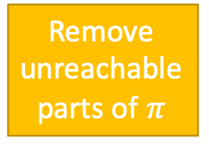
Example
Find-Safe-Solution-by-Determinisation(Σ,s₀,S_{g})
...
Σ_{d} ← mk-deterministic(Σ)
loop
Q ← leaves(s₀,𝜋) \ S_{g}
if Q = ∅ then
𝜋 ← 𝜋 \ {(s,a) ∈ 𝜋 | s ∉ $\hat{\text{γ}}$(s₀,𝜋)}
return 𝜋
select arbitrarily s ∈ Q
p′ ← Forward-search(Σ_{d},s,S_{g})
if p′ ≠ fail then
𝜋 ← Plan2policy(p’,s)
𝜋 ← 𝜋 ∪ {(s,a) ∈ 𝜋’ | s ∉ Dom(𝜋)}
else if … else
for every s’ and a s.t. 𝛾(s’,a) do
𝜋 ← 𝜋 \ {(s’,a)}
make actions in determinisation
not applicable in s’
Remove unreachable parts of $π$
foo

Slide 81
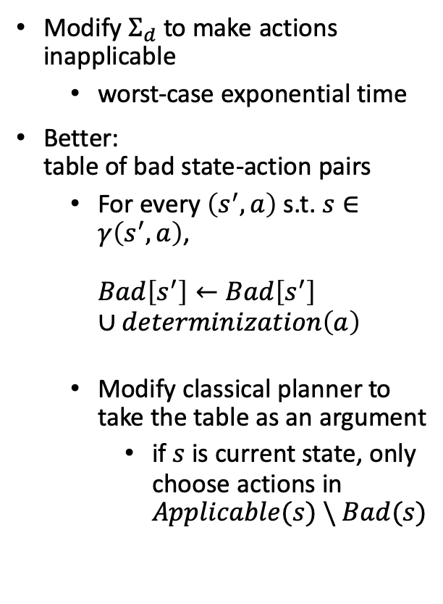
Making Actions Inapplicable
Find-Safe-Solution-by-Determinisation(Σ,s₀,S_{g})
if s₀ ∈ S_{g} then
return ∅
if Applicable(s₀) = ∅ then
return failure
𝜋 ← ∅
Σ_{d} ← mk-deterministic(Σ)
loop
Q ← leaves(s₀,𝜋) \ S_{g}
if Q = ∅ then
𝜋 ← 𝜋 \ {(s,a) ∈ 𝜋 | s ∉ $\hat{\text{γ}}$(s₀,𝜋)}
return 𝜋
select arbitrarily s ∈ Q
p′ ← Forward-search(Σ_{d},s,S_{g})
if p′ ≠ fail then
𝜋 ← Plan2policy(p’,s)
𝜋 ← 𝜋 ∪ {(s,a) ∈ 𝜋’ | s ∉ Dom(𝜋)}
else if s = s₀ then
return failure
else
for every s’ and a s.t. 𝛾(s’,a) do
𝜋 ← 𝜋 \ {(s’,a)}
make the actions in the
determinisation not
applicable in s’
Modify $Σ_{d}$ to make actions inapplicable
  worst-case exponential time
Better:
table of bad state-action pairs
  For every $\left(s^{′},a\right)$ s.t. $s∈γ\left(s^{′},a\right)$,
  $Bad\left[s^{′}\right]←Bad\left[s^{′}\right]$
  $∪determinization\left(a\right)$
  Modify classical planner to take the table as an argument
    if $s$ is current state, only choose actions in $Applicable(s) \backslash Bad(s)$

Slide 82
Intermediate Summary
Determinisation Techniques
  Guided-find-safe-solution
    call find-solution to get an unsafe solution
    call find-solution additional times on the leaves
  Find-safe-solution-by-determinization
    use determinized actions
    call classical planner rather than find-solution
    if dead-ends are encountered, modify actions that lead to them

Slide 83
Outline per the Book
5.2 Planning Problem
  Planning domains
  Plans as policies
  Planning problems and solutions
5.3 And/Or Graph Search
  Planning by forward search
5.5 Determinisation Techniques
  Guided planning for safe solutions
  Planning for safe solutions by determinisation
5.6 Online Approaches
  Lookahead
  Lookahead by Determinisation
  Lookahead with a bounded number of steps
Notes:
4.1 Intro

Slide 84
Online Approaches
Motivation
  Planning models are approximate – execution seldom works out as planned
  Large problems may require too much planning time
2nd motivation even more stronger in nondeterministic domains
  Nondeterminism makes planning exponentially harder
    Exponentially more time, exponentially larger policies
Offline vs Runtime
Search Spaces

Slide 85
Online Approaches
Need to identify good actions without exploring entire search space
  Can be done using heuristic estimates
Some domains are safely explorable
  Safe to create partial plans, because goal states are reachable from all situations
Other domains contain dead-ends, partial planning will not guarantee success
  Can get trapped in dead ends that we would have detected if we had planned fully
    No applicable actions
      Robot goes down a steep incline and can’t come back up
    Applicable actions, but caught in a loop
      Robot goes into a collection of rooms from which there’s no exit
  However, partial planning can still make success more likely

Slide 86
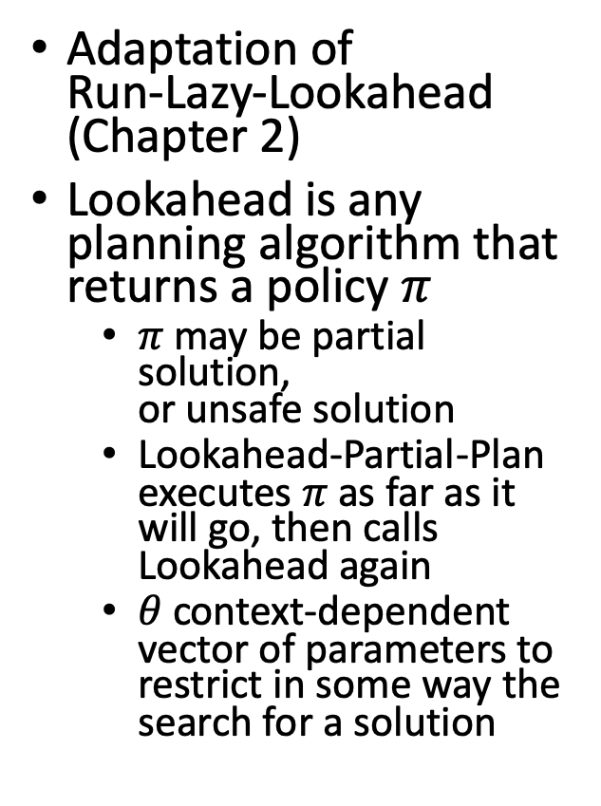
Lookahead-Partial-Plan
Adaptation of
Run-Lazy-Lookahead (Chapter 2)
Lookahead is any planning algorithm that returns a policy $π$
  $π$ may be partial solution,
  or unsafe solution
  Lookahead-Partial-Plan executes $π$ as far as it will go, then calls Lookahead again
  $θ$ context-dependent vector of parameters to restrict in some way the search for a solution
Lookahead-Partial-Plan(Σ,s₀,S_{g})
s ← s₀
while s ∉ S_{g} and Applicable(s) ≠ ∅ do
𝜋 ← Lookahead(s,𝜃)
if 𝜋 = ∅ then
return failure
else
perform partial plan 𝜋
s ← observe current state

Slide 87
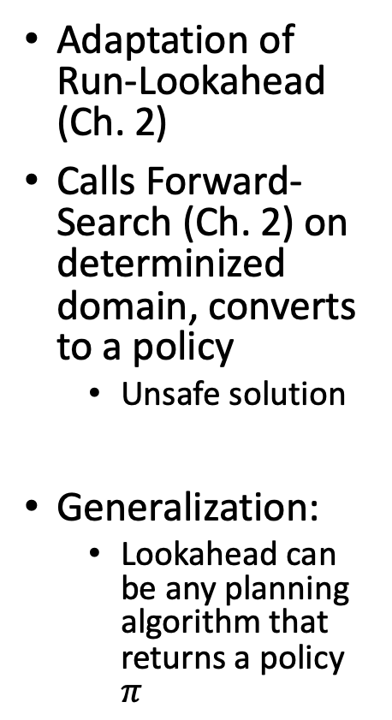
FS-Replan
Adaptation of
Run-Lookahead
(Ch. 2)
Calls Forward-Search (Ch. 2) on
determinized domain, converts to a policy
  Unsafe solution
Generalization:
  Lookahead can
  be any planning
  algorithm that
  returns a policy $π$
FS-Replan(Σ,s,S_{g})
𝜋_{d} ← ∅
while s ∉ S_{g} and Applicable(s) ≠ ∅ do
if 𝜋_{d} undefined for s then
𝜋_{d} ← Plan2policy(Forward-search(Σ_{d},s,S_{g}),s)
if 𝜋_{d} = failure then
return failure
perform action 𝜋_{d}(s)
s ← observe resulting state
Generalised-FS-Replan(Σ,s,S_{g})
𝜋_{d} ← ∅
while s ∉ S_{g} and Applicable(s) ≠ ∅ do
if 𝜋_{d} undefined for s then
𝜋_{d} ← Lookahead(s,𝜃)
if 𝜋_{d} = failure then
return failure
perform action 𝜋_{d}(s)
s ← observe resulting state

Slide 88
Possibilities for Lookahead
Lookahead could be one of the algorithms we discussed earlier
  Find-Safe-Solution
  Find-Acyclic-Solution
  Guided-Find-Safe-Solution
  Find-Safe-Solution-by-Determinization
What if it doesn’t have time
to run to completion?
  Can use the same techniques,
  we discussed in Chapter 3
    Receding horizon
    Sampling
    Subgoaling
    Iterative Deepening
Planning stage
Acting stage

Slide 89
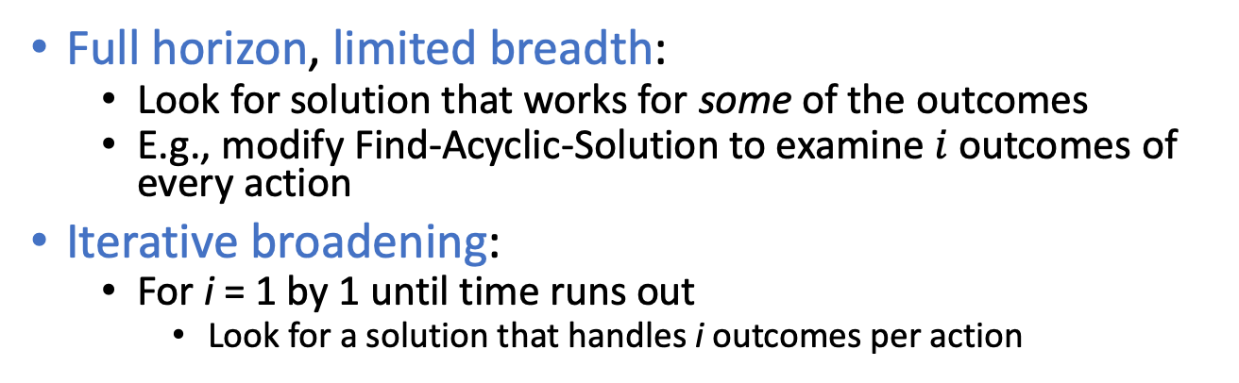
Possibilities for Lookahead (ct’d)
Full horizon, limited breadth:
  Look for solution that works for some of the outcomes
  E.g., modify Find-Acyclic-Solution to examine $i$ outcomes of every action
Iterative broadening:
  For i = 1 by 1 until time runs out
    Look for a solution that handles i outcomes per action
Find-Acyclic-Solution(Σ,s₀,S_{g})
𝜋 ← ∅
Frontier ← {s₀}
for every s ∈ Frontier \ S_{g} do
Frontier ← Frontier \ {s}
if Applicable(s) = ∅ then
return failure
nondeterministically choose a ∈ Applicable(s)
𝜋 ← 𝜋 ∪ (s,a)
Frontier ← Frontier ∪ (𝛾(s,a) \ Dom(𝜋))
if has-loops(𝜋,s,Frontier) then
return failure
return 𝜋
T ← i elements
of 𝛾(s,a) \ Dom(𝜋)
Frontier ← Frontier ∪ T

Slide 90
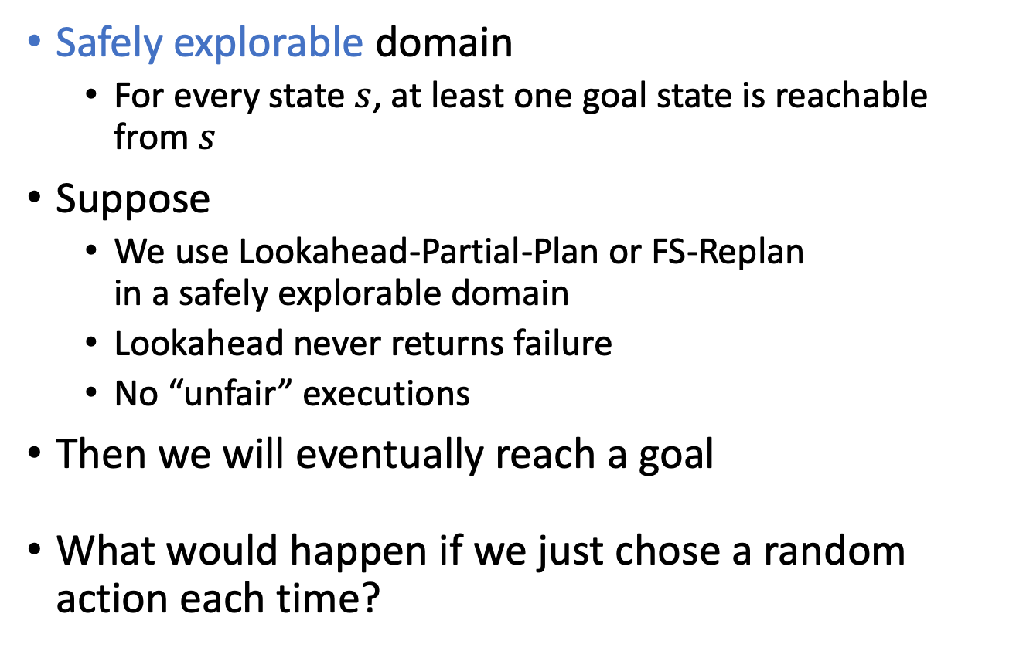
Safely Explorable Domains
Safely explorable domain
  For every state $s$, at least one goal state is reachable from $s$
Suppose
  We use Lookahead-Partial-Plan or FS-Replan
  in a safely explorable domain
  Lookahead never returns failure
  No “unfair” executions
Then we will eventually reach a goal
What would happen if we just chose a random action each time?

Slide 91
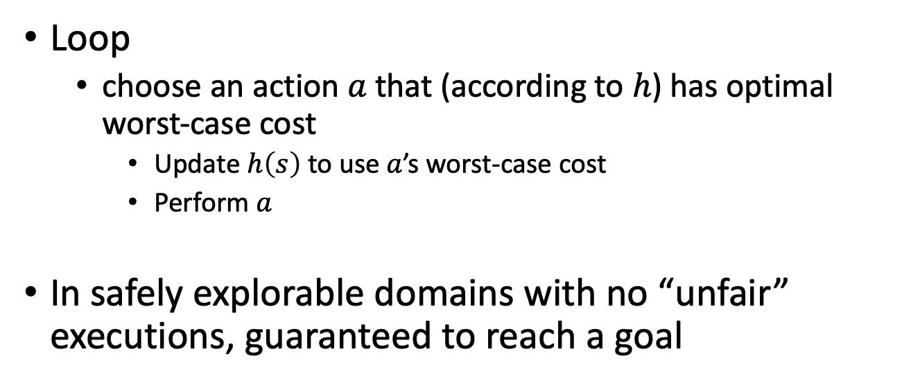
Min-Max LRTA*
Min-Max-LRTA*(Σ,s₀,S_{g})
s ← s₀
while s ∉ S_{g} and Applicable(s) ≠ ∅ do
a ← argmin_{a∈Applicable(s)} max_{s’∈𝛾(s,a)} h(s’)
h(s) ← max{h(s),1 + max_{s’∈𝛾(s,a)} h(s’)}
perform action a
s ← the current state
Assumes each action has cost 1
Can easily be modified to use cost ≠ 1
Loop
  choose an action $a$ that (according to $h$) has optimal worst-case cost
    Update $h\left(s\right)$ to use $a$’s worst-case cost
    Perform $a$
In safely explorable domains with no “unfair” executions, guaranteed to reach a goal

Slide 92
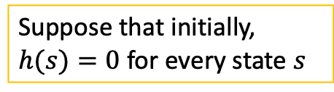
Example
Min-Max-LRTA*(Σ,s₀,S_{g})
s ← s₀
while s ∉ S_{g} and Applicable(s) ≠ ∅ do
a ← argmin_{a∈Applicable(s)} max_{s’∈𝛾(s,a)} h(s’)
h(s) ← max{h(s),1 + max_{s’∈𝛾(s,a)} h(s’)}
perform action a
s ← the current state
Suppose that initially,
$h(s)=0$ for every state $s$
h = 0

Slide 93
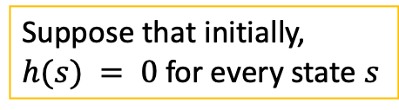
Example
Min-Max-LRTA*(Σ,s₀,S_{g})
s ← s₀
while s ∉ S_{g} and Applicable(s) ≠ ∅ do
a ← argmin_{a∈Applicable(s)} max_{s’∈𝛾(s,a)} h(s’)
h(s) ← max{h(s),1 + max_{s’∈𝛾(s,a)} h(s’)}
perform action a
s ← the current state
Suppose that initially,
$h(s) = 0$ for every state $s$
a = unload
h = 1
h = 0

Slide 94
Example
Min-Max-LRTA*(Σ,s₀,S_{g})
s ← s₀
while s ∉ S_{g} and Applicable(s) ≠ ∅ do
a ← argmin_{a∈Applicable(s)} max_{s’∈𝛾(s,a)} h(s’)
h(s) ← max{h(s),1 + max_{s’∈𝛾(s,a)} h(s’)}
perform action a
s ← the current state
Suppose that initially,
$h(s) = 0$ for every state $s$
h = 0
a = unload
h = 1
h = 0
a = park
h = 1+max(0,0,0)
= 1
h = 0

Slide 95
Example
Min-Max-LRTA*(Σ,s₀,S_{g})
s ← s₀
while s ∉ S_{g} and Applicable(s) ≠ ∅ do
a ← argmin_{a∈Applicable(s)} max_{s’∈𝛾(s,a)} h(s’)
h(s) ← max{h(s),1 + max_{s’∈𝛾(s,a)} h(s’)}
perform action a
s ← the current state
h = 0
a = deliver
Suppose that initially,
$h(s) = 0$ for every state $s$
h = 1
1 + max(1) = 2
1 + max(0,0) = 1
a = unload
h = 0
h = 1
h = 0
a = park
h = 1+max(0,0,0)
= 1
h = 0

Slide 96
Intermediate Summary
Online approaches
  Lookahead-partial-plan
    Adaptation of Run-Lazy-Lookahead
  FS-replan
    Adaptation of Run-Lookahead
Ways to do the lookahead
  Full breadth with limited depth
    iterative deepening
  Full depth with limited breadth
    iterative broadening
  Convergence in safely explorable domains
Min-Max-LRTA*
Can also adapt
Run-Concurrent-Lookahead
Can put bounds on both depth and breadth

Slide 97
Outline per the Book
5.2 Planning Problem
  Planning domains
  Plans as policies
  Planning problems and solutions
5.3 And/Or Graph Search
  Planning by forward search
5.5 Determinisation Techniques
  Guided planning for safe solutions
  Planning for safe solutions by determinisation
5.6 Online Approaches
  Lookahead
  Lookahead by Determinisation
  Lookahead with a bounded number of steps
⟹ Next: Making Simple Decisions
Notes:
4.1 Intro

