Slide 1
Advanced Topics Data Science and AI
Automated Planning and Acting
Simple Decision Making
Tanya Braun

Slide 2
Content
Planning and Acting with Deterministic Models
Planning and Acting with Refinement Methods
Planning and Acting with Temporal Models
Planning and Acting with Nondeterministic Models
Making Simple Decisions
  Utility Theory
  Decision Theory
  Relational Domains
Making Complex Decisions
Planning and Acting with Probabilistic Models
Provably Beneficial AI
Other: open world, perceiving, learning
  If time permits
Notes:
1-4, 7: Planning book
5: AIMA, IFIS papers on lifting
6: AIMA, relational planning, FO-POMDPs
8: Russell

Slide 3
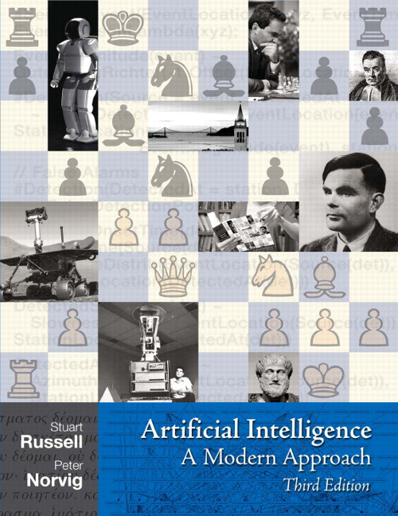
Literature
We now switch from
  Automated Planning and Acting
    Malik Ghallab, Dana Nau, Paolo Traverso
    Main source
to
  Artificial Intelligence:
  A Modern Approach (3rd ed.)
    Stuart Russell, Peter Norvig
    Decision theory
      Ch. 16 + 17
  Plus recent research papers
  mentioned in footnotes
http://www.laas.fr/planning
http://aima.cs.berkeley.edu

Slide 4

Acknowledgements
Material from Lise Getoor, Jean-Claude Latombe, Daphne Koller, and Stuart Russell
Compiled by Ralf Möller

Slide 5
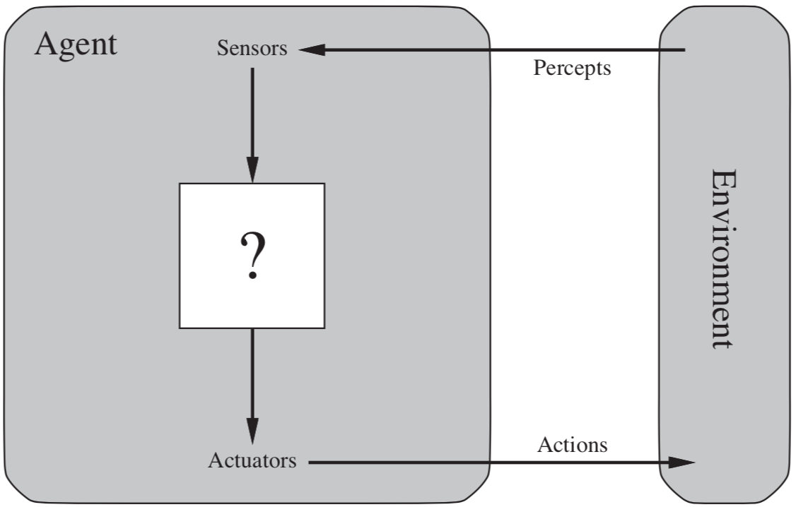
Decision Making under Uncertainty
Many environments have multiple possible outcomes
Some of these outcomes may be good;
others may be bad
Some may be very likely;
others unlikely
What’s a
poor agent
going to do??
AIMA, Russell/Norvig

Slide 6
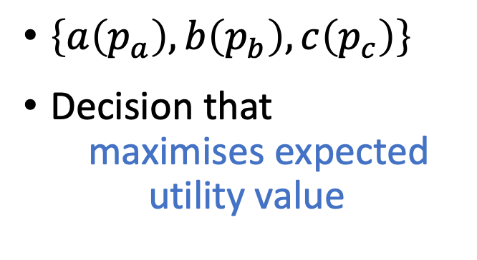
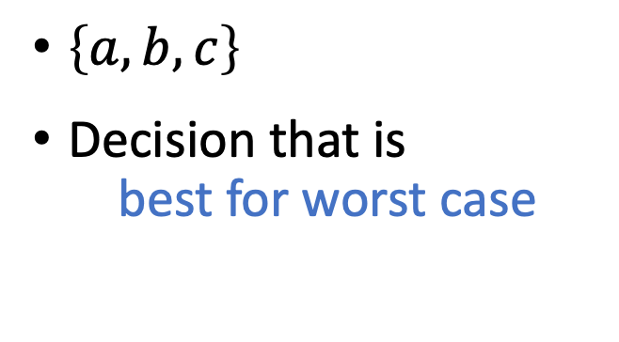
Nondeterministic vs. Probabilistic Uncertainty
?
?
a
b
c
a
b
c
Nondeterministic model
Probabilistic model
$\left\{a,b,c\right\}$
Decision that is
best for worst case
$\left\{a\left(p_{a}\right),b\left(p_{b}\right),c\left(p_{c}\right)\right\}$
Decision that
maximises expected utility value

Slide 7
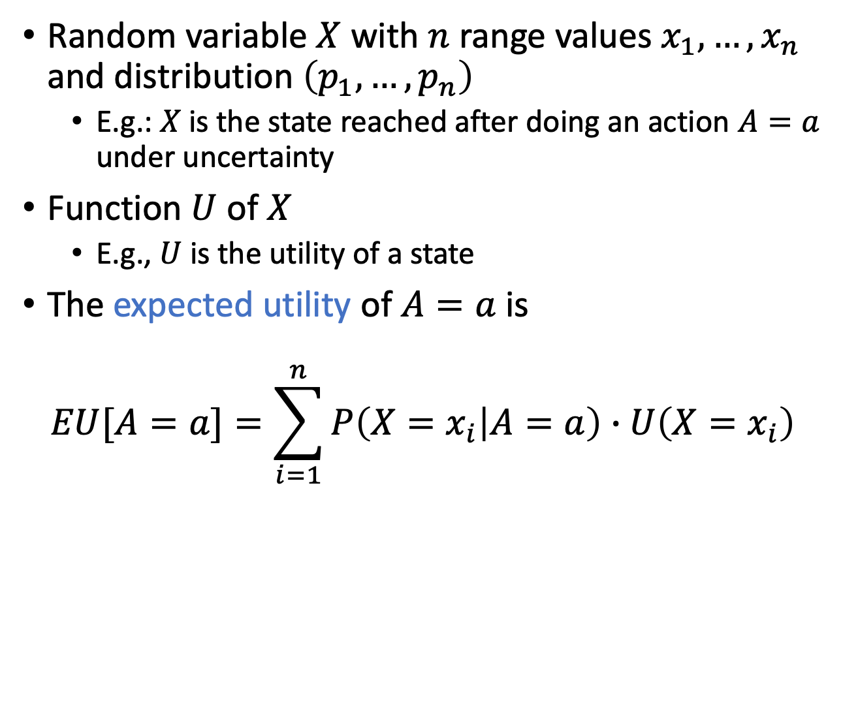
Expected Utility
Random variable $X$ with $n$ range values $x_{1},…,x_{n}$ and distribution $\left(p_{1},…,p_{n}\right)$
  E.g.: $X$ is the state reached after doing an action $A=a$ under uncertainty
Function $U$ of $X$
  E.g., $U$ is the utility of a state
The expected utility of $A=a$ is
$EU[A=a]=\sum_{i=1}^{n}{P\left(X=x_{i} | A=a\right)∙U\left(X=x_{i}\right)}$

Slide 8











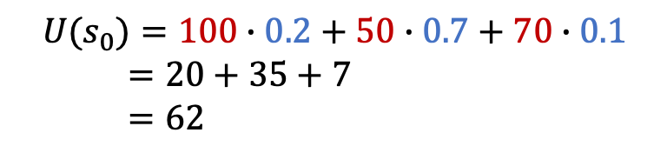
One State/One Action Example
$$s_{0}$$
$$U(s_{0})=100∙0.2+50∙0.7+70∙0.1$$
$=20+35+7$
$=62$
$$a_{1}$$
$$s_{1}$$
$$s_{2}$$
$$s_{3}$$
$$0.2$$
$$0.7$$
$$0.1$$
$$100$$
$$50$$
$$70$$

Slide 9






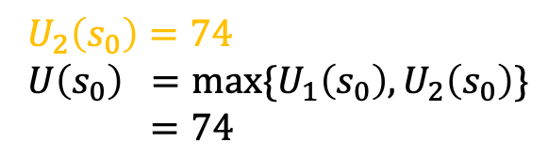

One State/Two Actions Example
$$U_{1}\left(s_{0}\right)=62$$
$$s_{0}$$
$U_{2}\left(s_{0}\right)=74$
$U\left(s_{0}\right) =max⁡\{U_{1}\left(s_{0}\right),U_{2}\left(s_{0}\right)\}$
$=74$
$$a_{1}$$
$$a_{2}$$
$$0.2$$
$$0.8$$
$$s_{1}$$
$$s_{2}$$
$$s_{3}$$
$$s_{4}$$
$$0.2$$
$$0.7$$
$$0.1$$
$$100$$
$$50$$
$$70$$
$$80$$

Slide 10


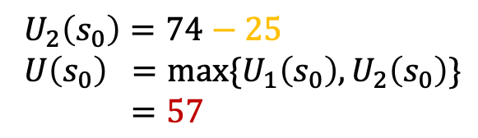

Introducing Action Costs
$$U_{1}\left(s_{0}\right)=62−5$$
$$s_{0}$$
$U_{2}\left(s_{0}\right)=74−25$
$U\left(s_{0}\right) =max⁡\{U_{1}\left(s_{0}\right),U_{2}\left(s_{0}\right)\}$
$=57$
$$a_{1}$$
$$a_{2}$$
$$−5$$
$$−25$$
$$0.2$$
$$0.8$$
$$s_{1}$$
$$s_{2}$$
$$s_{3}$$
$$s_{4}$$
$$0.2$$
$$0.7$$
$$0.1$$
$$100$$
$$50$$
$$70$$
$$80$$

Slide 11
MEU Principle
A rational agent should choose the action that maximizes agent’s expected utility
This is the basis of the field of decision theory
The MEU principle provides a normative criterion for rational choice of action
AI is solved!!!

Slide 12
Not quite…
Must have complete model of:
  Actions
  Utilities
  States
Even if you have a complete model, it might be computationally intractable
In fact, a truly rational agent takes into account the utility of reasoning as well – bounded rationality
Nevertheless, great progress has been made in this area, and we are able to solve much more complex decision-theoretic problems than ever before

Slide 13
Setting
Agent can perform actions in an environment
  Environment
    Episodic, i.e., not sequential
      Next episode does not depend on the previous episode
      So called static models (vs. dynamic/temporal, next lecture)
    Non-deterministic
      Outcomes of actions not unique
      Associated with probabilities (➝ probabilistic model)
    Partially observable
      Latent, i.e., not observable, random variables
  Agent has preferences over states/action outcomes
    Encoded in utility or utility function ➝ Utility theory
“Decision theory = Utility theory + Probability theory”
  Model the world with a probabilistic model
  Model preferences with a utility (function)
  Find action that leads to the maximum expected utility, also called decision making
    Lecture title: “Simple decisions” because episodic

Slide 14
Outline (mainly Ch. 16)
Utility theory
  Preferences
  Utilities
  Dominance
  Preference structure
Decision theory
  Decision networks
  Value of information
  Relational domains

Slide 15
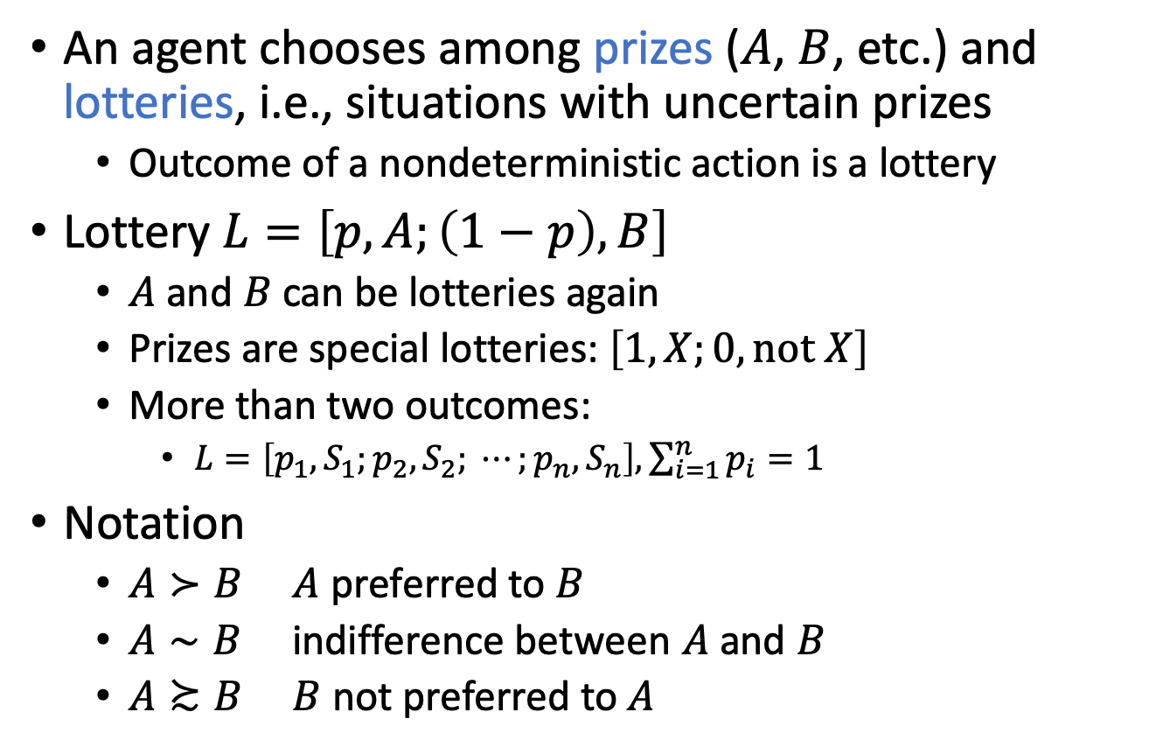
Preferences
An agent chooses among prizes ($A$, $B$, etc.) and lotteries, i.e., situations with uncertain prizes
  Outcome of a nondeterministic action is a lottery
Lottery $L=\left[p,A;\left(1−p\right), B\right]$
  $A$ and $B$ can be lotteries again
  Prizes are special lotteries: $\left[1,X;0, \text{not} X\right]$
  More than two outcomes:
    $L=\left[p_{1},S_{1};p_{2}, S_{2}; ⋯;p_{n}, S_{n}\right], \sum_{i=1}^{n}{p_{i}}=1$
Notation
  $A≻B$ $A$ preferred to $B$
  $A∼B$ indifference between $A$ and $B$
  $A≿B$ $B$ not preferred to $A$
Notes:
Think of the set of outcomes for each action as a lottery—think of each action as a ticket

Slide 16
Rational preferences
Idea: preferences of a rational agent must obey constraints
Rational preferences ⇒ behaviour describable as maximisation of expected utility

Slide 17
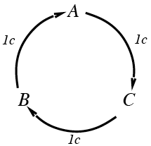
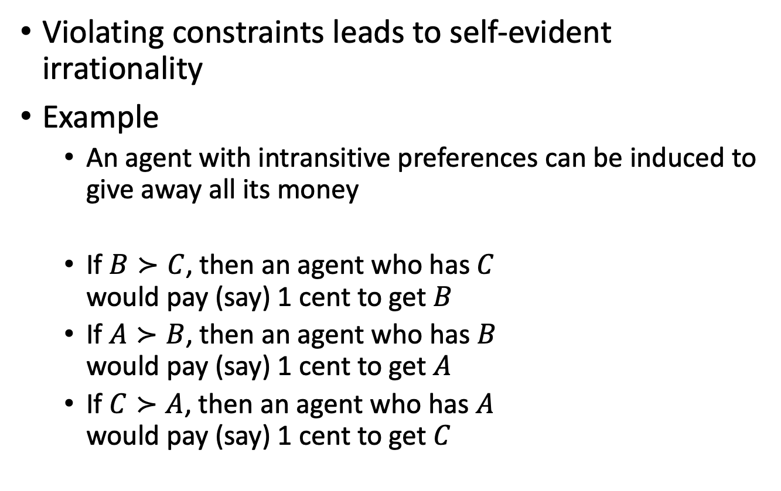
Rational preferences contd.
Violating constraints leads to self-evident irrationality
Example
  An agent with intransitive preferences can be induced to give away all its money
  If $B≻C$, then an agent who has $C$
  would pay (say) 1 cent to get $B$
  If $A≻B$, then an agent who has $B$
  would pay (say) 1 cent to get $A$
  If $C≻A$, then an agent who has $A$
  would pay (say) 1 cent to get $C$

Slide 18


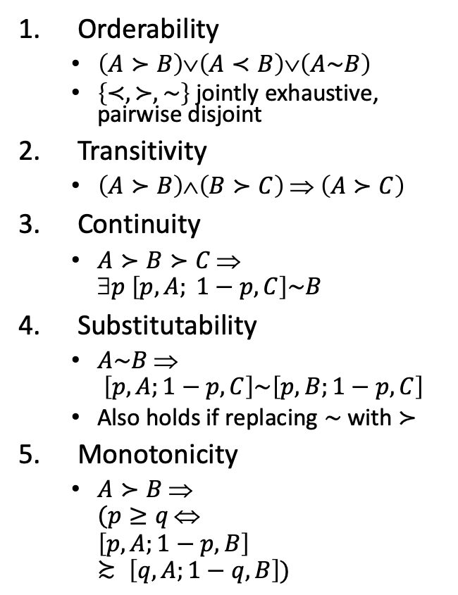












Axioms of Utility Theory
Orderability
  $\left(A≻B\right)∨\left(A≺B\right)∨\left(A\sim B\right)$
  $\left\{≺,≻, \sim \right\}$ jointly exhaustive, pairwise disjoint
Transitivity
  $\left(A≻B\right)∧\left(B≻C\right) ⇒ \left(A≻C\right)$
Continuity
  $A≻B≻C $
  $p \left[p,A; 1−p,C\right]\sim B$
Substitutability
  $A\sim B $
  $\left[p,A;1−p,C\right]\sim \left[p,B;1−p,C\right]$
  Also holds if replacing $\sim$with $≻$
Monotonicity
  $A≻B $
  $(p≥q $
  $\left[p,A;1−p,B\right]≿ \left[q,A;1−q,B\right])$
Decomposability
  $\left[p,A; 1−p, \left[q,B; 1−q, C\right]\right]\sim$
  $\left[p,A; \left(1−p\right)q, B;\left(1−p\right)\left(1−q\right), C\right]$
$$p$$
$$A$$
$$q$$
$$B$$
$$1−p$$
$$1−q$$
$$C$$
$$p$$
$$A$$
$$\left(1−p\right)q$$
$$B$$
$$\left(1−p\right)\left(1−q\right)$$
$$C$$
Decomposability: There is no fun in gambling.
Notes:
Orderability: Agent has to decide (refusing to bet is like refusing to allow time to pass)
Transitivity: example did not follow this axiom
Continuity: Agent will be indifferent between getting $B$ for sure and the lottery that yields $A$ with probability $p$ and $C$ with probability $1−p$
Substitutability: If agent is indifferent between A und B, then it is indifferent between the two if they are part of a more complex lottery
Monotonicity: A preferred over B, then lottery with higher probability for A preferred
Decomposability: Compound lotteries can be reduced to simpler ones using laws of probability (deep models equivalent to broad models); We can account for the enjoyment of gambling by encoding gambling events into the state description; for example, “Have $10 and gambled” could be preferred to “Have $10 and didn’t gamble.”

Slide 19
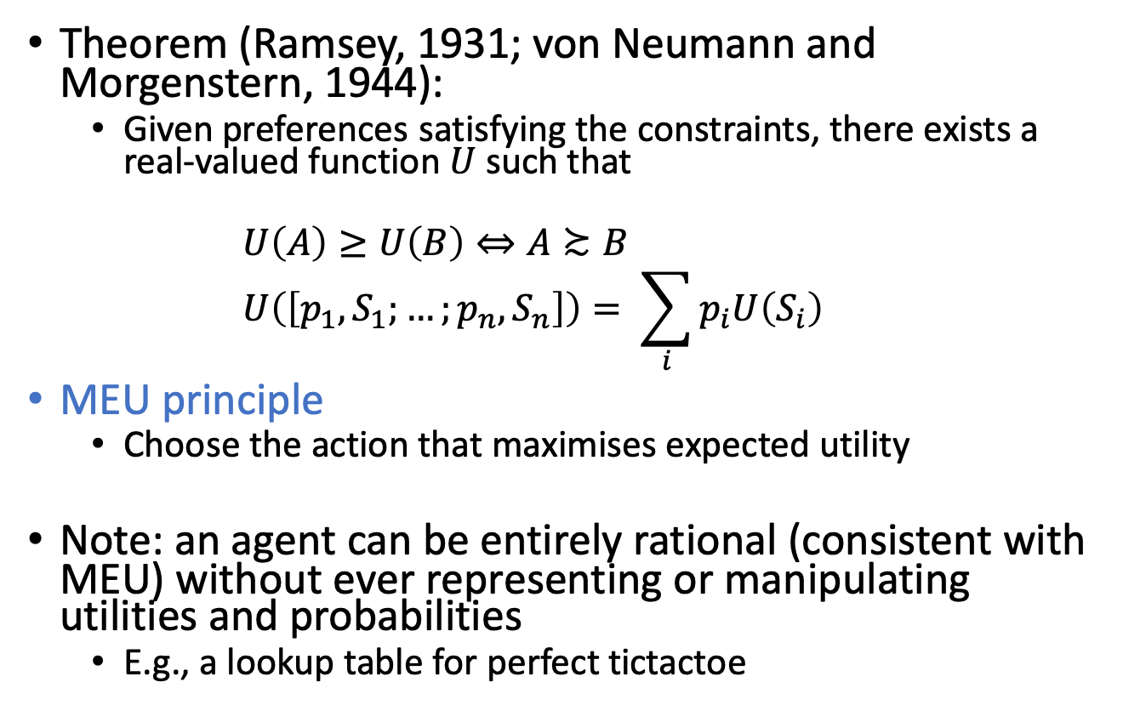
And Then There Was Utility
Theorem (Ramsey, 1931; von Neumann and Morgenstern, 1944):
  Given preferences satisfying the constraints, there exists a real-valued function $U$ such that
  $$U\left(A\right)≥U\left(B\right)⇔A≿B \\ U\left(\left[p_{1}, S_{1};…;p_{n},S_{n}\right]\right)= \sum_{i}{p_{i}U\left(S_{i}\right)}$$
MEU principle
  Choose the action that maximises expected utility
Note: an agent can be entirely rational (consistent with MEU) without ever representing or manipulating utilities and probabilities
  E.g., a lookup table for perfect tictactoe

Slide 20
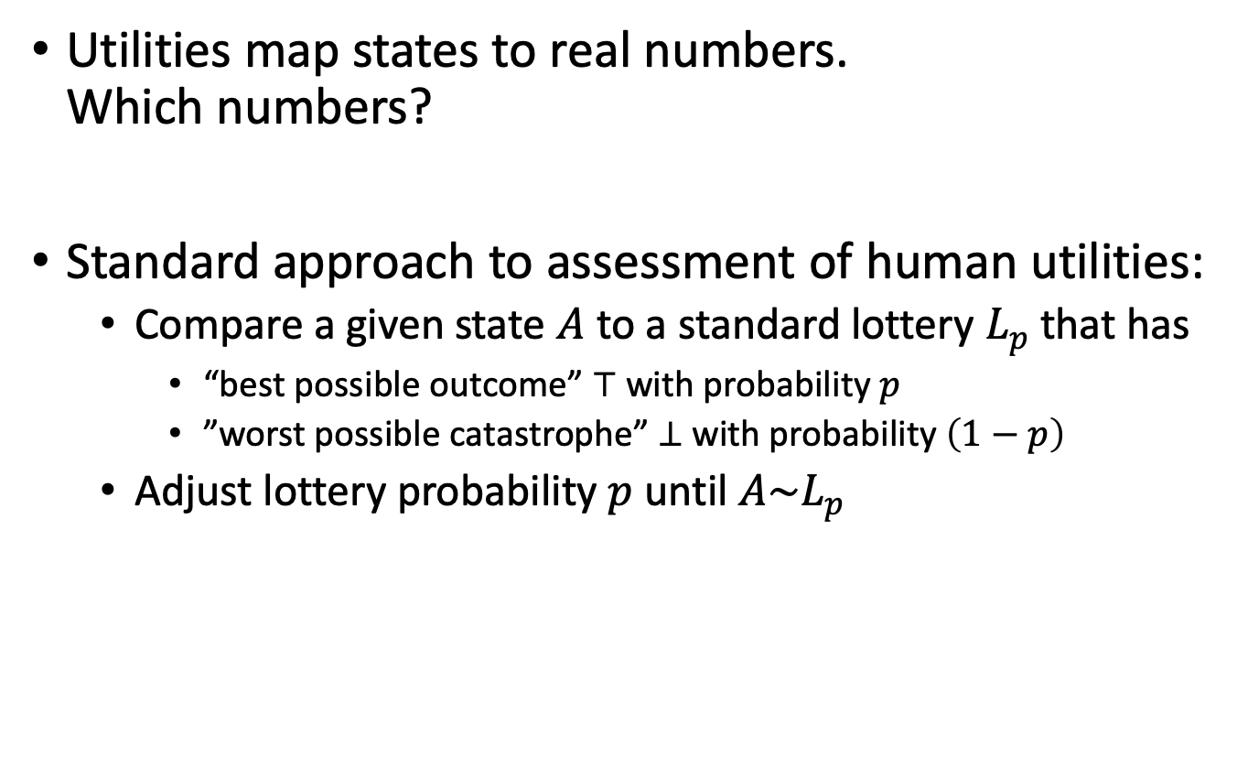



Utilities
Utilities map states to real numbers.
Which numbers?
Standard approach to assessment of human utilities:
  Compare a given state $A$ to a standard lottery $L_{p}$ that has
    “best possible outcome” $⊤$ with probability $p$
    ”worst possible catastrophe” $⊥$ with probability $\left(1−p\right)$
  Adjust lottery probability $p$ until $A\sim L_{p}$
$$0.999999$$
continue as before
pay-$30-and-continue-as-before
$$\sim L$$
$$0.000001$$
instant death

Slide 21
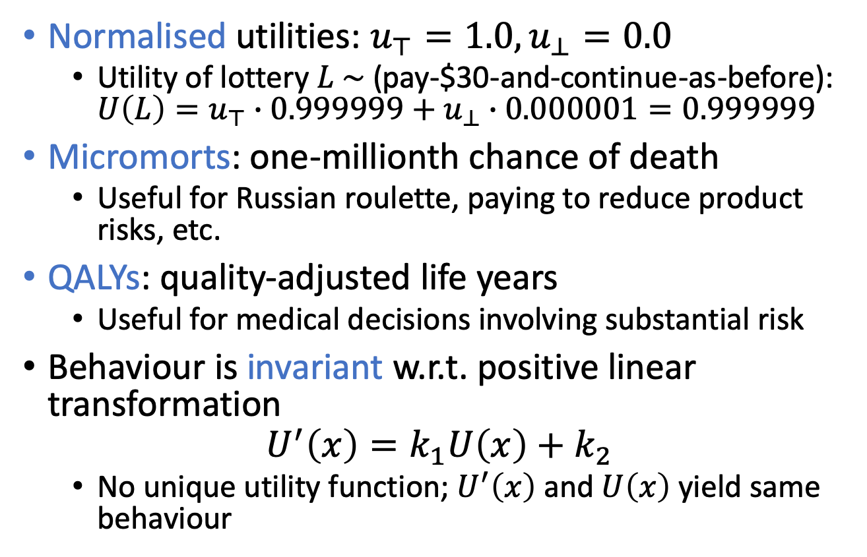
Utility scales
Normalised utilities: $u_{⊤}=1.0,u_{⊥}=0.0$
  Utility of lottery $L \sim$ (pay-$30-and-continue-as-before): $U\left(L\right)=u_{⊤}∙0.999999+u_{⊥}∙0.000001=0.999999$
Micromorts: one-millionth chance of death
  Useful for Russian roulette, paying to reduce product risks, etc.
QALYs: quality-adjusted life years
  Useful for medical decisions involving substantial risk
Behaviour is invariant w.r.t. positive linear transformation
$$U^{′}\left(x\right)=k_{1}U\left(x\right)+k_{2}$$
  No unique utility function; $U^{′}\left(x\right)$ and $U\left(x\right)$ yield same behaviour

Slide 22
Ordinal Utility Functions
With deterministic prizes only (no lottery choices), only ordinal utility can be determined, i.e., total order on prizes
  Ordinal utility function also called value function
  Provides a ranking of alternatives (states), but not a meaningful metric scale (numbers do not matter)

Slide 23
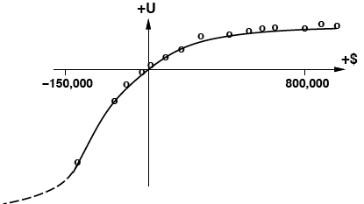
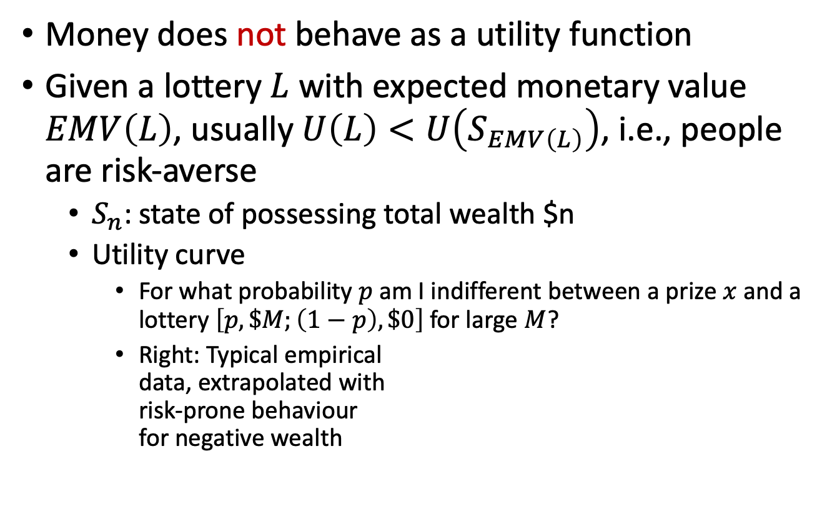
Money
Money does not behave as a utility function
Given a lottery $L$ with expected monetary value $EMV\left(L\right)$, usually $U\left(L\right)<U\left(S_{EMV\left(L\right)}\right)$, i.e., people are risk-averse
  $S_{n}$: state of possessing total wealth $n
  Utility curve
    For what probability $p$ am I indifferent between a prize $x$ and a lottery $\left[p,\$M;\left(1−p\right),\$0\right]$ for large $M$?
    Right: Typical empirical
    data, extrapolated with
    risk-prone behaviour
    for negative wealth
Notes:
Utility theory: roots in economics; obvious candidate: money (or an agent’s total net asssets)
agent prefers more money to less, all other things being equal, exhibits a monotonic preference for more money; nothing about preferences between lotteries involving money
logarithmic utility function; should not assume that this is the definitive utility function for monetary value, but it is likely that most people have a utility function that is concave for positive wealth

Slide 24
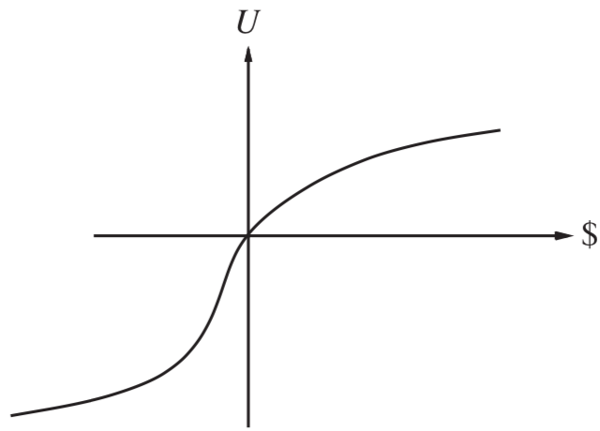

Money Versus Utility
Money $≠$ Utility
  More money is better, but not always in a linear relationship to the amount of money
Expected Monetary Value
  Risk-averse
    $U\left(L\right)<U\left(S_{EMV\left(L\right)}\right)$
  Risk-seeking
    $U\left(L\right)>U\left(S_{EMV\left(L\right)}\right)$
  Risk-neutral
    $U\left(L\right)=U\left(S_{EMV\left(L\right)}\right)$
    Linear curve
    For small changes in wealth
    relative to current wealth
Notes:
Averse: prefer a sure thing with a payoff that is less than the expected monetary value of a gamble
Seeking: someone already $10,000,000 in debt might well accept a gamble on a fair coin with a gain of $10,000,000 for heads and a loss of $20,000,000 for tails; Such behaviour might be called desperate, but it is rational if one is already in a desperate situation.
Neutral: Risk aversion is the basis for the insurance industry; People would rather pay a small insurance premium than gamble the price of their house against the chance of a fire. From the insurance company’s point of view, the price of the house is very small compared with the firm’s total reserves. This means that the insurer’s utility curve is approximately linear over such a small region, and the gamble costs the company almost nothing.

Slide 25
Multiattribute Utility Theory
A given state may have multiple utilities
  ...because of multiple evaluation criteria
  ...because of multiple agents (interested parties) with different utility functions
We will look at
  Cases in which decisions can be made without combining the attribute values into a single utility value
    Strict dominance
  Cases in which the utilities of attribute combinations can be specified very concisely
Notes:
Siting a new airport requires consideration of
disruption caused by construction;
the cost of land;
the distance from centers of population;
the noise of flight operations;
safety issues arising from local topography and weather conditions

Slide 26
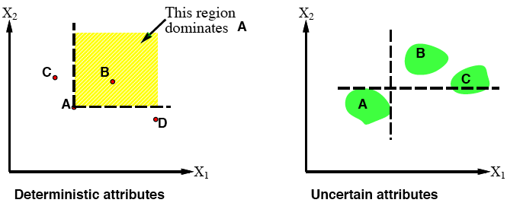

Strict dominance
Typically define attributes such that $U$ is monotonic in each ➝
Strict dominance
  Choice $B$ strictly dominates choice $A$ iff
  $∀ i :X_{i}\left(B\right)≥X_{i}\left(A\right)$ (and hence $U\left(B\right)≥U\left(A\right)$)
Notes:
B does not strictly dominate C (and D)
Seldom unique choice
cf. skylines
Strict dominance in uncertain case even less likely ➝ stochastic dominance

Slide 27
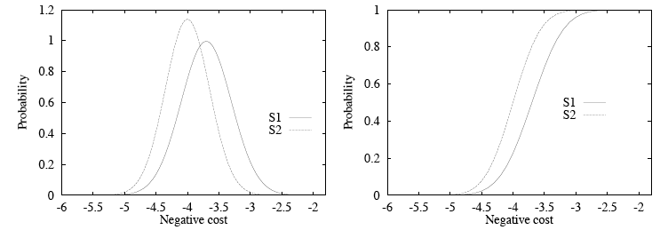
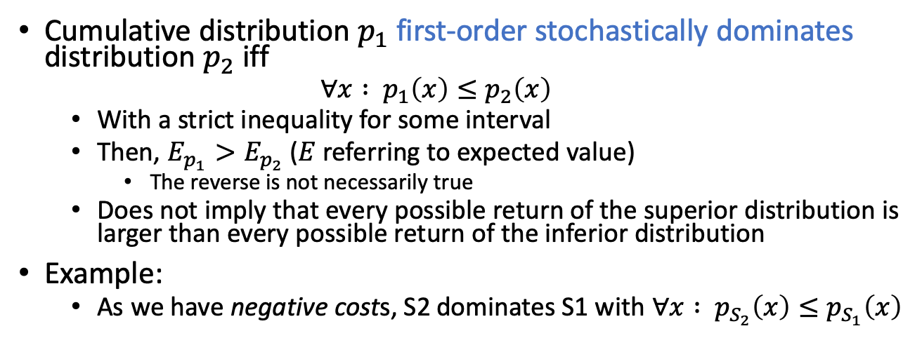
Stochastic dominance
Cumulative distribution $p_{1}$ first-order stochastically dominates distribution $p_{2}$ iff
  $$∀x : p_{1}\left(x\right)≤p_{2}\left(x\right)$$
  With a strict inequality for some interval
  Then, $E_{p_{1}}>E_{p_{2}}$ ($E$ referring to expected value)
    The reverse is not necessarily true
  Does not imply that every possible return of the superior distribution is larger than every possible return of the inferior distribution
Example:
  As we have negative costs, S2 dominates S1 with $∀x : p_{S_{2}}\left(x\right)≤p_{S_{1}}\left(x\right)$
https://people.duke.edu/~dgraham/ECO_463/Handouts/StochasticDominance.pdf
Notes:
First-order vs. second-order dominance
S1 stochastically dominates S2: negative cost, so lower is better

Slide 28
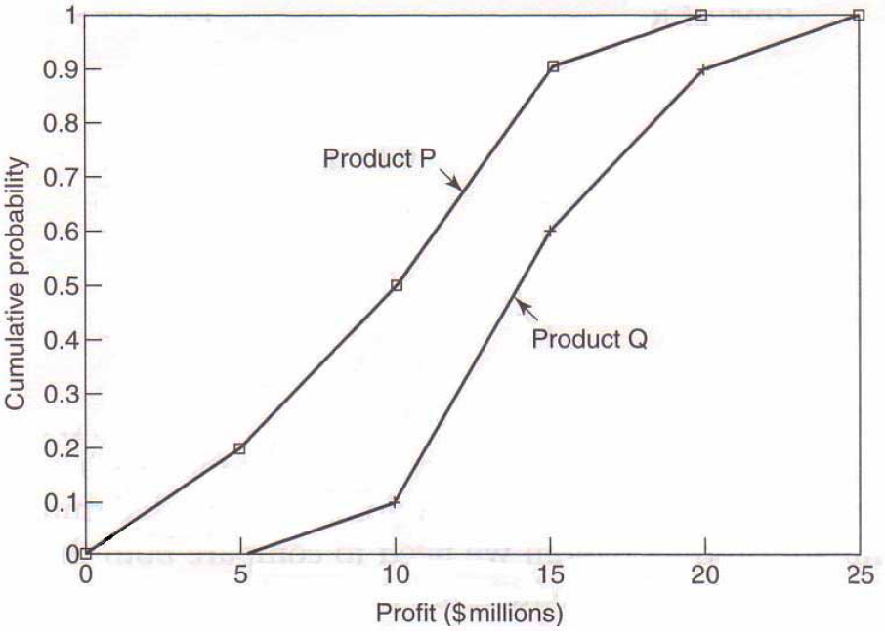
Example
Product P
Product Q
Profit ($m) | Probability
0 to under 5 | 0.2
5 to under 10 | 0.3
10 to under 15 | 0.4
15 to under 20 | 0.1
Profit ($m) | Probability
0 to under 5 | 0.0
5 to under 10 | 0.1
10 to under 15 | 0.5
15 to under 20 | 0.3
20 to under 25 | 0.1
Notes:
Product P first-order stochastically dominates product Q

Slide 29
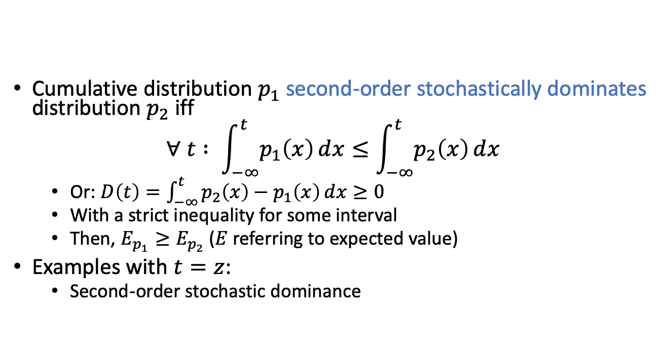
Stochastic dominance
Cumulative distribution $p_{1}$ second-order stochastically dominates distribution $p_{2}$ iff
$$∀ t : \int_{−∞}^{t}{p_{1}\left(x\right)ⅆx}≤\int_{−∞}^{t}{p_{2}\left(x\right)ⅆx}$$
  Or: $D\left(t\right)=\int_{−∞}^{t}{p_{2}\left(x\right)−p_{1}\left(x\right)ⅆx}≥0$
  With a strict inequality for some interval
  Then, $E_{p_{1}}≥E_{p_{2}}$ ($E$ referring to expected value)
Examples with $t=z$:
  Second-order stochastic dominance
  No dominance
https://people.duke.edu/~dgraham/ECO_463/Handouts/StochasticDominance.pdf
Figures: https://www.vosesoftware.com/riskwiki/Stochasticdominancetests.php

Slide 30
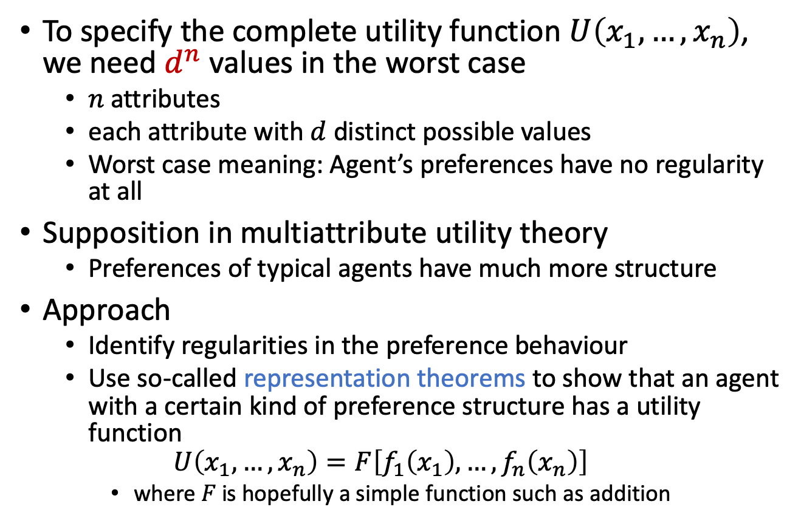
Preference Structure
To specify the complete utility function $U\left(x_{1},…,x_{n}\right)$, we need $d^{n}$ values in the worst case
  $n$ attributes
  each attribute with $d$ distinct possible values
  Worst case meaning: Agent’s preferences have no regularity at all
Supposition in multiattribute utility theory
  Preferences of typical agents have much more structure
Approach
  Identify regularities in the preference behaviour
  Use so-called representation theorems to show that an agent with a certain kind of preference structure has a utility function
  $$U\left(x_{1},…,x_{n}\right)=F\left[f_{1}\left(x_{1}\right),…,f_{n}\left(x_{n}\right)\right]$$
    where $F$ is hopefully a simple function such as addition
Notes:
Similar to Bayesian networks that decompose the joint probability of several random variables

Slide 31
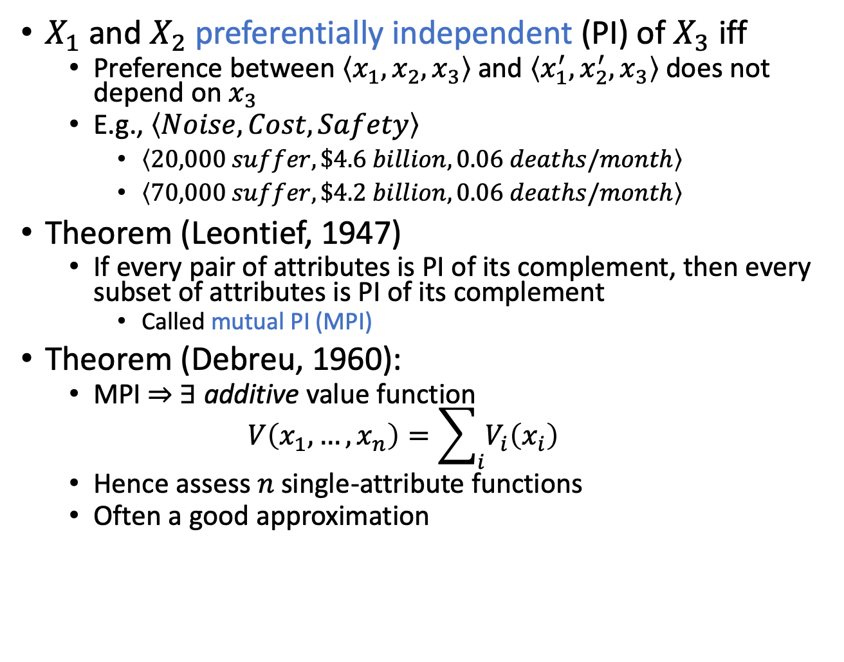
Preference structure: Deterministic
$X_{1}$ and $X_{2}$ preferentially independent (PI) of $X_{3}$ iff
  Preference between $\left\langle x_{1},x_{2},x_{3}\right\rangle$ and $\left\langle x_{1}^{′},x_{2}^{′},x_{3}\right\rangle$ does not depend on $x_{3}$
  E.g., $\left\langle Noise, Cost, Safety\right\rangle$
    $\left\langle 20,000 suffer, \$4.6 billion, 0.06 deaths/month\right\rangle$
    $\left\langle 70,000 suffer, \$4.2 billion, 0.06 deaths/month\right\rangle$
Theorem (Leontief, 1947)
  If every pair of attributes is PI of its complement, then every subset of attributes is PI of its complement
    Called mutual PI (MPI)
Theorem (Debreu, 1960):
  MPI ⇒ ∃ additive value function
  $$V\left(x_{1},…, x_{n}\right)=\sum_{i}{V_{i}\left(x_{i}\right)}$$
  Hence assess $n$ single-attribute functions
  Often a good approximation
Notes:
MPI, where it doesn’t hold: Suppose you are at a medieval market, considering the purchase of some hunting dogs, some chickens, and some wicker cages for the chickens. The hunting dogs are very valuable, but if you don’t have enough cages for the chickens, the dogs will eat the chickens; hence, the tradeoff between dogs and chickens depends strongly on the number of cages, and MPI is violated.
The existence of these kinds of interactions among various attributes makes it much harder to assess the overall value function.

Slide 32
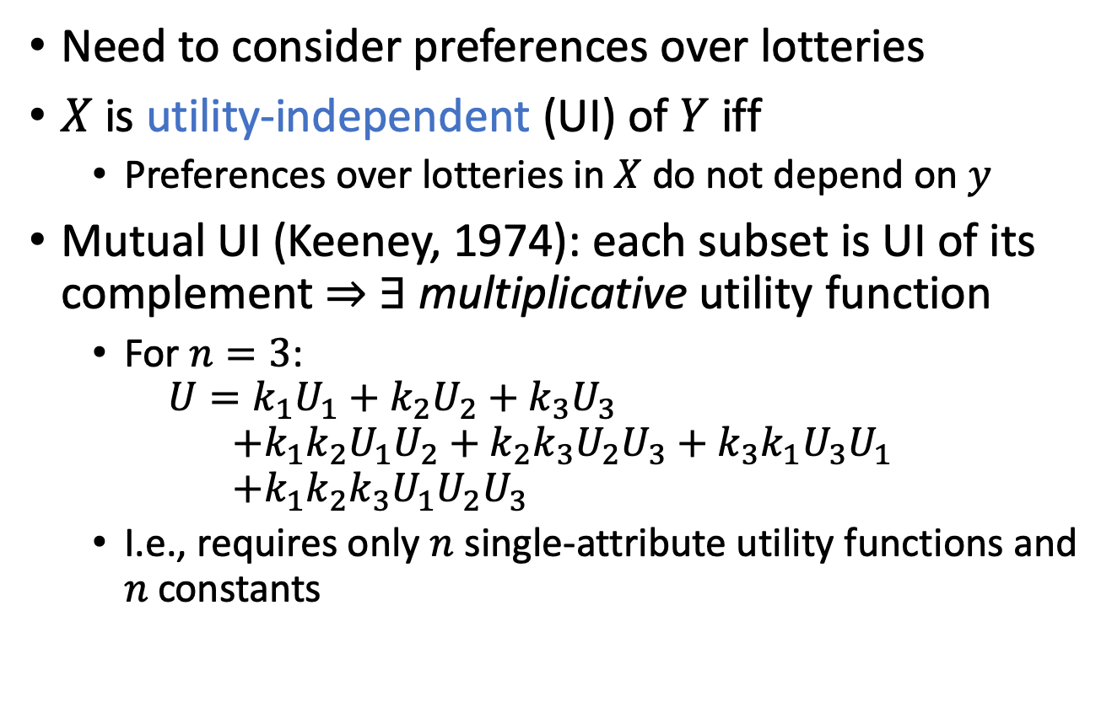
Preference structure: Stochastic
Need to consider preferences over lotteries
$X$ is utility-independent (UI) of $Y$ iff
  Preferences over lotteries in $X$ do not depend on $y$
Mutual UI (Keeney, 1974): each subset is UI of its complement ⇒ ∃ multiplicative utility function
  For $n=3$:
  $$U=k_{1}U_{1}+k_{2}U_{2}+k_{3}U_{3} \\ +k_{1}k_{2}U_{1}U_{2}+k_{2}k_{3}U_{2}U_{3}+k_{3}k_{1}U_{3}U_{1} \\ +k_{1}k_{2}k_{3}U_{1}U_{2}U_{3}$$
  I.e., requires only $n$ single-attribute utility functions and $n$ constants
Notes:
UI extension of PI
Routine procedures and software packages for generating preference tests to identify various canonical families of utility functions

Slide 33
Intermediate Summary
Preferences
  Preferences of a rational agent must obey constraints
Utilities
  Rational preferences = describable as maximisation of expected utility
  Utility axioms
  MEU principle
Dominance
  Strict dominance
  First-order + second-order stochastic dominance
Preference structure
  (Mutual) preferential independence
  (Mutual) utility independence

Slide 34
Outline
Utility theory
  Preferences
  Utilities
  Dominance
  Preference structure
Decision theory
  Decision networks
  Value of information
  Relational domains

Slide 35
Decision Networks
Extend Bayesian networks (BNs) to handle actions and utilities
  Or any other probabilistic (graphical) formalism
Also called influence diagrams
Use BN inference methods to solve MEU problems
Perform Value of Information calculations

Slide 36
Decision Networks cont.
Chance nodes:
random variables
  As in BNs
Decision nodes:
actions that decision maker can take
Utility/value nodes:
the utility of the outcome state

Slide 37
Umbrella Network
take/¬take
Take umbrella
have/¬have
rain/¬rain
Take | P(have| Take)
take | 1.0
¬take | 0.0
Have umbrella
Weather
P(rain)
0.4
sunny/rainy
Happiness
Forecast
Have | Weather | U(Have, Weather)
have | rain | -25
have | ¬rain | 0
¬have | rain | -100
¬have | ¬rain | 100
Weather | P(sunny | Weather)
rain | 0.3
¬rain | 0.8

Slide 38
Evaluating Decision Networks
Set the evidence variables for current state
For each possible value of the decision node:
  Set decision node to that value
  Calculate the posterior probability of the parent nodes of the utility node, using BN inference
  Calculate the resulting utility for action
Return the action with the highest utility

Slide 39
Umbrella Network
take/¬take
Take umbrella = take
Should I take my umbrella??
Take umbrella
have/¬have
rain/¬rain
Take | P(have| Take)
take | 1.0
¬take | 0.0
Have umbrella
Weather
P(rain)
0.4
1.0 ⋅
Σ
sunny/rainy
Happiness
Forecast
Have | Weather | U(Have, Weather)
have | rain | -25
have | ¬rain | 0
¬have | rain | -100
¬have | ¬rain | 100
Weather | P(sunny | Weather)
rain | 0.3
¬rain | 0.8
1.0 ⋅
0.4 ⋅
= -10
1.0 ⋅
0.6 ⋅
= 0
0.0 ⋅
0.4 ⋅
= 0
= 0
EU(take) = -10 + 0 + 0 + 0 = -10
0.0 ⋅
0.6 ⋅
Notes:
No evidence
Set up action
Eliminate Forecast (leads to probabilities of 1)
Multiply everything into U

Slide 40
Umbrella Network
take/¬take
Take umbrella = ¬take
Should I take my umbrella??
Take umbrella
MEU(Take) = 20
argmax = ¬take
have/¬have
rain/¬rain
Take | P(have| Take)
take | 1.0
¬take | 0.0
Have umbrella
Weather
P(rain)
0.4
1.0 ⋅
Σ
sunny/rainy
Happiness
Forecast
Have | Weather | U(Have, Weather)
have | rain | -25
have | ¬rain | 0
¬have | rain | -100
¬have | ¬rain | 100
Weather | P(sunny | Weather)
rain | 0.3
¬rain | 0.8
0.0 ⋅
0.4 ⋅
= 0
0.0 ⋅
0.6 ⋅
= 0
1.0 ⋅
0.4 ⋅
= -40
= 60
EU(¬take) = 0 + 0 - 40 + 60 = 20
1.0 ⋅
0.6 ⋅
EU(take) = -10 + 0 + 0 + 0 = -10
Notes:
No evidence
Set up action
Eliminate Forecast (leads to probabilities of 1)
Multiply everything into U

Slide 41
Decision Making in Decision Nets
Assumes that all available information provided to agent before it makes its decision
  Hardly ever the case
  Know what questions to ask!
Information value theory
  Choose what information to acquire
  Assume that prior to selecting an action represented by a decision node, the agent can acquire the value of any of the potentially observable chance nodes
    Simplified version of sequential decision making (next lecture)
      Observation actions affect only agent’s belief state, not the external physical state

Slide 42
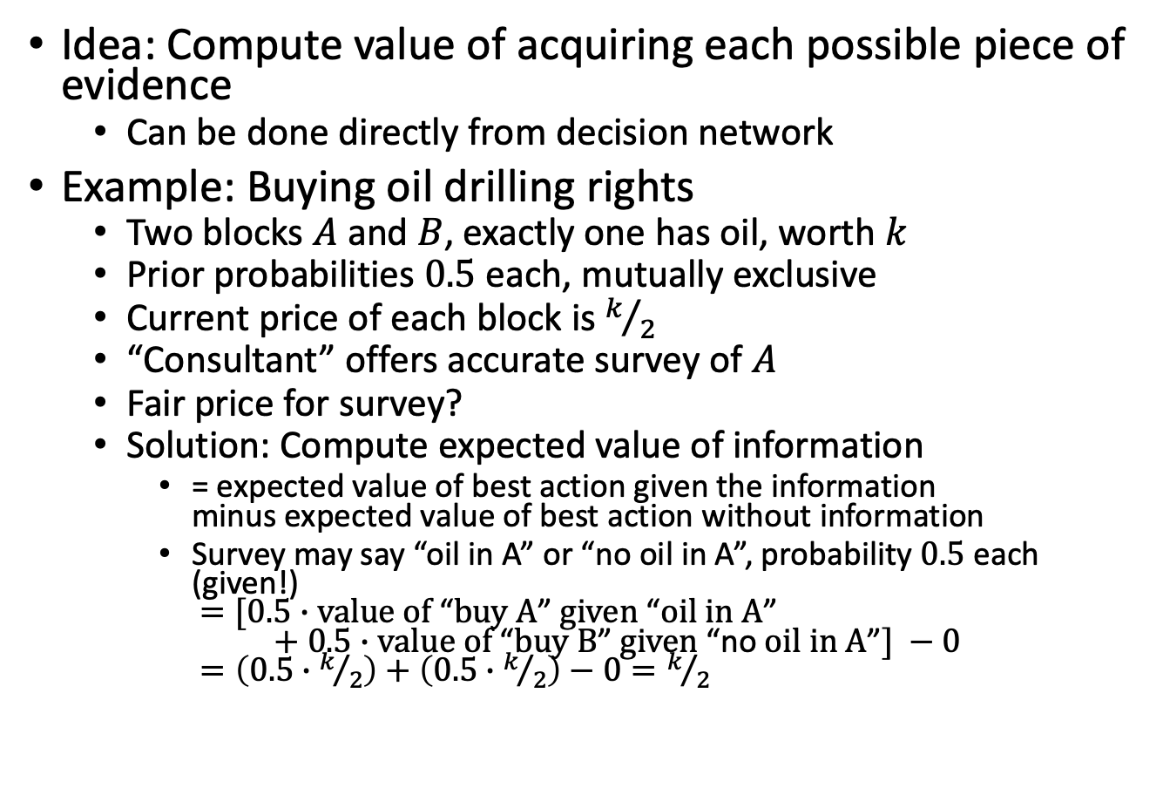
Value of information
Idea: Compute value of acquiring each possible piece of evidence
  Can be done directly from decision network
Example: Buying oil drilling rights
  Two blocks $A$ and $B$, exactly one has oil, worth $k$
  Prior probabilities $0.5$ each, mutually exclusive
  Current price of each block is $k/2$
  “Consultant” offers accurate survey of $A$
  Fair price for survey?
  Solution: Compute expected value of information
    = expected value of best action given the information
    minus expected value of best action without information
    Survey may say “oil in A” or “no oil in A”, probability $0.5$ each (given!)
    $=[0.5∙\text{value} \text{of} \text{“}\text{buy} \text{A}\text{”} \text{given} \text{“}\text{oil} \text{in} \text{A}\text{”}$
    $+ 0.5∙\text{value} \text{of} \text{“}\text{buy} \text{B}\text{”} \text{given} \text{“}\text{no} \text{oil} \text{in} \text{A}\text{”}] −0$
    $=\left(0.5∙k/2\right)+\left(0.5∙k/2\right)−0=k/2$

Slide 43
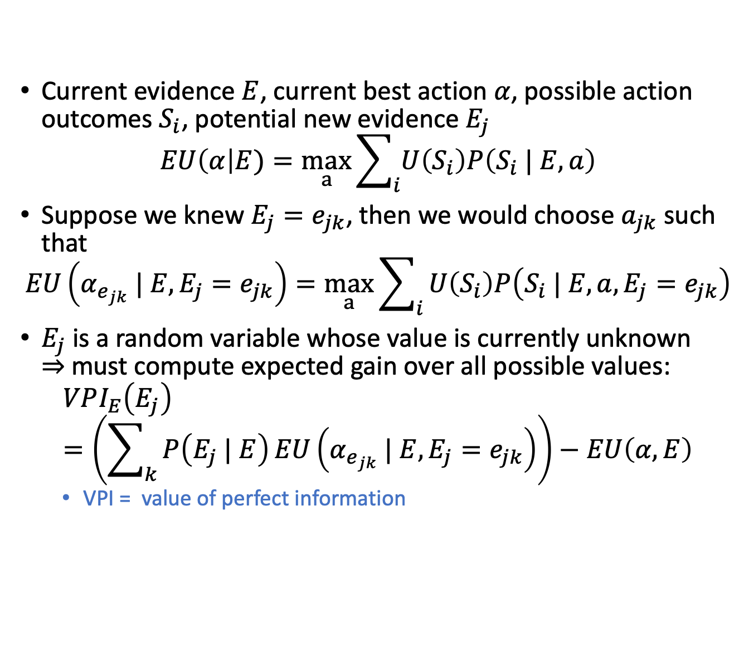
General formula
Current evidence $E$, current best action $α$, possible action outcomes $S_{i}$, potential new evidence $E_{j}$
$$EU\left(α\right|E)=\max_{a}\sum_{i}{U\left(S_{i}\right)P\left(S_{i} | E,a\right)}$$
Suppose we knew $E_{j}=e_{jk}$, then we would choose $a_{jk}$ such that
$$EU\left(α_{e_{jk}} | E,E_{j}=e_{jk}\right)=\max_{a}\sum_{i}{U\left(S_{i}\right)P\left(S_{i} | E,a, E_{j}=e_{jk}\right)}$$
$E_{j}$ is a random variable whose value is currently unknown
⇒ must compute expected gain over all possible values:
$$VPI_{E}\left(E_{j}\right)=\left(\sum_{k}{P\left(E_{j} | E\right)}EU\left(α_{e_{jk}} | E,E_{j}=e_{jk}\right)\right)−EU\left(α, E\right)$$
  VPI = value of perfect information

Slide 44
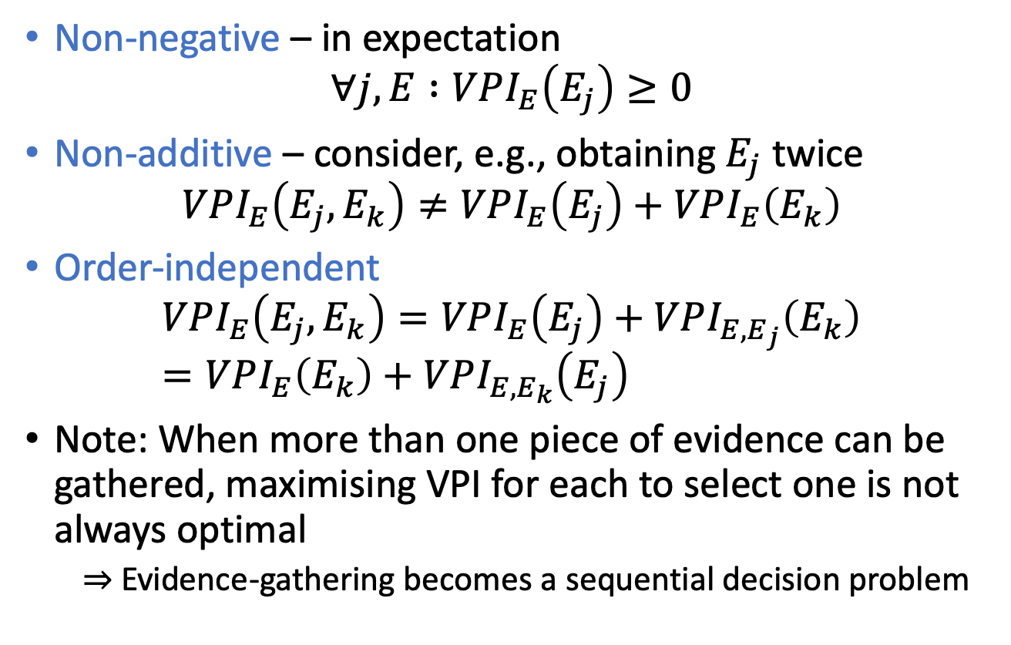
Properties of VPI
Non-negative – in expectation
$$∀j, E :VPI_{E}\left(E_{j}\right)≥0$$
Non-additive – consider, e.g., obtaining $E_{j}$ twice
$$VPI_{E}\left(E_{j}, E_{k}\right)≠VPI_{E}\left(E_{j}\right)+VPI_{E}\left(E_{k}\right)$$
Order-independent
$$VPI_{E}\left(E_{j}, E_{k}\right)=VPI_{E}\left(E_{j}\right)+VPI_{E,E_{j}}\left(E_{k}\right)=VPI_{E}\left(E_{k}\right)+VPI_{E,E_{k}}\left(E_{j}\right)$$
Note: When more than one piece of evidence can be gathered, maximising VPI for each to select one is not always optimal
  Evidence-gathering becomes a sequential decision problem

Slide 45
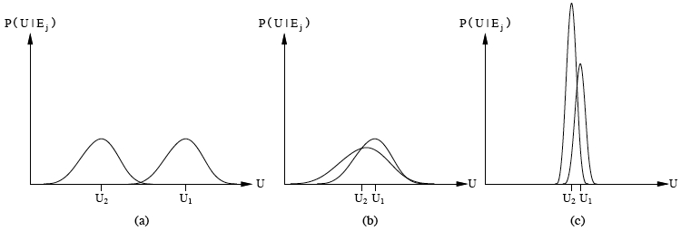
Qualitative behaviors
Choice is obvious, information worth little
Choice is non-obvious, information worth a lot
Choice is non-obvious, information worth little
Information has value to the extent that it is likely to cause a change of plan and to the extent that the new plan will be significantly better than the old plan
Notes:
(a) a1 with high probability always better than a2 leading to a distribution over utilities with average U1 and U2 respectively

Slide 46
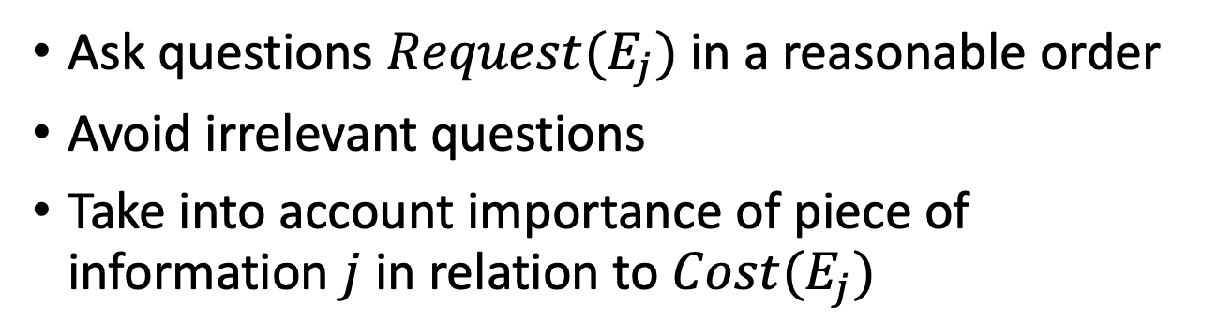
Information Gathering Agent
function INFORMATION-GATHERING-AGENT(percept)
returns: an action
persistent: D, a decision network
integrate percept into D
j ← the value that maximises VPI(E_{j})/Cost(E_{j})
if VPI(E_{j}) > Cost(E_{j}) then
return Request(E_{j})
else
return the best action from D
Ask questions $Request(E_{j})$ in a reasonable order
Avoid irrelevant questions
Take into account importance of piece of information $j$ in relation to $Cost(E_{j})$

Slide 47
Decision Making in Decision Nets II
Solving MEU/query answering problems intractable in general
  Query answering: Computing probability distributions (given evidence)
  Exponential in tree width of the graphical model
    Tree width ≈ Largest number of arguments in a table/factor to occur during calculations
Regularities in graphical model may allow to reduce the tree width by explicitly encoding them and using them during calculations

Slide 48
Relational Domains
Relations between objects/individuals/constants
  Regularities/symmetries
Constructs of first-order logic to parameterise a propositional formalism
  Symmetries encoded compactly using logical variables
  Parameterised random variables (PRVs) to denote sets of random variables behaving identically

Slide 49
Compact
Representation
$$Nat(D)$$
$$Man(W)$$
$$g_{1}$$
$$Epid$$
Factor graph to
parfactor graph
$$Travel(X)$$
$$Treat(X,M)$$
$$g_{2}$$
$$g_{3}$$
$$Man\text{.}war$$
$$Sick(X)$$
$$Man\text{.}virus$$
$$f_{1}^{3}$$
$$f_{1}^{1}$$
$$f_{1}^{2}$$
$$f_{1}^{4}$$
$$Nat\text{.}flood$$
$$Nat\text{.}fire$$
$$f_{2}^{1}$$
$$f_{2}^{1}$$
$$Epid$$
$$f_{3}^{1}$$
$$f_{3}^{1}$$
$$Treat\text{.}alice\text{.}m_{1}$$
$$Treat\text{.}bob\text{.}m_{1}$$
$$Travel\text{.}alice$$
$$f_{3}^{2}$$
$$f_{3}^{2}$$
$$Travel.bob$$
$$Sick\text{.}alice$$
$$f_{2}^{1}$$
$$f_{3}^{1}$$
$$f_{3}^{2}$$
$$Sick\text{.}bob$$
$$Treat\text{.}eve\text{.}m_{1}$$
$$Treat\text{.}alice\text{.}m_{2}$$
$$Treat\text{.}bob\text{.}m_{2}$$
$$Travel\text{.}eve$$
$$Sick\text{.}eve$$
$$Treat\text{.}eve\text{.}m_{2}$$

Slide 50
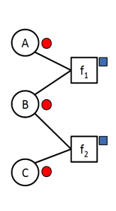
Compression: Pass the colours around
If you have a (propositional) model available*
Colour nodes according to the evidence you have
  No evidence, say red
  State „one“, say brown
  State „two“, say orange
  ...
Colour factors distinctively according to their equivalences For instance, assuming f₁ and f₂ to be identical and B appears at the second position within both, say blue
*can also be done at the „lifted“, i.e., relational level
Singla and Domingos (2008), Kersting et al. (2009), Ahmadi et al. (2013)

Slide 51
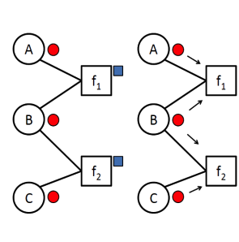
Compression: Pass the colours around
Each factor collects the colours of its neighbouring nodes
Slides @Kersting, modified

Slide 52
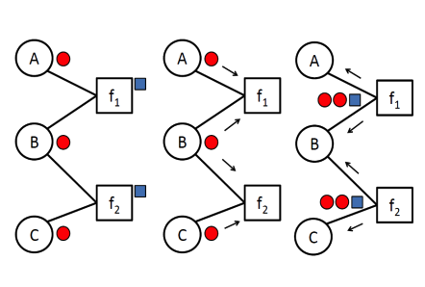
Compression: Pass the colours around
Each factor collects the colours of its neighbouring nodes
Each factor „signs“ its colour signature with its own colour
Slides @Kersting, modified

Slide 53
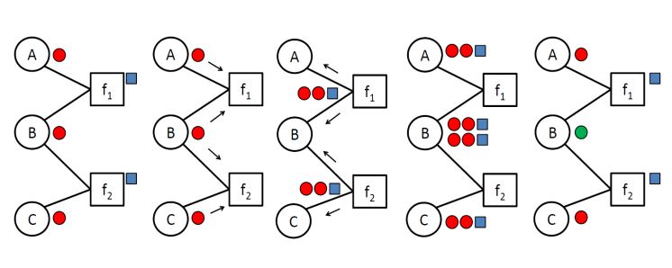
Compression: Pass the colours around
Each factor collects the colours of its neighbouring nodes
Each factor „signs“ its colour signature with its own colour
Each node collects the signatures of its neighbouring factors
Slides @Kersting, modified

Slide 54
Compression: Pass the colours around
Each factor collects the colours of its neighbouring nodes
Each factor „signs“ its colour signature with its own colour
Each node collects the signatures of its neighbouring factors
Nodes are recoloured according to the collected signatures
Slides @Kersting, modified

Slide 55
Compression: Pass the colours around
Each factor collects the colours of its neighbouring nodes
Each factor „signs“ its colour signature with its own colour
Each node collects the signatures of its neighbouring factors
Nodes are recoloured according to the collected signatures
If no new colour is created stop, otherwise go back to 1
A,C
f₁₂
B
Slides @Kersting, modified

Slide 56






























Compression
$$Man\text{.}war$$
$$Man\text{.}virus$$
$$f_{1}^{3}$$
$$f_{1}^{1}$$
$$f_{1}^{2}$$
$$f_{1}^{4}$$
$$Nat\text{.}flood$$
$$Nat\text{.}fire$$
$$f_{2}^{1}$$
$$f_{2}^{1}$$
$$Epid$$
$$f_{3}^{1}$$
$$f_{3}^{1}$$
$$Treat\text{.}alice\text{.}m_{1}$$
$$Treat\text{.}bob\text{.}m_{1}$$
$$Travel\text{.}alice$$
$$f_{3}^{2}$$
$$f_{3}^{2}$$
$$Travel.bob$$
$$Sick\text{.}alice$$
$$f_{2}^{1}$$
$$f_{3}^{1}$$
$$f_{3}^{2}$$
$$Sick\text{.}bob$$
$$Treat\text{.}eve\text{.}m_{1}$$
$$Treat\text{.}alice\text{.}m_{2}$$
$$Treat\text{.}bob\text{.}m_{2}$$
$$Travel\text{.}eve$$
$$Sick\text{.}eve$$
$$Treat\text{.}eve\text{.}m_{2}$$

Slide 57
Compression
$$Man\text{.}war$$
$$Man\text{.}virus$$
$$f_{1}^{3}$$
$$f_{1}^{1}$$
$$f_{1}^{2}$$
$$f_{1}^{4}$$
$$Nat\text{.}flood$$
$$Nat\text{.}fire$$
$$f_{2}^{1}$$
$$f_{2}^{1}$$
$$Epid$$
$$f_{3}^{1}$$
$$f_{3}^{1}$$
$$Treat\text{.}alice\text{.}m_{1}$$
$$Treat\text{.}bob\text{.}m_{1}$$
$$Travel\text{.}alice$$
$$f_{3}^{2}$$
$$f_{3}^{2}$$
$$Travel.bob$$
$$Sick\text{.}alice$$
$$f_{2}^{1}$$
$$f_{3}^{1}$$
$$f_{3}^{2}$$
$$Sick\text{.}bob$$
$$Treat\text{.}eve\text{.}m_{1}$$
$$Treat\text{.}alice\text{.}m_{2}$$
$$Treat\text{.}bob\text{.}m_{2}$$
$$Travel\text{.}eve$$
$$Sick\text{.}eve$$
$$Treat\text{.}eve\text{.}m_{2}$$

Slide 58
Compression
$$Man\text{.}war$$
$$Man\text{.}virus$$
$$f_{1}^{3}$$
$$f_{1}^{1}$$
$$f_{1}^{2}$$
$$f_{1}^{4}$$
$$Nat\text{.}flood$$
$$Nat\text{.}fire$$
$$f_{2}^{1}$$
$$f_{2}^{1}$$
$$Epid$$
$$f_{3}^{1}$$
$$f_{3}^{1}$$
$$Treat\text{.}alice\text{.}m_{1}$$
$$Treat\text{.}bob\text{.}m_{1}$$
$$Travel\text{.}alice$$
$$f_{3}^{2}$$
$$f_{3}^{2}$$
$$Travel.bob$$
$$Sick\text{.}alice$$
$$f_{2}^{1}$$
$$f_{3}^{1}$$
$$f_{3}^{2}$$
$$Sick\text{.}bob$$
$$Treat\text{.}eve\text{.}m_{1}$$
$$Treat\text{.}alice\text{.}m_{2}$$
$$Treat\text{.}bob\text{.}m_{2}$$
$$Travel\text{.}eve$$
$$Sick\text{.}eve$$
$$Treat\text{.}eve\text{.}m_{2}$$

Slide 59

Compression
$$Man\text{.}war$$
$$Man\text{.}virus$$
$$f_{1}^{3}$$
$$f_{1}^{1}$$
$$f_{1}^{2}$$
$$f_{1}^{4}$$
$$Nat\text{.}flood$$
$$Nat\text{.}fire$$
$$f_{2}^{1}$$
$$f_{2}^{1}$$
$$Epid$$
$$f_{3}^{1}$$
$$f_{3}^{1}$$
$$Treat\text{.}alice\text{.}m_{1}$$
$$Treat\text{.}bob\text{.}m_{1}$$
$$Travel\text{.}alice$$
$$f_{3}^{2}$$
$$f_{3}^{2}$$
$$Travel.bob$$
$$Sick\text{.}alice$$
$$f_{2}^{1}$$
$$f_{3}^{1}$$
$$f_{3}^{2}$$
$$Sick\text{.}bob$$
$$Treat\text{.}eve\text{.}m_{1}$$
$$Treat\text{.}alice\text{.}m_{2}$$
$$Treat\text{.}bob\text{.}m_{2}$$
$$Travel\text{.}eve$$
$$Sick\text{.}eve$$
$$Treat\text{.}eve\text{.}m_{2}$$

Slide 60









Compression
$$Nat(D)$$
$$Man(W)$$
$$g_{1}$$
$$Epid$$
$$Travel(X)$$
$$Treat(X,M)$$
$$g_{2}$$
$$g_{3}$$
$$Sick(X)$$
$$Man\text{.}war$$
$$Man\text{.}virus$$
$$f_{1}^{3}$$
$$f_{1}^{1}$$
$$f_{1}^{2}$$
$$f_{1}^{4}$$
$$Nat\text{.}flood$$
$$Nat\text{.}fire$$
$$f_{2}^{1}$$
$$f_{2}^{1}$$
$$Epid$$
$$f_{3}^{1}$$
$$f_{3}^{1}$$
$$Treat\text{.}alice\text{.}m_{1}$$
$$Treat\text{.}bob\text{.}m_{1}$$
$$Travel\text{.}alice$$
$$f_{3}^{2}$$
$$f_{3}^{2}$$
$$Travel.bob$$
$$Sick\text{.}alice$$
$$f_{2}^{1}$$
$$f_{3}^{1}$$
$$f_{3}^{2}$$
$$Sick\text{.}bob$$
$$Treat\text{.}eve\text{.}m_{1}$$
$$Treat\text{.}alice\text{.}m_{2}$$
$$Treat\text{.}bob\text{.}m_{2}$$
$$Travel\text{.}eve$$
$$Sick\text{.}eve$$
$$Treat\text{.}eve\text{.}m_{2}$$

Slide 61

Lifting
Factors with PRVs = parfactors
  Undirected (graphical) Model G
  E.g., $g_{2}$
$$Travel(X)$$ | $$Epid$$ | $$Sick(X)$$ | $$g_{2}$$
false | false | false | 5
false | false | true | 0
false | true | false | 4
false | true | true | 6
true | false | false | 4
true | false | true | 6
true | true | false | 2
true | true | true | 9
$$Nat(D)$$
$$Man(W)$$
$$g_{1}$$
$$Epid$$
$$Travel(X)$$
$$Treat(X,M)$$
$$g_{2}$$
$$g_{3}$$
$$Sick(X)$$
David Poole: First-order Probabilistic Inference, 2003.

Slide 62
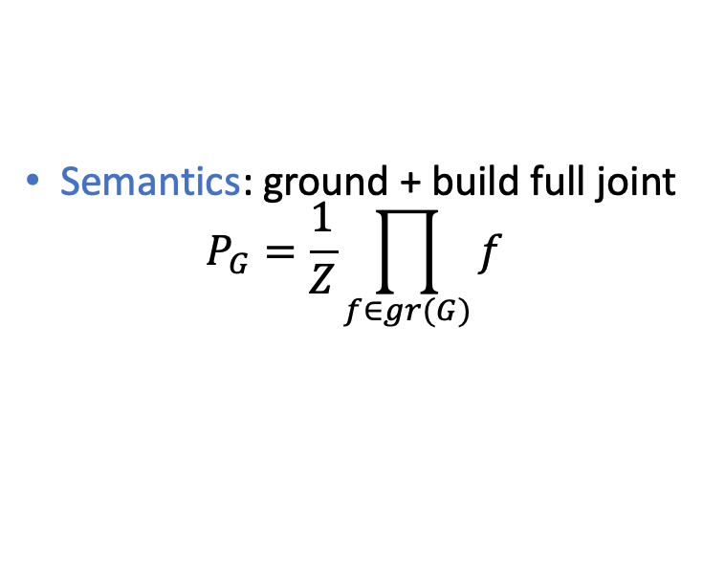

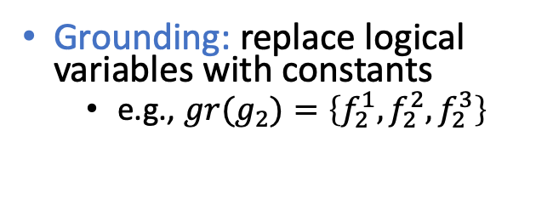
Grounding
Grounding: replace logical variables with constants
  e.g., ${gr(g}_{2})=\left\{f_{2}^{1},f_{2}^{2},f_{2}^{3}\right\}$
Semantics: ground + build full joint
$$P_{G}=\frac{1}{Z}\prod_{f∈gr(G)}{f}$$
$$Travel(eve)$$ | $$Epid$$ | $$Sick(eve)$$ | $$f_{2}^{1}$$
false | false | false | 5
false | false | true | 0
false | true | false | 4
false | true | true | 6
true | false | false | 4
true | false | true | 6
true | true | false | 2
true | true | true | 9
$$Travel(bob)$$ | $$Epid$$ | $$Sick(bob)$$ | $$f_{2}^{3}$$
false | false | false | 5
false | false | true | 0
false | true | false | 4
false | true | true | 6
true | false | false | 4
true | false | true | 6
true | true | false | 2
true | true | true | 9
$$Travel(X)$$ | $$Epid$$ | $$Sick(X)$$ | $$g_{2}$$
false | false | false | 5
false | false | true | 0
false | true | false | 4
false | true | true | 6
true | false | false | 4
true | false | true | 6
true | true | false | 2
true | true | true | 9
$$Nat(D)$$
$$Man(W)$$
$$g_{1}$$
$$Travel(alice)$$ | $$Epid$$ | $$Sick(alice)$$ | $$f_{2}^{2}$$
false | false | false | 5
false | false | true | 0
false | true | false | 4
false | true | true | 6
true | false | false | 4
true | false | true | 6
true | true | false | 2
true | true | true | 9
$$Epid$$
$$Travel(X)$$
$$Treat(X,M)$$
$$g_{2}$$
$$g_{3}$$
$$Sick(X)$$
David Poole: First-order Probabilistic Inference, 2003.

Slide 63




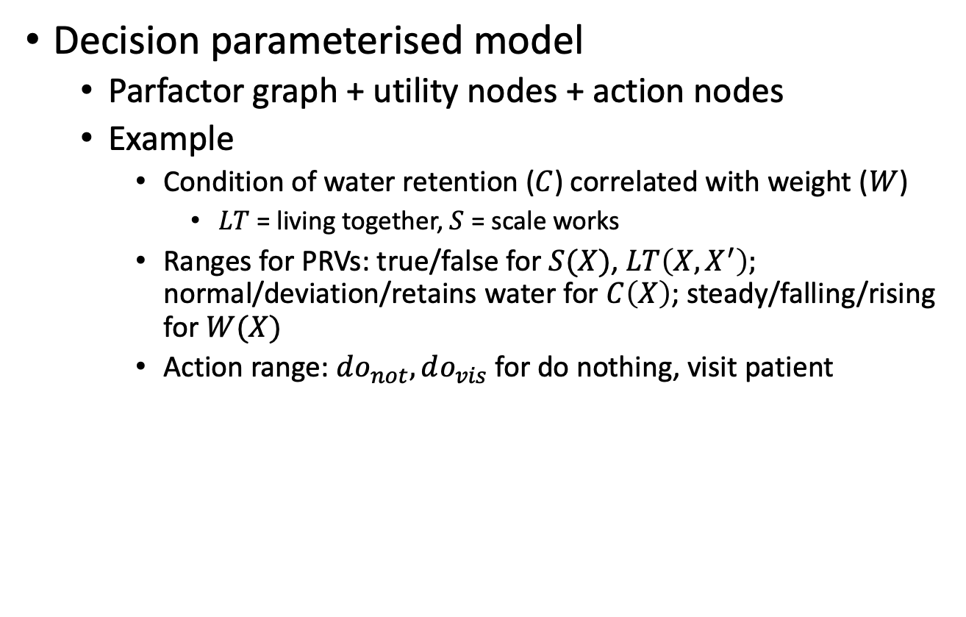






Lifted Decision Networks
Decision parameterised model
  Parfactor graph + utility nodes + action nodes
  Example
    Condition of water retention ($C$) correlated with weight ($W$)
      $LT$ = living together, $S$ = scale works
    Ranges for PRVs: true/false for $S(X)$, $LT\left(X,X^{′}\right);$ normal/deviation/retains water for $C\left(X\right)$; steady/falling/rising for $W(X)$
    Action range: $do_{not}, do_{vis}$ for do nothing, visit patient
$$A(X)$$
$$C(X^{′})$$
$$LT(X,X^{′})$$
$$g_{1}$$
$$C\left(X\right)$$
$$g_{3}$$
$$Util$$
$$W(X)$$
$$S(X)$$
$$g_{2}$$
Marcel Gehrke, TB, Ralf Möller, Alexander Waschkau, Christoph Strumann, Jost Steinhäuser: Lifted Maximum Expected Utility, 2019.

Slide 64


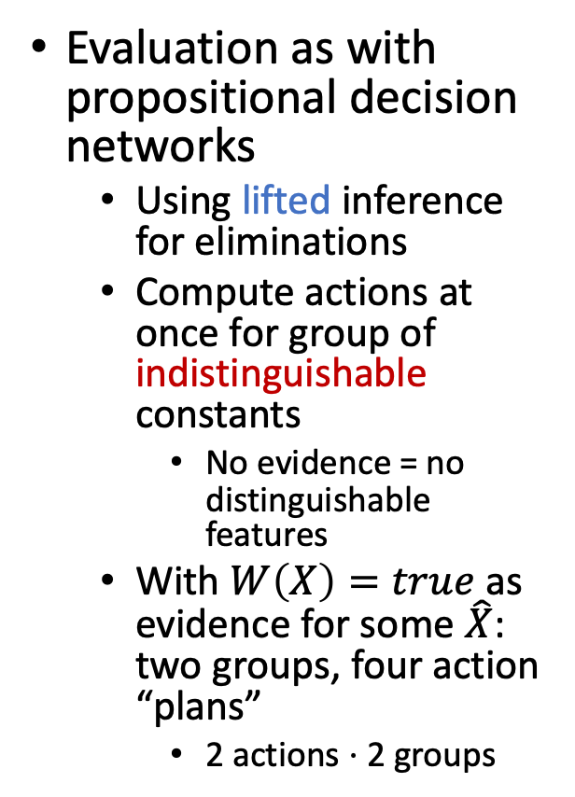








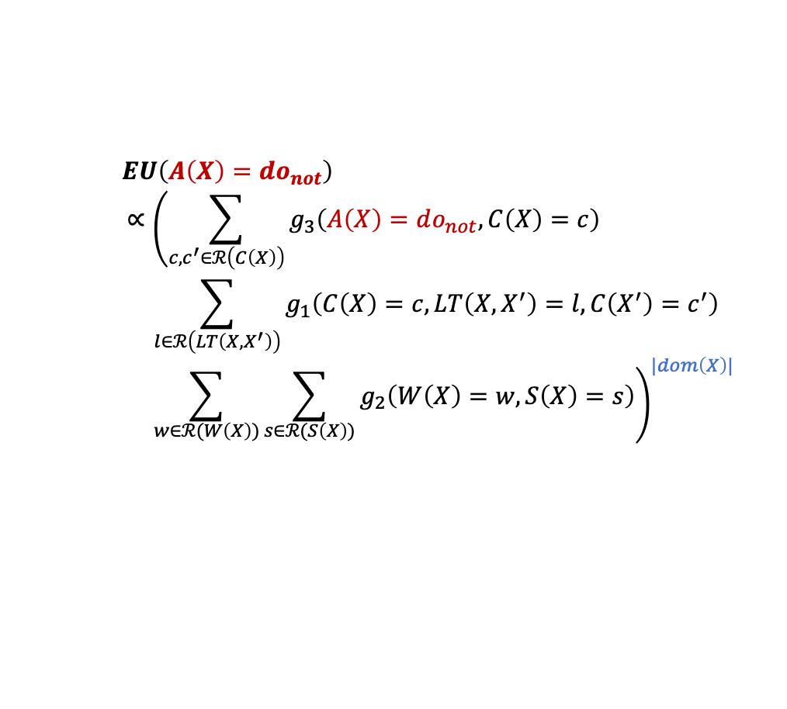


Evaluation: Example
Evaluation as with propositional decision networks
  Using lifted inference for eliminations
  Compute actions at once for group of indistinguishable constants
    No evidence = no distinguishable features
  With $W\left(X\right)=true$ as evidence for some $\hat{X}$: two groups, four action “plans”
    2 actions ⋅ 2 groups
$$A(X)$$
$$C(X^{′})$$
$$LT(X,X^{′})$$
$$g_{1}$$
$$C\left(X\right)$$
$$g_{3}$$
$$Util$$
$$W(X)$$
$$S(X)$$
$$g_{2}$$
$EU\left(A\left(X\right)=do_{not}\right)$
$$∝{\left(\sum_{c,c^{′}∈ℛ\left(C\left(X\right)\right)}{g_{3}\left(A\left(X\right)=do_{not}, C\left(X\right)=c\right)}=\sum_{l∈ℛ\left(LT\left(X,X^{′}\right)\right)}{g_{1}\left(C\left(X\right)=c, LT\left(X,X^{′}\right)=l,C\left(X^{′}\right)=c^{′}\right)}=\sum_{w∈ℛ(W\left(X\right))}{\sum_{s∈ℛ(S\left(X\right))}{g_{2}\left(W\left(X\right)=w, S\left(X\right)=s\right)}}\right)}^{|dom\left(X\right)|}$$
$$EU\left(A\left(X\right)=do_{vis}\right)$$
$MEU$: same action for all X
Marcel Gehrke, TB, Ralf Möller, Alexander Waschkau, Christoph Strumann, Jost Steinhäuser: Lifted Maximum Expected Utility, 2019.
Notes:
A(X^)=do_not, A(X)=do_not
A(X^)=do_not, A(X)=do_vis
A(X^)=do_vis, A(X)=do_not
A(X^)=do_vis, A(X)=do_vis

Slide 65
Lifted Decision Making
Solving MEU/query answering problems intractable in general
  Exponential in tree width of the graphical model
Explicitly encoded symmetries allows for tractable inference in terms of domain sizes for logical variables
  Polynomial in domain size
  Guy Van den Broeck: On the Completeness of First-order Knowledge Compilation for Lifted Probabilistic Inference, NIPS-11.
  Nima Taghipour, Jesse Davis, and Hendrik Blockeel: First-order Decomposition Trees, NIPS-13.
    Of course: the goal should be linear and better
  Tractability through exchangeability
  Mathias Niepert and Guy Van den Broeck: Tractability through Exchangeability: A New Perspective on Efficient Probabilistic Inference, AAAI-14.

Slide 66
Intermediate Summary
Decision networks
  Utilities, actions, random variables
  Evaluation: for each action setting, eliminate everything else
Value of information
  How much is a piece of information worth?
Relational domains
  First-order constructs for compact representation
  Same action for sets of indistinguishable constants

Slide 67
Outline
Utility theory
  Preferences
  Utilities
  Dominance
  Preference structure
Decision theory
  Decision networks
  Value of information
  Relational domains
⟹ Next: Making Complex Decisions

