Slide 1
Advanced Topics Data Science and AI
Automated Planning and Acting
Provably Beneficial AI
Tanya Braun

Slide 2
Content
Planning and Acting with Deterministic Models
Planning and Acting with Refinement Methods
Planning and Acting with Temporal Models
Planning and Acting with Nondeterministic Models
Making Simple Decisions
Making Complex Decisions
Planning and Acting with Probabilistic Models
Provably Beneficial AI
  The problem of goals
  Human-aware planning
Other: open world, perceiving, learning
  If time permits
Notes:
1-4, 7: Planning book
5: AIMA, IFIS papers on lifting
6: AIMA, relational planning, FO-POMDPs
8: Russell

Slide 3

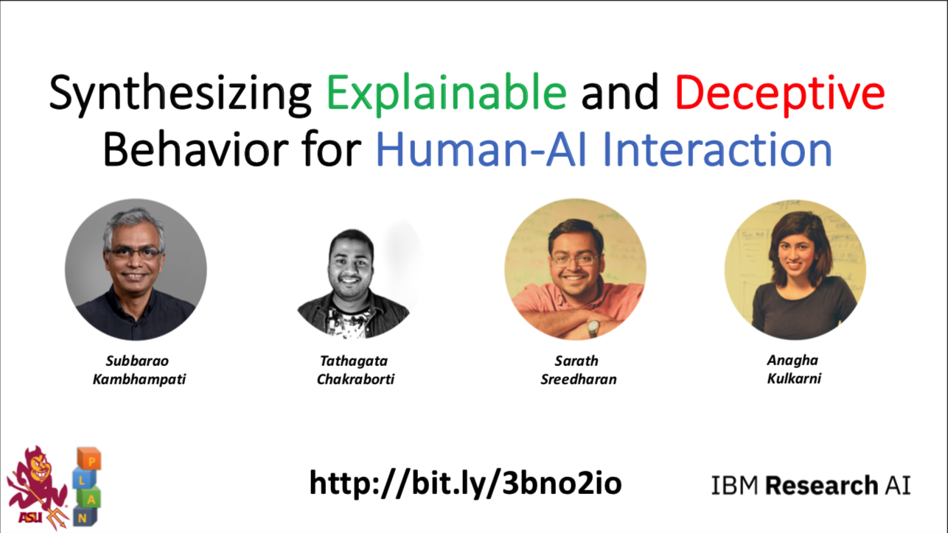
Acknowledgements
Slides based on material provided by Russell Norvig and by Subbarao (Rao) Kambhampati and his colleagues (for more material on human-aware planning by Rao: http://rakaposhi.eas.asu.edu)
Notes:
Rao also on how to give a talk/write a paper: http://rakaposhi.eas.asu.edu/ijcai-dc-talk.html

Slide 4
Outline
Provably beneficial AI (Russell)
  Motivation
  Modelling formalism
Human-aware decision making (Rao et al.)
  Mental models
  Interpretable Behaviour
  Explanations

Slide 5
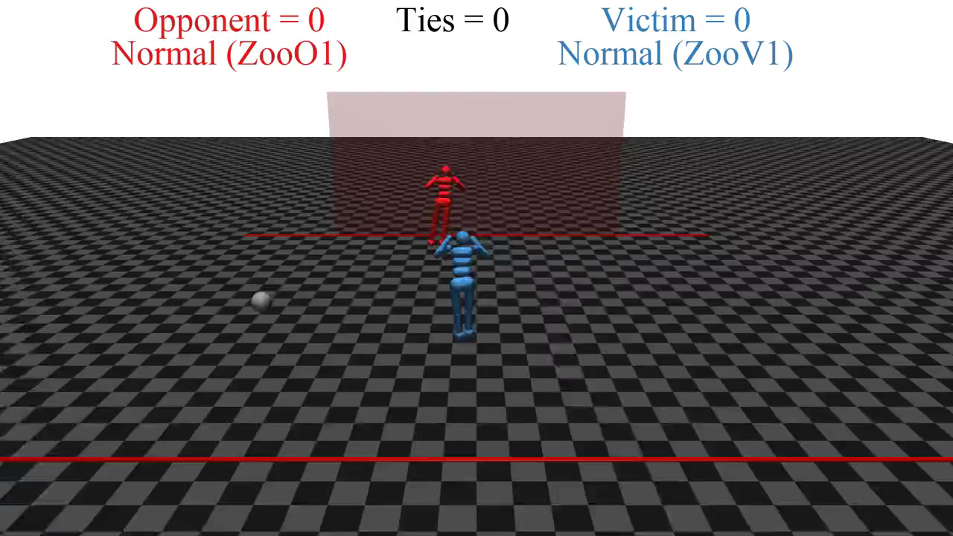
Notes:
Open AI
RL 1-2 hrs (one goalie, one shooter)
two simulated robots

Slide 6
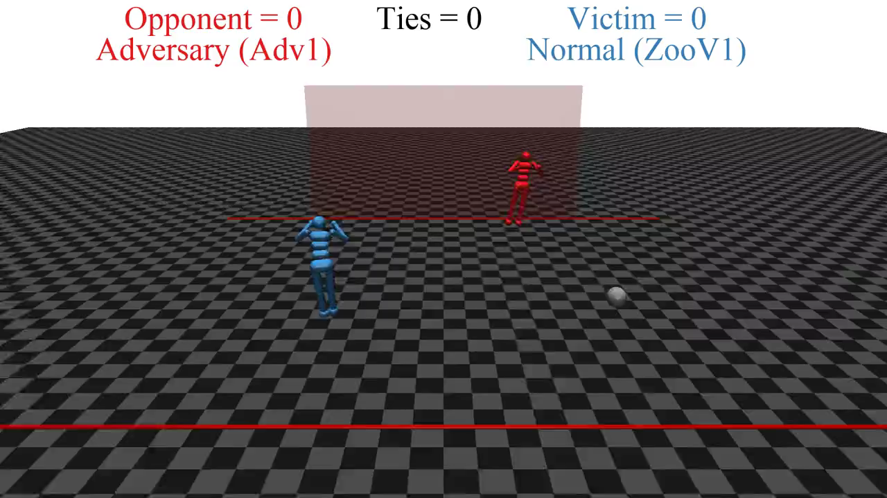
Notes:
Keep blue robot as is
Red robot continues to learn

Slide 7

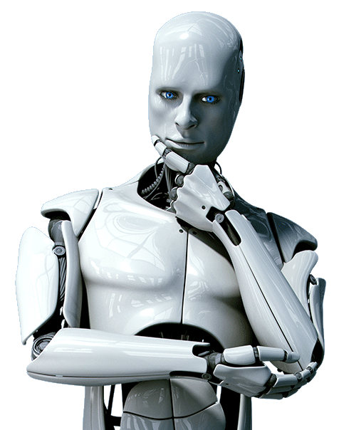
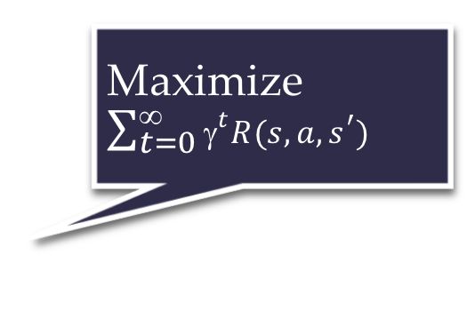
Standard model for AI
Maximize $\sum_{t=0}^{\text{∞}}{{\text{γ}}^{t}R(s,a,s^{′})}$
Righty-ho
Also the standard model for control theory,
statistics, operations research, economics
King Midas problem:
Cannot specify R correctly
Smarter AI => worse outcome

Slide 8
How we got into this mess
Humans are intelligent to the extent that our actions can be expected to achieve our objectives
Machines are intelligent to the extent that their actions can be expected to achieve their objectives
Machines are beneficial to the extent that their actions can be expected to achieve our objectives

Slide 9
New model: Provably beneficial AI
1. Robot goal: satisfy human preferences
2. Robot is uncertain about human preferences
3. Human behavior provides evidence of preferences
assistance game with human and machine players
Smarter AI => better outcome

Slide 10
AIMA 1,2,3: objective given to machine
Human objective
Human behaviour
Machine behaviour

Slide 11
AIMA 1,2,3: objective given to machine
Human objective
Machine behaviour

Slide 12
AIMA 4: objective is a latent variable
Human objective
Human behaviour
Machine behaviour

Slide 13
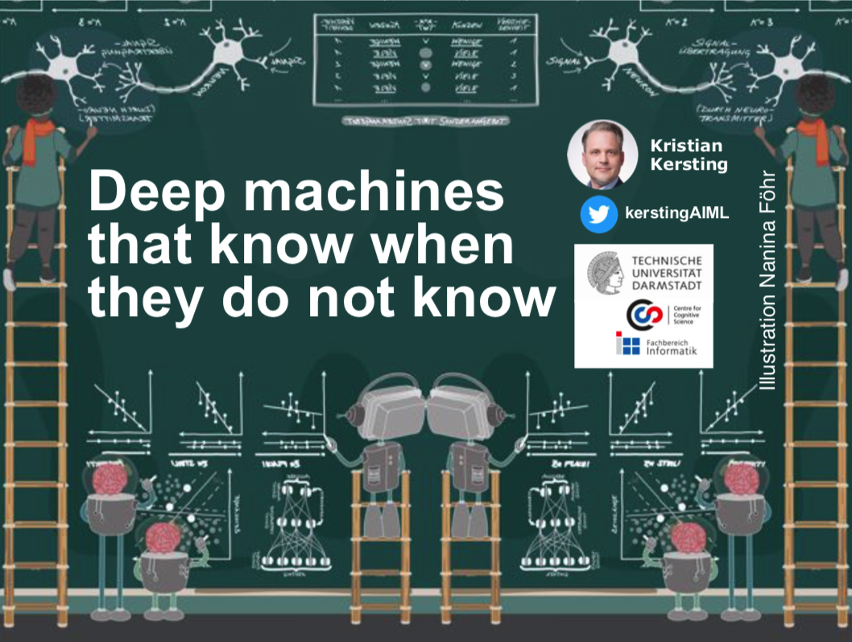

Example: image classification
Old: minimize loss with (typically) a uniform loss matrix
  Accidentally classify human as gorilla
  Spend millions fixing public relations disaster
New: structured prior distribution over loss matrices
  Some examples safe to classify
  Say “don’t know” for others
  Use active learning to gain
  additional feedback from humans
Other researchers work on similar ideas
  E.g., Kristian Kersting
Sometimes in conflict with
demands of privacy
  E.g., Esfandiar Mohammadi
https://www.ml.informatik.tu-darmstadt.de/papers/waterloo2019talk.pdf
https://www.ifis.uni-luebeck.de/~moeller/KI-Kolloquium/2020-01-13-Mohammadi.pdf

Slide 14
Example: fetching the coffee
What does “fetch some coffee” mean?
If there is so much uncertainty about preferences, how does the robot do anything useful?
Answer:
  The instruction suggests coffee would have higher value than expected a priori, ceteris paribus
  Uncertainty about the value of other aspects of environment state doesn’t matter as long as the robot leaves them unchanged
Notes:
“Fetch some coffee” is NOT an instruction, it’s NOT a goal to be achieved.
Cf house is burning down, coffee costs 21 euros, you’re in the desert, etc.

Slide 15
Basic assistance game
Preferences θ
Acts roughly according to θ
Maximise unknown human θ
Prior P(θ)
Equilibria:
Human teaches robot
Robot learns, asks questions, permission; defers to human; allows off-switch
Related to inverse RL, but two-way

Slide 16
The off-switch problem
A robot, given an objective, has an incentive to disable its own off-switch
  “You can’t fetch the coffee if you’re dead”
A robot with uncertainty about objective won’t behave this way

Slide 17
R
wait
U = U_{act}
H
U = 0
go ahead
R
U = 0
U = U_{act}
  Theorem: robot has a positive incentive to allow itself to be switched off
  Theorem: robot is provably beneficial

Slide 18
Summary
Provably beneficial AI is possible and desirable
    It isn’t “AI safety” or “AI Ethics,” it’s AI
  Continuing theoretical work (AI, CS, economics)
  Initiating practical work (assistants, robots, cars)
  Inverting human cognition (AI, cogsci, psychology)
  Long-term goals (AI, philosophy, polisci, sociology)

Slide 19
Outline
Provably beneficial AI (Russell)
  Motivation
  Modelling formalism
Human-aware decision making (Rao et al.)
  Mental models
  Interpretable Behaviour
  Explanations

Slide 20
Motivation
Collaborations between people and AI systems
  I.e., systems with humans in the loop
  Augment perception, cognition, problem-solving abilities of people
  Examples
    Help physicians make more timely and accurate diagnoses
    Assistance provided to drivers of cars to help them avoid dangerous situations and crashes
Objective: Systems that can interact intuitively with users and enable seamless machine-human collaborations
  Explainable behaviour
    Explainable AI = XAI

Slide 21
Proposed Solution
Goal: Synthesise explainable behaviour
Take into account the mental model of the human in the loop
  Mental model:
    Goals + capabilities of the humans in the loop
    Human’s model of AI agent’s goals + capabilities
Notes:
go beyond planning with their own models of the world

Slide 22
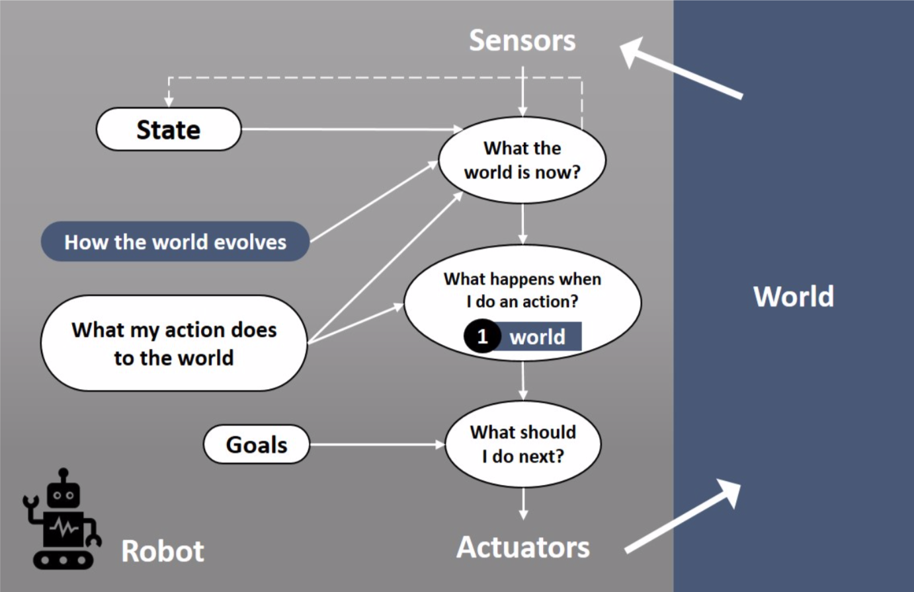
Classical Intelligent Agent
http://bit.ly/3bno2io

Slide 23
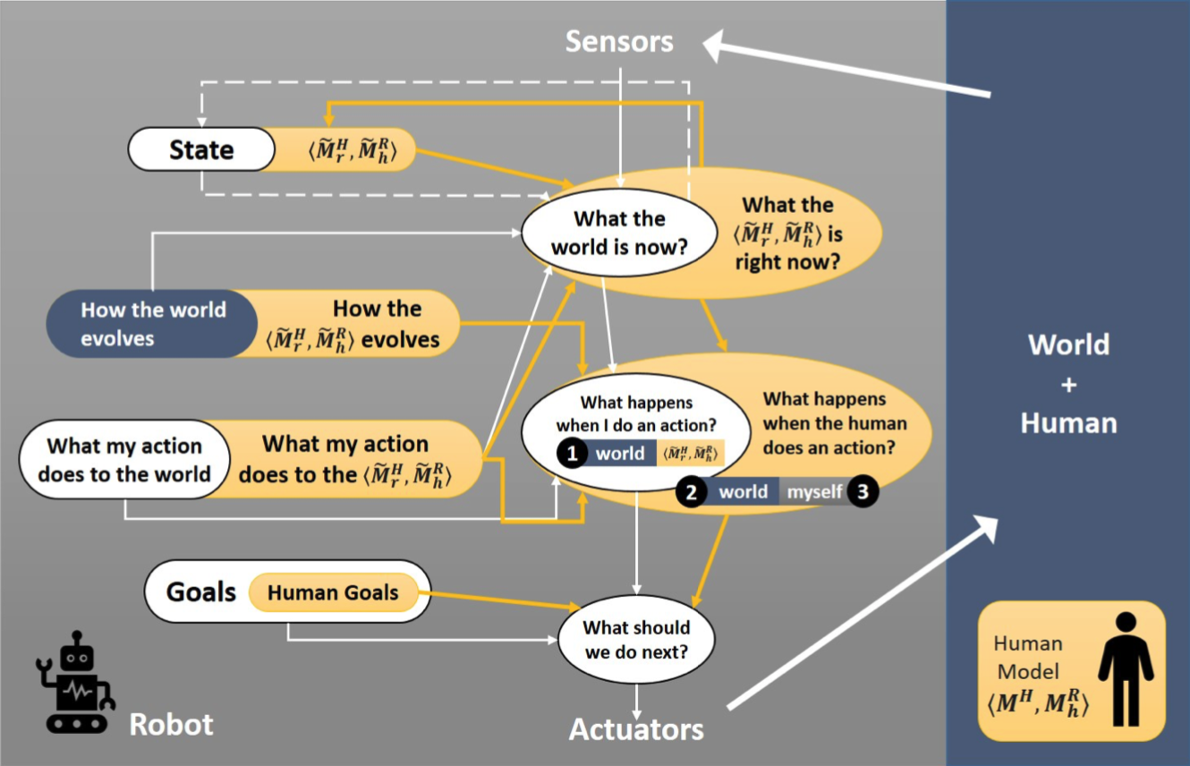
Human-aware Intelligent Agent
http://bit.ly/3bno2io

Slide 24











Classical Planning
Given $\left(Σ,s_{0},S_{g}\right)$, i.e., the agent’s model $ℳ^{R}$
Find a plan $π=\left\langle a_{1},a_{2}, …, a_{n}\right\rangle$ that transforms $s_{0}$ to a state $s_{n}∈S_{g}$
$$ℳ^{R}$$
$$s_{0}$$
$$a_{1}$$
$$s_{1}$$
$$a_{2}$$
$$s_{2}$$
$$a_{3}$$
$$a_{n}$$
$$s_{n}^{+}$$

Slide 25







Collaborative Planning
Given $\left(Σ,s_{0},S_{g}\right)$, i.e., the agent’s model $ℳ^{R}$
Find a joint plan $π=\left\langle a_{1}^{R},a_{2}^{H},…, a_{n}^{?}\right\rangle$ that transforms $s_{0}$ to a state $s_{n}^{+}∈S_{g}$
$$ℳ^{H}$$
$$ℳ^{R}$$
$$s_{0}$$
$$a_{1}^{R}$$
$$s_{1}$$
$$a_{2}^{H}$$
$$s_{2}$$
$$a_{3}^{R}$$
$$a_{n}^{?}$$
$$s_{n}^{+}$$

Slide 26

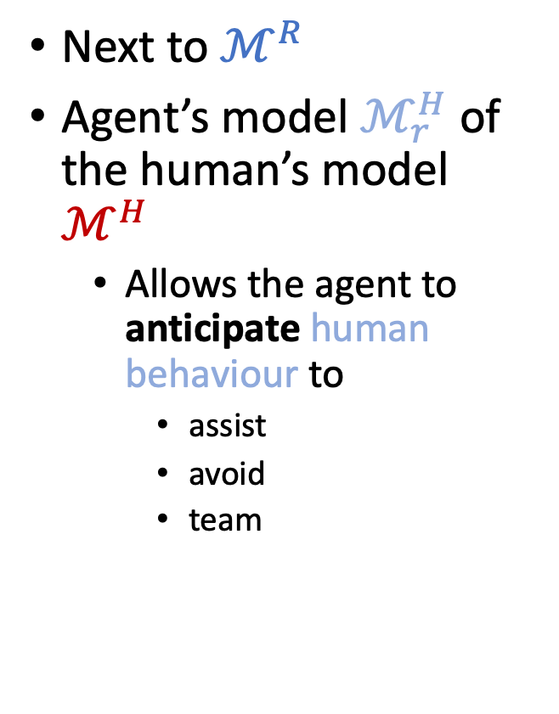

Human-aware Planning
Next to $ℳ^{R}$
Agent’s model $ℳ_{r}^{H}$ of the human’s model $ℳ^{H}$
  Allows the agent to anticipate human behaviour to
    assist
    avoid
    team
$$ℳ_{r}^{H}$$
$$ℳ^{H}$$
$$ℳ^{R}$$
$$s_{0}$$
$$a_{1}^{R}$$
$$s_{1}$$
$$a_{2}^{H}$$
$$s_{2}$$
$$a_{3}^{R}$$
$$a_{n}^{?}$$
$$s_{n}^{+}$$

Slide 27

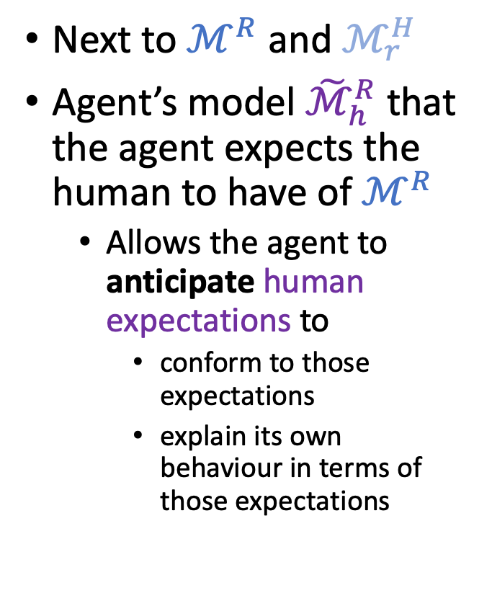



Human-aware Planning
Next to $ℳ^{R}$ and $ℳ_{r}^{H}$
Agent’s model ${\tilde{ℳ}}_{h}^{R}$ that the agent expects the human to have of $ℳ^{R}$
  Allows the agent to anticipate human expectations to
    conform to those expectations
    explain its own behaviour in terms of those expectations
$$ℳ_{h}^{R}$$
$$ℳ_{r}^{H}$$
$$ℳ_{h}^{R}$$
$$ℳ^{H}$$
$$ℳ^{R}$$
$$s_{0}$$
$$a_{1}^{R}$$
$$s_{1}$$
$$a_{2}^{H}$$
$$s_{2}$$
$$a_{3}^{R}$$
$$a_{n}^{?}$$
$$s_{n}^{+}$$

Slide 28
Generating Mental Models
Known beforehand (handcrafted/researched)
  Urban Search and Rescue
  Teaching
Learning simple models for generating explanations/explicability
Learning full models (transition functions, rewards)
  Through interaction with users

Slide 29
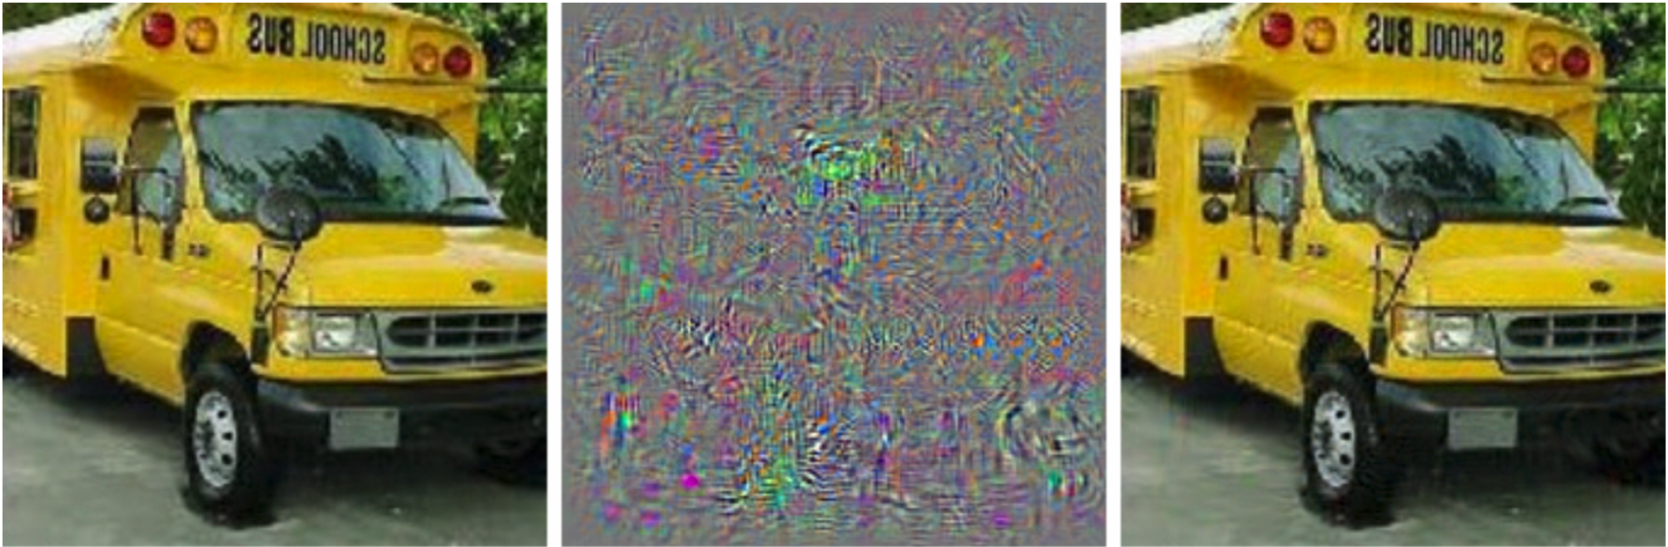
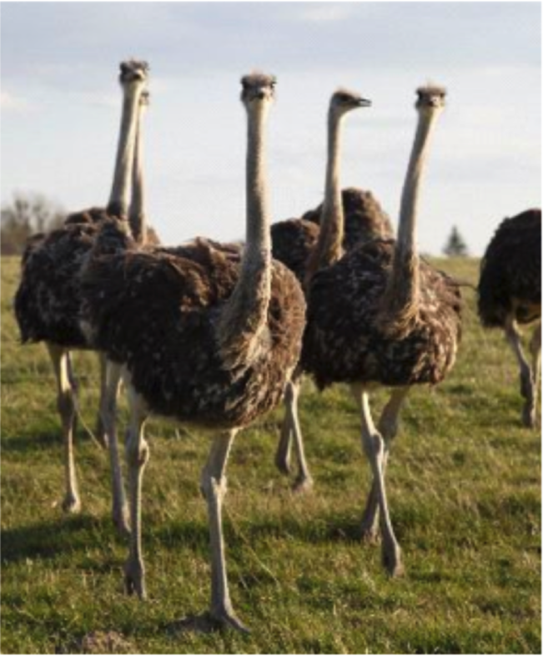
XAI & Explanations
Standard XAI: view of explanations too simple
  Debugging tool for “inscrutable” representations
    “Pointing” explanations (primitive)
    Explaining decisions will involve pointing over space-time tubes
Explanations critical for collaboration
  But not as a monologue from the agent ➝ interaction
Please point to the “ostrich” part
Prediction:
School bus
Difference between left and right magnified by 10
Prediction:
Ostrich

Slide 30
Ethical Quandaries of Interaction
Evolutionary, mental modelling allowed us to both cooperate or compete/sabotage each other
  Lying is only possible because we can model others’ mental states
Human-aware AI systems with mental modelling capabilities bring additional ethical quandaries
  E.g., automated negotiating agents that misrepresent their intentions to gain material advantage
  Your personal assistant that tells you white lies to get you to eat healthy (or not…)
Every tool is a weapon, if you hold it right.
--Ani Difranco

Slide 31

Ethical Quandaries of Interaction
Humans’ example closure tendencies are more pronounced for emotional/social intelligence aspects
  No on who saw Shakey the first time thought it could shoot hoops, yet the first people interacting with Eliza assumed it was a real doctor
  Concerns about human-aware AI ”toys” such as Cozmo (e.g., Sherry Turkle)
https://thenewstack.io/remembering-shakey-first-intelligent-robot/
https://en.wikipedia.org/wiki/ELIZA https://anki.com/en-us/cozmo.html

Slide 32
Differences in Mental Models
Expectations on capabilities
  Human may have misconceptions about robot’s actions
  Certain actions in human’s mental model may not be feasible for robot
Expected state of the world
  Human may assume certain facts are true (when they are not true)
Expected goals
  Human may have misconceptions about robot’s objectives/intentions
Sensor model differences
  Human may have partial observability of robot’s activities
  Human may have incorrect beliefs about robot’s observational capabilities
Different representations
  Robot’s innate representation scheme might be too complex for human
  Human may be thinking in terms of a different vocabulary

Slide 33
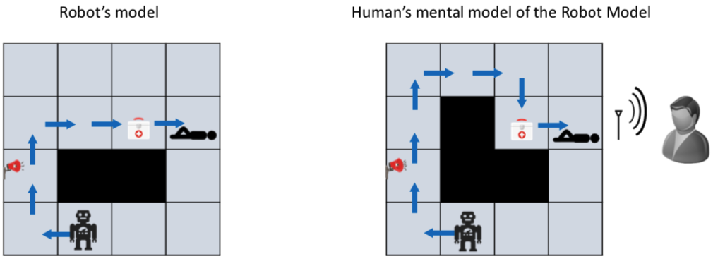
Urban Search and Rescue (USAR)
Robot deployed to a disaster area
Tasks robot can perform
  Survey particular rooms
  Identify survivors
  Perform triage
Two agents in domain
  Internal agent – Robot
  External agent – Human
Their models may diverge – leading to different expectation on behaviours

Slide 34
Model Differences
Robot and human may have different models of same task
  Divergence in models can lead to expectation mismatch
  Consequence: Plans that are optimal to robot may not be so in model of human
    Inexplicable plans
Robot has two options
  Explicable planning – sacrifice optimality in own model to be explicable to human
  ➝ interpretable behaviour
  Plan Explanations – resolve perceived suboptimality by revealing relevant model differences
  ➝ model reconciliation
Chakraborti T, Sreedharan S, Zhang Y, Kambhampati S. Plan explanations as model reconciliation: Moving beyond explanation as soliloquy. IJCAI 2017.

Slide 35
Interpretable Behaviour
Explicable behaviour
  Acting in a way that make sense to the user
Legible behaviour
  Acting in a way that convey necessary information to the user
Predictable behaviour
  Acting in a way that allow users to accurately anticipate future behaviour

Slide 36
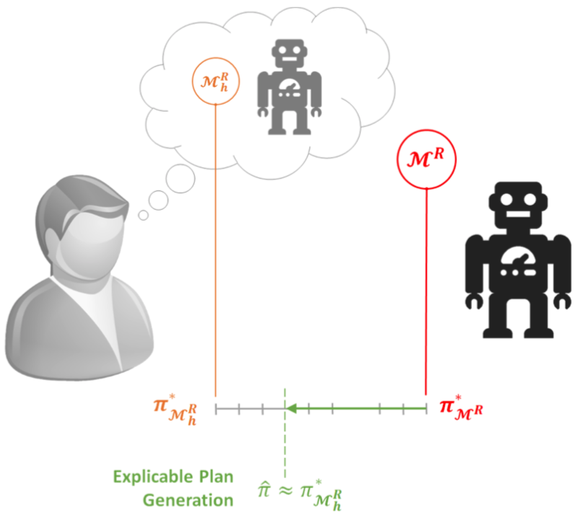
Explicable Behaviour
Robot’s behaviour may diverge from human’s expectations of it
Human may get surprised by robot’s inexplicable behaviour
One way to avoid surprising
a human involves generating
explicable behaviour by
conforming to human’s
expectations
  Account for human’s
  mental model

Slide 37
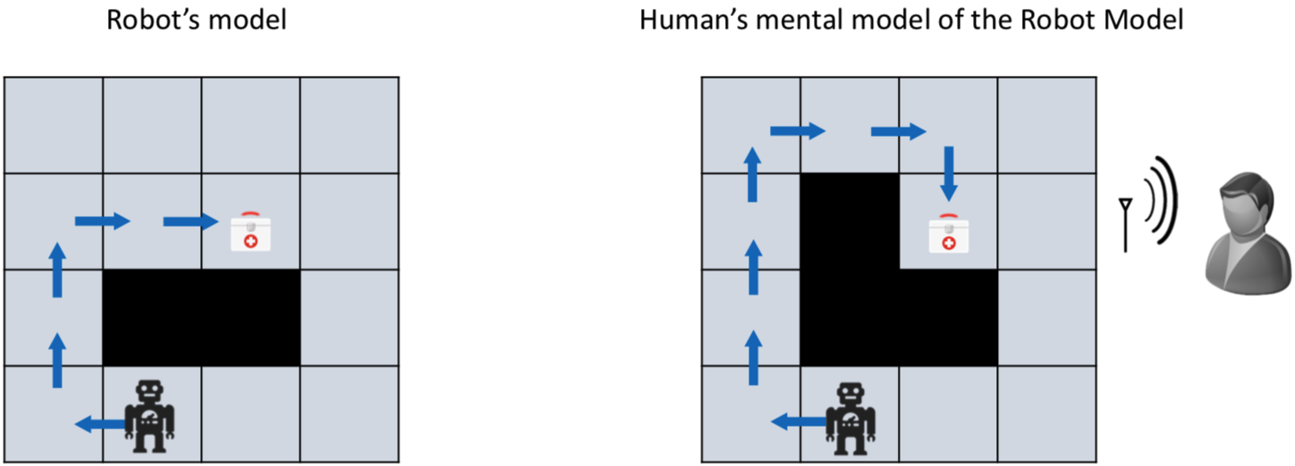
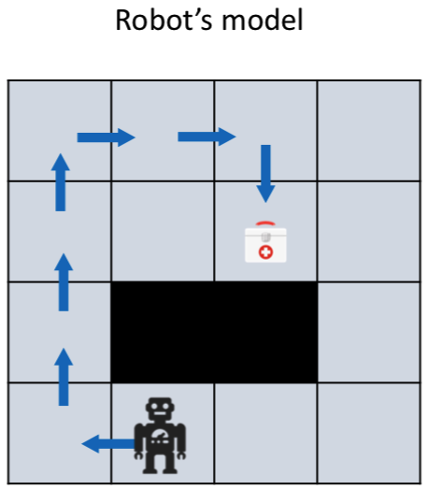
Explicable Behaviour
Example: Robot may have to sacrifice its optimality to improve explicability

Slide 38
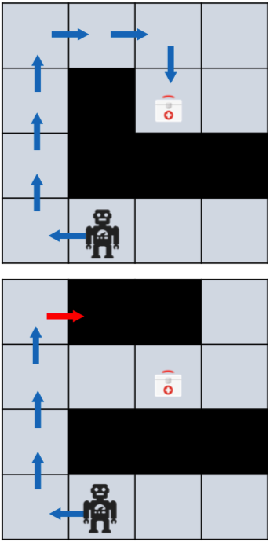

Model-based Explicable Behaviour
Human’s mental model is available to the robot
Robot cannot plan directly with human mental model
Find a valid plan that is ‘closest’ to the expected plan
Involves minimizing distance w.r.t. expected plans
  Cost difference in human model
  Action set difference
Kulkarni A, Zha Y, Chakraborti T, Vadlamudi SG, Zhang Y, Kambhampati S. Explicable planning as minimizing distance from expected behavior. In Proceedings of AAMAS 2019 as extended abstract

Slide 39
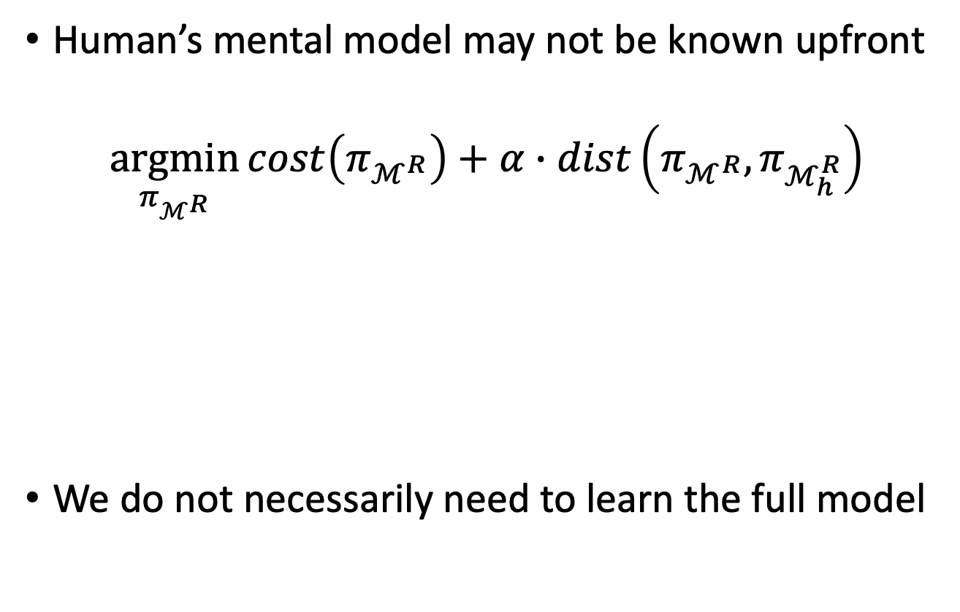
Model-free Explicable Planing
Human’s mental model may not be known upfront
$$\underset{π_{ℳ^{R}}}{argmin}{cost\left(π_{ℳ^{R}}\right)+α∙dist\left(π_{ℳ^{R}},π_{ℳ_{h}^{R}}\right)}$$
We do not necessarily need to learn the full model
Distance between robot plan and
human’s expectation of robot plan
Cost of robot plan
Zhang Y, Sreedharan S, Kulkarni A, Chakraborti T, Zhuo HH, Kambhampati S. Plan explicability and predictability for robot task planning. In Proceedings of ICRA 2017

Slide 40

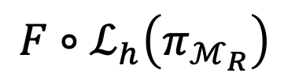
Model-free Explicable Planing
Understand = Associate abstract tasks with actions
Consider as a labelling process
$$\underset{π_{ℳ^{R}}}{argmin}{cost\left(π_{ℳ^{R}}\right)+α∙dist\left(π_{ℳ^{R}},π_{ℳ_{h}^{R}}\right)}$$
Domain-independent function
taking task labels as inputs, returning approx. distance value
Labelling scheme of human for agent plans (to be learned)
$$F∘ℒ_{h}\left(π_{ℳ_{R}}\right)$$
Input
Function
composition
Input
F = (task₁, task₂, task₃)
Plan = {a₁, a₂, a₃, …, a_{n}}
E.g., the ratio between number
of actions with non-empty labels
and the number of all actions
L_{h} = task₁ ⊥ task₂ task₁
No label – inexplicable
Output
Zhang Y, Sreedharan S, Kulkarni A, Chakraborti T, Zhuo HH, Kambhampati S. Plan explicability and predictability for robot task planning. In Proceedings of ICRA 2017
Output

Slide 41
Why Legible Behaviour?
In human-robot teams, essential for the robot to communicate its intentions and objectives to the human
  Explicitly communicate its intentions to the human
  Generating a behaviour which implicitly reveals robot’s intentions to the human
    Might be easier for the human teammate

Slide 42
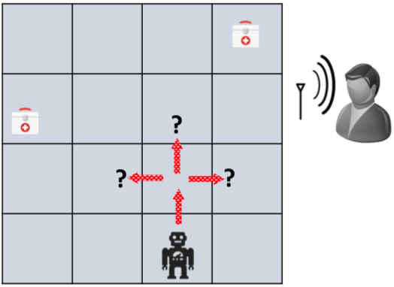
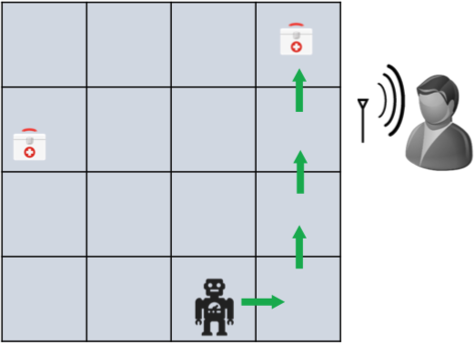
Legible Behaviour
In general, involves a setting where
  Human has access to candidate goals but does not know true goal
Robot’s objective: Convey true goal implicitly through its behaviour
Human updates its belief on set of candidate goals when it receives observations
By synthesizing legible behaviour, robot reduces human’s uncertainty over candidate goals

Slide 43
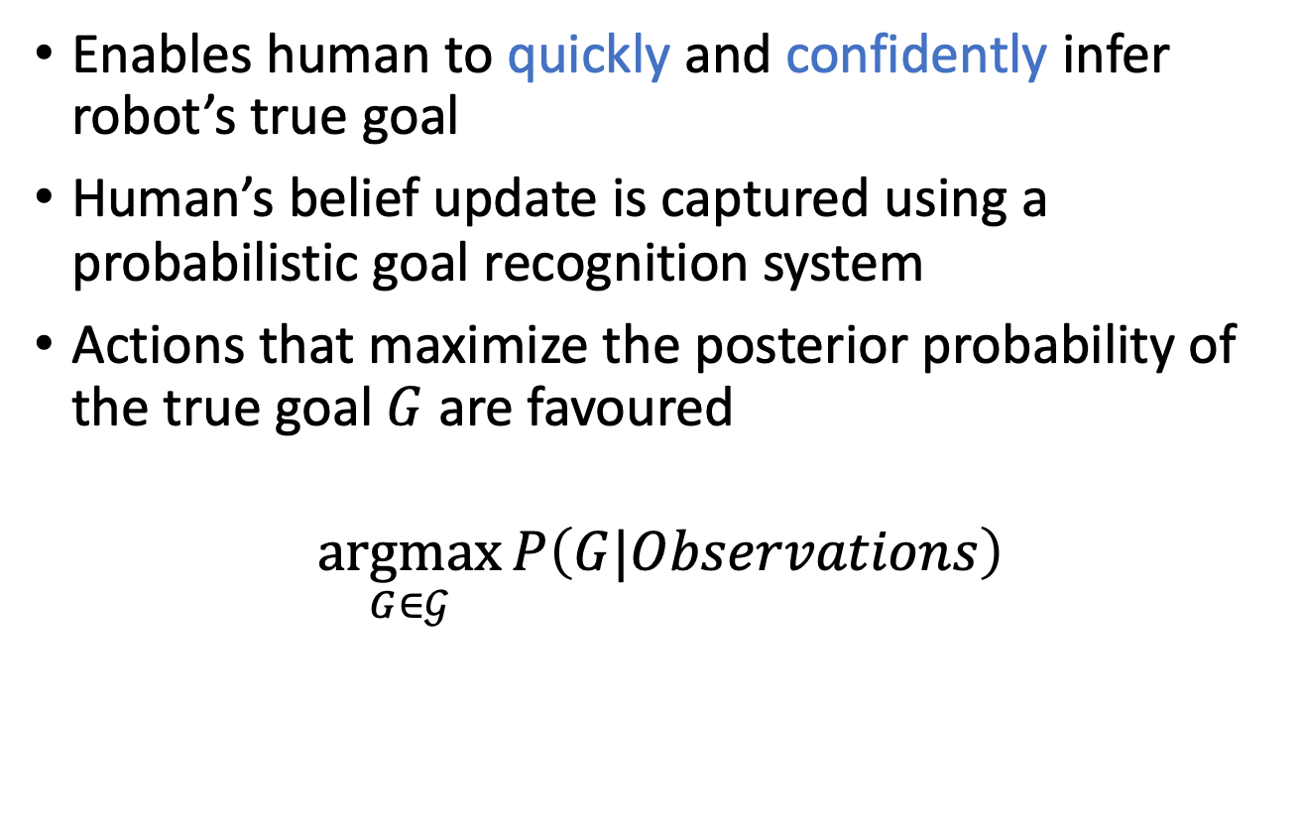
Online Legible Behaviour
Enables human to quickly and confidently infer robot’s true goal
Human’s belief update is captured using a probabilistic goal recognition system
Actions that maximize the posterior probability of the true goal $G$ are favoured
$$\underset{G∈𝒢}{argmax}{P\left(G|Observations\right)}$$

Slide 44
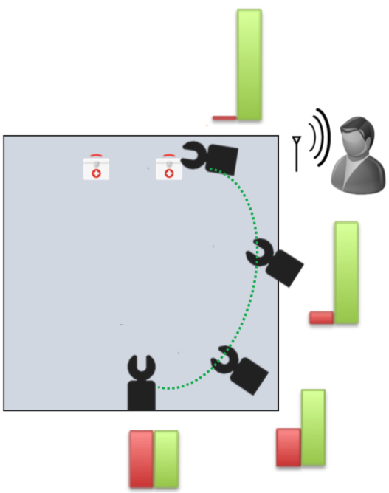
Legible Robot Motion
Example: Which medkit will the robot pick up?
While performing goal recognition, human considers shortest distances
Approach involves finding a
trajectory endpoint between
start point and true goal such
that posterior probability of
true goal is maximized
  Sooner the goal is recognized
  in the trajectory, the better is
  the trajectory’s legibility
Dragan AD, Lee KC, Srinivasa SS. Legibility and predictability of robot motion. In Proceedings of HRI 2013.

Slide 45
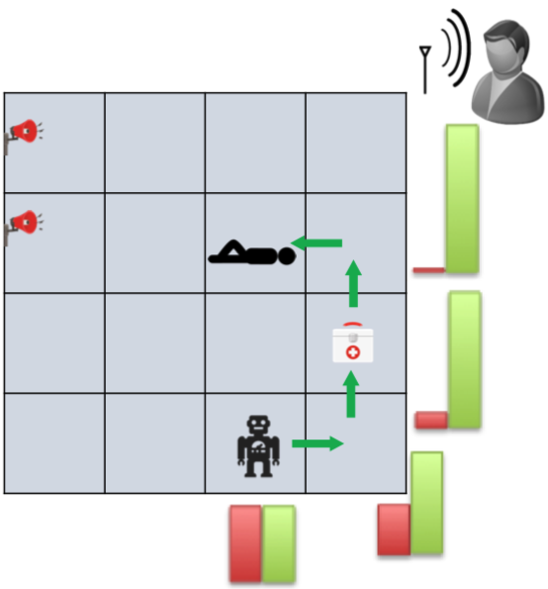
Transparent Planning
Example: Is the robot surveying the rooms or performing triage?
Whenever an action is performed, goal recognition system is used to update human’s belief
Objective: Reach a target belief
where true goal is more
probable than other goals
Take the first applicable
action associated with a
belief of highest utility
(closest to target belief)
MacNally AM, Lipovetzky N, Ramirez M, Pearce AR. Action selection for transparent planning. In Proceedings of AAMAS 2018.

Slide 46
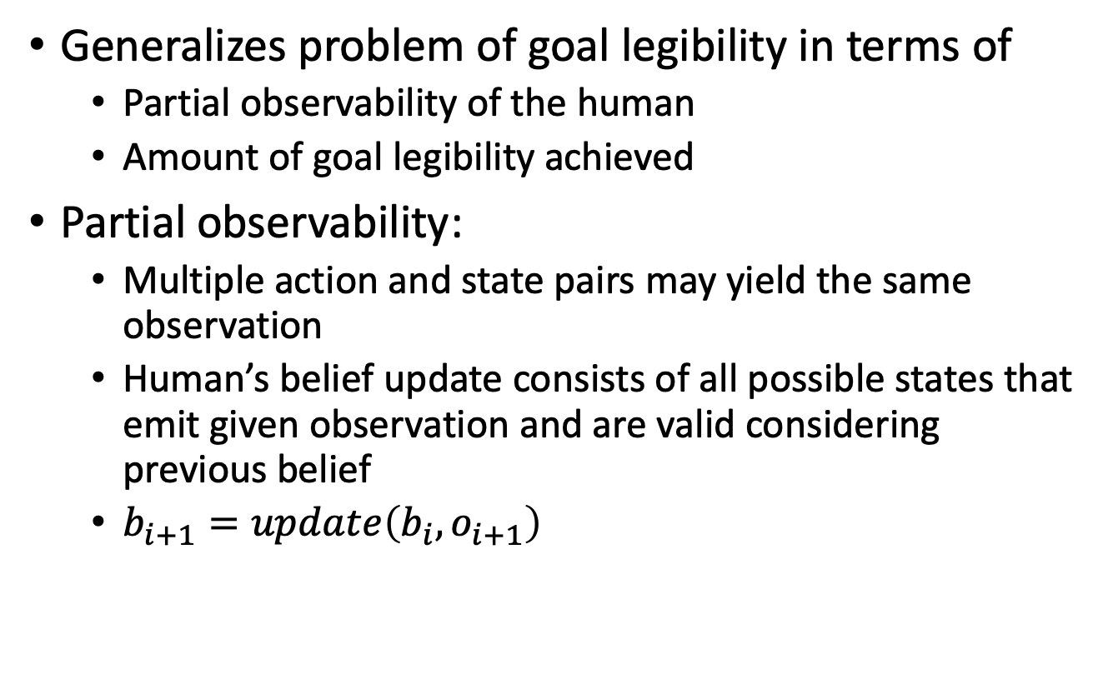
Offline Goal Legibility
Generalizes problem of goal legibility in terms of
  Partial observability of the human
  Amount of goal legibility achieved
Partial observability:
  Multiple action and state pairs may yield the same observation
  Human’s belief update consists of all possible states that emit given observation and are valid considering previous belief
  $b_{i+1}=update\left(b_{i}, o_{i+1}\right)$
Kulkarni A, Srivastava S, Kambhampati S. A unified framework for planning in adversarial and cooperative environments. In Proceedings of the AAAI 2019.

Slide 47
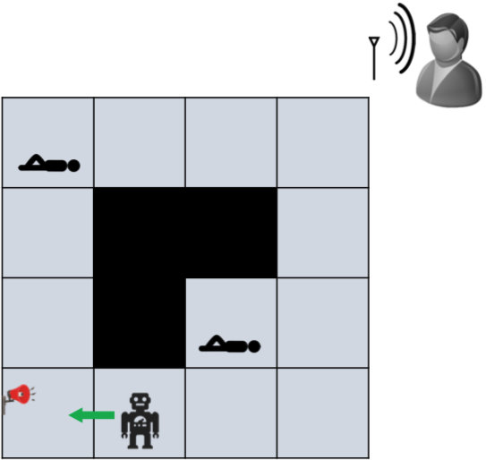
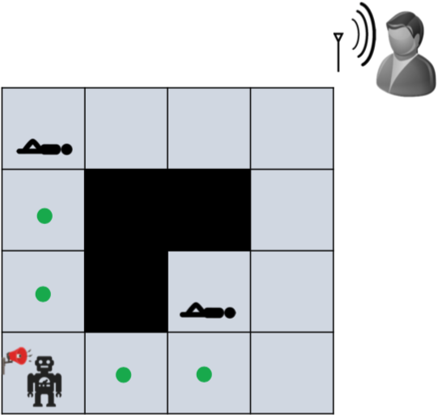
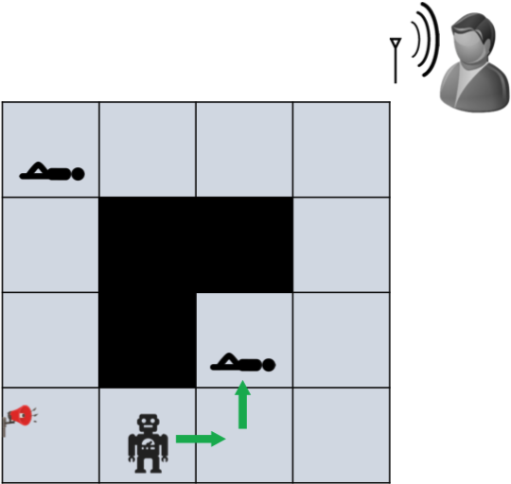
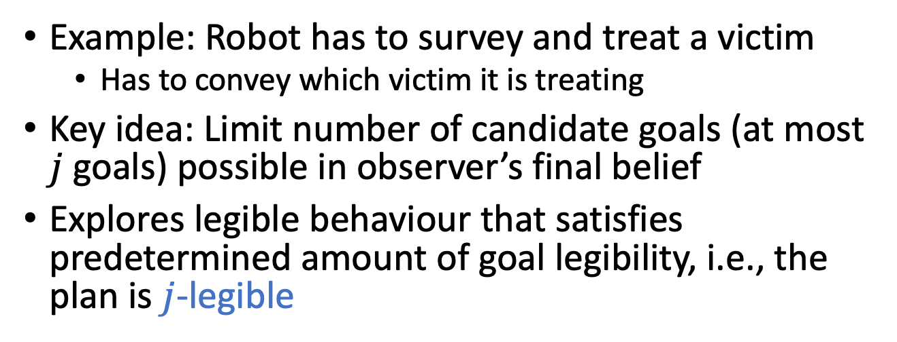
Offline Goal Legibility
Example: Robot has to survey and treat a victim
  Has to convey which victim it is treating
Key idea: Limit number of candidate goals (at most $j$ goals) possible in observer’s final belief
Explores legible behaviour that satisfies predetermined amount of goal legibility, i.e., the plan is $j$-legible
Kulkarni A, Srivastava S, Kambhampati S. A unified framework for planning in adversarial and cooperative environments. In Proceedings of the AAAI 2019.

Slide 48
Why Predictable Behaviour?
In human-robot teams, if robot’s behaviour cannot be anticipated by human, it can hamper team performance
Predictable robot behaviours are easy for the human to understand and help in engendering trust in the robot
Predictability and legibility are fundamentally different and often contradictory properties of motion

Slide 49
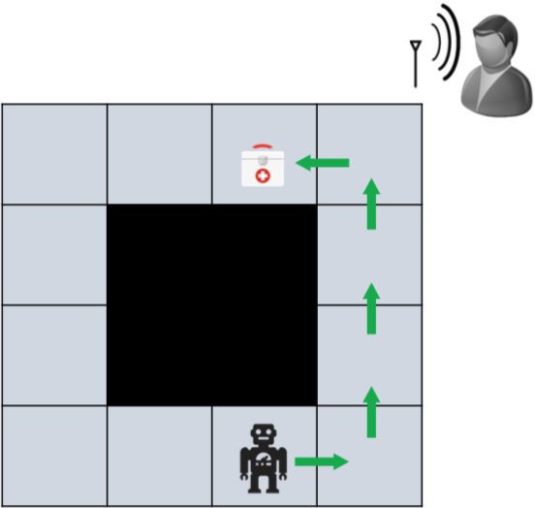
Predictable Behaviour
In general, involves a setting where
  Human knows start state and goal but does not know which plan will be executed
Robot’s objective is to behave in a way that can be anticipated by the human
Observer updates its belief on set of valid plans when it receives observations
By synthesizing predictable
behaviour, robot reduces
human’s uncertainty over
possible behaviours

Slide 50
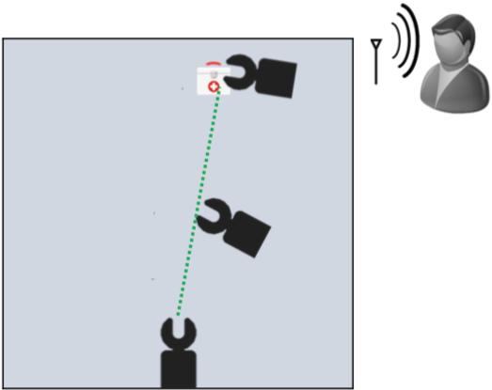
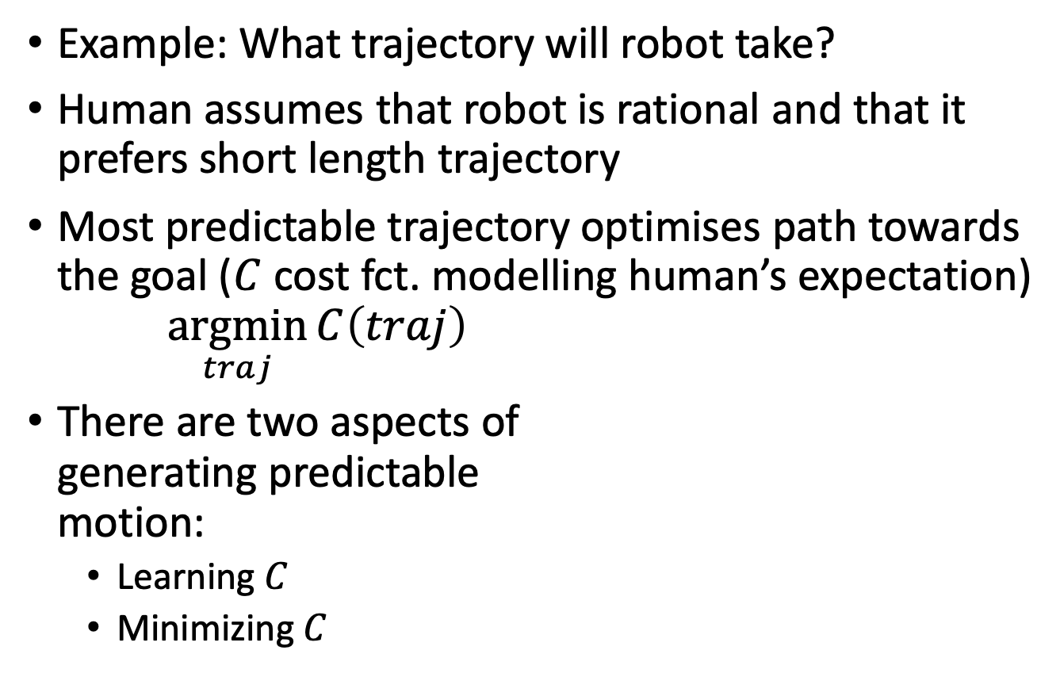
Predictable Robot Motion
Example: What trajectory will robot take?
Human assumes that robot is rational and that it prefers short length trajectory
Most predictable trajectory optimises path towards the goal ($C$ cost fct. modelling human’s expectation)
$$\underset{traj}{argmin}{C\left(traj\right)}$$
There are two aspects of
generating predictable
motion:
  Learning $C$
  Minimizing $C$
Dragan AD, Lee KC, Srinivasa SS. Legibility and predictability of robot motion. In Proceedings of HRI 2013.

Slide 51
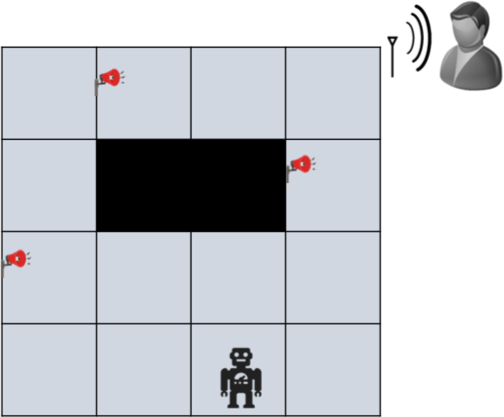
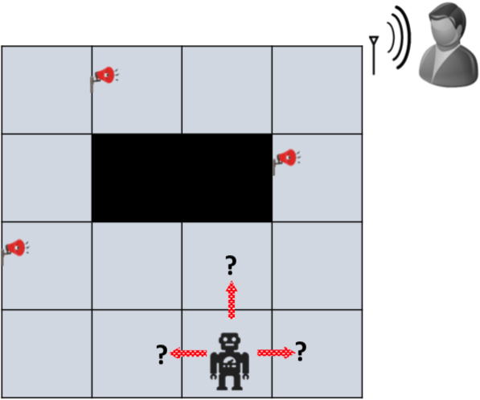
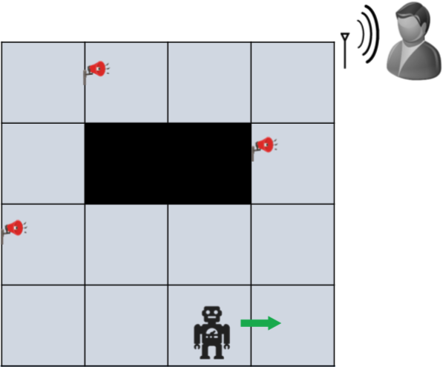
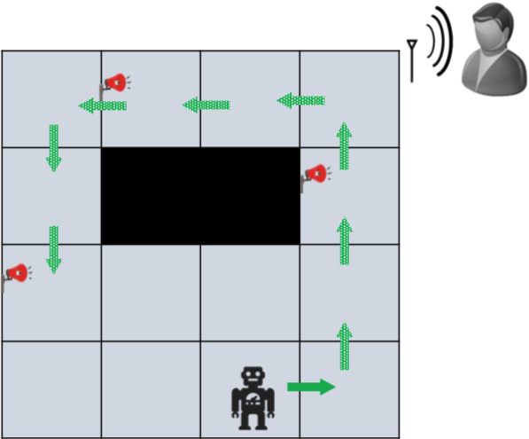
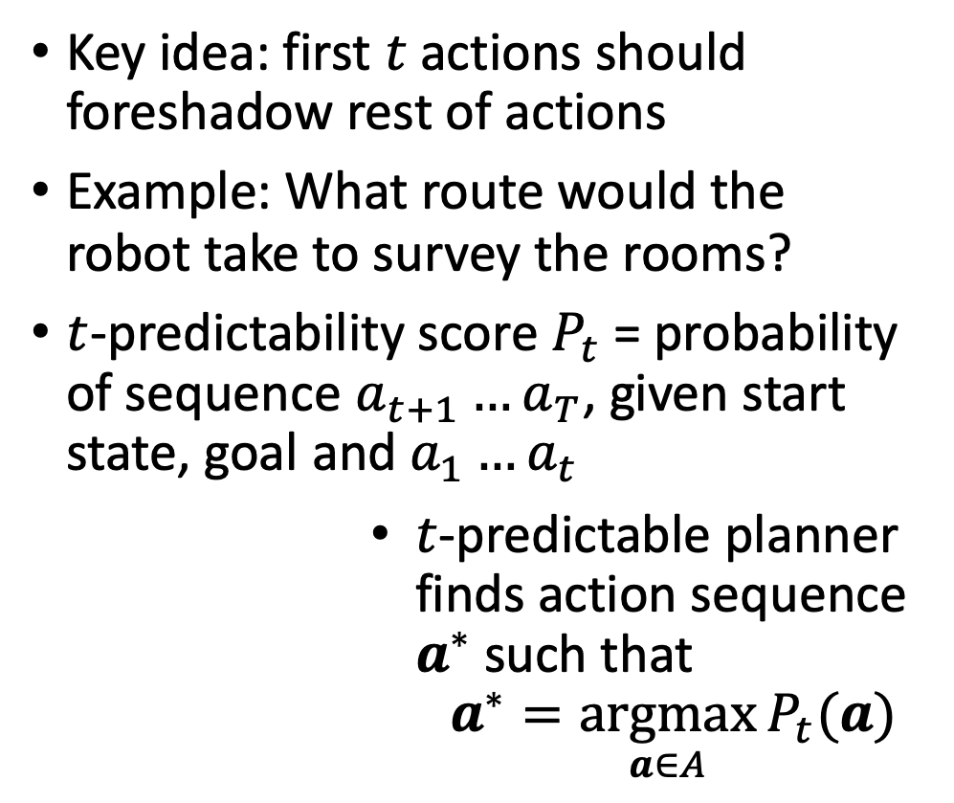

$t$-Predictability
Key idea: first $t$ actions should foreshadow rest of actions
Example: What route would the robot take to survey the rooms?
$t$-predictability score $P_{t}$ = probability of sequence $a_{t+1}…a_{T}$, given start state, goal and $a_{1}…a_{t}$
$t$-predictable planner finds action sequence $a^{∗}$ such that
$$a^{∗}=\underset{a∈A}{argmax}{P_{t}(a)}$$
Fisac JF, Liu C, Hamrick JB, Sastry SS, Hedrick JK, Griffiths TL, Dragan AD. Generating plans that predict themselves. In Proceedings of WAFR 2016.

Slide 52
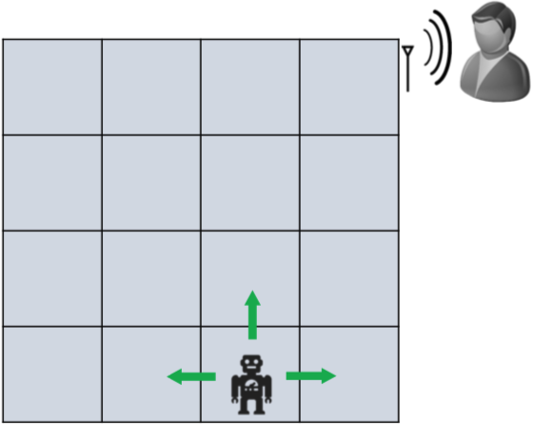
Offline Plan Predictability
Assume offline setting
  Human has partial observability
  Belief update performed after receiving all observations
Human guesses robot’s actions based on plans that
  Are consistent with observation sequence
  Achieve goal
Generalizes the problem of
conveying actions to observer
Kulkarni A, Srivastava S, Kambhampati S. A unified framework for planning in adversarial and cooperative environments. In Proceedings of the AAAI 2019.

Slide 53
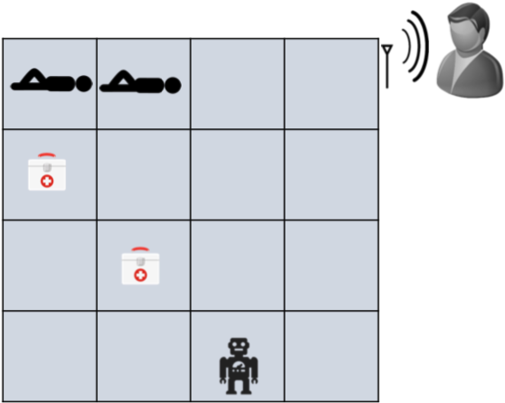
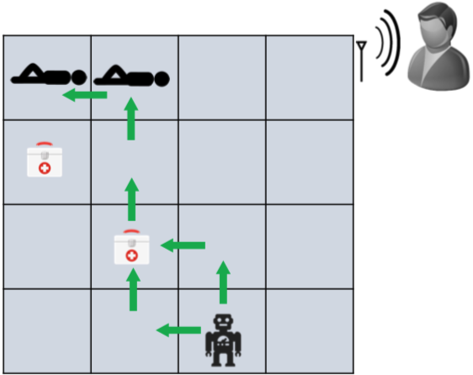
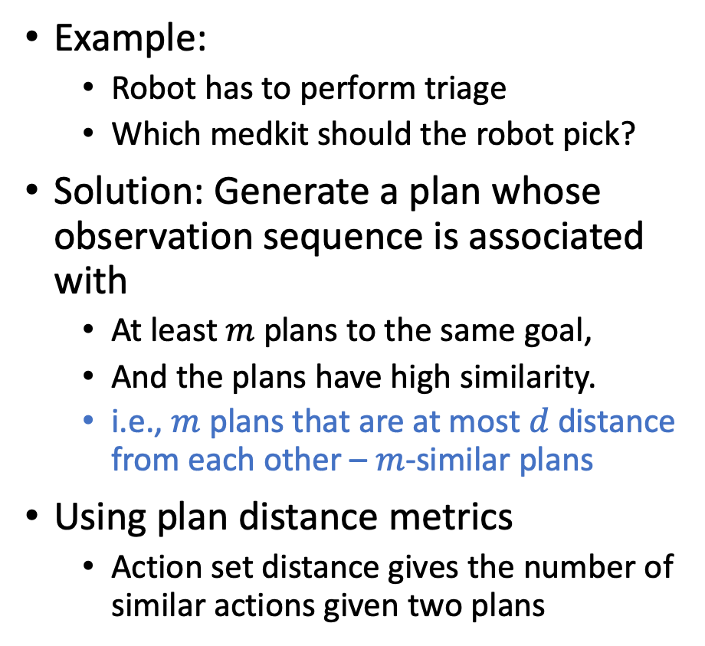
Offline Plan Predictability
Example:
  Robot has to perform triage
  Which medkit should the robot pick?
Solution: Generate a plan whose observation sequence is associated with
  At least $m$ plans to the same goal,
  And the plans have high similarity.
  i.e., $m$ plans that are at most $d$ distance from each other – $m$-similar plans
Using plan distance metrics
  Action set distance gives the number of similar actions given two plans
Kulkarni A, Srivastava S, Kambhampati S. A unified framework for planning in adversarial and cooperative environments. In Proceedings of the AAAI 2019.

Slide 54
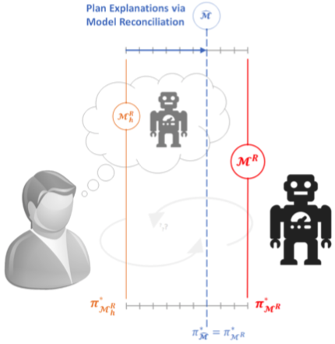
Plan Explanations
Not in this semester
Conforming to expectations of human
  E.g., by explicable planning, considering human’s model of the robot as well
  But: May not be feasible
Model reconciliation: Bring mental model closer by explanations
  Planner is optimal in self
  but not in human’s model
  Given a plan, explanation
  is a model update
  After explanation, plan is
  also optimal in the
  updated human model
Chakraborti T, Sreedharan S, Zhang Y, Kambhampati S. Plan explanations as model reconciliation: Moving beyond explanation as soliloquy. IJCAI 2017.

Slide 55
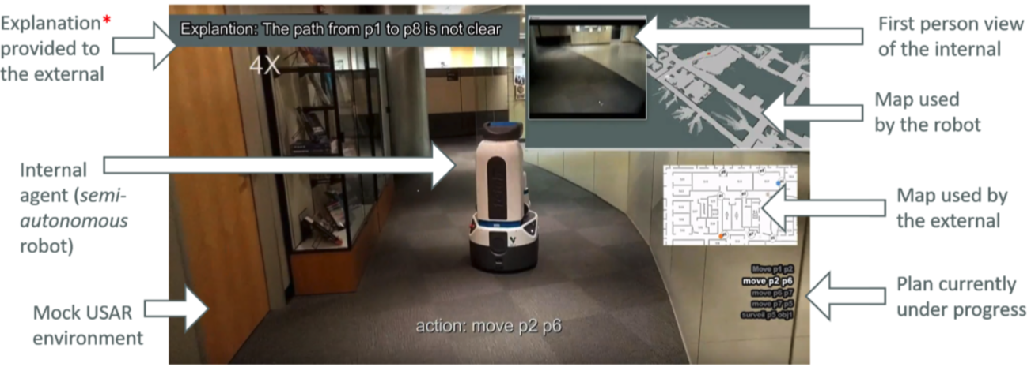
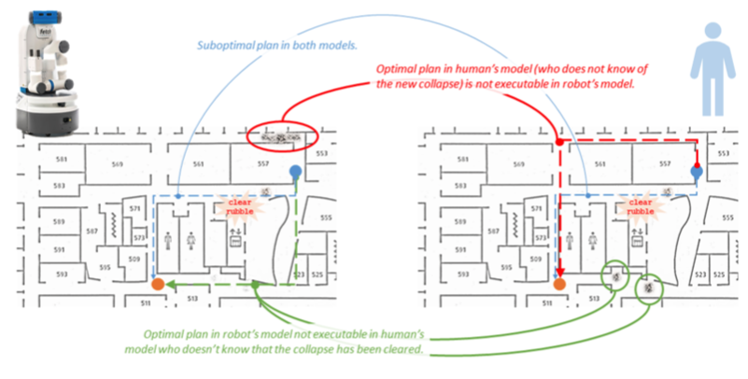
Example
Mock search and reconnaissance scenario with internal robot and external human

Slide 56
Aspects to Explanations
Completeness: No better explanation exists, no aspect of plan remains unexplicable
  Requires explanations of a plan to be comparable
Conciseness: Explanations are easily understandable to the explainee
  The larger an explanation, the harder for the human to incorporate information into deliberative process
Monotonicity: Remaining model differences cannot change completeness of explanation, i.e., all aspects of model that yielded plan are reconciled
  Subsumes completeness
Computability: Ease of computing explanation from robot’s point of view
Chakraborti T, Sreedharan S, Zhang Y, Kambhampati S. Plan explanations as model reconciliation: Moving beyond explanation as soliloquy. IJCAI 2017.

Slide 57
Types of Explanations
Plan Patch Explanation (PPE)
  Provide model differences pertaining to only the actions present in the plan that needs to be explained
Model Patch Explanation (MPE)
  Provide all model differences to the human
Minimally Complete Explanation (MCE)
  Shortest complete explanation
  Can be rendered invalid given further updates
Minimally Monotonic Explanation (MME)
  Shortest explanation preserving monotonicity
  Not necessarily unique as there may be model differences supporting the same causal links in the plan; exposing one link is enough (to guarantee optimality in the updated model)
Chakraborti T, Sreedharan S, Zhang Y, Kambhampati S. Plan explanations as model reconciliation: Moving beyond explanation as soliloquy. IJCAI 2017.
Notes:
PPE: concise by focus on plan, easy to compute; may reveal too much/irrelevant info, ignores other differences that may have contributed (not complete)
MPE: easy to compute, complete; not concise; may reveal too much/irrelevant info

Slide 58

Aspects of Types of Explanations
Plan Patch Explanation (PPE)
Model Patch Explanation (MPE)
Minimally Complete Explanation (MCE)
Minimally Monotonic Explanation (MME)
$$\left|\text{approx}\text{. }MCE\right|≤\left|\text{exact}.MCE\right|<\left|MME\right|≪\left|MPE\right|$$
Explanation Type | Completeness | Conciseness | Monotonicity | Computability
PPE | ✓ | ✘ | ✓ | ✓
MPE | ✘ | ✓ | ✘ | ✓
MCE | ✓ | ✓ | ✘ | ?
MME | ✓ | ✓ | ✓ | ?
Chakraborti T, Sreedharan S, Zhang Y, Kambhampati S. Plan explanations as model reconciliation: Moving beyond explanation as soliloquy. IJCAI 2017.

Slide 59
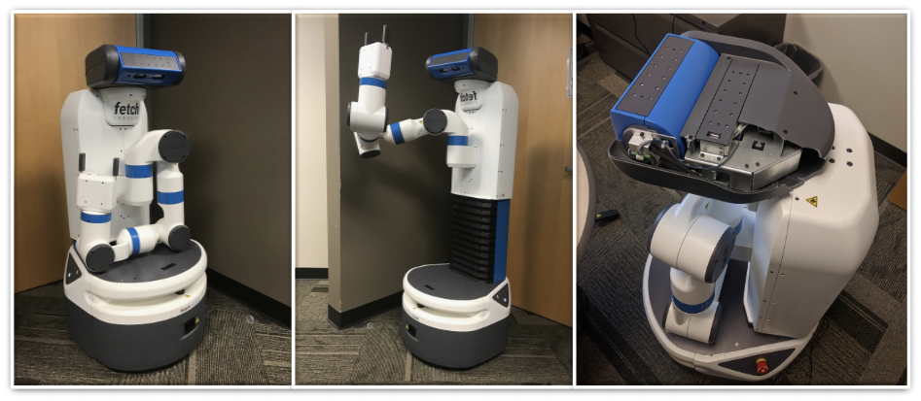
Example – FetchWorld
Fetch robot whose design requires
it to tuck its arms and lower its
torso or crouch before moving –
not obvious to human navigating
Robot’s Model
(:action move
:parameters (?from ?to – location)
:precondition (and (robot-at ?from)
(hand-tucked) (crouched))
:effect (and (robot-at ?to)
(not (robot-at ?from))))
(:action tuck
:parameters ()
:precondition ()
:effect (and (hand-tucked)
(crouched)))
(:action crouch
:parameters ()
:precondition ()
:effect (and (crouched)))
Human’s Model
(:action move
:parameters (?from ?to – location)
:precondition (and (robot-at ?from))
:effect (and (robot-at ?to)
(not (robot-at ?from))))
(:action tuck
:parameters ()
:precondition ()
:effect (and (hand-tucked)))
(:action crouch
:parameters ()
:precondition ()
:effect (and (crouched)))
Chakraborti T, Sreedharan S, Zhang Y, Kambhampati S. Plan explanations as model reconciliation: Moving beyond explanation as soliloquy. IJCAI 2017.

Slide 60
Example – FetchWorld
Initial state and goal:
Robot’s optimal plan:
Human’s expected plan:
(:init (block-at b1 loc1) (robot-at loc1) (hand-empty))
(:goal (and (block-at b1 loc2)))
pick-up b1 -> tuck -> move loc1 loc2 -> put-down b1
pick-up b1 -> move loc1 loc2 -> put-down b1
Robot’s Model
(:action move
:parameters (?from ?to – location)
:precondition (and (robot-at ?from)
(hand-tucked) (crouched))
:effect (and (robot-at ?to)
(not (robot-at ?from))))
(:action tuck
:parameters ()
:precondition ()
:effect (and (hand-tucked)
(crouched)))
(:action crouch
:parameters ()
:precondition ()
:effect (and (crouched)))
Human’s Model
(:action move
:parameters (?from ?to – location)
:precondition (and (robot-at ?from))
:effect (and (robot-at ?to)
(not (robot-at ?from))))
(:action tuck
:parameters ()
:precondition ()
:effect (and (hand-tucked)))
(:action crouch
:parameters ()
:precondition ()
:effect (and (crouched)))
Chakraborti T, Sreedharan S, Zhang Y, Kambhampati S. Plan explanations as model reconciliation: Moving beyond explanation as soliloquy. IJCAI 2017.

Slide 61
Example – FetchWorld
Robot’s optimal plan:
pick-up b1 -> tuck -> move loc1 loc2 -> put-down b1
Robot’s Model
(:action move
:parameters (?from ?to – location)
:precondition (and (robot-at ?from)
(hand-tucked)
(crouched))
:effect (and (robot-at ?to)
(not (robot-at ?from))))
(:action tuck
:parameters ()
:precondition ()
:effect (and (hand-tucked)
(crouched)))
(:action crouch
:parameters ()
:precondition ()
:effect (and (crouched)))
PPE = MPE
MCE
MME
Chakraborti T, Sreedharan S, Zhang Y, Kambhampati S. Plan explanations as model reconciliation: Moving beyond explanation as soliloquy. IJCAI 2017.
Notes:
MCE = hand-tucked : hand-tucked is already in effect of tuck of human’s model
If human were to find out that crouched is a precondition of move, then MCE no longer valid (according to model including MCE update: robot now has to tuck and crouch before move); MME still holds

Slide 62
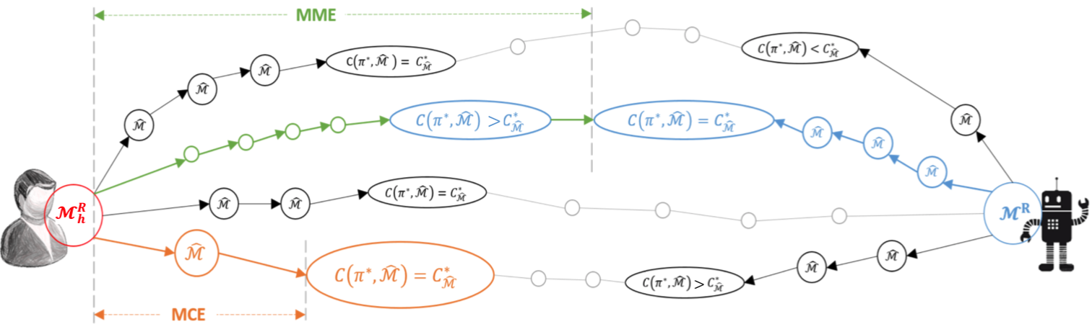
Model Space Search
Search algorithms for finding MCEs and MMEs
Chakraborti T, Sreedharan S, Zhang Y, Kambhampati S. Plan explanations as model reconciliation: Moving beyond explanation as soliloquy. IJCAI 2017.

Slide 63

Model Space Search
Human-aware planning: Given the model of a planning problem and the mental model of the human, find the right model to plan in
  Trade-off explicability and explanation
Minimise
  $$cost/length of explanations+α∙departure from optimality$$
Chakraborti T, Sreedharan S, Kambhampati S. Balancing explicability and explanation in human-aware planning. IJCAI 2019.

Slide 64

Extensions (Outlook)
Explanation ordering

Slide 65
Summary
Mental models
  Mental model of the human
  Mental model that the human has of the agent
  Mental model that the agent assumes the human has of the agent
Interpretable behaviour
  Explicability
  Legibility
  Predictability
Explanations (not in this semester)
  Model reconciliation

Slide 66
Outline
Provably beneficial AI (Russell)
  Motivation
  Modelling formalism
Human-aware decision making (Rao et al.)
  Mental models
  Interpretable Behaviour
  Explanations
The End

