Slide 1
Advanced Topics Data Science and AI
Automated Planning and Acting
Advanced Decision Making
Tanya Braun

Slide 2
Content
Planning and Acting with Deterministic Models
Planning and Acting with Refinement Methods
Planning and Acting with Temporal Models
Planning and Acting with Nondeterministic Models
Standard Decision
Making
Planning and Acting with Probabilistic Models
Advanced Decision
Making
  Provably Beneficial AI
  Partially-observable MDP (POMDP)
  Decentralised POMDP
Human-aware Planning
Notes:
1-4, 6: Planning book
5, 7: AIMA
8: Rao

Slide 3
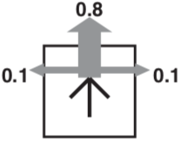
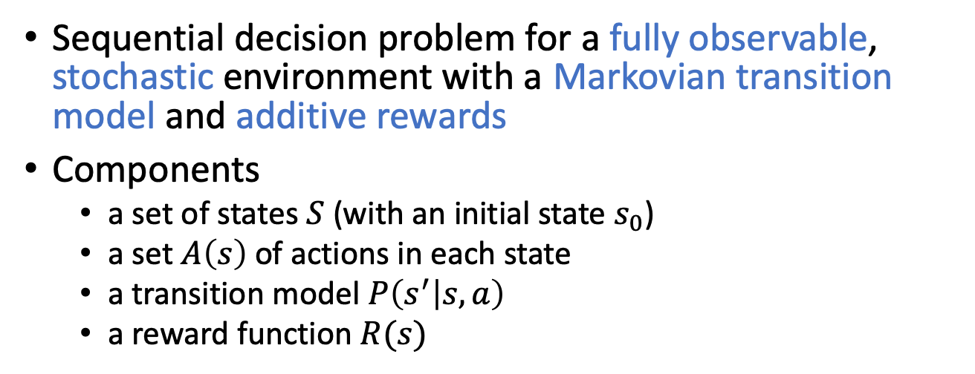

MDP
Sequential decision problem for a fully observable, stochastic environment with a Markovian transition model and additive rewards
Components
  a set of states $S$ (with an initial state $s_{0}$)
  a set $A\left(s\right)$ of actions in each state
  a transition model $P\left(s^{′} | s, a\right)$
  a reward function $R(s)$
+1
3
-1
U, D, L, R
2
1
each move costs $0.04$
1
2
3
4

Slide 4
Further Problems
Wrong goal formulation
  Hard to specify goal or reward/cost function correctly
Uncertainty about the world state due to imperfect (partial) information
  Noise
    e.g., in sensors
  Limited accuracy
    e.g., image resolution, geo-location
Multiple agents controlling an environment jointly
  Each agent is their own entity
    Own observations, own actions
  Joint reward from the environment

Slide 5
Outline
Provably Beneficial AI
  Hidden goals
Partially Observable Markov Decision Process (POMDP)
  POMDP agent, belief state, belief MDP
  Conditional plans, value iteration
Decentralised POMDP (Dec-POMDP)
  Dec-POMDP, local policy, joint policy, value function
  Communication, full observability, Dec-MDP
  Solutions for finite, infinite, indefinite horizon

Slide 6

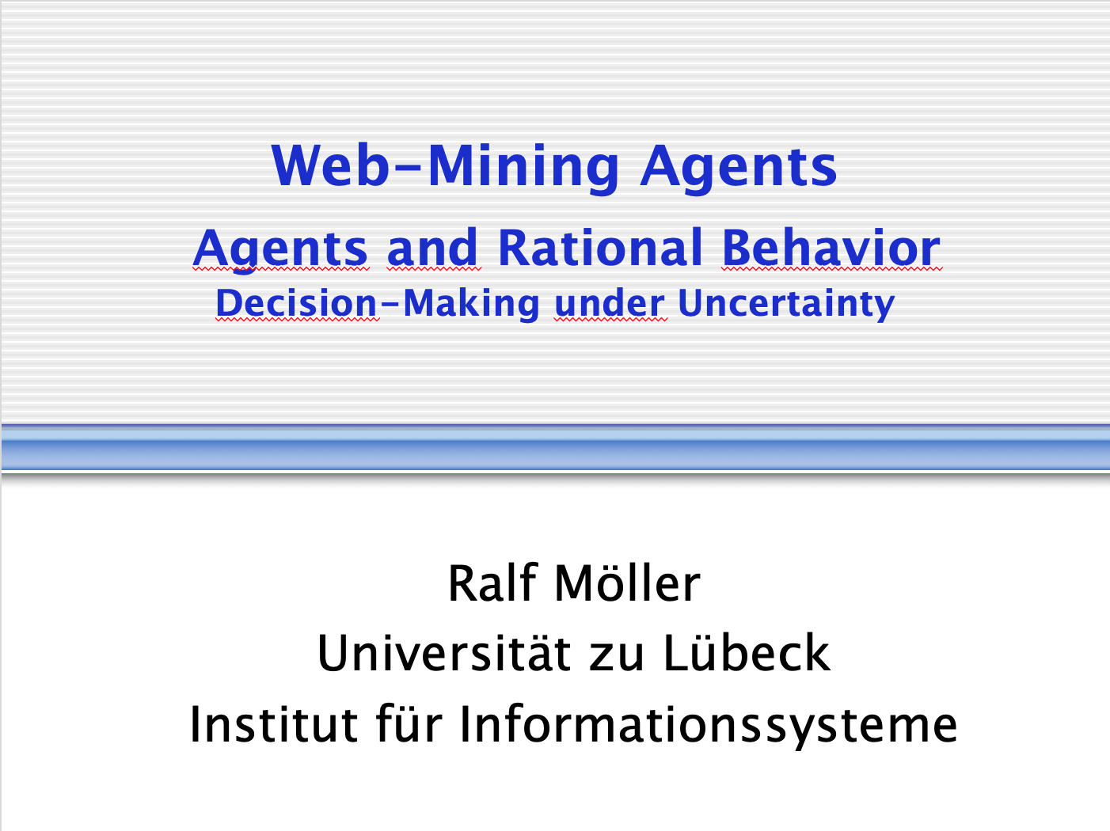
Acknowledgements
Part 1 based on a talk by Stuart Russell on Provably Beneficial AI
  There is a book by him on this topic for those interested
Part 2 based on material from Lise Getoor, Jean-Claude Latombe, Daphne Koller, and Stuart Russell, Xiaoli Fern compiled by Ralf Möller
  Slides based on
  AIMA Book, Chapter 17.4
Part 3 based on tutorial by Matthijs Spaan, Christopher Amato, Shlomo Zilberstein on Decision Making in Multiagent Settings: Team Decision Making
http://people.eecs.berkeley.edu/~russell/talks/2020/russell-aaai20-hntdtwwai-4x3.pptx
http://rbr.cs.umass.edu/camato/decpomdp/overview.html

Slide 7
Outline
Provably Beneficial AI
  Hidden goals
Partially Observable Markov Decision Process (POMDP)
  POMDP agent, belief state, belief MDP
  Conditional plans, value iteration
Decentralised POMDP (Dec-POMDP)
  Dec-POMDP, local policy, joint policy, value function
  Communication, full observability, Dec-MDP
  Solutions for finite, infinite, indefinite horizon

Slide 8
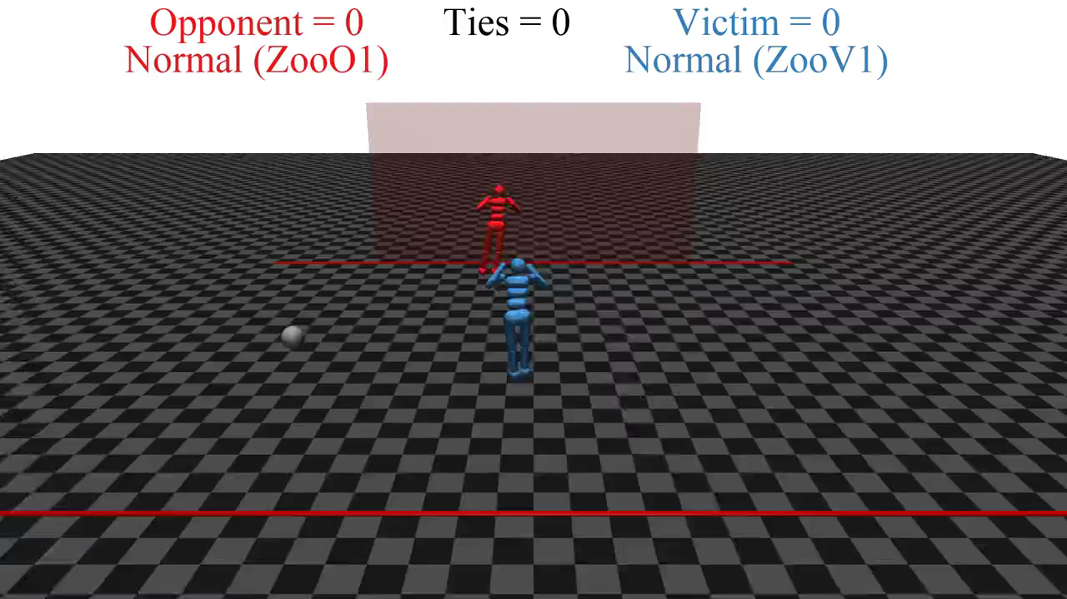
Notes:
Open AI
RL 1-2 hrs (one goalie, one shooter)
two simulated robots

Slide 9
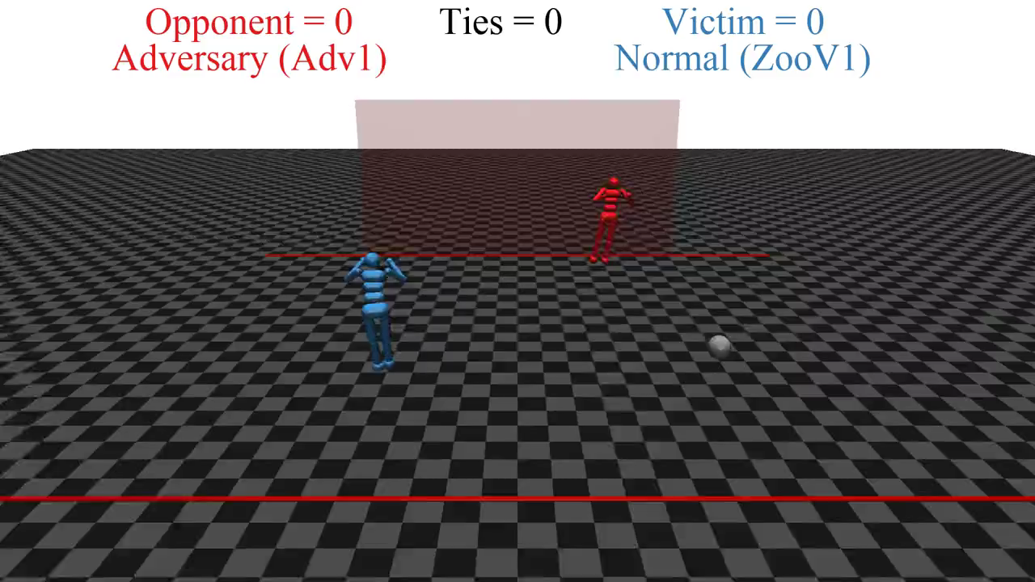
Notes:
Keep blue robot as is
Red robot continues to learn

Slide 10

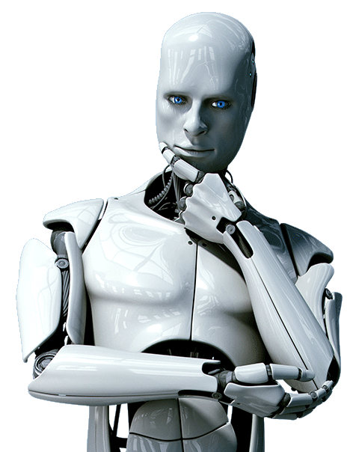
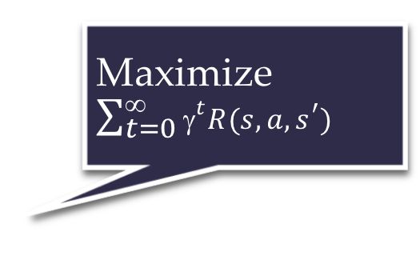
Standard Model for AI
Maximize $\sum_{t=0}^{\text{∞}}{{\text{γ}}^{t}R(s,a,s^{′})}$
Righty-ho
Also the standard model for control theory,
statistics, operations research, economics
King Midas problem:
Cannot specify R correctly
Smarter AI => worse outcome

Slide 11
How We Got into this Mess
Humans are intelligent to the extent that our actions can be expected to achieve our objectives
Machines are intelligent to the extent that their actions can be expected to achieve their objectives
Machines are beneficial to the extent that their actions can be expected to achieve our objectives

Slide 12
New Model: Provably Beneficial AI
1. Robot goal: satisfy human preferences
2. Robot is uncertain about human preferences
3. Human behavior provides evidence of preferences
assistance game with human and machine players
Smarter AI => better outcome

Slide 13
AIMA 1,2,3: Objective Given to Machine
Human objective
Human behaviour
Machine behaviour

Slide 14
AIMA 1,2,3: Objective Given to Machine
Human objective
Machine behaviour

Slide 15
AIMA 4: Objective Is a Latent Variable
Human objective
Human behaviour
Machine behaviour

Slide 16
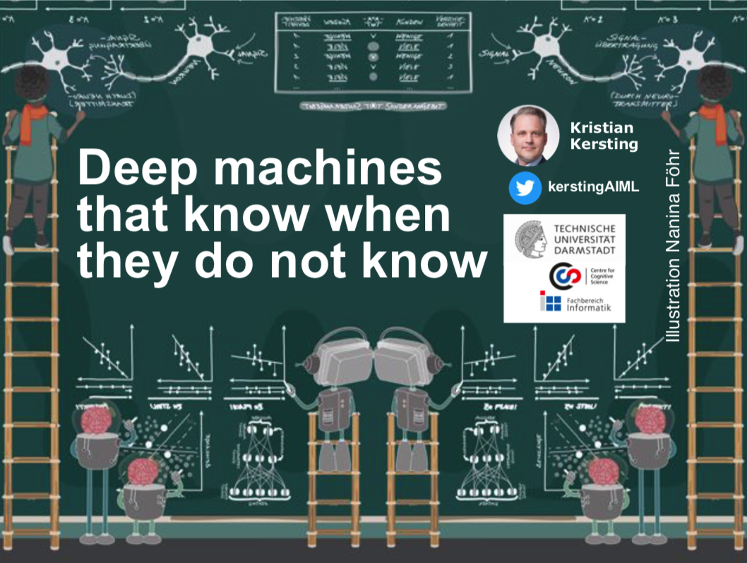

Example: Image Classification
Old: minimize loss with (typically) a uniform loss matrix
  Accidentally classify human as gorilla
  Spend millions fixing public relations disaster
New: structured prior distribution over loss matrices
  Some examples safe to classify
  Say “don’t know” for others
  Use active learning to gain
  additional feedback from humans
Other researchers work on similar ideas
  E.g., Kristian Kersting
Sometimes in conflict with
demands of privacy
  E.g., Esfandiar Mohammadi
https://www.ml.informatik.tu-darmstadt.de/papers/waterloo2019talk.pdf
https://www.ifis.uni-luebeck.de/~moeller/KI-Kolloquium/2020-01-13-Mohammadi.pdf

Slide 17
Example: Fetching Coffee
What does “fetch some coffee” mean?
If there is so much uncertainty about preferences, how does the robot do anything useful?
Answer:
  The instruction suggests coffee would have higher value than expected a priori, ceteris paribus
  Uncertainty about the value of other aspects of environment state doesn’t matter as long as the robot leaves them unchanged
Notes:
“Fetch some coffee” is NOT an instruction, it’s NOT a goal to be achieved.
Cf house is burning down, coffee costs 21 euros, you’re in the desert, etc.

Slide 18
Basic Assistance Game
Preferences θ
Acts roughly according to θ
Maximise unknown human θ
Prior P(θ)
Equilibria:
Human teaches robot
Robot learns, asks questions, permission; defers to human; allows off-switch
Related to inverse RL, but two-way

Slide 19
The Off-switch Problem
A robot, given an objective, has an incentive to disable its own off-switch
  “You can’t fetch the coffee if you’re dead”
A robot with uncertainty about objective won’t behave this way

Slide 20
R
wait
U = U_{act}
H
U = 0
go ahead
R
U = 0
U = U_{act}
  Theorem: robot has a positive incentive to allow itself to be switched off
  Theorem: robot is provably beneficial

Slide 21
Intermediate Summary
Provably beneficial AI is possible and desirable
    It isn’t “AI safety” or “AI Ethics,” it’s AI
  Continuing theoretical work (AI, CS, economics)
  Initiating practical work (assistants, robots, cars)
  Inverting human cognition (AI, cogsci, psychology)
  Long-term goals (AI, philosophy, polisci, sociology)

Slide 22
Outline
Provably Beneficial AI
  Hidden goals
Partially Observable Markov Decision Process (POMDP)
  POMDP agent, belief state, belief MDP
  Conditional plans, value iteration
Decentralised POMDP (Dec-POMDP)
  Dec-POMDP, local policy, joint policy, value function
  Communication, full observability, Dec-MDP
  Solutions for finite, infinite, indefinite horizon

Slide 23
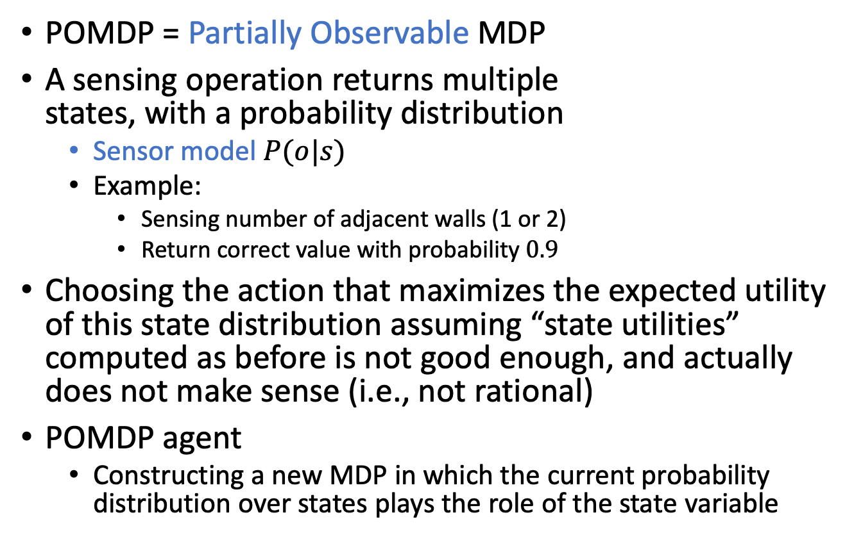
POMDP
POMDP = Partially Observable MDP
A sensing operation returns multiple
states, with a probability distribution
  Sensor model $P(o|s)$
  Example:
    Sensing number of adjacent walls (1 or 2)
    Return correct value with probability $0.9$
Choosing the action that maximizes the expected utility of this state distribution assuming “state utilities” computed as before is not good enough, and actually does not make sense (i.e., not rational)
POMDP agent
  Constructing a new MDP in which the current probability distribution over states plays the role of the state variable
+1
3
-1
2
1
1
2
3
4

Slide 24
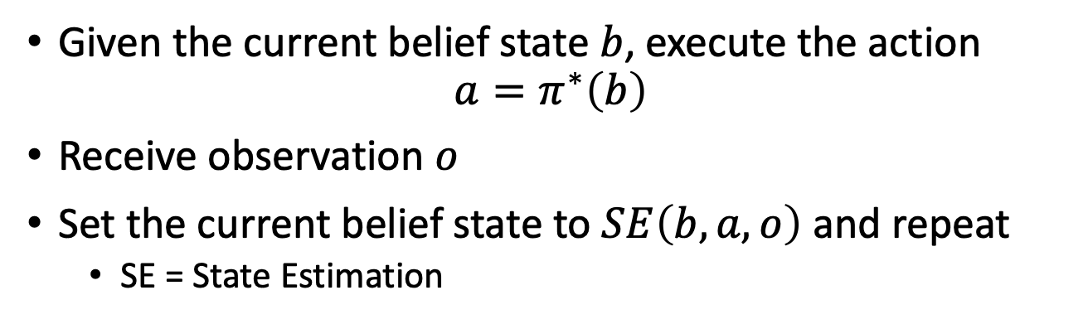


Decision cycle of a POMDP agent
Action
World
Observation
$$b$$
SE
$$π$$
Agent
Given the current belief state $b$, execute the action
$a=π^{∗}\left(b\right)$
Receive observation $o$
Set the current belief state to $SE\left(b,a,o\right)$ and repeat
  SE = State Estimation

Slide 25

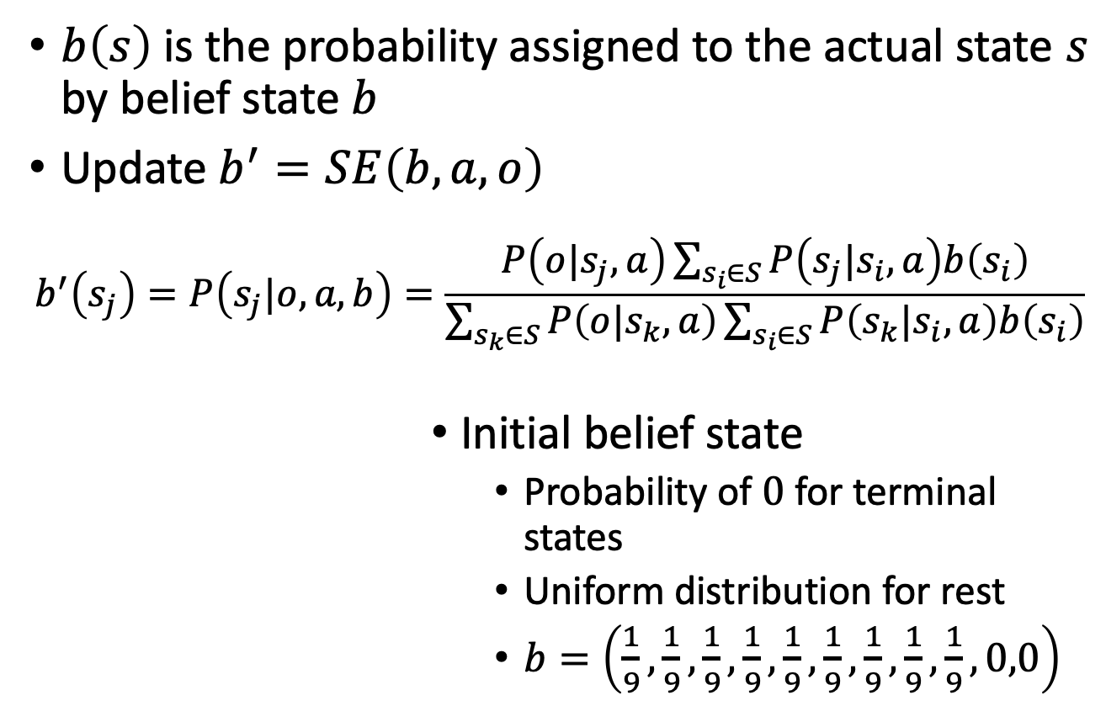








Belief State & Update
$b\left(s\right)$ is the probability assigned to the actual state $s$ by belief state $b$
Update $b^{′}=SE\left(b,a,o\right)$
  $$b^{′}\left(s_{j}\right)=P\left(s_{j}|o,a,b\right)=\frac{P\left(o|s_{j},a\right)\sum_{s_{i}∈S}{P\left(s_{j}|s_{i}, a\right)b\left(s_{i}\right)}}{\sum_{s_{k}∈S}{P\left(o|s_{k},a\right)}\sum_{s_{i}∈S}{P\left(s_{k}|s_{i}, a\right)b\left(s_{i}\right)}}$$
Initial belief state
  Probability of $0$ for terminal states
  Uniform distribution for rest
  $b=\left(\frac{1}{9},\frac{1}{9},\frac{1}{9},\frac{1}{9},\frac{1}{9},\frac{1}{9},\frac{1}{9},\frac{1}{9},\frac{1}{9},0,0\right)$
$$0.\overline{1}$$
$$0.\overline{1}$$
$$0.0$$
3
$$0.\overline{1}$$
$$0.\overline{1}$$
$$0.\overline{1}$$
$$0.0$$
2
1
$$0.\overline{1}$$
$$0.\overline{1}$$
$$0.\overline{1}$$
$$0.\overline{1}$$
1
2
3
4
Notes:
RM: I think there is only one belief state. Having more means a distribution over belief states. What should this be?
But this one belief state distribution is orthogonal to Utilities, these are the same for all belief states.

Slide 26

































Belief State & Update
Update $b^{′}=SE\left(b,a,o\right)$
  $$b^{′}\left(s_{j}\right)=P\left(s_{j}|o,a,b\right)=\frac{P\left(o|s_{j},a\right)\sum_{s_{i}∈S}{P\left(s_{j}|s_{i}, a\right)b\left(s_{i}\right)}}{\sum_{s_{k}∈S}{P\left(o|s_{k},a\right)}\sum_{s_{i}∈S}{P\left(s_{k}|s_{i}, a\right)b\left(s_{i}\right)}}$$
  Consider as two stage-update
    Update for the action
    Update for the observation
$$b$$
$b^{\left(1\right)}$
${b^{\left(2\right)}=b}^{′}$
$$0.\overline{1}$$
$$0.\overline{1}$$
$$0.0$$
$$0.2$$
$$0.\overline{1}$$
$$0.0\overline{2}$$
$$0.0$$
$$0.0$$
3
$$0.\overline{1}$$
3
3
$$0.06569$$
$$0.03650$$
$$0.06569$$
$$0.\overline{1}$$
$$0.\overline{1}$$
$$0.0$$
$$0.\overline{1}$$
$$0.\overline{1}$$
$$0.0\overline{1}$$
$$0.03285$$
2
2
2
$$0.03650$$
$$0.32847$$
1
$$0.\overline{1}$$
$$0.\overline{1}$$
$$0.\overline{1}$$
$$0.\overline{1}$$
1
$$0.2$$
$$0.\overline{1}$$
$$0.\overline{1}$$
$$0.0\overline{1}$$
1
$$0.06569$$
$$0.03650$$
$$0.32847$$
$$0.00365$$
1
2
3
4
1
2
3
4
1
2
3
4
Move L once
Perceive 1 wall

Slide 27
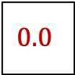
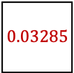

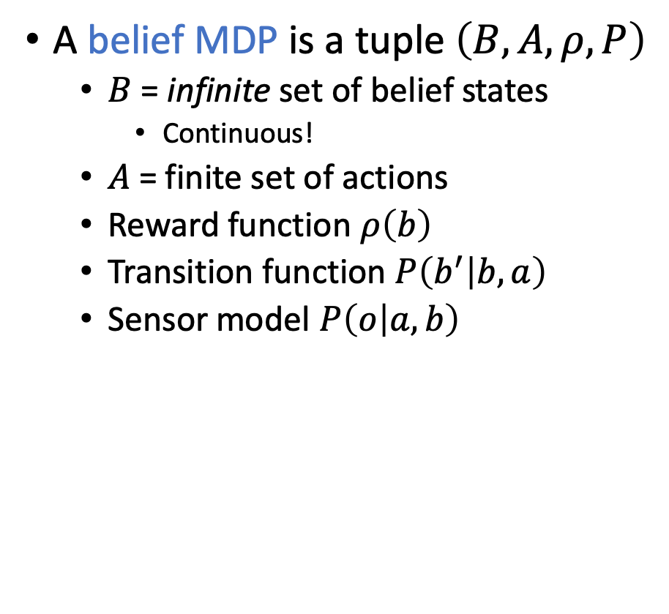

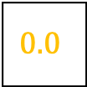

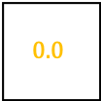











Belief MDP
A belief MDP is a tuple $\left(B, A, ρ,P\right)$
  $B$ = infinite set of belief states
    Continuous!
  $A$ = finite set of actions
  Reward function $ρ\left(b\right)$
  Transition function $P\left(b^{′} | b, a\right)$
  Sensor model $P\left(o | a,b\right)$
$$b$$
$$0.\overline{1}$$
$$0.\overline{1}$$
$$0.0$$
3
$$0.\overline{1}$$
$$0.\overline{1}$$
$$0.\overline{1}$$
$$0.0$$
2
1
$$0.\overline{1}$$
$$0.\overline{1}$$
$$0.\overline{1}$$
$$0.\overline{1}$$
1
2
3
4
Move L once,
perceive 1 wall
$b^{′}$
$$0.0$$
3
$$0.06569$$
$$0.03650$$
$$0.06569$$
$$0.03285$$
2
$$0.03650$$
$$0.32847$$
1
$$0.06569$$
$$0.03650$$
$$0.32847$$
$$0.00365$$
1
2
3
4

Slide 28
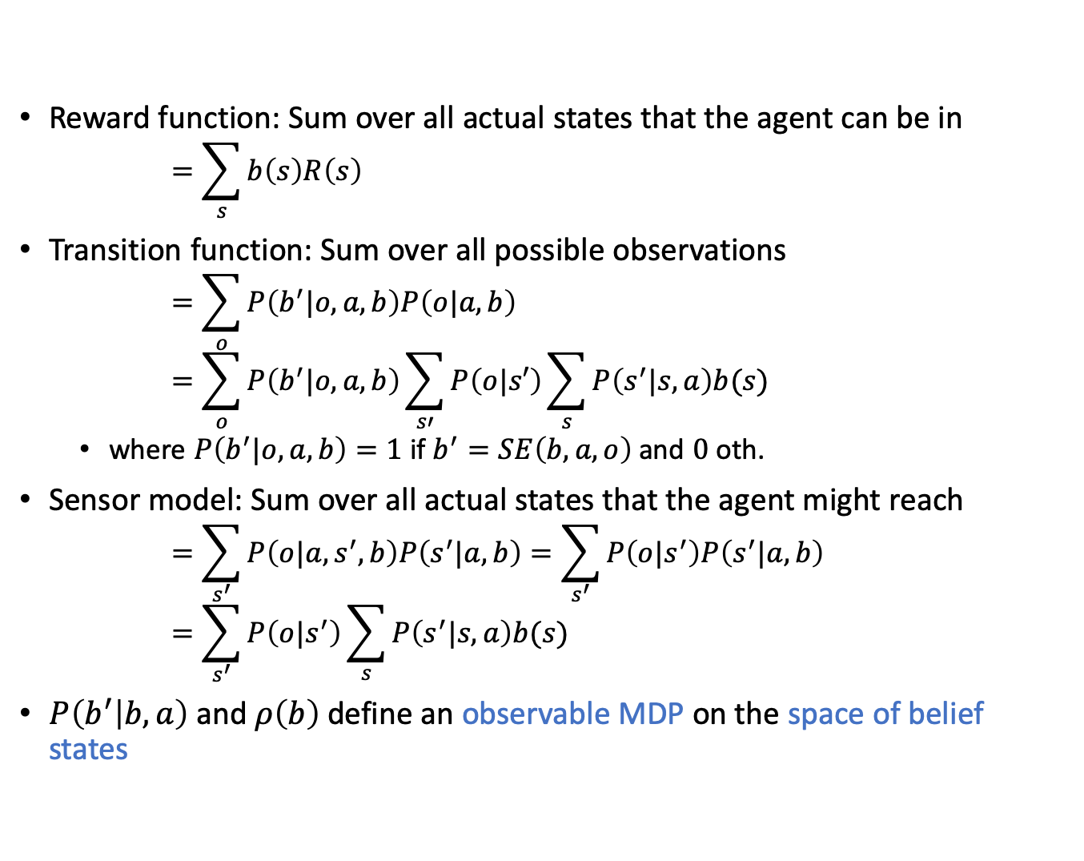



Belief MDP
Reward function: Sum over all actual states that the agent can be in
  $$=\sum_{s}{b\left(s\right)R\left(s\right)}$$
Transition function: Sum over all possible observations
  $$=\sum_{o}{P\left(b^{′}|o,a,b\right)P\left(o|a,b\right)}=\sum_{o}{P\left(b^{′}|o,a,b\right)\sum_{s′}{P\left(o|s′\right)\sum_{s}{P\left(s^{′}|s,a\right)b(s)}}}$$
  where $P\left(b^{′}|o,a,b\right)=1$ if $b^{′}=SE\left(b,a,o\right)$ and $0$ oth.
Sensor model: Sum over all actual states that the agent might reach
  $$=\sum_{s^{′}}{P\left(o|a,s^{′},b\right)P\left(s^{′}|a,b\right)}=\sum_{s^{′}}{P\left(o|s^{′}\right)P\left(s^{′}|a,b\right)} \\ =\sum_{s^{′}}{P\left(o|s^{′}\right)\sum_{s}{P\left(s^{′}|s,a\right)b(s)}}$$
$P\left(b^{′} | b, a\right)$ and $ρ\left(b\right)$ define an observable MDP on the space of belief states
$$ρ\left(b\right)$$
$$P\left(b^{′} | b, a\right)$$
$$P\left(o | a,b\right)$$

Slide 29
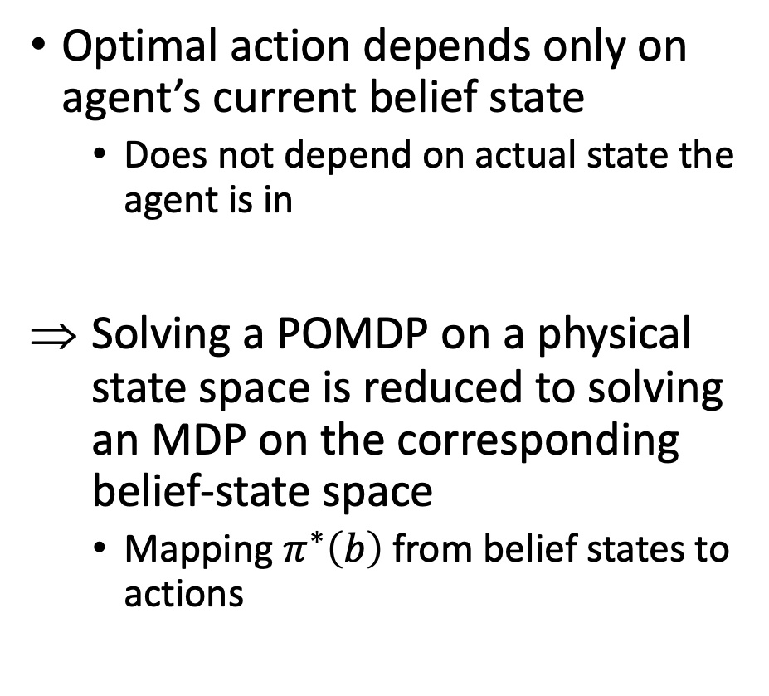
Belief MDP
Optimal action depends only on agent’s current belief state
  Does not depend on actual state the agent is in
Solving a POMDP on a physical state space is reduced to solving an MDP on the corresponding belief-state space
  Mapping $π^{∗}\left(b\right)$ from belief states to actions
$$b$$
$$0.\overline{1}$$
$$0.\overline{1}$$
$$0.0$$
3
$$0.\overline{1}$$
$$0.\overline{1}$$
$$0.\overline{1}$$
$$0.0$$
2
1
$$0.\overline{1}$$
$$0.\overline{1}$$
$$0.\overline{1}$$
$$0.\overline{1}$$
1
2
3
4
Move L once,
perceive 1 wall
$b^{′}$
$$0.0$$
3
$$0.06569$$
$$0.03650$$
$$0.06569$$
$$0.03285$$
2
$$0.03650$$
$$0.32847$$
1
$$0.06569$$
$$0.03650$$
$$0.32847$$
$$0.00365$$
1
2
3
4

Slide 30
Example Scenario
0.111
0.111
0.111
0.000
0.300
0.010
0.008
0.000
3
3
0.111
0.111
0.000
0.221
0.059
0.012
2
2
1
0.111
0.111
0.111
0.111
1
0.371
0.012
0.008
0.000
1
2
3
4
1
2
3
4
Initial distribution
After moving L five times
0.622
0.221
0.071
0.024
0.005
0.007
0.019
0.775
3
3
0.005
0.003
0.022
0.034
0.007
0.105
2
2
1
0.003
0.024
0.003
0.000
1
0.005
0.006
0.008
0.030
1
2
3
4
1
2
3
4
After moving U five times
After moving R five times

Slide 31
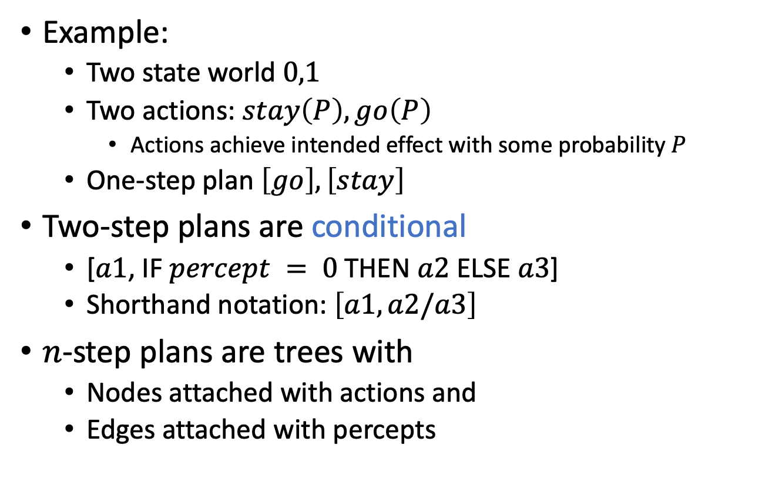
Conditional Plans
Example:
  Two state world $0,1$
  Two actions: $stay\left(P\right), go\left(P\right)$
    Actions achieve intended effect with some probability $P$
  One-step plan $\left[go\right], \left[stay\right]$
Two-step plans are conditional
  [$a1$, IF $percept = 0$ THEN $a2$ ELSE $a3$]
  Shorthand notation: $\left[a1, a2\text{/}a3\right]$
$n$-step plans are trees with
  Nodes attached with actions and
  Edges attached with percepts

Slide 32
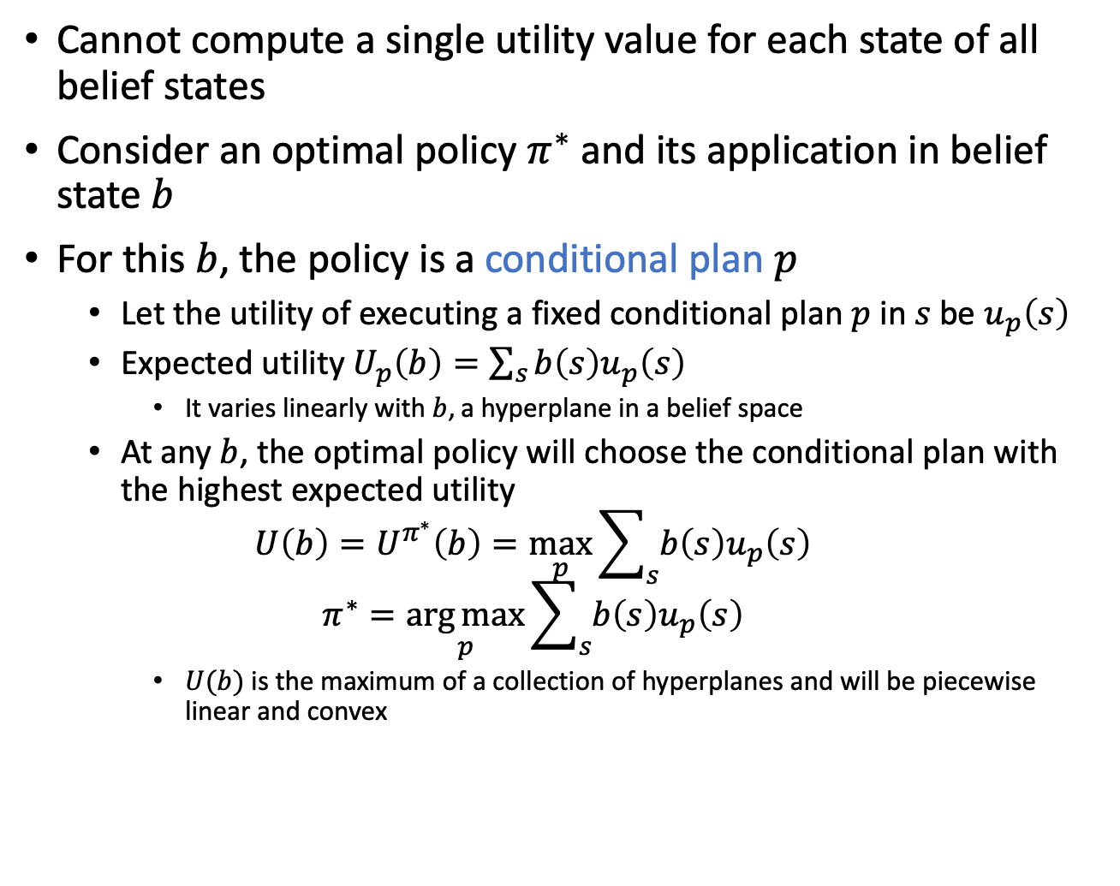
Value Iteration for POMDPs
Cannot compute a single utility value for each state of all belief states
Consider an optimal policy $π^{∗}$ and its application in belief state $b$
For this $b$, the policy is a conditional plan $p$
  Let the utility of executing a fixed conditional plan $p$ in $s$ be $u_{p}\left(s\right)$
  Expected utility $U_{p}\left(b\right)=\sum_{s}{b\left(s\right)u_{p}\left(s\right)}$
    It varies linearly with $b$, a hyperplane in a belief space
  At any $b$, the optimal policy will choose the conditional plan with the highest expected utility
  $$U\left(b\right)=U^{π^{∗}}\left(b\right)=\max_{p}{\sum_{s}{b\left(s\right)u_{p}\left(s\right)}}$$
  $$π^{∗}=\underset{p}{\arg{max}}{\sum_{s}{b\left(s\right)u_{p}\left(s\right)}}$$
    $U(b)$ is the maximum of a collection of hyperplanes and will be piecewise linear and convex

Slide 33
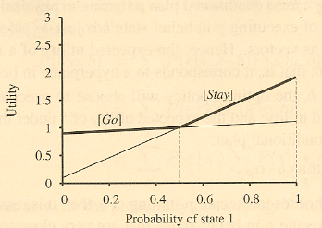
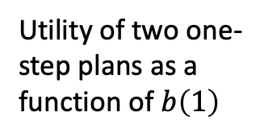
Example
Compute the utilities for conditional plans of depth 2 by
  considering each possible first action
  each possible subsequent percept
  each way of choosing a depth-1 plan to execute for each percept
Utility of two one-step plans as a function of $b\left(1\right)$

Slide 34
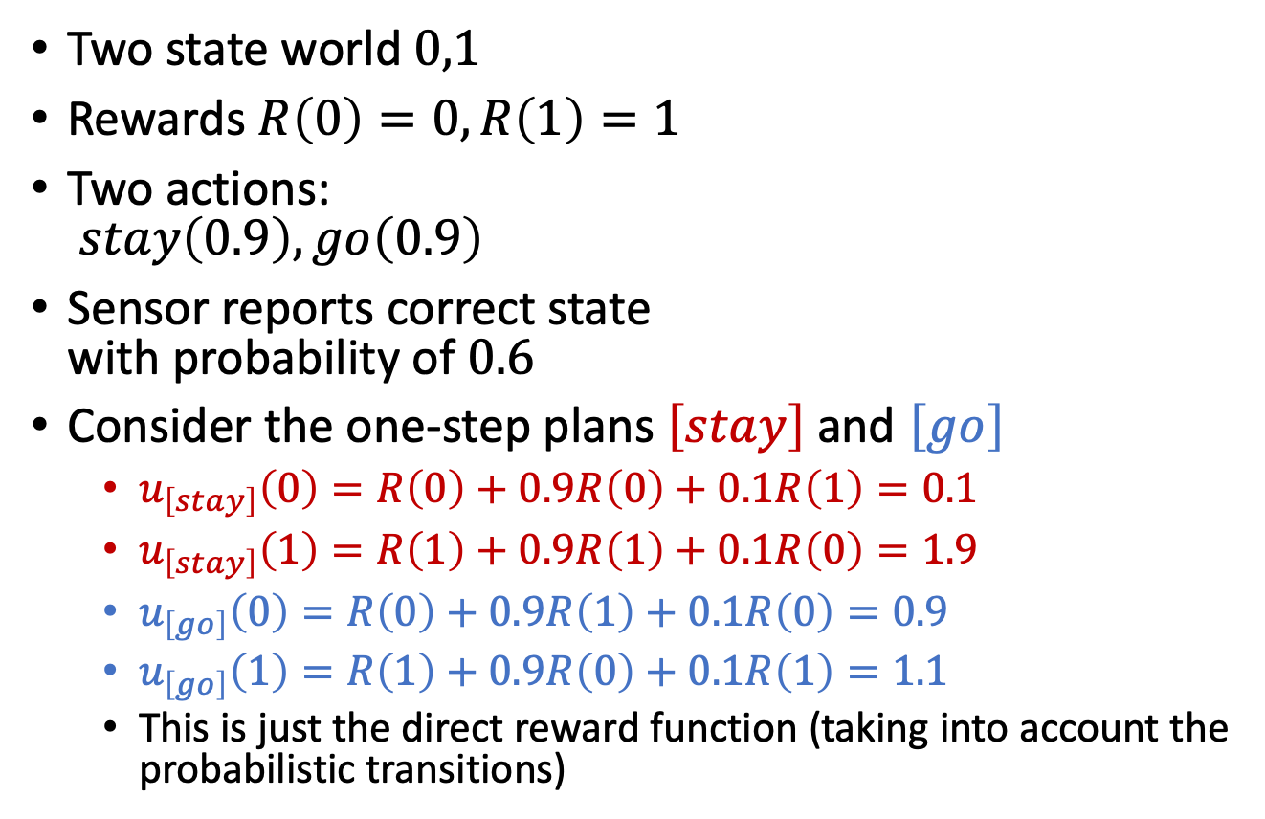
Example
Two state world $0,1$
Rewards $R\left(0\right)=0, R\left(1\right)=1$
Two actions:
$stay\left(0.9\right), go\left(0.9\right)$
Sensor reports correct state
with probability of $0.6$
Consider the one-step plans $\left[stay\right]$ and $\left[go\right]$
  $u_{\left[stay\right]}\left(0\right)=R\left(0\right)+0.9R\left(0\right)+0.1R\left(1\right)=0.1$
  $u_{\left[stay\right]}\left(1\right)=R\left(1\right)+0.9R\left(1\right)+0.1R\left(0\right)=1.9$
  $u_{\left[go\right]}\left(0\right)=R\left(0\right)+0.9R\left(1\right)+0.1R\left(0\right)=0.9$
  $u_{\left[go\right]}\left(1\right)=R\left(1\right)+0.9R\left(0\right)+0.1R\left(1\right)=1.1$
  This is just the direct reward function (taking into account the probabilistic transitions)

Slide 35

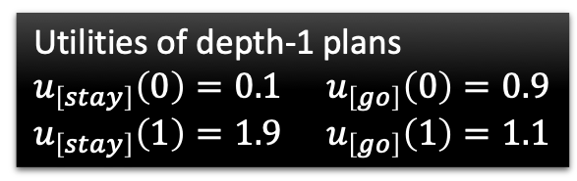
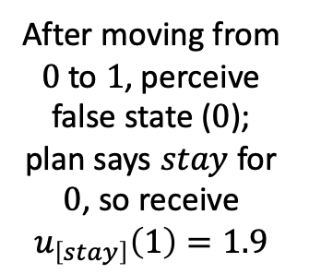
8 distinct depth-2 plans for each state
  Utilities of depth-1 plans
  $u_{\left[stay\right]}\left(0\right)=0.1$ $u_{\left[go\right]}\left(0\right)=0.9$
  $u_{\left[stay\right]}\left(1\right)=1.9$ $u_{\left[go\right]}\left(1\right)=1.1$
Utility of depth-1 plan given state, outcome of first action, and percept
After moving from $0$ to $1$, perceive false state ($0$); plan says $stay$ for $0$, so receive
$$u_{\left[stay\right]}\left(1\right)=1.9$$
Sum over states reachable with first action
Probability of next state
Probability of percept
  $u_{\left[stay,stay/stay\right]}\left(0\right)=R\left(0\right)+\left(0.9∙\left(0.6∙0.1+0.4∙0.1\right)+0.1∙\left(0.6∙1.9+0.4∙1.9\right)\right)=0.28$
  $u_{\left[stay,stay/stay\right]}\left(1\right)=R\left(1\right)+\left(0.9∙\left(0.6∙1.9+0.4∙1.9\right)+0.1∙\left(0.6∙0.1+0.4∙0.1\right)\right)=2.72$
  $$u_{\left[stay,go/stay\right]}\left(0\right), u_{\left[stay,stay/go\right]}\left(0\right),u_{\left[stay,go/go\right]}\left(0\right)$$
  $$u_{\left[stay,go/stay\right]}\left(1\right), u_{\left[stay,stay/go\right]}\left(1\right),u_{\left[stay,go/go\right]}\left(1\right)$$
  $u_{\left[go,stay/stay\right]}\left(0\right)=R\left(0\right)+\left(0.9∙\left(0.6∙1.9+0.4∙1.9\right)+0.1∙\left(0.6∙0.1+0.4∙0.1\right)\right)=1.72$
  $u_{\left[go,stay/stay\right]}\left(1\right)=R\left(1\right)+\left(0.9∙\left(0.6∙0.1+0.4∙0.1\right)+0.1∙\left(0.6∙1.9+0.4∙1.9\right)\right)=1.28$
  $$u_{\left[go,go/stay\right]}\left(0\right), u_{\left[go,stay/go\right]}\left(0\right),u_{\left[go,go/go\right]}\left(0\right)$$
  $$u_{\left[go,go/stay\right]}\left(1\right), u_{\left[go,stay/go\right]}\left(1\right),u_{\left[go,go/go\right]}\left(1\right)$$
Reward of state
Sum over possible percepts

Slide 36
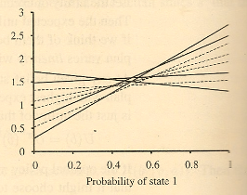
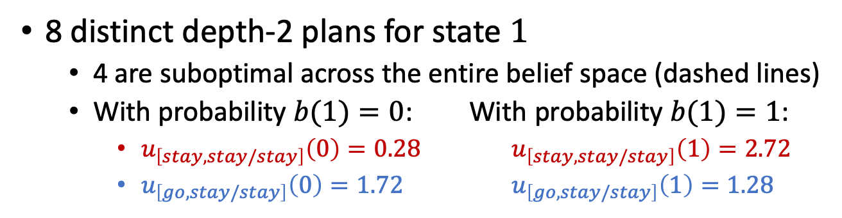
Example
8 distinct depth-2 plans for state $1$
  4 are suboptimal across the entire belief space (dashed lines)
  With probability $b(1)=0$: With probability $b(1)=1$:
    $u_{\left[stay,stay/stay\right]}\left(0\right)=0.28$ $u_{\left[stay,stay/stay\right]}\left(1\right)=2.72$
    $u_{\left[go,stay/stay\right]}\left(0\right)=1.72$ $u_{\left[go,stay/stay\right]}\left(1\right)=1.28$
•
•

Slide 37
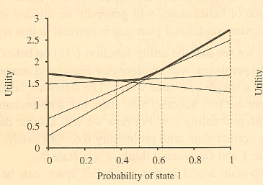
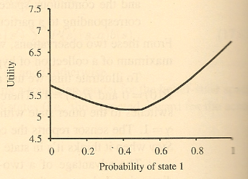
Example
Utility of four undominated
two-step plans
Utility function for optimal
eight step plans

Slide 38
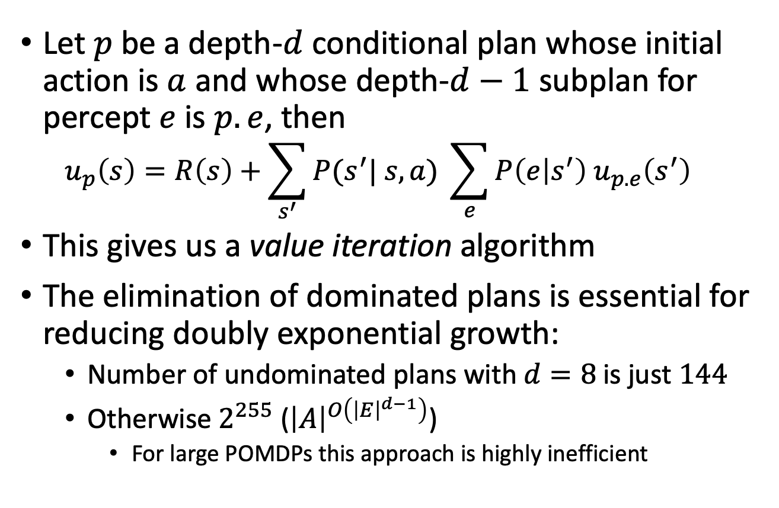
General Formula
Let $p$ be a depth-$d$ conditional plan whose initial action is $a$ and whose depth-$d−1$ subplan for percept $e$ is $p.e$, then
  $$u_{p}\left(s\right)=R\left(s\right)+\sum_{s^{′}}{P(s^{′}| s,a) }\sum_{e}{P\left(e | s^{′}\right) u_{p.e}\left(s^{′}\right)}$$
This gives us a value iteration algorithm
The elimination of dominated plans is essential for reducing doubly exponential growth:
  Number of undominated plans with $d=8$ is just $144$
  Otherwise $2^{255}$ (${\left|A\right|}^{O\left({\left|E\right|}^{d−1}\right)}$)
    For large POMDPs this approach is highly inefficient

Slide 39
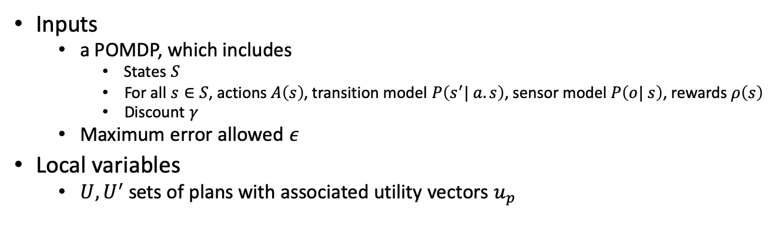
Value Iteration: Algorithm
function value-iteration(pomdp,𝜖)
U’ ← a set containing the empty plan [] with u[](s)=R(s)
repeat
U ← U’
U’ ← the set of all plans consisting of an action and,
for each possible next percept, a plan in U with
utility vectors computed as on previous slide
U’ ← Remove-dominated-plans(U’)
until Max-difference(U,U’) < 𝜖(1-𝛾)/𝛾
return U
Inputs
  a POMDP, which includes
    States $S$
    For all $s∈S$, actions $A\left(s\right)$, transition model $P\left(s^{′}| a.s\right)$, sensor model $P\left(o| s\right)$, rewards $ρ\left(s\right)$
    Discount $γ$
  Maximum error allowed $ε$
Local variables
  $U, U^{′}$ sets of plans with associated utility vectors $u_{p}$

Slide 40
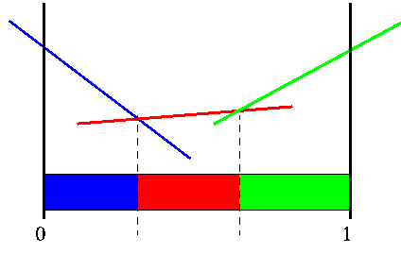
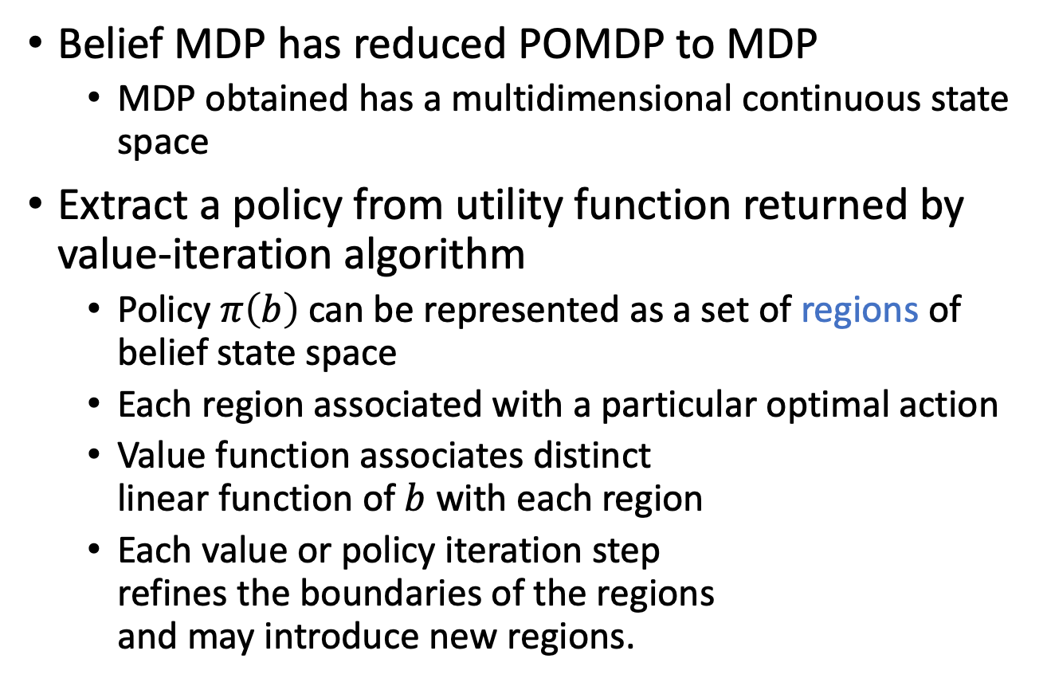
Solutions for POMDP
Belief MDP has reduced POMDP to MDP
  MDP obtained has a multidimensional continuous state space
Extract a policy from utility function returned by value-iteration algorithm
  Policy $π\left(b\right)$ can be represented as a set of regions of belief state space
  Each region associated with a particular optimal action
  Value function associates distinct
  linear function of $b$ with each region
  Each value or policy iteration step
  refines the boundaries of the regions
  and may introduce new regions.
Notes:
RM: Methods based on value and policy iteration focus on finding optimal policies. For some POMDPs, the optimal policy has infinitely many regions , so the simple list-of-regions approach fails and more ingenious methods are needed.
The policy is a sequence which gives the mapping from all states to all corresponding actions. So the agents using these methods have to memorize all the possible states from the very beginning of solving the problem. If the problems are more complex with observations and with a few dozen states, the methods will not work or work inefficiently. That means maybe sometimes the agent update policy with some states they will hardly get into.
Method based on lookahead search which we will describe next is a different, approximate method for solving those complex POMDPs.

Slide 41
Intermediate Summary
POMDP
  Uncertainty about state ➝ belief state
  Solving a POMDP = Solving an MDP on space of belief states
  Policy = conditional plans
  Value iteration to find optimal policy
    Very expensive, even with deletion of dominated plans
What to do alternatively? Find sub-optimal plans
Sampling approaches
In combination with deep learning methods

Slide 42
Outline
Provably Beneficial AI
  Hidden goals
Partially Observable Markov Decision Process (POMDP)
  POMDP agent, belief state, belief MDP
  Conditional plans, value iteration
Decentralised POMDP (Dec-POMDP)
  Dec-POMDP, local policy, joint policy, value function
  Communication, full observability, Dec-MDP
  Solutions for finite, infinite, indefinite horizon

Slide 43
Multi-agent Scenarios
Ambulance allocation
  Multiple ambulance services
    Business oriented operation
    Competition for government funds and public opinion
  Given several locations that require medical assistance, how many ambulances from which firm will go to which location?
Firefighters
  Maintain effort toward saving the building or draw back and minimise the spread of fire?
  Concentrate on a multitude of smaller fires or allow controlled unification and deal with only one location?
    Will transportation routes be endangered?
    Are there still civilians evacuating from the area/building?
  Push through the fire to victims or save the fire crew and pull out?
    If multiple crews are on site, which one goes? When?

Slide 44

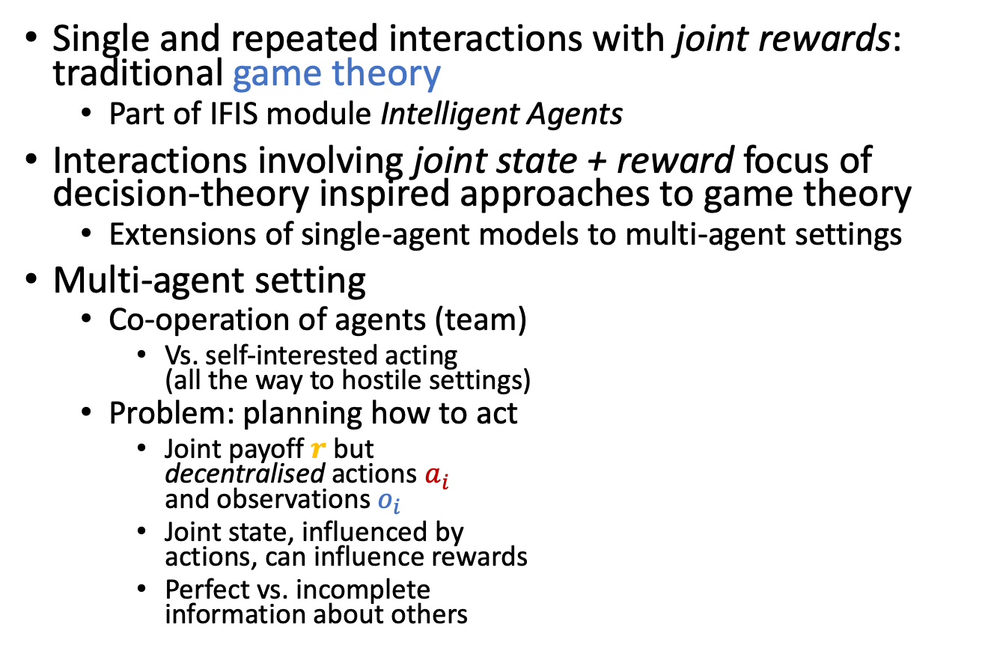




Setting
Single and repeated interactions with joint rewards: traditional game theory
  Part of IFIS module Intelligent Agents
Interactions involving joint state + reward focus of decision-theory inspired approaches to game theory
  Extensions of single-agent models to multi-agent settings
Multi-agent setting
  Co-operation of agents (team)
    Vs. self-interested acting
    (all the way to hostile settings)
  Problem: planning how to act
    Joint payoff $r$ but
    decentralised actions $a_{i}$
    and observations $o_{i}$
    Joint state, influenced by
    actions, can influence rewards
    Perfect vs. incomplete
    information about others
$$r$$
$$o_{1}$$
Environment
$$a_{1}$$
…
…
$$o_{n}$$
$$a_{n}$$

Slide 45
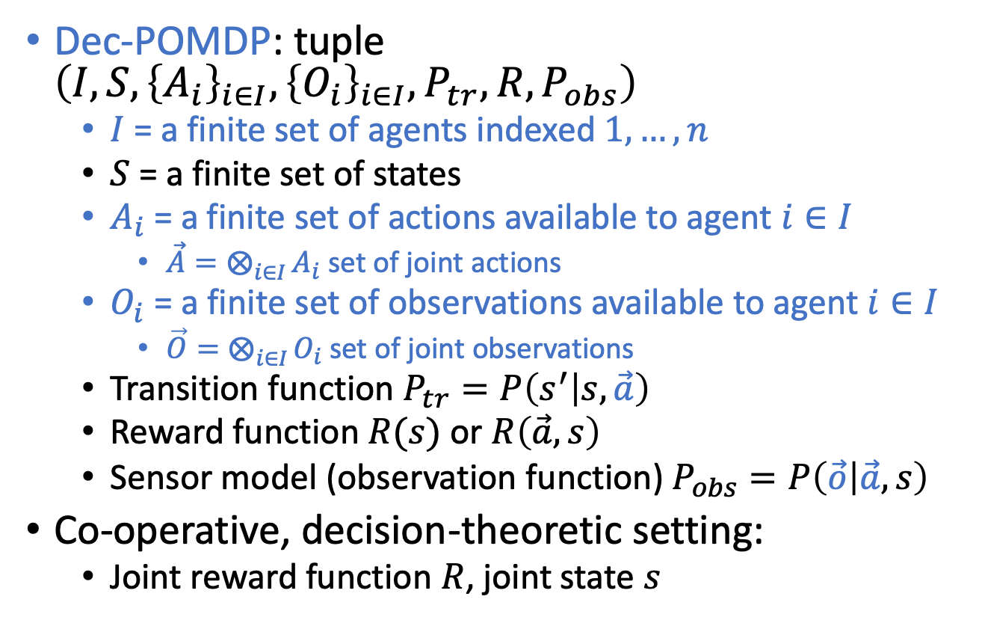
Decentralised POMDP (Dec-POMDP)
Dec-POMDP: tuple $\left(I,S, {\left\{A_{i}\right\}}_{i∈I}, {\left\{O_{i}\right\}}_{i∈I},P_{tr},R,P_{obs}\right)$
  $I$ = a finite set of agents indexed $1,…, n$
  $S$ = a finite set of states
  $A_{i}$ = a finite set of actions available to agent $i∈I$
    $\vec{A}=⨂_{i∈I}{A_{i}}$ set of joint actions
  $O_{i}$ = a finite set of observations available to agent $i∈I$
    $\vec{O}=⨂_{i∈I}{O_{i}}$ set of joint observations
  Transition function $P_{tr}=P\left(s^{′} | s, \vec{a}\right)$
  Reward function $R(s)$ or $R\left(\vec{a},s\right)$
  Sensor model (observation function) $P_{obs}=P\left(\vec{o} | \vec{a},s\right)$
Co-operative, decision-theoretic setting:
  Joint reward function $R$, joint state $s$

Slide 46
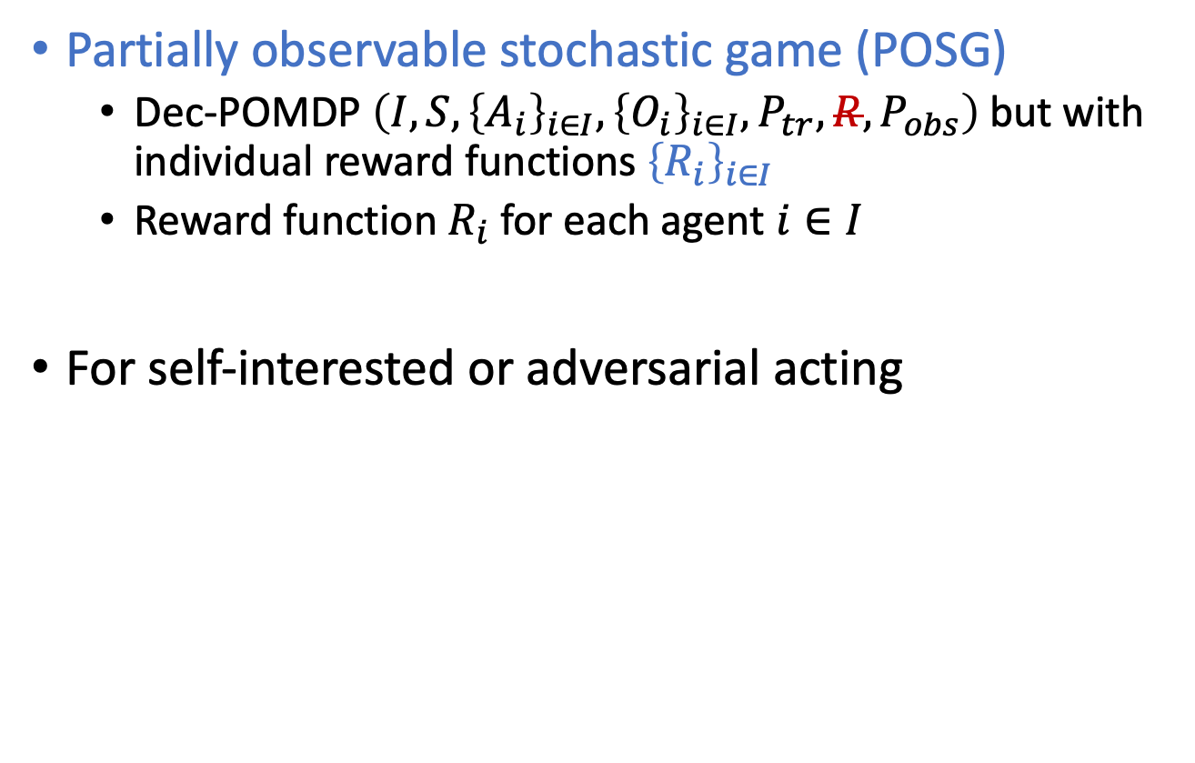
Generalising Dec-POMDPs
Partially observable stochastic game (POSG)
  Dec-POMDP $\left(I,S, {\left\{A_{i}\right\}}_{i∈I}, {\left\{O_{i}\right\}}_{i∈I},P_{tr},R,P_{obs}\right)$but with individual reward functions ${\left\{R_{i}\right\}}_{i∈I}$
  Reward function $R_{i}$ for each agent $i∈I$
For self-interested or adversarial acting

Slide 47
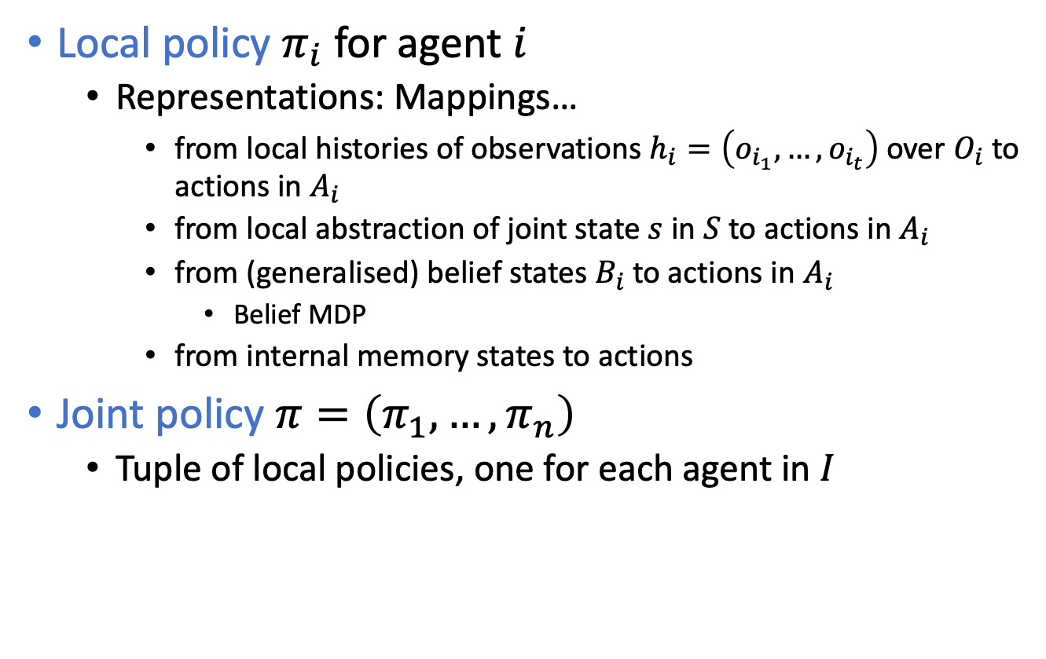
Policies for Dec-POMDPs
Local policy $π_{i}$ for agent $i$
  Representations: Mappings…
    from local histories of observations $h_{i}=\left(o_{i_{1}},…,o_{i_{t}}\right)$ over $O_{i}$ to actions in $A_{i}$
    from local abstraction of joint state $s$ in $S$ to actions in $A_{i}$
    from (generalised) belief states $B_{i}$ to actions in $A_{i}$
      Belief MDP
    from internal memory states to actions
Joint policy $π=\left(π_{1},…,π_{n}\right)$
  Tuple of local policies, one for each agent in $I$

Slide 48
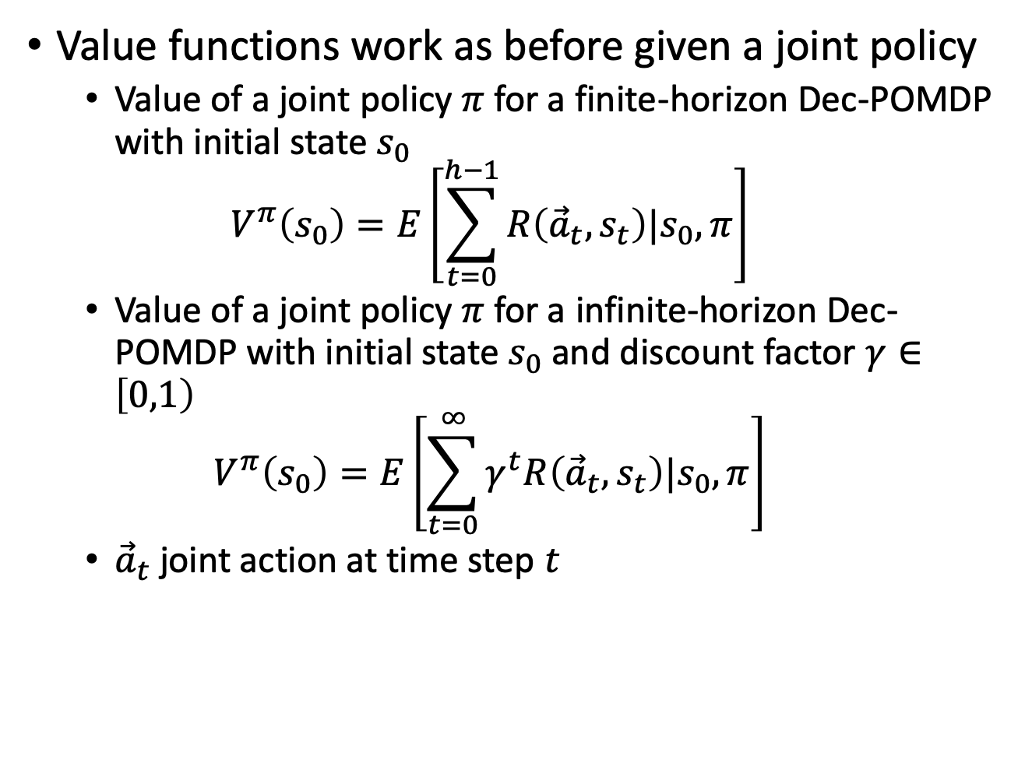
Value Functions for Dec-POMDPs
Value functions work as before given a joint policy
  Value of a joint policy $π$ for a finite-horizon Dec-POMDP with initial state $s_{0}$
  $$V^{π}\left(s_{0}\right)=E\left[\sum_{t=0}^{h−1}{R\left({\vec{a}}_{t}, s_{t}\right)|s_{0},π}\right]$$
  Value of a joint policy $π$ for a infinite-horizon Dec-POMDP with initial state $s_{0}$ and discount factor $γ∈\left[0,1\right)$
  $$V^{π}\left(s_{0}\right)=E\left[\sum_{t=0}^{∞}{γ^{t}R\left({\vec{a}}_{t}, s_{t}\right)|s_{0},π}\right]$$
  ${\vec{a}}_{t}$ joint action at time step $t$

Slide 49
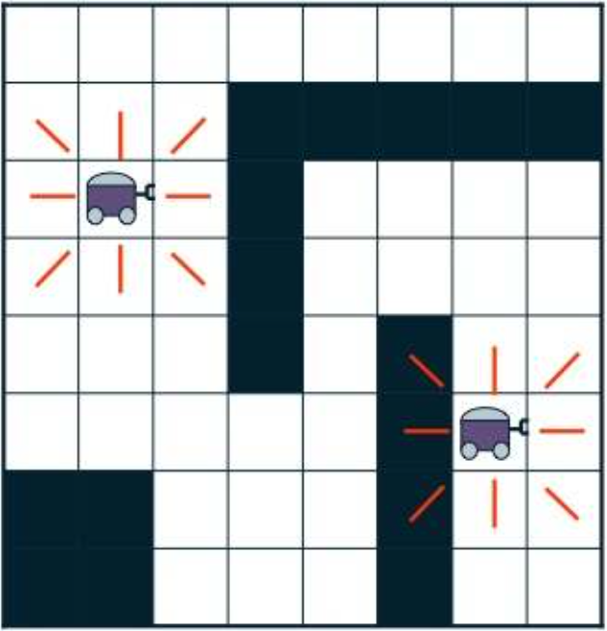
Example: Two-agent Grid World
Agents: two
States: grid cell pairs
Actions: move U, D, L, R, stay
Transitions: noisy
Observations: cell occupancy in the directions of the red lines
Rewards: negative unless sharing the same square

Slide 50

Example: The Dec-Tiger Problem
A toy problem:
decentralized tiger
Opening correct door:
both receive treasure
Opening wrong door:
both get attacked by a tiger
Agents can open a door, or listen
Two noisy observations:
hear tiger left or right
Don’t know the other’s actions or observations

Slide 51
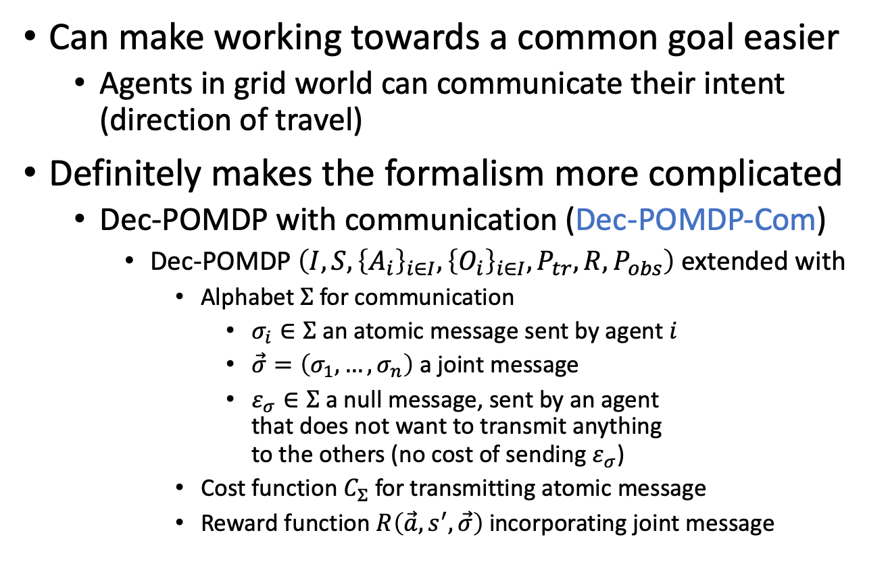
Communication?
Can make working towards a common goal easier
  Agents in grid world can communicate their intent (direction of travel)
Definitely makes the formalism more complicated
  Dec-POMDP with communication (Dec-POMDP-Com)
    Dec-POMDP $\left(I,S, {\left\{A_{i}\right\}}_{i∈I}, {\left\{O_{i}\right\}}_{i∈I},P_{tr},R,P_{obs}\right)$ extended with
      Alphabet $Σ$ for communication
        $σ_{i}∈Σ$ an atomic message sent by agent $i$
        $\vec{σ}=\left(σ_{1},…,σ_{n}\right)$ a joint message
        $ε_{σ}∈Σ$ a null message, sent by an agent
        that does not want to transmit anything
        to the others (no cost of sending $ε_{σ}$)
      Cost function $C_{Σ}$ for transmitting atomic message
      Reward function $R\left(\vec{a},s^{′},\vec{σ}\right)$ incorporating joint message
  New dimensions:
  Do agents always share information?
  Can they intentionally withhold information?
  Can they lie?

Slide 52
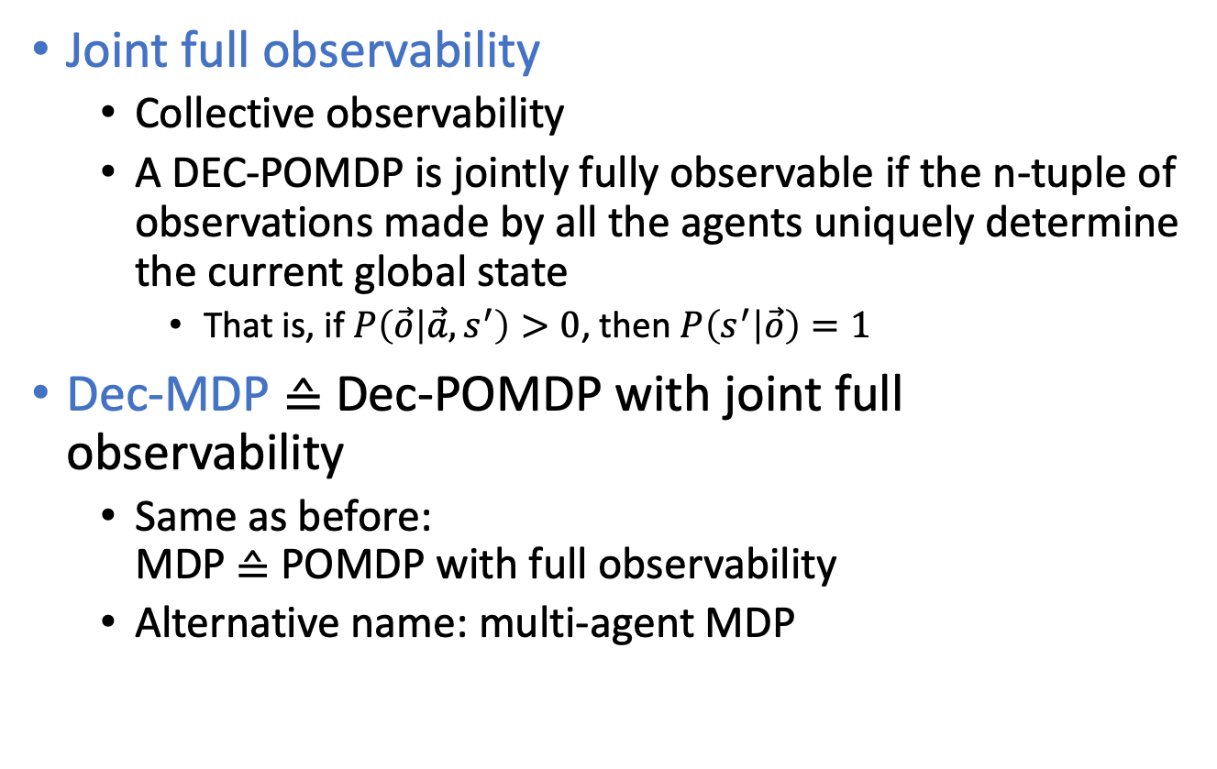
Dec-MDP
Joint full observability
  Collective observability
  A DEC-POMDP is jointly fully observable if the n-tuple of observations made by all the agents uniquely determine the current global state
    That is, if $P\left(\vec{o} | \vec{a}, s^{′}\right)>0$, then $P\left(s^{′} | \vec{o}\right)=1$
Dec-MDP ≙ Dec-POMDP with joint full observability
  Same as before:
  MDP ≙ POMDP with full observability
  Alternative name: multi-agent MDP

Slide 53
Solving Dec-POMDPs
Problem: No joint belief available
  Only partial information about state available to each agent
Complexity: NEXP-complete
  Optimal solutions using dynamic programming paradigm + exploiting structure if present
  Reduction to NP when agents mostly independent + communication can be explicitly modelled and analysed
    Requires that one can factorise the joint state space into a state space for each agent that is mostly independent of all others
    The same goes for the observations and the reward function

Slide 54
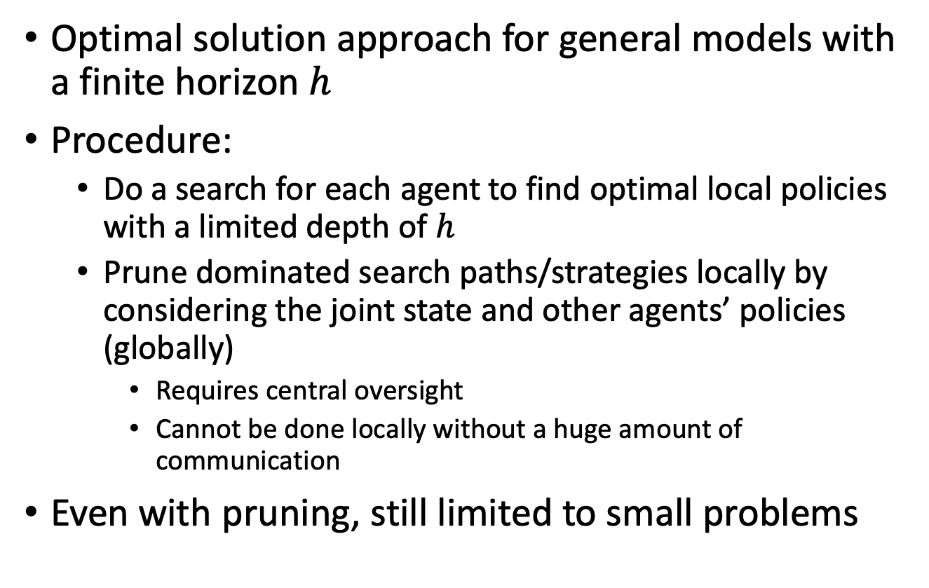
Exhaustive Search
Optimal solution approach for general models with a finite horizon $h$
Procedure:
  Do a search for each agent to find optimal local policies with a limited depth of $h$
  Prune dominated search paths/strategies locally by considering the joint state and other agents’ policies (globally)
    Requires central oversight
    Cannot be done locally without a huge amount of communication
Even with pruning, still limited to small problems

Slide 55

Exhaustive Search and Pruning
Without Pruning
With Pruning

Slide 56

Exhaustive Search and Pruning
Without Pruning
With Pruning

Slide 57
Exhaustive Search and Pruning
Without Pruning
With Pruning

Slide 58
Exhaustive Search and Pruning
Without Pruning
With Pruning

Slide 59
Exhaustive Search and Pruning
Without Pruning
With Pruning

Slide 60
Exhaustive Search and Pruning
Without Pruning
With Pruning

Slide 61


Exhaustive Search and Pruning
Without Pruning
With Pruning

Slide 62

Joint Equilibrium Search for Policies
JESP(dec-pomdp)
while not converged do
for i = 1 to n do
Fix other agent policies
Find a best response policy for agent i
Approximate solution approach for general models with a finite horizon $h$
Instead of exhaustive search, find best response
  Local optimum
  Convergence criterion needed
    E.g., no change (or only $ε$ change) in any policy
  Same worst case complexity, but in practice much faster
  Can include pruning, further heuristics when looking for best response policy

Slide 63













Multi-agent A* (MAA*)
Optimal solution approach for general models with a finite horizon $h$
A*-like search over partially specified joint policies
  $φ^{t}=\left(δ^{0},…,δ^{t−1}\right)$
  $δ^{t}=\left(δ_{0}^{t}, …, δ_{n}^{t}\right)$
  $δ_{i}^{t} : {\vec{O}}_{i}^{t} →A_{i}$
Requires an admissible
heuristic function $\hat{V}\left(φ^{t}\right)$
$$φ^{0}$$
$$δ^{0}$$
$$δ^{0′′}$$
$$δ^{0′}$$
$$φ^{1}$$
$$φ^{1′}$$
. . .
$$φ^{1′′}$$
$$δ^{1}$$
$$δ^{1′}$$
  $$\underset{\begin{aligned} \\ \\ F\end{aligned}}{\underbrace{\hat{V}\left(φ^{t}\right)}}=\underset{\begin{aligned} \\ \\ G\end{aligned}}{\underbrace{V^{0…t−1}\left(φ^{t}\right)}}+\underset{\begin{aligned} \\ \\ H\end{aligned}}{\underbrace{{\hat{V}}^{t…h−1}\left(φ^{t}\right)}}$$
$$φ^{2}$$
. . .
$$φ^{2′}$$

Slide 64
How to get a heuristic function?
Solve simplified settings, e.g.,
  Solve the underlying MDP (approximately or optimally) given assumptions:
    Centralised observations
    Full observability
      Simulate / sample unobserved values
  Solve a belief MDP given assumption
    Centralised observations
Domain-specific heuristics

Slide 65

Memory Bounded Search
MBDP(𝛴,s₀,S_{g})
Start with a one-step policy for each agent
for t = h downto 1 do
Backup each agent’s policy
for k = 1 to maxTrees do
Compute heuristic policy and resulting
belief state b
Chose best set of trees starting at b
Select best set of trees for initial state b₀
MBDP =
Memory
Bounded
Dynamic
Programming
Approximate solution approach for general models with a finite horizon $h$
Do not keep all policies at each step but a fixed number for each agent $maxTrees$
  Select $maxTrees$ in a way that $maxTrees∙\left|I\right|$ trees fit into memory
    Can be difficult to choose; often small in practice
  Select trees by using heuristic (like A*)

Slide 66

Infinite Horizon
Approximate using a large enough horizon $h$
  Neither efficient, nor compact
Selection of solution approaches based on solution approaches already seen for MDPs / POMDPs:
  Policy iteration
    Start with one-step plans, extend further
    Automata-based approaches (Moore/Mealy automata to represent policy)
    Intractable for all but the smallest problems
  Best-first search
    Finds optimal fixed-size solutions; use start state info
    High search time ➝ small sizes only
Further solution approaches use non-linear programming

Slide 67
Indefinite Horizon
Many natural problems terminate after a goal is reached
  Meeting or catching a target
  Cooperatively completing a task
Unclear how many steps are needed until termination
Under certain assumptions can produce an optimal solution
  E.g., terminal actions and negative rewards
    Such as the 4x3 grid:
    terminal states, negative rewards for all but one terminal state
Otherwise, can bound the solution quality by sampling

Slide 68
Benchmark Problems
DEC-Tiger
  (Nair et al., 2003)
BroadcastChannel
  (Hansen et al., 2004)
Meeting on a grid
  (Bernstein et al., 2005)
Cooperative Box Pushing
  (Seuken and Zilberstein, 2007a)
Recycling Robots
  (Amato et al., 2007)
FireFighting
  (Oliehoek et al., 2008b)
Sensor network problems
  (Nair et al., 2005; Kumar and Zilberstein, 2009a,b)

Slide 69
Software for Dec-POMDPs
The MADP toolbox aims to provide a software platform for research in decision-theoretic multiagent planning (Spaan and Oliehoek, 2008)
Main features:
  Uniform representation for several popular multiagent models
  Parser for a file format for discrete Dec-POMDPs
  Shared functionality for planning algorithms
  Implementation of several Dec-POMDP planners
Released as free software, with special attention to the extensibility of the toolbox
Provides benchmark problems
  Such as on the previous slide

Slide 70
agents: 2
discount: 1
values: reward
states: tiger-left tiger-right
start:
uniform
actions:
listen open-left open-right
listen open-left open-right
observations:
hear-left hear-right
hear-left hear-right
Dec-Tiger Problem Specification and Program
#include "ProblemDecTiger.h"
#include "JESPExhaustivePlanner.h"
int main()
{
ProblemDecTiger dectiger;
JESPExhaustivePlanner jesp(3,&dectiger);
jesp.Plan();
std::cout
<< jesp.GetExpectedReward()
<< std::endl;
std::cout
<< jesp.GetJointPolicy()->SoftPrint()
<< std::endl;
return(0);
}
# Transitions
T: * :
uniform
T: listen listen :
identity
# Observations
O: * :
uniform
O: listen listen : tiger-left : hear-left hear-left : 0.7225
O: listen listen : tiger-left : hear-left hear-right : 0.1275
[...]
O: listen listen : tiger-right : hear-left hear-left : 0.0225
# Rewards
R: listen listen : * : * : * : -2
R: open-left open-left : tiger-left : * : * : -50
[...]
R: open-left listen: tiger-right : * : * : 9

Slide 71
Interim Summary
Dec-POMDPs
  Local policies, joint policy, value functions
  Communication, full observability, Dec-MDP
Solutions for
  Finite horizon
  Infinite horizon
  Indefinite horizon
MADP tool box
  Benchmark problems

Slide 72
Hierarchy of Formalisms
Most general: POSG
  Set of agents, individual reward functions, environment only partially observable
Specifications
  Decentralisation
    Joint reward function
  2a. Observable environment
  2b. Multi to single agent
Most specific: MDP
  One agent, (therefore) one reward function, observable environment
POSG
Dec-POMDP
POMDP
MDP
Dec-MDP
Propositional
modelling!

Slide 73
First-order Modelling
First-order / relational MDPs
  Use representatives while planning
  E.g., it is important that a box with
  medical supplies arrives at a destination
  but not which box in particular that is
  (of a set of boxes with medical supplies)
Lifting for agents
  Novel propositional situations worth exploring may be instances of a well-known context in the relational setting
  ➝ exploitation promising
  E.g., household robot learning water-taps
    Having opened one or two water-taps in a kitchen, one can expect other water-taps in kitchens to behave similarly
    Priority for exploring water-taps in kitchens in general reduced
    Information gathered likely to carry over to water-taps in other places
    Hard to model in propositional setting: each water-tap is novel
Research is not finished; first-order / relational/ lifted modelling not yet fully explored, especially regarding multi-agent

Slide 74
Outline
Provably Beneficial AI
  Hidden goals
Partially Observable Markov Decision Process (POMDP)
  POMDP agent, belief state, belief MDP
  Conditional plans, value iteration
Decentralised POMDP (Dec-POMDP)
  Dec-POMDP, local policy, joint policy, value function
  Communication, full observability, Dec-MDP
  Solutions for finite, infinite, indefinite horizon
⟹ Next: Human-aware planning

