Slide 1
Intelligent Agents: Web-mining Agents Probabilistic Graphical Models
Introduction
Tanya Braun

Slide 2
Welcome
Part of the module:
Intelligent Agents (CS4514-KP12)
Consists of two lectures per week
First lecture per week on
Autonomous Agents and Information Retrieval
Second lecture per week on
Probabilistic Graphical Models

Slide 3
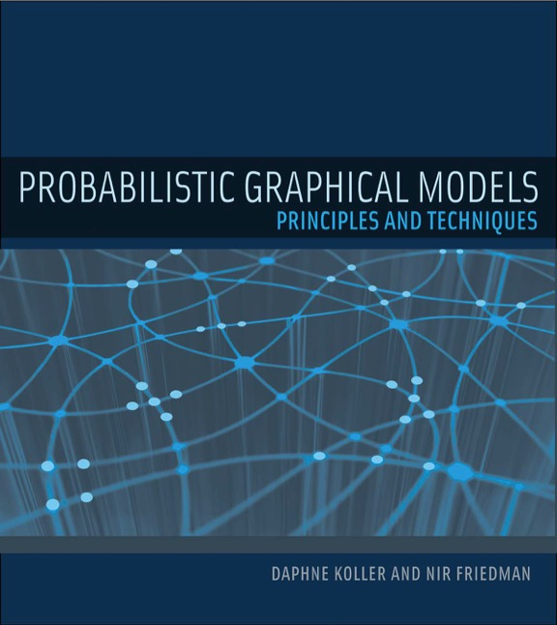
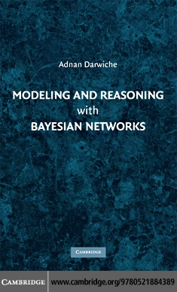
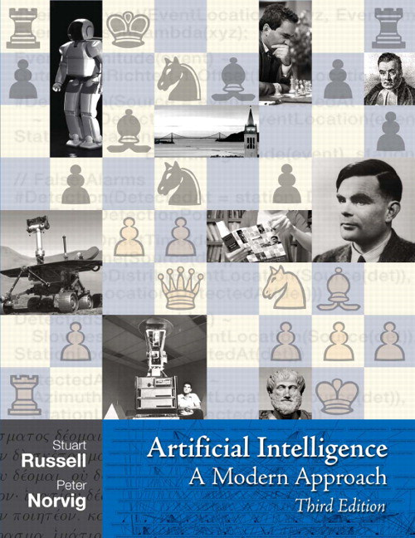
Literature: Books
Modelling and Reasoning with Bayesian Networks
Adnan Darwiche
Probabilistic Graphical Models
Daphne Koller, Nir Friedman
Artificial Intelligence: A Modern Approach (3rd ed.)
Stuart Russell, Peter Norvig

Slide 4
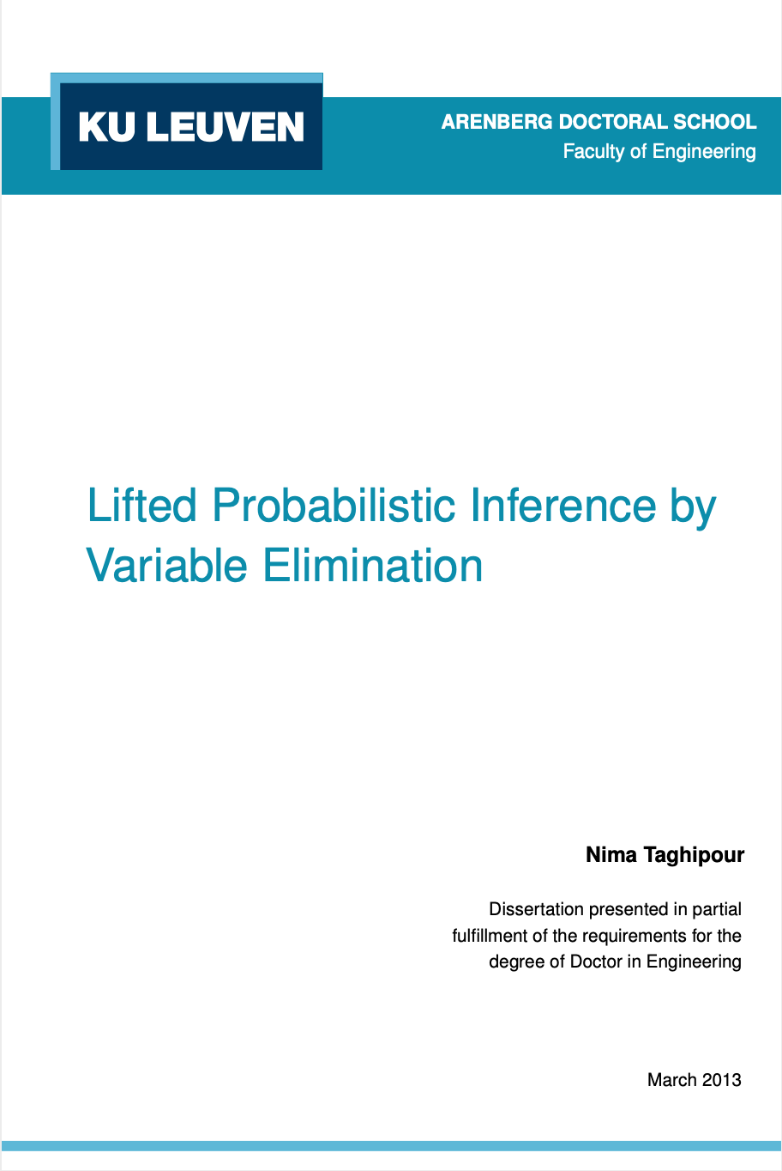
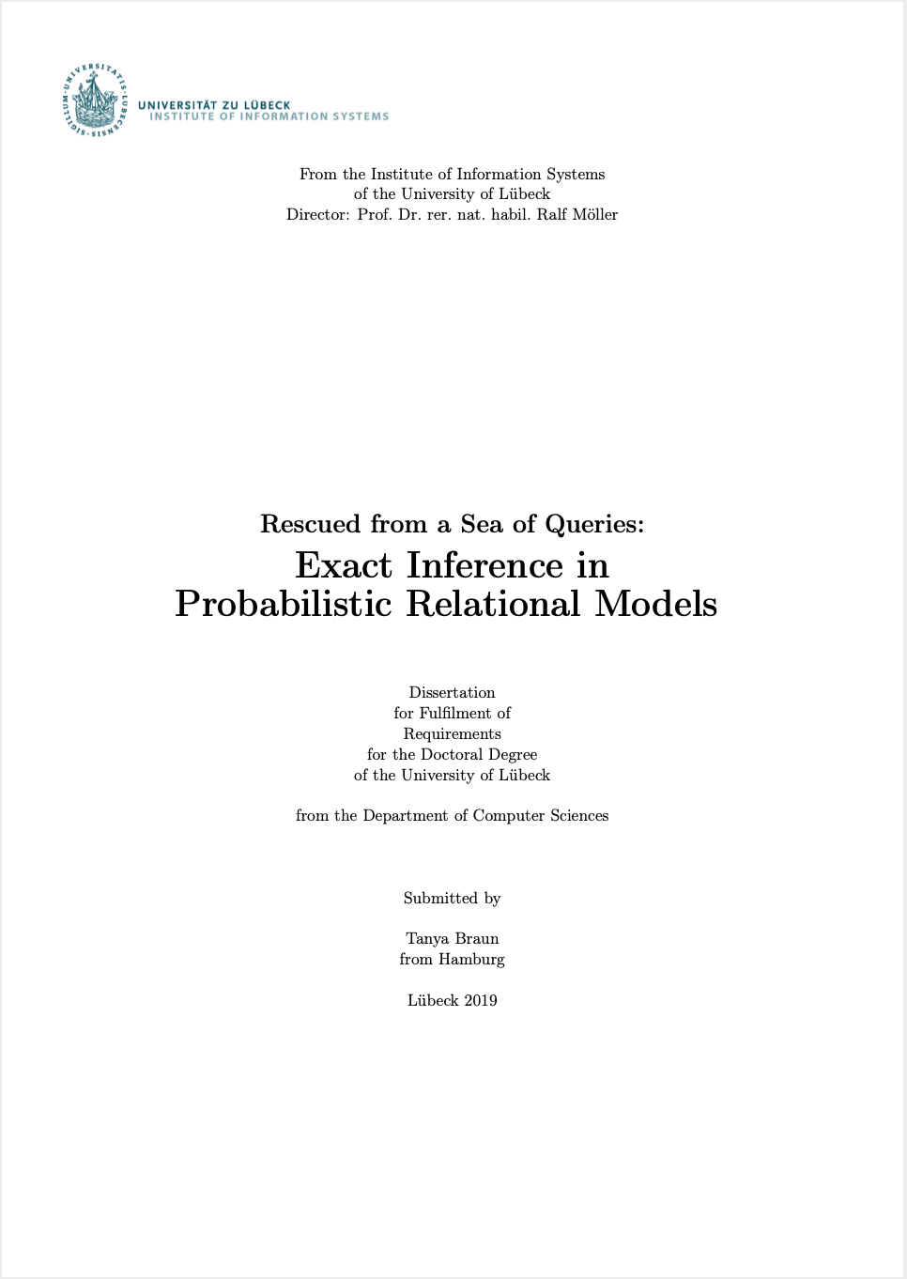
Literature: Other than Books
Two PhD theses (especially for Sections 1-3):
Nima Taghipour: Lifted Probabilistic Inference by Variable Elimination. KU Leuven, 2013.
https://lirias.kuleuven.be/1656026?limo=0
Tanya Braun: Rescued from a Sea of Queries: Exact Inference in Probabilistic Relational Models. UzL, 2020.
https://www.ifis.uni-luebeck.de/~braun/Diss/Braun_diss.pdf
Further research papers referenced in slides

Slide 5
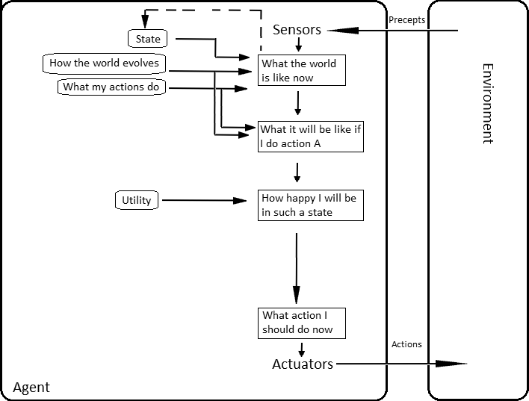
Setting: Agent with Utilities
AIMA, Russell/Norvig

Slide 6
Probabilistic Graphical Models (PGMs)
Recap: Propositional modelling
Factor model, Bayesian network, Markov network
Semantics, inference tasks + algorithms + complexity
Probabilistic relational models (PRMs)
Parameterised models, Markov logic networks
Semantics, inference tasks
Lifted inference
LVE, LJT, FOKC
Theoretical analysis
Lifted learning
Recap: propositional learning
From ground to lifted models
Direct lifted learning
Approximate Inference: Sampling
Importance sampling
MCMC methods
Sequential models & inference
Dynamic PRMs
Semantics, inference tasks + algorithms + complexity, learning
Decision making
(Dynamic) Decision PRMs
Semantics, inference tasks + algorithms, learning
Continuous Models
Probabilistic soft logic: modelling, semantics, inference tasks + algorithms

