Slide 1
Intelligent Agents:
Web-mining Agents
Probabilistic Graphical Models
Lifted Inference
Tanya Braun

Slide 2
Probabilistic Graphical Models (PGMs)
Recap: Propositional modelling
  Factor model, Bayesian network, Markov network
  Semantics, inference tasks
  + algorithms + complexity
Probabilistic relational models (PRMs)
  Parameterised models, Markov logic networks
  Semantics, inference tasks
Lifted inference
  LVE, LJT, FOKC
  Theoretical analysis
Lifted learning
  Recap: propositional learning
  From ground to lifted models
  Direct lifted learning
Approximate Inference: Sampling
  Importance sampling
  MCMC methods
Sequential models & inference
  Dynamic PRMs
  Semantics, inference tasks
  + algorithms + complexity, learning
Decision making
  (Dynamic) Decision PRMs
  Semantics, inference tasks
  + algorithms, learning
Continuous Space
  Gaussian distributions and Bayesian networks
  Probabilistic soft logic

Slide 3



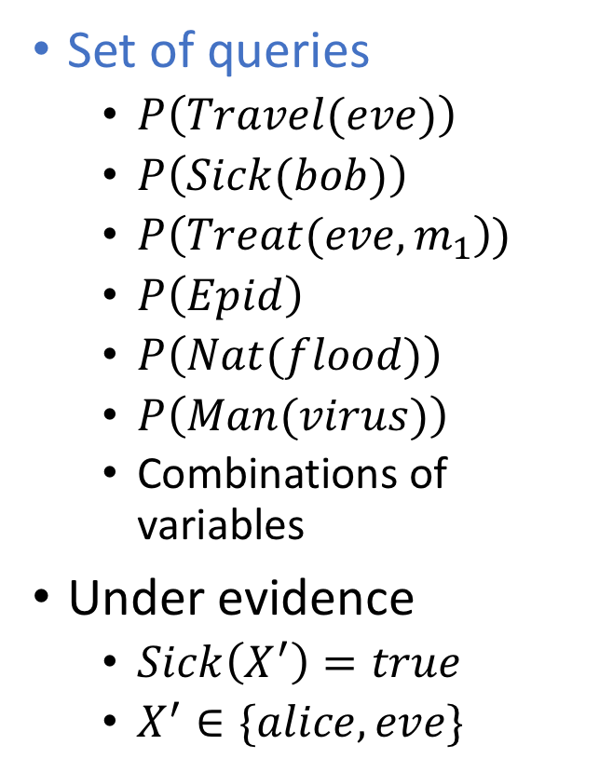






Problem: Many Queries
Set of queries
  $P\left(Travel(eve)\right)$
  $P\left(Sick(bob)\right)$
  $P\left(Treat(eve,m_{1}\right))$
  $P\left(Epid\right)$
  $P\left(Nat(flood)\right)$
  $P\left(Man(virus)\right)$
  Combinations of variables
Under evidence
  $Sick\left(X^{′}\right)=true$
  $X^{′}∈\{alice, eve\}$
LVE restarts with initial model for each query
Build a helper structure
to precompute parts
$$Nat\left(D\right)$$
$$Man\left(M\right)$$
$$g_{1}$$
$$Epid$$
$$Travel\left(X\right)$$
$$Treat\left(X,P\right)$$
$$g_{2}$$
$$g_{3}$$
$$Sick\left(X\right)$$

Slide 4
Outline: 3. Lifted Inference
Lifted variable elimination (LVE)
  Operators
  Algorithm
  Complexity (including first-order dtrees), completeness, tractability
  Variants
Lifted junction tree algorithm (LJT)
  First-order junction trees (FO jtrees)
  Algorithm
  Complexity, completeness
  Variants
First-order knowledge compilation (FOKC)
  Normal form, circuits
  Algorithm
  Complexity, completeness
Most probable assignment queries
  Distribution vs. assignment queries
  Most probable explanation (MPE) , Maximum-a-posteriori (MAP) assignments
  Changes in LVE, LJT, FOKC
  Complexity, completeness

Slide 5







Clustering of Models
Idea: Find subsets (clusters) of PRVs that are “enough” for certain queries
  E.g.,
    For queries about instances of $Nat\left(D\right)$, $Man\left(W\right)$, $Epid$
      $Nat\left(D\right)$, $Man\left(W\right)$, $Epid$ are enough
    For queries about instances of $Travel\left(X\right)$, $Sick\left(X\right)$, $Epid$
      $Travel\left(X\right)$, $Sick\left(X\right)$, $Epid$ are enough
    For queries about instances of $Treat\left(X,M\right)$, $Sick\left(X\right)$, $Epid$
      $Treat\left(X,M\right)$, $Sick\left(X\right)$, $Epid$ are enough
$$Nat\left(D\right)$$
$$Man\left(W\right)$$
$$g_{1}$$
$$Epid$$
$$Travel\left(X\right)$$
$$Treat\left(X,M\right)$$
$$g_{2}$$
$$g_{3}$$
$$Sick\left(X\right)$$

Slide 6

Clustering of Models
But: If only parfactors used that contain the PRVs of a cluster, information stored in all other parfactors ignored
  E.g.,
    $Nat\left(D\right)$, $Man\left(W\right)$, $Epid$: $g_{1}$ ➝ misses $g_{2}$, $g_{3}$
    $Travel\left(X\right)$, $Sick\left(X\right)$, $Epid$: $g_{2}$ ➝ misses $g_{1}$, $g_{3}$
    $Treat\left(X,M\right)$, $Sick\left(X\right)$, $Epid$: $g_{3}$ ➝ misses $g_{1}$, $g_{2}$
Only correct if clusters are independent from each other
  How can we achieve independence?
$$Nat\left(D\right)$$
$$Man\left(W\right)$$
$$g_{1}$$
$$Epid$$
$$Travel\left(X\right)$$
$$Treat\left(X,M\right)$$
$$g_{2}$$
$$g_{3}$$
$$Sick\left(X\right)$$

Slide 7
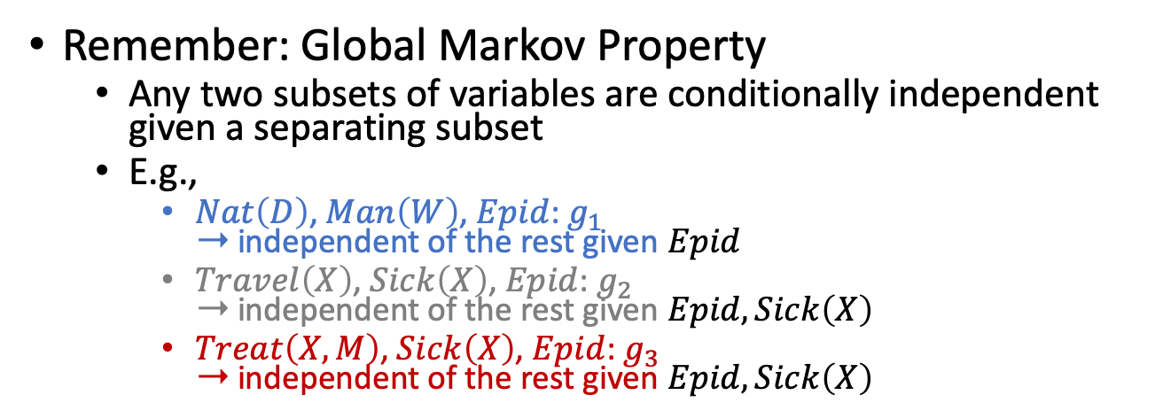
Clustering of Models
Remember: Global Markov Property
  Any two subsets of variables are conditionally independent given a separating subset
  E.g.,
    $Nat\left(D\right)$, $Man\left(W\right)$, $Epid$: $g_{1}$
    ➝ independent of the rest given $Epid$
    $Travel\left(X\right)$, $Sick\left(X\right)$, $Epid$: $g_{2}$
    ➝ independent of the rest given $Epid,Sick\left(X\right)$
    $Treat\left(X,M\right)$, $Sick\left(X\right)$, $Epid$: $g_{3}$
    ➝ independent of the rest given $Epid,Sick\left(X\right)$
$$Nat\left(D\right)$$
$$Man\left(W\right)$$
$$g_{1}$$
$$Epid$$
$$Travel\left(X\right)$$
$$Treat\left(X,M\right)$$
$$g_{2}$$
$$g_{3}$$
$$Sick\left(X\right)$$

Slide 8
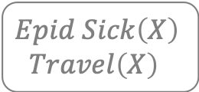


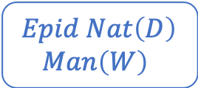

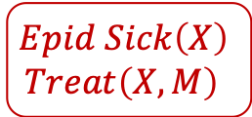
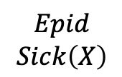

Clustering of Models
Put clusters and their separators into a graph structure where
  Nodes are clusters with parfactors assigned containing the cluster PRVs (local model)
  Edges are labelled with the separator between neighbouring nodes
  If two nodes contain the same PRV, every node on the path between the two nodes contain the PRV (running intersection property)
$$Epid Nat\left(D\right)$$
$$Man\left(W\right)$$
$$Epid Sick\left(X\right)$$
$$Travel\left(X\right)$$
$$Epid Sick\left(X\right)$$
$$Treat\left(X,M\right)$$
$$Epid$$
$$Epid$$
$$Sick\left(X\right)$$
$$g_{1}$$
$$g_{2}$$
$$g_{3}$$
$$Nat\left(D\right)$$
$$Man\left(W\right)$$
$$g_{1}$$
$$Epid$$
$$Travel\left(X\right)$$
$$Treat\left(X,M\right)$$
$$g_{2}$$
$$g_{3}$$
$$Sick\left(X\right)$$

Slide 9
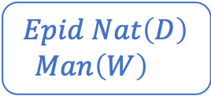




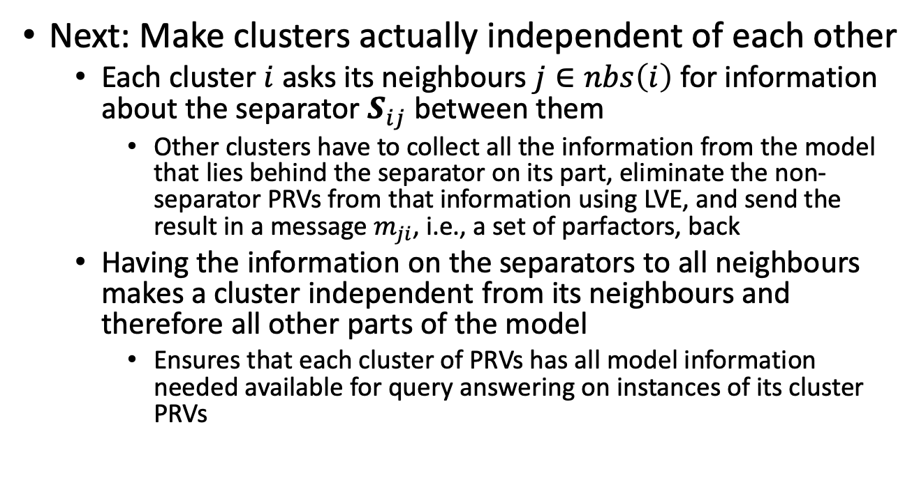
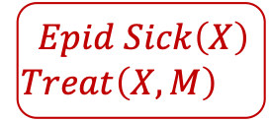


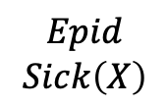
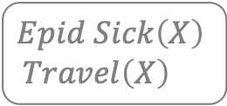

Clustering of Models
Next: Make clusters actually independent of each other
  Each cluster $i$ asks its neighbours $j∈nbs\left(i\right)$ for information about the separator $S_{ij}$ between them
    Other clusters have to collect all the information from the model that lies behind the separator on its part, eliminate the non-separator PRVs from that information using LVE, and send the result in a message $m_{ji}$, i.e., a set of parfactors, back
  Having the information on the separators to all neighbours makes a cluster independent from its neighbours and therefore all other parts of the model
    Ensures that each cluster of PRVs has all model information needed available for query answering on instances of its cluster PRVs
$$Epid Nat\left(D\right)$$
$$Man\left(W\right)$$
$$Epid Sick\left(X\right)$$
$$Travel\left(X\right)$$
$$Epid Sick\left(X\right)$$
$$Treat\left(X,M\right)$$
$$C_{1}$$
$$Epid$$
$$C_{2}$$
$$Epid$$
$$Sick\left(X\right)$$
$$C_{3}$$
$$g_{1}$$
$$g_{2}$$
$$g_{3}$$

Slide 10
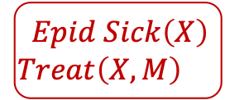




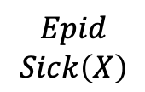

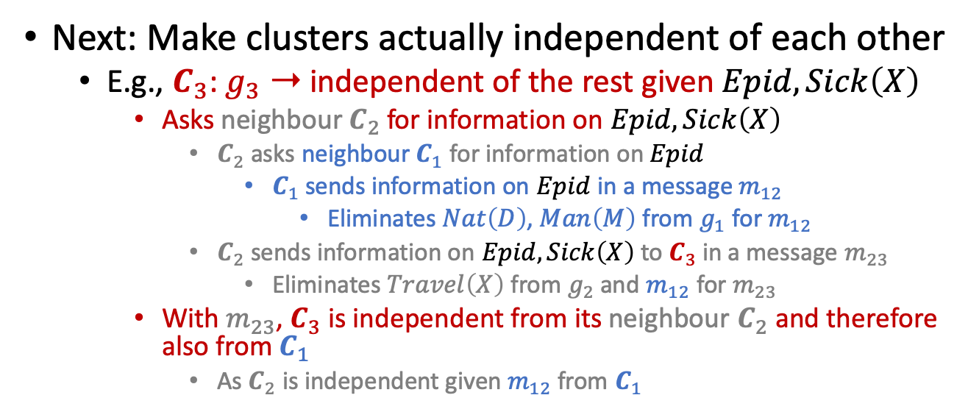


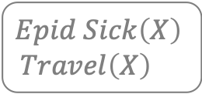

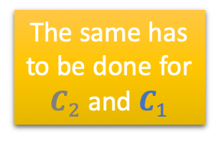



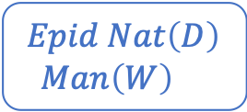




Clustering of Models
Next: Make clusters actually independent of each other
  E.g., $C_{3}$: $g_{3}$ ➝ independent of the rest given $Epid,Sick\left(X\right)$
    Asks neighbour $C_{2}$ for information on $Epid,Sick\left(X\right)$
      $C_{2}$ asks neighbour $C_{1}$ for information on $Epid$
        $C_{1}$ sends information on $Epid$ in a message $m_{12}$
          Eliminates $Nat\left(D\right)$, $Man\left(M\right)$ from $g_{1}$ for $m_{12}$
      $C_{2}$ sends information on $Epid,Sick\left(X\right)$to $C_{3}$in a message $m_{23}$
        Eliminates $Travel\left(X\right)$ from $g_{2}$ and $m_{12}$ for $m_{23}$
    With $m_{23}$, $C_{3}$ is independent from its neighbour $C_{2}$ and therefore also from $C_{1}$
      As $C_{2}$ is independent given $m_{12}$ from $C_{1}$
The same has to be done for $C_{2}$ and $C_{1}$
$Epid$?
$Epid,Sick\left(X\right)$?
$$Epid Nat\left(D\right)$$
$$Man\left(W\right)$$
$$Epid Sick\left(X\right)$$
$$Travel\left(X\right)$$
$$Epid Sick\left(X\right)$$
$$Treat\left(X,M\right)$$
$$C_{1}$$
$$Epid$$
$$C_{2}$$
$$Epid$$
$$Sick\left(X\right)$$
$$C_{3}$$
$$g_{1}$$
$$m_{12}$$
$$g_{2}$$
$$m_{23}$$
$$g_{3}$$
Eliminate
$$Nat\left(D\right),Man\left(W\right)$$
Eliminate
$$Travel\left(X\right)$$
$$m_{12}$$
$Epid$!
$$m_{23}$$
$Epid,Sick\left(X\right)$!

Slide 11

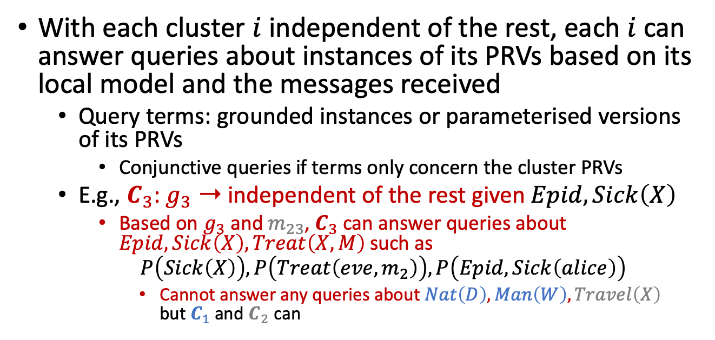

Clustering of Models
With each cluster $i$ independent of the rest, each $i$ can answer queries about instances of its PRVs based on its local model and the messages received
  Query terms: grounded instances or parameterised versions of its PRVs
    Conjunctive queries if terms only concern the cluster PRVs
  E.g., $C_{3}$: $g_{3}$ ➝ independent of the rest given $Epid,Sick\left(X\right)$
    Based on $g_{3}$ and $m_{23}$, $C_{3}$ can answer queries about $Epid, Sick\left(X\right),Treat\left(X,M\right)$ such as
    $$P\left(Sick\left(X\right)\right),P\left(Treat\left(eve,m_{2}\right)\right),P\left(Epid,Sick\left(alice\right)\right)$$
      Cannot answer any queries about $Nat\left(D\right),Man\left(W\right),Travel\left(X\right)$
      but $C_{1}$ and $C_{2}$ can
$$Epid Nat\left(D\right)$$
$$Man\left(W\right)$$
$$Epid Sick\left(X\right)$$
$$Travel\left(X\right)$$
$$Epid Sick\left(X\right)$$
$$Treat\left(X,M\right)$$
$$C_{1}$$
$$Epid$$
$$C_{2}$$
$$Epid$$
$$Sick\left(X\right)$$
$$C_{3}$$
$$g_{1}$$
$$m_{21}$$
$$m_{12}$$
$$g_{2}$$
$$m_{32}$$
$$m_{23}$$
$$g_{3}$$

Slide 12




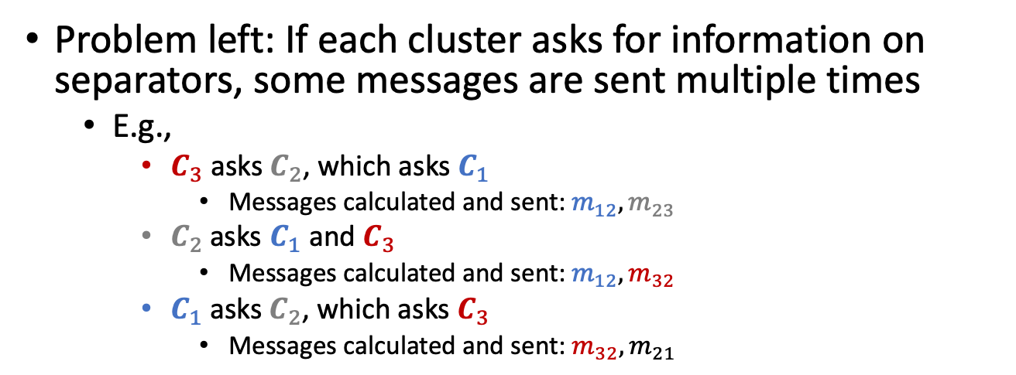





Clustering of Models
Problem left: If each cluster asks for information on separators, some messages are sent multiple times
  E.g.,
    $C_{3}$ asks $C_{2}$, which asks $C_{1}$
      Messages calculated and sent: $m_{12},m_{23}$
    $C_{2}$asks $C_{1}$ and $C_{3}$
      Messages calculated and sent: $m_{12},m_{32}$
    $C_{1}$ asks $C_{2}$, which asks $C_{3}$
      Messages calculated and sent: $m_{32},m_{21}$
Organise in way that messages are calculated only once
$Epid$?
$Epid,Sick\left(X\right)$?
$Epid$?
$Epid,Sick\left(X\right)$?
$Epid$?
$Epid,Sick\left(X\right)$?
$$Epid Nat\left(D\right)$$
$$Man\left(W\right)$$
$$Epid Sick\left(X\right)$$
$$Travel\left(X\right)$$
$$Epid Sick\left(X\right)$$
$$Treat\left(X,M\right)$$
$$C_{1}$$
$$Epid$$
$$C_{2}$$
$$Epid$$
$$Sick\left(X\right)$$
$$C_{3}$$
$$m_{12}$$
$$m_{23}$$
$$m_{12}$$
$$m_{32}$$
$$m_{21}$$
$$m_{32}$$

Slide 13

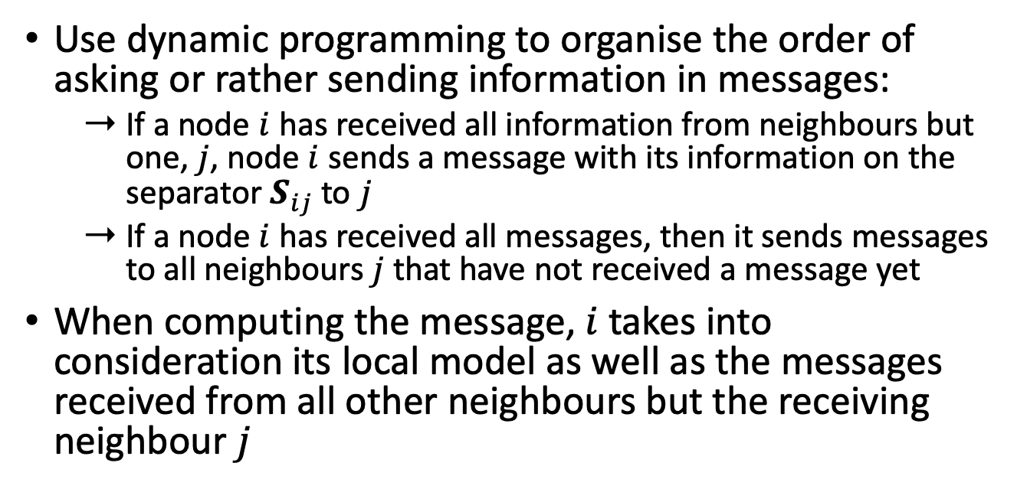


Clustering of Models
Use dynamic programming to organise the order of asking or rather sending information in messages:
  If a node $i$ has received all information from neighbours but one, $j$, node $i$ sends a message with its information on the separator $S_{ij}$ to $j$
  If a node $i$has received all messages, then it sends messages to all neighbours $j$ that have not received a message yet
When computing the message, $i$takes into consideration its local model as well as the messages received from all other neighbours but the receiving neighbour $j$
$$Epid Nat\left(D\right)$$
$$Man\left(W\right)$$
$$Epid Sick\left(X\right)$$
$$Travel\left(X\right)$$
$$Epid Sick\left(X\right)$$
$$Treat\left(X,M\right)$$
$$C_{1}$$
$$C_{2}$$
$$C_{3}$$
$$m_{12}$$
$$m_{32}$$
$$m_{21}$$
$$m_{23}$$

Slide 14
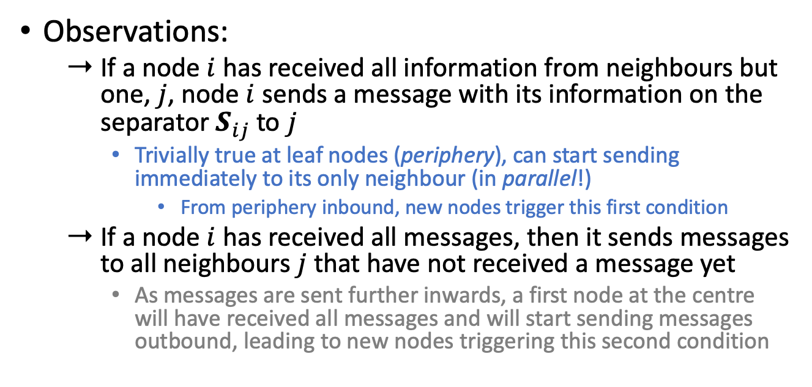
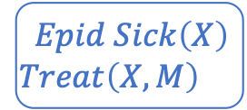

Clustering of Models
Observations:
  If a node $i$ has received all information from neighbours but one, $j$, node $i$ sends a message with its information on the separator $S_{ij}$ to $j$
    Trivially true at leaf nodes (periphery), can start sending immediately to its only neighbour (in parallel!)
      From periphery inbound, new nodes trigger this first condition
  If a node $i$has received all messages, then it sends messages to all neighbours $j$ that have not received a message yet
    As messages are sent further inwards, a first node at the centre will have received all messages and will start sending messages outbound, leading to new nodes triggering this second condition
$$Epid Nat\left(D\right)$$
$$Man\left(W\right)$$
$$Epid Sick\left(X\right)$$
$$Travel\left(X\right)$$
$$Epid Sick\left(X\right)$$
$$Treat\left(X,M\right)$$
$$C_{1}$$
$$C_{2}$$
$$C_{3}$$
These two passes from periphery inbound and back suffice to distribute all information and make the clusters independent from each other*
* Shown by Steffen L. Lauritzen and David J. Spiegelhalter: Local Computations with Probabilities on Graphical Structures and Their Application to Expert Systems. In: Journal of the Royal Statistical Society. Series B: Methodological, 1988.

Slide 15













Foundations of Clustering
History in propositional probabilistic inference:
  Based on probability propagation introduced by Pearl (1988)
    If a BN is a polytree, i.e., the underlying undirected graph has no trivial cycles, then
      Treat each node in a BN as a cluster with the random variables (randvars) of the accompanying CPT as the cluster randvars
      Send messages along the edges (to parents and children), eliminating randvars not occurring in the parent or child nodes
$$U_{1}$$
$$U_{2}$$
$$π\left(U_{1},V\right)$$
$$λ\left(V,U_{2}\right)$$
$$π\left(U_{2},V\right)$$
$$λ\left(V,U_{1}\right)$$
$$V$$
$$λ\left(V_{1},V\right)$$
$$π\left(V,V_{2}\right)$$
$$π\left(V,V_{1}\right)$$
$$λ\left(V_{2},V\right)$$
$$V_{1}$$
$$V_{2}$$
Judea Pearl: Reverend Bayes on Inference Engines: A Distributed Hierarchical Approach. In: AAAI-82 Proceedings of the 2nd National Conference on Artificial Intelligence, 1982.

Slide 16
Foundations of Clustering
History in propositional probabilistic inference:
  If no polytree, the cycles mess up the message passing along the edges (information arrives multiple times)
    Send messages nonetheless (exact if polytree, approximate otherwise): called belief propagation as an algorithm for approximate inference
    Exact inference required ➝ put the cycles into one cluster
    Graph formed called a junction tree (jtree)
      A first-order version of a jtree was induced on the previous slides
      Also known as clique tree (since the cycles often form cliques in the model graph) or join tree
      Propositional version introduced by Lauritzen and Spiegelhalter (1988)
      Shenoy and Shafer (1989) introduce three axioms of local computations to show correctness of doing computations locally
Steffen L. Lauritzen and David J. Spiegelhalter: Local Computations with Probabilities on Graphical Structures and Their Application to Expert Systems. In: Journal of the Royal Statistical Society. Series B: Methodological, 1988.
Prakash P. Shenoy and Glenn R. Shafer: Axioms for Probability and Belief-Function Propagation. In: Uncertainty in Artificial Intelligence 4, 1990.

Slide 17
First-order Jtree (FO Jtree)
As seen on the earlier slides
  Acyclic graph
  Nodes contain PRVs, which form clusters
  Edges are based on the separators between the clusters
  Nodes have parfactors assigned
Next slides:
  Formal definition
  Construction
    Get an acyclic structure with valid separators and each parfactor of a model assigned to a local model
$$Epid Nat\left(D\right)$$
$$Man\left(W\right)$$
$$Epid Sick\left(X\right)$$
$$Travel\left(X\right)$$
$$Epid Sick\left(X\right)$$
$$Treat\left(X,M\right)$$
$$C_{1}$$
$$Epid$$
$$C_{2}$$
$$Epid$$
$$Sick\left(X\right)$$
$$C_{3}$$
$$g_{1}$$
$$g_{2}$$
$$g_{3}$$

Slide 18

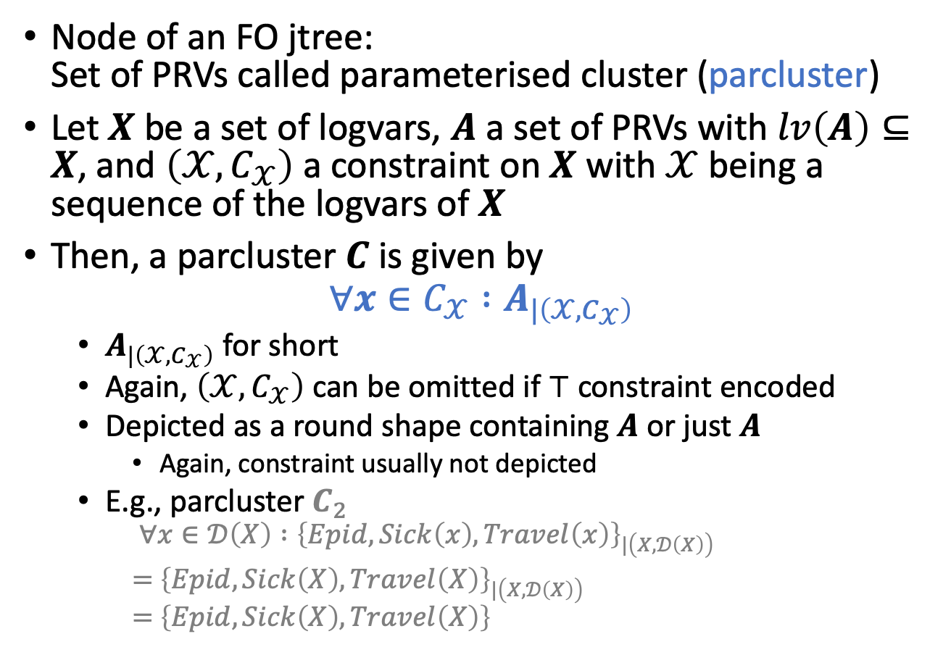


Parameterised Clusters
Node of an FO jtree:
Set of PRVs called parameterised cluster (parcluster)
Let $X$ be a set of logvars, $A$ a set of PRVs with $lv\left(A\right)⊆X$, and $\left(𝒳,C_{𝒳}\right)$ a constraint on $X$ with $𝒳$being a sequence of the logvars of $X$
Then, a parcluster $C$ is given by
$$∀x∈C_{𝒳} :A_{|\left(𝒳,C_{𝒳}\right)}$$
  $A_{|\left(𝒳,C_{𝒳}\right)}$ for short
  Again, $\left(𝒳,C_{𝒳}\right)$ can be omitted if $⊤$ constraint encoded
  Depicted as a round shape containing $A$ or just $A$
    Again, constraint usually not depicted
  E.g., parcluster $C_{2}$
    $$∀x∈𝒟\left(X\right) :{\left\{Epid,Sick\left(x\right),Travel\left(x\right)\right\}}_{|\left(X,𝒟\left(X\right)\right)}$$
    $=$ ${\left\{Epid,Sick\left(X\right),Travel\left(X\right)\right\}}_{|\left(X,𝒟\left(X\right)\right)}$
    $=$ $\left\{Epid,Sick\left(X\right),Travel\left(X\right)\right\}$
$$Epid Sick\left(X\right)$$
$$Travel\left(X\right)$$
$$Epid Sick\left(X\right)$$
$$Travel\left(X\right)$$
$$C_{2}$$

Slide 19
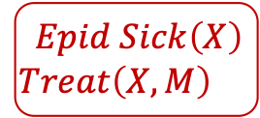
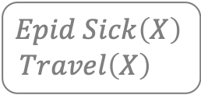

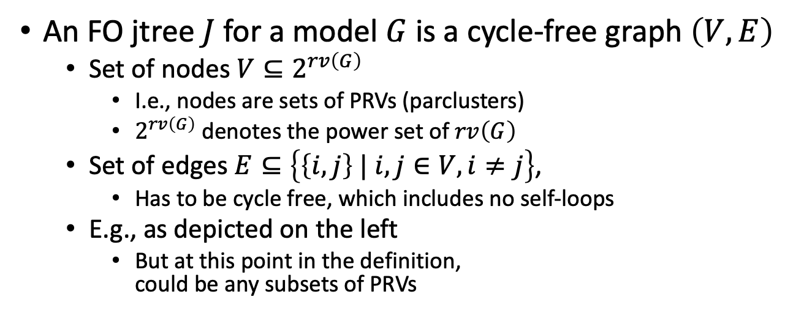


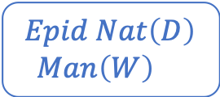
FO Jtree
An FO jtree $J$ for a model $G$ is a cycle-free graph $\left(V,E\right)$
  Set of nodes $V⊆2^{rv\left(G\right)}$
    I.e., nodes are sets of PRVs (parclusters)
    $2^{rv\left(G\right)}$ denotes the power set of $rv\left(G\right)$
  Set of edges $E⊆\left\{\left\{i,j\right\} | i,j∈V, i≠j\right\}$,
    Has to be cycle free, which includes no self-loops
  E.g., as depicted on the left
    But at this point in the definition,
    could be any subsets of PRVs
$$Nat\left(D\right)$$
$$Man\left(M\right)$$
$$g_{1}$$
$$Epid Nat\left(D\right)$$
$$Man\left(W\right)$$
$$Epid$$
$$C_{1}$$
$$Epid Sick\left(X\right)$$
$$Travel\left(X\right)$$
$$Travel\left(X\right)$$
$$Treat\left(X,P\right)$$
$$g_{2}$$
$$g_{3}$$
$$C_{2}$$
$$Sick\left(X\right)$$
$$Epid Sick\left(X\right)$$
$$Treat\left(X,M\right)$$
$$C_{3}$$

Slide 20




FO Jtree
An FO jtree $J$ for a model $G$ is a cycle-free graph $\left(V,E\right)$
  Has to satisfy three properties:
    $∀C∈V :C⊆rv\left(G\right)$
    $∀g∈G : ∃C∈V :rv\left(g\right)⊆C$
    If $∃A∈rv\left(G\right) :A∈C_{i} ∧A∈C_{j}$ with $C_{i},C_{j}∈V$, then
    $∀C_{k}∈V$ on the path between $C_{i},C_{j} :A∈C_{k}$
    (running intersection property)
  E.g., as depicted on the left
    Only the following and one with
    $C_{3}$ at the centre are valid
$$Nat\left(D\right)$$
$$Man\left(M\right)$$
$$g_{1}$$
$$Epid Nat\left(D\right)$$
$$Man\left(W\right)$$
$$Epid$$
$$C_{1}$$
$$g_{1}$$
$$Epid Sick\left(X\right)$$
$$Travel\left(X\right)$$
$$Travel\left(X\right)$$
$$Treat\left(X,P\right)$$
$$g_{2}$$
$$g_{3}$$
$$C_{2}$$
$$Sick\left(X\right)$$
$$g_{2}$$
$$Epid Sick\left(X\right)$$
$$Treat\left(X,M\right)$$
$$C_{3}$$
$$g_{3}$$

Slide 21
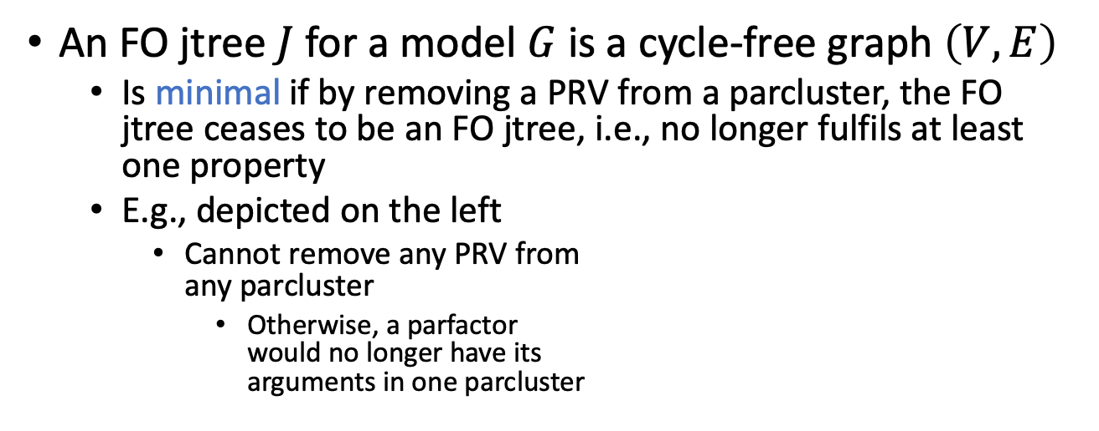
FO Jtree
An FO jtree $J$ for a model $G$ is a cycle-free graph $\left(V,E\right)$
  Is minimal if by removing a PRV from a parcluster, the FO jtree ceases to be an FO jtree, i.e., no longer fulfils at least one property
  E.g., depicted on the left
    Cannot remove any PRV from
    any parcluster
      Otherwise, a parfactor
      would no longer have its
      arguments in one parcluster
$$Nat\left(D\right)$$
$$Man\left(M\right)$$
$$g_{1}$$
$$Epid Nat\left(D\right)$$
$$Man\left(W\right)$$
$$Epid$$
$$C_{1}$$
$$g_{1}$$
$$Epid Sick\left(X\right)$$
$$Travel\left(X\right)$$
$$Travel\left(X\right)$$
$$Treat\left(X,P\right)$$
$$g_{2}$$
$$g_{3}$$
$$C_{2}$$
$$Sick\left(X\right)$$
$$g_{2}$$
$$Epid Sick\left(X\right)$$
$$Treat\left(X,M\right)$$
$$C_{3}$$
$$g_{3}$$

Slide 22
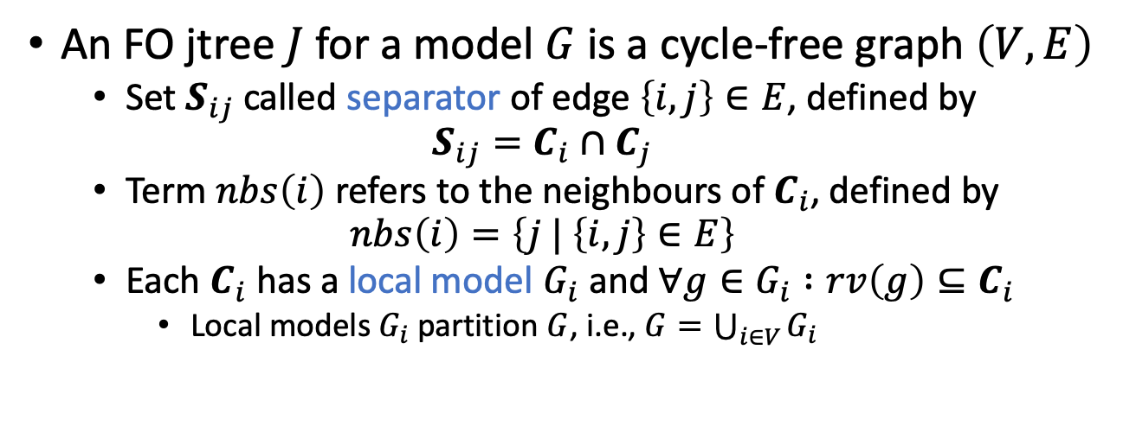
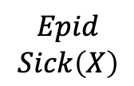
FO Jtree
An FO jtree $J$ for a model $G$ is a cycle-free graph $\left(V,E\right)$
  Set $S_{ij}$ called separator of edge $\left\{i,j\right\}∈E$, defined by
  $$S_{ij}=C_{i}∩C_{j}$$
  Term $nbs\left(i\right)$ refers to the neighbours of $C_{i}$, defined by
  $$nbs\left(i\right)=\left\{j | \left\{i,j\right\}∈E\right\}$$
  Each $C_{i}$ has a local model $G_{i}$ and $∀g∈G_{i} :rv\left(g\right)⊆C_{i}$
    Local models $G_{i}$ partition $G$, i.e., $G=\bigcup_{i∈V}{G_{i}}$
$$Nat\left(D\right)$$
$$Man\left(M\right)$$
$$g_{1}$$
$$Epid Nat\left(D\right)$$
$$Man\left(W\right)$$
$$Epid$$
$$C_{1}$$
$$g_{1}$$
$$Epid$$
$$Epid Sick\left(X\right)$$
$$Travel\left(X\right)$$
$$Travel\left(X\right)$$
$$Treat\left(X,P\right)$$
$$g_{2}$$
$$g_{3}$$
$$C_{2}$$
$$Sick\left(X\right)$$
$$g_{2}$$
$$Epid$$
$$Sick\left(X\right)$$
$$Epid Sick\left(X\right)$$
$$Treat\left(X,M\right)$$
$$C_{3}$$
$$g_{3}$$

Slide 23






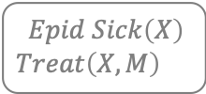









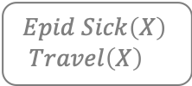









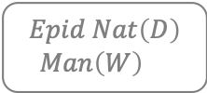


















Construction
Where do we get the
FO jtree from s.t. the jtree
  is acyclic
  fulfils the three FO jtree properties
  has the model parfactors automatically assigned to
  fitting parclusters?
Clusters of an FO dtree
+ undirected dtree edges
+ minimisation
= FO jtree
$$Nat(D)$$
$$Man(W)$$
$$g_{1}$$
$$Epid$$
$$Travel(X)$$
$$Treat(X,M)$$
$$g_{2}$$
$$g_{3}$$
$$Sick(X)$$
$$Epid$$
$$∅$$
$$Nat\left(D\right)$$
$$∀w :⊤$$
$$∀x :⊤$$
$$∅$$
$$Epid$$
$$Epid$$
$$Man\left(w\right)$$
$$Sick\left(x\right)$$
$$Epid$$
$$Nat\left(D\right),Epid$$
$$∅$$
$$∀d:⊤$$
$$∅$$
$$Man\left(w\right)$$
$$Nat\left(D\right),Epid$$
$$Sick\left(x\right)$$
$$Epid$$
$$∀m :⊤$$
$$Epid Nat\left(D\right)$$
$$Man\left(W\right)$$
$$Epid Sick\left(X\right)$$
$$Travel\left(X\right)$$
$$Epid Sick\left(X\right)$$
$$Treat\left(X,M\right)$$
$$∅$$
$$Treat\left(x,m\right)$$
$$Travel\left(x\right)$$
$$Man\left(w\right)$$
$$Nat\left(d\right),Epid$$
$$Sick\left(x\right)$$
$$Epid$$
$$Sick\left(x\right)$$
$$Epid$$
$$C_{1}$$
$$C_{2}$$
$$C_{3}$$
$$g_{1}$$
$$g_{2}$$
$$g_{3}$$
$$g_{1}$$
$$g_{3}$$
$$g_{2}$$

Slide 24



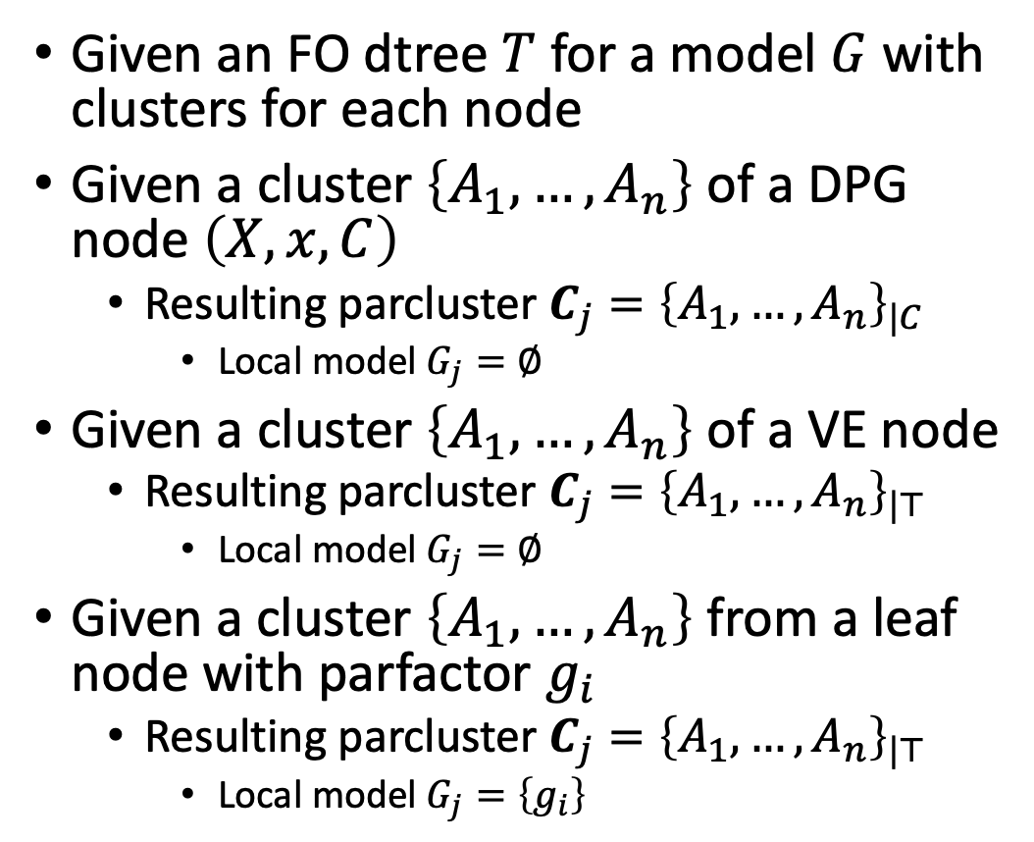





Clusters ➝ Parclusters
Given an FO dtree $T$ for a model $G$ with clusters for each node
Given a cluster $\left\{A_{1},…,A_{n}\right\}$ of a DPG node $\left(X,x,C\right)$
  Resulting parcluster $C_{j}={\left\{A_{1},…,A_{n}\right\}}_{|C}$
    Local model $G_{j}=∅$
Given a cluster $\left\{A_{1},…,A_{n}\right\}$ of a VE node
  Resulting parcluster $C_{j}={\left\{A_{1},…,A_{n}\right\}}_{|⊤}$
    Local model $G_{j}=∅$
Given a cluster $\left\{A_{1},…,A_{n}\right\}$ from a leaf node with parfactor $g_{i}$
  Resulting parcluster $C_{j}={\left\{A_{1},…,A_{n}\right\}}_{|⊤}$
    Local model $G_{j}=\left\{g_{i}\right\}$
Let’s carry the constraint around for a bit to make it explicit
$$∀x :⊤$$
$$Epid$$
$$Epid_{|⊤}$$
$$Sick\left(x\right)$$
$$Epid$$
$$Epid,Sick\left(x\right)$$
$$g_{2}$$
$$Epid,Sick\left(x\right),$$
$$Travel\left(x\right)$$
$$g_{2}$$

Slide 25
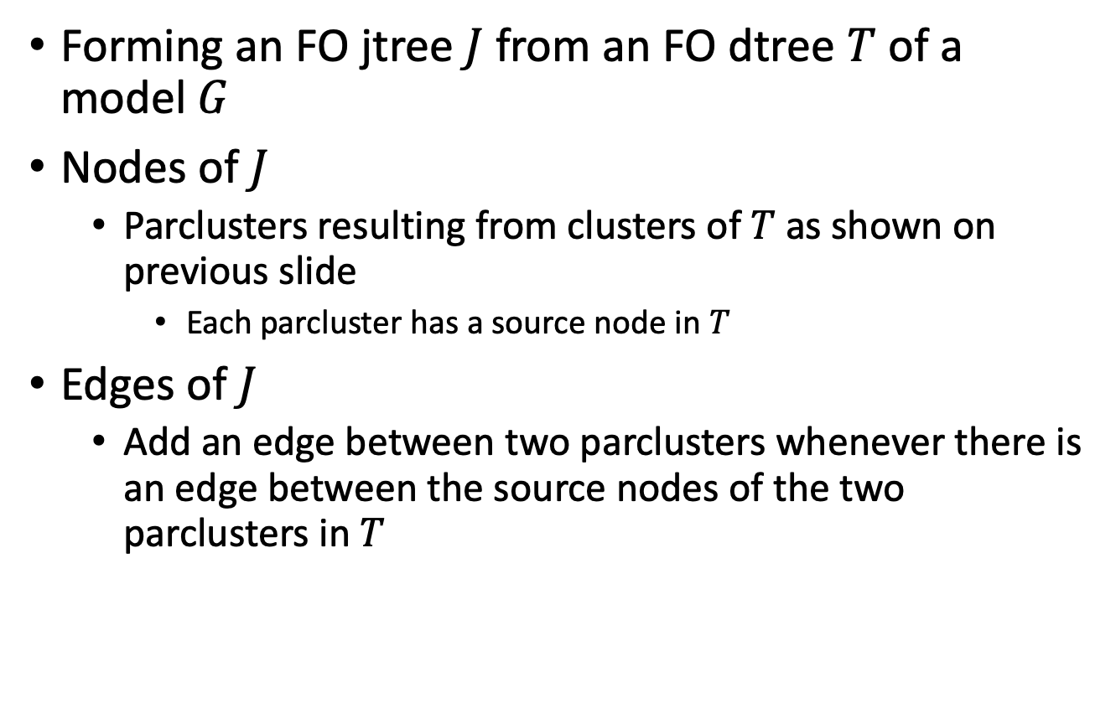
FO Dtree ➝ FO Jtree
Forming an FO jtree $J$ from an FO dtree $T$ of a model $G$
Nodes of $J$
  Parclusters resulting from clusters of $T$ as shown on previous slide
    Each parcluster has a source node in $T$
Edges of $J$
  Add an edge between two parclusters whenever there is an edge between the source nodes of the two parclusters in $T$

Slide 26



































FO Dtree ➝ FO Jtree
Result after transformation
  Fulfils the three jtree properties
  But is not minimal
$$Epid$$
$$Epid$$
$$∅$$
$$Nat\left(D\right)$$
$$∀w :⊤$$
$$∀x :⊤$$
$$∅$$
$$Epid,Nat{\left(D\right)}_{|⊤}$$
$$Epid_{|⊤}$$
$$Epid$$
$$Epid$$
$$Man\left(w\right)$$
$$Sick\left(x\right)$$
$$Epid$$
$$Epid,Nat\left(D\right), Man\left(w\right)$$
$$Epid,Sick\left(x\right)$$
$$Nat\left(D\right),Epid$$
$$∅$$
$$∀d:⊤$$
$$∅$$
$$Epid,Man\left(w\right),Nat{\left(D\right)}_{|⊤}$$
$$Epid,Sick{\left(x\right)}_{|⊤}$$
$$Man\left(w\right)$$
$$Nat\left(D\right),Epid$$
$$Sick\left(x\right)$$
$$Epid$$
$$∀m :⊤$$
$$∅$$
$$Treat\left(x,m\right)$$
$$Travel\left(x\right)$$
$$Epid,Nat\left(d\right), Man\left(w\right)$$
$$Epid,Sick\left(x\right),$$
$$Treat\left(x,m\right)$$
$$Epid,Sick\left(x\right),$$
$$Travel\left(x\right)$$
$$Man\left(w\right)$$
$$Nat\left(d\right),Epid$$
$$Sick\left(x\right)$$
$$Epid$$
$$Sick\left(x\right)$$
$$Epid$$
$$g_{1}$$
$$g_{3}$$
$$g_{2}$$
$$Epid,Nat\left(d\right),Man\left(w\right)$$
$$Epid,Sick\left(x\right),$$
$$Treat\left(x,m\right)$$
$$Epid,Sick\left(x\right),$$
$$Travel\left(x\right)$$
$$g_{1}$$
$$g_{3}$$
$$g_{2}$$

Slide 27



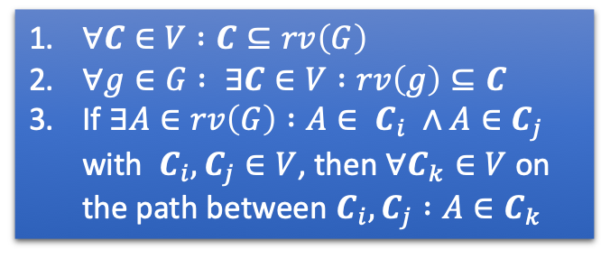



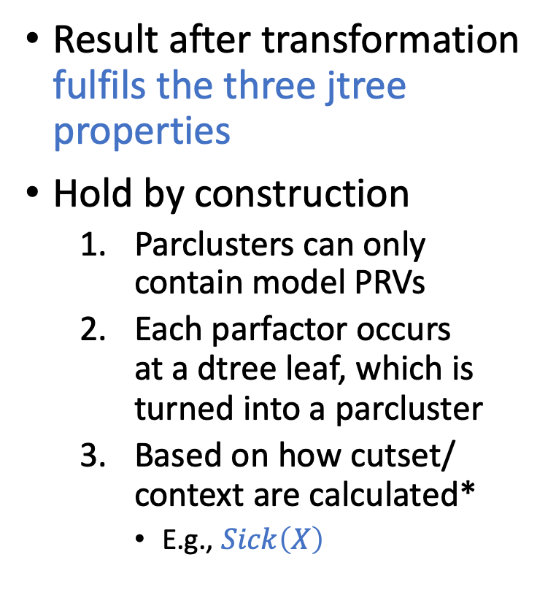










FO Dtree ➝ FO Jtree
Result after transformation fulfils the three jtree properties
Hold by construction
  Parclusters can only
  contain model PRVs
  Each parfactor occurs
  at a dtree leaf, which is
  turned into a parcluster
  Based on how cutset/
  context are calculated*
    E.g., $Sick\left(X\right)$
  $∀C∈V :C⊆rv\left(G\right)$
  $∀g∈G : ∃C∈V :rv\left(g\right)⊆C$
  If $∃A∈rv\left(G\right) :A∈ C_{i} ∧A∈C_{j}$ with $C_{i},C_{j}∈V$, then $∀C_{k}∈V$ on the path between $C_{i},C_{j} :A∈C_{k}$
$$Epid$$
$$Epid,Nat{\left(D\right)}_{|⊤}$$
$$Epid_{|⊤}$$
$$Epid,Nat\left(D\right), Man\left(w\right)$$
$$Epid,Sick\left(x\right)$$
$$Epid,Man\left(w\right),Nat{\left(D\right)}_{|⊤}$$
$$Epid,Sick{\left(x\right)}_{|⊤}$$
$$Epid,Nat\left(d\right), Man\left(w\right)$$
$$Epid,Sick\left(x\right),$$
$$Treat\left(x,m\right)$$
$$Epid,Sick\left(x\right),$$
$$Travel\left(x\right)$$
* Proof for jtrees: Adnan Darwiche: Recursive Conditioning.
In: Artificial Intelligence, 2001.
Proof for FO jtrees: Tanya B: Rescued from a Sea of
Queries: Exact Inference in Probabilistic Relational
Models. PhD thesis, 2020.
$$Epid,Nat\left(d\right),Man\left(w\right)$$
$$Epid,Sick\left(x\right),$$
$$Treat\left(x,m\right)$$
$$Epid,Sick\left(x\right),$$
$$Travel\left(x\right)$$
$$g_{1}$$
$$g_{3}$$
$$g_{2}$$

Slide 28






FO Dtree ➝ FO Jtree
Result after transformation not minimal
  Can remove complete parclusters
  and still have an FO jtree
    Even if we keep parclusters
    that carry constraint
    information that
    we would otherwise lose
  E.g.,
    Parclusters marked
Observation
  Parclusters are
  subsets of other
  parclusters
    Use for minimisation
$$Epid$$
$$Epid,Nat{\left(D\right)}_{|⊤}$$
$$Epid_{|⊤}$$
$$Epid,Nat\left(D\right), Man\left(w\right)$$
$$Epid,Sick\left(x\right)$$
$$Epid,Man\left(w\right),Nat{\left(D\right)}_{|⊤}$$
$$Epid,Sick{\left(x\right)}_{|⊤}$$
$$Epid,Nat\left(d\right), Man\left(w\right)$$
$$Epid,Sick\left(x\right),$$
$$Treat\left(x,m\right)$$
$$Epid,Sick\left(x\right),$$
$$Travel\left(x\right)$$
$$Epid,Nat\left(d\right),Man\left(w\right)$$
$$Epid,Sick\left(x\right),$$
$$Treat\left(x,m\right)$$
$$Epid,Sick\left(x\right),$$
$$Travel\left(x\right)$$
$$g_{1}$$
$$g_{3}$$
$$g_{2}$$

Slide 29
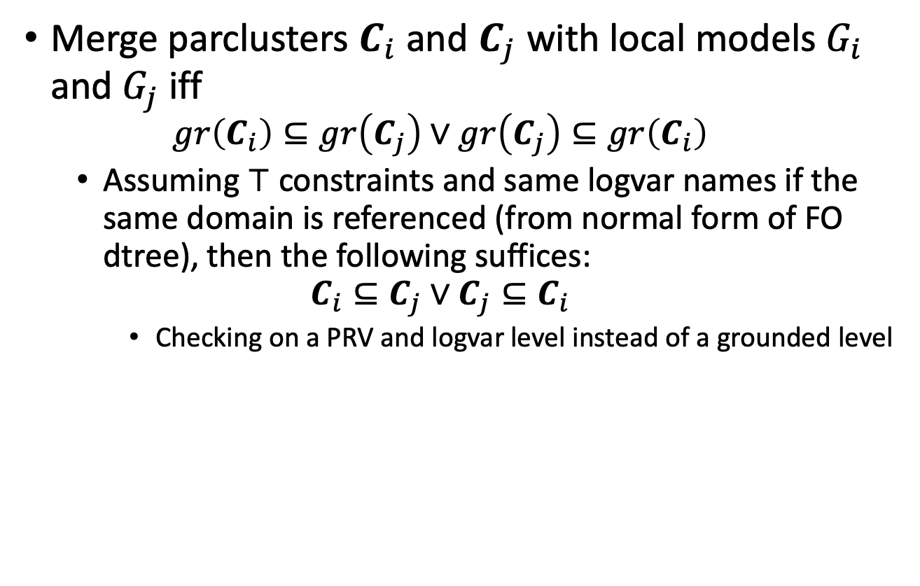
Minimisation
Merge parclusters $C_{i}$ and $C_{j}$ with local models $G_{i}$ and $G_{j}$ iff
  $$gr\left(C_{i}\right)⊆gr\left(C_{j}\right)∨gr\left(C_{j}\right)⊆gr\left(C_{i}\right)$$
  Assuming $⊤$ constraints and same logvar names if the same domain is referenced (from normal form of FO dtree), then the following suffices:
  $$C_{i}⊆C_{j}∨C_{j}⊆C_{i}$$
    Checking on a PRV and logvar level instead of a grounded level

Slide 30



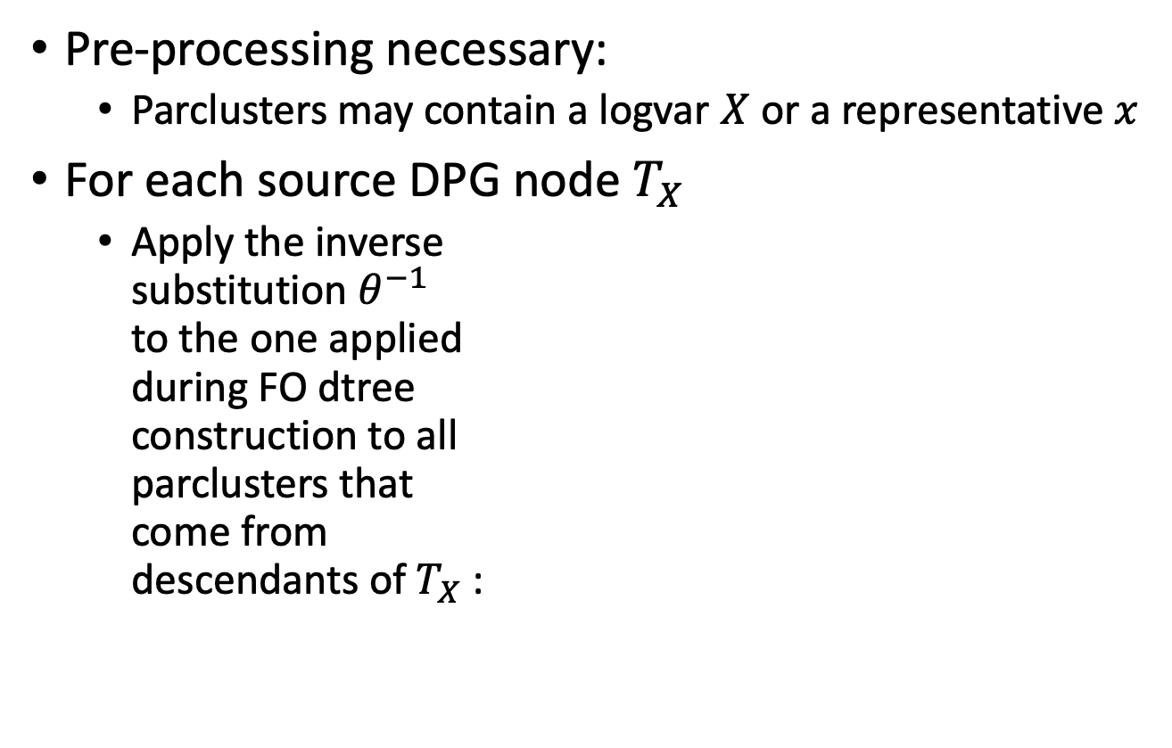





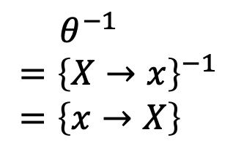
Minimisation
Pre-processing necessary:
  Parclusters may contain a logvar $X$ or a representative $x$
For each source DPG node $T_{X}$
  Apply the inverse
  substitution $θ^{−1}$
  to the one applied
  during FO dtree
  construction to all
  parclusters that
  come from
  descendants of $T_{X}$:
root
$$Epid$$
$$T_{W}$$
$$Epid,Nat{\left(D\right)}_{|⊤}$$
$$T_{X}$$
$$Epid_{|⊤}$$
$$T_{w}$$
$$Epid,Nat\left(D\right), Man\left(w\right)$$
$$T_{x}$$
$$Epid,Sick\left(x\right)$$
$$T_{D}$$
$$Epid,Man\left(w\right),Nat{\left(D\right)}_{|⊤}$$
$$T_{M}$$
$$Epid,Sick{\left(x\right)}_{|⊤}$$
$$T_{d}$$
$$Epid,Nat\left(d\right), Man\left(w\right)$$
$$T_{m}$$
$$Epid,Sick\left(x\right),$$
$$Treat\left(x,m\right)$$
$$Epid,Sick\left(x\right),$$
$$Travel\left(x\right)$$
$$θ^{−1} \\ ={\left\{X→x\right\}}^{−1} \\ =\left\{x→X\right\}$$
$$Epid,Nat\left(d\right),Man\left(w\right)$$
$$Epid,Sick\left(x\right),$$
$$Treat\left(x,m\right)$$
$$Epid,Sick\left(x\right),$$
$$Travel\left(x\right)$$
$$g_{1}$$
$$g_{3}$$
$$g_{2}$$

Slide 31
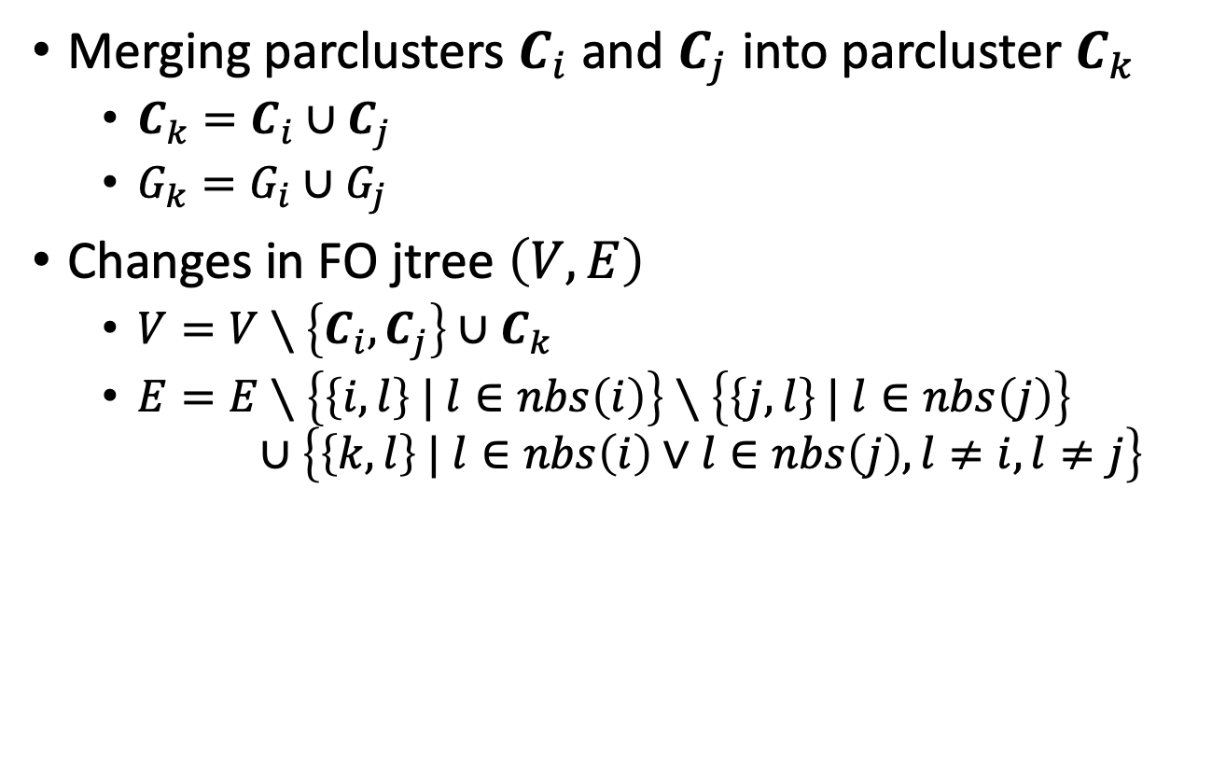
Minimisation
Merging parclusters $C_{i}$ and $C_{j}$ into parcluster $C_{k}$
  $C_{k}=C_{i}∪C_{j}$
  $G_{k}=G_{i}∪G_{j}$
Changes in FO jtree $\left(V,E\right)$
  $V=V∖\left\{C_{i},C_{j}\right\}∪C_{k}$
  $E=E∖\left\{\left\{i,l\right\} | l∈nbs\left(i\right)\right\}∖\left\{\left\{j,l\right\} | l∈nbs\left(j\right)\right\}$
  $∪\left\{\left\{k,l\right\} | l∈nbs\left(i\right)∨l∈nbs\left(j\right),l≠i,l≠j\right\}$

Slide 32




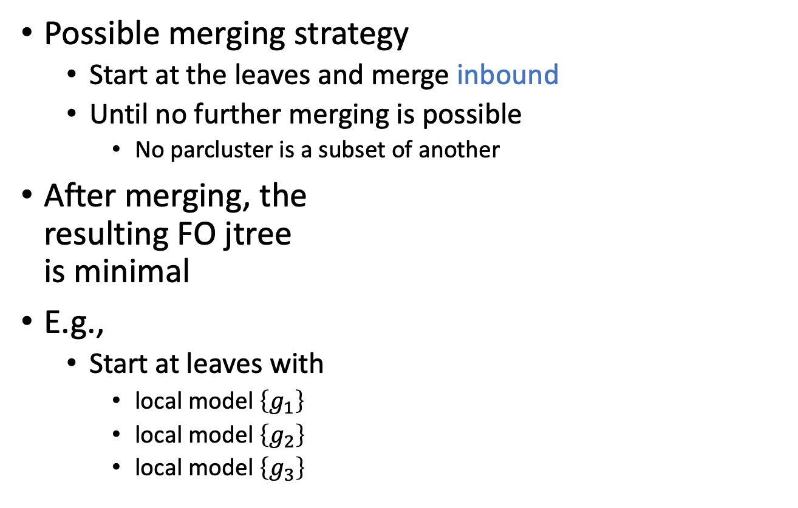






Minimisation
Possible merging strategy
  Start at the leaves and merge inbound
  Until no further merging is possible
    No parcluster is a subset of another
After merging, the
resulting FO jtree
is minimal
E.g.,
  Start at leaves with
    local model $\left\{g_{1}\right\}$
    local model $\left\{g_{2}\right\}$
    local model $\left\{g_{3}\right\}$
root
$$Epid$$
$$T_{W}$$
$$Epid,Nat{\left(D\right)}_{|⊤}$$
$$T_{X}$$
$$Epid_{|⊤}$$
$$T_{w}$$
$$Epid,Nat\left(D\right), Man\left(W\right)$$
$$T_{x}$$
$$Epid,Sick\left(X\right)$$
$$T_{D}$$
$$Epid,Man\left(W\right),Nat{\left(D\right)}_{|⊤}$$
$$T_{M}$$
$$Epid,Sick{\left(X\right)}_{|⊤}$$
$$T_{d}$$
$$Epid,Nat\left(D\right), Man\left(W\right)$$
$$T_{m}$$
$$Epid,Sick\left(X\right),$$
$$Treat\left(X,M\right)$$
$$Epid,Sick\left(X\right),$$
$$Travel\left(X\right)$$
$$Epid,Nat\left(D\right),Man\left(W\right)$$
$$Epid,Sick\left(X\right),$$
$$Treat\left(X,M\right)$$
$$Epid,Sick\left(X\right),$$
$$Travel\left(X\right)$$
$$g_{1}$$
$$g_{3}$$
$$g_{2}$$

Slide 33


Minimisation: Example Continued
Consider leaf parcluster with local model $\left\{g_{1}\right\}$
  Let us call it $C_{1}$
  Merge inbound
    $C_{1}$ and $T_{d}$ parcluster
    identical ➝ merge
    (call result $C_{1}$again)
root
$$Epid$$
$$T_{W}$$
$$Epid,Nat{\left(D\right)}_{|⊤}$$
$$T_{X}$$
$$Epid_{|⊤}$$
$$T_{w}$$
$$Epid,Nat\left(D\right), Man\left(W\right)$$
$$T_{x}$$
$$Epid,Sick\left(X\right)$$
$$T_{D}$$
$$Epid,Man\left(W\right),Nat{\left(D\right)}_{|⊤}$$
$$T_{M}$$
$$Epid,Sick{\left(X\right)}_{|⊤}$$
$$T_{d}$$
$$Epid,Nat\left(D\right), Man\left(W\right)$$
$$T_{m}$$
$$Epid,Sick\left(X\right),$$
$$Treat\left(X,M\right)$$
$$Epid,Sick\left(X\right),$$
$$Travel\left(X\right)$$
$$C_{1}$$
$$Epid,Nat\left(D\right),Man\left(W\right)$$
$$Epid,Sick\left(X\right),$$
$$Treat\left(X,M\right)$$
$$Epid,Sick\left(X\right),$$
$$Travel\left(X\right)$$
$$g_{1}$$
$$g_{3}$$
$$g_{2}$$

Slide 34



Minimisation: Example Continued
Consider leaf parcluster with local model $\left\{g_{1}\right\}$
  Let us call it $C_{1}$
  Merge inbound
    $C_{1}$ and $T_{d}$ parcluster
    identical ➝ merge
    (call result $C_{1}$again)
    $C_{1}$ and $T_{D}$ parcluster
    identical ➝ merge
root
$$Epid$$
$$T_{W}$$
$$Epid,Nat{\left(D\right)}_{|⊤}$$
$$T_{X}$$
$$Epid_{|⊤}$$
$$T_{w}$$
$$Epid,Nat\left(D\right), Man\left(W\right)$$
$$T_{x}$$
$$Epid,Sick\left(X\right)$$
$$T_{D}$$
$$Epid,Man\left(W\right),Nat{\left(D\right)}_{|⊤}$$
$$T_{M}$$
$$Epid,Sick{\left(X\right)}_{|⊤}$$
$$C_{1}$$
$$Epid,Nat\left(D\right), Man\left(W\right)$$
$$T_{m}$$
$$Epid,Sick\left(X\right),$$
$$Treat\left(X,M\right)$$
$$Epid,Sick\left(X\right),$$
$$Travel\left(X\right)$$
$$g_{1}$$
$$Epid,Sick\left(X\right),$$
$$Treat\left(X,M\right)$$
$$Epid,Sick\left(X\right),$$
$$Travel\left(X\right)$$
$$g_{3}$$
$$g_{2}$$

Slide 35



Minimisation: Example Continued
Consider leaf parcluster with local model $\left\{g_{1}\right\}$
  Let us call it $C_{1}$
  Merge inbound
    $C_{1}$ and $T_{d}$ parcluster
    identical ➝ merge
    (call result $C_{1}$again)
    $C_{1}$ and $T_{D}$ parcluster
    identical ➝ merge
    $C_{1}$ and $T_{w}$ parcluster
    identical ➝ merge
root
$$Epid$$
$$T_{W}$$
$$Epid,Nat{\left(D\right)}_{|⊤}$$
$$T_{X}$$
$$Epid_{|⊤}$$
$$T_{w}$$
$$Epid,Nat\left(D\right), Man\left(W\right)$$
$$T_{x}$$
$$Epid,Sick\left(X\right)$$
$$C_{1}$$
$$Epid,Man\left(W\right),Nat{\left(D\right)}_{|⊤}$$
$$T_{M}$$
$$Epid,Sick{\left(X\right)}_{|⊤}$$
$$g_{1}$$
$$T_{m}$$
$$Epid,Sick\left(X\right),$$
$$Treat\left(X,M\right)$$
$$Epid,Sick\left(X\right),$$
$$Travel\left(X\right)$$
$$Epid,Sick\left(X\right),$$
$$Treat\left(X,M\right)$$
$$Epid,Sick\left(X\right),$$
$$Travel\left(X\right)$$
$$g_{3}$$
$$g_{2}$$

Slide 36


Minimisation: Example Continued
Consider leaf parcluster with local model $\left\{g_{1}\right\}$
  Let us call it $C_{1}$
  Merge inbound
    $C_{1}$ and $T_{d}$ parcluster
    identical ➝ merge
    (call result $C_{1}$again)
    $C_{1}$ and $T_{D}$ parcluster
    identical ➝ merge
    $C_{1}$ and $T_{w}$ parcluster
    identical ➝ merge
    $T_{W}$ parcluster subset
    of $C_{1}$ ➝ merge
root
$$Epid$$
$$T_{W}$$
$$Epid,Nat{\left(D\right)}_{|⊤}$$
$$T_{X}$$
$$Epid_{|⊤}$$
$$C_{1}$$
$$Epid,Nat\left(D\right), Man\left(W\right)$$
$$T_{x}$$
$$Epid,Sick\left(X\right)$$
$$g_{1}$$
$$T_{M}$$
$$Epid,Sick{\left(X\right)}_{|⊤}$$
$$T_{m}$$
$$Epid,Sick\left(X\right),$$
$$Treat\left(X,M\right)$$
$$Epid,Sick\left(X\right),$$
$$Travel\left(X\right)$$
$$Epid,Sick\left(X\right),$$
$$Treat\left(X,M\right)$$
$$Epid,Sick\left(X\right),$$
$$Travel\left(X\right)$$
$$g_{3}$$
$$g_{2}$$

Slide 37

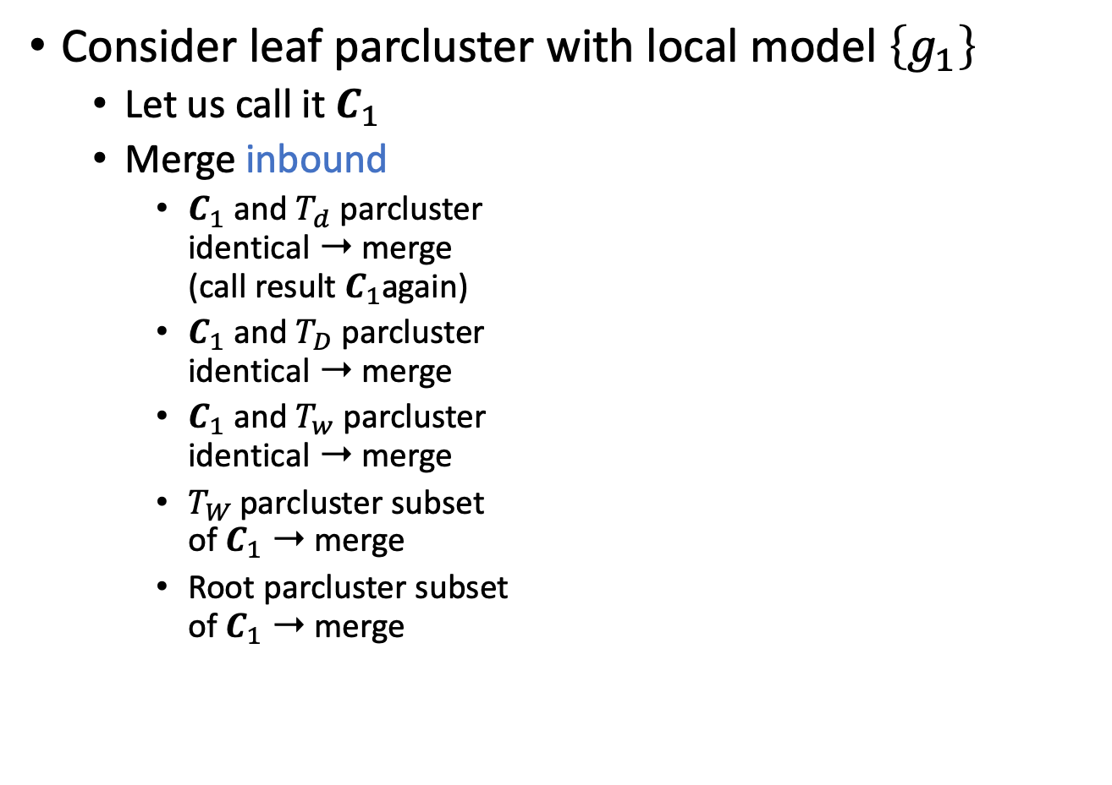


Minimisation: Example Continued
Consider leaf parcluster with local model $\left\{g_{1}\right\}$
  Let us call it $C_{1}$
  Merge inbound
    $C_{1}$ and $T_{d}$ parcluster
    identical ➝ merge
    (call result $C_{1}$again)
    $C_{1}$ and $T_{D}$ parcluster
    identical ➝ merge
    $C_{1}$ and $T_{w}$ parcluster
    identical ➝ merge
    $T_{W}$ parcluster subset
    of $C_{1}$ ➝ merge
    Root parcluster subset
    of $C_{1}$ ➝ merge
root
$$Epid$$
$$C_{1}$$
$${Epid,Nat\left(D\right),Man\left(W\right)}_{|⊤}$$
$$T_{X}$$
$$Epid_{|⊤}$$
$$g_{1}$$
$$T_{x}$$
$$Epid,Sick\left(X\right)$$
$$T_{M}$$
$$Epid,Sick{\left(X\right)}_{|⊤}$$
$$T_{m}$$
$$Epid,Sick\left(X\right),$$
$$Treat\left(X,M\right)$$
$$Epid,Sick\left(X\right),$$
$$Travel\left(X\right)$$
$$Epid,Sick\left(X\right),$$
$$Treat\left(X,M\right)$$
$$Epid,Sick\left(X\right),$$
$$Travel\left(X\right)$$
$$g_{3}$$
$$g_{2}$$

Slide 38



Minimisation: Example Continued
Consider leaf parcluster with local model $\left\{g_{1}\right\}$
  Let us call it $C_{1}$
  Merge inbound
    $C_{1}$ and $T_{d}$ parcluster
    identical ➝ merge
    (call result $C_{1}$again)
    $C_{1}$ and $T_{D}$ parcluster
    identical ➝ merge
    $C_{1}$ and $T_{w}$ parcluster
    identical ➝ merge
    $T_{W}$ parcluster subset
    of $C_{1}$ ➝ merge
    Root parcluster subset
    of $C_{1}$ ➝ merge
$${Epid,Nat\left(D\right),Man\left(W\right)}_{|⊤}$$
$$C_{1}$$
$$g_{1}$$
$$T_{X}$$
$$Epid_{|⊤}$$
$$T_{x}$$
$$Epid,Sick\left(X\right)$$
$$T_{M}$$
$$Epid,Sick{\left(X\right)}_{|⊤}$$
$$T_{m}$$
$$Epid,Sick\left(X\right),$$
$$Treat\left(X,M\right)$$
$$Epid,Sick\left(X\right),$$
$$Travel\left(X\right)$$
$$Epid,Sick\left(X\right),$$
$$Treat\left(X,M\right)$$
$$Epid,Sick\left(X\right),$$
$$Travel\left(X\right)$$
$$g_{3}$$
$$g_{2}$$

Slide 39


Minimisation: Example Continued
Consider leaf parcluster with local model $\left\{g_{1}\right\}$
  Let us call it $C_{1}$
  At this point, we have reached
  the former root and cannot
  merge further inbound
    Also: the $T_{X}$ parcluster
    contains logvar $X$, which is not
    a subset or superset of the
    logvars of $C_{1}$ ($D,W$)
  Merging stops
$$C_{1}$$
$${Epid,Nat\left(D\right),Man\left(W\right)}_{|⊤}$$
$$g_{1}$$
$$T_{X}$$
$$Epid_{|⊤}$$
$$T_{x}$$
$$Epid,Sick\left(X\right)$$
$$T_{M}$$
$$Epid,Sick{\left(X\right)}_{|⊤}$$
$$T_{m}$$
$$Epid,Sick\left(X\right),$$
$$Treat\left(X,M\right)$$
$$Epid,Sick\left(X\right),$$
$$Travel\left(X\right)$$
$$Epid,Sick\left(X\right),$$
$$Treat\left(X,M\right)$$
$$Epid,Sick\left(X\right),$$
$$Travel\left(X\right)$$
$$g_{3}$$
$$g_{2}$$

Slide 40


Minimisation: Example Continued
Consider leaf parcluster with local model $\left\{g_{2}\right\}$
  Let us call it $C_{2}$
  Merge inbound
    $C_{2}$ and neighbouring parcluster
    identical ➝ merge
$$C_{1}$$
$${Epid,Nat\left(D\right),Man\left(W\right)}_{|⊤}$$
$$g_{1}$$
$$T_{X}$$
$$Epid_{|⊤}$$
$$T_{x}$$
$$Epid,Sick\left(X\right)$$
$$T_{M}$$
$$Epid,Sick{\left(X\right)}_{|⊤}$$
$$T_{m}$$
$$Epid,Sick\left(X\right),$$
$$Treat\left(X,M\right)$$
$$Epid,Sick\left(X\right),$$
$$Travel\left(X\right)$$
$$Epid,Sick\left(X\right),$$
$$Treat\left(X,M\right)$$
$$Epid,Sick\left(X\right),$$
$$Travel\left(X\right)$$
$$g_{3}$$
$$C_{2}$$
$$g_{2}$$

Slide 41



Minimisation: Example Continued
Consider leaf parcluster with local model $\left\{g_{2}\right\}$
  Let us call it $C_{2}$
  Merge inbound
    $C_{2}$ and neighbouring parcluster
    identical ➝ merge
    $T_{x}$ parcluster is a subset of $C_{2}$
    ➝ merge
$$C_{1}$$
$${Epid,Nat\left(D\right),Man\left(W\right)}_{|⊤}$$
$$g_{1}$$
$$T_{X}$$
$$Epid_{|⊤}$$
$$T_{x}$$
$$Epid,Sick\left(X\right)$$
$$T_{M}$$
$$Epid,Sick{\left(X\right)}_{|⊤}$$
$$T_{m}$$
$$Epid,Sick\left(X\right),$$
$$Treat\left(X,M\right)$$
$$Epid,Sick\left(X\right),$$
$$Travel\left(X\right)$$
$$C_{2}$$
$$g_{2}$$
$$Epid,Sick\left(X\right),$$
$$Treat\left(X,M\right)$$
$$g_{3}$$

Slide 42




Minimisation: Example Continued
Consider leaf parcluster with local model $\left\{g_{2}\right\}$
  Let us call it $C_{2}$
  Merge inbound
    $C_{2}$ and neighbouring parcluster
    identical ➝ merge
    $T_{x}$ parcluster is a subset of $C_{2}$
    ➝ merge
    $T_{X}$ parcluster is a subset of $C_{2}$
    ➝ merge
$$C_{1}$$
$${Epid,Nat\left(D\right),Man\left(W\right)}_{|⊤}$$
$$g_{1}$$
$$T_{X}$$
$$Epid_{|⊤}$$
$$C_{2}$$
$$Epid,Sick\left(X\right),Travel\left(X\right)$$
$$g_{2}$$
$$T_{M}$$
$$Epid,Sick{\left(X\right)}_{|⊤}$$
$$T_{m}$$
$$Epid,Sick\left(X\right),$$
$$Treat\left(X,M\right)$$
$$Epid,Sick\left(X\right),$$
$$Treat\left(X,M\right)$$
$$g_{3}$$

Slide 43




Minimisation: Example Continued
Consider leaf parcluster with local model $\left\{g_{2}\right\}$
  Let us call it $C_{2}$
  Merge inbound
    $C_{2}$ and neighbouring parcluster
    identical ➝ merge
    $T_{x}$ parcluster is a subset of $C_{2}$
    ➝ merge
    $T_{X}$ parcluster is a subset of $C_{2}$
    ➝ merge
  Merging cannot move further
  inbound
    $C_{1}$ is neither a subset nor a
    superset of $C_{2}$
    Merging stops
$$C_{1}$$
$${Epid,Nat\left(D\right),Man\left(W\right)}_{|⊤}$$
$$g_{1}$$
$$C_{2}$$
$${Epid,Sick\left(X\right),Travel\left(X\right)}_{|⊤}$$
$$g_{2}$$
$$T_{M}$$
$$Epid,Sick{\left(X\right)}_{|⊤}$$
$$T_{m}$$
$$Epid,Sick\left(X\right),$$
$$Treat\left(X,M\right)$$
$$Epid,Sick\left(X\right),$$
$$Treat\left(X,M\right)$$
$$g_{3}$$

Slide 44


Minimisation: Example Continued
Consider leaf parcluster with local model $\left\{g_{3}\right\}$
  Let us call it $C_{3}$
  Merge inbound
    $C_{3}$ and $T_{m}$ parcluster identical
    ➝ merge
$$C_{1}$$
$${Epid,Nat\left(D\right),Man\left(W\right)}_{|⊤}$$
$$g_{1}$$
$$C_{2}$$
$${Epid,Sick\left(X\right),Travel\left(X\right)}_{|⊤}$$
$$g_{2}$$
$$T_{M}$$
$$Epid,Sick{\left(X\right)}_{|⊤}$$
$$T_{m}$$
$$Epid,Sick\left(X\right),$$
$$Treat\left(X,M\right)$$
$$C_{3}$$
$$Epid,Sick\left(X\right),$$
$$Treat\left(X,M\right)$$
$$g_{3}$$

Slide 45



Minimisation: Example Continued
Consider leaf parcluster with local model $\left\{g_{3}\right\}$
  Let us call it $C_{3}$
  Merge inbound
    $C_{3}$ and $T_{m}$ parcluster identical
    ➝ merge
    $T_{m}$ parcluster is a subset of $C_{3}$
    ➝ merge
$$C_{1}$$
$${Epid,Nat\left(D\right),Man\left(W\right)}_{|⊤}$$
$$g_{1}$$
$$C_{2}$$
$${Epid,Sick\left(X\right),Travel\left(X\right)}_{|⊤}$$
$$g_{2}$$
$$T_{M}$$
$$Epid,Sick{\left(X\right)}_{|⊤}$$
$$C_{3}$$
$$Epid,Sick\left(X\right),$$
$$Treat\left(X,M\right)$$
$$g_{3}$$

Slide 46




Minimisation: Example Continued
Consider leaf parcluster with local model $\left\{g_{3}\right\}$
  Let us call it $C_{3}$
  Merge inbound
    $C_{3}$ and $T_{m}$ parcluster identical
    ➝ merge
    $T_{m}$ parcluster is a subset of $C_{3}$
    ➝ merge
  Merging cannot move further
  inbound
    $C_{3}$ is neither a subset nor a
    superset of $C_{2}$
    Merging stops
$$C_{1}$$
$${Epid,Nat\left(D\right),Man\left(W\right)}_{|⊤}$$
$$g_{1}$$
$$C_{2}$$
$${Epid,Sick\left(X\right),Travel\left(X\right)}_{|⊤}$$
$$g_{2}$$
$$C_{3}$$
$${Epid,Sick\left(X\right),Treat\left(X,M\right)}_{|⊤}$$
$$g_{3}$$

Slide 47

Minimisation: Example Continued
Resulting FO jtree $J$ from FO dtree $T$ given model $G$
  If we had started merging from leaf with $g_{3}$ inbound before merging from leaf with $g_{2}$, $C_{2}$ and $C_{3}$ would be switched
$$Epid$$
$$∅$$
$$Nat(D)$$
$$Man(W)$$
$$Nat\left(D\right)$$
$$∅$$
$$g_{1}$$
$$Epid$$
$$∀w :⊤$$
$$∀x :⊤$$
$$Epid$$
$$Epid$$
$$Man\left(w\right)$$
$$Sick\left(x\right)$$
$$Travel(X)$$
$$Treat(X,M)$$
$$Epid$$
$$g_{2}$$
$$g_{3}$$
$$Nat\left(D\right),Epid$$
$$Sick(X)$$
$$∅$$
$$∀d:⊤$$
$$∅$$
$$Man\left(w\right)$$
$$Nat\left(D\right),Epid$$
$$Sick\left(x\right)$$
$$Epid$$
$$∀m :⊤$$
$$Epid Nat\left(D\right)$$
$$Man\left(W\right)$$
$$Epid Sick\left(X\right)$$
$$Travel\left(X\right)$$
$$Epid Sick\left(X\right)$$
$$Treat\left(X,M\right)$$
$$∅$$
$$Treat\left(x,m\right)$$
$$Travel\left(x\right)$$
$$Man\left(w\right)$$
$$Nat\left(d\right),Epid$$
$$Sick\left(x\right)$$
$$Epid$$
$$Sick\left(x\right)$$
$$Epid$$
$$C_{1}$$
$$C_{2}$$
$$C_{3}$$
$$g_{1}$$
$$g_{2}$$
$$g_{3}$$
$$g_{1}$$
$$g_{3}$$
$$g_{2}$$

Slide 48

FO Jtree Construction
Given a model $G$, the following steps are necessary
  Bring $G$ into the required normal form for FO dtree construction
  Construct an FO dtree $T$ for $G$
  Translate $T$ into an FO jtree $J$
  Apply inverse substitutions to parclusters of descendants of DPG nodes in $J$
  Minimise $J$
Next?
FO jtrees for query answering
  Messages need to be passed to ensure independence
  What about evidence?
Construction

Slide 49

Message Passing in FO Jtrees
Ensure independence between parclusters
Send messages based on two conditions
  If a node $i$ has received all messages from neighbours but one, $j$, node $i$ calculates and sends a message to $j$
  If a node $i$has received all messages, then it calculates and sends messages to all neighbours $j$ that have not received a message yet
$$Epid Nat\left(D\right)$$
$$Man\left(W\right)$$
$$Epid Sick\left(X\right)$$
$$Travel\left(X\right)$$
$$Epid Sick\left(X\right)$$
$$Treat\left(X,M\right)$$
$$C_{1}$$
$$Epid$$
$$C_{2}$$
$$Epid$$
$$Sick\left(X\right)$$
$$C_{3}$$
$$g_{1}$$
$$g_{2}$$
$$g_{3}$$

Slide 50

Message Passing in FO Jtrees
Message $m_{ij}$ from sender $C_{i}$ to receiver $C_{j}$
  Set of parfactors ${\left\{g_{l}\right\}}_{l=1}^{n}$ with $rv\left(g_{l}\right)⊆S_{ij}$
  To calculate
    Collect necessary information from local model and received messages:
    $$G_{ij}=G_{i}∪\bigcup_{k∈nbs\left(i\right),k≠j}{m_{ki}}$$
      Ignore the message that came from $C_{j}$ (if it already exists)
    Call slightly modified LVE with $G_{ij}$ as input model, $S_{ij}$ as query, and no evidence: ${\text{LV}\text{E}}^{∗}\left(G_{ij},S_{ij},∅\right)$
      Specification of ${\text{LVE}}^{∗}$: next slide
$$Epid Nat\left(D\right)$$
$$Man\left(W\right)$$
$$Epid Sick\left(X\right)$$
$$Travel\left(X\right)$$
$$Epid Sick\left(X\right)$$
$$Treat\left(X,M\right)$$
$$C_{1}$$
$$Epid$$
$$C_{2}$$
$$Epid$$
$$Sick\left(X\right)$$
$$C_{3}$$
$$g_{1}$$
$$g_{2}$$
$$g_{3}$$

Slide 51

LVE for Message Passing
${\text{LVE}}^{∗}\left(G, Q,{\left\{g_{e}\right\}}_{e=1}^{m}\right)$
  $G←$ Shatter $G$ on $Q$, ${\left\{g_{e}\right\}}_{e=1}^{m}$, and on itself
  $G←$Absorb ${\left\{g_{e}\right\}}_{e=1}^{m}$ in $G$
  while $G$ contains non-query terms do
    if a PRV $A$ fulfils the preconditions of $\text{sum}\text{−}\text{out}$ then
      $G←$Apply $\text{sum}\text{−}\text{out}$ to $A$ in $G$
    else
      $G←$ Apply an enabling operator
      ($\text{multiply}\text{, }\text{count}\text{−}\text{convert}\text{, }\text{expand}\text{, }$
      $\text{count}\text{−}\text{normalise}\text{, }\text{split}\text{, }\text{ground}$)
      on some parfactors in $G$
  $g←$Multiply all parfactors in $G$ into one parfactor
  $g←$ Normalise the potentials in $g$
  return $g$
  return $G$

Slide 52






Message Passing in FO Jtrees
E.g.,
  Message $m_{12}$ from $C_{1}$ to $C_{2}$
    Collect $G_{12}=\left\{g_{1}\right\}∪∅$
      No further neighbours except $C_{2}$
    Call ${\text{LVE}}^{∗}\left(\left\{g_{1}\right\},\left\{Epid\right\},∅\right)$
      ${\text{LVE}}^{∗}$ eliminates $Nat\left(D\right),Man\left(W\right)$ from $\left\{g_{1}\right\}$
        Count-converting $Nat\left(D\right)$ into $\#_{D}\left[Nat\left(D\right)\right]$
        Summing out $Man\left(W\right)$ and then $\#_{D}\left[Nat\left(D\right)\right]$
        Returning $\left\{g_{1}^{′}\right\}$
    Send $\left\{g_{1}^{′}\right\}$ as $m_{12}$ to $C_{2}$
$$Epid Nat\left(D\right)$$
$$Man\left(W\right)$$
$$Epid Sick\left(X\right)$$
$$Travel\left(X\right)$$
$$Epid Sick\left(X\right)$$
$$Treat\left(X,M\right)$$
$$C_{1}$$
$$Epid$$
$$C_{2}$$
$$Epid$$
$$Sick\left(X\right)$$
$$C_{3}$$
$$g_{1}$$
$$g_{2}$$
$$g_{3}$$
$$m_{12}$$

Slide 53


Message Passing in FO Jtrees
E.g.,
  Message $m_{32}$ from $C_{3}$ to $C_{2}$
    Collect $G_{32}=\left\{g_{3}\right\}∪∅$
      No further neighbours except $C_{2}$
    Call ${\text{LVE}}^{∗}\left(\left\{g_{3}\right\},\left\{Epid,Sick\left(X\right)\right\},∅\right)$
      ${\text{LVE}}^{∗}$ eliminates $Treat\left(X,M\right)$ from $\left\{g_{3}\right\}$
        Summing out $Treat\left(X,M\right)$
        Returning $\left\{g_{3}^{′}\right\}$
    Send $\left\{g_{3}^{′}\right\}$ as $m_{32}$ to $C_{2}$
$$Epid Nat\left(D\right)$$
$$Man\left(W\right)$$
$$Epid Sick\left(X\right)$$
$$Travel\left(X\right)$$
$$Epid Sick\left(X\right)$$
$$Treat\left(X,M\right)$$
$$C_{1}$$
$$Epid$$
$$C_{2}$$
$$Epid$$
$$Sick\left(X\right)$$
$$C_{3}$$
$$g_{1}$$
$$g_{2}$$
$$m_{12}$$
$$g_{3}$$
$$m_{32}$$

Slide 54


Message Passing in FO Jtrees
E.g.,
  Message $m_{21}$ from $C_{2}$ to $C_{1}$
    Collect $G_{21}=\left\{g_{2}\right\}∪m_{32}$
      Further neighbour: $C_{3}$, sent message $m_{32}=\left\{g_{3}^{′}\right\}$
    Call ${\text{LVE}}^{∗}\left(\left\{g_{2},g_{3}^{′}\right\},\left\{Epid\right\},∅\right)$
      ${\text{LVE}}^{∗}$ eliminates $Travel\left(X\right),Sick\left(X\right)$ from $\left\{g_{2},g_{3}^{′}\right\}$
        Summing out $Travel\left(X\right)$ from $g_{2}$, yielding $g_{2}^{′}$
        Summing out $Sick\left(X\right)$ from product of $g_{2}^{′}$ and $g_{3}^{′}$, yielding $g_{23}^{′}$
        Returning $\left\{g_{23}^{′}\right\}$
    Send $\left\{g_{23}^{′}\right\}$ as $m_{21}$ to $C_{1}$
$$Epid Nat\left(D\right)$$
$$Man\left(W\right)$$
$$Epid Sick\left(X\right)$$
$$Travel\left(X\right)$$
$$Epid Sick\left(X\right)$$
$$Treat\left(X,M\right)$$
$$C_{1}$$
$$Epid$$
$$C_{2}$$
$$Epid$$
$$Sick\left(X\right)$$
$$C_{3}$$
$$g_{1}$$
$$g_{2}$$
$$m_{12}$$
$$m_{32}$$
$$g_{3}$$
$$m_{21}$$

Slide 55


Message Passing in FO Jtrees
E.g.,
  Message $m_{23}$ from $C_{2}$ to $C_{3}$
    Collect $G_{23}=\left\{g_{2}\right\}∪m_{12}$
      Further neighbour: $C_{1}$, sent message $m_{12}=\left\{g_{1}^{′}\right\}$
    Call ${\text{LVE}}^{∗}\left(\left\{g_{2},g_{1}^{′}\right\},\left\{Epid,Sick\left(X\right)\right\},∅\right)$
      ${\text{LVE}}^{∗}$ eliminates $Travel\left(X\right)$ from $\left\{g_{2},g_{1}^{′}\right\}$
        Summing out $Travel\left(X\right)$ from $g_{2}$, yielding $g_{2}^{′}$
        Returning $\left\{g_{2}^{′},g_{1}^{′}\right\}$
    Send $\left\{g_{2}^{′},g_{1}^{′}\right\}$ as $m_{23}$ to $C_{3}$
$$Epid Nat\left(D\right)$$
$$Man\left(W\right)$$
$$Epid Sick\left(X\right)$$
$$Travel\left(X\right)$$
$$Epid Sick\left(X\right)$$
$$Treat\left(X,M\right)$$
$$C_{1}$$
$$Epid$$
$$C_{2}$$
$$Epid$$
$$Sick\left(X\right)$$
$$C_{3}$$
$$g_{1}$$
$$m_{21}$$
$$g_{2}$$
$$m_{12}$$
$$m_{32}$$
$$g_{3}$$
$$m_{23}$$

Slide 56

Message Passing: Overview
Given an FO jtree $J$, send messages if one of the two conditions is true
  If a node $i$ has received all messages from neighbours but one, $j$, node $i$ calculates and sends a message to $j$
  If a node $i$has received all messages, then it calculates and sends messages to all neighbours $j$ that have not received a message yet
To calculate a message:
    Collect necessary information from local model and received messages:
    $$G_{ij}=G_{i}∪\bigcup_{k∈nbs\left(i\right),k≠j}{m_{ki}}$$
    Call ${\text{LVE}}^{∗}\left(G_{ij},S_{ij},∅\right)$
Message Passing

Slide 57








Query Answering in FO Jtrees
After message passing, the parclusters are independent from each other given the messages
  Prepared for query answering
For each query with query term $Q$
  Find parcluster $C_{i}$ s.t. $Q∈C_{i}$
  Collect information from local model and messages, i.e,
  $$G_{Q}=G_{i}∪\bigcup_{j∈nbs\left(i\right)}{m_{ji}}$$
  Call $\text{LVE}\left(G_{Q},Q,∅\right)$ and return or store result of the call
Query Answering
$$Epid Nat\left(D\right)$$
$$Man\left(W\right)$$
$$Epid Sick\left(X\right)$$
$$Travel\left(X\right)$$
$$Epid Sick\left(X\right)$$
$$Treat\left(X,M\right)$$
$$C_{1}$$
$$Epid$$
$$C_{2}$$
$$Epid$$
$$Sick\left(X\right)$$
$$C_{3}$$
$$g_{1}$$
$$m_{21}$$
$$g_{2}$$
$$m_{12}$$
$$m_{32}$$
$$g_{3}$$
$$m_{23}$$

Slide 58

Query Answering in FO Jtrees
E.g., $P\left(Epid\right)$
  All parclusters contain $Epid$, choose one at random, e.g., $C_{2}$
  Collect $G_{Epid}=\left\{g_{2}\right\}∪m_{12}∪m_{32}=\left\{g_{2},g_{1}^{′},g_{3}^{′}\right\}$
  Call $\text{LVE}\left(\left\{g_{2},g_{1}^{′},g_{3}^{′}\right\},Epid,∅\right)$, yielding a parfactor $g$ containing the probability distribution over $Epid$
What about evidence?
$$Epid Nat\left(D\right)$$
$$Man\left(W\right)$$
$$Epid Sick\left(X\right)$$
$$Travel\left(X\right)$$
$$Epid Sick\left(X\right)$$
$$Treat\left(X,M\right)$$
$$C_{1}$$
$$Epid$$
$$C_{2}$$
$$Epid$$
$$Sick\left(X\right)$$
$$C_{3}$$
$$g_{1}$$
$$m_{21}$$
$$g_{2}$$
$$m_{12}$$
$$m_{32}$$
$$g_{3}$$
$$m_{23}$$

Slide 59

Evidence in FO Jtrees
Evidence applies to PRVs in some parclusters
  Changes the distributions in local models
  Information sent in messages might change
    Even if summed out and therefore hidden from the other parclusters
Therefore, handle evidence before sending messages
Given a set of evidence parfactors ${\left\{φ_{e}{\left(R\left(X\right)\right)}_{|C_{e}}\right\}}_{e=1}^{m}$
  For each $φ_{e}\left(R\left(X\right)\right)$
    For each parcluster $C_{i}$ where $R\left(X\right)∈C_{i}$
      Shatter $G_{i}$ on $R{\left(X\right)}_{|C_{e}}$
      Absorb $φ_{e}{\left(R\left(X\right)\right)}_{|C_{e}}$ in $G_{i}$
Only, then send messages
Evidence Entering
$$Epid Nat\left(D\right)$$
$$Man\left(W\right)$$
$$Epid Sick\left(X\right)$$
$$Travel\left(X\right)$$
$$Epid Sick\left(X\right)$$
$$Treat\left(X,M\right)$$
$$C_{1}$$
$$Epid$$
$$C_{2}$$
$$Epid$$
$$Sick\left(X\right)$$
$$C_{3}$$
$$g_{1}$$
$$g_{2}$$
$$g_{3}$$

Slide 60

Evidence in FO Jtrees
E.g., given $Sick\left(eve\right)=true$ as evidence in $g_{e}$
  In $C_{2}$
    Shatter $G_{2}=\left\{g_{2}\right\}$ on $Sick\left(eve\right)$, yielding $\left\{g_{2}^{e}, g_{2}^{′}\right\}$
    Absorb $g_{e}$ in $g_{2}^{e}$, yielding $g_{2}^{e′}$
    Result: $G_{2}=\left\{g_{2}^{e′}, g_{2}^{′}\right\}$
  In $C_{3}$
    Shatter $G_{3}=\left\{g_{3}\right\}$ on $Sick\left(eve\right)$, yielding $\left\{g_{3}^{e}, g_{3}^{′}\right\}$
    Absorb $g_{e}$ in $g_{3}^{e}$, yielding $g_{3}^{e′}$
    Result: $G_{3}=\left\{g_{3}^{e′}, g_{3}^{′}\right\}$
  Then, send messages based on the local models that have absorbed the evidence
$$Epid Nat\left(D\right)$$
$$Man\left(W\right)$$
$$Epid Sick\left(X\right)$$
$$Travel\left(X\right)$$
$$Epid Sick\left(X\right)$$
$$Treat\left(X,M\right)$$
$$C_{1}$$
$$Epid$$
$$C_{2}$$
$$Epid$$
$$Sick\left(X\right)$$
$$C_{3}$$
$$g_{1}$$
$$g_{2}$$
$$g_{3}$$

Slide 61



Evidence in FO Jtrees
E.g., given $Sick\left(eve\right)=true$ as evidence in $g_{e}$
  Message $m_{12}$ does not change compared to previous example
  Message $m_{32}$ calculated based on $\left\{g_{3}^{e′}, g_{3}^{′}\right\}$
    Call ${\text{LVE}}^{∗}\left(\left\{g_{3}^{e′}, g_{3}^{′}\right\},\left\{Epid,Sick\left(X\right)\right\},∅\right)$, yielding $\left\{g_{3}^{e′′}, g_{3}^{′′}\right\}$
  Message $m_{23}$ calculated based on $\left\{g_{2}^{e′}, g_{2}^{′}\right\}∪m_{12}$
    Call ${\text{LVE}}^{∗}\left(\left\{g_{2}^{e′}, g_{2}^{′},g_{1}^{′}\right\},\left\{Epid,Sick\left(X\right)\right\},∅\right)$, yielding $\left\{g_{2}^{e′′}, g_{2}^{′′},g_{1}^{′}\right\}$
  Message $m_{21}$ calculated based on $\left\{g_{2}^{e′}, g_{2}^{′}\right\}∪m_{32}$
    Call ${\text{LVE}}^{∗}\left(\left\{g_{2}^{e′}, g_{2}^{′},g_{3}^{e′′}, g_{3}^{′′}\right\},\left\{Epid \right\},∅\right)$, yielding $\left\{g_{2}^{e′′}, g_{2}^{′′},g_{3}^{e′′}, g_{3}^{′′′}\right\}$
$$Epid Nat\left(D\right)$$
$$Man\left(W\right)$$
$$Epid Sick\left(X\right)$$
$$Travel\left(X\right)$$
$$Epid Sick\left(X\right)$$
$$Treat\left(X,M\right)$$
$$C_{1}$$
$$Epid$$
$$C_{2}$$
$$Epid$$
$$Sick\left(X\right)$$
$$C_{3}$$
$$g_{1}$$
$$g_{2}^{e′}, g_{2}^{′}$$
$$g_{3}^{e′},g_{3}^{′}$$

Slide 62

Evidence and Queries in FO Jtrees
After evidence handling
  All queries are answered in an FO jtree with handled evidence ${\left\{g_{e}\right\}}_{e=1}^{m}$ yield results conditional on ${\left\{g_{e}\right\}}_{e=1}^{m}$
  So, given evidence ${\left\{g_{e}\right\}}_{e=1}^{m}$ and query terms ${\left\{Q_{i}\right\}}_{i=1}^{n}$ for a model $G$
    The posed queries are $P\left(Q_{i} |{\left\{g_{e}\right\}}_{e=1}^{m}\right), 1≤i≤n$, w.r.t. $P_{G}$
FO jtree constructed without specific evidence
  Reuse for different evidence sets
    As long as model stays the same
  Reset the local models before entering new evidence
$$Epid Nat\left(D\right)$$
$$Man\left(W\right)$$
$$Epid Sick\left(X\right)$$
$$Travel\left(X\right)$$
$$Epid Sick\left(X\right)$$
$$Treat\left(X,M\right)$$
$$C_{1}$$
$$Epid$$
$$C_{2}$$
$$Epid$$
$$Sick\left(X\right)$$
$$C_{3}$$
$$g_{1}$$
$$g_{2}$$
$$g_{3}$$

Slide 63

LJT: Algorithm
$LJT\left(G, {\left\{Q_{i}\right\}}_{i=1}^{n},{\left\{g_{e}\right\}}_{e=1}^{m}\right)$
  Construct an FO jtree $J$ for $G$
  Enter evidence ${\left\{g_{e}\right\}}_{e=1}^{m}$ into $J$
  Pass message in $J$
  Answer queries with query terms ${\left\{Q_{i}\right\}}_{i=1}^{n}$ in $J$
Look for blue boxes on the previous slides to find the descriptions of each step
Constant overhead for FO jtree construction
Payoff if given multiple queries
Step Name

Slide 64

























Comparison to Ground Inference
Propositional Junction Tree Algorithm (JT)
  Same algorithm, only with propositional model
  E.g., $gr\left(G\right)$
$$Epid Man.war$$
$$Dis.fire Dis.flood$$
$$f_{1}^{3}$$
$$f_{1}^{4}$$
$$Epid Man.virus$$
$$Dis.fire Dis.flood$$
$$f_{1}^{1}$$
$$f_{1}^{2}$$
$$Epid Sick.alice$$
$$Travel.alice$$
$$f_{2}^{2}$$
$$Epid Sick.eve$$
$$Travel.eve$$
$$f_{2}^{1}$$
$$Epid Sick.bob$$
$$Travel.bob$$
$$f_{2}^{3}$$
$$Epid Sick.alice$$
$$Treat.alice.m1$$
$$Epid Sick.alice$$
$$Treat.alice.m2$$
$$Epid Sick.bob$$
$$Treat.bob.m1$$
$$Epid Sick.bob$$
$$Treat.bob.m2$$
$$f_{3}^{1}$$
$$f_{3}^{2}$$
$$f_{3}^{3}$$
$$f_{3}^{4}$$
$$f_{3}^{5}$$
$$f_{3}^{6}$$
$$Epid Sick.eve$$
$$Treat.eve.m1$$
$$Epid Sick.eve$$
$$Treat.eve.m2$$

Slide 65












































Junction Tree: Messages
From periphery to centre and back
$$Epid Man.war$$
$$Dis.fire Dis.flood$$
$$f_{1}^{3}$$
$$f_{1}^{4}$$
$$m_{war}$$
$$m_{a,back}$$
$$m_{virus}$$
$$Epid Man.virus$$
$$Dis.fire Dis.flood$$
$$f_{1}^{1}$$
$$f_{1}^{2}$$
$$m_{e,back}$$
$$m_{b,back}$$
$$m_{alice}$$
$$m_{eve}$$
$$m_{bob}$$
$$Epid Sick.alice$$
$$Travel.alice$$
$$f_{2}^{2}$$
$$Epid Sick.eve$$
$$Travel.eve$$
$$f_{2}^{1}$$
$$Epid Sick.bob$$
$$Travel.bob$$
$$f_{2}^{3}$$
$$m_{m_{1},back}$$
$$m_{m_{1},back}$$
$$m_{m_{1},back}$$
$$m_{m_{1}}$$
$$m_{m_{2},back}$$
$$m_{m_{2}}$$
$$m_{m_{2},back}$$
$$m_{m_{1}}$$
$$m_{m_{2},back}$$
$$m_{m_{2}}$$
$$Epid Sick.alice$$
$$Treat.alice.m1$$
$$Epid Sick.alice$$
$$Treat.alice.m2$$
$$Epid Sick.bob$$
$$Treat.bob.m1$$
$$Epid Sick.bob$$
$$Treat.bob.m2$$
$$m_{m_{1}}$$
$$f_{3}^{1}$$
$$f_{3}^{2}$$
$$m_{m_{2}}$$
$$f_{3}^{3}$$
$$f_{3}^{4}$$
$$f_{3}^{5}$$
$$f_{3}^{6}$$
$$Epid Sick.eve$$
$$Treat.eve.m1$$
$$Epid Sick.eve$$
$$Treat.eve.m2$$
Notes:
E.g., answer P(Travel.eve)

Slide 66

















Junction Tree: Symmetry ➝ Inefficiency
Identical messages incoming
Information already present
Calculating identical messages + sending information partially present
$$f_{1}^{1}$$
$$f_{1}^{2}$$
$$m_{eve}$$
$$m_{bob} m_{alice}$$
$$m_{war}$$
$$Epid Man.virus$$
$$Dis.fire Dis.flood$$
$$m_{a,back}$$
$$f_{2}^{2}$$
$${m_{m_{1}} m}_{m}$$
$$m_{e,back}$$
$$m_{b,back}$$
$$Epid Sick.eve$$
$$Travel.eve$$
  $m_{eve}:$Eliminate $Travel\text{.}eve, Sick\text{.}eve$ from $f_{2}^{2}, m_{p_{1}},m_{p_{2}}$
$m_{m_{1}}:$Eliminate $Treat\text{.}eve\text{.}m_{1}$
from $f_{3}^{1}$
$$m_{m_{1},back}$$
$$f_{3}^{2}$$
$$f_{3}^{5}$$
$$m_{m_{2},back}$$
  $m_{m_{2}}:$Eliminate $Treat\text{.}eve\text{.}m_{2}$
  from $f_{3}^{2}$
$$Epid Sick.eve$$
$$Treat.eve.m1$$
$$Epid Sick.eve$$
$$Treat.eve.m2$$

Slide 67
























Compact Encoding of Jtrees
$$Epid Man.war$$
$$Dis.fire Dis.flood$$
$$f_{1}^{3}$$
$$f_{1}^{4}$$
$$Epid Man.virus$$
$$Dis.fire Dis.flood$$
$$f_{1}^{1}$$
$$f_{1}^{2}$$
$$Epid Sick.alice$$
$$Travel.alice$$
$$f_{2}^{2}$$
$$Epid Sick.eve$$
$$Travel.eve$$
$$f_{2}^{1}$$
$$Epid Sick.bob$$
$$Travel.bob$$
$$f_{2}^{3}$$
$$Epid Sick.alice$$
$$Treat.alice.m1$$
$$Epid Sick.alice$$
$$Treat.alice.m2$$
$$Epid Sick.bob$$
$$Treat.bob.m1$$
$$Epid Sick.bob$$
$$Treat.bob.m2$$
$$f_{3}^{1}$$
$$f_{3}^{2}$$
$$f_{3}^{3}$$
$$f_{3}^{4}$$
$$f_{3}^{5}$$
$$f_{3}^{6}$$
$$Epid Sick.eve$$
$$Treat.eve.m1$$
$$Epid Sick.eve$$
$$Treat.eve.m2$$
$$Epid Nat\left(D\right)$$
$$Man\left(W\right)$$
$$Epid Sick\left(X\right)$$
$$Travel\left(X\right)$$
$$Epid Sick\left(X\right)$$
$$Treat\left(X,M\right)$$
$$C_{1}$$
$$C_{2}$$
$$C_{3}$$
$$g_{1}$$
$$g_{2}$$
$$g_{3}$$

Slide 68

Message Calculation Strategies
Message calculation strategy seen so far
  Eliminate all non-separator PRVs from all messages but the one that came from receiver and the local model
  Called Shafer-Shenoy architecture after the two researchers who first presented the scheme
Another strategy for JT exists, called Hugin architecture
  Multiply the factors of local model $G_{i}$ into one factor $g_{i}$
  Multiply each incoming message $m_{ji}$ into $g_{i}$
    Store $m_{ji}$ as well
    Each message consists of only one factor (no longer a set)
  When sending message $m_{ij}$
    Eliminate all non-separator randvars from $\frac{g_{i}}{m_{ji}}$
      I.e., divide $g_{i}$ by $m_{ji}$ first
      If $m_{ji}$ does not exist, then divide by a symbolic $1$ (or no division)

Slide 69









Message Calculation Strategies
What about a
Lifted Hugin?
Hugin architecture continued
  May enlarge the factors at each node to the worst-case size of each node
    E.g., $G_{i}=\left\{φ\left(R,S\right),φ\left(S,T\right)\right\}$ ➝ $g_{i}=φ\left(R,S,T\right)$
  May lead to more involved multiplications
    E.g., multiplying message $m_{ij}=φ\left(R\right)$ into $g_{i}=φ\left(R,S,T\right)$ more involved then multiplying $φ\left(R\right)$ into an intermediate result $φ^{′}\left(R\right)$
  Pays off if the nodes of the jtree have a high degree
    Many duplicate multiplications
    during message calculation
    E.g., $m_{3i},m_{4i},m_{5i},m_{6i}$ and $g_{i}$ have
    to be multiplied for both $m_{1i},m_{2i}$
  Requires a division operator for factors
$$m_{1i}$$
$$m_{2i}$$
$$m_{6i}$$
$$m_{3i}$$
$$R, S, T$$
$$m_{5i}$$
$$g_{i}$$
$$m_{4i}$$

Slide 70
Message Calculation Strategies
Lifted Hugin?
  Arguments pro and con also apply to lifted version
    May enlarge the factors at each node to the worst-case size of each node
    May lead to more involved multiplications
    Pays off if the nodes of the jtree have a high degree
    Requires a division operator for factors
  Main obstacle: So far, no lifted division operator
    We are working on it @Moritz
  Also, CAUTION: In general, parfactors may be multiplied with different logvars such that previously unnecessary count conversions might become necessary

Slide 71










In terms of Lifting: Is it that simple?
Algorithm-induced groundings due to message passing
  For message calculation, non-separator PRVs are eliminated with separator PRVs as the query terms containing logvars
    Non-separator PRVs have to fulfil $\text{sum}\text{−}\text{out}$ preconditions
      $∀B∈rv\left(G∖\left\{g\right\}\right) :gr\left(B_{|C}\right)∩gr\left(A_{|\left(𝒳,C_{𝒳}\right)}\right)=∅$
      $∀X∈\left\{X | \left|π_{X}\left(C_{𝒳}\right)\right|>1\right\} :X∈lv\left(A\right)$
      $X^{excl}=lv\left(A\right)∖\left(X∖lv\left(A\right)\right)$ count-normalised w.r.t. $X^{com}=lv\left(A\right)∩X$ in $C$, with $X$ the set of $𝒳$
    Preconditions 1 + 3 fulfilled by construction
    Precondition 2 may not be fulfilled ➝ can cause groundings
    E.g., logvar $E$ added to PRVs $Epid,Sick\left(X\right),Treat\left(X,M\right)$
      When calculating $m_{23}$, one has to eliminate $Travel\left(X\right)$
        But: it does not contain both $X$ and $E$ and a count conversion does not apply as $E$ occurs in two PRVs ➝ $E$ gets grounded
$$Epid\left(E\right) Nat\left(D\right)$$
$$Man\left(W\right)$$
$$Epid\left(E\right) Sick\left(X,E\right)$$
$$Travel\left(X\right)$$
$$Epid\left(E\right) Sick\left(X,E\right)$$
$$Treat\left(X,M,E\right)$$
$$C_{1}$$
$$Epid\left(E\right)$$
$$C_{2}$$
$$Epid\left(E\right)$$
$$Sick\left(X,E\right)$$
$$C_{3}$$
$$m_{23}$$

Slide 72














Conditions on Groundings
For a lifted calculation of message $m_{ij}$, it necessarily has to hold that
  for each PRV $A∈\left(C_{i}∖S_{ij}\right)$, i.e., $A$ has to be eliminated:
    for each separator PRV $S∈S_{ij} :lv\left(S\right)⊆lv\left(A\right)$ (Cond. 1)
If Cond. 1 does not hold, i.e., $lv\left(S\right)⊈lv\left(A\right)$, one may induce Cond. 1 by count conversion
  If $lv\left(S\right)∖lv\left(A\right)$ are countable in $G_{ij}$ (Cond. 2)
✓
✓
✓
✓
$$Epid Nat\left(D\right)$$
$$Man\left(W\right)$$
$$Epid Sick\left(X\right)$$
$$Travel\left(X\right)$$
$$Epid Sick\left(X\right)$$
$$Treat\left(X,M\right)$$
$$C_{1}$$
$$Epid$$
$$C_{2}$$
$$Epid$$
$$Sick\left(X\right)$$
$$C_{3}$$
✓
✓
✗
✗
✗
✓
$$Epid\left(E\right) Nat\left(D\right)$$
$$Man\left(W\right)$$
$$Epid\left(E\right) Sick\left(X,E\right)$$
$$Travel\left(X\right)$$
$$Epid\left(E\right) Sick\left(X,E\right)$$
$$Treat\left(X,M,E\right)$$
$$C_{1}$$
$$Epid\left(E\right)$$
$$C_{2}$$
$$Epid\left(E\right)$$
$$Sick\left(X,E\right)$$
$$C_{3}$$

Slide 73

Conditions on Groundings
Problem with induced Cond. 1 using count conversions on the logvars in $lv\left(S\right)∖lv\left(A\right)$:
  Logvars that were previously not counted are now counted
  All receiving parclusters need to be able to handle the counted versions, which needs to be checked
    If a newly counted logvar arrives at a parcluster $C_{k}$, it has to be countable in $G_{k}$ as well (Cond. 3)
      For further calculations, since they refer to the same set of randvars, they have to occur in the same form, i.e., at one point the logvar has to be counted in $G_{k}$ as well
✓
✓
✓
✓
$$Epid Nat\left(D\right)$$
$$Man\left(W\right)$$
$$Epid Sick\left(X\right)$$
$$Travel\left(X\right)$$
$$Epid Sick\left(X\right)$$
$$Treat\left(X,M\right)$$
$$C_{1}$$
$$Epid$$
$$C_{2}$$
$$Epid$$
$$Sick\left(X\right)$$
$$C_{3}$$
✓
✓
✗
✓
$$Epid\left(E\right) Nat\left(D\right)$$
$$Man\left(W\right)$$
$$Epid\left(E\right) Sick\left(X,E\right)$$
$$Travel\left(X\right)$$
$$Epid\left(E\right) Sick\left(X,E\right)$$
$$Treat\left(X,M,E\right)$$
$$C_{1}$$
$$Epid\left(E\right)$$
$$C_{2}$$
$$Epid\left(E\right)$$
$$Sick\left(X,E\right)$$
$$C_{3}$$

Slide 74





Fusion
Extra step at end of construction called fusion
  Test each possible message $m_{ij}$ for each PRV $A$ to eliminate and each separator PRV $S$ based on the three conditions
    If Cond. 1 holds: no groundings for $A$ and $S$; continue
    Otherwise:
      If Cond. 2 holds: check Cond. 3
        If Cond. 3 holds: no groundings for $A$ and $S$; continue
        Otherwise: groundings; mark $m_{ij}$; continue with next message
      Otherwise: groundings; mark $m_{ij}$; continue with next message
  For each message $m_{ij}$ marked:
    Merge parclusters $C_{i},C_{j}$ (as in minimisation)
  E.g.,
    Testing marks $m_{23}$
    ➝ merge $C_{2},C_{3}$
Fusion
$$Epid\left(E\right) Sick\left(X,E\right)$$
$$Travel\left(X\right)$$
$$Treat\left(X,M,E\right)$$
$$Epid\left(E\right) Nat\left(D\right)$$
$$Man\left(W\right)$$
$$C_{1}$$
$$C_{2}^{′}$$
✓
✓
✗
✓
$$Epid\left(E\right) Nat\left(D\right)$$
$$Man\left(W\right)$$
$$Epid\left(E\right) Sick\left(X,E\right)$$
$$Travel\left(X\right)$$
$$Epid\left(E\right) Sick\left(X,E\right)$$
$$Treat\left(X,M,E\right)$$
$$C_{1}$$
$$C_{2}$$
$$C_{3}$$

Slide 75

LJT: Complexity
Uses also the notion of lifted width $w_{T}=\left(w_{g},w_{\#}\right)$
  $w_{g}$ largest ground width
  $w_{\#}$ largest counting width
  As FO jtree constructed from FO dtree, $w_{T}$ identical between LVE and LJT
    Fusion may change $w_{T}$ in terms of the FO jtree
      But in terms of the LVE calculations in the merged parcluster, $w_{T}$ is still the same with multiple nodes being combined into one
      For simplicity, let us consider models that all fulfil Cond. 1 in fusion such that $w_{T}$ is identical for both LJT and LVE

Slide 76

LJT: Complexity
LJT complexity based on complexity of LVE:
$$O\left(n_{T}∙\log_{2}\left(n\right)∙r^{w_{g}}∙n^{r_{\#}w_{\#}}\right)$$
Complexity of individual steps
  Construction: linear in number of nodes, no calculations; negligible compared to later steps
  Evidence entering: $O\left(n_{J}∙\log_{2}\left(n\right)∙r^{w_{g}−1}∙n^{r_{\#}w_{\#}}\right)$
    Absorbing evidence complexity: $O\left(\log_{2}\left(n\right)∙r^{w_{g}−1}∙n^{r_{\#}w_{\#}}\right)$
      Visits $\frac{1}{r}∙r^{w_{g}}∙n^{r_{\#}w_{\#}}$ lines, possibly exponentiates the potentials
    At each node ➝ $n_{J}∙O\left(\log_{2}\left(n\right)∙r^{w_{g}−1}∙n^{r_{\#}w_{\#}}\right)$
      $n_{J}$ number of nodes in FO jtree $J$
    For each $e$ evidence parfactors ➝ $e∙O\left(n_{J}∙\log_{2}\left(n\right)∙r^{w_{g}−1}∙n^{r_{\#}w_{\#}}\right)$
      Assuming $e≪n_{J}$ ➝ $O\left(n_{J}∙\log_{2}\left(n\right)∙r^{w_{g}−1}∙n^{r_{\#}w_{\#}}\right)$
  First two steps accumulated: $O\left(n_{J}∙\log_{2}\left(n\right)∙r^{w_{g}−1}∙n^{r_{\#}w_{\#}}\right)$

Slide 77

LJT: Complexity
Complexity of individual steps
  First two steps accumulated: $O\left(n_{J}∙\log_{2}\left(n\right)∙r^{w_{g}−1}∙n^{r_{\#}w_{\#}}\right)$
  Message passing: $O\left(n_{J}∙\log_{2}\left(n\right)∙r^{w_{g}}∙n^{r_{\#}w_{\#}}\right)$
    Calculating one message = answering one query on a parcluster
      Worst-case parfactor size at parcluster: $r^{w_{g}}∙n^{r_{\#}w_{\#}}$
      Elimination of $\left|C_{i}∖S_{ij}\right|$ PRVs goes through each line, potentials may be exponentiated ➝ $O\left(\log_{2}\left(n\right)∙r^{w_{g}}∙n^{r_{\#}w_{\#}}\right)$
    Two messages per edge, $n_{J}−1$ edges in $J$ ➝ $n_{J}∙O\left(\log_{2}\left(n\right)∙r^{w_{g}}∙n^{r_{\#}w_{\#}}\right)$
  Query answering: $O\left(m∙\log_{2}\left(n\right)∙r^{w_{g}}∙n^{r_{\#}w_{\#}}\right)$
    Each query answered in one parcluster ➝ $O\left(\log_{2}\left(n\right)∙r^{w_{g}}∙n^{r_{\#}w_{\#}}\right)$
    With $m$ query terms ➝ $m∙O\left(\log_{2}\left(n\right)∙r^{w_{g}}∙n^{r_{\#}w_{\#}}\right)$
All four steps accumulated:
$$O\left(\left(n_{J}+m\right)∙\log_{2}\left(n\right)∙r^{w_{g}}∙n^{r_{\#}w_{\#}}\right)$$

Slide 78


Comparison to LVE
For both holds: $w_{g}$ bounded from below by $\max_{φ\left(A_{1},…, A_{k}\right)∈G}{k}$
LVE complexity of one query
= LJT complexity of message passing
  $O\left(n_{T}∙\log_{2}\left(n\right)∙r^{w_{g}}∙n^{r_{\#}w_{\#}}\right)$ vs.
  $O\left(n_{J}∙\log_{2}\left(n\right)∙r^{w_{g}}∙n^{r_{\#}w_{\#}}\right)$
  Actual number of calculations:
    In LVE: $c_{LVE}$
    For message pass: $2∙c_{LVE}$
For $m$ queries
  LVE: $O\left(m∙n_{T}∙\log_{2}\left(n\right)∙r^{w_{g}}∙n^{r_{\#}w_{\#}}\right)$
  LJT: $O\left(\left(n_{J}+m\right)∙\log_{2}\left(n\right)∙r^{w_{g}}∙n^{r_{\#}w_{\#}}\right)$
  Difference in $m∙n_{T}$ vs. $\left(n_{J}+m\right)$
    LVE has complexity of $O\left(n_{T}∙\log_{2}\left(n\right)∙r^{w_{g}}∙n^{r_{\#}w_{\#}}\right)$ for one query
    LJT only complexity of $O\left(\log_{2}\left(n\right)∙r^{w_{g}}∙n^{r_{\#}w_{\#}}\right)$ for one query
LJT only pays off if $m>1$, most likely, starting with third query (two queries in LVE = one message pass)

Slide 79

LJT: Completeness
Completeness results from LVE also hold for LJT
  Proof using the FO jtree properties and the fusion conditions on a case basis regarding separators:
    Separators containing only propositional randvars
      Do not interfere with elimination order for $\text{sum}\text{−}\text{out}$
    Separators additionally containing one-logvar PRVs
      Do not interfere with elimination order for $\text{sum}\text{−}\text{out}$
        Two-logvar PRVs within a parcluster eliminable
        One logvar PRVs within a parcluster eliminable
          Given all available counting versions
          (Along the lines of completeness proof for $ℳ^{1prv}$)
    Separators additionally containing two-logvar PRVs
      All two-logvar PRVs eliminable
        If inequality constraint between them ➝ same parcluster, eliminable within one parcluster using group inversion
      Because of fusion, PRVs with less logvars also part of separator or eliminable (may it be through extra count conversion)
        Else parclusters would have been merged

Slide 80
LJT: Implementation
Available at:
  https://www.ifis.uni-luebeck.de/index.php?id=518&L=2
  Based on the LVE implementation by Taghipour
    Available at:
      https://dtai.cs.kuleuven.be/software/gcfove
  Includes an implementation of the propositional junction tree algorithm for comparison
Input: BLOG files
  Based on Bayesian Logic Programming Language
    https://bayesianlogic.github.io

Slide 81












Runtimes: Increasing Domain Sizes
Example model
  All domain sizes $∈$
  $\{2,4,…,20, 30, …,100,$
  $200, …,1000\}$
  No evidence
  Queries:
    $P\left(Travel\left(x_{1}\right)\right)$
    $P\left(Sick\left(x_{1}\right)\right)$
    $P\left(Treat\left(x_{1},m_{1}\right)\right)$
    $P\left(Nat\left(d_{1}\right)\right)$
    $P\left(Man\left(w_{1}\right)\right)$
    $P\left(Epid\right)$
  Test trade-off (overhead vs. faster inference)
Test increasing
  Ground width $w_{g}$
    Default: 3
  Counting width $w_{\#}$
    Default: 1
  Number of nodes $n_{J}$
    Default: 3
  Domain size $n$
    Default: 1000
  Based on
$$Nat(D)$$
$$Man(W)$$
$$g_{1}$$
$$Epid$$
$$Travel(X)$$
$$Treat(X,M)$$
$$g_{2}$$
$$g_{3}$$
$$Sick(X)$$
$O\left(n_{J}∙\log_{2}\left(n\right)∙r^{w_{g}}∙n^{r_{\#}w_{\#}}\right)$

Slide 82






Step-wise
$O\left(n_{J}∙\log_{2}\left(n\right)∙r^{w_{g}}∙n^{r_{\#}w_{\#}}\right)$
$n$ ranging from $2$ to $1000$
$n_{J}$ ranging from $2$ to $11$
$w_{g}$ ranging from $2$ to $11$
$w_{\#}$ ranging from $0$ to $9$
Runtimes in milliseconds
Default: $n=1000,n_{J}=3,w_{g}=3, w_{\#}=1$

Slide 83
Queries answering
FOKC: see next lecture
compile: all overhead time
$n$ ranging from $2$ to $1000$
$n_{J}$ ranging from $2$ to $11$
$w_{g}$ ranging from $2$ to $11$
$w_{\#}$ ranging from $0$ to $9$
Runtimes in milliseconds
Default: $n=1000,n_{J}=3,w_{g}=3, w_{\#}=1$

Slide 84

Trade-off Evaluation: Criteria
For multi-query algorithms
  Overhead to set off (model is compiled into a helper structure)
  vs.
  Shorter individual query answering time
With
  $t_{q,cpl}$ runtime for answering single query with an algorithm that uses compilation
  $t_{q,uncpl}$runtime for answering single query with an algorithm without compilation
  $t_{c,cpl}$ runtime for compilation with an algorithm that uses compilation
  What is the ratio between individual query answering times?
  $$α=\frac{t_{q,cpl}}{t_{q,uncpl}}$$
  How many queries does it take to offset the overhead?
  $$β=\frac{t_{c,cpl}}{t_{q,uncpl}−t_{q,cpl}}$$
    Makes only sense if $α>1$

Slide 85

Trade-off
FOKC: see next lecture
$n$ ranging from $2$ to $1000$
$n_{J}$ ranging from $2$ to $11$
$w_{g}$ ranging from $2$ to $11$
$w_{\#}$ ranging from $0$ to $9$
Default: $n_{J}=3,w_{g}=3, w_{\#}=1$

Slide 86
Beyond Standard LJT
LJT is basically a framework for query answering that is independent of
  Specific function encoding ➝ calculating algorithm has to work with the encoding
    Such as lists, tables, ADDs, etc.
  Concrete query language ➝ whatever the calculating algorithm can handle, LJT can (within parclusters)
    E.g., with LVE, queries with
      Uncertain evidence
      Parameterised query terms
    One exception: conjunctive queries!
  Could use any other query answering algorithm for calculations as long as the query answering algorithm can handle message calculations

Slide 87






LJT for Conjunctive Queries
Problem if query terms occur outside of one parcluster
  E.g., with the FO jtree below
    $P\left(Epid,Sick\left(eve\right)\right)$ ✓
    $P\left(Travel\left(eve\right),Treat\left(eve,m_{1}\right)\right)$ ✗
Solution:
Temporarily merge parclusters such that the query terms occur in one parcluster
$$Epid Nat\left(D\right)$$
$$Man\left(W\right)$$
$$Epid Sick\left(X\right)$$
$$Travel\left(X\right)$$
$$Epid Sick\left(X\right)$$
$$Treat\left(X,M\right)$$
$$C_{1}$$
$$C_{2}$$
$$C_{3}$$

Slide 88





















Parcluster Merging for Queries
Find a subgraph $J^{′}$ of the FO jtree $J$ for the query terms $Q$such that $J^{′}$ such that $Q⊆rv\left(J^{′}\right)$
  For query answering, use a set $G_{Q}$ that consists of local models in $J^{′}$ and messages from outside $J^{′}$
Why subgraph?
  Allows for ignoring messages within $J^{′}$ and including messages from outside $J^{′}$ into parclusters of $J^{′}$
    No duplicate information used
    Messages reused as much as possible
  E.g., consider subgraph of $C_{i},C_{k},C_{j}$ for query on $R_{1},T_{1}$
    Take all outside messages and local models
    Ignore inside messages $m_{ki},m_{ik},m_{jk},m_{kj}$
$$m_{1i}$$
$$m_{2i}$$
$$m_{1k}$$
$$m_{2k}$$
$$m_{1j}$$
$$m_{2j}$$
$$m_{5i}$$
$$m_{3j}$$
$$R_{1}, R_{2}, R_{3}$$
$$S_{1}, S_{2},S_{3}$$
$$T_{1}, T_{2}, T_{3}$$
$$m_{4i}$$
$$m_{ki}$$
$$m_{ik}$$
$$m_{jk}$$
$$m_{kj}$$
$$m_{4j}$$
$$g_{i}$$
$$g_{k}$$
$$g_{j}$$

Slide 89
















Parcluster Merging for Queries
If using disconnected parclusters
  Cannot directly use local models and all messages
    Messages from the neighbouring parcluster on the path between the disconnected parclusters contain duplicate information
      E.g., consider $C_{i},C_{j}$ for query on $R_{1},T_{1}$ with local models and all messages
        $m_{kj}$ contains all information from behind $C_{i}$ through $m_{ik}$ and the other information collected at $C_{k}$ ($g_{k}, m_{1k},m_{2k}$)
          $m_{ik}$ contains duplicated information compared to what is available at $C_{i}$ minus $m_{ki}$
        Same holds for $m_{ki}$: contains information from behind $C_{j}$ through $m_{jk}$ and the other information collected at $C_{k}$ ($g_{k}, m_{1k},m_{2k}$)
          $m_{jk}$ contains duplicated information compared to what is available at $C_{j}$ minus $m_{kj}$
        With both messages $m_{kj}$ and $m_{ki}$, also the other information collected at $C_{k}$ ($g_{k}, m_{1k},m_{2k}$) duplicated
$$m_{1i}$$
$$m_{2i}$$
$$m_{1k}$$
$$m_{2k}$$
$$m_{1j}$$
$$m_{2j}$$
$$m_{5i}$$
$$m_{3j}$$
$$R_{1}, R_{2}, R_{3}$$
$$S_{1}, S_{2},S_{3}$$
$$T_{1}, T_{2}, T_{3}$$
$$m_{4i}$$
$$m_{ki}$$
$$m_{ik}$$
$$m_{jk}$$
$$m_{kj}$$
$$m_{4j}$$
$$g_{i}$$
$$g_{k}$$
$$g_{j}$$

Slide 90

Parcluster Merging for Queries
If using disconnected parclusters
  Cannot directly use local models and all messages
  Two possibilities
    Use local models and all messages of each parcluster except
      One message on the path
      Remove the information from beyond in the other
      E.g., ignore $m_{kj}$ and remove from $m_{ki}$ the information encoded in $m_{jk}$
    Use local models and all messages of each parcluster except
      Both messages on the path
      Send the information that lies on the path between them to one of the parclusters in a new message
      E.g., ignore $m_{kj}$ and $m_{ki}$; send a new message from $C_{k}$ using $g_{k}, m_{1k},m_{2k}$ to either $C_{i}$ or $C_{j}$
  Other version much simpler!
$$m_{1i}$$
$$m_{2i}$$
$$m_{1k}$$
$$m_{2k}$$
$$m_{1j}$$
$$m_{2j}$$
$$m_{5i}$$
$$m_{3j}$$
$$R_{1}, R_{2}, R_{3}$$
$$S_{1}, S_{2},S_{3}$$
$$T_{1}, T_{2}, T_{3}$$
$$m_{4i}$$
$$m_{ki}$$
$$m_{ik}$$
$$m_{jk}$$
$$m_{kj}$$
$$m_{4j}$$
$$g_{i}$$
$$g_{k}$$
$$g_{j}$$

Slide 91

Parcluster Merging for Queries
Find a subgraph $J^{′}$ of the FO jtree $J$ for the query terms $Q$such that $J^{′}$ such that $Q⊆rv\left(J^{′}\right)$
Subgraph should be minimal for optimal performance, i.e., a minimisation problem to solve:
$$\underset{J^{′}}{argmin}{|rv\left(J^{′}\right)|} \\ s.t. Q⊆rv\left(J^{′}\right)$$
  Trade-off between finding a subgraph fast and finding a minimal one
    It is not about the number of parclusters but the number of PRVs in the parclusters!

Slide 92

Parcluster Merging for Queries
Find a subgraph $J^{′}$ of the FO jtree $J$ for the query terms $Q$such that $J^{′}$ such that $Q⊆rv\left(J^{′}\right)$
Subgraph should be minimal for optimal performance, i.e., a minimisation problem to solve:
$$\underset{J^{′}}{argmin}{|rv\left(J^{′}\right)|} \\ s.t. Q⊆rv\left(J^{′}\right)$$
  Simple heuristics (without guarantees on optimality):
    Start with one parcluster that fulfils $Q∩C_{i}≠∅$ as $J^{′}$
      $Q^{′}=Q∖C_{i}$ remains as not covered by $J^{′}$
    Perform a breadth-first search starting at $C_{i}$
      Whenever a newly visited parcluster $C_{j}$ fulfils $Q^{′}∩C_{j}≠∅$, add all parclusters on the path between $C_{i}$ and $C_{j}$ to $J^{′}$ (if not already part of $J^{′}$) and set $Q^{′}=Q^{′}∖C_{i}$
    until $Q^{′}=∅$

Slide 93







Query Answering in FO jtrees
Given an FO jtree $J$ with messages passed
  Prepared for query answering
For each query with query terms $Q$
  Find subgraph $J^{′}$ s.t. $Q⊆rv\left(J^{′}\right)$
  Collect information from local models and outside messages, i.e,
  $$G_{Q}=\bigcup_{i∈J^{′}}{G_{i}}∪\bigcup_{\begin{aligned}j∈nbs\left(i\right) \\ i∈J^{′},j∉J^{′}\end{aligned}}{m_{ji}}$$
  Call $\text{LVE}\left(G_{Q},Q,∅\right)$ and return or store result of the call
Query Answering
$$Epid Nat\left(D\right)$$
$$Man\left(W\right)$$
$$Epid Sick\left(X\right)$$
$$Travel\left(X\right)$$
$$Epid Sick\left(X\right)$$
$$Treat\left(X,M\right)$$
$$C_{1}$$
$$Epid$$
$$C_{2}$$
$$Epid$$
$$Sick\left(X\right)$$
$$C_{3}$$
$$g_{1}$$
$$m_{21}$$
$$g_{2}$$
$$m_{12}$$
$$m_{32}$$
$$g_{3}$$
$$m_{23}$$

Slide 94















Example
E.g., $P\left(Travel\left(eve\right),Treat\left(eve,m_{1}\right)\right)$
  Subgraph: $C_{2},C_{3}$
  Submodel for query answering: $G_{Q}=\left(g_{2},g_{3},m_{12}\right)$
  Call LVE with $G_{Q}$ and $Q=\left\{Travel\left(eve\right),Treat\left(eve,m_{1}\right)\right\}$
    Split off query terms
    Eliminate all non-query terms
    Normalise the result
$$g_{1}^{′}$$
$$Epid$$
$$Travel\left(X\right)$$
$$Treat\left(X,M\right)$$
$$g_{2}$$
$$g_{3}$$
$$Sick\left(X\right)$$
$$Epid Nat\left(D\right)$$
$$Man\left(W\right)$$
$$Epid Sick\left(X\right)$$
$$Travel\left(X\right)$$
$$Epid Sick\left(X\right)$$
$$Treat\left(X,M\right)$$
$$C_{1}$$
$$Epid$$
$$C_{2}$$
$$Epid$$
$$Sick\left(X\right)$$
$$C_{3}$$
$$g_{1}$$
$$m_{21}$$
$$g_{2}$$
$$m_{12}$$
$$m_{32}$$
$$g_{3}$$
$$m_{23}$$

Slide 95

Complexity & Runtimes
With conjunctive queries, complexity for answering a single query depends on the size of the subtree $n_{J^{′}}$
  $O\left(n_{J^{′}}∙\log_{2}\left(n\right)∙r^{w_{g}}∙n^{r_{\#}w_{\#}}\right)$
  Assumption is that query terms occur close together and therefore $n_{J^{′}}$ hopefully small
Runtime behaviour observable in implementation
  Increasing $n_{J^{′}}$ on x-axis
  Runtimes in milliseconds
  More parclusters needed,
  runtimes increase
    Closer to compile time
    Closer to LVE time

Slide 96
Interim Summary
Motivation
  Find clusters that are enough for query answering
FO jtree
  From FO dtree clusters to FO jtree parclusters
LJT algorithm
  Propagation/message passing: Dynamic programming
Complexity
  Compared to LVE
    Overhead for construction, message passing
    Savings during query answering
Completeness
  Results for LVE hold as well
Implementation
Conjunctive queries
  Find subgraph covering the query terms

