Slide 1
Intelligent Agents: Web-mining Agents Probabilistic Graphical Models
Lifted Learning
Tanya Braun

Slide 2
Probabilistic Graphical Models (PGMs)
Recap: Propositional modelling
Factor model, Bayesian network, Markov network
Semantics, inference tasks + algorithms + complexity
Probabilistic relational models (PRMs)
Parameterised models, Markov logic networks
Semantics, inference tasks
Lifted inference
LVE, LJT, FOKC
Theoretical analysis
Lifted learning
Recap: propositional learning
From ground to lifted models
Direct lifted learning
Approximate Inference: Sampling
Importance sampling
MCMC methods
Sequential models & inference
Dynamic PRMs
Semantics, inference tasks + algorithms + complexity, learning
Decision making
(Dynamic) Decision PRMs
Semantics, inference tasks + algorithms, learning
Continuous Space
Gaussian distributions and Bayesian networks
Probabilistic soft logic

Slide 3
Outline: 4. Lifted Learning
Recap: Learning directed models
Maximum likelihood (ML) estimation, expectation-maximisation (EM), structural EM
Learning undirected models
Iterative fitting procedure
Lifted encoding of propositional models
Colour passing
Statistical relational learning
First-order inductive learning
Decision tree representations

Slide 4
Learning BNs
Known structure, unknown parameters in CPTs
Fully observable (complete data)
Maximum-likelihood (ML) estimation
Hidden (unobservable) variables (incomplete data)
Expectation-maximisation (EM)
Unknown structure
Model selection
Structural EM
See also propaedeutic material in Moodle course: Grundlagen des Lernens mit partiellen Daten: Expectation Maximisation (EM) (pdf, pptx, mp4)

Slide 5
General ML procedure
Express the likelihood of the data as a function of the parameters to be learned
Take the derivative of the log likelihood with respect to each parameter
Find the parameter value that makes the derivative equal to 0
The last step can be computationally very expensive in real-world learning tasks

Slide 6
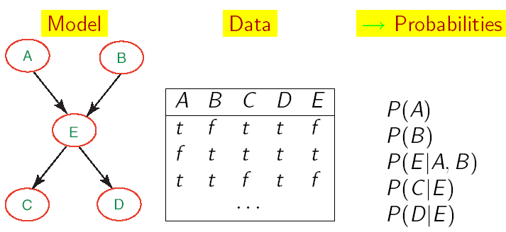
Learning BNs: Complete Data
ML estimation for simplest form of BN learning:
Known structure
Data containing observations for all variables
All variables are observable, no missing data
Only thing to learn are the network’s parameters
Entries of the CPTs
Count how often which range value occurs given the different values for its parent nodes

Slide 7
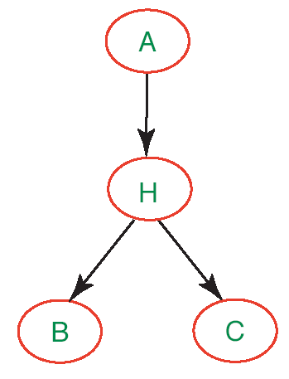
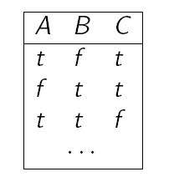
Learning with Hidden Variables
If network has hidden variables, no data available for them
Cannot count the range values
E.g., $H$ occurrences on the left
Quick fix: Get rid of hidden ones
But: may make model much more complex
E.g., example below
Range values for all:
$$low, moderate, high$$
Numbers attached to nodes denote how many parameters need to be specified for the CPT of that node

Slide 8
EM: General Idea
Start from “invented” (e.g., randomly generated) information to solve the learning problem
Determine the network parameters
Refine initial guess by cycling through two steps
Expectation (E): update the data with predictions generated via the current model
Calculate expected counts
Maximisation (M): given the updated data, update the model parameters using MLE
Same step compared to learning parameters for fully observable networks
Full description: see material linked on slide 4

Slide 9
Parameter Estimation
Assume known structure
Goal: estimate BN parameters $θ$ given data $D$
$θ$: CPT entries $P\left(X | Parents\left(X\right)\right)$
Parameterisation $θ$ is good if it is likely to generate the observed data $D=\left\{{\left(x_{1},…,x_{n}\right)}_{m}\right\}$:
$$Score\left(θ\right)=P\left(D|θ\right)=\prod_{m}{P\left({\left(x_{1},…,x_{n}\right)}_{m}|θ\right)}$$
Maximum Likelihood Estimation (MLE) Principle: Choose $θ^{∗}$ so as to maximise $Score$
Inherent bias by the assumed structure
Only as accurate as the structure allows it to be
i.i.d. samples

Slide 10
Structure Learning
Unknown network structure
Given training set $D$
Find model that best matches $D$, includes:
Model selection
Parameter estimation (as on previous slides)
B
E
Inducer
A
C
Data D
Some of the following slides from an AI course “Graphical models“
by Burgard/De Raedt/Kersting/Nebel

Slide 11
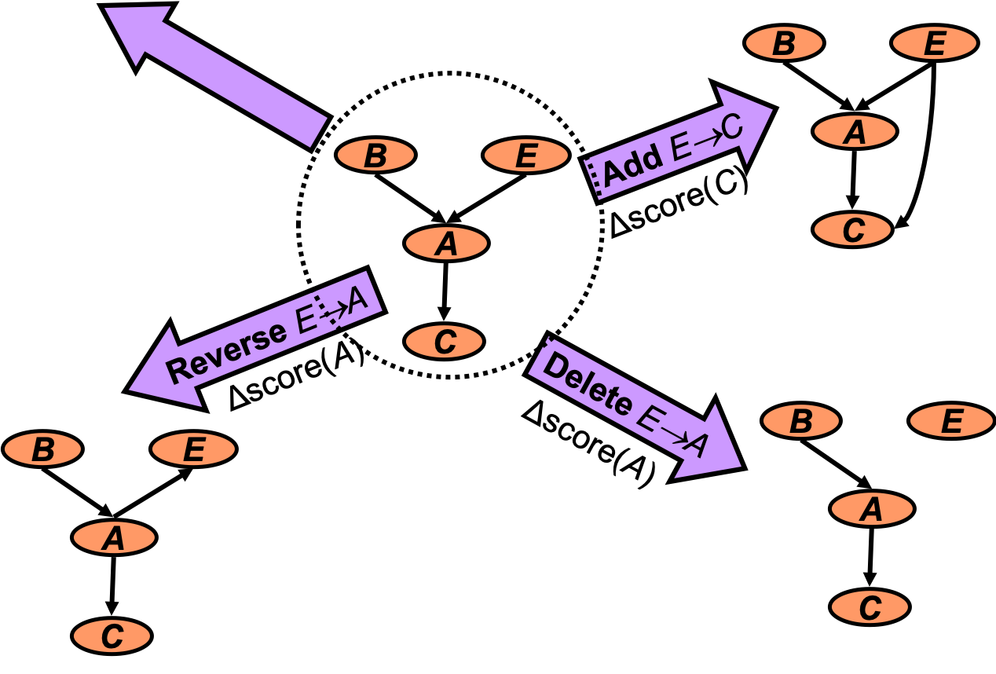
Model selection
Goal: Select the best network structure
Input: Training data, Scoring function
Output: A network that maximises the score
Perform heuristic search for model candidates
Perform EM for parameters
If complete data ➝ all variables known ➝ MLE instead of EM
Score each model
Pick model with highest score

Slide 12
Local Search in Practice
Perform EM for each candidate graph
Parameter space
$$G_{3}$$
$$G_{2}$$
$$G_{1}$$
Parametric optimisation (EM)
Local Maximum
$$G_{4}$$
$$G_{n}$$
Computationally expensive
Parameter optimisation via EM – non-trivial
Need to perform EM for all candidate structures
Spend time even on poor candidates
Data might be incomplete

Slide 13
Structure Learning: Incomplete Data
There might be hidden variables
No data available for the hidden variables
Search space becomes that much larger
Idea:
Use current model to help evaluate new structures
Outline:
Perform search in (Structure, Parameters) space
At each iteration, use current model for finding either:
Better scoring parameters: “parametric” EM step
or
Better scoring structure: “structural” EM step

Slide 14
EM
Data
E
S X D C B
<? 0 1 0 1>
<1 1 ? 0 1>
<0 0 0 ? ?>
<? ? 0 ? 1>
………
B
A
Expectation
Inference:
P(S|X=0,D=1,C=0,B=1)
Current model
Expected
counts
Maximisation
Parameters
S X D C B
1 0 1 0 1
1 1 1 0 1
0 0 0 0 0
1 0 0 0 1
………..
EM-algorithm:
iterate until convergence

Slide 15
Structural EM
E
B
Data
E
S X D C B
<? 0 1 0 1>
<1 1 ? 0 1>
<0 0 0 ? ?>
<? ? 0 ? 1>
………
A
A
Expectation
B
Inference:
P(S|X=0,D=1,C=0,B=1)
Current model
Expected
counts
Maximisation
Parameters
S X D C B
1 0 1 0 1
1 1 1 0 1
0 0 0 0 0
1 0 0 0 1
………..
Maximisation
Structure
SEM-algorithm:
iterate until convergence
E
B
E
E
A
A
A
B
B

Slide 16
Interim Summary
Known structure, fully observable: only need to do parameter estimation
Known structure, hidden variables: use expectation maximisation (EM) to estimate parameters
Unknown structure, fully observable: do heuristic search through structure space, then parameter estimation
Unknown structure, hidden variables: structural EM

Slide 17
Outline: 4. Lifted Learning
Recap: Learning directed models
Maximum likelihood (ML) estimation, expectation-maximisation (EM), structural EM
Learning undirected models
Iterative fitting procedure
Lifted encoding of propositional models
Colour passing
Relational learning
First-order inductive learning
Decision tree representations

Slide 18
Undirected Models
BNs have the advantage of a normalisation constant of $Z=1$
Parameter estimation reduces to estimating parameters of local CPTs
Undirected models do not have this advantage
$$P_{F}= \frac{1}{Z}\prod_{i=1}^{n}{φ_{i}\left(R_{1},…, R_{k}\right)}$$
$$Z=\sum_{r_{1}∈ℛ(R_{1})}{\sum_{r_{n}∈ℛ(R_{n})}{\prod_{i=1}^{k}{φ_{i}\left(r_{1},…, r_{k}\right)}}}$$
$Z$ combines all variables in model in one function

Slide 19
ML Procedure for Undirected Models
Given a model $F={\left\{f_{i}\right\}}_{i=1}^{n}$ with $l$ random variables $R∈rv\left(F\right)$ with range values $r∈ℛ\left(R\right)$
Let $W=×_{i=1}^{l}ℛ\left(R_{i}\right)$ denote the set of possible worlds
With $r=\left(r_{1},…,r_{l}\right)$ referring to a single world (compound event for $rv\left(F\right)$)
Let $r_{α}$ denote the projection of $r$ onto the randvars of some entity $α$
E.g., $r_{f}=π_{rv\left(f\right)}\left(r\right)$: project $r$ onto the randvars in $f$
Let $φ_{f}$ refer to the potential function of $f$
Given a data set $D$ with $k$ compound events for $rv\left(F\right)$ (i.e., complete data)
Let $\#\left(r\right)$ denote how often $r$ has been observed in $D$
Could write $D$ as multi-set, i.e., $D={\left\{{\left(r,\#\left(r\right)\right)}_{i}\right\}}_{i=1}^{m}$

Slide 20
ML Procedure for Undirected Models
Express the likelihood $P\left(D|θ\right)$ of the data $D$ as a function of the parameters $θ$ to be learned
$θ$ refers to the potentials in the factors of $F$
$$P\left(D|θ\right)=\prod_{r∈W}{P{\left(r|θ\right)}^{\#\left(r\right)}}$$
In this formulation, $P\left(D|θ\right)$ can become zero if an $r∈W$ has not been observed
E.g., initialise all counts to $1$ to circumvent problem
and take the logarithm
$$\log{P\left(D|θ\right)}=\log{\prod_{r∈W}{P{\left(r|θ\right)}^{\#\left(r\right)}}}$$

Slide 21
ML Procedure for Undirected Models
$$\log{P\left(D|θ\right)}=\log{\prod_{r∈W}{P{\left(r|θ\right)}^{\#\left(r\right)}}}$$
$φ_{f}\left(r_{f}\right)$refers to parameter $∈θ$
$$=\sum_{r∈W}{\#\left(r\right)\log{P\left(r|θ\right)}}=\sum_{r∈W}{\#\left(r\right)\log\left(\frac{1}{Z}\prod_{f∈F}{φ_{f}\left(r_{f}\right)}\right)}$$
$$=\sum_{r∈W}{\#\left(r\right)\left(\log\left(\frac{1}{Z}\right)+\log{\prod_{f∈F}{φ_{f}\left(r_{f}\right)}}\right)}$$
$$=\sum_{r∈W}{\#\left(r\right)\left(−\log\left(Z\right)+\sum_{f∈F}{\log{φ_{f}\left(r_{f}\right)}}\right)}$$
$$=\left(\sum_{r∈W}{\#\left(r\right)\sum_{f∈F}{\log{φ_{f}\left(r_{f}\right)}}}\right)−\sum_{r∈W}{\#\left(r\right)\log\left(Z\right)}$$
$$=\left(\sum_{r∈W}{\#\left(r\right)\sum_{f∈F}{\log{φ_{f}\left(r_{f}\right)}}}\right)−k\log\left(Z\right)$$
$$=\left(\sum_{f∈F}{\sum_{r_{f}∈ℛ\left(rv\left(f\right)\right)}{\#\left(r_{f}\right)\log{φ_{f}\left(r_{f}\right)}}}\right)−k\log\left(Z\right)$$

Slide 22
ML Procedure for Undirected Models
Take the derivative of the log likelihood with respect to each parameter, i.e., $φ_{f}\left(r_{f}\right)$
Derivation of $l_{1}$
$$\log{P\left(D|θ\right)}=\left(\sum_{f∈F}{\sum_{r_{f}∈ℛ\left(rv\left(f\right)\right)}{\#\left(r_{f}\right)\log{φ_{f}\left(r_{f}\right)}}}\right)−k\log\left(Z\right)$$
$$l_{1}$$
$$l_{2}$$
$$\frac{∂l_{1}}{∂φ_{f}\left(r_{f}\right)}=\#\left(r_{f}\right)∙\frac{1}{φ_{f}\left(r_{f}\right)}$$
Derivation of $log$:
$$\frac{∂\log{f\left(x\right)}}{∂x}=\frac{1}{f\left(x\right)}∙\frac{∂f\left(x\right)}{∂x}$$
E.g., if $f\left(x\right)=x$: $$\frac{∂\log{x}}{∂x}=\frac{1}{x}∙\frac{∂x}{∂x}=\frac{1}{x}∙1=\frac{1}{x}$$
constant w.r.t. $φ_{f}\left(r_{f}\right)$

Slide 23
ML Procedure for Undirected Models
Derivation of $l_{2}=k\log\left(Z\right)$
$$\frac{∂l_{2}}{∂φ_{f}\left(r_{f}\right)}=k∙\frac{1}{Z}∙\frac{∂Z}{∂φ_{f}\left(r_{f}\right)}=k∙\frac{1}{Z}∙\frac{∂}{∂φ_{f}\left(r_{f}\right)}∙\sum_{s∈W}{\prod_{e∈F}{φ_{e}\left(s_{e}\right)}}$$
Only those summands that contain $φ_{f}\left(r_{f}\right)$ remain; derivation of the others returns $0$; use indicator function to denote this:
$$δ\left(r,s\right)=\left\{\begin{aligned}\begin{matrix}1 & \text{if} r=s\end{matrix} \\ \begin{matrix}0 & \text{otherwise}\end{matrix}\end{aligned}\right.$$
$$=k∙\frac{1}{Z}∙\sum_{s∈W}{δ\left(r_{f},s_{f}\right)\frac{∂}{∂φ_{f}\left(r_{f}\right)}∙\prod_{e∈F}{φ_{e}\left(s_{e}\right)}}$$
One of the $e$’s is $f$, i.e., $φ_{f}\left(r_{f}\right)=φ_{e}\left(s_{e}\right)$ for one $e$; the rest is constant w.r.t. $φ_{f}\left(r_{f}\right)$
$$=\frac{∂}{∂φ_{f}\left(r_{f}\right)}∙φ_{f}\left(s_{f}\right)∙\prod_{\begin{aligned}e∈F \\ e≠f\end{aligned}}{φ_{e}\left(s_{e}\right)}=\prod_{\begin{aligned}e∈F \\ e≠f\end{aligned}}{φ_{e}\left(s_{e}\right)}$$
$$=\frac{φ_{f}\left(r_{f}\right)}{φ_{f}\left(r_{f}\right)}∙\prod_{\begin{aligned}e∈F \\ e≠f\end{aligned}}{φ_{e}\left(s_{e}\right)}=\frac{1}{φ_{f}\left(r_{f}\right)}∙\prod_{\begin{aligned}e∈F\end{aligned}}{φ_{e}\left(s_{e}\right)}$$

Slide 24
ML Procedure for Undirected Models
Derivation of $l_{2}$
$$\frac{∂l_{2}}{∂φ_{f}\left(r_{f}\right)}=k∙\frac{1}{Z}∙\sum_{s∈W}{δ\left(r_{f},s_{f}\right)\frac{1}{φ_{f}\left(r_{f}\right)}∙\prod_{\begin{aligned}e∈F\end{aligned}}{φ_{e}\left(s_{e}\right)}}$$
$$=k∙\frac{1}{φ_{f}\left(r_{f}\right)}∙\sum_{s∈W}{δ\left(r_{f},s_{f}\right)∙\frac{1}{Z}∙\prod_{\begin{aligned}e∈F\end{aligned}}{φ_{e}\left(s_{e}\right)}}$$
$$=k∙\frac{1}{φ_{f}\left(r_{f}\right)}∙\sum_{s∈W}{δ\left(r_{f},s_{f}\right)∙P\left(s\right)}$$
$$=k∙\frac{1}{φ_{f}\left(r_{f}\right)}∙P\left(r_{f}\right)$$

Slide 25
ML Procedure for Undirected Models
Take the derivative of the log likelihood with respect to each parameter, i.e., $φ_{f}\left(r_{f}\right)$
Derivative for each parameter $φ_{f}\left(r_{f}\right)$
$$\log{P\left(D|θ\right)}=\left(\sum_{f∈F}{\sum_{r_{f}∈ℛ\left(rv\left(f\right)\right)}{\#\left(r_{f}\right)\log{φ_{f}\left(r_{f}\right)}}}\right)−k\log\left(Z\right)$$
$$l_{1}$$
$$l_{2}$$
$$\frac{∂l_{1}}{∂φ_{f}\left(r_{f}\right)}=\frac{\#\left(r_{f}\right)}{φ_{f}\left(r_{f}\right)}$$
$$\frac{∂l_{2}}{∂φ_{f}\left(r_{f}\right)}=k∙\frac{P\left(r_{f}\right)}{φ_{f}\left(r_{f}\right)}$$
$$\frac{∂\log{P\left(D|θ\right)}}{∂φ_{f}\left(r_{f}\right)}=\frac{\#\left(r_{f}\right)}{φ_{f}\left(r_{f}\right)}−k∙\frac{P\left(r_{f}\right)}{φ_{f}\left(r_{f}\right)}$$

Slide 26
ML Procedure for Undirected Models
Find the parameter value that makes the derivative equal to 0
States that the ML estimates should be in such a way that the model marginals $P\left(r_{f}\right)$ are equal to the normalised empirical counts:
$$P^{\#}\left(r_{f}\right)≝\frac{\#\left(r_{f}\right)}{k}=P\left(r_{f}\right)$$
Does not state how to get the estimates
$$\frac{∂\log{P\left(D|θ\right)}}{∂φ_{f}\left(r_{f}\right)}=\frac{\#\left(r_{f}\right)}{φ_{f}\left(r_{f}\right)}−k∙\frac{P\left(r_{f}\right)}{φ_{f}\left(r_{f}\right)}=0$$
$$→ \frac{\#\left(r_{f}\right)}{φ_{f}\left(r_{f}\right)}=k∙\frac{P\left(r_{f}\right)}{φ_{f}\left(r_{f}\right)}$$
$$\#\left(r_{f}\right)=k∙P\left(r_{f}\right)$$
$$\frac{\#\left(r_{f}\right)}{k}=P\left(r_{f}\right)$$
$$!$$

Slide 27
Factors over Maximal Cliques
Markov net with potential functions over its maximal cliques
Clique: set of nodes where every node is directly connected with every other node
In factor graphs: Directly connected = appear in same factor
Maximal clique
There is no node in the graph that you could add to the clique with the clique remaining a clique
Equivalent factor models
Corresponding junction tree with the nodes of each clique as the clusters and one factor per cluster assigned as local model with its arguments making up the cluster
$$Epid$$
$$Travel\text{.}eve$$
$$Sick\text{.}eve$$
Markov network (MN)
$$Epid$$
$$Travel\text{.}eve$$
$$Sick\text{.}eve$$
Factor graph (FG)
$$Travel.eve \\ Epid$$
$$Sick\left(eve\right) \\ Epid$$
$$C_{1}$$
$$C_{2}$$
$$f_{1}$$
$$f_{2}$$
Junction tree

Slide 28
Factors over Maximal Cliques
Factor model $F={\left\{f_{i}\right\}}_{i=1}^{n}$ with a junction tree $\left(V,E\right)$ where
$$∀f∈F :∃ C_{i}∈V :rv\left(f\right)=C_{i} \\ ∧∀C_{j}∈V, i≠j, rv\left(f\right)⊈C_{i}$$
➝ Each $C_{i}$ has one factor $f_{i}$ assigned
Full joint represented:
$$P_{F}=\frac{1}{Z}\prod_{f∈F}{f}=\frac{1}{Z}\prod_{C_{i}∈V}{f_{i}}=\frac{\prod_{C_{i}∈V}{P\left(C_{i}\right)}}{\prod_{\left\{i,j\right\}∈E}{P\left(S_{ij}\right)}}$$
For a world $r$,
$$P\left(r\right)=\frac{\prod_{C_{i}∈V}{P\left(r_{i}\right)}}{\prod_{\left\{i,j\right\}∈E}{P\left(r_{ij}\right)}}=\frac{\prod_{f∈F}{P\left(r_{f}\right)}}{\prod_{\left\{i,j\right\}∈E}{P\left(r_{ij}\right)}}$$

Slide 29
Factors over Maximal Cliques
$$P\left(r\right)=\frac{\prod_{C_{i}∈V}{P\left(r_{i}\right)}}{\prod_{\left\{i,j\right\}∈E}{P\left(r_{ij}\right)}}=\frac{\prod_{f∈F}{P\left(r_{f}\right)}}{\prod_{\left\{i,j\right\}∈E}{P\left(r_{ij}\right)}}$$
Set factors to be the normalised empirical counts $P^{\#}\left(r_{f}\right)$ and, for each separator, pick one neighbour and divide the factor by the normalised empirical count of the separator $P^{\#}\left(r_{ij}\right)$, i.e.,
For each $f∈F$,
Set $φ_{f}\left(r_{f}\right)←P^{\#}\left(r_{f}\right)$
For each $\left\{i,j\right\}∈E$, i.e., separator $S_{ij}$,
Choose $h∈\left\{i,j\right\}$ at random
Set $φ_{h}\left(r_{h}\right)←\frac{φ_{h}\left(r_{h}\right)}{P^{\#}\left(r_{ij}\right)}$
Enforces $Z=1$
As we have now probability distributions in the factors
$$P^{\#}\left(r_{f}\right)≝\frac{\#\left(r_{f}\right)}{k}=P\left(r_{f}\right)$$
$$!$$
LearnMaxCliques

Slide 30
Learning with General Factors
If factors over non-maximal cliques, closed form solution not possible; fixed-point iteration:
Update rule
$φ_{f}^{(t+1)}\left(r_{f}\right)←φ_{f}^{t}\left(r_{f}\right)\frac{P^{\#}\left(r_{f}\right)}{P^{t}\left(r_{f}\right)}$
$φ_{f}^{t}\left(r_{f}\right)$ current potentials
$P^{\#}\left(r_{f}\right)$ fixed
$P^{t}\left(r_{f}\right)$ query to compute on current $φ_{f}^{t}\left(r_{f}\right)$
$$\frac{∂\log{P\left(D|θ\right)}}{∂φ_{f}\left(r_{f}\right)}=\frac{\#\left(r_{f}\right)}{φ_{f}\left(r_{f}\right)}−k∙\frac{P\left(r_{f}\right)}{φ_{f}\left(r_{f}\right)}=0$$
$$→ \frac{\#\left(r_{f}\right)}{φ_{f}\left(r_{f}\right)}=k∙\frac{P\left(r_{f}\right)}{φ_{f}\left(r_{f}\right)}$$
$$\frac{\#\left(r_{f}\right)}{k∙φ_{f}\left(r_{f}\right)}=\frac{P\left(r_{f}\right)}{φ_{f}\left(r_{f}\right)}$$
$$\frac{P^{\#}\left(r_{f}\right)}{φ_{f}\left(r_{f}\right)}=\frac{P\left(r_{f}\right)}{φ_{f}\left(r_{f}\right)}$$
$$\frac{φ_{f}\left(r_{f}\right)}{P^{\#}\left(r_{f}\right)}=\frac{φ_{f}\left(r_{f}\right)}{P\left(r_{f}\right)}$$
$$φ_{f}\left(r_{f}\right)=φ_{f}\left(r_{f}\right)\frac{P^{\#}\left(r_{f}\right)}{P\left(r_{f}\right)}$$

Slide 31
Iterative proportional fitting
Iterative proportional fitting (IPF) procedure
Initialise all factors with $t=0$ uniformly, e.g., all potentials $1$
for $t=1,2, …$ do
if convergence criterion does not hold then
for all $r_{f}∈ℛ\left(rv\left(f\right)\right),f∈F$ do
$φ_{f}^{(t+1)}\left(r_{f}\right)←φ_{f}^{t}\left(r_{f}\right)\frac{P^{\#}\left(r_{f}\right)}{P^{t}\left(r_{f}\right)}$
else break
Convergence criterion, e.g., given error threshold $ε$
$∀f∈F :φ_{f}^{\left(t+1\right)}\left(r_{f}\right)−φ_{f}^{t}\left(r_{f}\right)<ε$
Many $P^{t}\left(r_{f}\right)$ queries to compute over all factors!
Efficient execution using a junction tree (jtree)
IPF
Radim Jiroušek: Solution of the Marginal Problem and Decomposable Distributions. In: Kybernetika 27, 1991.
Radim Jiroušek and Stanislav Přeučil: On the Effective Implementation of the Iterative Proportional Fitting Procedure. In: Computational Statistics & Data Analysis 19, 1995.

Slide 32
IPF with Jtrees
Compute $P^{t}\left(r_{f}\right)$ using current $m_{ji}^{t}$ and $F_{i}^{t}$
Organise in a reasonable way over all local factors and assignments
Use jtree to compute $P^{t}\left(r_{f}\right)$ efficiently
Construction independent of parameters
IPF-JT: IPF with junction trees
Construct a jtree
Initialise all factors and messages uniformly for $t=0$
Pick a random cluster $C_{i}$ as the current cluster
for $t=1,2, …$ do
if convergence criterion does not hold then
for all $r_{f}∈ℛ\left(rv\left(f\right)\right),f∈F_{i}^{t}$ do
$φ_{f}^{(t+1)}\left(r_{f}\right)←φ_{f}^{t}\left(r_{f}\right)\frac{P^{\#}\left(r_{f}\right)}{P^{t}\left(r_{f}\right)}$
else break
Choose a neighbour $C_{j}$ as new current cluster at random
Compute and send message $m_{ij}^{t}$ to $C_{j}$
No ordering prescribed; implicit requirement that all $C_{i}$ visited enough times
E.g., start at a leaf, traverse the clusters by depth first search
IPF-JT
Yee Whye Teh and Max Welling: On Improving the Efficiency of the Iterative Proportional Fitting Procedure. In: AISTATS-03 Proceedings of the Ninth International Workshop on Artificial Intelligence and Statistics, 2003.

Slide 33
Properties of IPF Updates
Reduces to one update per factor if factors are over maximal cliques
Coordinate ascent algorithm
Coordinates = parameters $θ$ in clusters
At each step, the update increases the log-likelihood of the data $\log{P\left(D|θ\right)}$and it will converge to a global maximum
Maximising the log-likelihood is equivalent to minimising the KL divergence (cross entropy)
$$\max{\log{P\left(D|θ\right)}}⇔\min{KL\left(P^{\#}\left(r\right)∥P\left(r|θ\right)\right)} \\ KL\left(P^{\#}\left(r\right)∥P\left(r|θ\right)\right)=\sum_{r}{P^{\#}\left(r\right)\log{\frac{P^{\#}\left(r\right)}{P\left(r|θ\right)}}}$$
Max-entropy principle for parameterisation: dual perspective to MLE
$$P^{\#}\left(r\right)$$
$$P\left(r|θ\right)$$
$$KL\left(P^{\#}\left(r\right)∥P\left(r|θ\right)\right)$$

Slide 34
IPF with Incomplete Data
Problem with incomplete data:
Update rule
$$φ_{f}^{(t+1)}\left(r_{f}\right)←φ_{f}^{t}\left(r_{f}\right)\frac{P^{\#}\left(r_{f}\right)}{P^{t}\left(r_{f}\right)}$$
Hidden variables do not have $P^{\#}\left(r_{f}\right)$
EM-IPF: IPF procedure merged with EM scheme
E step: Calculate expected counts for hidden variables
M step: Update parameters $φ_{f}^{\left(t+1\right)}\left(r_{f}\right)$
Could also use jtree for efficiency

Slide 35
Interim Summary
Parameter learning in undirected models harder because of $Z≠1$
IPF
Fix-point iteration
Reduces to one update per factor if factors on maximal cliques
Then $Z=1$ enforced
Jtrees for efficiency
Update per cluster, then send updated information to neighbour
EM version for incomplete data

Slide 36
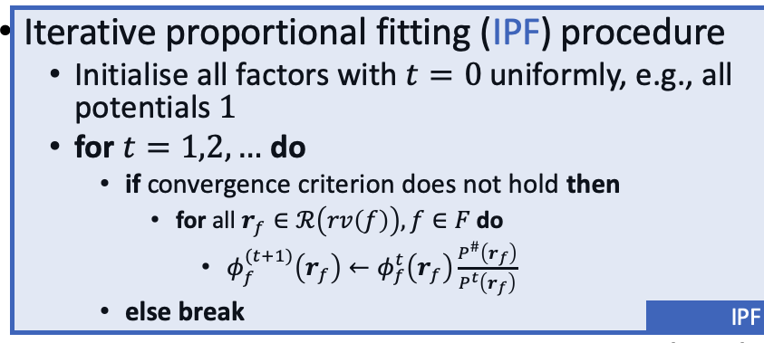
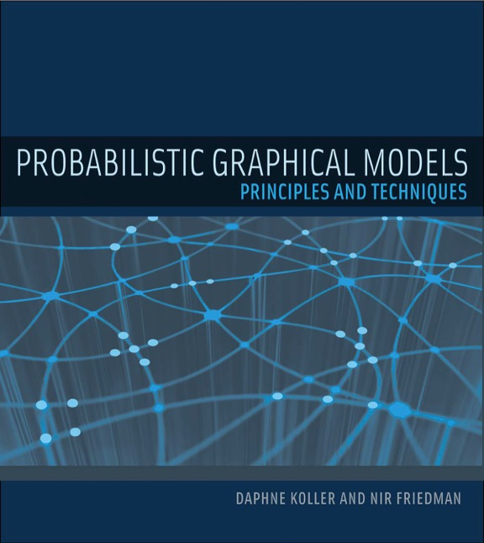
Addendum to Propositional Learning
Can use approximate inference to compute queries in update rule
E.g., sampling
Can use alternative objectives
Pseudo-likelihood
Contrastive divergence
Structure learning
In undirected models can follow the same idea as before
Model selection + parameter estimation, possibly interleaved as in structural EM
Different approach: independence tests
Find which randvars are independent of each other, delete edges accordingly
As indicated in first lecture on propositional models
See Chapter 20, in “Probabilistic Graphical Models” by Koller & Friedman (2009) for more details on learning

Slide 37
Generative & Discriminative Models
Methods described are for learning models representing a full joint probability distribution $P\left(X,Y\right)$
One can do any kind of inference (prediction, classification, any probability of randvars) one is interested in
Generative models
In contrast: Discriminative models (such as neural nets)
Specifically designed and trained to maximise performance of classification: $P\left(Y|X\right)$
$Y$ a classification randvar and $X$ a vector of features
Generally perform better on classification than generative models when given a reasonable amount of training data
By focusing on modelling a conditional distribution
In both cases: Models are an abstraction/generalisation of data, which cannot represent the data with 100% accuracy. Only the data can do that.

Slide 38
Outline: 4. Lifted Learning
Recap: Learning directed models
Maximum likelihood (ML) estimation, expectation-maximisation (EM), structural EM
Learning undirected models
Iterative fitting procedure
Lifted encoding of propositional models
Colour passing
Relational learning
First-order inductive learning
Decision tree representations

Slide 39
Compression
$$Nat(D)$$
$$Man(W)$$
$$g_{1}$$
$$Epid$$
Goal
$$Travel(X)$$
$$Treat(X,M)$$
$$g_{2}$$
$$g_{3}$$
$$Sick(X)$$
$$Man\text{.}war$$
Input
$$Man\text{.}virus$$
$$f_{1}^{3}$$
$$f_{1}^{1}$$
$$f_{1}^{2}$$
$$f_{1}^{4}$$
$$Nat\text{.}flood$$
$$Nat\text{.}fire$$
$$f_{2}^{2}$$
$$f_{2}^{3}$$
$$Epid$$
$$f_{3}^{3}$$
$$f_{3}^{5}$$
$$Treat\text{.}alice\text{.}m_{1}$$
$$Treat\text{.}bob\text{.}m_{1}$$
$$Travel\text{.}alice$$
$$f_{3}^{4}$$
$$f_{3}^{6}$$
$$Travel.bob$$
$$Sick\text{.}alice$$
$$f_{2}^{1}$$
$$f_{3}^{1}$$
$$f_{3}^{2}$$
$$Sick\text{.}bob$$
$$Treat\text{.}eve\text{.}m_{1}$$
$$Treat\text{.}alice\text{.}m_{2}$$
$$Treat\text{.}bob\text{.}m_{2}$$
$$Travel\text{.}eve$$
$$Sick\text{.}eve$$
$$Treat\text{.}eve\text{.}m_{2}$$

Slide 40
Recap: Foundations of Clustering
History in propositional probabilistic inference:
Based on probability propagation introduced by Pearl (1988)
If a BN is a polytree, i.e., the underlying undirected graph has no trivial cycles, then
Treat each node in a BN as a cluster with the randvars of the accompanying CPT as the cluster randvars
Send messages along the edges (to parents and children), eliminating randvars not occurring in the parent or child nodes
$$U_{1}$$
$$U_{2}$$
$$π\left(U_{1},V\right)$$
$$λ\left(V,U_{2}\right)$$
$$π\left(U_{2},V\right)$$
$$λ\left(V,U_{1}\right)$$
$$V$$
$$λ\left(V_{1},V\right)$$
$$π\left(V,V_{2}\right)$$
$$π\left(V,V_{1}\right)$$
$$λ\left(V_{2},V\right)$$
$$V_{1}$$
$$V_{2}$$
Judea Pearl: Reverend Bayes on Inference Engines: A Distributed Hierarchical Approach. In: AAAI-82 Proceedings of the 2nd National Conference on Artificial Intelligence, 1982.

Slide 41
Loopy Belief Propagation
Pass messages on graph
If no cycles: exact
Else: approximate
Lifted (loopy) belief propagation
Exploit computational symmetries
Compress graph whenever nodes would send identical messages
Send messages on compressed graph
Colour passing algorithm for compression
Parag Singla and Pedro Domingos: Lifted First-order Belief Propagation. In AAAI-08 Proceedings of the 23rd AAAI Conference on Artificial Intelligence, 2008.
Kristian Kersting, Babak Ahmadi, and Sriraam Natarajan. Counting Belief Propagation. In UAI-09 Proceedings of the 25th Conference on Uncertainty in Artificial Intelligence, 2009.
Babak Ahmadi, Kristian Kersting, Martin Mladenov, and Sriraam Natarajan. Exploiting Symmetries for Scaling Loopy Belief Propagation and Relational Training. In Machine Learning. 92(1):91-132, 2013.

Slide 42
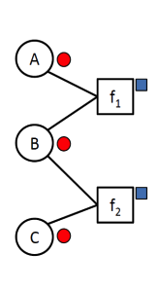
Compression: Pass the colours around*
Colour nodes according to the evidence you have
No evidence, say red
State „one“, say brown
State „two“, say orange
...
Colour factors distinctively according to their equivalences For instance, assuming f₁ and f₂ to be identical and B appears at the second position within both, say blue
*can also be done at the „lifted“, i.e., relational level

Slide 43
Compression
Colour nodes and factors
1 colour for the nodes: ●
3 colours for the factors: ■ ■ ■
$$Man\text{.}war$$
$$Man\text{.}virus$$
$$f_{1}^{3}$$
$$f_{1}^{1}$$
$$f_{1}^{2}$$
$$f_{1}^{4}$$
$$Nat\text{.}flood$$
$$Nat\text{.}fire$$
$$f_{2}^{2}$$
$$f_{2}^{3}$$
$$Epid$$
$$f_{3}^{3}$$
$$f_{3}^{5}$$
$$Treat\text{.}alice\text{.}m_{1}$$
$$Treat\text{.}bob\text{.}m_{1}$$
$$Travel\text{.}alice$$
$$f_{3}^{4}$$
$$f_{3}^{6}$$
$$Travel.bob$$
$$Sick\text{.}alice$$
$$f_{2}^{1}$$
$$f_{3}^{1}$$
$$f_{3}^{2}$$
$$Sick\text{.}bob$$
$$Treat\text{.}eve\text{.}m_{1}$$
$$Treat\text{.}alice\text{.}m_{2}$$
$$Treat\text{.}bob\text{.}m_{2}$$
$$Travel\text{.}eve$$
$$Sick\text{.}eve$$
$$Treat\text{.}eve\text{.}m_{2}$$

Slide 44
Compression
Factors collecting colours from nodes, signing their own colours to the collected ones
$$Man\text{.}war$$
$$Man\text{.}virus$$
$$f_{1}^{3}$$
$$f_{1}^{1}$$
$$f_{1}^{2}$$
$$f_{1}^{4}$$
$$Nat\text{.}flood$$
$$Nat\text{.}fire$$
$$f_{2}^{2}$$
$$f_{2}^{3}$$
$$Epid$$
$$f_{3}^{3}$$
$$f_{3}^{5}$$
$$Treat\text{.}alice\text{.}m_{1}$$
$$Treat\text{.}bob\text{.}m_{1}$$
$$Travel\text{.}alice$$
$$f_{3}^{4}$$
$$f_{3}^{6}$$
$$Travel.bob$$
$$Sick\text{.}alice$$
$$f_{2}^{1}$$
$$f_{3}^{1}$$
$$f_{3}^{2}$$
$$Sick\text{.}bob$$
$$Treat\text{.}eve\text{.}m_{1}$$
$$Treat\text{.}alice\text{.}m_{2}$$
$$Treat\text{.}bob\text{.}m_{2}$$
$$Travel\text{.}eve$$
$$Sick\text{.}eve$$
$$Treat\text{.}eve\text{.}m_{2}$$

Slide 45
Compression
Nodes collecting colours from factors
$$Man\text{.}war$$
$$Man\text{.}virus$$
$$f_{1}^{3}$$
$$f_{1}^{1}$$
$$f_{1}^{2}$$
$$f_{1}^{4}$$
$$Nat\text{.}flood$$
$$Nat\text{.}fire$$
$$f_{2}^{2}$$
$$f_{2}^{3}$$
$$Epid$$
$$f_{3}^{3}$$
$$f_{3}^{5}$$
$$Treat\text{.}alice\text{.}m_{1}$$
$$Treat\text{.}bob\text{.}m_{1}$$
$$Travel\text{.}alice$$
$$f_{3}^{4}$$
$$f_{3}^{6}$$
$$Travel.bob$$
$$Sick\text{.}alice$$
$$f_{2}^{1}$$
$$f_{3}^{1}$$
$$f_{3}^{2}$$
$$Sick\text{.}bob$$
$$Treat\text{.}eve\text{.}m_{1}$$
$$Treat\text{.}alice\text{.}m_{2}$$
$$Treat\text{.}bob\text{.}m_{2}$$
$$Travel\text{.}eve$$
$$Sick\text{.}eve$$
$$Treat\text{.}eve\text{.}m_{2}$$

Slide 46
Compression
Recolour nodes based on collected signatures
5 colours for the nodes: ● ● ● ● ●
Factors as before
$$Man\text{.}war$$
$$Man\text{.}virus$$
$$f_{1}^{3}$$
$$f_{1}^{1}$$
$$f_{1}^{2}$$
$$f_{1}^{4}$$
$$Nat\text{.}flood$$
$$Nat\text{.}fire$$
$$f_{2}^{2}$$
$$f_{2}^{3}$$
$$Epid$$
$$f_{3}^{3}$$
$$f_{3}^{5}$$
$$Treat\text{.}alice\text{.}m_{1}$$
$$Treat\text{.}bob\text{.}m_{1}$$
$$Travel\text{.}alice$$
$$f_{3}^{4}$$
$$f_{3}^{6}$$
$$Travel.bob$$
$$Sick\text{.}alice$$
$$f_{2}^{1}$$
$$f_{3}^{1}$$
$$f_{3}^{2}$$
$$Sick\text{.}bob$$
$$Treat\text{.}eve\text{.}m_{1}$$
$$Treat\text{.}alice\text{.}m_{2}$$
$$Treat\text{.}bob\text{.}m_{2}$$
$$Travel\text{.}eve$$
$$Sick\text{.}eve$$
$$Treat\text{.}eve\text{.}m_{2}$$

Slide 47
Compression
If no new colour created, stop. Otherwise, pass colours again.
Before: ●
After: ● ● ● ● ●
$$Man\text{.}war$$
$$Man\text{.}virus$$
$$f_{1}^{3}$$
$$f_{1}^{1}$$
$$f_{1}^{2}$$
$$f_{1}^{4}$$
$$Nat\text{.}flood$$
$$Nat\text{.}fire$$
$$f_{2}^{2}$$
$$f_{2}^{3}$$
$$Epid$$
$$f_{3}^{3}$$
$$f_{3}^{5}$$
$$Treat\text{.}alice\text{.}m_{1}$$
$$Treat\text{.}bob\text{.}m_{1}$$
$$Travel\text{.}alice$$
$$f_{3}^{4}$$
$$f_{3}^{6}$$
$$Travel.bob$$
$$Sick\text{.}alice$$
$$f_{2}^{1}$$
$$f_{3}^{1}$$
$$f_{3}^{2}$$
$$Sick\text{.}bob$$
$$Treat\text{.}eve\text{.}m_{1}$$
$$Treat\text{.}alice\text{.}m_{2}$$
$$Treat\text{.}bob\text{.}m_{2}$$
$$Travel\text{.}eve$$
$$Sick\text{.}eve$$
$$Treat\text{.}eve\text{.}m_{2}$$

Slide 48
Compression
Factors collecting colours from nodes, signing their own colours to the collected ones
$$Man\text{.}war$$
$$Man\text{.}virus$$
$$f_{1}^{3}$$
$$f_{1}^{1}$$
$$f_{1}^{2}$$
$$f_{1}^{4}$$
$$Nat\text{.}flood$$
$$Nat\text{.}fire$$
$$f_{2}^{2}$$
$$f_{2}^{3}$$
$$Epid$$
$$f_{3}^{3}$$
$$f_{3}^{5}$$
$$Treat\text{.}alice\text{.}m_{1}$$
$$Treat\text{.}bob\text{.}m_{1}$$
$$Travel\text{.}alice$$
$$f_{3}^{4}$$
$$f_{3}^{6}$$
$$Travel.bob$$
$$Sick\text{.}alice$$
$$f_{2}^{1}$$
$$f_{3}^{1}$$
$$f_{3}^{2}$$
$$Sick\text{.}bob$$
$$Treat\text{.}eve\text{.}m_{1}$$
$$Treat\text{.}alice\text{.}m_{2}$$
$$Treat\text{.}bob\text{.}m_{2}$$
$$Travel\text{.}eve$$
$$Sick\text{.}eve$$
$$Treat\text{.}eve\text{.}m_{2}$$

Slide 49
Compression
Nodes collecting colours from factors
$$Man\text{.}war$$
$$Man\text{.}virus$$
$$f_{1}^{3}$$
$$f_{1}^{1}$$
$$f_{1}^{2}$$
$$f_{1}^{4}$$
$$Nat\text{.}flood$$
$$Nat\text{.}fire$$
$$f_{2}^{2}$$
$$f_{2}^{3}$$
$$Epid$$
$$f_{3}^{3}$$
$$f_{3}^{5}$$
$$Treat\text{.}alice\text{.}m_{1}$$
$$Treat\text{.}bob\text{.}m_{1}$$
$$Travel\text{.}alice$$
$$f_{3}^{4}$$
$$f_{3}^{6}$$
$$Travel.bob$$
$$Sick\text{.}alice$$
$$f_{2}^{1}$$
$$f_{3}^{1}$$
$$f_{3}^{2}$$
$$Sick\text{.}bob$$
$$Treat\text{.}eve\text{.}m_{1}$$
$$Treat\text{.}alice\text{.}m_{2}$$
$$Treat\text{.}bob\text{.}m_{2}$$
$$Travel\text{.}eve$$
$$Sick\text{.}eve$$
$$Treat\text{.}eve\text{.}m_{2}$$

Slide 50
Compression
Recolour nodes based on collected signatures
5 colours for the nodes: ● ● ● ● ●
Factors as before
$$Man\text{.}war$$
$$Man\text{.}virus$$
$$f_{1}^{3}$$
$$f_{1}^{1}$$
$$f_{1}^{2}$$
$$f_{1}^{4}$$
$$Nat\text{.}flood$$
$$Nat\text{.}fire$$
$$f_{2}^{2}$$
$$f_{2}^{3}$$
$$Epid$$
$$f_{3}^{3}$$
$$f_{3}^{5}$$
$$Treat\text{.}alice\text{.}m_{1}$$
$$Treat\text{.}bob\text{.}m_{1}$$
$$Travel\text{.}alice$$
$$f_{3}^{4}$$
$$f_{3}^{6}$$
$$Travel.bob$$
$$Sick\text{.}alice$$
$$f_{2}^{1}$$
$$f_{3}^{1}$$
$$f_{3}^{2}$$
$$Sick\text{.}bob$$
$$Treat\text{.}eve\text{.}m_{1}$$
$$Treat\text{.}alice\text{.}m_{2}$$
$$Treat\text{.}bob\text{.}m_{2}$$
$$Travel\text{.}eve$$
$$Sick\text{.}eve$$
$$Treat\text{.}eve\text{.}m_{2}$$

Slide 51
Compression
If no new colour created, stop. Otherwise, pass colours again.
Before: ● ● ● ● ●
After: ● ● ● ● ●
No new colour!
$$Man\text{.}war$$
$$Man\text{.}virus$$
$$f_{1}^{3}$$
$$f_{1}^{1}$$
$$f_{1}^{2}$$
$$f_{1}^{4}$$
$$Nat\text{.}flood$$
$$Nat\text{.}fire$$
$$f_{2}^{2}$$
$$f_{2}^{3}$$
$$Epid$$
$$f_{3}^{3}$$
$$f_{3}^{5}$$
$$Treat\text{.}alice\text{.}m_{1}$$
$$Treat\text{.}bob\text{.}m_{1}$$
$$Travel\text{.}alice$$
$$f_{3}^{4}$$
$$f_{3}^{6}$$
$$Travel.bob$$
$$Sick\text{.}alice$$
$$f_{2}^{1}$$
$$f_{3}^{1}$$
$$f_{3}^{2}$$
$$Sick\text{.}bob$$
$$Treat\text{.}eve\text{.}m_{1}$$
$$Treat\text{.}alice\text{.}m_{2}$$
$$Treat\text{.}bob\text{.}m_{2}$$
$$Travel\text{.}eve$$
$$Sick\text{.}eve$$
$$Treat\text{.}eve\text{.}m_{2}$$

Slide 52
Compression
$$Nat(D)$$
$$Man(W)$$
$$g_{1}$$
$$Epid$$
Compressed graph:
$$Travel(X)$$
$$Treat(X,M)$$
$$g_{2}$$
$$g_{3}$$
$$Sick(X)$$
$$Man\text{.}war$$
$$Man\text{.}virus$$
$$f_{1}^{3}$$
$$f_{1}^{1}$$
$$f_{1}^{2}$$
$$f_{1}^{4}$$
$$Nat\text{.}flood$$
$$Nat\text{.}fire$$
$$f_{2}^{2}$$
$$f_{2}^{3}$$
$$Epid$$
$$f_{3}^{3}$$
$$f_{3}^{5}$$
$$Treat\text{.}alice\text{.}m_{1}$$
$$Treat\text{.}bob\text{.}m_{1}$$
$$Travel\text{.}alice$$
$$f_{3}^{4}$$
$$f_{3}^{6}$$
$$Travel.bob$$
$$Sick\text{.}alice$$
$$f_{2}^{1}$$
$$f_{3}^{1}$$
$$f_{3}^{2}$$
$$Sick\text{.}bob$$
$$Treat\text{.}eve\text{.}m_{1}$$
$$Treat\text{.}alice\text{.}m_{2}$$
$$Treat\text{.}bob\text{.}m_{2}$$
$$Travel\text{.}eve$$
$$Sick\text{.}eve$$
$$Treat\text{.}eve\text{.}m_{2}$$

Slide 53
Colour Passing Compression
Algorithm:
Each factor collects the colours of its neighbouring nodes
Each factor “signs“ its colour signature with its own colour
Each node collects the signatures of its neighbouring factors
Nodes are recoloured according to the collected signatures
If no new colour is created stop, otherwise go back to 1
Afterwards, build compressed version by combining randvars of same colour using logvars
Uses exact symmetries in factors
Same colour if factors considered equivalent
Could specify an approximate version to further compress a model
E.g., consider $\left(1.0,2.0\right)$ and $\left(1.1,2.0\right)$ to be equivalent
Babak Ahmadi, Kristian Kersting, Martin Mladenov, and Sriraam Natarajan. Exploiting Symmetries for Scaling Loopy Belief Propagation and Relational Training. In Machine Learning. 92(1):91-132, 2013.

Slide 54
Interim Summary
Compress a model (lifted or ground) based on semantics
Pass colours around until convergence (no new colours)
Uses exact symmetries in factors
Same colour if factors considered equivalent
Ignores syntax
E.g., names of randvars
“Literal” translation of propositional models into lifted models
Take the ground model, find the symmetries, combine them into a compact encoding

Slide 55
Outline: 4. Lifted Learning
Recap: Learning directed models
Maximum likelihood (ML) estimation, expectation-maximisation (EM), structural EM
Learning undirected models
Iterative fitting procedure
Lifted encoding of propositional models
Colour passing
Relational learning
First-order inductive learning
Decision tree representations

Slide 56
Relational Parameter Learning
Assumption: individual instances in training data behave indistinguishably
Relational representation captures the setting with adequate accuracy
Assuming relational structure is known
Complete data, e.g., using MLE
MLNs: decomposes per rule because of $\log{\exp{w}}=w$
PM: e.g., use IPF
Can use lifted inference for queries during learning
Data on groundings mapped to PRVs/predicates
Incomplete data: EM version
Could cluster instances into different domains and shatter model to increase accuracy
Trade-off between compact representation (no clustering) and accuracy (each instance in own cluster)

Slide 57
Structure Learning
Can follow the same idea of structural EM
Already NP-hard problem in propositional setting
More complicated because there are not only randvars but also logvars that can be combined together
Other approaches
Relation learning in logics, e.g.,
First-order inductive learning (FOIL)
First-order logical decision trees (FOLDTs)
Combined with weights/probabilities
Learning approximate models, e.g.,
Relational dependency networks (RDNs)
Using a relational probability tree for local distributions in RDNs
Boosted learning: Learn a set of distributions to approximate a local distribution (RDN-Boost)

Slide 58
Knowledge-based Inductive Learning
Logic perspective on learning
Examples are composed of descriptions and classifications
Objective is to find a hypothesis that explains the classification of the examples, given their descriptions
$\text{Hypothesis}∧\text{Descriptions}⊨\text{Classifications}$
Knowledge-based inductive learning
Background knowledge helps to explain examples
$\text{Background}∧\text{Hypothesis}∧\text{Descriptions}⊨\text{Classifications}$
E.g., inferring disease $D$ from symptoms not enough to explain prescription of medicine $M$
Rule that $M$ is effective against $D$ needed
Using knowledge, effective hypothesis space reduced to include only those theories consistent with what is already known
Prior knowledge can be used to reduce size of hypothesis explaining the observations
Smaller hypotheses easier to find
Main research field: inductive logic programming (ILP)

Slide 59
First-order Inductive Learning (FOIL)
Learns function-free Horn clauses for a target concept given a set of positive and negative examples and some background knowledge
Form of ILP
Form of top-down learning
Start from a general rule and specialize it
E.g., learning family relations from examples
Observations are an extended family tree
Mother, Father and Married relations
Male and Female properties
Target predicates, e.g., $Grandparent, BrotherInLaw, Ancestor$
John Ross Quinlan: Learning Logical Definitions from Relations. In Machine Learning, 1990.

Slide 60
A Not Up-to-date Example
George |><| Mum
Spencer |><| Kydd
Elizabeth |><| Philip
Margaret
Diana |><| Charles
Anne |><| Mark
Andrew |><| Sarah
Edward
William
Harry
Peter
Zara
Beatrice
Eugenie

Slide 61
Example Continued: $Grandparent$
$$\text{Background}∧\text{Hypothesis}∧\text{Descriptions}⊨\text{Classifications}$$
Descriptions include facts like
Sentences in Classifications depend on the target concept being learned
In the example: 12 positive, 388 negative
Goal: find a set of sentences for Hypothesis such that the entailment constraint is satisfied
E.g., without background knowledge, hypothesis is:
$$Father\left(Philip, Charles\right), Mother\left(Mum, Margaret\right)$$
$$Married\left(Diana, Charles\right), Male\left(Philip\right),Female\left(Beatrice\right)$$
$$Grandparent\left(Mum, Charles\right),¬Grandparent\left(Mum, Harry\right)$$
$$Grandparent\left(x,y\right)⇔\left[∃z Mother\left(x,z\right)∧Mother\left(z,y\right)\right] \\ ∨\left[∃z Mother\left(x,z\right)∧Father\left(z,y\right)\right] \\ ∨\left[∃z Father\left(x,z\right)∧Mother\left(z,y\right)\right] \\ ∨\left[∃z Father\left(x,z\right)∧Father\left(z,y\right)\right]$$

Slide 62
Background Knowledge
$$\text{Background}∧\text{Hypothesis}∧\text{Descriptions}⊨\text{Classifications}$$
A little bit of background knowledge helps a lot
E.g.,
Background knowledge contains
Grandparent is now reduced to
Constructive induction algorithm
Create new predicates to facilitate the expression of explanatory hypotheses
E.g.,
Introduce a predicate $Parent$ to simplify the definitions of the target predicates
$$Parent\left(x,y\right)⇔\left[Mother\left(x,y\right)∨Father\left(x,y\right)\right]$$
$$Grandparent\left(x,y\right)⇔\left[∃z Parent\left(x,z\right)∧Parent\left(z,y\right)\right]$$
Notes:
Background knowledge 背景知識 はいけいちしき
Reduce 簡単化される たんかんかされる
Constructive induction 構成的帰納 こうせいてききのう
Create 作り出す つくりだす
New predicate 新述語 しんじゅつご
Express 表現する ひょうげんする
Explanatory hypotheses 説明仮説 せつめいかせつ
Simplify 単純化する たんじんかする
Definition 定義 ていぎ
Target predicate 目標概念 もくひょうがいねん

Slide 63
FOIL: $Grandparent$ Example
Split positive and negative examples
Construct set of Horn clauses with $Grandfather\left(x,y\right)$ as head with the positive examples as instances of the $Grandfather$ relationship
Start with a clause with an empty body
All examples are now classified as positive, so specialize to rule out the negative examples
Incorrectly classifies the 12 positive examples
Incorrect on a larger part of the negative examples
Prefer the third clause and specialise it further
Positive:
Negative:
Start:
3 potential additions:
Further specialisation:
<$George$,$Anne$>, <$Philip$,$Peter$>,
<$Spencer$,$Harry$>, …
<$George$,$Elizabeth$>, <$Harry$,$Zara$>,
<$Charles$,$Philip$>, …
$$______⇒Grandfather\left(x,y\right)$$
$Father\left(x,y\right)⇒Grandfather\left(x,y\right)$
$Parent\left(x,z\right)⇒Grandfather\left(x,y\right)$
$Father\left(x,z\right)⇒Grandfather\left(x,y\right)$
$$Father\left(x,z\right)∧Parent\left(z,y\right)$$
$$⇒Grandfather\left(x,y\right)$$

Slide 64
FOIL: Algorithm
function $\text{FOIL}$($examples$, $target$) returns a set of Horn clauses
inputs: $examples$, set of examples
$target$, a literal for the goal predicate
local variables: $clauses$, set of clauses, initially empty
while $examples$ contains positive examples do
$clause←\text{New}\text{−}\text{Clause}\left(examples,target\right)$
remove examples covered by $clause$ from examples
add $clause$ to $clauses$
return $clauses$
Function $\text{New}\text{−}\text{Clause}$: generate a clause that covers all positive examples while excluding as many negative examples as possible
FOIL

Slide 65
FOIL: New Clause
function $\text{New}\text{−}\text{Clause}\left(examples, target\right)$ returns a Horn clause
local variables:
$clause$, a clause with target as head and an empty body
$l$, a literal to be added to the clause
$extended$, a set of examples with values for new variables
$extended←examples$
while $extended$ contains negative examples do
$l←\text{Choose}\text{−}\text{Literal}(\text{New}\text{−}\text{Literals}(clause), extended)$
append $l$ to the body of clause
$extended←$ set of examples created by applying
$\text{Extend}\text{−}\text{Example}$ to each example in $extended$ for $l$
return $clause$
FOIL: new clause

Slide 66
FOIL: New Literals
$\text{New}\text{−}\text{Literals}$: generates a set of new literals to possibly be added to the body of a clause
Input:
$clause$, a clause
Output:
$literals$, a set of literals
E.g.,
Using predicates
Valid: $Mother\left(z,u\right)$, $Married\left(z,z\right)$, $Grandfather\left(v,x\right)$
Invalid: $Married\left(u,v\right)$
Inequality: $z≠x$
Arithmetic comparisons: $x>y$ (not meaningful)
Approach: Add to $literals$
Using predicates:
Negated or unnegated
Use any existing predicate (including the goal)
By allowing the target predicate at this point, FOIL is able to learn recursive definitions, but has to be kept from infinite recursion.
Arguments must be variables
Each literal must include at least one variable from an earlier literal or from the head of the clause
Tests for equality and for inequality of variables, already occurring in the rule
Test on empty lists
Arithmetic comparisons
Also on threshold values
$$Father\left(x,z\right)⇒Grandfather\left(x,y\right)$$

Slide 67
FOIL: Choose Literal
$\text{Choose}\text{−}\text{Literal}$: heuristic function that chooses a literal out of a set of literals
Input:
$literals$, a set of literals to choose from
$extended$, a set of positive and negative examples
Possibly any other input required for making a decision
Output: $literal$, the chosen literal
Approach:
Base decision on a criterion such as information gain
How much better can one distinguish the positive and the negative examples given the current clause $R_{0}$ compared to an extended version $R_{1}$ with the literal added to the body of the clause
$$Gain\left(R_{0},R_{1}\right)=t\left(\log_{2}{\frac{p_{1}}{p_{1}+n_{1}}}−\log_{2}{\frac{p_{0}}{p_{0}+n_{0}}}\right)$$
$p_{i},n_{i}$ denote the number of positive, negative examples covered by $R_{i}$ (classified as positive by $R_{i}$)
$t$ denotes the number of positive examples covered by both
cf. entropy and information gain for decision trees

Slide 68
FOIL: Extend Example
function $\text{Extend}\text{−}\text{Example}(example, literal)$ returns a set of examples
if $example$ satisfies $literal$ then
return the set of examples created by extending
$example$ with each possible constant value for
each new variable in $literal$
else
return the empty set
FOIL: extend example

Slide 69
FOIL: Optimisations
The way $\text{New}\text{−}\text{Literal}$ changes the clauses leads to a very large branching factor
Improve performance by using type information
E.g., $Parent\left(x,n\right)$ where $x$ is a person and $n$ is a number
Ockham’s razor to eliminate hypotheses
If the clause becomes longer than the total length of the positive examples that the clause explains, this clause is not a valid hypothesis
Rules/FOL formulas have to satisfy all positive examples while excluding all negative examples
Otherwise inconsistent
Combine with probabilities or weights to reflect inconsistency and uncertainty

Slide 70
Decision Tree Representation
Represent result as decision tree
Target (head) as root, followed by decision nodes (body)
(Conjunctions of) literals in inner nodes
Left child: path from root to inner node evaluates to $true$
Right child: path from root to inner node evaluates to $false$
Different nodes can share variables under the restriction that a variable introduced in a node must not occur in right branch of that node
Leaves: indicate if path is a model
Rework to contain class labels ➝ first-order logical decision tree
E.g.,
$$Father\left(x,z\right)∧Parent\left(z,y\right)$$
$$⇒Grandfather\left(x,y\right)$$
Follows from semantics of tree:
Variable $X$ introduced in a node is existentially quantified within the conjunction of that node
Right subtree only relevant if conjunction fails (“there is no such $X$”), in which case further reference to $X$ is meaningless
$$Grandfather\left(x,y\right)$$
$$Father\left(x,z\right)$$
$$true$$
$$false$$
$$Parent\left(z,y\right)$$
$$false$$
$$true$$
$$false$$
$$true$$
$$false$$
More on decision trees: Topic 7 here
Hendrik Blockeel and Luc De Raedt: Top-down Induction of First-order Logical Decision Trees. In Artificial Intelligence, 1998.

Slide 71
First-order Logical Decision Trees
Instead of learning a logic program, learn a first-order logical decision tree, FOLDT
Logical representation of a relational decision tree
Input: examples, background knowledge, target concept (classes)
$true$/$false$ in the FOIL setting
Output: FOLDT
Defined as on previous slide with leaves containing class names
Idea:
Choose (a conjunction of) literals at each inner node such that the examples are split up in groups that are as homogeneous as possible with respect to classes occurring (very idea of decision trees)
Called learning from interpretations
Also what ProbLog does
Hendrik Blockeel and Luc De Raedt: Top-down Induction of First-order Logical Decision Trees. In Artificial Intelligence, 1998.

Slide 72
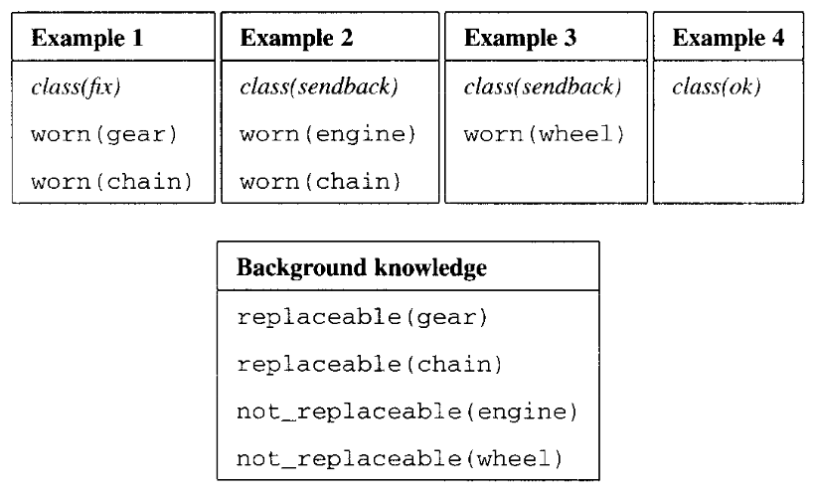
FOLDT: Example
Input examples, background knowledge
Idea of what is to learn:
Check a machine with parts $X$
If machine contains worn parts that cannot be replaced by engineer, send back to manufacturer
If all worn parts can replaced, then fix it
No worn parts, ok
Learning progress
Resulting logic program:
$$true$$
$$false$$
$$true$$
$$false$$
$$true$$
$$false$$
Hendrik Blockeel and Luc De Raedt: Top-down Induction of First-order Logical Decision Trees. In Artificial Intelligence, 1998.
class(ok) $←∀X : ¬worn\left(X\right)$
class(sendback) $←∃X : worn\left(X\right)∧not\text{_}replaceable\left(X\right)$
class(fix) $←∃X : worn\left(X\right)∧$
$∀Y :\left(¬worn\left(Y\right)∨¬not\text{_}replaceable\left(X\right)\right)$

Slide 73
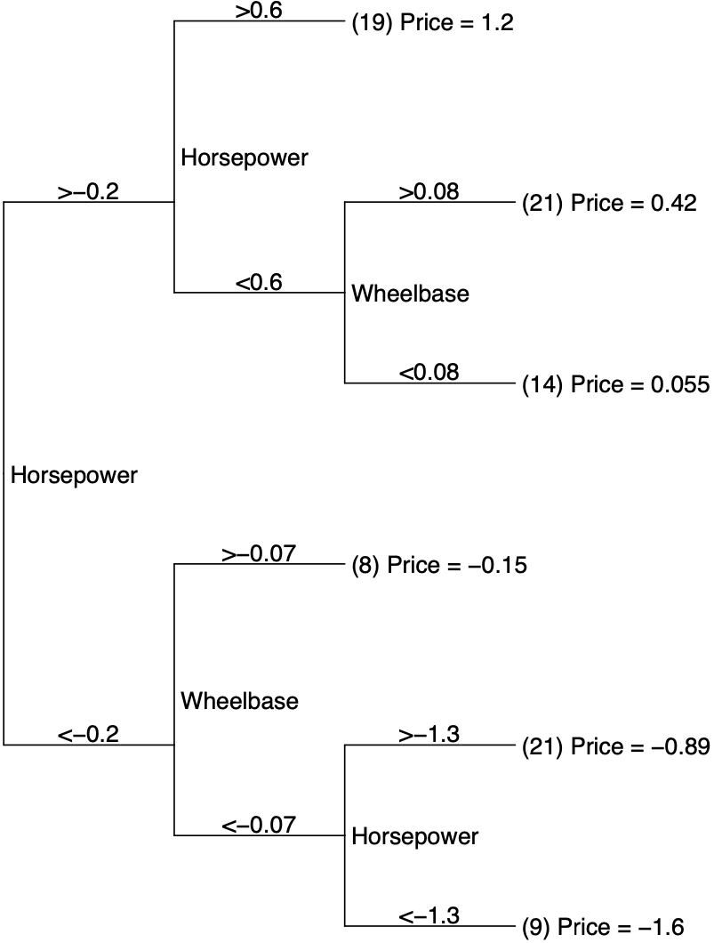
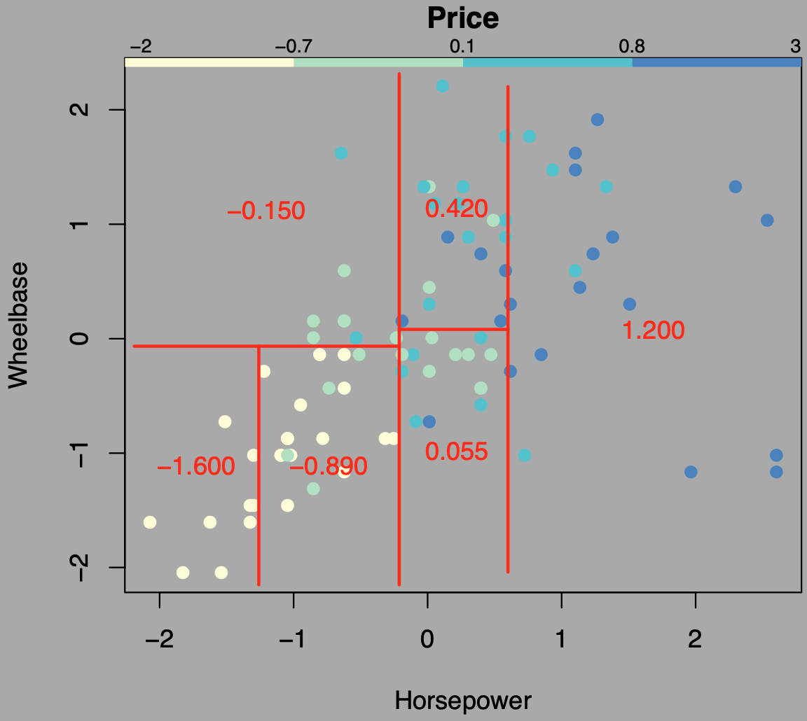
Regression Trees
Regression trees = decision trees with continuous values (regression values) in leaves
Could base decision on variance
Depends on application how regression values are calculated
E.g., predict price of cars
Regression values = average
http://www.stat.cmu.edu/~cshalizi/350-2006/lecture-10.pdf

Slide 74
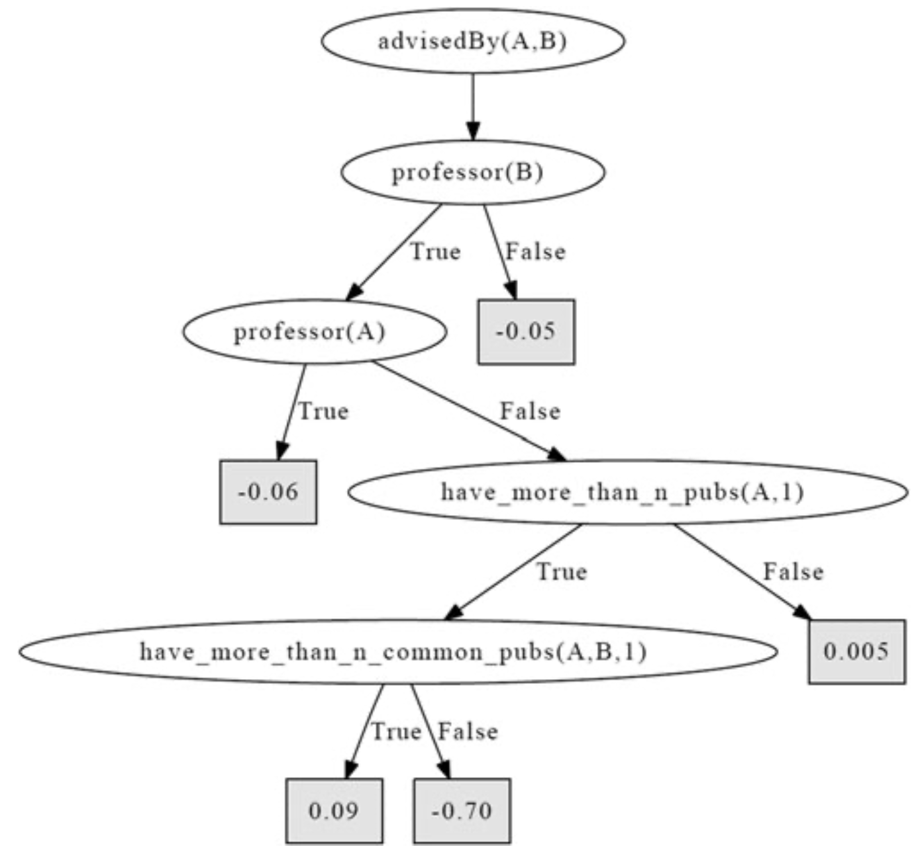
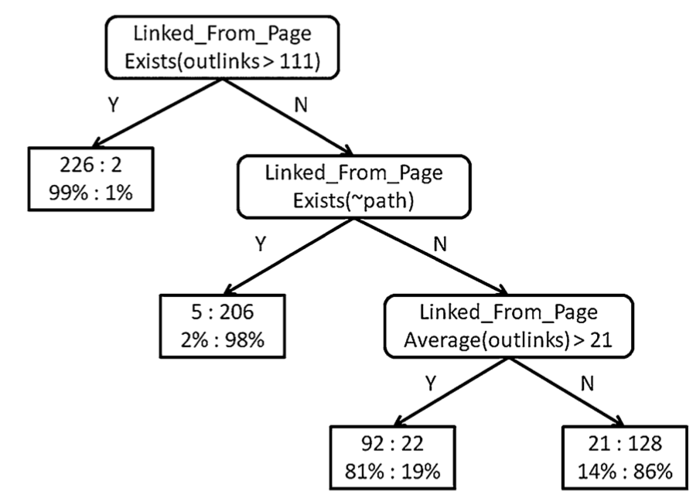
Relational Regression & Probability Trees
Relational regression tree (RRT)
FOLDT with continuous values in leaves
Relational probability tree (RPT)
FOLDT with probability distributions in leaves
Goal: Is $A$ advised by $B$?
Goal: Is a web page a student web page?
(WebKB data set)
There are some differences what they allow inner nodes to be
Not important to grasp the general idea
Left figure: Sriraam Natarajan, Tushar Khot, Kristian Kersting, Bernd Gutmann, Jude Shavlik: Gradient-based Boosting for Statistical Relational Learning: The Relational Dependency Network Case. In Machine Learning, 2012.
Right figure: Jennifer Neville, David Jensen, Lisa Friedland, and Michael Hay: Learning Relational Probability Trees. In SIGKDD-03 Proceedings, 2003. // WebKB data set: http://www.cs.cmu.edu/~webkb/

Slide 75
Learn Approximate Models
Relational dependency networks (RDNs)
Using RPTs for local distributions in RDNs
Boosted learning: Learn a set of distributions to approximate a local distribution
Set of RRTs for local distributions in RDNs
Based on approximate propositional model of dependency networks (DN)
Next slides
DNs
RDNs
Learning RPTs for RDNs
Boosted learning for RDNs

Slide 76
Dependency Networks
Dependency network
Like a BN, i.e., a directed graph, but allowing for cycles
Each node corresponding to randvar $R_{k}$ has a conditional probability distribution (CPD) $P\left(R_{k}|parents\left(R_{k}\right)\right)$ assigned
Approximate model
Represent joint distribution as a product of (conditional) marginals
Does not necessarily result in coherent joint distribution
If no cycles: exact (and equivalent to BN)
If discrete randvars and positive local CPDs ➝ full joint recoverable [see Heckerman et al. (2000) for proof/details]
Allows for learning each distribution independently from the rest
Can work well with large amounts of data
Due to representing conditionals, better suited for classification
CPDs:
$$P\left(A|D\right) \\ P\left(B|A\right) \\ P\left(C|B,D\right) \\ P\left(D|A\right)$$
$$P_{F}\left(r_{f}\right)=\frac{\prod_{f∈F}{P\left(r_{f}\right)}}{\prod_{\left\{i,j\right\}∈E}{P\left(r_{ij}\right)}}$$
$$A$$
$$B$$
$$D$$
$$C$$
David Heckerman, David Maxwell Chickering, Christopher Meek, Robert Rounthwaite, and Carl Kadie: Dependency Networks for Inference, Collaborative Filtering, and Data Visualisation. In Journal of Machine Learning Research, 2000.

Slide 77
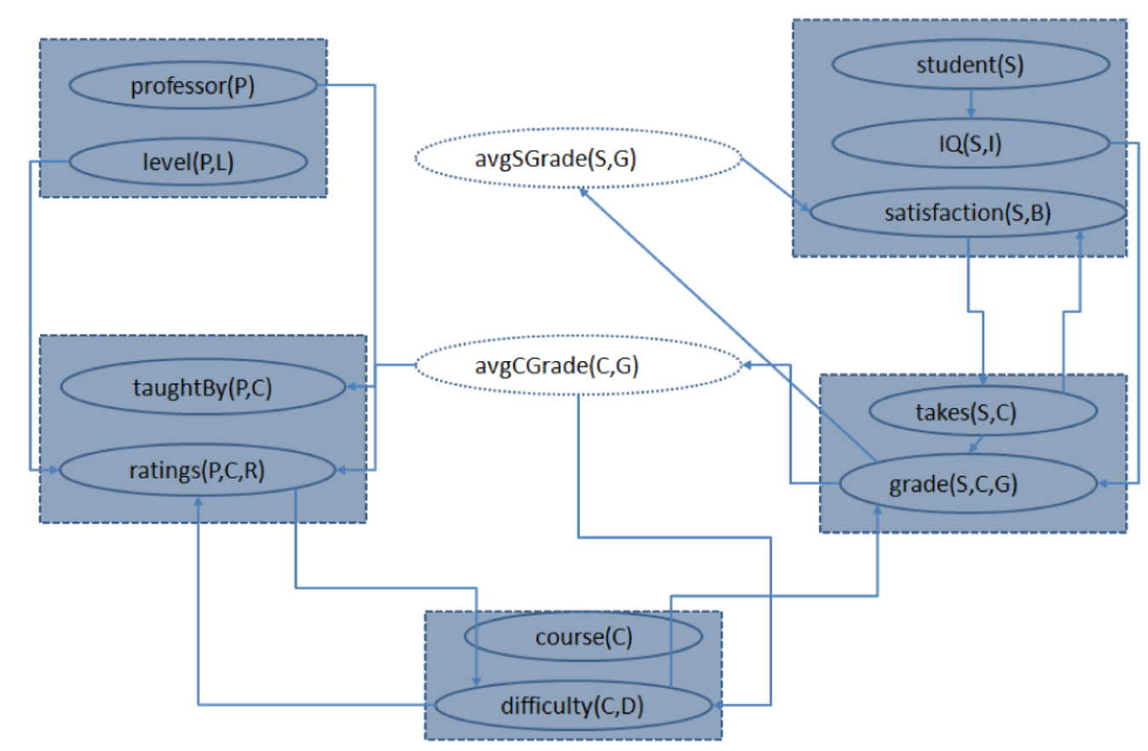
Relational Dependency Networks
Relational aspects explicitly modelled in DN
Relational databases as original motivation and backend for algorithms; logic perspective here
Represent joint distribution as a product of (conditional) marginals over ground atoms
Inference by grounding and unrolling the model such that we have a BN again and then sampling on the ground BN
Each predicate $A_{k}$ associated with a CPD $P\left(A_{k}|parents\left(A_{k}\right)\right)$
Aggregators such as count, max, average
$$P_{F}\left(r_{f}\right)=\frac{\prod_{f∈F}{P\left(r_{f}\right)}}{\prod_{\left\{i,j\right\}∈E}{P\left(r_{ij}\right)}}$$
Jennifer Neville and David Jensen: Relational Dependency Networks. In Journal of Machine Learning Research, 2007.
Figure: Sriraam Natarajan, Tushar Khot, Kristian Kersting, Bernd Gutmann, Jude Shavlik: Gradient-based Boosting for Statistical Relational Learning: The Relational Dependency Network Case. In Machine Learning, 2012.

Slide 78
Learning RPTs for RDNs
Represent CPD not as a table but as an RPT
Learn RPTs individually for each (target) predicate
Construct aggregators: $mode$, $count$, $proportion$, $degree$
Inner nodes: decisions on aggregators
Actually restricted to aggregated predicates
Method: Recursive greedy partitioning
Split on feature that maximises the correlation between feature and class using $χ^{2}$ statistics
Pre-pruning with
$p$-value cut-off at $\frac{0.05}{\#attr}$
depth cut-off at $7$
Class distribution in leaves
$χ^{2}$ statistics: Calculate a so-called $p$-value as roughly the normalised sum of squared deviations between observed and theoretical frequencies
Used in hypothesis testing to test, e.g., if observed values follow a theoretical distribution; given $α$, often $α=0.05$, if $p<α$, reject H₀
(More: Topic 5 here)
Jennifer Neville, David Jensen, Lisa Friedland, and Michael Hay: Learning Relational Probability Trees. In SIGKDD-03 Proceedings, 2003.
Notes:
Goal of this RPT is to predict whether a web page is a student web page based on the number of outgoing links.
Numbers at a leaf node report the number and percentage of positive and negative examples reaching that leaf

Slide 79
Boosting Idea
Use an ensemble of classifiers ($x$: feature vector, $y$: class labels)
Each classifier marginally better than random guessing
Idea: each (simple) classifier works well enough for a subset of the samples but not all of them; loop:
Train a classifier $h_{i}\left(x\right)$ on the current training set, add it to ensemble
Find out which samples do not work well in ensemble, prioritise them, e.g., weight them higher ($w_{i+1}$), in the current training set $S^{′}$
Combine these weak classifiers to one strong classifier $h\left(x\right)$
Using a weighted sum: $h\left(x\right)=\sum_{i}{α_{i}h_{i}\left(x\right)}$
E.g., AdaBoost with decision trees:
$$h\left(x\right)=α_{1}h_{1}\left(x\right)$$
$$+α_{2}h_{2}\left(x\right)$$
$$+…+α_{n}h_{n}\left(x\right)$$
$$S^{′}=\left\{{\left(x,y,w_{1}\right)}_{i}\right\}$$
$$S^{′}=\left\{{\left(x,y,w_{2}\right)}_{i}\right\}$$
$$S^{′}=\left\{{\left(x,y,w_{2}\right)}_{i}\right\}$$
…
Stop when validation
performance plateaus
$$h_{1}\left(x\right)$$
$$h_{2}\left(x\right)$$
$$h_{n}\left(x\right)$$
(more on ensemble methods: Topic 8 here)
https://www.cs.princeton.edu/~schapire/papers/explaining-adaboost.pdf

Slide 80
Functional-gradient Ascent
Models given by
$$\frac{\exp{ψ\left(y;x\right)}}{\sum_{y^{′}}{\exp{ψ\left(y^{′};x\right)}}}$$
Method for potential functions of models
Start with initial potential $ψ_{0}$ and iteratively add gradients $Δ_{i}$
After $m$ iterations, potential is given by
$$ψ_{m}=ψ_{0}+Δ_{1}+…+Δ_{m}$$
$Δ_{m}$ is the functional gradient at iteration $m$ and given by
$$Δ_{m}=η_{m}∙E_{x,y}\left[\frac{∂}{∂ψ_{m−1}}\log{P\left(y|x;ψ_{m−1}\right)}\right]$$
$η_{m}$ learning rate
Basically, each $Δ_{m}$ is a step in the direction of the gradient of the log likelihood function and $η_{m}$ is the parameter that controls the step size
Thomas G. Dietterich, Guohua Hao, and Adam Ashenfelter: Gradient Tree Boosting for Training Conditional Random Fields. In Journal of Machine Learning Research, 2008.

Slide 81
Functional Gradient Tree Boosting
Since full joint unknown, treat data as surrogate
Instead of computing functional gradient over a potential function, functional gradients are computed for each training sample $y_{i};x_{i}$ (conditioned on potential from previous it.)
$$Δ_{m}\left(y_{i};x_{i}\right)=∇_{ψ}\sum_{i}{\log{P\left(y_{i}|x_{i};ψ\right)}{\left.​\right|}_{ψ_{m−1}}}$$
Set of $Δ_{m}\left(y_{i};x_{i}\right)$ over all $i$ form set of training examples
Train a function $h_{m}$ that approximates $Δ_{m}\left(y_{i};x_{i}\right)$
Build/fit a regression tree $h_{m}$ to minimise
$$\sum_{i}{{\left(h_{m}\left(y_{i};x_{i}\right)−Δ_{m}\left(y_{i};x_{i}\right)\right)}^{2}}$$
Fitted function $h_{m}$ not exactly the same as $Δ_{m}$ but will point in same general direction (assuming enough training examples)
Then, the new potential at stage $m$ is given by
$$ψ_{m}=ψ_{m−1}+η_{m}h_{m}$$
After $M$ iterations, there are $M$ regression trees to represent $ψ$
Thomas G. Dietterich, Guohua Hao, and Adam Ashenfelter: Gradient Tree Boosting for Training Conditional Random Fields. In Journal of Machine Learning Research, 2008.

Slide 82
Functional Gradient for RDNs
RDN represented as a set of conditional distributions $P\left(Y|parents\left(Y\right)\right)$ for all predicates $Y$
Let $P\left(y|parents\left(y\right)\right)$ for a grounding $y$ of $Y$ be
$$P\left(y|parents\left(y\right)\right)=\frac{\exp{ψ\left(y;x\right)}}{\sum_{y^{′}}{\exp{ψ\left(y^{′};x\right)}}}$$
where
$∀x∈x, x≠y,$ $ψ\left(y;x\right)$denotes potential function of $y$ given all other $x, x≠y$ and $y^{′}$ iterates through all possible groundings of $Y$
Probability of example/grounding $y_{i}$ of example $i$
$$P\left(y_{i};x_{i}\right)=\frac{\exp{ψ\left(y_{i};x_{i}\right)}}{\sum_{y^{′}}{\exp{ψ\left(y^{′};x_{i}\right)}}}$$
Logarithm of $P\left(y_{i};x_{i}\right)$
$$\log{P\left(y_{i};x_{i}\right)}=\frac{\log{\exp{ψ\left(y_{i};x_{i}\right)}}}{\log{\sum_{y^{′}}{\exp{ψ\left(y^{′};x_{i}\right)}}}} \\ =ψ\left(y_{i};x_{i}\right)−\log{\sum_{y^{′}}{\exp{ψ\left(y^{′};x_{i}\right)}}}$$
Sriraam Natarajan, Tushar Khot, Kristian Kersting, Bernd Gutmann, Jude Shavlik: Gradient-based Boosting for Statistical Relational Learning: The Relational Dependency Network Case. In Machine Learning, 2012.

Slide 83
Functional Gradient for RDNs
$$\log{P\left(y_{i};x_{i}\right)}=ψ\left(y_{i};x_{i}\right)−\log{\sum_{y^{′}}{\exp{ψ\left(y^{′};x_{i}\right)}}}$$
Functional gradient for $y_{i}$ of example $i$
Gradient at each example: adjustment required for the probabilities to match the observed value for that example
Use $y_{i};x_{i}$ and $Δ_{m}\left(y_{i};x_{i}\right)$ for all examples to fit an RRT
$$Δ_{m}\left(y_{i};x_{i}\right)=\frac{∂\log{P\left(y_{i};x_{i}\right)}}{∂ψ\left(y_{i}=1;x_{i}\right)} \\ =I\left(y_{i}=1;x_{i}\right)−\frac{1}{\sum_{y^{′}}{\exp{ψ\left(y^{′};x_{i}\right)}}}\frac{∂}{∂ψ\left(y_{i}=1;x_{i}\right)}\sum_{y^{′}}{\exp{ψ\left(y^{′};x_{i}\right)}} \\ =I\left(y_{i}=1;x_{i}\right)−\frac{\exp{ψ\left(y^{′};x_{i}\right)}}{\sum_{y^{′}}{\exp{ψ\left(y^{′};x_{i}\right)}}}=I\left(y_{i}=1;x_{i}\right)−P\left(y_{i}=1;x_{i}\right)$$
Indicator function that returns $1$ if $a_{i}=1$ and $0$ otherwise
Sriraam Natarajan, Tushar Khot, Kristian Kersting, Bernd Gutmann, Jude Shavlik: Gradient-based Boosting for Statistical Relational Learning: The Relational Dependency Network Case. In Machine Learning, 2012.

Slide 84
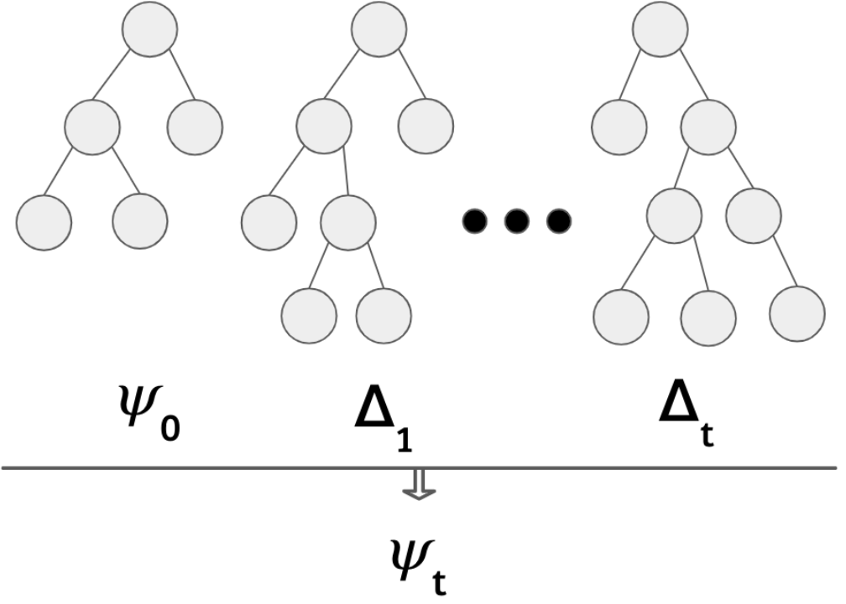
RDN-Boost: Overview
For each $ψ\left(A_{k};parents\left(A_{k}\right)\right)∈F$
I.e., for each predicate $A_{k}$
Build a set of RRTs, which form $ψ$
Each RRT estimates the gradient with which to update $ψ$
Using the gradient of each example of $f$ as training examples
$$P_{F}\left(r_{f}\right)=\frac{\prod_{f∈F}{P\left(r_{f}\right)}}{\prod_{\left\{i,j\right\}∈E}{P\left(r_{ij}\right)}}$$
$$ψ_{0}$$
$$Δ_{1}$$
$$Δ_{m}$$
$$ψ_{m}$$
Left figure: Siwen Yam, Devendra Singh Dhami, and Sriraam Natarajan: The Curious Case of Stacking Boosted Relational Dependency Networks. In 1st I Can’t Believe It’s Not Better Workshop (ICBINB@NeurIPS 2020), 2020.
Right figure: Sriraam Natarajan, Tushar Khot, Kristian Kersting, Bernd Gutmann, Jude Shavlik: Gradient-based Boosting for Statistical Relational Learning: The Relational Dependency Network Case. In Machine Learning, 2012.

Slide 85
RDN-Boost
procedure $\text{TreeBoostForRDNs}(Data)$
for $1≤k≤K$ do ▹Iterate through $K$ predicates
for $1≤m≤M$ do ▹Iterate through $M$ gradient steps
$S_{k}←\text{GenExamples}\left(k;Data;F_{m−1}^{k}\right)$ ▹Generate examples
$Δ_{m}\left(k\right)←\text{FitRelRegressTree}\left(S_{k};L;D\right)$ ▹Functional gradient
$F_{m}^{k}←F_{m−1}^{k}+Δ_{m}\left(k\right)$ ▹Update model
$P\left(a_{k}|parents\left(A_{k}\right)\right)∝ψ^{k}$ ▹ $ψ^{k}$ is obtained by grounding $F_{M}^{k}$
function $\text{GenExamples}\left(k, Data, F\right)$
$S←∅$
for $1≤i≤N_{k}$ do ▹Iterative over all examples
Compute $P\left(y_{k}^{i}=1;x_{k}^{i}\right),x_{k}^{i}=parents\left(y_{k}^{i}\right)$ ▹Probab. of $y_{k}^{i}$ being true
$Δ\left(y_{k}^{i};x_{k}^{i}\right)←I\left(y_{k}^{i}=1\right)−P\left(y_{k}^{i}=1;x_{k}^{i}\right)$ ▹Compute gradient
$S←S∪\left\{\left(\left(x_{k}^{i},y_{k}^{i}\right),Δ\left(y_{k}^{i};x_{k}^{i}\right)\right)\right\}$ ▹Update regression examples
return $S$
function $\text{FitRelRegressTree}$ returns an RRT fitted for $S_{k}$ with a maximum of $L$ leaves and a maximum depth $D$ (cut-off criteria)
FOIL: extend example
Sriraam Natarajan, Tushar Khot, Kristian Kersting, Bernd Gutmann, Jude Shavlik: Gradient-based Boosting for Statistical Relational Learning: The Relational Dependency Network Case. In Machine Learning, 2012.

Slide 86
Bagging
Ensemble method that reduces variance compared to boosting reducing bias
Compare: Random forests
Set of decision trees
Each tree learned on
Sampled subset of training instances
Sampled set of features available for each decision
Combine both: Learn a set of boosted RDN models
Each run of RDN-Boost uses a sampled subset of the training examples
Only consider a random 50% of the candidate literals
Increased prediction accuracy + easy parallelisation
Boosting does decrease variance with a large number of gradient steps, so bagging + boosting only has positive effect if considering small number of gradient steps
Sriraam Natarajan, Tushar Khot, Kristian Kersting, Bernd Gutmann, Jude Shavlik: Gradient-based Boosting for Statistical Relational Learning: The Relational Dependency Network Case. In Machine Learning, 2012.

Slide 87
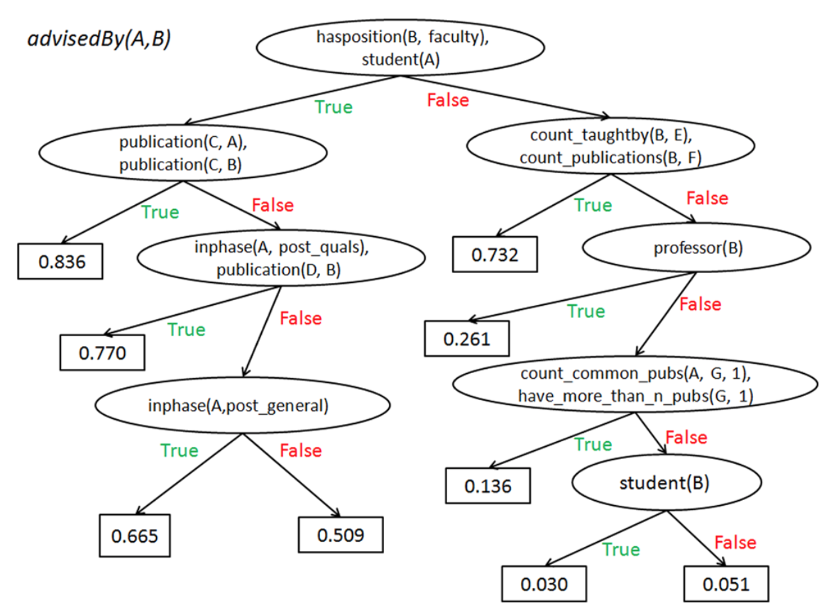
Interpretability
Set of RRTs not really interpretable
Combine all RRTs into one tree and produce probabilities in leaves for interpretation by humans
Sriraam Natarajan, Tushar Khot, Kristian Kersting, Bernd Gutmann, Jude Shavlik: Gradient-based Boosting for Statistical Relational Learning: The Relational Dependency Network Case. In Machine Learning, 2012.

Slide 88
Interim Summary
FOIL
Logic based: Learn relations given examples, background knowledge and a target concept
First-order logical decision trees
Logic based: Learn relations in tree form given examples, background knowledge and a target concept
Regression/probability trees
Leaves with continuous values/probability distributions
Relational versions: predicates in inner nodes
Represent conditional distributions as trees
Boosting
Set of trees to represent distributions
Can construct weighted FOL formulas to build an MLN and then convert it to whatever form one needs (FOKC; LVE/LJT)
Very little work on learning the structure of general parameterised models or MLNs

Slide 89
Other Stuff
Lifted BP
Deterministically approximate
Based on colour passing
Lifted orbits

Slide 90
Outline: 4. Lifted Learning
Recap: Learning directed models
Maximum likelihood (ML) estimation, expectation-maximisation (EM), structural EM
Learning undirected models
Iterative fitting procedure
Lifted encoding of propositional models
Colour passing
Statistical relational learning
First-order inductive learning
Decision tree representations
⇒ Next: Approximate Inference

