Slide 1
Intelligent Agents:
Web-mining Agents
Probabilistic Graphical Models
Sequential Models & Inference
Tanya Braun

Slide 2
Probabilistic Graphical Models (PGMs)
Recap: Propositional modelling
  Factor model, Bayesian network, Markov network
  Semantics, inference tasks
  + algorithms + complexity
Probabilistic relational models (PRMs)
  Parameterised models, Markov logic networks
  Semantics, inference tasks
Lifted inference
  LVE, LJT, FOKC
  Theoretical analysis
Lifted learning
  Recap: propositional learning
  From ground to lifted models
  Direct lifted learning
Approximate Inference: Sampling
  Importance sampling
  MCMC methods
Sequential models & inference
  Dynamic PRMs
  Semantics, inference tasks
  + algorithms + complexity, learning
Decision making
  (Dynamic) Decision PRMs
  Semantics, inference tasks
  + algorithms, learning
Continuous Models
  Probabilistic soft logic: modelling, semantics, inference tasks + algorithms

Slide 3
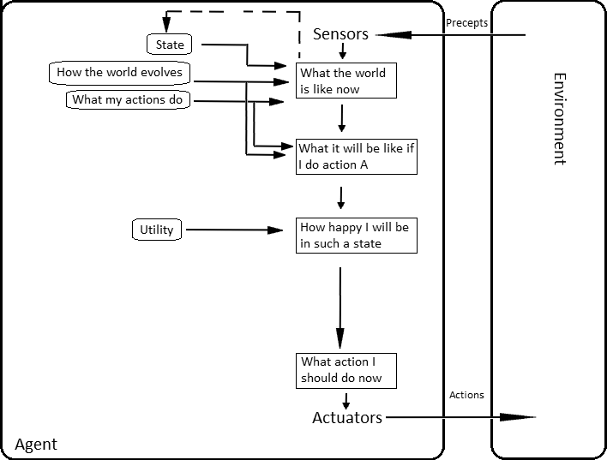
Setting: Agent with Utilities
AIMA, Russell/Norvig

Slide 4
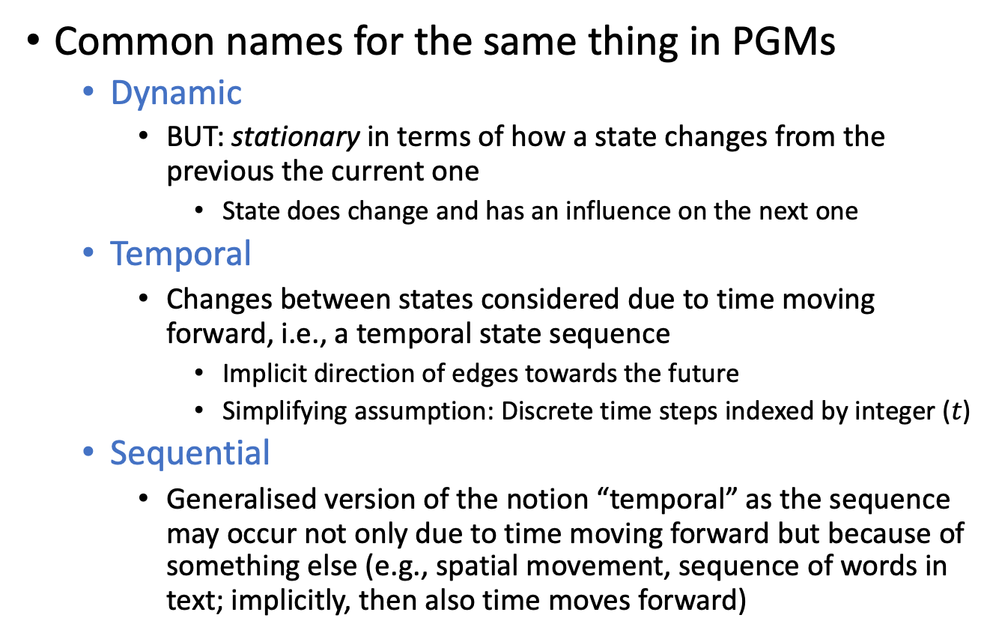
A Note on Naming Conventions
Common names for the same thing in PGMs
  Dynamic
    BUT: stationary in terms of how a state changes from the previous the current one
      State does change and has an influence on the next one
  Temporal
    Changes between states considered due to time moving forward, i.e., a temporal state sequence
      Implicit direction of edges towards the future
      Simplifying assumption: Discrete time steps indexed by integer ($t$)
  Sequential
    Generalised version of the notion “temporal” as the sequence may occur not only due to time moving forward but because of something else (e.g., spatial movement, sequence of words in text; implicitly, then also time moves forward)

Slide 5

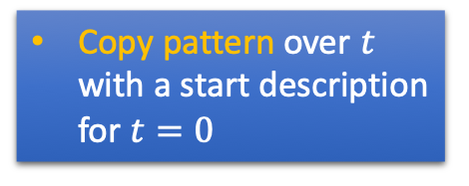
Remember in IR Topic 4: DBNs
Actually, a specific DBN: Hidden Markov model (HMM)
  One state randvar $R_{t}$
    Latent (hidden)
  One evidence randvar $E_{t}$
    Observable
  Two CPTs (+ prior for $R_{0}$)
    State transition: $P\left(R_{t}|R_{t−1}\right)$
    Evidence emission: $P\left(E_{t}|R_{t}\right)$
Copy pattern over $t$ with a start description for $t=0$
R_{t-1} | P(R_{t}|R_{t-1})
T F | 0.7 0.3
P(R₀)
Rain₀
…
Rain_{t-1}
Rain_{t}
R_{t} | P(U_{t}|R_{t})
T F | 0.9 0.2
Umbrella_{t-1}
Umbrella_{t}
Time slices

Slide 6
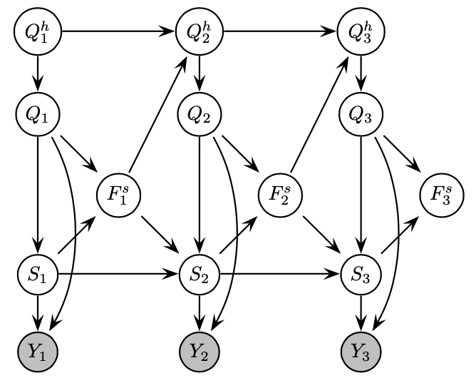

DBNs: Generalising HMMs
Set of randvars
  Some latent, some observable
  (marked grey in figure)
Set of CPTs connecting randvars
(+ description for $t=0$)
  Within a time step:
  only $t$ occur as indices
  Between time steps:
  different $t$’s occur as indices
    If only $t$ and $t−1$ occur:
    Markov-1 assumption (as in HMMs)
Copied for each time step
Turn a discrete DBN into an HMM by combining all latent randvars into one and all observable randvars into another randvar, multiplying CPTs accordingly
  Gives up the (conditional) independences between randvars
  ➝ may (greatly) increase the number of entries in the CPTs
Time slices
Figure: Kevin P. Murphy: Dynamic Bayesian Networks: Representation, Inference and Learning. PhD thesis, University of California, Berkeley, 2002.

Slide 7

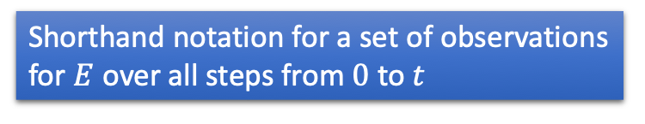
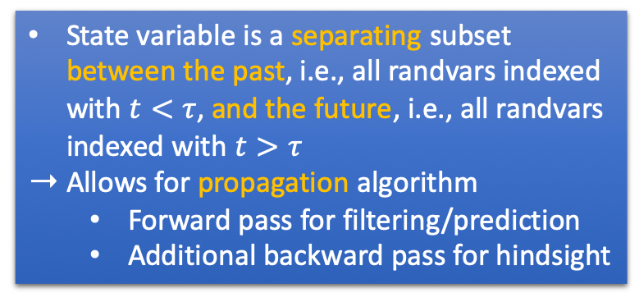
Tasks in HMMs
Query $P\left(R_{π}|E_{0:τ}\right)$, $τ$ the current step
  Filtering: $π=τ$
  Prediction: $π>τ$
  Hindsight: $π<τ$
    Also called smoothing
  MPE
    In HMMs: solved by
    Viterbi algorithm
Shorthand notation for a set of observations for $E$ over all steps from $0$ to $t$
State variable is a separating subset between the past, i.e., all randvars indexed with $t<τ$, and the future, i.e., all randvars indexed with $t>τ$
Allows for propagation algorithm
  Forward pass for filtering/prediction
  Additional backward pass for hindsight
Rain₀
…
Rain_{t-1}
Rain_{t}
Umbrella_{t-1}
Umbrella_{t}
Time slices

Slide 8
Solving Tasks in DBNs
Not one randvar that separates past from future
Find separating subset that make the past independent from the present and the present independent from the future
  So called interface
    Separates current slice from previous and subsequent slices
To automatically find
interfaces and specify
a similar propagation
algorithm, we will use
jtrees again
  Collect information about
  past at forward interface
  and send it onwards
Time slices
Kevin P. Murphy: Dynamic Bayesian Networks: Representation, Inference and Learning. PhD thesis, University of California, Berkeley, 2002.

Slide 9
Outline: 6. Sequential Models & Inf.
Lifted modelling of sequences
  Parameterised dynamic models (PDMs)
  Modelling, semantics
Lifted dynamic inference
  Inference tasks
  Interfaces
  Lifted dynamic junction tree algorithm (LDJT)
  Theoretical analysis: complexity
Keeping inference polynomial
  Problem of evidence over time in lifted models
  Temporal approximate merging (TAMe)

Slide 10
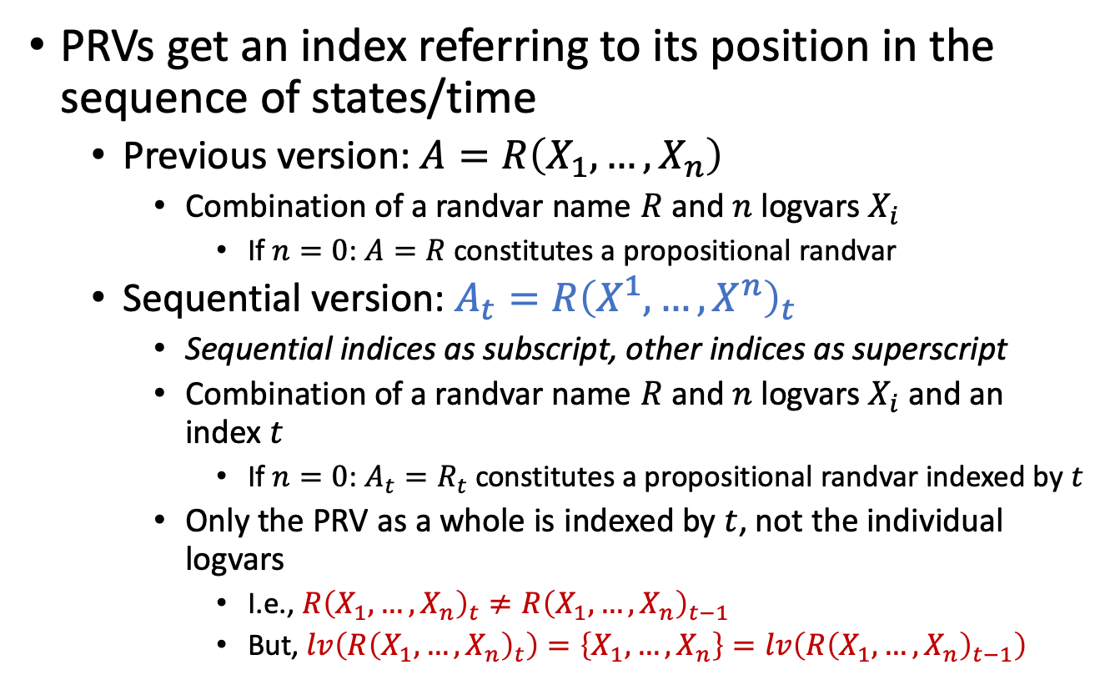
Step/Time-indexed PRVs
PRVs get an index referring to its position in the sequence of states/time
  Previous version: $A=R\left(X_{1},…, X_{n}\right)$
    Combination of a randvar name $R$ and $n$ logvars $X_{i}$
      If $n=0$: $A=R$ constitutes a propositional randvar
  Sequential version: $A_{t}=R{\left(X^{1},…, X^{n}\right)}_{t}$
    Sequential indices as subscript, other indices as superscript
    Combination of a randvar name $R$ and $n$ logvars $X_{i}$ and an
    index $t$
      If $n=0$: $A_{t}=R_{t}$ constitutes a propositional randvar indexed by $t$
    Only the PRV as a whole is indexed by $t$, not the individual logvars
      I.e., $R{\left(X_{1},…, X_{n}\right)}_{t}≠R{\left(X_{1},…, X_{n}\right)}_{t−1}$
      But, $lv\left(R{\left(X_{1},…, X_{n}\right)}_{t}\right)=\left\{X_{1},…, X_{n}\right\}=lv\left(R{\left(X_{1},…, X_{n}\right)}_{t−1}\right)$
Marcel Gehrke, Tanya Braun, and Ralf Möller. Lifted Dynamic Junction Tree Algorithm. In ICCS-18 Proceedings of the International Conference on Conceptual Structures, 2018.

Slide 11
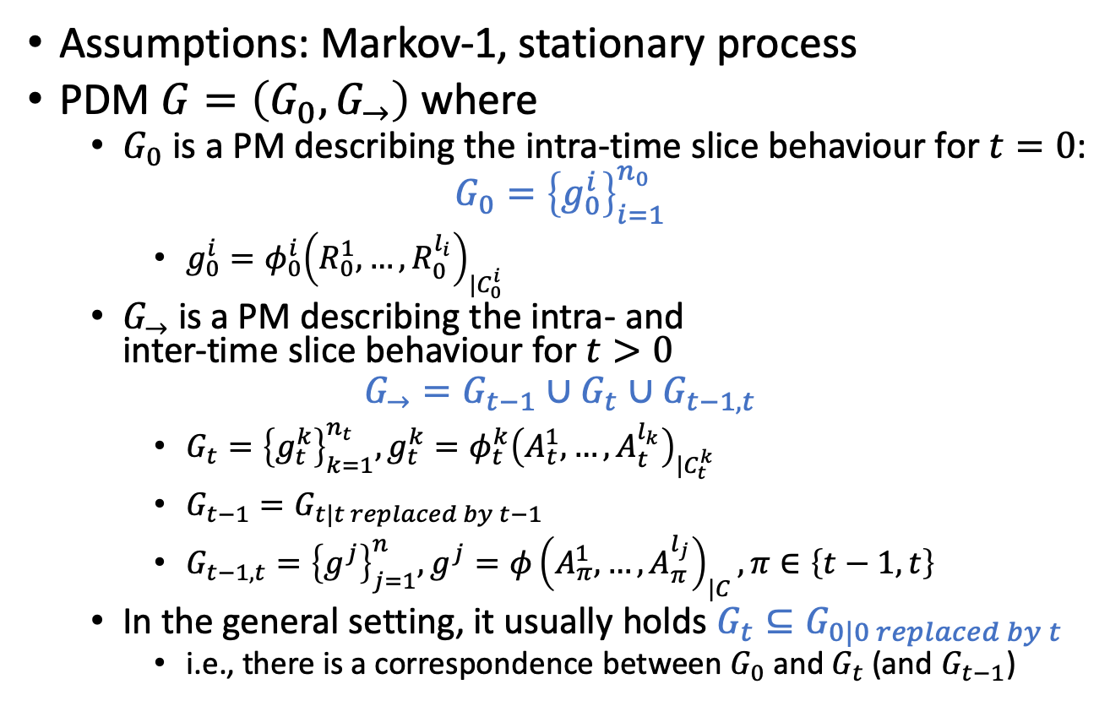
Parameterised Dynamic Models (PDMs)
Assumptions: Markov-1, stationary process
PDM $G=\left(G_{0},G_{→}\right)$ where
  $G_{0}$ is a PM describing the intra-time slice behaviour for $t=0$:
  $$G_{0}={\left\{g_{0}^{i}\right\}}_{i=1}^{n_{0}}$$
    $g_{0}^{i}=φ_{0}^{i}{\left(R_{0}^{1},…,R_{0}^{l_{i}}\right)}_{|C_{0}^{i}}$
  $G_{→}$ is a PM describing the intra- and
  inter-time slice behaviour for $t>0$
  $$G_{→}=G_{t−1}∪G_{t}∪G_{t−1,t}$$
    $G_{t}={\left\{g_{t}^{k}\right\}}_{k=1}^{n_{t}},g_{t}^{k}=φ_{t}^{k}{\left(A_{t}^{1},…,A_{t}^{l_{k}}\right)}_{|C_{t}^{k}}$
    $G_{t−1}=G_{t|t replaced by t−1}$
    $G_{t−1,t}={\left\{g^{j}\right\}}_{j=1}^{n},g^{j}=φ{\left(A_{π}^{1},…,A_{π}^{l_{j}}\right)}_{|C}, π∈\left\{t−1,t\right\}$
  In the general setting, it usually holds $G_{t}⊆G_{0|0 replaced by t}$
    i.e., there is a correspondence between $G_{0}$ and $G_{t}$ (and $G_{t−1}$)
Also called a 2-(time) slice model as it contains descriptions for two time slices
Marcel Gehrke, Tanya Braun, and Ralf Möller. Lifted Dynamic Junction Tree Algorithm. In ICCS-18 Proceedings of the International Conference on Conceptual Structures, 2018.

Slide 12





















PDM: Example
$G_{0}=\left\{g_{0}^{1},g_{0}^{2},g_{0}^{3}\right\}$
$G_{→}=\left\{g_{t−1}^{2},g_{t−1}^{3}\right\}∪\left\{g_{t}^{2},g_{t}^{3}\right\}∪\left\{g^{E}\right\}$
$$g_{0}^{1}$$
$${Epid}_{0}$$
$$Treat{\left(X,M\right)}_{0}$$
$$g_{0}^{2}$$
$$g_{0}^{3}$$
$${Travel\left(X\right)}_{0}$$
$${Sick\left(X\right)}_{0}$$
$$g^{E}$$
$${Epid}_{t−1}$$
$${Epid}_{t}$$
$$Treat{\left(X,M\right)}_{t−1}$$
$$Treat{\left(X,M\right)}_{t}$$
$$g_{t−1}^{2}$$
$$g_{t−1}^{3}$$
$$g_{t}^{2}$$
$$g_{t}^{3}$$
$${Travel\left(X\right)}_{t−1}$$
$${Sick\left(X\right)}_{t−1}$$
$${Travel\left(X\right)}_{t}$$
$${Sick\left(X\right)}_{t}$$
Time slices

Slide 13


HMMs as PDMs
PDM $G=\left(G_{0},G_{→}\right)$
  $G_{0}={\left\{g^{i}\right\}}_{i=1}^{n_{0}}$
  $G_{→}=$
  $G_{t−1}∪G_{t}∪G_{t−1,t}$
In the HMM setting,
  $G_{0}=\left\{P\left(R_{0}\right)\right\}$
  $G_{t}=\left\{P\left(E_{t} | R_{t}\right)\right\}$
  $G_{t−1}=\left\{P\left(E_{t−1} | R_{t−1}\right)\right\}$
  $G_{t−1,t}=\left\{P\left(R_{t}|R_{t−1}\right)\right\}$
R_{t-1} | P(R_{t}|R_{t-1})
T F | 0.7 0.3
P(R₀)
Rain₀
…
Rain_{t-1}
Rain_{t}
R_{t} | P(U_{t}|R_{t})
T F | 0.9 0.2
Umbrella_{t-1}
Umbrella_{t}
Time slices

Slide 14
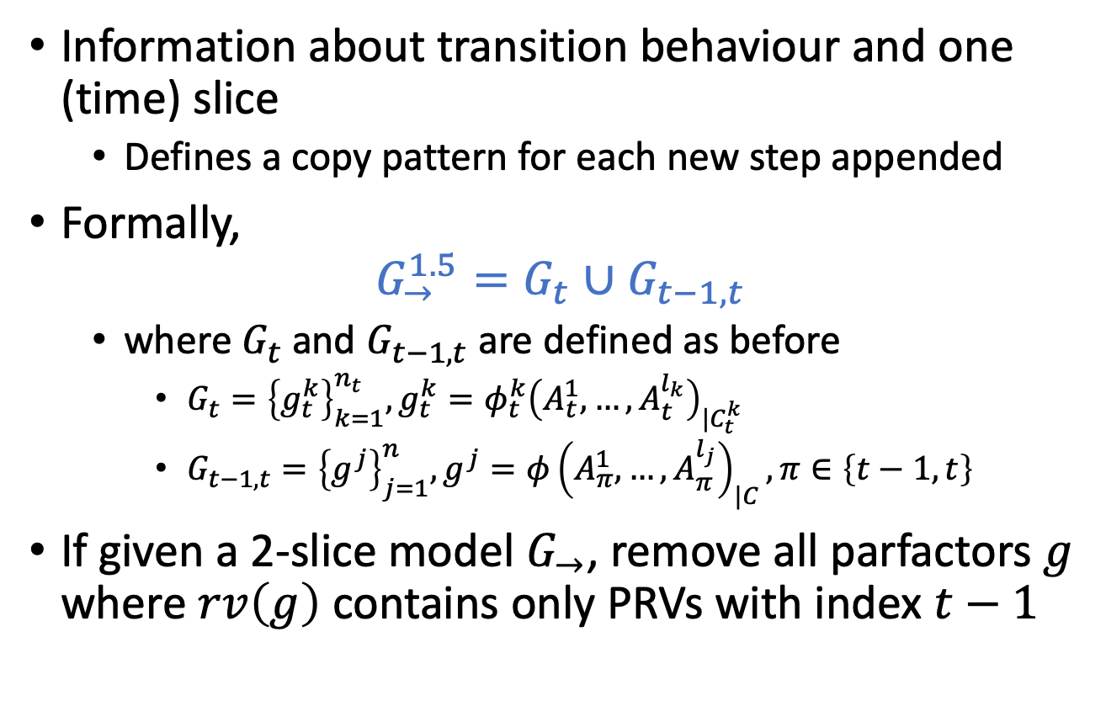
1.5-slice Model
Information about transition behaviour and one (time) slice
  Defines a copy pattern for each new step appended
Formally,
$$G_{→}^{1.5}=G_{t}∪G_{t−1,t}$$
  where $G_{t}$ and $G_{t−1,t}$ are defined as before
    $G_{t}={\left\{g_{t}^{k}\right\}}_{k=1}^{n_{t}},g_{t}^{k}=φ_{t}^{k}{\left(A_{t}^{1},…,A_{t}^{l_{k}}\right)}_{|C_{t}^{k}}$
    $G_{t−1,t}={\left\{g^{j}\right\}}_{j=1}^{n},g^{j}=φ{\left(A_{π}^{1},…,A_{π}^{l_{j}}\right)}_{|C}, π∈\left\{t−1,t\right\}$
If given a 2-slice model $G_{→}$, remove all parfactors $g$ where $rv\left(g\right)$ contains only PRVs with index $t−1$

Slide 15



















1.5-slice Model: Example
2-slice model
1.5-slice model
$$g^{E}$$
$${Epid}_{t−1}$$
$${Epid}_{t}$$
$$Treat{\left(X,M\right)}_{t−1}$$
$$Treat{\left(X,M\right)}_{t}$$
$$g_{t−1}^{2}$$
$$g_{t−1}^{3}$$
$$g_{t}^{2}$$
$$g_{t}^{3}$$
$${Travel\left(X\right)}_{t−1}$$
$${Sick\left(X\right)}_{t−1}$$
$${Travel\left(X\right)}_{t}$$
$${Sick\left(X\right)}_{t}$$
$$g^{E}$$
$${Epid}_{t−1}$$
$${Epid}_{t}$$
$$Treat{\left(X,M\right)}_{t}$$
$$g_{t}^{2}$$
$$g_{t}^{3}$$
$${Sick\left(X\right)}_{t−1}$$
$${Travel\left(X\right)}_{t}$$
$${Sick\left(X\right)}_{t}$$

Slide 16
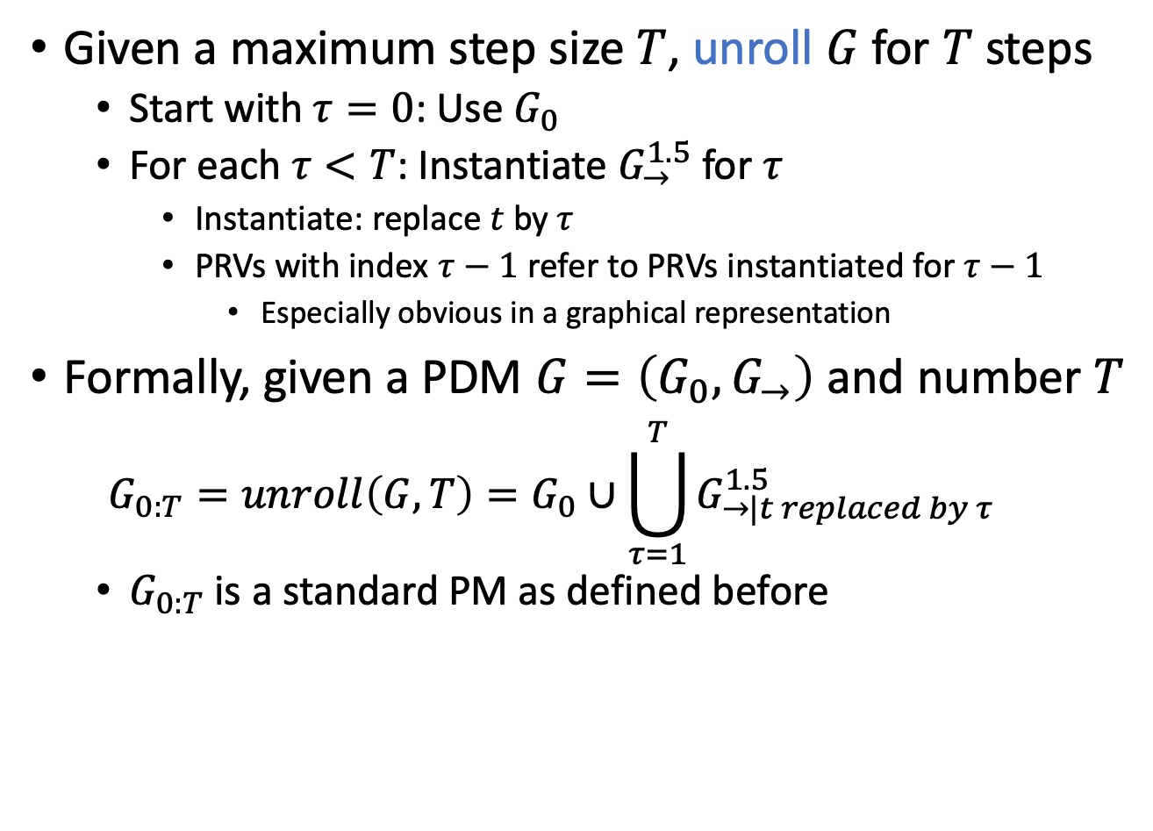
Unrolling a PDM
Given a maximum step size $T$, unroll $G$ for $T$ steps
  Start with $τ=0$: Use $G_{0}$
  For each $τ<T$: Instantiate $G_{→}^{1.5}$ for $τ$
    Instantiate: replace $t$ by $τ$
    PRVs with index $τ−1$ refer to PRVs instantiated for $τ−1$
      Especially obvious in a graphical representation
Formally, given a PDM $G=\left(G_{0},G_{→}\right)$ and number $T$
  $$G_{0:T}=unroll\left(G,T\right)=G_{0}∪\bigcup_{τ=1}^{T}{G_{→|t replaced by τ}^{1.5}}$$
  $G_{0:T}$ is a standard PM as defined before

Slide 17



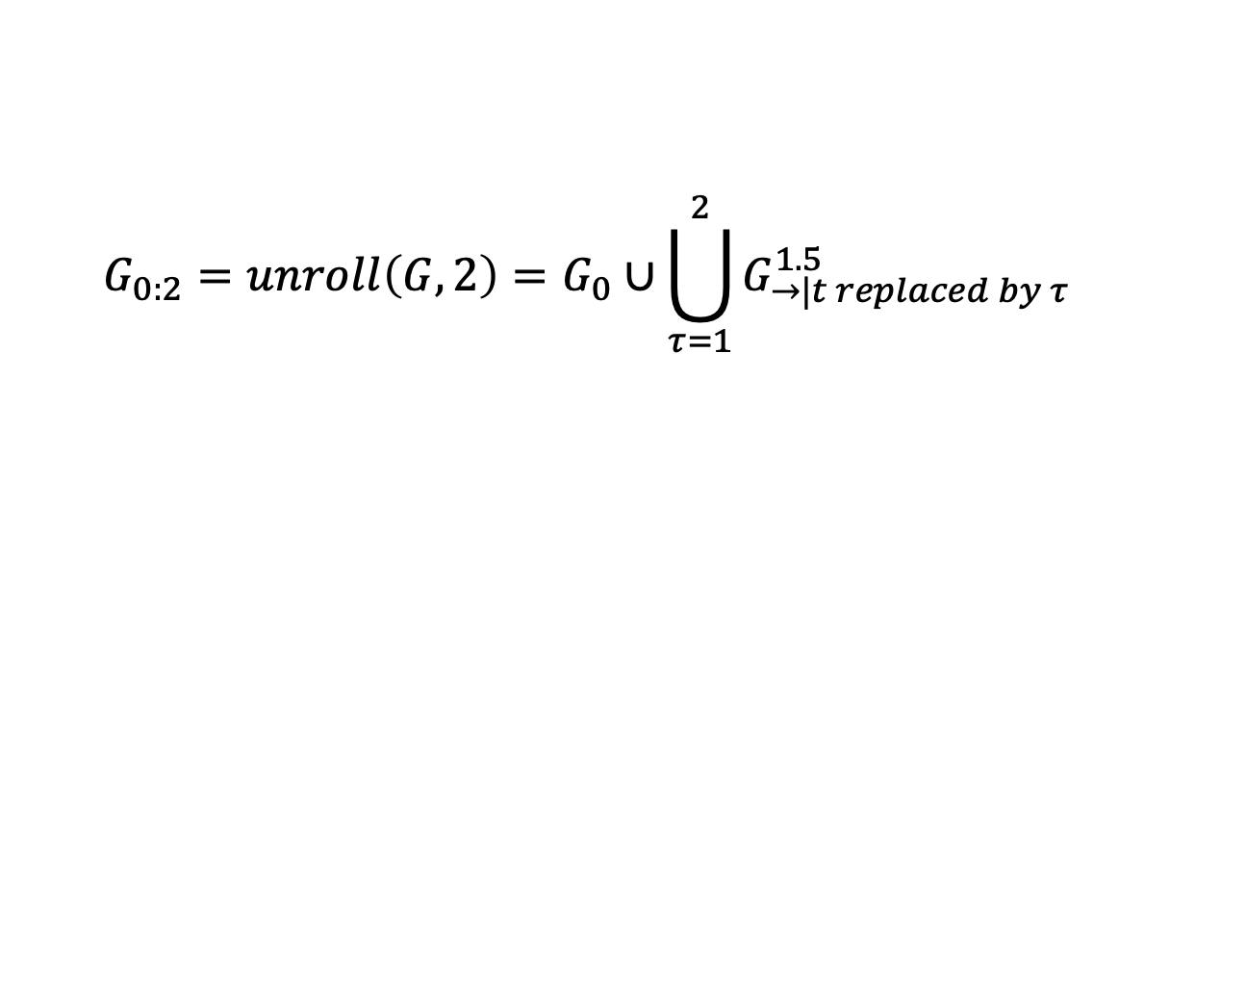


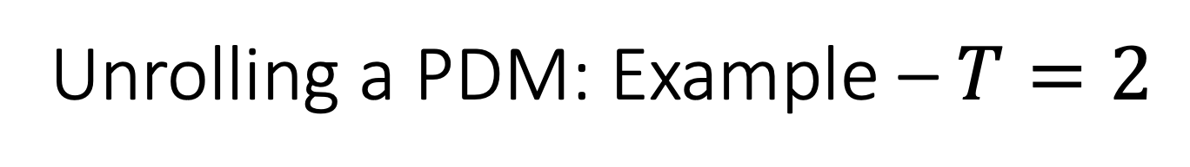

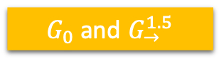









Unrolling a PDM: Example – $T=2$
  $$G_{0:2}=unroll\left(G,2\right)=G_{0}∪\bigcup_{τ=1}^{2}{G_{→|t replaced by τ}^{1.5}}$$
$$g_{0}^{1}$$
$${Epid}_{0}$$
$$Treat{\left(X,M\right)}_{0}$$
$G_{0}$ and $G_{→}^{1.5}$
$$g_{0}^{2}$$
$$g_{0}^{3}$$
$${Travel\left(X\right)}_{0}$$
$${Sick\left(X\right)}_{0}$$
$$g^{E}$$
$${Epid}_{t−1}$$
$${Epid}_{t}$$
$$Treat{\left(X,M\right)}_{t}$$
$$g_{t}^{2}$$
$$g_{t}^{3}$$
$${Sick\left(X\right)}_{t−1}$$
$${Travel\left(X\right)}_{t}$$
$${Sick\left(X\right)}_{t}$$

Slide 18
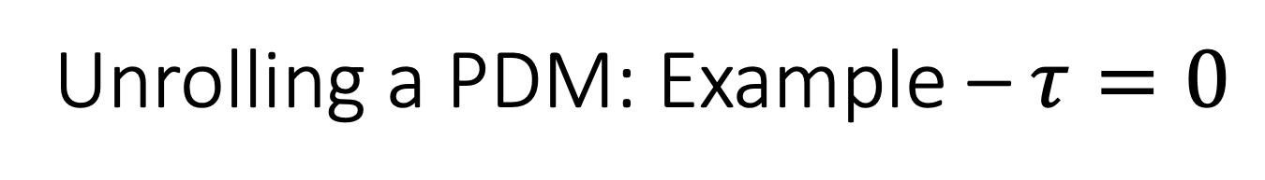
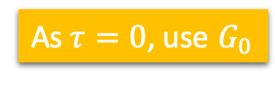
Unrolling a PDM: Example – $τ=0$
  $$G_{0:2}=unroll\left(G,2\right)=G_{0}∪\bigcup_{τ=1}^{2}{G_{→|t replaced by τ}^{1.5}}$$
$$g_{0}^{1}$$
$${Epid}_{0}$$
$$Treat{\left(X,M\right)}_{0}$$
As $τ=0$, use $G_{0}$
$$g_{0}^{2}$$
$$g_{0}^{3}$$
$${Travel\left(X\right)}_{0}$$
$${Sick\left(X\right)}_{0}$$

Slide 19


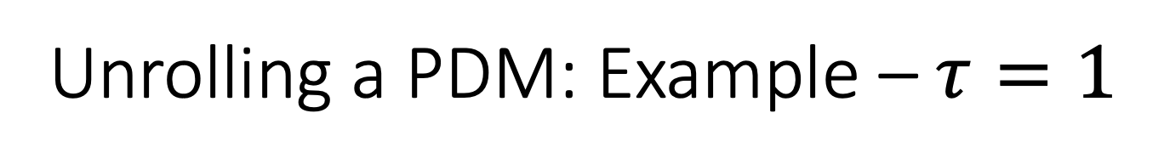

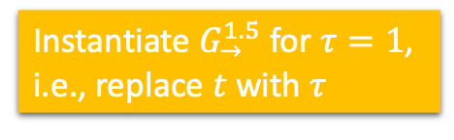



Unrolling a PDM: Example – $τ=1$
  $$G_{0:2}=unroll\left(G,2\right)=G_{0}∪\bigcup_{τ=1}^{2}{G_{→|t replaced by τ}^{1.5}}$$
$$g_{0}^{1}$$
$${Epid}_{0}$$
$$Treat{\left(X,M\right)}_{0}$$
Instantiate $G_{→}^{1.5}$ for $τ=1$, i.e., replace $t$ with $τ$
$$g_{0}^{2}$$
$$g_{0}^{3}$$
$${Travel\left(X\right)}_{0}$$
$${Sick\left(X\right)}_{0}$$
$$g^{E}$$
$${Epid}_{1−1}$$
$${Epid}_{1}$$
$$Treat{\left(X,M\right)}_{1}$$
$$g_{t}^{2}$$
$$g_{t}^{3}$$
$${Sick\left(X\right)}_{1−1}$$
$${Travel\left(X\right)}_{1}$$
$${Sick\left(X\right)}_{1}$$

Slide 20

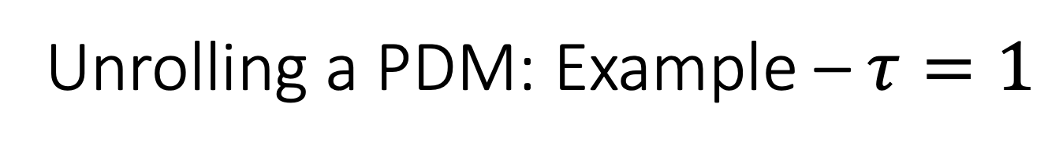
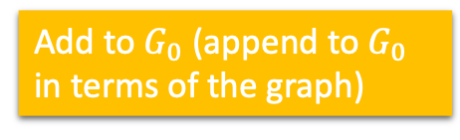

Unrolling a PDM: Example – $τ=1$
  $$G_{0:2}=unroll\left(G,2\right)=G_{0}∪\bigcup_{τ=1}^{2}{G_{→|t replaced by τ}^{1.5}}$$
$$g_{0}^{1}$$
$${Epid}_{0}$$
$$Treat{\left(X,M\right)}_{0}$$
Add to $G_{0}$ (append to $G_{0}$ in terms of the graph)
$$g_{0}^{2}$$
$$g_{0}^{3}$$
$${Travel\left(X\right)}_{0}$$
$${Sick\left(X\right)}_{0}$$
$$g^{E}$$
$${Epid}_{0}$$
$${Epid}_{1}$$
$$Treat{\left(X,M\right)}_{1}$$
$$g_{t}^{2}$$
$$g_{t}^{3}$$
$${Sick\left(X\right)}_{0}$$
$${Travel\left(X\right)}_{1}$$
$${Sick\left(X\right)}_{1}$$

Slide 21















Unrolling a PDM: Example – $τ=1$
  $$G_{0:2}=unroll\left(G,2\right)=G_{0}∪\bigcup_{τ=1}^{2}{G_{→|t replaced by τ}^{1.5}}$$
$$G_{0:τ}=G_{0:1}=G_{0}∪G_{→|t replaced by 1}^{1.5}$$
$$g^{E}$$
$$g_{0}^{1}$$
$${Epid}_{0}$$
$${Epid}_{1}$$
$$Treat{\left(X,M\right)}_{0}$$
$$Treat{\left(X,M\right)}_{1}$$
$$g_{0}^{2}$$
$$g_{0}^{3}$$
$$g_{t}^{2}$$
$$g_{t}^{3}$$
$${Travel\left(X\right)}_{0}$$
$${Sick\left(X\right)}_{0}$$
$${Travel\left(X\right)}_{1}$$
$${Sick\left(X\right)}_{1}$$

Slide 22







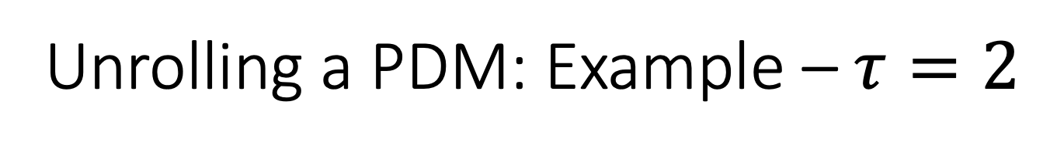









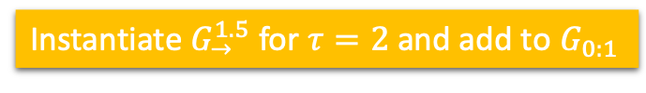



Unrolling a PDM: Example – $τ=2$
  $$G_{0:2}=unroll\left(G,2\right)=G_{0}∪\bigcup_{τ=1}^{2}{G_{→|t replaced by τ}^{1.5}}$$
Instantiate $G_{→}^{1.5}$ for $τ=2$ and add to $G_{0:1}$
$$g^{E}$$
$$g^{E}$$
$$g_{0}^{1}$$
$${Epid}_{0}$$
$${Epid}_{1}$$
$${Epid}_{2}$$
$$Treat{\left(X,M\right)}_{0}$$
$$Treat{\left(X,M\right)}_{1}$$
$$Treat{\left(X,M\right)}_{2}$$
$$g_{0}^{2}$$
$$g_{0}^{3}$$
$$g_{t}^{2}$$
$$g_{t}^{3}$$
$$g_{t}^{2}$$
$$g_{t}^{3}$$
$${Travel\left(X\right)}_{0}$$
$${Sick\left(X\right)}_{0}$$
$${Travel\left(X\right)}_{1}$$
$${Sick\left(X\right)}_{1}$$
$${Travel\left(X\right)}_{2}$$
$${Sick\left(X\right)}_{2}$$
$$G_{0:τ}=G_{0:2}=unroll\left(G,2\right)$$

Slide 23







PDM: Semantics
Given a PDM $G=\left(G_{0},G_{→}\right)$ and number $T$, semantics as defined for PMs
  Unrolling for $T$ steps, grounding, and building a full joint distribution
$$P_{\left(G,T\right)}=\frac{1}{Z}\prod_{f∈gr\left(G_{0:T}\right)}{f}$$
After unrolling for $T=2$
$$g^{E}$$
$$g^{E}$$
$$g_{0}^{1}$$
$${Epid}_{0}$$
$${Epid}_{1}$$
$${Epid}_{2}$$
$$Treat{\left(X,M\right)}_{0}$$
$$Treat{\left(X,M\right)}_{1}$$
$$Treat{\left(X,M\right)}_{2}$$
$$g_{0}^{2}$$
$$g_{0}^{3}$$
$$g_{t}^{2}$$
$$g_{t}^{3}$$
$$g_{t}^{2}$$
$$g_{t}^{3}$$
$${Travel\left(X\right)}_{0}$$
$${Sick\left(X\right)}_{0}$$
$${Travel\left(X\right)}_{1}$$
$${Sick\left(X\right)}_{1}$$
$${Travel\left(X\right)}_{2}$$
$${Sick\left(X\right)}_{2}$$
Marcel Gehrke, Tanya Braun, and Ralf Möller. Lifted Dynamic Junction Tree Algorithm. In ICCS-18 Proceedings of the International Conference on Conceptual Structures, 2018.

Slide 24










































PDM: Semantics
After grounding
  $𝒟\left(X\right)=\left\{a,e,b\right\},𝒟\left(M\right)=\left\{m\right\}$
$$g^{E}$$
$$g^{E}$$
$$g_{0}^{1}$$
$${Epid}_{0}$$
$${Epid}_{1}$$
$${Epid}_{2}$$
$$Treat{\left(a,m\right)}_{0}$$
$$Treat{\left(a,m\right)}_{1}$$
$$Treat{\left(a,m\right)}_{2}$$
$$g_{0}^{2}$$
$$g_{0}^{3}$$
$$g_{1}^{2}$$
$$1$$
$$g_{2}^{2}$$
$$g_{2}^{3}$$
$${Travel\left(a\right)}_{0}$$
$${Sick\left(a\right)}_{0}$$
$${Travel\left(a\right)}_{1}$$
$${Sick\left(a\right)}_{1}$$
$${Travel\left(a\right)}_{2}$$
$${Sick\left(a\right)}_{2}$$
$$g^{E}$$
$$g^{E}$$
$$Treat{\left(e,m\right)}_{0}$$
$$Treat{\left(e,m\right)}_{1}$$
$$Treat{\left(e,m\right)}_{2}$$
$$g_{0}^{2}$$
$$g_{0}^{3}$$
$$g_{1}^{2}$$
$$g_{1}^{3}$$
$$g_{2}^{2}$$
$$g_{2}^{3}$$
$${Travel\left(e\right)}_{0}$$
$${Sick\left(e\right)}_{0}$$
$${Travel\left(e\right)}_{1}$$
$${Sick\left(e\right)}_{1}$$
$${Travel\left(e\right)}_{2}$$
$${Sick\left(e\right)}_{2}$$
$$g^{E}$$
$$g^{E}$$
$$Treat{\left(b,m\right)}_{0}$$
$$Treat{\left(b,m\right)}_{1}$$
$$Treat{\left(b,m\right)}_{2}$$
$$g_{0}^{2}$$
$$g_{0}^{3}$$
$$g_{1}^{2}$$
$$g_{1}^{3}$$
$$g_{2}^{2}$$
$$g_{2}^{3}$$
$${Travel\left(b\right)}_{0}$$
$${Sick\left(b\right)}_{0}$$
$${Travel\left(b\right)}_{1}$$
$${Sick\left(b\right)}_{1}$$
$${Travel\left(b\right)}_{2}$$
$${Sick\left(b\right)}_{2}$$

Slide 25
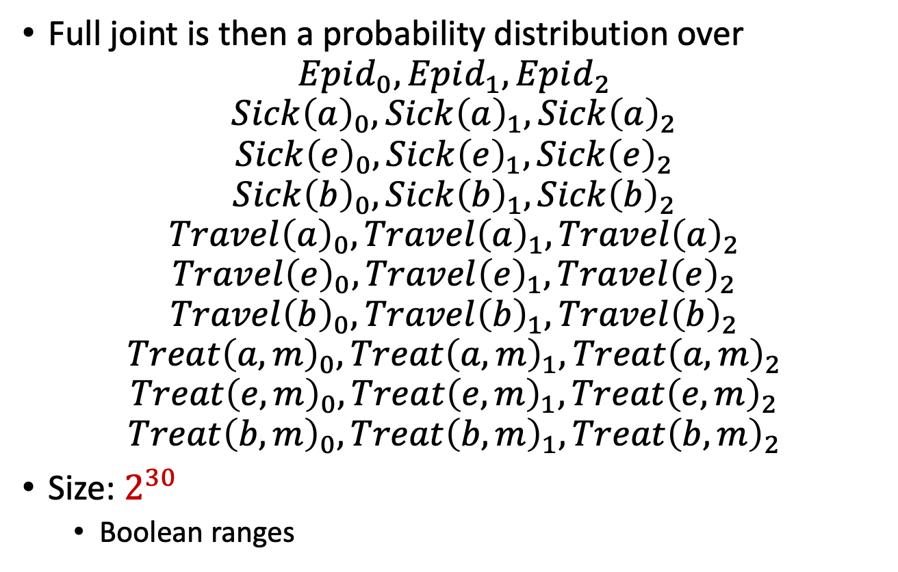
PDM: Semantics
Full joint is then a probability distribution over
$$Epid_{0},Epid_{1},Epid_{2}$$
$$Sick{\left(a\right)}_{0},Sick{\left(a\right)}_{1},Sick{\left(a\right)}_{2}$$
$$Sick{\left(e\right)}_{0},Sick{\left(e\right)}_{1},Sick{\left(e\right)}_{2}$$
$$Sick{\left(b\right)}_{0},Sick{\left(b\right)}_{1},Sick{\left(b\right)}_{2}$$
$$Travel{\left(a\right)}_{0},Travel{\left(a\right)}_{1},Travel{\left(a\right)}_{2}$$
$$Travel{\left(e\right)}_{0},Travel{\left(e\right)}_{1},Travel{\left(e\right)}_{2}$$
$$Travel{\left(b\right)}_{0},Travel{\left(b\right)}_{1},Travel{\left(b\right)}_{2}$$
$$Treat{\left(a,m\right)}_{0},Treat{\left(a,m\right)}_{1},Treat{\left(a,m\right)}_{2}$$
$$Treat{\left(e,m\right)}_{0},Treat{\left(e,m\right)}_{1},Treat{\left(e,m\right)}_{2}$$
$$Treat{\left(b,m\right)}_{0},Treat{\left(b,m\right)}_{1},Treat{\left(b,m\right)}_{2}$$
Size: $2^{30}$
  Boolean ranges

Slide 26
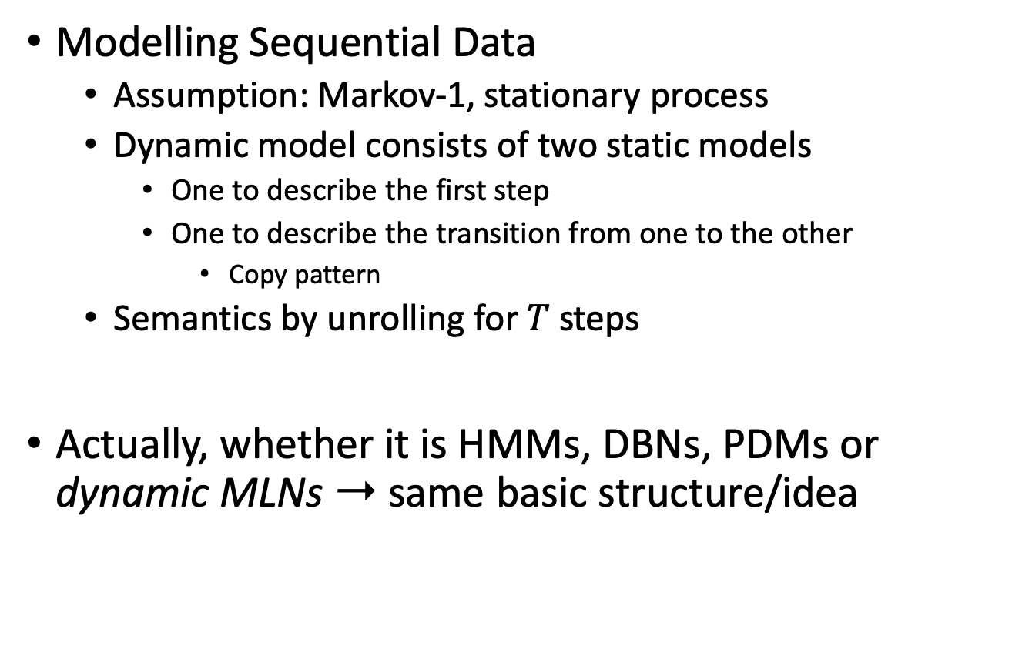
Interim Summary
Modelling Sequential Data
  Assumption: Markov-1, stationary process
  Dynamic model consists of two static models
    One to describe the first step
    One to describe the transition from one to the other
      Copy pattern
  Semantics by unrolling for $T$ steps
Actually, whether it is HMMs, DBNs, PDMs or dynamic MLNs ➝ same basic structure/idea

Slide 27
Outline: 6. Sequential Models & Inf.
Lifted modelling of sequences
  Parameterised dynamic models (PDMs)
  Modelling, semantics
Lifted dynamic inference
  Inference tasks
  Interfaces
  Lifted dynamic junction tree algorithm (LDJT)
  Theoretical analysis: complexity, completeness
Keeping inference polynomial
  Problem of evidence over time in lifted models
  Temporal approximate merging (TAMe)

Slide 28
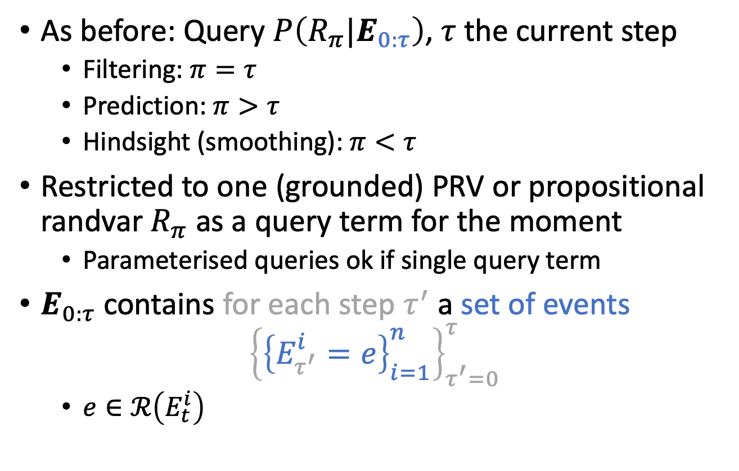
PDM: Tasks
As before: Query $P\left(R_{π}|E_{0:τ}\right)$, $τ$ the current step
  Filtering: $π=τ$
  Prediction: $π>τ$
  Hindsight (smoothing): $π<τ$
Restricted to one (grounded) PRV or propositional randvar $R_{π}$ as a query term for the moment
  Parameterised queries ok if single query term
$E_{0:τ}$ contains for each step $τ^{′}$ a set of events
$${\left\{{\left\{E_{τ^{′}}^{i}=e\right\}}_{i=1}^{n}\right\}}_{τ^{′}=0}^{τ}$$
  $e∈ℛ\left(E_{t}^{i}\right)$
Marcel Gehrke, Tanya Braun, and Ralf Möller. Lifted Dynamic Junction Tree Algorithm. In ICCS-18 Proceedings of the International Conference on Conceptual Structures, 2018.

Slide 29
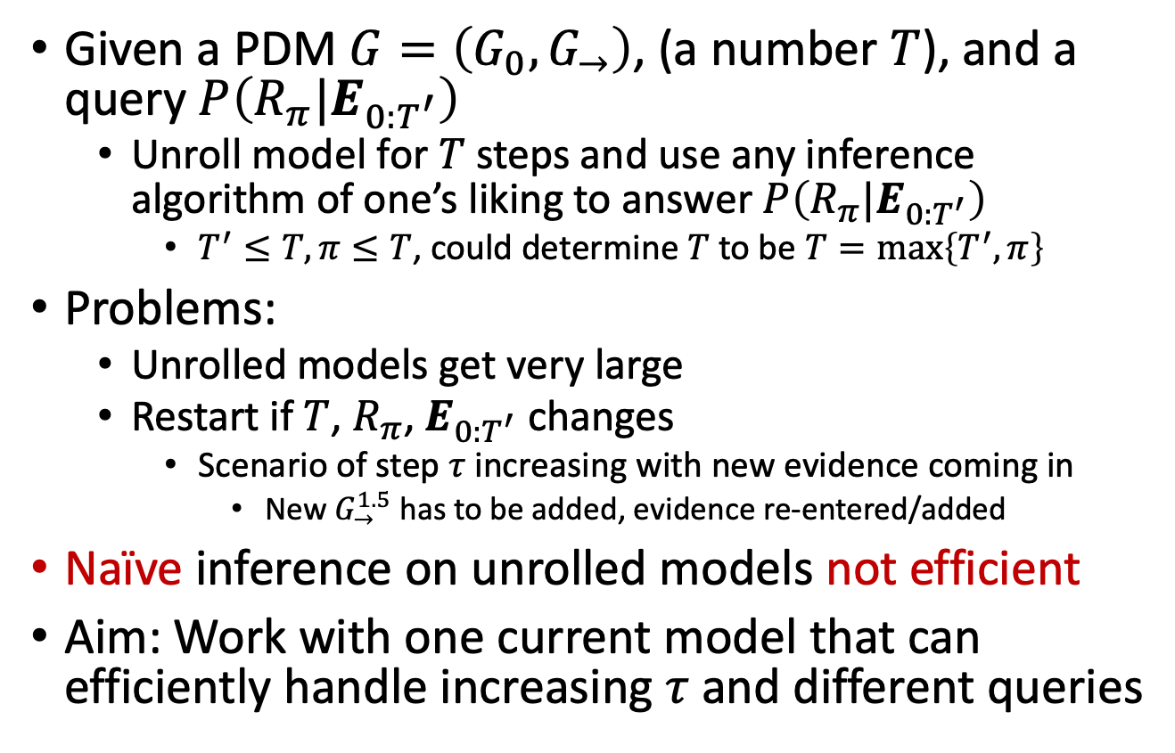
Naïve Inference by Unrolling
Given a PDM $G=\left(G_{0},G_{→}\right)$, (a number $T$), and a query $P\left(R_{π}|E_{0:T^{′}}\right)$
  Unroll model for $T$ steps and use any inference algorithm of one’s liking to answer $P\left(R_{π}|E_{0:T^{′}}\right)$
    $T^{′}≤T,π≤T$, could determine $T$ to be $T=\max\left\{T^{′},π\right\}$
Problems:
  Unrolled models get very large
  Restart if $T$, $R_{π}$, $E_{0:T^{′}}$ changes
    Scenario of step $τ$ increasing with new evidence coming in
      New $G_{→}^{1.5}$ has to be added, evidence re-entered/added
Naïve inference on unrolled models not efficient
Aim: Work with one current model that can efficiently handle increasing $τ$ and different queries

Slide 30











Clustering
Remember: Parclusters are sets of PRVs enough for query answering
  Arranged in an acyclic graph (FO jtree)
  Messages provide information over separators of remaining part of model, make a parcluster independent from its neighbours
Want something similar for sequential inference where slices are independent given separating subsets, so-called interfaces, between them
$$Epid Nat\left(D\right)$$
$$Man\left(W\right)$$
$$Epid Sick\left(X\right)$$
$$Travel\left(X\right)$$
$$Epid Sick\left(X\right)$$
$$Treat\left(X,M\right)$$
$$C_{1}$$
$$Epid$$
$$C_{2}$$
$$Epid$$
$$Sick\left(X\right)$$
$$C_{3}$$
$$g_{1}$$
$$g_{2}$$
$$g_{3}$$

Slide 31

Clustering
In unrolled example, want interfaces such that the following independences hold
  $G_{0}$ independent from $G_{1:2}$
  $G_{1}$ independent from $G_{0},G_{2}$
  $G_{2}$ independent from $G_{0:1}$
$$g^{E}$$
$$g^{E}$$
$$g_{0}^{1}$$
$${Epid}_{0}$$
$${Epid}_{1}$$
$${Epid}_{2}$$
$$Treat{\left(X,M\right)}_{0}$$
$$Treat{\left(X,M\right)}_{1}$$
$$Treat{\left(X,M\right)}_{2}$$
$$g_{0}^{2}$$
$$g_{0}^{3}$$
$$g_{t}^{2}$$
$$g_{t}^{3}$$
$$g_{t}^{2}$$
$$g_{t}^{3}$$
$${Travel\left(X\right)}_{0}$$
$${Sick\left(X\right)}_{0}$$
$${Travel\left(X\right)}_{1}$$
$${Sick\left(X\right)}_{1}$$
$${Travel\left(X\right)}_{2}$$
$${Sick\left(X\right)}_{2}$$

Slide 32






PDM: Interfaces
Separating subsets that make the past independent from the present and the present independent from the future
  Relevant model parts: transition parfactors
    Those that contain PRVs with index $t−1$ and $t$
$$g^{E}$$
$${Epid}_{t−1}$$
$${Epid}_{t}$$
$$Treat{\left(X,M\right)}_{t−1}$$
$$Treat{\left(X,M\right)}_{t}$$
$$g_{t−1}^{2}$$
$$g_{t−1}^{3}$$
$$g_{t}^{2}$$
$$g_{t}^{3}$$
$${Travel\left(X\right)}_{t−1}$$
$${Sick\left(X\right)}_{t−1}$$
$${Travel\left(X\right)}_{t}$$
$${Sick\left(X\right)}_{t}$$
Time slices
Marcel Gehrke, Tanya Braun, and Ralf Möller. Lifted Dynamic Junction Tree Algorithm. In ICCS-18 Proceedings of the International Conference on Conceptual Structures, 2018.

Slide 33

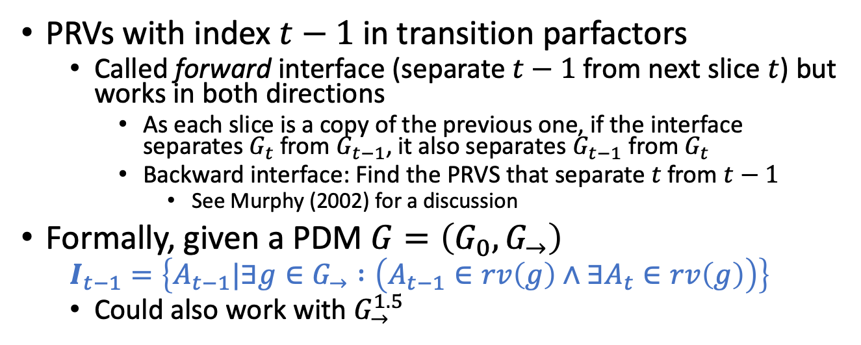

PDM: Interfaces
PRVs with index $t−1$ in transition parfactors
  Called forward interface (separate $t−1$ from next slice $t$) but works in both directions
    As each slice is a copy of the previous one, if the interface separates $G_{t}$ from $G_{t−1}$, it also separates $G_{t−1}$ from $G_{t}$
    Backward interface: Find the PRVS that separate $t$ from $t−1$
      See Murphy (2002) for a discussion
Formally, given a PDM $G=\left(G_{0},G_{→}\right)$
  $$I_{t−1}=\left\{A_{t−1}|∃g∈G_{→} :\left(A_{t−1}∈rv\left(g\right)∧∃A_{t}∈rv\left(g\right)\right)\right\}$$
  Could also work with $G_{→}^{1.5}$
$$g^{E}$$
$${Epid}_{t−1}$$
$${Epid}_{t}$$
$$Treat{\left(X,M\right)}_{t−1}$$
$$Treat{\left(X,M\right)}_{t}$$
$$g_{t−1}^{2}$$
$$g_{t−1}^{3}$$
$$g_{t}^{2}$$
$$g_{t}^{3}$$
$${Travel\left(X\right)}_{t−1}$$
$${Sick\left(X\right)}_{t−1}$$
$${Travel\left(X\right)}_{t}$$
$${Sick\left(X\right)}_{t}$$
Time slices
Marcel Gehrke, Tanya Braun, and Ralf Möller. Lifted Dynamic Junction Tree Algorithm. In ICCS-18 Proceedings of the International Conference on Conceptual Structures, 2018.

Slide 34
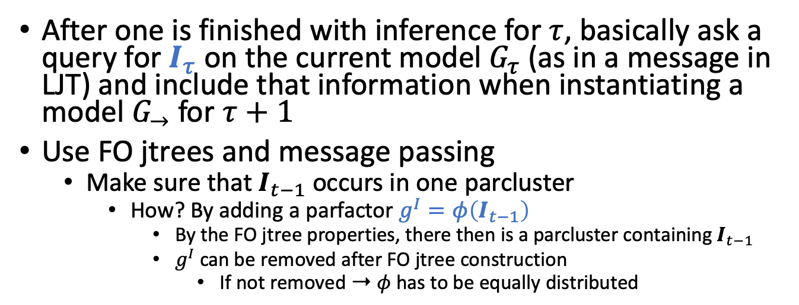
PDM: Interfaces – Moving forward
After one is finished with inference for $τ$, basically ask a query for $I_{τ}$ on the current model $G_{τ}$ (as in a message in LJT) and include that information when instantiating a model $G_{→}$ for $τ+1$
Use FO jtrees and message passing
  Make sure that $I_{t−1}$ occurs in one parcluster
    How? By adding a parfactor $g^{I}=φ\left(I_{t−1}\right)$
      By the FO jtree properties, there then is a parcluster containing $I_{t−1}$
      $g^{I}$can be removed after FO jtree construction
        If not removed ➝ $φ$ has to be equally distributed
$$g^{E}$$
$${Epid}_{t−1}$$
$${Epid}_{t}$$
$$Treat{\left(X,M\right)}_{t−1}$$
$$Treat{\left(X,M\right)}_{t}$$
$$g_{t−1}^{2}$$
$$g_{t−1}^{3}$$
$$g_{t}^{2}$$
$$g_{t}^{3}$$
$${Travel\left(X\right)}_{t−1}$$
$${Sick\left(X\right)}_{t−1}$$
$${Travel\left(X\right)}_{t}$$
$${Sick\left(X\right)}_{t}$$
Time slices
Marcel Gehrke, Tanya Braun, and Ralf Möller. Lifted Dynamic Junction Tree Algorithm. In ICCS-18 Proceedings of the International Conference on Conceptual Structures, 2018.

Slide 35
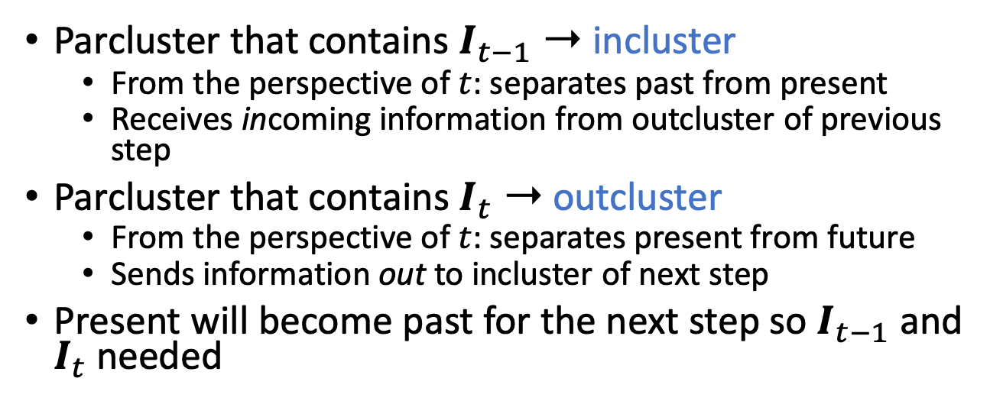
PDM: Incluster & Outcluster
Parcluster that contains $I_{t−1}$ ➝ incluster
  From the perspective of $t$: separates past from present
  Receives incoming information from outcluster of previous step
Parcluster that contains $I_{t}$ ➝ outcluster
  From the perspective of $t$: separates present from future
  Sends information out to incluster of next step
Present will become past for the next step so $I_{t−1}$ and $I_{t}$ needed
$$g^{E}$$
$${Epid}_{t−1}$$
$${Epid}_{t}$$
$$Treat{\left(X,M\right)}_{t−1}$$
$$Treat{\left(X,M\right)}_{t}$$
$$g_{t−1}^{2}$$
$$g_{t−1}^{3}$$
$$g_{t}^{2}$$
$$g_{t}^{3}$$
$${Travel\left(X\right)}_{t−1}$$
$${Sick\left(X\right)}_{t−1}$$
$${Travel\left(X\right)}_{t}$$
$${Sick\left(X\right)}_{t}$$
Time slices
Marcel Gehrke, Tanya Braun, and Ralf Möller. Lifted Dynamic Junction Tree Algorithm. In ICCS-18 Proceedings of the International Conference on Conceptual Structures, 2018.

Slide 36
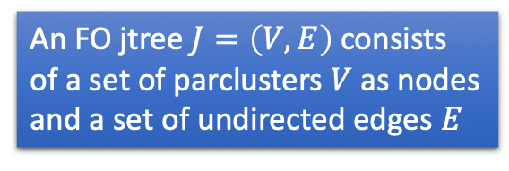
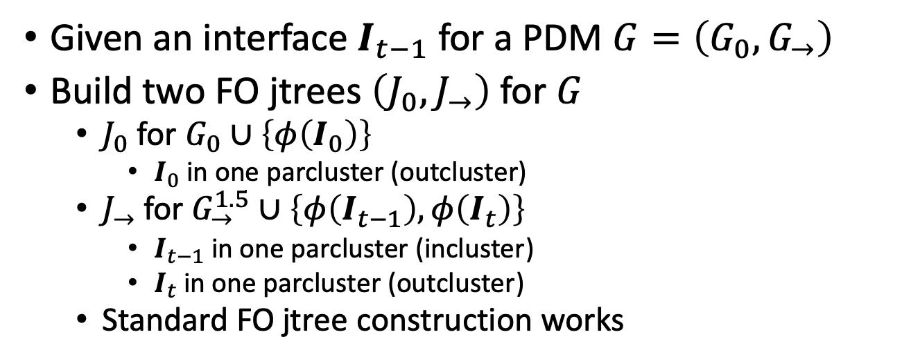
Dynamic FO Jtrees
Given an interface $I_{t−1}$ for a PDM $G=\left(G_{0},G_{→}\right)$
Build two FO jtrees $\left(J_{0},J_{→}\right)$ for $G$
  $J_{0}$ for $G_{0}∪\left\{φ\left(I_{0}\right)\right\}$
    $I_{0}$ in one parcluster (outcluster)
  $J_{→}$ for $G_{→}^{1.5}∪\left\{φ\left(I_{t−1}\right),φ\left(I_{t}\right)\right\}$
    $I_{t−1}$ in one parcluster (incluster)
    $I_{t}$ in one parcluster (outcluster)
  Standard FO jtree construction works
An FO jtree $J=\left(V,E\right)$ consists
of a set of parclusters $V$ as nodes
and a set of undirected edges $E$
$$g^{E}$$
$${Epid}_{t−1}$$
$${Epid}_{t}$$
$$Treat{\left(X,M\right)}_{t−1}$$
$$Treat{\left(X,M\right)}_{t}$$
$$g_{t−1}^{2}$$
$$g_{t−1}^{3}$$
$$g_{t}^{2}$$
$$g_{t}^{3}$$
$${Travel\left(X\right)}_{t−1}$$
$${Sick\left(X\right)}_{t−1}$$
$${Travel\left(X\right)}_{t}$$
$${Sick\left(X\right)}_{t}$$
Time slices
Marcel Gehrke, Tanya Braun, and Ralf Möller. Lifted Dynamic Junction Tree Algorithm. In ICCS-18 Proceedings of the International Conference on Conceptual Structures, 2018.

Slide 37











Dynamic FO Jtrees: Example
$J_{0}$ for $G_{0}∪\left\{g_{0}^{I}\right\}$
Here, both parclusters contain the interface variables
  Both could be outcluster
  Outcluster determined by which parcluster contains $g^{I}$
$$g_{0}^{I}$$
$$Epid_{0} Sick{\left(X\right)}_{0}$$
$$Travel{\left(X\right)}_{0}$$
$$g_{0}^{1}$$
$${Epid}_{0}$$
$$C_{0}^{out}$$
$$Treat{\left(X,M\right)}_{0}$$
$$g_{0}^{1},g_{0}^{2}$$
$$g_{0}^{I}$$
Remove
$$g_{0}^{2}$$
$$g_{0}^{3}$$
$$Epid_{0} Sick{\left(X\right)}_{0}$$
$$Treat{\left(X,M\right)}_{0}$$
$${Travel\left(X\right)}_{0}$$
$${Sick\left(X\right)}_{0}$$
$$C_{0}^{1}$$
$$g_{0}^{3}$$

Slide 38










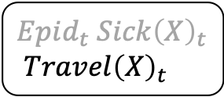





Dynamic FO Jtrees: Example
$J_{→}$ for $G_{→}^{1.5}∪\left\{g_{t−1}^{I},g_{t}^{I}\right\}$
$$Epid_{t−1} Sick{\left(X\right)}_{t−1}$$
$${Epid}_{t}$$
$$Epid_{t} Sick{\left(X\right)}_{t}$$
$$Travel{\left(X\right)}_{t}$$
$$C_{1}^{in}$$
$$C_{1}^{out}$$
$$g^{E}$$
$$g_{t−1}^{I}$$
$$g_{t}^{2}$$
$$g_{t}^{I}$$
Remove
$$Epid_{t} Sick{\left(X\right)}_{t}$$
$$Treat{\left(X,M\right)}_{t}$$
$$C_{1}^{1}$$
$$g_{t}^{3}$$
$$g^{E}$$
$$g_{t}^{I}$$
$${Epid}_{t−1}$$
$${Epid}_{t}$$
$$Treat{\left(X,M\right)}_{t}$$
$$g_{t−1}^{I}$$
$$g_{t}^{2}$$
$$g_{t}^{3}$$
$${Sick\left(X\right)}_{t−1}$$
$${Travel\left(X\right)}_{t}$$
$${Sick\left(X\right)}_{t}$$

Slide 39

Dynamic FO Jtrees: Unrolling
Given two FO jtrees $\left(J_{0},J_{→}\right)$ for $G$ and a number $T$, unroll the FO jtree by
  For $τ=0$, taking $J_{0}=\left(V_{0},E_{0}\right)$
  For $τ<T$, taking $J_{→}=\left(V_{→},E_{→}\right)$ instantiated for $τ$
  For all $τ−1,τ$, adding an edge between outcluster of $τ−1$ and incluster of $τ$
Formally, $J_{0:T}=\left(V,E\right)$ where
  $$V=V_{0}∪\bigcup_{τ=1}^{T}{V_{τ}}$$
  $$E=E_{0}∪\bigcup_{τ=1}^{T}{E_{τ}}∪\bigcup_{τ=1}^{T}{\left\{\left\{out,in\right\} | C_{τ−1}^{out}∧C_{τ}^{in}\right\}}$$

Slide 40






















$T=2$
  $τ=0$
  $τ=1$
$$Epid_{0} Sick{\left(X\right)}_{0}$$
$$Travel{\left(X\right)}_{0}$$
$$C_{0}^{out}$$
$$g_{0}^{1},g_{0}^{2}$$
$$Epid_{0} Sick{\left(X\right)}_{0}$$
$$Treat{\left(X,M\right)}_{0}$$
$$C_{0}^{1}$$
$$g_{0}^{3}$$
$$Epid_{0} Sick{\left(X\right)}_{0}$$
$$Travel{\left(X\right)}_{0}$$
$$Epid_{0} Sick{\left(X\right)}_{0}$$
$${Epid}_{1}$$
$$Epid_{1} Sick{\left(X\right)}_{1}$$
$$Travel{\left(X\right)}_{1}$$
$$C_{0}^{out}$$
$$C_{1}^{in}$$
$$C_{1}^{out}$$
$$g_{0}^{1},g_{0}^{2}$$
$$g^{E}$$
$$g_{1}^{2}$$
$$Epid_{0} Sick{\left(X\right)}_{0}$$
$$Treat{\left(X,M\right)}_{0}$$
$$Epid_{1} Sick{\left(X\right)}_{1}$$
$$Treat{\left(X,M\right)}_{1}$$
$$C_{0}^{1}$$
$$C_{1}^{1}$$
$$g_{0}^{3}$$
$$g_{1}^{3}$$

Slide 41


























Dynamic FO Jtrees: Unrolling – $T=2$
$τ=T=2$
Unrolling unnecessary!
  Because of the interface, current FO jtree $J_{τ}$ enough to answer queries about current step $τ$
    Inference within one step ➝ LJT
    Moving forward ➝ send message from $C_{τ}^{out}$ to $C_{τ+1}^{in}$
$$Epid_{0} Sick{\left(X\right)}_{0}$$
$$Travel{\left(X\right)}_{0}$$
$$Epid_{0} Sick{\left(X\right)}_{0}$$
$${Epid}_{1}$$
$$Epid_{1} Sick{\left(X\right)}_{1}$$
$$Travel{\left(X\right)}_{1}$$
$$Epid_{1} Sick{\left(X\right)}_{1}$$
$${Epid}_{2}$$
$$Epid_{2} Sick{\left(X\right)}_{2}$$
$$Travel{\left(X\right)}_{2}$$
$$C_{0}^{out}$$
$$C_{1}^{in}$$
$$C_{1}^{out}$$
$$C_{2}^{in}$$
$$C_{2}^{out}$$
$$g_{0}^{1},g_{0}^{2}$$
$$g^{E}$$
$$g_{1}^{2}$$
$$g^{E}$$
$$g_{2}^{2}$$
$$Epid_{0} Sick{\left(X\right)}_{0}$$
$$Treat{\left(X,M\right)}_{0}$$
$$Epid_{1} Sick{\left(X\right)}_{1}$$
$$Treat{\left(X,M\right)}_{1}$$
$$Epid_{2} Sick{\left(X\right)}_{2}$$
$$Treat{\left(X,M\right)}_{2}$$
$$C_{0}^{1}$$
$$C_{1}^{1}$$
$$C_{2}^{1}$$
$$g_{0}^{3}$$
$$g_{1}^{3}$$
$$g_{2}^{3}$$

Slide 42

Moving Forward
Inference within a step $τ$ will follow LJT
  One can ask a set of queries for $τ$ efficiently
  Ensures that all information is available at $C_{τ}^{out}$ to calculate the forward message that makes $τ+1$ independent from $τ$
Moving forward:
  Calculate a forward message $α_{τ}$ over the separator between $C_{τ}^{out}$ and $C_{τ+1}^{in}$ using local model $G_{τ}^{out}$ and messages $m_{τ}^{j,out}$
  Instantiate $J_{→}$ for $τ+1$
  Add $α_{τ}$ to local model of $C_{τ+1}^{in}$
  Drop $J_{τ}$
  Perform inference in $J_{τ+1}$
Marcel Gehrke, Tanya Braun, and Ralf Möller. Lifted Dynamic Junction Tree Algorithm. In ICCS-18 Proceedings of the International Conference on Conceptual Structures, 2018.

Slide 43

















Moving Forward: Example
$τ=0$
  Current FO jtree
  Intra-slice messages: $m_{0}^{1,out}$, $m_{0}^{out,1}$
  Answer queries for $P\left(R_{0}|E_{0}\right)$
Inter-slice message: $α_{0}$
  Eliminate non-separator PRV $Travel{\left(X\right)}_{0}$ from local model $G_{0}^{out}=\left\{g_{0}^{1},g_{0}^{2}\right\}$ and $m_{0}^{1,out}$
  Send result as message $α_{0}$ to $C_{1}^{in}$
$$Epid_{0}$$
$$Sick{\left(X\right)}_{0}$$
$$Epid_{0} Sick{\left(X\right)}_{0}$$
$$Travel{\left(X\right)}_{0}$$
$$Epid_{0} Sick{\left(X\right)}_{0}$$
$${Epid}_{1}$$
$$C_{0}^{out}$$
$$C_{1}^{in}$$
$$g_{0}^{1},g_{0}^{2}$$
$$m_{0}^{1,out}$$
$$α_{0}$$
$$g^{E}$$
$$Epid_{0} Sick{\left(X\right)}_{0}$$
$$Treat{\left(X,M\right)}_{0}$$
$α_{0}$ contains all information from $G_{0}$ including $E_{0}$, making step $0$ and $1$ independent
$$C_{0}^{1}$$
$$g_{0}^{3}$$
$$m_{0}^{out,1}$$
Next: Instantiate an FO jtree for $τ=1$ and add $α_{0}$ to the local model of $C_{1}^{in}$

Slide 44





















Moving Forward: Example
$τ=1$
  Current FO jtree
  Intra-slice messages: $m_{0}^{out,in}$, $m_{1}^{in,out}$, $m_{0}^{1,out}$, $m_{0}^{out,1}$
  Answer queries for $P\left(R_{1}|E_{0:1}\right)$
Inter-slice message: $α_{1}$
  Eliminate non-separator PRV $Travel{\left(X\right)}_{1}$ from local model $G_{1}^{out}=\left\{g_{1}^{2}\right\}$ and $m_{1}^{1,out},m_{1}^{in,out}$
  Send $α_{1}$ to $C_{2}^{in}$
$$Epid_{1}$$
$$Sick{\left(X\right)}_{1}$$
$$Epid_{0} Sick{\left(X\right)}_{0}$$
$${Epid}_{1}$$
$$Epid_{1} Sick{\left(X\right)}_{1}$$
$$Travel{\left(X\right)}_{1}$$
$$Epid_{1} Sick{\left(X\right)}_{1}$$
$${Epid}_{2}$$
$$C_{1}^{in}$$
$$C_{1}^{out}$$
$$α_{1}$$
$$C_{2}^{in}$$
$$α_{0}$$
$$g^{E}$$
$$m_{1}^{out,in}$$
$$g_{1}^{2}$$
$$m_{1}^{1,out},m_{1}^{in,out}$$
$$g^{E}$$
During message passing, the information in $α_{0}$ is passed around as well and therefore also included when calculating $α_{1}$.
$α_{1}$ now includes information of $G_{0:1}$ including $E_{0:1}$, making step $1$ and $2$ independent.
Next: Instantiate an FO jtree for $τ=2$ and add $α_{1}$ to the local model of $C_{2}^{in}$
$$Epid_{1} Sick{\left(X\right)}_{1}$$
$$Treat{\left(X,M\right)}_{1}$$
$$C_{1}^{1}$$
$$g_{1}^{3}$$
$$m_{1}^{out,1}$$

Slide 45










Filtering
Queries answered in this fashion: filtering queries
  $P\left(R_{τ}|E_{0:τ}\right)$
  Queries for the current
  step given all previous
  evidence
  Upsides
    Only one current FO jtree
    One additional message to
    move forward
What about prediction and hindsight?
  $P\left(R_{π}|E_{0:τ}\right)$, $π≠τ$
$$Epid_{0} Sick{\left(X\right)}_{0}$$
$${Epid}_{1}$$
$$Epid_{1} Sick{\left(X\right)}_{1}$$
$$Travel{\left(X\right)}_{1}$$
$$C_{1}^{in}$$
$$C_{1}^{out}$$
$$g^{E}$$
$$g_{1}^{2}$$
$$Epid_{1} Sick{\left(X\right)}_{1}$$
$$Treat{\left(X,M\right)}_{1}$$
$$C_{1}^{1}$$
$$g_{1}^{3}$$
Marcel Gehrke, Tanya Braun, and Ralf Möller. Lifted Dynamic Junction Tree Algorithm. In ICCS-18 Proceedings of the International Conference on Conceptual Structures, 2018.

Slide 46

Prediction
Prediction queries for future PRV instances
  $P\left(R_{π}|E_{0:τ}\right)$, $π>τ$
  Flashing into the future, i.e., moving forward to $π$ without seeing evidence in between, i.e.,
    Filtering query $P\left(R_{π}|E_{0:π}\right)$ where the evidence sets between $τ+1$ and $π$ in $E_{0:π}$ are empty: $E_{τ+1:π}={\left\{∅_{τ^{′}}\right\}}_{τ^{′}=τ+1}^{π}$
Prediction query answering
  Given $τ$ current step
  Move forward until $τ=π$
    When moving forward, only an inbound message pass with the outcluster as centre is necessary
  Answer query with query term $R_{π}$
    If only one query, locate parcluster $C_{π}^{i}$ containing $R_{π}$ and trigger one inbound message pass with $C_{π}^{i}$ as centre
    Otherwise, perform complete message passing
Saves half of the messages
Marcel Gehrke, Tanya Braun, and Ralf Möller. Lifted Dynamic Junction Tree Algorithm. In ICCS-18 Proceedings of the International Conference on Conceptual Structures, 2018.

Slide 47












Prediction: Example
$P\left({Epid}_{3}|E_{0:1}\right)$, $3>1$
  No evidence for steps $2$ and $3$: $E_{2:3}={\left\{∅_{τ^{′}}\right\}}_{τ^{′}=2}^{3}$
  Given $τ=1$ current step, move forward until $τ=3$, then answer query with query term ${Epid}_{3}$
  $τ=2$, current FO jtree with $α_{1}$ in local model of $C_{2}^{in}$
    Send intra-slice messages towards $C_{2}^{out}$ (collect all information at outcluster); also, no evidence entering as $∅_{2}$
    Calculate inter-slice message $α_{2}$
$$Epid_{1} Sick{\left(X\right)}_{1}$$
$${Epid}_{2}$$
$$Epid_{2} Sick{\left(X\right)}_{2}$$
$$Travel{\left(X\right)}_{2}$$
$α_{2}$
$$C_{2}^{in}$$
$$C_{2}^{out}$$
$$g^{E}$$
$α_{1}$
$$g_{2}^{2}$$
$$m_{2}^{1,out},m_{2}^{in,out}$$
$$Epid_{2} Sick{\left(X\right)}_{2}$$
$$Treat{\left(X,M\right)}_{2}$$
$$C_{2}^{1}$$
$$g_{2}^{3}$$

Slide 48












Prediction: Example
$P\left({Epid}_{3}|E_{0:1}\right)$, $3>1$
  $τ=3$, current FO jtree with $α_{2}$ in local model of $C_{3}^{in}$
  If answering only ${Epid}_{3}$, collect messages at one of the parclusters, e.g., $C_{3}^{in}$ and answer query
    If so, no need to also calculate $m_{3}^{in,out},m_{3}^{out,1}$
$$Epid_{2} Sick{\left(X\right)}_{2}$$
$${Epid}_{3}$$
$$Epid_{3} Sick{\left(X\right)}_{3}$$
$$Travel{\left(X\right)}_{3}$$
$$C_{3}^{in}$$
$$C_{3}^{out}$$
$$g^{E}$$
$α_{2}$
$$m_{3}^{out,in}$$
$$g_{3}^{2}$$
$$m_{3}^{1,out}$$
$$Epid_{3} Sick{\left(X\right)}_{3}$$
$$Treat{\left(X,M\right)}_{3}$$
$$C_{3}^{1}$$
$$g_{3}^{3}$$

Slide 49

Hindsight: Moving Back Again
Hindsight queries for past PRV instances
  $P\left(R_{π}|E_{0:τ}\right)$, $π<τ$
  Looking back given what we know now in terms of evidence, i.e.,
    From the current step $τ$, we have to go back and send the information accumulated between $π$ and $τ$ to $π$ and then answer a filtering query in step $π$ again
Hindsight query answering
  Given $τ$ current step
  Move backward until $τ=π$
    Calculate backward messages $β_{τ}$ starting from $τ$ until $π$
      When moving backward, only an inbound message pass with the incluster as centre is necessary
  Answer query with query term $R_{π}$
Marcel Gehrke, Tanya Braun, and Ralf Möller. Relational Forward Backward Algorithm for Multiple Queries. In FLAIRS-32 Proceedings of the 32nd International Florida Artificial Intelligence Research Society Conference, 2019.

Slide 50




















Hindsight: Backward Message $β_{τ}$
Same as forward but sent from $C_{τ}^{in}$ to $C_{τ−1}^{out}$
  Forward message $α_{τ}$ contains all information on $G_{0:τ}$ including $E_{0:τ}$, making $τ+1$ independent from $τ$
  Backward message $β_{τ}$ contains all information on $G_{τ:T}$ including $E_{τ:T}$, making $τ−1$ independent from $τ$
    Exclude forward message $α_{τ−1}$ for calculation, as that information is already present at slide $τ$
E.g., calculate $β_{3}$ by eliminating ${Epid}_{3}$ from $g^{E}$, $m_{3}^{out,in}$ (without $α_{2}$)
$$Epid_{2}$$
$$Sick{\left(X\right)}_{2}$$
$$Epid_{2} Sick{\left(X\right)}_{2}$$
$$Travel{\left(X\right)}_{2}$$
$$Epid_{2} Sick{\left(X\right)}_{2}$$
$${Epid}_{3}$$
$$Epid_{3} Sick{\left(X\right)}_{3}$$
$$Travel{\left(X\right)}_{3}$$
$$C_{2}^{out}$$
$$C_{3}^{in}$$
$$C_{3}^{out}$$
$$g_{2}^{2}$$
$$β_{3}$$
$$g^{E}$$
$α_{2}$
$$m_{3}^{out,in}$$
$$g_{3}^{2}$$
$$m_{3}^{in,out},m_{3}^{1,out}$$
$$Epid_{3} Sick{\left(X\right)}_{3}$$
$$Treat{\left(X,M\right)}_{3}$$
$$C_{3}^{1}$$
$$g_{3}^{3}$$
$$m_{3}^{out,1}$$
Marcel Gehrke, Tanya Braun, and Ralf Möller. Relational Forward Backward Algorithm for Multiple Queries. In FLAIRS-32 Proceedings of the 32nd International Florida Artificial Intelligence Research Society Conference, 2019.

Slide 51














Hindsight: Independences
Given $P\left(R_{π}|E_{0:τ}\right)$, $π<τ$, at goal slice $π$,
  Forward message $α_{π−1}$ contains all information on $G_{0:π−1}$ including $E_{0:π−1}$, making $π$ independent of $π−1$
    Requires storing forward messages $α_{τ}$; otherwise, one would have to re-do moving forward from $0$ to $π$
  Backward message $β_{π+1}$ contains all information on $G_{π+1:τ}$ including $E_{π+1:τ}$, making $π$ independent of $π+1$
$$Epid_{0}$$
$$Sick{\left(X\right)}_{0}$$
$$Epid_{1}$$
$$Sick{\left(X\right)}_{1}$$
$$Epid_{0} Sick{\left(X\right)}_{0}$$
$${Epid}_{1}$$
$$Epid_{1} Sick{\left(X\right)}_{1}$$
$$Travel{\left(X\right)}_{1}$$
$$C_{1}^{in}$$
$$C_{1}^{out}$$
$α_{0}$
$$g^{E}$$
$$g_{1}^{2}$$
$$β_{3}$$
$$Epid_{1} Sick{\left(X\right)}_{1}$$
$$Treat{\left(X,M\right)}_{1}$$
$$C_{1}^{1}$$
$$g_{1}^{3}$$
Marcel Gehrke, Tanya Braun, and Ralf Möller. Relational Forward Backward Algorithm for Multiple Queries. In FLAIRS-32 Proceedings of the 32nd International Florida Artificial Intelligence Research Society Conference, 2019.

Slide 52





Hindsight: Example
$P\left({Epid}_{1}|E_{0:3}\right)$, $1<3$
  Given $τ=3$ current step, move backward until $τ=1$, then answer query with query term ${Epid}_{1}$
  $τ=3$, current FO jtree with $α_{2}$ in local model of $C_{3}^{in}$
    Calculate backward message $β_{3}$
    Instantiate an FO jtree for $τ=2$, add $β_{3}$ to local model of $C_{2}^{out}$
$$Epid_{2}$$
$$Sick{\left(X\right)}_{2}$$
$$Epid_{2} Sick{\left(X\right)}_{2}$$
$$Travel{\left(X\right)}_{2}$$
$$Epid_{2} Sick{\left(X\right)}_{2}$$
$${Epid}_{3}$$
$$Epid_{3} Sick{\left(X\right)}_{3}$$
$$Travel{\left(X\right)}_{3}$$
$$C_{2}^{out}$$
$$C_{3}^{in}$$
$$C_{3}^{out}$$
$$g_{2}^{2}$$
$$β_{3}$$
$$g^{E}$$
$α_{2}$
$$m_{3}^{out,in}$$
$$g_{3}^{2}$$
$$m_{3}^{in,out},m_{3}^{1,out}$$
$$Epid_{3} Sick{\left(X\right)}_{3}$$
$$Treat{\left(X,M\right)}_{3}$$
$$C_{3}^{1}$$
$$g_{3}^{3}$$
$$m_{3}^{out,1}$$

Slide 53


















Hindsight: Example
$P\left({Epid}_{1}|E_{0:3}\right)$, $1<3$
  $τ=2$, current FO jtree with $β_{3}$ in local model of $C_{2}^{out}$
    Enter evidence $E_{2}$, send messages inbound to $C_{2}^{in}$
    Calculate backward message $β_{2}$, ignoring $α_{1}$
    Instantiate an FO jtree for $τ=1$, add $β_{2}$ to local model of $C_{1}^{out}$
$$Epid_{1}$$
$$Sick{\left(X\right)}_{1}$$
$$Epid_{1} Sick{\left(X\right)}_{1}$$
$$Travel{\left(X\right)}_{1}$$
$$Epid_{1} Sick{\left(X\right)}_{1}$$
$${Epid}_{2}$$
$$Epid_{2} Sick{\left(X\right)}_{2}$$
$$Travel{\left(X\right)}_{2}$$
$$C_{1}^{out}$$
$$C_{2}^{in}$$
$$C_{2}^{out}$$
$$g_{1}^{2}$$
$$β_{2}$$
$$g^{E}$$
$α_{1}$
$$m_{2}^{out,in}$$
$$g_{2}^{2}$$
$$m_{2}^{1,out}$$
$$β_{3}$$
$$Epid_{2} Sick{\left(X\right)}_{2}$$
$$Treat{\left(X,M\right)}_{2}$$
$$C_{2}^{1}$$
$$g_{2}^{3}$$

Slide 54






Hindsight: Example
$P\left({Epid}_{1}|E_{0:3}\right)$, $1<3$
  $τ=1$, current FO jtree with $β_{2}$ in local model of $C_{1}^{out}$
    Enter evidence $E_{1}$
    If answering only ${Epid}_{1}$, collect messages at one of the parclusters, e.g., $C_{1}^{1}$ and answer query
      If so, no need to also calculate $m_{1}^{out,in},m_{1}^{1,out}$
$$Epid_{0}$$
$$Sick{\left(X\right)}_{0}$$
$$Epid_{1}$$
$$Sick{\left(X\right)}_{1}$$
$$Epid_{0} Sick{\left(X\right)}_{0}$$
$${Epid}_{1}$$
$$Epid_{1} Sick{\left(X\right)}_{1}$$
$$Travel{\left(X\right)}_{1}$$
$$C_{1}^{in}$$
$$C_{1}^{out}$$
$α_{0}$
$$g^{E}$$
$$g_{1}^{2}$$
$$β_{2}$$
$$m_{1}^{in,out}$$
$$Epid_{1} Sick{\left(X\right)}_{1}$$
$$Treat{\left(X,M\right)}_{1}$$
$$C_{1}^{1}$$
$$g_{1}^{3}$$
$$m_{1}^{out,1}$$

Slide 55

General Query Answering
Relational forward-backward algorithm for all types of queries, Filtering, prediction, hindsight
Set of queries $Q_{0:T_{q}}={\left\{{\left\{Q_{π_{i}}^{i}\right\}}_{i=1}^{m_{t}}\right\}}_{t=0}^{T_{q}}$
  Basically a stream of queries
  For efficiency, go through $Q_{0:T_{q}}$ by $t$ and through each ${\left\{Q_{π_{i}}^{i}\right\}}_{i=1}^{m_{t}}$ by type of query and $π_{i}$
    Filtering queries
    Prediction queries, ordered by increasing $π_{i}$
    Hindsight queries, ordered by decreasing $π_{i}$
    Order of 2. and 3. could be exchanged
Marcel Gehrke, Tanya Braun, and Ralf Möller. Relational Forward Backward Algorithm for Multiple Queries. In FLAIRS-32 Proceedings of the 32nd International Florida Artificial Intelligence Research Society Conference, 2019.

Slide 56

General Query Answering
Given $τ$ as the current step with query terms ${\left\{Q_{π_{i}}^{i}\right\}}_{i=1}^{m_{τ}}$ and a completed message pass for $τ$
  For all $Q_{π_{i}}^{i}$where $τ=π_{i}$, answer $Q_{π_{i}}^{i}$ in $J_{τ}$
  For all $Q_{π_{i}}^{i}$ where $τ<π_{i}$, move forward without evidence until $\max_{i}{π_{i}}$
    Instantiate FO jtrees and calculate messages accordingly
    Whenever $τ=π_{i}$ while moving forward, answer $Q_{π_{i}}^{i}$
  For all $Q_{π_{i}}^{i}$ where $τ>π_{i}$, move backward until $\min_{i}{π_{i}}$
    Instantiate FO jtrees, enter evidence, and calculate messages accordingly
    Whenever $τ=π_{i}$ while moving backward, answer $Q_{π_{i}}^{i}$
Marcel Gehrke, Tanya Braun, and Ralf Möller. Relational Forward Backward Algorithm for Multiple Queries. In FLAIRS-32 Proceedings of the 32nd International Florida Artificial Intelligence Research Society Conference, 2019.

Slide 57

Lifted Dynamic Jtree Algorithm (LDJT)
procedure $\text{LDJT}$($\left(G_{0},G_{→}\right),Q_{0:T_{q}},E_{0:T_{e}}$)
Build 1.5-slice model $G_{→}^{1.5}$
Construct FO jtree $\left(J_{0},J_{→}\right)$ for $G_{0}$ and $G_{→}^{1.5}$
for $τ$ in $0…T_{q}$ do
Instantiate $J_{τ}$
Add $α_{τ−1}$ to incluster of $J_{τ}$ ▹if $τ>0$
Enter evidence $E_{τ}$ into $J_{τ}$
Pass messages in $J_{τ}$
Answer queries $Q_{τ}$
Calculate $α_{τ}$
In online inference, two streams, one for incoming evidence, one for incoming queries instead of inputs $Q_{0:T_{q}},E_{0:T_{e}}$
LDJT
Marcel Gehrke, Tanya Braun, and Ralf Möller. Relational Forward Backward Algorithm for Multiple Queries. In FLAIRS-32 Proceedings of the 32nd International Florida Artificial Intelligence Research Society Conference, 2019.

Slide 58

Approaches to Backward Passes
Backward passes as presented so far require recalculating some of the messages
  Each step backwards without queries for a step
    Calculate an inbound message pass with $n−1$ messages, $n$ the number of parclusters in $J_{τ}$
      Collect model information and evidence for $τ$ as well as future information in $β_{τ+1}$
  Each step backwards with queries for a step
    Calculate a complete message pass with $2\left(n−1\right)$ messages, $n$ the number of parclusters in $J_{τ}$
  BUT: only one FO jtree in memory at a time
    For hindsight queries, forward messages need to be stored!
What if LDJT does not drop FO jtrees once $τ$ moves forward?
  Keep instantiations vs. instantiating them on demand
Marcel Gehrke, Tanya Braun, and Ralf Möller. Relational Forward Backward Algorithm for Multiple Queries. In FLAIRS-32 Proceedings of the 32nd International Florida Artificial Intelligence Research Society Conference, 2019.

Slide 59

Keep Instantiations
What does LDJT pay in memory?
  Additionally store local models, intra-slice messages for each slice
How much runtime can LDJT save?
  C.f., adaptive message passing: Only update those messages affected by new incoming information in $β_{τ+1}$
  Each step backwards without queries for a step
    Calculate messages on path between outcluster and incluster of $J_{τ}$ ➝ up to $n−1$ messages, $n$ the number of parclusters in $J_{τ}$
  Each step backwards with queries for a step
    Calculate an outbound message pass with $n−1$ messages, $n$ the number of parclusters in $J_{τ}$
Marcel Gehrke, Tanya Braun, and Ralf Möller. Relational Forward Backward Algorithm for Multiple Queries. In FLAIRS-32 Proceedings of the 32nd International Florida Artificial Intelligence Research Society Conference, 2019.

Slide 60





















































Example: $P\left({Epid}_{1}|E_{0:3}\right)$
In $τ=2$ (no queries)
  Keep instantiations: $m_{2}^{1,out}$ (on path)
  Ondemand: $m_{2}^{1,out},m_{2}^{out,in}$ (inbound to $C_{2}^{in}$)
In $τ=1$ (with multiple queries)
  Keep instantiations: $m_{1}^{out,1},m_{1}^{out,in}$(outbound)
  Ondemand: $m_{1}^{out,1},m_{1}^{out,in},m_{1}^{1,out},m_{1}^{in,out}$
$$Epid_{0} Sick{\left(X\right)}_{0}$$
$$Travel{\left(X\right)}_{0}$$
$$Epid_{0} Sick{\left(X\right)}_{0}$$
$${Epid}_{1}$$
$$Epid_{1} Sick{\left(X\right)}_{1}$$
$$Travel{\left(X\right)}_{1}$$
$$Epid_{1} Sick{\left(X\right)}_{1}$$
$${Epid}_{2}$$
$$Epid_{2} Sick{\left(X\right)}_{2}$$
$$Travel{\left(X\right)}_{2}$$
$$Epid_{2} Sick{\left(X\right)}_{2}$$
$${Epid}_{3}$$
$$Epid_{3} Sick{\left(X\right)}_{3}$$
$$Travel{\left(X\right)}_{3}$$
$$C_{0}^{out}$$
$$C_{1}^{in}$$
$$C_{1}^{out}$$
$$C_{2}^{in}$$
$$C_{2}^{out}$$
$$C_{3}^{in}$$
$$C_{3}^{out}$$
$$g_{0}^{1},g_{0}^{2}$$
$$m_{0}^{1,out}$$
$$α_{0}$$
$$g^{E}$$
$$m_{1}^{out,in}$$
$$g_{1}^{2}$$
$$m_{1}^{1,out}$$
$$α_{1}$$
$$g^{E}$$
$$m_{2}^{out,in}$$
$$g_{2}^{2}$$
$$m_{2}^{1,out}$$
$$β_{3}$$
$$α_{2}$$
$$g^{E}$$
$$m_{3}^{out,in}$$
$$g_{2}^{2}$$
$$m_{3}^{1,out}$$
$$m_{1}^{in,out}$$
$$m_{2}^{in,out}$$
$$m_{3}^{in,out}$$
$$Epid_{0} Sick{\left(X\right)}_{0}$$
$$Treat{\left(X,M\right)}_{0}$$
$$Epid_{1} Sick{\left(X\right)}_{1}$$
$$Treat{\left(X,M\right)}_{1}$$
$$Epid_{2} Sick{\left(X\right)}_{2}$$
$$Treat{\left(X,M\right)}_{2}$$
$$Epid_{3} Sick{\left(X\right)}_{3}$$
$$Treat{\left(X,M\right)}_{3}$$
$$C_{0}^{1}$$
$$C_{1}^{1}$$
$$C_{2}^{1}$$
$$C_{3}^{1}$$
$$g_{0}^{3}$$
$$m_{0}^{out,1}$$
$$g_{1}^{3}$$
$$m_{1}^{out,1}$$
$$g_{2}^{3}$$
$$m_{2}^{out,1}$$
$$g_{3}^{3}$$
$$m_{3}^{out,1}$$
Basically the unrolled FO jtree in memory

Slide 61


Approaches to Backward Passes
Keeping all instantiations in memory not sustainable
  Aim was to have a memory-efficient algorithm that does not need the complete model from the first step onwards
Could trade off runtime vs. memory requirements
  Keep the last $k$ instantiations
    Analyse data/queries for typical lags
  Instantiate on demand for queries with large lags
 | Keep instantiations | Instantiate on demand
Steps without queries | $$≤n−1$$ | $$n−1$$
Steps with queries | $$n−1$$ | $$2(n−1)$$
Additional memory | Local models + messages | Only $α_{t}$ messages
Marcel Gehrke, Tanya Braun, and Ralf Möller. Relational Forward Backward Algorithm for Multiple Queries. In FLAIRS-32 Proceedings of the 32nd International Florida Artificial Intelligence Research Society Conference, 2019.

Slide 62
Beyond Standard LDJT
$$Epid_{0} Sick{\left(X\right)}_{0}$$
$${Epid}_{1}$$
$$Epid_{1} Sick{\left(X\right)}_{1}$$
$$Travel{\left(X\right)}_{1}$$
$$C_{1}^{in}$$
$$C_{1}^{out}$$
$$g^{E}$$
$$g_{1}^{2}$$
$$Epid_{1} Sick{\left(X\right)}_{1}$$
$$Treat{\left(X,M\right)}_{1}$$
$$C_{1}^{1}$$
$$g_{1}^{3}$$
Algorithm-induced groundings with LDJT
Conjunctive queries in PDMs, MPE/MAP queries in PDMs,
Complexity analysis, Implementation/runtimes

Slide 63



Algorithm-induced Groundings
Like LJT, LDJT may induce groundings during message passing
  Intra-slice: use LJT-fusion to avoid
    Merge parclusters if a separator PRV induces groundings

Slide 64

Algorithm-induced Groundings
Inter-slice?
  Check if calculation of $α_{t}$ leads to groundings using the same conditions as LJT-fusion
    If so, extend incluster with PRV that causes groundings
      Do not merge but keep separate to keep up sequential/temporal separation between $t$ and $t+1$
  But: still may lead to outcluster of $t$ or incluster of $t+1$ being a subset of the other (separation removed) that cannot be avoided if wanting to avoid groundings
Trade off between lifting and handling temporal aspects due to restrictions on elimination orders
Marcel Gehrke, Tanya Braun, and Ralf Möller. Preventing Unnecessary Groundings in the Lifted Dynamic Junction Tree Algorithm. In: Proceedings of the AI 2018: Advances in Artificial Intelligence, 2018.
Marcel Gehrke, Tanya Braun, Ralf Möller: Towards Preventing Unnecessary Groundings in the Lifted Dynamic Junction Tree Algorithm. In: Proceedings of KI 2018: Advances in Artificial Intelligence, 2018.

Slide 65














































Conjunctive Queries
May contain query terms that cover multiple steps
  E.g., $P\left(Epid_{1},Travel{\left(X\right)}_{3}\right)$
Conjunctive query answering
  Find subgraph covering all query terms (like LJT)
    Unroll FO jtrees for steps occurring in query
  Take parcluster $C$ with largest overlap with query terms
  Add all query terms to $C$
  Ensure running intersection property by extending parclusters
  Perform an inbound message pass with $C$ at centre and answer query at $C$
$$Epid_{0} Sick{\left(X\right)}_{0}$$
$${Epid}_{1}$$
$$Epid_{1} Sick{\left(X\right)}_{1}$$
$$Travel{\left(X\right)}_{1}$$
$$Epid_{1} Sick{\left(X\right)}_{1}$$
$${Epid}_{2}$$
$$Epid_{2} Sick{\left(X\right)}_{2}$$
$$Travel{\left(X\right)}_{2}$$
$$Epid_{2} Sick{\left(X\right)}_{2}$$
$${Epid}_{3}$$
$$Epid_{3} Sick{\left(X\right)}_{3}$$
$$Travel{\left(X\right)}_{3}$$
$$C_{1}^{in}$$
$$C_{1}^{out}$$
$$C_{2}^{in}$$
$$Epid_{1}$$
$$C_{2}^{out}$$
$$Epid_{1}$$
$$C_{3}^{in}$$
$$Epid_{1}$$
$$C_{3}^{out}$$
$$α_{0}$$
$$g^{E}$$
$$m_{1}^{out,in}$$
$$g_{1}^{2}$$
$$m_{1}^{1,out}$$
$$α_{1}$$
$$g^{E}$$
$$m_{2}^{out,in}$$
$$g_{2}^{2}$$
$$m_{2}^{1,out}$$
$$α_{2}$$
$$g^{E}$$
$$m_{3}^{out,in}$$
$$g_{2}^{2}$$
$$m_{3}^{1,out}$$
$$m_{1}^{in,out}$$
$$m_{2}^{in,out}$$
$$m_{3}^{in,out}$$
$$Epid_{1} Sick{\left(X\right)}_{1}$$
$$Treat{\left(X,M\right)}_{1}$$
$$Epid_{2} Sick{\left(X\right)}_{2}$$
$$Treat{\left(X,M\right)}_{2}$$
$$Epid_{3} Sick{\left(X\right)}_{3}$$
$$Treat{\left(X,M\right)}_{3}$$
$$C_{1}^{1}$$
$$C_{2}^{1}$$
$$C_{3}^{1}$$
$$g_{1}^{3}$$
$$m_{1}^{out,1}$$
$$g_{2}^{3}$$
$$m_{2}^{out,1}$$
$$g_{3}^{3}$$
$$m_{3}^{out,1}$$
Marcel Gehrke, Tanya Braun, and Ralf Möller. Answering Multiple Conjunctive Queries with the Lifted Dynamic Junction Tree Algorithm. In: Proceedings of the AI 2018: Advances in Artificial Intelligence, 2018.

Slide 66

Sequential MAP (and MPE)
Most probable assignments to PRVs $U_{|C^{′}}$ given evidence $e$
  $${MAP}_{G}\left(U_{|C^{′}}|e\right)=\underset{u∈ℛ\left(U_{|C^{′}}\right)}{argmax}{\sum_{t∈ℛ\left(T_{|C^{′′}}\right)}{P\left({\left(U=u\right)}_{|C^{′}},{\left(T=t\right)}_{|C^{′′}}|e\right)}}$$
Now, queries for a most probable sequence
Procedure (like MAP-LJT)
  Find a subgraph covering $U_{|C^{′}}$
  Eliminate $T_{|C^{′′}}$ using LVE operators in model of subgraph
  Eliminate $U_{|C^{′}}$ using MPE-LVE operators
Marcel Gehrke, Tanya Braun, and Ralf Möller. Lifted Temporal Most Probable Explanation. In ICCS-19 Proceedings of the International Conference on Conceptual Structures, 2019.

Slide 67

Sequential MAP (and MPE)
Most probable assignments to PRVs $U_{|C^{′}}$ given evidence $e$
  $${MAP}_{G}\left(U_{|C^{′}}|e\right)=\underset{u∈ℛ\left(U_{|C^{′}}\right)}{argmax}{\sum_{t∈ℛ\left(T_{|C^{′′}}\right)}{P\left({\left(U=u\right)}_{|C^{′}},{\left(T=t\right)}_{|C^{′′}}|e\right)}}$$
If MAP query but over complete time steps
  MPE for all PRVs in $G_{τ_{1}:τ_{2}}$ given evidence $E_{0:τ_{2}}$
  Starting at $τ=τ_{1}$ with $α_{τ−1}$ calculated as before
    Move forward until $τ=τ_{2}$ using MPE-LVE operators in calculations
      Inbound message passes with outclusters as centre
Marcel Gehrke, Tanya Braun, and Ralf Möller. Lifted Temporal Most Probable Explanation. In ICCS-19 Proceedings of the International Conference on Conceptual Structures, 2019.

Slide 68

Complexity
LJT complexity for message passing and query answering
$$O_{MP}=O\left(n_{J}∙\log_{2}\left(n\right)∙r^{w_{g}}∙n^{r_{\#}w_{\#}}\right) \\ O_{QA}= O\left(\log_{2}\left(n\right)∙r^{w_{g}}∙n^{r_{\#}w_{\#}}\right)$$
  $n_{T},n_{J}$ number of nodes in FO dtree/jtree
  $n$ largest domain size
  $r$ largest range size, $r_{\#}$ largest range size of a PRV in a CRV
  $w_{g}$ largest ground width
  $w_{\#}$ largest counting width
LDJT: Moving forward in time
  Uses message passing within each time step ➝ $O_{MP}$
  Uses LJT query answering for inter-slice message ➝ $O_{QA}$
Lifted calculations
Largest parfactor size
What are the worst-case and best-case scenarios in terms of queries?

Slide 69


Complexity
Given a maximum number $T$ occurring over all $M$ queries ($M=\sum_{t=0}^{T}{m_{t}}$, $m=\frac{1}{T}\sum_{t=0}^{T}{m_{t}}$)
  Moving forward: $T∙\left(O_{MP}+O_{QA}\right)$
  Best worst case at a time step $τ=τ^{′}∈\left\{0,…,T\right\}$
    Filtering query for $τ^{′}$, each with $O_{QA}$
  Overall,
$$=T∙\left(O_{MP}+O_{QA}\right)+M∙O_{QA}=\left(T∙n_{J}+T+M\right)∙O\left(\log_{2}\left(n\right)∙r^{w_{g}}∙n^{r_{\#}w_{\#}}\right) \\ =O\left(\left(T∙n_{J}+M\right)∙\log_{2}\left(n\right)∙r^{w_{g}}∙n^{r_{\#}w_{\#}}\right)=O\left(\left(T∙n_{J}+T∙m\right)∙\log_{2}\left(n\right)∙r^{w_{g}}∙n^{r_{\#}w_{\#}}\right)$$
Compare LJT complexity
$$O\left(\left(n_{J}+m\right)∙\log_{2}\left(n\right)∙r^{w_{g}}∙n^{r_{\#}w_{\#}}\right)$$

Slide 70

Complexity
  Worst worst case at a time step $τ=τ^{′}∈\left\{0,…,T\right\}$
    Hindsight query for $τ=0$
      Backward message pass to $τ=0$: $τ^{′}∙\left(O_{MP}+O_{QA}\right)$
    Prediction query for $τ=T$
      Forward message pass to $τ=T$: $\left(T−τ^{′}\right)∙\left(O_{MP}+O_{QA}\right)$
    Together, a hindsight and a prediction query yield a complexity of
    $$=τ^{′}∙\left(O_{MP}+O_{QA}\right)+\left(T−τ^{′}\right)∙\left(O_{MP}+O_{QA}\right) \\ =T∙\left(O_{MP}+O_{QA}\right)$$
    For $m$ queries per step, we have
    $$T∙\left(O_{MP}+O_{QA}\right)+m∙O_{QA}$$
  For $T$ steps, we have
  $$=T∙T∙\left(O_{MP}+O_{QA}\right)+T∙m∙O_{QA}=T^{2}∙\left(O_{MP}+O_{QA}\right)+M∙O_{QA}$$

Slide 71


Complexity
  Worst worst case at a time step $τ=τ^{′}∈\left\{0,…,T\right\}$
  Moving forward: $T∙\left(O_{MP}+O_{QA}\right)$
  Query answering complexity
  $$T^{2}∙\left(O_{MP}+O_{QA}\right)+M∙O_{QA}$$
  Overall,
$$=T∙\left(O_{MP}+O_{QA}\right)+T^{2}∙\left(O_{MP}+O_{QA}\right)+M∙O_{QA} \\ =\left(T∙n_{J}+T+T^{2}∙n_{J}+T^{2}+M\right)∙O_{QA} \\ =O\left(\left(\left(T^{2}+T\right)∙n_{J}+M\right)∙\log_{2}\left(n\right)∙r^{w_{g}}∙n^{r_{\#}w_{\#}}\right)=O\left(\left(\left(T^{2}+T\right)∙n_{J}+T∙m\right)∙\log_{2}\left(n\right)∙r^{w_{g}}∙n^{r_{\#}w_{\#}}\right)$$
Compare filtering complexity
$$O\left(\left(T∙n_{J}+T∙m\right)∙\log_{2}\left(n\right)∙r^{w_{g}}∙n^{r_{\#}w_{\#}}\right)$$

Slide 72


























Comparison to Ground Inference
Grounding with
  $𝒟\left(X\right)=\left\{a,e,b\right\}$
  $𝒟\left(M\right)=\left\{m\right\}$
Earning of LVE vs. VE
  $n_{gr\left(T\right)}≫n_{T}$
  (with large domains)
  $w≫\left(w_{g}+w_{\#}\right)$
  (with count conversions)
    Without count conversions, $w=w_{g}$ and $w_{\#}=0$
In sequential case,
  Earnings because of lifting the interface
    Even without count conversions, $w≫w_{g}$
$$g^{E}$$
$${Epid}_{t−1}$$
$${Epid}_{t}$$
$$Treat{\left(a,m\right)}_{t−1}$$
$$Treat{\left(a,m\right)}_{t}$$
$$g_{t−1}^{2}$$
$$g_{t−1}^{3}$$
$$g_{t}^{2}$$
$$g_{t}^{3}$$
$${Travel\left(a\right)}_{t−1}$$
$${Sick\left(a\right)}_{t−1}$$
$${Travel\left(a\right)}_{t}$$
$${Sick\left(a\right)}_{t}$$
$$g^{E}$$
$$Treat{\left(e,m\right)}_{t−1}$$
$$Treat{\left(e,m\right)}_{t}$$
$$g_{t−1}^{2}$$
$$g_{t−1}^{3}$$
$$g_{t}^{2}$$
$$g_{t}^{3}$$
$${Travel\left(e\right)}_{t−1}$$
$${Sick\left(e\right)}_{t−1}$$
$${Travel\left(e\right)}_{t}$$
$${Sick\left(e\right)}_{t}$$
$$g^{E}$$
$$Treat{\left(b,m\right)}_{t−1}$$
$$Treat{\left(b,m\right)}_{t}$$
$$g_{t−1}^{2}$$
$$g_{t−1}^{3}$$
$$g_{t}^{2}$$
$$g_{t}^{3}$$
$${Travel\left(b\right)}_{t−1}$$
$${Sick\left(b\right)}_{t−1}$$
$${Travel\left(b\right)}_{t}$$
$${Sick\left(b\right)}_{t}$$

Slide 73





Runtimes
n = 10
Fig. 1
Algorithms for comparison
  LDJT as presented here
  DJT: propositional interface algorithm
  LJT FOJT: unrolling the FO jtree
    Performs similar to LDJT as they perform the same calculations only LJT FOJT has to keep unrolled model in memory
  LJT Model: unrolling the model
X-axis: maximum number of steps $T$
Y-axis: runtime in seconds
Figs. 1 + 2: Filtering queries
Fig. 3: Hindsight queries
  Prediction runtimes look similar
Fig. 4: Preventing groundings
Fig. 2
Fig. 3
Fig. 4
Implementation available at:
https://www.ifis.uni-luebeck.de/index.php?id=483

Slide 74


A Note on Approximations
Boyen-Koller algorithm
  Assume independences in interface
    Partition of interface required as input
      E.g., $\left\{\left\{A,C\right\},\left\{B\right\}\right\}$ in an interface $\left\{A,B,C\right\}$
  Query no longer over complete interface but as a product over independent parts
    Inter-slice message: Union of the results of queries of the individual parts of the partition
    E.g., call LVE with the local model at $C_{τ}^{out}$and a query for $\left\{A,C\right\}$ and a query for $\left\{B\right\}$:
    $$α_{τ}=\left\{\text{LVE}\left(G_{τ}^{out},\left\{A,C\right\},∅\right),\text{LVE}\left(G_{τ}^{out},\left\{B\right\},∅\right)\right\}$$
  Exact algorithm if independences actually hold, otherwise approximate
Xavier Boyen and Daphne Koller: Tractable Inference for Complex Stochastic Processes. In: UAI-98 Proceedings of the Fourteenth Conference on Uncertainty in Artificial Intelligence, 1998.

Slide 75
A Note on Approximations
Factored-frontier algorithm (Murphy, 2002)
  Remember:
    Probability propagation on polytree BNs: Send messages directly between the nodes
    Probability propagation in general graphs called (loopy) belief propagation (BP): Send messages directly between the nodes
      Similar to the colour passing scheme but sending actual messages instead of just colours
      Exact if polytree, otherwise approximate
      Lifted BP: Compress a graph (using colour passing) and send lifted messages on compressed graph
  Core idea: Use BP over time
  Lifted version for dynamic MLNs using lifted BP
  (Ahmadi et al, 2013)
Kevin P. Murphy: Dynamic Bayesian Networks: Representation, Inference and Learning. PhD thesis, University of California, Berkeley, 2002.
Babak Ahmadi, Kristian Kersting, Martin Mladenov, and Sriraam Natarajan. Exploiting Symmetries for Scaling Loopy Belief Propagation and Relational Training. In Machine Learning. 92(1):91-132, 2013.

Slide 76
Interim Summary
Interfaces to separate past from present and present from future
  Inter-slice messages
    Forward message to propagate all information up to current slice to next slice
    Backward message to propagate all information down to current slice to previous slice
LDJT algorithm
  LJT algorithm for intra-slice inference
  Inter-slice messages to move in time
  Algorithm-induced groundings possible but not necessarily preventable while keeping sequential separation up
  Reduced complexity in terms of lifted interface

Slide 77
Outline: 6. Sequential Models & Inf.
Lifted modelling of sequences
  Parameterised dynamic models (PDMs)
  Modelling, semantics
Lifted dynamic inference
  Inference tasks
  Interfaces
  Lifted dynamic junction tree algorithm (LDJT)
  Theoretical analysis: complexity
Keeping inference polynomial
  Problem of evidence over time in lifted models
  Temporal approximate merging (TAMe)

Slide 78
The Problem with Evidence
Evidence can ground a model over time
Non-symmetric evidence
  Observe evidence for some instances in one time step
  Observe evidence for a subset of these instances in another time step
  Splits a logvar slowly over time
Vanilla junction trees for each time step
  Without any splits
Forward message carries over splits, leading to slowly grounding a model over time
Marcel Gehrke, Tanya Braun, and Ralf Möller. Lifted Taming Reasoning in Temporal Probabilistic Relational Models Explanation. In Proceedings of the ECAI 2020, 2020.

Slide 79
















Evidence over Time
Slight variation of example
  Replace $Epid_{t}$ with $R{\left(X\right)}_{t}$
Evidence: ${Tl}_{3}\left(x_{1}\right)=true$
  Split $g_{3}^{2}$ into
    $g_{3}^{2^{=1}}$for $x_{1}$ and
    $g_{3}^{2^{≠1}}$ for $X≠x_{1}$
$α_{3}$ consists of
  $m_{3}^{in,out}$
  $m_{3}^{1,out}$
  $g_{3}^{2^{=1}}$ and $g_{3}^{2^{≠1}}$ with ${Tl}_{3}(X)$ eliminated
$${R\left(X\right)}_{2} {S\left(X\right)}_{2}$$
$${R\left(X\right)}_{3}$$
$${R\left(X\right)}_{3} {S\left(X\right)}_{3}$$
$${Tl\left(X\right)}_{3}$$
$${R\left(X\right)}_{3} {S\left(X\right)}_{3}$$
$${R\left(X\right)}_{4}$$
$$C_{3}^{in}$$
$$C_{3}^{out}$$
$$α_{3}$$
$$C_{4}^{in}$$
$α_{2}g^{E}$ $m_{3}^{out,in}$
$$g_{3}^{2}$$
$$m_{3}^{in,out}$$
$$g^{E}$$
$$m_{3}^{1,out}$$
$${R\left(X\right)}_{3} {S\left(X\right)}_{3}$$
$${Tt\left(X,M\right)}_{3}$$
$$C_{3}^{1}$$
$$g_{3}^{3}m_{3}^{out,1}$$

Slide 80

















Evidence over Time
Next step $τ=4$
Evidence:
${Tl}_{4}\left(x_{2}\right)=true$
  Split $g_{4}^{2}$ into
    $g_{4}^{2^{=2}}$for $x_{2}$ and
    $g_{4}^{2^{≠2}}$ for $X≠x_{2}$
$α_{3}$ contains
  $g_{3}^{2^{=1}}$ and $g_{3}^{2^{≠1}}$ with ${Tl}_{3}(X)$ eliminated
  For $m_{4}^{in,out}$, $X$ is split w.r.t. $x_{1}$
In $α_{4}$, $X$ is split w.r.t. $x_{1}$ and $x_{2}$
$X$ is slowly grounded
$${R\left(X\right)}_{3} {S\left(X\right)}_{3}$$
$${R\left(X\right)}_{4}$$
$${R\left(X\right)}_{4} {S\left(X\right)}_{4}$$
$${Tl\left(X\right)}_{4}$$
$${R\left(X\right)}_{4} {S\left(X\right)}_{4}$$
$${R\left(X\right)}_{5}$$
$$C_{4}^{in}$$
$$C_{4}^{out}$$
$$α_{4}$$
$$C_{5}^{in}$$
$α_{3}g^{E}$ $m_{4}^{out,in}$
$$g_{4}^{2}$$
$$m_{4}^{in,out}$$
$$g^{E}$$
$$m_{4}^{1,out}$$
$${R\left(X\right)}_{4} {S\left(X\right)}_{4}$$
$${Tt\left(X,M\right)}_{4}$$
$$C_{4}^{1}$$
$$g_{4}^{3}m_{4}^{out,1}$$

Slide 81
Undoing Splits
Need to undo splits to
keep reasoning polynomial w.r.t. domain sizes
Where can splits be undone efficiently?
How to undo splits?
Is it reasonable to undo splits?
  Effect of slight differences in evidence?
  Impact of evidence vs. temporal behaviour of model?
Marcel Gehrke, Tanya Braun, and Ralf Möller. Lifted Taming Reasoning in Temporal Probabilistic Relational Models Explanation. In Proceedings of the ECAI 2020, 2020.

Slide 82















1. Where Can Splits Be Undone Efficiently?
Evidence causes splits in a logical variable
in the same way in all factors in a model
LDJT always instantiates a vanilla junction tree
Forward message carries over splits
$${R\left(X\right)}_{2} {S\left(X\right)}_{2}$$
$${R\left(X\right)}_{3}$$
$${R\left(X\right)}_{3} {S\left(X\right)}_{3}$$
$${Tl\left(X\right)}_{3}$$
$${R\left(X\right)}_{3} {S\left(X\right)}_{3}$$
$${R\left(X\right)}_{4}$$
$$C_{3}^{in}$$
$$C_{3}^{out}$$
$$α_{3}$$
$$C_{4}^{in}$$
$α_{2}g^{E}$ $m_{3}^{out,in}$
$$g_{3}^{2}$$
$$m_{3}^{in,out}$$
$$g^{E}$$
$$m_{3}^{1,out}$$
$${R\left(X\right)}_{3} {S\left(X\right)}_{3}$$
$${Tt\left(X,M\right)}_{3}$$
$$C_{3}^{1}$$
$$g_{3}^{3}m_{3}^{out,1}$$
Marcel Gehrke, Tanya Braun, and Ralf Möller. Lifted Taming Reasoning in Temporal Probabilistic Relational Models Explanation. In Proceedings of the ECAI 2020, 2020.

Slide 83
2. How to Undo Splits?
The colour passing algorithm can
efficiently identify exact symmetries
But
  Evidence causes differences in distributions
Need to find approximate symmetries to undo splits caused by evidence
Need a way to merge factors
Marcel Gehrke, Tanya Braun, and Ralf Möller. Lifted Taming Reasoning in Temporal Probabilistic Relational Models Explanation. In Proceedings of the ECAI 2020, 2020.

Slide 84



Comparing Parfactors: Approaches
Comparing all marginals is expensive
Comparing the joint distribution over the complete interface is expensive
Comparing marginals of a subset of PRVs can determine non-similar factors similar
  E.g.,
    $𝒟\left(X\right)=\left\{x_{1}\right\}$
    $P\left(S\left(x_{1}\right)=true\right)$: $\frac{2}{3}$ $\frac{2}{3}$
    $P\left(R\left(x_{1}\right)=true\right)$: $\frac{5}{12}$ $\frac{1}{2}$
$$R\left(X\right)$$ | $$S\left(X\right)$$ | $$g$$
$$false$$ | $$false$$ | $$0$$
$$false$$ | $$true$$ | $$7$$
$$true$$ | $$false$$ | $$4$$
$$true$$ | $$true$$ | $$1$$
$$R\left(X\right)$$ | $$S\left(X\right)$$ | $$g$$
$$false$$ | $$false$$ | $$2$$
$$false$$ | $$true$$ | $$4$$
$$true$$ | $$false$$ | $$2$$
$$true$$ | $$true$$ | $$4$$
Marcel Gehrke, Tanya Braun, and Ralf Möller. Lifted Taming Reasoning in Temporal Probabilistic Relational Models Explanation. In Proceedings of the ECAI 2020, 2020.

Slide 85



Comparing Parfactors
Potentials determine distributions
Similar ratios in potentials lead to similar marginals and similar factors
  E.g.,
    $𝒟\left(X\right)=\left\{x_{1}\right\}$
    $P\left(S\left(x_{1}\right)=true\right)$: $\frac{4}{10}$ $\frac{4}{10}$
    $P\left(R\left(x_{1}\right)=true\right)$: $\frac{3}{10}$ $\frac{3}{10}$
    $P\left(S\left(x_{1}\right)=true,R\left(x_{1}\right)=true\right)$: $\frac{1}{10}$ $\frac{0.9}{10}$
$$R\left(X\right)$$ | $$S\left(X\right)$$ | $$g$$
$$false$$ | $$false$$ | $$4$$
$$false$$ | $$true$$ | $$3$$
$$true$$ | $$false$$ | $$2$$
$$true$$ | $$true$$ | $$1$$
$$R\left(X\right)$$ | $$S\left(X\right)$$ | $$g$$
$$false$$ | $$false$$ | $$3.9$$
$$false$$ | $$true$$ | $$3.1$$
$$true$$ | $$false$$ | $$2.1$$
$$true$$ | $$true$$ | $$0.9$$
Marcel Gehrke, Tanya Braun, and Ralf Möller. Lifted Taming Reasoning in Temporal Probabilistic Relational Models Explanation. In Proceedings of the ECAI 2020, 2020.

Slide 86
Identifying Similar Groups
Groups are equal if they have the same full joint distribution
Full joint distribution computationally hard to get
Use parfactors as vector
If vectors of two groups point in same direction, they have a similar full joint distribution
Marcel Gehrke, Tanya Braun, and Ralf Möller. Lifted Taming Reasoning in Temporal Probabilistic Relational Models Explanation. In Proceedings of the ECAI 2020, 2020.

Slide 87



Find Approximate Symmetries
Cosine similarity for similarity of vectors
$$\cos\left(θ\right)=\frac{\sum_{i=1}^{n}{A_{i}{⋅B}_{i}}}{\sqrt{\sum_{i=1}^{n}{A_{i}^{2}}}⋅\sqrt{\sum_{i=1}^{n}{B_{i}^{2}}}}$$
E.g.,
  $\cos\left(θ\right)=\frac{0⋅2+7⋅4+4⋅2+1⋅4}{\sqrt{0+49+16+1}⋅\sqrt{4+16+4+16}}\sim 0.7785$
$$Tl\left(X\right)$$ | $$S\left(X\right)$$ | $$g$$
$$false$$ | $$false$$ | $$0$$
$$false$$ | $$true$$ | $$7$$
$$true$$ | $$false$$ | $$4$$
$$true$$ | $$true$$ | $$1$$
$$Tl\left(X\right)$$ | $$S\left(X\right)$$ | $$g$$
$$false$$ | $$false$$ | $$2$$
$$false$$ | $$true$$ | $$4$$
$$true$$ | $$false$$ | $$2$$
$$true$$ | $$true$$ | $$4$$
Marcel Gehrke, Tanya Braun, and Ralf Möller. Lifted Taming Reasoning in Temporal Probabilistic Relational Models Explanation. In Proceedings of the ECAI 2020, 2020.

Slide 88



Find Approximate Symmetries
Cosine similarity for similarity of vectors
$$\cos\left(θ\right)=\frac{\sum_{i=1}^{n}{A_{i}{⋅B}_{i}}}{\sqrt{\sum_{i=1}^{n}{A_{i}^{2}}}⋅\sqrt{\sum_{i=1}^{n}{B_{i}^{2}}}}$$
E.g.,
  $\cos\left(θ\right)=\frac{4⋅3.9+3⋅3.1+2⋅2.1+1⋅0.9}{\sqrt{16+9+4+1}⋅\sqrt{15.21+9.61+4.41+0.81}}\sim 0.9993$
$$Tl\left(X\right)$$ | $$S\left(X\right)$$ | $$g$$
$$false$$ | $$false$$ | $$4$$
$$false$$ | $$true$$ | $$3$$
$$true$$ | $$false$$ | $$2$$
$$true$$ | $$true$$ | $$1$$
$$Tl\left(X\right)$$ | $$S\left(X\right)$$ | $$g$$
$$false$$ | $$false$$ | $$3.9$$
$$false$$ | $$true$$ | $$3.1$$
$$true$$ | $$false$$ | $$2.1$$
$$true$$ | $$true$$ | $$0.9$$
Marcel Gehrke, Tanya Braun, and Ralf Möller. Lifted Taming Reasoning in Temporal Probabilistic Relational Models Explanation. In Proceedings of the ECAI 2020, 2020.

Slide 89



Find Approximate Symmetries
Cosine similarity for similarity of vectors
$$\cos\left(θ\right)=\frac{\sum_{i=1}^{n}{A_{i}{⋅B}_{i}}}{\sqrt{\sum_{i=1}^{n}{A_{i}^{2}}}⋅\sqrt{\sum_{i=1}^{n}{B_{i}^{2}}}}$$
E.g.,
  $\cos\left(θ\right)=\frac{4⋅8+3⋅6+2⋅4+1⋅3}{\sqrt{16+9+4+1}⋅\sqrt{64+36+16+4}}=1$
$$Tl\left(X\right)$$ | $$S\left(X\right)$$ | $$g$$
$$false$$ | $$false$$ | $$4$$
$$false$$ | $$true$$ | $$3$$
$$true$$ | $$false$$ | $$2$$
$$true$$ | $$true$$ | $$1$$
$$Tl\left(X\right)$$ | $$S\left(X\right)$$ | $$g$$
$$false$$ | $$false$$ | $$8$$
$$false$$ | $$true$$ | $$6$$
$$true$$ | $$false$$ | $$4$$
$$true$$ | $$true$$ | $$2$$
Use $1−cos\left(θ\right)$ as distance function in clustering algorithm
Marcel Gehrke, Tanya Braun, and Ralf Möller. Lifted Taming Reasoning in Temporal Probabilistic Relational Models Explanation. In Proceedings of the ECAI 2020, 2020.

Slide 90
Cluster Groups
Density-based clustering as unknown number of clusters
  E.g., DBSCAN
Cosine similarity as distance function
Use ANOVA for testing fitness of clustering
  Hypothesis testing
  Do the cluster means sufficiently distinguish the clusters?
Marcel Gehrke, Tanya Braun, and Ralf Möller. Lifted Taming Reasoning in Temporal Probabilistic Relational Models Explanation. In Proceedings of the ECAI 2020, 2020.

Slide 91
Merge Groups
Merge groups of cluster by calculating mean of cluster while accounting for groundings
Replace old groups with merged group in forward message
Marcel Gehrke, Tanya Braun, and Ralf Möller. Lifted Taming Reasoning in Temporal Probabilistic Relational Models Explanation. In Proceedings of the ECAI 2020, 2020.

Slide 92








Merging Parfactors
$$Tl\left(X\right)$$ | $$S\left(X\right)$$ | $$g$$
$$false$$ | $$false$$ | $$4$$
$$false$$ | $$true$$ | $$3$$
$$true$$ | $$false$$ | $$2$$
$$true$$ | $$true$$ | $$1$$
$$\left|𝒟\left(X\right)\right|=4$$
Merge similar parfactors, accounting for groundings
$$Tl\left(X^{′}\right)$$ | $$S\left(X^{′}\right)$$ | $$g$$
$$false$$ | $$false$$ | $$7.9$$
$$false$$ | $$true$$ | $$6$$
$$true$$ | $$false$$ | $$3.9$$
$$true$$ | $$true$$ | $$2.1$$
$$\left|𝒟\left(X^{′}\right)\right|=4$$
$$\left|𝒟\left(X\right)\right|=10$$
$$Tl\left(X\right)$$ | $$S\left(X\right)$$ | $$g$$
$$false$$ | $$false$$ | $$\frac{\left(4⋅4+7.9⋅4+15.7⋅2\right)}{10}\text{=7.9}$$
$$false$$ | $$true$$ | $$\frac{\left(3⋅4+6⋅4+12.2⋅2\right)}{10}=6.04$$
$$true$$ | $$false$$ | $$\frac{\left(2⋅4+3.9⋅4+8.1⋅2\right)}{10}=3.98$$
$$true$$ | $$true$$ | $$\frac{\left(1⋅4+2.1⋅4+3.8⋅2\right)}{10}=2$$
$$Tl\left(X^{′′}\right)$$ | $$S\left(X^{′′}\right)$$ | $$g$$
$$false$$ | $$false$$ | $$15.7$$
$$false$$ | $$true$$ | $$12.2$$
$$true$$ | $$false$$ | $$8.1$$
$$true$$ | $$true$$ | $$3.8$$
$$\left|𝒟\left(X^{′′}\right)\right|=2$$

Slide 93

Runtimes and Error
DBSCAN for Clustering
ANOVA for checking fitness of clusters
$$π$$ | Max | Min | Average
0 | 0.0001537746121 | 0.0000000001720 | 0.0000191206488
2 | 0.0000000851654 | 0.0000000000001 | 0.0000000111949
4 | 0.0000000000478 | 0 | 0.0000000000068
Marcel Gehrke, Tanya Braun, and Ralf Möller. Lifted Taming Reasoning in Temporal Probabilistic Relational Models Explanation. In Proceedings of the ECAI 2020, 2020.

Slide 94
Is It Reasonable to Undo Splits?
Approximate forward message
For each time step, sequential behaviour is multiplied onto the forward message
Indefinitely bounded error due to
sequential behaviour
$${R\left(X\right)}_{2} {S\left(X\right)}_{2}$$
$${R\left(X\right)}_{3}$$
$${R\left(X\right)}_{3} {S\left(X\right)}_{3}$$
$${Tl\left(X\right)}_{3}$$
$${R\left(X\right)}_{3} {S\left(X\right)}_{3}$$
$${R\left(X\right)}_{4}$$
$$C_{3}^{in}$$
$$C_{3}^{out}$$
$$α_{3}$$
$$C_{4}^{in}$$
$α_{2}g^{E}$ $m_{3}^{out,in}$
$$g_{3}^{2}$$
$$m_{3}^{in,out}$$
$$g^{E}$$
$$m_{3}^{1,out}$$
$${R\left(X\right)}_{3} {S\left(X\right)}_{3}$$
$${Tt\left(X,M\right)}_{3}$$
Without any new evidence, the model would become fully lifted again!
$$C_{3}^{1}$$
$$g_{3}^{3}m_{3}^{out,1}$$
Marcel Gehrke, Tanya Braun, and Ralf Möller. Lifted Taming Reasoning in Temporal Probabilistic Relational Models Explanation. In Proceedings of the ECAI 2020, 2020.

Slide 95
Interim Summary
Need to undo splits to
keep reasoning polynomial w.r.t. domain sizes
Where can splits be undone efficiently?
  Undo splits in a forward message
How to undo splits?
  Find approximate symmetries
  Merge based on groundings
Is it reasonable to undo splits?
  Yes, due to the temporal model behaviour
  (indefinitely bounded error)
    Achieve fully lifted model again without new evidence
Marcel Gehrke, Tanya Braun, and Ralf Möller. Lifted Taming Reasoning in Temporal Probabilistic Relational Models Explanation. In Proceedings of the ECAI 2020, 2020.

Slide 96

Outlook
Changing domains over time/sequences
  Towards open-world assumption
Non-stationarity
  Outside forces change the distributions
  C.f., reinforcement learning
Markov-k
  Influence might be further in the future than just the next step ➝ Something that will be even more apparent during next topic, decision making, where actions might only have an effect after $c$ steps
OngoingResearch@IFIS

Slide 97
Outline: 6. Sequential Models & Inf.
Lifted modelling of sequences
  Parameterised dynamic models (PDMs)
  Modelling, semantics
Lifted dynamic inference
  Inference tasks
  Interfaces
  Lifted dynamic junction tree algorithm (LDJT)
  Theoretical analysis: complexity
Keeping inference polynomial
  Problem of evidence over time in lifted models
  Temporal approximate merging (TAMe)
⇒ Next: Decision Making

