Slide 1
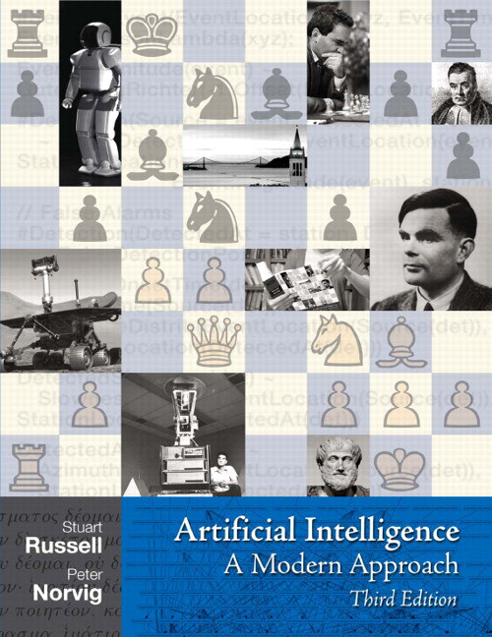
Automated Planning and Acting
Introduction
Tanya Braun

Slide 2
Organisational Stuff: Lecture
Topic: Automated Planning and Acting
Module: Formal Methods (small, 3 + 1)
Language: English
Schedule: Tuesdays, 16.15-17.45 pm
Thursdays, 16.15-17.45 am
  Overview on dates and progress in Learnweb
  Every two weeks: last 30 minutes on Thursdays explicitly for Q&A?
There are lecture recordings available from last semester (@Uni Lübeck) that I can make available if interested
  Same content, different layout; a handful of cross references to Uni Lübeck lectures that I would update here
  Warning: May not correspond one to one regarding progress in presence
Notes:
Lecture slides available as soon as they are finished
May be updated after a lecture to correct typos or reflect an in-course discussion (latest update time marked in Learnweb)

Slide 3
Organisational Stuff: Lecture
Topic: Automated Planning and Acting
Goal:
  Get to know a set of deliberation methods for automated planning and acting
  Bring you up to speed on the foundations of current research
    Most research on planning and acting is in English ➝ lecture in English
  So, the goal is at the end of semester to be able to understand and explain
    what inputs are necessary, what is output, and how does a method proceed on a high level,
    what advantages and shortcomings exist,
    when which method works in contrast to other methods.

Slide 4
Organisational Stuff: Exercises ➝ Seminar
Schedule: tba (towards end of semester)
Task: Give a presentation on a selected topic
  Ties to lecture expected
  How to fill the time is up to you!
    Theory
    Exercises
    Programming
Goal: Practice to talk in English, carry a presentation for an extended period of time, the skill set necessary to understand and present an advanced topic
Exact setup depends on the number of course participants
  Duration: 45 minutes
  On your own or in teams of two to three people
Show of hands who plans to participate as of now? (Not binding!)
Notes:
*Practical solution techniques for first-order MDPs

Slide 5
Organisational Stuff: Exercises ➝ Seminar
Assignment of topics in Learnweb over the course of next week
Topic areas
  Topics 1-2 on deterministic planning
  Topic 3 on refinement methods
  Topic 4-6 on nondeterministic planning
  Topic 7-8 on probabilistic planning
  Topics 9-10 on other deliberation methods
You can find a starting point for each topic in the main book
  Look at references in book for more info
  these topics do not appear in the book but get a paper/article as a starting point
Topics (selection)
  Hierarchical Task Network Planning
  Planning with Control Rules
  REAP
  Symbolic Model Checking Techniques
  Planning based on Search Automata
  Acting with Input/Output Automata
  First-order MDPs*
  Solution techniques for decentralised MDPs*
  Hybrid Models
  Ontologies for Planning and Acting
Notes:
*Practical solution techniques for first-order MDPs

Slide 6
Organisational Stuff: Exam
≤20 participants: Oral exam at the end of the semester
>20 participants: Written exam on 7 February, 2022 (Mon)
Prerequisites to participate in exam
  Seminar presentation
  Exam registration

Slide 7
Literature
Automated Planning and Acting
  Malik Ghallab, Dana Nau, Paolo Traverso
  Main source
Artificial Intelligence: A Modern Approach
(3rd ed.; abbreviation: AIMA)
  Stuart Russell, Peter Norvig
  Decision theory:
    Chs. 16 + 17
  Reinforcement learning
    Ch. 21
Further research papers may be announced in lectures
http://www.laas.fr/planning
http://aima.cs.berkeley.edu

Slide 8
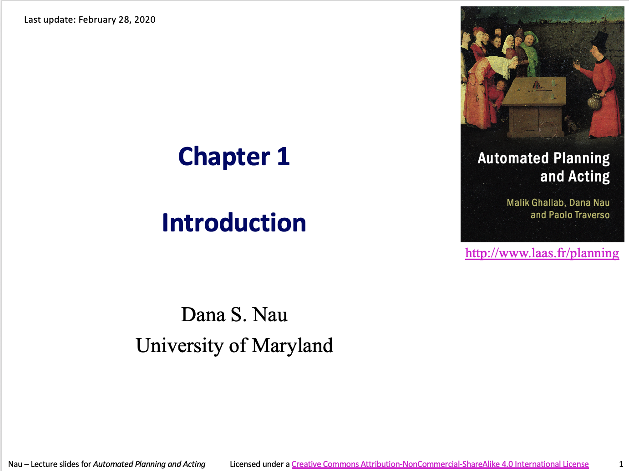
Acknowledgements
If not stated otherwise, slides are adapted from material provided by Dana Nau
http://www.laas.fr/planning

Slide 9
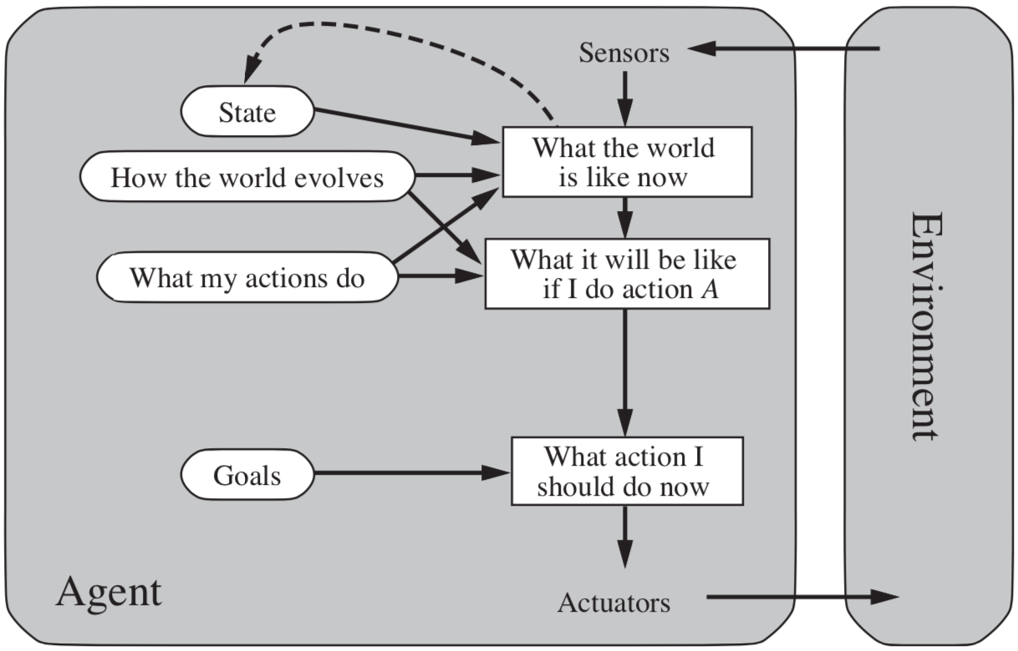
General Agent Setting
AIMA, Russell/Norvig

Slide 10
Setting Specific to Planning and Acting
Actor: agent that performs actions
Deliberation functions
  Planning
    What actions to perform
  Acting
    How to perform them
Actor
Deliberation components
Objectives
Queries
Planning
Other
actors
Acting
Plans
Messages
Commands
Percepts
Execution platform
Actuations
Signals
External world

Slide 11
Planning
Relies on prediction + search
Uses descriptive models of the actions
  Predict what the actions will do, but don’t tell how to do them
Search over predicted states and possible organizations of feasible actions
Different types of actions
  Different predictive models
  Different planning problems and techniques
  Motion and manipulation pl.
  Perception planning
  Navigation planning
  Communication planning
  Task planning
Most AI planning
a
s′ = γ(s,a)
s
• • •

Slide 12
Acting
Traditional “AI planning” view does not consider acting specially:
  Carrying out an action is just execution
  Doesn’t require the actor to think about how
Sometimes that’s true
  If the environment has been engineered to make it true
Usually acting is more complicated
Actor
Deliberation components
Objectives
Queries
Planning
Other
actors
Acting
Plans
Messages
Commands
Percepts
Execution platform
Actuations
Signals
External world

Slide 13

Acting as Execution
Notes:
Warehouse distribution center. Automated platforms to bring cabinets to people preparing orders.
Platforms follow a precise network of guides painted on the floor. Don’t need to deliberate about how to act;
environment engineered to cover all cases they’ll need to cope with.

Slide 14
Deliberative Acting
Actor is situated in a dynamic unpredictable environment
  Adapt actions to current context
  React to events
Relies on
  Operational models telling how to perform the actions
  Observations of current state
Planning stage
Acting stage

Slide 15
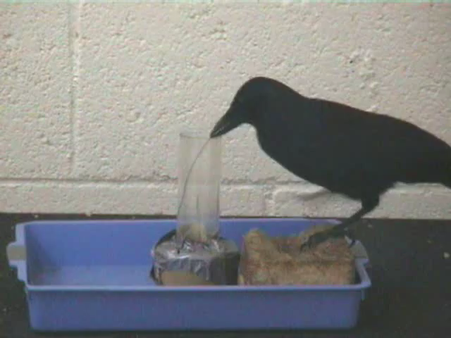
Deliberative Acting
Notes:
New Caledonian crow trying to use a piece of wire to get food that’s out of reach, figures out it won’t work
Figures out how to brace the wire to bend it into a hook, uses the hook to get the food

Slide 16
General Characteristics
Multiple levels of abstraction
  Actors are organised into physical subsystems
Heterogeneous reasoning
  Different techniques
    At different levels
    In different subsystems at same level
Continual online planning
  Can’t plan everything in advance
  Plans are abstract and partial until more detail is needed
Actor
Deliberation components
Objectives
Queries
Planning
Other
actors
Acting
Plans
Messages
Commands
Percepts
Execution platform
Actuations
Signals
External world
Notes:
Deliberation reflects levels

Slide 17
Example: Service Robot
respond to user requests
Multiple levels of abstraction
  Higher levels: more planning
  Lower levels: more acting
Heterogeneous reasoning
  bring o7 to room2: abstract steps
  navigate to room1: path planning
  open door: reactive
Continual online planning
  Is o7 really in room1?
  What kind of door?
  Close enough to the doorknob?
…
bring o7 to loc2
…
go to
hallway
navigate
to loc1
fetch
o7
navigate
to loc2
deliver
o7
Planning Acting
…
…
…
…
move to door
open door
get out
close door
…
…
…
identify
type
of
door
move
close
to
knob
grasp
knob
turn
knob
maintain
move
back
ungrasp
pull
monitor
pull
monitor

Slide 18
Example: Harbour Management
manage incoming shipment
Importing/exporting cars
  Based on Bremen Harbour
Multiple levels of abstraction
  Reflect physical
  organization of harbour
Heterogeneous reasoning
  Different components work in different ways
  Online synthesis of automata to control their interactions
Continual online planning
  Top level can be planned offline
  The rest is online, based
  on current conditions
unload
unpack
store
await order
prepare
deliver
…
…
…
…
…
registration
manager
storage
assignment
manager
storage area A manager
Planning Acting
storage area B
manager
…
…
storage area
C manager
…
booking
manager
navigation
release
manager
…
…
…

Slide 19
Content
Planning and Acting with Deterministic Models
  Conventional AI planning
Planning and Acting with Refinement Methods
  Abstract activities ➝ collections of less-abstract activities
Planning and Acting with Temporal Models
  Reasoning about time constraints
Planning and Acting with Nondeterministic Models
  Actions with multiple possible outcomes
Standard Decision Making
  Utility theory
  Markov decision process (MDP)
Planning and Acting with Probabilistic Models
  Actions with multiple possible outcomes, with probabilities
Advanced Decision Making
  Hidden goals
  Partially observable MDP (POMDP)
  Decentralised POMDP
Human-aware Planning
  Planning with a human in the loop
Notes:
1-4, 6: Planning book
5, 7: AIMA
8: Rao

