Slide 1
Automated Planning and Acting
Deterministic Models
Tanya Braun

Slide 2
Content
Planning and Acting with Deterministic Models
  State-variable representation
  Forward State-Space Search
  Heuristic Functions
  Backward Search
  Plan-Space Search
Planning and Acting with Refinement Methods
Planning and Acting with Temporal Models
Planning and Acting with Nondeterministic Models
Standard Decision
Making
Planning and Acting with Probabilistic Models
Advanced Decision
Making
Human-aware Planning
Notes:
1-4, 6: Planning book
5, 7: AIMA
8: Rao

Slide 3
Outline per the Book
2.1 State-variable representation
  State = {values of variables}; action = changes to those values
2.2 Forward state-space search
  Start at initial state, look for sequence of actions that achieve goal
2.3 Heuristic functions
  How to guide a forward state-space search
2.6 Incorporating planning into an actor
  Online lookahead, unexpected events
2.4 Backward search
  Start at goal state, go backwards toward initial state
2.5 Plan-space search
  Start with incomplete plan for getting from initial state to goal state, make transformations to fix flaws in the plan

Slide 4
Motivation
How to model a complex environment?
  Generally need simplifying assumptions
Classical planning
  Finite, static world
    Change occurs only when the actor causes it
  No concurrent actions, no explicit time
    Just a sequence of states and actions ⟨s₀, a₁, s₁, a₂, s₂, …⟩
  Determinism, no uncertainty
    Can predict exactly what each action will do
    No accidents, no “chance” outcomes
Avoids a lot of complications
  But most real-world environments don’t satisfy the assumptions
Errors in prediction
  OK if they’re infrequent and don’t have severe consequences

Slide 5
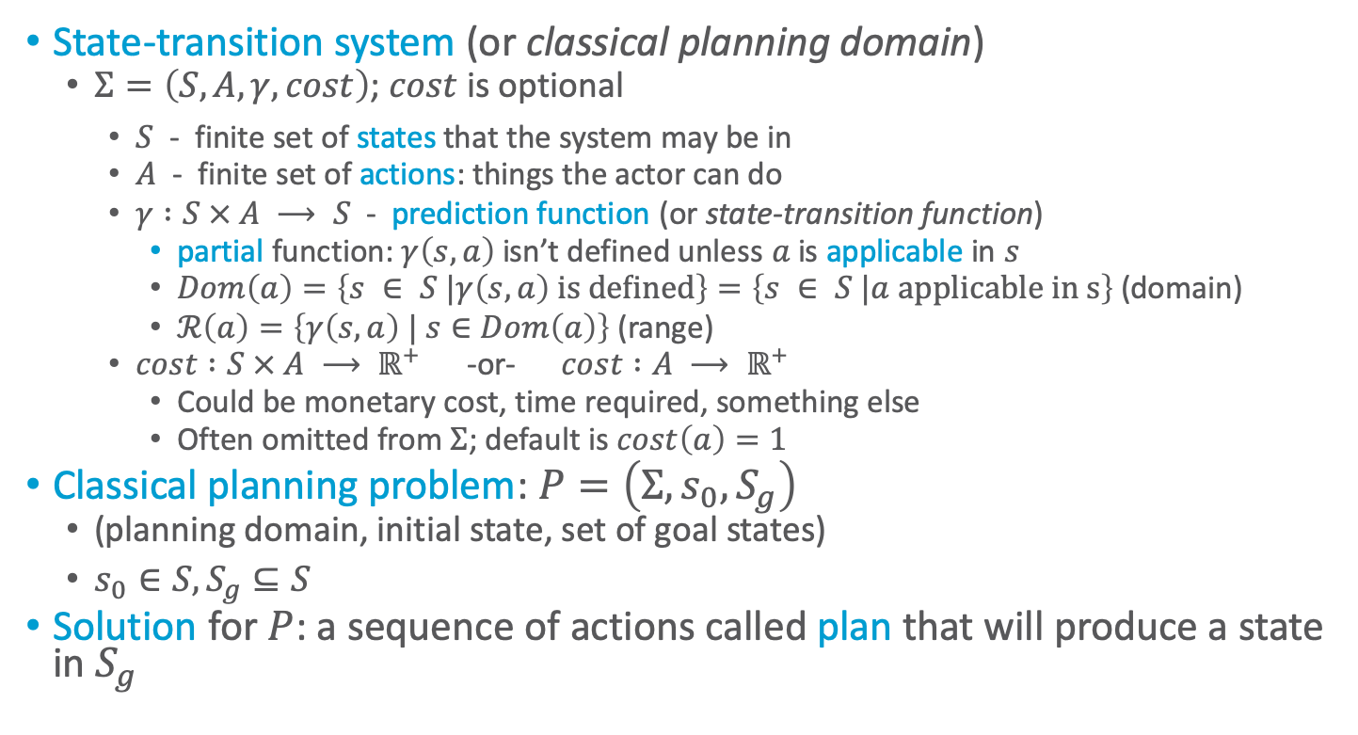
Domain Model
State-transition system (or classical planning domain)
  $Σ=\left(S, A, γ, cost\right)$; $cost$ is optional
    $S$ - finite set of states that the system may be in
    $A$ - finite set of actions: things the actor can do
    $γ :S × A ⟶ S$ - prediction function (or state-transition function)
      partial function: $γ\left(s, a\right)$ isn’t defined unless $a$ is applicable in $s$
      $Dom\left(a\right)=\left\{s ∈ S |γ\left(s, a\right) \text{is} \text{defined}\right\}=\left\{s ∈ S |a \text{applicable} \text{in} \text{s}\right\}$ (domain)
      $ℛ\left(a\right)=\left\{γ\left(s, a\right) | s∈Dom\left(a\right)\right\}$ (range)
    $cost :S × A ⟶ ℝ^{+}$ -or- $cost :A ⟶ ℝ^{+}$
      Could be monetary cost, time required, something else
      Often omitted from $Σ$; default is $cost\left(a\right)=1$
Classical planning problem: $P=\left(Σ, s_{0}, S_{g}\right)$
  (planning domain, initial state, set of goal states)
  $s_{0}∈S, S_{g}⊆S$
Solution for $P$: a sequence of actions called plan that will produce a state in $S_{g}$
Notes:
Reach one state of S_g
Can also think of it as an automaton
Next: Representing \Sigma

Slide 6

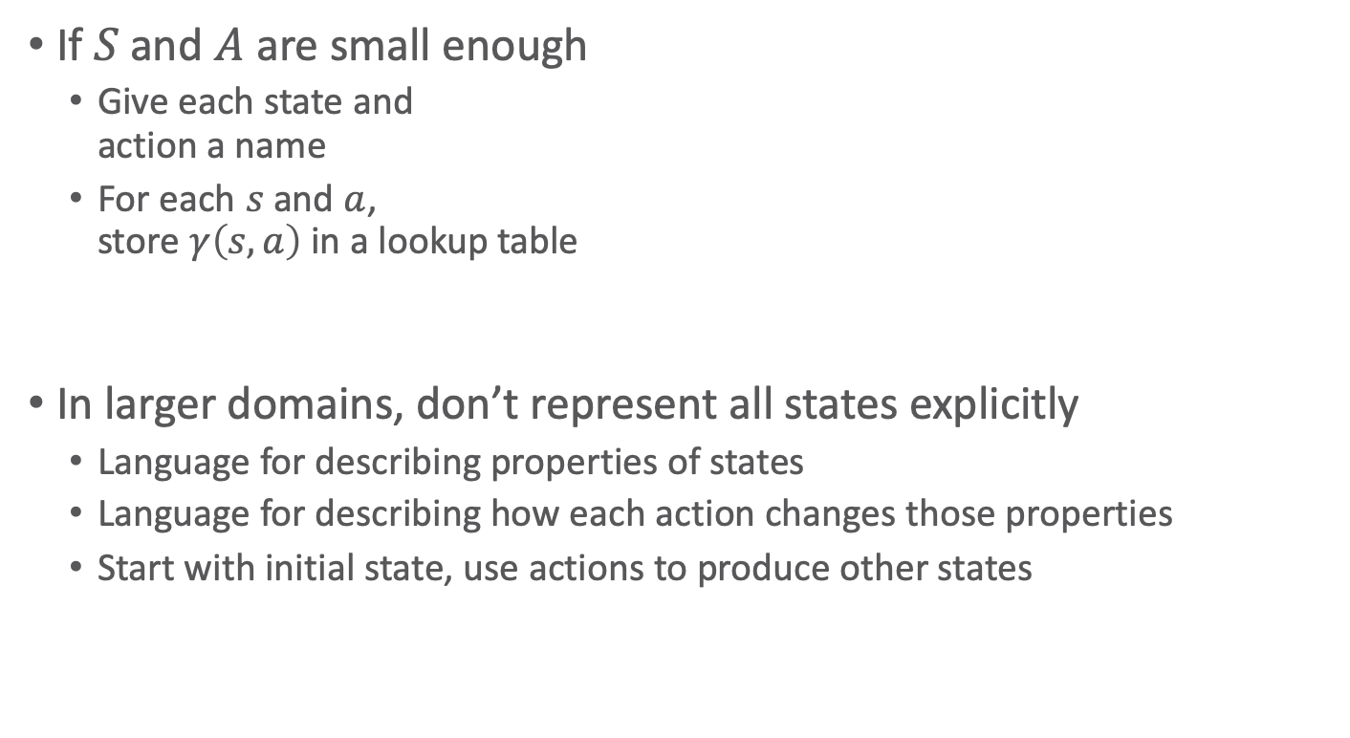
Representing $Σ$
If $S$ and $A$ are small enough
  Give each state and
  action a name
  For each $s$ and $a$,
  store $γ\left(s, a\right)$ in a lookup table
In larger domains, don’t represent all states explicitly
  Language for describing properties of states
  Language for describing how each action changes those properties
  Start with initial state, use actions to produce other states
Notes:
Loc_i: possible states of actor in road network
Actions move actor form one state to another
Cost: e.g. distance

Slide 7
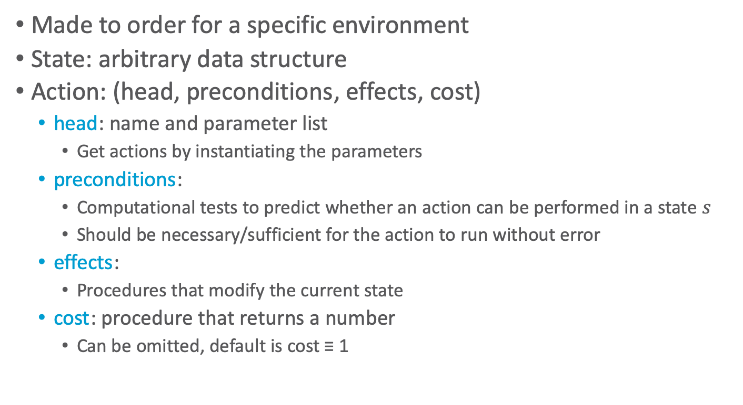
Domain-specific Representation
Made to order for a specific environment
State: arbitrary data structure
Action: (head, preconditions, effects, cost)
  head: name and parameter list
    Get actions by instantiating the parameters
  preconditions:
    Computational tests to predict whether an action can be performed in a state $s$
    Should be necessary/sufficient for the action to run without error
  effects:
    Procedures that modify the current state
  cost: procedure that returns a number
    Can be omitted, default is cost ≡ 1

Slide 8
Example
Drilling holes in a metal workpiece
  A state
    Geometric model of the workpiece,
    information about its location and orientation
    Capabilities and status of drilling machine and drill bit
  Several actions
    Putting the workpiece onto the drilling machine
    Clamping it
    Loading a drill bit
    Drilling (next slide)

Slide 9
Drilling
Name and parameters:
  drill-hole(machine, drill-bit, workpiece, geometry, machining-tolerances)
Preconditions
  Can the drilling machine and drill bit produce a hole having the desired geometry and machining tolerances?
  Is the drill bit installed? Is the workpiece clamped onto the drilling platform? Etc.
Effects
  Geometric model of new workpiece geometry,
  annotated with tolerances
Cost
  Estimate of time or monetary cost

Slide 10
Discussion
Advantage of domain-specific representation:
  Can choose whatever works best for that particular domain
Disadvantage:
  For each new domain, need new representation and deliberation algorithms
Alternative: domain-independent representation
  Try to create a “standard format” that can be used for many different planning domains
  Deliberation algorithms that work for anything in this format
State-variable representation
  Simple formats for describing states and actions
  Limited representational capability
    But easy to compute, easy to reason about
  Domain-independent search algorithms and heuristic functions that can be used in all state-variable planning problems

Slide 11
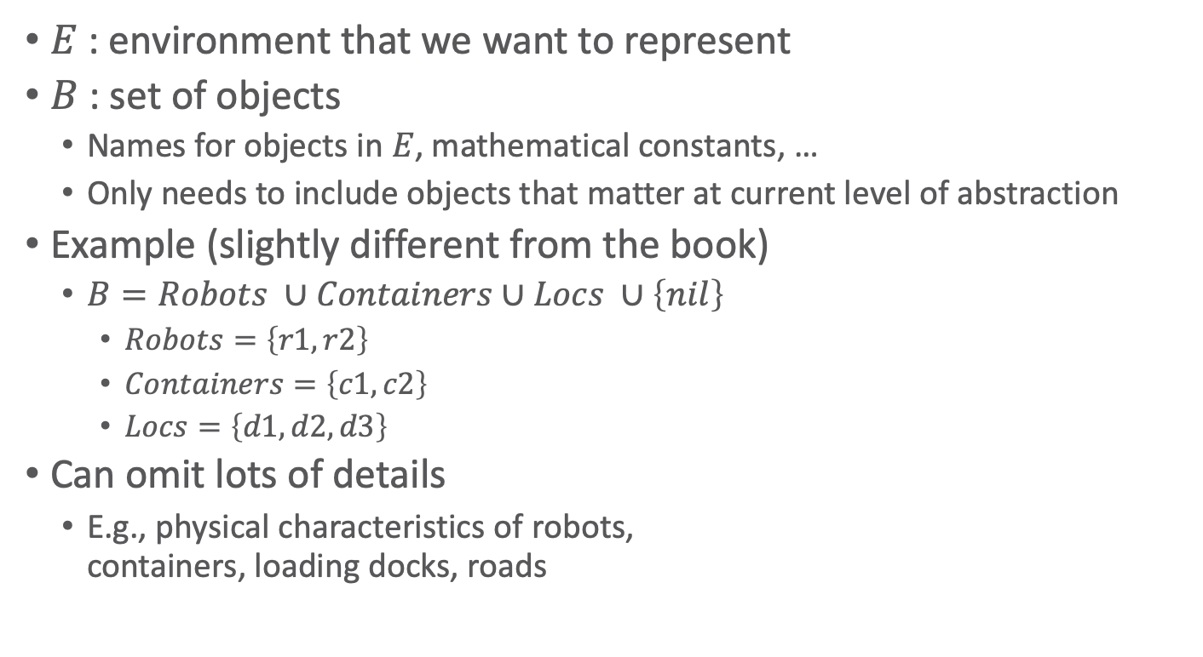
State-Variable Representation
$E$ : environment that we want to represent
$B$ : set of objects
  Names for objects in $E$, mathematical constants, …
  Only needs to include objects that matter at current level of abstraction
Example (slightly different from the book)
  $B=Robots ∪Containers∪Locs ∪\left\{nil\right\}$
    $Robots=\left\{r1, r2\right\}$
    $Containers=\left\{c1, c2\right\}$
    $Locs=\left\{d1, d2,d3\right\}$
Can omit lots of details
  E.g., physical characteristics of robots,
  containers, loading docks, roads
d3
r1
r2
c1
c2
d1
d2

Slide 12
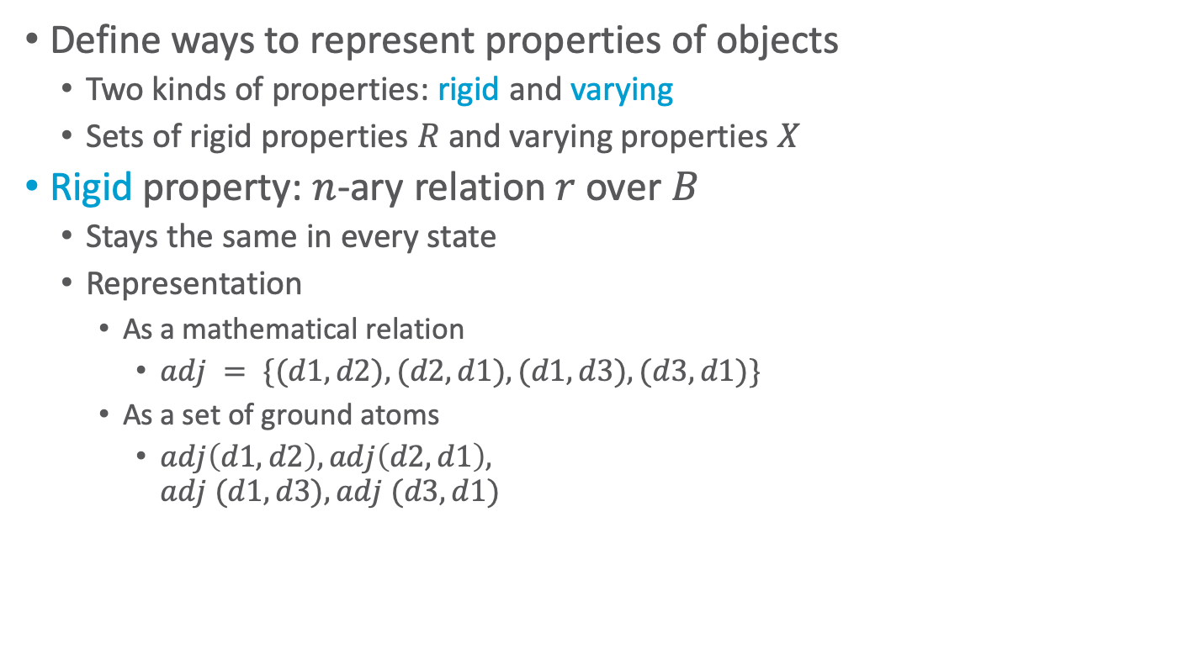
Properties of Objects
Define ways to represent properties of objects
  Two kinds of properties: rigid and varying
  Sets of rigid properties $R$ and varying properties $X$
Rigid property: $n$-ary relation $r$ over $B$
  Stays the same in every state
  Representation
    As a mathematical relation
      $adj = \{(d1,d2), (d2,d1), (d1,d3), (d3,d1)\}$
    As a set of ground atoms
      $adj\left(d1,d2\right), adj\left(d2,d1\right),$
      $adj (d1,d3), adj (d3,d1)$
d3
r1
r2
c1
c2
d1
d2
Notes:
adj = adjacent; loc is adjacent if connected by road
Terminology from first-order logic:
ground: fully instantiated, no variable symbols
atom ≡ atomic formula ≡ positive literal
≡ predicate symbol with list of arguments
negative literal ≡ negated atom ≡ atom with a negation sign in front of it

Slide 13
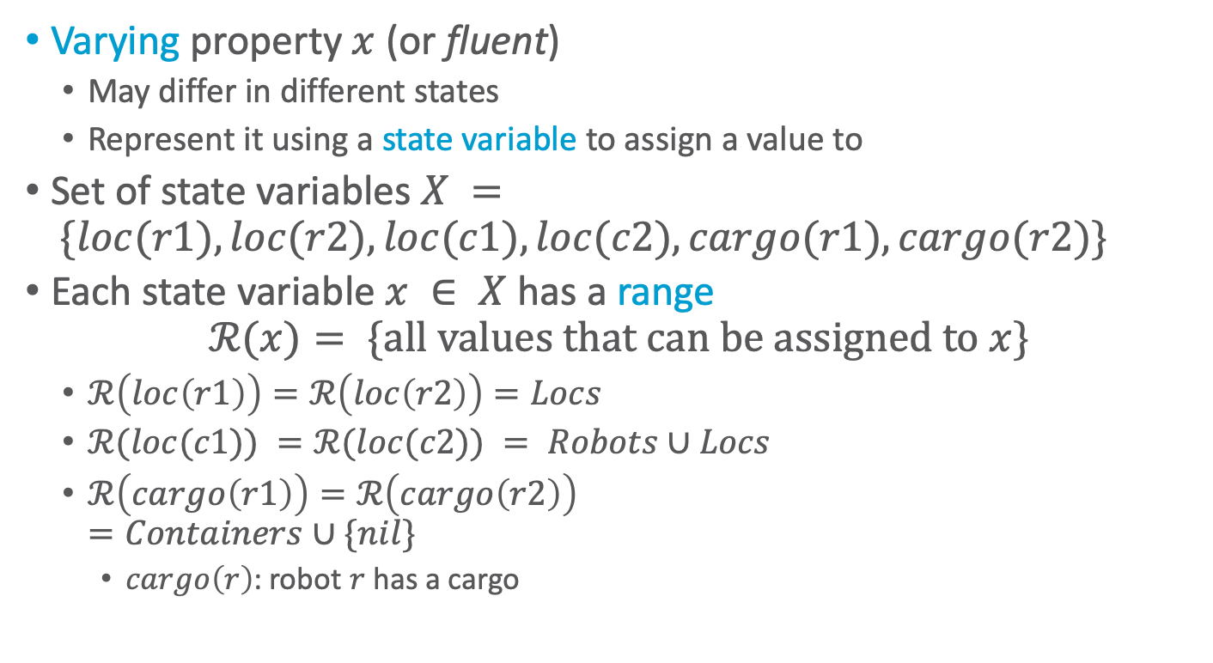
Varying Properties
Varying property $x$ (or fluent)
  May differ in different states
  Represent it using a state variable to assign a value to
Set of state variables $X = \{loc(r1), loc(r2), loc(c1), loc(c2), cargo(r1), cargo(r2)\}$
Each state variable $x ∈ X$ has a range
$$ℛ(x)= \{\text{all} \text{values} \text{that} \text{can} \text{be} \text{assigned} \text{to} x\}$$
  $ℛ\left(loc\left(r1\right)\right)=ℛ\left(loc\left(r2\right)\right)=Locs$
  $ℛ(loc(c1)) =ℛ(loc(c2)) = Robots∪Locs$
  $ℛ\left(cargo\left(r1\right)\right)=ℛ\left(cargo\left(r2\right)\right)$
  $=Containers∪\{nil\}$
    $cargo\left(r\right)$: robot $r$ has a cargo
d3
r1
r2
c1
c2
d1
d2
Notes:
cargo(r) : robot r carries a cargo

Slide 14
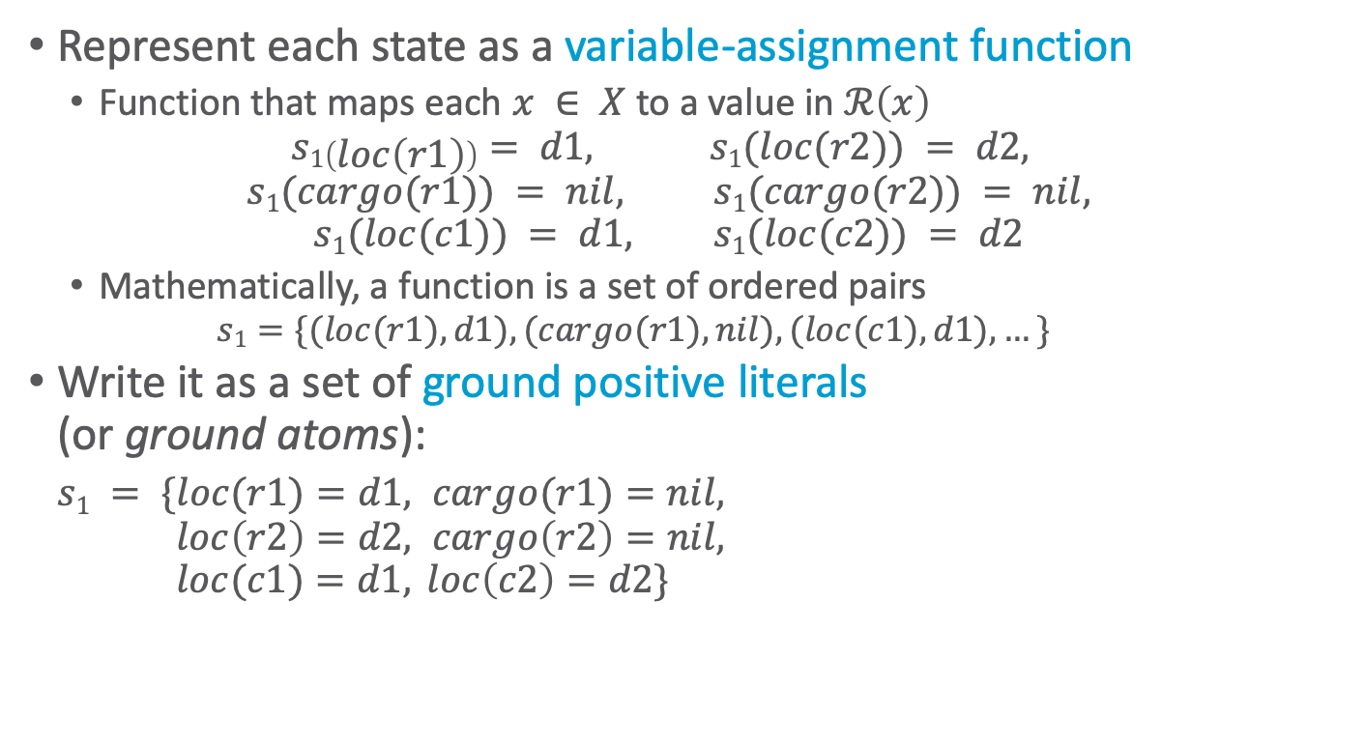
States as Functions
Represent each state as a variable-assignment function
  Function that maps each $x ∈ X$ to a value in $ℛ\left(x\right)$
  $$s1\left(loc\left(r1\right)\right)= d1, s1(loc(r2)) = d2,$$
  $$s1(cargo(r1)) = nil, s1(cargo(r2)) = nil,$$
  $$s1(loc(c1)) = d1, s1(loc(c2)) = d2$$
  Mathematically, a function is a set of ordered pairs
    $$s1=\{(loc(r1), d1), (cargo(r1), nil), (loc(c1), d1), …\}$$
Write it as a set of ground positive literals
(or ground atoms):
  $s1 = \{loc(r1)=d1, cargo(r1)=nil,$
  $loc\left(r2\right)=d2, cargo\left(r2\right)=nil,$
  $loc(c1)=d1, loc\left(c2\right)=d2\}$
d3
r1
r2
c1
c2
d1
d2

Slide 15
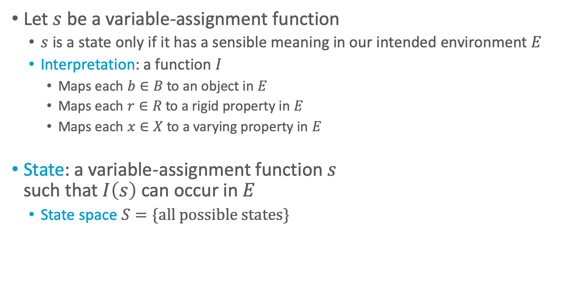
States as Functions
Let $s$ be a variable-assignment function
  $s$ is a state only if it has a sensible meaning in our intended environment $E$
  Interpretation: a function $I$
    Maps each $b∈B$ to an object in $E$
    Maps each $r∈R$ to a rigid property in $E$
    Maps each $x∈X$ to a varying property in $E$
State: a variable-assignment function $s$
such that $I\left(s\right)$ can occur in $E$
  State space $S=\{\text{all} \text{possible} \text{states}\}$
d3
r1
r2
c1
c2
d1
d2
Notes:
Map strings like d1, c1, etc to objects in environment (loading docks)

Slide 16
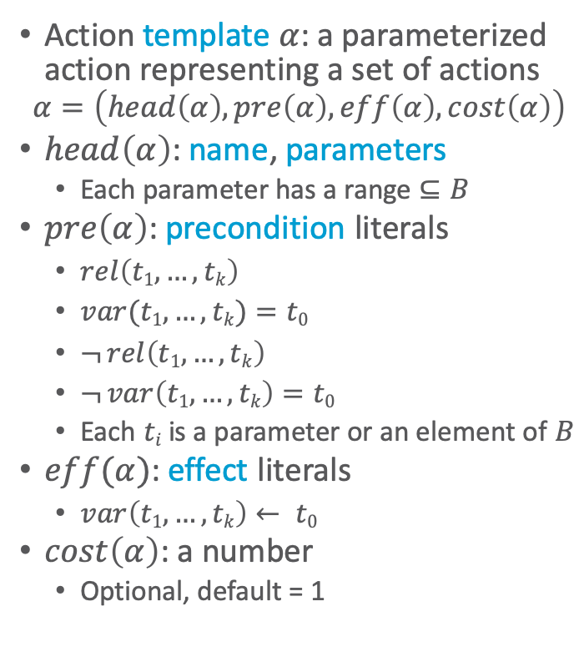
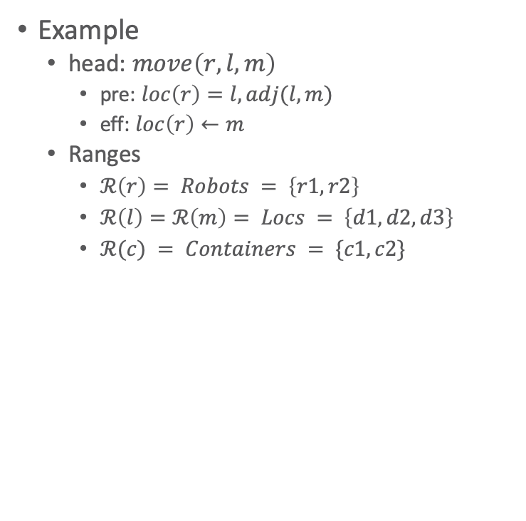
Action Templates
Action template $α$: a parameterized action representing a set of actions
$$α=\left(head\left(α\right), pre\left(α\right), eff\left(α\right), cost\left(α\right)\right)$$
$head\left(α\right)$: name, parameters
  Each parameter has a range $⊆B$
$pre\left(α\right)$: precondition literals
  $rel\left(t1,…,tk\right)$
  $var(t1,…,tk)=t0$
  $¬ rel\left(t1,…,tk\right)$
  $¬ var\left(t1,…,tk\right)=t0$
  Each $ti$ is a parameter or an element of $B$
$eff(α)$: effect literals
  $var\left(t1,…,tk\right)← t0$
$cost\left(α\right)$: a number
  Optional, default = 1
Example
  head: $move\left(r,l,m\right)$
    pre: $loc\left(r\right)=l, adj(l,m)$
    eff: $loc\left(r\right)←m$
  Ranges
    $ℛ\left(r\right)= Robots = \left\{r1,r2\right\}$
    $ℛ\left(l\right)=ℛ\left(m\right)= Locs = \left\{d1,d2,d3\right\}$
    $ℛ(c) = Containers = \{c1,c2\}$
d3
r1
r2
c1
c2
d1
d2
Notes:
Head: syntactic way to refer to an action in a unique way

Slide 17
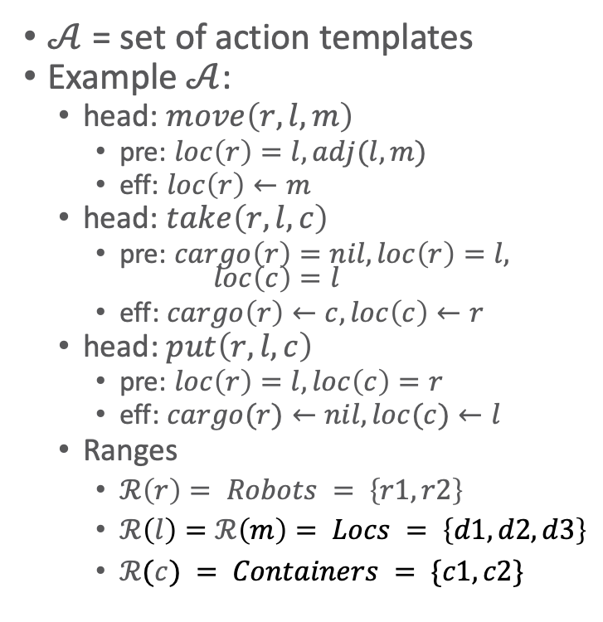
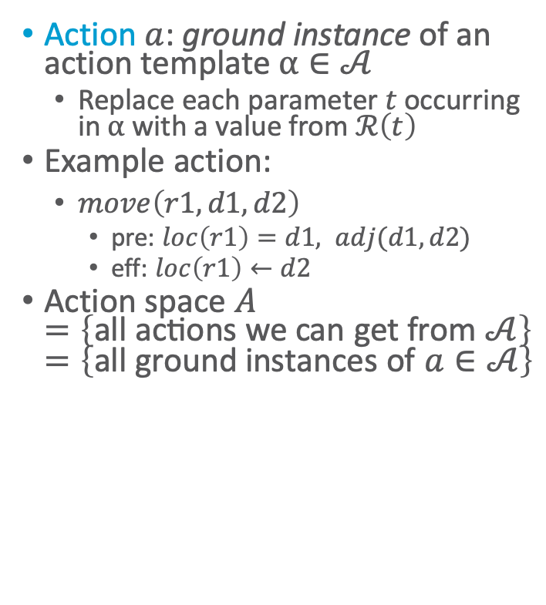
Actions
How many move actions exist?
Action $a$: ground instance of an action template $α∈𝒜$
  Replace each parameter $t$ occurring in $α$ with a value from $ℛ\left(t\right)$
Example action:
  $move\left(r1,d1,d2\right)$
    pre: $loc\left(r1\right)=d1, adj(d1,d2)$
    eff: $loc\left(r1\right)←d2$
Action space $A$
$=\left\{\text{all} \text{actions} \text{we} \text{can} \text{get} \text{from} 𝒜\right\}=\left\{\text{all} \text{ground} \text{instances} \text{of} a∈𝒜\right\}$
$𝒜$ = set of action templates
Example $𝒜$:
  head: $move\left(r,l,m\right)$
    pre: $loc\left(r\right)=l, adj(l,m)$
    eff: $loc\left(r\right)←m$
  head: $take\left(r,l,c\right)$
    pre: $cargo\left(r\right)=nil, loc\left(r\right)=l,$
    $loc\left(c\right)=l$
    eff: $cargo\left(r\right)←c, loc\left(c\right)←r$
  head: $put\left(r,l,c\right)$
    pre: $loc\left(r\right)=l, loc\left(c\right)=r$
    eff: $cargo(r)←nil, loc(c)←l$
  Ranges
    $ℛ\left(r\right)= Robots = \left\{r1,r2\right\}$
    $ℛ\left(l\right)=ℛ\left(m\right)= Locs = \left\{d1,d2,d3\right\}$
    $ℛ(c) = Containers = \{c1,c2\}$
d3
r1
r2
c1
c2
d1
d2
Notes:
|gr(move(r,l,m))| = 2 * 3 * 3 = 18
|Robots| = 2
|Locs| = 3

Slide 18
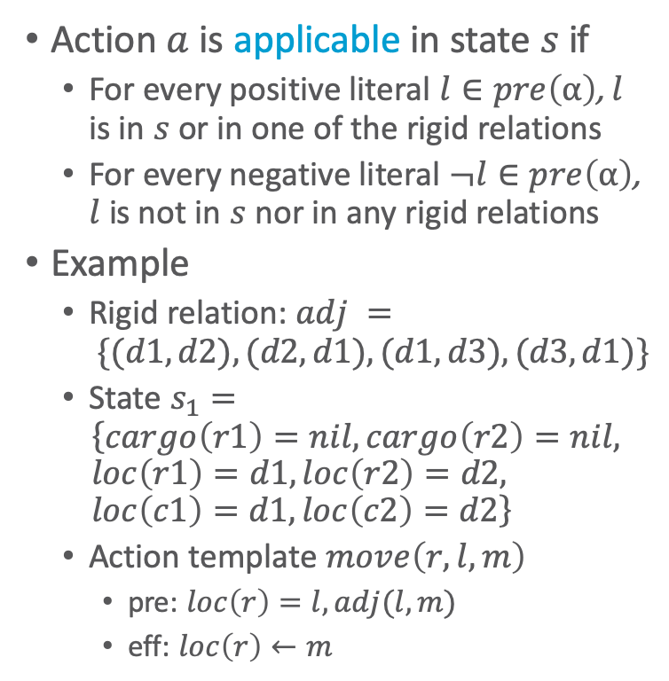
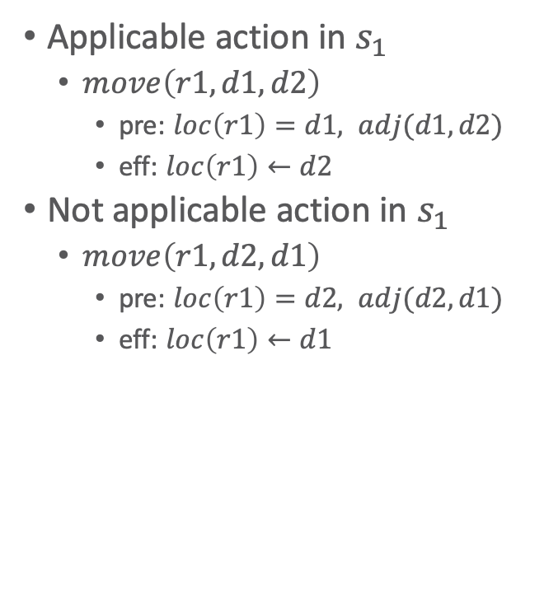
Applicability
How many applicable move actions exist?
Action $a$ is applicable in state $s$ if
  For every positive literal $l∈pre\left(α\right)$, $l$ is in $s$ or in one of the rigid relations
  For every negative literal $¬l∈pre\left(α\right)$, $l$ is not in $s$ nor in any rigid relations
Example
  Rigid relation: $adj = \{(d1,d2), (d2,d1), (d1,d3), (d3,d1)\}$
  State $s_{1}=$
  $$\left\{cargo\left(r1\right)=nil, cargo\left(r2\right)=nil, loc\left(r1\right)=d1, loc\left(r2\right)=d2, loc\left(c1\right)=d1, loc\left(c2\right)=d2\right\}$$
  Action template $move\left(r,l,m\right)$
    pre: $loc\left(r\right)=l, adj(l,m)$
    eff: $loc\left(r\right)←m$
Applicable action in $s_{1}$
  $move\left(r1,d1,d2\right)$
    pre: $loc\left(r1\right)=d1, adj(d1,d2)$
    eff: $loc\left(r1\right)←d2$
Not applicable action in $s_{1}$
  $move\left(r1,d2,d1\right)$
    pre: $loc\left(r1\right)=d2, adj(d2,d1)$
    eff: $loc\left(r1\right)←d1$
Why?
d3
r1
r2
c1
c2
d1
d2
Notes:
Not applicable: r1 not at d2
Applicable move actions: 3 (of 18 possible move actions)
r1: 2 moves (d1->d2, d1 ->d3)
r2: 1 move (d2->d1)

Slide 19
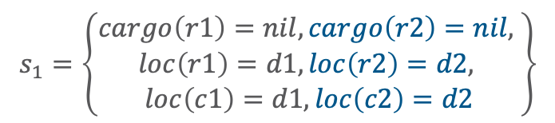
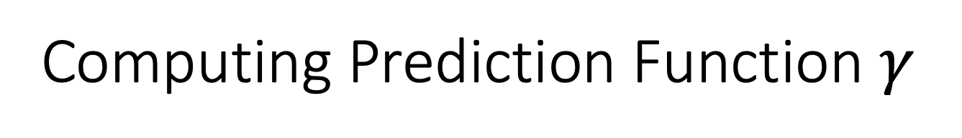
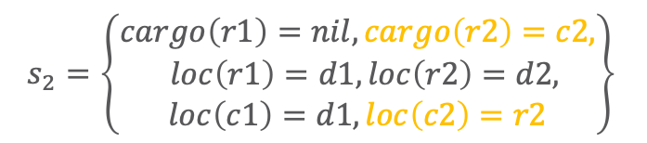


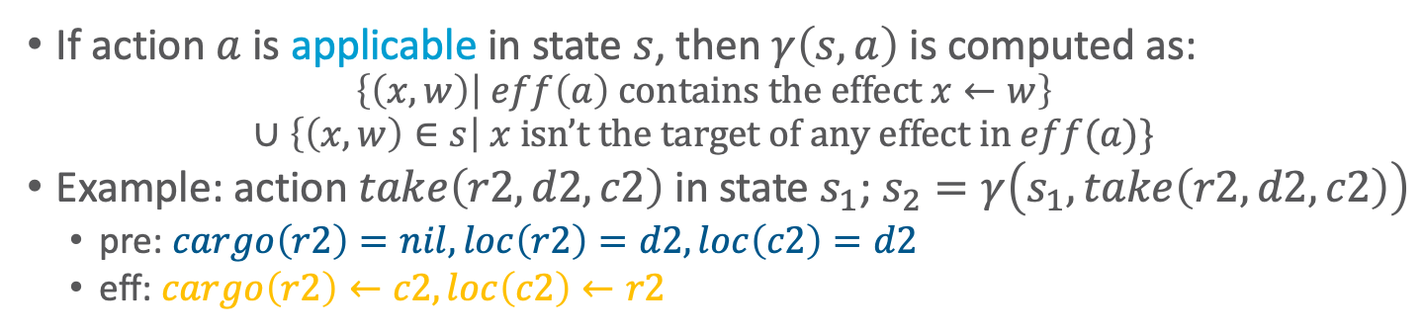
Computing Prediction Function $γ$
If action $a$ is applicable in state $s$, then $γ\left(s,a\right)$ is computed as:
  $$\left\{\left(x,w\right) | eff\left(a\right) \text{contains} \text{the} \text{effect} x←w\right\}$$
  $$∪\left\{\left(x,w\right)∈s\right| x \text{isn}\text{’}\text{t} \text{the} \text{target} \text{of} \text{any} \text{effect} \text{in} eff(a)\}$$
Example: action $take\left(r2,d2,c2\right)$ in state $s_{1}$; $s_{2}=γ\left(s_{1},take\left(r2, d2, c2\right)\right)$
  pre: $cargo\left(r2\right)=nil, loc\left(r2\right)=d2, loc\left(c2\right)=d2$
  eff: $cargo\left(r2\right)←c2, loc\left(c2\right)←r2$
$$s_{1}=\left\{\begin{aligned}cargo\left(r1\right)=nil, cargo\left(r2\right)=nil, \\ loc\left(r1\right)=d1, loc\left(r2\right)=d2, \\ loc\left(c1\right)=d1, loc\left(c2\right)=d2\end{aligned}\right\}$$
$$s_{2}=\left\{\begin{aligned}cargo\left(r1\right)=nil, cargo\left(r2\right)=c2, \\ loc\left(r1\right)=d1, loc\left(r2\right)=d2, \\ loc\left(c1\right)=d1, loc\left(c2\right)=r2\end{aligned}\right\}$$
d3
d3
r1
r2
r1
r2
c2
c1
c2
c1
d1
$$s_{1}$$
d2
d1
$$s_{2}$$
d2
Notes:
State transition function or prediction function

Slide 20
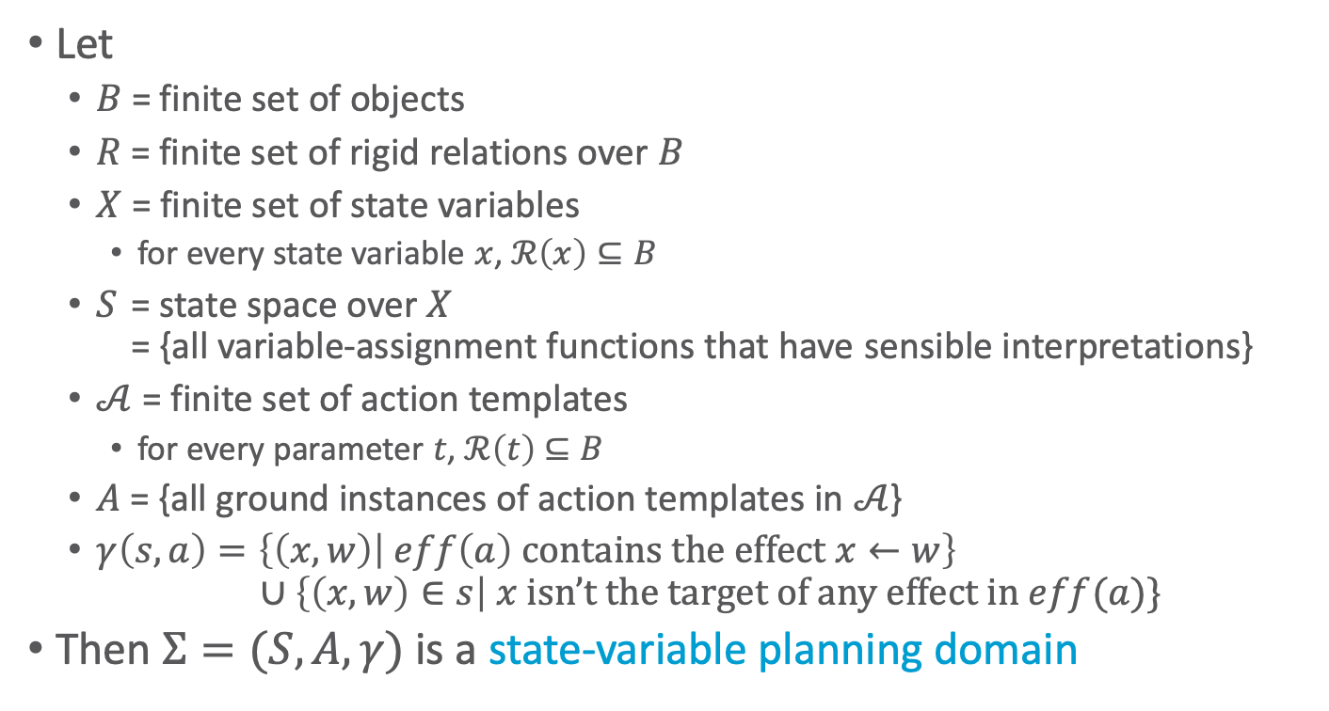
State-Variable Planning Domain
Let
  $B$ = finite set of objects
  $R$ = finite set of rigid relations over $B$
  $X$ = finite set of state variables
    for every state variable $x$, $ℛ\left(x\right)⊆B$
  $S$ = state space over $X$
  = {all variable-assignment functions that have sensible interpretations}
  $𝒜$ = finite set of action templates
    for every parameter $t$, $ℛ\left(t\right)$ $⊆B$
  $A$ = {all ground instances of action templates in $𝒜$}
  $γ\left(s,a\right)=\left\{\left(x,w\right) | eff\left(a\right) \text{contains} \text{the} \text{effect} x←w\right\}$
  $∪\left\{\left(x,w\right)∈s\right| x \text{isn}\text{’}\text{t} \text{the} \text{target} \text{of} \text{any} \text{effect} \text{in} eff(a)\}$
Then $Σ=(S,A,γ)$ is a state-variable planning domain
Notes:
Instead of a state-transition system (classical planning domain)

Slide 21


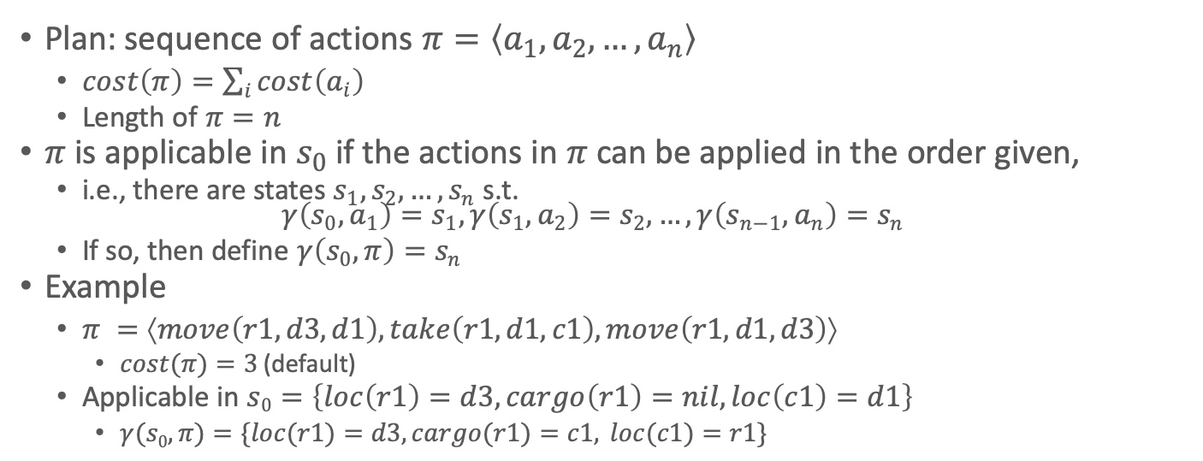
Plans
Plan: sequence of actions $π=\left\langle a_{1},a_{2},…, a_{n}\right\rangle$
  $cost\left(π\right)=\sum_{i}{cost\left(a_{i}\right)}$
  Length of $π=n$
$π$ is applicable in $s_{0}$ if the actions in $π$can be applied in the order given,
  i.e., there are states $s_{1},s_{2},…, s_{n}$ s.t.
  $γ\left(s_{0}, a_{1}\right)=s_{1},γ\left(s_{1}, a_{2}\right)=s_{2}, …,γ\left(s_{n−1}, a_{n}\right)=s_{n}$
  If so, then define $γ\left(s_{0}, π\right)=s_{n}$
Example
  $π =⟨move\left(r1,d3,d1\right), take\left(r1,d1,c1\right), move\left(r1,d1,d3\right)⟩$
    $cost(π)=3$ (default)
  Applicable in $s0=\left\{loc\left(r1\right)=d3, cargo\left(r1\right)=nil, loc\left(c1\right)=d1\right\}$
    $γ(s0,π)=\{loc(r1)=d3, cargo(r1)=c1, loc(c1)=r1\}$
r1
r1
c1
d3
d3
c1
$$s_{0}$$
d1
$$s_{3}=γ\left(s_{0},π\right)$$
d1
d2
d2

Slide 22
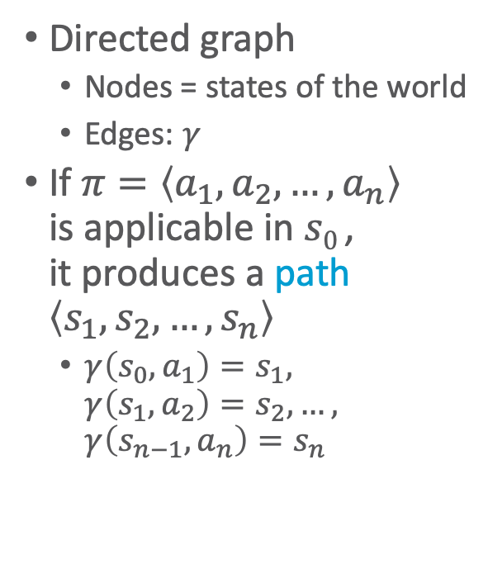


State Space
$s0$:
Directed graph
  Nodes = states of the world
  Edges: $γ$
If $π=\left\langle a_{1},a_{2},…, a_{n}\right\rangle$
is applicable in $s0$ ,
it produces a path $\left\langle s_{1},s_{2},…, s_{n}\right\rangle$
  $γ\left(s_{0}, a_{1}\right)=s_{1},$
  $γ\left(s_{1}, a_{2}\right)=s_{2}, …,$
  $γ\left(s_{n−1}, a_{n}\right)=s_{n}$
$s1$:

Slide 23
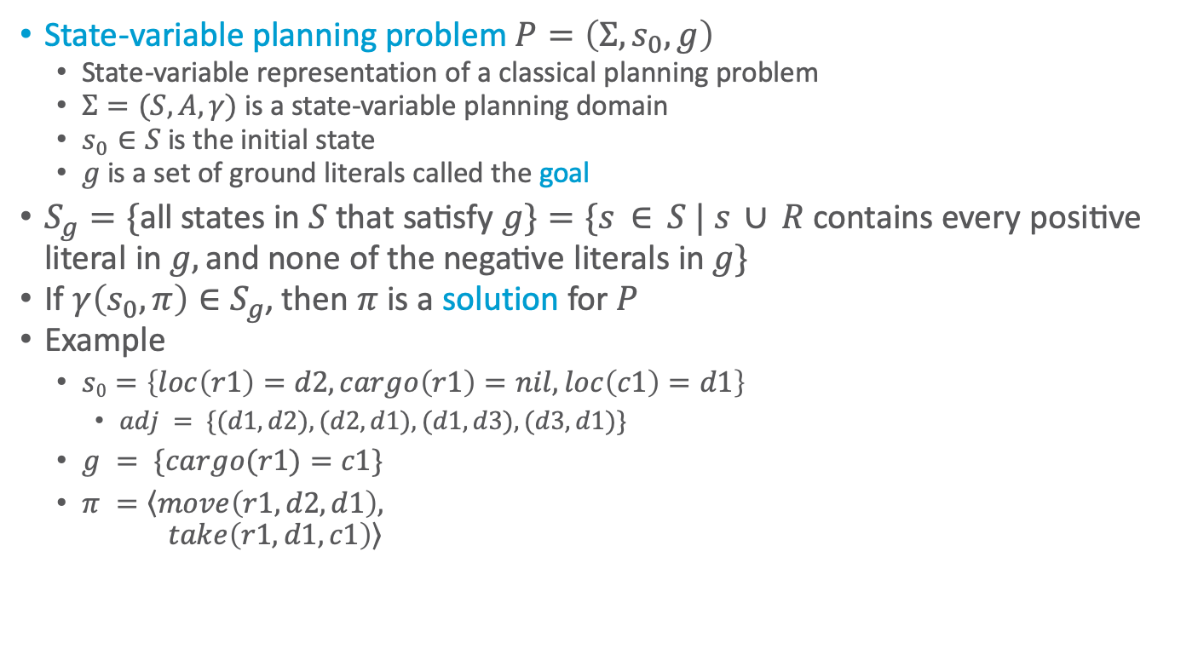


Planning Problems
State-variable planning problem $P=\left(Σ,s_{0},g\right)$
  State-variable representation of a classical planning problem
  $Σ=(S,A,γ)$ is a state-variable planning domain
  $s_{0}∈S$ is the initial state
  $g$ is a set of ground literals called the goal
$S_{g}=\{\text{all} \text{states} \text{in} S \text{that} \text{satisfy} g\}=\{s ∈ S | s ∪ R \text{contains} \text{every} \text{positive} \text{literal} \text{i}\text{n} g,\text{and} \text{none} \text{of} \text{the} \text{negative} \text{literals} \text{in} g\}$
If $γ\left(s_{0}, π\right)∈S_{g}$, then $π$ is a solution for $P$
Example
  $s0=\left\{loc\left(r1\right)=d2, cargo\left(r1\right)=nil, loc\left(c1\right)=d1\right\}$
    $adj = \{(d1,d2), (d2,d1), (d1,d3), (d3,d1)\}$
  $g = \{cargo(r1)=c1\}$
  $π =\left\langle move\left(r1,d2,d1\right),\right.$
  $\left.take\left(r1,d1,c1\right)\right\rangle$
d3
r1
r1
c1
How many solutions of length 3 exist?
c1
d1
$$s_{0}$$
d2
$$g$$
Notes:
None

Slide 24
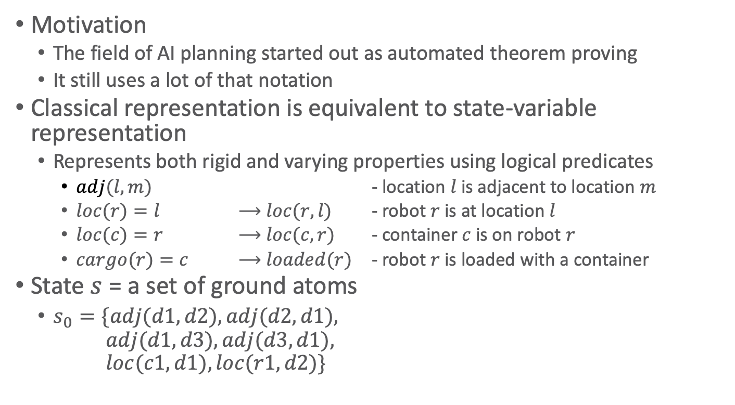
Classical Representation
Motivation
  The field of AI planning started out as automated theorem proving
  It still uses a lot of that notation
Classical representation is equivalent to state-variable representation
  Represents both rigid and varying properties using logical predicates
    $adj(l,m)$ - location $l$ is adjacent to location $m$
    $loc(r)=l$ ⟶ $loc(r,l)$ - robot $r$ is at location $l$
    $loc(c)=r$ ⟶ $loc(c,r)$ - container $c$ is on robot $r$
    $cargo(r)=c$ ⟶ $loaded(r)$ - robot $r$ is loaded with a container
State $s$ = a set of ground atoms
  $s_{0}=\{adj(d1,d2), adj(d2,d1),$
  $adj(d1,d3), adj(d3,d1),$
  $loc(c1,d1), loc(r1,d2)\}$
d3
r1
c1
d1
d2
Notes:
nil – false, c – true, which c on which r through loc of c
could also do cargo(r,c)

Slide 25

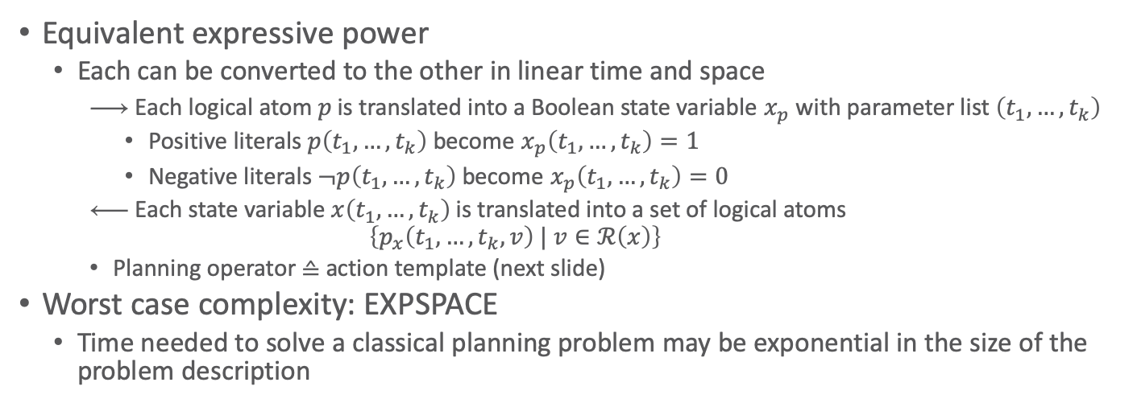
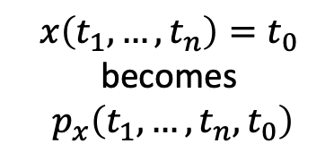
Classical Representation
$p\left(t_{1},…,t_{k}\right)$ becomes $x_{p}\left(t_{1},…,t_{k}\right)=1$
Classical
representation
$$x\left(t_{1},…,t_{n}\right)=t_{0}$$
becomes
$$p_{x}\left(t_{1},…,t_{n},t_{0}\right)$$
State-variable
representation
Equivalent expressive power
  Each can be converted to the other in linear time and space
    Each logical atom $p$ is translated into a Boolean state variable $x_{p}$ with parameter list $\left(t_{1},…,t_{k}\right)$
      Positive literals $p\left(t_{1},…,t_{k}\right)$ become $x_{p}\left(t_{1},…,t_{k}\right)=1$
      Negative literals $¬p\left(t_{1},…,t_{k}\right)$ become $x_{p}\left(t_{1},…,t_{k}\right)=0$
    Each state variable $x\left(t_{1},…,t_{k}\right)$ is translated into a set of logical atoms
    $$\left\{p_{x}\left(t_{1},…,t_{k}, v\right) | v∈ℛ\left(x\right)\right\}$$
    Planning operator ≙ action template (next slide)
Worst case complexity: EXPSPACE
  Time needed to solve a classical planning problem may be exponential in the size of the problem description

Slide 26
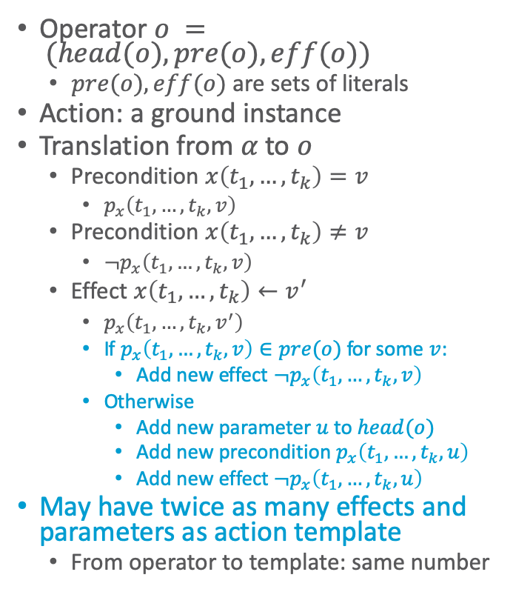
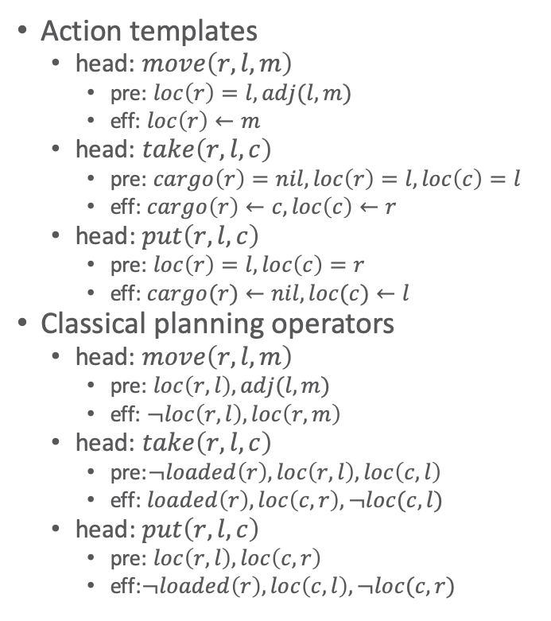
Classical Planning Operators
Operator $o = (head(o), pre(o), eff(o))$
  $pre(o), eff(o)$ are sets of literals
Action: a ground instance
Translation from $α$ to $o$
  Precondition $x\left(t_{1},…,t_{k}\right)=v$
    $p_{x}\left(t_{1},…,t_{k},v\right)$
  Precondition $x\left(t_{1},…,t_{k}\right)≠v$
    $¬p_{x}\left(t_{1},…,t_{k},v\right)$
  Effect $x\left(t_{1},…,t_{k}\right)←v^{′}$
    $p_{x}\left(t_{1},…,t_{k},v^{′}\right)$
    If $p_{x}\left(t_{1},…,t_{k},v\right)∈pre(o)$ for some $v$:
      Add new effect $¬p_{x}\left(t_{1},…,t_{k},v\right)$
    Otherwise
      Add new parameter $u$ to $head(o)$
      Add new precondition $p_{x}\left(t_{1},…,t_{k},u\right)$
      Add new effect $¬p_{x}\left(t_{1},…,t_{k},u\right)$
May have twice as many effects and parameters as action template
  From operator to template: same number
Action templates
  head: $move\left(r,l,m\right)$
    pre: $loc\left(r\right)=l, adj(l,m)$
    eff: $loc\left(r\right)←m$
  head: $take\left(r,l,c\right)$
    pre: $cargo\left(r\right)=nil, loc\left(r\right)=l, loc\left(c\right)=l$
    eff: $cargo\left(r\right)←c, loc\left(c\right)←r$
  head: $put\left(r,l,c\right)$
    pre: $loc\left(r\right)=l, loc\left(c\right)=r$
    eff: $cargo(r)←nil, loc(c)←l$
Classical planning operators
  head: $move\left(r,l,m\right)$
    pre: $loc\left(r,l\right), adj(l,m)$
    eff: $¬loc\left(r,l\right),loc\left(r,m\right)$
  head: $take\left(r,l,c\right)$
    pre:$¬loaded\left(r\right), loc\left(r,l\right), loc\left(c,l\right)$
    eff: $loaded\left(r\right), loc\left(c,r\right),¬loc(c,l)$
  head: $put\left(r,l,c\right)$
    pre: $loc\left(r,l\right), loc\left(c,r\right)$
    eff:$¬loaded\left(r\right), loc\left(c,l\right),¬loc(c,r)$
Notes:
Add u: says that p_x has a value before the action and that value no longer holds after the action as it is now v’
Why: The reason is that each state variable x(t1, . . . , tn) has only one value at a time, so the planning operator must ensure that px(t1,...,tn,v) is true for only one v at a time. In the state-variable representation, this happens automatically; but in the classical representation, asserting a new value requires explicitly deleting the old one.

Slide 27
PDDL – Planning Domain Definition Language
Language for defining planning domains and problems
  LISP-like syntax
Original version ≈ 1996
  Just classical planning
Multiple revisions and extensions
  Different subsets accommodate different kinds of planning
We’ll discuss the classical-planning subset
  Chapter 2 of the PDDL book

Slide 28
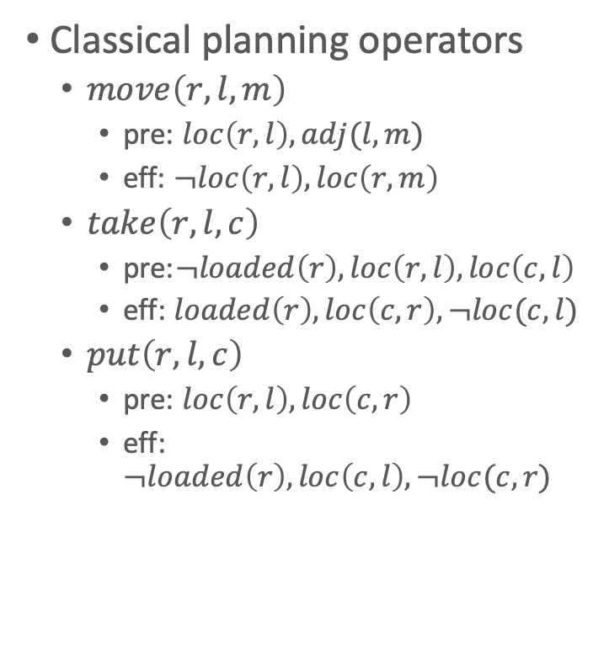
Example Domain
(define (domain example-domain-1)
(requirements :negative-preconditions)
(:action move
:parameters (?r ?l ?m)
:precondition (and (loc ?r ?l)
(adj ?l ?m))
:effect (and (not (loc ?r ?l))
(loc ?r ?m)))
(:action take
:parameters (?r ?l ?c)
:precondition (and (loc ?r ?l)
(loc ?c ?l)
(not (loaded ?r)))
:effect (and (not (loc ?r ?l))
(loc ?r ?m)))
(:action put
:parameters (?r ?l ?c)
:precondition (and (loc ?r ?l)
(loc ?c ?r))
:effect (and (loc ?c ?l)
(not (loc ?c ?r))
(not (loaded ?r)))))
Classical planning operators
  $move\left(r,l,m\right)$
    pre: $loc\left(r,l\right), adj(l,m)$
    eff: $¬loc\left(r,l\right),loc\left(r,m\right)$
  $take\left(r,l,c\right)$
    pre:$¬loaded\left(r\right), loc\left(r,l\right), loc\left(c,l\right)$
    eff: $loaded\left(r\right), loc\left(c,r\right),¬loc(c,l)$
  $put\left(r,l,c\right)$
    pre: $loc\left(r,l\right), loc\left(c,r\right)$
    eff:$¬loaded\left(r\right), loc\left(c,l\right),¬loc(c,r)$
Notes:
prefix notation of logical formulas

Slide 29



Example Problem
Initial state $s_{0}=$
$\{adj(d1,d2), adj(d2,d1),$
$adj(d1,d3), adj(d3,d1),$
$loc(c1,d1), loc(r1,d2)\}$
Goal state $g = \{loc(c1,r1)\}$
(define (problem example-problem-1)
(:domain example-domain-1))
(:init
(adj d1 d2)
(adj d2 d1)
(adj d1 d3)
(adj d3 d1)
(loc c1 d1)
(loc r1 d2)
(:goal (loc c1 r1)))
d3
r1
c1
r1
c1
d1
$$s_{0}$$
d2
$$g$$

Slide 30
Example Typed Domain
(define (domain example-domain-2)
(:requirements
:negative-preconditions
:typing)
(:types
location movable-obj - object
robot container - movable-obj)
(:predicates
(loc ?r - movable-obj
?l - location)
(loaded ?r - robot)
(adjacent ?l ?m - location))
(:action move
:parameters (?r - robot
?l ?m - location)
<<as before>>
(:action take
:parameters (?r - robot
?l - location
?c - container)
<<as before>>
(:action put
:parameters (?r - robot
?l - location
?c - container)
<<as before>>

Slide 31
Example Typed Problem
(define (problem example-problem-2)
(:domain example-domain-2))
(:objects
r1 - robot
c1 - container
loc1 loc2 loc3 - location)
(:init
(adjacent d1 d2)
(adjacent d2 d1)
(adjacent d1 d3)
(adjacent d3 d1)
(loc c1 d1)
(loc r1 d2)
(:goal (loc c1 r1)))
(define (problem example-problem-1)
(:domain example-domain-1))
(:init
(adj d1 d2)
(adj d2 d1)
(adj d1 d3)
(adj d3 d1)
(loc c1 d1)
(loc r1 d2)
(:goal (loc c1 r1)))
d3
r1
c1
r1
c1
d1
$$s_{0}$$
d2
$$g$$

Slide 32
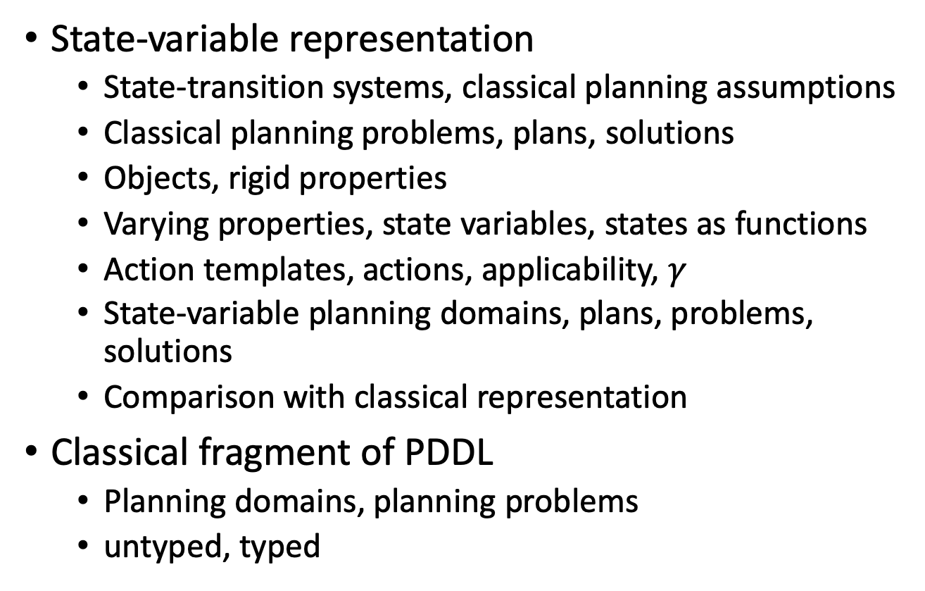
Intermediate Summary
State-variable representation
  State-transition systems, classical planning assumptions
  Classical planning problems, plans, solutions
  Objects, rigid properties
  Varying properties, state variables, states as functions
  Action templates, actions, applicability, $γ$
  State-variable planning domains, plans, problems, solutions
  Comparison with classical representation
Classical fragment of PDDL
  Planning domains, planning problems
  untyped, typed

Slide 33
Outline per the Book
2.1 State-variable representation
  State = {values of variables}; action = changes to those values
2.2 Forward state-space search
  Start at initial state, look for sequence of actions that achieve goal
2.3 Heuristic functions
  How to guide a forward state-space search
2.6 Incorporating planning into an actor
  Online lookahead, unexpected events
2.4 Backward search
  Start at goal state, go backwards toward initial state
2.5 Plan-space search
  Start with incomplete plan for getting from initial state to goal state, make transformations to fix flaws in the plan

Slide 34
Planning as Search
Nearly all planning procedures are search procedures
  Search tree: the data structure the procedure uses to keep track of which paths it has explored
Example: Russell & Norvig, Artificial Intelligence: A Modern Approach

Slide 35
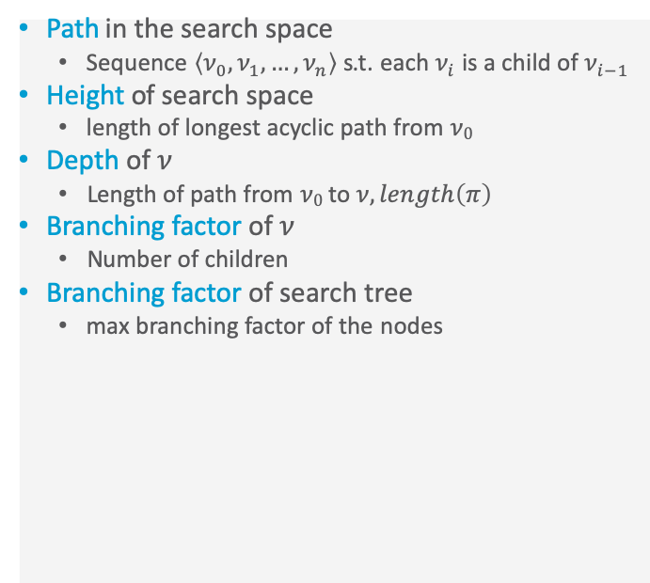
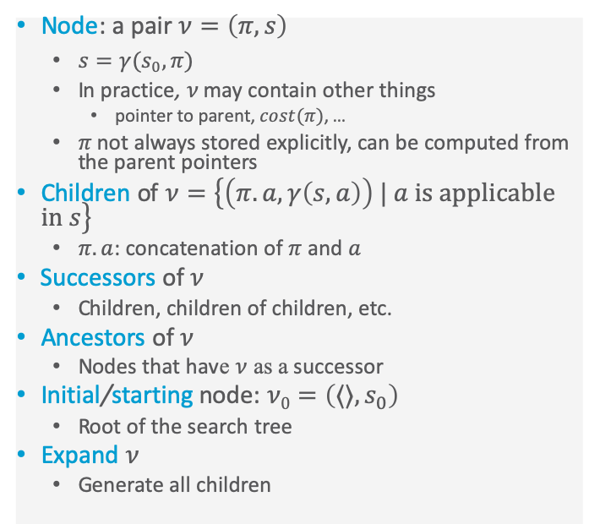
Search-Tree Terminology
Node: a pair $ν=\left(π,s\right)$
  $s=γ(s_{0},π)$
  In practice, $ν$ may contain other things
    pointer to parent, $cost(π)$, …
  $π$ not always stored explicitly, can be computed from the parent pointers
Children of $ν=\left\{\left(π.a, γ\left(s,a\right)\right) | a \text{is} \text{applicable} \text{in} s\right\}$
  $π.a$: concatenation of $π$ and $a$
Successors of $ν$
  Children, children of children, etc.
Ancestors of $ν$
  Nodes that have $ν$ as a successor
Initial/starting node: $ν0=\left(⟨⟩, s_{0}\right)$
  Root of the search tree
Expand $ν$
  Generate all children
Path in the search space
  Sequence $\left\langle ν_{0}, ν_{1}, …, ν_{n}\right\rangle$ s.t. each $ν_{i}$ is a child of $ν_{i−1}$
Height of search space
  length of longest acyclic path from $ν0$
Depth of $ν$
  Length of path from $ν0$ to $ν,length\left(π\right)$
Branching factor of $ν$
  Number of children
Branching factor of search tree
  max branching factor of the nodes

Slide 36
Forward Search
Forward-search(Σ,s₀,g)
s ← s₀
𝜋 ← ⟨⟩
loop
if s satisfies g then
return 𝜋
A′ ←{a ∈ A | a is applicable in s}
if A′ = ∅ then
return failure
nondeterministically choose a ∈ A′ s ← 𝛾(s,a)
𝜋 ← 𝜋.a
Nondeterministic algorithm
  Sound: if an execution trace returns a plan π, it’s a solution
  Complete: if the planning problem is solvable, at least one of the possible execution traces will return a solution
Represents a class of deterministic search algorithms
  Depends on how you implement the nondeterministic choice
    Which leaf node to expand next, which nodes to prune
  Sound but not
  necessarily
  complete

Slide 37
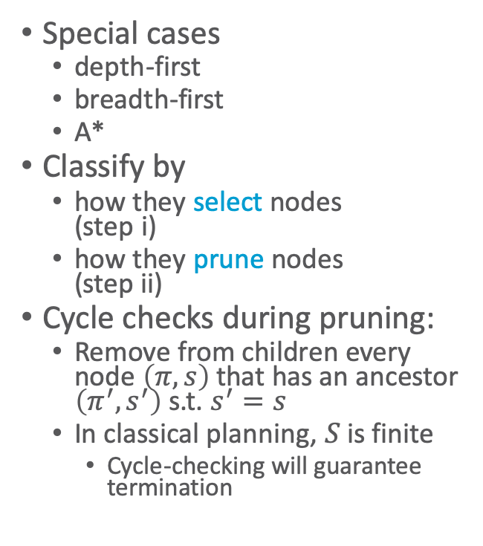
Deterministic Version
Deterministic-Search(Σ,s₀,g)
Frontier ← {(⟨⟩, s₀)}
Expanded ← ∅
while Frontier ≠ ∅ do
select a node 𝜈 = (𝜋,s) ∈ Frontier (i)
remove 𝜈 from Frontier
add 𝜈 to Expanded
if s satisfies g then
return 𝜋
Children ←
{(𝜋.a, 𝛾(s,a)) | s satisfies pre(a)}
prune 0 or more nodes from
Children, Frontier, Expanded (ii)
Frontier ← Frontier ∪ Children
return failure
Special cases
  depth-first
  breadth-first
  A*
Classify by
  how they select nodes
  (step i)
  how they prune nodes
  (step ii)
Cycle checks during pruning:
  Remove from children every node $\left(π,s\right)$ that has an ancestor $\left(π^{′},s^{′}\right)$ s.t. $s^{′}=s$
  In classical planning, $S$ is finite
    Cycle-checking will guarantee termination
Notes:
Frontier: set of candidate nodes to be visited
Expanded: already visited nodes

Slide 38
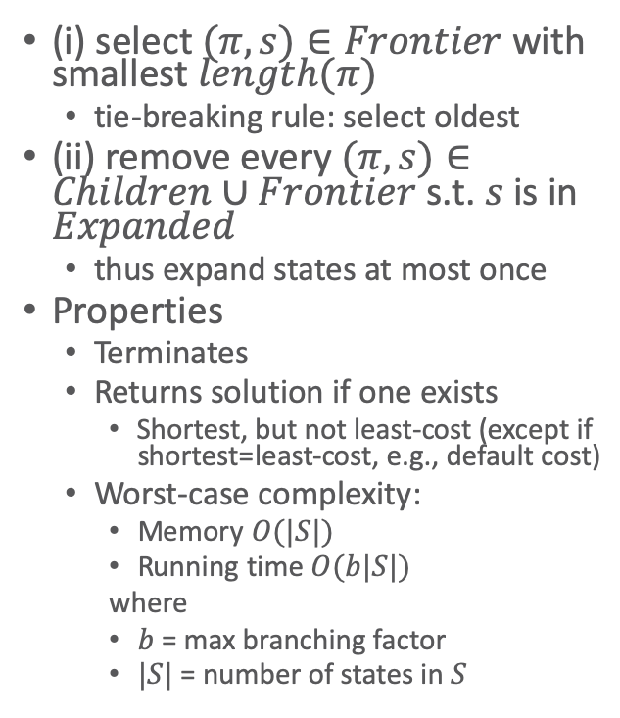
Breadth-first search
(BFS)
Deterministic-Search(Σ,s₀,g)
Frontier ← {(⟨⟩, s₀)}
Expanded ← ∅
while Frontier ≠ ∅ do
select a node 𝜈 = (𝜋,s) ∈ Frontier (i)
remove 𝜈 from Frontier
add 𝜈 to Expanded
if s satisfies g then
return 𝜋
Children ←
{(𝜋.a, 𝛾(s,a)) | s satisfies pre(a)}
prune 0 or more nodes from
Children, Frontier, Expanded (ii)
Frontier ← Frontier ∪ Children
return failure
(i) select $(π,s)∈Frontier$ with smallest $length(π)$
  tie-breaking rule: select oldest
(ii) remove every $(π,s)∈Children∪Frontier$ s.t. $s$ is in $Expanded$
  thus expand states at most once
Properties
  Terminates
  Returns solution if one exists
    Shortest, but not least-cost (except if shortest=least-cost, e.g., default cost)
  Worst-case complexity:
    Memory $O(|S|)$
    Running time $O(b|S|)$
    where
    $b$ = max branching factor
    $|S|$ = number of states in $S$
Notes:
Implementation: FIFO queue

Slide 39
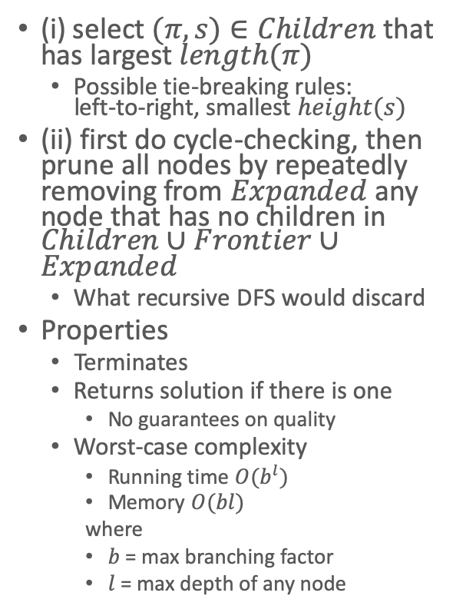
Depth-First Search
(DFS)
Deterministic-Search(Σ,s₀,g)
Frontier ← {(⟨⟩, s₀)}
Expanded ← ∅
while Frontier ≠ ∅ do
select a node 𝜈 = (𝜋,s) ∈ Frontier (i)
remove 𝜈 from Frontier
add 𝜈 to Expanded
if s satisfies g then
return 𝜋
Children ←
{(𝜋.a, 𝛾(s,a)) | s satisfies pre(a)}
prune 0 or more nodes from
Children, Frontier, Expanded (ii)
Frontier ← Frontier ∪ Children
return failure
(i) select $(π,s)∈Children$ that has largest $length(π)$
  Possible tie-breaking rules:
  left-to-right, smallest $height(s)$
(ii) first do cycle-checking, then prune all nodes by repeatedly removing from $Expanded$ any node that has no children in $Children∪Frontier∪Expanded$
  What recursive DFS would discard
Properties
  Terminates
  Returns solution if there is one
    No guarantees on quality
  Worst-case complexity
    Running time $O(b^{l})$
    Memory $O(bl)$
    where
    $b$ = max branching factor
    $l$ = max depth of any node
Notes:
(ii) basically garbage collection, keep only nodes along current path (same happens in recursive DFS when a recursive call returns)
basically just has current path in memory therefore efficient in terms of memory, namely, only O(bl)
runtime possibly worse than BFS if many paths to each state

Slide 40
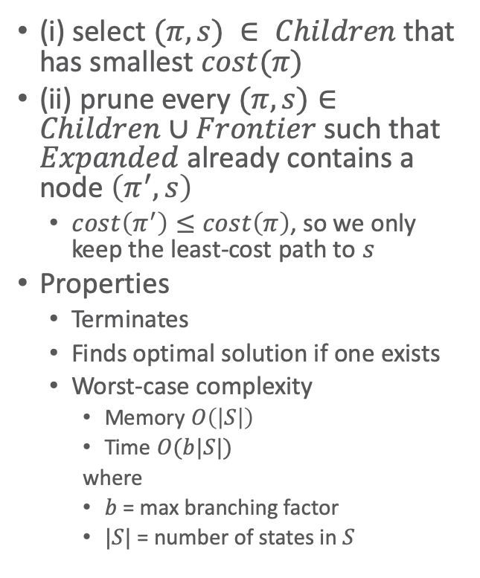
Uniform-Cost Search
Deterministic-Search(Σ,s₀,g)
Frontier ← {(⟨⟩, s₀)}
Expanded ← ∅
while Frontier ≠ ∅ do
select a node 𝜈 = (𝜋,s) ∈ Frontier (i)
remove 𝜈 from Frontier
add 𝜈 to Expanded
if s satisfies g then
return 𝜋
Children ←
{(𝜋.a, 𝛾(s,a)) | s satisfies pre(a)}
prune 0 or more nodes from
Children, Frontier, Expanded (ii)
Frontier ← Frontier ∪ Children
return failure
(i) select $(π,s) ∈ Children$that has smallest $cost(π)$
(ii) prune every $(π,s)∈Children∪Frontier$ such that $Expanded$ already contains a node $\left(π^{′},s\right)$
  $cost\left(π^{′}\right)≤cost\left(π\right)$, so we only keep the least-cost path to $s$
Properties
  Terminates
  Finds optimal solution if one exists
  Worst-case complexity
    Memory $O\left(\left|S\right|\right)$
    Time $O(b|S|)$
    where
    $b$ = max branching factor
    $|S|$ = number of states in $S$
Notes:
Similar to BFS

Slide 41
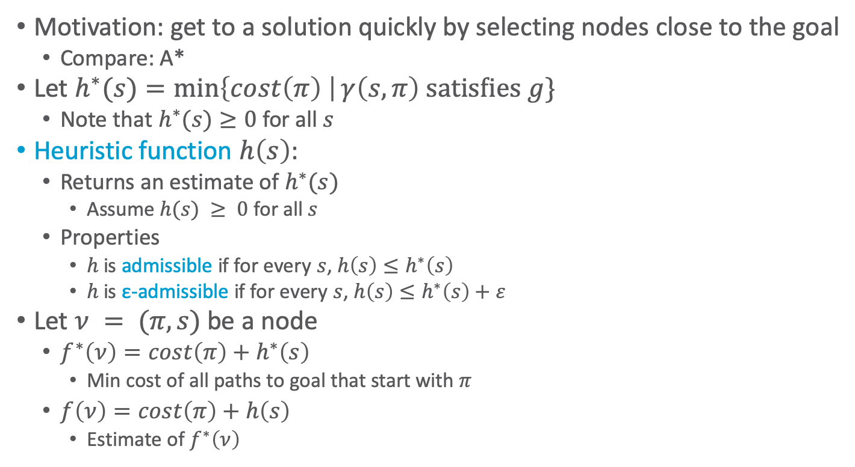
Heuristic Function
Motivation: get to a solution quickly by selecting nodes close to the goal
  Compare: A*
Let $h^{∗}(s)=\min\left\{cost\left(π\right) \right|γ\left(s,π\right) \text{satisfies} g\}$
  Note that $h^{∗}(s)≥0$ for all $s$
Heuristic function $h\left(s\right)$:
  Returns an estimate of $h^{∗}(s)$
    Assume $h(s) ≥ 0$ for all $s$
  Properties
    $h$ is admissible if for every $s$, $h\left(s\right)≤h^{∗}\left(s\right)$
    $h$ is ε-admissible if for every $s$, $h\left(s\right)≤h^{∗}\left(s\right)+ε$
Let $ν = (π,s)$ be a node
  $f^{∗}\left(ν\right)=cost\left(π\right)+h^{∗}\left(s\right)$
    Min cost of all paths to goal that start with $π$
  $f\left(ν\right)=cost\left(π\right)+h\left(s\right)$
    Estimate of $f^{∗}\left(ν\right)$

Slide 42
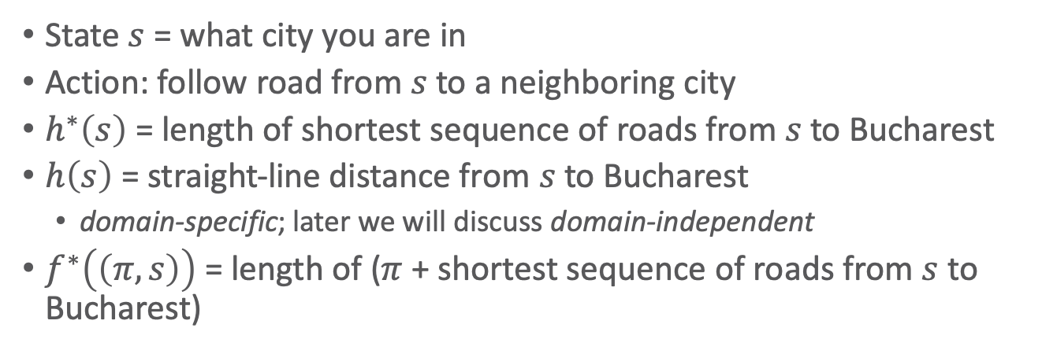

Example
straight-line dist. from s to Bucharest
Arad 366
Bucharest 0
Craiova 160
Dobreta 242
Fagaras 176
Iasi 226
Lugoj 244
Mehadia 241
Neamt 234
Oradea 380
Pitesti 100
Rimnicu Vilcea 193
Sibiu 253
Timisoara 329
Urziceni 80
Vaslui 199
Zerind 374
$$s_{0}$$
goal
State $s$ = what city you are in
Action: follow road from $s$ to a neighboring city
$h^{∗}\left(s\right)$ = length of shortest sequence of roads from $s$ to Bucharest
$h\left(s\right)$ = straight-line distance from $s$ to Bucharest
  domain-specific; later we will discuss domain-independent
$f^{∗}\left(\left(π,s\right)\right)$ = length of ($π$ + shortest sequence of roads from $s$ to Bucharest)
Example: Russell & Norvig, Artificial Intelligence: A Modern Approach

Slide 43
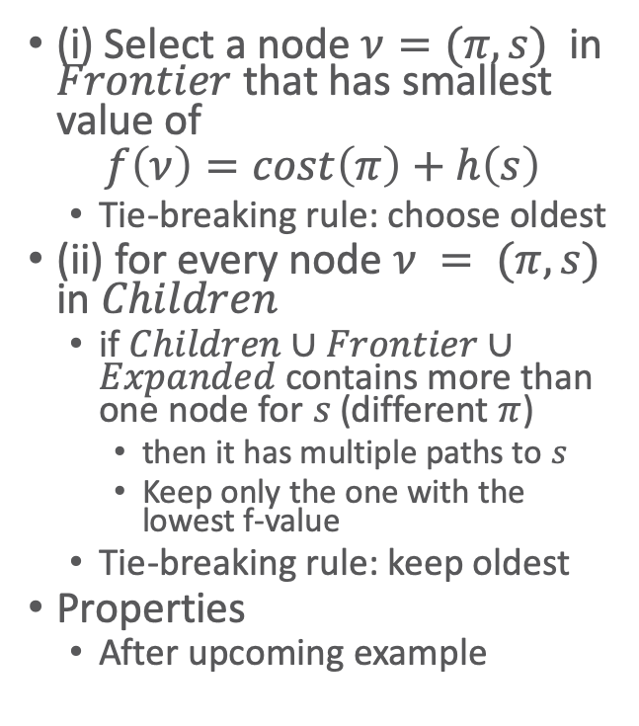
A*
Deterministic-Search(Σ,s₀,g)
Frontier ← {(⟨⟩, s₀)}
Expanded ← ∅
while Frontier ≠ ∅ do
select a node 𝜈 = (𝜋,s) ∈ Frontier (i)
remove 𝜈 from Frontier
add 𝜈 to Expanded
if s satisfies g then
return 𝜋
Children ←
{(𝜋.a, 𝛾(s,a)) | s satisfies pre(a)}
prune 0 or more nodes from
Children, Frontier, Expanded (ii)
Frontier ← Frontier ∪ Children
return failure
(i) Select a node $ν=(π,s)$ in $Frontier$ that has smallest value of
$$f\left(ν\right)=cost\left(π\right)+h\left(s\right)$$
  Tie-breaking rule: choose oldest
(ii) for every node $ν = (π,s)$ in $Children$
  if $Children∪Frontier∪Expanded$ contains more than one node for $s$ (different $π$)
    then it has multiple paths to $s$
    Keep only the one with the lowest f-value
  Tie-breaking rule: keep oldest
Properties
  After upcoming example

Slide 44
straight-line dist. from s to Bucharest
Arad 366
Bucharest 0
Craiova 160
Dobreta 242
Fagaras 176
Iasi 226
Lugoj 244
Mehadia 241
Neamt 234
Oradea 380
Pitesti 100
Rimnicu Vilcea 193
Sibiu 253
Timisoara 329
Urziceni 80
Vaslui 199
Zerind 374

Slide 45
straight-line dist. from s to Bucharest
Arad 366
Bucharest 0
Craiova 160
Dobreta 242
Fagaras 176
Iasi 226
Lugoj 244
Mehadia 241
Neamt 234
Oradea 380
Pitesti 100
Rimnicu Vilcea 193
Sibiu 253
Timisoara 329
Urziceni 80
Vaslui 199
Zerind 374

Slide 46
straight-line dist. from s to Bucharest
Arad 366
Bucharest 0
Craiova 160
Dobreta 242
Fagaras 176
Iasi 226
Lugoj 244
Mehadia 241
Neamt 234
Oradea 380
Pitesti 100
Rimnicu Vilcea 193
Sibiu 253
Timisoara 329
Urziceni 80
Vaslui 199
Zerind 374
X

Slide 47
straight-line dist. from s to Bucharest
Arad 366
Bucharest 0
Craiova 160
Dobreta 242
Fagaras 176
Iasi 226
Lugoj 244
Mehadia 241
Neamt 234
Oradea 380
Pitesti 100
Rimnicu Vilcea 193
Sibiu 253
Timisoara 329
Urziceni 80
Vaslui 199
Zerind 374
X
X

Slide 48
straight-line dist. from s to Bucharest
Arad 366
Bucharest 0
Craiova 160
Dobreta 242
Fagaras 176
Iasi 226
Lugoj 244
Mehadia 241
Neamt 234
Oradea 380
Pitesti 100
Rimnicu Vilcea 193
Sibiu 253
Timisoara 329
Urziceni 80
Vaslui 199
Zerind 374
X
X
X

Slide 49
straight-line dist. from s to Bucharest
Arad 366
Bucharest 0
Craiova 160
Dobreta 242
Fagaras 176
Iasi 226
Lugoj 244
Mehadia 241
Neamt 234
Oradea 380
Pitesti 100
Rimnicu Vilcea 193
Sibiu 253
Timisoara 329
Urziceni 80
Vaslui 199
Zerind 374
X
X
X
X
X

Slide 50
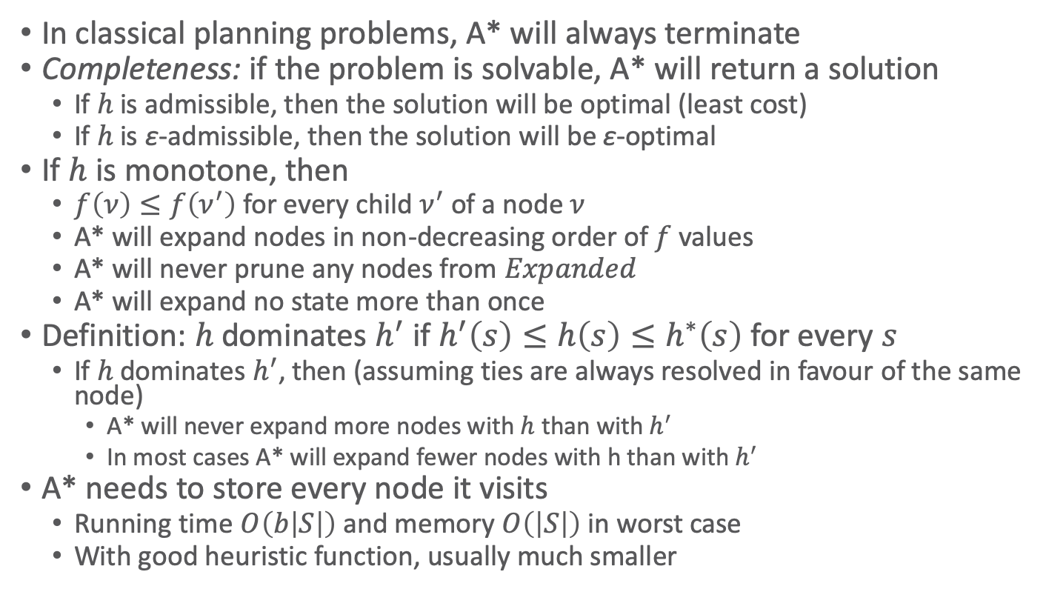
Properties of A*
In classical planning problems, A* will always terminate
Completeness: if the problem is solvable, A* will return a solution
  If $h$ is admissible, then the solution will be optimal (least cost)
  If $h$ is ε-admissible, then the solution will be ε-optimal
If $h$ is monotone, then
  $f\left(ν\right)≤f\left(ν^{′}\right)$ for every child $ν^{′}$ of a node $ν$
  A* will expand nodes in non-decreasing order of $f$ values
  A* will never prune any nodes from $Expanded$
  A* will expand no state more than once
Definition: $h$ dominates $h^{′}$ if $h^{′}\left(s\right)≤h\left(s\right)≤h^{∗}\left(s\right)$ for every $s$
  If $h$ dominates $h^{′}$, then (assuming ties are always resolved in favour of the same node)
    A* will never expand more nodes with $h$ than with $h^{′}$
    In most cases A* will expand fewer nodes with h than with $h^{′}$
A* needs to store every node it visits
  Running time $O\left(b\left|S\right|\right)$ and memory $O\left(\left|S\right|\right)$ in worst case
  With good heuristic function, usually much smaller

Slide 51
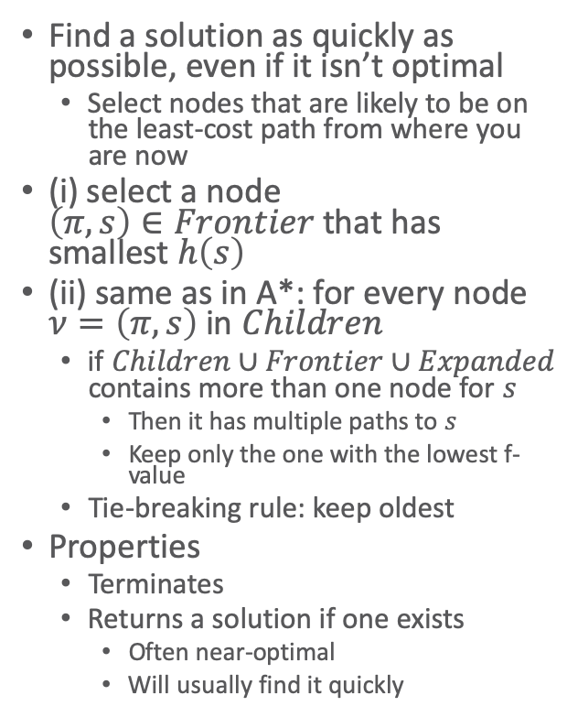
Greedy Best-First Search
(GBFS)
Deterministic-Search(Σ,s₀,g)
Frontier ← {(⟨⟩, s₀)}
Expanded ← ∅
while Frontier ≠ ∅ do
select a node 𝜈 = (𝜋,s) ∈ Frontier (i)
remove 𝜈 from Frontier
add 𝜈 to Expanded
if s satisfies g then
return 𝜋
Children ←
{(𝜋.a, 𝛾(s,a)) | s satisfies pre(a)}
prune 0 or more nodes from
Children, Frontier, Expanded (ii)
Frontier ← Frontier ∪ Children
return failure
Find a solution as quickly as possible, even if it isn’t optimal
  Select nodes that are likely to be on the least-cost path from where you are now
(i) select a node
$\left(π,s\right)∈Frontier$ that has smallest $h\left(s\right)$
(ii) same as in A*: for every node $ν=\left(π,s\right)$ in 𝐶ℎ𝑖𝑙𝑑𝑟𝑒𝑛
  if $Children∪Frontier∪Expanded$ contains more than one node for $s$
    Then it has multiple paths to $s$
    Keep only the one with the lowest f-value
  Tie-breaking rule: keep oldest
Properties
  Terminates
  Returns a solution if one exists
    Often near-optimal
    Will usually find it quickly

Slide 52
straight-line dist. from s to Bucharest
Arad 366
Bucharest 0
Craiova 160
Dobreta 242
Fagaras 176
Iasi 226
Lugoj 244
Mehadia 241
Neamt 234
Oradea 380
Pitesti 100
Rimnicu Vilcea 193
Sibiu 253
Timisoara 329
Urziceni 80
Vaslui 199
Zerind 374
366

Slide 53
straight-line dist. from s to Bucharest
Arad 366
Bucharest 0
Craiova 160
Dobreta 242
Fagaras 176
Iasi 226
Lugoj 244
Mehadia 241
Neamt 234
Oradea 380
Pitesti 100
Rimnicu Vilcea 193
Sibiu 253
Timisoara 329
Urziceni 80
Vaslui 199
Zerind 374
253
329 374

Slide 54
straight-line dist. from s to Bucharest
Arad 366
Bucharest 0
Craiova 160
Dobreta 242
Fagaras 176
Iasi 226
Lugoj 244
Mehadia 241
Neamt 234
Oradea 380
Pitesti 100
Rimnicu Vilcea 193
Sibiu 253
Timisoara 329
Urziceni 80
Vaslui 199
Zerind 374
X
329 374
366 176 380 193

Slide 55
straight-line dist. from s to Bucharest
Arad 366
Bucharest 0
Craiova 160
Dobreta 242
Fagaras 176
Iasi 226
Lugoj 244
Mehadia 241
Neamt 234
Oradea 380
Pitesti 100
Rimnicu Vilcea 193
Sibiu 253
Timisoara 329
Urziceni 80
Vaslui 199
Zerind 374
X
329 374
expanded 4 nodes
  instead of 6
solution cost 450
  instead of 418
366
X
380 193
253 0

Slide 56
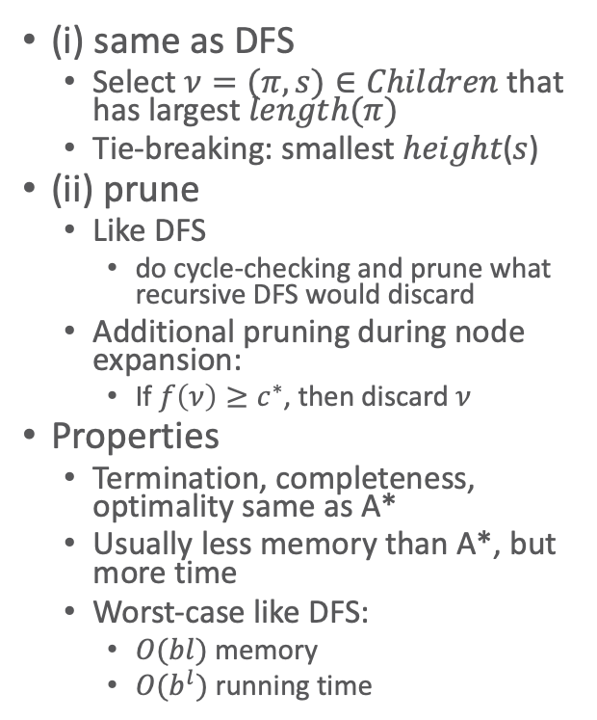
Depth-First
Branch and Bound (DFBB)
Deterministic-Search(Σ,s₀,g)
Frontier ← {(⟨⟩, s₀)}
Expanded ← ∅
c*← ∞
𝜋*← failure
while Frontier ≠ ∅ do
select a node 𝜈 = (𝜋,s) ∈ Frontier (i)
remove 𝜈 from Frontier
add 𝜈 to Expanded
if s satisfies g then
return 𝜋
if s satisfies g and cost(𝜋) < c* then
c*← cost(𝜋); 𝜋*← 𝜋
else if f(𝜈) < c* then
Children ← {(𝜋.a, 𝛾(s,a)) |
s satisfies pre(a)}
prune 0 or more nodes from
Children, Frontier, Expanded (ii)
Frontier ← Frontier ∪ Children
return failure 𝜋*
(i) same as DFS
  Select $ν=(π,s)∈Children$ that has largest $length(π)$
  Tie-breaking: smallest ℎ𝑒𝑖𝑔ℎ𝑡(𝑠)
(ii) prune
  Like DFS
    do cycle-checking and prune what recursive DFS would discard
  Additional pruning during node expansion:
    If $f\left(ν\right)≥c^{∗}$, then discard $ν$
Properties
  Termination, completeness, optimality same as A*
  Usually less memory than A*, but more time
  Worst-case like DFS:
    $O(bl)$ memory
    $O(b^{l})$ running time

Slide 57
straight-line dist. from s to Bucharest
Arad 366
Bucharest 0
Craiova 160
Dobreta 242
Fagaras 176
Iasi 226
Lugoj 244
Mehadia 241
Neamt 234
Oradea 380
Pitesti 100
Rimnicu Vilcea 193
Sibiu 253
Timisoara 329
Urziceni 80
Vaslui 199
Zerind 374

Slide 58
straight-line dist. from s to Bucharest
Arad 366
Bucharest 0
Craiova 160
Dobreta 242
Fagaras 176
Iasi 226
Lugoj 244
Mehadia 241
Neamt 234
Oradea 380
Pitesti 100
Rimnicu Vilcea 193
Sibiu 253
Timisoara 329
Urziceni 80
Vaslui 199
Zerind 374

Slide 59
straight-line dist. from s to Bucharest
Arad 366
Bucharest 0
Craiova 160
Dobreta 242
Fagaras 176
Iasi 226
Lugoj 244
Mehadia 241
Neamt 234
Oradea 380
Pitesti 100
Rimnicu Vilcea 193
Sibiu 253
Timisoara 329
Urziceni 80
Vaslui 199
Zerind 374
X

Slide 60
straight-line dist. from s to Bucharest
Arad 366
Bucharest 0
Craiova 160
Dobreta 242
Fagaras 176
Iasi 226
Lugoj 244
Mehadia 241
Neamt 234
Oradea 380
Pitesti 100
Rimnicu Vilcea 193
Sibiu 253
Timisoara 329
Urziceni 80
Vaslui 199
Zerind 374
X
X

Slide 61
straight-line dist. from s to Bucharest
Arad 366
Bucharest 0
Craiova 160
Dobreta 242
Fagaras 176
Iasi 226
Lugoj 244
Mehadia 241
Neamt 234
Oradea 380
Pitesti 100
Rimnicu Vilcea 193
Sibiu 253
Timisoara 329
Urziceni 80
Vaslui 199
Zerind 374
X
X
X
X
X

Slide 62
straight-line dist. from s to Bucharest
Arad 366
Bucharest 0
Craiova 160
Dobreta 242
Fagaras 176
Iasi 226
Lugoj 244
Mehadia 241
Neamt 234
Oradea 380
Pitesti 100
Rimnicu Vilcea 193
Sibiu 253
Timisoara 329
Urziceni 80
Vaslui 199
Zerind 374
X
c*=418
π*= ⟨a_{AS}, a_{SR}, a_{RP}, a_{PB}⟩
X
X
X
X

Slide 63
straight-line dist. from s to Bucharest
Arad 366
Bucharest 0
Craiova 160
Dobreta 242
Fagaras 176
Iasi 226
Lugoj 244
Mehadia 241
Neamt 234
Oradea 380
Pitesti 100
Rimnicu Vilcea 193
Sibiu 253
Timisoara 329
Urziceni 80
Vaslui 199
Zerind 374
X
c*=418
π*= ⟨a_{AS}, a_{SR}, a_{RP}, a_{PB}⟩
X
X
X
X
X

Slide 64
straight-line dist. from s to Bucharest
Arad 366
Bucharest 0
Craiova 160
Dobreta 242
Fagaras 176
Iasi 226
Lugoj 244
Mehadia 241
Neamt 234
Oradea 380
Pitesti 100
Rimnicu Vilcea 193
Sibiu 253
Timisoara 329
Urziceni 80
Vaslui 199
Zerind 374
X
c*=418
π*= ⟨a_{AS}, a_{SR}, a_{RP}, a_{PB}⟩
X
X
X
X
X
X
X

Slide 65
straight-line dist. from s to Bucharest
Arad 366
Bucharest 0
Craiova 160
Dobreta 242
Fagaras 176
Iasi 226
Lugoj 244
Mehadia 241
Neamt 234
Oradea 380
Pitesti 100
Rimnicu Vilcea 193
Sibiu 253
Timisoara 329
Urziceni 80
Vaslui 199
Zerind 374
X
X
c*=418
π*= ⟨a_{AS}, a_{SR}, a_{RP}, a_{PB}⟩
X
X
X
X
X
X
X
X

Slide 66
straight-line dist. from s to Bucharest
Arad 366
Bucharest 0
Craiova 160
Dobreta 242
Fagaras 176
Iasi 226
Lugoj 244
Mehadia 241
Neamt 234
Oradea 380
Pitesti 100
Rimnicu Vilcea 193
Sibiu 253
Timisoara 329
Urziceni 80
Vaslui 199
Zerind 374
X
X
c*=418
π*= ⟨a_{AS}, a_{SR}, a_{RP}, a_{PB}⟩
X
X
X
X
X
X
X

Slide 67
straight-line dist. from s to Bucharest
Arad 366
Bucharest 0
Craiova 160
Dobreta 242
Fagaras 176
Iasi 226
Lugoj 244
Mehadia 241
Neamt 234
Oradea 380
Pitesti 100
Rimnicu Vilcea 193
Sibiu 253
Timisoara 329
Urziceni 80
Vaslui 199
Zerind 374
X
X
X
c*=418
π*= ⟨a_{AS}, a_{SR}, a_{RP}, a_{PB}⟩
X
X
X
X
X
X
X
X

Slide 68
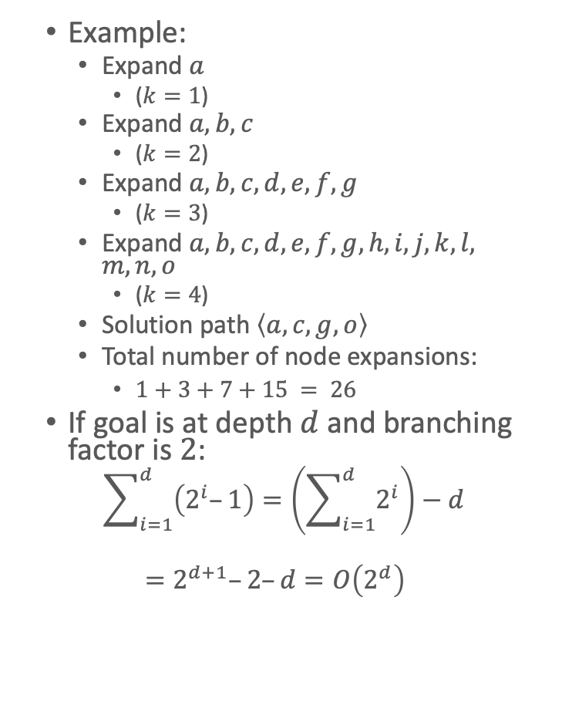
Iterative Deepening Search
(IDS)
IDS(Σ,s₀,g)
  for k = 1 to ∞ do
  𝜋* ← do DFS, backtracking at every
  node of depth k
  if 𝜋* ≠ failure then
  return 𝜋*
  if the search generated
  no nodes of depth k then
  return failure
Example:
  Expand $a$
    ($k=1$)
  Expand $a, b, c$
    ($k=2$)
  Expand $a, b, c, d, e, f, g$
    ($k=3$)
  Expand $a, b, c, d, e, f, g, h, i, j, k, l, m, n, o$
    ($k=4$)
  Solution path $\left\langle a,c,g,o\right\rangle$
  Total number of node expansions:
    $1+3+7+15 = 26$
If goal is at depth $d$ and branching factor is $2$:
  $$\sum_{i=1}^{d}{\left(2^{i}–1\right)}=\left(\sum_{i=1}^{d}{2^{i}}\right)−d$$
  $$=2^{d+1}–2–d=O\left(2^{d}\right)$$
Notes:
A bit like BFS with each iteration going a step further
Within an iteration: DFS ➝ so DFS does not follow inexplicably long paths

Slide 69
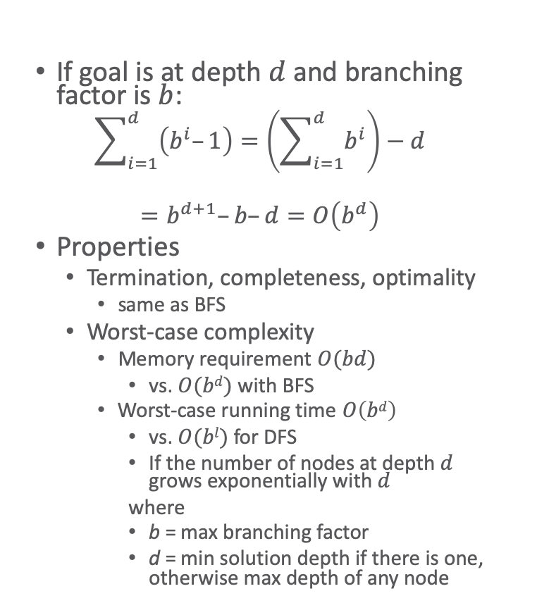
Iterative Deepening Search
(IDS)
IDS(Σ,s₀,g)
  for k = 1 to ∞ do
  𝜋* ← do DFS, backtracking at every
  node of depth k
  if 𝜋* ≠ failure then
  return 𝜋*
  if the search generated
  no nodes of depth k then
  return failure
If goal is at depth $d$ and branching factor is $b$:
  $$\sum_{i=1}^{d}{\left(b^{i}–1\right)}=\left(\sum_{i=1}^{d}{b^{i}}\right)−d$$
  $$=b^{d+1}–b–d=O\left(b^{d}\right)$$
Properties
  Termination, completeness, optimality
    same as BFS
  Worst-case complexity
    Memory requirement $O(bd)$
      vs. $O(bd)$ with BFS
    Worst-case running time $O\left(bd\right)$
      vs. $O(bl)$ for DFS
      If the number of nodes at depth $d$
      grows exponentially with $d$
      where
      b = max branching factor
      d = min solution depth if there is one, otherwise max depth of any node

Slide 70
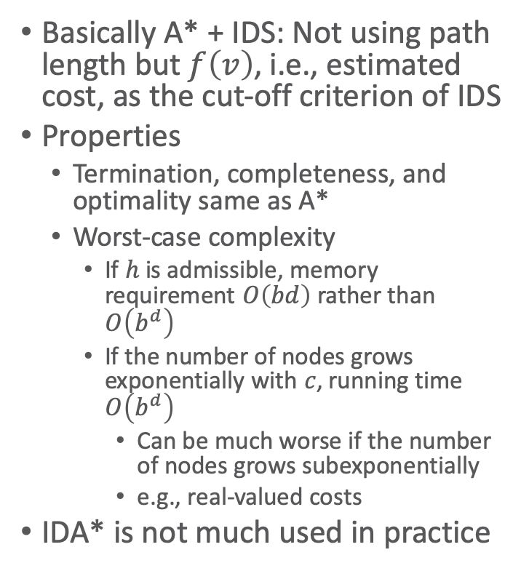
IDA*
IDA*(Σ,s₀,g)
  c ← 0
  loop
  𝜋* ← do DFS, backtracking whenever
  f(𝜈) > c
  if 𝜋* ≠ failure then
  return π*
  if DFS didn’t generate
  an f(𝜈) > c then
  return failure
  c ← the smallest f(𝜈) > c
  where backtracking occurred
Basically A* + IDS: Not using path length but $f\left(v\right)$, i.e., estimated cost, as the cut-off criterion of IDS
Properties
  Termination, completeness, and optimality same as A*
  Worst-case complexity
    If $h$ is admissible, memory requirement $O\left(bd\right)$ rather than $O\left(b^{d}\right)$
    If the number of nodes grows exponentially with $c$, running time $O\left(b^{d}\right)$
      Can be much worse if the number of nodes grows subexponentially
        e.g., real-valued costs
IDA* is not much used in practice

Slide 71
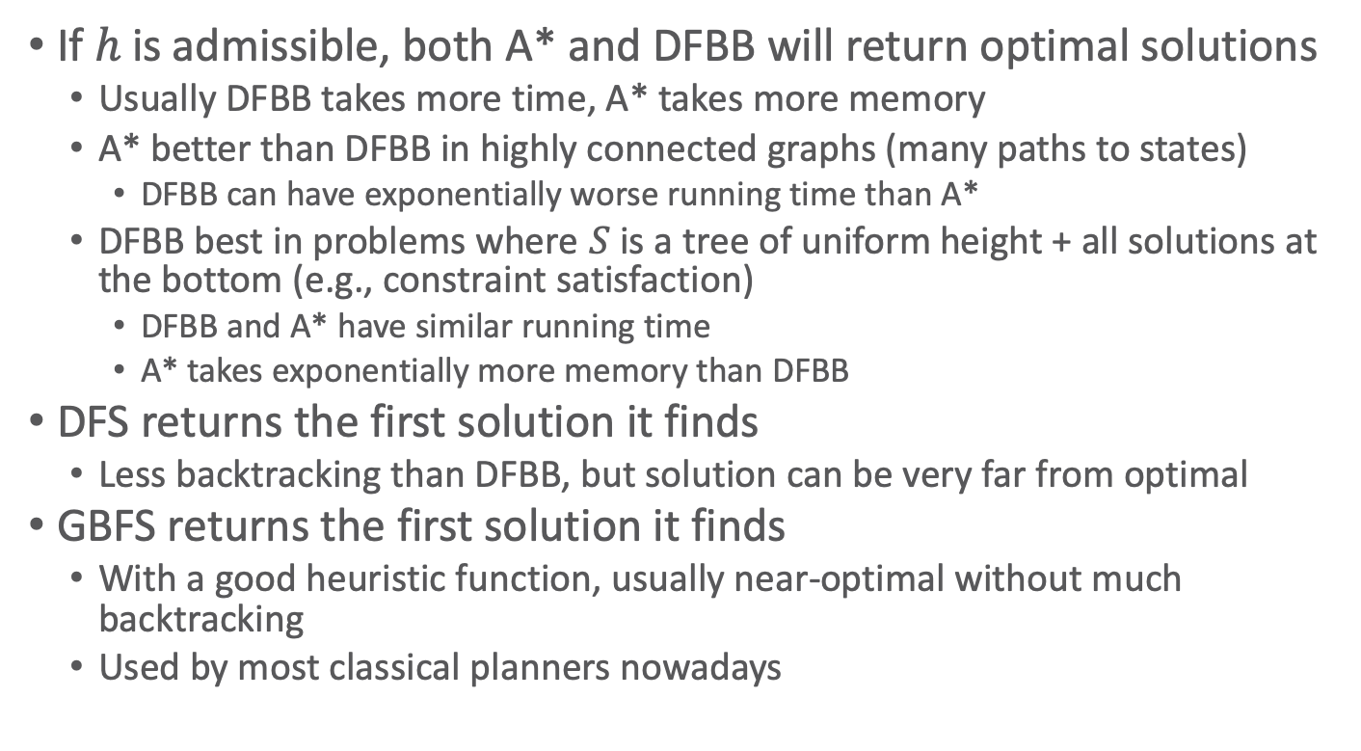
Discussion
If $h$ is admissible, both A* and DFBB will return optimal solutions
  Usually DFBB takes more time, A* takes more memory
  A* better than DFBB in highly connected graphs (many paths to states)
    DFBB can have exponentially worse running time than A*
  DFBB best in problems where $S$ is a tree of uniform height + all solutions at the bottom (e.g., constraint satisfaction)
    DFBB and A* have similar running time
    A* takes exponentially more memory than DFBB
DFS returns the first solution it finds
  Less backtracking than DFBB, but solution can be very far from optimal
GBFS returns the first solution it finds
  With a good heuristic function, usually near-optimal without much backtracking
  Used by most classical planners nowadays

Slide 72
Intermediate Summary
Forward-search, Deterministic-Search
Cycle-checking
Breadth-first, depth-first, uniform-cost search
A*, GBFS, DFBB
IDS, IDA*

Slide 73
Outline per the Book
2.1 State-variable representation
  State = {values of variables}; action = changes to those values
2.2 Forward state-space search
  Start at initial state, look for sequence of actions that achieve goal
2.3 Heuristic functions
  How to guide a forward state-space search
2.6 Incorporating planning into an actor
  Online lookahead, unexpected events
2.4 Backward search
  Start at goal state, go backwards toward initial state
2.5 Plan-space search
  Start with incomplete plan for getting from initial state to goal state, make transformations to fix flaws in the plan

Slide 74
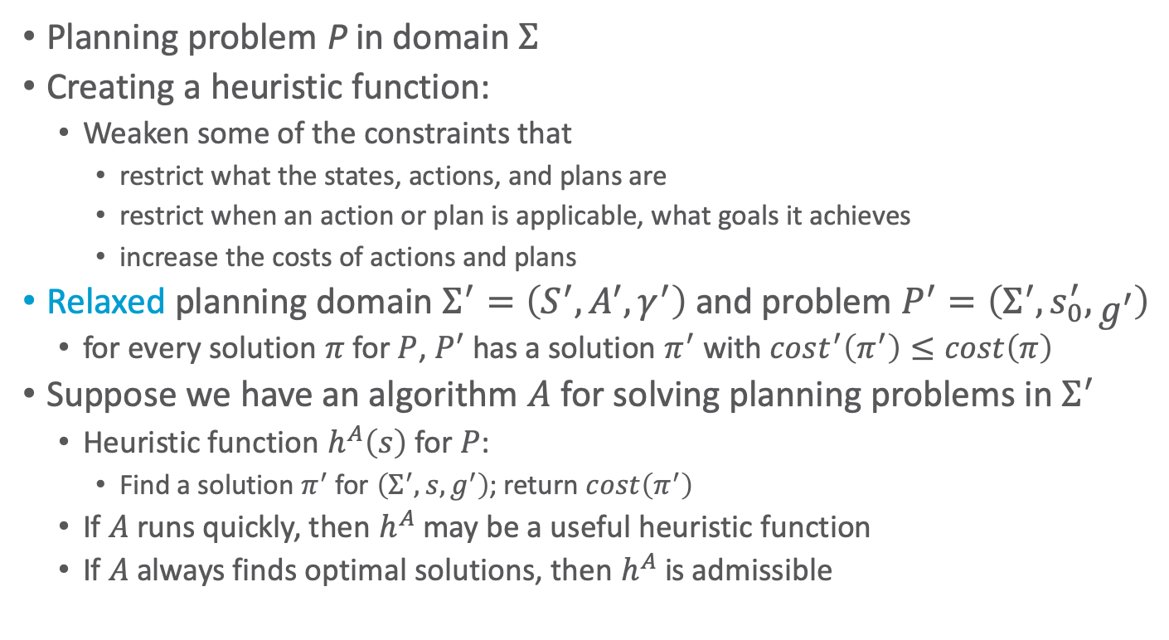
Heuristic Functions
Planning problem P in domain $Σ$
Creating a heuristic function:
  Weaken some of the constraints that
    restrict what the states, actions, and plans are
    restrict when an action or plan is applicable, what goals it achieves
    increase the costs of actions and plans
Relaxed planning domain $Σ^{′}=\left(S^{′},A^{′},γ^{′}\right)$ and problem $P^{′}=\left(Σ^{′},s_{0}^{′},g^{′}\right)$
  for every solution $π$ for $P$, $P^{′}$ has a solution $π^{′}$ with $cost^{′}\left(π^{′}\right)≤cost\left(π\right)$
Suppose we have an algorithm $A$ for solving planning problems in $Σ^{′}$
  Heuristic function $h^{A}\left(s\right)$ for $P$:
    Find a solution $π^{′}$ for $\left(Σ^{′},s,g^{′}\right)$; return $cost\left(π^{′}\right)$
  If $A$ runs quickly, then $h^{A}$ may be a useful heuristic function
  If $A$ always finds optimal solutions, then $h^{A}$ is admissible
Notes:
Xi

Slide 75
Example from A*
Relaxation: let vehicle travel in a straight line
between any pair of cities
  straight-line-distance ≤ distance by road
straight-line dist. from s to Bucharest
Arad 366
Bucharest 0
Craiova 160
Dobreta 242
Fagaras 176
Iasi 226
Lugoj 244
Mehadia 241
Neamt 234
Oradea 380
Pitesti 100
Rimnicu Vilcea 193
Sibiu 253
Timisoara 329
Urziceni 80
Vaslui 199
Zerind 374

Slide 76
Domain-independent Heuristics
Heuristic functions that can be used work in any classical planning problem
  Additive-cost heuristic
  Max-cost heuristic
  Delete-relaxation heuristics
    Optimal relaxed solution
    Fast-forward heuristic
  Landmark heuristics
In the book, but I’ll skip them

Slide 77
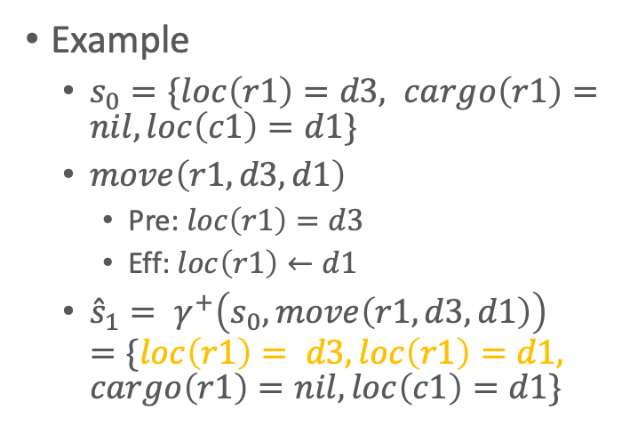
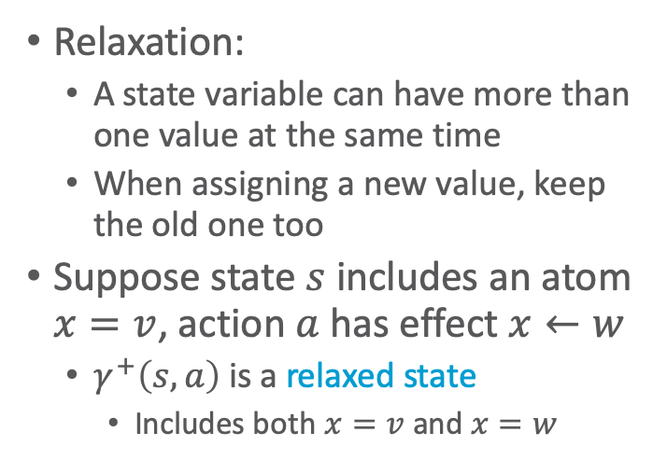

Delete-Relaxation
Relaxation:
  A state variable can have more than one value at the same time
  When assigning a new value, keep the old one too
Suppose state $s$ includes an atom $x=v$, action $a$ has effect $x←w$
  $γ^{+}\left(s,a\right)$ is a relaxed state
    Includes both $x=v$ and $x=w$
Example
  $s_{0}=\{loc\left(r1\right)=d3, cargo\left(r1\right)=nil, loc\left(c1\right)=d1\}$
  $move\left(r1, d3, d1\right)$
    Pre: $loc\left(r1\right)=d3$
    Eff: $loc\left(r1\right)←d1$
  ${\hat{s}}_{1}= γ^{+}\left(s_{0}, move\left(r1,d3,d1\right)\right)$
  $=\{loc\left(r1\right)= d3, loc\left(r1\right)=d1, cargo\left(r1\right)=nil, loc\left(c1\right)=d1\}$
r1
r1
d3
d3
c1
c1
d1
d2
d1
d2
$$s_{0}$$
$$\hat{s}$$

Slide 78
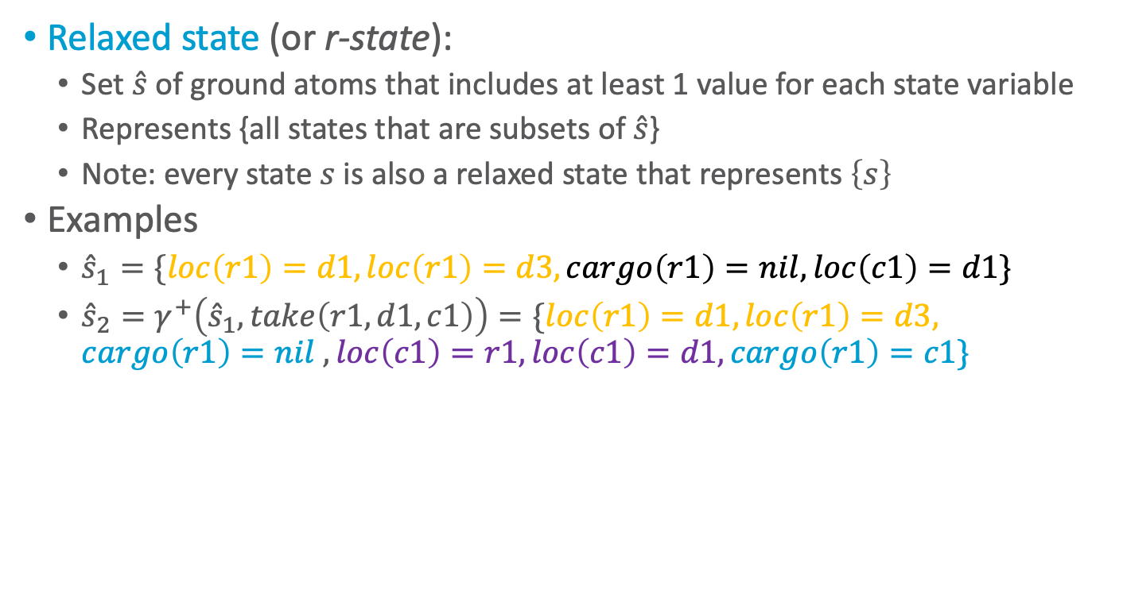


Relaxed States
Relaxed state (or r-state):
  Set $\hat{s}$ of ground atoms that includes at least 1 value for each state variable
  Represents {all states that are subsets of $\hat{s}$}
  Note: every state $s$ is also a relaxed state that represents $\left\{s\right\}$
Examples
  ${\hat{s}}_{1}=\{loc\left(r1\right)=d1, loc\left(r1\right)=d3,cargo\left(r1\right)=nil, loc\left(c1\right)=d1\}$
  ${\hat{s}}_{2}=γ^{+}\left({\hat{s}}_{1},take\left(r1,d1,c1\right)\right)=\{loc\left(r1\right)=d1,loc\left(r1\right)=d3, cargo\left(r1\right)=nil , loc\left(c1\right)=r1,loc\left(c1\right)=d1,cargo\left(r1\right)=c1\}$
r1
r1
d3
d3
c1
c1
d1
d2
d1
d2
$${\hat{s}}_{1}$$
$${\hat{s}}_{2}$$
Notes:
state = exactly one value for each variable

Slide 79

R-applicability
An r-state $\hat{s}$ r-satisfies a set of literals $g$ if a set $s⊆\hat{s}$ satisfies g
Action $a$ is r-applicable in $\hat{s}$ if $\hat{s}$ r-satisfies $pre\left(a\right)$
  i.e., $\hat{s}$contains a subset $s$ that satisfies the preconditions of $a$
  If $a$ is r-applicable, then $γ^{+}\left(\hat{s},a\right)=\hat{s}∪γ\left(s,a\right)$
$π=\left\langle a_{1}, …, a_{n}\right\rangle$ is r-applicable in ${\hat{s}}_{0}$ if there are r-states ${\hat{s}}_{1},{\hat{s}}_{2}, …, {\hat{s}}_{n}$such that
  $a_{1}$ is r-applicable in ${\hat{s}}_{0}$ and $γ^{+}\left({\hat{s}}_{0},a_{1}\right)={\hat{s}}_{1}$
  $a_{2}$ is r-applicable in ${\hat{s}}_{1}$ and $γ^{+}\left({\hat{s}}_{1},a_{2}\right)={\hat{s}}_{2}$
  …
  $a_{n}$ is r-applicable in ${\hat{s}}_{n−1}$ and $γ^{+}\left({\hat{s}}_{n−1},a_{n}\right)={\hat{s}}_{n}$
In this case, $γ^{+}\left({\hat{s}}_{n−1},π\right)={\hat{s}}_{n}$
Notes:
Subset: not necessarily strict

Slide 80




Example
r1
d3
$$s_{0}$$
$s_{0}=\{loc\left(r1\right)=d3,$
$cargo\left(r1\right)=nil, loc\left(c1\right)=d1\}$
$move\left(r1, d3, d1\right)$
  Pre: $loc\left(r1\right)=d3$
  Eff: $loc\left(r1\right)←d1$
${\hat{s}}_{1}=γ^{+}\left({\hat{s}}_{1},move\left(r1,d1,c1\right)\right)=\{loc\left(r1\right)=d1, loc\left(r1\right)=d3, cargo\left(r1\right)=nil, loc\left(c1\right)=d1\}$
$take\left(r,l,c\right)$
  pre: $cargo\left(r\right)=nil, loc\left(r\right)=l, loc\left(c\right)=l$
  eff: $cargo\left(r\right)←c, loc\left(c\right)←r$
${\hat{s}}_{2}=γ^{+}\left({\hat{s}}_{1},take\left(r1,d1,c1\right)\right)=\{loc\left(r1\right)=d1,loc\left(r1\right)=d3, cargo\left(r1\right)=nil , loc\left(c1\right)=r1, loc\left(c1\right)=d1,cargo\left(r1\right)=c1\}$
c1
d1
d2
r1
d3
$${\hat{s}}_{1}$$
c1
d1
d2
r1
d3
$${\hat{s}}_{2}$$
c1
d1
d2

Slide 81


Relaxed Solution
Planning problem $P=\left(Σ, s_{0}, g\right)$
Plan $π$ is a relaxed solution for $P$ if $γ^{+}\left({\hat{s}}_{0},π\right)$ r-satisfies $g$
Example:
  Initial $s_{0}=\{loc\left(r1\right)=d3, cargo\left(r1\right)=nil, loc\left(c1\right)=d1\}$
  Goal states $g=\{loc\left(r1\right)=d3, loc\left(c1\right)=r1\}$
  Plan $π =\left\langle move\left(r1,d3,d1\right), \right.\left.take\left(r1,c1,d1\right)\right\rangle$
  End state $γ^{+}(s_{0},π) = \{loc\left(r1\right)=d1, loc\left(r1\right)=d3, cargo\left(r1\right)=nil, loc\left(c1\right)=r1, loc\left(c1\right)=d1, cargo\left(r1\right)=c1\}$
r1
c1
d3
$$g$$
r1
r1
d3
d3
c1
c1
d1
$$s_{0}$$
d2
d1
d2
$${\hat{s}}_{2}$$

Slide 82



Optimal Relaxed Solution Heuristic
How does this compare with $h^{∗}\left(s\right)$?
Given a planning problem $P=\left(Σ, s_{0}, g\right)$
Optimal relaxed solution heuristic:
  $h^{+}\left(s\right)$ = minimum cost of all relaxed solutions for $P$
Example:
  Initial $s_{0}=\{loc\left(r1\right)=d3, cargo\left(r1\right)=nil, loc\left(c1\right)=d1\}$
  Goal states $g=\{loc\left(r1\right)=d3,loc\left(c1\right)=r1\}$
  $π =\left\langle move\left(r1,d3,d1\right), \right.\left.take\left(r1,c1,d1\right)\right\rangle$
    $cost\left(π\right)=2$
  No less-costly relaxed solution, so $h^{+}\left(s_{0}\right)=2$
r1
d3
r1
c1
c1
d3
d1
$$s_{0}$$
d2
$$g$$
Notes:
Heuristic $h^{+}≤h^{∗}$ as each ordinary solution is also a solution to P, therefore admissible heuristics
Expensive to compute

Slide 83





Example
r1
$s_{0}=\{loc\left(r1\right)=d3, cargo\left(r1\right)=nil, loc\left(c1\right)=d1\}$
In $s_{0}$, two applicable actions
  $a_{1}=move\left(r1,d3,d1\right)$
    $s_{1}=\{loc\left(r1\right)=d1, cargo\left(r1\right)=nil, loc\left(c1\right)=d1\}$
  $a_{2}=move\left(r1,d3,d2\right)$
    $s_{2}=\{loc\left(r1\right)=d2, cargo\left(r1\right)=nil, loc\left(c1\right)=d1\}$
GBFS evaluates $h^{+}\left(s_{1}\right)$ and $h^{+}\left(s_{2}\right)$, and chooses to move to whichever is smaller
$$s_{0}$$
d3
c1
d1
d2
d3
$$s_{1}$$
r1
c1
d1
d2
What are $h^{+}\left(s_{1}\right)$ and $h^{+}\left(s_{2}\right)$ and where does GBFS move?
d3
$$s_{2}$$
r1
c1
r1
c1
d3
d1
d2
$g=\{loc\left(r1\right)=d3,loc\left(c1\right)=r1\}$
Notes:
Both relaxed states contain $loc\left(r1\right)=d3$
$s_{1}$: Action take: $h^{+}\left(s_{1}\right)=1$
$s_{2}$: Action move d3 (cycle): $h^{+}\left(s_{2}\right)= ?$
$s_{2}$: Action move d1, take: $h^{+}\left(s_{2}\right)=2$

Slide 84

Fast-Forward Heuristic
Every state is also a relaxed state
Every solution is also a relaxed solution
$h^{+}\left(s\right)$ = minimum cost of all relaxed solutions
  Thus $h^{+}$ is admissible
  Problem: computing it is NP-hard
Fast-Forward Heuristic $h^{FF}$
  An approximation of $h^{+}$ that is easier to compute
    Upper bound on $h^{+}$
  Name comes from a planner called Fast Forward

Slide 85

Preliminaries
Let $A_{1}$ be a set of actions that are r-applicable in $\hat{s}$
  Can apply them in any order and get same result
  Define result of applying $A_{1}$ in $\hat{s}$ as
  $$γ^{+}\left(\hat{s},A_{1}\right)=\hat{s}∪\bigcup_{a∈A_{1}}{eff\left(a\right)}$$
Let ${\hat{s}}_{1}=γ^{+}\left({\hat{s}}_{0},A_{1}\right)$
  Suppose $A_{2}$ is a set of actions that are r-applicable in ${\hat{s}}_{1}$
  Define $γ^{+}\left({\hat{s}}_{0},\left\langle A_{1},A_{2}\right\rangle \right)=γ^{+}\left({\hat{s}}_{1},A_{2}\right)$
  ...
  Define $γ^{+}\left({\hat{s}}_{0},\left\langle A_{1},A_{2}, …, A_{n}\right\rangle \right)$ in the obvious way
Notes:
since r-state is a union of all states

Slide 86


Fast-Forward Heuristic
  HFF(Σ,s,g)
    // construct a relaxed solution ⟨A₁,A₂,…,A_{k}⟩:
    ŝ₀ ← s
    for k = 1; k++; a subset of ŝ_{k} r-satisfies g do
      A_{k} = {all actions r-applicable in ŝ_{k–1}}
      ŝ_{k} = 𝛾⁺(s_{k–1}, A_{k})
      if k > 1 and ŝ_{k} = ŝ_{k–1} then
      return ∞ // there’s no solution
    // extract minimal relaxed solution ⟨â₁, â₂, …, â_{k}⟩:
    ĝ_{k} = g
    for i = k down to 1 do
      â_{i} = any minimal subset of A_{i} such that 𝛾⁺(ŝ_{i-1},â_{i}) r-satisfies ĝ_{i}
      ĝ_{i−1} ← (ĝ_{i} ∖ eff(â_{i})) ∪ pre(â_{i})
      $\hat{π}$ ← ⟨â₁,…,â_{k}⟩
    return ∑_{a is an action in} $\hat{π}$ cost(a) // upper bound on h⁺
Find a minimal relaxed solution and return its cost
  Generates a sequence of successively larger r-states and sets of applicable actions until ${\hat{s}}_{k}$ r-satisfies $g:$
  $${\hat{s}}_{0}, A_{1},{\hat{s}}_{1}, A_{2},{\hat{s}}_{2}, …,A_{k−1},{\hat{s}}_{k−1},A_{k},{\hat{s}}_{k}$$
  Extract minimal relaxed solution from that sequence

Slide 87

Fast-Forward Heuristic
  HFF(Σ,s,g)
    // construct a relaxed solution ⟨A₁,A₂,…,A_{k}⟩:
    ŝ₀ ← s
    for k = 1; k++; a subset of ŝ_{k} r-satisfies g do
      A_{k} = {all actions r-applicable in ŝ_{k–1}}
      ŝ_{k} = 𝛾⁺(s_{k–1}, A_{k})
      if k > 1 and ŝ_{k} = ŝ_{k–1} then
      return ∞ // there’s no solution
    // extract minimal relaxed solution ⟨â₁, â₂, …, â_{k}⟩:
    ĝ_{k} = g
    for i = k down to 1 do
      â_{i} = any minimal subset of A_{i} such that 𝛾⁺(ŝ_{i-1},â_{i}) r-satisfies ĝ_{i}
      ĝ_{i−1} ← (ĝ_{i} ∖ eff(â_{i})) ∪ pre(â_{i})
      $\hat{π}$ ← ⟨â₁,…,â_{k}⟩
    return ∑_{a is an action in} $\hat{π}$ cost(a) // upper bound on h⁺
Find a minimal relaxed solution and return its cost
Define $h^{FF}$ = the value returned by HFF($Σ,s,g$)
  Return value is ambiguous
    Each $â_{i}$ in $h^{FF}\left(s\right)$ is a minimal set of actions s.t. $γ^{+}\left({\hat{s}}_{i−1},â_{i}\right)$ r-satisfies $pre(â_{i})$
    Depends on which minimal subsets we choose
Notes:
Ambiguous as value depends on the minimal subset chosen, which can be arbitrary (and not optimal)
Not ok for A*, but ok for GBFS where not optimal solutions are acceptable

Slide 88

Example (as before)
r1
$s_{0}=\{loc\left(r1\right)=d3,$
$cargo\left(r1\right)=nil, loc\left(c1\right)=d1\}$
In $s_{0}$, two applicable actions
  $a_{1}=move\left(r1,d3,d1\right)$
    $s_{1}=\{loc\left(r1\right)=d1, cargo\left(r1\right)=nil, loc\left(c1\right)=d1\}$
  $a_{2}=move\left(r1,d3,d2\right)$
    $s_{2}=\{loc\left(r1\right)=d2, cargo\left(r1\right)=nil, loc\left(c1\right)=d1\}$
GBFS using $h^{FF}$
  Compute $h^{FF}\left(s_{1}\right)$ and $h^{FF}\left(s_{2}\right)$
  Move to whichever is smaller
$$s_{0}$$
d3
c1
d1
d2
d3
$$s_{1}$$
r1
c1
d1
d2
d3
$$s_{2}$$
r1
c1
r1
c1
d3
d1
d2
$g=\{loc\left(r1\right)=d3,loc\left(c1\right)=r1\}$
Notes:
Both relaxed states contain $loc\left(r1\right)=d3$

Slide 89








Example
    // construct a relaxed solution ⟨A₁,A₂,…,A_{k}⟩:
    ŝ₀ ← s
    for k = 1; k++; subset of ŝ_{k} r-satisfies g do
      A_{k} = {all actions r-applicable in ŝ_{k–1}}
      ŝ_{k} = 𝛾⁺(s_{k–1}, A_{k})
      if k > 1 and ŝ_{k} = ŝ_{k–1} then
      return ∞ // there’s no solution
Relaxed Planning Graph (RPG) from ${\hat{s}}_{0}=s_{1}$ to $g$
(solid lines indicate preconditions/effects):
Atoms in ${\hat{s}}_{0}=s_{1}$:
$loc\left(r1\right)=d1$
$loc\left(c1\right)=d1$
$cargo\left(r1\right)=nil$
Actions in $A_{1}$:
$move(r1,d1,d2)$
$move(r1,d1,d3)$
$take(r1,c1,d1)$
Atoms in ${\hat{s}}_{1}$:
$loc\left(r1\right)=d2$
$loc\left(r1\right)=d3$
$loc\left(c1\right)=r1$
$cargo\left(r1\right)=c1$
$loc\left(r1\right)=d1$
$loc\left(c1\right)=d1$
$cargo\left(r1\right)=nil$
$\left\langle A_{1}\right\rangle$ is a relaxed solution
  $γ^{+}(s_{0}, A_{1})$ r-satisfies $g$
from ${\hat{s}}_{0}$:
r1
c1
d3
r1
d3
c1
$g=\{loc\left(r1\right)=d3, loc\left(c1\right)=r1\}$
d1
d2
    $$s_{1}=\{loc\left(r1\right)=d1, cargo\left(r1\right)=nil, loc\left(c1\right)=d1\}$$

Slide 90





Example
    // extract minimal relaxed solution
    ĝ_{k} = g
    for i = k down to 1 do
      â_{i} = minimal subset of A_{i} s.t. 𝛾⁺(ŝ_{i-1},â_{i}) r-satisfies ĝ_{i}
      ĝ_{i−1} ← (ĝ_{i} ∖ eff(â_{i})) ∪ pre(â_{i})
Relaxed Planning Graph (RPG) from ${\hat{s}}_{0}=s_{1}$ to $g$
(follow lines from atoms in $g$: all if precond.; one if eff.)
Atoms in ${\hat{s}}_{0}=s_{1}$:
$loc\left(r1\right)=d1$
$loc\left(c1\right)=d1$
$cargo\left(r1\right)=nil$
Actions in $A_{1}$:
$move(r1,d1,d2)$
$move(r1,d1,d3)$
$take(r1,c1,d1)$
Atoms in ${\hat{s}}_{1}$:
$loc\left(r1\right)=d2$
$loc\left(r1\right)=d3$
$loc\left(c1\right)=r1$
$cargo\left(r1\right)=c1$
$loc\left(r1\right)=d1$
$loc\left(c1\right)=d1$
$cargo\left(r1\right)=nil$
$\left\langle {\hat{a}}_{1}\right\rangle$ is a minimal relaxed solution
Cost of each action is 1, so $h^{FF}\left(s_{1}\right)=2$
$loc\left(r1\right)=d1$
$loc\left(c1\right)=d1$
$cargo\left(r1\right)=nil$
$move(r1,d1,d3)$
$take(r1,c1,d1)$
$$\left\langle {\hat{a}}_{1}\right\rangle$$
from ${\hat{s}}_{0}$:
r1
c1
d3
r1
d3
c1
$g=\{loc\left(r1\right)=d3, loc\left(c1\right)=r1\}$
d1
d2
    $$s_{1}=\{loc\left(r1\right)=d1, cargo\left(r1\right)=nil, loc\left(c1\right)=d1\}$$

Slide 91









Example
    // construct a relaxed solution ⟨A₁,A₂,…,A_{k}⟩:
    ŝ₀ ← s
    for k = 1; k++; subset of ŝ_{k} r-satisfies g do
      A_{k} = {all actions r-applicable in ŝ_{k–1}}
      ŝ_{k} = 𝛾⁺(s_{k–1}, A_{k})
      if k > 1 and ŝ_{k} = ŝ_{k–1} then
      return ∞ // there’s no solution
RPG from ${\hat{s}}_{0}=s_{2}$ to $g$
Atoms in ${\hat{s}}_{0}=s_{2}$:
$loc\left(r1\right)=d2$
$loc\left(c1\right)=d1$
$cargo\left(r1\right)=nil$
Actions in $A_{1}$:
$move(r1,d2,d3)$
$move(r1,d2,d1)$
Atoms in ${\hat{s}}_{1}$:
$loc\left(r1\right)=d3$
$loc\left(r1\right)=d1$
$loc\left(r1\right)=d2$
$loc\left(c1\right)=d1$
$cargo\left(r1\right)=nil$
Actions in $A_{2}$:
$move(r1,d3,d2)$
$move(r1,d1,d2)$
$move(r1,d3,d1)$
$move(r1,d1,d3)$
$move(r1,d2,d1)$
$move(r1,d2,d3)$
$take(r1,c1,d1)$
Atoms in ${\hat{s}}_{2}$:
$loc\left(r1\right)=d2$
$loc\left(c1\right)=d1$
$cargo\left(r1\right)=nil$
$loc\left(r1\right)=d1$
$loc\left(r1\right)=d3$
$cargo\left(r1\right)=c1$
$loc\left(c1\right)=r1$
from ${\hat{s}}_{1}$
from ${\hat{s}}_{0}$:
$\left\langle A_{1},A_{2}\right\rangle$ is a relaxed solution
r1
c1
d3
r1
d3
c1
$g=\{loc\left(r1\right)=d3, loc\left(c1\right)=r1\}$
d1
d2
$$s_{2}=\{loc\left(r1\right)=d2, cargo\left(r1\right)=nil, loc\left(c1\right)=d1\}$$

Slide 92








Example
    // extract minimal relaxed solution
    ĝ_{k} = g
    for i = k down to 1 do
      â_{i} = minimal subset of A_{i} s.t. 𝛾⁺(ŝ_{i-1},â_{i}) r-satisfies ĝ_{i}
      ĝ_{i−1} ← (ĝ_{i} ∖ eff(â_{i})) ∪ pre(â_{i})
Could have followed other eff. line
(would have lead to $h^{FF}\left(s_{1}\right)=2$)
RPG from ${\hat{s}}_{0}=s_{2}$ to $g$
Atoms in ${\hat{s}}_{0}=s_{2}$:
$loc\left(r1\right)=d2$
$loc\left(c1\right)=d1$
$cargo\left(r1\right)=nil$
Actions in $A_{1}$:
$move(r1,d2,d3)$
$move(r1,d2,d1)$
Atoms in ${\hat{s}}_{1}$:
$loc\left(r1\right)=d3$
$loc\left(r1\right)=d1$
$loc\left(r1\right)=d2$
$loc\left(c1\right)=d1$
$cargo\left(r1\right)=nil$
Actions in $A_{2}$:
$move(r1,d3,d2)$
$move(r1,d1,d2)$
$move(r1,d3,d1)$
$move(r1,d1,d3)$
$move(r1,d2,d1)$
$move(r1,d2,d3)$
$take(r1,c1,d1)$
Atoms in ${\hat{s}}_{2}$:
$loc\left(r1\right)=d2$
$loc\left(c1\right)=d1$
$cargo\left(r1\right)=nil$
$loc\left(r1\right)=d1$
$loc\left(r1\right)=d3$
$cargo\left(r1\right)=c1$
$loc\left(c1\right)=r1$
$$\left\langle {\hat{a}}_{1}\right\rangle$$
from ${\hat{s}}_{1}$
from ${\hat{s}}_{0}$:
$\left\langle {\hat{a}}_{1},{\hat{a}}_{2}\right\rangle$ is a minimal relaxed solution
Cost of each action is 1, so $h^{FF}\left(s_{1}\right)=3$
$$\left\langle {\hat{a}}_{2}\right\rangle$$
r1
c1
d3
r1
d3
c1
$g=\{loc\left(r1\right)=d3, loc\left(c1\right)=r1\}$
d1
d2
$$s_{2}=\{loc\left(r1\right)=d2, cargo\left(r1\right)=nil, loc\left(c1\right)=d1\}$$

Slide 93

Properties
Running time is polynomial in $|A|+ \sum_{x∈X}{|ℛ(x)|}$
Minimal solution doesn’t mean smallest cost
  A solution $π$ to $P$is minimal if
    no subsequence of $π$ is also a solution for $P$.
  A solution $π$ to $P$is shortest if
    there is no solution $π^{′}$ such that $\left|π^{′}\right|<|π|$.
  A solution $π$ to $P$is cost-optimal if
    $cost\left(π\right)=\min\left\{cost\left(π^{′}\right)\right|π^{′}\text{is} \text{a} \text{solution} \text{for} P\}$.
  $h^{FF}\left(s\right)$ = value returned by HFF($Σ,s,g$)
    $h^{FF}\left(s\right)$ = ∑ costs of â₁, …, â_{k}
  $h^{FF}\left(s\right)≥h^{+}\left(s\right)$ = smallest cost of any relaxed plan from $s$ to goal
  $h^{FF}$ not admissible
Notes:
|A| as each action might occur at one point in the planning graph
sum over all possible values of state variables as each value might occur at one point and the relaxed state accumulates all descriptions at which point the previous and current state would be the same and HFF stops

Slide 94
Example
Suppose the goal atoms are c7, c8, c9. How many minimal solutions are there?
  Assume default cost of 1
Notes:
a5, a7 + a1, a2, a4 = 5 (at + c3, c4, c5, c6 have to hold; with a3 not minimal)
a6, a7 + a2, a4 = 4 (at + c5, c6 have to hold)
a6, a7 + a3, a4 = 4 (at + c5, c6 have to hold)
(with a5,a6,a7 not minimal)
3 minimal solutions
Shortest solution = minimal cost: 4
Strategy so far: Make state description larger s.t. we reach the goal state earlier (start at start and move to goal)
Alternative strategy: break goal down/find intermediate goals necessary to reach final goal (start at goal and move to start)

Slide 95


Landmark Heuristics
$P=(Σ,s_{0},g)$ be a planning problem
Let $φ=φ_{1}∨…∨φ_{m}$ be a disjunction of ground atoms
$φ$ is a landmark for $P$ if $φ$ is true at some point in every solution for $P$
Example landmarks
  $loc\left(r1\right)=d1$
  $loc\left(r1\right)=d3 ∨ loc\left(r1\right)=d2$
  $loc\left(r1\right)=d3$
r1
d3
r1
c1
c1
d3
d1
d2
$g=\{loc\left(r1\right)=d3, loc\left(c1\right)=r1\}$
  $$s_{0}=\{loc\left(r1\right)=d3,cargo\left(r1\right)=nil, loc\left(c1\right)=d1\}$$
Notes:
$loc\left(r1\right)=d1$ has to hold at some point for r1 to pick up c1 and thus have c1 at location r1

Slide 96










Why are Landmarks Useful?
Breaks down a problem into smaller subproblems
Suppose $m_{1},m_{2}, m_{3}$ are landmarks
  Every solution to $P$ must achieve $m_{1},m_{2}, m_{3}$
Possible strategy:
  find a plan to go from $s_{0}$ to any state $s_{1}$ that satisfies $m_{1}$
  find a plan to go from $s_{1}$ to any state $s_{2}$ that satisfies $m_{2}$
  …
$$s_{0}$$
$$m_{1}$$
$$m_{2}$$
$$m_{3}$$
$$g$$
$$P_{1}$$
$$P_{2}$$
$$P_{3}$$
$$P_{4}$$

Slide 97

Computing Landmarks
Worst-case complexity:
  Deciding whether $φ$ is a landmark is PSPACE-complete
  As hard as solving the planning problem itself
But there are often useful landmarks that can be found more easily
  Polynomial time
  Going to see one such procedure based on RPGs
    Why RPGs?
      Solving relaxed planning problems easier
        Computing landmarks for relaxed planning problems easier
      A landmark for a relaxed planning problem is a landmark for the original planning problem as well

Slide 98







RPG-based Landmark Computation
Main intuition:
  if $φ$ is a landmark, can get new landmarks from the preconditions of the actions that achieve $φ$
Example:
  goal $g$
  $\left\{a_{1}, a_{2}\right\}$ = all actions that achieve $g$
  $pre\left(a_{1}\right)=\left\{p_{1}, q\right\}$
  $pre\left(a_{2}\right)=\left\{q, p_{2}\right\}$
  To achieve $g$, must achieve
  $(p_{1}∧q)∨(p_{2}∧q)$
    same as $q∧\left(p_{1}∨p_{2}\right)$
  Landmarks:
    $q$
    $p_{1}∨p_{2}$
$$p_{1}$$
$$a_{1}$$
$$q$$
$$g$$
$$a_{2}$$
$$p_{2}$$

Slide 99


RPG-based Landmark Computation
Suppose goal is
$g=\left\{g_{1}, g_{2},…, g_{k}\right\}$
  Trivially, every $g_{i}$ is a landmark
Suppose
$g_{1}=\left(loc\left(r1\right)=d1\right)$
  Two actions can achieve g₁:
    $move\left(r1,d3,d1\right)$
    $move\left(r1,d2,d1\right)$
  Preconditions
    $loc\left(r1\right)=d3$
    $loc\left(r1\right)=d2$
New landmark: $φ^{′}=$
$$\left(loc\left(r1\right)=d3∨loc\left(r1\right)=d2\right)$$
$move\left(r,l,m\right)$
  pre: $loc\left(r\right)=l$
  eff: $loc\left(r\right)←m$
$take\left(r,l,c\right)$
  pre: $cargo\left(r\right)=nil,$
  $loc\left(r\right)=l, loc\left(c\right)=l$
  eff: $cargo\left(r\right)←c, loc\left(c\right)←r$
$put\left(r,l,c\right)$
  pre: $loc\left(r\right)=l, loc\left(c\right)=r$
  eff: $cargo(r)←nil, loc(c)←l$
r1
d3
c1
d1
d2
  $$s_{0}=\{loc\left(r1\right)=d3,cargo\left(r1\right)=nil, loc\left(c1\right)=d1\}$$

Slide 100










RPG-based Landmark Computation
RPG-Landmarks(s₀, g = {g₁, g₂,…, g_{k}})
  queue ← {g_{i} ∈ g | s₀ doesn’t satisfy g_{i}};
  Landmarks ← ∅
  A ← all actions
  while queue ≠ ∅ do
    remove a g_{i} from queue
    Landmarks ← Landmarks ∪ g_{i}
    R ← {actions whose effects include g_{i}}
    if s₀ satisfies pre(a) for some a ∈ R then
    return Landmarks
    generate RPG from s₀ and A ∖ R, stop when ŝ_{k}=ŝ_{k–1}
    N ← {a ∈ R | a r-applicable in ŝ_{k}}
    if N = ∅ then
    return failure
    Pre ← ⋃{pre(a)|a ∈ N}∖ s₀
    𝛷 ← {p₁∨p₂∨…∨p_{m}|m≤4,∀a∈N ∃i:p_{i}∈pre(a),∀i:p_{i}∈Pre}
    for each 𝜑 ∈ 𝛷 do
      add 𝜑 to queue
  return Landmarks
$$p_{1}$$
$$a_{1}$$
$$q_{1}$$
$$p_{2}$$
$$g_{i}$$
$$a_{2}$$
$$q_{2}$$
$$p_{3}$$
$$a_{3}$$
$$q_{3}$$

Slide 101











RPG-based Landmark Computation
RPG-Landmarks(s₀, g = {g₁, g₂,…, g_{k}})
  queue ← {g_{i} ∈ g | s₀ doesn’t satisfy g_{i}};
  Landmarks ← ∅
  A ← all actions
  while queue ≠ ∅ do
    remove a g_{i} from queue
    Landmarks ← Landmarks ∪ g_{i}
    R ← {actions whose effects include g_{i}}
    if s₀ satisfies pre(a) for some a ∈ R then
    return Landmarks
    generate RPG from s₀ and A ∖ R, stop when ŝ_{k}=ŝ_{k–1}
    N ← {a ∈ R | a r-applicable in ŝ_{k}}
    if N = ∅ then
    return failure
    Pre ← ⋃{pre(a)|a ∈ N}∖ s₀
    𝛷 ← {p₁∨p₂∨…∨p_{m}|m≤4,∀a∈N ∃i:p_{i}∈pre(a),∀i:p_{i}∈Pre}
    for each 𝜑 ∈ 𝛷 do
      add 𝜑 to queue
  return Landmarks
$$p_{1}$$
$$a_{1}$$
$$q_{1}$$
$$p_{2}$$
$$g_{i}$$
$$a_{2}$$
$$q_{2}$$
$$p_{3}$$
$$a_{3}$$
$$q_{3}$$
“relevant” actions $R$

Slide 102





RPG-based Landmark Computation
RPG-Landmarks(s₀, g = {g₁, g₂,…, g_{k}})
  queue ← {g_{i} ∈ g | s₀ doesn’t satisfy g_{i}};
  Landmarks ← ∅
  A ← all actions
  while queue ≠ ∅ do
    remove a g_{i} from queue
    Landmarks ← Landmarks ∪ g_{i}
    R ← {actions whose effects include g_{i}}
    if s₀ satisfies pre(a) for some a ∈ R then
    return Landmarks
    generate RPG from s₀ and A ∖ R, stop when ŝ_{k}=ŝ_{k–1}
    N ← {a ∈ R | a r-applicable in ŝ_{k}}
    if N = ∅ then
    return failure
    Pre ← ⋃{pre(a)|a ∈ N}∖ s₀
    𝛷 ← {p₁∨p₂∨…∨p_{m}|m≤4,∀a∈N ∃i:p_{i}∈pre(a),∀i:p_{i}∈Pre}
    for each 𝜑 ∈ 𝛷 do
      add 𝜑 to queue
  return Landmarks
$$p_{1}$$
$$a_{1}$$
$$q_{1}$$
$$p_{2}$$
$$g_{i}$$
$$a_{2}$$
$$q_{2}$$
$$p_{3}$$
$$a_{3}$$
$$q_{3}$$
all r-achievable atoms
Notes:
Produce an r-state that contains every atom that can be produced by the “non-relevant” actions (keep going beyond where HFF stops)
Find out which actions of those that reach the goal are reachable from the start

Slide 103

RPG-based Landmark Computation
RPG-Landmarks(s₀, g = {g₁, g₂,…, g_{k}})
  queue ← {g_{i} ∈ g | s₀ doesn’t satisfy g_{i}};
  Landmarks ← ∅
  A ← all actions
  while queue ≠ ∅ do
    remove a g_{i} from queue
    Landmarks ← Landmarks ∪ g_{i}
    R ← {actions whose effects include g_{i}}
    if s₀ satisfies pre(a) for some a ∈ R then
    return Landmarks
    generate RPG from s₀ and A ∖ R, stop when ŝ_{k}=ŝ_{k–1}
    N ← {a ∈ R | a r-applicable in ŝ_{k}}
    if N = ∅ then
    return failure
    Pre ← ⋃{pre(a)|a ∈ N}∖ s₀
    𝛷 ← {p₁∨p₂∨…∨p_{m}|m≤4,∀a∈N ∃i:p_{i}∈pre(a),∀i:p_{i}∈Pre}
    for each 𝜑 ∈ 𝛷 do
      add 𝜑 to queue
  return Landmarks
$$p_{1}$$
$$a_{1}$$
$$q_{1}$$
$$p_{2}$$
$$g_{i}$$
$$a_{2}$$
$$q_{2}$$
$$p_{3}$$
$$a_{3}$$
$$q_{3}$$
“necessary” actions $N$: the only ones that can be r-applied and achieve $g_{i}$

Slide 104

RPG-based Landmark Computation
RPG-Landmarks(s₀, g = {g₁, g₂,…, g_{k}})
  queue ← {g_{i} ∈ g | s₀ doesn’t satisfy g_{i}};
  Landmarks ← ∅
  A ← all actions
  while queue ≠ ∅ do
    remove a g_{i} from queue
    Landmarks ← Landmarks ∪ g_{i}
    R ← {actions whose effects include g_{i}}
    if s₀ satisfies pre(a) for some a ∈ R then
    return Landmarks
    generate RPG from s₀ and A ∖ R, stop when ŝ_{k}=ŝ_{k–1}
    N ← {a ∈ R | a r-applicable in ŝ_{k}}
    if N = ∅ then
    return failure
    Pre ← ⋃{pre(a)|a ∈ N}∖ s₀
    𝛷 ← {p₁∨p₂∨…∨p_{m}|m≤4,∀a∈N ∃i:p_{i}∈pre(a),∀i:p_{i}∈Pre}
    for each 𝜑 ∈ 𝛷 do
      add 𝜑 to queue
  return Landmarks
$$p_{1}$$
$$a_{1}$$
$$q_{1}$$
$$p_{2}$$
$$g_{i}$$
$$a_{2}$$
$$q_{2}$$
$$p_{3}$$
$$a_{3}$$
$$q_{3}$$
New disjunctive landmark
Notes:
Consider every possible disjunction of atoms with the given properties
m <= 4 to avoid combinatorial explosion, 4 more or less arbitrary
for each action in N there is a precondition atom in the disjunction
p_i a precondition of at least one action in N
means that none of the actions in N will be applicable until the disjunction is true

Slide 105



Example
RPG-Landmarks(s₀, g = {g₁, g₂,…, g_{k}})
  queue ← {g_{i} ∈ g | s₀ doesn’t satisfy g_{i}};
  Landmarks ← ∅
  A ← all actions
  while queue ≠ ∅ do
  ...
$move\left(r,l,m\right)$
    pre: $loc\left(r\right)=l$
    eff: $loc\left(r\right)←m$
$take\left(r,l,c\right)$
    pre: $cargo\left(r\right)=nil,$
    $loc\left(r\right)=l, loc\left(c\right)=l$
    eff: $cargo\left(r\right)←c, loc\left(c\right)←r$
$put\left(r,l,c\right)$
    pre: $loc\left(r\right)=l, loc\left(c\right)=r$
    eff: $cargo(r)←nil, loc(c)←l$
$queue = \left\{loc\left(c1\right)=r1\right\}$
$Landmarks=∅$
r1
d3
true in s₀
r1
c1
c1
d3
d1
d2
$g=\{loc\left(r1\right)=d3, loc\left(c1\right)=r1\}$
  $$s_{0}=\{loc\left(r1\right)=d3,cargo\left(r1\right)=nil, loc\left(c1\right)=d1\}$$

Slide 106

Example
RPG-Landmarks(s₀, g = {g₁, g₂,…, g_{k}})
  ...
    while queue ≠ ∅ do
    remove a g_{i} from queue
    Landmarks ← Landmarks ∪ g_{i}
    R ← {actions whose effects include g_{i}}
    if s₀ satisfies pre(a) for some a ∈ R then
    return Landmarks
$move\left(r,l,m\right)$
    pre: $loc\left(r\right)=l$
    eff: $loc\left(r\right)←m$
$take\left(r,l,c\right)$
    pre: $cargo\left(r\right)=nil,$
    $loc\left(r\right)=l, loc\left(c\right)=l$
    eff: $cargo\left(r\right)←c, loc\left(c\right)←r$
$put\left(r,l,c\right)$
    pre: $loc\left(r\right)=l, loc\left(c\right)=r$
    eff: $cargo(r)←nil, loc(c)←l$
$queue =∅$
$Landmarks=\left\{loc\left(c1\right)=r1\right\}$
$R=\{take\left(r1,d1,c1\right), take\left(r1,d2,c1\right), take\left(r1,d3,c1\right)\}$
r1
d3
true in s₀
r1
c1
c1
d3
d1
d2
$g=\{loc\left(r1\right)=d3, loc\left(c1\right)=r1\}$
  $$s_{0}=\{loc\left(r1\right)=d3,cargo\left(r1\right)=nil, loc\left(c1\right)=d1\}$$

Slide 107







Example
RPG-Landmarks(s₀, g = {g₁, g₂,…, g_{k}})
  ...
    while queue ≠ ∅ do
    ...
    generate RPG from s₀ and A ∖ R, stop when ŝ_{k}=ŝ_{k–1}
    N ← {a ∈ R | a r-applicable in ŝ_{k}}
    if N = ∅ then
    return failure
$move\left(r,l,m\right)$
    pre: $loc\left(r\right)=l$
    eff: $loc\left(r\right)←m$
$take\left(r,l,c\right)$
    pre: $cargo\left(r\right)=nil,$
    $loc\left(r\right)=l, loc\left(c\right)=l$
    eff: $cargo\left(r\right)←c, loc\left(c\right)←r$
$put\left(r,l,c\right)$
    pre: $loc\left(r\right)=l, loc\left(c\right)=r$
    eff: $cargo(r)←nil, loc(c)←l$
$queue =∅$
$Landmarks=\left\{loc\left(c1\right)=r1\right\}$
$R=\{take\left(r1,d1,c1\right), take\left(r1,d2,c1\right), take\left(r1,d3,c1\right)\}$
$N=\left\{take\left(r1,d1,c1\right)\right\}$
${\hat{s}}_{0}:$
$loc\left(c1\right)=d1$
$loc\left(r1\right)=d3$
$cargo\left(r1\right)=nil$
$A_{1}:$
$move\left(r1,d3,d1\right)$
$move\left(r1,d3,d2\right)$
both ${\hat{s}}_{1}$ and ${\hat{s}}_{2}$:
$loc\left(r1\right)=d1$
$loc(r1)=d2$
$loc(c1)=d1$
$loc(r1)=d3$
$cargo(r1)=nil$
RPG using $A\backslash R$
$$take\left(r1,c1,d1\right)$$
From ${\hat{s}}_{0}$

Slide 108





Example
RPG-Landmarks(s₀, g = {g₁, g₂,…, g_{k}})
  ...
    while queue ≠ ∅ do
    ...
    Pre ← ⋃{pre(a)|a ∈ N}∖ s₀
    𝛷 ← {p₁∨p₂∨…∨p_{m}|m≤4,∀a∈N ∃i:p_{i}∈pre(a),∀i:p_{i}∈Pre}
    for each 𝜑 ∈ 𝛷 do
      add 𝜑 to queue
$move\left(r,l,m\right)$
    pre: $loc\left(r\right)=l$
    eff: $loc\left(r\right)←m$
$take\left(r,l,c\right)$
    pre: $cargo\left(r\right)=nil,$
    $loc\left(r\right)=l, loc\left(c\right)=l$
    eff: $cargo\left(r\right)←c, loc\left(c\right)←r$
$put\left(r,l,c\right)$
    pre: $loc\left(r\right)=l, loc\left(c\right)=r$
    eff: $cargo(r)←nil, loc(c)←l$
$queue =\left\{loc\left(c1\right)=d1\right\}$
$Landmarks=\left\{loc\left(c1\right)=r1\right\}$
$R=\{take\left(r1,d1,c1\right), take\left(r1,d2,c1\right), take\left(r1,d3,c1\right)\}$
$N=\left\{take\left(r1,d1,c1\right)\right\}$
$take\left(r1,d1,c1 \right)$
pre: $cargo\left(r1\right)=nil,$
$loc\left(r1\right)=d1,$
$loc\left(c1\right)=d1$
satisfied in ${\hat{s}}_{0}$
add to $queue$

Slide 109






Landmark Heuristic
Every solution to the problem needs to achieve all the computed landmarks
One possible heuristic:
  $h^{sl}\left(s\right)$ = number of landmarks returned by RPG-Landmarks
  Is this heuristic admissible?
    No
There are other more-advanced landmark heuristics
  Some of them are admissible
  Check textbook for references
$$g_{1}$$
$$g = \left\{g_{1}, g_{2}\right\}$$
Two landmarks: $g_{1}, g_{2}$
Optimal plan: $\left\langle a_{1}\right\rangle$, length = 1
$$s_{0}$$
$$a_{1}$$
$$g2$$

Slide 110

Intermediate Summary
Heuristic functions
  Straight-line distance example
  Delete-relaxation heuristics
    relaxed states, $γ^{+}$, $h^{+}$, HFF, $h^{FF}$
  Disjunctive landmarks, RPG-Landmark, $h^{sl}$
    Get necessary actions by making RPG for all non-relevant actions

Slide 111
Outline per the Book
2.1 State-variable representation
  State = {values of variables}; action = changes to those values
2.2 Forward state-space search
  Start at initial state, look for sequence of actions that achieve goal
2.3 Heuristic functions
  How to guide a forward state-space search
2.6 Incorporating planning into an actor
  Online lookahead, unexpected events
2.4 Backward search
  Start at goal state, go backwards toward initial state
2.5 Plan-space search
  Start with incomplete plan for getting from initial state to goal state, make transformations to fix flaws in the plan

Slide 112
Incorporating Planning into an Actor
Plans are abstract
  Need additional refinement
  (Chapter 3)
The best laid schemes o’ mice an’ men,
Gang aft agley.
–Robert Burns
Plans don’t always work
  What to do about it?
Actor
Deliberation components
Objectives
Queries
Planning
Other
actors
Acting
Plans
Messages
Commands
Percepts
Execution platform
Actuations
Signals
External world

Slide 113






Service Robot
$s_{0}=\{loc\left(r1\right)=loc3, loc\left(o7\right)=loc1, cargo\left(r1\right)=nil\}$
$g=\left\{loc\left(o7\right)=loc2\right\}$
$π = \left\langle a1, a2, a3, a4, a5\right\rangle$
  $a1 = go\left(r1,loc3,hall\right)$
  $a2 = navigate\left(r1,hall,loc1\right)$
  $a3 = take\left(r1,loc1,o7\right)$
  $a4 = navigate\left(r1,loc1,loc2\right)$
  $a5 = put\left(r1,loc2,o7\right)$
$go\left(r, l, m\right)$
  pre: $adj\left(l,m\right), loc\left(r\right)=l$
  eff: $loc\left(r\right)←m$
$navigate(r, l, m)$
  pre: $¬adj\left(l, m\right), loc\left(r\right)=l$
  eff: $loc\left(r\right)←m$
$take\left(r, l, o\right)$
  pre: $loc\left(r\right)=l, loc\left(o\right)=l,$
  $cargo\left(r\right)=nil$
  eff: $loc(o)←r, cargo\left(r\right)←o$
respond to user requests
What are possible issues?
…
bring o7 to loc2
…
$$a_{1}$$
$$a_{2}$$
$$a_{3}$$
$$a_{4}$$
$$a_{5}$$
go to
hallway
navigate
to loc1
fetch
o7
navigate
to loc2
deliver
o7
…
…
…
…
move to door
open door
get out
close door
…
…
…
identify
type
of
door
move
close
to
knob
grasp
knob
turn
knob
maintain
move
back
ungrasp
pull
monitor
pull
monitor
Notes:
Execution failures – “open door” fails
Unexpected events –
someone loads an object onto r1
Incorrect info – navigation
error, a₂ goes to wrong place
Partial information –
don’t know loc(o7)

Slide 114

Using Planning in Acting
Run-Lookahead(Σ,g)
while s ← abstraction of
observed state 𝜉 ⊭ g do
𝜋 ← Lookahead(Σ,s,g)
if 𝜋 = failure then
return failure
a ← pop-first-action(𝜋)
perform a
Lookahead is the planner
Receding horizon:
  Call Lookahead, obtain $π$, perform 1st action, call Lookahead again …
  Like game-tree search (chess, checkers, etc.)
Useful when unpredictable things are likely to happen
  Re-plans immediately
Potential problem:
  May pause repeatedly
  while waiting for
  Lookahead to return
  What if $ξ$ changes
  during the wait?
Planning stage
Acting stage
Notes:
Abstraction of observed state (may omit parts that are irrelevant or include hypothesised values of state variables that the actor cannot currently observe)
Useful, for example, in unpredictable or dynamic environments in which some of the states are likely to be different from what the planner predicted.

Slide 115

Using Planning in Acting
Run-Lazy-Lookahead(Σ,g)
s ← abstraction of
observed state 𝜉
while s ⊭ g do
𝜋 ← Lookahead(Σ,s,g)
if π = failure then
return failure
while 𝜋 ≠ ⟨⟩ and s ⊭ g and
Simulate(Σ,s,g,𝜋)
≠ failure do
a ← pop-first-action(𝜋)
perform a
s ← abstraction of
observed state 𝜉
Call Lookahead, execute the plan as far as possible, don’t call Lookahead again unless necessary
Simulate tests whether the plan will execute correctly
  Could just compute $γ\left(s,π\right)$, or could do something more detailed
    Lower-level refinement, physics-based simulation
Potential problems
  May might miss
  opportunities to
  replace $π$ with a
  better plan
  Without Simulate, may
  not detect problems
  until it is too late
Planning stage
Acting stage
Notes:
Useful in environments where it is computationally expensive to call Lookahead and the actions in π are likely to produce the predicted outcomes.
Sometimes it can be difficult to predict that replanning is needed without actually doing the replanning to find out.

Slide 116

Using Planning in Acting
Run-Concurrent-Lookahead(Σ,g)
𝜋 ← ⟨⟩
s ← abstraction of
observed state 𝜉
// thread 1 + 2 run concurrently
thread 1:
loop
𝜋 ← Lookahead(Σ,s,g)
thread 2:
loop
if s ⊨ g then
return success
else if 𝜋 = failure then
return failure
else if 𝜋 ≠ ⟨⟩ and s ⊭ g and
Simulate(Σ,s,g,𝜋)
≠ failure then
a ← pop-first-action(𝜋)
perform a
s ← abstraction of
observed state 𝜉
May detect opportunities earlier than Run-Lazy-Lookahead
  But may miss some that Run-Lookahead would find
Without Simulate, may fail to detect problems until it is too late
  Not as bad at this as Run-Lazy-Lookahead
  Possible work-around: restart Lookahead each time $s$ changes
Notes:
Costs more resources with two threads

Slide 117


How to do Lookahead
Subgoaling
  Instead of planning for $g$,
  plan for a subgoal $g^{′}$
  Once $g^{′}$ is achieved,
  plan for next subgoal
Receding horizon
  Return a plan that goes
  just part-way to $g^{′}$
  E.g., cut off search at
    every plan whose cost exceeds some value $c_{max}$
    or whose length exceeds some value $l_{max}$
    or when no time is left
  Horizon recedes on the actor’s
  successive calls to the planner
Sampling
  Try a few (e.g., randomly chosen)
  depth-first rollouts,
  take the one that looks best
Can use combinations of these
$$g$$
Planning stage
Acting stage
Notes:
Subgoaling: e.g., domain specific or ordered sequence of landmarks

Slide 118

Receding-Horizon
Search
Deterministic-Search(Σ,s₀,g)
Frontier ← {(⟨⟩,s₀)}
Expanded ← ∅
while Frontier ≠ ∅ do
select a node 𝜈 = (𝜋,s) ∈ Frontier (i)
remove 𝜈 from Frontier
add 𝜈 to Expanded
if s satisfies g then
return 𝜋
Children ←
{(𝜋.a, 𝛾(s,a)) | s satisfies pre(a)}
prune 0 or more nodes from
Children, Frontier, Expanded (ii)
Frontier ← Frontier ∪ Children
return failure
After line (i), put something like these:
  cost-based cutoff:
  if $cost\left(π\right)+h\left(s\right)>c_{max}$ then
  return $π$
  length-based cutoff :
  if $|π|>l_{max}$ then
  return $π$
  time-based cutoff:
  if time-left() = 0 then
  return $π$

Slide 119
Partial or Non-optimal
Plans
Greedy(Σ,s₀,g,Visited)
if s satisfies g then
return 𝜋
Act ← {a ∈ A| s satisfies pre(a) and
𝛾(s,a) ∉ Visited}
if Act = ∅ then
return failure
a ← argmin_{a∈Act} h(𝛾(s,a)) (i)
𝜋 ← Greedy(Σ, 𝛾(s,a),g,Visited ∪ {s})
if 𝜋 ≠ failure then
return a.𝜋
return failure
Sampling
  Planner is a modified version of greedy algorithm
  Make randomized choice at (i)
  Run several times, get several solutions
  Return best one
Actor calls the planner repeatedly as it acts
  An analogous technique is used in the game of Go
Planning stage
Acting stage
Notes:
h = estimate of the minimum cost of getting from s to goal

Slide 120
Intermediate Summary
Incorporating Planning into an actor
  Things that can go wrong while acting
  Algorithms
    Run-Lookahead
    Run-Lazy-Lookahead
    Run-Concurrent-Lookahead
  Lookahead
    Subgoaling
    Receding-horizon search
    Sampling

Slide 121
Outline per the Book
2.1 State-variable representation
  State = {values of variables}; action = changes to those values
2.2 Forward state-space search
  Start at initial state, look for sequence of actions that achieve goal
2.3 Heuristic functions
  How to guide a forward state-space search
2.6 Incorporating planning into an actor
  Online lookahead, unexpected events
2.4 Backward search
  Start at goal state, go backwards toward initial state
2.5 Plan-space search
  Start with incomplete plan for getting from initial state to goal state, make transformations to fix flaws in the plan

Slide 122

Backward Search
Forward search starts at the initial state
  Choose applicable action
  Compute state transition $s^{′}=γ\left(s,a\right)$
Backward search starts at the goal
  Chooses relevant action
    A possible “last action” before the goal
  Computes inverse state transition $g^{′}=γ^{−1}\left(g,a\right)$
    $g^{′}$ = properties a state $s^{′}$ should satisfy in order for $\left(s^{′},a\right)$ to satisfy $g$
Sometimes has a lower branching factor
  Forward: 7 applicable actions
    five load actions, two move actions
  Backward: $g=\{loc\left(r1\right)=d3\}$
    two relevant actions:
    $move\left(r1,d1,d3\right),$
    $move\left(r1,d2,d3\right)$
d3
r1
c1
c2
c3
c4
c5
d1
d2

Slide 123

Relevance
Idea: when can $a$ be useful as the last action of a plan $π$ for achieving $g$?
  $a$ can make at least one atom in $g$ true that wasn’t true already
  $a$ doesn’t make any part of $g$ false
Formally,
$a$ is relevant for $g=\left\{x_{1}=c_{1}, …, x_{k}=c_{k}\right\}$ if
  at least one atom in $g$ is also in $eff\left(a\right)$
    i.e., $g$ contains $x=c$ and $eff\left(a\right)$ contains $x←c$
  for every atom $x=c$ in $g$
    $a$ doesn’t make $x=c$ false
      i.e., $eff\left(a\right)$ doesn’t contain $x←c^{′}$ for some $c^{′}≠c$
      if $pre\left(a\right)$ requires $x=c$ to be false, then $eff\left(a\right)$ makes it true
                i.e., if $pre\left(a\right)$ contains $x≠c$ or $x=c^{′}$, then $eff\left(a\right)$ contains $x←c$

Slide 124




Relevance
$adj= \{\left(d1,d2\right), \left(d1,d3\right), \left(d2,d1\right), \left(d2,d3\right), \left(d3,d1\right), \left(d3,d2\right)\}$
$s = \{loc\left(c1\right)=d1, loc\left(c2\right)=d1, loc\left(c3\right)=d1, loc\left(r1\right)=d2, cargo\left(r1\right)=nil, loc\left(r2\right)=d2, cargo\left(r2\right)=nil\}$
$g=\{loc\left(c1\right)=r1, loc\left(r1\right)=d3\}$
For each action below, is it relevant for $g$?
  $take\left(r1,d1,c1\right)$
  $take\left(r1,d2,c1\right)$
  $put\left(r2,d3,c1\right)$
  $move\left(r1,d1,d3\right)$
  $move\left(r1,d3,d1\right)$
  $move\left(r1,d2,d3\right)$
$move\left(r,l,m\right)$
  pre: $loc\left(r\right)=l, adj(l,m)$
  eff: $loc\left(r\right)←m$
$take\left(r,l,c\right)$
  pre: $cargo\left(r\right)=nil, loc\left(r\right)=l, loc\left(c\right)=l$
  eff: $cargo\left(r\right)←c, loc\left(c\right)←r$
$put\left(r,l,c\right)$
  pre: $loc\left(r\right)=l, loc\left(c\right)=r$
  eff: $cargo(r)←nil, loc(c)←l$
Ranges
  $ℛ\left(r\right)= Robots = \left\{r1,r2\right\}$
  $ℛ\left(l\right)=ℛ\left(m\right)= Locs = \left\{d1,d2,d3\right\}$
  $ℛ(c) = Containers = \{c1,c2,c3\}$
r1
c1
d3
r1
r2
d3
c1
c2
c3
$$g$$
d1
$$s$$
d2
Notes:
Relevant (g_1 = (loc(c1)=r1), g_2 = (loc(r1) = d3))
take(r1,d1,c1) → g_1
take(r1,d2,c1) → g_1
move(r1,d1,d3) → g_2
move(r1,d2,d3) → g_2
Not relevant
put(r2,d3,c1) has no effect on goal
move(r1,d3,d1) makes g_2 false

Slide 125


Inverse State Transitions
If $a$ is relevant for $g$, then
$$γ^{−1}\left(g,a\right)=pre\left(a\right)∪\left(g – eff\left(a\right)\right)$$
If $a$ isn’t relevant for $g$, then $γ^{−1}\left(g,a\right)$ is undefined
Example:
  $g = \{loc(c1)=r1\}$
  What is $γ^{−1}\left(g, take\left(r1,d3,c1\right)\right)$?
  What is $γ^{−1}\left(g, take\left(r2,d1,c1\right)\right)$?
$move\left(r,l,m\right)$
  pre: $loc\left(r\right)=l, adj(l,m)$
  eff: $loc\left(r\right)←m$
$take\left(r,l,c\right)$
  pre: $cargo\left(r\right)=nil, loc\left(r\right)=l, loc\left(c\right)=l$
  eff: $cargo\left(r\right)←c, loc\left(c\right)←r$
$put\left(r,l,c\right)$
  pre: $loc\left(r\right)=l, loc\left(c\right)=r$
  eff: $cargo(r)←nil, loc(c)←l$
d3
r1
r2
c1
c2
c3
d1
d2
$$s$$
Notes:
Relevance the inverse concept to applicability
Take(r1,d3,c1)
pre: cargo(r1)=nil, loc(r1)=d3, loc(c1)=d3
eff: cargo(r1) <- c1, loc(c1) <- r1 (in g)
Inv: cargo(r1)=nil, loc(r1)=d3, loc(c1)=d3
Take(r2,d1,c1)
pre: cargo(r2)=nil, loc(r2)=d1, loc(c1)=c1
eff: cargo(r2) <- c1, loc(c1) <- r2 (makes g false -> not relevant; also, no effect makes an atom of g true)

Slide 126

Backward Search
Backward-search(Σ,s₀,g₀)
g ← g₀
𝜋 ← ⟨⟩ (i)
loop
if s₀ satisfies g then
return 𝜋
A′ ←{a ∈ A | a is relevant for g}
if A′ = ∅ then
return failure
nondeterministically choose a ∈ A′ g ← 𝛾⁻¹(g,a)
𝜋 ← a.𝜋 (ii)
Cycle checking:
  After line (i), put
    $$Solved←\left\{g\right\}$$
  After line (ii), put
    either this:
    if $g∈Solved$ then
    return failure
    $$Solved←Solved∪\left\{g\right\}$$
    or this:
    if $∃g^{′}∈Solved \text{s}\text{.}\text{t}\text{.} g⊆g^{′}$ then
    return failure
    $$Solved←Solved∪\left\{g\right\}$$
With cycle checking, sound and complete
  If $\left(Σ,s_{0},g_{0}\right)$ is solvable, then at least one of the execution traces will find a solution
g₁
a₁
g₄
a₄
s₀
g₂
g
a₂
g₅
a₅
a₃
g₃
Notes:
Solved represents the set of all states that are “already solved,” that is, states from which π or one of π’s suffixes will achieve g0;
and g′ represents the set of all states from which the plan a.π will achieve g0.
If every state that a.π can solve is already solved, then it is useless to prepend a to π.
For any solution that we can find this way, another branch of the search space will contain a shorter solution that omits a.

Slide 127









Branching Factor
Motivation for Backward-search was to reduce
the branching factor
  As written, doesn’t accomplish that
Solve this by lifting:
  When possible, leave
  variables uninstantiated
d7
d5
d6
$$move\left(r1,d1,d3\right)$$
d4
d3
r1
$$move\left(r1,d2,d3\right)$$
$$move\left(r1,d4,d3\right)$$
d1
d2
$$γ^{−1}$$
$$g = \left\{loc\left(r1\right)=d3\right\}$$
. . .
$$γ^{−1}$$
$$move\left(r1,y,d3\right)$$
$$g = \left\{loc\left(r1\right)=d3\right\}$$
$$move\left(r1,d7,d3\right)$$

Slide 128
Lifted Backward Search
Backward-search(Σ,s₀,g₀)
g ← g₀
𝜋 ← ⟨⟩
loop
if s₀ satisfies g then
return 𝜋
A′ ←{a ∈ A | a is relevant for g}
if A′ = ∅ then
return failure
nondeterministically choose a ∈ A′ g ← 𝛾⁻¹(g,a)
𝜋 ← a.𝜋
Like Backward-search but much smaller branching factor
  Keep track of what values were substituted for which parameters
  I won’t discuss the details
  Plan-space planning (later) does something similar
Lifted-Backward-search(𝒜,s₀,g)
𝜋 ← ⟨⟩
loop
if s₀ satisfies g then
return 𝜋
A ← {(a,𝜃)| a is a standardisation of an action template in 𝒜,
𝜃 is an mgu for an atom of g and an atom of eff⁺(a), and
𝛾⁻¹(𝜃(g),𝜃(a)) is defined}
if A = ∅ then
return failure
nondeterministically choose (a,𝜃) ∈ A
g ← 𝛾 ⁻¹(𝜃(g),𝜃(a))
Notes:
mgu = most general unifier

Slide 129

Intermediate Summary
Backward State-space Search
  Relevance, inverse state transition $γ^{−1}$
  Backward search, cycle checking
  Lifted backward search (briefly)

Slide 130
Outline per the Book
2.1 State-variable representation
  State = {values of variables}; action = changes to those values
2.2 Forward state-space search
  Start at initial state, look for sequence of actions that achieve goal
2.3 Heuristic functions
  How to guide a forward state-space search
2.6 Incorporating planning into an actor
  Online lookahead, unexpected events
2.4 Backward search
  Start at goal state, go backwards toward initial state
2.5 Plan-space search
  Start with incomplete plan for getting from initial state to goal state, make transformations to fix flaws in the plan

Slide 131
Plan-Space Search
Formulate planning as a constraint satisfaction problem
  Use constraint-satisfaction techniques to produce solutions that are more flexible than ordinary plans
    E.g., plans in which the actions are partially ordered
    Postpone ordering decisions until the plan is being executed
      The actor may have a better idea about which ordering is best
First step toward temporal planning (Chapter 4 in book)
Basic idea:
  Backward search from the goal
  Each node of the search space is a partial plan that contains flaws
    Remove the flaws by making refinements
  If successful, we will get a partially ordered solution

Slide 132














Definitions
d
c
a
b
p3
p4
p1
p2
Partially ordered plan
  Partially ordered set of nodes
  Each node contains an action
Partially ordered solution
  Partially ordered plan $π$ such that
  every total ordering of $π$ is a solution
Partial plan
  Partially ordered set of nodes that
  contain partially instantiated actions
  Inequality constraints
    e.g. $z≠x$ or $w≠p1$
  Causal links (dashed arcs)
    Use action $a$ to establish
    precondition $p$ of action $b$
$$s_{0}$$
$$move\left(d,a,p3\right)$$
$$move\left(c,b,p4\right)$$
$$move\left(a,p3,d\right)$$
$$move\left(b,p4,c\right)$$
a
b
$$g$$
d
c
pre: $loc\left(y\right)=p1$
pre: $loc\left(z\right)=p2$
$$foo\left(y\right)$$
$$bar\left(y\right)$$
$$baz\left(z\right)$$
eff: $loc\left(y\right)=p1$
$$z≠y$$
Notes:
Partial plan = partially ordered plan but actions may be only partially instantiated + there are constraints (inequality constraints + causal links)

Slide 133










Flaws: 1. Open Goals
A precondition $p$ of an action $b$ is an open goal if there is no causal link for $p$
Resolve the flaw by creating a causal link
  Find an action $a$ (either already in $π$, or can add it to $π$) that can establish $p$
  Can precede $b$
  Can have $p$ as an effect
  Do substitutions on variables to make $a$ assert $p$
    E.g., replace $x$ with $y$
  Add an ordering constraint $a≺b$
  Create a causal link from $a$ to $p$
pre: $loc\left(y\right)=p1$
pre: $loc\left(y\right)=p1$
$$bar\left(y\right)$$
$$foo\left(y\right)$$
$$bar(y)$$
$$foo\left(x\right)$$
eff: $loc\left(y\right)←p1$
eff: $loc\left(x\right)=p1$
replace $x$ with $y$

Slide 134







Flaws: 2. Threats
Suppose we have a causal link from action $a$ to precondition $p$ of action $b$
Action $c$ threatens the link if $c$ may affect $p$ and may come between $a$ and $b$
  $c$ is a threat even if it makes $p$ true rather than false
    Causal link means $a$, not $c$, is supposed to establish $p$ for $b$
    Plan in which $c$ establishes $p$ will be generated on another path in the search space
Three possible ways to resolve the flaw:
  Make $c≺a$
  Make $b≺c$
  Add inequality constraints to prevent $c$ from affecting $p$
$$clobber\left(z\right)$$
eff: $loc\left(z\right)←p2$
pre: $loc\left(y\right)=p1$
$$foo\left(y\right)$$
$$bar\left(y\right)$$
eff: $loc\left(y\right)←p1$

Slide 135





PSP Algorithm
PSP(Σ,𝜋)
loop
if Flaws(𝜋) = ∅ then
return 𝜋
arbitrarily select f ∈ Flaws(𝜋)
R ←{all feasible resolvers for f}
if R = ∅ then
return failure
nondeterministically choose 𝜌 ∈ R
𝜋 ← 𝜌(𝜋)
Initial plan is always $\left\{Start, Finish\right\}$ with
$Start≺Finish$
  Start
    No preconditions
    Effects: atoms in $s_{0}$
  Finish
    Preconditions: atoms in $g$
    No effects
PSP is sound and complete
  Returns a partially ordered plan $π$ s.t. any total ordering of $π$ will achieve $g$
  In some environments, could execute actions in parallel
pre: $g$
$Start$
$Finish$
eff: $s_{0}$

Slide 136
Example
d
c
a
b
Finish has two open goals: pos(a)=d, pos(b)=c
p3
p4
p1
p2
Start
clear(p1)=T clear(p2)=T clear(p3)=F clear(p4)=F
clear(a)=F clear(b)=F clear(c)=T clear(d)=T
pos(a)=p3 pos(b)=p4 pos(c)=b pos(d)=a
loop
if Flaws(𝜋) = ∅ then
return 𝜋
arbitrarily select f ∈ Flaws(π)
R ←{all feasible resolvers for f}
if R = ∅ then
return failure
nondeterministically choose 𝜌 ∈ R
𝜋 ← ρ(𝜋)
move(c, y, z)
pre: pos(c)=y, clear(c)=T, clear(z)=T
eff: pos(c)←z, clear(y)←T, clear(z)←F
ℛ(c) = Containers
ℛ(y) = ℛ(z) = Container ∪ pallets
pos(a)=d
pos(b)=c
a
b
d
c
Finish

Slide 137
Example
d
c
a
b
For each open goal, add a new action
  Every new action a must have Start ≺ a ≺ Finish
p3
p4
p1
p2
Start
clear(p1)=T clear(p2)=T clear(p3)=F clear(p4)=F
clear(a)=F clear(b)=F clear(c)=T clear(d)=T
pos(a)=p3 pos(b)=p4 pos(c)=b pos(d)=a
clear(d)=T
clear(a)=T
pos(a)=y₁
pos(b)=y₂
clear(b)=T
clear(c)=T
move(a,y₁,d)
move(b,y₂,c)
move(c, y, z)
pre: pos(c)=y, clear(c)=T, clear(z)=T
eff: pos(c)←z, clear(y)←T, clear(z)←F
ℛ(c) = Containers
ℛ(y) = ℛ(z) = Container ∪ pallets
pos(a)=d
pos(b)=c
a
b
d
c
Finish

Slide 138
Example
d
c
a
b
Resolve four open goals using the Start action
  substitute y₁=p3, y₂=p4
p3
p4
p1
p2
Start
clear(p1)=T clear(p2)=T clear(p3)=F clear(p4)=F
clear(a)=F clear(b)=F clear(c)=T clear(d)=T
pos(a)=p3 pos(b)=p4 pos(c)=b pos(d)=a
y₁
y₂
clear(d)=T
clear(a)=T
pos(a)=p3
pos(b)=p4
clear(b)=T
clear(c)=T
move(a,p3,d)
move(b,p4,c)
move(c, y, z)
pre: pos(c)=y, clear(c)=T, clear(z)=T
eff: pos(c)←z, clear(y)←T, clear(z)←F
ℛ(c) = Containers
ℛ(y) = ℛ(z) = Container ∪ pallets
pos(a)=d
pos(b)=c
a
b
d
c
Finish

Slide 139
Example
d
c
a
b
New action to resolve open goal
1st threat has one resolver: z₃≠d
2nd threat has two resolvers:
  move(b,p4,c) ≺ move(x₃,a,z₃)
  z₃≠c
p3
p4
p1
p2
Start
clear(p1)=T clear(p2)=T clear(p3)=F clear(p4)=F
clear(a)=F clear(b)=F clear(c)=T clear(d)=T
pos(a)=p3 pos(b)=p4 pos(c)=b pos(d)=a
clear(z₃)=T
clear(x₃)=T
pos(x₃)=a
move(x₃,a,z₃)
1
2
clear(d)=T
clear(a)=T
pos(a)=p3
pos(b)=p4
clear(b)=T
clear(c)=T
move(a,p3,d)
move(b,p4,c)
move(c, y, z)
pre: pos(c)=y, clear(c)=T, clear(z)=T
eff: pos(c)←z, clear(y)←T, clear(z)←F
ℛ(c) = Containers
ℛ(y) = ℛ(z) = Container ∪ pallets
pos(a)=d
pos(b)=c
a
b
d
c
Finish

Slide 140
Example
z₃≠c
z₃≠d
d
c
a
b
p3
p4
Threats resolved
p1
p2
Start
clear(p1)=T clear(p2)=T clear(p3)=F clear(p4)=F
clear(a)=F clear(b)=F clear(c)=T clear(d)=T
pos(a)=p3 pos(b)=p4 pos(c)=b pos(d)=a
clear(z₃)=T
clear(x₃)=T
pos(x₃)=a
move(x₃,a,z₃)
clear(d)=T
clear(a)=T
pos(a)=p3
pos(b)=p4
clear(b)=T
clear(c)=T
move(a,p3,d)
move(b,p4,c)
move(c, y, z)
pre: pos(c)=y, clear(c)=T, clear(z)=T
eff: pos(c)←z, clear(y)←T, clear(z)←F
ℛ(c) = Containers
ℛ(y) = ℛ(z) = Container ∪ pallets
pos(a)=d
pos(b)=c
a
b
d
c
Finish

Slide 141
Example
z₃≠c
z₃≠d
d
c
a
b
1st threat has two resolvers:
  An ordering constraint, and z₄≠d
2nd threat has three resolvers:
  Two ordering constraints, and z₄≠a
3rd threat has one: z₄≠c
p3
p4
p1
p2
Start
Start
clear(z₃)=T
clear(x₃)=T
pos(x₃)=a
pos(x₄)=b
clear(x₄)=T
clear(z₄)=T
move(x₃,a,z₃)
move(x₄,b,z₄)
3
1
2
clear(d)=T
clear(a)=T
pos(a)=p3
pos(b)=p4
clear(b)=T
clear(c)=T
move(a,p3,d)
move(b,p4,c)
move(c, y, z)
pre: pos(c)=y, clear(c)=T, clear(z)=T
eff: pos(c)←z, clear(y)←T, clear(z)←F
ℛ(c) = Containers
ℛ(y) = ℛ(z) = Container ∪ pallets
pos(a)=d
pos(b)=c
a
b
d
c
Finish

Slide 142
Example
z₃≠c
z₃≠d
z₄≠a
z₄≠c
z₄≠d
d
c
a
b
Resolve the three threats using inequality constraints
p3
p4
p1
p2
Start
clear(z₃)=T
clear(x₃)=T
pos(x₃)=a
pos(x₄)=b
clear(x₄)=T
clear(z₄)=T
move(x₃,a,z₃)
move(x₄,b,z₄)
clear(d)=T
clear(a)=T
pos(a)=p3
pos(b)=p4
clear(b)=T
clear(c)=T
move(a,p3,d)
move(b,p4,c)
move(c, y, z)
pre: pos(c)=y, clear(c)=T, clear(z)=T
eff: pos(c)←z, clear(y)←T, clear(z)←F
ℛ(c) = Containers
ℛ(y) = ℛ(z) = Container ∪ pallets
pos(a)=d
pos(b)=c
a
b
d
c
Finish

Slide 143
Example
z₃≠c
z₃≠d
satisfied
z₄≠a
z₄≠c
z₄≠d
d
c
a
b
Resolve five open goals using the Start action
  substitute
  x₃=d, x₄=c, z₃=p1
p3
p4
p1
p2
Start
x₃
x₃
x₄
x₄
clear(p1)=T
clear(d)=T
pos(d)=a
pos(c)=b
clear(c)=T
clear(z₄)=T
z₃
move(d,a,p1)
move(c,b,z₄)
clear(d)=T
clear(a)=T
pos(a)=p3
pos(b)=p4
clear(b)=T
clear(c)=T
move(a,p3,d)
move(b,p4,c)
move(c, y, z)
pre: pos(c)=y, clear(c)=T, clear(z)=T
eff: pos(c)←z, clear(y)←T, clear(z)←F
ℛ(c) = Containers
ℛ(y) = ℛ(z) = Container ∪ pallets
pos(a)=d
pos(b)=c
a
b
d
c
Finish

Slide 144
Example
z₄≠a
z₄≠c
z₄≠d
d
c
a
b
p3
p4
Threatened causal link
Resolvers:
  move(d,a,p1) ≺ move(c,b,z₄)
  z₄≠p1
p1
p2
Start
clear(p1)=T
clear(d)=T
pos(d)=a
pos(c)=b
clear(c)=T
clear(z₄)=T
move(d,a,p1)
move(c,b,z₄)
clear(d)=T
clear(a)=T
pos(a)=p3
pos(b)=p4
clear(b)=T
clear(c)=T
move(a,p3,d)
move(b,p4,c)
move(c, y, z)
pre: pos(c)=y, clear(c)=T, clear(z)=T
eff: pos(c)←z, clear(y)←T, clear(z)←F
ℛ(c) = Containers
ℛ(y) = ℛ(z) = Container ∪ pallets
pos(a)=d
pos(b)=c
a
b
d
c
Finish

Slide 145
Example
z₄≠a
z₄≠c
z₄≠d
z₄≠p1
d
c
a
b
p3
p4
Threat resolved
p1
p2
Start
clear(p1)=T
clear(d)=T
pos(d)=a
pos(c)=b
clear(c)=T
clear(z₄)=T
move(d,a,p1)
move(c,b,z₄)
clear(d)=T
clear(a)=T
pos(a)=p3
pos(b)=p4
clear(b)=T
clear(c)=T
move(a,p3,d)
move(b,p4,c)
move(c, y, z)
pre: pos(c)=y, clear(c)=T, clear(z)=T
eff: pos(c)←z, clear(y)←T, clear(z)←F
ℛ(c) = Containers
ℛ(y) = ℛ(z) = Container ∪ pallets
pos(a)=d
pos(b)=c
a
b
d
c
Finish

Slide 146

Example
z₄≠a
z₄≠c
z₄≠d
z₄≠p1
satisfied
d
c
a
b
Resolve open goal using the Start action
  substitute $z_{4}=p2$
No more flaws, so we’re done!
p3
p4
p1
p2
Start
z₄
clear(p1)=T
clear(d)=T
pos(d)=a
pos(c)=b
clear(c)=T
clear(p2)=T
move(d,a,p1)
move(c,b,p2)
clear(d)=T
clear(a)=T
pos(a)=p3
pos(b)=p4
clear(b)=T
clear(c)=T
move(a,p3,d)
move(b,p4,c)
move(c, y, z)
pre: pos(c)=y, clear(c)=T, clear(z)=T
eff: pos(c)←z, clear(y)←T, clear(z)←F
ℛ(c) = Containers
ℛ(y) = ℛ(z) = Container ∪ pallets
pos(a)=d
pos(b)=c
a
b
d
c
Finish

Slide 147
Example
d
c
a
b
PSP returns this solution:
p3
p4
p1
p2
Start
move(d,a,p1)
move(c,b,p2)
move(a,p3,d)
move(b,p4,c)
a
b
d
c
Finish

Slide 148

Example 2
d
c
a
b
Go back to the last threat, choose the other resolver:
  $move\left(d,a,p1\right)≺move\left(c,b,z_{4}\right)$
  $z_{4}≠p1$
z₄≠a
z₄≠c
z₄≠d
p3
p4
p1
p2
Start
clear(p1)=T
clear(d)=T
pos(d)=a
pos(c)=b
clear(c)=T
clear(z₄)=T
move(d,a,p1)
move(c,b,z₄)
clear(d)=T
clear(a)=T
pos(a)=p3
pos(b)=p4
clear(b)=T
clear(c)=T
move(a,p3,d)
move(b,p4,c)
pos(a)=d
pos(b)=c
a
b
d
c
Finish

Slide 149
Example 2
d
c
a
b
Threat resolved
z₄≠a
z₄≠c
z₄≠d
p3
p4
p1
p2
Start
clear(p1)=T
clear(d)=T
pos(d)=a
pos(c)=b
clear(c)=T
clear(z₄)=T
move(d,a,p1)
move(c,b,z₄)
clear(d)=T
clear(a)=T
pos(a)=p3
pos(b)=p4
clear(b)=T
clear(c)=T
move(a,p3,d)
move(b,p4,c)
pos(a)=d
pos(b)=c
a
b
d
c
Finish

Slide 150

Example 2
d
c
a
b
Resolve open goal
  substitute $z_{4}=p2$
No more flaws, so we’re done
z₄≠a
z₄≠c
z₄≠d
satisfied
p3
p4
p1
p2
Start
z₄
clear(p1)=T
clear(d)=T
pos(d)=a
pos(c)=b
clear(c)=T
clear(p2)=T
move(d,a,p1)
move(c,b,p2)
clear(d)=T
clear(a)=T
pos(a)=p3
pos(b)=p4
clear(b)=T
clear(c)=T
move(a,p3,d)
move(b,p4,c)
pos(a)=d
pos(b)=c
a
b
d
c
Finish

Slide 151
Example 2
d
c
a
b
Like previous solution, but has another ordering constraint
p3
p4
p1
p2
Start
move(d,a,p1)
move(c,b,p2)
move(a,p3,d)
move(b,p4,c)
a
b
d
c
Finish

Slide 152
Node-selection Heuristics
Analogy to constraint-satisfaction problems (CSPs)
  Resolving a flaw in PSP
  ≈ assigning a value to a variable in a CSP
What flaw to work on next?
  Fewest Alternatives First (FAF)
    Choose a flaw having the fewest resolvers
    ≈ Minimum Remaining Values (MRV) heuristic for CSPs
To resolve the flaw, which resolver to try first?
  Least Constraining Resolver (LCR)
    Choose a resolver that rules out the fewest resolvers for the other flaws
    ≈ Least Constraining Value (LCV) heuristic for CSPs

Slide 153






















Example
Fewest Alternatives First:
  1st threat has two resolvers: an ordering constraint, and $z_{4}≠d$
  2nd threat has three resolvers: 2 ordering constraints, and $z_{4}≠a$
  3rd threat has one resolver: $z_{4}≠c$
So resolve the 3rd threat first
$$Start$$
$$z_{3}≠c$$
$$z_{3}≠d$$
$$pos\left(x_{3}\right)=a$$
$$pos\left(x_{4}\right)=b$$
$$clear\left(z_{3}\right)=T$$
$$clear\left(x_{3}\right)=T$$
$$clear\left(x_{4}\right)=T$$
$$clear(z_{4})=T$$
$$move\left(x_{3},a,z_{3}\right)$$
$$move\left(x_{4},b,z_{4}\right)$$
1
3
2
$$clear\left(d\right)=T$$
$$clear\left(a\right)=T$$
$$pos\left(a\right)=p3$$
$$pos\left(b\right)=p4$$
$$clear\left(b\right)=T$$
$$move\left(a,p3,d\right)$$
$$move\left(b,p4,c\right)$$
$$clear\left(c\right)=T$$
$$pos\left(a\right)=d$$
$$pos\left(b\right)=c$$
$$Finish$$

Slide 154

Node-selection Heuristics
In PSP, introducing a new action introduces new flaws to resolve
  The plan can get arbitrarily large; want it to be as small as possible
    Not like CSPs, where the search tree always has a fixed depth
  Avoid introducing new actions unless necessary
To choose between actions $a$ and $b$, estimate distance from $s_{0}$ to $Pre\left(a\right)$ and $Pre\left(b\right)$
  Can use the heuristic functions we discussed earlier

Slide 155





Discussion
Problem: how to prune infinitely long paths in the search space?
  Loop detection is based on recognizing
  states or goals we have seen before
  In a partially ordered plan, we do not know the states
Can we prune if $π$ contains the same action more than once?
  $\left\langle a1, a2, …, a1, …\right\rangle$
  No. Sometimes we might need the
  same action several times in different
  states of the world
  E.g., Towers of Hanoi problem
    Do this action many times:
      stack disk1 onto disk2
…
$$s$$
$$s^{′}$$
$$s$$

Slide 156

A Weak Pruning Technique
Can prune all partial plans of $n$ or more actions, where $n=\left|S\right|$
  Not very helpful
“I’m not sure whether there’s a good pruning technique for plan-space planning.”
– Dana Nau

Slide 157
Intermediate Summary
Plan-space Search
  Partially ordered plans and solutions
  partial plans, causal links
  flaws: open goals, threats, resolvers
  PSP algorithm, long example, node-selection heuristics

Slide 158
Summary
2.1 State-variable representation
  State = {values of variables}; action = changes to those values
2.2 Forward state-space search
  Start at initial state, look for sequence of actions that achieve goal
2.3 Heuristic functions
  How to guide a forward state-space search
2.6 Incorporating planning into an actor
  Online lookahead, unexpected events
2.4 Backward search
  Start at goal state, go backwards toward initial state
2.5 Plan-space search
  Start with incomplete plan for getting from initial state to goal state, make transformations to fix flaws in the plan
⟹ Next: Planning and Acting with Refinement Methods

