Slide 1

Automated Planning and Acting
Temporal Models
  $$\left[t_{s}, t_{e}\right]bring\left(r,c,p\right)$$
pile(c) = p′
freight(r) = empty
move
move
t₁
uncover
load
unload
t₂
t_{s} t₃ t₄ t₅ t₆ t₇ t_{e}
Tanya Braun

Slide 2
Content
Planning and Acting with Deterministic Models
Planning and Acting with Refinement Methods
Planning and Acting with Temporal Models
  Temporal Representation
  Planning with Temporal Refinement Methods
  Constraint Management
  Acting with Temporal Models
Planning and Acting with Nondeterministic Models
Standard Decision
Making
Planning and Acting with Probabilistic Models
Advanced Decision
Making
Human-aware Planning
Notes:
1-4, 6: Planning book
5, 7: AIMA
8: Rao

Slide 3
Temporal Models
Durations of actions
Delayed effects and preconditions
  E.g., resources borrowed or consumed during an action
Time constraints on goals
  Relative or absolute
Exogenous events expected to occur in the future
  When?
Maintenance actions:
  Maintain a property (≠ changing a value)
  E.g., track a moving target, keep a spring latch in position
Concurrent actions
  Interacting effects, joint effects
Delayed commitment
  Instantiation at acting time

Slide 4
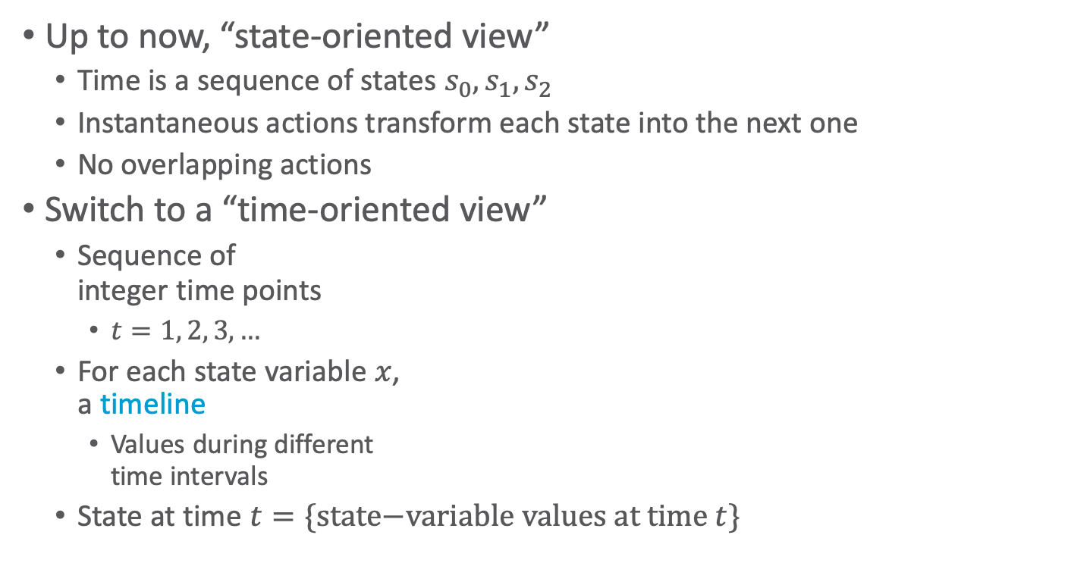
Timelines
Up to now, “state-oriented view”
  Time is a sequence of states $s_{0}, s_{1}, s_{2}$
  Instantaneous actions transform each state into the next one
  No overlapping actions
Switch to a “time-oriented view”
  Sequence of
  integer time points
    $t=1, 2, 3, …$
  For each state variable $x$,
  a timeline
    Values during different
    time intervals
  State at time $t=\{\text{state}\text{−}\text{variable} \text{values} \text{at} \text{time} t\}$
t
t+1
x
state variables
y
time
Notes:
Not yet continuous time

Slide 5
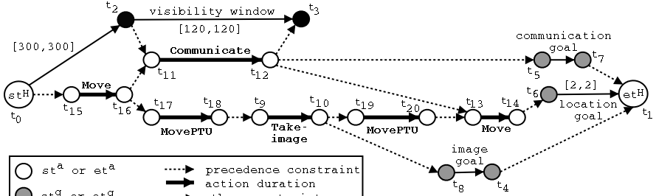
Timelines
Sets of constraints on state variables and events
  Reflect predicted actions and events
Planning is constraint-based
Notes:
Timeline planning: constraint-based planning

Slide 6
Outline per the Book
4.2 Representation
  Timelines
  Actions and tasks
  Chronicles
4.3 Temporal Planning
  Resolvers and flaws
  Search space
4.4 Constraint Management
  Consistency of object constraints and time constraints
  Controlling the actions when we do not know how long they will take
4.5 Acting with Temporal Models
  Acting with atemporal refinement
  Dispatching
  Observation actions
Notes:
4.1 Intro

Slide 7
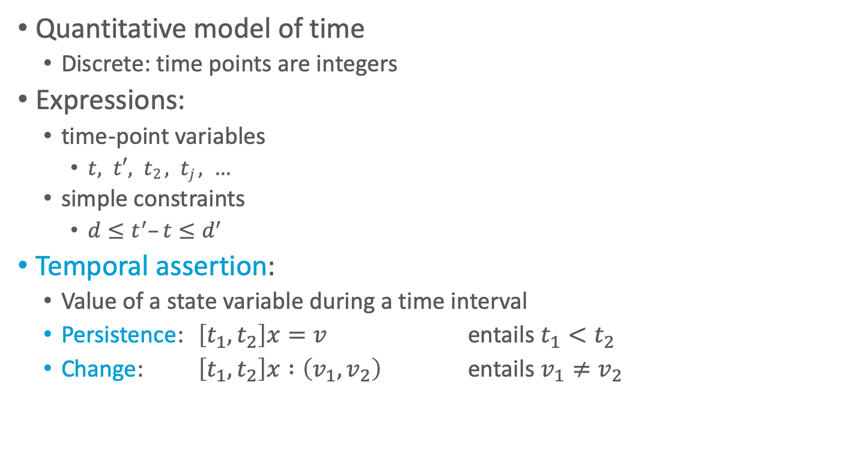
Representation
Quantitative model of time
  Discrete: time points are integers
Expressions:
  time-point variables
    $t, t′, t2 , tj , …$
  simple constraints
    $d≤t^{′}–t≤d^{′}$
Temporal assertion:
  Value of a state variable during a time interval
  Persistence: $\left[t_{1}, t_{2}\right]x=v$ entails $t_{1}<t_{2}$
  Change: $\left[t_{1}, t_{2}\right]x :\left(v_{1}, v_{2}\right)$ entails $v_{1}≠v_{2}$

Slide 8

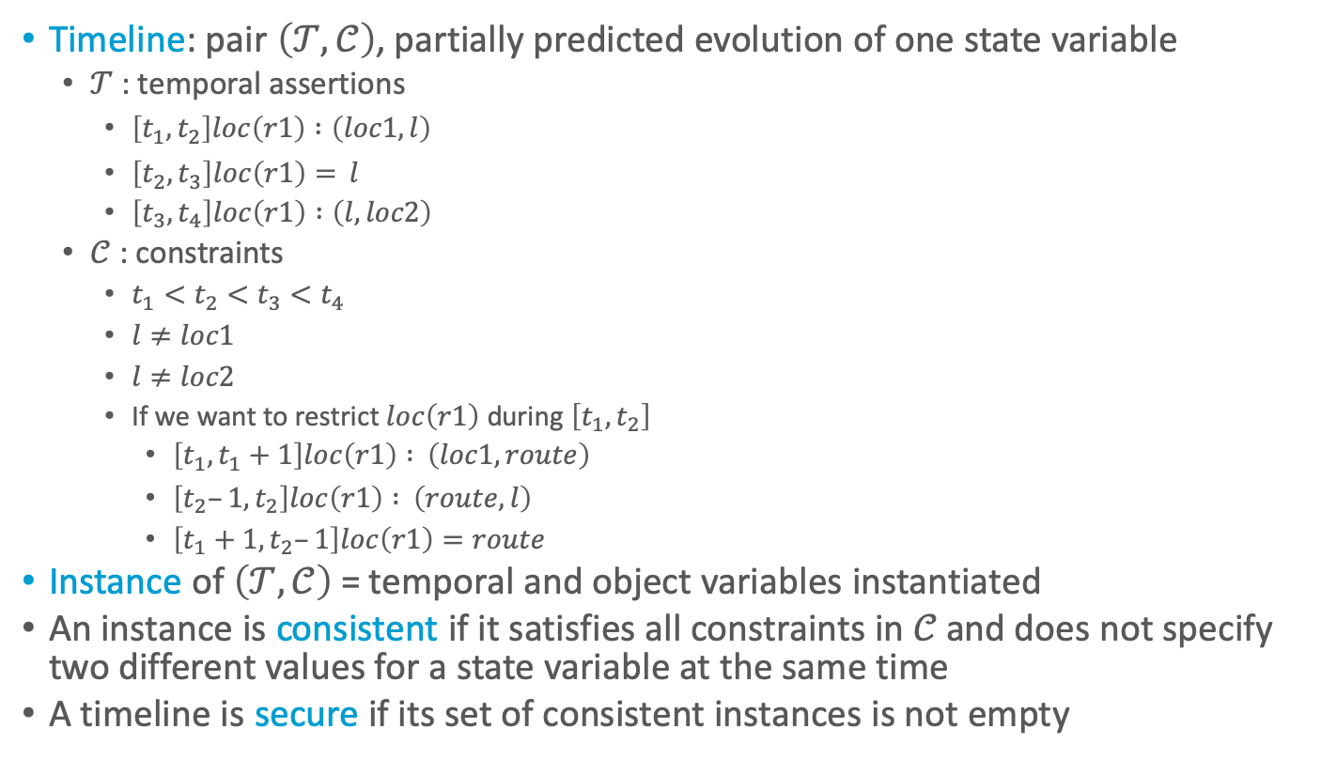







Timeline
Timeline: pair $\left(𝒯,𝒞\right)$, partially predicted evolution of one state variable
  $𝒯$: temporal assertions
    $\left[t_{1}, t_{2}\right]loc\left(r1\right) :\left(loc1, l\right)$
    $\left[t_{2}, t_{3}\right]loc\left(r1\right)= l$
    $\left[t_{3}, t_{4}\right]loc\left(r1\right) :\left(l, loc2\right)$
  $𝒞$ : constraints
    $t_{1}<t_{2}<t_{3}<t_{4}$
    $l≠loc1$
    $l≠loc2$
    If we want to restrict $loc\left(r1\right)$ during $\left[t_{1}, t_{2}\right]$
      $\left[t_{1}, t_{1}+1\right]loc\left(r1\right) : \left(loc1, route\right)$
      $\left[t_{2}–1, t_{2}\right]loc\left(r1\right) : \left(route,l\right)$
      $\left[t_{1}+1, t_{2}–1\right]loc\left(r1\right)=route$
Instance of $\left(𝒯,𝒞\right)$ = temporal and object variables instantiated
An instance is consistent if it satisfies all constraints in $𝒞$ and does not specify two different values for a state variable at the same time
A timeline is secure if its set of consistent instances is not empty
$$l$$
Persistence
$$loc\left(r1\right)$$
$$loc1$$
Change
$$loc2$$
$$t_{1}$$
$$t_{2}$$
$$t_{3}$$
$$t_{4}$$
Notes:
A timeline does not say anything about when it happens and how much time passes between the ti’s
Constraints with route make it that r1 leaves loc1 at t1 and arrives at l at t2 and is in some intermediate state route in between

Slide 9
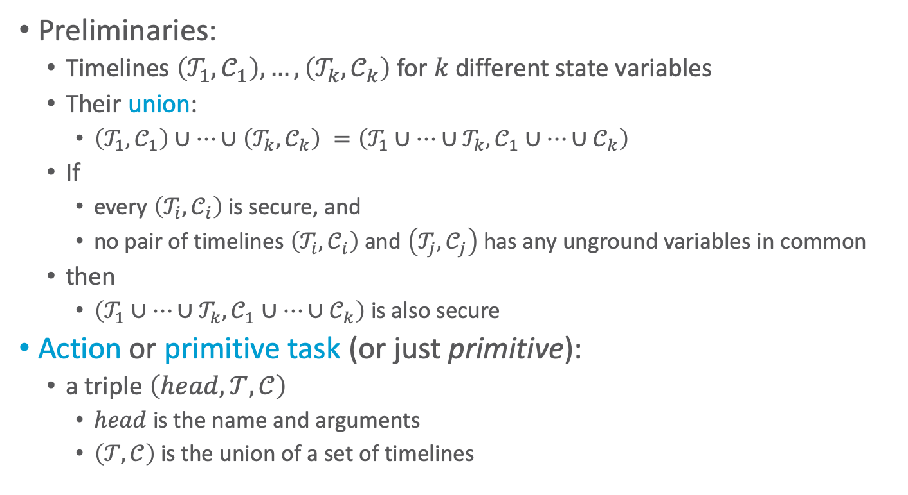
Actions
Preliminaries:
  Timelines $\left(𝒯_{1},𝒞_{1}\right), …,\left(𝒯_{k},𝒞_{k}\right)$ for $k$ different state variables
  Their union:
    $\left(𝒯_{1},𝒞_{1}\right)∪…∪\left(𝒯_{k},𝒞_{k}\right) =\left(𝒯_{1}∪…∪𝒯_{k}, 𝒞_{1}∪…∪𝒞_{k}\right)$
  If
    every $\left(𝒯_{i},𝒞_{i}\right)$ is secure, and
    no pair of timelines $\left(𝒯_{i},𝒞_{i}\right)$ and $\left(𝒯_{j},𝒞_{j}\right)$ has any unground variables in common
  then
    $\left(𝒯_{1}∪…∪𝒯_{k}, 𝒞_{1}∪…∪𝒞_{k}\right)$ is also secure
Action or primitive task (or just primitive):
  a triple $\left(head,𝒯,𝒞\right)$
    $head$ is the name and arguments
    $\left(𝒯,𝒞\right)$ is the union of a set of timelines

Slide 10
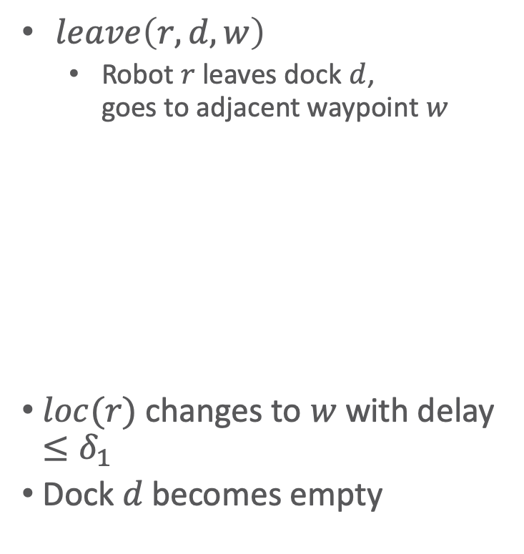
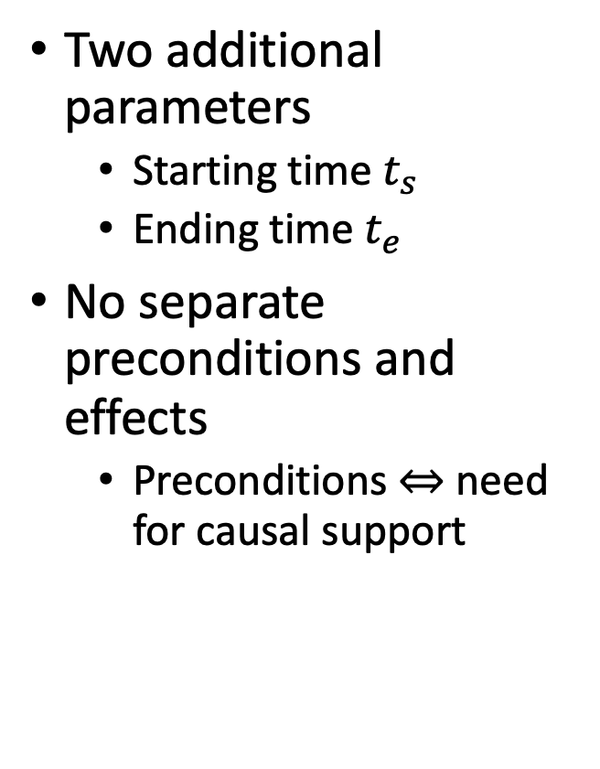
Actions
$leave\left(r,d,w\right)$
  Robot $r$ leaves dock $d$,
  goes to adjacent waypoint $w$
$loc(r)$ changes to $w$ with delay $≤δ_{1}$
Dock $d$ becomes empty
Two additional parameters
  Starting time $t_{s}$
  Ending time $t_{e}$
No separate preconditions and effects
  Preconditions ⇔ need for causal support
leave(r,d,w)
  assertions:
    [t_{s},t_{e}] loc(r): (d,w)
    [t_{s},t_{e}] occupant(d): (r,empty)
  constraints:
    t_{e} ≤ t_{s} + δ₁
    adj(d,w)
• w
r
d

Slide 11
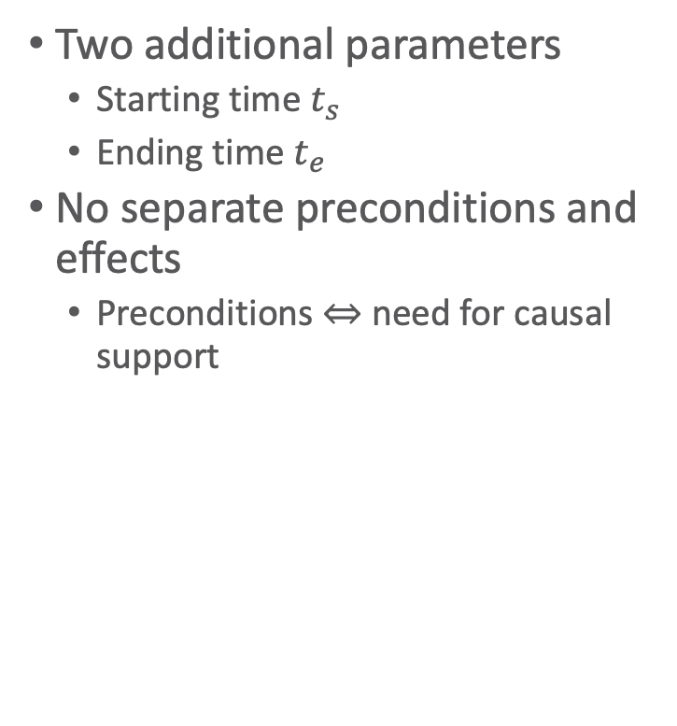
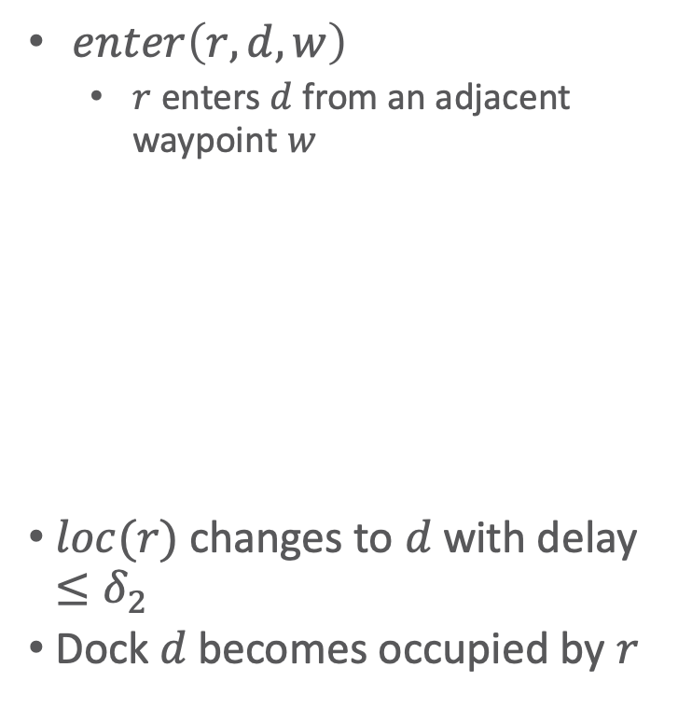
Actions
$enter\left(r,d,w\right)$
  $r$ enters $d$ from an adjacent waypoint $w$
$loc(r)$ changes to $d$ with delay $≤δ_{2}$
Dock $d$ becomes occupied by $r$
Two additional parameters
  Starting time $t_{s}$
  Ending time $t_{e}$
No separate preconditions and effects
  Preconditions ⇔ need for causal support
    enter(r,d,w)
    assertions:
    [t_{s},t_{e}] loc(r): (w,d)
    [t_{s},t_{e}] occupant(d): (empty,r)
    constraints:
    t_{e} ≤ t_{s} + δ₂
    adj(d,w)
r
• w
d

Slide 12

Actions
$take\left(k,c,r,d\right)$
  Action: crane $k$ takes
  container $c$ from $r$
  on dock $d$
Two additional parameters
  Starting time $t_{s}$
  Ending time $t_{e}$
No separate preconditions and effects
  Preconditions ⇔ need for causal support
k
c
book omits d
r
d
take(k,c,r,d)
assertions:
[t_{s},t_{e}] pos(c): (r, k) // where container c is
[t_{s},t_{e}] grip(k): (empty, c) // what crane k’s gripper is holding
[t_{s},t_{e}] freight(r): (c,empty) // what r is carrying
[t_{s},t_{e}] loc(r) = d // where r is
constraints:
attached(k,d)

Slide 13
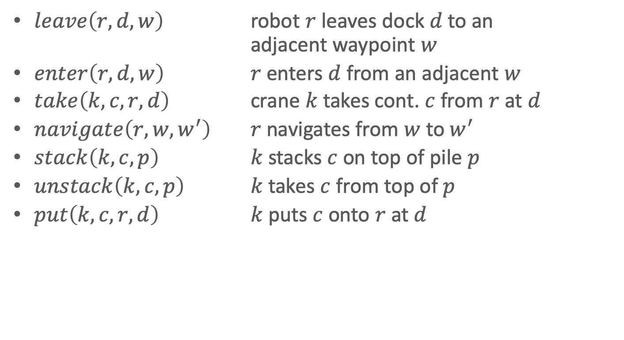
Actions
$leave\left(r,d,w\right)$ robot $r$ leaves dock $d$ to an
adjacent waypoint $w$
$enter\left(r,d,w\right)$ $r$ enters $d$ from an adjacent $w$
$take\left(k,c,r,d\right)$ crane $k$ takes cont. $c$ from $r$ at $d$
$navigate\left(r,w,w^{′}\right)$ $r$ navigates from $w$ to $w^{′}$
$stack\left(k,c,p\right)$ $k$ stacks $c$ on top of pile $p$
$unstack\left(k,c,p\right)$ $k$ takes $c$ from top of $p$
$put\left(k,c,r,d\right)$ $k$ puts $c$ onto $r$ at $d$
k
book omits d
c
• w
r
d

Slide 14


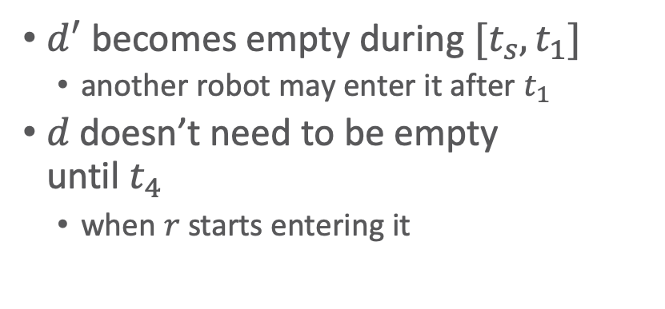
Tasks and Methods
  $$\left[t_{s},t_{e}\right]move\left(r,d\right)$$
navigate
Task: move robot r to dock d
  $\left[t_{s},t_{e}\right]move\left(r,d\right)$
Method:
leave
enter
t_{s} t₁ t₂ t₃ t₄ t_{e}
  m-move1(r,d,d′,w,w′)
  task: move(r,d)
  refinement:
  [t_{s},t₁] leave(r,d′,w′)
  [t₂,t₃] navigate(r,w′,w)
  [t₄,t_{e}] enter(r,d,w)
  assertions:
  [t_{s},t_{s}+1] loc(r) = d′
  constraints:
  adj(d,w),
  adj(d′,w′), d ≠ d′,
  connected(w,w′),
  t₁ ≤ t₂, t₃ ≤ t₄
$d^{′}$ becomes empty during $[t_{s},t_{1}]$
  another robot may enter it after $t_{1}$
$d$ doesn’t need to be empty
until $t_{4}$
  when $r$ starts entering it
• w2
d2
• w1
r1
d1
Notes:
Refinements: all actions

Slide 15
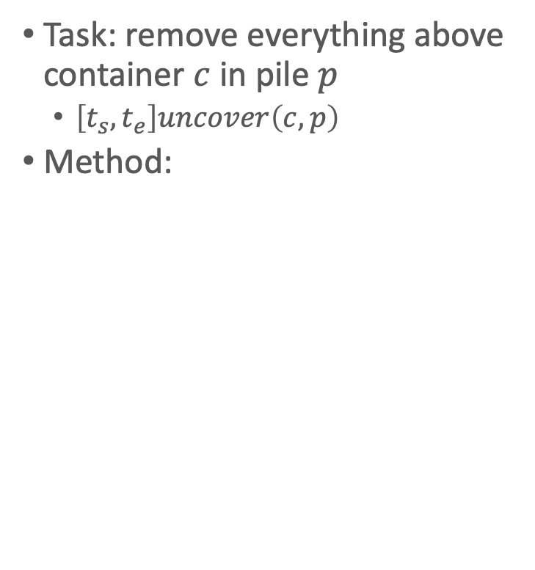

Tasks and Methods
  $$\left[t_{s},t_{e}\right]uncover\left(c,p\right)$$
stack
Task: remove everything above container $c$ in pile $p$
  $\left[t_{s},t_{e}\right]uncover\left(c,p\right)$
Method:
unstack
uncover
t_{s} t₁ t₂ t₃ t₄ t_{e}
  m-uncover(c,p,k,d,p′)
  task: uncover(c,p)
refinement: [t_{s},t₁] unstack(k,c′,p) // action
[t₂,t₃] stack(k,c′,p′) // action
[t₄,t_{e}] uncover(c,p) // recursive uncover
  assertions: [t_{s},t_{s}+1] pile(c) = p
  [t_{s},t_{s}+1] top(p) = c′
  [t_{s}, t_{s}+1] grip(k) = empty
constraints: attached(k,d), attached(p,d),
attached(p′,d),
p ≠ p′, c′ ≠ c,
t₁ ≤ t₂, t₃ ≤ t₄
k1
c1
c2
c3
p1
p2
Notes:
Refinements: actions + another task/method

Slide 16
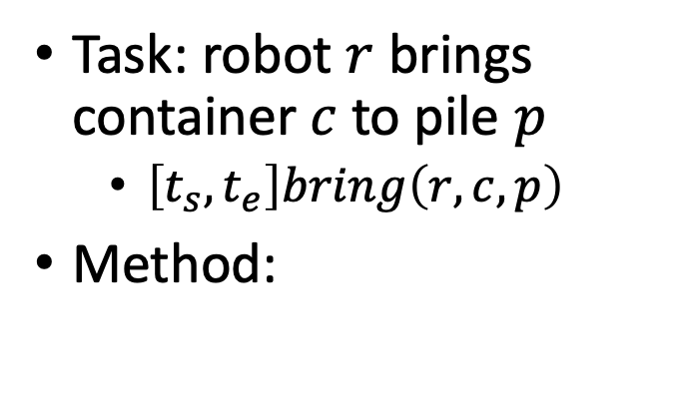
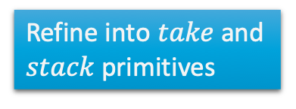
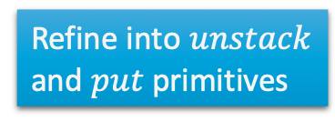
Tasks and Methods
  $$\left[t_{s}, t_{e}\right]bring\left(r,c,p\right)$$
pile(c) = p′
freight(r) = empty
Task: robot $r$ brings
container $c$ to pile $p$
  $\left[t_{s}, t_{e}\right]bring\left(r,c,p\right)$
Method:
move
move
t₁
uncover
load
unload
t₂
t_{s} t₃ t₄ t₅ t₆ t₇ t_{e}
m-bring(r,c,p,p′,d,d′)
task: bring(r,c,p)
  refinement: [t_{s},t₁] move(r,d′)
  [t_{s},t₂] uncover(c,p′)
  [t₃,t₄] load(k′,r,c,p′)
  [t₅,t₆] move(r,d)
  [t₇,t_{e}] unload(k,r,c,p)
  assertions: [t_{s},t₃] pile(c) = p′
  [t_{s},t₃] freight(r) = empty
constraints: attached(p′,d′), attached(p,d), d ≠ d′
attached(k′,d′), attached(k,d), k ≠ k′
t₁ ≤ t₃, t₂ ≤ t₃, t₄ ≤ t₅, t₆ ≤ t₇
Refine into $unstack$ and $put$ primitives
k2
r1
• w2
Refine into $take$ and $stack$ primitives
d2
k1
p3
• w1
c1
d1
p1
p2
Notes:
Refinements: parallel actions

Slide 17
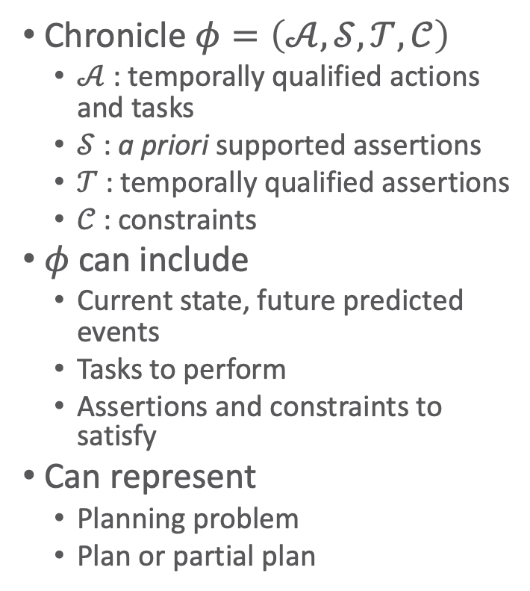

Chronicles:
Unions of Timelines
ϕ₀:
tasks: [t,t’] bring(r,c1,d4)
supported: [t_{s}] loc(r1)=d1
[t_{s}] loc(r2)=d2
[t_{s}+10,t_{s}+δ] docked(ship1)=d3
[t_{s}] top(pile-ship1)=c1
[t_{s}] pos(c1)=pallet
assertions: [t_{e}] loc(r1)=d1
[t_{e}] loc(r2)=d2
constraints: t_{s} = 0 < t < t' < t_{e} , 20 ≤ δ ≤ 30
Chronicle $φ=\left(𝒜,𝒮,𝒯,𝒞\right)$
  $𝒜$ : temporally qualified actions and tasks
  $𝒮$ : a priori supported assertions
  $𝒯$ : temporally qualified assertions
  $𝒞$ : constraints
$φ$ can include
  Current state, future predicted events
  Tasks to perform
  Assertions and constraints to satisfy
Can represent
  Planning problem
  Plan or partial plan
  $$\left[t_{s}, t_{e}\right]bring\left(r,c1,d4\right)$$
loc(r1) = d1
top(pile-ship1) = c1
docked(ship1) = d3
loc(r1) = d1
t_{s} t t_{s}+10 t_{s}+𝛿 t’ t_{e}
Notes:
Problem representation that has flaws that need to be resolved ➝ turns problem into plan representation

Slide 18
Intermediate Summary
Timelines
  Temporal assertions (change, persistence), constraints
  Conflicts, consistency, security, causal support
Chronicle: union of several timelines
  Consistency, security, causal support
Actions represented by chronicles
  No separate preconditions and effects
    Preconditions ⇔ need for causal support

Slide 19
Outline per the Book
4.2 Representation
  Timelines
  Actions and tasks
  Chronicles
4.3 Temporal Planning
  Resolvers and flaws
  Search space
4.4 Constraint Management
  Consistency of object constraints and time constraints
  Controlling the actions when we do not know how long they will take
4.5 Acting with Temporal Models
  Acting with atemporal refinement
  Dispatching
  Observation actions
Notes:
4.1 Intro

Slide 20



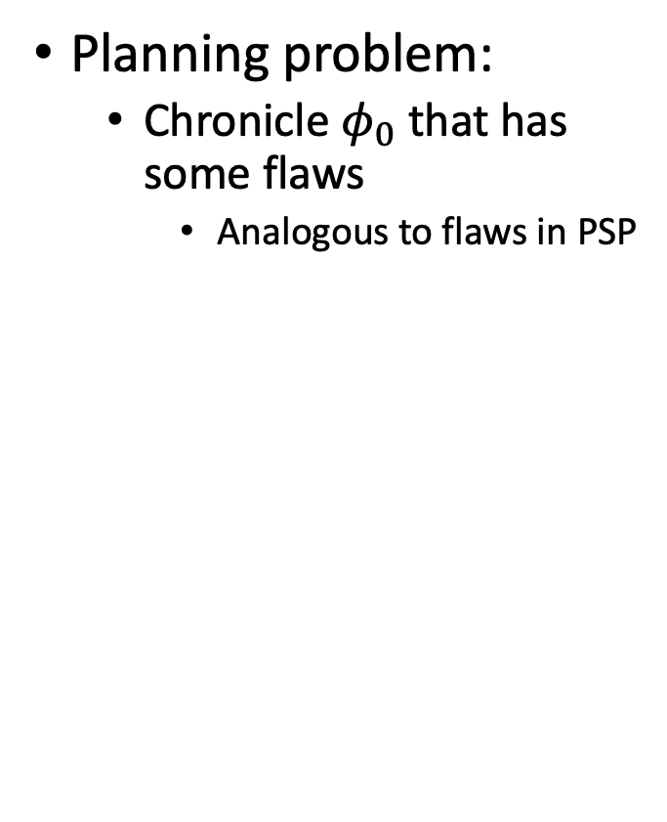













Planning
Planning problem:
  Chronicle $φ_{0}$ that has some flaws
    Analogous to flaws in PSP
Add new assertions, constraints, actions to resolve the flaws
  ϕ₀: tasks: (none)
  supported: (none)
assertions: [t₁,t₂] loc(r1) = l
[t₃,t₄] loc(r1) : (loc3,loc4)
constraints: adj(loc3,w1)
adj(w1,loc3)
adj(loc4,w2)
adj(w2,loc4)
connected(w1,w2)
  ϕ₀: tasks: [t₂,t₃] move(r1,loc3)
  supported: (none)
assertions: [t₁,t₂] loc(r1) = l
[t₃,t₄] loc(r1) : (loc3,loc4)
constraints: adj(loc3,w1)
adj(w1,loc3)
adj(loc4,w2)
adj(w2,loc4)
connected(w1,w2)
$$l$$
$$loc4$$
$$l$$
$$loc4$$
$$loc\left(r1\right)$$
$$loc\left(r1\right)$$
move
$$loc3$$
$$loc3$$
$$t_{1}$$
$$t_{2}$$
$$t_{3}$$
$$t_{4}$$
$$t_{1}$$
$$t_{2}$$
$$t_{3}$$
$$t_{4}$$
Notes:
Keep constraints consistent

Slide 21




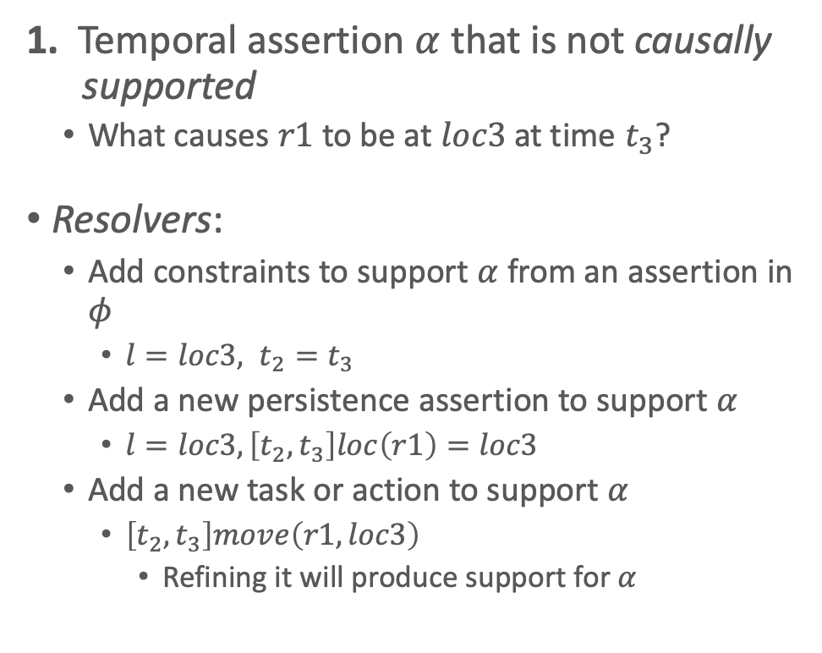

























Flaws (1)
$$l$$
$$loc4$$
$$loc\left(r1\right)$$
Like an open goal in PSP
$$loc3$$
1. Temporal assertion $α$ that is not causally supported
  What causes $r1$ to be at $loc3$ at time $t_{3}$?
Resolvers:
  Add constraints to support $α$ from an assertion in $φ$
    $l=loc3, t_{2}=t_{3}$
  Add a new persistence assertion to support $α$
    $l=loc3, \left[t_{2},t_{3}\right]loc\left(r1\right)=loc3$
  Add a new task or action to support $α$
    $\left[t_{2},t_{3}\right]move\left(r1,loc3\right)$
      Refining it will produce support for $α$
$$t_{1}$$
$$t_{2}$$
$$t_{3}$$
$$t_{4}$$
$$loc4$$
$$loc\left(r1\right)$$
$$l=loc3$$
$$t_{1}$$
$$t_{2}=t_{3}$$
$$t_{4}$$
$$loc4$$
$$loc\left(r1\right)$$
$$l=loc3$$
$$t_{1}$$
$$t_{2}$$
$$t_{3}$$
$$t_{4}$$
$$l$$
$$loc4$$
$$loc\left(r1\right)$$
move
$$loc3$$
$$t_{1}$$
$$t_{2}$$
$$t_{3}$$
$$t_{4}$$

Slide 22
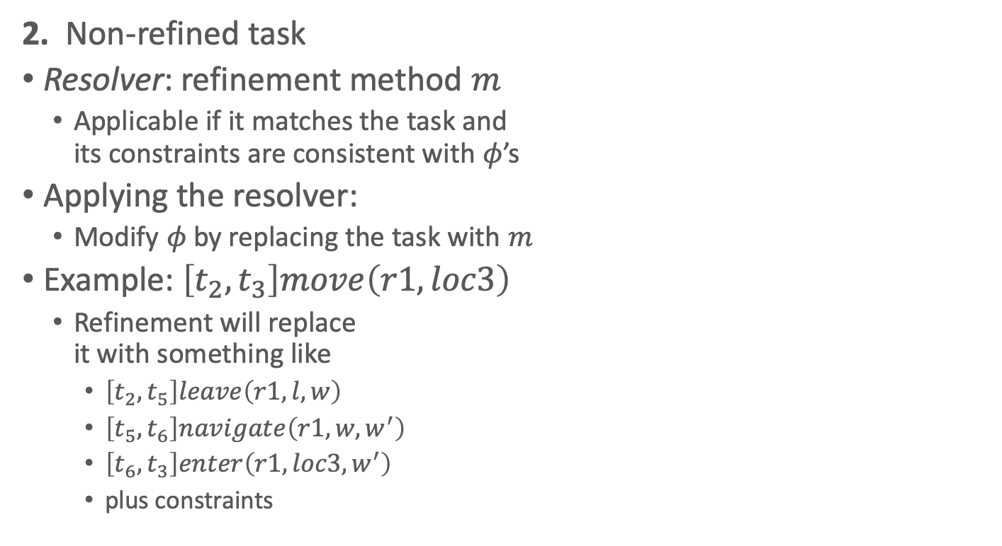
Flaws (2)
Like a task in SeRPE
2. Non-refined task
Resolver: refinement method $m$
  Applicable if it matches the task and
  its constraints are consistent with $φ$’s
Applying the resolver:
  Modify $φ$ by replacing the task with $m$
Example: $\left[t_{2},t_{3}\right]move\left(r1,loc3\right)$
  Refinement will replace
  it with something like
    $\left[t_{2},t_{5}\right]leave\left(r1,l,w\right)$
    $\left[t_{5},t_{6}\right]navigate\left(r1, w, w^{′}\right)$
    $\left[t_{6},t_{3}\right]enter\left(r1,loc3,w^{′}\right)$
    plus constraints
$$l$$
$$loc4$$
$$loc\left(r1\right)$$
move
$$loc3$$
$$t_{1}$$
$$t_{2}$$
$$t_{3}$$
$$t_{4}$$

Slide 23


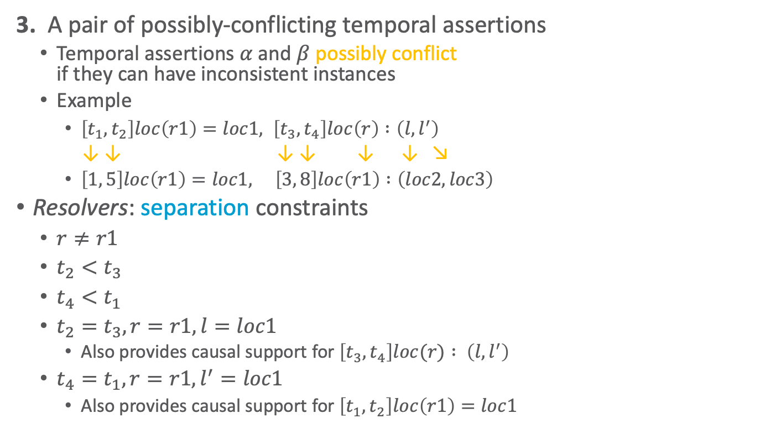














Flaws (3)
Like a threat in PSP
3. A pair of possibly-conflicting temporal assertions
  Temporal assertions $α$ and $β$ possibly conflict
  if they can have inconsistent instances
  Example
    $\left[t_{1},t_{2}\right]loc\left(r1\right)=loc1, \left[t_{3},t_{4}\right]loc\left(r\right) :\left(l, l^{′}\right)$
    ↓ ↓ ↓ ↓ ↓ ↓ ↘
    $\left[1, 5\right]loc\left(r1\right)=loc1, \left[3, 8\right]loc\left(r1\right) :\left(loc2,loc3\right)$
Resolvers: separation constraints
  $r≠r1$
  $t_{2}<t_{3}$
  $t_{4}<t_{1}$
  $t_{2}=t_{3}, r=r1, l=loc1$
    Also provides causal support for $\left[t_{3},t_{4}\right]loc(r) : \left(l, l^{′}\right)$
  $t_{4}=t_{1}, r=r1, l^{′}=loc1$
    Also provides causal support for $\left[t_{1},t_{2}\right]loc\left(r1\right)=loc1$
$$loc1$$
$$loc\left(r\right)$$
$$l^{′}$$
$$loc\left(r1\right)$$
$$l$$
$$t_{1}$$
$$t_{2}$$
$$t_{3}$$
$$t_{4}$$
$$loc1$$
$$loc3$$
$$loc\left(r1\right)$$
$$loc2$$
$$t_{1}=1$$
$$t_{2}=5$$
$$t_{4}=8$$
$$t_{3}=3$$

Slide 24
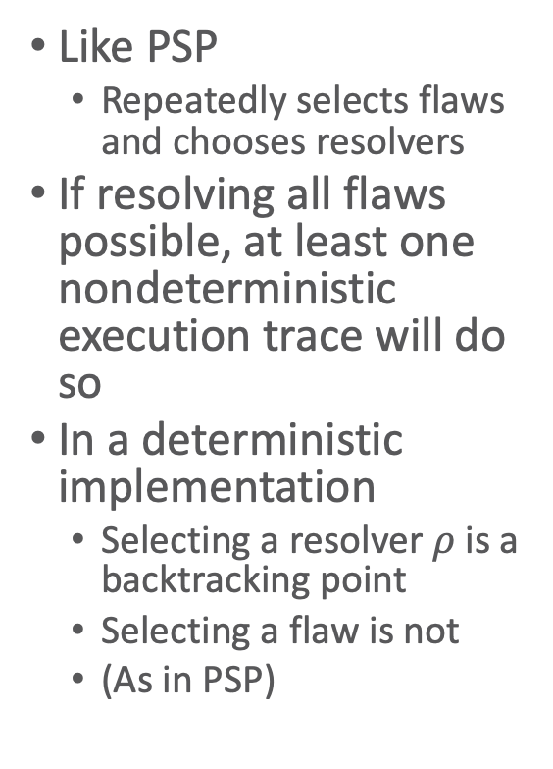
Planning Algorithm
TemPlan(𝜙) // recursive version (book)
Flaws ← set of flaws of 𝜙
if Flaws = ∅ then
return 𝜙
arbitrarily select f ∈ Flaws
Resolvers ← set of resolvers of f
if Resolvers = ∅ then
return failure
nondeterministically choose 𝜌 ∈ Resolvers
𝜙 ← Transform(𝜙, 𝜌)
TemPlan(𝜙,Σ)
Like PSP
  Repeatedly selects flaws and chooses resolvers
If resolving all flaws possible, at least one nondeterministic execution trace will do so
In a deterministic implementation
  Selecting a resolver $ρ$ is a backtracking point
  Selecting a flaw is not
  (As in PSP)
TemPlan(𝜙) // iterative version
loop
Flaws ← set of flaws of 𝜙
if Flaws = ∅ then
return 𝜙
arbitrarily select f ∈ Flaws
Resolvers ← set of resolvers of f
if Resolvers = ∅ then
return failure
nondeterministically choose 𝜌 ∈ Resolvers
𝜙 ← Transform(𝜙, 𝜌)

Slide 25
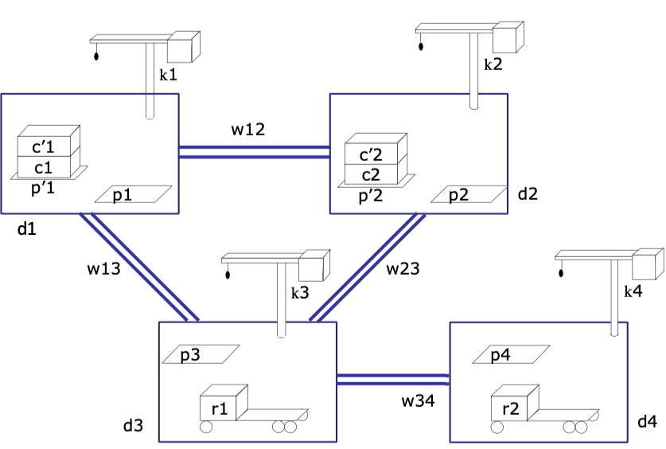
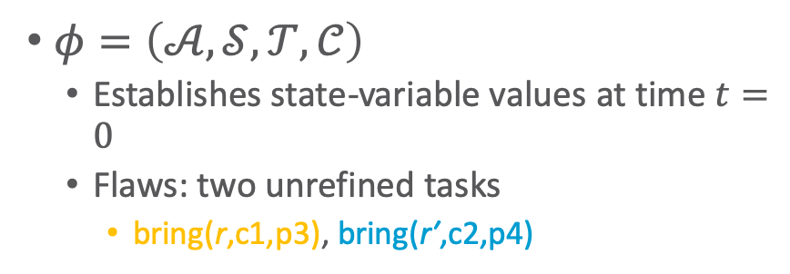
Example
  ϕ₀: tasks: bring(r,c1,p3)
  bring(r′,c2,p4)
  supported: [0] loc(r1)=d3
  [0] freight(r1)=empty
  [0] pile(c1)=p′1
  [0] pile(c′1)=p′1
  [0] pos(c1)=pallet
  [0] pos(c′1)=c1
  . . .
assertions: (none)
constraints:
adj(d1,w12)
adj(d1,w13)
. . .
$φ=\left(𝒜,𝒮,𝒯,𝒞\right)$
  Establishes state-variable values at time $t=0$
  Flaws: two unrefined tasks
    bring(r,c1,p3), bring(r′,c2,p4)

Slide 26
Example
  ϕ₀: tasks: bring(r,c1,p3)
  bring(r′,c2,p4)
  supported: [0] loc(r1)=d3
  [0] freight(r1)=empty
  [0] pile(c1)=p′1
  [0] pile(c′1)=p′1
  [0] pos(c1)=pallet
  [0] pos(c′1)=c1
  . . .
assertions: (none)
constraints:
adj(d1,w12)
adj(d1,w13)
. . .
Flaws: two unrefined tasks
  bring(r,c1,p3), bring(r′,c2,p4)
Refinement for both:
m-bring(r,c,p,p′,d,d′,k,k′)
task: bring(r,c,p)
refinement: [t_{s},t₁] move(r,d′)
[t_{s},t₂] uncover(c,p′)
[t₃,t₄] load(k′,r,c,p′)
[t₅,t₆] move(r,d)
[t₇,t_{e}] unload(k,r,c,p)
assertions: [t_{s},t₃] pile(c) = p′
[t_{s},t₃] freight(r) = empty
constraints: attached(p′,d′),
attached(p,d), d ≠ d′
attached(k′,d′),
attached(k,d), k ≠ k′
t₁ ≤ t₃, t₂ ≤ t₃, t₄ ≤ t₅, t₆ ≤ t₇

Slide 27

Method Instance
  ϕ₀: tasks: bring(r,c1,p3)
  bring(r′,c2,p4)
  supported: [0] loc(r1)=d3
  [0] freight(r1)=empty
  [0] pile(c1)=p′1
  [0] pile(c′1)=p′1
  [0] pos(c1)=pallet
  [0] pos(c′1)=c1
  . . .
assertions: (none)
constraints:
adj(d1,w12)
adj(d1,w13)
. . .
Instantiate $c=c1$ and $p=p3$ to
match $bring\left(r,c1,p3\right)$
  $p^{′},d,d^{′},k,k^{′}$
  instantiated to
  match book
  Needed later to
  satisfy action
  preconditions
m-bring(r,c1,p3,p′1,d3,d1,k3,k1)
task: bring(r,c1,p3)
refinement: [t_{s},t₁] move(r,d1)
[t_{s},t₂] uncover(c1,p′1)
[t₃,t₄] load(k1,r,c1,p′1)
[t₅,t₆] move(r, d3)
[t₇,t_{e}] unload(k3,r,c1,p3)
assertions: [t_{s},t₃] pile(c1) = p′1
[t_{s},t₃] freight(r) = empty
constraints: attached(p′1,d1),
attached(p3,d3), d3 ≠ d1
attached(k1,d1),
attached(k3,d3), k3 ≠ k1
t₁ ≤ t₃, t₂ ≤ t₃, t₄ ≤ t₅, t₆ ≤ t₇
Notes:
Instantiation not yet needed

Slide 28

Modified Chronicle
  ϕ₁: tasks: [t_{s},t₁] move(r,d1)
  [t_{s},t₂] uncover(c1,p′1)
  [t₃,t₄] load(k1,r,c1,p′1)
  [t₅,t₆] move(r,d3)
  [t₇,t_{e}] unload(k3,r,c1,p3)
  bring(r′,c2,p4)
  supported: [0] loc(r1)=d3
  [0] freight(r1)=empty
  [0] pile(c1)=p′1
  [0] pile(c′1)=p′1
  [0] pos(c1)=pallet
  [0] pos(c′1)=c1
  . . .
assertions: [t_{s},t₃] pile(c1) = p′1
[t_{s},t₃] freight(r) = empty
constraints: t_{s}<t₁≤t₃, t_{s}<t₂≤t₃, t₄≤t₅, t₆≤t₇,
adj(d1,w12), adj(d1,w13),
. . .
Changes to $φ_{0}$
  Removed $bring\left(r,c1,p3\right)$
  Added 5 tasks, 2 assertions, 10 constraints
Flaws
  6 unrefined tasks, 2 unsupported assertions

Slide 29

Method Instance
  ϕ₁: tasks: [t_{s},t₁] move(r,d1)
  [t_{s},t₂] uncover(c1,p′1)
  [t₃,t₄] load(k1,r,c1,p′1)
  [t₅,t₆] move(r,d3)
  [t₇,t_{e}] unload(k3,r,c1,p3)
  bring(r′,c2,p4)
  supported: [0] loc(r1)=d3
  [0] freight(r1)=empty
  [0] pile(c1)=p′1
  [0] pile(c′1)=p′1
  [0] pos(c1)=pallet
  [0] pos(c′1)=c1
  . . .
assertions: [t_{s},t₃] pile(c1) = p′1
[t_{s},t₃] freight(r) = empty
constraints: t_{s}<t₁≤t₃, t_{s}<t₂≤t₃, t₄≤t₅, t₆≤t₇,
adj(d1,w12), adj(d1,w13),
. . .
Instantiate $r=r^{′}, c=c2, p=p4$ to
match $bring\left(r^{′},c2,p4\right)$
  $p^{′},d,d^{′},k,k^{′}$
  instantiated to
  match book again
m-bring(r’,c2,p4,p′2,d4,d2,k4,k2)
task: bring(r’,c2,p4)
refinement: [t_{s},t₁] move(r’,d2)
[t_{s},t₂] uncover(c2,p′2)
[t₃,t₄] load(k2,r’,c2,p′2)
[t₅,t₆] move(r’, d4)
[t₇,t_{e}] unload(k4,r’,c2,p4)
assertions: [t_{s},t₃] pile(c2) = p′2
[t_{s},t₃] freight(r’) = empty
constraints: attached(p′2,d2),
attached(p4,d4), d4 ≠ d2
attached(k2,d2),
attached(k4,d4), k4 ≠ k2
t₁ ≤ t₃, t₂ ≤ t₃, t₄ ≤ t₅, t₆ ≤ t₇
Notes:
Instantiation not yet needed
Is it ok to instantiate $r=r^{′}$?

Slide 30
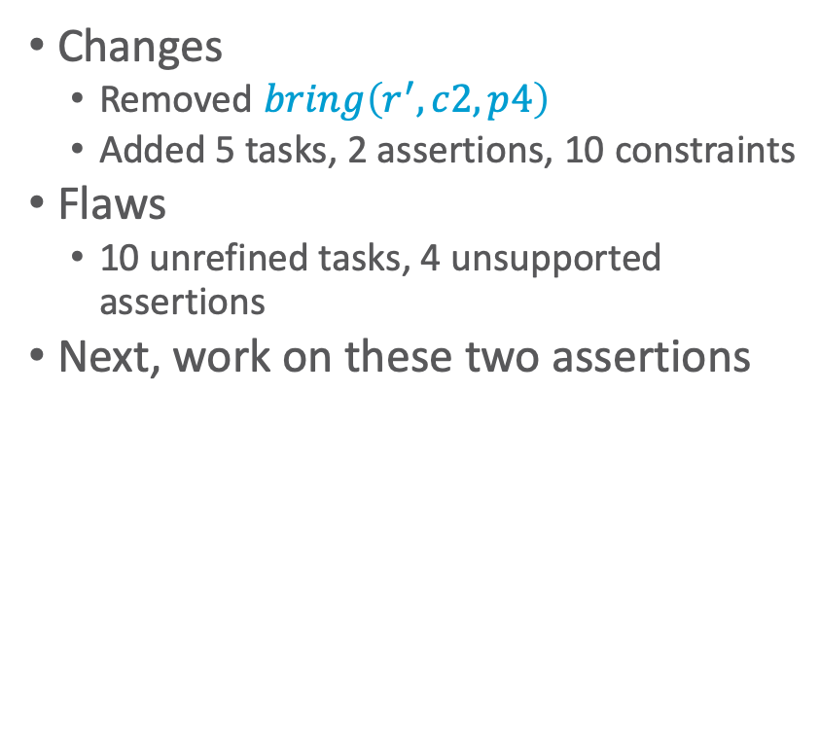
Modified Chronicle
  ϕ₂: tasks: [t_{s},t₁] move(r,d1)
  [t_{s},t₂] uncover(c1,p′1)
  [t₃,t₄] load(k1,r,c1,p′1)
  [t₅,t₆] move(r,d3)
  [t₇,t_{e}] unload(k3,r,c1,p3)
[t′_{s},t′₁] move(r′,d2)
[t′_{s},t′₂] uncover(c2,p′2)
[t′₃,t′₄] load(k4,r′,c2,p′2)
[t′₅,t′₆] move(r′,d4)
[t′₇,t′_{e}] unload(k2,r′,c2,p′2)
  supported: [0] loc(r1)=d3
  [0] freight(r1)=empty
  [0] pile(c1)=p′1
  . . .
assertions: [t_{s},t₃] pile(c1) = p′1
[t_{s},t₃] freight(r) = empty [t′_{s},t′₃] pile(c2) = p′2
[t′_{s},t′₁] freight(r′) = empty
constraints: t_{s}<t₁≤t₃, t_{s}<t₂≤t₃, t₄≤t₅, t₆≤t₇,
t′_{s}<t′₁≤t′₃, t′_{s}<t′₂≤t′₃, t′₄≤t′₅, t′₆≤t′₇,
adj(d1,w12), adj(d1,w13), . . .
Changes
  Removed $bring\left(r^{′},c2,p4\right)$
  Added 5 tasks, 2 assertions, 10 constraints
Flaws
  10 unrefined tasks, 4 unsupported assertions
Next, work on these two assertions

Slide 31
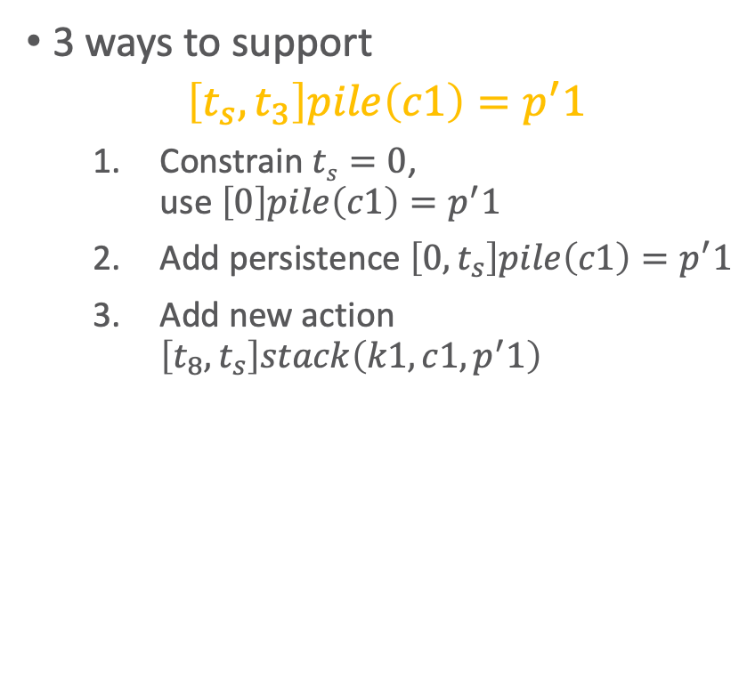
Supporting the Assertions
  ϕ₂: tasks: [t_{s},t₁] move(r,d1)
  [t_{s},t₂] uncover(c1,p′1)
  [t₃,t₄] load(k1,r,c1,p′1)
  [t₅,t₆] move(r,d3)
  [t₇,t_{e}] unload(k3,r,c1,p3)
[t′_{s},t′₁] move(r′,d2)
[t′_{s},t′₂] uncover(c2,p′2)
[t′₃,t′₄] load(k4,r′,c2,p′2)
[t′₅,t′₆] move(r′,d4)
[t′₇,t′_{e}] unload(k2,r′,c2,p′2)
  supported: [0] loc(r1)=d3
  [0] freight(r1)=empty
  [0] pile(c1)=p′1
  . . .
assertions: [t_{s},t₃] pile(c1) = p′1
[t_{s},t₃] freight(r) = empty [t′_{s},t′₃] pile(c2) = p′2
[t′_{s},t′₁] freight(r′) = empty
constraints: t_{s}<t₁≤t₃, t_{s}<t₂≤t₃, t₄≤t₅, t₆≤t₇,
t′_{s}<t′₁≤t′₃, t′_{s}<t′₂≤t′₃, t′₄≤t′₅, t′₆≤t′₇,
adj(d1,w12), adj(d1,w13), . . .
3 ways to support
$$\left[t_{s},t_{3}\right]pile\left(c1\right)=p^{′}1$$
  Constrain $ts=0$,
  use $\left[0\right]pile\left(c1\right)=p^{′}1$
  Add persistence $\left[0,t_{s}\right]pile\left(c1\right)=p^{′}1$
  Add new action $\left[t_{8},t_{s}\right]stack\left(k1,c1, p^{′}1\right)$
Will any of them also provide support for
[t_{s},t₃] freight(r) = empty
?
Notes:
No

Slide 32
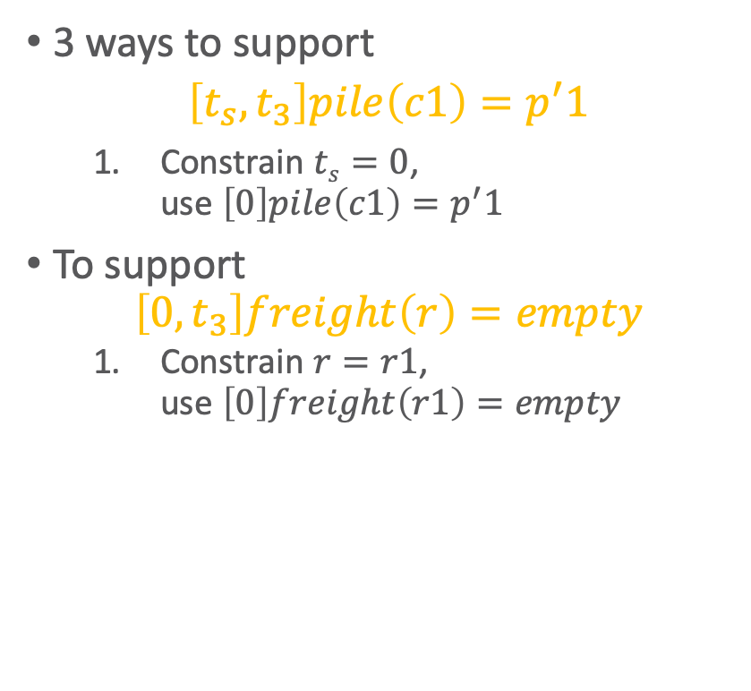
Supporting the Assertions
  ϕ₂: tasks: [0,t₁] move(r,d1)
  [0,t₂] uncover(c1,p′1)
  [t₃,t₄] load(k1,r,c1,p′1)
  [t₅,t₆] move(r,d3)
  [t₇,t_{e}] unload(k3,r,c1,p3)
[t′_{s},t′₁] move(r′,d2)
[t′_{s},t′₂] uncover(c2,p′2)
[t′₃,t′₄] load(k4,r′,c2,p′2)
[t′₅,t′₆] move(r′,d4)
[t′₇,t′_{e}] unload(k2,r′,c2,p′2)
  supported: [0] loc(r1)=d3
  [0] freight(r1)=empty
  [0] pile(c1)=p′1
  . . .
  [0,t₃] pile(c1) = p′1
  assertions: [0,t₃] freight(r) = empty
  [t′_{s},t′₃] pile(c2) = p′2
  [t′_{s},t′₁] freight(r′) = empty
constraints: 0<t₁≤t₃, 0<t₂≤t₃, t₄≤t₅, t₆≤t₇,
t′_{s}<t′₁≤t′₃, t′_{s}<t′₂≤t′₃, t′₄≤t′₅, t′₆≤t′₇,
adj(d1,w12), adj(d1,w13), . . .
3 ways to support
$$\left[t_{s},t_{3}\right]pile\left(c1\right)=p^{′}1$$
  Constrain $ts=0$,
  use $\left[0\right]pile\left(c1\right)=p^{′}1$
To support
$$\left[0,t_{3}\right]freight\left(r\right)=empty$$
  Constrain $r=r1$,
  use $\left[0\right]freight\left(r1\right)=empty$
Notes:
Should 0<t1, 0<t2 have been there already?

Slide 33
Supporting the Assertions
  ϕ₂: tasks: [0,t₁] move(r1,d1)
  [0,t₂] uncover(c1,p′1)
  [t₃,t₄] load(k1,r1,c1,p′1)
  [t₅,t₆] move(r1,d3)
  [t₇,t_{e}] unload(k3,r1,c1,p3)
[t′_{s},t′₁] move(r′,d2)
[t′_{s},t′₂] uncover(c2,p′2)
[t′₃,t′₄] load(k4,r′,c2,p′2)
[t′₅,t′₆] move(r′,d4)
[t′₇,t′_{e}] unload(k2,r′,c2,p′2)
  supported: [0] loc(r1)=d3
  [0] freight(r1)=empty
  [0] pile(c1)=p′1
  . . .
  [0,t₃] pile(c1) = p′1
  [0,t₃] freight(r1) = empty
assertions: [t′_{s},t′₃] pile(c2) = p′2
[t′_{s},t′₁] freight(r′) = empty
constraints: 0<t₁≤t₃, 0<t₂≤t₃, t₄≤t₅, t₆≤t₇,
t′_{s}<t′₁≤t′₃, t′_{s}<t′₂≤t′₃, t′₄≤t′₅, t′₆≤t′₇,
adj(d1,w12), adj(d1,w13), . . .
3 ways to support
$$\left[t_{s},t_{3}\right]pile\left(c1\right)=p^{′}1$$
  Constrain $ts=0$,
  use $\left[0\right]pile\left(c1\right)=p^{′}1$
To support
$$\left[0,t_{3}\right]freight\left(r\right)=empty$$
  Constrain $r=r1$,
  use $\left[0\right]freight\left(r1\right)=empty$
Notes:
Should 0<t1, 0<t2 have been there already?

Slide 34

Supporting the Assertions
  ϕ₂: tasks: [0,t₁] move(r1,d1)
  [0,t₂] uncover(c1,p′1)
  [t₃,t₄] load(k1,r1,c1,p′1)
  [t₅,t₆] move(r1,d3)
  [t₇,t_{e}] unload(k3,r1,c1,p3)
[t′_{s},t′₁] move(r′,d2)
[t′_{s},t′₂] uncover(c2,p′2)
[t′₃,t′₄] load(k4,r′,c2,p′2)
[t′₅,t′₆] move(r′,d4)
[t′₇,t′_{e}] unload(k2,r′,c2,p′2)
  supported: [0] loc(r1)=d3
  [0] freight(r1)=empty
  [0] pile(c1)=p′1
  . . .
  [0,t₃] pile(c1) = p′1
  [0,t₃] freight(r1) = empty
assertions: [t′_{s},t′₃] pile(c2) = p′2
[t′_{s},t′₁] freight(r′) = empty
constraints: 0<t₁≤t₃, 0<t₂≤t₃, t₄≤t₅, t₆≤t₇,
t′_{s}<t′₁≤t′₃, t′_{s}<t′₂≤t′₃, t′₄≤t′₅, t′₆≤t′₇,
adj(d1,w12), adj(d1,w13), . . .
To support
$$\left[t_{s}^{′},t_{3}^{′}\right]pile\left(c2\right)=p^{′}2$$
  Add persistence condition $\left[0,t_{s}^{′}\right]pile\left(c2\right)=p^{′}2$
  Constrain $t_{s}^{′}=0$
  Add new action $stack\left(k2,c2, p^{′}2\right)$
Notes:
Different choice to see effect

Slide 35
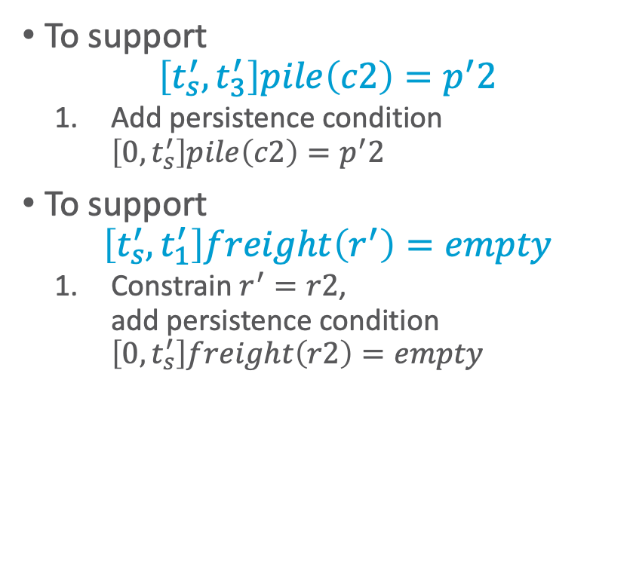
Supporting the Assertions
  ϕ₂: tasks: [0,t₁] move(r1,d1)
  [0,t₂] uncover(c1,p′1)
  [t₃,t₄] load(k1,r1,c1,p′1)
  [t₅,t₆] move(r1,d3)
  [t₇,t_{e}] unload(k3,r1,c1,p3)
[t′_{s},t′₁] move(r′,d2)
[t′_{s},t′₂] uncover(c2,p′2)
[t′₃,t′₄] load(k4,r′,c2,p′2)
[t′₅,t′₆] move(r′,d4)
[t′₇,t′_{e}] unload(k2,r′,c2,p′2)
  supported: [0] loc(r1)=d3
  [0] freight(r1)=empty
  [0] pile(c1)=p′1 . . .
  [0,t₃] pile(c1) = p′1
  [0,t₃] freight(r1) = empty
  [0,t′_{s}] pile(c2)=p′2
  [t′_{s},t′₃] pile(c2) = p′2
assertions: [t′_{s},t′₁] freight(r′) = empty
constraints: 0<t₁≤t₃, 0<t₂≤t₃, t₄≤t₅, t₆≤t₇,
t′_{s}<t′₁≤t′₃, t′_{s}<t′₂≤t′₃, t′₄≤t′₅, t′₆≤t′₇,
adj(d1,w12), adj(d1,w13), . . .
To support
$$\left[t_{s}^{′},t_{3}^{′}\right]pile\left(c2\right)=p^{′}2$$
  Add persistence condition $\left[0,t_{s}^{′}\right]pile\left(c2\right)=p^{′}2$
To support
$$\left[t_{s}^{′},t_{1}^{′}\right]freight\left(r^{′}\right)=empty$$
  Constrain $r^{′}=r2$,
  add persistence condition $\left[0,t_{s}^{′}\right]freight\left(r2\right)=empty$
Notes:
Persistence condition [0,t′_{s}] freight(r2)=empty because ts’ not constrained to 0 (compare to ts)

Slide 36
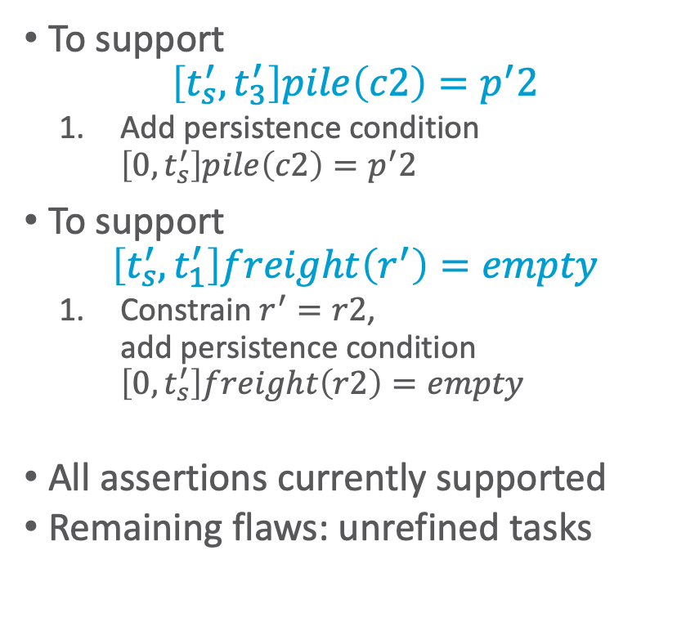
Supporting the Assertions
  ϕ₂: tasks: [0,t₁] move(r1,d1)
  [0,t₂] uncover(c1,p′1)
  [t₃,t₄] load(k1,r1,c1,p′1)
  [t₅,t₆] move(r1,d3)
  [t₇,t_{e}] unload(k3,r1,c1,p3)
[t′_{s},t′₁] move(r2,d2)
[t′_{s},t′₂] uncover(c2,p′2)
[t′₃,t′₄] load(k4,r2,c2,p′2)
[t′₅,t′₆] move(r2,d4)
[t′₇,t′_{e}] unload(k2,r2,c2,p′2)
  supported: [0] loc(r1)=d3
  [0] freight(r1)=empty
  [0] pile(c1)=p′1 . . .
  [0,t₃] pile(c1) = p′1
  [0,t₃] freight(r1) = empty
[0,t′_{s}] pile(c2)=p′2
[t′_{s},t′₃] pile(c2) = p′2
[0,t′_{s}] freight(r2)=empty
[t′_{s},t′₁] freight(r2) = empty
assertions: (none)
constraints: 0<t₁≤t₃, 0<t₂≤t₃, t₄≤t₅, t₆≤t₇,
t′_{s}<t′₁≤t′₃, t′_{s}<t′₂≤t′₃, t′₄≤t′₅, t′₆≤t′₇,
adj(d1,w12),adj(d1,w13), . . .
To support
$$\left[t_{s}^{′},t_{3}^{′}\right]pile\left(c2\right)=p^{′}2$$
  Add persistence condition $\left[0,t_{s}^{′}\right]pile\left(c2\right)=p^{′}2$
To support
$$\left[t_{s}^{′},t_{1}^{′}\right]freight\left(r^{′}\right)=empty$$
  Constrain $r^{′}=r2$,
  add persistence condition $\left[0,t_{s}^{′}\right]freight\left(r2\right)=empty$
All assertions currently supported
Remaining flaws: unrefined tasks
Notes:
Persistence condition [0,t′_{s}] freight(r2)=empty because ts’ not constrained to 0 (compare to ts)

Slide 37
Example of Conflicts
  ϕ₂: tasks: [0,t₁] move(r1,d1)
  [0,t₂] uncover(c1,p′1)
  [t₃,t₄] load(k1,r1,c1,p′1)
  [t₅,t₆] move(r1,d3)
  [t₇,t_{e}] unload(k3,r1,c1,p3)
[t′_{s},t′₁] move(r2,d2)
[t′_{s},t′₂] uncover(c2,p′2)
[t′₃,t′₄] load(k4,r2,c2,p′2)
[t′₅,t′₆] move(r2,d4)
[t′₇,t′_{e}] unload(k2,r2,c2,p′2)
  supported: [0] loc(r1)=d3
  [0] freight(r1)=empty
  [0] pile(c1)=p′1 . . .
  [0,t₃] pile(c1) = p′1
  [0,t₃] freight(r1) = empty
[0,t′_{s}] pile(c2)=p′2
[t′_{s},t′₃] pile(c2) = p′2
[0,t′_{s}] freight(r2)=empty
[t′_{s},t′₁] freight(r2) = empty
assertions: (none)
constraints: 0<t₁≤t₃, 0<t₂≤t₃, t₄≤t₅, t₆≤t₇,
t′_{s}<t′₁≤t′₃, t′_{s}<t′₂≤t′₃, t′₄≤t′₅, t′₆≤t′₇,
adj(d1,w12),adj(d1,w13), . . .
Refining tasks into actions will produce possibly-conflicting assertions
  move(r2,d4) must go from d2 through d3
  Conflict: occupant(d3)=r1, occupant(d3)=r2
Resolvers:
  Separation constraints to ensure r2 only goes through d3 while r1 away from d3
    E.g., by ensuring move(r1,d3) has happened

Slide 38
Heuristics for Guiding
TemPlan
TemPlan(𝜙)
Flaws ← set of flaws of 𝜙
if Flaws = ∅ then
return 𝜙
arbitrarily select f ∈ Flaws
Resolvers ← set of resolvers of f
if Resolvers = ∅ then
return failure
nondeterministically choose 𝜌 ∈ Resolvers
𝜙 ← Transform(𝜙, 𝜌)
TemPlan(𝜙)
Flaw selection, resolver selection heuristics
similar to those in PSP
  Select the flaw with the
  smallest number of resolvers
  Choose the resolver that rules out the fewest resolvers for the other flaws
There is also a problem with constraint management
  We ignored it when discussing PSP
  We discuss it next
PSP(Σ,𝜋)
loop
if Flaws(𝜋) = ∅ then
return 𝜋
arbitrarily select f ∈ Flaws(𝜋)
R ←{all feasible resolvers for f}
if R = ∅ then
return failure
nondeterministically choose ρ ∈ R
𝜋 ← ρ(𝜋)
return 𝜋

Slide 39
Intermediate Summary
Planning problems
  Three kinds of flaws and their resolvers:
    tasks (that need to be refined),
    causal support (for assertions),
    security (of instantiations)
  Partial plans, solution plans
Planning: TemPlan
  Like PSP but with tasks, temporal assertions, temporal constraints

Slide 40
Outline per the Book
4.2 Representation
  Timelines
  Actions and tasks
  Chronicles
4.3 Temporal Planning
  Resolvers and flaws
  Search space
4.4 Constraint Management
  Consistency of object constraints and time constraints
  Controlling the actions when we do not know how long they will take
4.5 Acting with Temporal Models
  Acting with atemporal refinement
  Dispatching
  Observation actions
Notes:
4.1 Intro

Slide 41
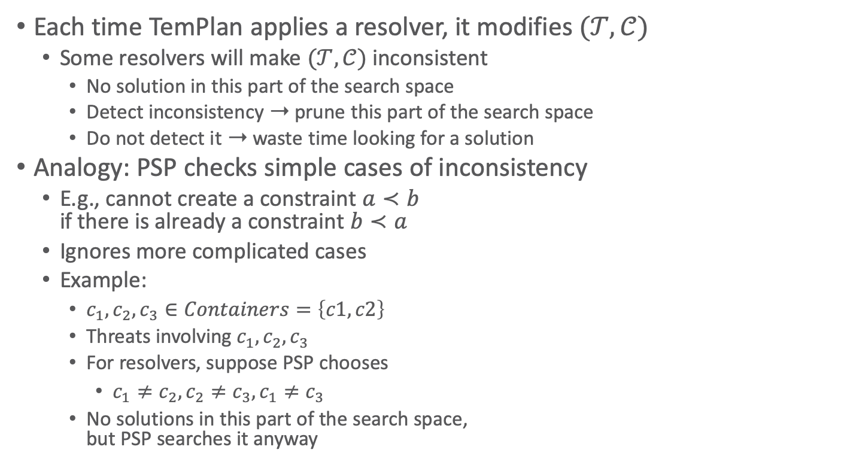
Constraint Management
Each time TemPlan applies a resolver, it modifies $(𝒯,𝒞)$
  Some resolvers will make $(𝒯,𝒞)$ inconsistent
    No solution in this part of the search space
    Detect inconsistency ➝ prune this part of the search space
    Do not detect it ➝ waste time looking for a solution
Analogy: PSP checks simple cases of inconsistency
  E.g., cannot create a constraint $a≺b$
  if there is already a constraint $b≺a$
  Ignores more complicated cases
  Example:
    $c_{1},c_{2}, c_{3}∈Containers=\left\{c1, c2\right\}$
    Threats involving $c_{1},c_{2}, c_{3}$
    For resolvers, suppose PSP chooses
      $c_{1}≠c_{2}, c_{2}≠c_{3}, c_{1}≠c_{3}$
    No solutions in this part of the search space,
    but PSP searches it anyway
Notes:
Example: Because only two different containers c1 and c2 exist

Slide 42
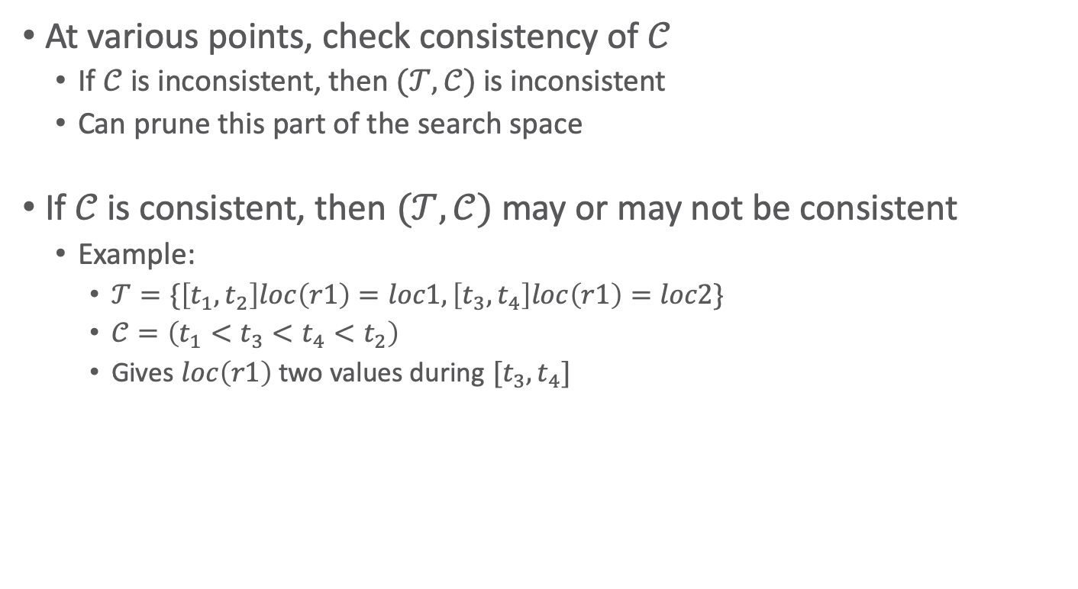
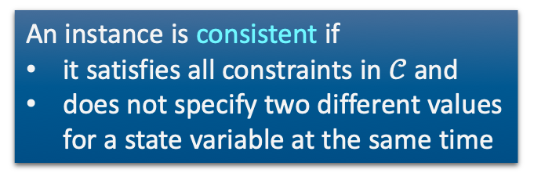
Constraint Management in TemPlan
At various points, check consistency of $𝒞$
  If $𝒞$ is inconsistent, then $(𝒯,𝒞)$ is inconsistent
  Can prune this part of the search space
If $𝒞$ is consistent, then $(𝒯,𝒞)$ may or may not be consistent
  Example:
    $𝒯=\{\left[t_{1},t_{2}\right]loc\left(r1\right)=loc1,\left[t_{3},t_{4}\right]loc\left(r1\right)=loc2\}$
    $𝒞=\left(t_{1}<t_{3}<t_{4}<t_{2}\right)$
    Gives $loc\left(r1\right)$ two values during $[t_{3},t_{4}]$
An instance is consistent if
it satisfies all constraints in $𝒞$ and
does not specify two different values for a state variable at the same time

Slide 43
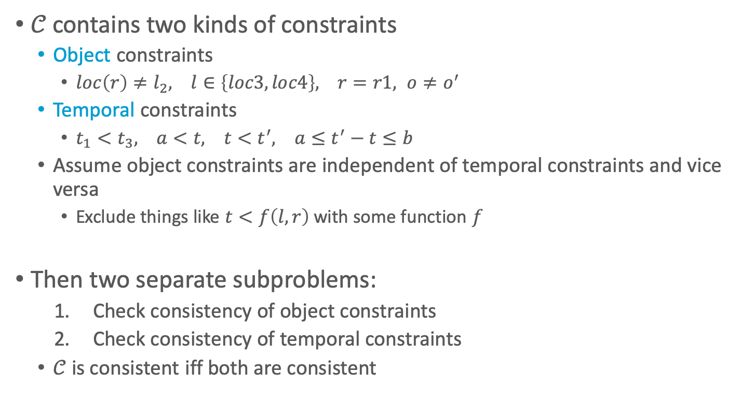

Consistency of $𝒞$
$𝒞$ contains two kinds of constraints
  Object constraints
    $loc\left(r\right)≠l_{2}, l∈\left\{loc3, loc4\right\}, r=r1, o≠o^{′}$
  Temporal constraints
    $t_{1}<t_{3}, a<t, t<t^{′}, a≤t^{′}−t≤b$
  Assume object constraints are independent of temporal constraints and vice versa
    Exclude things like $t<f\left(l,r\right)$ with some function $f$
Then two separate subproblems:
  Check consistency of object constraints
  Check consistency of temporal constraints
  $𝒞$ is consistent iff both are consistent

Slide 44
Object Constraints
Constraint-satisfaction problem – NP-complete
Can write an algorithm that is complete but runs in exponential time
  If there is an inconsistency, always finds it
  Might prune a lot, but spends lots of time at each node
Instead, use a technique that is
incomplete but takes polynomial time
  Detects some inconsistencies
  but not others
    Runs much faster,
    but prunes fewer nodes

Slide 45




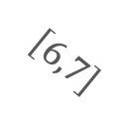
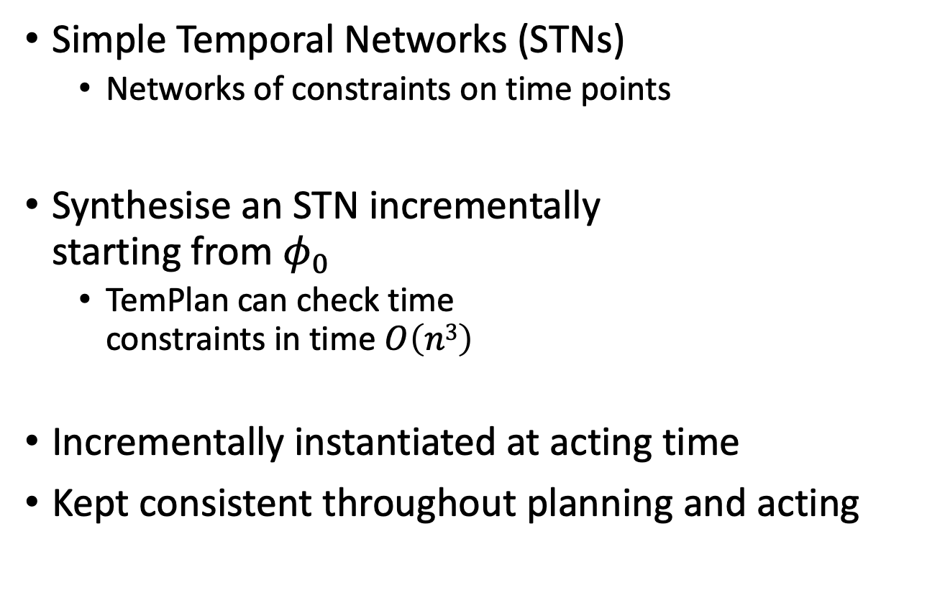






Time Constraints: Representation
Simple Temporal Networks (STNs)
  Networks of constraints on time points
Synthesise an STN incrementally
starting from $φ_{0}$
  TemPlan can check time
  constraints in time $O\left(n3\right)$
Incrementally instantiated at acting time
Kept consistent throughout planning and acting
$$t_{2}$$
$$\left[3,4\right]$$
$$\left[1,2\right]$$
$$t_{4}$$
$$t_{1}$$
$$\left[1,7\right]$$
$$t_{3}$$
$$\left[1,2\right]$$
$$\left[6,7\right]$$
$$\left[4,5\right]$$
$$t_{5}$$

Slide 46
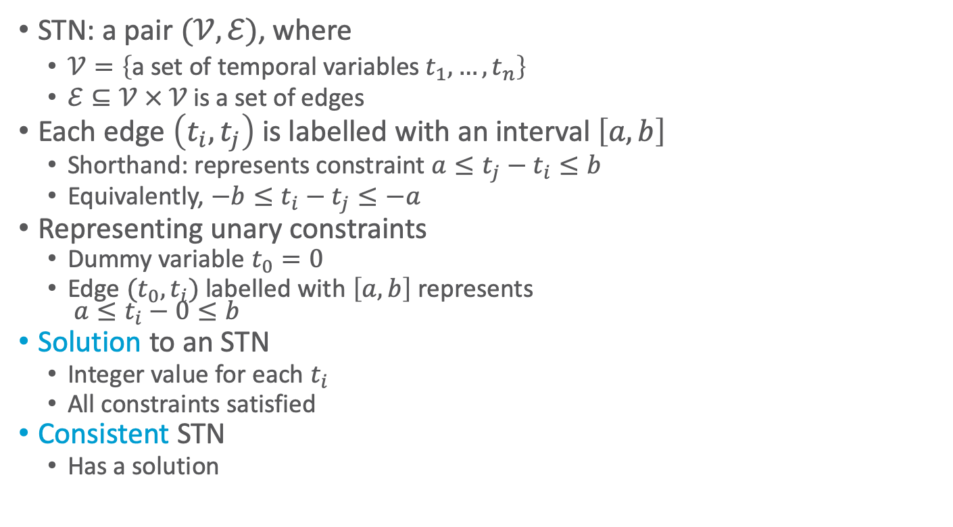
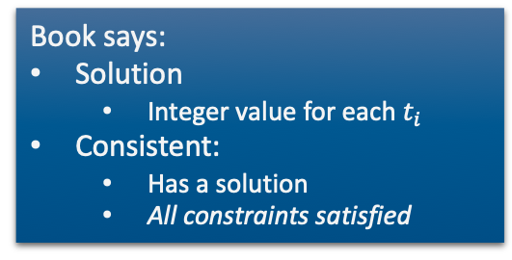
Simple Temporal Networks
Is this network consistent?
t₂
[1,2]
[3,4]
STN: a pair $(𝒱,ℰ)$, where
  $𝒱=\left\{\text{a} \text{set} \text{of} \text{temporal} \text{variables} t_{1}, …, t_{n}\right\}$
  $ℰ⊆𝒱 × 𝒱$ is a set of edges
Each edge $\left(t_{i},t_{j}\right)$ is labelled with an interval $\left[a,b\right]$
  Shorthand: represents constraint $a≤t_{j}−t_{i}≤b$
  Equivalently, $−b≤t_{i}−t_{j}≤−a$
Representing unary constraints
  Dummy variable $t_{0}=0$
  Edge $(t_{0},t_{i})$ labelled with $\left[a,b\right]$ represents
  $a≤t_{i}−0≤b$
Solution to an STN
  Integer value for each $t_{i}$
  All constraints satisfied
Consistent STN
  Has a solution
t₁
t₃
[2,3]
t₂
[1,2]
[3,4]
t₁
t₃
[–3,–2]
Book says:
Solution
  Integer value for each $t_{i}$
Consistent:
  Has a solution
  All constraints satisfied
!
Notes:
[x,y] before it was an interval in an assertion, now it is a [min,max] duration in a constraint
Minimum duration t1, t2 + t2, t3 : 4 vs. duration between 2 and 3 => inconsistent
Complete calculation:
t1 = x
1 <= t2 - x <= 2 -> t2 = x+1 or t2 = x+2
2 <= t3 - x <= 3 -> t3 = x+2 or t2 = x+3
3 <= t3 - t2 <= 4 -> 3 <= (x + 2 oder 3) – (x + 1 oder 2) <= 4 -> 3 <= 2 oder 3 – 1 oder 2 <= 4
3 <= 2 – 1 <= 4 -> 3 <= 1 <= 4 X
3 <= 2 – 2 <= 4 -> 3 <= 0 <= 4 X
3 <= 3 – 1 <= 4 -> 3 <= 2 <= 4 X
3 <= 3 – 2 <= 4 -> 3 <= 1 <= 4 X
No

Slide 47
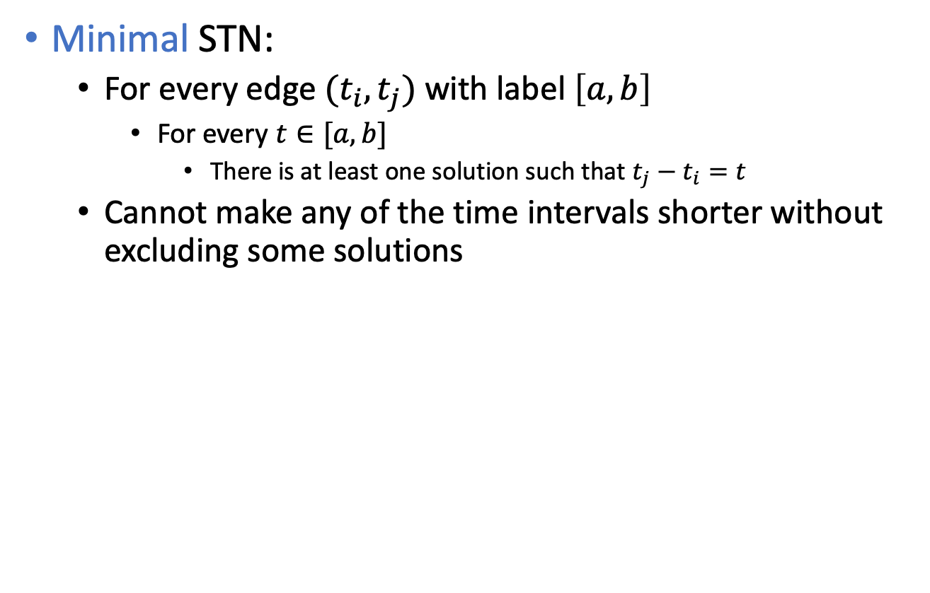
Time Constraints
Minimal STN:
  For every edge $(t_{i},t_{j})$ with label $\left[a,b\right]$
    For every $t∈[a,b]$
      There is at least one solution such that $t_{j}−t_{i}=t$
  Cannot make any of the time intervals shorter without excluding some solutions
t₂
[1,2]
[3,4]
t₁
t₃
[3,7]
Is this network minimal?
Notes:
Every value in interval belongs to a solution
Minimum duration t1, t2 + t2, t3 : 4 vs. duration of 3 in [3,7] => not minimal
Maximum duration t1, t2 + t2, t3 : 6 vs. duration of 7 in [3,7] => not minimal
Minimal with [4,6]
Complete calculation
t1 = x
1 <= t2 - x <= 2 -> t2 = x+1 or t2 = x+2
3 <= t3 - x <= 7 -> t3 = x+3 to t3 = x+7
3 <= t3 - t2 <= 4 -> 3 <= (x + 3 bis 7) – (x + 1 oder 2) <= 4 -> 3 <= 3 bis 7 – 1 oder 2 <= 4
3 <= 3 – 1 <= 4 -> 3 <= 2 <= 4 X
3 <= 4 – 1 <= 4 -> 3 <= 3 <= 4 v
3 <= 5 – 1 <= 4 -> 3 <= 4 <= 4 v
3 <= 7 – 1 <= 4 -> 3 <= 6 <= 4 X
3 <= 3 – 2 <= 4 -> 3 <= 1 <= 4 X
3 <= 5 – 2 <= 4 -> 3 <= 3 <= 4 v
3 <= 6 – 2 <= 4 -> 3 <= 4 <= 4 v
3 <= 7 – 2 <= 4 -> 3 <= 5 <= 4 X
t1 = x, t2 = x+1, t3=x+4 or t3=x+5
t1 = x, t2 = x+2, t3=x+5 or t3=x+6
t2-t1 in [1,2] : x+1-x = 1 or x+2-x = 2 v
t3-t1 in [3,7] : x+4-x = 4 or x+5-x = 5 or x+6-x=6 but no 3 or 7 X -> not minimal
t3-t2 in [3,4] : x+(4 or 5) – (x+1) = (3 or 4) or x+(5 or 6) – (x+2) = (3 or 4) v
No

Slide 48
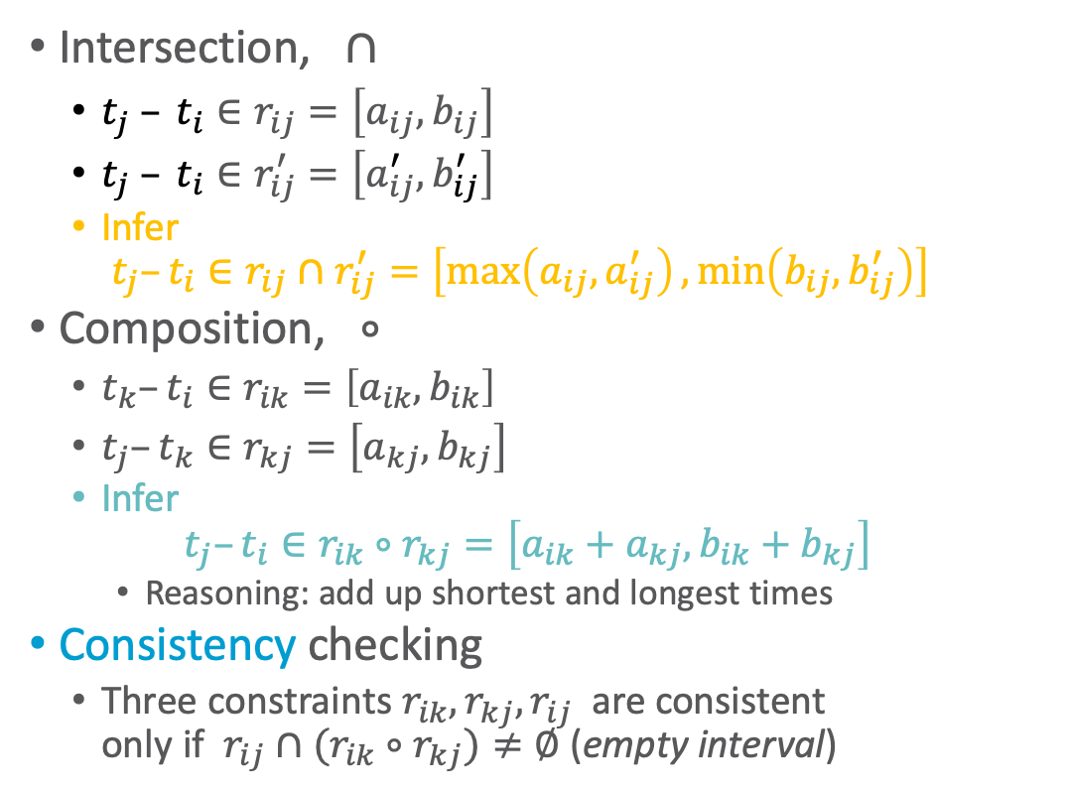




Operations on STNs
r_{ij}
t_{i}
t_{j}
Intersection, $∩$
  $t_{j} – t_{i}∈r_{ij}=\left[a_{ij},b_{ij}\right]$
  $t_{j} – t_{i}∈r_{ij}^{′}=\left[a_{ij}^{′},b_{ij}^{′}\right]$
  Infer
  $t_{j}–t_{i}∈r_{ij}∩r_{ij}^{′}=\left[\max\left(a_{ij},a_{ij}^{′}\right),\min\left(b_{ij},b_{ij}^{′}\right)\right]$
Composition, $∘$
  $t_{k}–t_{i}∈r_{ik}=\left[a_{ik},b_{ik}\right]$
  $t_{j}–t_{k}∈r_{kj}=\left[a_{kj},b_{kj}\right]$
  Infer
  $t_{j}–t_{i}∈r_{ik}∘r_{kj}=\left[a_{ik}+a_{kj}, b_{ik}+b_{kj}\right]$
    Reasoning: add up shortest and longest times
Consistency checking
  Three constraints $r_{ik}, r_{kj}, r_{ij}$are consistent
  only if $r_{ij}∩(r_{ik}∘r_{kj})≠∅$ (empty interval)
r′_{ij}
$$r_{ij}∩r_{ij}^{′}$$
r_{ik}
t_{k}
r_{kj}
t_{i}
t_{j}
$$r_{ik}∘r_{kj}$$
t_{k}
r_{kj}
r_{ik}
r_{ij}
t_{j}
t_{i}
$$r_{ik}∘r_{kj}$$
$$r_{ij}∩\left(r_{ik}∘r_{kj}\right)$$

Slide 49
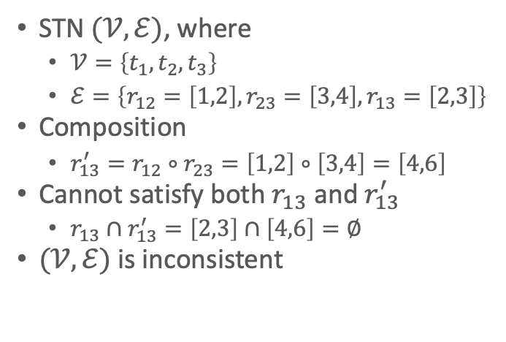
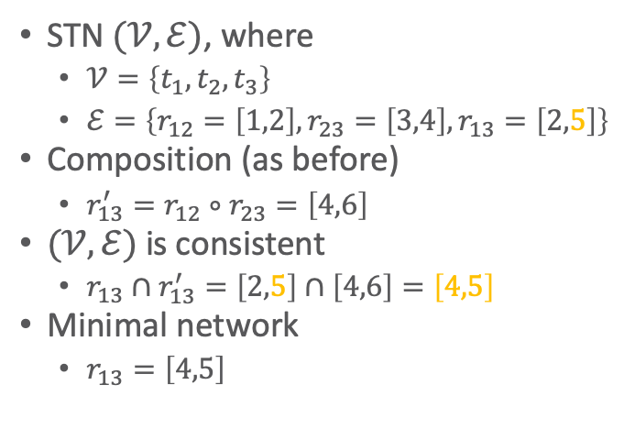
Two Examples
t₂
t₂
[1,2]
[3,4]
[1,2]
[3,4]
t₁
t₃
t₁
t₃
[2,3]
[2,5]
STN $(𝒱,ℰ)$, where
  $𝒱=\left\{t_{1}, t_{2}, t_{3}\right\}$
  $ℰ=\left\{r_{12}=\left[1,2\right], r_{23}=\left[3,4\right],r_{13}=\left[2,3\right]\right\}$
Composition
  $r_{13}^{′}=r_{12}∘r_{23}=\left[1,2\right]∘\left[3,4\right]=\left[4,6\right]$
Cannot satisfy both $r_{13}$ and $r_{13}^{′}$
  $r_{13}∩r_{13}^{′}=\left[2,3\right]∩\left[4,6\right]=∅$
$(𝒱,ℰ)$ is inconsistent
STN $(𝒱,ℰ)$, where
  $𝒱=\left\{t_{1}, t_{2}, t_{3}\right\}$
  $ℰ=\left\{r_{12}=\left[1,2\right],r_{23}=\left[3,4\right], r_{13}=\left[2,5\right]\right\}$
Composition (as before)
  $r_{13}^{′}=r_{12}∘r_{23}=\left[4,6\right]$
$(𝒱,ℰ)$ is consistent
  $r_{13}∩r_{13}^{′}=\left[2,5\right]∩\left[4,6\right]=\left[4,5\right]$
Minimal network
  $r_{13}=\left[4,5\right]$
t₂
[1,2]
[3,4]
t₁
t₃
[4,5]
Notes:
$r_{13}∩r_{13}^{′}=\left[2,3\right]∩\left[4,6\right]=[4,3]$ = empty

Slide 50


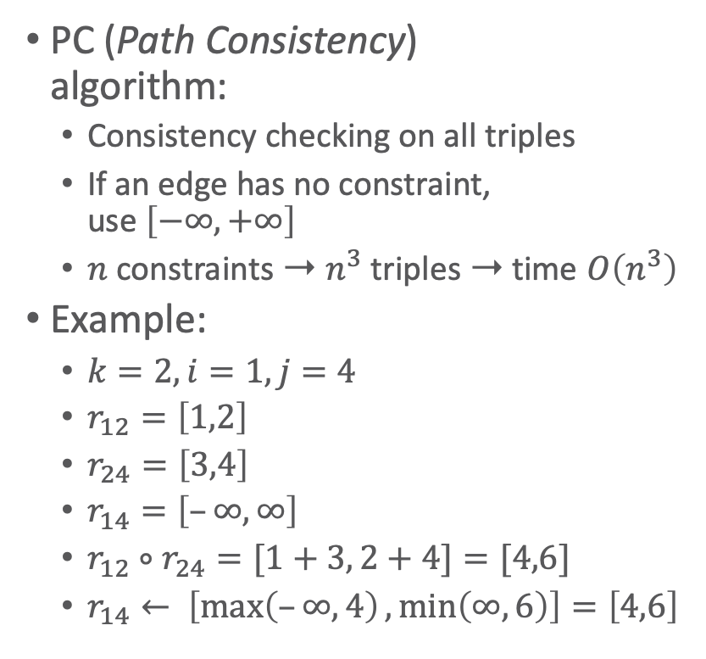

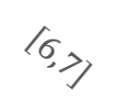









Operations on STNs
PC(𝒱,ℰ)
for 1 ≤ k ≤ n do
for 1 ≤ i < j ≤ n, i ≠ j, j ≠ k do
r_{ij} ← r_{ij} ∩ [r_{ik} ∘ r_{kj}]
if r_{ij} = ∅ then
return inconsistent
return consistent
PC (Path Consistency)
algorithm:
  Consistency checking on all triples
  If an edge has no constraint,
  use $\left[−∞, +∞\right]$
  $n$ constraints ➝ $n^{3}$ triples ➝ time $O\left(n^{3}\right)$
Example:
  $k=2, i=1, j=4$
  $r_{12}=\left[1,2\right]$
  $r_{24}=\left[3,4\right]$
  $r_{14}=\left[–∞,∞\right]$
  $r_{12}∘r_{24}=[1+3, 2+4]=[4,6]$
  $r_{14}← \left[\max\left(–∞,4\right),\min\left(∞,6\right)\right]=\left[4,6\right]$
$$k$$
$$t_{2}$$
$$\left[3,4\right]$$
$$\left[1,2\right]$$
$$t_{4}$$
$$t_{1}$$
$$j$$
$$i$$
$$t_{3}$$
$$\left[1,2\right]$$
$$\left[6,7\right]$$
$$\left[4,5\right]$$
$$t_{5}$$
Notes:
Use in TemPlan

Slide 51











Operations on STNs
PC(𝒱,ℰ)
for 1 ≤ k ≤ n do
for 1 ≤ i < j ≤ n, i ≠ j, j ≠ k do
r_{ij} ← r_{ij} ∩ [r_{ik} ∘ r_{kj}]
if r_{ij} = ∅ then
return inconsistent
return consistent
PC makes network minimal
  Shrinks each $r_{ij}$ to exclude values
  that are not in any solution
  Doing so, it detects
  inconsistent networks
    $r_{ij}=[a_{ij},b_{ij}]$ empty ➝ inconsistent
Graph: dashed lines
  Constraints that were shrunk
Can modify PC to make it incremental
  Input
    A consistent, minimal STN
    A new constraint $r_{ij}^{′}$
  Incorporate $r_{ij}^{′}$ in time $O\left(n^{2}\right)$
$$t_{1}$$
bring&move
$$t_{2}$$
$$\left[30,50\right]$$
$$\left[25,55\right]$$
$$\left[−5,5\right]$$
$$\left[15,50\right]$$
$$\left[0,15\right]$$
$$t_{3}$$
$$\left[5,10\right]$$
$$t_{4}$$
uncover
Notes:
Shrunk: at least those with no constraints get an infinity constraint that gets most likely shrunk

Slide 52

Pruning TemPlan’s search space
Take the time constraints in $𝒞$
  Write them as an STN
  Use PC to check whether STN is consistent
  If it is inconsistent, TemPlan can backtrack

Slide 53
Controllability
Constraint Management with Uncertain Durations

Slide 54







Controllability
Suppose TemPlan gives you a chronicle and you want to execute it
  Constraints on time points
  Need to reason about these to decide when to start each action
$$t_{1}$$
bring&move
$$t_{2}$$
$$\left[30,50\right]$$
$$\left[−5,5\right]$$
$$t_{3}$$
$$\left[5,10\right]$$
$$t_{4}$$
uncover

Slide 55
Controllability
Solid lines: duration constraints
  Robot will do bring&move, will take 30 to 50 time units
  Crane will do uncover, will take 5 to 10 time units
Dashed line: synchronization constraint
  Do not want either the crane or robot to wait long
  At most 5 seconds between the two ending times
Objective
  Choose time points that will
  satisfy all the constraints
$$t_{1}$$
bring&move
$$t_{2}$$
$$\left[30,50\right]$$
$$\left[−5,5\right]$$
$$t_{3}$$
$$\left[5,10\right]$$
$$t_{4}$$
uncover

Slide 56














Controllability
Suppose we run PC
PC returns a minimal and consistent network
  There exist time points that satisfy all the constraints
Would work if we could choose all four time points
  But we cannot choose $t_{2}$ and $t_{4}$
$t_{1}$ and $t_{3}$ are controllable
  Actor can control when each action starts
$t_{2}$ and $t_{4}$ are contingent
  Cannot control how long the actions take
  Random variables that are known
  to satisfy the duration constraints
    $t_{2}∈\left[t_{1}+30, t_{1}+50\right]$
    $t_{4}∈\left[t_{3}+5, t_{3}+10\right]$
$$t_{1}$$
bring&move
$$t_{2}$$
$$\left[30,50\right]$$
$$\left[−5,5\right]$$
$$t_{3}$$
$$\left[5,10\right]$$
$$t_{4}$$
uncover
$$t_{1}$$
bring&move
$$t_{2}$$
$$\left[30,50\right]$$
$$\left[25,55\right]$$
$$\left[−5,5\right]$$
$$\left[15,50\right]$$
$$\left[0,15\right]$$
$$t_{3}$$
$$\left[5,10\right]$$
$$t_{4}$$
uncover
Notes:
STN below: minimal network

Slide 57












Controllability
$$t_{1}$$
bring&move
$$t_{2}$$
Cannot guarantee that all constraints will be satisfied
Start bring&move at
time $t_{1}=0$
Suppose the durations are
  bring&move $30$, uncover $10$
  $t_{2}=t_{1}+30=30$
  $t_{4}=t_{3}+10$
  $t_{4}–t_{2}=t_{3}–20$
Constraint $r_{24}$:
  $–5≤t_{4}– t_{2}≤5$
  $–5≤t_{3}–20≤5$
  $15 ≤ t_{3} ≤25$
Must start uncover
at $t_{3}≤25$
$$\left[30,50\right]$$
But if we start uncover at $t_{3}≤25$, neither action has finished yet
  We do not yet know
  how long they will take
Durations might instead be
  bring&move $50$, uncover $5$
  $t_{2}=t_{1}+50=50$
  $t_{4}=t_{3}+5≤25+5=30$
  $t_{4}–t_{2}≤30–50= –20$
    Violates $r_{24}$
$$\left[25,55\right]$$
$$\left[−5,5\right]$$
$$\left[15,50\right]$$
$$\left[0,15\right]$$
$$t_{3}$$
$$\left[5,10\right]$$
$$t_{4}$$
uncover
Notes:
$t_{4}–t_{2}$ plug in values for t4 and t2
t3<= 25: bring&move running

Slide 58


STNUs
STNU (Simple Temporal Network with Uncertainty):
  A 4-tuple $\left(𝒱,\tilde{𝒱},ℰ,\tilde{ℰ}\right)$
    $𝒱$ ={controllable time points}
      E.g., starting times of actions
    $\tilde{𝒱}$ ={contingent time points}
      E.g., ending times of actions
Controllable and contingent constraints:
  Synchronization between two starting times: controllable
  Duration of an action: contingent
  Synchronization between ending points of two actions: contingent
  Synchronization between end of one action, start of another:
    Controllable if the new action starts after the old one ends
    Contingent if the new action starts before the old one ends
Want a way for the actor to choose time points in $𝒱$ (starting times) that guarantee that constraints are satisfied
    $ℰ$ ={controllable constraints}
    $\tilde{ℰ}$ ={contingent constraints}

Slide 59

Three kinds of controllability
$\left(𝒱,\tilde{𝒱},ℰ,\tilde{ℰ}\right)$ is strongly controllable if the actor can choose values for $𝒱$ such that success will occur for all values of $\tilde{𝒱}$ that satisfy $\tilde{ℰ}$
  Actor can choose the values for $𝒱$ offline
  The right choice will work regardless of $\tilde{𝒱}$
$\left(𝒱,\tilde{𝒱},ℰ,\tilde{ℰ}\right)$ is weakly controllable if the actor can choose values for $𝒱$ such that success will occur for at least one combination of values for $\tilde{𝒱}$
  Actor can choose the values for $𝒱$ only if the actor knows in advance what the values of $\tilde{𝒱}$ will be
Dynamic controllability:
  Game-theoretic model: actor vs. environment
  A player’s strategy: a function $σ$ telling what to do in every situation
    Choices may differ depending on what has happened so far
  $\left(𝒱,\tilde{𝒱},ℰ,\tilde{ℰ}\right)$ is dynamically controllable if ∃ strategy for an actor that will guarantee success regardless of the environment’s strategy

Slide 60


Dynamic Execution
For $t=0, 1, 2, …$
  Actor chooses an unassigned set of variables $𝒱_{t}⊆𝒱$ that all can be assigned the value $t$ without violating any constraints in $ℰ$
    ≈ actions the actor chooses to start at time $t$
  Simultaneously, environment chooses an unassigned set of variables ${\tilde{𝒱}}_{t}\text{⊆}\tilde{𝒱}$ that all can be assigned the value $t$ without violating any constraints in $\tilde{ℰ}$
    ≈ actions that finish at time $t$
  Each chosen time point $v$ is assigned $v←t$
  Failure if any of the constraints in $ℰ∪\tilde{ℰ}$ are violated
    There might be violations that neither $𝒱_{t}$ nor ${\tilde{𝒱}}_{t}$ caused individually
  Success if all variables in $𝒱∪\tilde{𝒱}$ have values and no constraints are violated
Dynamic execution strategies $σ_{A}$ for actor, $σ_{E}$ for environment
  $σ_{A}(h_{t−1})$ = {what events in $𝒱$ to trigger at time $t$, given $h_{t−1}$}
  $σ_{E}(h_{t−1})$ = {what events in $\tilde{𝒱}$ to trigger at time $t$, given $h_{t−1}$}
    $h_{t}=h_{t−1}⋅\left(σ_{A}\left(h_{t−1}\right)∪σ_{E}\left(h_{t−1}\right)\right)$
$\left(𝒱,\tilde{𝒱},ℰ,\tilde{ℰ}\right)$ is dynamically controllable if $∃ σ_{A}$ that will guarantee success $∀ σ_{E}$
$r_{ij}=\left[l,u\right]$ is violated
if $t_{i}$ and $t_{j}$ have values
and $t_{j}−t_{i}∉\left[l,u\right]$

Slide 61












Example
Instead of a single bring&move task, two separate bring and move tasks
Actor’s dynamic execution strategy
  Trigger $t_{1}$ at whatever time you want
  Wait and observe $t$
  Trigger $t^{′}$ at any time from $t$ to $t+5$
  Trigger $t_{3}=t^{′}+10$
  For every $t_{2}∈\left[t^{′}+15, t^{′}+20\right]$ and $t_{4}∈[t_{3}+5, t_{3}+10]$
    $t_{4}∈\left[t^{′}+15, t^{′}+20\right]$
    So, $t_{4}–t_{2}∈\left[–5, 5\right]$
  Thus, all constraints are satisfied
$$t_{1}$$
bring
$$t$$
$$t^{′}$$
move
$$t_{2}$$
$$\left[15,25\right]$$
$$\left[0,5\right]$$
$$\left[15,20\right]$$
$$\left[−5,5\right]$$
$$t_{3}$$
$$\left[5,10\right]$$
$$t_{4}$$
uncover
Notes:
replace t₃ with t’ in $t_{4}∈[t_{3}+5, t_{3}+10]$
Shortest time of t4 - longest time of t2
Longest time of t4 - shortest time of t2

Slide 62

Dynamic Controllability Checking
For a chronicle $φ=\left(𝒜,𝒮,𝒯,𝒞\right)$
  Temporal constraints in $𝒞$ correspond to an STNU
  Adapt TemPlan to test not only consistency but also dynamic controllability (*) of the STNU
  If we detect cases where it is not dynamically controllable, then backtrack
Use PC as well
  If PC($𝒱∪\tilde{𝒱}$, $ℰ∪\tilde{ℰ}$) reduces a contingent constraint, then $\left(𝒱,\tilde{𝒱},ℰ,\tilde{ℰ}\right)$ is not dynamically controllable
    Can prune this branch
  If it does not reduce any contingent constraints, we do not know whether $\left(𝒱,\tilde{𝒱},ℰ,\tilde{ℰ}\right)$ is dynamically controllable
    Only necessary, not sufficient condition
  Two options
    Either continue down this branch and backtrack later if necessary, or
    Extend PC to detect more cases where $\left(𝒱,\tilde{𝒱},ℰ,\tilde{ℰ}\right)$ is not dynamically controllable
      Additional constraint propagation rules
Notes:
Contingent constraints not controllable, reduction implies controllability

Slide 63


Additional Constraint Propagation Rules
t_{s}
[a, b]
t_{e}
Case 1: $u≥0$
  $t$ must come before $t_{e}$
Add a composition constraint $\left[a^{′},b^{′}\right]$
  Find $\left[a^{′},b^{′}\right]$ such that $\left[a^{′},b^{′}\right]∘\left[u,v\right]=\left[a,b\right]$
    $\left[a^{′}+u, b^{′}+v\right]=\left[a,b\right]$
    $a^{′}=a–u, b^{′}=b–v$
[u, v]
t
⟹ contingent ⟶ controllable $a^{′}=a–u, b^{′}=b–v$

Slide 64


Additional Constraint Propagation Rules
t_{s}
[a, b]
t_{e}
Case 2: $u<0$ and $v≥0$
  $t$ may be before or after $t_{e}$
Add a wait constraint $\left\langle t_{e}, α\right\rangle$
  $α$ defined w.r.t.
  some controllable time point $t_{s}$
  Wait until either $t_{e}$ occurs or current time is $t_{s}+α$, whichever comes first
[u, v]
t
⟹ contingent ⟶ controllable $a^{′}=a–u, b^{′}=b–v$

Slide 65
Extended Version of PC
We want a fast algorithm that TemPlan can run at each node, to decide whether to backtrack
There is an extended version of PC that runs in polynomial time, but it has high overhead
Possible compromise: use ordinary PC most of the time
  Run extended version occasionally, or at end of search before returning plan
⟹ contingent ⟶ controllable $a^{′}=a–u, b^{′}=b–v$

Slide 66
Intermediate Summary
Constraint management
  Consistency of object constraints
    Constraint-satisfaction problem
  Consistency of time constraints
    STN, solution, minimality, consistency
    PC
Controllability
  STNU, controllable, contingent
  Dynamic controllability

Slide 67
Outline per the Book
4.2 Representation
  Timelines
  Actions and tasks
  Chronicles
4.3 Temporal Planning
  Resolvers and flaws
  Search space
4.4 Constraint Management
  Consistency of object constraints and time constraints
  Controlling the actions when we do not know how long they will take
4.5 Acting with Temporal Models
  Acting with atemporal refinement
  Dispatching
  Observation actions
Notes:
4.1 Intro

Slide 68
Atemporal Refinement of Primitive Actions
TemPlan’s action templates may correspond to compound tasks
  In RAE, refine into commands with refinement methods
  TemPlan’s
  action template
  (descriptive model)
  RAE’s
  refinement method
  (operational model)
leave(r,d,w)
  assertions: [t_{s},t_{e}] loc(r): (d,w)
    [t_{s},t_{e}] occupant(d): (r,empty)
  constraints: t_{e} ≤ t_{s} + δ₁
  adj(d,w)
m-leave(r,d,w,e)
  task: leave(r,d,w)
  pre: loc(r)=d, adj(d,w), exit(e,d,w)
  body: until empty(e)
  wait(1)
    goto(r,e)

Slide 69
Discussion
Pros
  Simple online refinement with RAE
  Avoids breaking down uncertainty of contingent duration
  Can be augmented with temporal monitoring functions in RAE
    E.g., watchdogs, methods with duration preferences
Cons
  Does not handle temporal requirements at the command level,
    E.g., synchronise two robots that must act concurrently
Can augment RAE to include temporal reasoning
  Call it eRAE
  One essential component: a dispatching function
Notes:
E.g, useful to account for time needed to open door, assessed from statistics.
However, breaking this duration into how long it takes to reach for the handle and how long to turn the handle introduces more noise in operational models.
Still RAE requires some temporal reasoning
Dispatching takes into account past occurrences and the current time; these are propagated into the temporal network to keep it dynamically controllable

Slide 70










Acting With Temporal Models
Dispatching procedure: a dynamic execution strategy
  Controls when to start each action
  Given a dynamically controllable plan with executable primitives,
  it triggers corresponding commands from online observations
Example
  robot $r2$ needs to leave dock $d2$
  before robot $r1$ can enter $d2$
  crane $k$ needs to uncover $c$
  then put $c$ onto $r1$
k
r2
c′
w2
c
q
p
$$t_{3}$$
d2
leave(r2,d2)
w1
r1
$$t_{1}$$
$$t_{2}$$
$$t_{5}$$
$$t_{7}$$
$$t_{8}$$
$$t_{9}$$
leave(r1,d1)
navigate(r1)
enter(r1,d2)
d1
$$t_{4}$$
$$t_{6}$$
unstack(k,c,p)
putdown(k,c,r1)
leave(r1,d2)
unstack(k,c′,p)
stack(k,c′,q)

Slide 71

Dispatching
Dispatch(𝒱,Ṽ,ℰ,Ẽ)
initialise the network
while there are time points in 𝒱 that
have not been triggered do
update now
update the time points in Ṽ that have
been newly observed
update enabled
trigger every t ∈ enabled s.t. now=u_{t}
arbitrarily choose other time points
in enabled and trigger them
propagate values of triggered
timepoints (change [l_{t},u_{t}] for
each future timepoint t)
Let $\left(𝒱,\tilde{𝒱},ℰ,\tilde{ℰ}\right)$ be a
controllable STNU
that is grounded
  Different from a grounded
  expression in logic
  At least one time point $t^{∗}$ is
  instantiated
    Bounds each time point $t$
    within an interval $\left[l_{t},u_{t}\right]$
Controllable time point $t$ in the future:
  $t$ is alive if current time $now∈\left[l_{t},u_{t}\right]$
  $t$ is enabled if
    It is alive
    For every precedence constraint $t^{′}<t$, $t^{′}$ has occurred
    For every wait constraint $⟨t_{e}, α⟩$, $t_{e}$ has occurred or $α$ has expired
      $α$ has expired if $t_{s}$ has occurred and $t_{s}+α≤now$
Notes:
trigger elements of V at the right moment, given the observation of elements of V ̃, and given the progress of current time, denoted now
As time goes by, some time points have occurred: triggered by the actor for controllable points or observed for contingent ones
Trigger those points that cannot wait any longer
Arbitrary choice to trigger any other enabled point (consider domain specific considerations)

Slide 72

Example
Dispatch(𝒱,Ṽ,ℰ,Ẽ)
initialise the network
while there are time points in 𝒱 that
have not been triggered do
update now
update the time points in Ṽ that have
been newly observed
update enabled
trigger every t ∈ enabled s.t. now=u_{t}
arbitrarily choose other time points
in enabled and trigger them
propagate values of triggered
timepoints (change [l_{t},u_{t}] for
each future timepoint t)
Trigger $t_{1}$, observe leave finish
Enable and trigger $t_{2}$, enables $t_{3}$, $t_{4}$
Trigger $t_{3}$ soon enough to allow $enter\left(r1,d2\right)$ at time $t_{5}$
Trigger $t_{4}$ soon enough to allow $stack\left(k,c^{′}\right)$ at time $t_{6}$
Rest of plan is linear:
  Choose each $t_{i}$ after the previous action ends
$$t_{3}$$
leave(r2,d2)
$$t_{1}$$
$$t_{2}$$
$$t_{5}$$
leave(r1,d1)
navigate(r1)
enter(r1,d2)
$$t_{7}$$
$$t_{8}$$
$$t_{9}$$
$$t_{4}$$
$$t_{6}$$
unstack(k,c,p)
putdown(k,c,r1)
leave(r1,d2)
unstack(k,c′,p)
stack(k,c′,q)

Slide 73











Example from Slide 61
Dispatch(𝒱,Ṽ,ℰ,Ẽ)
initialise the network
while there are time points in 𝒱 that
have not been triggered do
update now
update the time points in Ṽ that have
been newly observed
update enabled
trigger every t ∈ enabled s.t. now=u_{t}
arbitrarily choose other time points
in enabled and trigger them
propagate values of triggered
timepoints (change [l_{t},u_{t}] for
each future timepoint t)
Trigger $t_{1}$ at time $0$
Wait and observe $t$; this enables $t^{′}$
Trigger $t^{′}$ at any time from $t$ to $t+5$
Trigger $t_{3}$ at time $t^{′}+10$
  $t_{2}∈\left[t^{′}+15, t^{′}+20\right]$
  $t_{4}∈[t_{3}+5, t_{3}+10]=[t^{′}+15, t^{′}+20]$
  so $t_{4}–t_{2}∈\left[–5, 5\right]$
$$t_{1}$$
bring
$$t$$
$$t^{′}$$
move
$$t_{2}$$
$$\left[15,25\right]$$
$$\left[0,5\right]$$
$$\left[15,20\right]$$
$$\left[−5,5\right]$$
$$t_{3}$$
$$\left[5,10\right]$$
$$t_{4}$$
uncover

Slide 74

Dispatching
Dispatch(𝒱,Ṽ,ℰ,Ẽ)
initialise the network
while there are time points in 𝒱 that
have not been triggered do
update now
update the time points in Ṽ that have
been newly observed
update enabled
trigger every t ∈ enabled s.t. now=u_{t}
arbitrarily choose other time points
in enabled and trigger them
propagate values of triggered
timepoints (change [l_{t},u_{t}] for
each future timepoint t)
Propagation step most
costly one
  $O\left(n^{3}\right)$
  $n$ the number of remaining
  future time points in network
Ideally propagation fast enough to allow iterations and updates of $now$ consistent with temporal granularity of plan
Notes:
trigger elements of V at the right moment, given the observation of elements of V ̃, and given the progress of current time, denoted now
As time goes by, some time points have occurred: triggered by the actor for controllable points or observed for contingent ones
Trigger those points that cannot wait any longer
Arbitrary choice to trigger any other enabled point (consider domain specific considerations)

Slide 75
Deadline Failures
Suppose something makes it impossible to start an action on time
Do one of the following:
  Stop the delayed action, and look for new plan
  Let the delayed action finish, try to repair the plan by resolving violated constraints at the STNU propagation level
    E.g., accommodate a delay in navigate by delaying the whole plan
  Let the delayed action finish, try to repair the plan some other way
$$t_{3}$$
leave(r2,d2)
$$t_{1}$$
$$t_{2}$$
$$t_{5}$$
leave(r1,d1)
navigate(r1)
enter(r1,d2)
$$t_{7}$$
$$t_{8}$$
$$t_{9}$$
$$t_{4}$$
$$t_{6}$$
unstack(k,c,p)
putdown(k,c,r1)
leave(r1,d2)
unstack(k,c′,p)
stack(k,c′,q)

Slide 76
Partial Observability
Tacit assumption: All occurrences of contingent events are observable
  Observation needed for dynamic controllability
In general, not all events are observable
POSTNU (Partially Observable STNU)
  STNU where the
  contingent time points
  are given by a set of
  invisible and a set of
  observable timepoints
    POSTNU = STNU
    if Invisible = ∅
  Dynamically controllable?
Controllable
Timepoints Invisible
Contingent
Observable
Arthur Bit-Monnot, Malik Ghallab, Félix Ingrand: “Which Contingent Events to Observe for the Dynamic Controllability of a Plan”, IJCAI-16

Slide 77









Observation Actions
Example
$$\left[19:00,19:30\right]$$
$$t_{1}$$
$$t$$
$$t^{′}$$
driving
$$t_{2}$$
$$\left[1,2\right]$$
$$\left[20,25\right]$$
working
$$\left[−5,10\right]$$
$$t_{3}$$
$$\left[25,30\right]$$
$$t_{4}$$
Controllable
Contingent
cooking
Invisible
observable
Arthur Bit-Monnot, Malik Ghallab, Félix Ingrand: “Which Contingent Events to Observe for the Dynamic Controllability of a Plan”, IJCAI-16

Slide 78
Dynamic Controllability
A POSTNU is dynamically controllable if
  there exists an execution strategy that chooses future controllable points to meet all the constraints, given the observation of past visible points
Check dynamic controllability
  Map an POSTNU to an STNU by deleting invisible time points and adding corresponding constraints on controllable and observable time points
  Check dynamic controllability of the mapped STNU
    E.g., using the extended PC algorithm
  More details in the paper
Arthur Bit-Monnot, Malik Ghallab, Félix Ingrand: “Which Contingent Events to Observe for the Dynamic Controllability of a Plan”, IJCAI-16

Slide 79
Dynamic Controllability
A POSTNU is dynamically controllable if
  there exists an execution strategy that chooses future controllable points to meet all the constraints, given the observation of past visible points
Observable ≠ visible
  Observable means it will be known when observed
    It can be temporarily hidden
  Aim: Find out which time points need to be observed for the plan to be dynamically controllable (details in paper)
Controllable
Timepoints Invisible
Contingent Visible
Observable
Hidden
Arthur Bit-Monnot, Malik Ghallab, Félix Ingrand: “Which Contingent Events to Observe for the Dynamic Controllability of a Plan”, IJCAI-16

Slide 80
Intermediate Summary
Acting
  Atemporal refinement
    eRAE
    Dispatching
      Alive, enabled
  Deadline failures
  Partial observability
    Invisible, observable (hidden/visible)

Slide 81
Outline per the Book
4.2 Representation
  Timelines
  Actions and tasks
  Chronicles
4.3 Temporal Planning
  Resolvers and flaws
  Search space
4.4 Constraint Management
  Consistency of object constraints and time constraints
  Controlling the actions when we do not know how long they will take
4.5 Acting with Temporal Models
  Acting with atemporal refinement
  Dispatching
  Observation actions
⟹ Next: Planning and Acting with Nondeterministic Models
Notes:
4.1 Intro

